Slide 1
Introduction Beam Time Retreat
11.-12.07.2024
FAIR/GSI Management

Slide 2
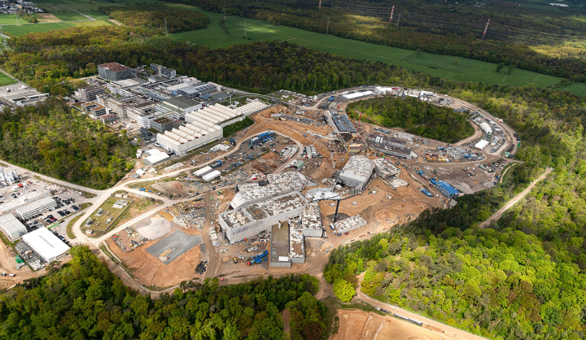
Achievements FAIR / GSI @ 2024
Beamtime 2024 successful with some technical issues and good scientific results
Good progress @ FAIR
FAIR concrete works finished
FAIR accelerator installation started
FAIR Council 09./10. Juli 2024
positive funding steps France / Sweden / Poland in support of the realisation process ES/FS and steps forward towards FS+
commissioning budget 2024/2025 released

Slide 3
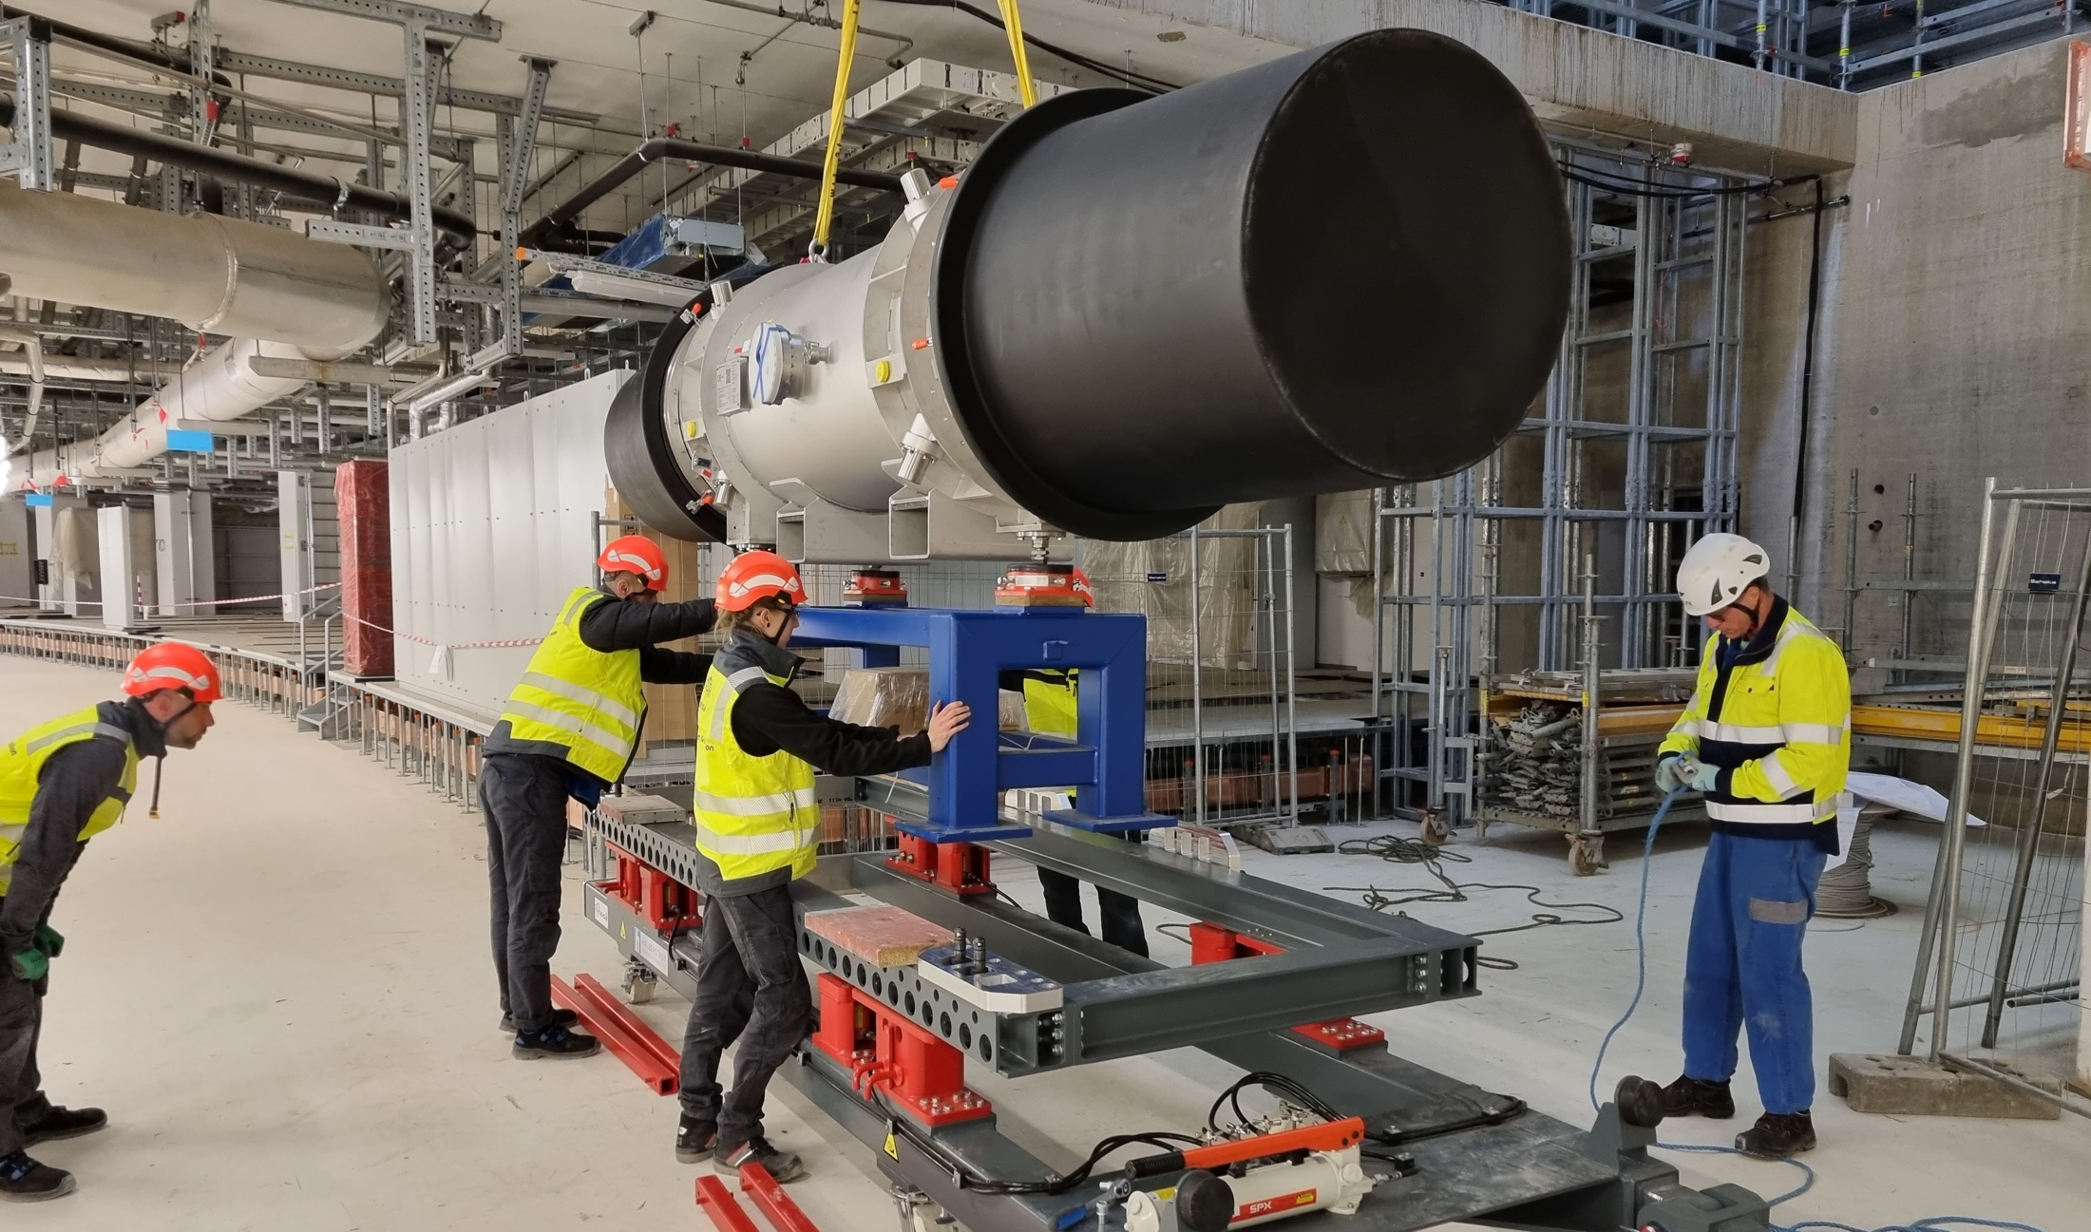
Our Challenges and path forward
Funding and personnel @ FAIR / GSI remain tight and critical
Shutdown Works / beamtime and FAIR installation require strong prioritization and focus
Ramping up FAIR installation is a must for ES/FS in 2027/2028
Optimisation / Digitalization of administrative processes and tools
FAIR and GSI HostLab - integration process

Slide 4
Our Challenges and path forward
What do we need to do?
It is vital that
We have a clear plan on our priorities and have to stay focussed on the essential activities
We must follow this path in the day-to-day work
We need to identify well in advance the critical activities and mitigate them
Integrated communication is key
We keep our optimistic and professional approach towards solutions in these challenging times.

Slide 5
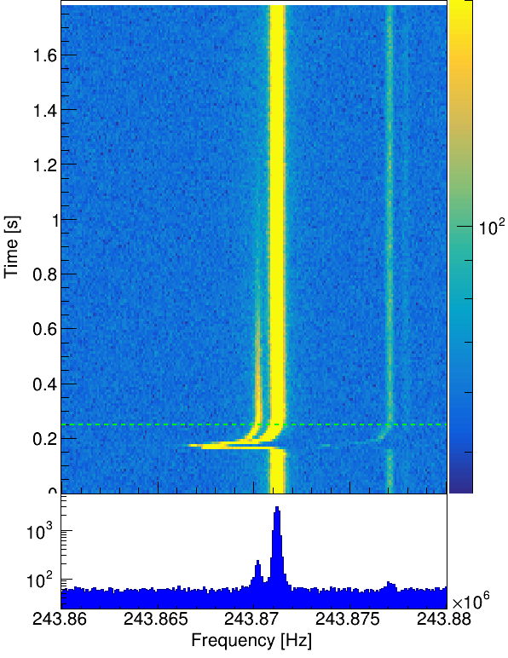
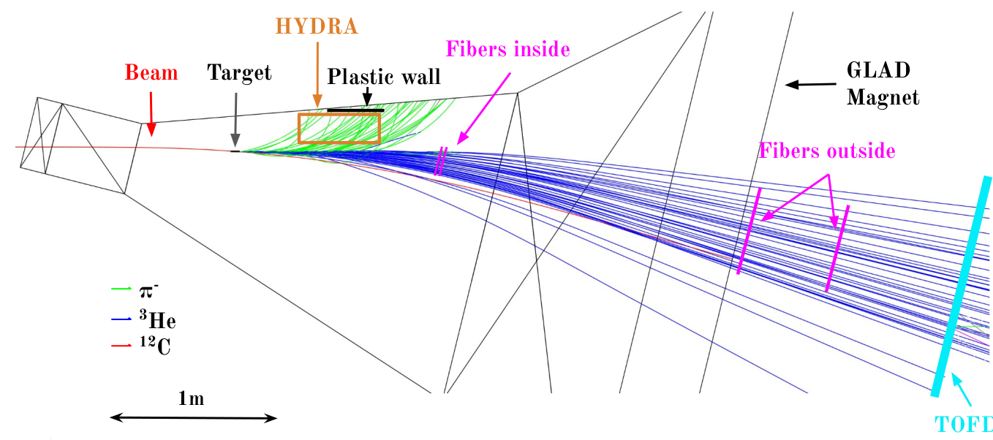
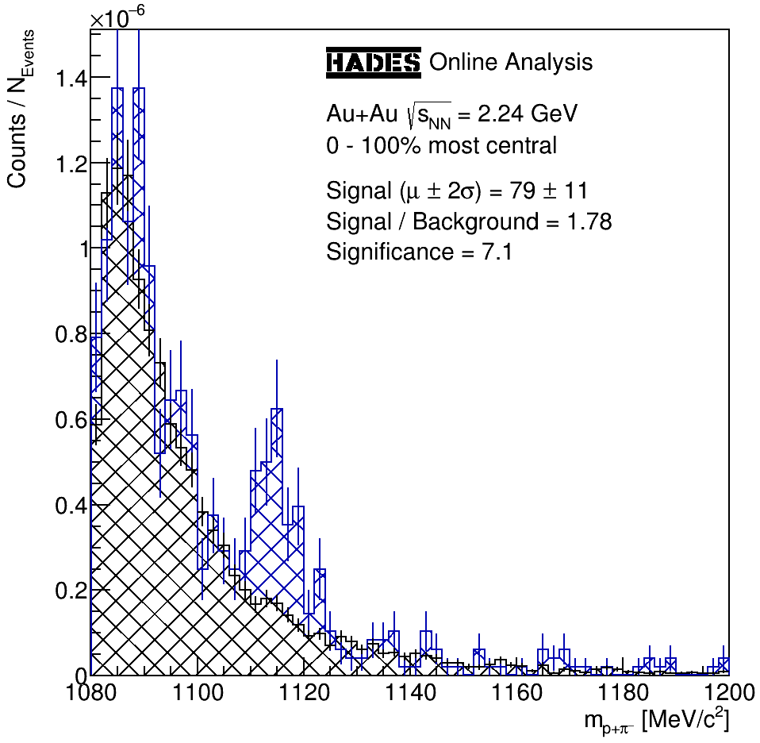
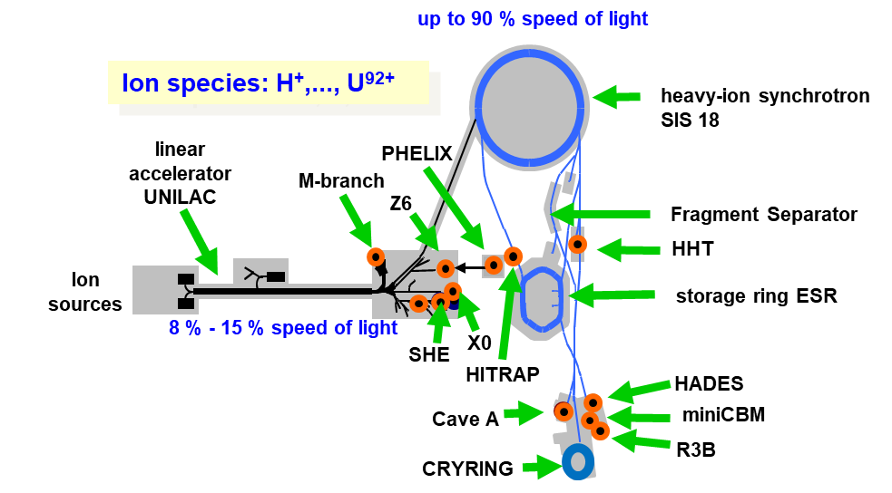
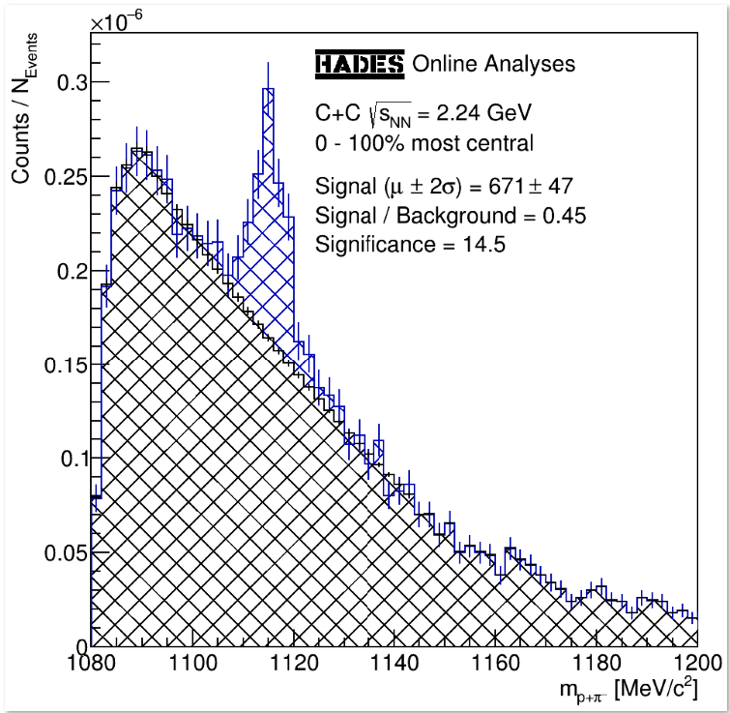
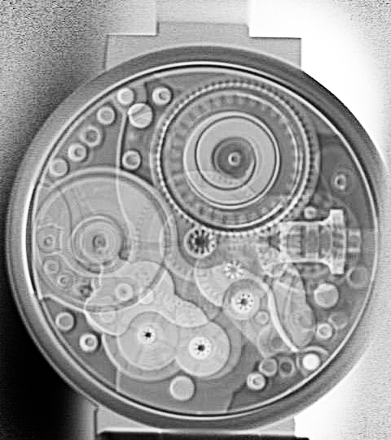
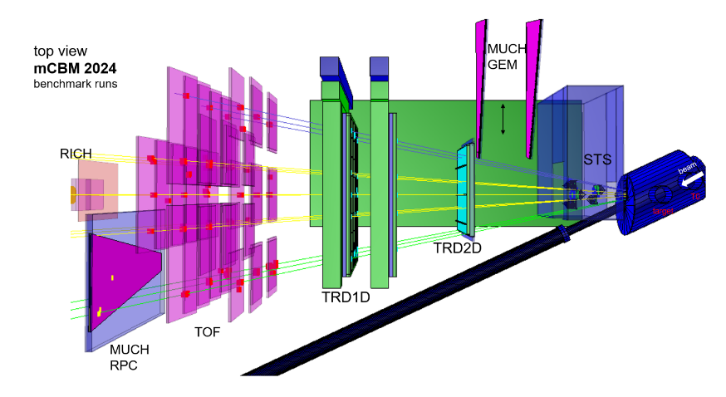
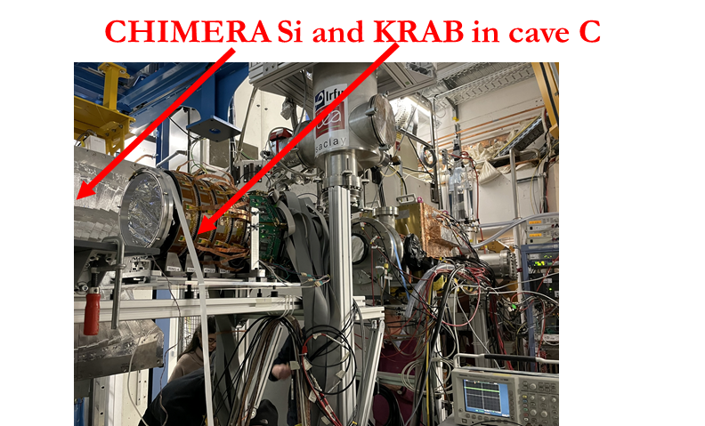
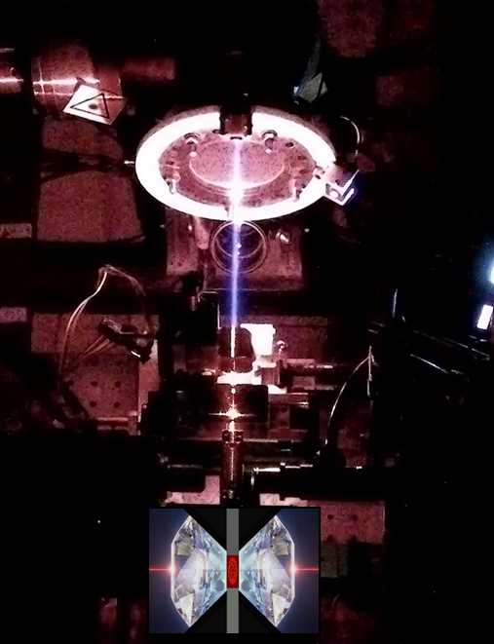
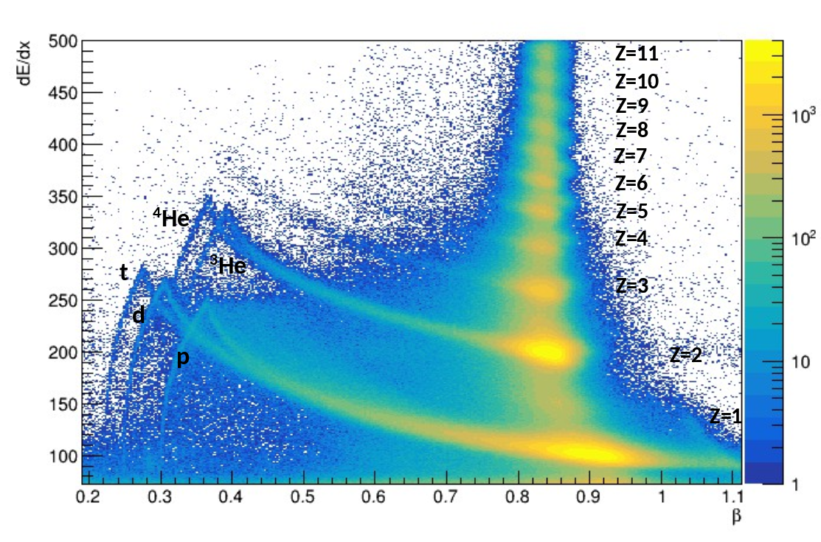
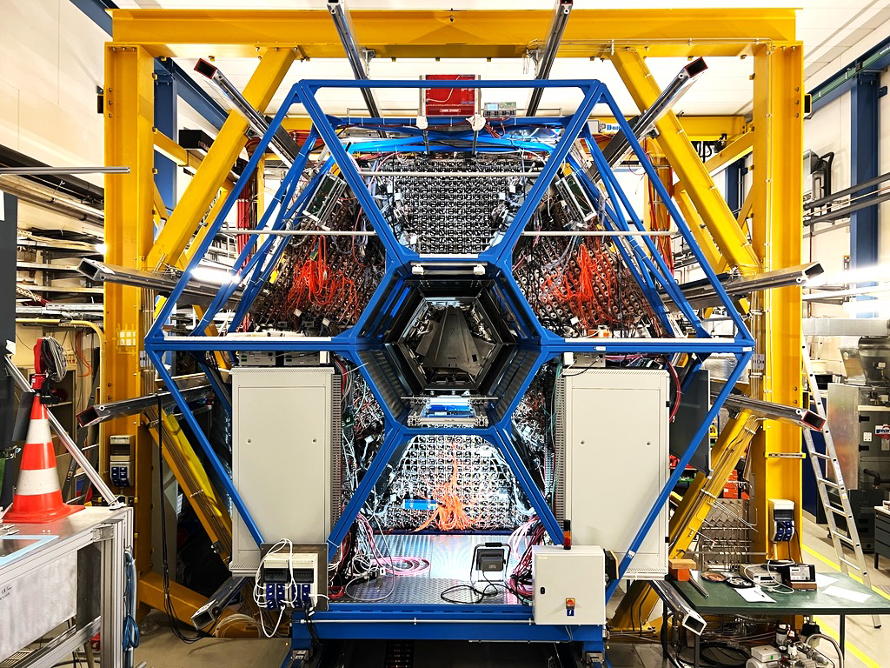
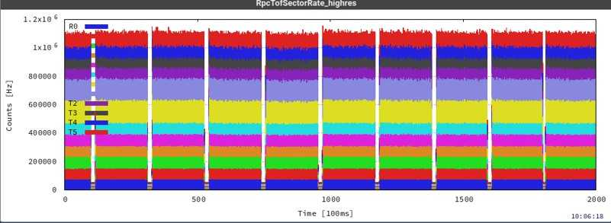
Beamtime 2024 – Experimental view
Many thanks to the accelerator crew

Slide 6
FAIR/GSI strategic operation scenario towards FAIR
beam time
Acc. Operation total / days
140
Pre-paration works
EH
140+30
renovation
EH
140
renovation
EH
140
200
240
240
240
240
beam time
Physics beam time/ days
100
100+30
50
70
min. 120*
215
215
215
215
POF 5
Project phases (ES, FS, FS+)
FAIR Installation of Accelerator Components
FAIR Hardware Commissioning
FCC OP ready
UNILAC CS ready
DR
FAIR Beam Commissioning
PCP reached
Facility availability
early science (ES) →
now
included
SIS18 → SFRS → NUSTAR
still
missing
first science (FS) →
SIS100 → SFRS → NUSTAR
first science + (FS+) →
SIS100 –> CBM
UNILAC → EH, SIS18 → TH, EX, FRS, ESR → HITRAP, Cryring
2024
2025
2026
2027
2028
2029
2030
2031
2032
FAIR Phase 0
Early Science
Early Science & First Science+
Science

