Slide 1
Systematic Customer Feedback: Experience at GSI
and Lessons learned for FAIR
talk from: GSI/FAIR Accelerator Beam Time Retreat 2021
- User feedback -
Daniel Severin

Slide 2
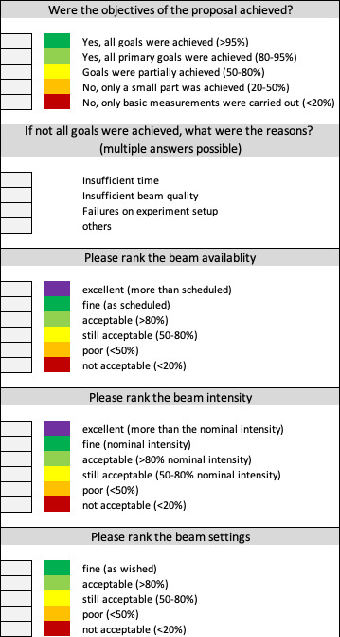
“Rainbow” Questionnaire
All experiments of the actual BT 2021 (executed until mid June) got a questionnaire asking for feedback.
Out of 34 experiment 32 answered and were taken into account.
First part focuses on scientific achievements. Note that some of the experiments are in the process of data analysis and some experiments only took partly the granted beamtime.
Second part point to the accelerator performance concerning beam availability, intensity, and settings. Note that beam availability excellent means more than scheduled and beam intensity excellent means about the nominal intensity.

Slide 3
Scientific objectives

Slide 4
Non-achievement reasons

Slide 5
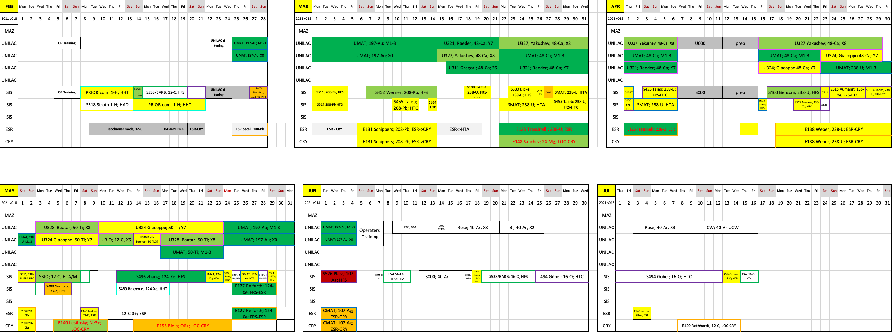

Scientific objectives

Slide 6
Scientific objectives
S483 Nociforo: Experiment only partly scheduled
S526 Plass: Major failure of detector system
CMAT/E153 Breuer/Biela: Cryring extraction/ local source

Slide 7
Beam availability

Slide 8
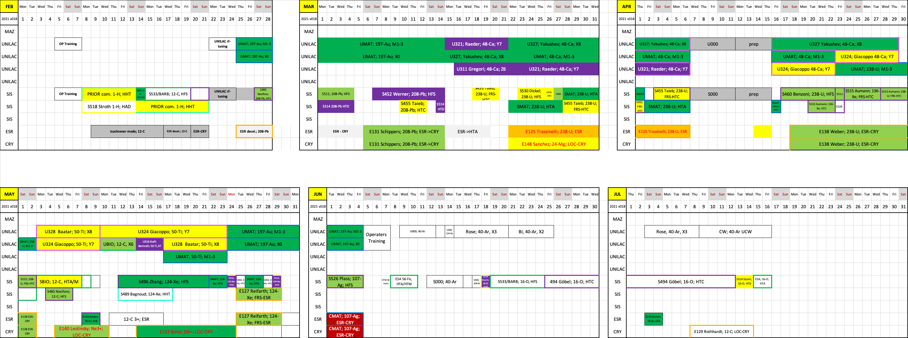

Beam availability

Slide 9
Beam availability
E125: Technical issues at ESR
U324/U328: PIG Ti-operation
CMAT: Cryring extraction

Slide 10
Beam intensity

Slide 11
Beam settings

Slide 12
Lessons learned
Overall a very successful beamtime
  don‘t forget the boundary conditions: COVID-19, Campus challenges, short beamtimes
Challenges
  run a highly parallel and dense program
  experiment and partly machine commissioning within the physics run
  longer machine chains
Measures
  better preparation of the run (pattern and optics prep. bevor the exp. starts)
  sustainable basic beam settings (link UNILAC-SIS18)
Critical points
  personnel !!! (both sides machine & experiment)
  machine development

Slide 13
Thank you for the last few months. It was and is a pleasure to work with all of you and make this beamtime a success!
Thanks for you attention!

Slide 14
Some ideas…
define reference values (comparable)
  most important for research: parameters at target
also secondary performance parameters besides availability and intensity like:
  setup times
  spill structure
  parallel operation capability
transparent timeline of upgrade projects

