Slide 1
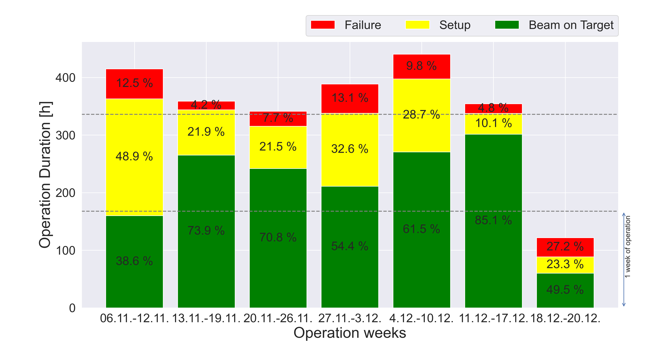
Wochenstatistik
Notes:
1 bis 1.5 Parallel Machine Exp; Cryring worked with local Source
4th week – change to Uranium

Slide 2
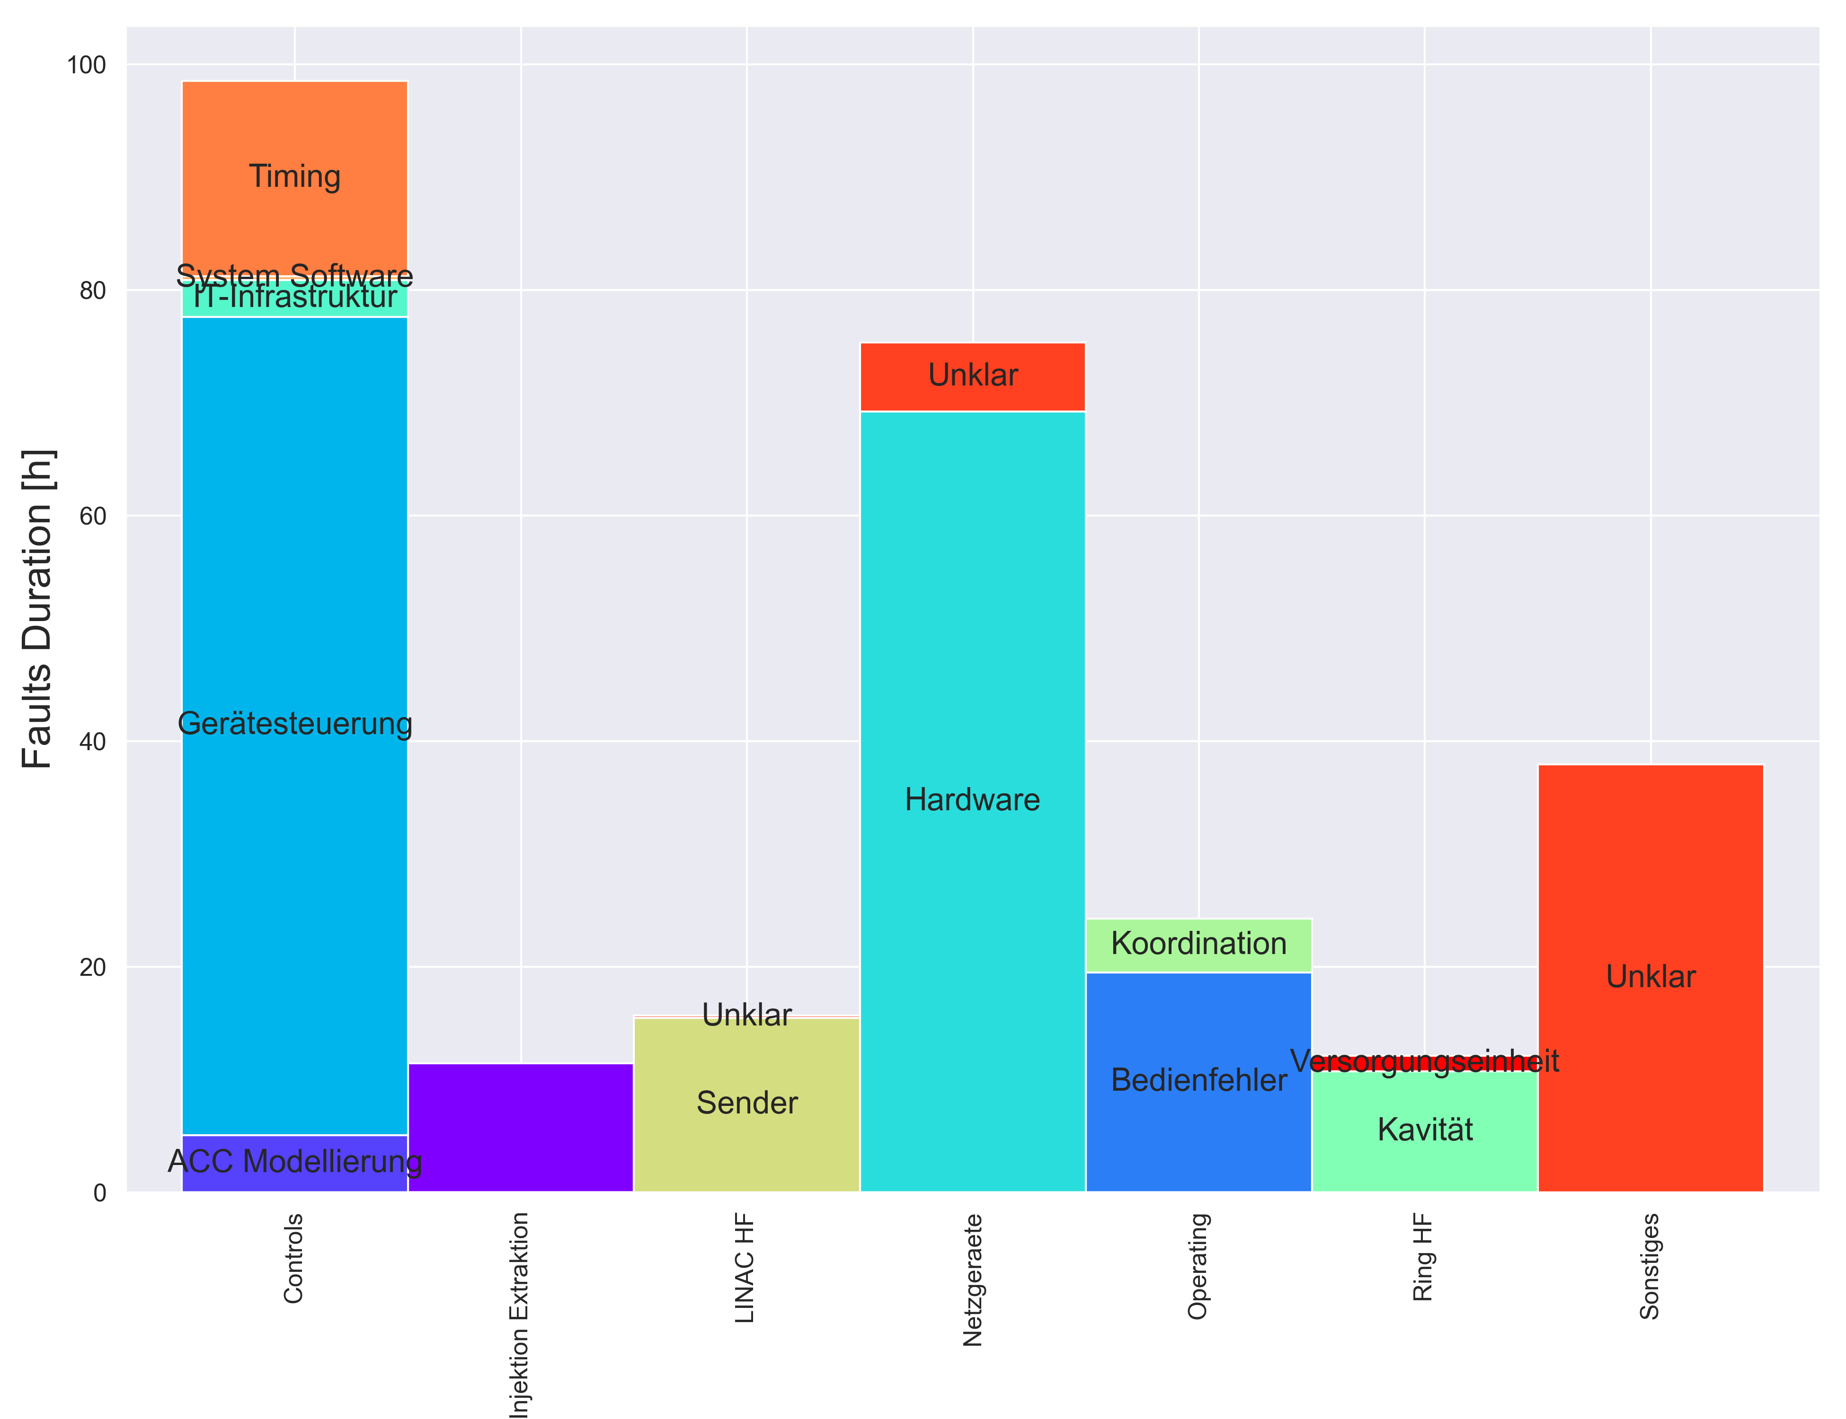
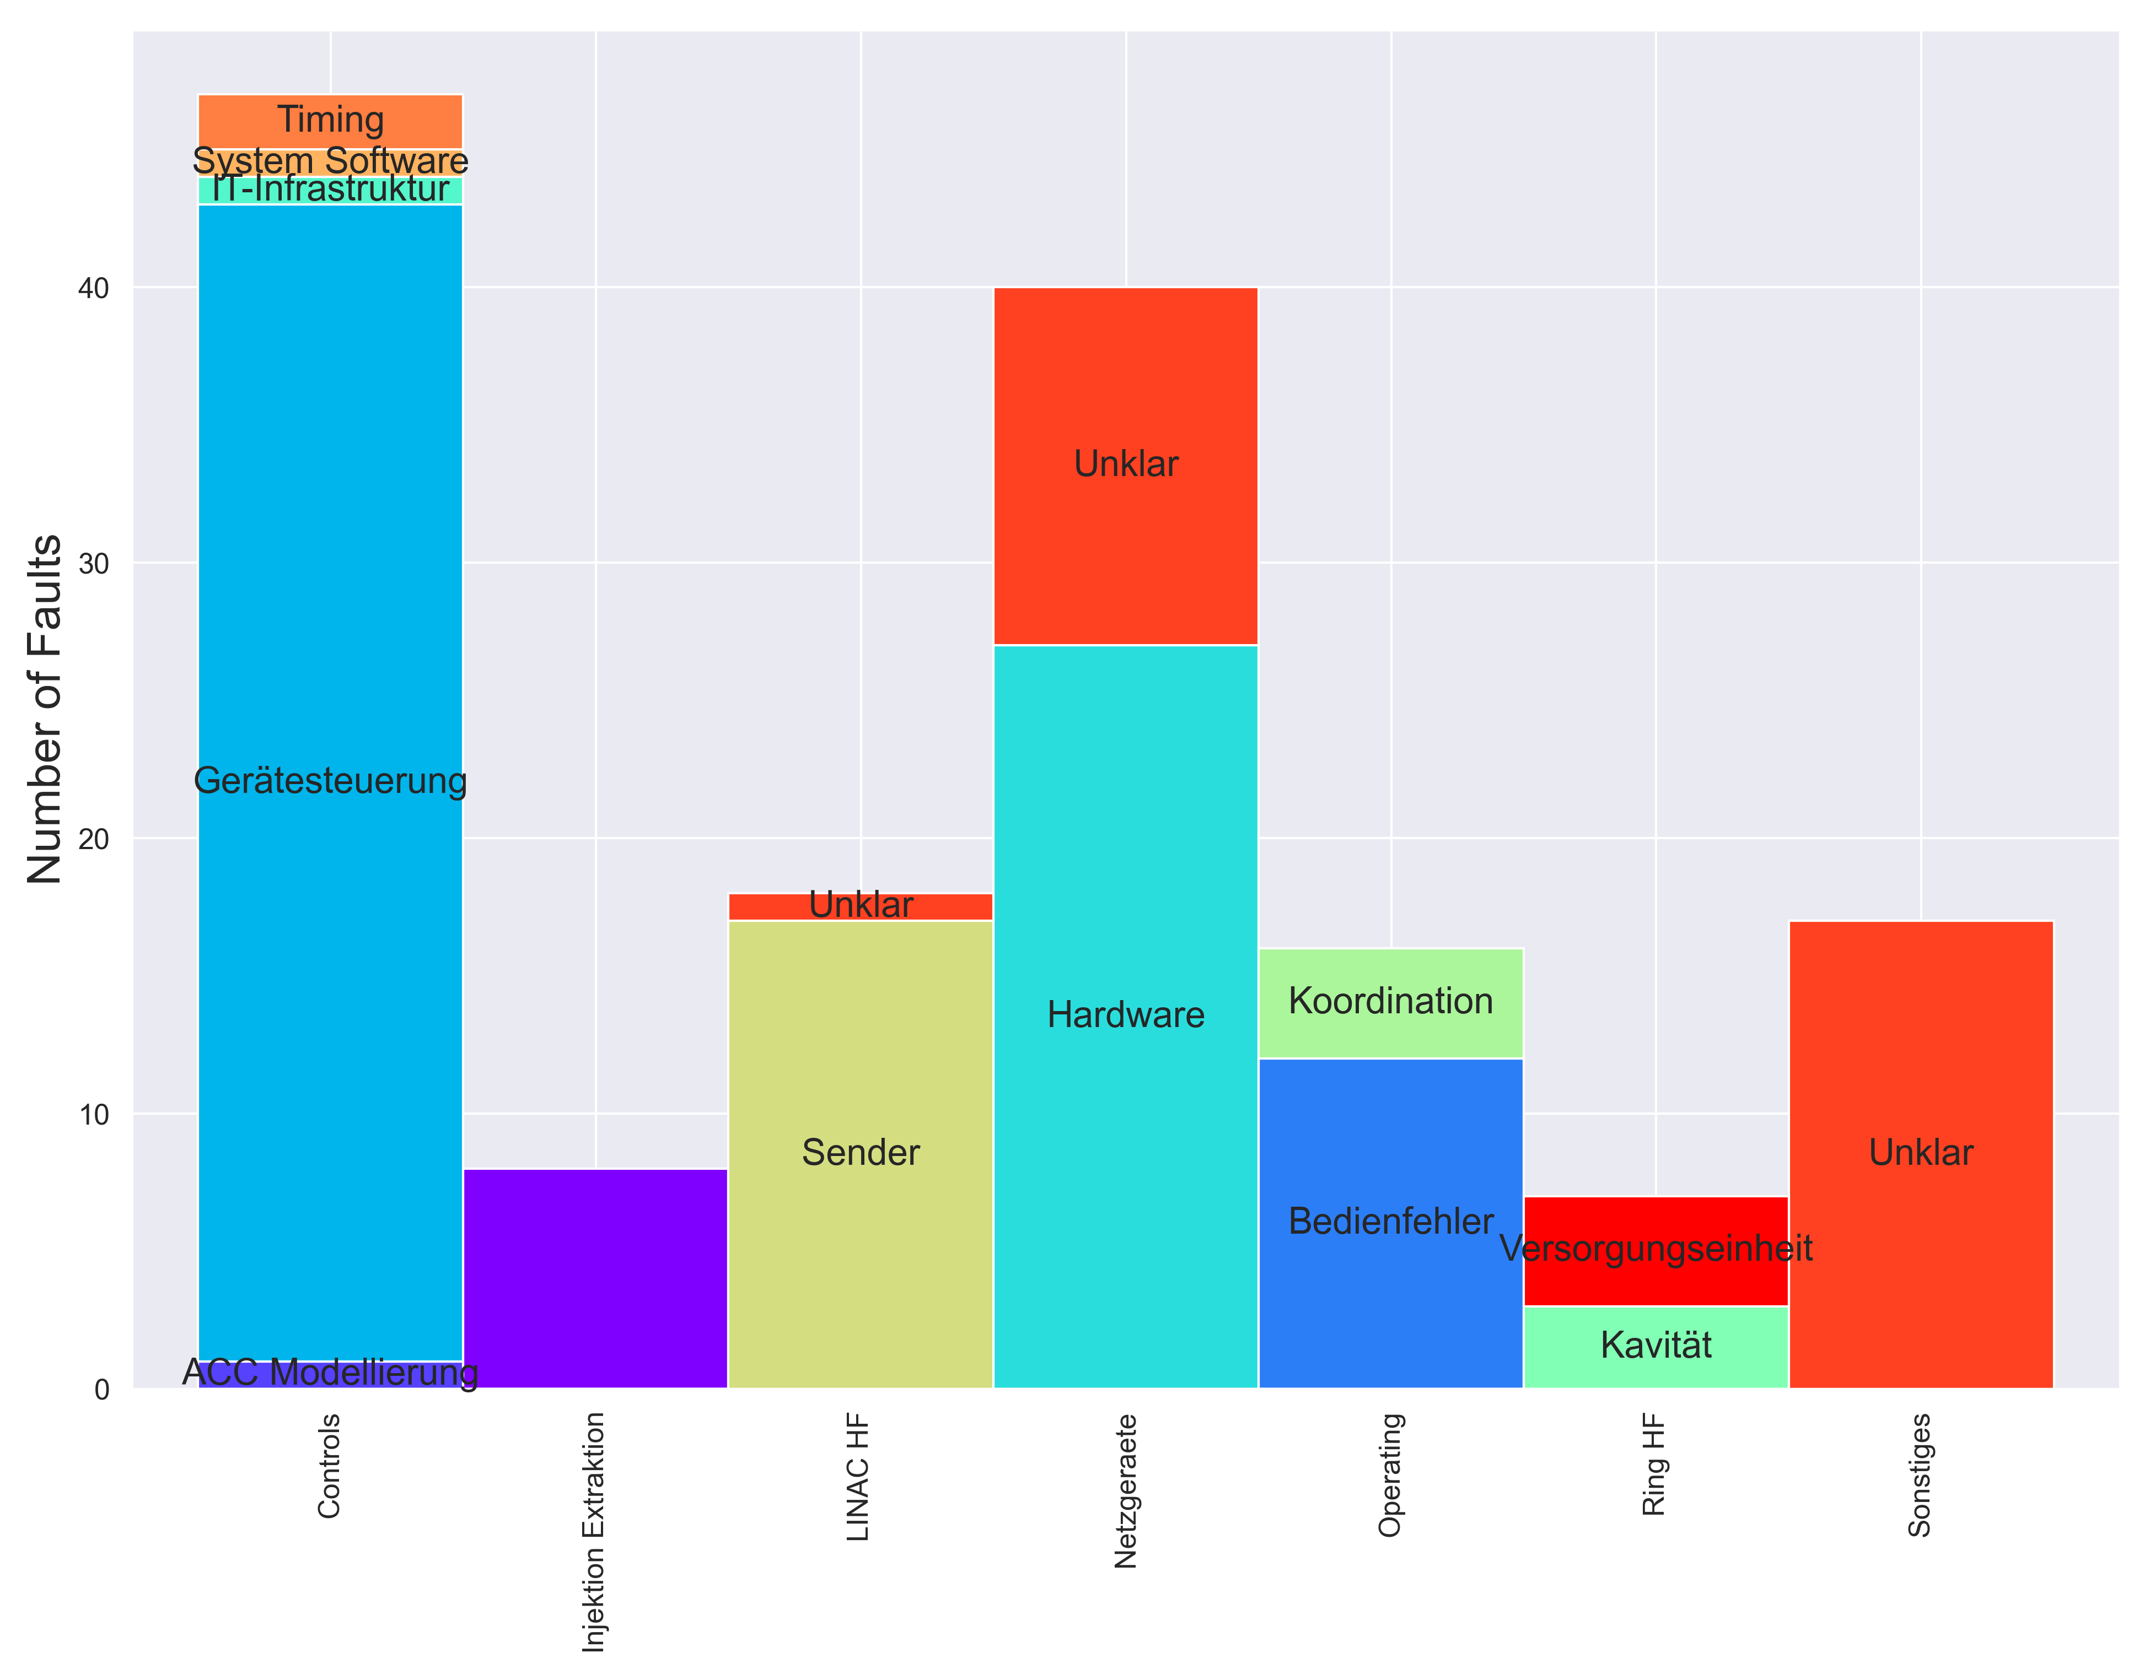
Ausfälle der gesamten Anlage
Notes:
Unilac to listed here
Controls – Frontend (PE Error, Real Time Error)
Inj/Extr – TK Chopper

Slide 3
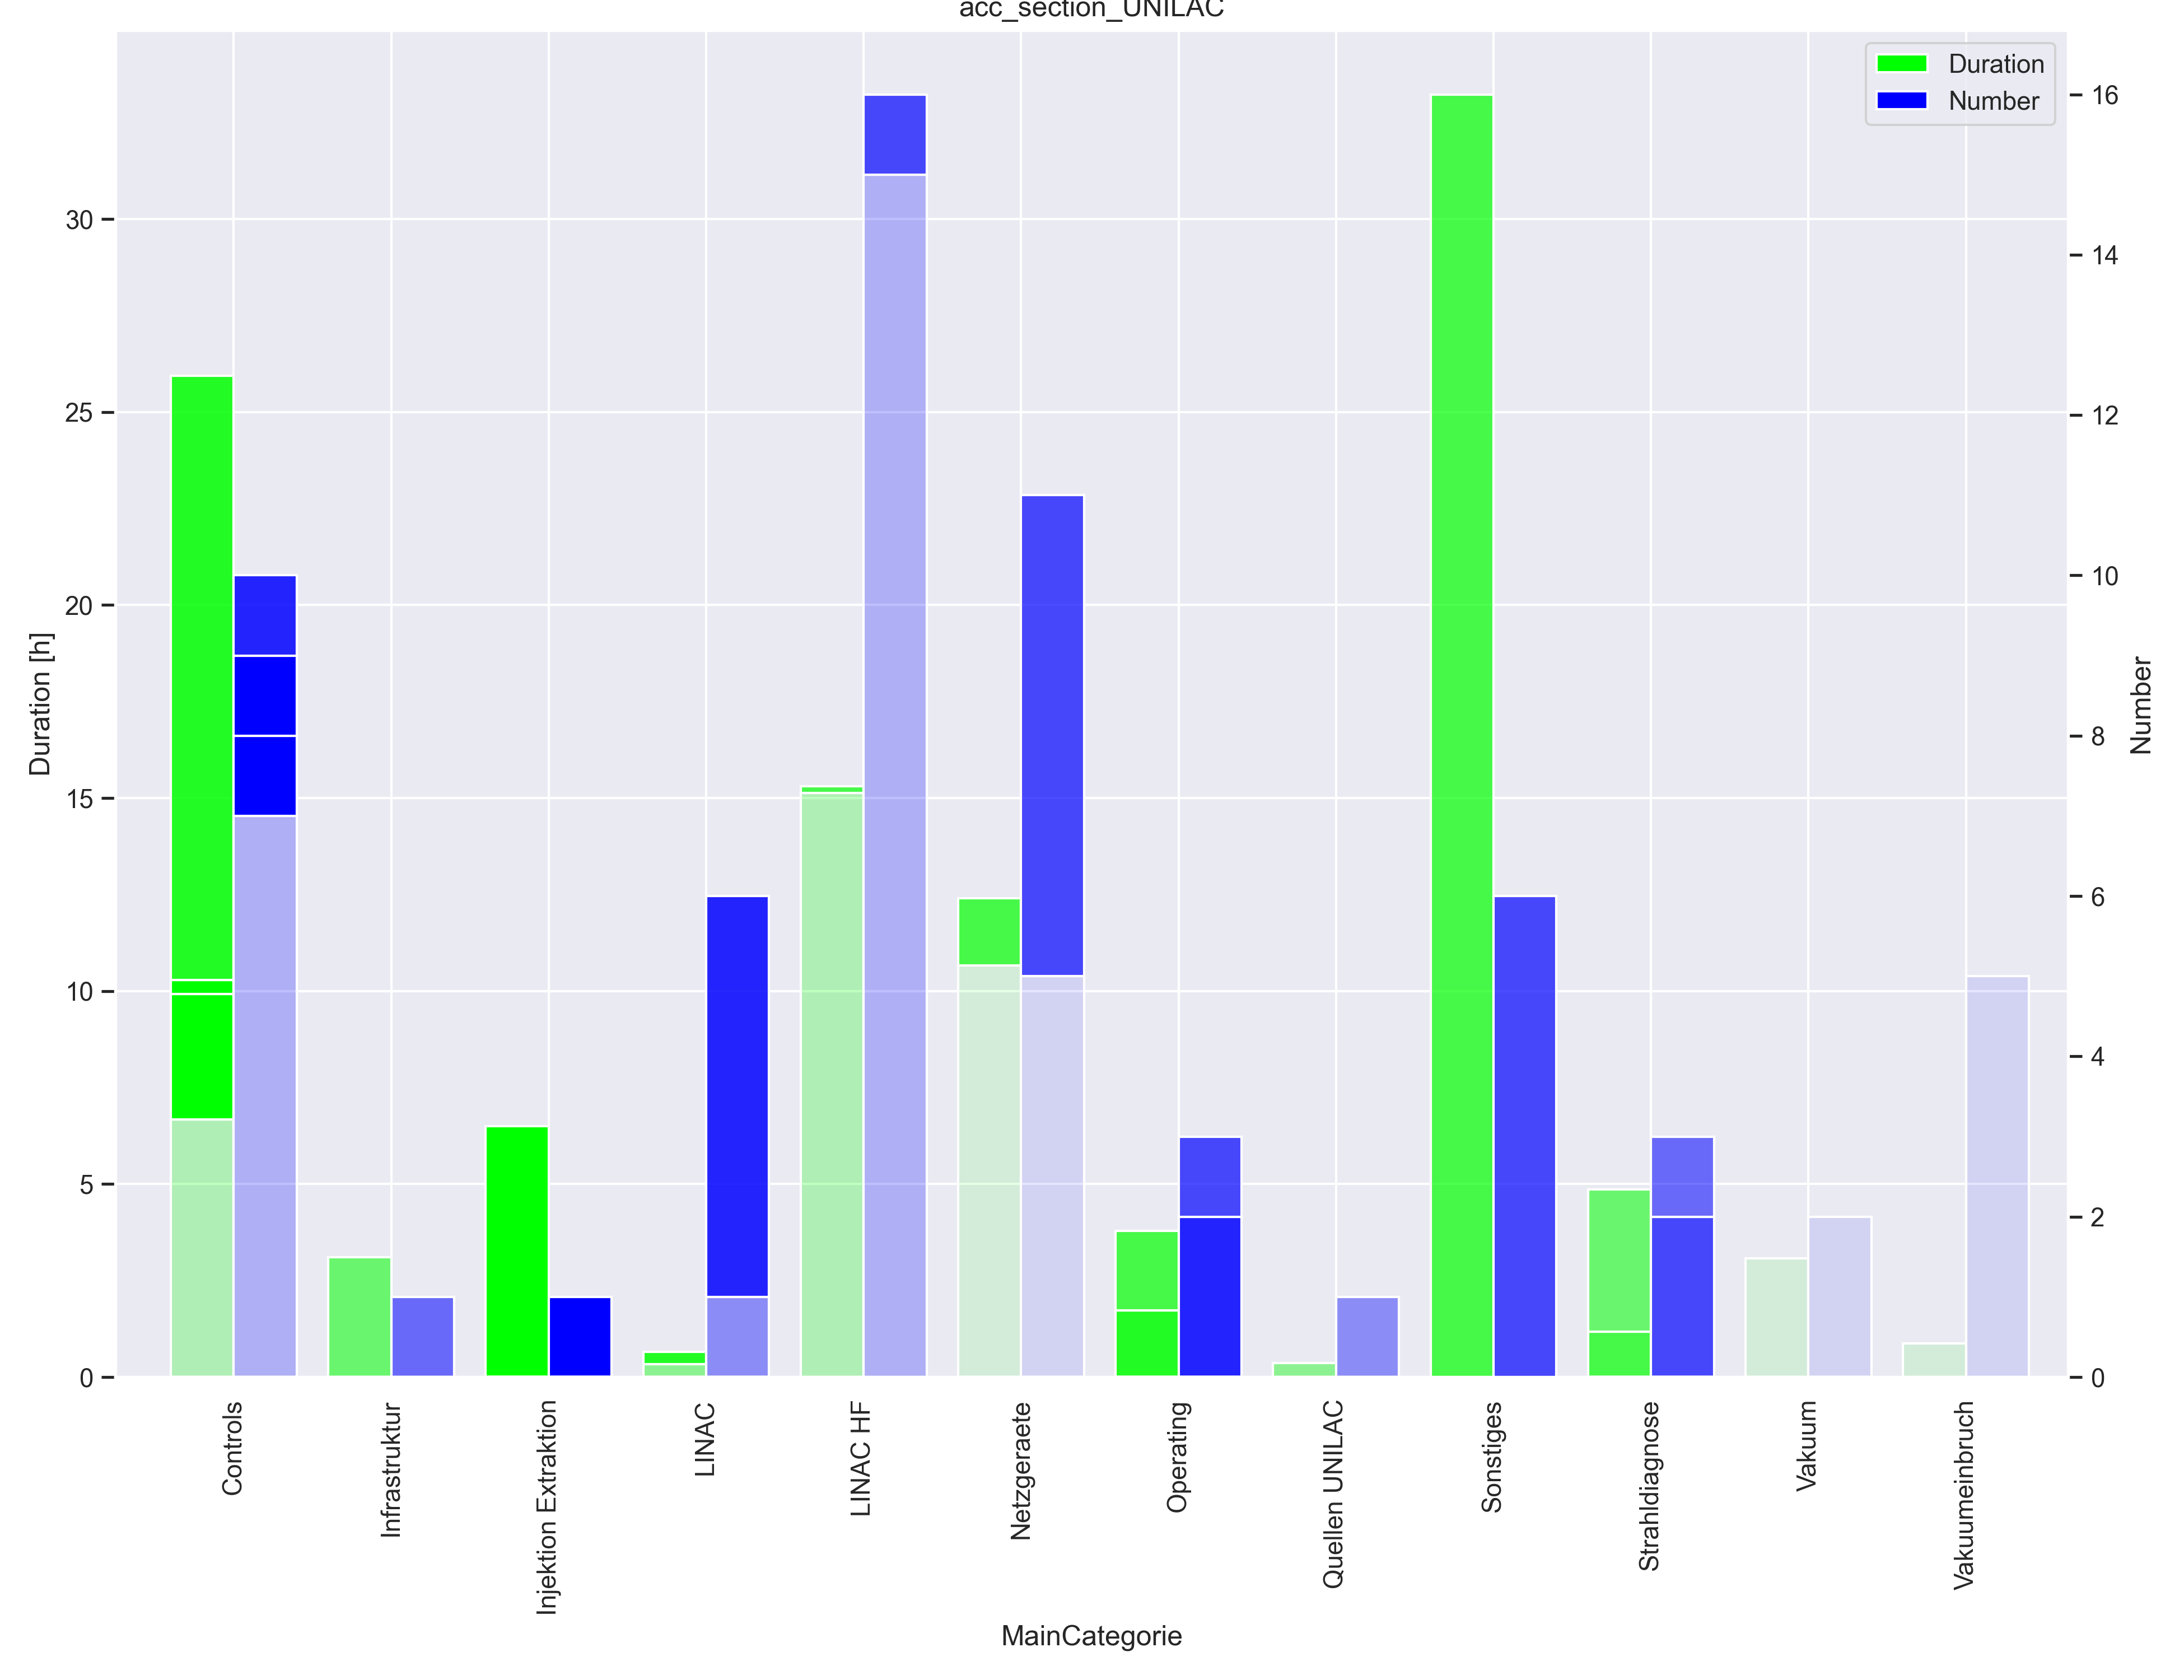
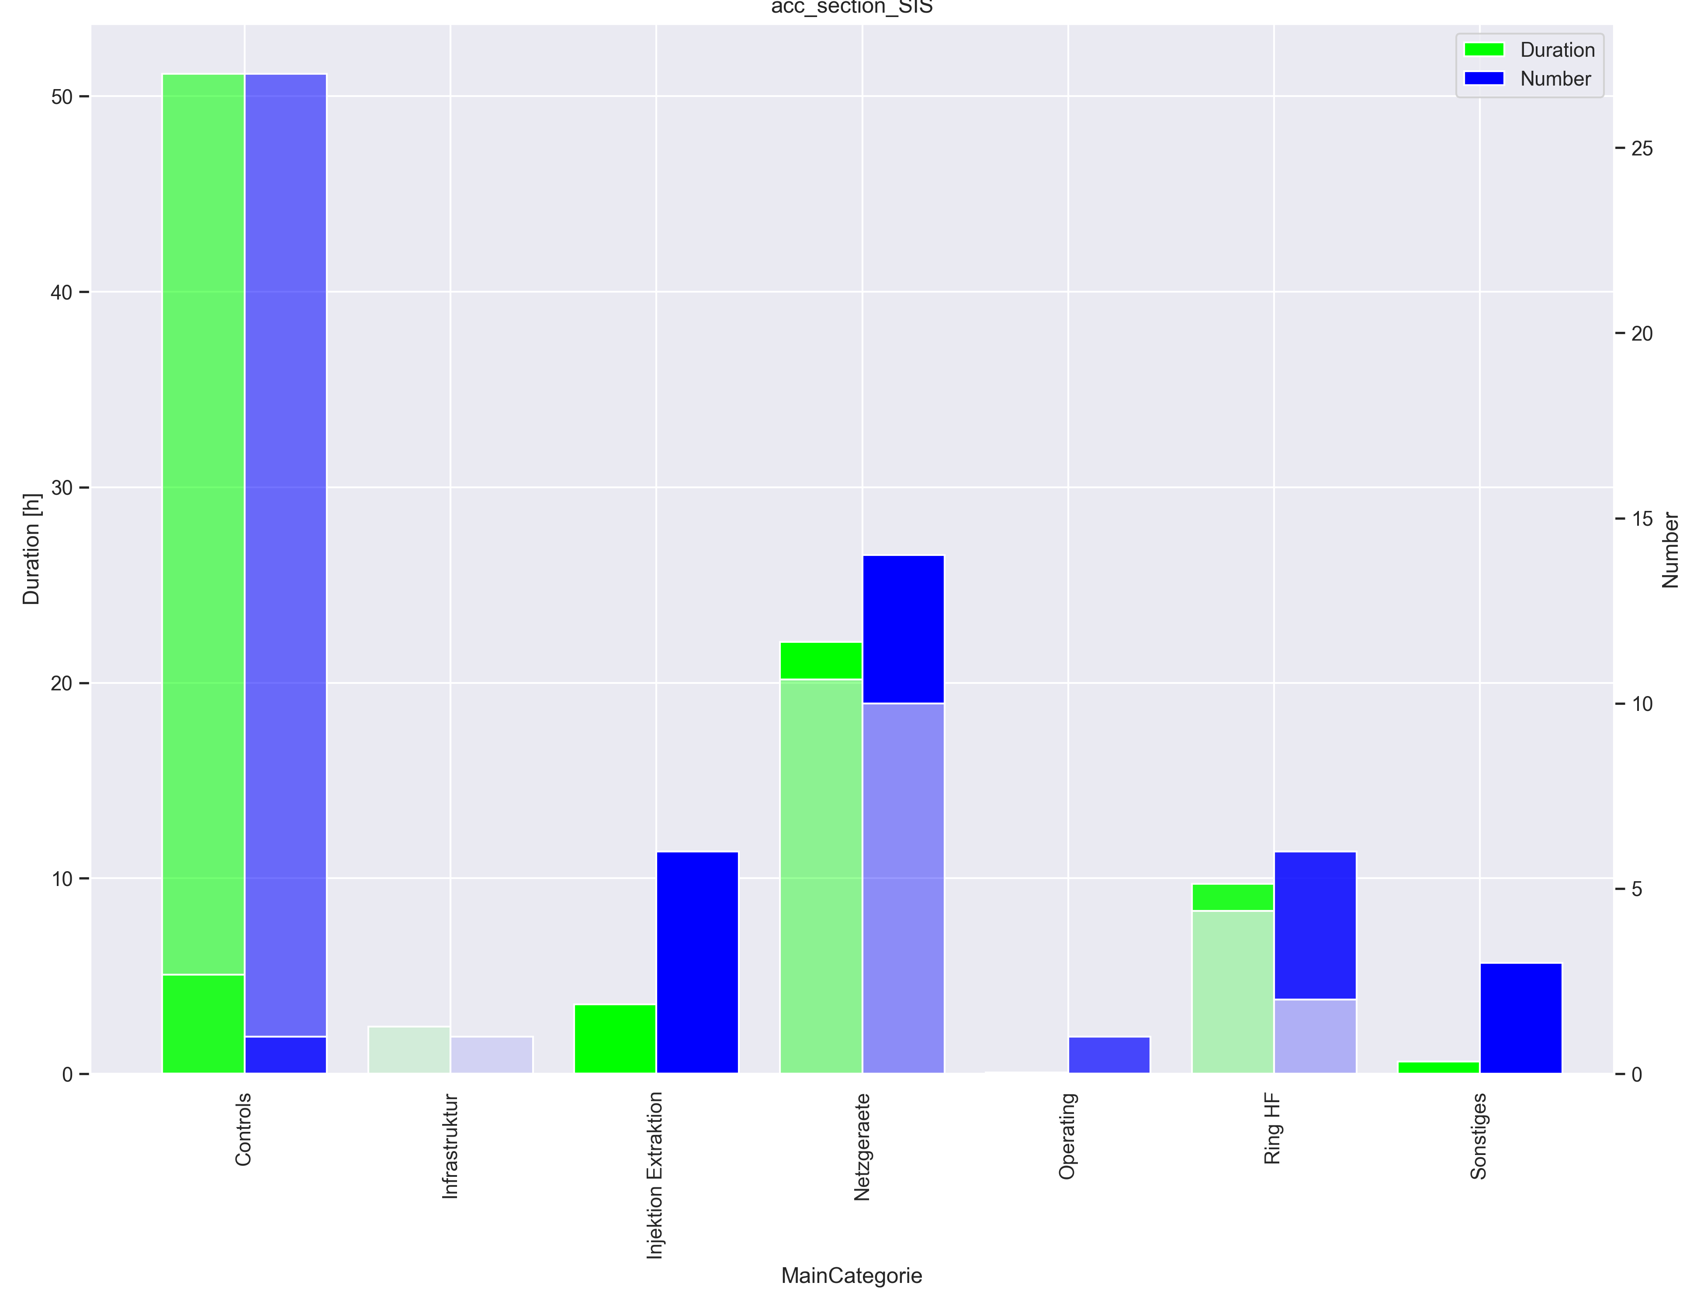
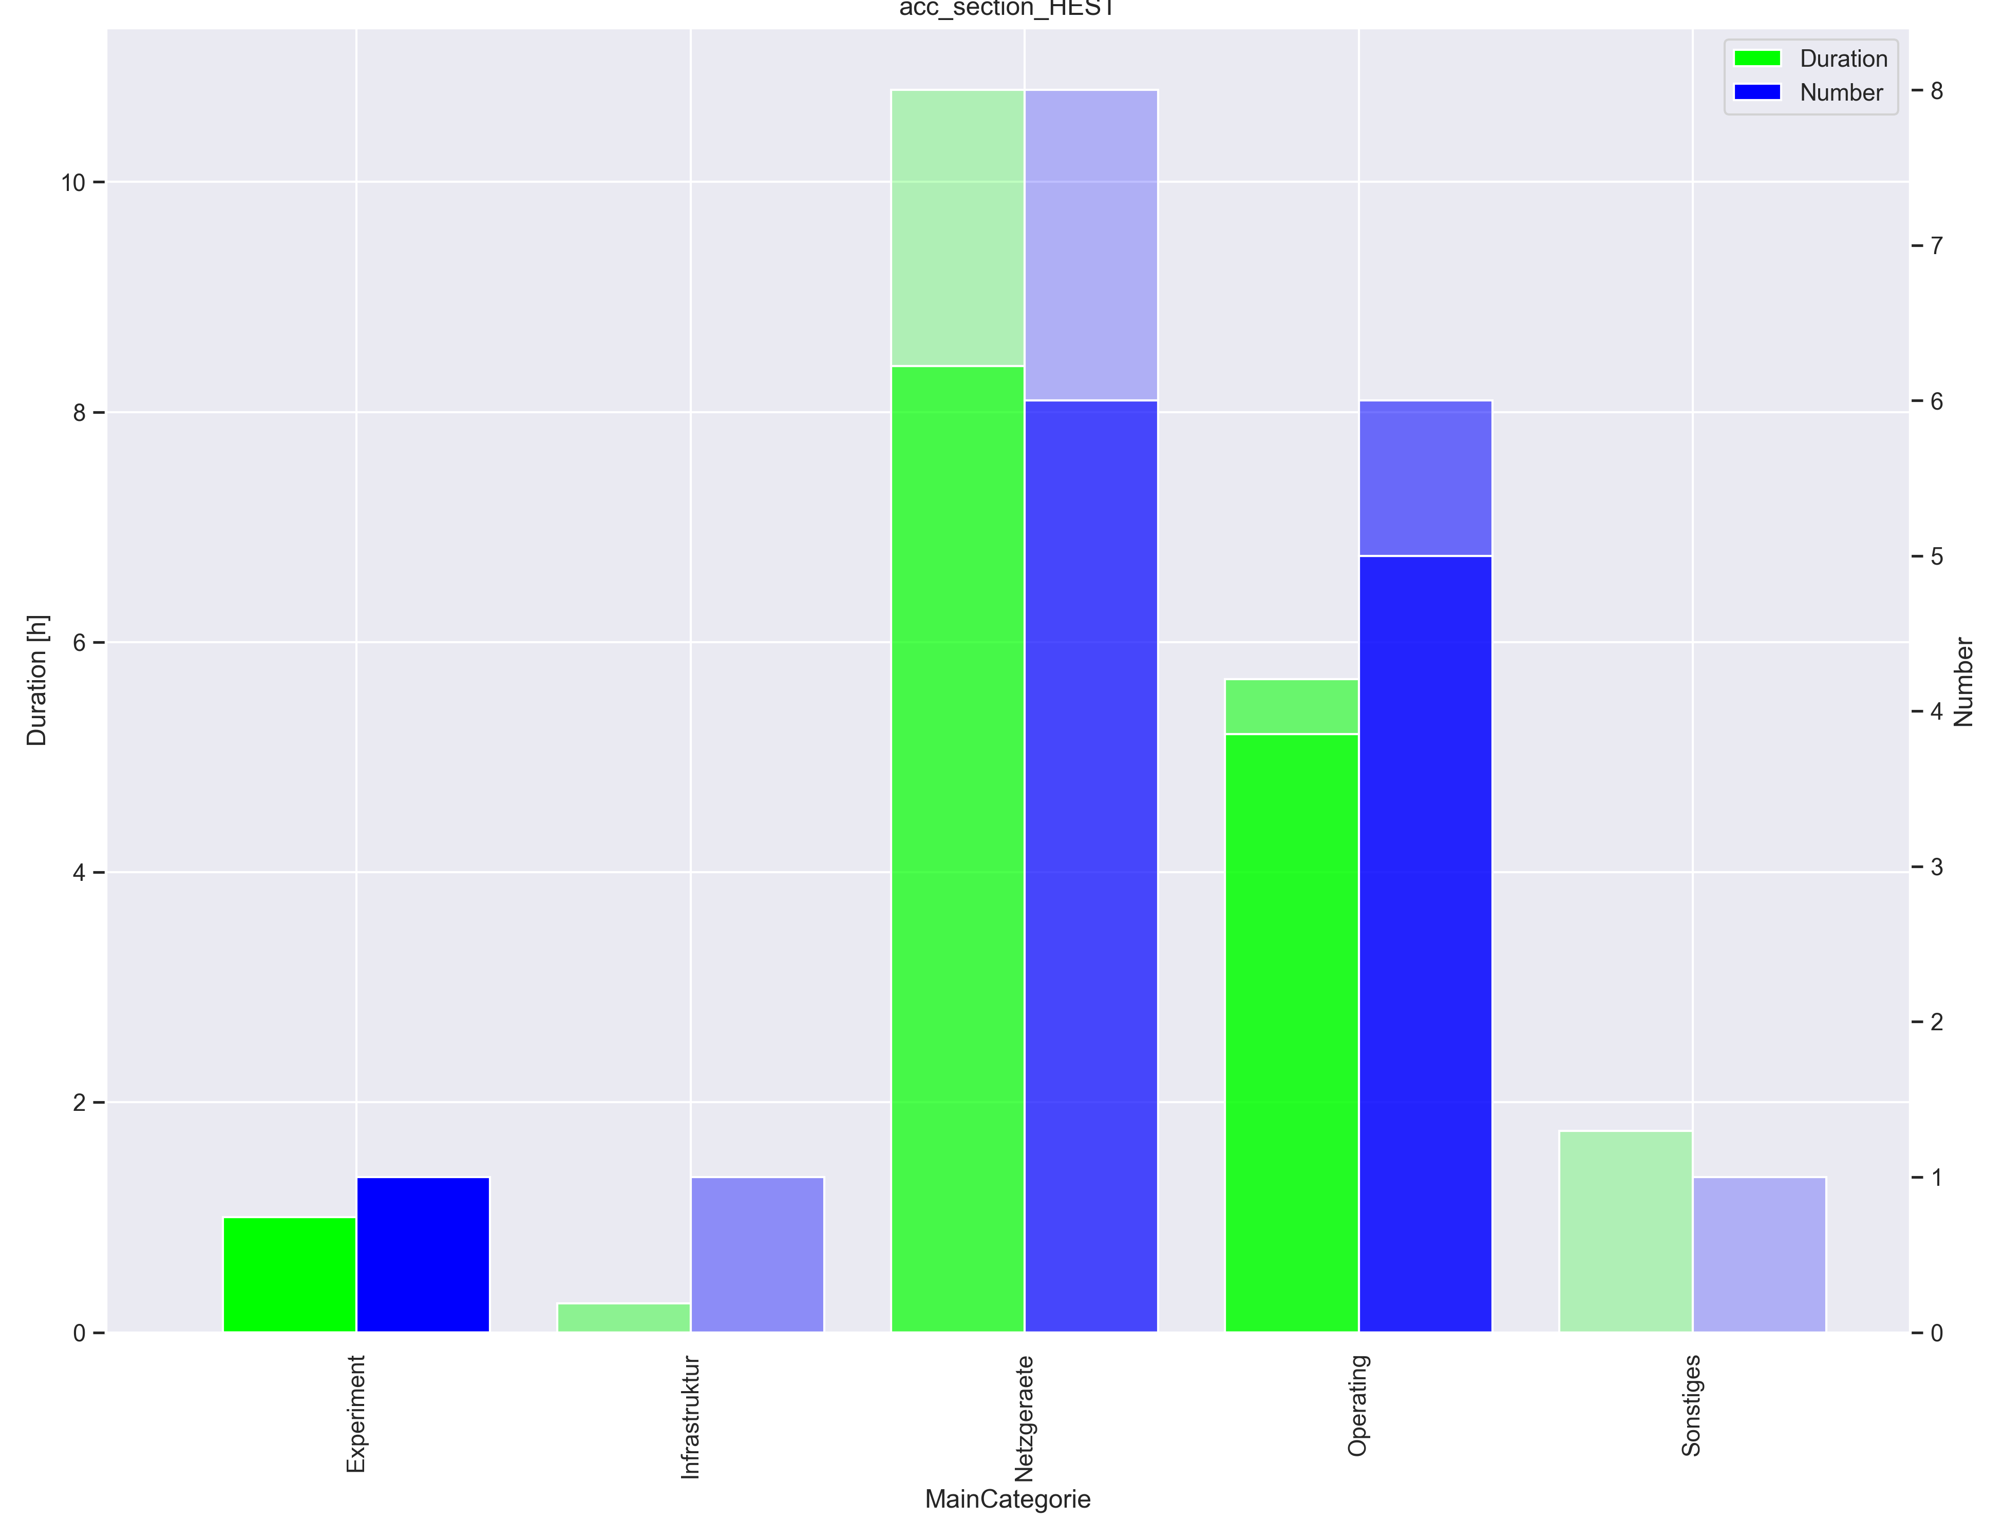
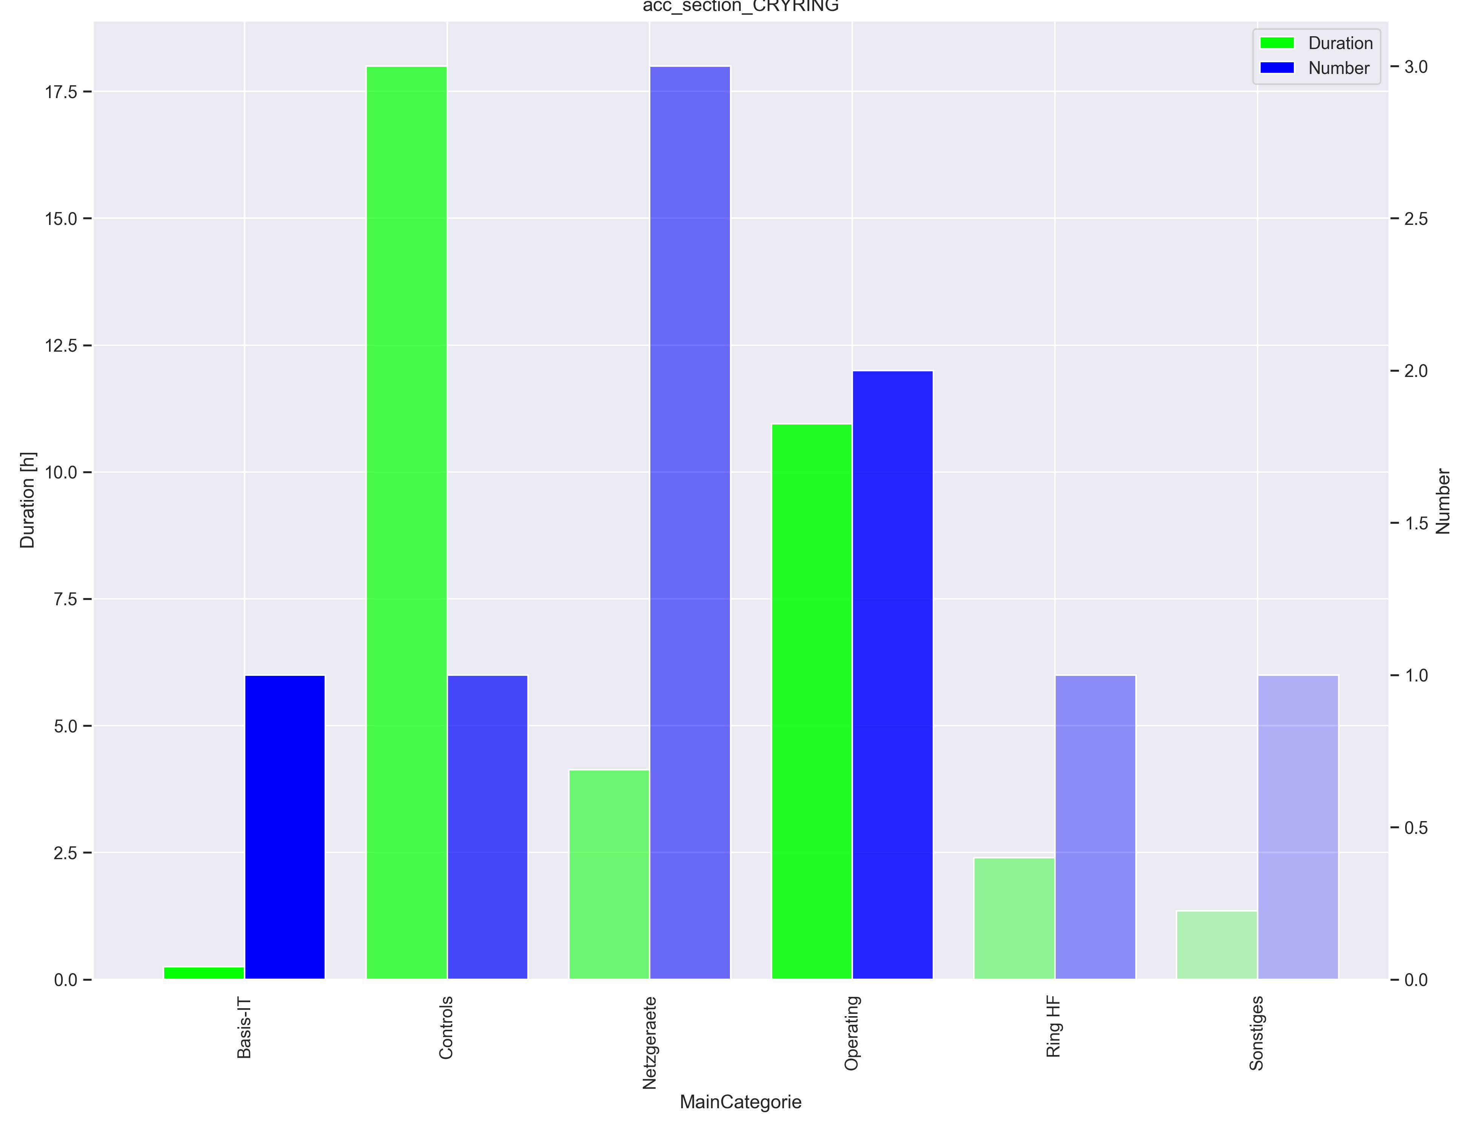
Ausfälle pro Maschine

