Slide 1
Micro Vertex Detector
A Status Report
| Tobias Stockmanns on behalf of the MVD group

Slide 2
Introduction

Slide 3
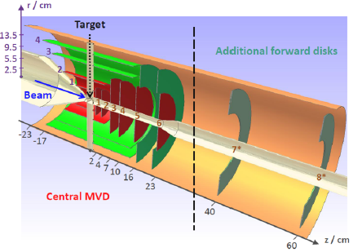
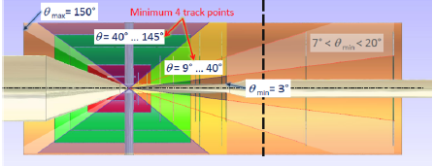
MVD Structure
2 barrel pixel layers
4 pixel disks
2 barrel strip layers
2 mixed disks
2 optional lambda disks

Slide 4
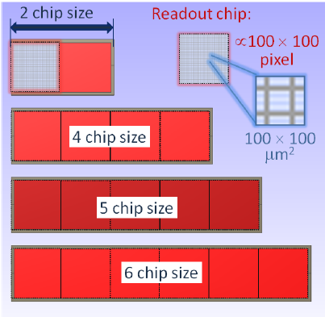
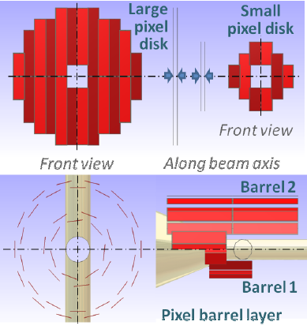
MVD Pixel Part

Slide 5
MVD Strip Part

Slide 6
Pixel Part

Slide 7
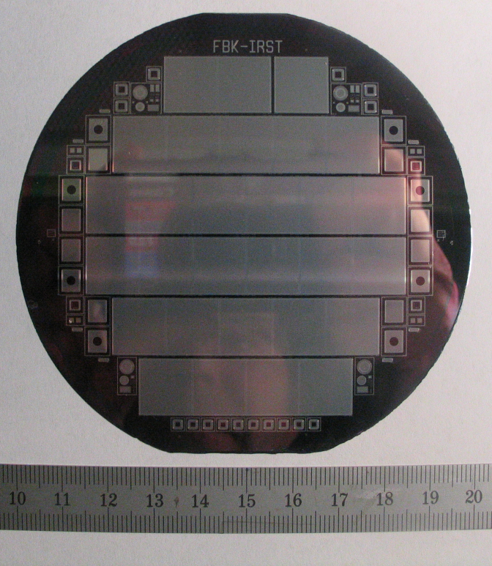
Pixel Sensor
Epitaxial silicon sensor
Different sensor prototypes with epi-thicknesses of 50, 75, 100 µm – 100 µm selected for PANDA
Qualification of prototypes on its way
Irradiation done with neutrons and protons up to (and beyond) PANDA specifications
Full size prototype available with PANDA geometry

Slide 8
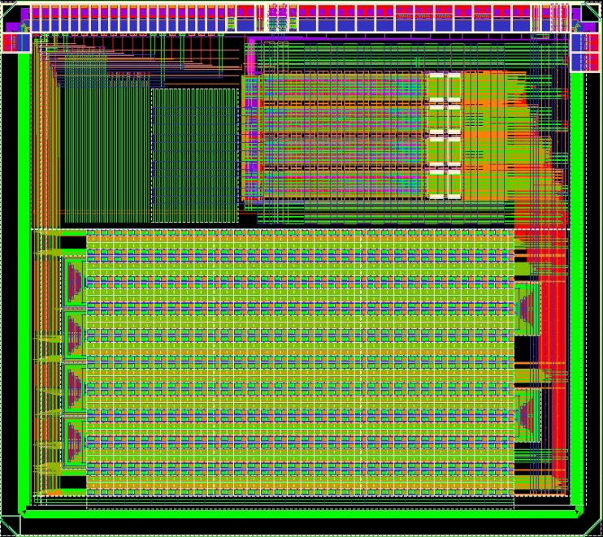
Pixel Readout Electronics - ToPix
Recent prototype ToPix3:
2 x 128 + 2 x 32 double columns with 4 x 4.5 mm² size
Complete pixel cell with full column architecture, end of column logic, buffers
Simplified multiplexer and serializer
Extensively tested in lab and in three testbeams at CERN and Jülich up to the maximum PANDA rates
Future prototype ToPix4:
Design is ongoing

Slide 9
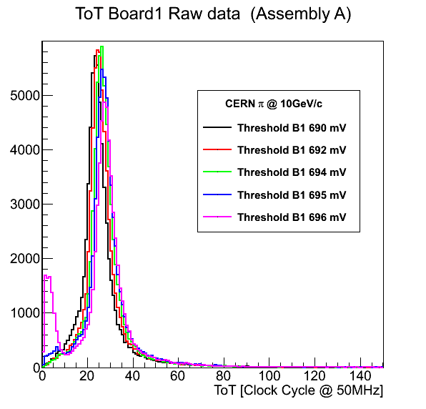
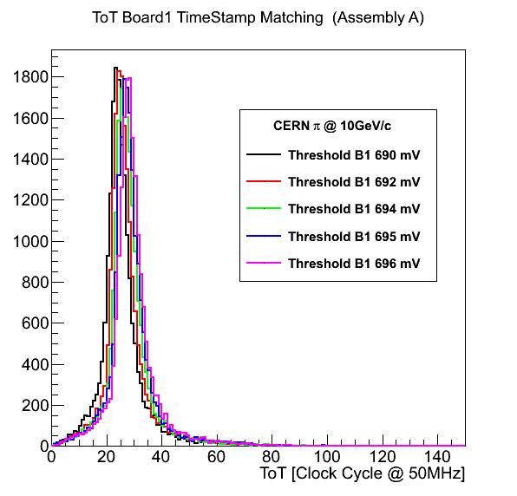
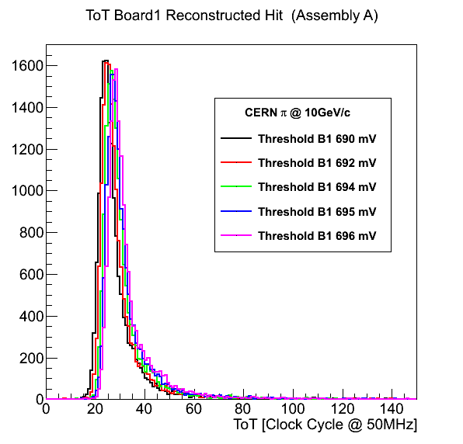
CERN Testbeam

Slide 10
Strip Part

Slide 11
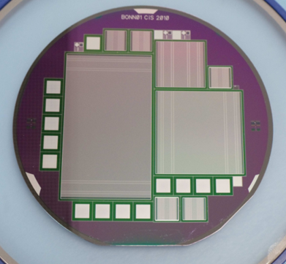
Strip Sensors
Standard double sided silicon strip sensor
280 µm thickness final thickness
Pitch 65 µm
Several different prototypes tested
Full prototype sensor in test

Slide 12
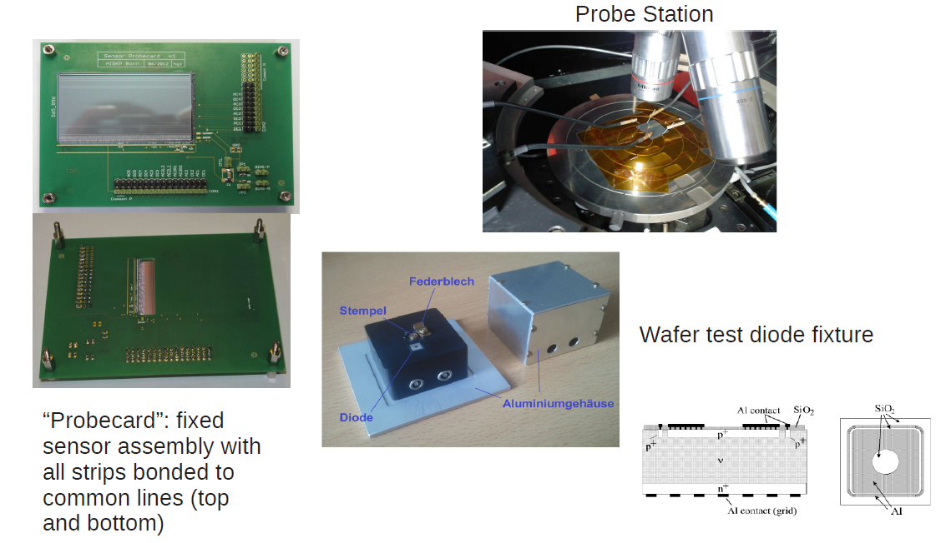
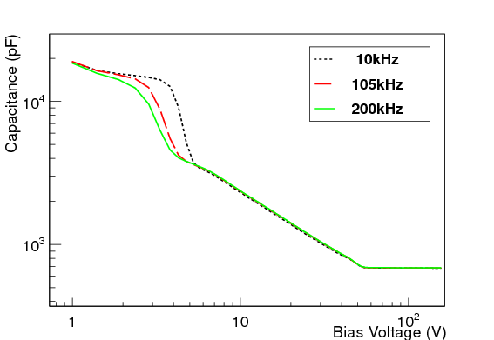
Test setup

Slide 13
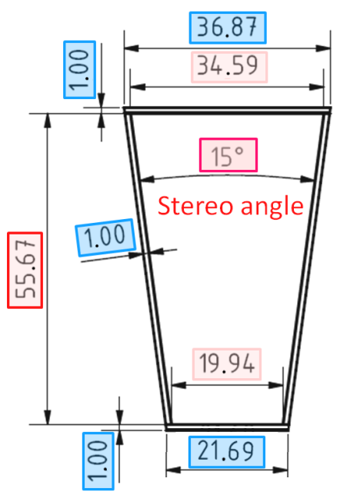
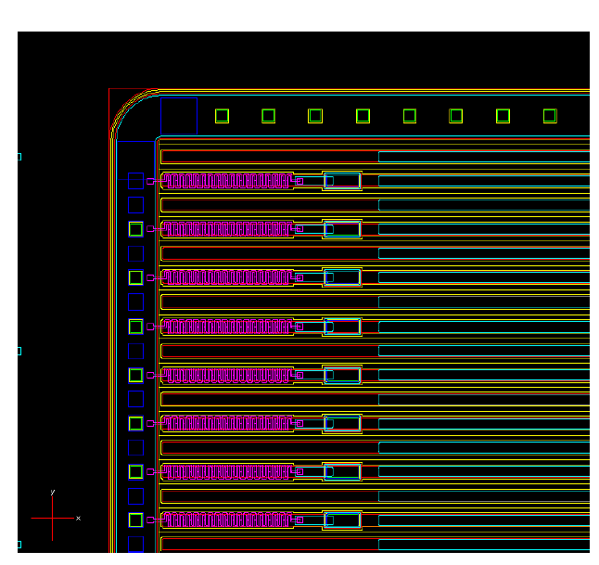
Strip Sensors
Wedge sensor
First prototype submitted last year to CiS
280 µm thickness
67.5 µm pitch
Expected to be back end of March
Probestation and lab setup in preparation in Jülich
Barrel sensor
New prototype submitted in January
Expected to be back in May
Only change: poly-silicon instead of punch-through biasing

Slide 14
Strip Readout Electronics
No free running strip front-end chip with PANDA specifications is available
Development of an own strip readout chip has started as a combined activity of Torino, Giessen and Jülich

Slide 15
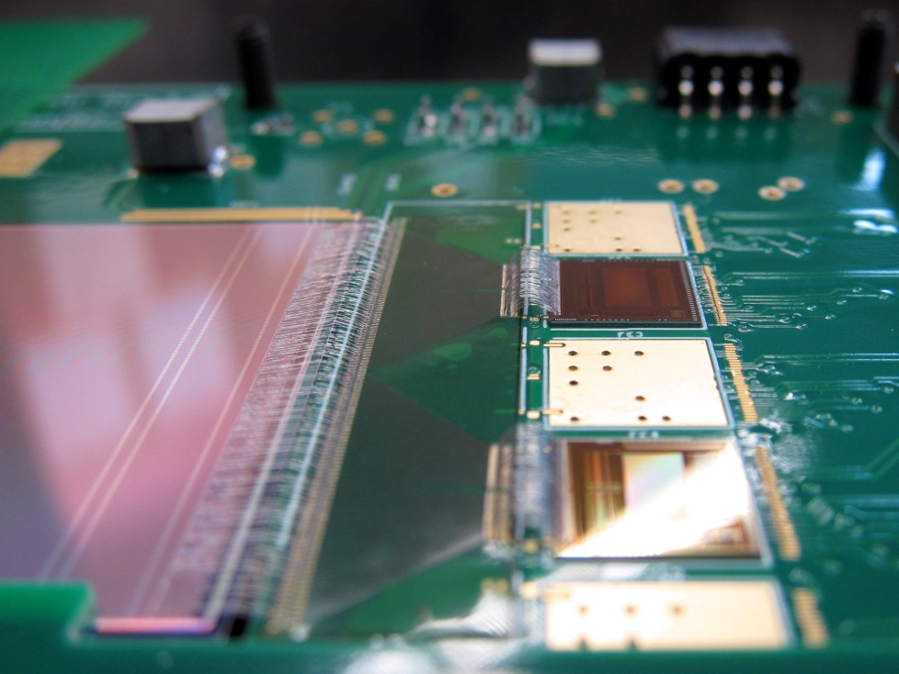
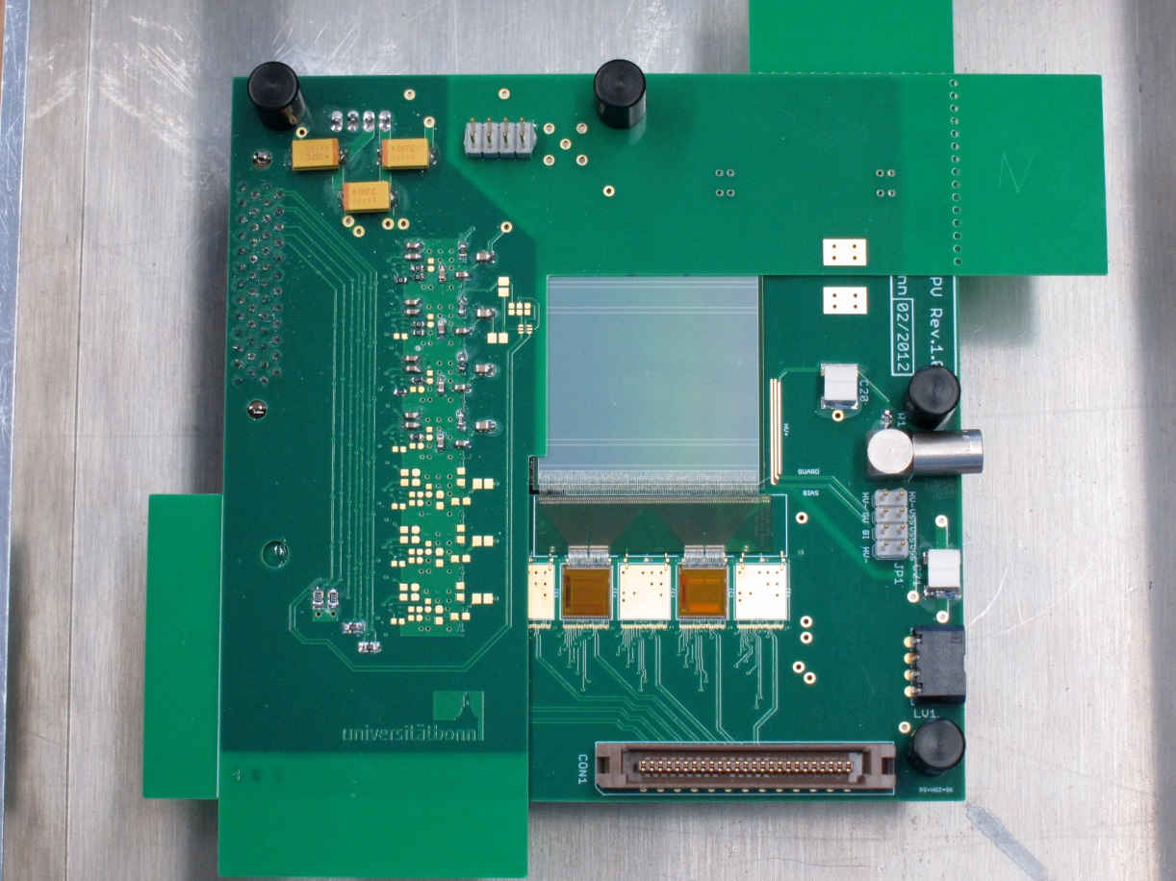
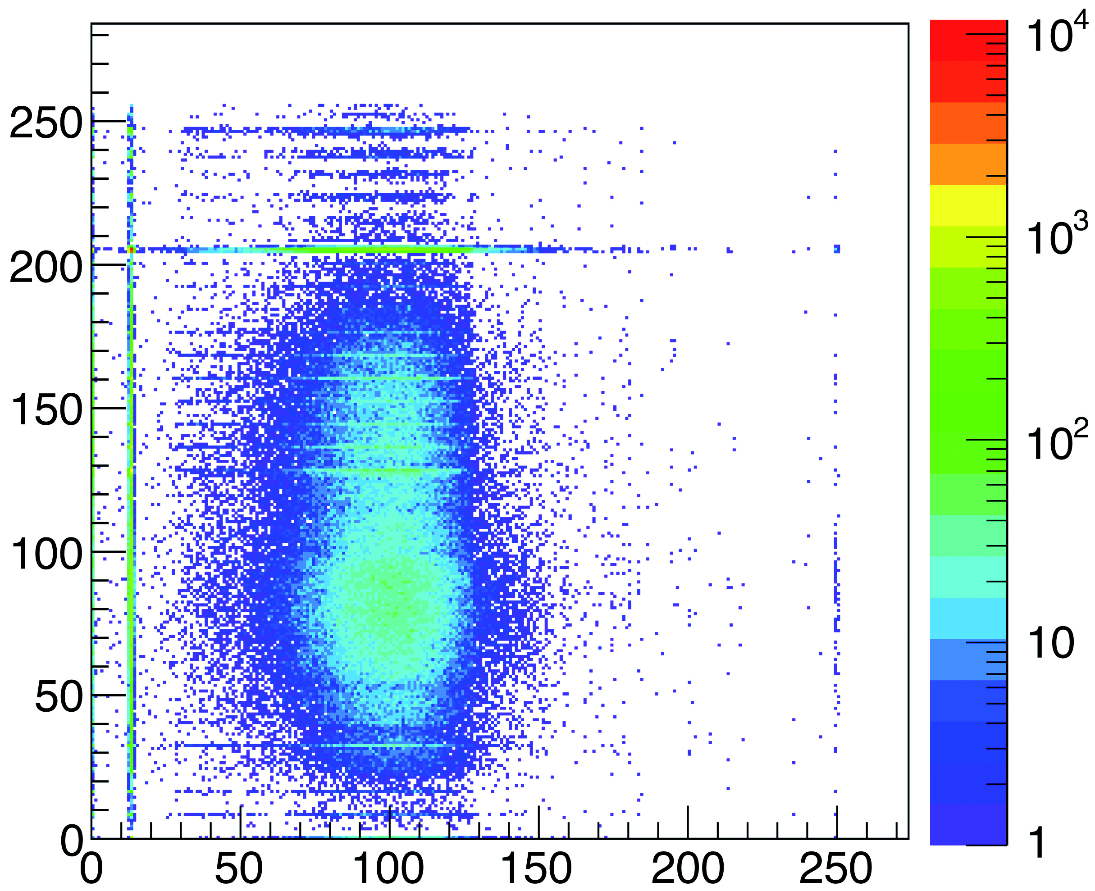
New Flex Pitch Adaptor
Flex-PA and squared sensor assembled on a test board and successfully tested at SPS, CERN (September 2012)

Slide 16
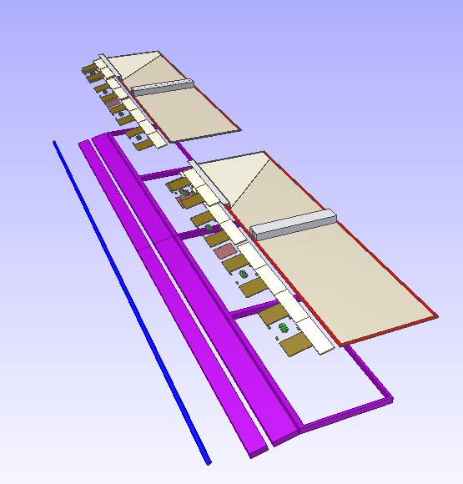
Module Concept
Carbon fiber support structure
Rectangular sensors with 90° stereo angle
Front end electronics at the side
Cooling available below front end electronics
Data concentrator to do feature extraction at the end of a stave

Slide 17
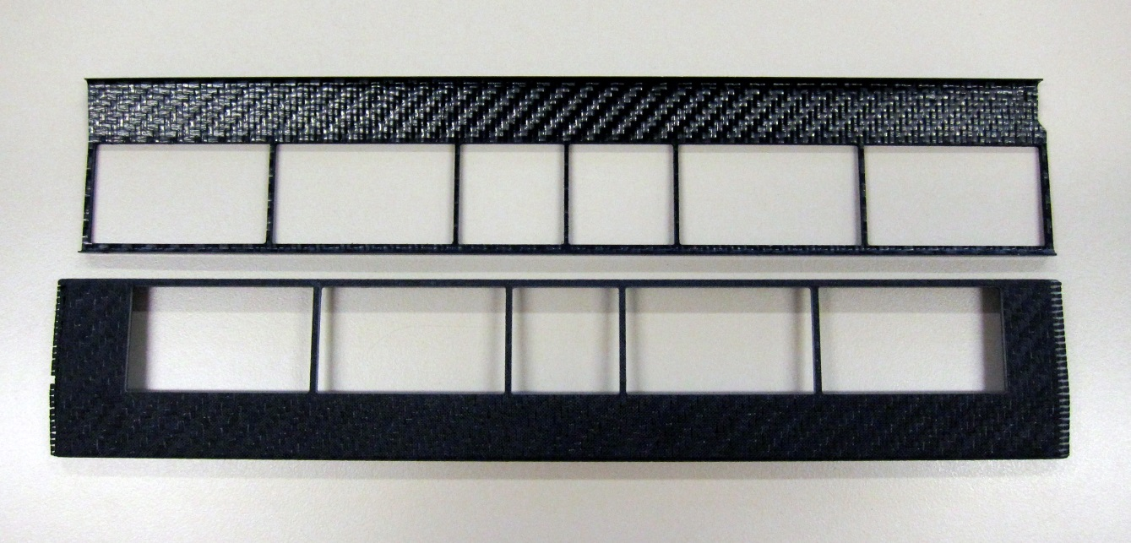
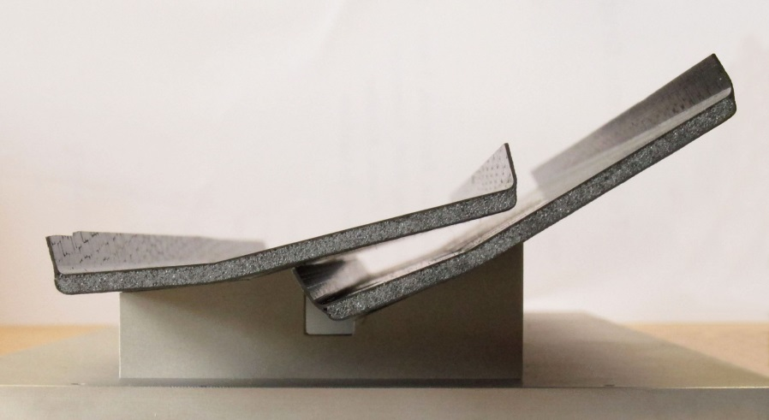
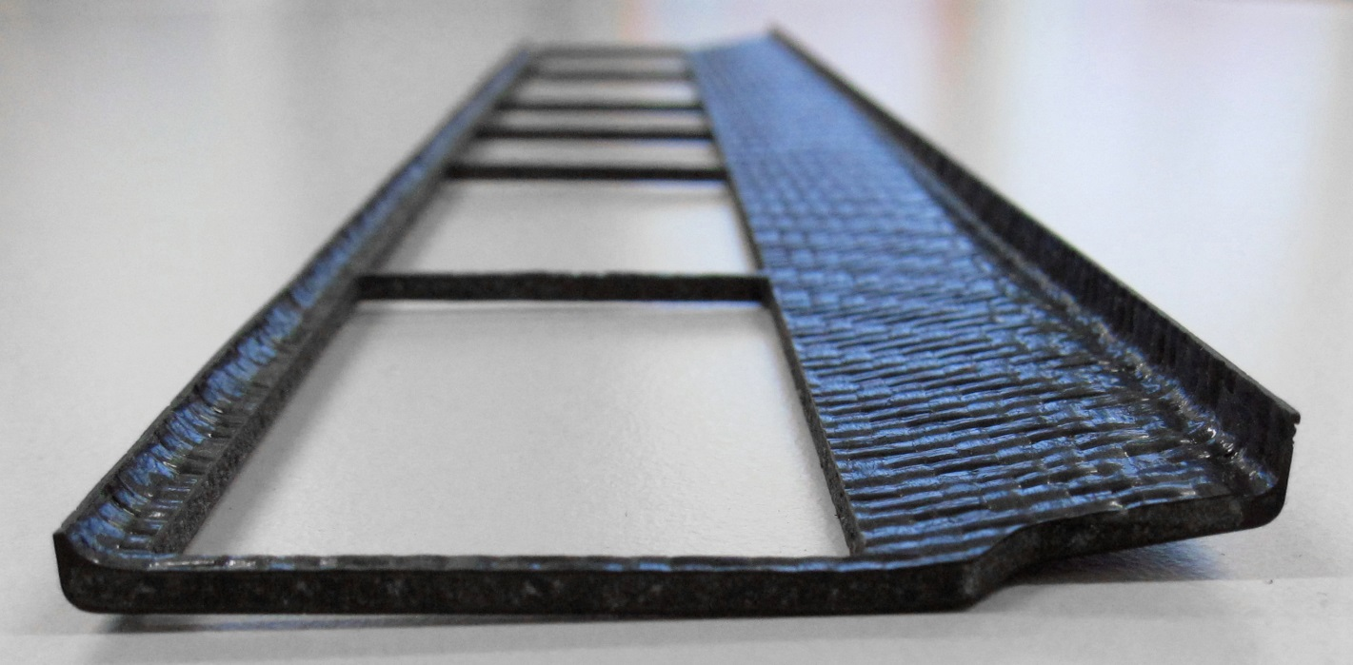
Prototypes

Slide 18
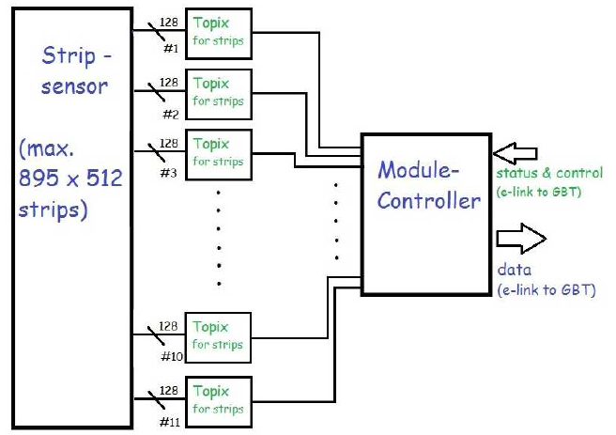
Data Concentrator

Slide 19
Infrastructure

Slide 20
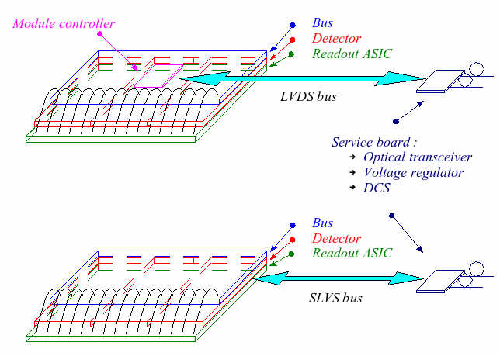
Off-Detector Electronics
Readout scheme:
Electrical data transmission with 320 Mbit/s serial links
Aluminium cables tested succesfully
Connection to module bus under study
Optical data conversion immediately after active volume of MVD
Optical data transmission done with GBT which is under development at CERN for LHC upgrade
Powering scheme via DC-DC converters under test

Slide 21
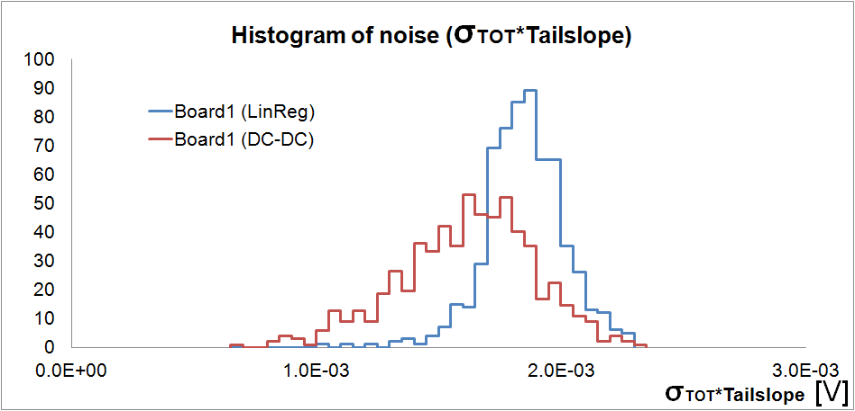
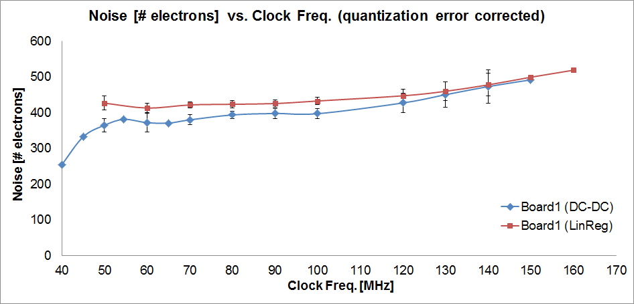
DC-DC powering concept
Power regulator developed for LHC experiments
Air coils to operate in magnetic fields
80 % efficiency

Slide 22
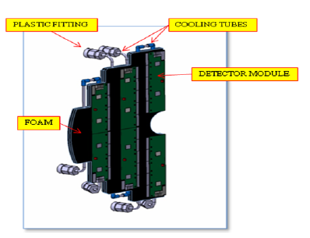
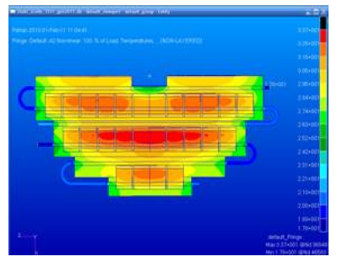
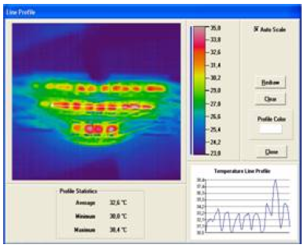
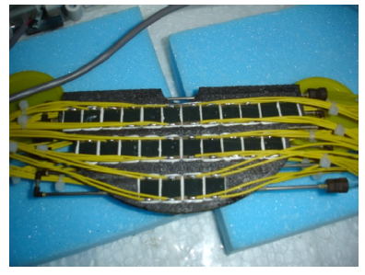
Cooling System
Water based cooling system
Depression mode
Operating at room temperature
Carbon foam with high thermal conductivity

Slide 23
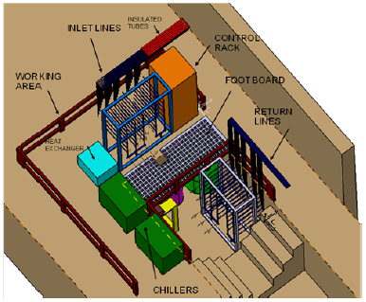
Cooling Plant
Design based on ALICE cooling system for the silicon part
First design of a common cooling plant for strip and pixel part finished
Space requested
A smaller test setup will be set up in the near future

Slide 24
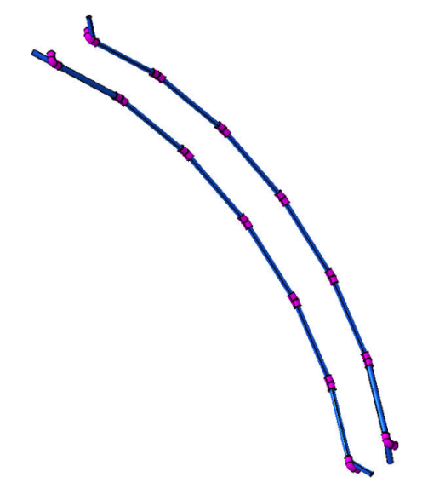
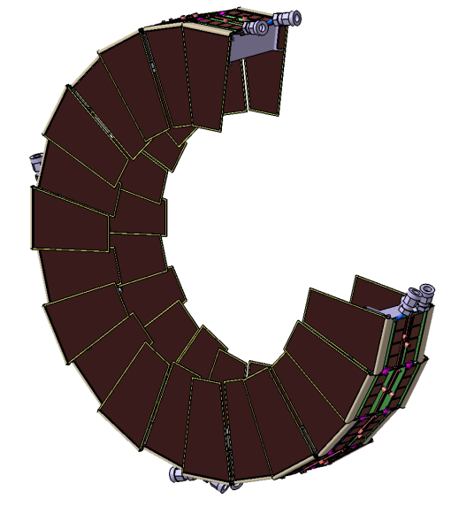
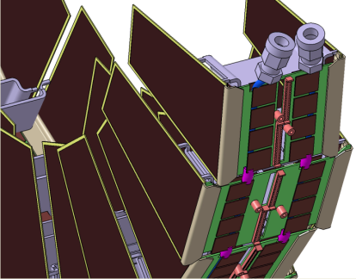
Cooling Concept Strip Disks

Slide 25
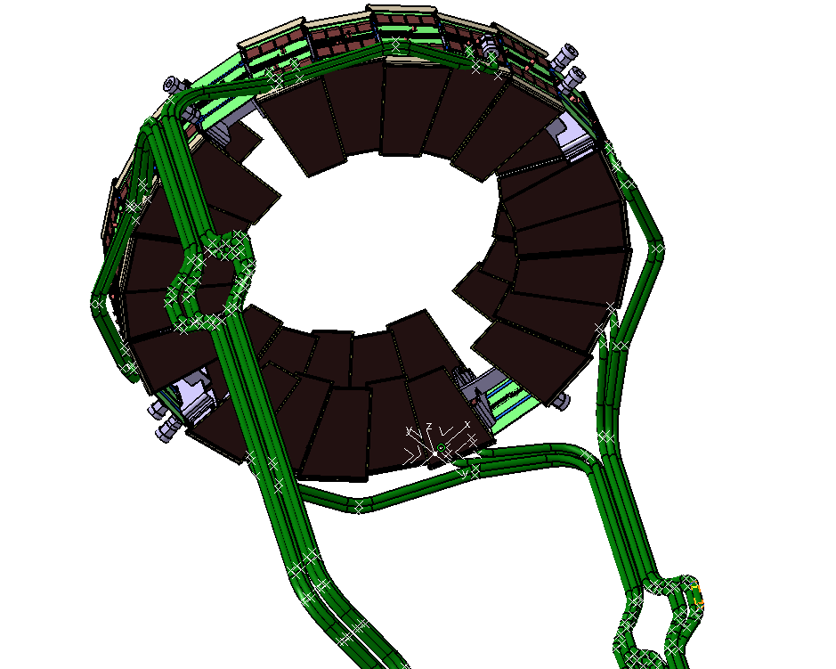
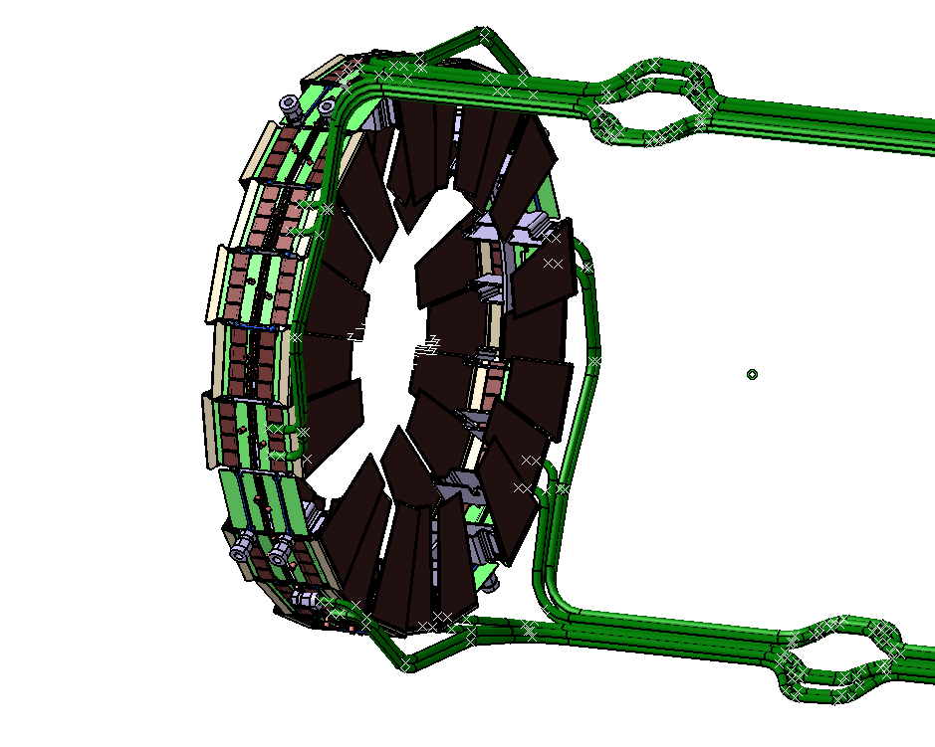
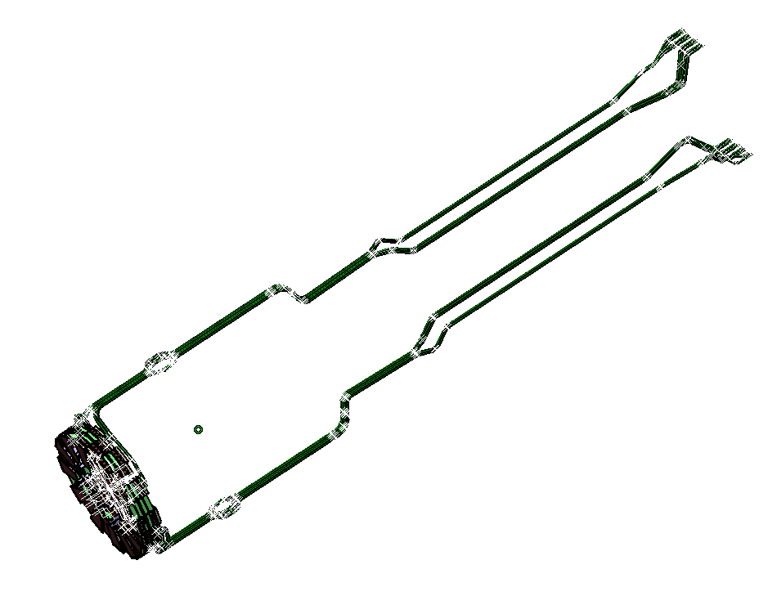
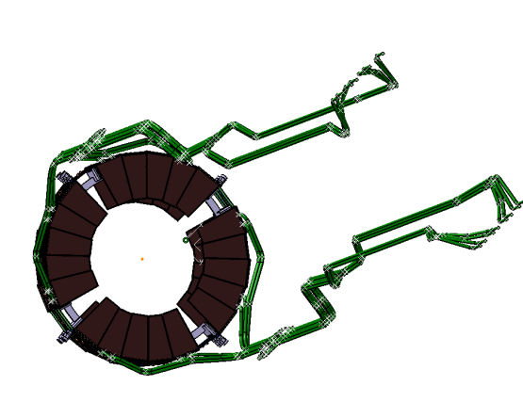
Cooling Concept Strip Disks

Slide 26
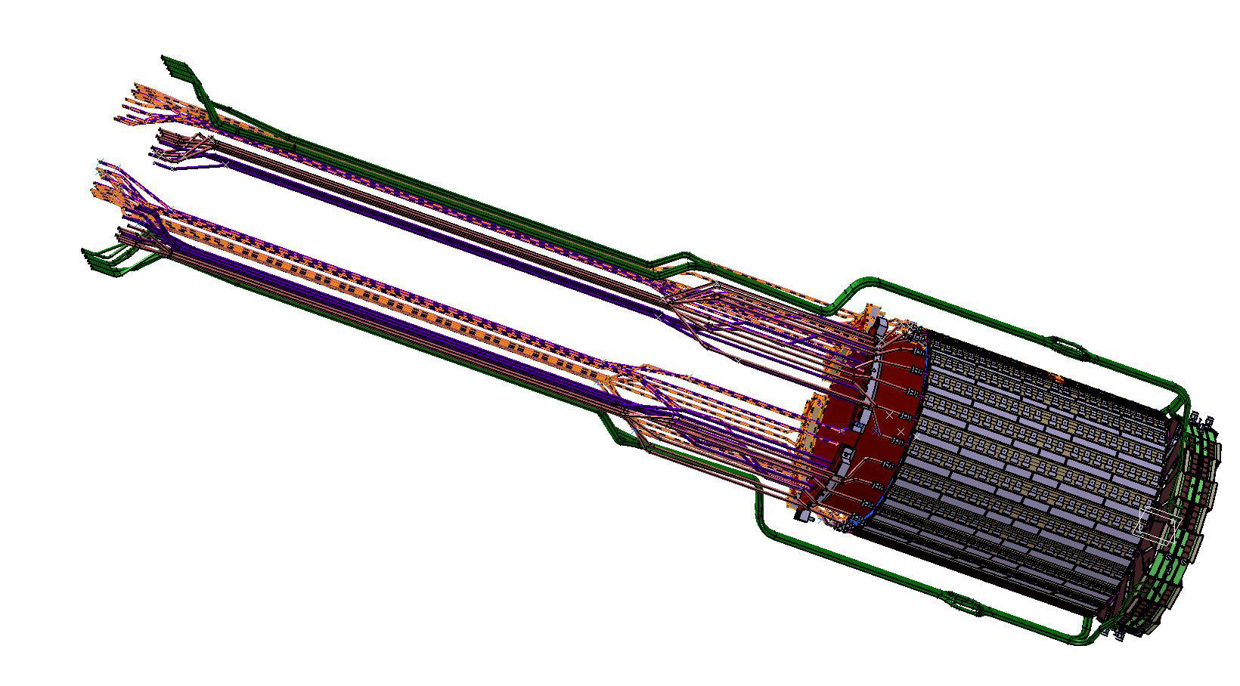
Cooling Concept Strip Disks

Slide 27
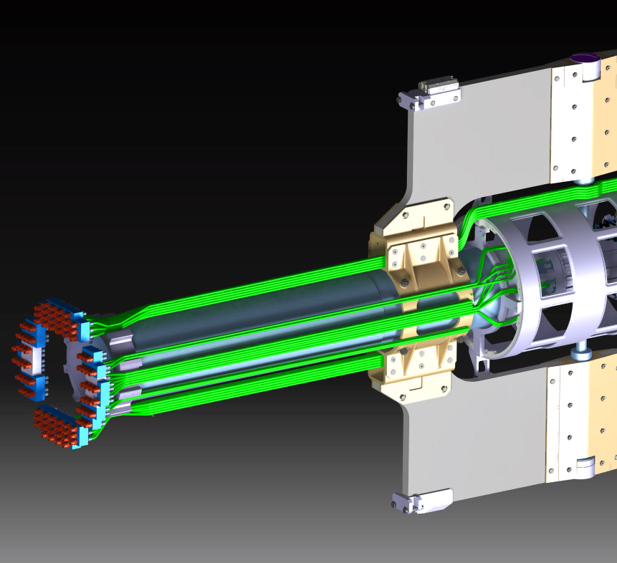
ITEM | # | Area (mm²)
Cooling Tubes | 150 | 2400
Power/Signal cables | 5600 | 23200
Total (no safety factor) |  | 25600
Patch Panel for Cooling Manifolds
Polyurethane flex tubes Ø4xØ2.5

Slide 28
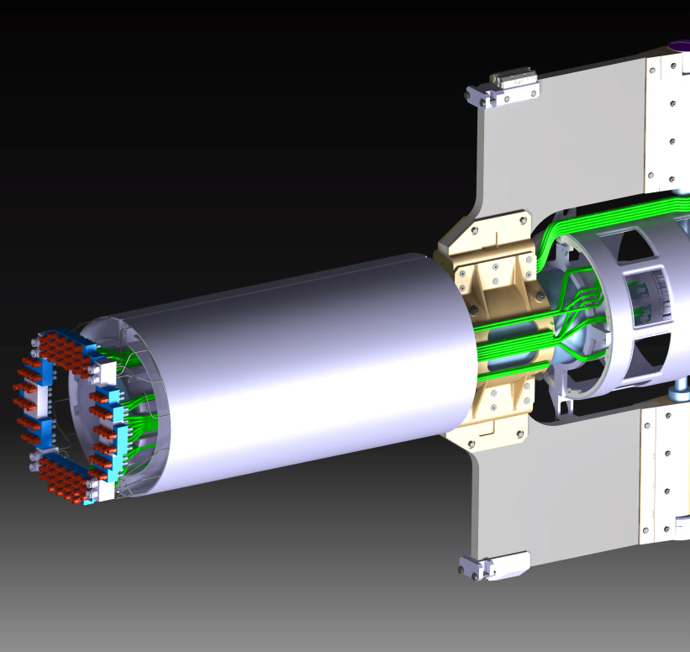
Parameter | Pixel | Strip | Power (W)
GBT | 122 | 26 (41) | 350 (385)
DC-DC Conv. | 596 | 1322
GBT support structure
2 halves – suspended on the Beam-Pipe

Slide 29
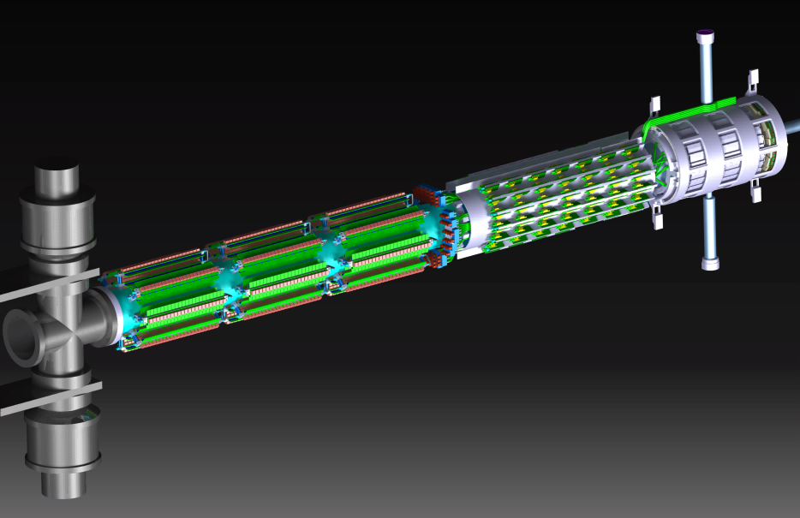
MVD
DC-DC CONVERTERS
COOLING MANIFOLDS
GBTs
2840 mm

Slide 30
Cable Routing
From the outside to the MVD (through GBT area):
powering of the chips (analog and digital) for strips (FE) and pixels (ToPiX)
powering of the MDCs (strip part only)
powering of the sensors (HV) for strips and pixels
From the GBT boards to the MVD:
flat data cables
From the outside to the GBT boards:
powering of the GBT boards
optical fibers
1
GBT
MVD
3
2

Slide 31
Cable Routing
From the outside to the MVD (through GBT area):
from disks: 1584 cables, 7722 mm²
from barrels: 3592 cables, 11964 mm²
TOTAL: 5176 cables, 19686 mm²
From the GBT boards to the MVD:
614 cables, 2149 mm²
From the outside to the GBT boards:
1026 cables, 2294 mm²
1
GBT
MVD
3
2

Slide 32
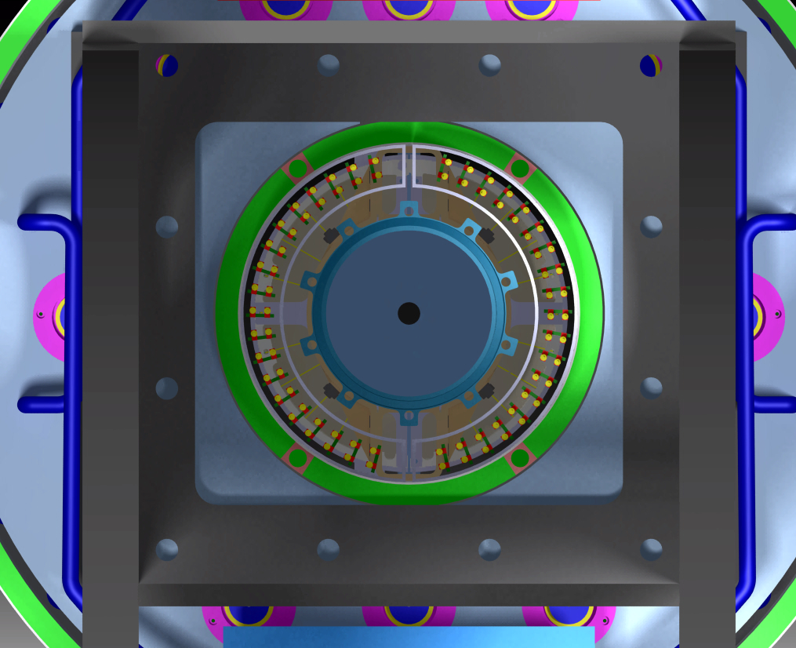
Services
GBT support cage
BW end-cap
Ø222 mm
Ø320 mm
Ø298 mm

Slide 33
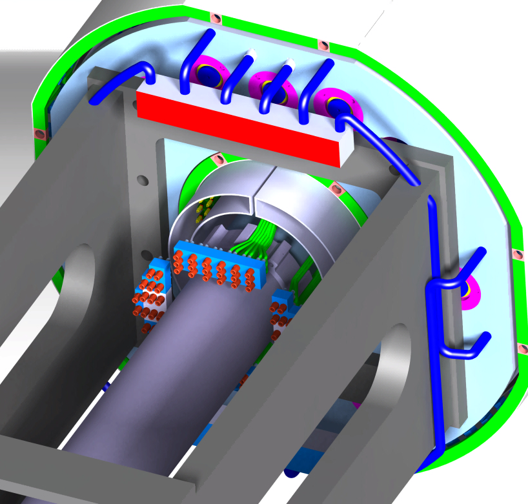
Services
GBT support structure | 31000 mm²
Cooling tubes | 2400 mm²
Through cables | 19700 mm²
Total | 53100 mm²
GBT support cage
Ø_{EXT}317 mm
(special flange shadow included)
SAFETY FACTOR NOT INCLUDED
Cooling manifolds

Slide 34
Monte-Carlo SimulationS and Performance Studies

Slide 35
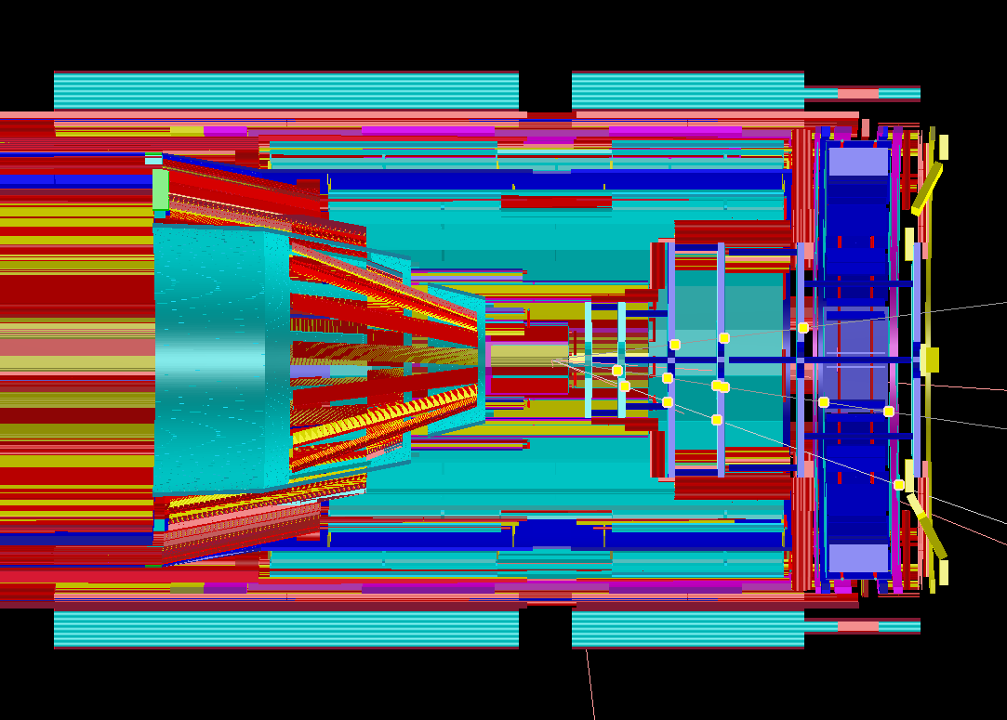
MVD Model in pandaRoot

Slide 36
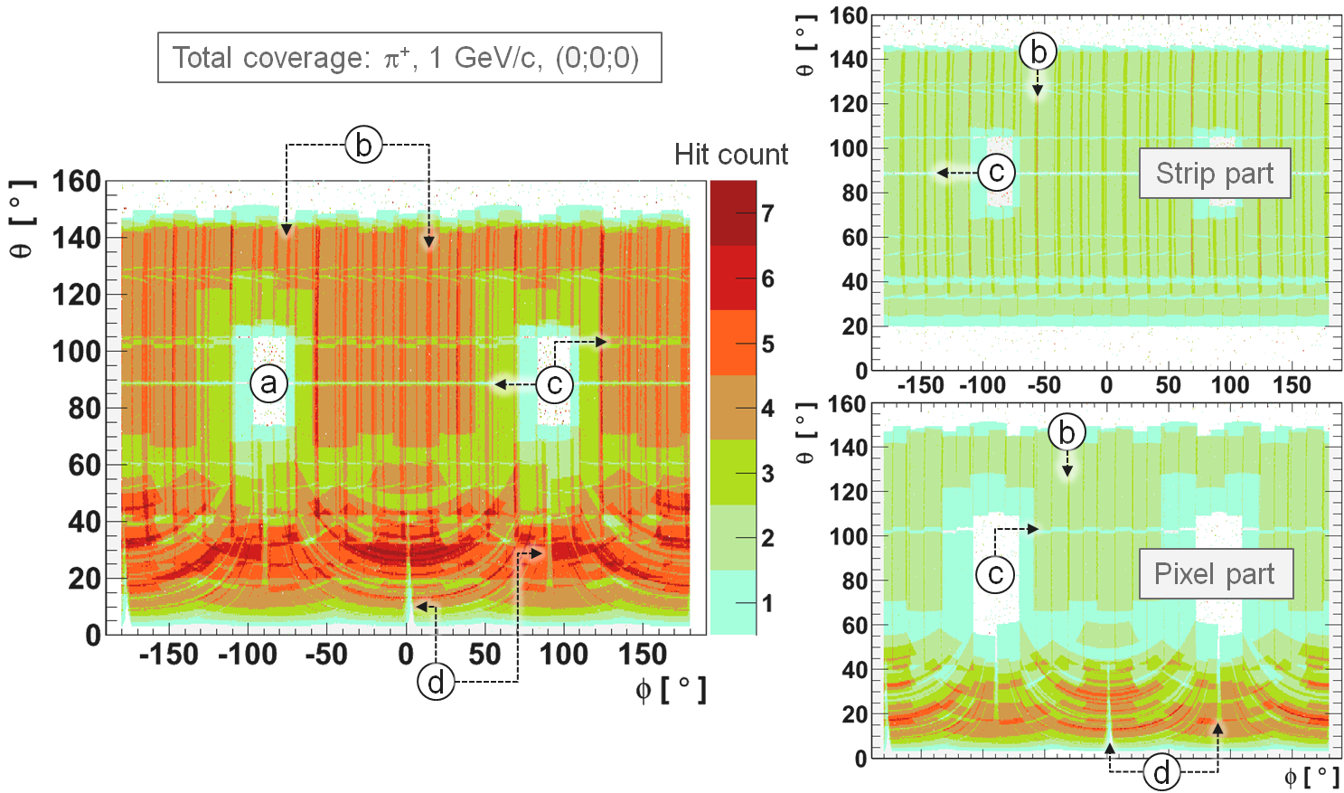
Simulation Studies - Coverage

Slide 37
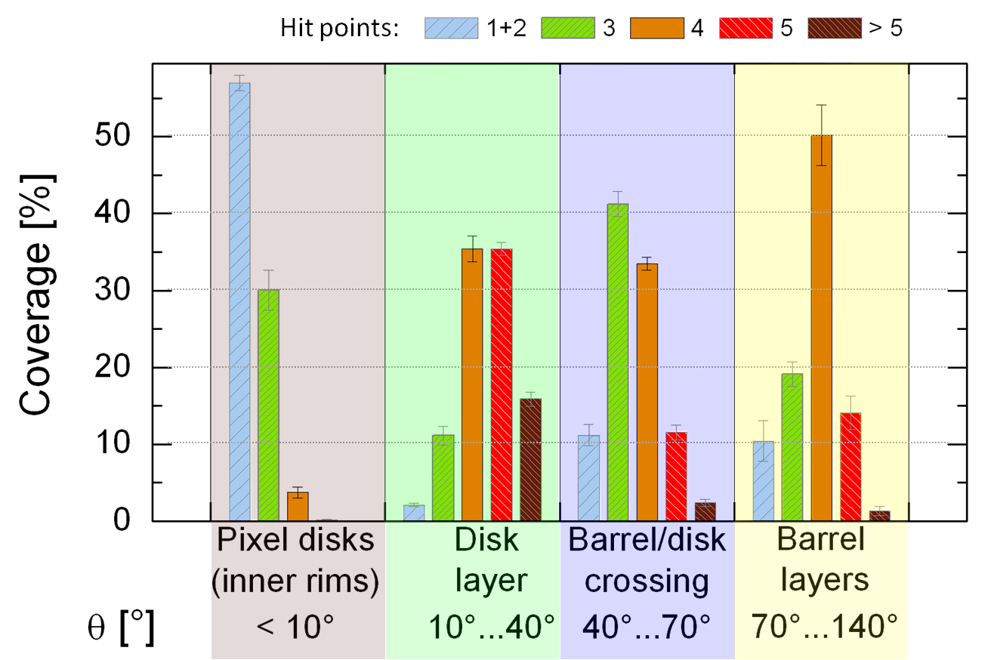
Points per Track

Slide 38
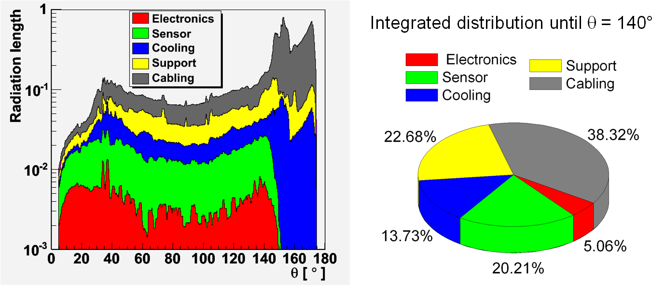
Material Budget
Integral of the rad. length in active area

Slide 39
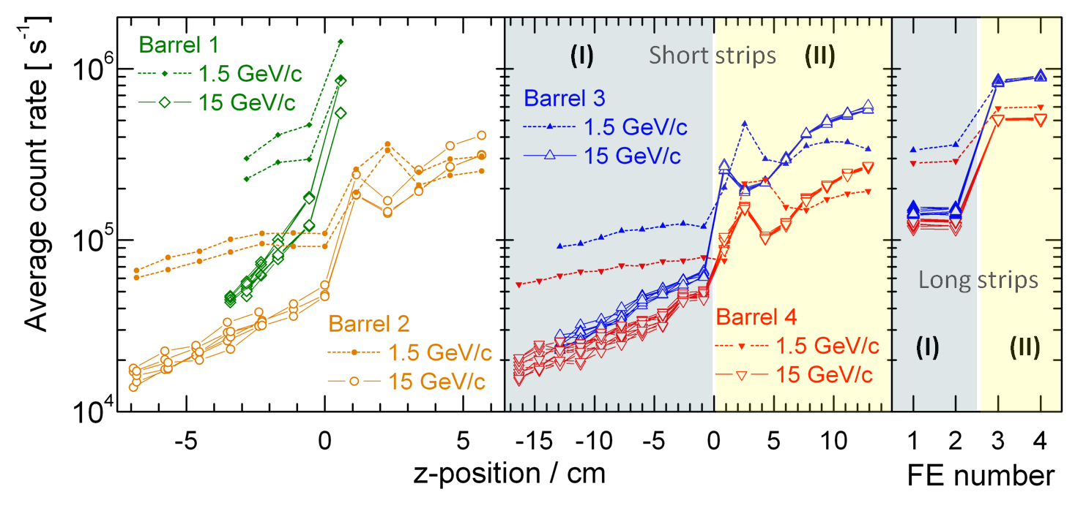
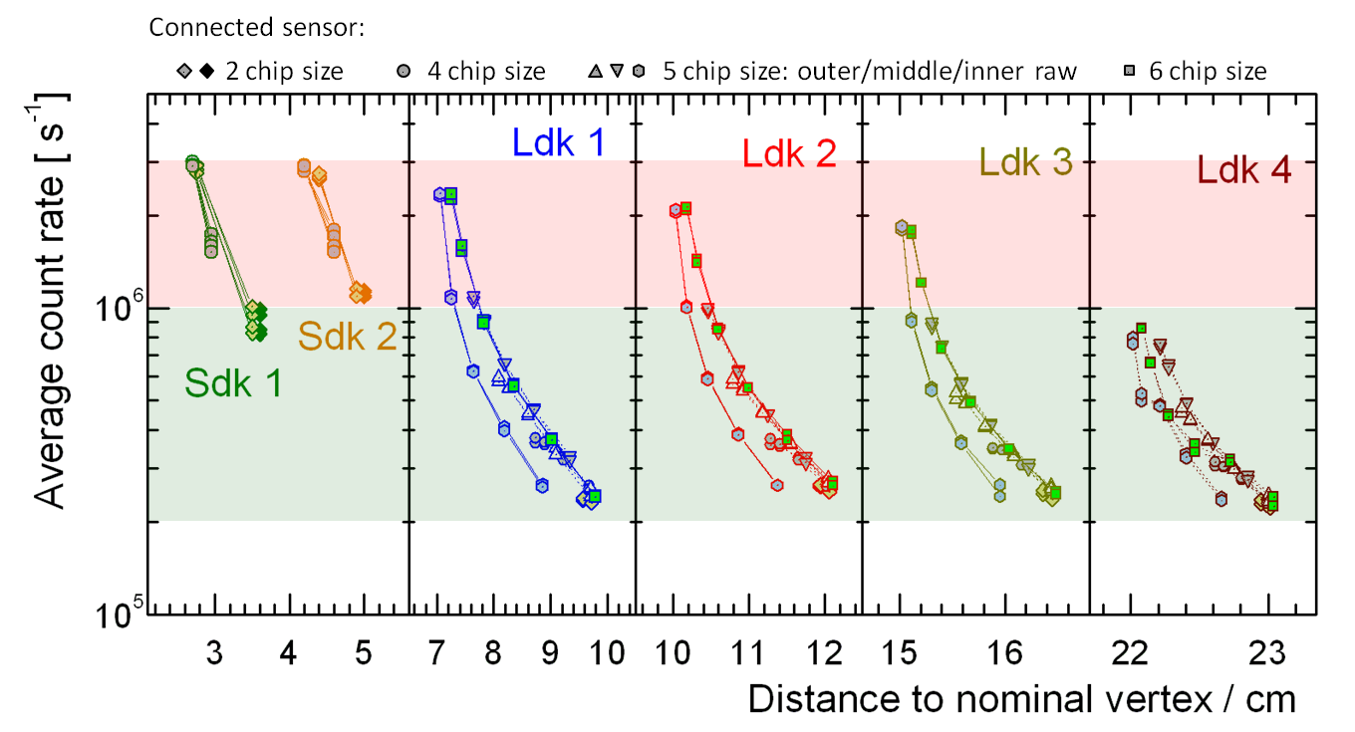
Count Rates

Slide 40
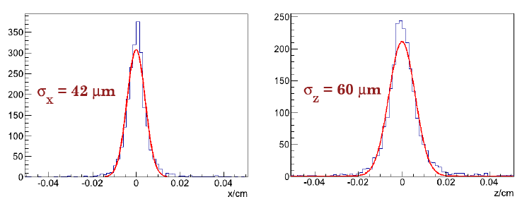
Vertex Resolution J/ψ

Slide 41
Simulated Physics Channels
Inclusive reconstruction of the
High precision measurement of the
Dalitz plot analysis for higher excited D mesons

Slide 42
Summary
Large progress was made in the last year after handing in the TDR:
ToPix3 scrutinized in lab and test beams
ToPix4 design almost finished
Strip electronics design started
Sensor prototypes for all subparts of MVD available or expected in near future
Mechanics design finished up to details
Mechanics prototypes in production
Design of service routing and placement ongoing and very challenging

Slide 43
MVD Groups
Universität Gießen: S. Bianco, K.-Th. Brinkmann, E. Gutz, A. Pitka, T. Quagli, R. Schnell, H.-G. Zaunick
FZ Jülich: D. Deermann, S. Esch , E. Fracassi , A. Goerres, D. Grunwald, A. Herten, H. Kleines, J. Marder, T. Stockmanns, J. Ritman
FH Südwestfalen: H. Sohlbach
INFN Torino: P. De Remigis, D. Calvo , S. Coli, A. Fillippi, G. Giraudo, G. Mazza, S. Marcello, A. Rivetti, R. Wheadon, L. Zotti

Slide 44
Data Concentrator

