Slide 1
High-Resolution Dielectronic Recombination of Berylliumlike Gold Ions at the Electron Cooler of CRYRING@ESR Storage Ring
Mirko Looshorn
(mirko-dieter.looshorn@physik.uni-giessen.de)
I. Physikalisches Institut, Justus-Liebig-Universität Gießen, 35392 Gießen
GSI Helmholtzzentrum für Schwerionenforschung GmbH, 64291 Darmstadt
Helmholtz Forschungsakademie Hessen für FAIR, Campus Gießen, 35392 Gießen

Slide 2
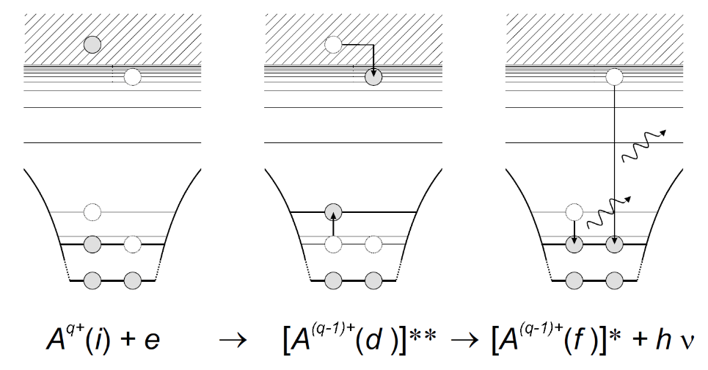
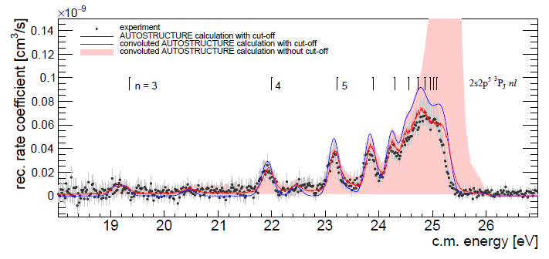
Dielectronic recombination
Dielectronic Recombination (DR):
DR collision spectroscopy:
successful spectroscopic tool for, e.g.:
test of QED in strong fields
investigations of nuclear properties via isotope shift
lifetime studies
measurement of input data for plasma modelling and astrophysics (submitted Proposal for O²⁺)
time inverse Auger effect
resonant capture of free electron → doubly-excited state of ion
E_{rel} + E_{bind} = E_{exc}
de-excitation by photon emission
O-like Ne²⁺
Menz, 2024, publication in preparation

Slide 3
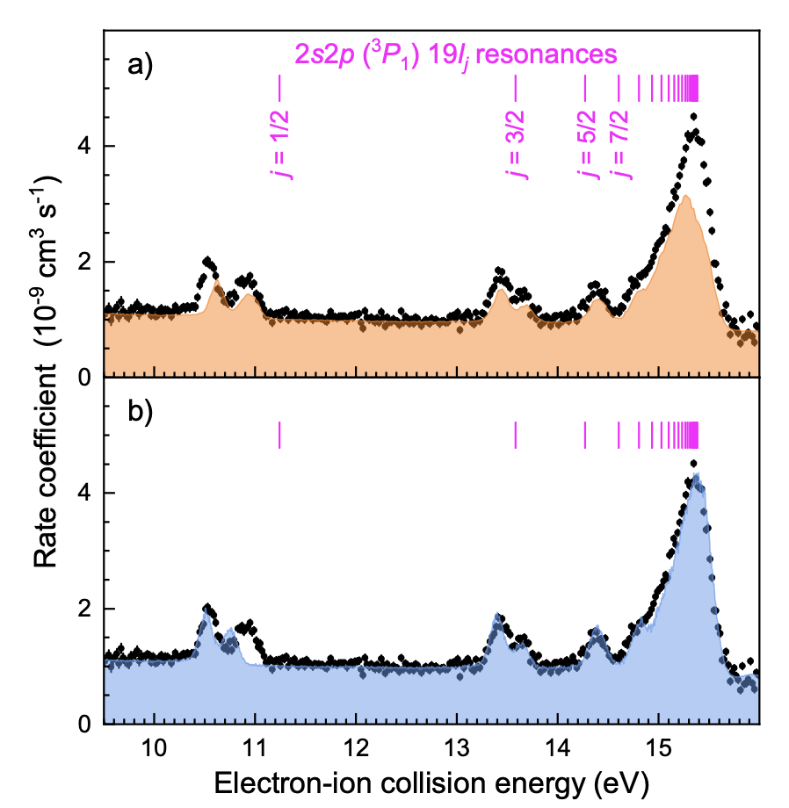
Motivation
Dielectronic recombination of Pb⁷⁸⁺
Experiment E131 (Pb⁷⁸⁺, 2022):
Collision-energy range 9.3-16.5 eV
Energy uncertainty of about 30 meV
Challenges state-of-the-art atomic structure calculations
Experiment G025 (Au⁷⁵⁺, 2024):
Usage of new developed high voltage divider (FC20)
Improved vacuum conditions
Goal: Increasing the experimental accuracy
Fuchs et al., publication in preparation

Slide 4
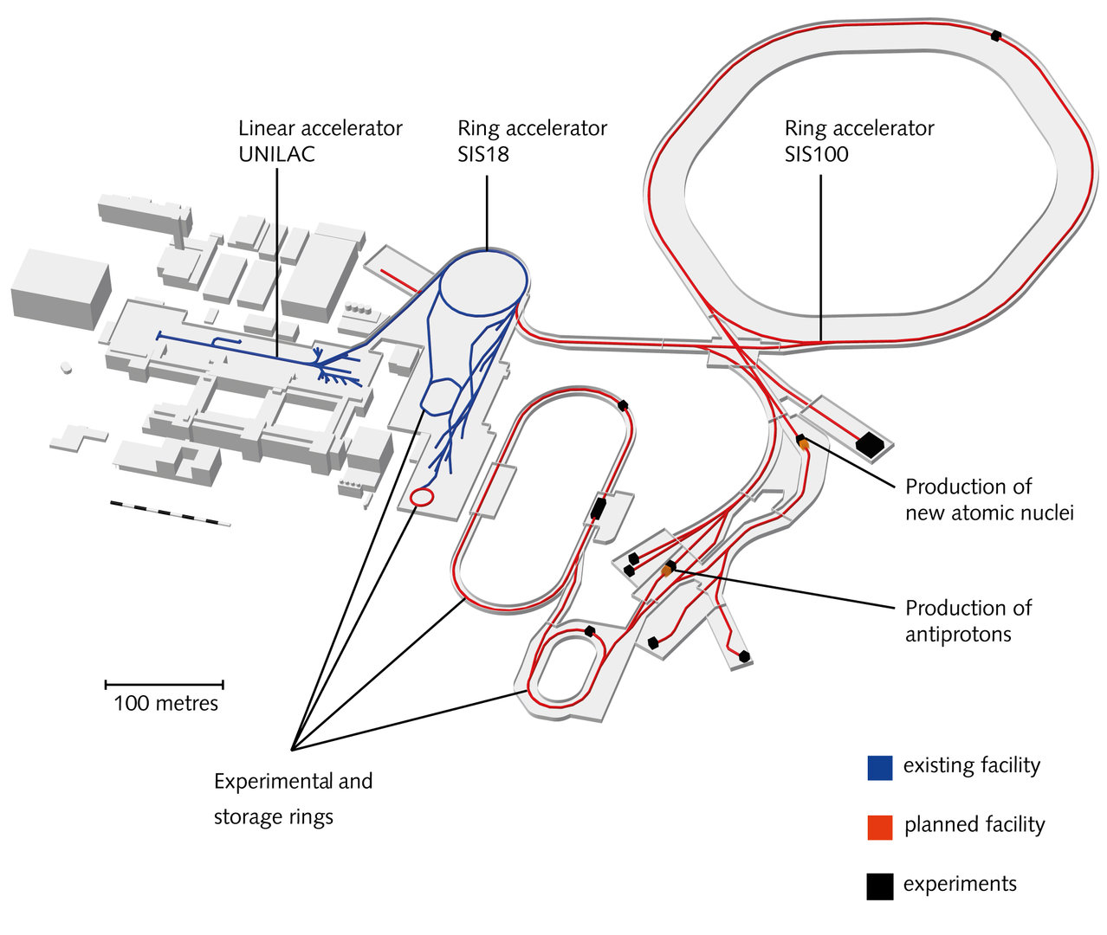
Experimental conditions
Be-like ¹⁹⁷Au⁷⁵⁺ ions:
used full GSI accelerator chain (UNILAC → SIS18 → ESR → CRYRING)
SIS18:
Generation of the desired charge state q =75
Up to 1x10⁹ ions
ESR:
Deceleration and cooling of the Au⁷⁵⁺ ions
Up to 2x10⁷ ions
CRYRING:
Ion beam energy: 12 MeV/u
Ion beam lifetime: > 30 s
Up to 7x10⁶ ions
Detector count rate: up to 260 kHz
~ 90 % usage of ion beam over ten days of beamtime

Slide 5
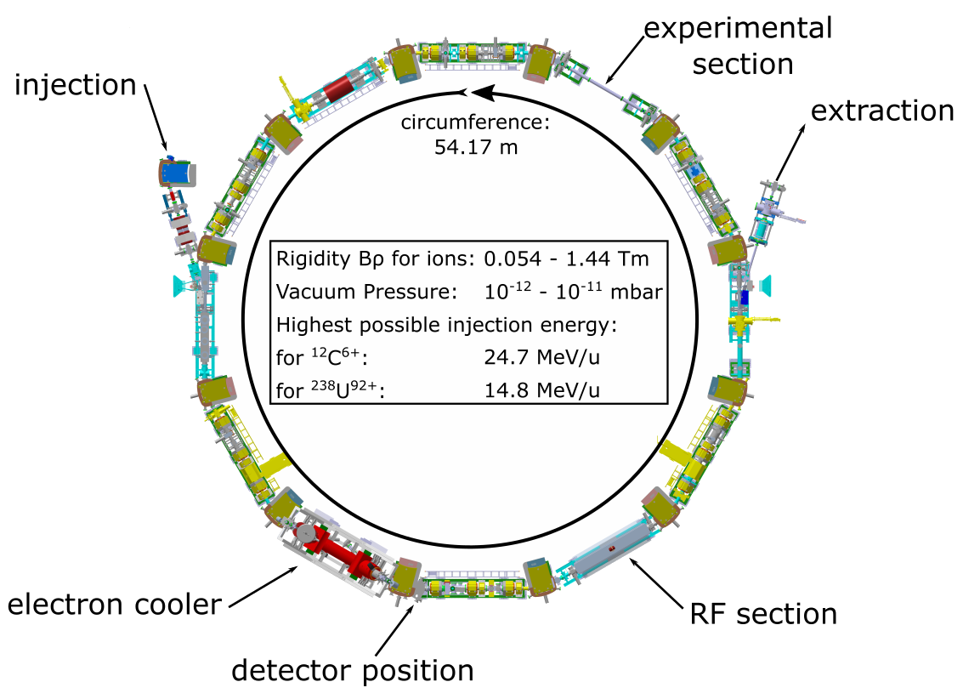
CRYRING@ESR
YR03 (Ecool) and YR04
detector position
Channeltron detector
Germanium x-ray detector

Slide 6
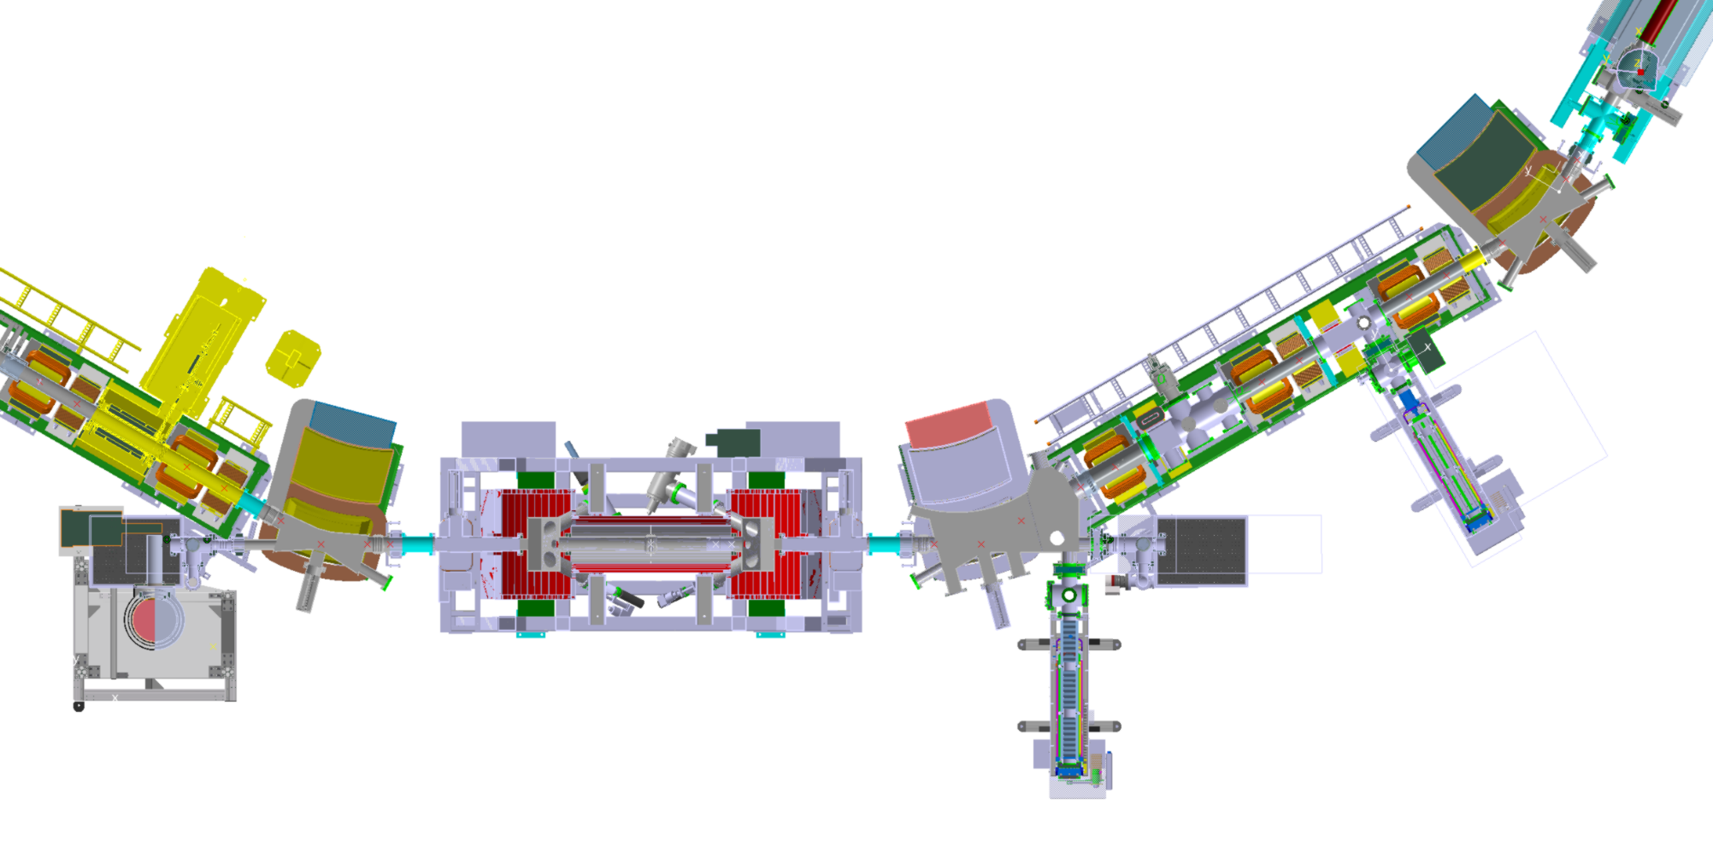
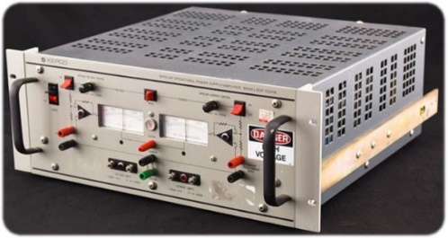
YR03 (Cooler) / YR04 (Detectors)
KEPKO
HV amplifier for fast changes of the cooler cathode voltage
High purity germanium x-ray detector
Channeltron detector
q > 30
used for Au⁷⁵⁺ beam time
Electron cooler
controlled by raspi and microcontrollers via local network with fiber optics
fairly independent from accelerator control (just uses trigger signals)
Scintillation detector
q < 20
used for Ne²⁺/Ne³⁺ and S³⁺ beam time

Slide 7
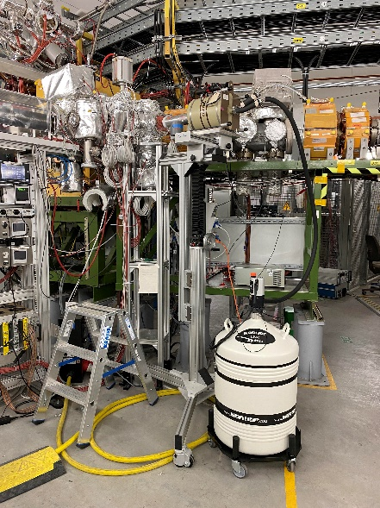
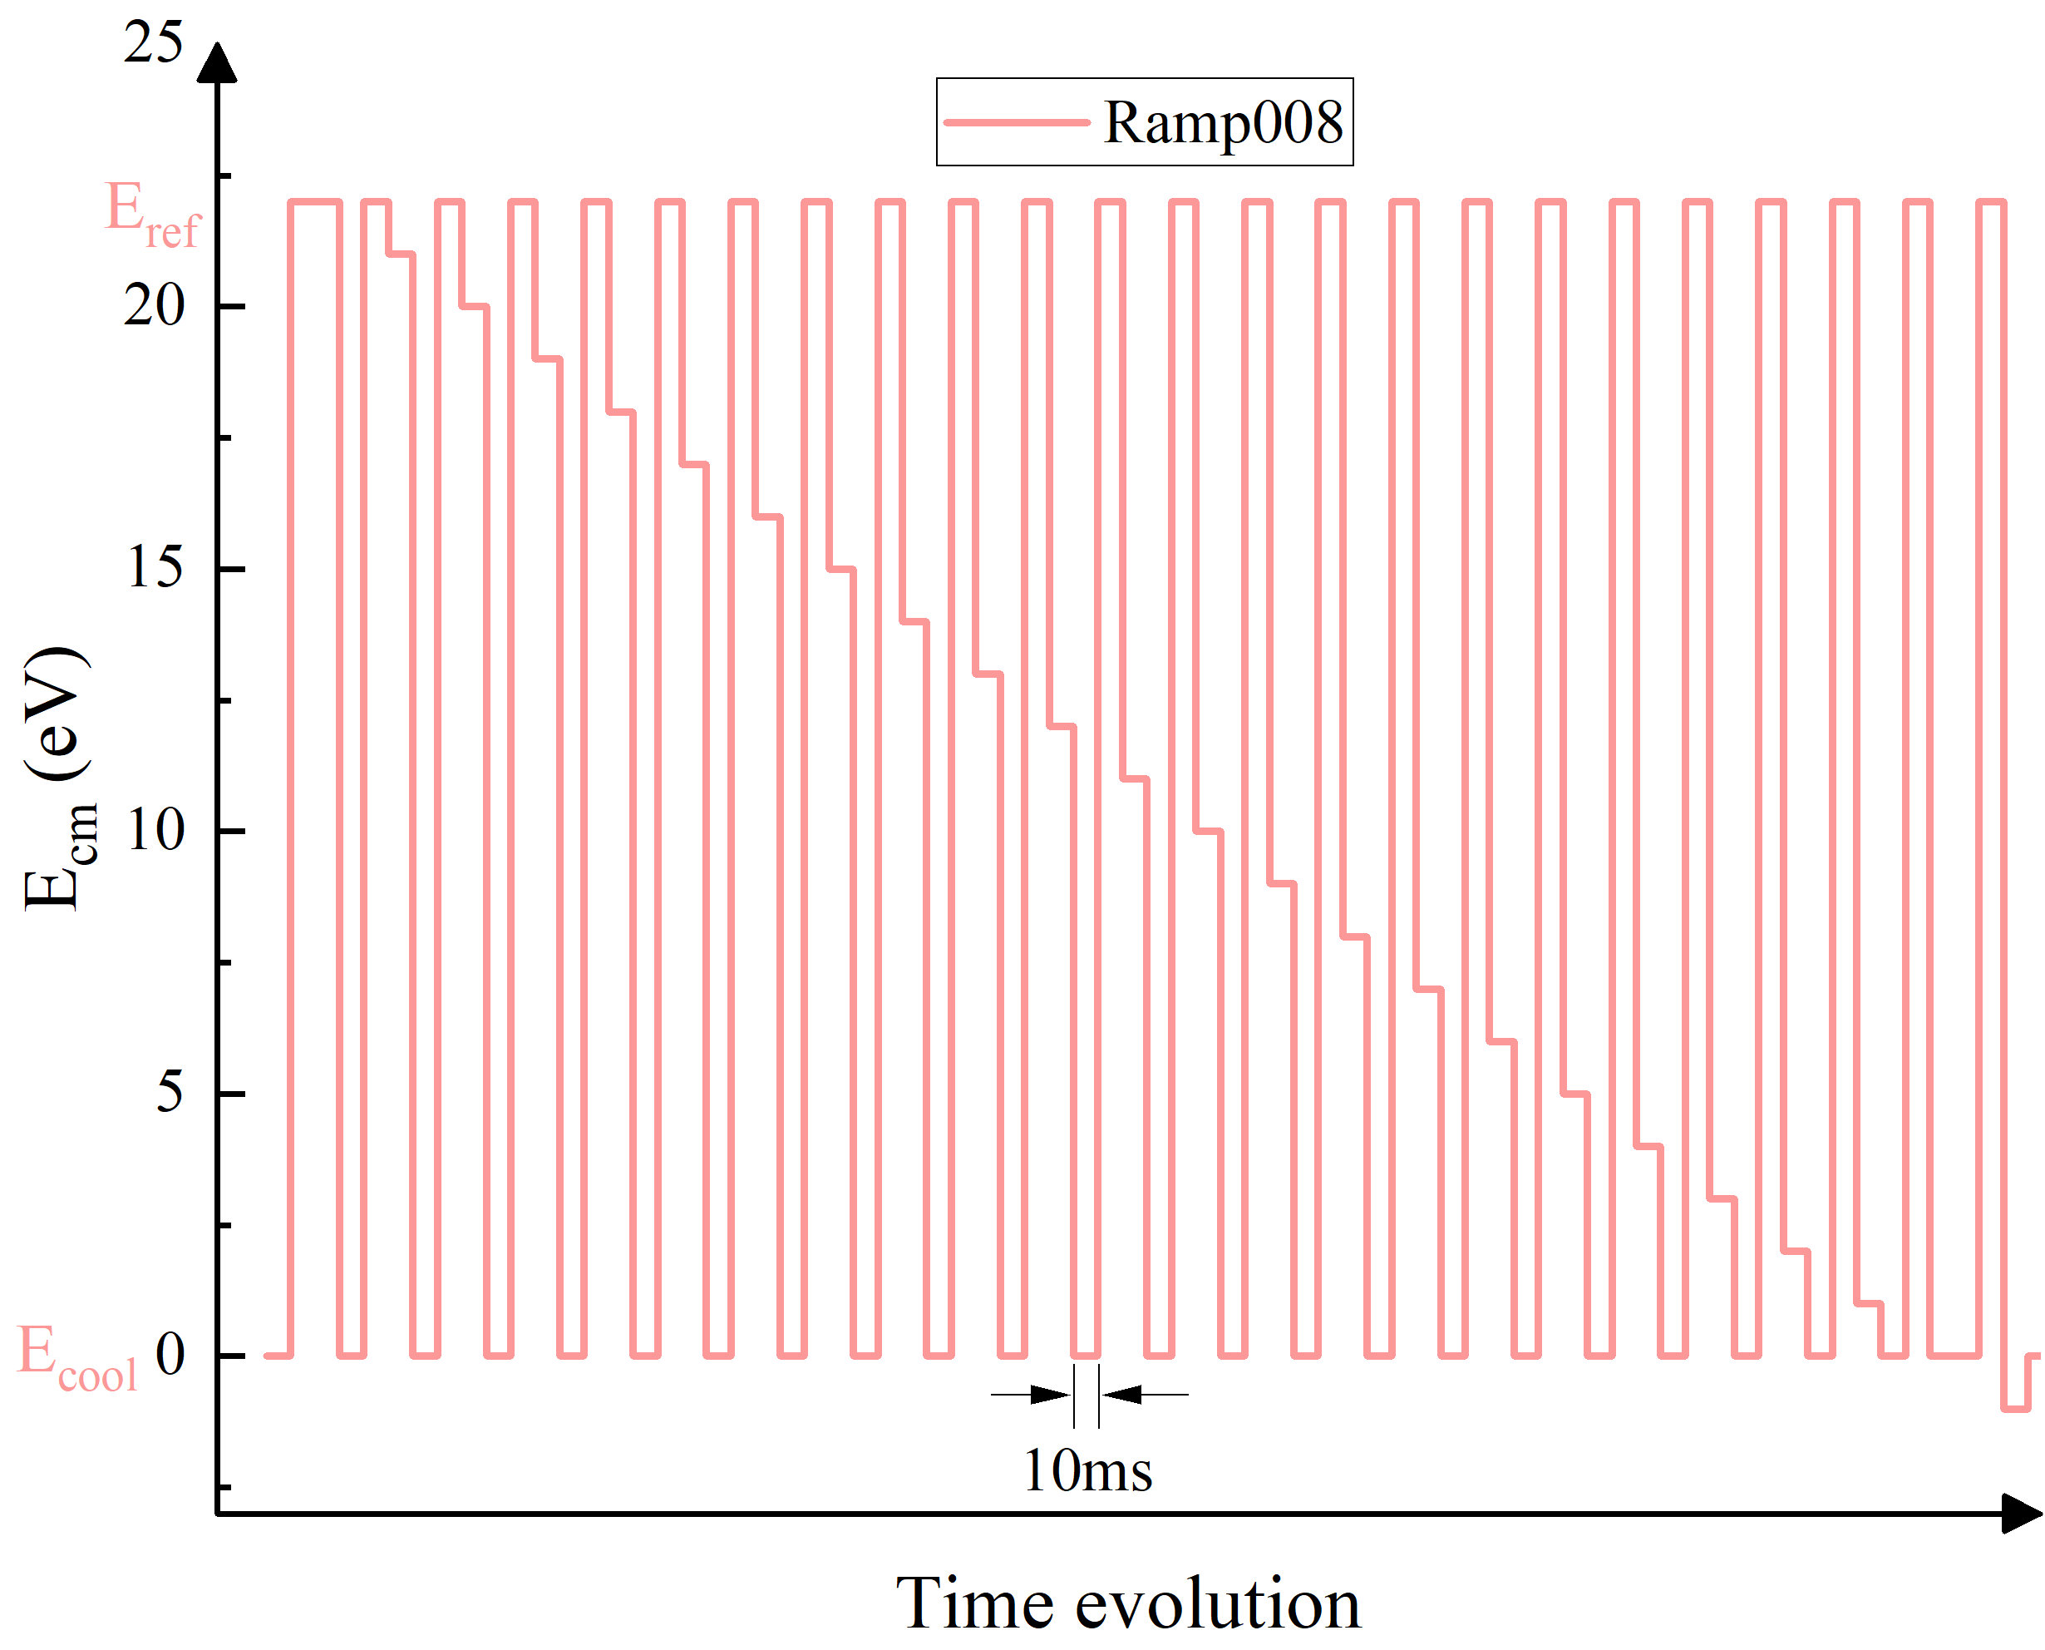
Experimental setup
Merged-beam setup of electron and ion beam
adiabatic expansion → low electron temperatures kT|| and kT⊥
Au⁷⁵⁺
Au⁷⁵⁺
Au⁷⁴⁺
Cooling step:
ion velocity = electron velocity
Reference / measurement step:
cooler voltage + detuning voltage
relative energy between ions and electrons
detection of recombined ions (product beam)

Slide 8
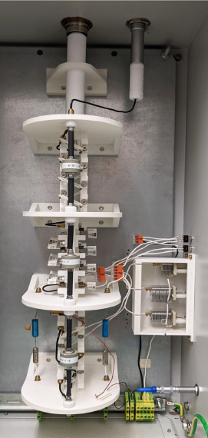
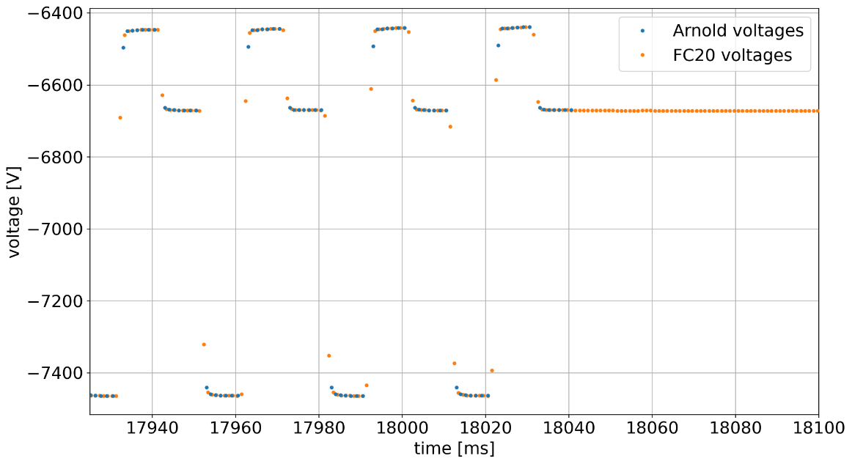
Voltage divider
Inside FC20
Measurement of U_{electron, lab} with three different HV divider setups:
G35 from Münster: high precision, but slow
FC20 from Münster: high precision, fast
Arnold2 from Gießen: lower precision, but fast
Ramp 008
Scale factor measurement 6.3.2024: scale factor = 1027.7698+/-0.0004 Scale factor measurement 18.3.2024 scale factor = 1027.7694+/-0.0004
Dirkes T., Hannen V.M. , 2024, Spezifikation des frequenzkompensierten Hochspannungsteilers FC20 (GSI internal).

Slide 9
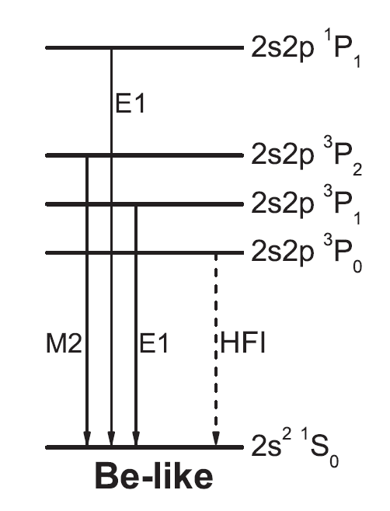
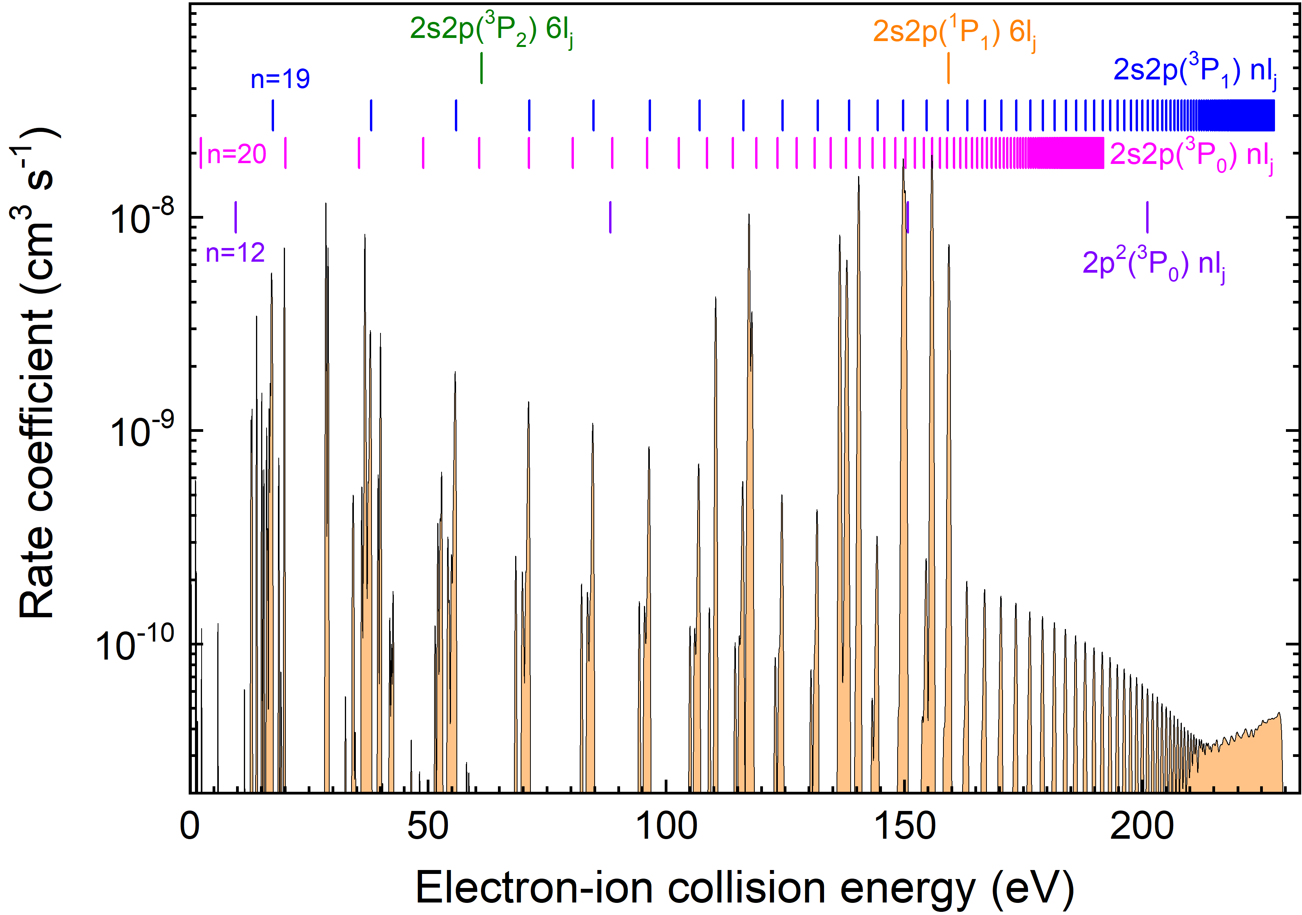
Theory for ¹⁹⁷Au⁷⁵⁺
Excitation from ground state:
2s² ¹S₀ → 2s2p (³P₁) nl_{j} series for n ≥ 19
rate coefficient: ~ 10⁻⁹ cm³ s⁻¹
2s² ¹S₀ → 2s2p (³P₀) nl_{j} series for n ≥ 20
rate coefficient for n=20: ~ 10⁻¹¹ cm³ s⁻¹
→ couldn’t be measured
2s² ¹S₀ → 2s2p (¹P₁) nl_{j} series for n ≥ 6
rate coefficient: ~ 10⁻⁹ cm³ s⁻¹
Autostructure calculated DR-resonances over the whole measured spectra. RR is not included.

Slide 10
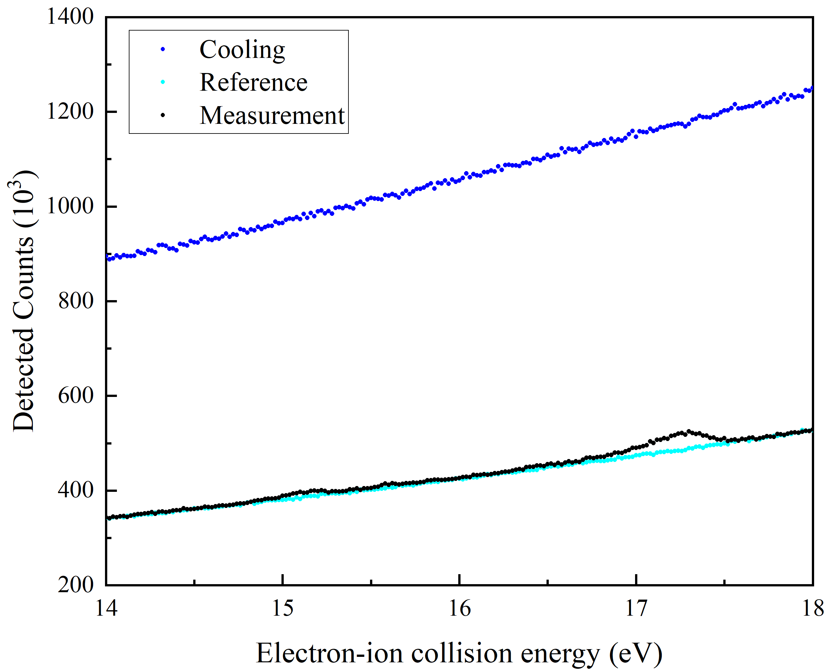
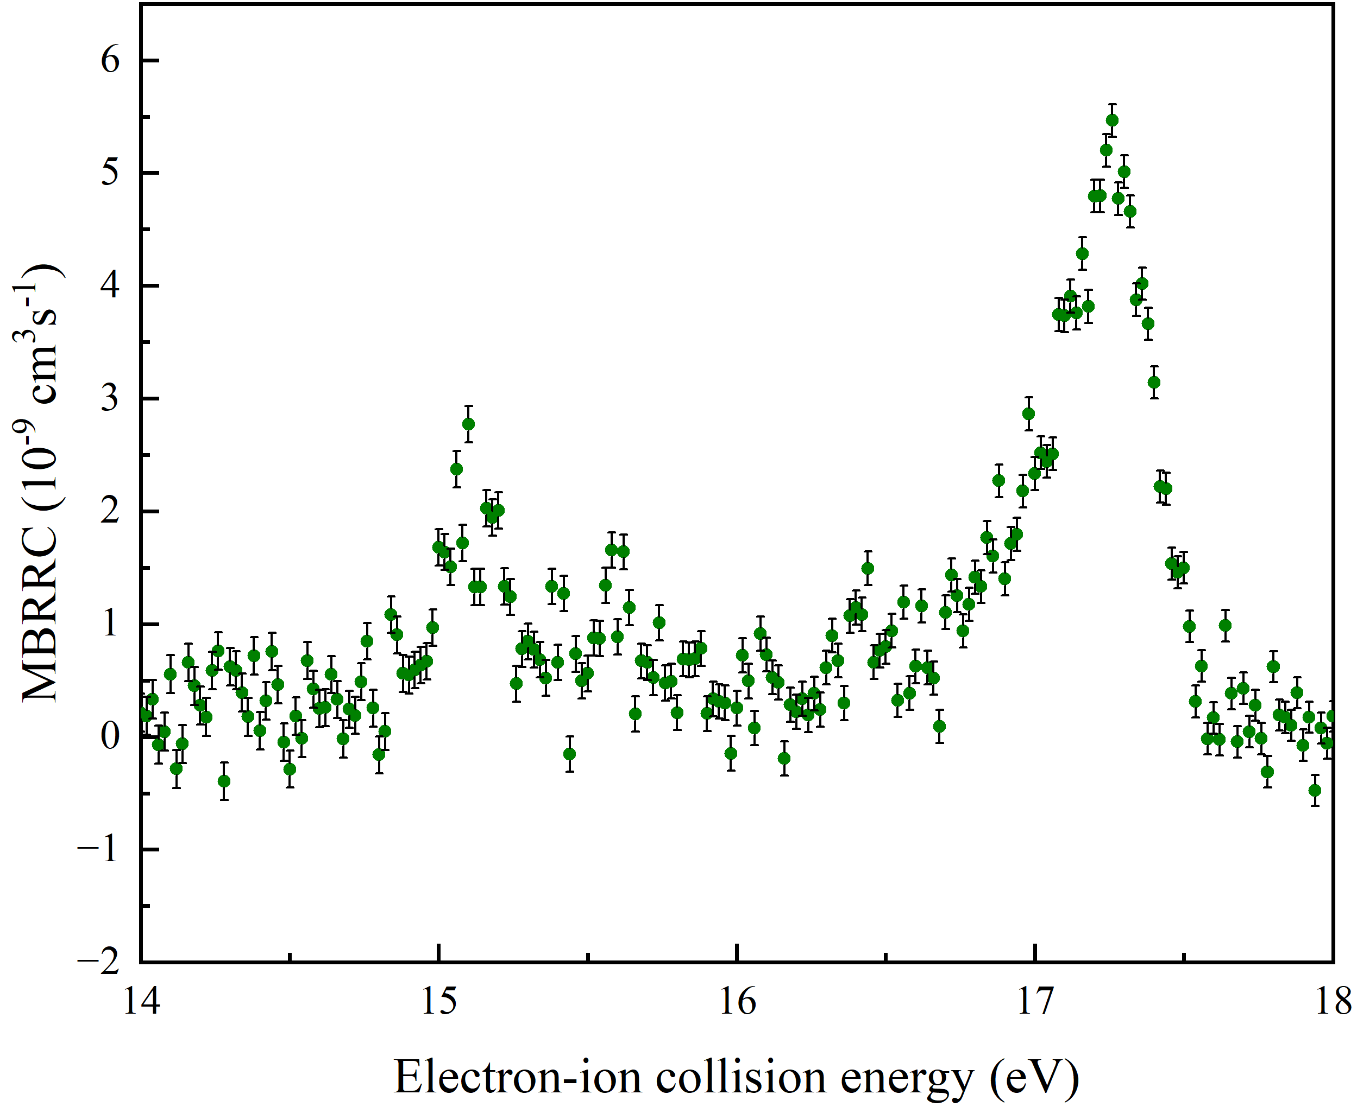
DR measurement
Associated DR process
n=19
2s² ¹S₀ →2s2p ³P₁
E_{exc} = 229.476 eV (Cheng et al., Phys. Rev. A 77, 052504 (2008))
j-dependent Electron-ion collision energies E_{rel}(j)
E_{rel}(1/2) = 13.92668 eV
E_{rel}(39/2) = 17.44132 eV
Ecm reverse (-2 eV, 22 eV, 0.04 eV)
Reference energy: 22 eV
total time of voltage ramp: ~ 18.132 s
cooler voltage: 6695 V (ion energy 12 MeV/u)
expansion factor: 33.33
meas. steps: 601
Sum of detected counts over all cycles in the different steps in a predefined scanning sequence.
Experimental recorded “Merged beams recombination rate coefficient (MBRRC) as a function of the relative energy between the beams (raw spectrum)

Slide 11
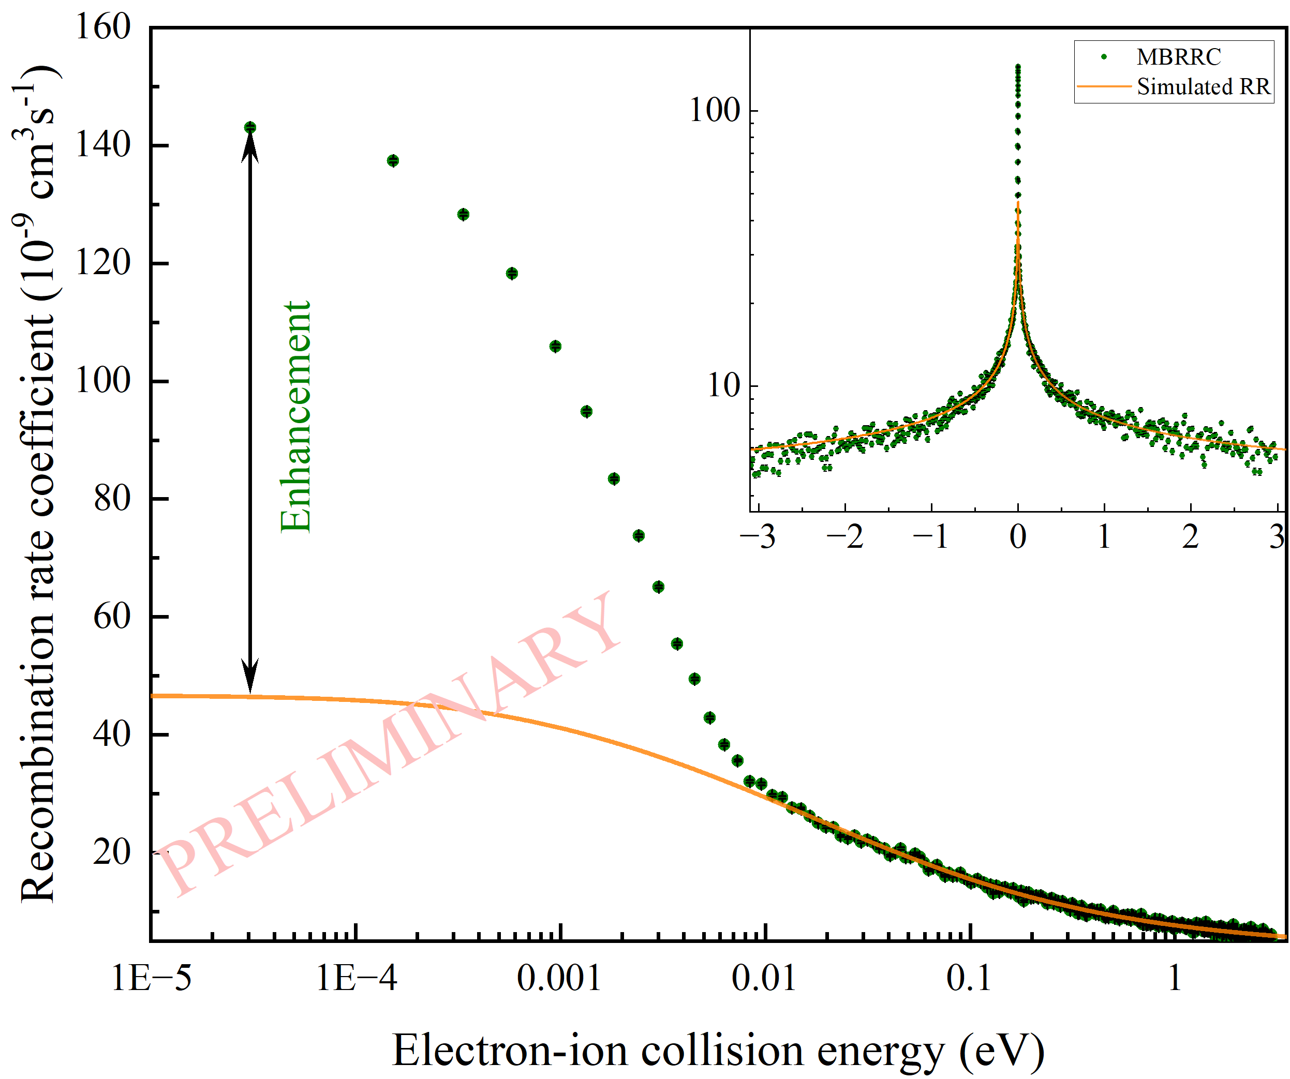
Preliminary results
Ramp 047
Recombination rate coefficient:
Used parameters:
Elab maeander (cool-ref-meas)
total time of voltage ramp: ~ 20.895 s
cooler voltage: 6695 V
electron current: 49.5 mA
expansion factor: 33.33
meas. steps: 571
R … count rate (with substracted background signal)
N_{i} … number of stored ions (from fit of ion current signal)
n_{e} … electron density
L … length of interaction region
U … ring circumference

Slide 12
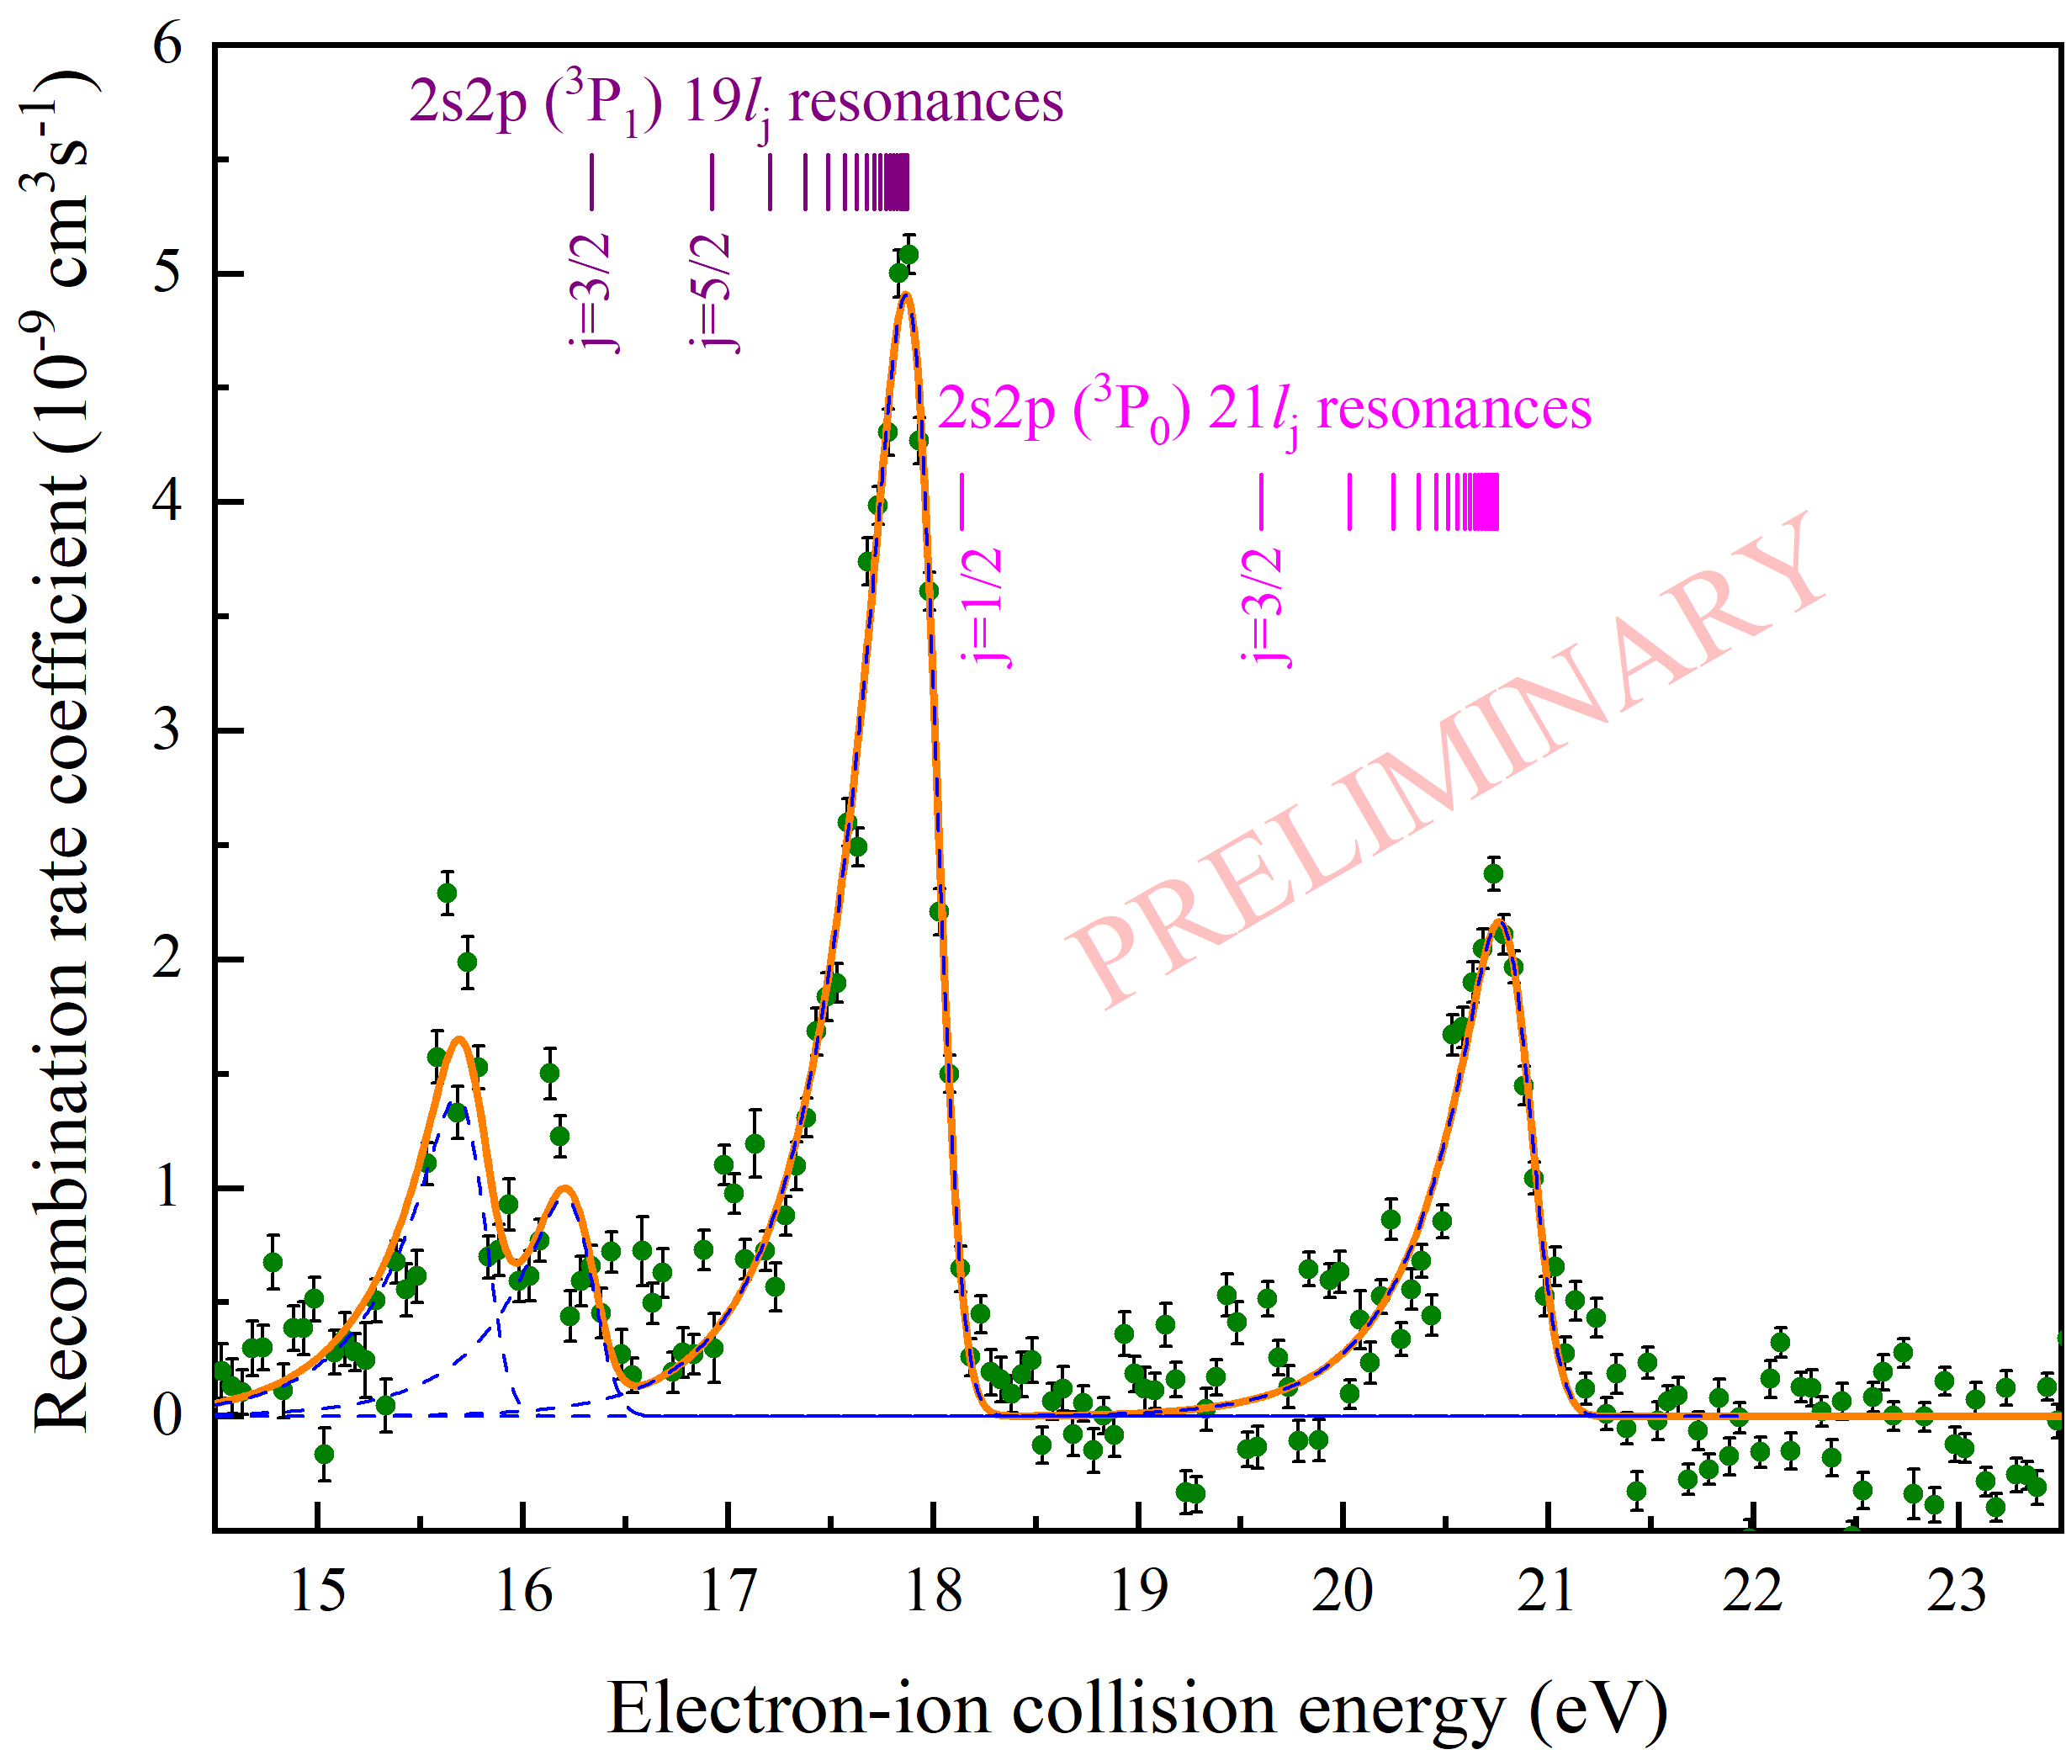
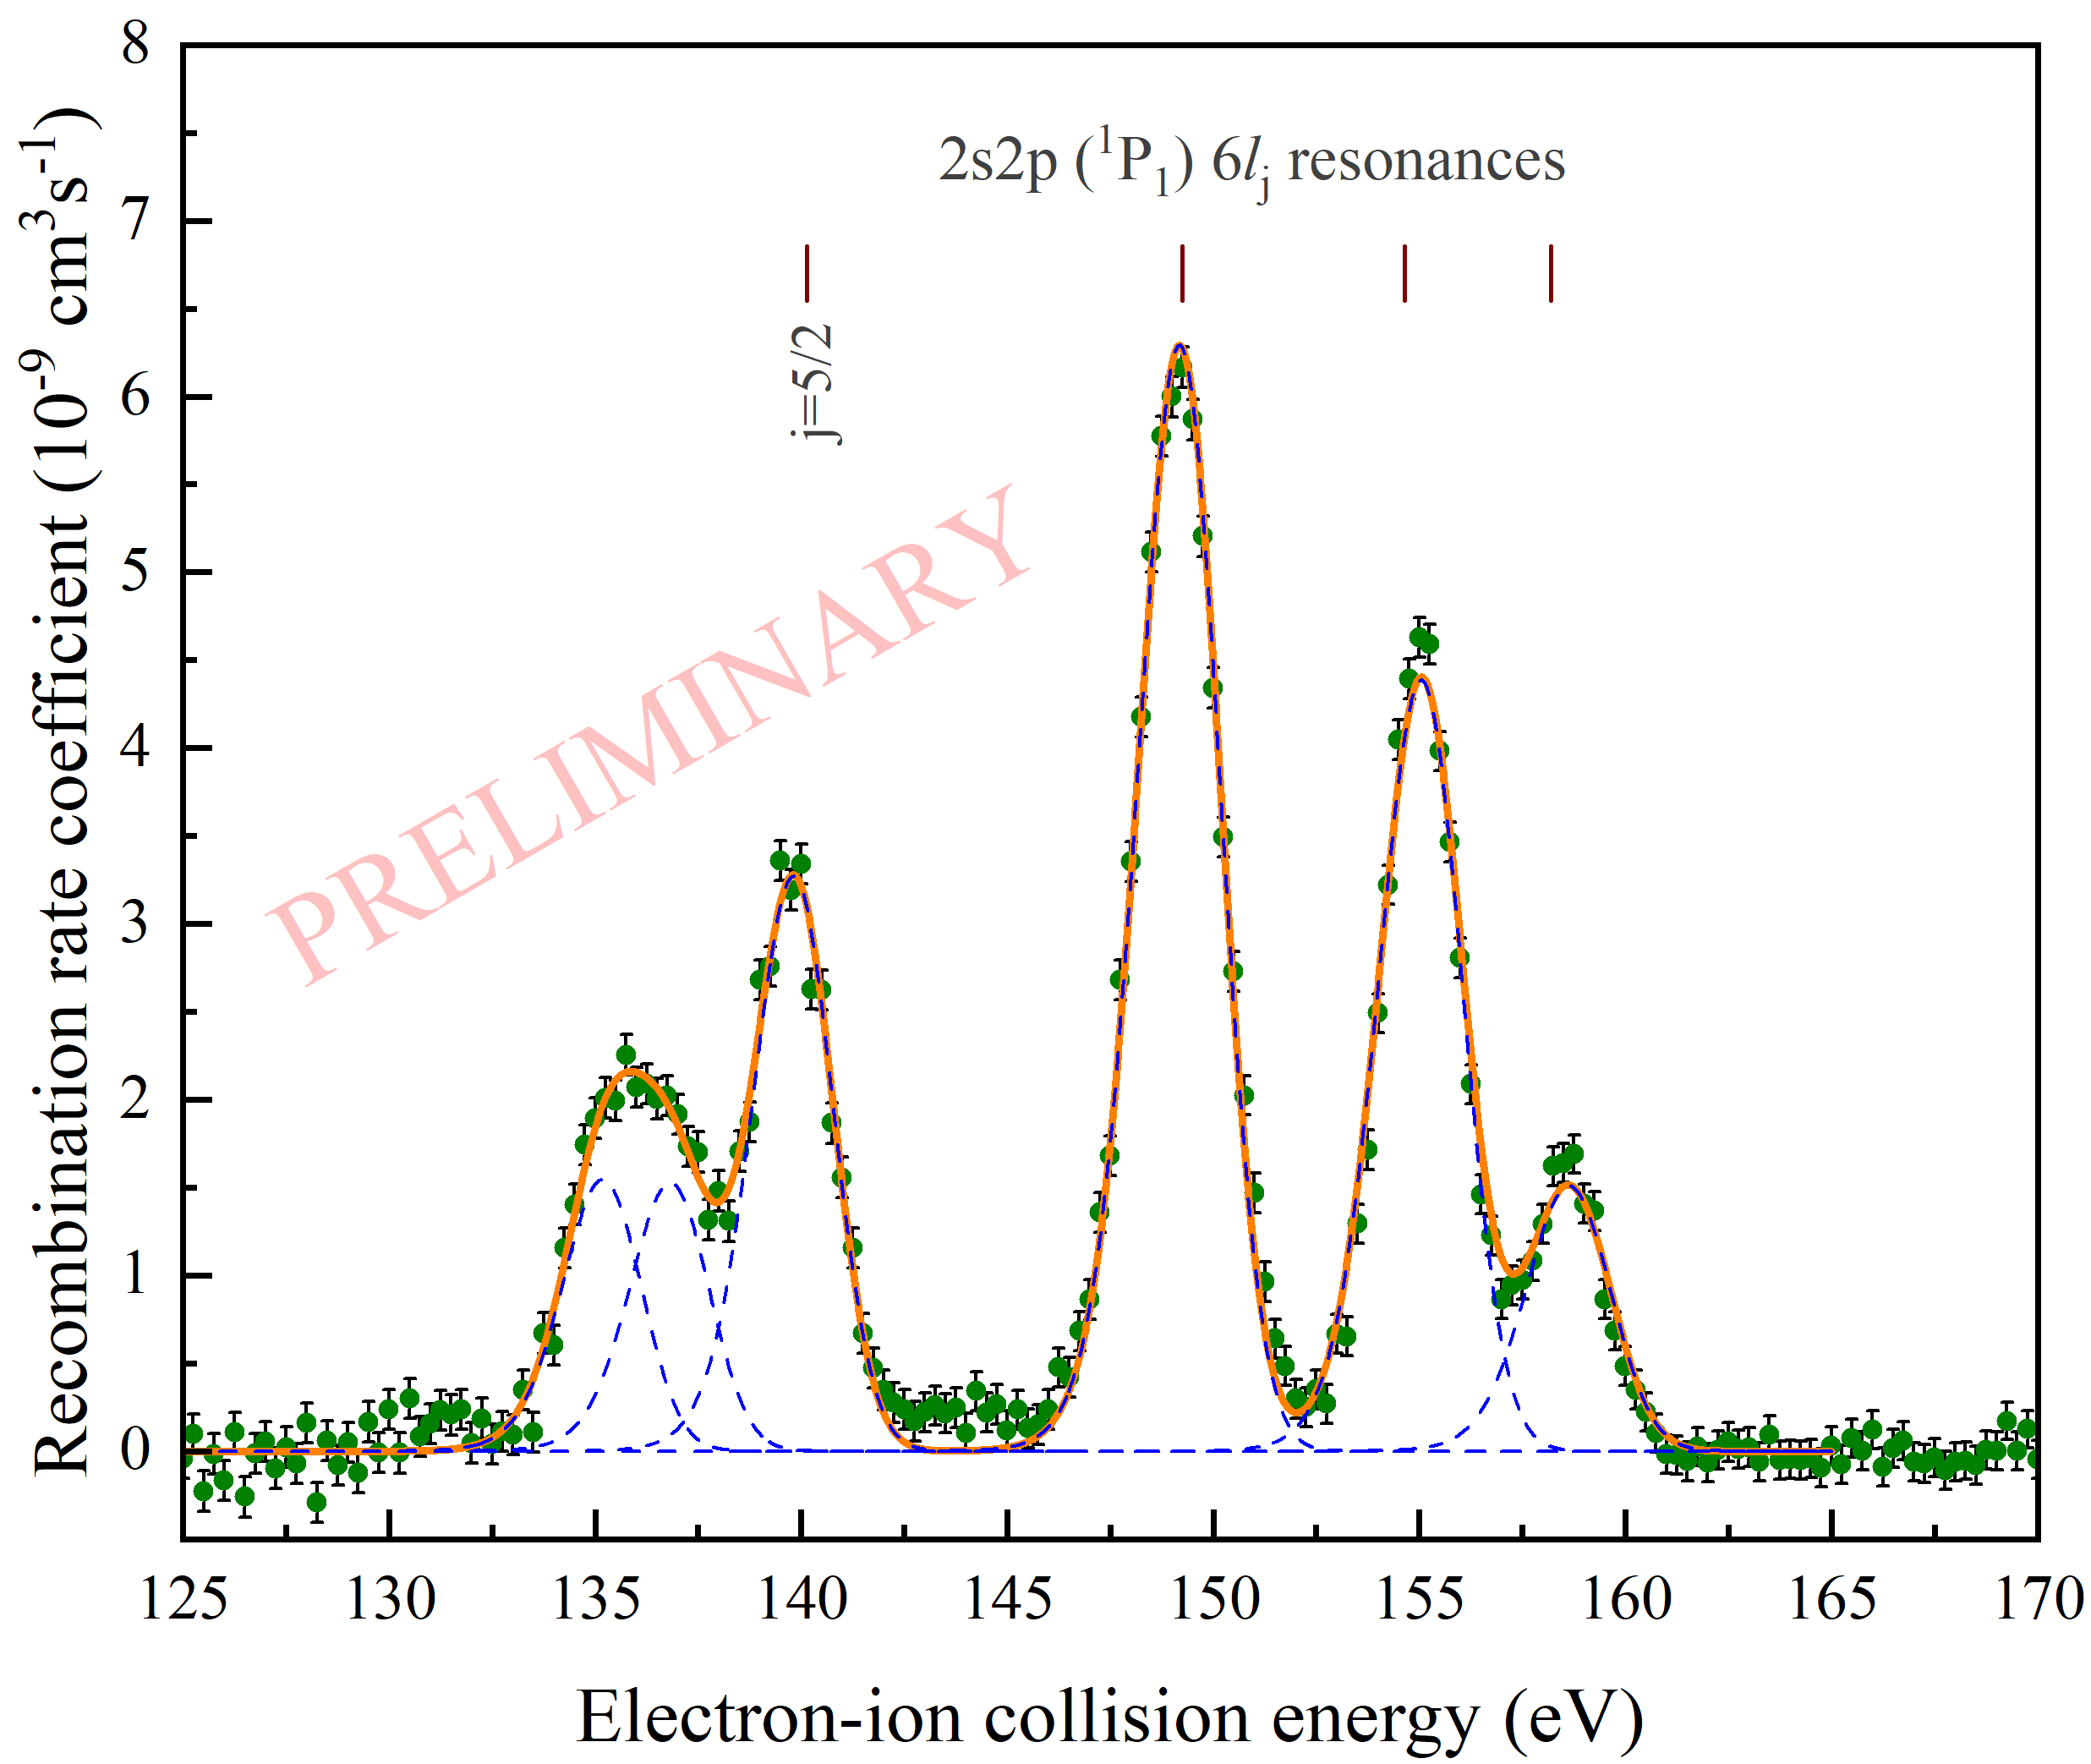
Preliminary results
Ramp 029
Ramp 055/056

Slide 13
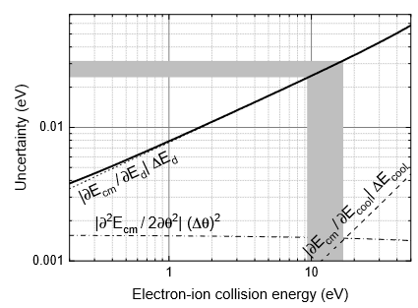
Main uncertainties
Background signal from recombination with residual gas:
caused by non-ideal vacuum (~ 3 x 10⁻¹¹ mbar)
vacuum conditions in electron cooler not known exactly (they might be worse locally)
inhibits measurement of small rate coefficients!
Former E131 ²⁰⁸Pb⁷⁸⁺ beamtime
Getting correct energy axis:
error caused by calibration against G35
uncertainty of measurement of ion energy, i.e. cooling energy
measurement on “both sides of energy axis”, i.e. positive and negative detuning energies
center-of-mass energy uncertainty E131: ΔE/E = ~ 3 x 10⁻³

Slide 14
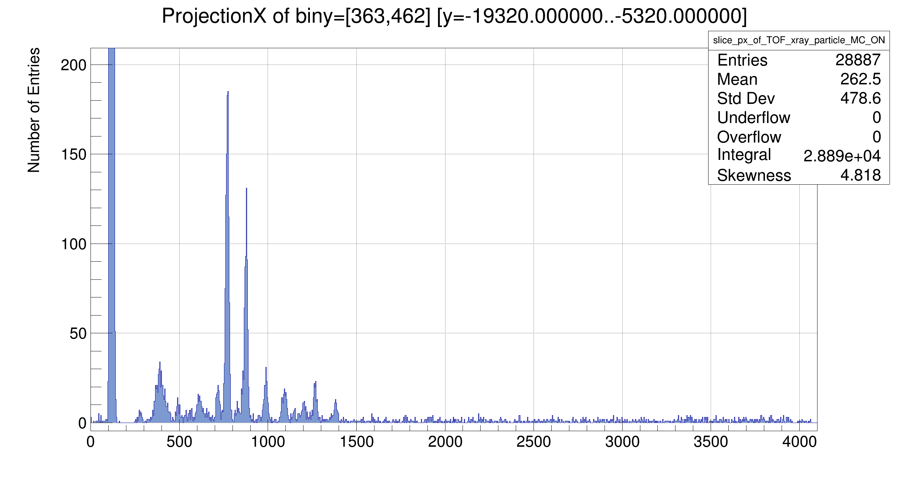
X-ray spectroscopy
X-rays associated with radiative recombination for Au⁷⁵⁺
Balmer
L-RR
j=1/2
j=3/2
X-ray spectrum from an alpha source (²⁴¹Am) was used for calibration
Peak positions for L-RR are determined by the ionization energy of B-like Au (~21.92 keV)

Slide 15
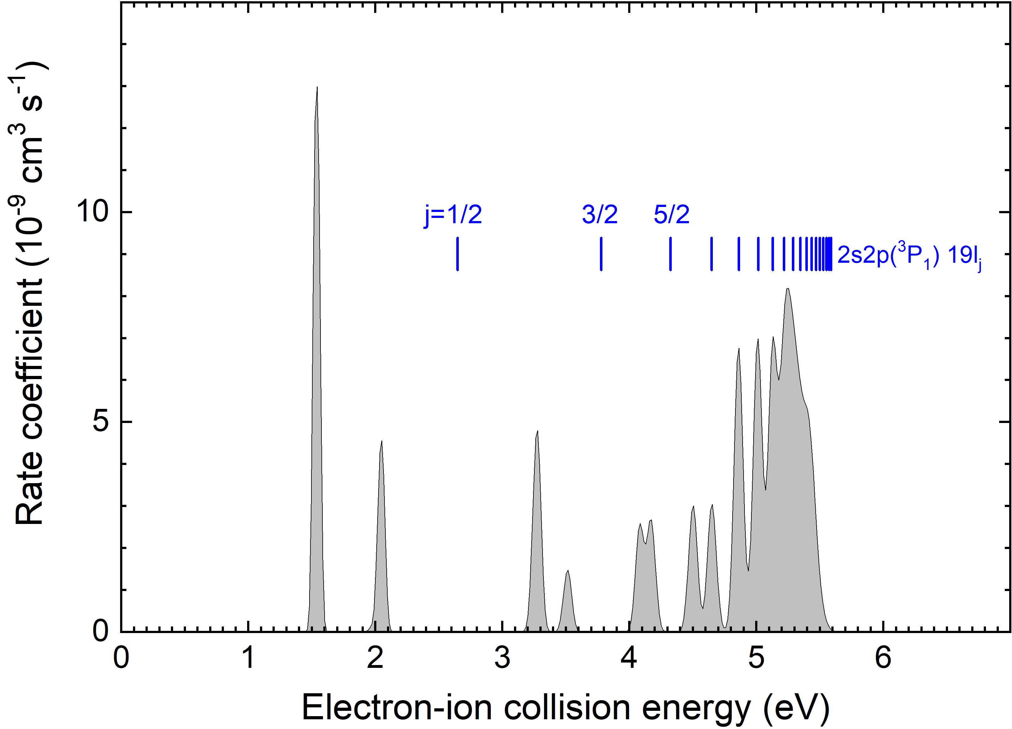
Summary & Outlook
Summary:
high-resolution DR collision spectroscopy of Be-like ¹⁹⁷Au⁷⁵⁺ ion at 12 MeV/u in CRYRING@ESR
second experiment using the full GSI accelerator chain after E131
~ 5 x 10⁶ Pb⁷⁸⁺ ions stored in CRYRING with a beam lifetime of > 30 s
relative peak positions and peak strengths must be compared with theoretical calculations
beam temperatures must be obtained from the fits of the resonances
attainable experimental statistical uncertainty limited by CRYRING vacuum (~ 3 x 10⁻¹¹ mbar)
Outlook:
future high-resolution studies with Be-like heavy ions at low energies, e.g. U⁸⁸⁺

Slide 16
Many thanks to
… Carsten Brandau^{1,3}, Michael Fogle⁴, Jan Glorius³, Elena O. Hanu^{3,5}, Volker Hannen⁶, Frank Herfurth³, Pierre-Michel Hillenbrand^{1,3}, Claude Krantz³, Michael Lestinsky³, Esther B. Menz^{3,5,7}, Reinhold Schuch⁸, Uwe Spillmann³, Ken Ueberholz⁶, Shu-Xing Wang^{1,2}, Thomas Stöhlker^{3,5,7} and Stefan Schippers^{1,2}
¹JLU Gießen, ²HFHF Campus Gießen, ³GSI, ⁴Auburn University, ⁵HI Jena, ⁶WWU Münster, ⁷FSU Jena, ⁸Stockholm University

