Slide 1
Fixed-target Experiments and Infrastructure Upgrades at the CERN M2 Beamline
KHuK Jahrestagung 2025
J. Bernhard (CERN)
12 December 2025

Slide 2
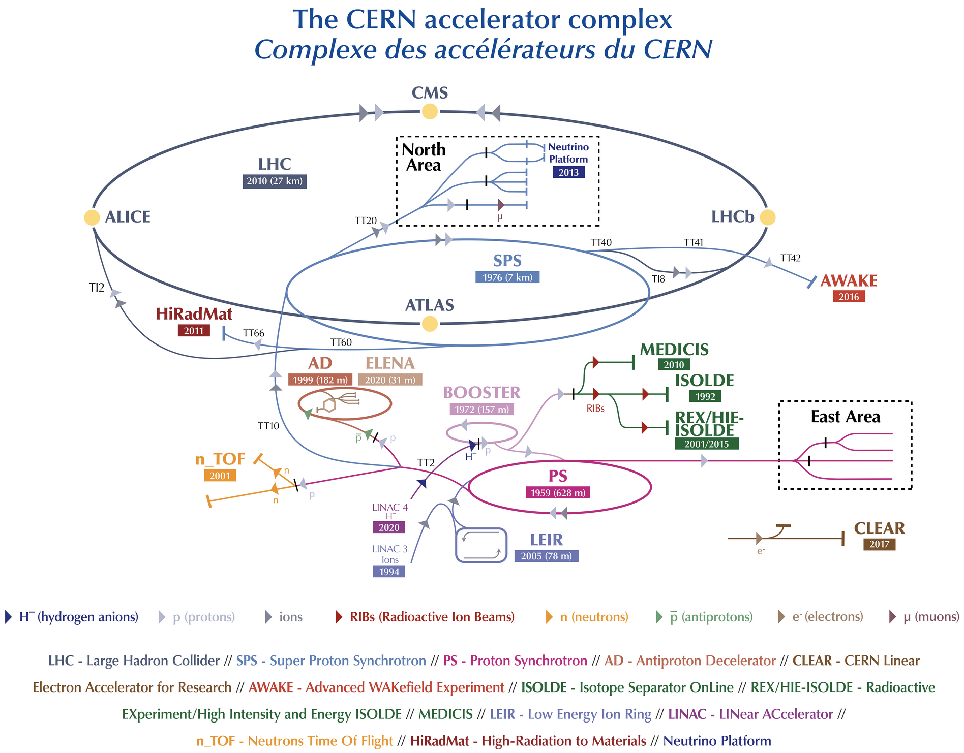
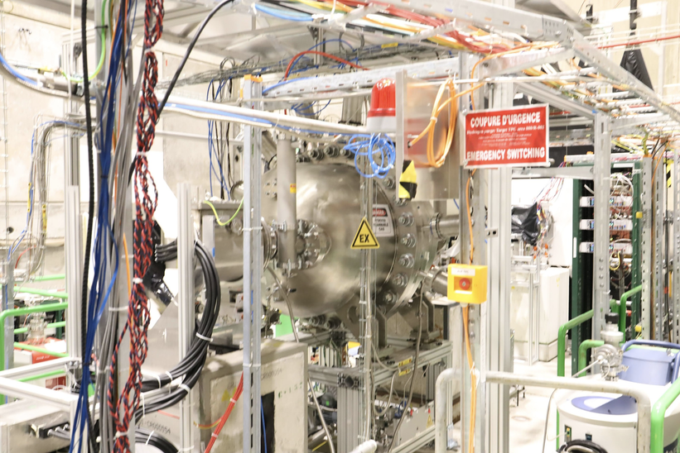
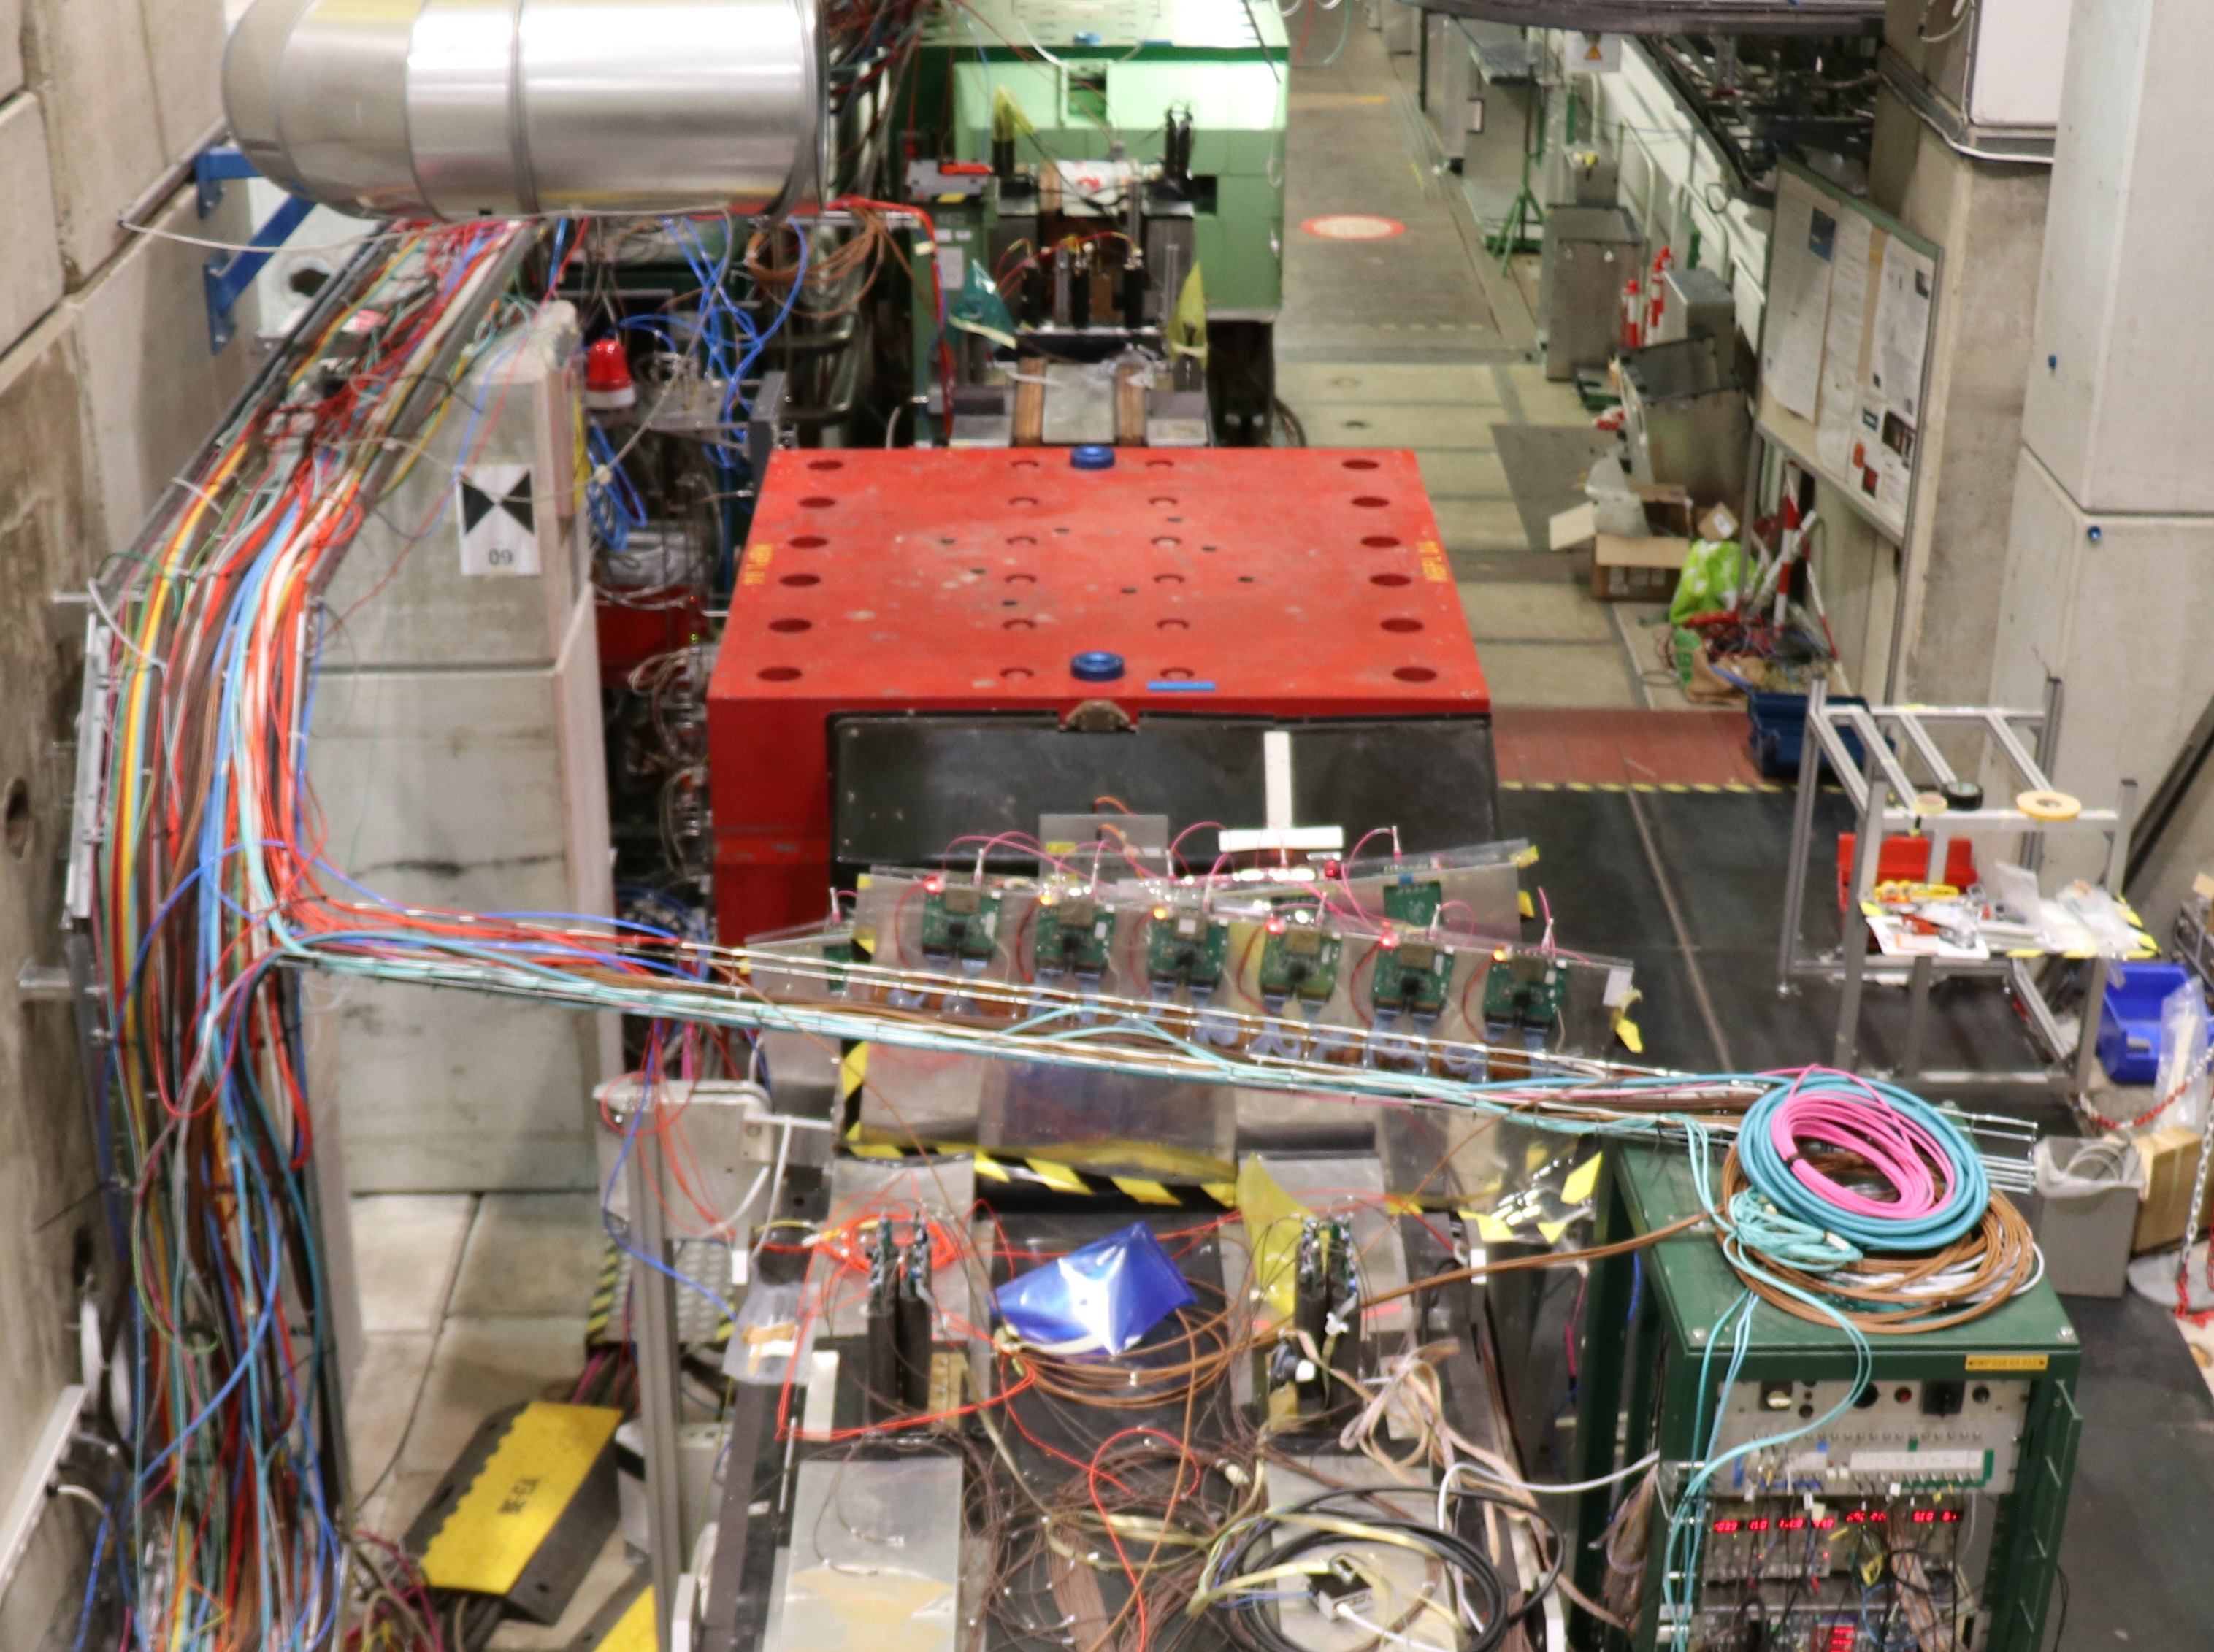
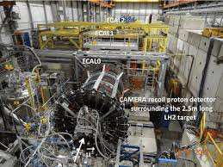
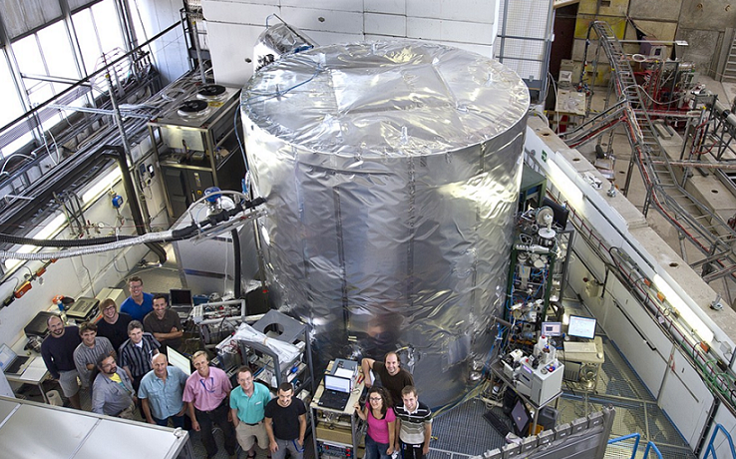
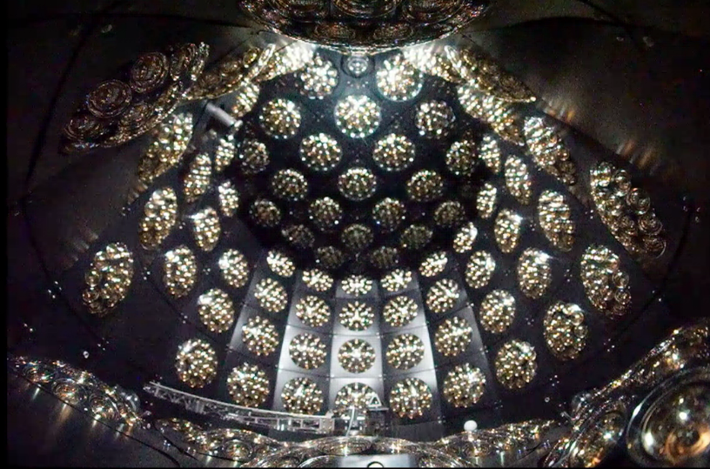
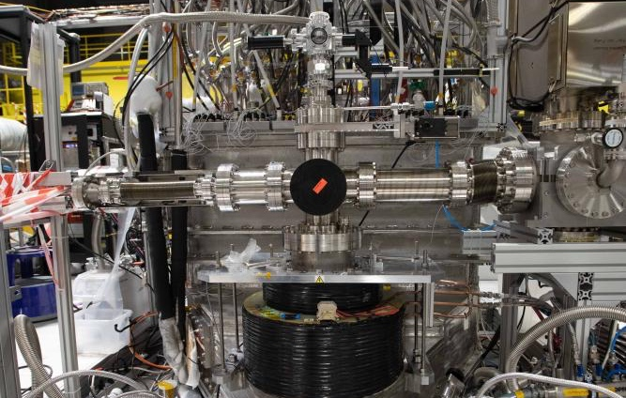
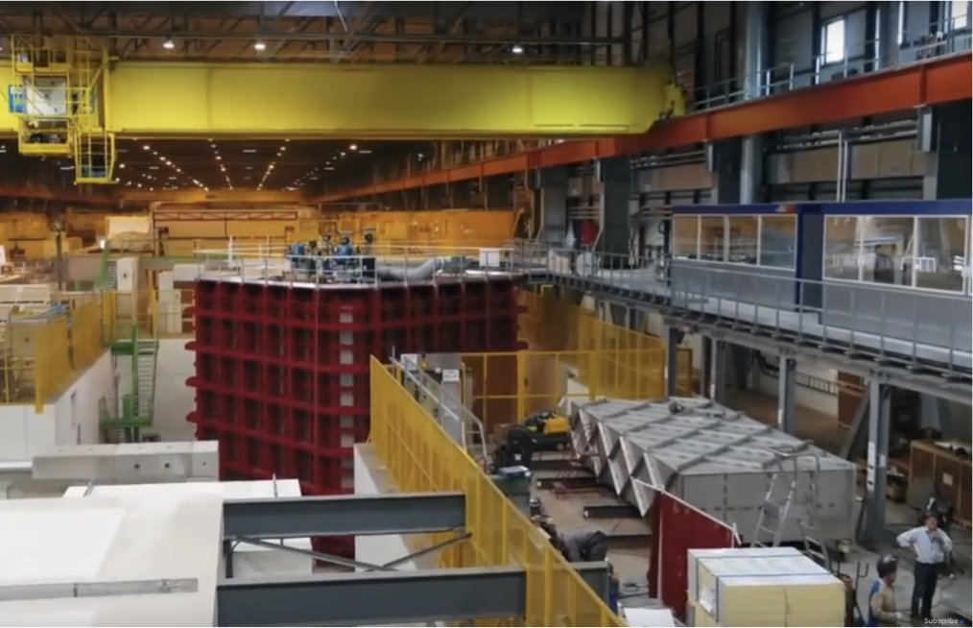
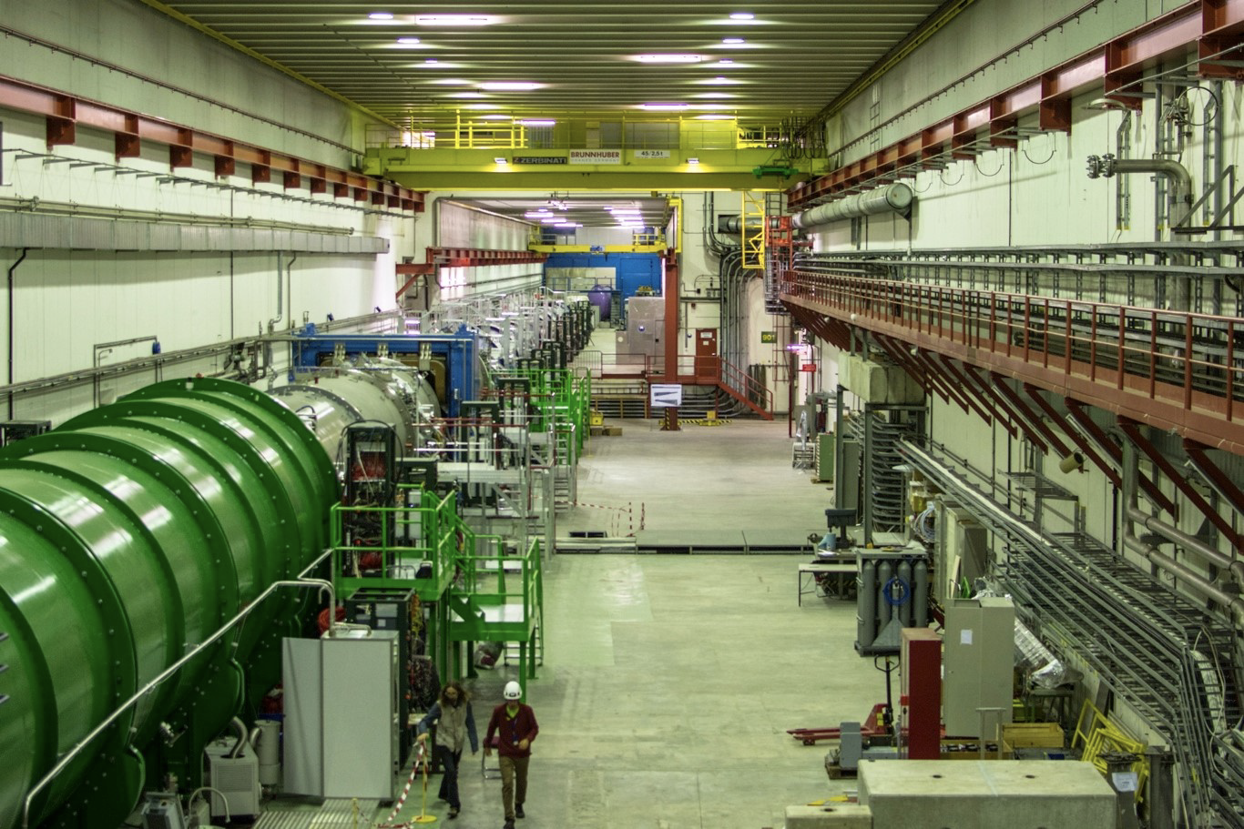
Science Diversity at CERN
Three main sites for fixed-target physics:
The North Area is one of the most diverse experimental facilities that currently exists, serving proton, hadron, electron, muon, and ion beams to yearly over 200 user teams for detector R&D and to the NA61, NA62, NA64, and NA66/AMBER experiments, the two large neutrino platform cryostats, as well as to the GIF++ and CERF irradiation facilities, with combined more than 2000 users. SHiP, a new dark matter search experiment, has just been approved.
The renovated East Area serves the CLOUD experiment, both IRRAD and CHARM irradiation facilities, and ideas for new detectors like WCTE.
In AD/ELENA, precision gets a whole new definition: BASE, BASE-STEP, ALPHA, GBAR, ASACUSA, AEgIS and PUMA set records for fundamental constants and found that anti-matter really falls down.
Significant consolidation efforts are underway and have been carried out.

Slide 3
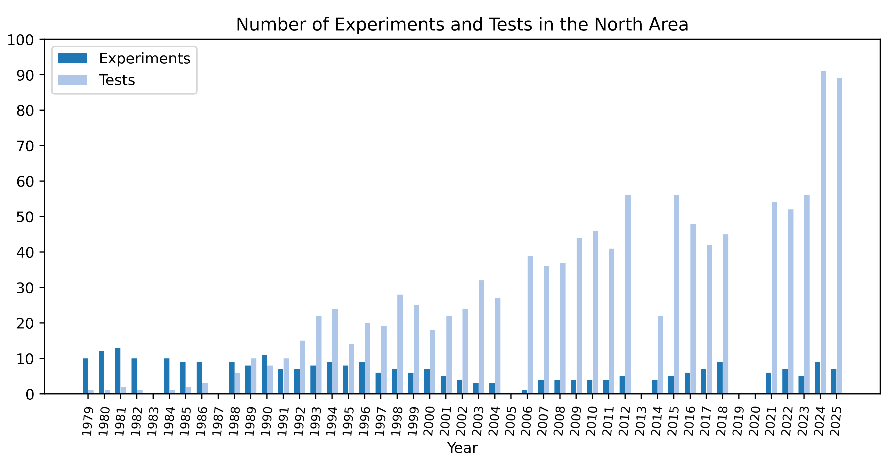
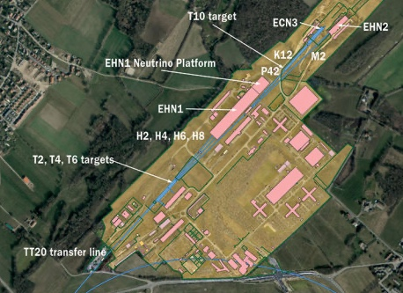
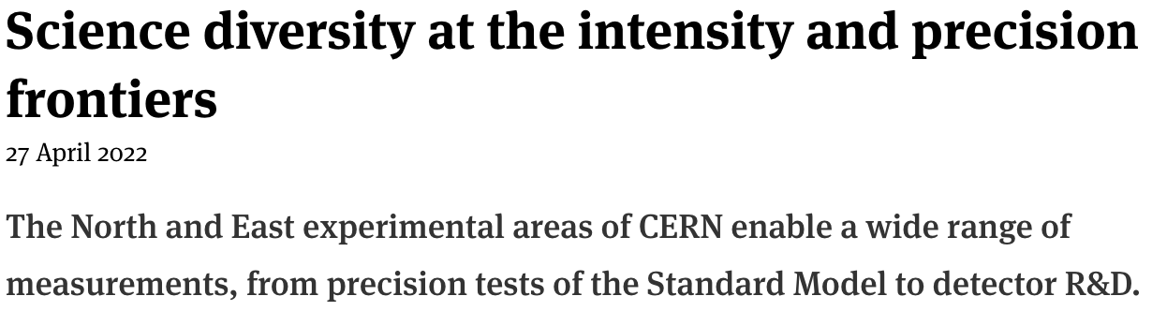
Science Diversity at CERN
Three main sites for fixed-target physics:
The North Area is one of the most diverse experimental facilities that currently exists, serving proton, hadron, electron, muon, and ion beams to yearly over 200 user teams for detector R&D and to the NA61, NA62, NA64, and NA66/AMBER experiments, the two large neutrino platform cryostats, as well as to the GIF++ and CERF irradiation facilities, with combined more than 2000 users. SHiP, a new dark matter search experiment, has just been approved.
The renovated East Area serves the CLOUD experiment, both IRRAD and CHARM irradiation facilities, and ideas for new detectors like WCTE.
In AD/ELENA, precision gets a whole new definition: BASE, BASE-STEP, ALPHA, GBAR, ASACUSA, AEgIS and PUMA set records for fundamental constants and found that anti-matter really falls down.
Significant consolidation efforts are underway and have been carried out.
→CERN Courier

Slide 4
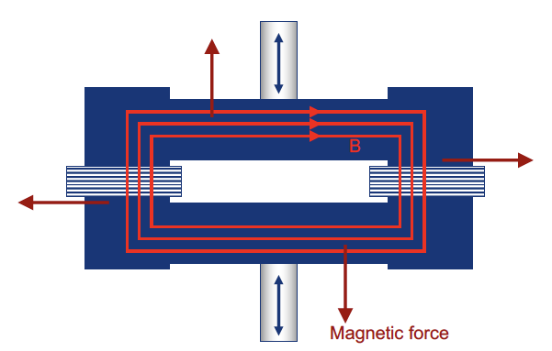

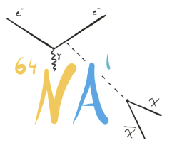

The M2 Beam at the North Area
M2 is a 1.1 km-long secondary beamline, transporting particles produced from the T6 target to the EHN2 hall.
In particular, the line has a 700 m long hadron section to allow hadron decays to muons, followed by 9.9 m Beryllium inside a dipole to absorb hadrons while muons pass through.
A 400 m long muon section selects the final muon momentum with the help of magnetic collimators (scrapers) and cleans the muon beam halo.
M2 has three main operation modes:
High-energy, high-intensity muon beams: Normally for muon momenta up to 160 GeV/c. Higher momenta up to 220 GeV/c are possible, but the flux drops very rapidly with beam momentum.
High-intensity secondary hadron beams: For momenta up to 280 GeV/c when absorber is retracted
Low-energy, low-intensity electron beams for calibration purposes (e.g. for EM calorimeters).
Experiments
Be Absorber
(160 ± 5) GeV/c
(172 ± 17) GeV/c
p
π,K
µ
Scrapers
BEND 6
700 m
400 m
EHN2 Hall
Hadron Decay Section
Muon Cleaning Section

Slide 5
The M2 Beam at the North Area
M2 is a 1.1 km-long secondary beamline, transporting particles produced from the T6 target to the EHN2 hall.
In particular, the line has a 700 m long hadron section to allow hadron decays to muons, followed by 9.9 m Beryllium inside a dipole to absorb hadrons while muons pass through.
A 400 m long muon section selects the final muon momentum with the help of magnetic collimators (scrapers) and cleans the muon beam halo.
M2 has three main operation modes:
High-energy, high-intensity muon beams: Normally for muon momenta up to 160 GeV/c. Higher momenta up to 220 GeV/c are possible, but the flux drops very rapidly with beam momentum.
High-intensity secondary hadron beams: For momenta up to 280 GeV/c when absorber is retracted.
Low-energy, low-intensity electron beams for calibration purposes (e.g. for EM calorimeters).
Beam Mode | Momentum (GeV/c) | Max. Flux (ppp / 4.8s) | Typical Δp/p (%) | Typical RMS spot at COMPASS target | Polarisation | Absorber (9.9 m Be) | Sec. target (5 mm Pb)
Muons | +208/190 +172/160 | ~10⁸ 2.5 10⁸ | 3% | 8 x 8 mm | 80% | IN | OUT
Hadrons | +190 -190 Max. 280 | 10⁸ (RP) 4 10⁸ (with dedicated dump) | ₋ | 5 x 5 mm | ₋ | OUT | OUT
Electrons | -10 to -40 | < 2 10 ⁴ | ₋ | > 10 x 10 mm | ₋ | OUT | IN

Slide 6
M2 Fixed-Target Physics Overview
Hosting three experiments, currently taking data or entering operation, with complementary long-term physics programmes:
AMBER/NA66 → see A. Thiel’s presentation, taking data
QCD facility with a broad and staged physics programme
Phase 1: proton structure and QCD precision measurements
proton charge radius with high-energy μp scattering (ongoing)
antiproton production cross sections (cosmic-ray and dark-matter context, completed)
pion- and kaon-induced Drell-Yan processes (planned)
Phase 2: hadron spectroscopy and structure with high-intensity kaon beams (proposal in preparation)
NA64µ → taking data
Precision search for feebly interacting particles in the muon sector
Missing-energy technique using high-intensity muon beams
Strong sensitivity to dark photons and other hidden-sector mediators
MUonE → pilot run completed, proposal in preparation
High-precision measurement of elastic μ-e scattering
Experimental determination of the leading hadronic vacuum polarisation contribution to (g−2)_{µ}
Complementary to the e⁺e⁻ dispersive approach, providing an independent cross-check also for lattice-QCD determinations

Slide 7
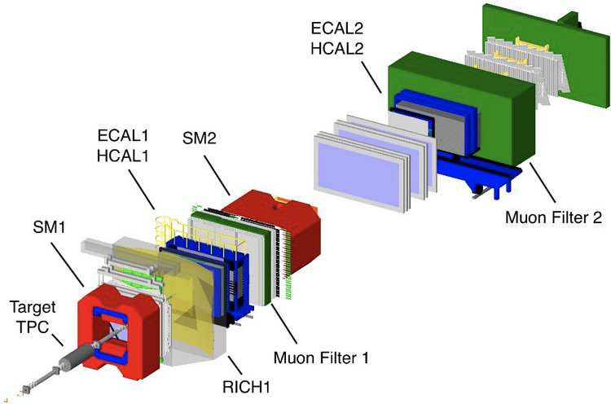
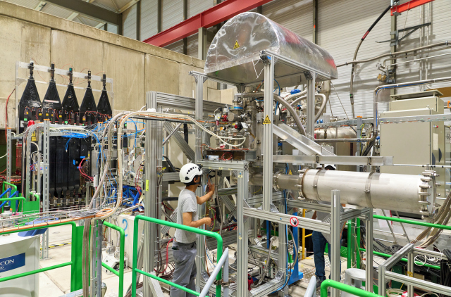
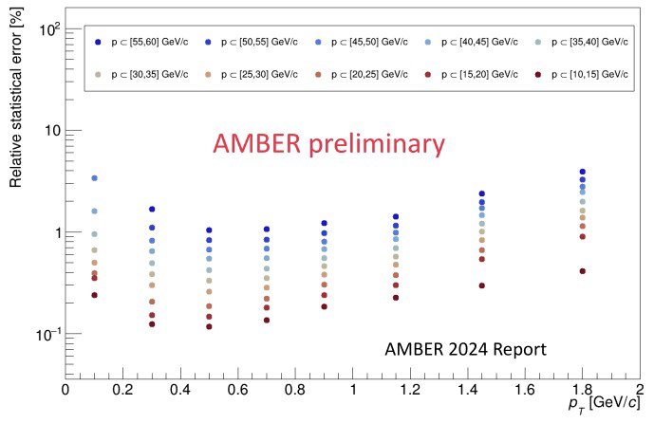
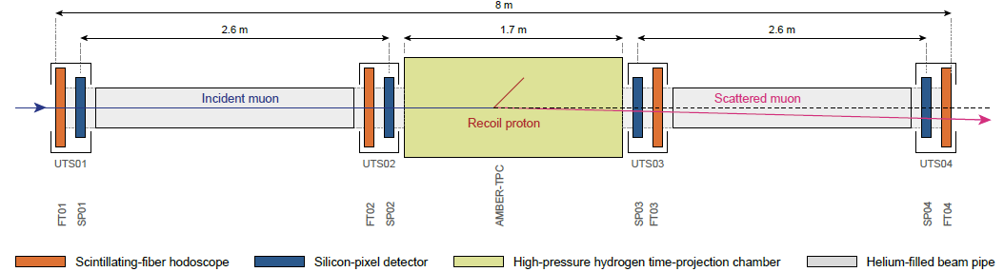
AMBER
PBARX (antiproton production):
Inclusive antiproton production in p-He, p-H and p-D collisions
Data taken in 2023/2024 at multiple beam momenta from 80 to 250 GeV/c
Analysis ongoing, first publication in preparation
PRM (proton charge radius):
High-energy μp elastic scattering using an active H₂ target (TPC)
2025 focused on commissioning and beam tests of the high-pressure TPC
First long physics data taking in 2026, exclusive user of M2
→ See A. Thiel’s talk

Slide 8
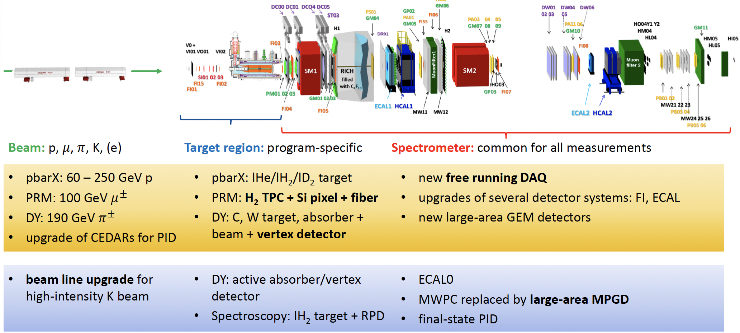
AMBER
Phase-1 programme continues after LS3 with focus on PRM and Drell-Yan with pion and kaon beams providing access to meson structure and PDFs in fixed-target kinematics
Detector and infrastructure upgrades:
Significant upgrades of tracking/ vertex detectors
Deployment of a new DAQ and readout architecture
CEDAR beam PID upgrades for high-intensity π/K separation
Phase-2: Preparation of a high-intensity programme with kaon beams
Hadron spectroscopy, quark and gluon PDFs through Drell-Yan and prompt photon processes, electro- magnetic and Primakoff reactions, kaon charge radius measurement
Proposal is being worked on
B. Ketzer, SPSC, September 2025
→ See A. Thiel’s talk

Slide 9
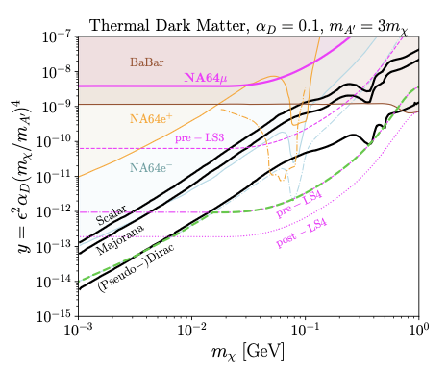
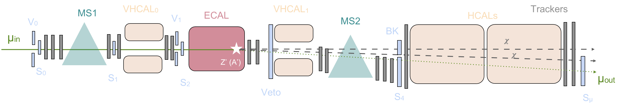
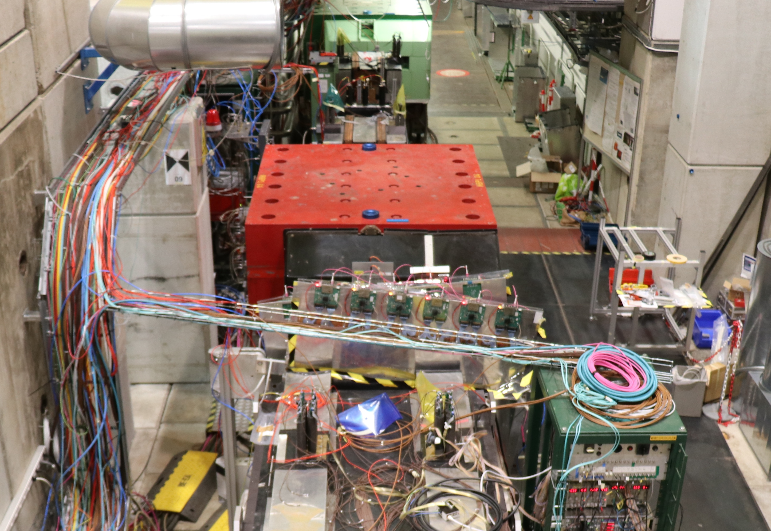
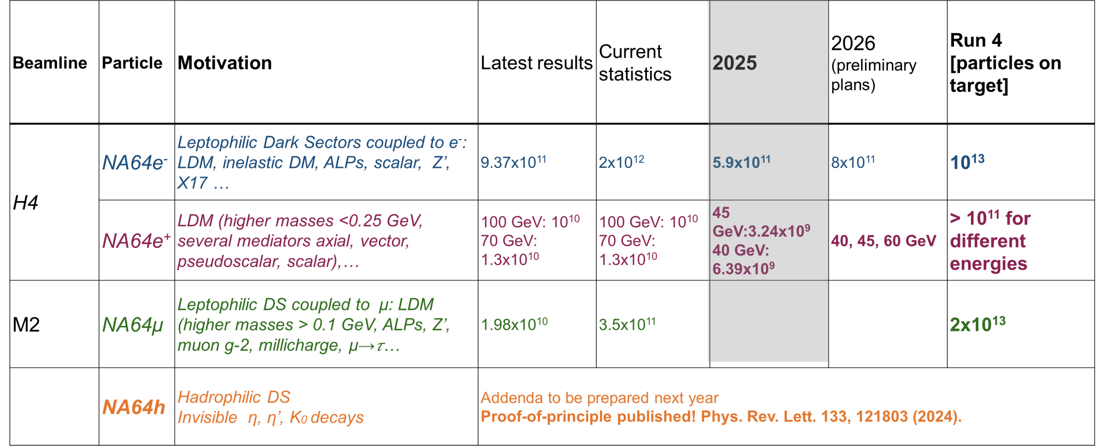
NA64µ
NA64 ESPPU input (arXiv:2505.14291)
Active beam-dump search for feebly interacting particles in the muon sector
Missing-energy technique with hermetic veto system
Strong sensitivity to dark photons, L_{μ}-L_{τ} gauge bosons and light DM
Analysis of data collected up to 2022 (2×10¹⁰ μOT) published
Setup optimized in 2023-2024 to minimize the main background sources and increase intensity (3.5×10¹¹ μOT collected)
Final goal: Collect 2×10¹³ μOT after LS3
L. Marsicano, SPSC, September 2025
NA64µ @ M2

Slide 10
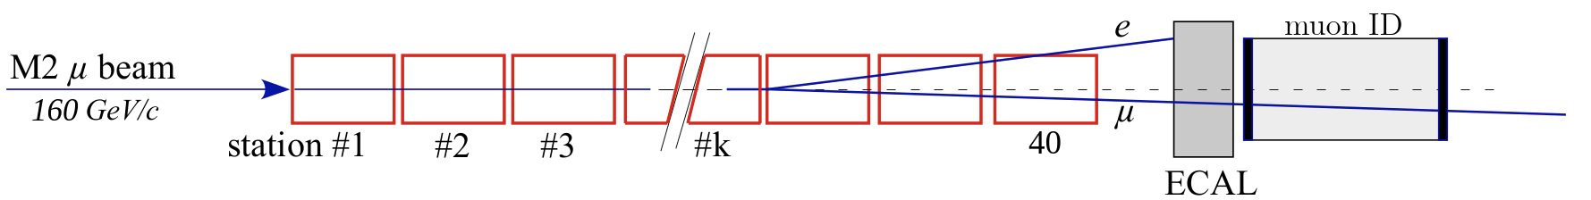
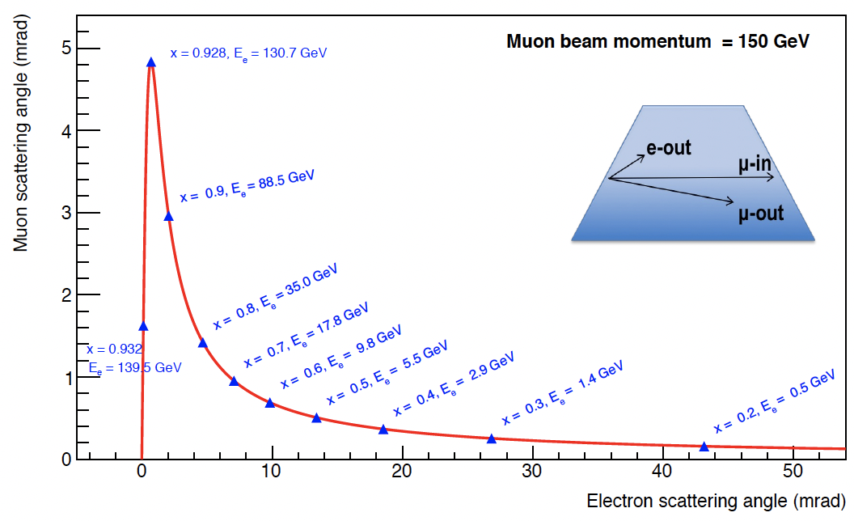
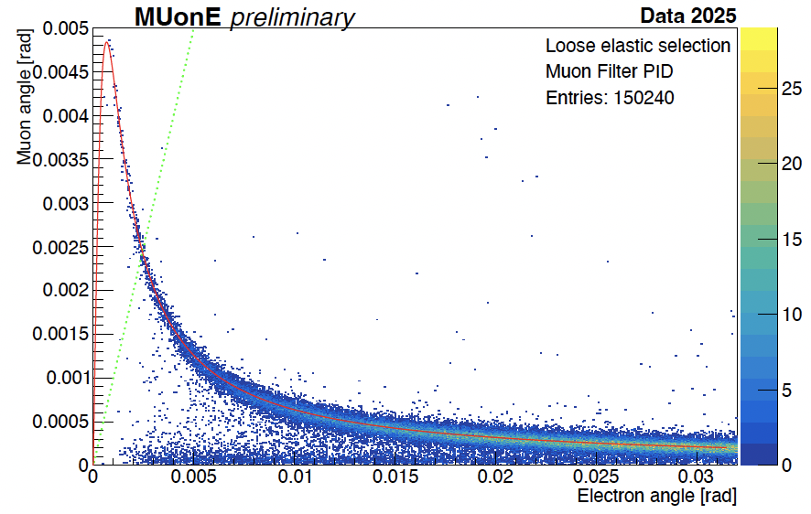
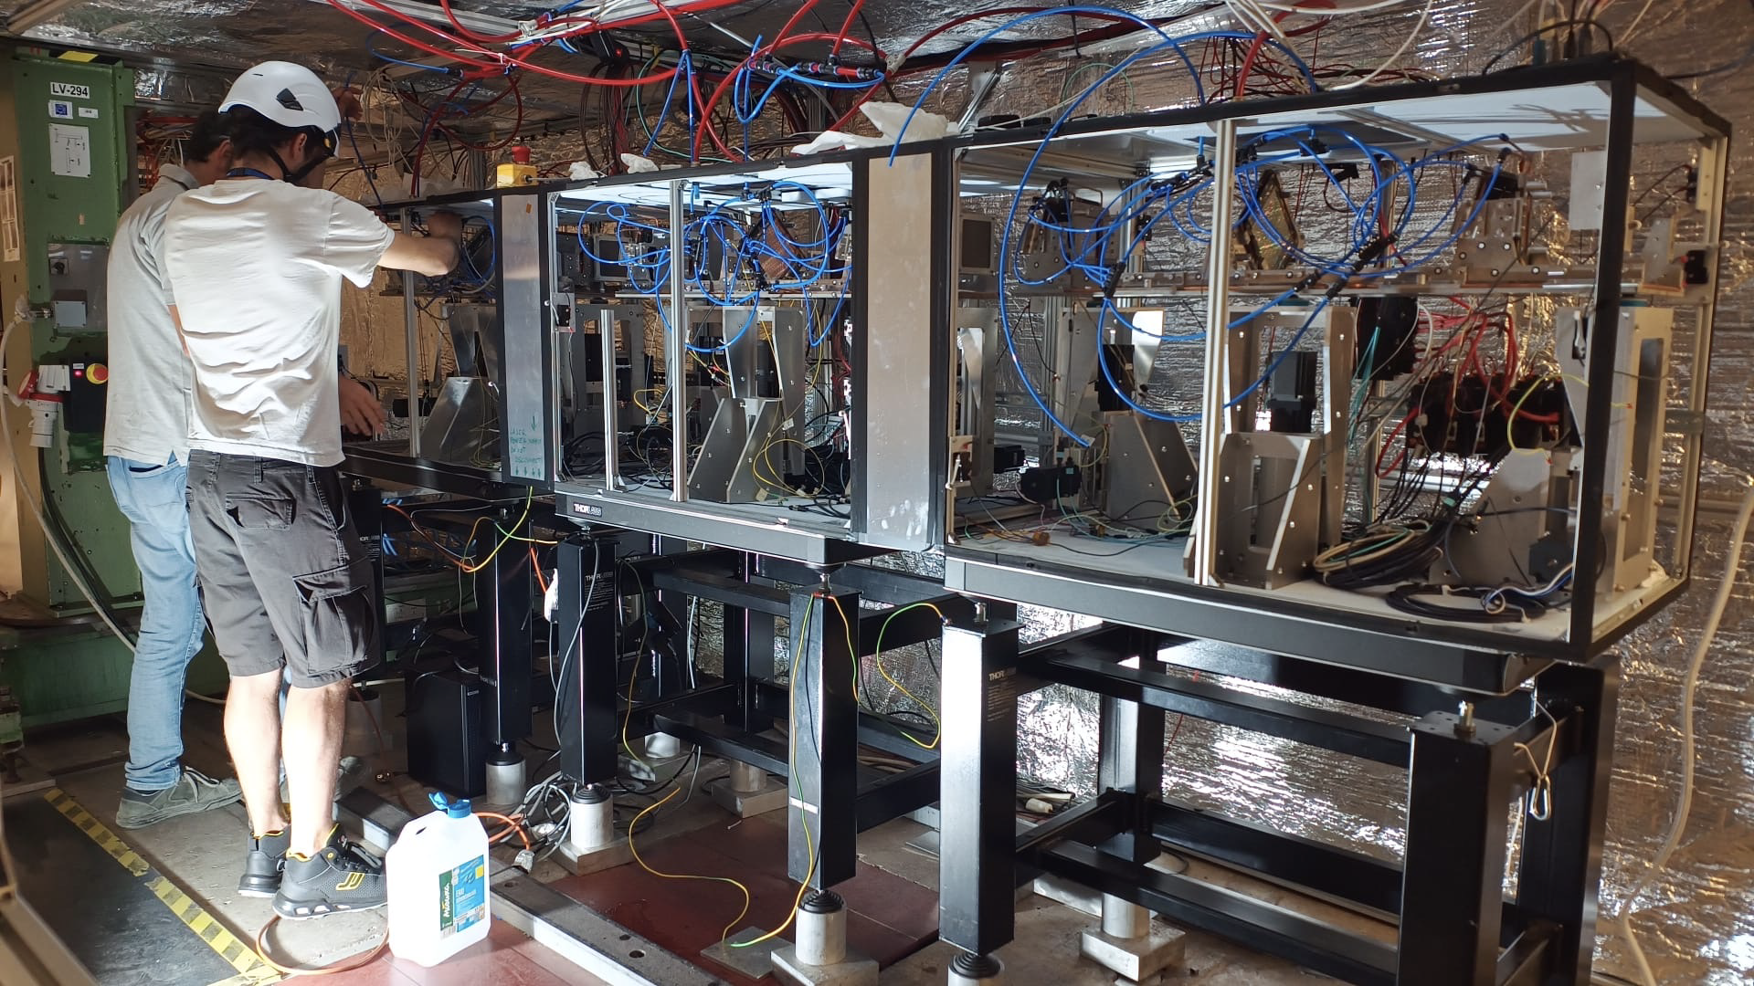
MUonE
High-precision measurement of elastic μ-e scattering at small angles
Direct experimental access to the leading hadronic vacuum polarisation contribution
Space-like momentum transfer, free from time-like hadronic resonances, and thus complementary to e⁺e⁻ dispersive approach
Independent experimental cross-check, also relevant for lattice-QCD determinations
Pilot run completed, proposal under preparation for data taking after LS3
G. Cantatore - MPP2025 Liverpool

Slide 11
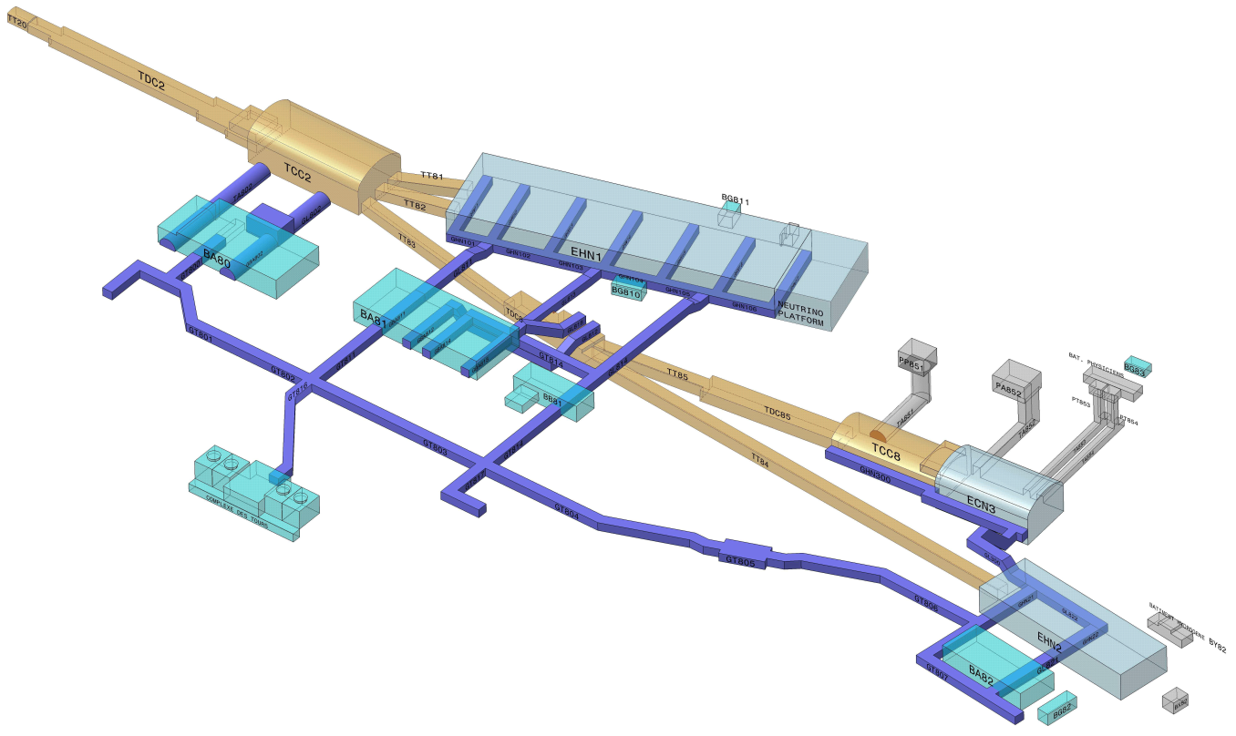

North Area Consolidation Project
Primary beam area
A few numbers:
7 beamlines (6.3 km cumulated)
564 beamline magnets (cycled & DC)
9 experimental magnets (spectrometers)
391 power circuits
300 m
Secondary beam area
1250 m
Experimental halls
Underground beam tunnels & caverns
Underground
technical galleries
Service
buildings

Slide 12
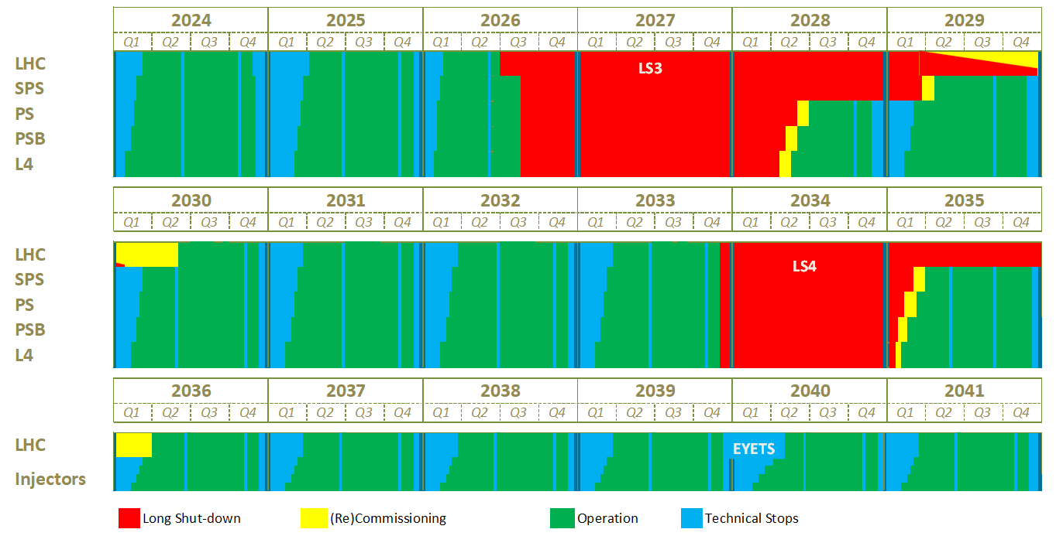
North Area Consolidation Project
NA-CONS Phase 1 during Long Stop 3
NA-CONS will be carried out in two phases, matching the long-term CERN running schedule, making it mostly transparent to test-beam users and experiments.
During the already on-going first phase, infrastructure for all primary beams, tunnels, caverns and important safety upgrades are carried out.
During the second phase, surface buildings and experimental areas will be renovated.
NA-CONS is a major CERN project and demonstrates commitment to fixed-target physics in the long-term with an investment of over 170 MCHF.
NA-CONS Phase 2 during Long Stop 4

Slide 13
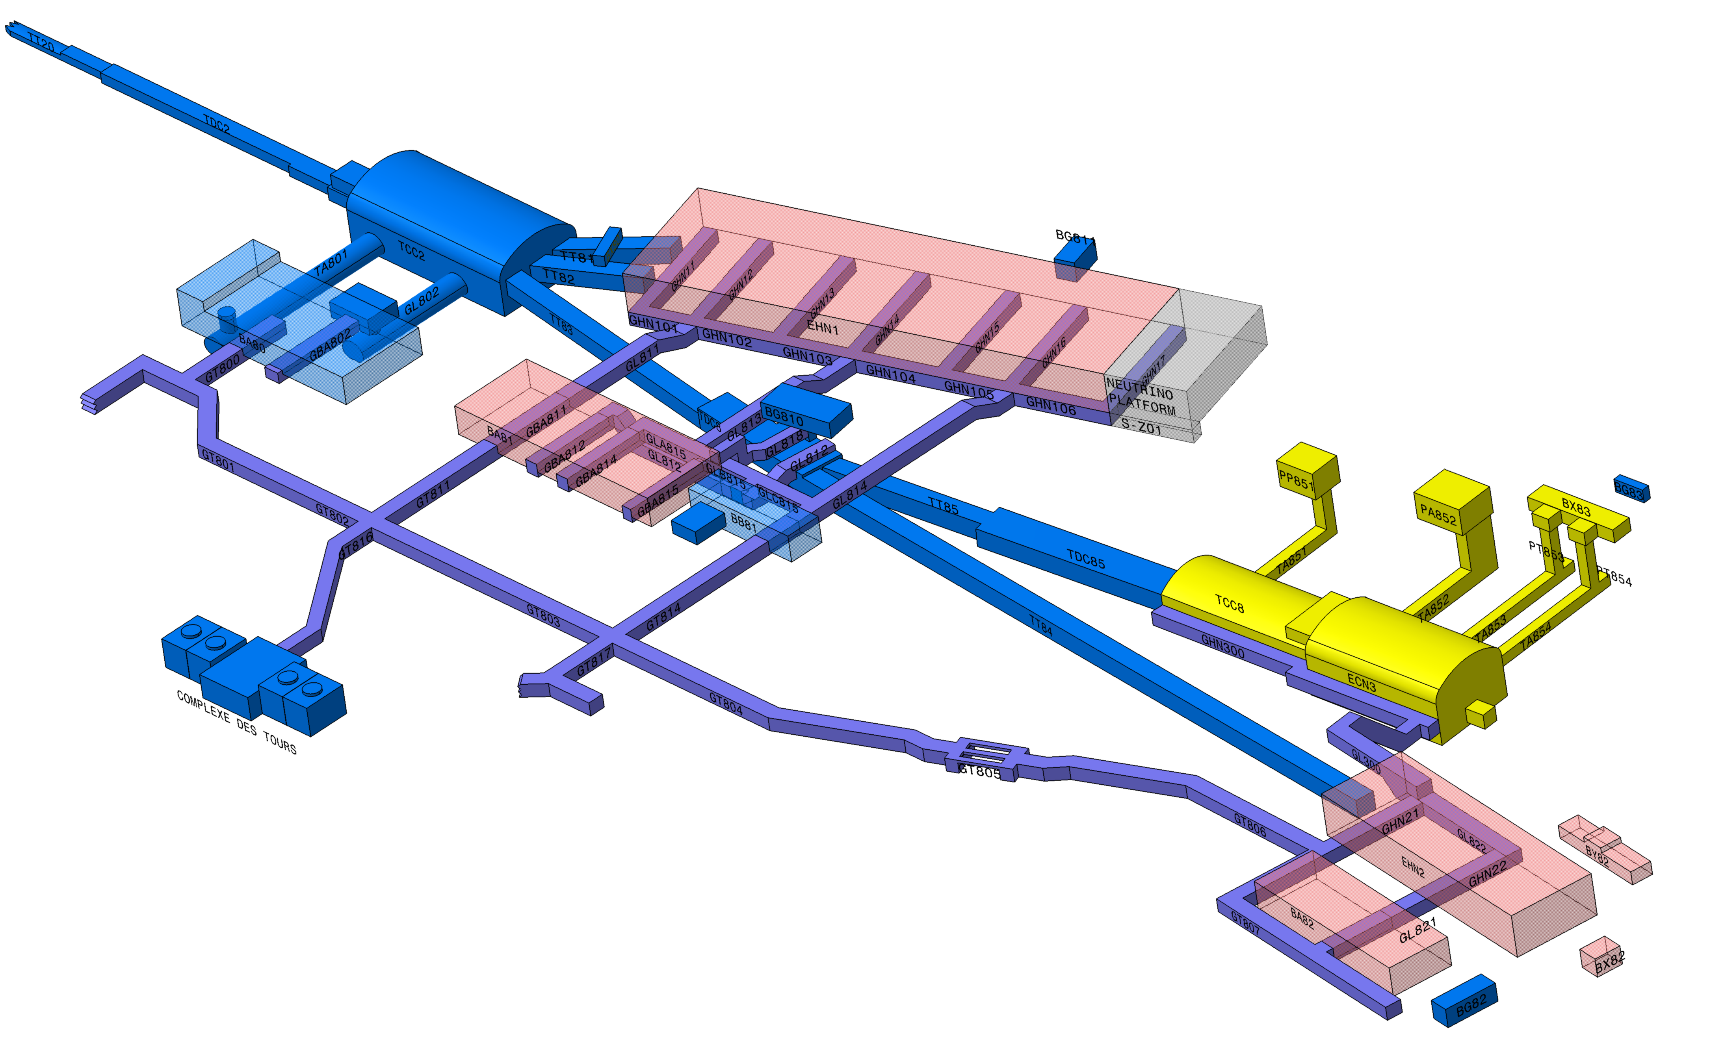

North Area Consolidation Project
Consolidation Phase 1 (2019 – 2028):
Primary areas including TDC2, TCC2, BA2, BA80
Beamlines towards EHN1, EHN2, ECN3
Towards a new North Area:
Systematic replacement of all power converters
BA2, BA80 in Phase 1
BA81, BA82 in Phase 2
Consolidation of related electrical infrastructure: transformers, switchboards, DC cables…
Renovation of related cooling and ventilation infrastructure
Renovation of surface buildings
Magnet consolidation including preparation of operational spares
Fully refurbished primary target area (TCC2) including new magnets and XTAX collimators/dumps
HI-ECN3 project for
SHiP experiment (additional 60 MCHF)
Consolidation Phase 2 (2029 – 2035): BA81, BA82, EHN1, EHN2
→ CERN invests a total of 170 MCHF in the North Area consolidation ←

Slide 14
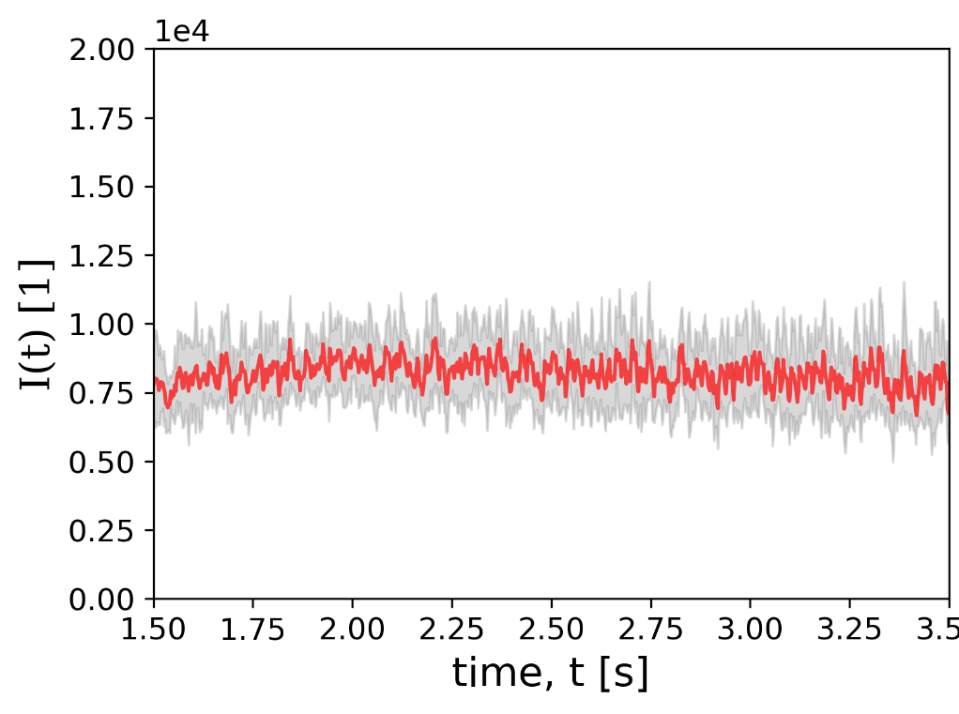
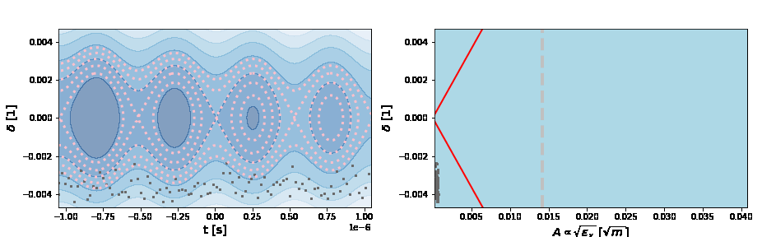
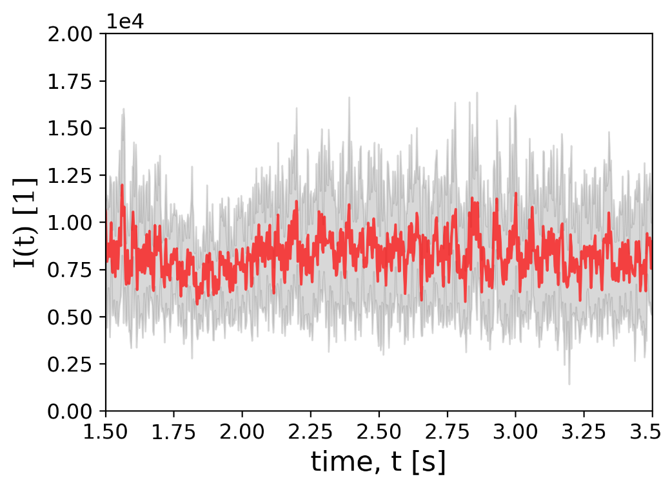
Beam Extraction – Time Structures
EBC on
P. Arrutia (CERN)
EBC off
With experiments requiring to run at highest intensities, the extraction quality becomes more important.
Especially time structures at 50 Hz and 150 Hz, introduced via power converters, can easily lead to data acquisition issues due to peaks in the instantaneous intensity.
Amongst several improvements on the hardware and controls-side, empty bucket channelling looks very promising: the de-bunched beam is forced up and “channelled” between the empty buckets.

Slide 15
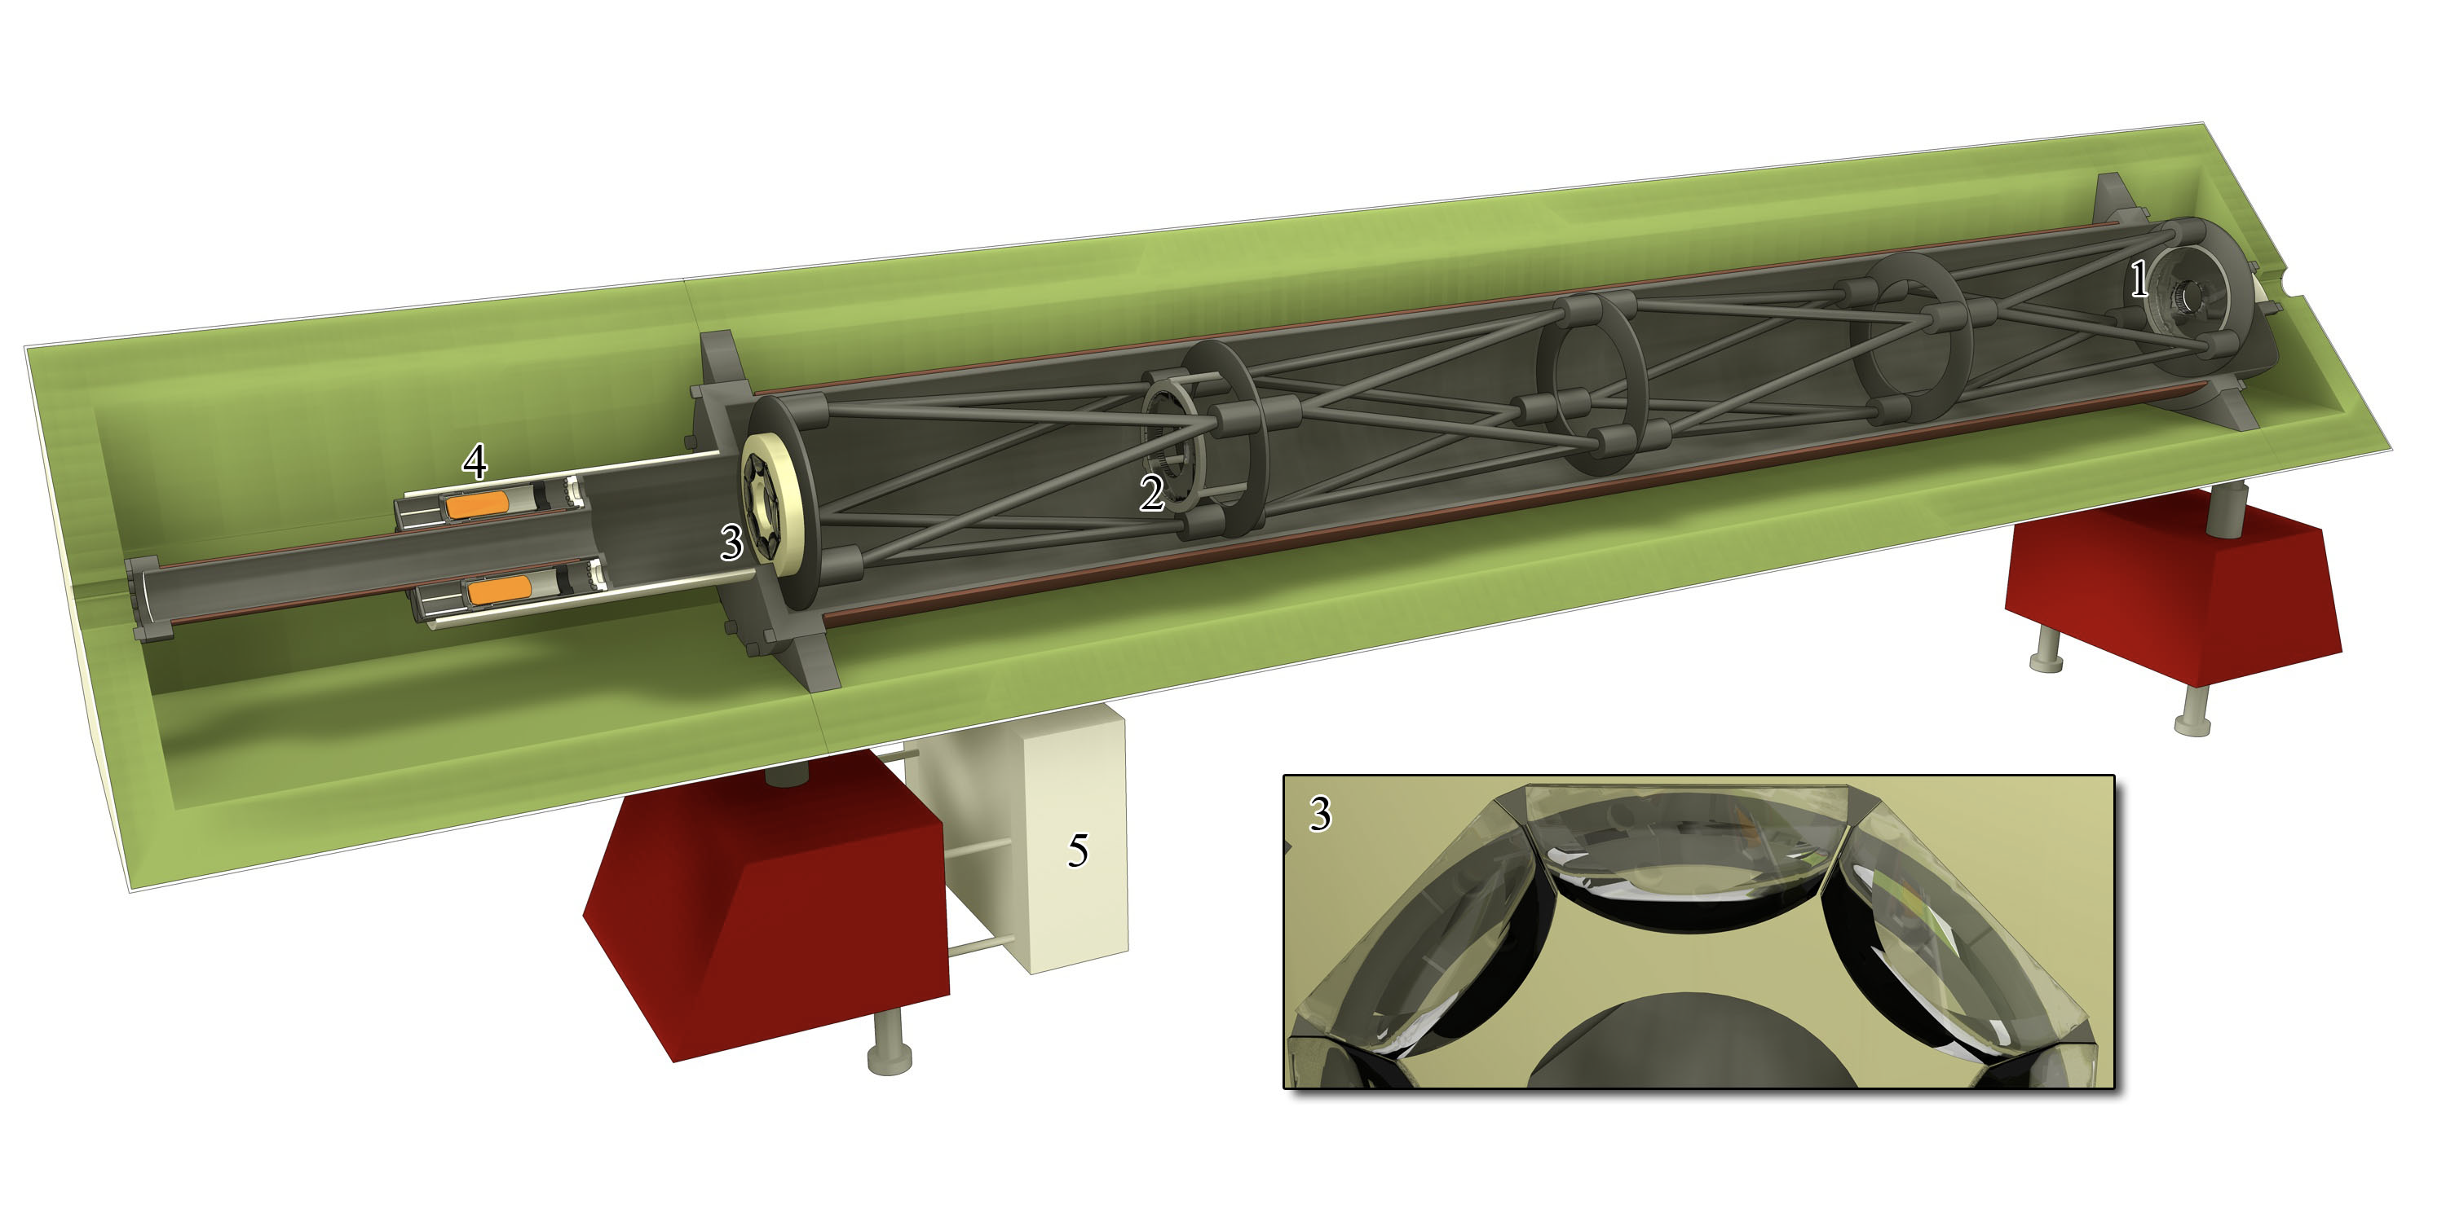
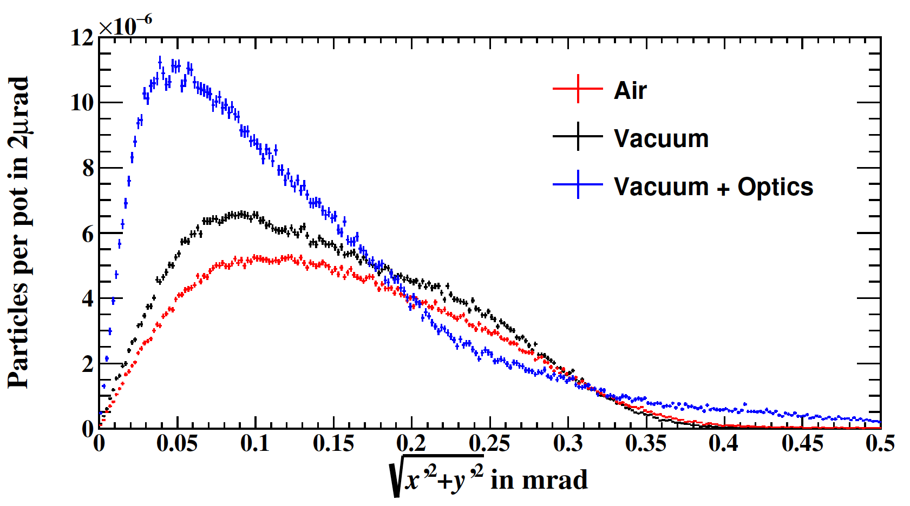
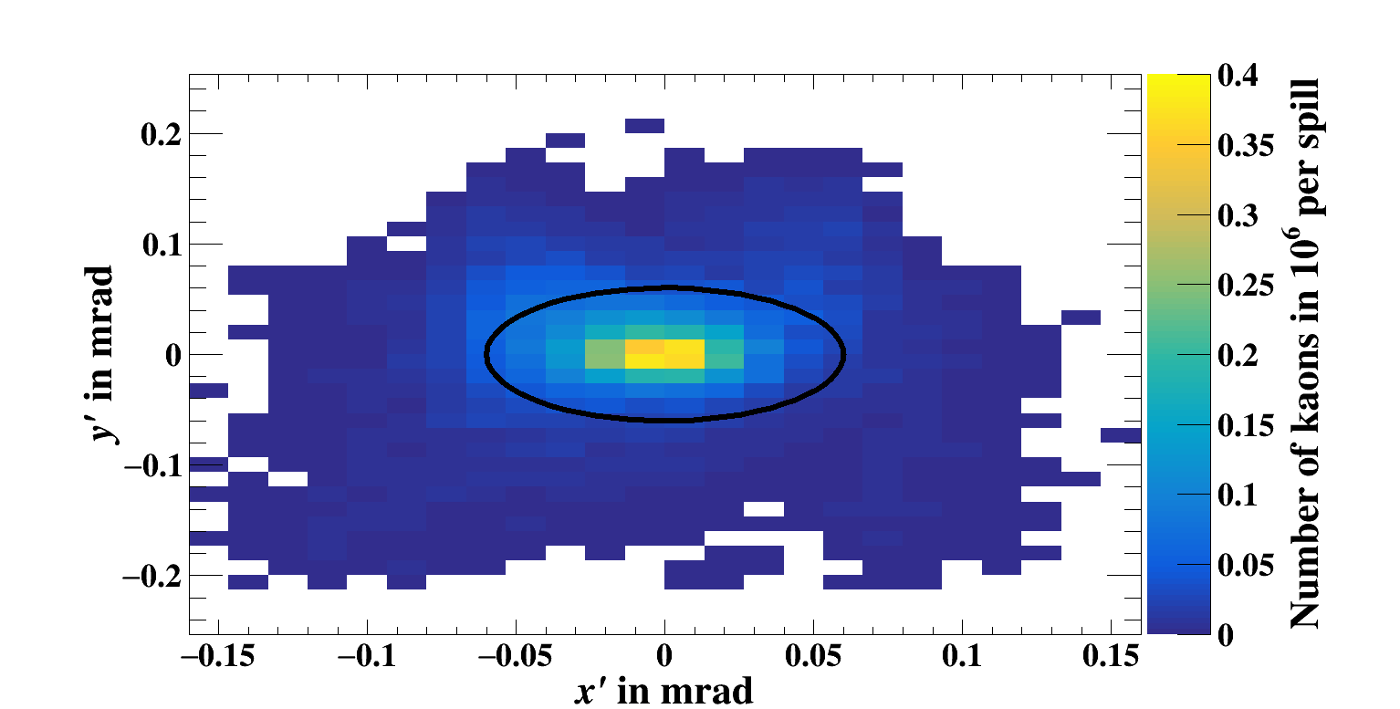
M2 Upgrades for AMBER Hadron Beams
The AMBER experiment has a wide range of QCD-related measurements with needs of muon and hadron beams of high intensities.
So far, the limit of the hadron beam intensity is 4e8 per 4.8 s extraction for the Drell-Yan measurement, constrained by radiation protection (overground hall).
As the beam contains hadrons of all sorts, differential Cherenkov detectors (CEDARs) are used for beam particle identification, which are sensitive to the beam divergence.
Combined with an upgrade of the CEDAR PMT readout and additional heavy shielding, increasing the intensity to a max. 1e9 hadrons per 4.8 s spill is planned, still being able to discriminate minority particles in the beam, e.g. Kaons.
In order to reduce beam losses and to reduce the beam divergence for better PID, the vacuum of the M2 line is going to be completed (about 80 m out of 1.2 km in air) and will be upgraded. An additional collimator will improve the collimation scheme and clean beam tails with higher divergence.
Outcome of the study: 6e6 kaons per spill within 60 µrad divergence (now 2.7e6).
→ Additional investment of 1 MCHF, which was just endorsed.
CEDAR

Slide 16
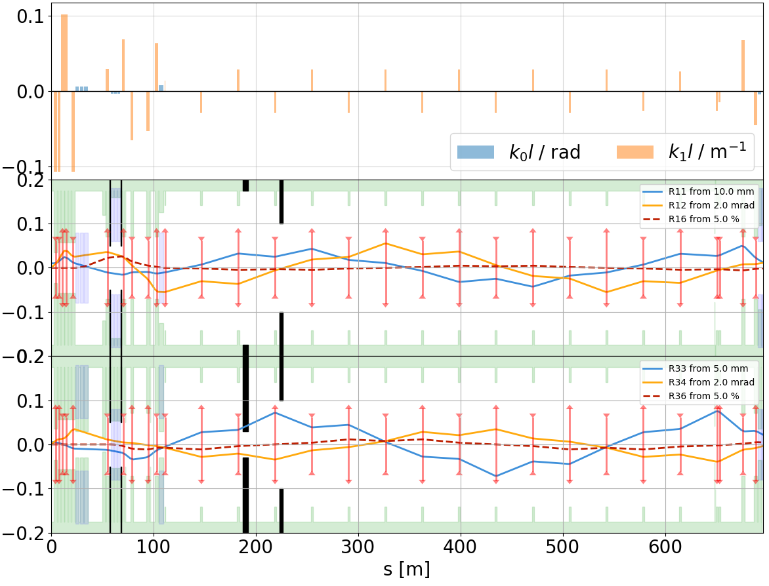
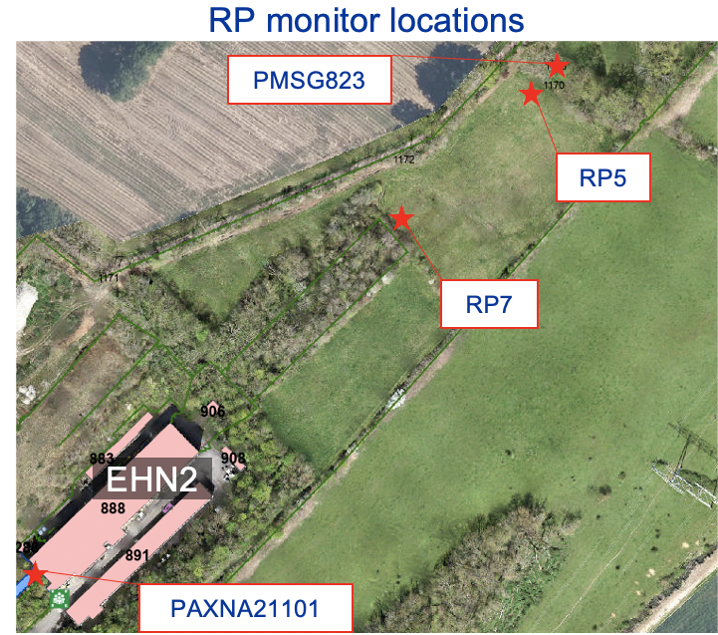
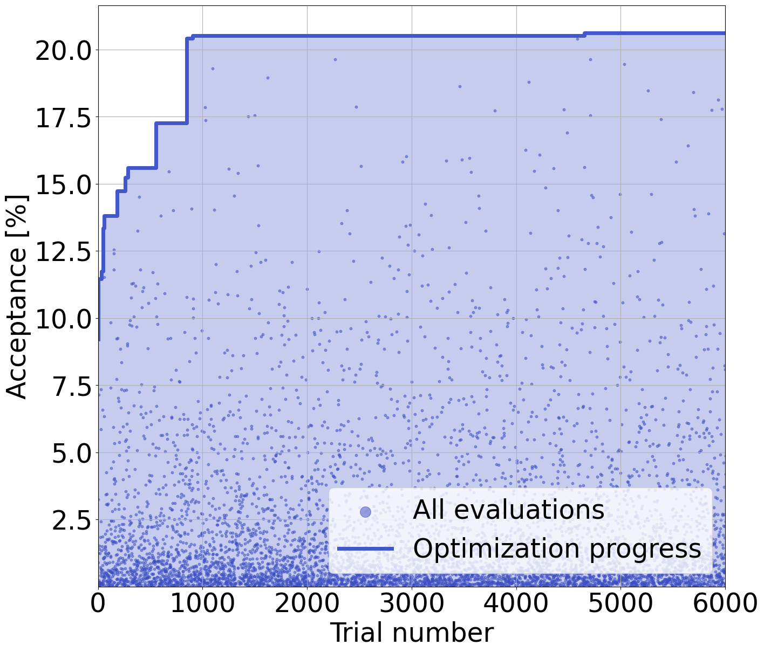
M2 Upgrades for Muon and Electron Beams
Already now M2 is the highest energy muon beam in the world with unrivalled intensities.
Currently, we are limited by radiation at environmental RP monitors at the CERN site fence.
With the proposed upgrades for better hadron beam transmission in M2, an optimised acceptance for the frontend automatically also increases the muon and electron beam intensity.
Recently, we tried a Bayesian optimization on the first 6 acceptance quadrupoles → factor 2 increase of electron rate and factor 1.6 on muons.
Now we are optimising the positioning of the final downward deflection magnet, which might help to stay within radiation protection limits with higher beam intensities for MUonE and NA64µ.
G. Dal Maso
D. Banerjee

Slide 17
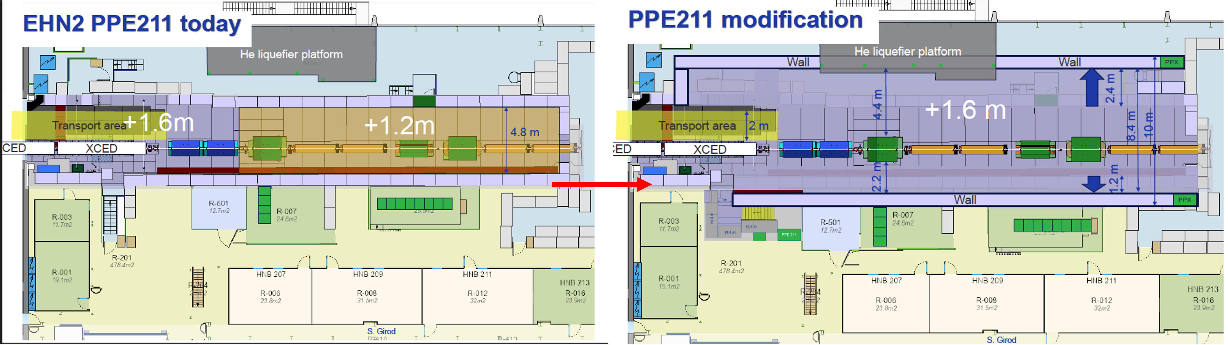
Operating Three Experiments
With three long-term experiments, space and lengthy change-over times can become a dominant constraint for scheduling.
A rail-based system would allow fast exchange of experiments and beamline elements, improving operational efficiency.
More space…
S. Girod
D. Banerjee

Slide 18
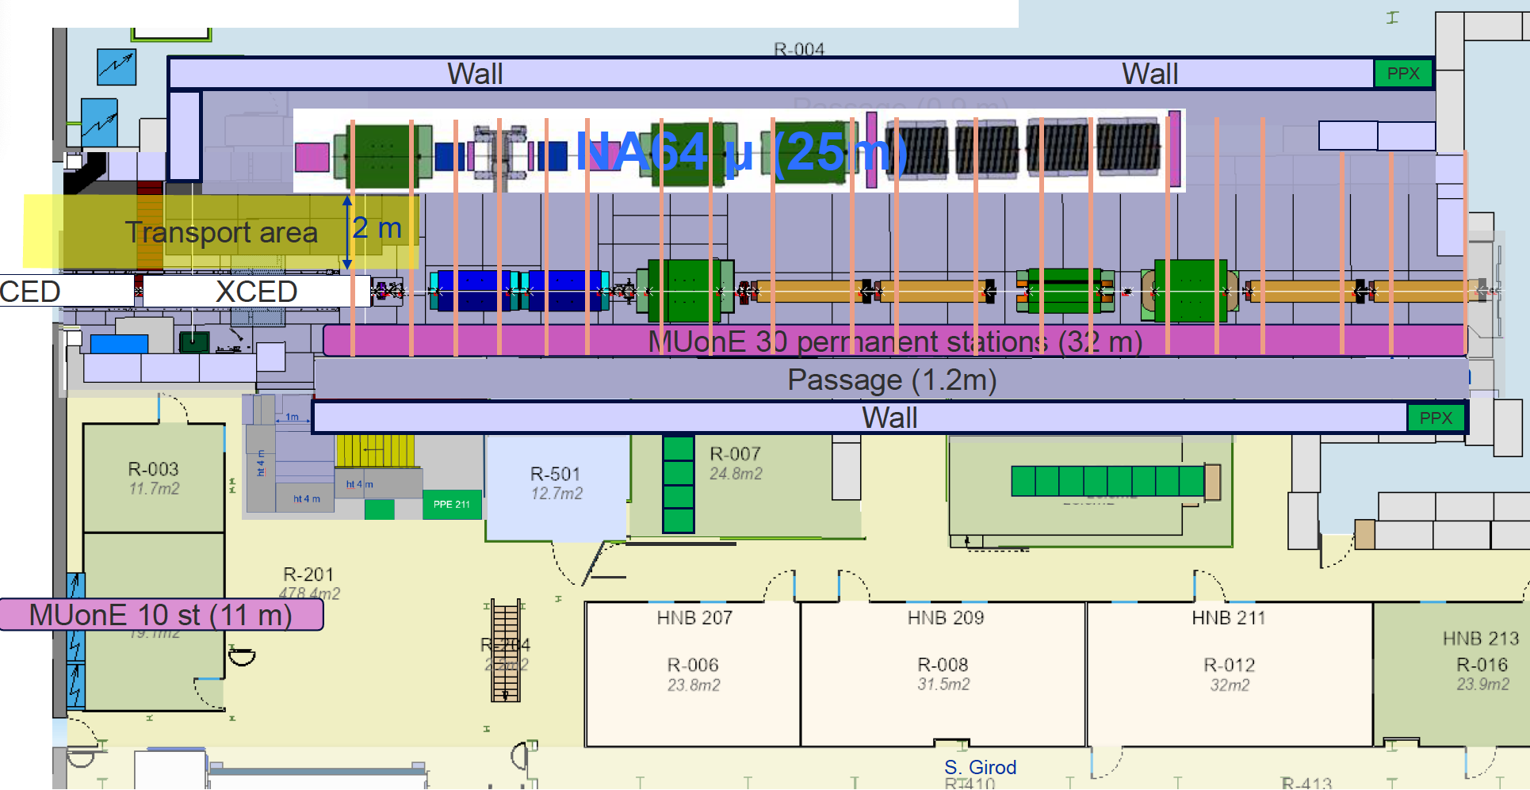
Operating Three Experiments
With three long-term experiments, space and lengthy change-over times can become a dominant constraint for scheduling.
A rail-based system would allow fast exchange of experiments and beamline elements, improving operational efficiency.
… and more flexibility.

Slide 19
Summary
M2 has a rich and diverse long-term physics programme Hosting three complementary experiments with sustained operation over many years: AMBER, NA64µ, and MUonE.
Fixed-target physics is a strategic and long-term commitment at CERN CERN is investing heavily in fixed-target infrastructure, in particular in the North Area.
More than 170 MCHF invested in the North Area consolidation programme This investment secures reliable, high-intensity operation for the coming decades and provides a stable framework supporting continued engagement by the experimental community and its funding agencies.
Infrastructure upgrades are essential to fully exploit physics potential Beam quality, intensity, and operational efficiency are key to enabling the next generation of precision and intensity-frontier experiments.
Efficient operation of multiple long-term experiments requires new concepts Solutions such as modular layouts and rail-based systems can significantly reduce change-over times and improve scheduling flexibility.
johannes.bernhard@cern.ch

Slide 20
Thank you very much for your attention!

