Slide 1
FAIR Status
Thomas Nilsson,
GSI/FAIR Scientific Managing Director
KHuK Jahrestagung,11-13 December 2025

Slide 2
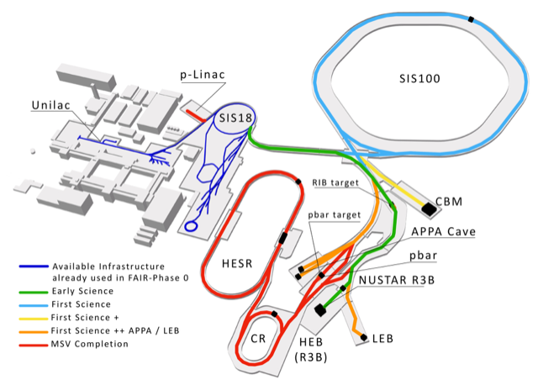


FAIR steps towards succesful start!
FAIR 2028

Slide 3
FAIR & GSI Integrated Schedule
Level 2 Plan
FAIR First beam (T1S1-I)
2024 2025 2026 2027 2028
2024
2025
2026
2027
2028
Q3
Q4
Q1
Q2
Q3
Q4
Q1
Q2
Q3
Q4
Q1
Q2
Q3
Q4
Q1
Q2
Q3
Q4
GSI-Beam Time
Beam Time
Beam Time
Beam Time
Beam Time
Beam Time
FAIR
Beam
Comm.
Beam Time
FAIR
Beam
Comm.
FCC Construction & Procurement of Interior equipment
Equipment
Installation
Commissioning
ACC operation from new FCC
Injector Controls Upgrade: 1st version of new production system
Injector Controls Upgrade: finalization
Controls & BI Digitization UNILAC, SIS18, ESR, Cryring, HEBT
EH refurbishment
SIS-18 Hematite bar replacement
Civil Construction
FAIR Tech. Buildings Infrastructure
FAIR Buildings Testing & Commissioning
HBO
Regular Operation of Tech. Buildings Infrastructure
FAIR Accelerator / Experiments Procurement & Manufacturing
SFRS-ES
SIS100-FS
FAIR Accelerator / Experiments Installation
FBE Installation - T1S1-I
HEBT/SFRS-ES
SIS100-FS
HEBT-ES Hardware-Commissioning
FBE-local comm.
Remote-integ.
Dry-Runs
Teil 2
.
Dry run-beam comm.
Start of ES
science program
Dry-
Runs
ES Beam Commissioning
Start of FS science program
SFRS Hardware-Commissioning
Cryo 2 Commissioning
SFRS Cooldown
HEBT & SIS100-FS Hardware-Commissioning
FS Beam Commissioning
SIS100 Cooldown
Version Q4.2 2025

Slide 4
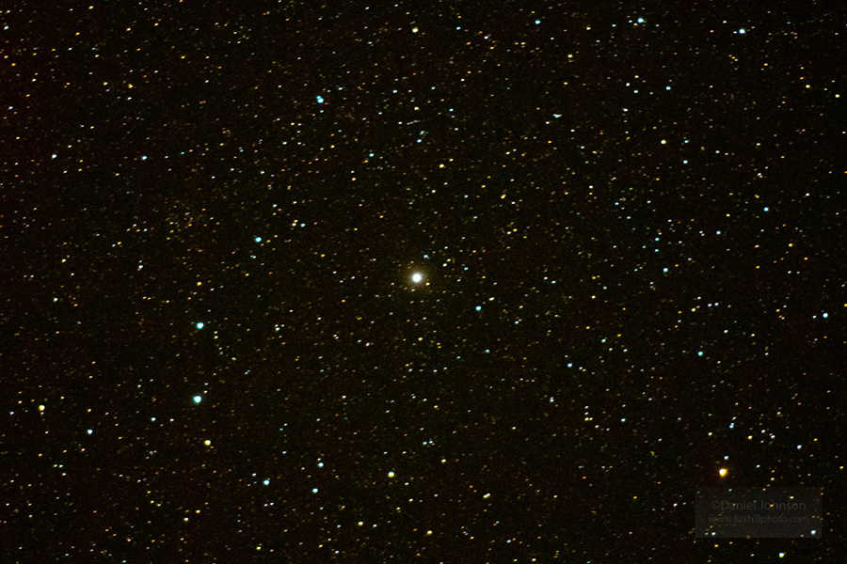

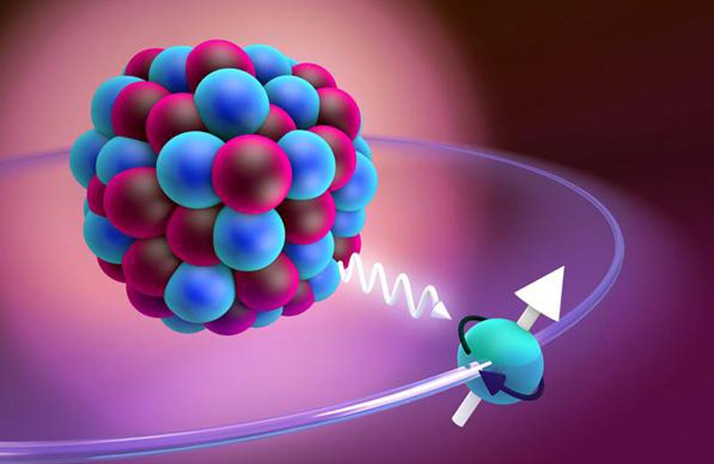


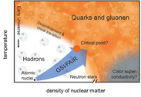

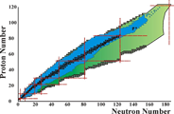
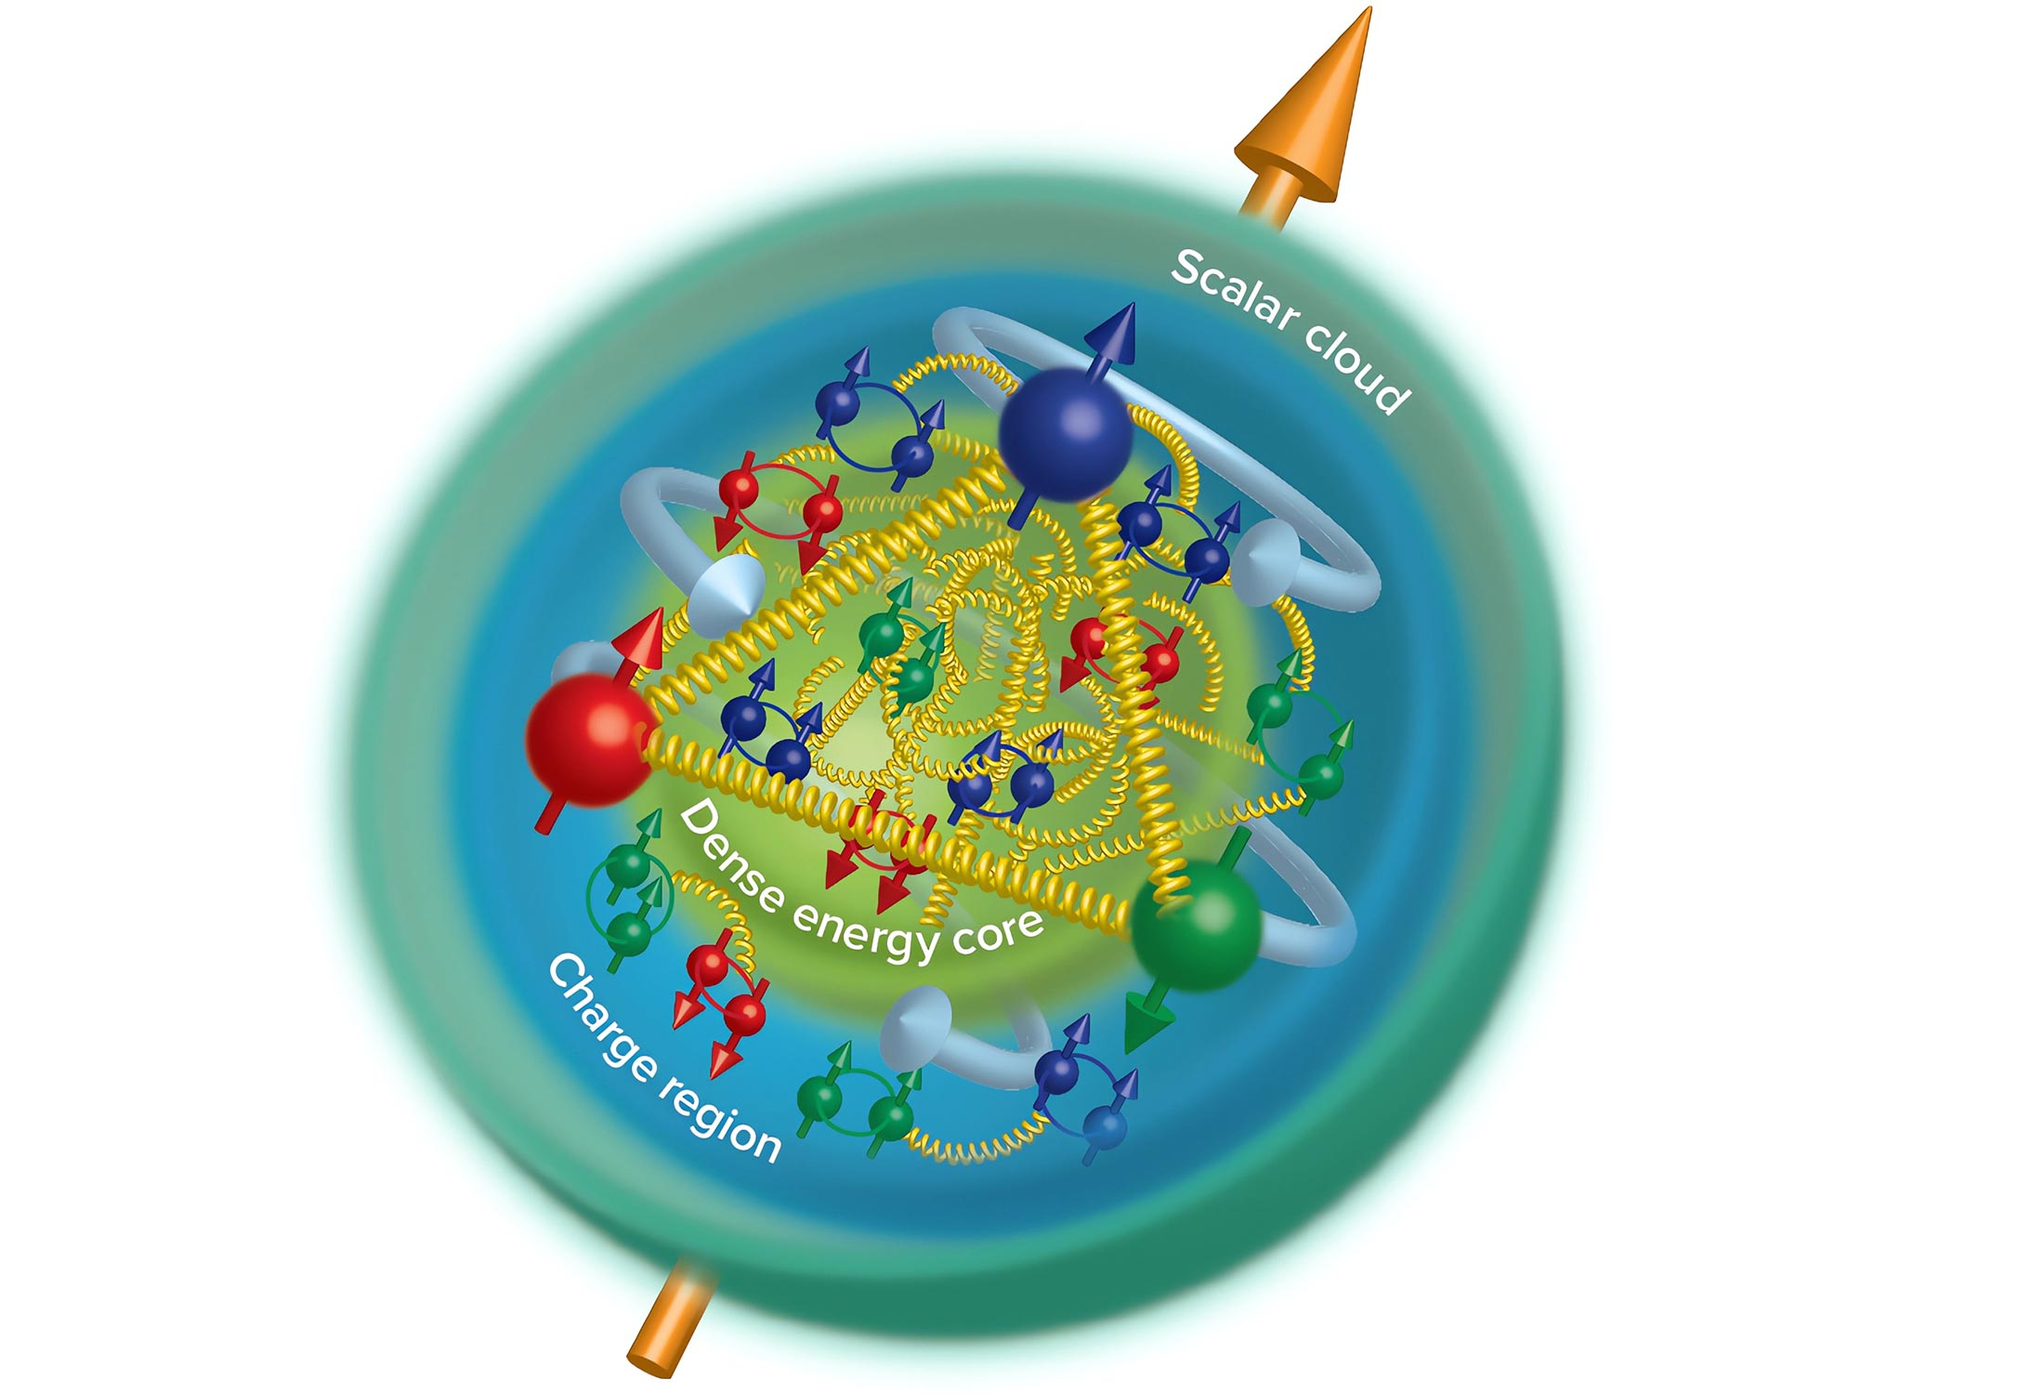

temperature
Precision tests of QED
Cosmic ray simulator for irradiation studies
Materials under high pressure
QCD matter at high baryon densities
Phase transition and critical point
Particles in dense medium
density
Nucleosynthesis of heavy elements
Structure of exotic nuclei (e.g. hypernuclei)
Neutron matter equation of state
Gluonic excitations: Hybrids, glueballs
Precision spectroscopy of charmonium states
Time-like form factors, nucleon structure

Slide 5
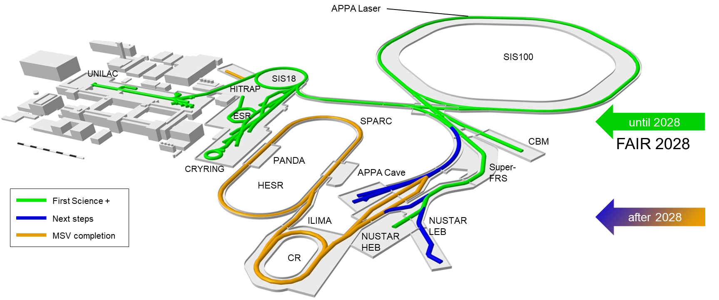
Our vision for the future: FAIR 2028
FAIR in 2028 will feature the most valuable science program which can be hosted in the FS(+) infrastructure.
The ”FAIR 2028“ science program will include:
APPA experiments at the low-energy rings, at SIS100, at the caves at SIS18 and UNILAC with and at PHELIX and a limited set of experiments which could be hosted at all the caves served by SIS100
NUSTAR at the Super FRS with SIS100 beams, plus SHE and MATS experiments at UNILAC and ILIMA at the low-energy rings
CBM at the new cave with SIS100 beams, and HADES at SIS18
PANDA is developing a hadron physics program to be carried as bridge towards the program with antiprotons, when possible using the caves and beams available at GSI/FAIR and synergies with other experiments.
→Research Strategy for the integrated FAIR/GSI campus
Thomas Nilsson | MAC-28

Slide 6
Research Strategy Meeting for the integrated FAIR/GSI campus, July 2025:
Priority 0:
overarching priority is the scheduled completion of the facilities for
Early Science,
First Science
and First Science +
→ FAIR 2028
permitting world-unique Research
200 days of physics beam time annually from 2029
FAIR2028
Early Science (ES)
First Science/+ (FS/FS+)
200 days/y
>5 y SIS100
UNILAC/Rings

Slide 7
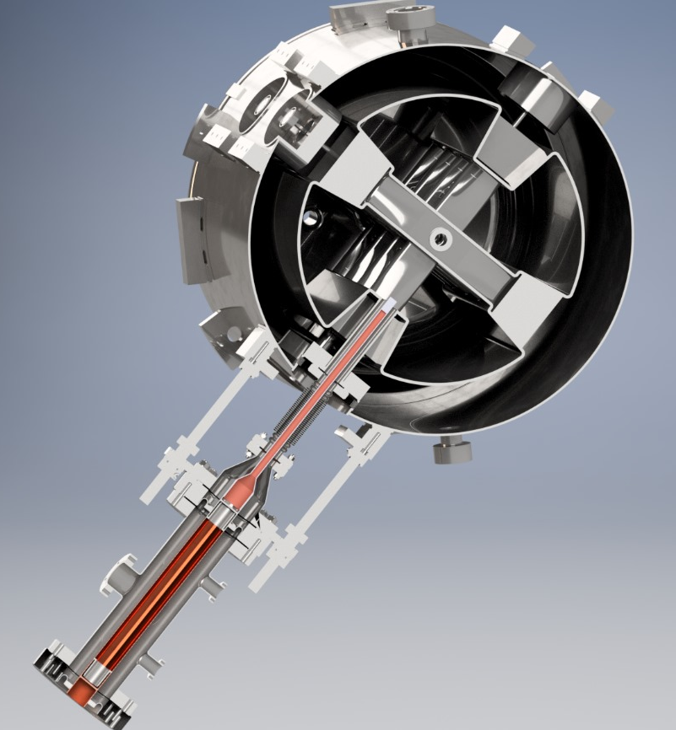
Research Strategy Meeting for the integrated FAIR/GSI campus, July 2025:
Priority 1:
Research at the installations of First Science ++
Commissioning of the Low Energy Branch and APPA Caves
Realisation of HELIAC for Material Research, and Superheavy Elements

Slide 8
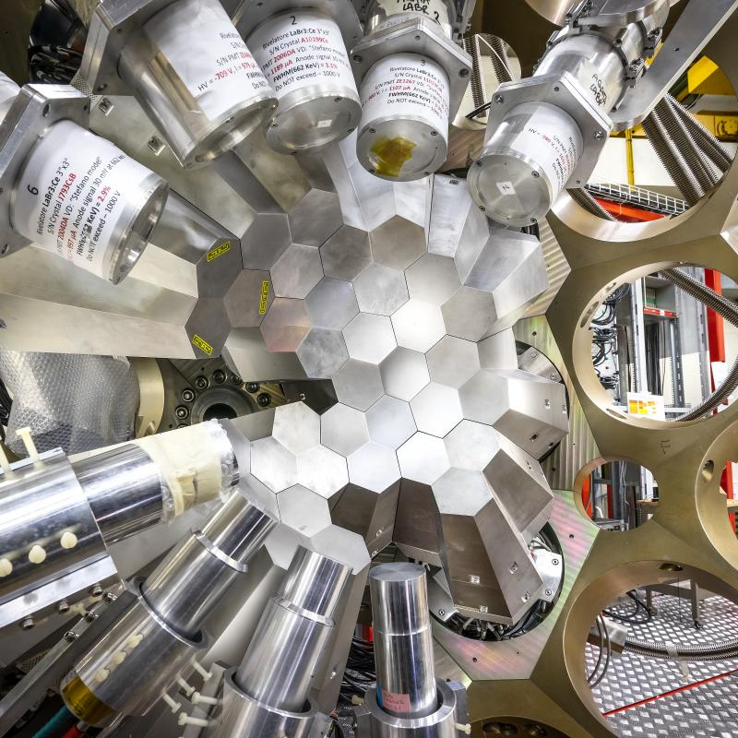
Research Strategy Meeting for the integrated FAIR/GSI campus, July 2025:
Further goals: Research with
Uranium intensity increased by a factor of 5 PHELIX successor for laser physics AGATA in the NUSTAR Low Energy Building from 2032 Thorium beam
At least five years of operation with SIS100 before installing the Alvarez 2.0

Slide 9
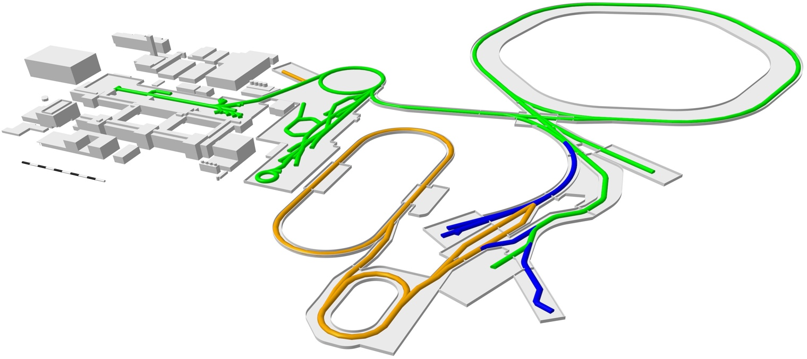
Long-term goals
APPA Laser
SIS100
UNILAC
SIS18
HITRAP
ESR
SPARC
CBM
CRYRING
PANDA
Super-FRS
APPA Cave
HESR
First Science +
after 2028
Next steps
ILIMA
NUSTAR LEB
MSV completion
NUSTAR HEB
CR
First priority: Make use of available buildings

Slide 10

FAIR Phase-0 Scientific Programme
up to 90 % speed of light
Started in 2019, annual runs of ~110 days until FAIR operation
Supported by FAIR partners, so far:
Finland, France, Germany, (Romania*), Sweden and the UK
Ion species: H⁺,..., U⁹²⁺
heavy-ion synchrotron
SIS 18
linear accelerator
UNILAC
PHELIX
M-branch
Z6
Fragment Separator
*Romania contributed 2019-22
Harvesting rich results of data taking
Beam time 2025
Extremely successful data taking for experiments and machine studies
Record number of physics days
Minimal downtimes
HHT
Ion
sources
storage ring ESR
8 % - 15 % speed of light
X0
SHE
HITRAP
HADES
Cave A
miniCBM
R3B
CRYRING

Slide 11
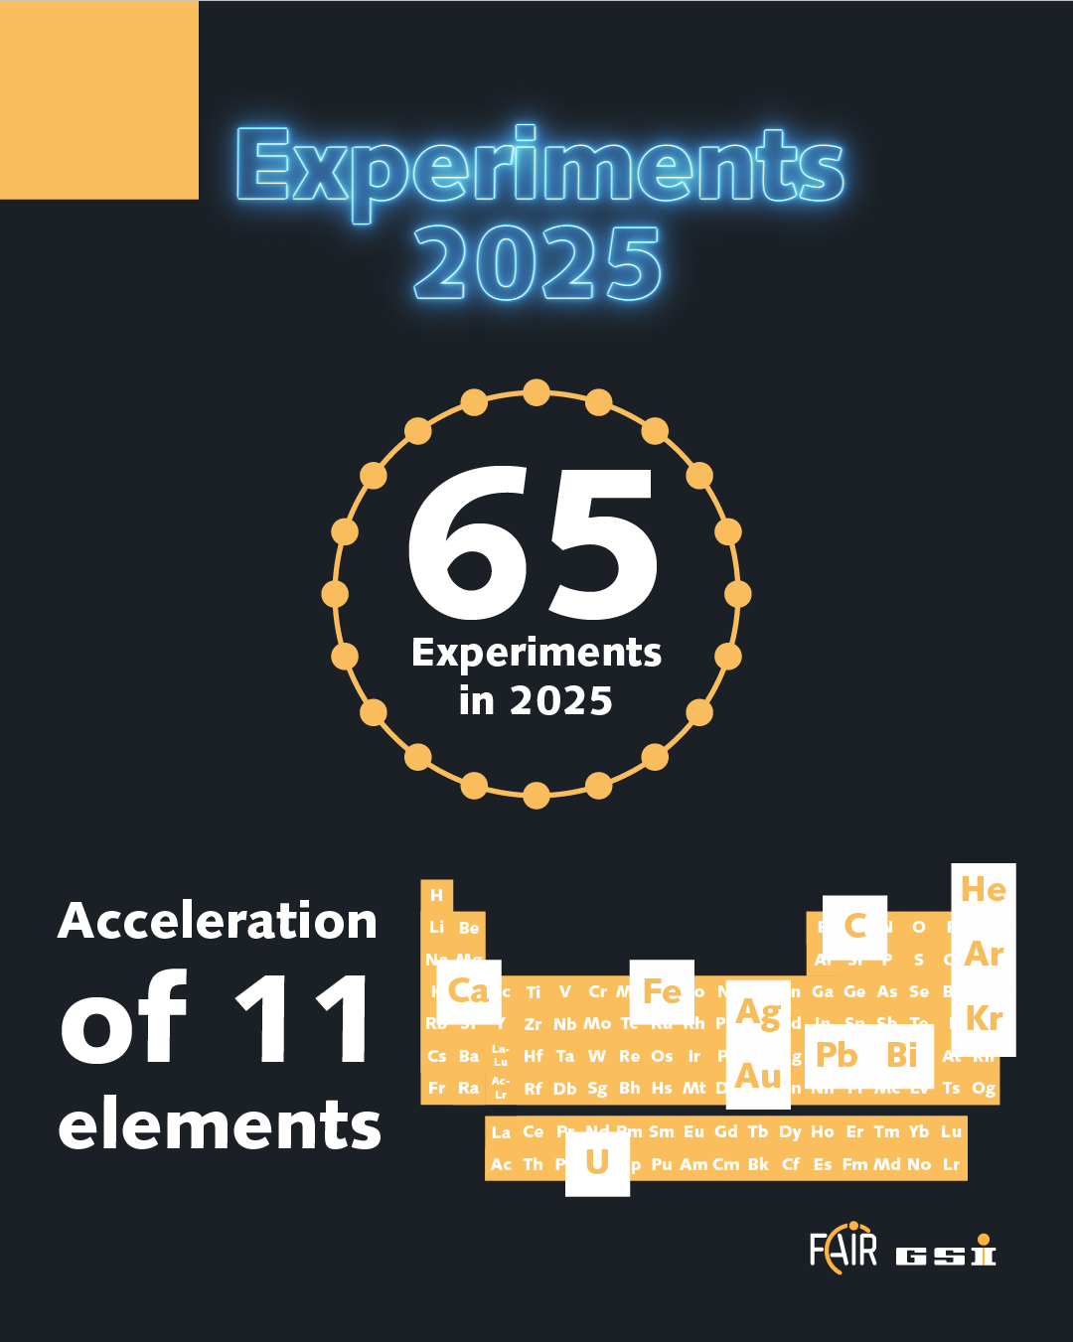
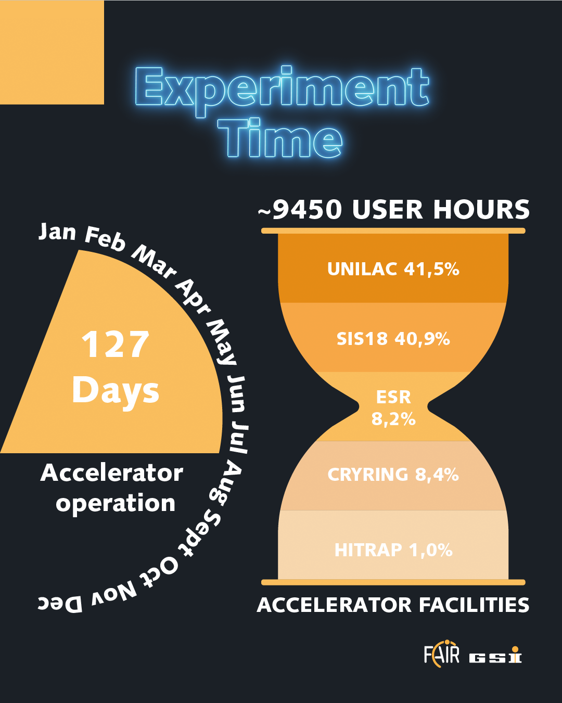
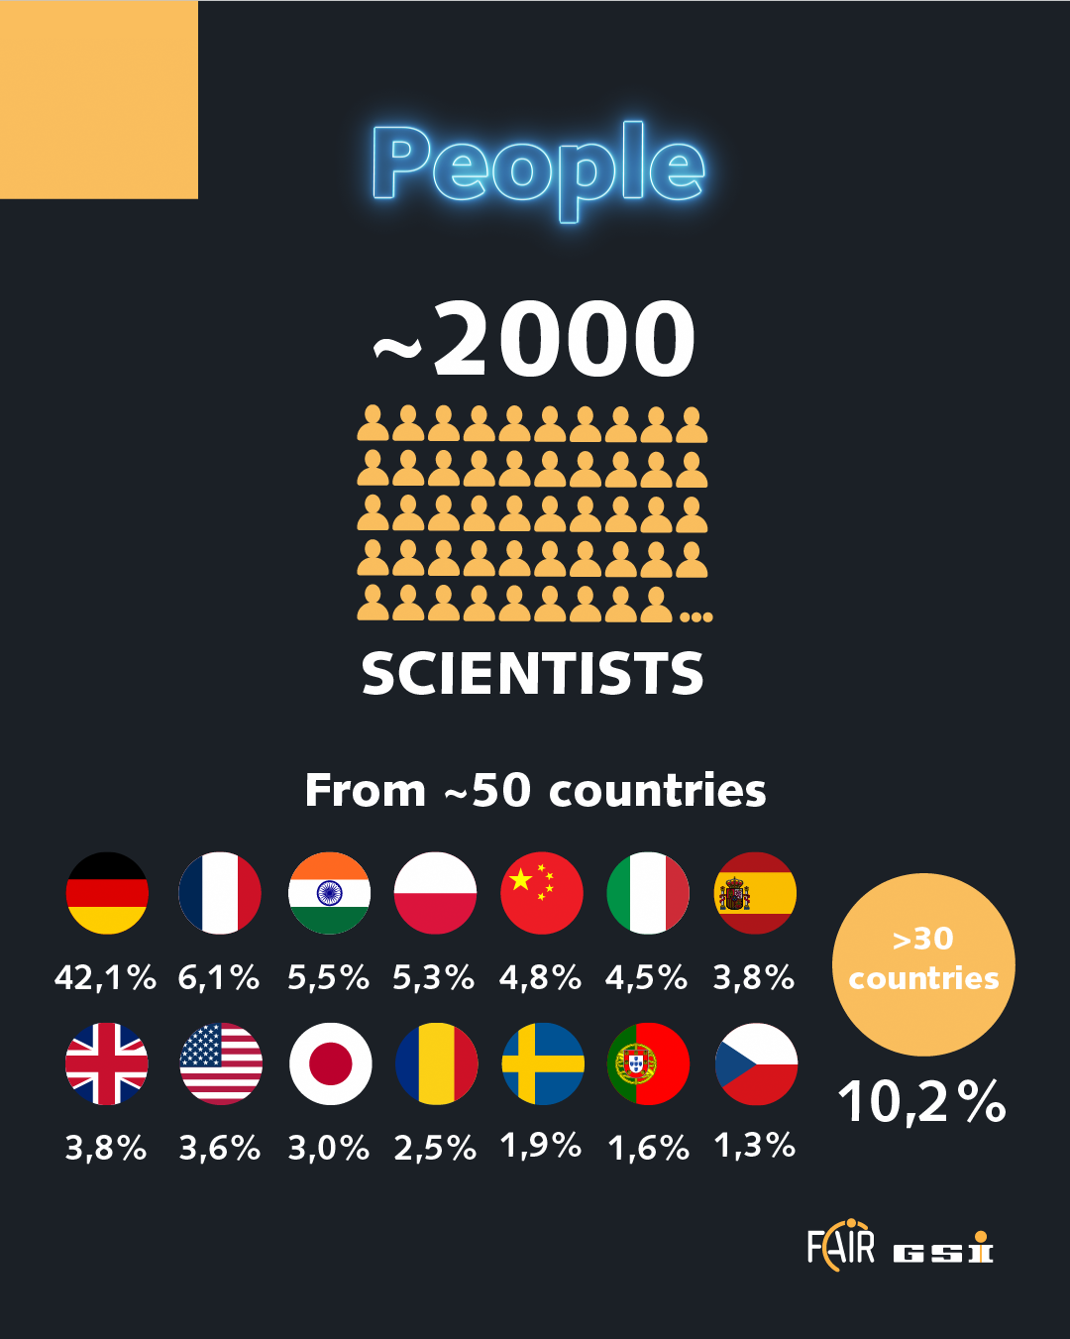
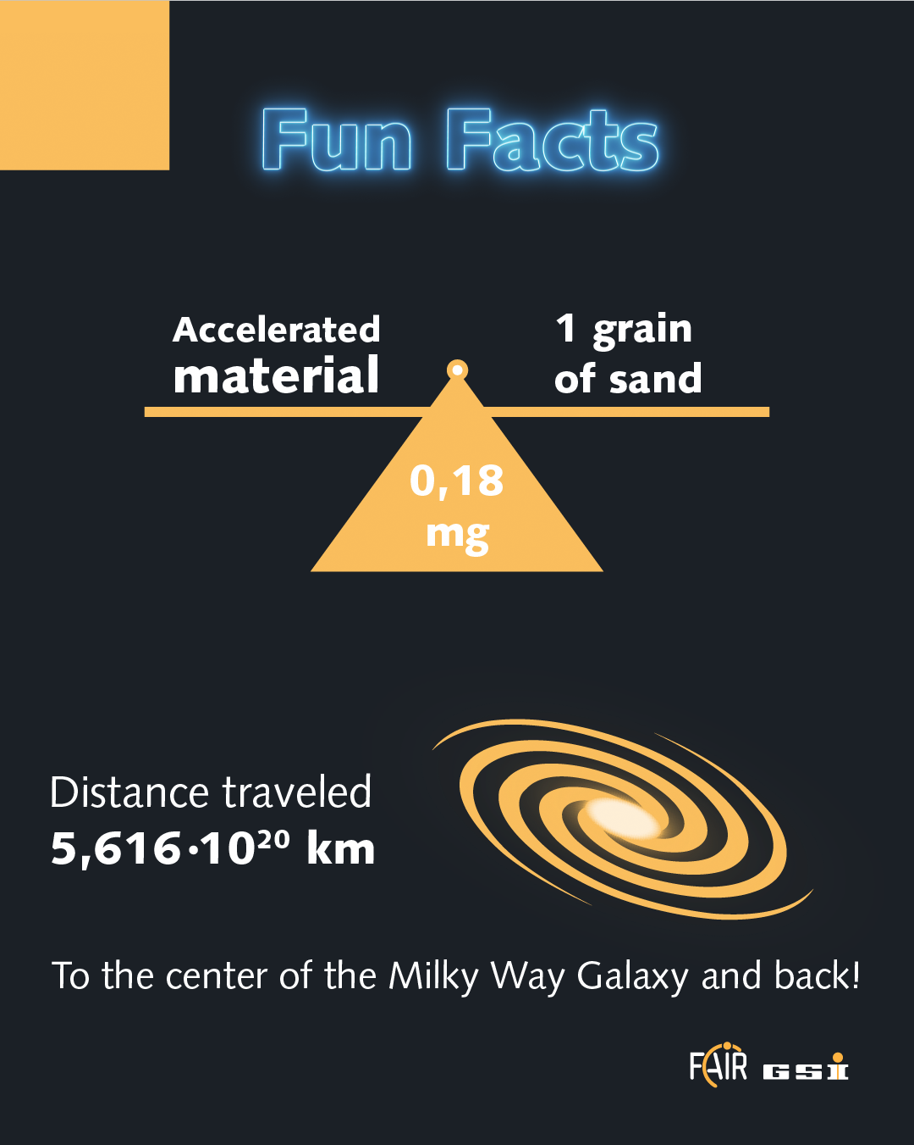
Beam Time 2025 – publicity figures

Slide 12
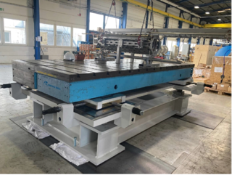

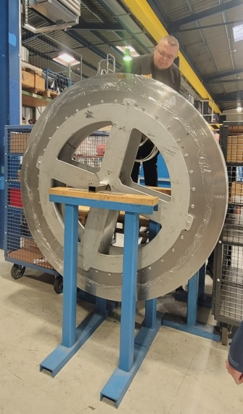
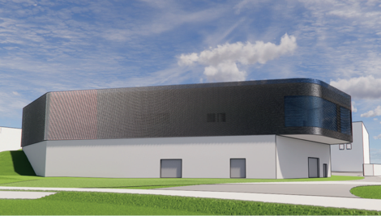

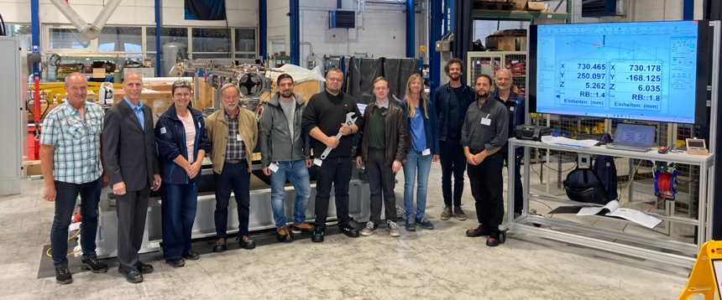
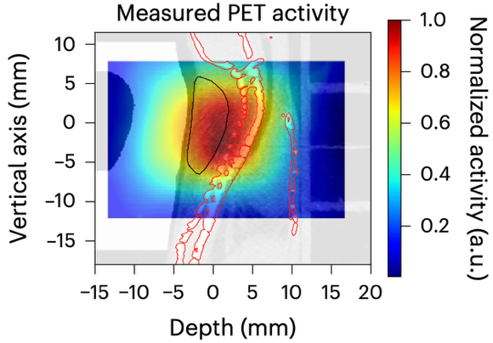


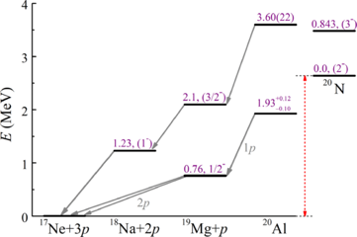
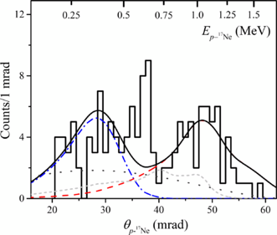
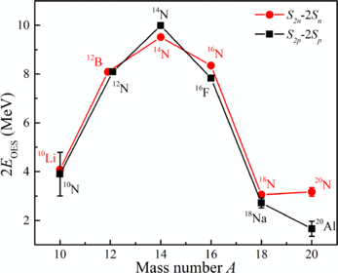
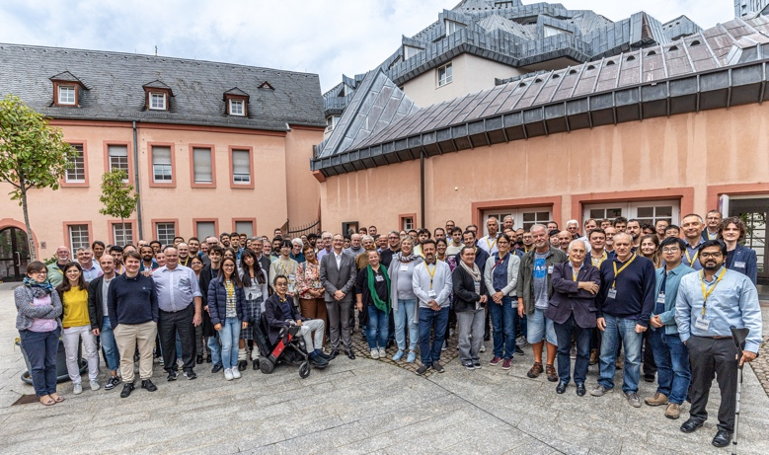

Major Experiment Highlights
CBM Magnet:
FAT of magnet support
first dipole coil impregnated
Laser-Building planned
next to APPA Cave within EU- financed project THRILL
APPA/NUSTAR
Nature publication for Biophysics (ERC grant)
NUSTAR
Discovery of new isotope 20Al – 3-proton emitter – Isospin breaking
RICH Conference in Mainz in Sept 2025
strong participation/leadership of the PANDA collaboration

Slide 13
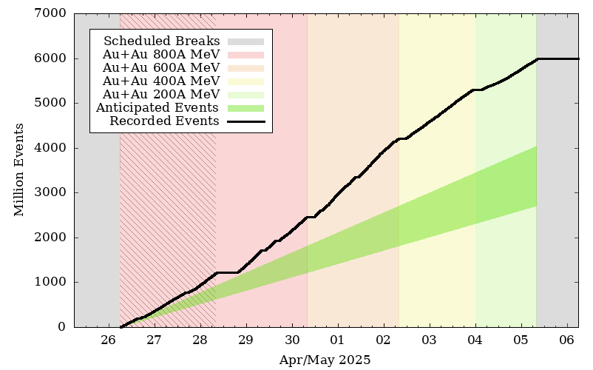
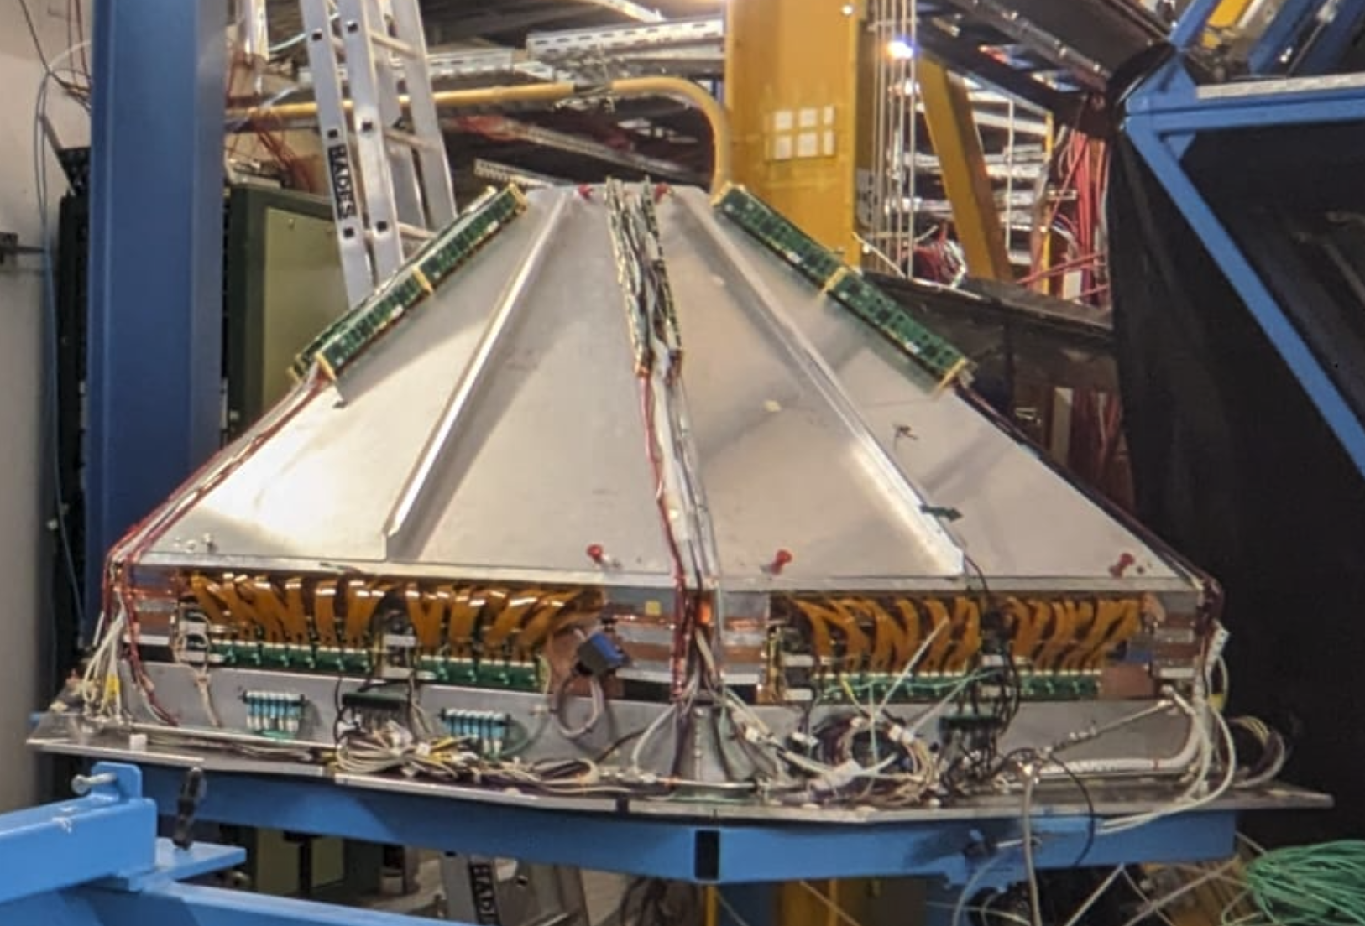
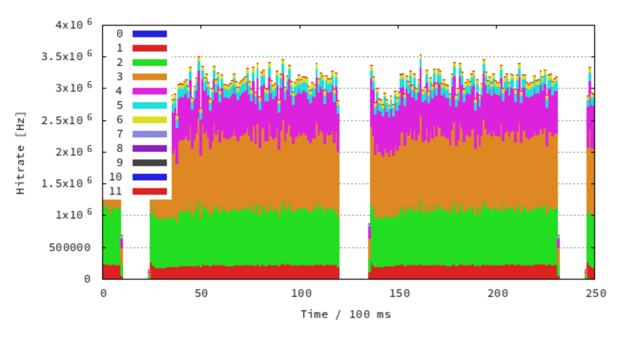
Beamtime highlight
HADES run successfully completed
“Au+Au BES completed with anticipated statistics despite shorter run time”
New SOS system enabled event rates about a factor two larger than without! (duty factor and micro spill improved)
5.9 Billion events in 11 days (33.5 shifts)
Four different beam energies investigated
Successful repair of broken cold box in time for run
FEE replaced with newly designed boards for the two inner tracking planes (MDC I & II)
Coloured bands: 800, 600, 400 200 A MeV (from red to light green)
Hatched area: weekend before scheduled beam time
Green wedge (anticipated statistics): lower boundary rate assumed in proposal (w/o SOS and FEE upgrade), upper boundary includes maximum expected gain after upgrade of FEE (w/o SOS).

Slide 14
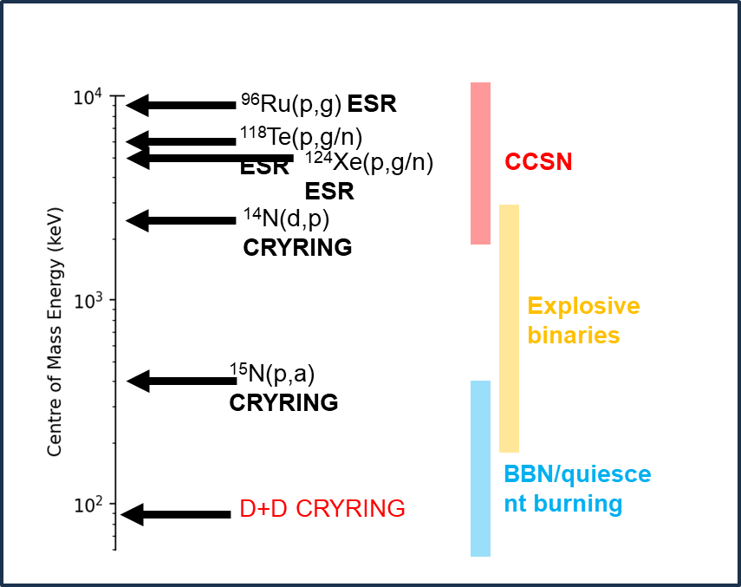
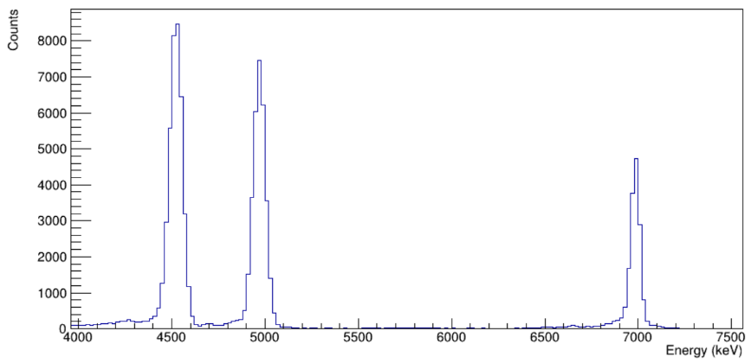
Beamtime highlight D+D reaction cross section at the Gamov Window
All reaction products of interest observed
Statistics of 1-2% for the majority of energies, including those within the Big Bang Nucleosynthesis energy range down to 90 keV/u
Initial luminosity calculations suggest a factor 1000 increase compared to measurements in 2024!
Analysis ongoing to understand systematics and calculate luminosity with required precision
³H
³He
¹H

Slide 15
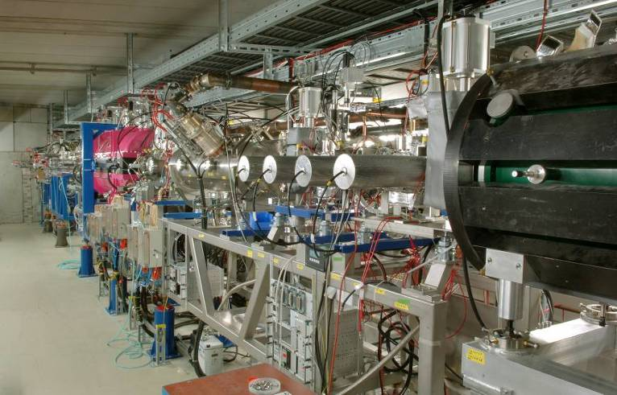
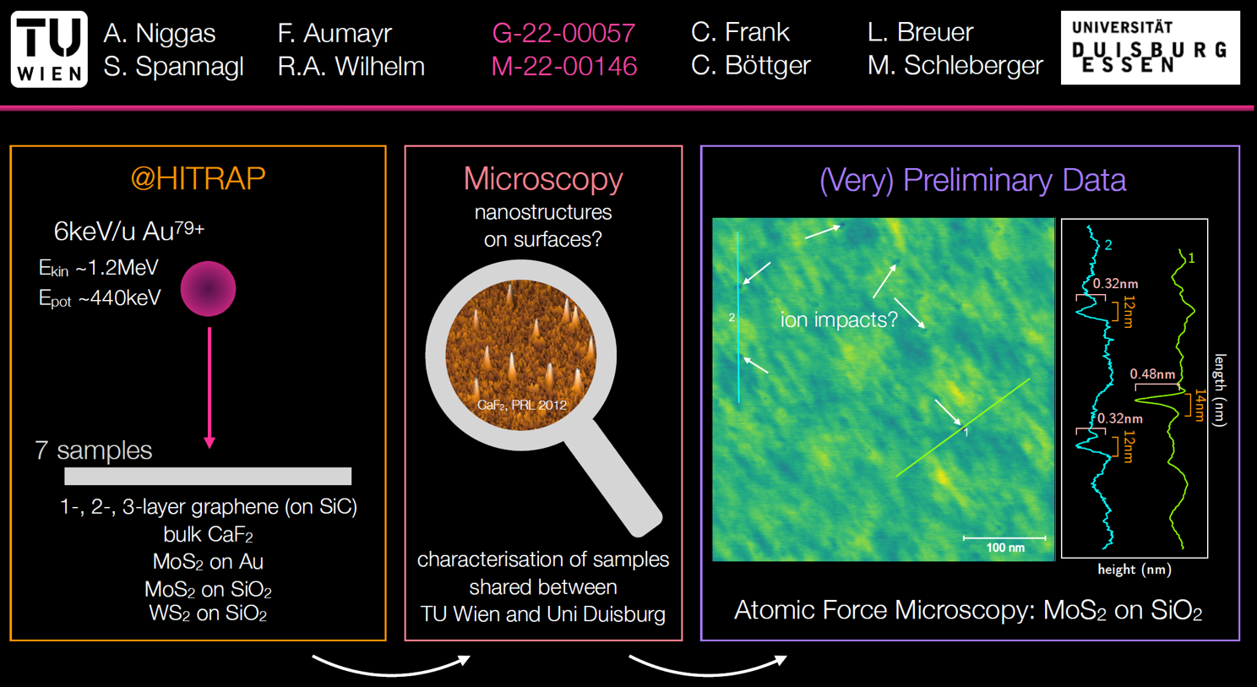


HITRAP: First Experiment with Decelerated Bare Ions at High-Z
Beamtime 2025: Nanostructuring of monolayer graphene using slow heavy ions at high charge states (G-22-00057)

Slide 16
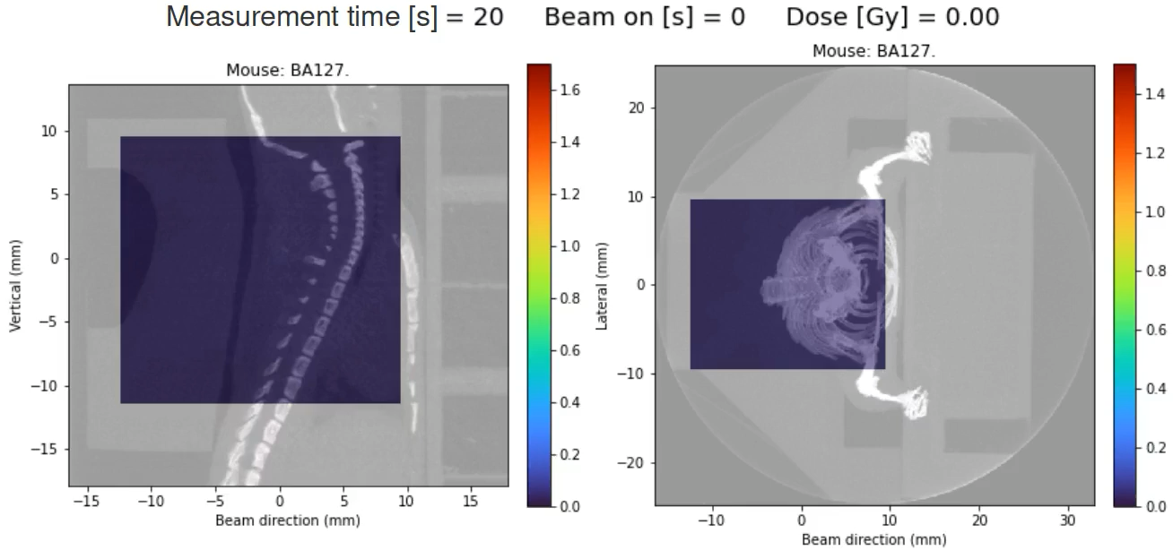
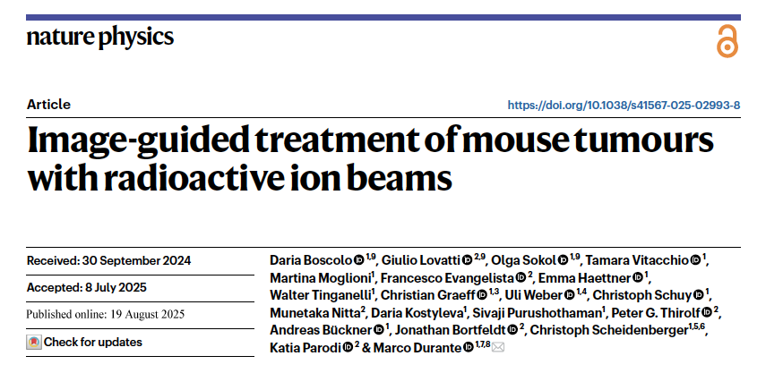


Scientific highlight First image-guided treatment in vivo with radioactive ion beams
Boscolo et al., Nat. Phys. 19.8.2025

Slide 17
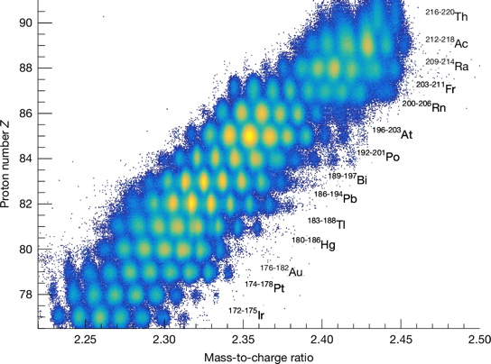
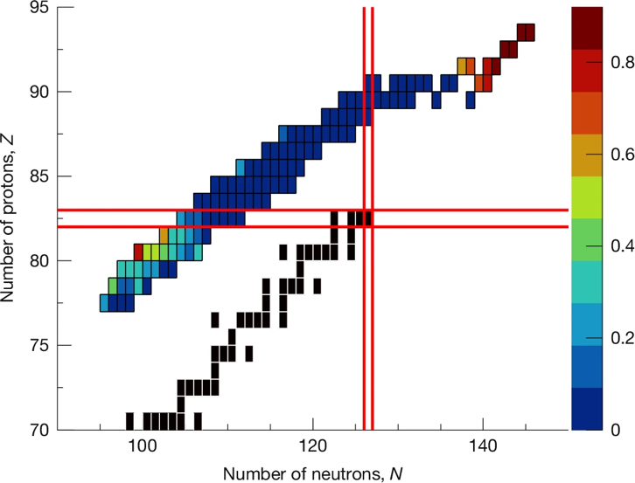

Some highlights … New island of asymmetric fission
Fission of exotic nuclei
Important in r-process nucleosynthesis: fragment distributions + fission barriers
Experiment: Charge distributions for for 100 neutron-deficient isotopes produced in Coulomb fission
New asymmetric fission island in the sub-lead region discovered
Map of evolution of asymmetric fission
First Science at R³B
(p,2p) induced fission enables measurement of excitation energy (-> fission barriers)
Charge- and mass-distributions + fission barriers towards r-process nuclei
P. Morfouace, Nature doi:10.1038/s41586-025-08882-7 (2025)

Slide 18
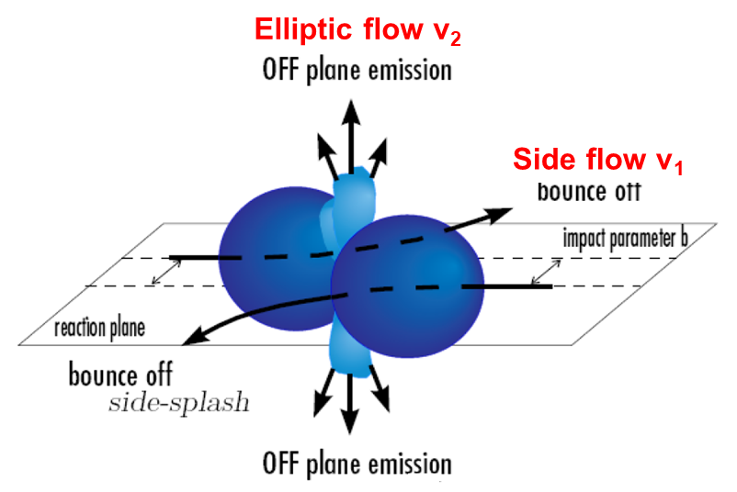
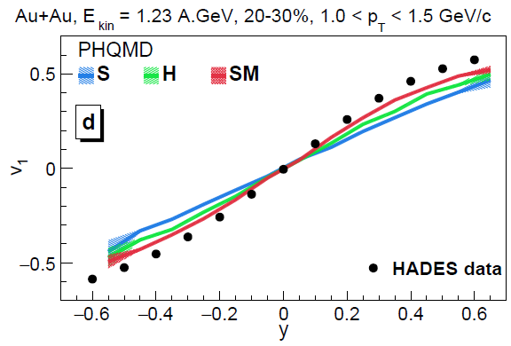
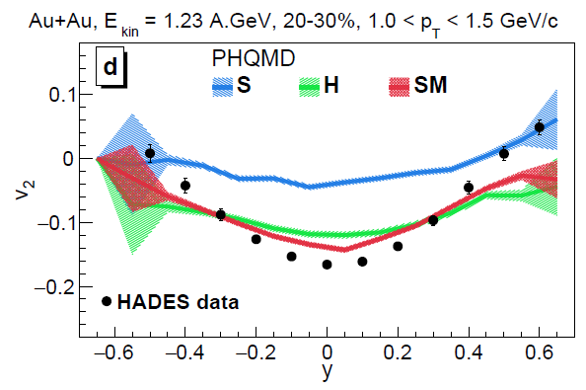

Constraints on the equation-of-state (EoS) of nuclear matter
EoS dependence of v1, v2 of protons and clusters at SIS: PHQMD vs HADES
EoS:
S – soft
H – hard
SM - soft momentum dependent potential
Strong EoS dependence of v₁(y), v₂(y) and v₂(p_{T}) of clusters
HADES data favor a soft momentum dependent potential
V. Kireyeu et al., arXiv:2411.04969

Slide 19
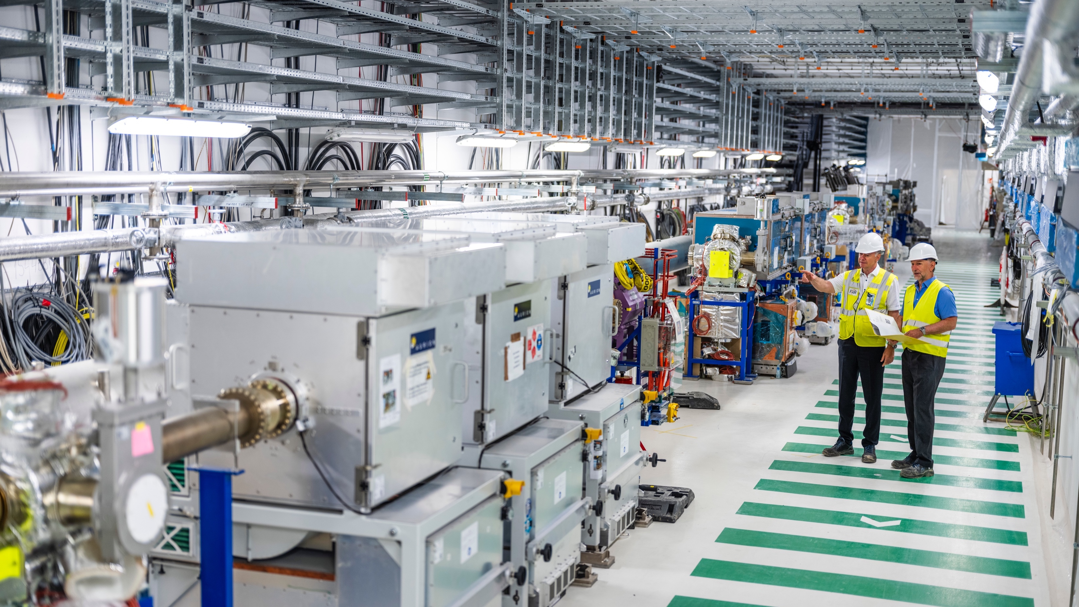


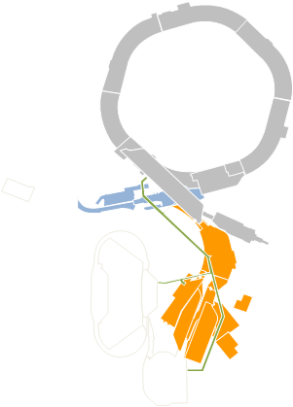
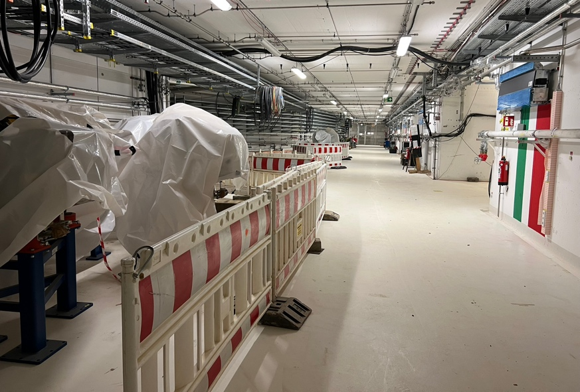
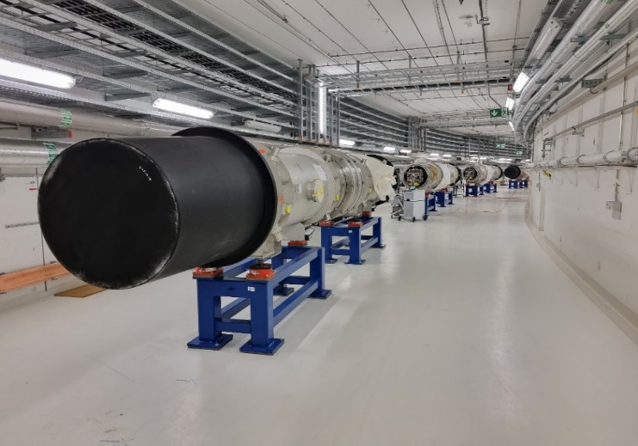
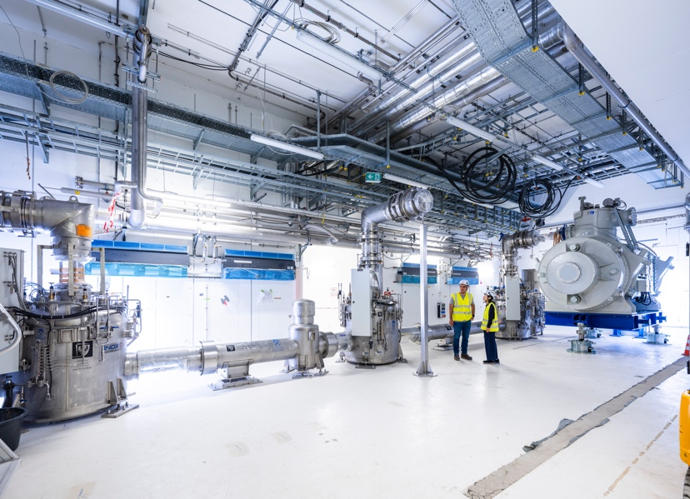
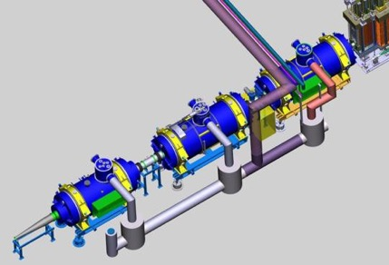
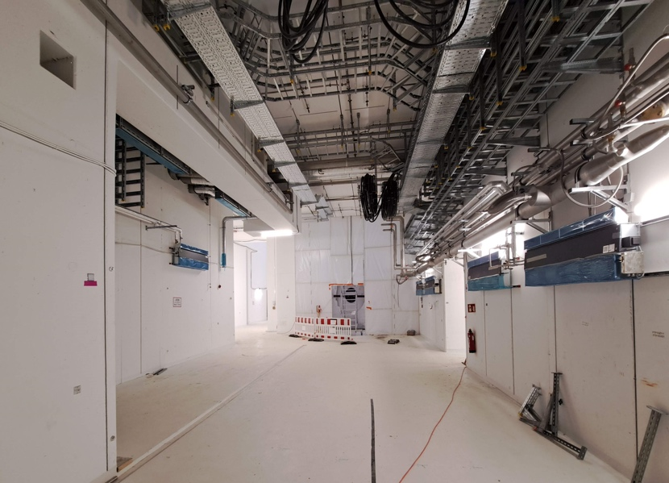
Installation und Start der Inbetriebnahme
Mega-Science-Projekt FAIR: Installation and Start of Commisioning
SIS100
HEBT
Sector 4
HEBT
S-FRS
© J. Hosan, GSI/FAIR
Pre Target Area

Slide 20
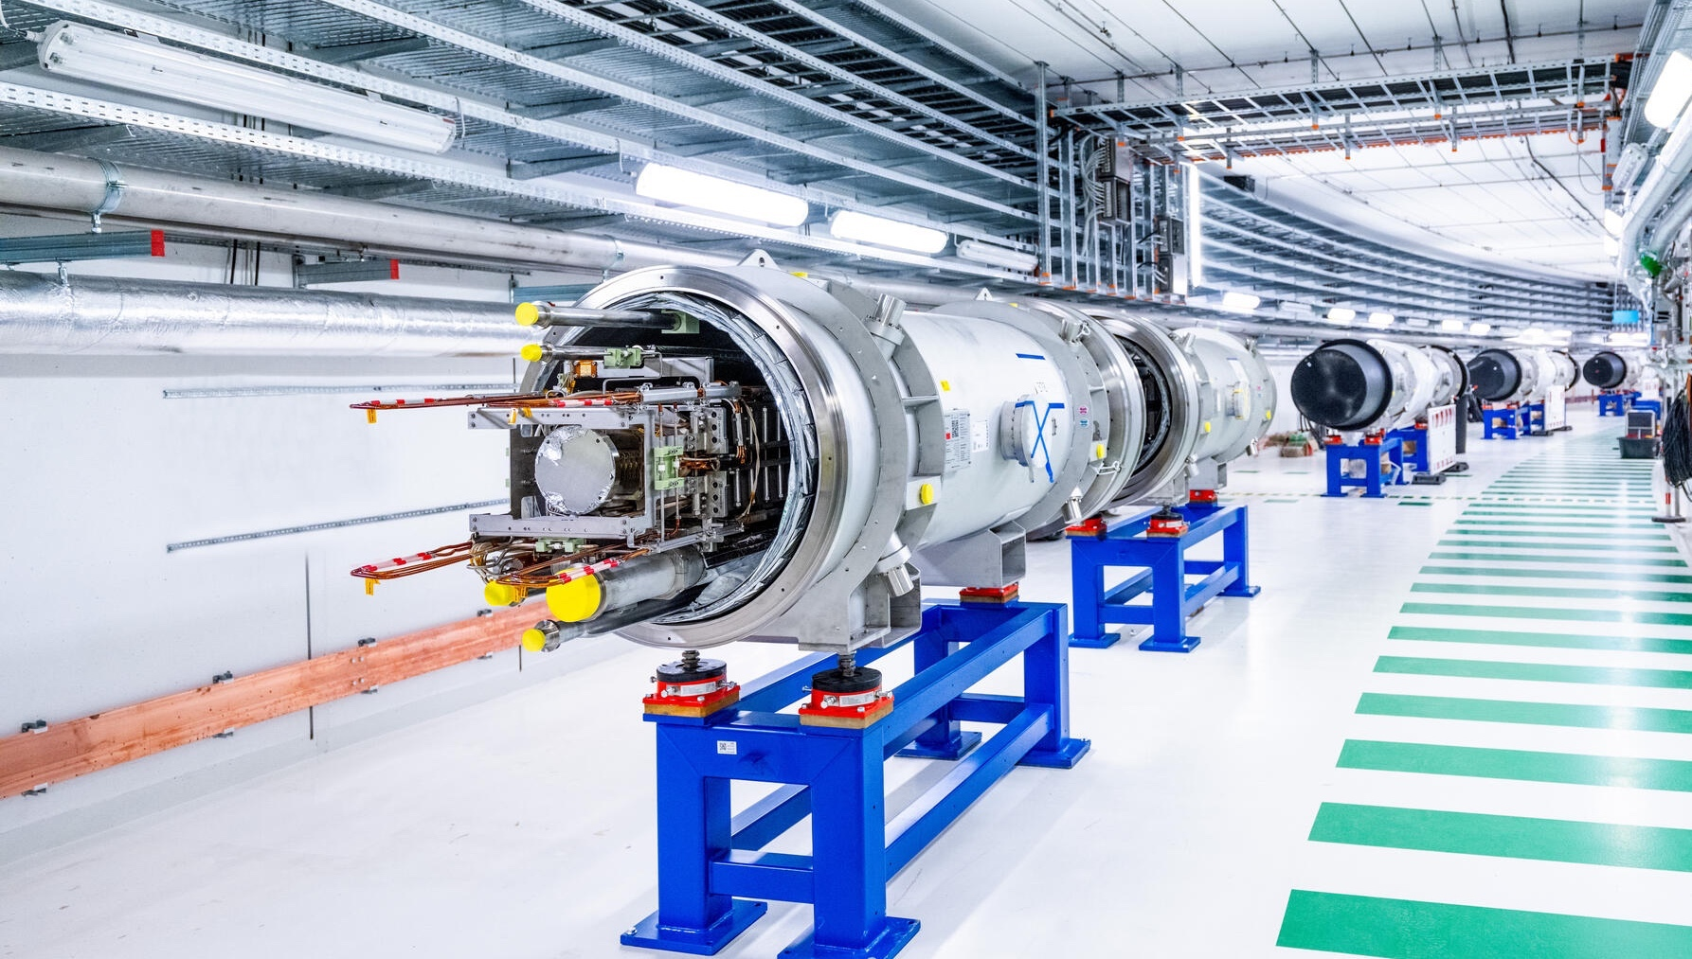
FAIR-Projektstatus: Beschleunigerinstallation im SIS100-Tunnel
Heavy-ion Synchrotron “SIS100”
© J. Hosan, GSI/FAIR
© GSI/FAIR, Zeitrausch
Notes:
Bild neu

Slide 21
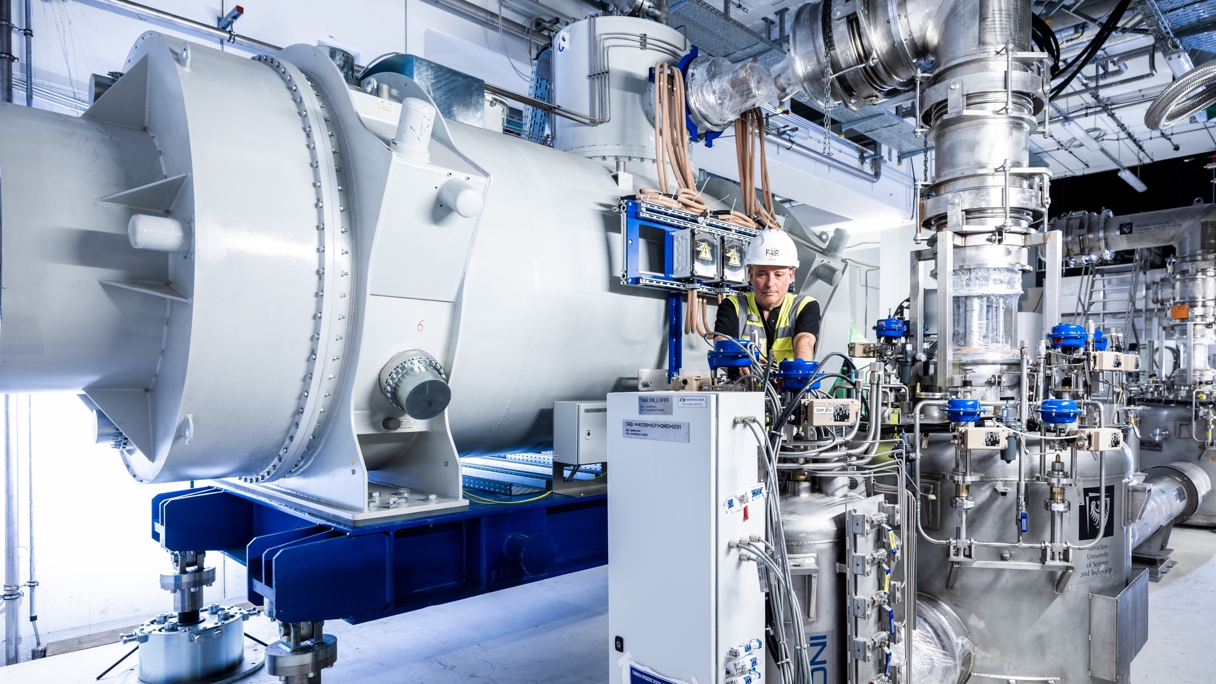
Installation Super-FRS
Super-FRS components
© J. Hosan, GSI/FAIR

Slide 22
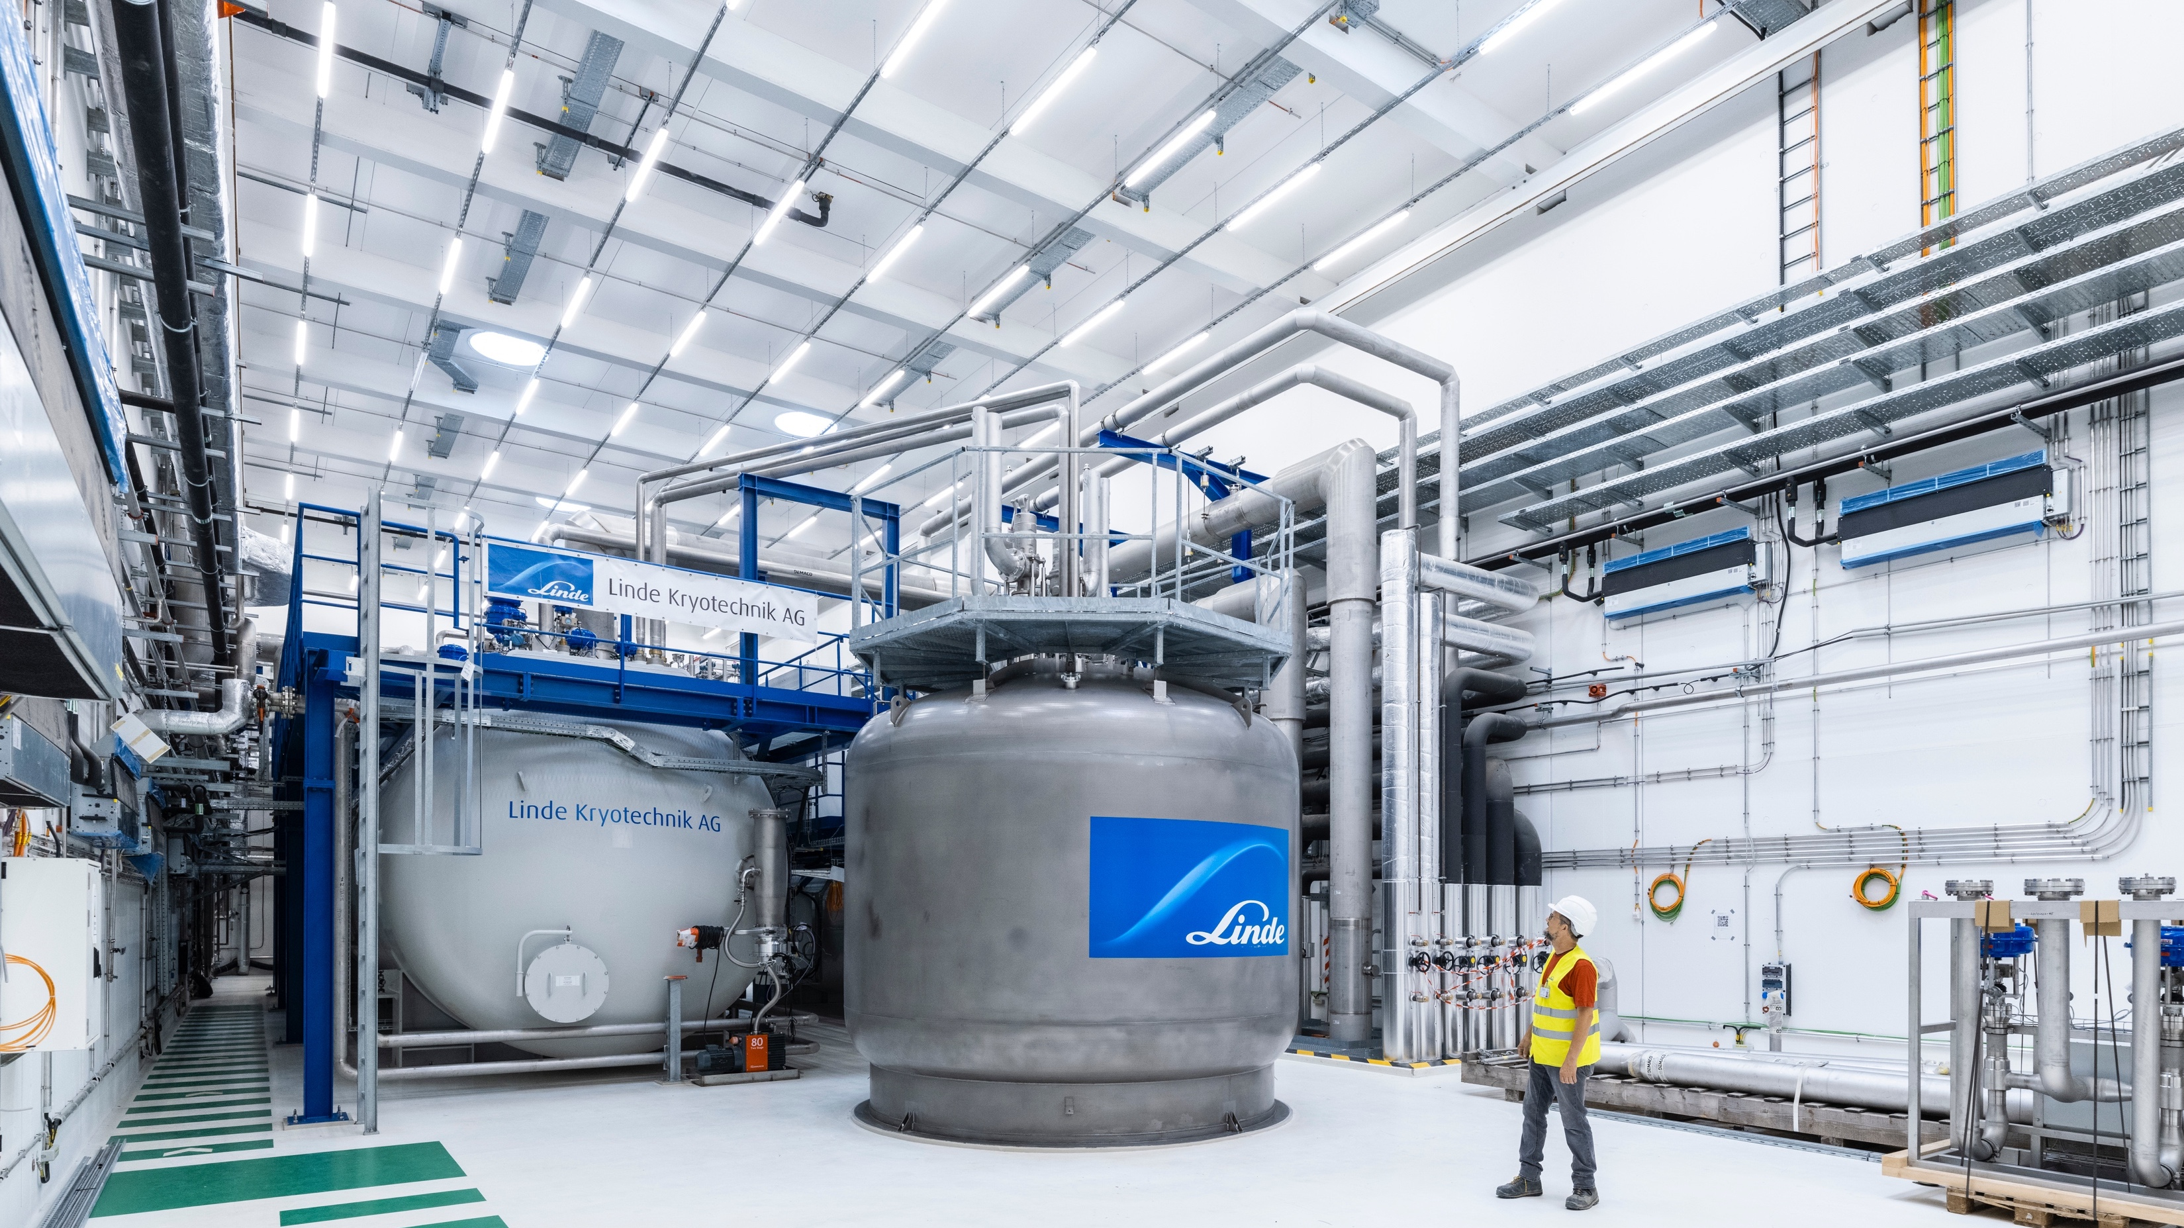
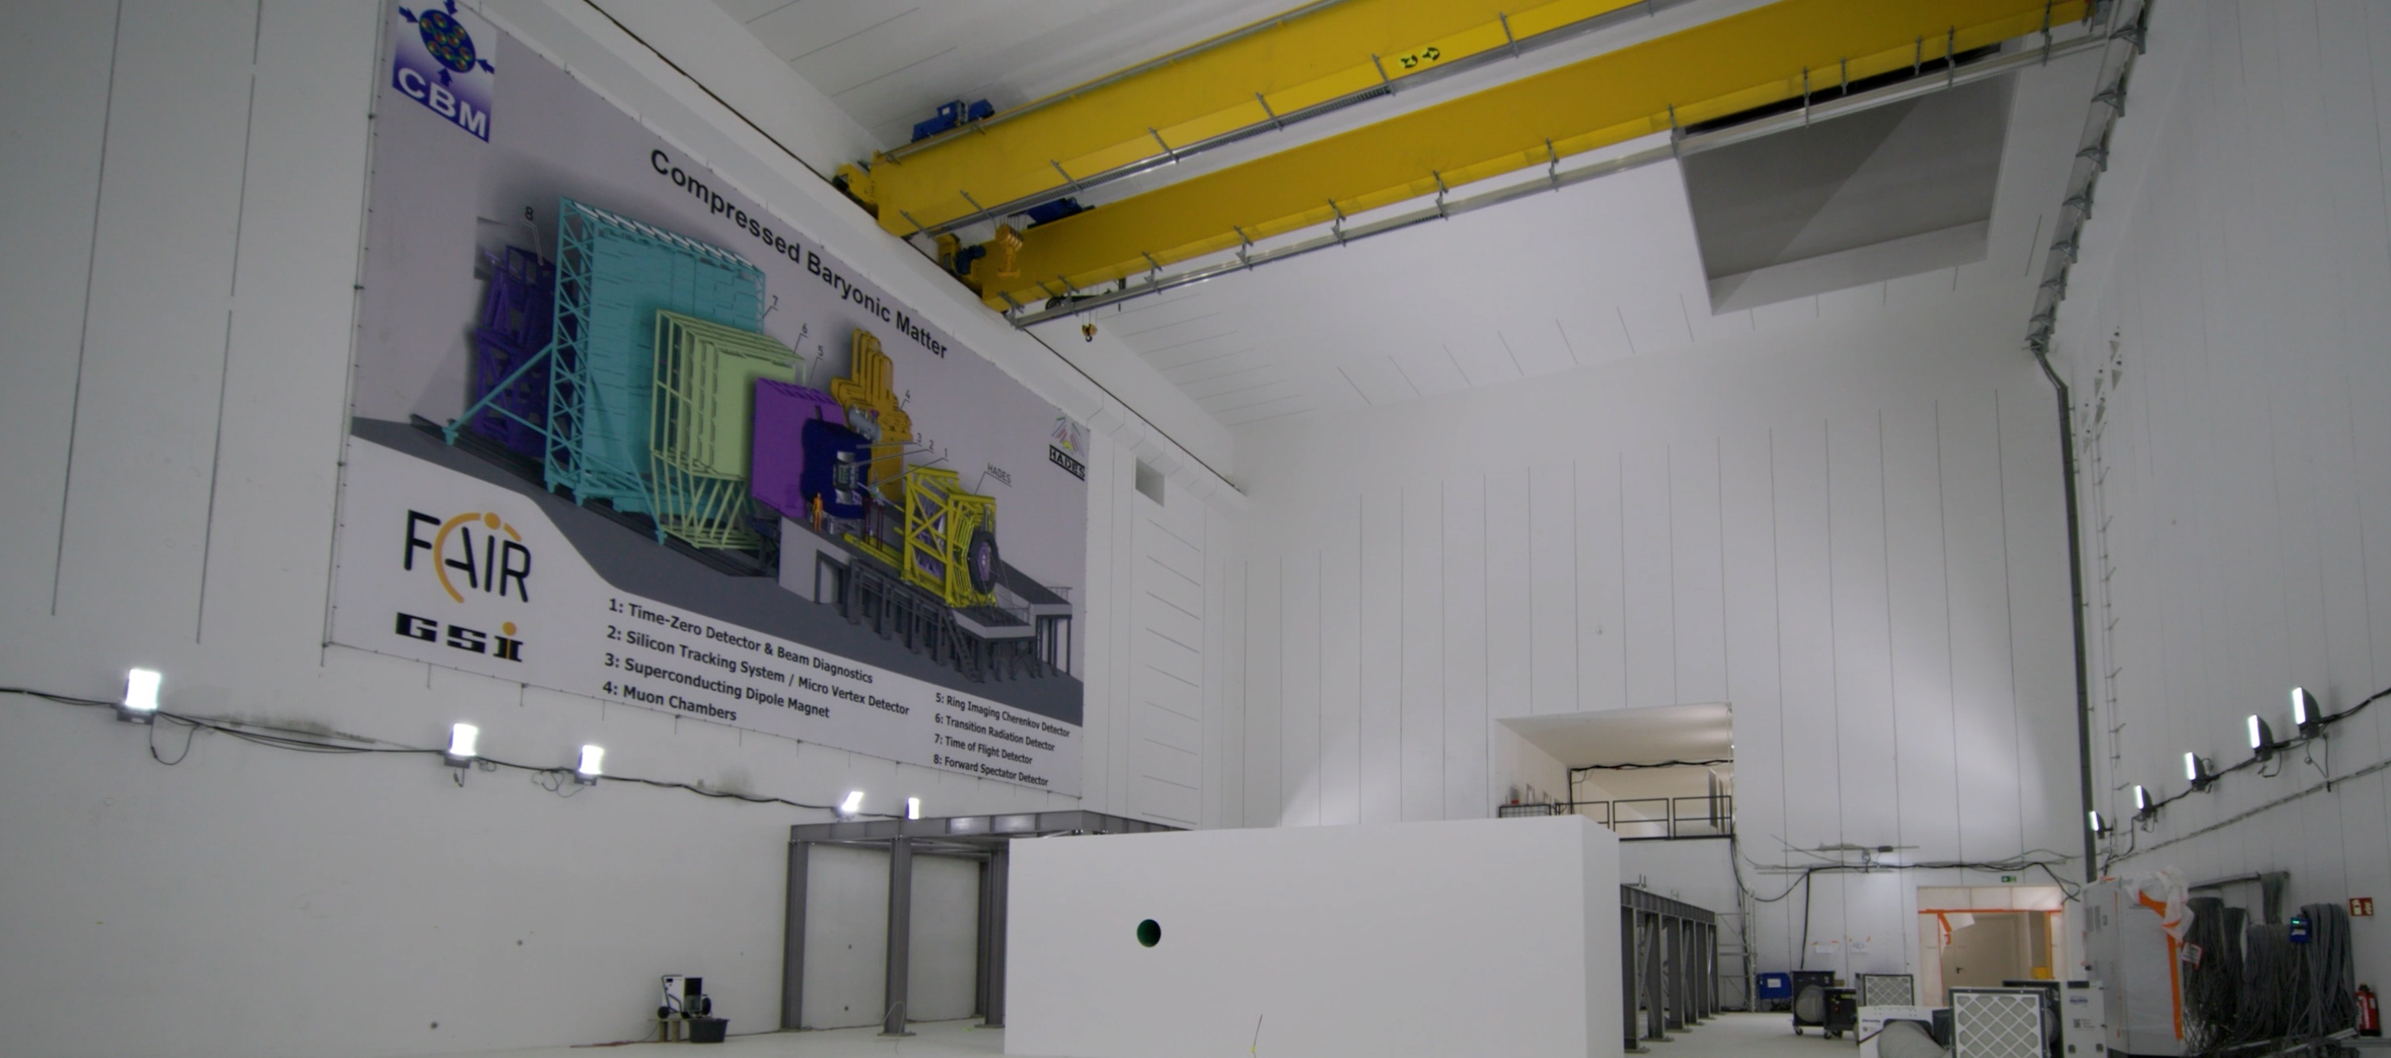
CBM-Experiment
Commisioning Cryoplant
© J. Hosan, GSI/FAIR
© GSI/FAIR; Zeitrausch
Notes:
Zukunft raus

Slide 23
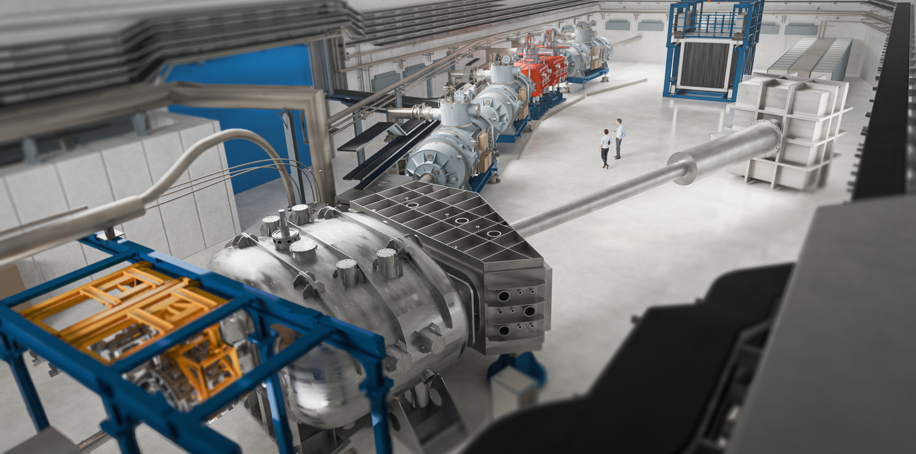
NUSTAR-R3B@FAIR

Slide 24
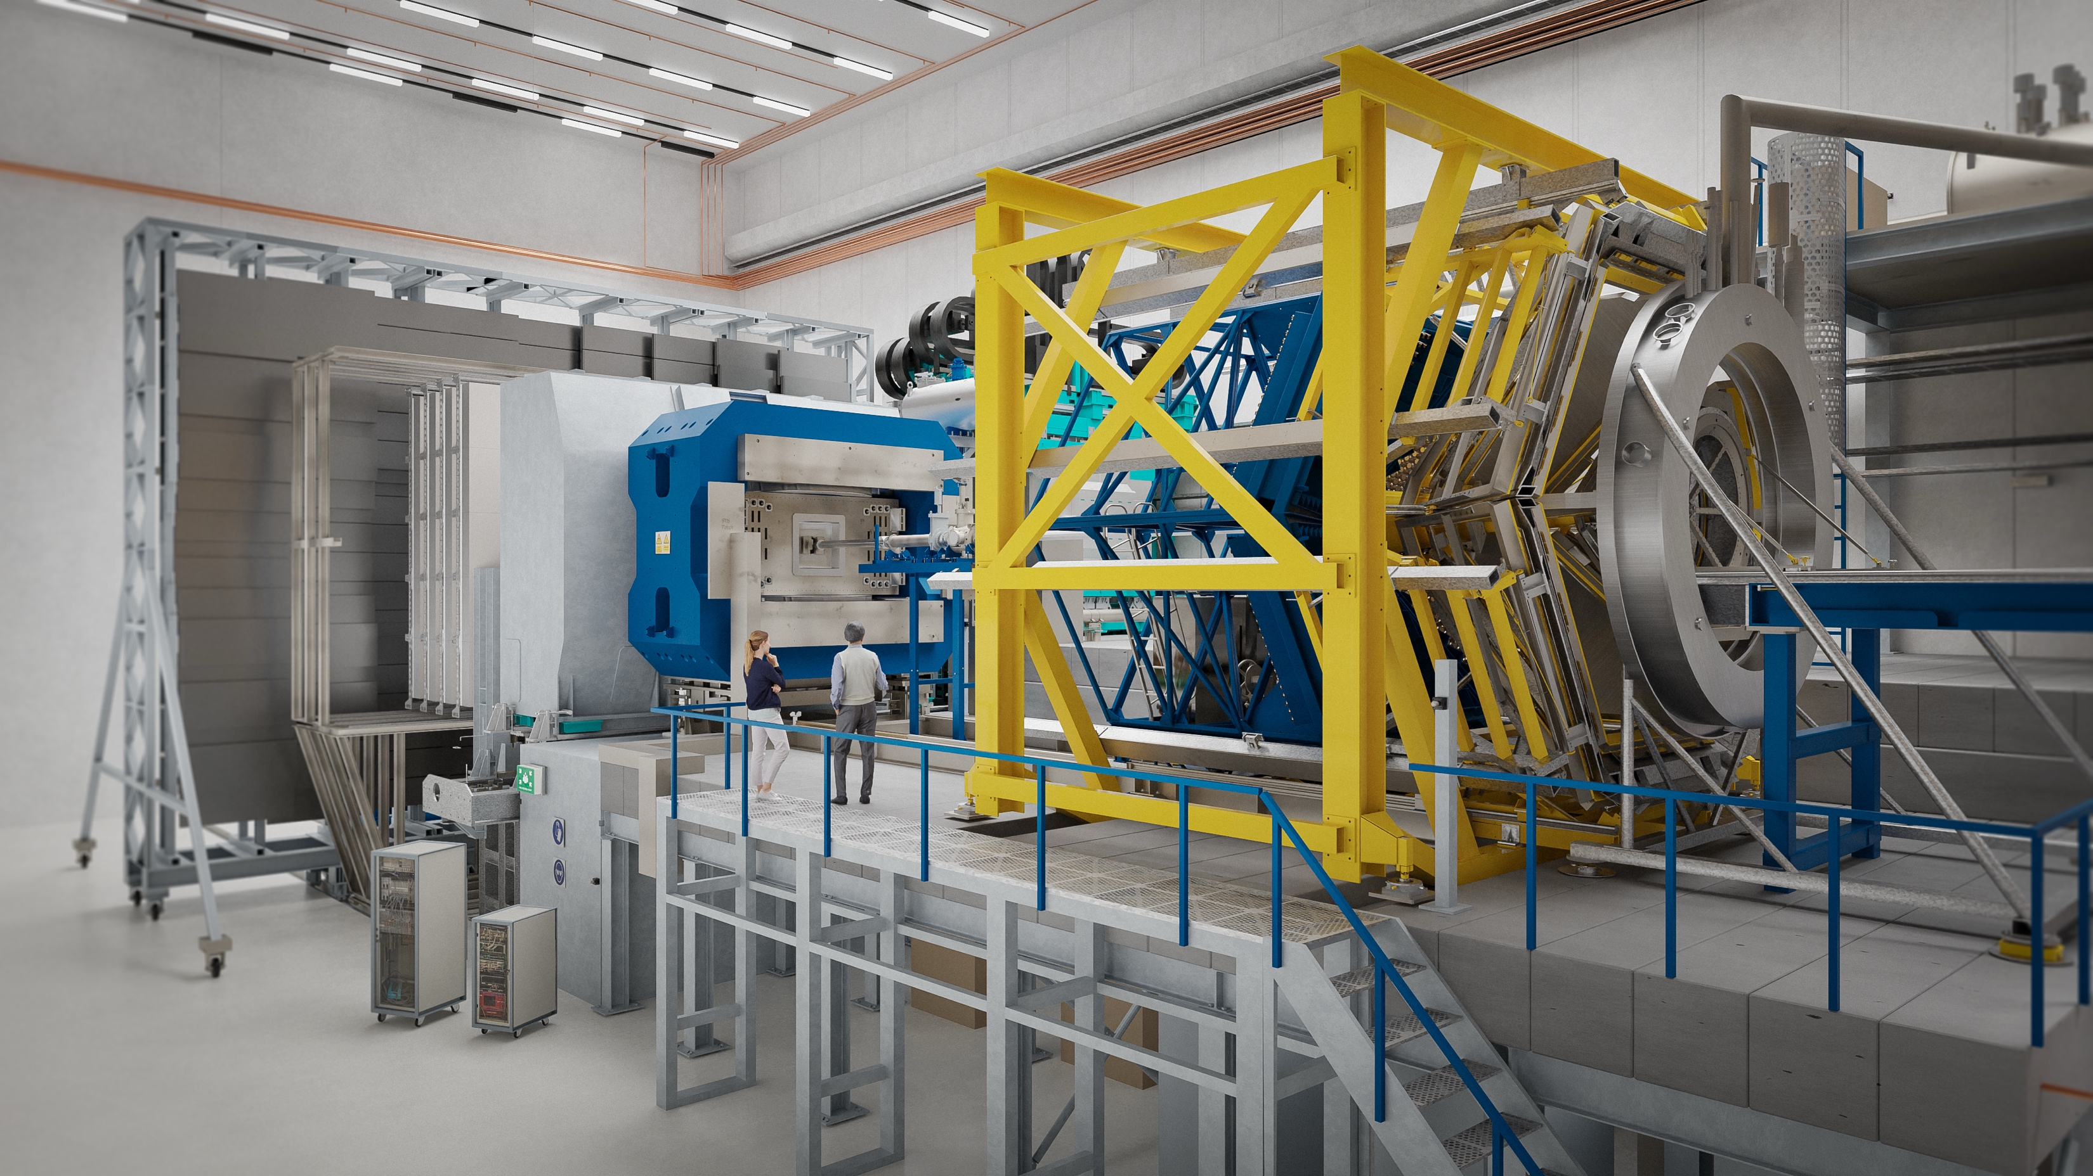
CBM – Compressed Baryonic Matter
© GSI/FAIR, Zeitrausch
Final setup in cave including HADES
Notes:
Welche zukünftigen Möglichkeiten bietet FAIR im Bereich CBM?
Bild: Visualisierung CBM-Experiment an FAIR

Slide 25



Pion- and proton-induced QCD studies at GSI/FAIR Hadron physics
Hadron Physics at GSI and FAIR: Prospects for the Next Decade
Roadmap
Versatile program during the various phases of FAIR
FAIR Phase0: pions/protons at HADES@SIS18
FS+: protons at CBM@SIS100
…towards antiprotons at HESR

Slide 26

GSI in Helmholtz – PoF V (2028-2034)
Centre Evaluation of GSI Science in 2025 very successful
Next step: Strategic Evaluation of the field Matter in Q2 2026
Deutsches Elektronen-Synchrotron DESY, Hamburg and Zeuthen
Forschungszentrum Jülich FZJ, Jülich
Helmholtzzentrum für Schwerionenforschung GSI, Darmstadt HI Jena: Helmholtz-Institut Jena, HIM: Helmholtz-Institut Mainz
Helmholtz-Zentrum Berlin für Materialien und Energie HZB, Berlin
Helmholtz-Zentrum Dresden-Rossendorf HZDR, Dresden
Helmholtz-Zentrum Hereon Hereon, Geesthacht
Karlsruhe Institute of Technology KIT, Karlsruhe
A powerful alliance of world-class laboratories
Thomas Nilsson | MAC-28

Slide 27

German Hightech Agenda
BMFTR has produced a document (in German only)
https://www.bmftr.bund.de/EN/Research/HightechAgenda/HightechAgenda_node.html
Focus on six key technologies
Artificial intelligence (AI)
Quantum technologies
Microelectronics
Biotechnology
Fusion and climate-neutral energy generation
Technologies for climate-neutral mobility
in addition:
Strategic research fields
Notes:
Distributed detector lab, Fusion research

Slide 28


FAIR Council met on 9-10 Dec 2025
At a very constructive meeting, the impressive progress of the project was acknowledged with delegations of all shareholders on site.
An extraordinary Council meeting in April is expected to decide on FS+, provided India confirms its announced additional commitment.
Meanwhile the Management is authorised to do further preparatory steps towards FS+.

Slide 29

ErUM-Pro in GSI-FAIR
German university groups play a leading role in research at GSI-FAIR
Authorship (often leading) in scientific publications
High international visibility
Crucial contributions to
Experimental set-ups at FAIR
Detector and accelerator developments
Education and attraction of young talents
Continued support essential for the scientific success of FAIR (and GSI)
Highlights and progress in tomorrow´s FSP-talks!

Slide 30

Thank you for your attention

Slide 31
Backup?

Slide 32

FAIR Experiment Status Overview
Collaborations work on maximising the science output
Under the FAIR2028 goal
Experimental preparations progress
Construction progress is slowly increasing towards completion
Test/Commissioning progress also is increasing

