Slide 1
Modeling event building architecture for the triggerless data acquisition system for PANDA experiment at the HESR facility at FAIR/GSI
Krzysztof Korcyl
Institue of Nuclear Physics Polish Academy of Sciences
&
Cracow University of Technology

Slide 2
Agenda
PANDA experiment – detectors and requirements for DAQ system
the push-only architecture
Compute Node in ATCA standard
data flow in the architecture
short introduction on discrete event modelling
modeling results
latency
queues dynamics
load monitoring
summary

Slide 3
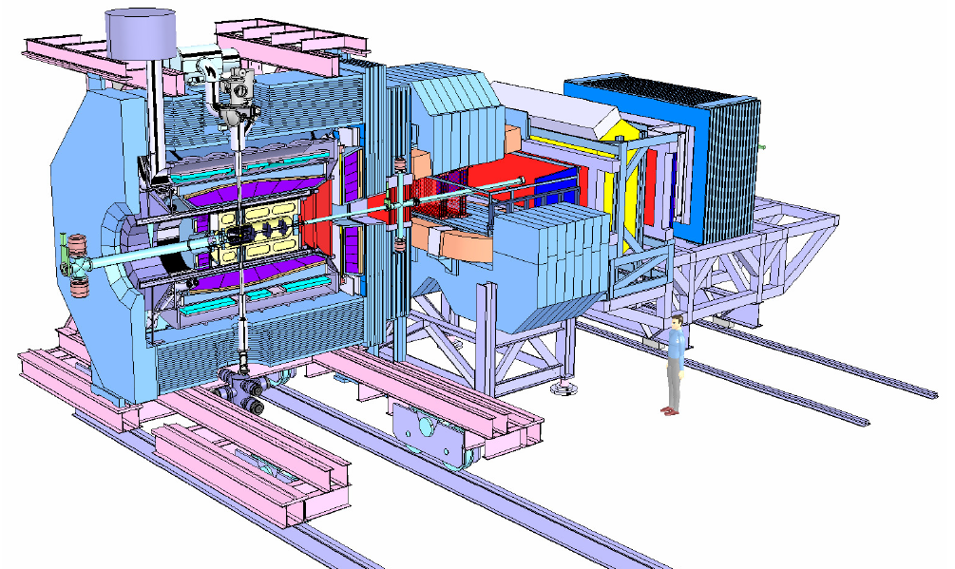
PANDA detectors
Experiment at HESR (High Energy Storage Ring) in FAIR (Facility for Antiproton and Ion Research ) complex at GSI, Darmstadt.
Tracking detectors:
Micro Vertex Detector
Central Tracker
Gas Electron Multiplier Stations
Forward Tracker
Particles identification:
DIRC (Detection of Internally Reflected Cherenkov)
Time of Flight System
Muon Detection System
Ring Imaging Cherenkov Detector
Calorimetry:
Electromagnetic calorimeter

Slide 4
PANDA DAQ requirements
interaction rate: up to 20 MHz (luminosity 2* 10³² cm⁻²s⁻¹)
typical event size : ~4 kB
expected throughput: 80 GB/s (100 GB/s)
rich physics program requires a high flexibility in event selection
front end electronics working in continuous sampling mode
lack of hardware trigger signal

Slide 5
The push-only architecture
SODA
Time Distribution System
Passive point-to-multipoint bidirectional fiber network providing time reference with precission better than 20 ps and performs synchronization of data taking
SODA
SODA
SODA
SODA

Slide 6
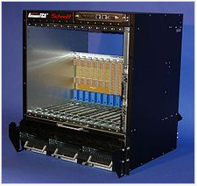
ATCA crate and backplane
ATCA – Advanced Telecommunications Computing Architecture
Backplane: one of possible configuration is full mesh (connects each pair of modules with dedicated point-to-point bidirectional llink

Slide 7
Compute Node
Each board is equipped with 5 Virtex4 FX60 FPGAs.
High bandwidth
connectivity is provided by 8 Gbit optical links connected to RocketIO ports (6.5 Gb/s). In addition the board is equipped with five Gbit Ethernet links

Slide 8
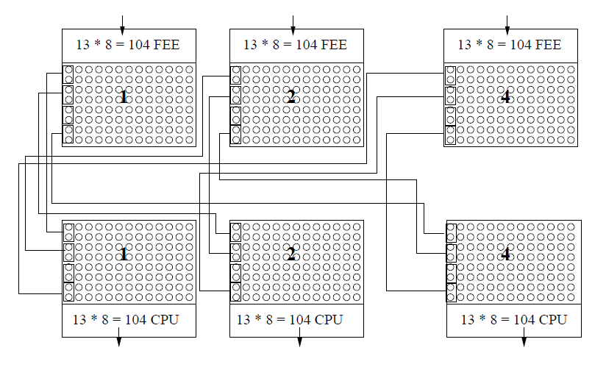
Inter-crate wiring
416
Module in slot N at the FEE level connects, with 2 links trunks, to modules at slots N at the CPU level.
416
The odd events packets at the FEE level are first routed via the backplane and then outbound to the CPU level via a proper trunk. The even events packets outbound to the CPU level first and then use backplane to change the slot.

Slide 9
Inter-crate routing animation
205
366

Slide 10
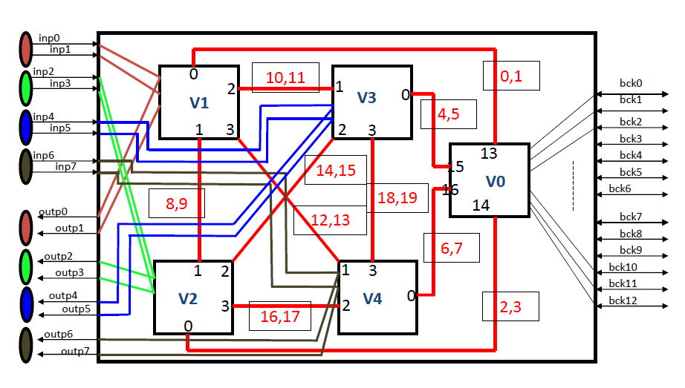
Onboard Virtex connections
Virtex0 – handles all communications to/from the backplane
Virtex1-4 - manage 2 input and 2 output ports at the front panel

Slide 11
Discrete event modeling
Model – computer program simulating system dynamics in time (support from SystemC library)
Fixed time step
Discrete events
t
events
t
State of the system remains constant between events
Processing system in a state may lead to scheduling a new event in the future

Slide 12
Parameterization of ports
SendFifo – occupation can grow if multiple writes are allowed OR the link speed is smaller than the speed of write OR the recent packets are smaller than the former ones.
ReceiveFifo – occupation can grow if the queue head can not be transferred due to destination being busy with another transfer OR the recent packets are smaller than the former ones.
The transfer speed is a parameter – during the simulations it was set to 6.5 Gb/s (RocketIO)

Slide 13
Model of data source
Data source – Data Concentrator:
Simulates operation of the accelerator
Burst: 2 us of interactions + 400 ns gap
Superburst: 10 bursts
Generates data packet with a size proportional to the sum of number of inter-interactions calculated from Poisson distribution with average of 20 MHz
Uniform data size for all Data Concentrators
100 GB/s - av. link usage 37%
173 GB/s - av. link usage 70%
Simulates the 8b/10b conversion, tags packets with destination CPU number and pushes into the architecture.

Slide 14
Model of data sink
Data sink – event building CPU:
Simulates event building of 416 fragments with the same tag
size of burst: ~300 kB
size of super-burst: ~3 MB

Slide 15
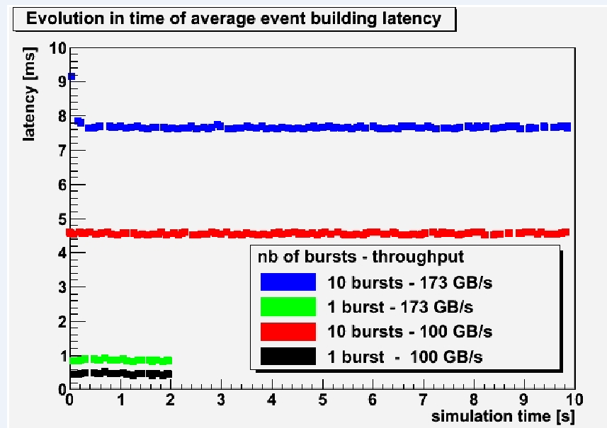
Event building latency
Stable latency in time indicates ability of the architecture to switch not only 100 GB/s but up to 173 GB/s

Slide 16
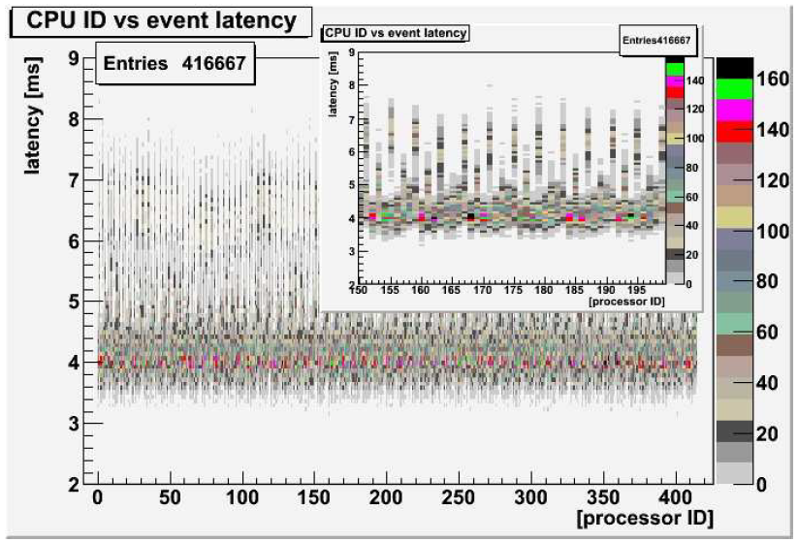
Load distribution between CPUs
The CPU for next event is calculated with the formula:
N_{t+1} = mod (N_{t} + 79) , 416)

Slide 17
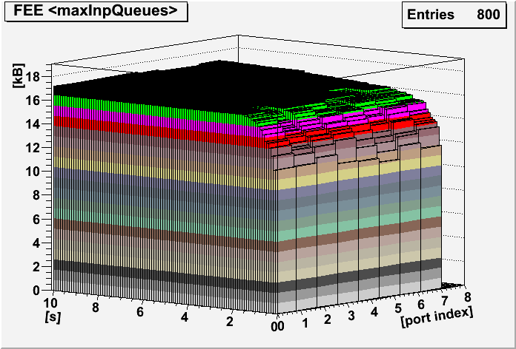
Monitoring queues’ evolution
Averaged maximal queue length in input ports at the FEE level. The averaging was over the ports with the same index in all FEE modules.

Slide 18
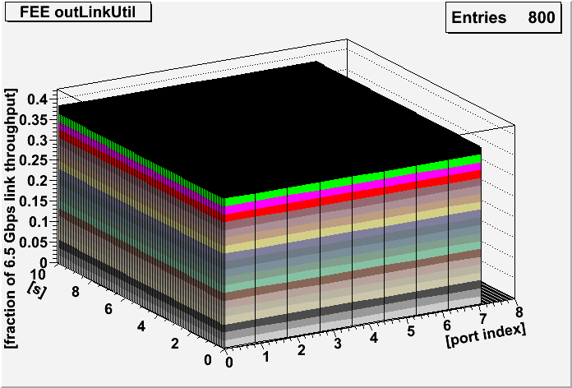
Monitoring links’ load
Load on fiber links connecting output ports from the FEE level with input ports at the CPU level. Homogenious load indicates proper routing scheme – also for trunking.

Slide 19
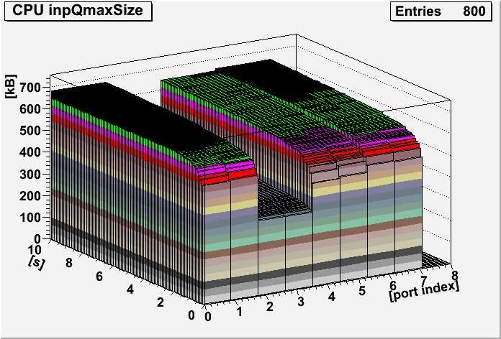
Monitoring queues
Average of maximal length of input queues at the CPU level. The average was made with ports with the same index on all modules.

Slide 20
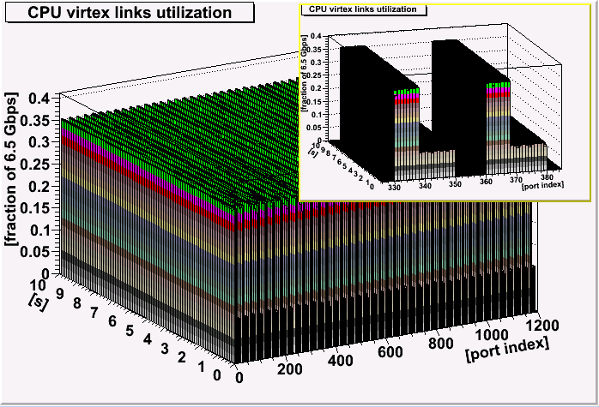
Monitoring Virtex link’s occupation
At the CPU level, the packets heading for odd-numbered CPUs go via the backplane to the slot with destination CPU.

Slide 21
Summary
We propose the event building architecture for the triggerless DAQ system for the PANDA experiment.
The architecture uses Compute Node modules in ATCA standard.
We built simplified models of the components using SystemC library and run the full scale simulations to demonstrate required performance and to analyse dynamics of the system.
The push-only mode provides 100 GB/s throughput which allows to perform burst/super-burst building and to run selection algorithms on fully assembled data.
with the input links loaded up to 70% of their nominal capacity the architecture can handle up to 173 GB/s

Slide 22
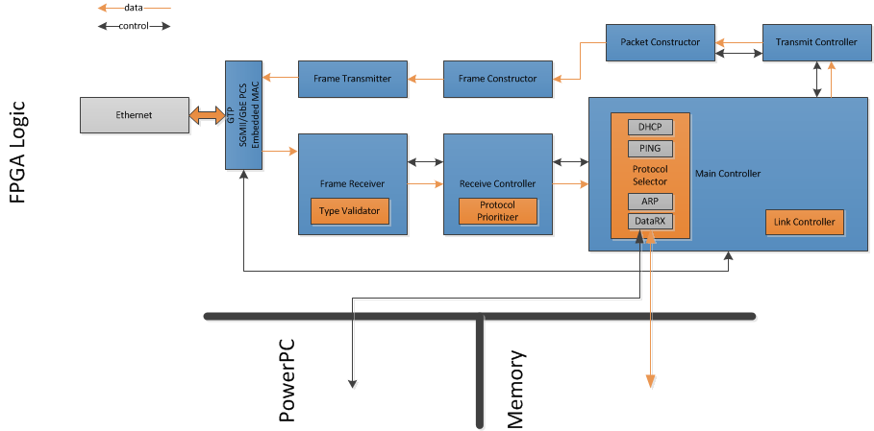
Basic networking
Various higher level protocols implementations:
Network recognition (ARP, DHCP, ICMP)
Transmission of data to the event builders over UDP
Multi-frame packets (up to 64kB packets)
Dynamic, multiple event builders addressing possible

Slide 23
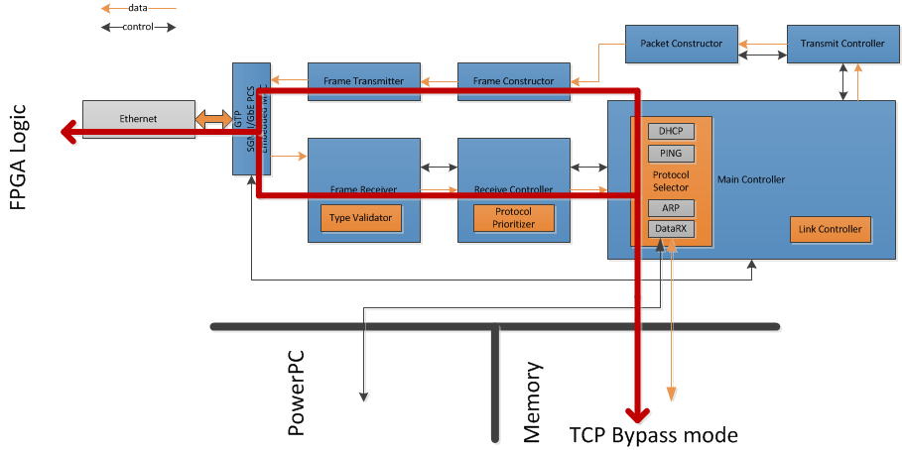
TCP Extension
Implementation of „TCP bypass mode” channel
Allows the injection of received by hardware TCP frames into linux kernel
Transmission of TCP frames generated by the kernel
Ongoing development of „true” TCP implementation
Telnet protocol implementation in progress

Slide 24
General features
Tested on:
Virtex 4 FX
Virtex 5 LX
Will be on Virtex 5 FX
Lattice ECP2M
Lattice ECP3M
Implemented to work on optical link or copper cable
Max transmission speed (when data available): 118MBps
Jumbo frames
VLAN support
Easily configurable set of protocols

