Slide 1
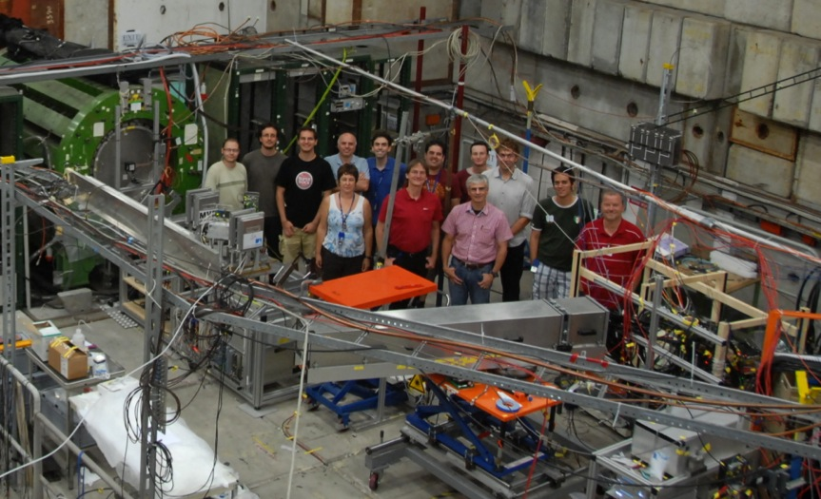
PANDA BARREL DIRC
T9 TEST BEAM
AUG 10 – SEP 3, 2012
PANDA MVD & DIRC groups at CERN test beam 2012
Test beam ended about
one week ago, so today: just some pictures
On behalf of the DIRCies who were at CERN for the test beam:
Erlangen: Albert, Alex, Fred
GSI: Andreas, Carsten, Doro, Georg, Greg, JS, Maria, Marko
Jochen Schwiening, GSI – PANDA Collaboration Meeting, Paris, Sept. 2012

Slide 2
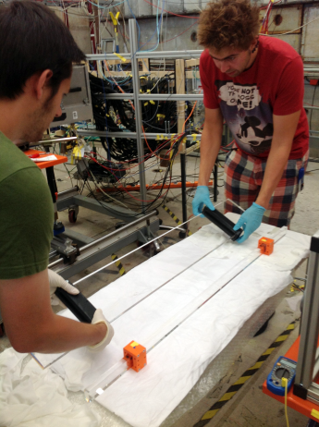
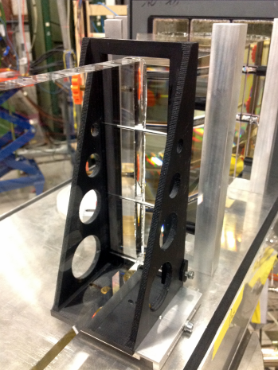
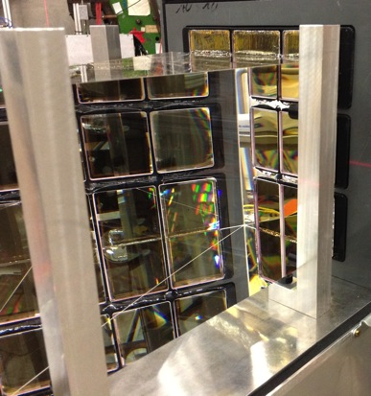
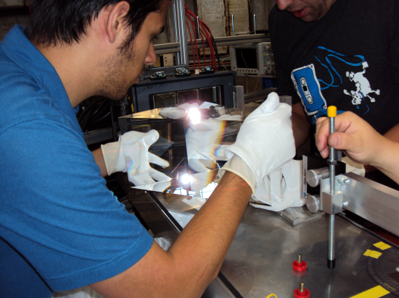
PANDA BARREL DIRC PROTOTYPE 2012
Goal: Verify design concepts in particle beam at T9
→ Cherenkov angle resolution, photon yield, π/K/p particle identification
Top priorities in 2012:
First look at prism as compact expansion volume,
plate as an alternative to bar geometry.

Slide 3
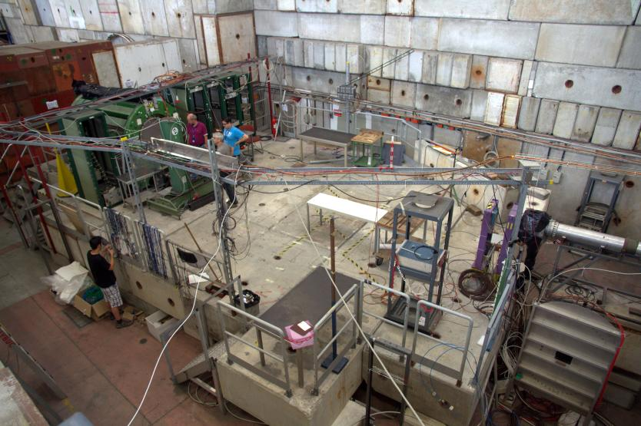
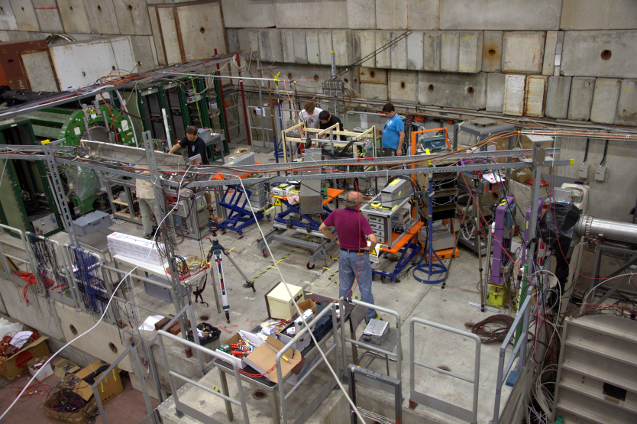
PANDA PROTOTYPES 2012
T9 area after CLAS12 departure
on Friday, Aug 10, 11am
T9 area a few hours later: all prototypes installed,
ready for first beam

Slide 4
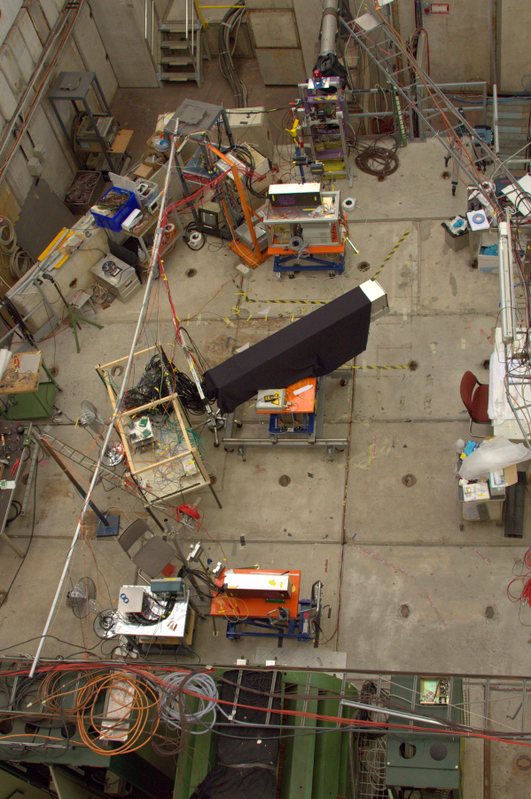
PANDA PROTOTYPES 2012
MCP-TOF station 1&2 (Erlangen)
SciTil
Fiber Tracker station 1&2 (Mainz)
Barrel DIRC
Aug 8: pre-assembly in storage area behind T9.
Aug 10: move prototypes into T9, safety approval.
Aug 10-20: all prototypes taking data.
Aug 20: MVD completes program, prototype removed from T9, DIRC setup rearranged.
Aug 20-Sep 3: DIRC, TOF, SciTil continue run.
Sep 3, 11am: End of run.
Barrel DIRC wrote ~220M triggers to disk.
Thanks to our MVD colleagues for the excellent cooperation.
Cave layout on Aug 21.

Slide 5
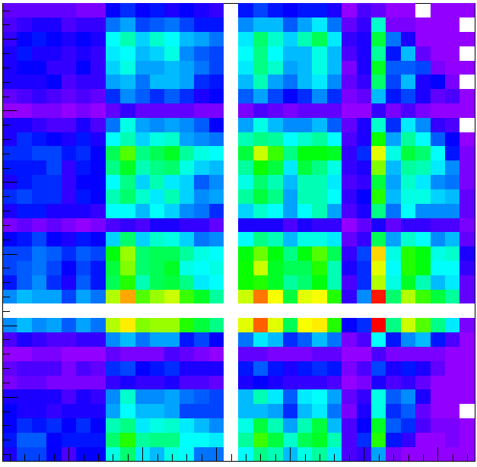
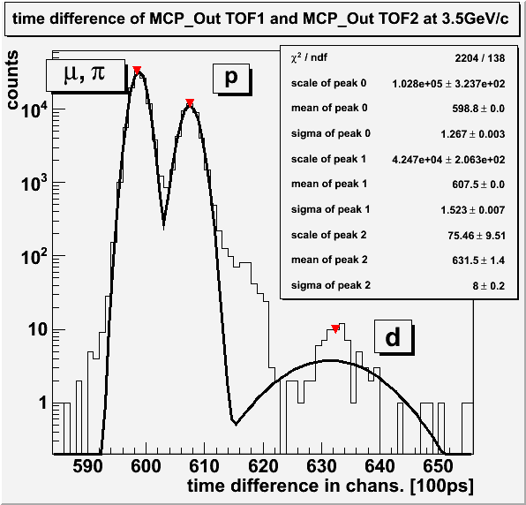
PANDA PROTOTYPES 2012
Online hit map from fiber tracker
3D tracking for DIRC, reduce error on track angle, correct beam divergence
Time of flight information using two MCP-PMTs,
particles producing Cherenkov light
on small radiator block and inside MCP
→ low-momentum PID, enhance rings in DIRC

Slide 6
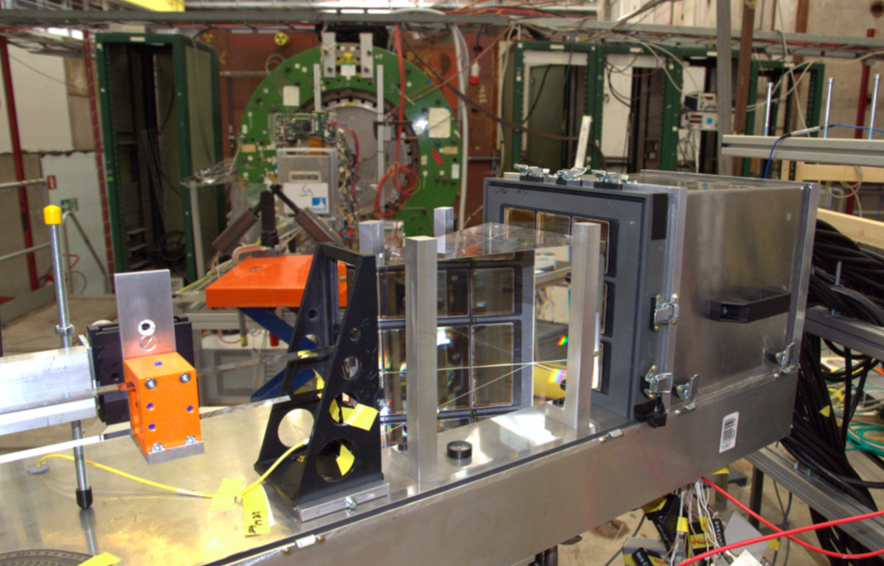
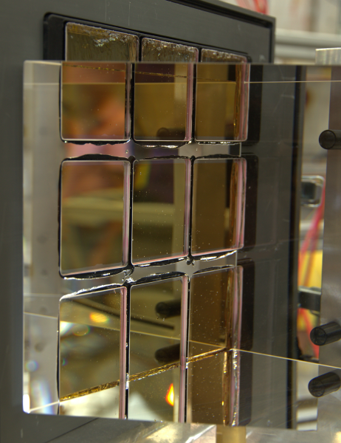
PANDA BARREL DIRC PROTOTYPE 2012
Prism coupled to MCP with EJ-550 grease
Bar
Lens
Prism 17x20x30cm³
9 MCPs

Slide 7
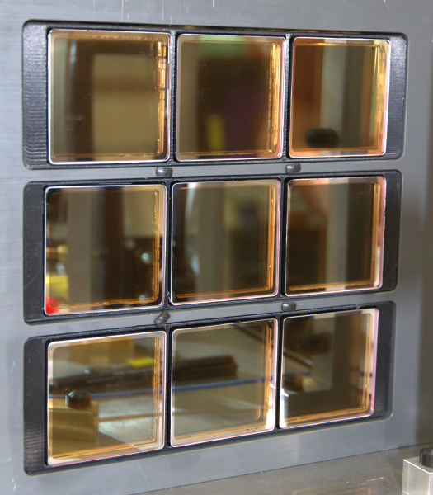
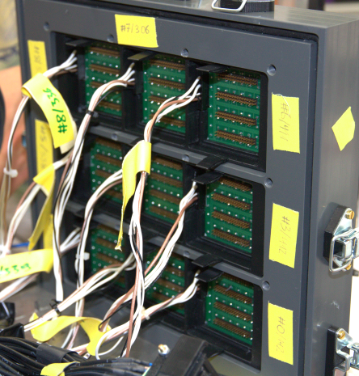
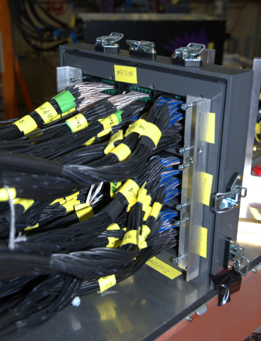
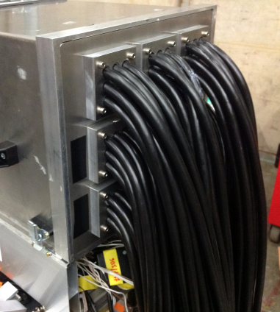
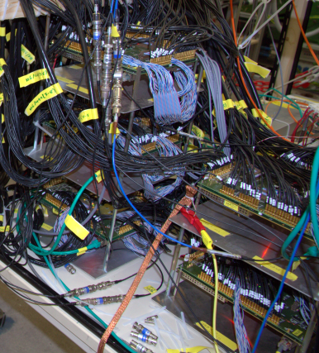
PANDA BARREL DIRC PROTOTYPE 2012
DIRC rings imaged onto 9 Planacon MCPs (576 pixels)
Total of 896 channels in DAQ (7 TRBs with TOF addOns)
Thanks to our HADES colleagues for help with the DAQ.

Slide 8
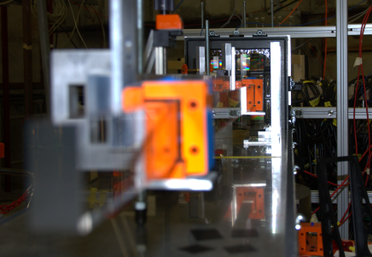
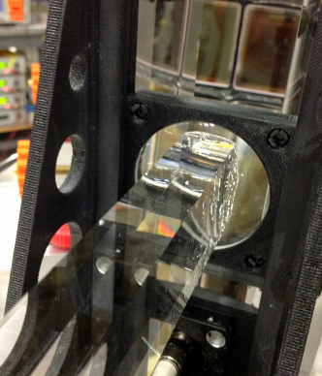
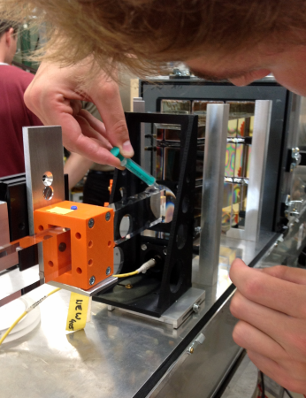
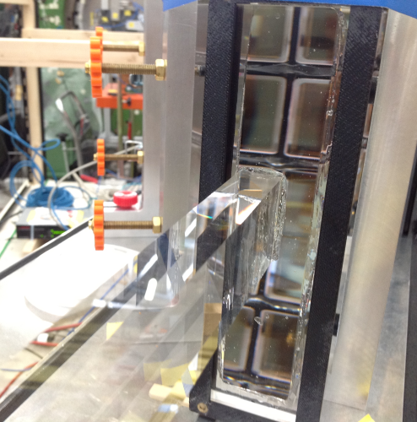
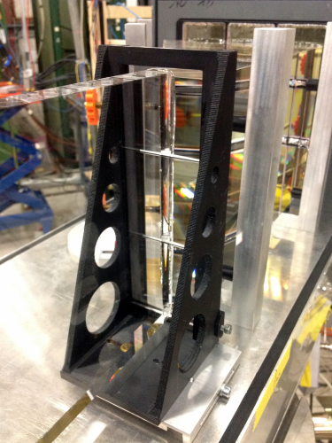
PANDA BARREL DIRC PROTOTYPE 2012
Bar coupled to A/R coated spherical lens with grease and with matching liquid
Bar and lens coupled to high-refractive index cylindrical compound lens (works without air gap)

Slide 9
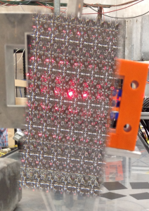
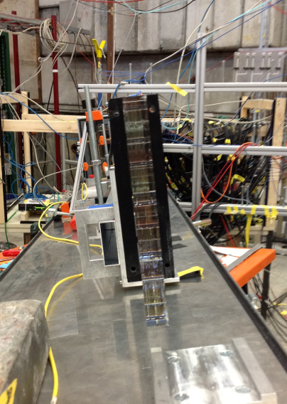
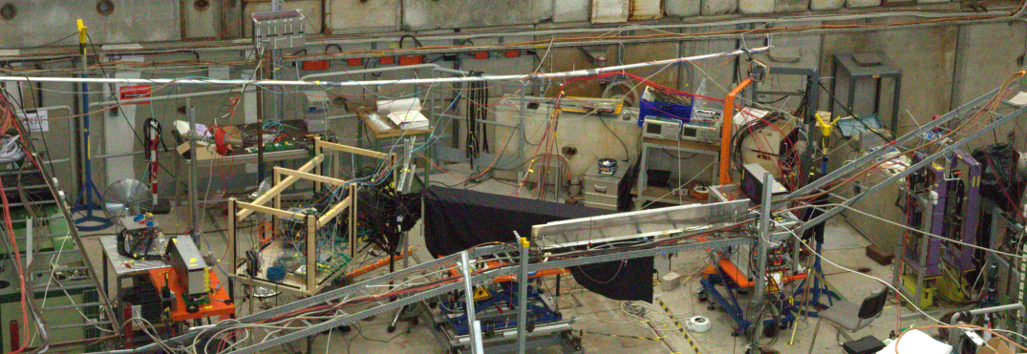
PANDA BARREL DIRC PROTOTYPE 2012
Varied many critical parameters
Plate vs. bar
Lens types and coatings
Bar manufacturer (InSync, LZOS, Zeiss, Lithotec)
Beam momentum
Polar angle of beam to bar/plate
Beam position (x&z) on bar/plate
Fused silica vs. acrylic
Positioning of bar/plate on prism
Azimuth angle of beam to bar/plate
and more…

Slide 10
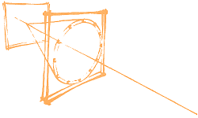
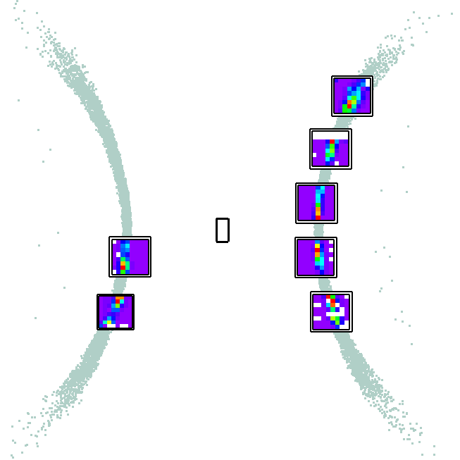
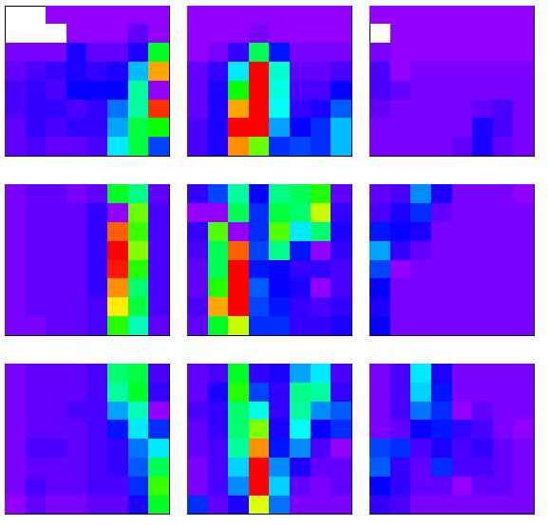
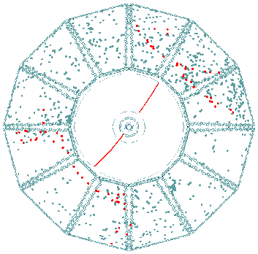
PANDA BARREL DIRC PROTOTYPE 2012
DIRC hit patterns do not look like your typical RICH detector
Ring image gets folded due to propagation in bar/plate
Part of the ring escapes, not totally internally reflected
→ broken rings, complex, disjoint images
What do we see in 2012 with the prism?
PANDA Barrel DIRC in 2011
“Fishes”
BABAR DIRC

Slide 11
PANDA BARREL DIRC PROTOTYPE 2012
Simulation: polar angles 20-80 deg
Data: polar angles around 55 deg
dots: photon hit position; histogram: pixel occupancy
(Sorry, Greg’s “swimming fishes” animated gifs work only in ppt version of talk.)

Slide 12
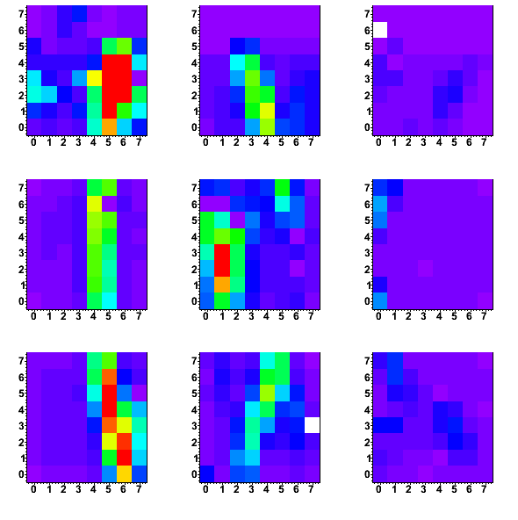
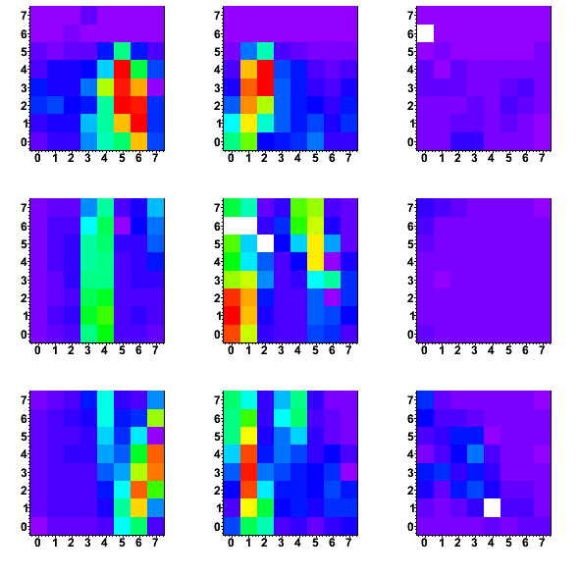
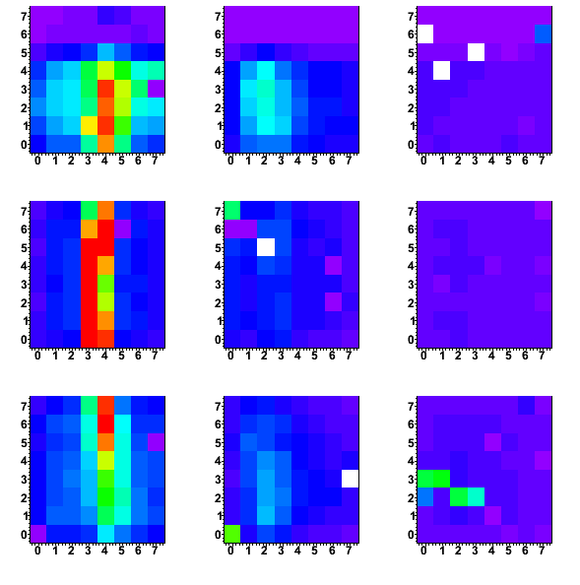
PANDA BARREL DIRC PROTOTYPE 2012
InSync bar
LZOS bar
InSync plate
220M triggers with many interesting parameter changes.
Very rich data set, lots of work ahead.
Hope to have first results for talk at IEEE NSS 2012 on Oct 31st – stay tuned…

