Slide 1
Study of Luminosity Monitor for
PANDA@FAIR, GSI
I.I.T. Bombay
Manoj B. Jadhav
Supervisor
Prof. Raghava Varma
PANDA Collaboration Meeting, PARIS – September 11, 2012
Notes:
----- Meeting Notes (02/08/12 23:34) -----
good morning every one, today im presenting my work on design and simulation for luminosity monitor detector for panda collabration.

Slide 2
Outline
Luminosity Monitor Detector (PANDA)
Framework & Full Simulation Chain
Building Blocks for Simulation Study
Monte-Carlo Simulation Results
Digitization & Reconstruction
Effect of Solenoid Magnetic Field
Radiation Hard Detector
Challenges with Si-detector technology
Alternative to Si-detector : Diamond
Simulation Results for Silicon & Diamond
Plans to Test Diamond Sensors at IIT Bombay
Summary
Notes:
----- Meeting Notes (02/08/12 23:34) -----
here is outlook of my talk
some introduction to luminosity & its physicsal requirement
then LMD at panda experiment
then I will discuss briefly on framework and simulation chain for LMD
and after that i will move to Radiaiton hard detectors as an alternative to Silicon detectors
then comapare simulaiton results for si and Diamond
plan to growth and fabricate Diamond sensors at IITBombay
and last summary

Slide 3
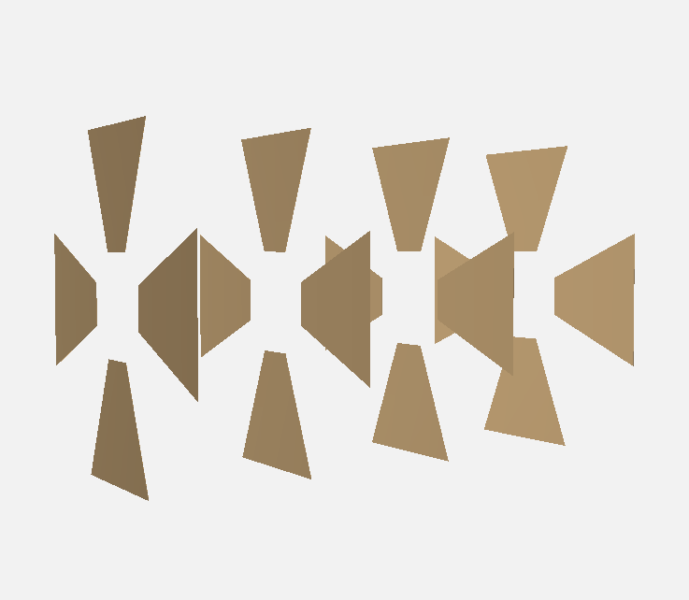
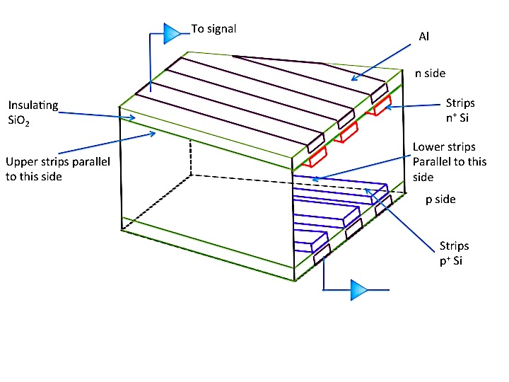
Setup used for simulation
Tentative Geometry:
Notes:
----- Meeting Notes (03/08/12 00:56) -----
here is lmd havung trapezoidal shape
this shows geometry of detector sensors

Slide 4
Setup used for simulation
Detector Geometry:
7.81 cm
Silicon Strip Sensor Specifications:
Double-sided strip sensor
Dimension : Trapezoid
(3.35 cm X 7.81 cm) X 7 cm
Thickness : 150 μm
Pitch: 50 μm
Strip Orientation: parallel to sidewalls
of Trapezoid (diamond shape overlapping)
16 sensors placed at 4 planes,
4 sensors/plane (up & down, left & right),
10 cm between the neighbor planes
50μm-pitch
7 cm
Strips
on back
Strip
on front
3.35cm
Beam
Notes:
----- Meeting Notes (03/08/12 00:56) -----
it is double sided strip detectors with trapezoidal shape with thikness of 150 micron and 50 mmicro pitch strips are oriented so that to form diamond shape overlaping
there are 4 plans separeted by 10 cm with 4 sensors at each plane at 11 meters downstream the target

Slide 5
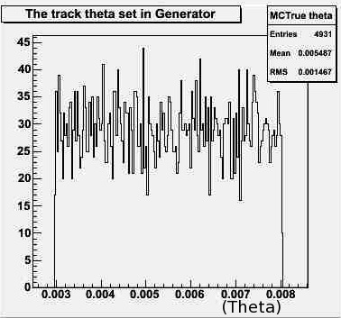
Monte-Carlo Simulation Results
Generator:
BOX Generator
For single particle event
ThetaRange: 0.17 – 0.45 degrees (3-8 mrad)
PhiRange: 0 – 360 degrees
Simulation setting:
1. Beam Particle : Antiproton
2. Momentum : 8.9 GeV/c
3. No. of events : 10000
4. Propagation : Geant3
Digitization parameters:
Noise : 1000 electrons
Threshold of signal : 5000 electrons
result contains:
1. Energy Loss.
2. Position Reconstruction
Notes:
----- Meeting Notes (03/08/12 01:25) -----
In simulation as we seen earier box generator generates 10000 events in theta range 2-9 mrad and full phi coverage with mom 8.9 for antiproton which will be propagated thro geant3
results of this contains energy loss and position reconstruction
here is hit position along x and y axis, x axis is shifted to 25 cm becauss of effect of dipole mag fiels on beam
this is three dim view of hits on det planes
and this shown the energy deposited in detector plane which is around 48 Kev for silicon in 150 micron sensor

Slide 6
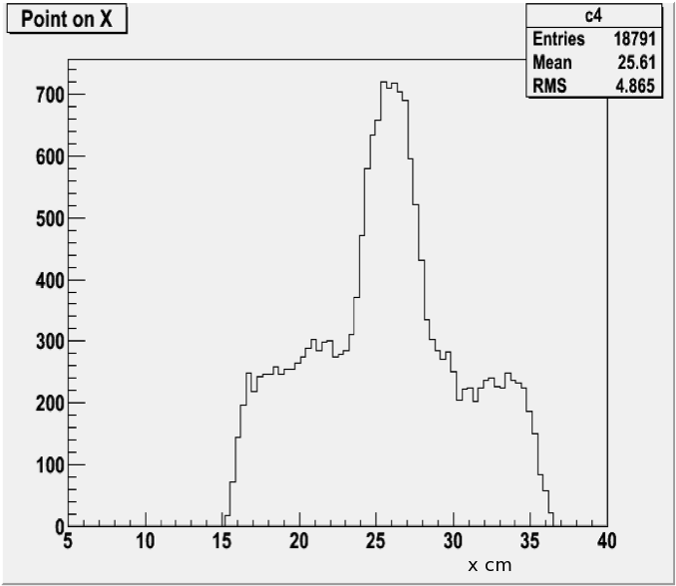
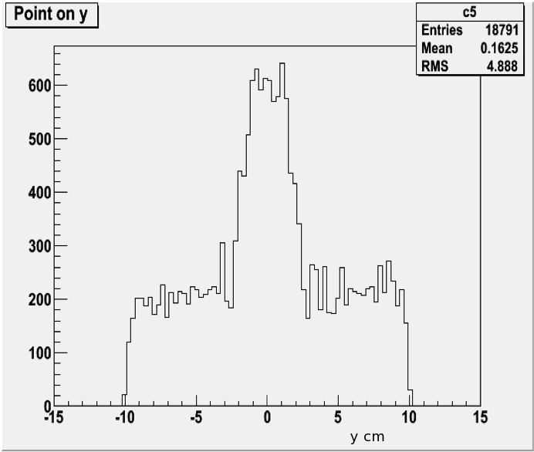
Monte-Carlo Simulation Results
Generator:
BOX Generator
For single particle event
ThetaRange: 0.17 – 0.45 degrees (3-8 mrad)
PhiRange: 0 – 360 degrees
Simulation setting:
1. Beam Particle : Antiproton
2. Momentum : 8.9 GeV/c
3. No. of events : 10000
4. Propagation : Geant3
Digitization parameters:
Noise : 1000 electrons
Threshold of signal : 5000 electrons
result contains:
1. Energy Loss.
2. Position Reconstruction
Notes:
----- Meeting Notes (03/08/12 01:25) -----
In simulation as we seen earier box generator generates 10000 events in theta range 2-9 mrad and full phi coverage with mom 8.9 for antiproton which will be propagated thro geant3
results of this contains energy loss and position reconstruction
here is hit position along x and y axis, x axis is shifted to 25 cm becauss of effect of dipole mag fiels on beam
this is three dim view of hits on det planes
and this shown the energy deposited in detector plane which is around 48 Kev for silicon in 150 micron sensor

Slide 7
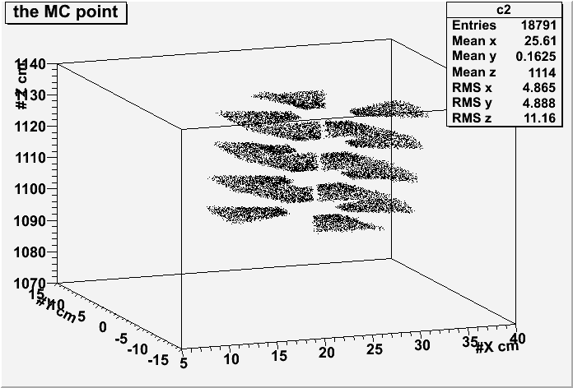
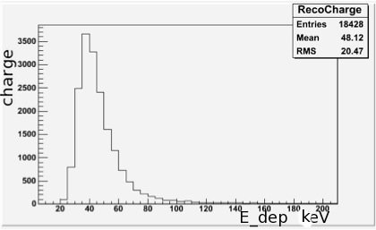
Monte-Carlo Simulation Results
Generator:
BOX Generator
For single particle event
ThetaRange: 0.17 – 0.45 degrees (3-8 mrad)
PhiRange: 0 – 360 degrees
Simulation setting:
1. Beam Particle : Antiproton
2. Momentum : 8.9 GeV/c
3. No. of events : 10000
4. Propagation : Geant3
Digitization parameters:
Noise : 1000 electrons
Threshold of signal : 5000 electrons
result contains:
1. Energy Loss.
2. Position Reconstruction
Notes:
----- Meeting Notes (03/08/12 01:25) -----
In simulation as we seen earier box generator generates 10000 events in theta range 2-9 mrad and full phi coverage with mom 8.9 for antiproton which will be propagated thro geant3
results of this contains energy loss and position reconstruction
here is hit position along x and y axis, x axis is shifted to 25 cm becauss of effect of dipole mag fiels on beam
this is three dim view of hits on det planes
and this shown the energy deposited in detector plane which is around 48 Kev for silicon in 150 micron sensor

Slide 8
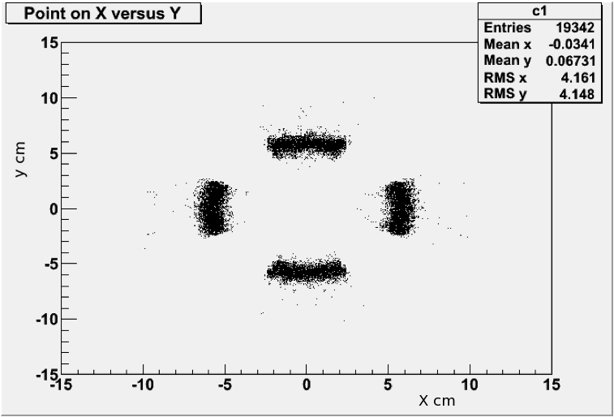
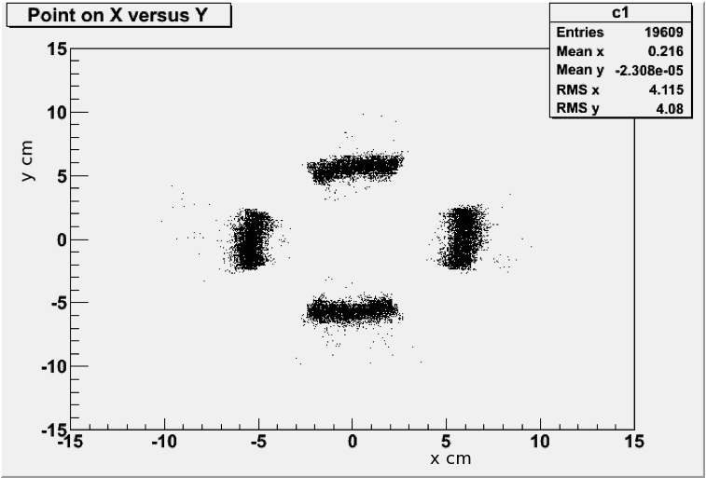
Effect of Solenoid Magnetic Field
BoxGenerator;
Beam Particle: antiProton;
Beam momentum: 3.5GeV/c;
Fixed theta: 5.2 mrad;
Azimuth: 0~360;
Solenoid Field off
Solenoid Field on
Give rise to shift in Theta toward beam axis for antiProton.
Notes:
----- Meeting Notes (03/08/12 01:25) -----
here we studied effect off solenoidal field on event reconstruction and it shows field give rise shift in theta toward beam axis for atiproton

Slide 9
Challenges with Si-Detector Technology
With Luminosity of 10³² cm⁻²s⁻¹, Si-detector technology may suffer Radiation Damage
Effects of radiation induced defects:
Charge trapping at defect centers
Enhanced generation or recombination current
Modification of the electrostatic potential within device due to changes in space - charge profile
Reduced charge
collection efficiency (CCE)
Wide Band gap material : Radiation Hard
This reduces the generation/recombination rates
Increase in energy gap suppresses leakage currents
Notes:
----- Meeting Notes (03/08/12 01:25) -----
some challenges with silicon teh
for luminosity of 10^32 si needs frequent replacement
because radiation defects such as
charge trapping at defect centrers & enhanced gen or recomb current which reduces CCE
change in space charge profile changes lectrostatic potential
enhancement in bulk and surface current
bias voltage is also storng fuction of radiation fluences

Slide 10
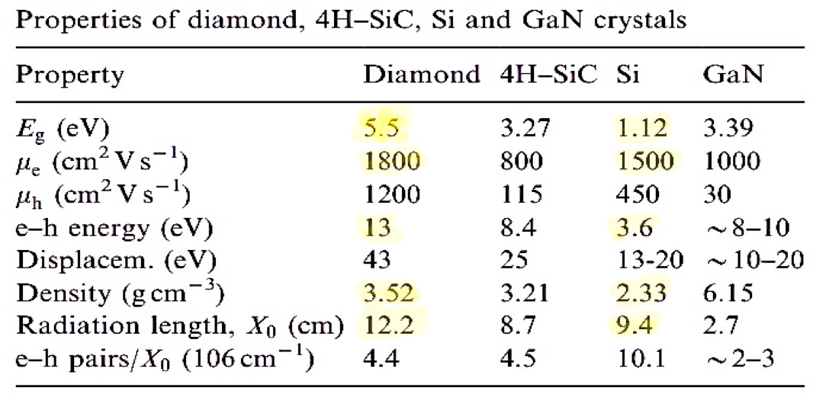
Diamonds are Forever
For Diamond,
With Band gap Eg = 5.5 eV is an insulator
Average energy needed to create an e_/h pair is 13.6 eV. (Silicon Eg = 3.61 eV )
This implies negligible intrinsic carrier densities even at room temperature but less electron hole pairs
Notes:
----- Meeting Notes (03/08/12 01:25) -----
alteranative to si
soem wide band gap materials are radiaitn hard
like GaN or Diamond
so defects are deep inside which reduces gen/recomb rate
and suppresses leakage current
----- Meeting Notes (03/08/12 01:30) -----
table shows some properties w.rt. si

Slide 11
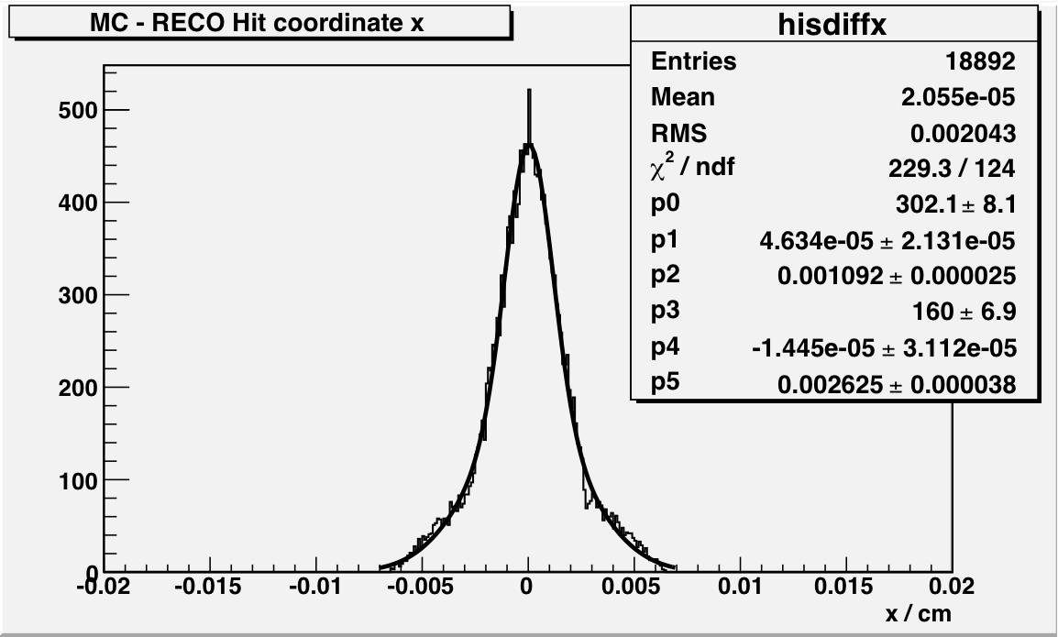
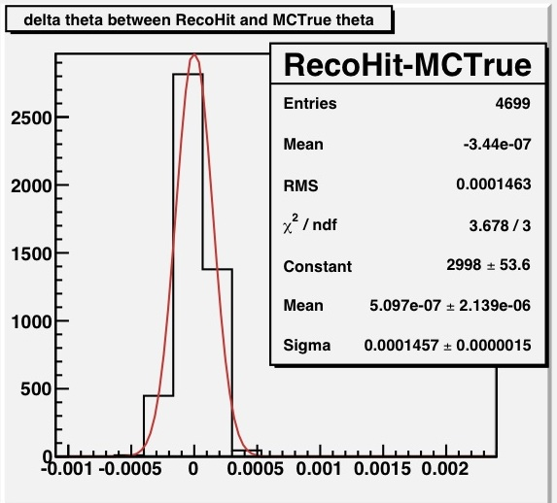
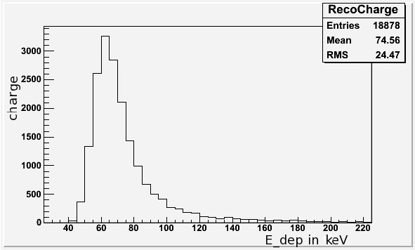
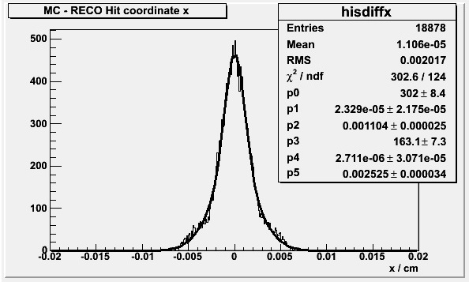
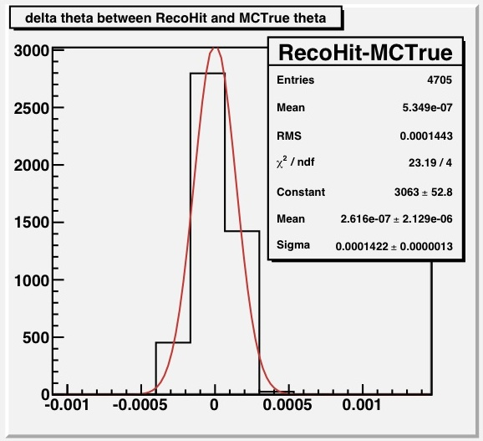
Full Simulation Chain Results
Silicon
dTheta (radian)
Diamond
dTheta (radian)
antiproton@8.9 GeV/c
Notes:
----- Meeting Notes (03/08/12 01:45) -----
now results of full simulatin chain for silicon
after recontruction we got charge from E_dep
subtrating MC hit from reco hit we get posittin reco error i.e. pos resolution which is 10.92 for si
and dtheta of 0.145 mrad

Slide 12
Full Simulation Chain Results
antiproton@8.9 GeV/c
Material\Results | Energy Deposited | Position Reconstruction Error | deltaTheta/Theta
Silicon | 48.12 keV | 10.92 micron | 0.145 mrad
Diamond | 74.56 keV | 11.04 micron | 0.142 mrad
Implies Diamond can be used as LMD with same performance as Silicon plus advantage of Radiation Hardness

Slide 13
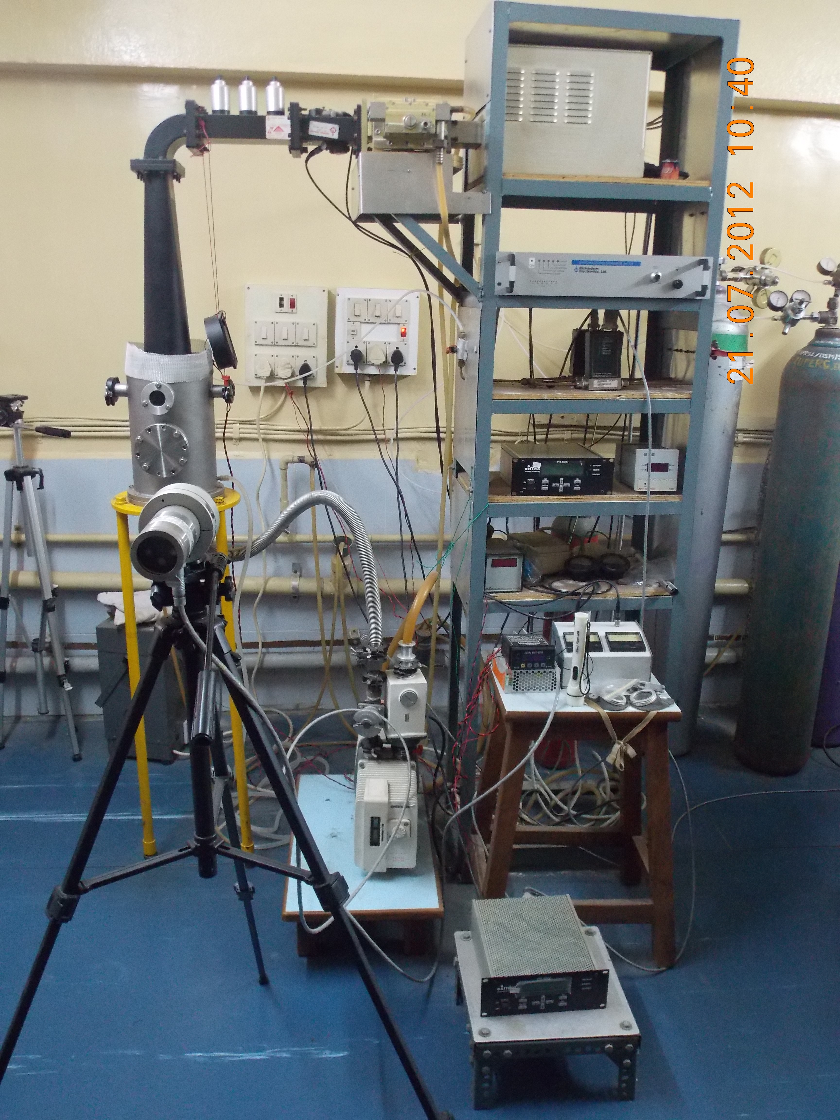
Plan for Testing Diamond Sensors at IIT Bombay
The detectors can be fabricated from poly-crystalline diamond substrates grown using the microwave plasma-chemical vapor deposition technique (MP-CVD).
Mixture of methane and hydrogen.
We are in process of making detector starting from 30 μm thick CVD diamond.
This facility for MP-CVD is available at IIT Bombay.
After testing this sensor we will move for Single Crystal Diamond with large dimensions with strips.
Notes:
----- Meeting Notes (03/08/12 01:45) -----
this is plan for testing diamond sensor here at our department
detectir can be fabricated from polycrystalline diamond grown using MP CVD from mixture of methane and hydrogen
we ar ein process to make 30 micron cvd diamond
this is set up for growth technique in plasma lab
after this we will move for sinlgle crystal with large dimension

Slide 14
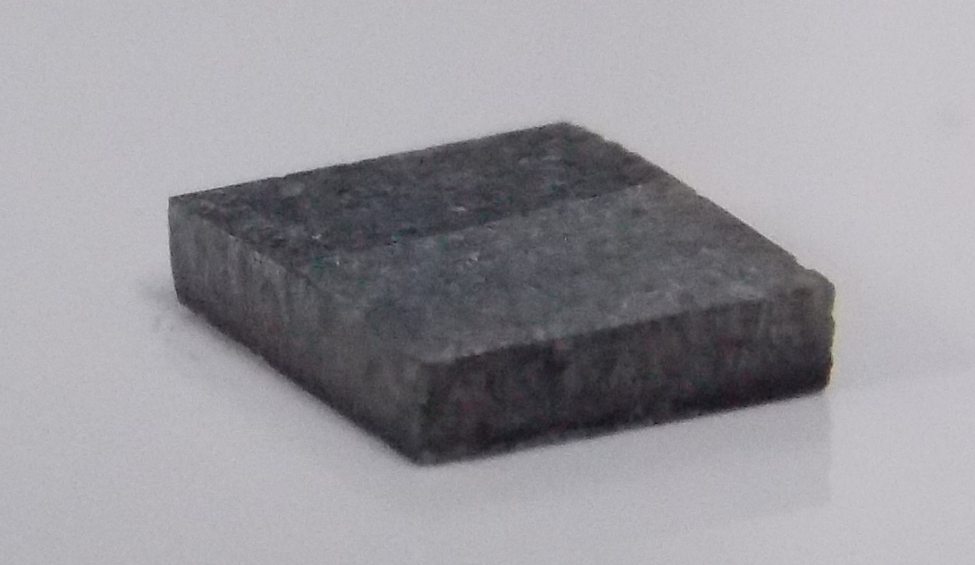
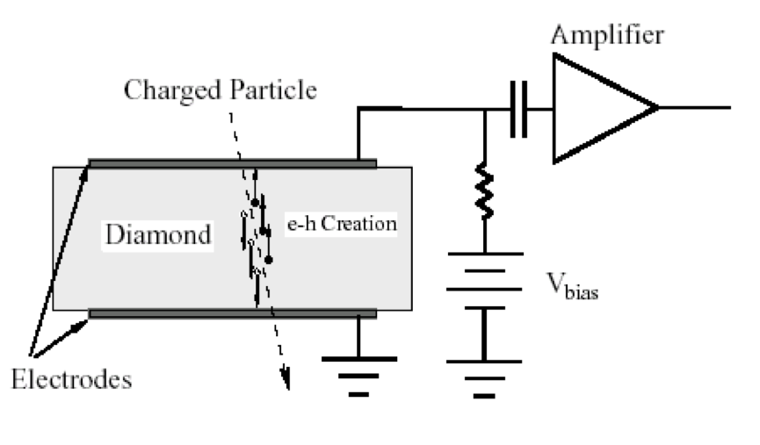
Plan for Testing Diamond Sensors at IIT Bombay
Diamond sample of 30 μm thickness with silicon substrate is available for primary testing at IIT Bombay.
Samples with area of 0.5cm × 0.5cm.
Notes:
----- Meeting Notes (03/08/12 01:45) -----
this is plan for testing diamond sensor here at our department
detectir can be fabricated from polycrystalline diamond grown using MP CVD from mixture of methane and hydrogen
we ar ein process to make 30 micron cvd diamond
this is set up for growth technique in plasma lab
after this we will move for sinlgle crystal with large dimension

Slide 15
Plan for Testing Diamond Sensors at IIT Bombay
Continued ………
Plan to characterize the detector pre & post irradiation
An Am²⁴¹ radioactive source, 5.48 MeV α - particle, can be used for CCE measurement
The energy scale calibration using reference Silicon surface barrier diode assuming to have 100% CCE will be used
CCE is given by ratio of experimentally calculated energy deposit on detector to theoretical value of energy deposited by a 5.48 MeV α – particle
We will test our detector for time and energy resolution, typically <100 ps has been achieved for proton with Diamond Detector
We have also explored making strips and Wire Bonding and the facility for making strips is being developed at IIT Bombay
Notes:
----- Meeting Notes (03/08/12 01:45) -----
paln to characterised for irradiaiton
using am 241 source so we requird vacuum chamber and silicon surface barrier as reference detector
CCE can calculated by energy deposited in detector nad theory value for am241

Slide 16
Summary
A alternate geometry of luminosity monitor with double-sided strip
(150 µm , 50 µm pitch) was studied within PandaRoot framework.
With a alternate geometry the effect of the Solenoid field reproduced.
Simulation result indicates that we can implement Diamond sensors as Radiation Hard alternative to a traditional Silicon material which provides same reliability as silicon.
Diamond has better radiation length which reduces multiple scattering.
Plans to fabricate Diamond detector for testing at IIT Bombay.
Further Simulation study will be extended to track follower and track finder as well as Geane fitting algorithm.
Notes:
----- Meeting Notes (03/08/12 01:45) -----
summary
tentive geometry for double sided sstrip os studied
effect of solenoid is seen
diamond can be used insted si as aradiaiton hard
plan to grow diamond sample in coming semister
and simulaiton for track finder and follower has to do as well as geane fitting has to do to study transpotation in mag field

Slide 17
-: Thank You :-
Notes:
----- Meeting Notes (03/08/12 01:45) -----
thank you

