Slide 1


Work progress in Turin x the MVD
MVD meeting
PANDA meeting, September 11° 2012
Daniela Calvo

Slide 2
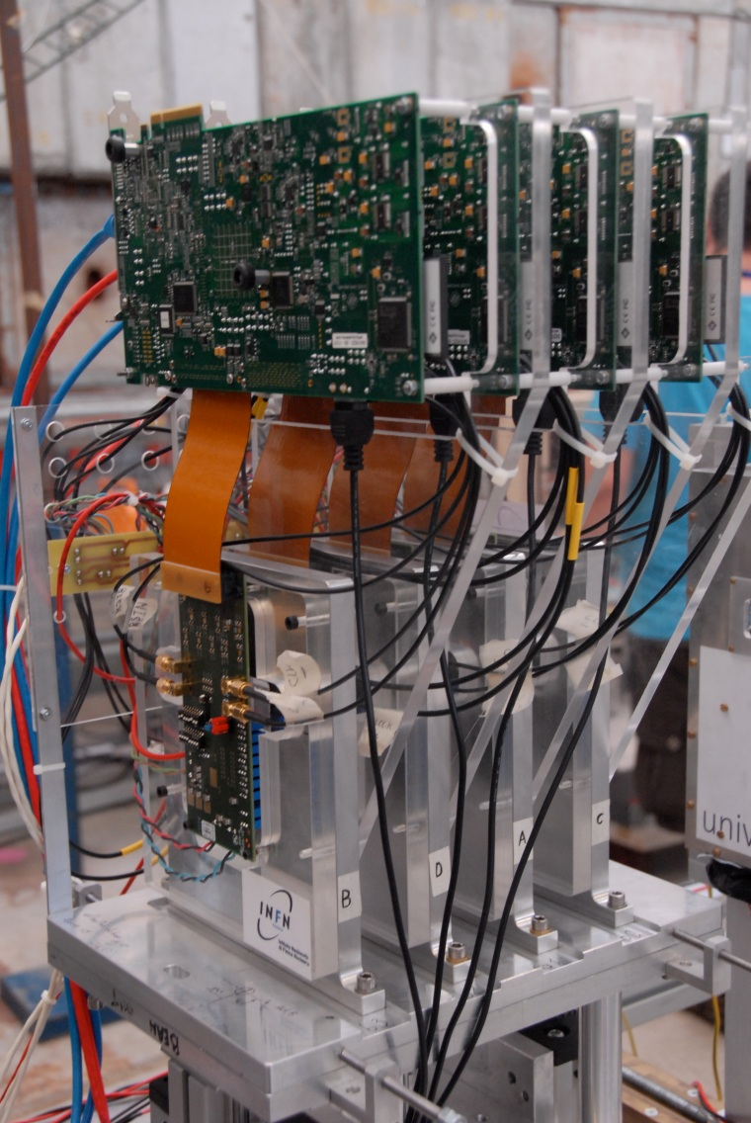
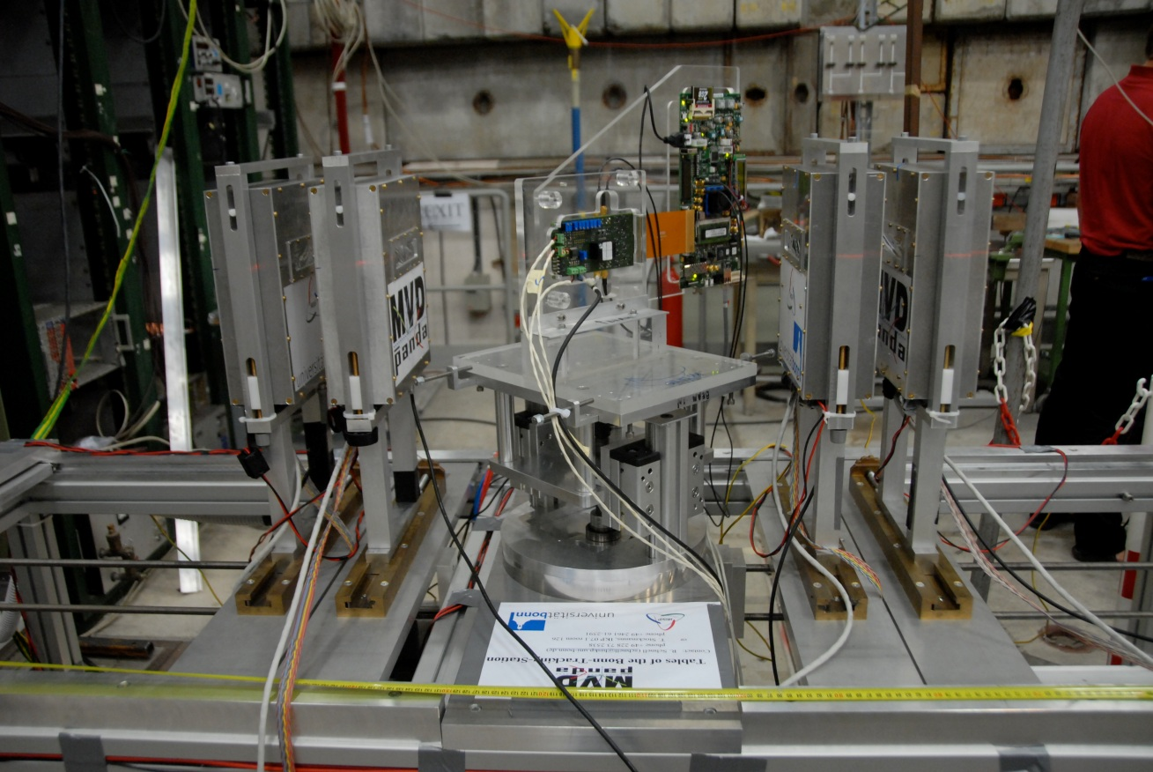
Pixel assemblies
Beam test @CERN in August to study thin epi sensors with ToPix3 → done!:
3 x 100 and 1 x 150 μm
3 x 100 and 1 x 100 μm irradiated sensor (with and without O₂)
in the pixel tracking station configuration
and 1 x 100 μm in the angle rotation configuration
with strip telescope
Preliminary online analysis was done → (Laura)
The analysis of the data of Juelich beam test → in progress (Laura)

Slide 3
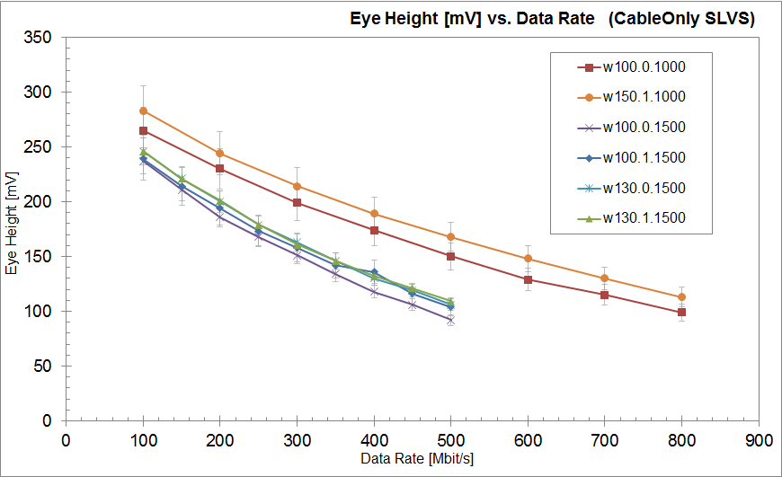
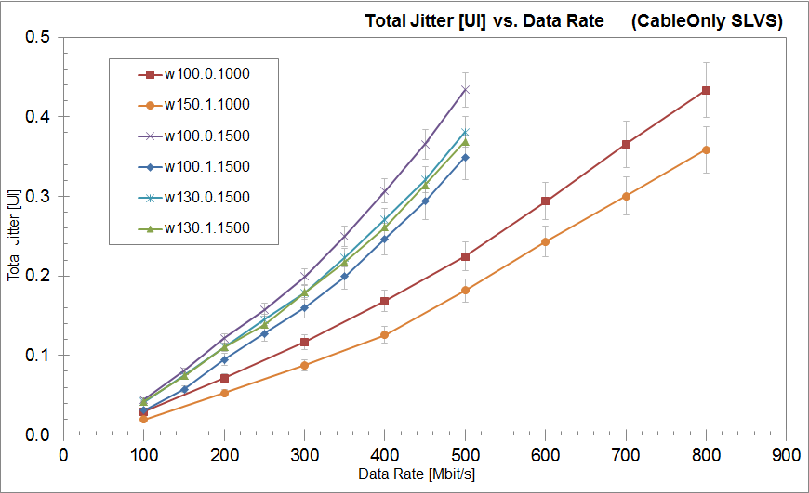
Electronics
ToPix4 project → in progress (Angelo)
Detailed study of ToPix3 → in progress (Marco – December meeting)
DC-DC study → in progress (Paolo – December meeting)
Long aluminum microstrips study → done! (Paolo – December meeting)

Slide 4
Mechanics
Mechanics meeting on July 4th @ GSI
Mvd services study → at present blocked, waiting availability of mechanics designer from EMC (October)
Mvd support prototypes (plastic…) → in progress
(Beppe)
Cooling part → blocked , waiting more information about power consumption of strip and pixel readout

