Slide 1
MVD Software and Simulation Status
PANDA Computing Week - Torino
| Tobias Stockmanns

Slide 2
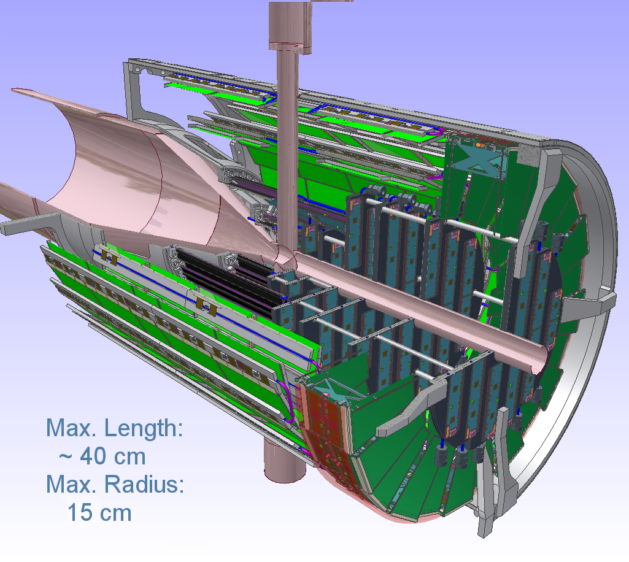
Micro-Vertex-Detector

Slide 3
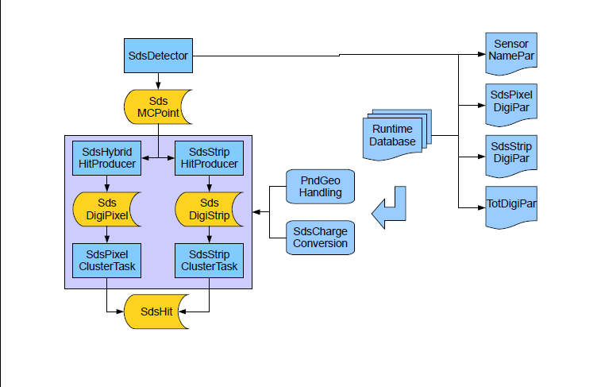
Structure of the Code – SDS base

Slide 4
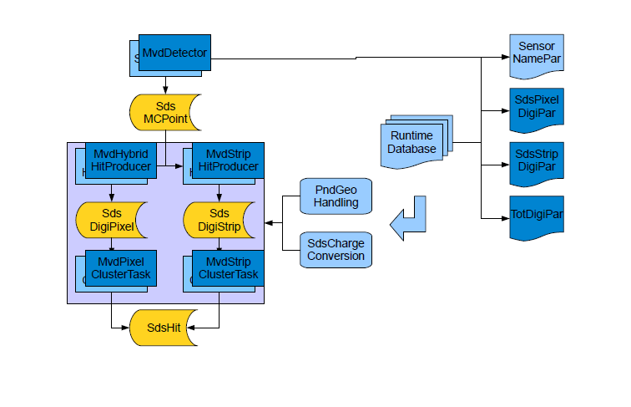
Structure of the Code - MVD

Slide 5
MC Simulation

Slide 6
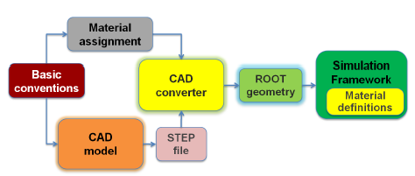
Monte Carlo Generation – MC Points
Available in the code:
  MC code development finished
  Most realistic detector model within PANDA
  Four actual geometry files:
    Mvd-2.1_FullVersion.root
    Mvd-2.1_Sensitive.root
    Mvd-2.1_AddDisks_FullVersion.root
    Mvd-2.1_AddDisks_Sensitive.root
Simulations done:
  Hit rate studies
  Radiation length
  Radiation damage

Slide 7
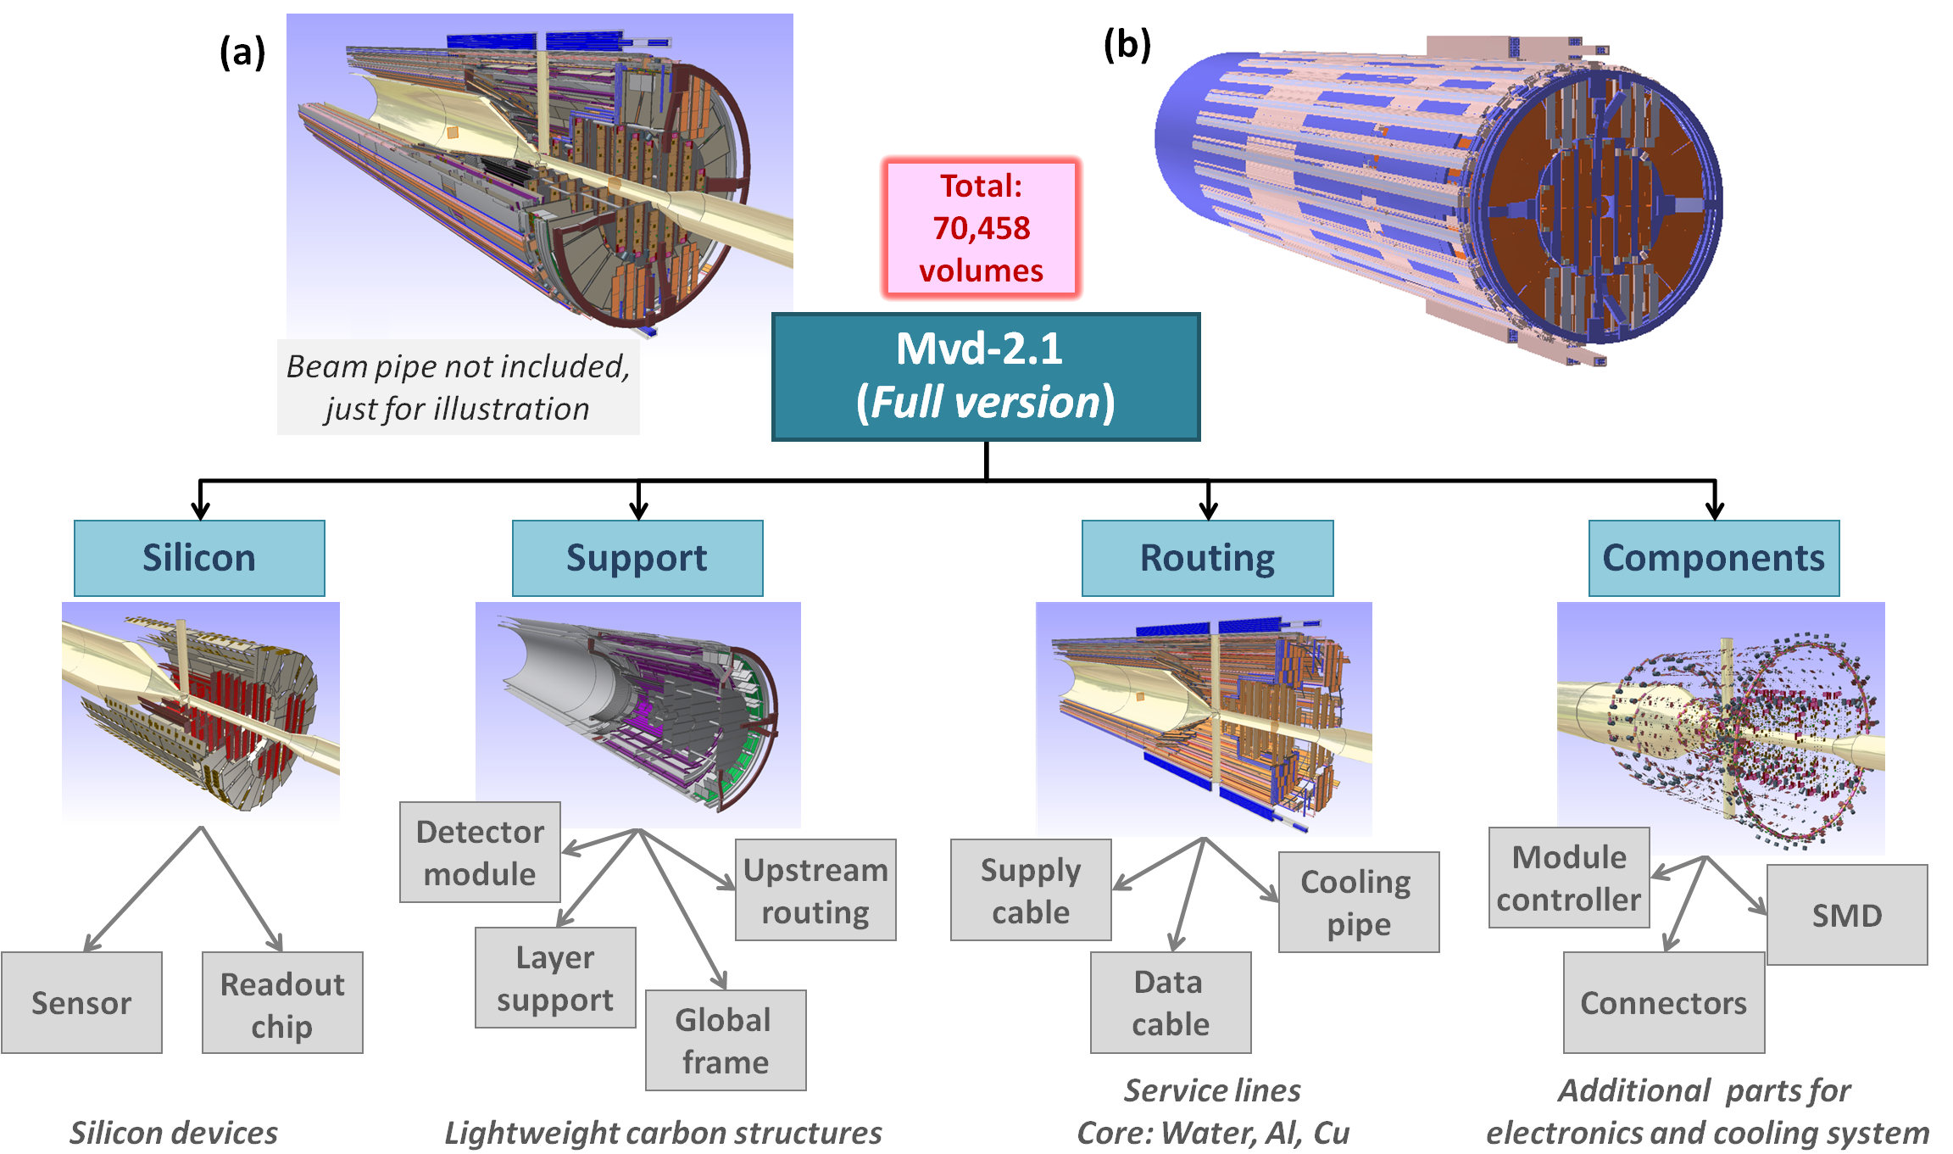
Detector description with CAD Converter

Slide 8
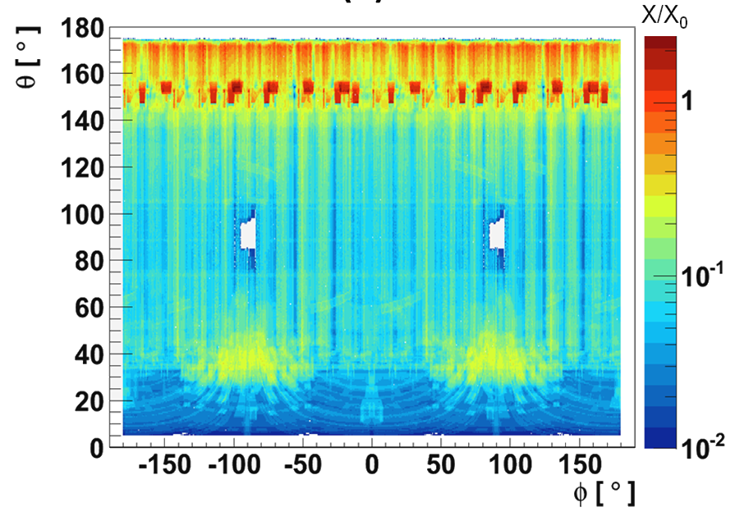
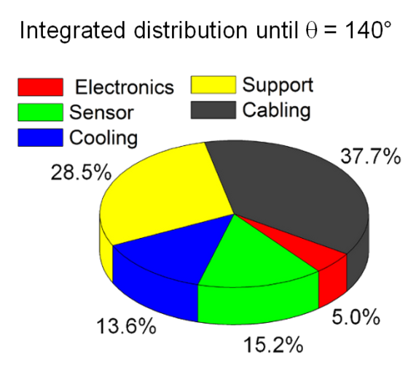
Radiation length of MVD
Map of radiation length
Radiation length of different
detector parts
Detailed map of radiation length used for detector optimization

Slide 9
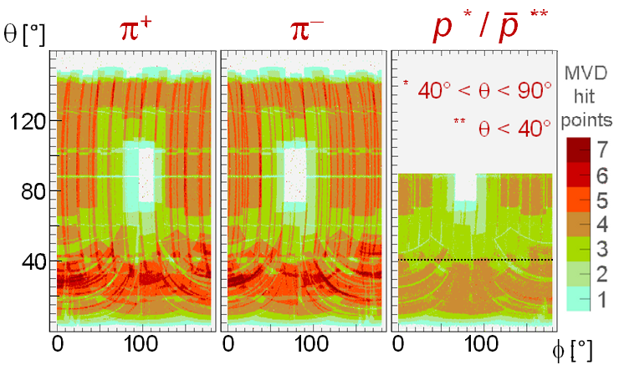
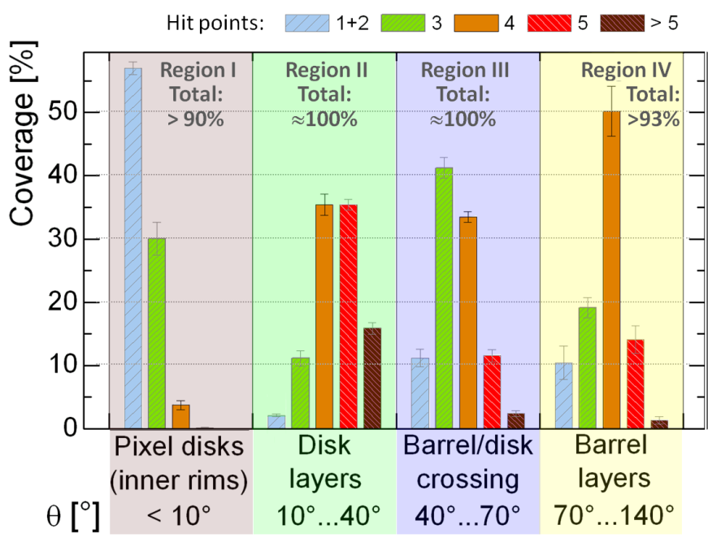
Hitpoints per track
Hitpoints per track for different
theta angles
Map of hitpoints per track
Detailed map of hitpoints per track used for detector optimization

Slide 10
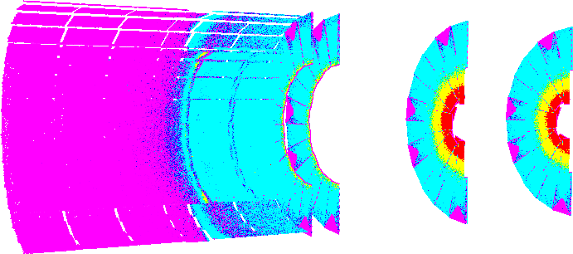
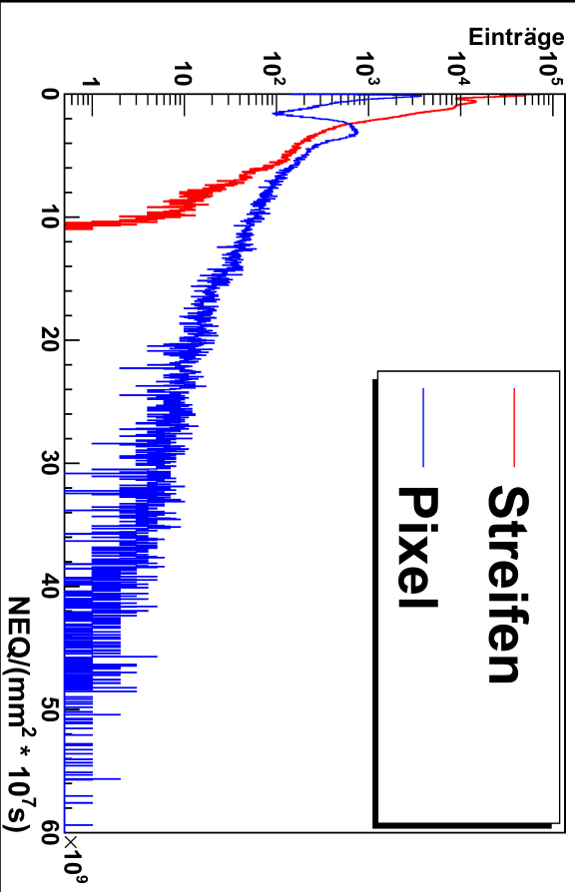
Radiation damage
Radiation damage distrubution for 15 GeV/c on p target
Strips
Pixel
Simulation of radiative environment as input for the electronics/sensor development

Slide 11
Digitization

Slide 12
Digitization
Available in the code:
  Charge distribution in pixel/strip based on linear model between entry and exit point and charge diffusion
  Triangular model of preamplifier
  Generator for noisy hits
  Time structure of readout
Simulations done:
  Count/data rates
  Charge resolution
  Time resolution
What is missing in the code?
  Magnetic and electric field effects for charge diffusion
  More realistic model of preamplifier

Slide 13
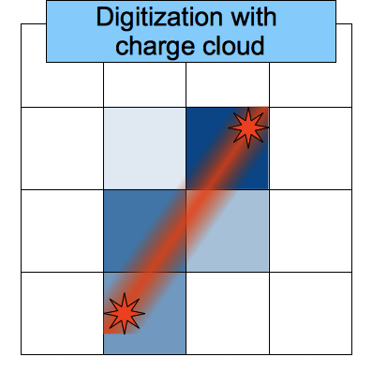
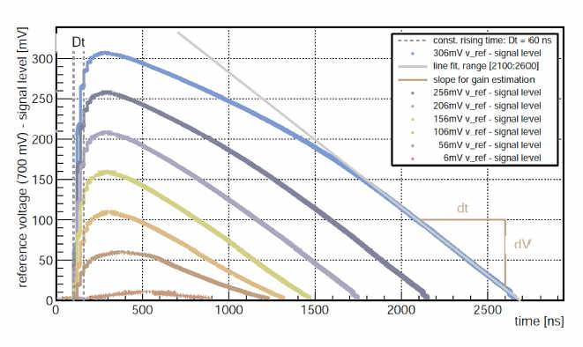
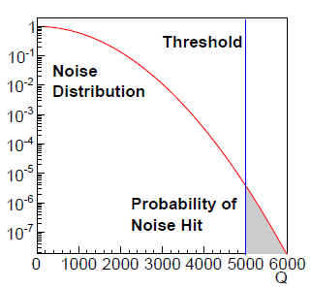
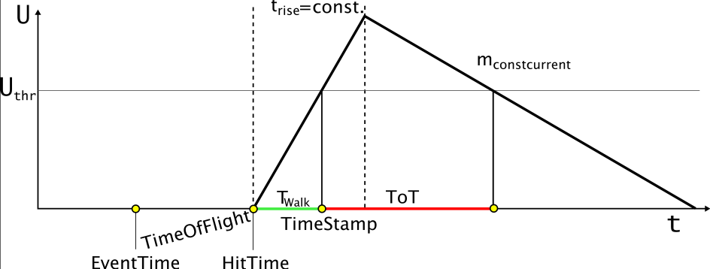
Digitization
Measured pulse shape ToPix2
Noisy pixel generation
Preamp model pandaRoot

Slide 14
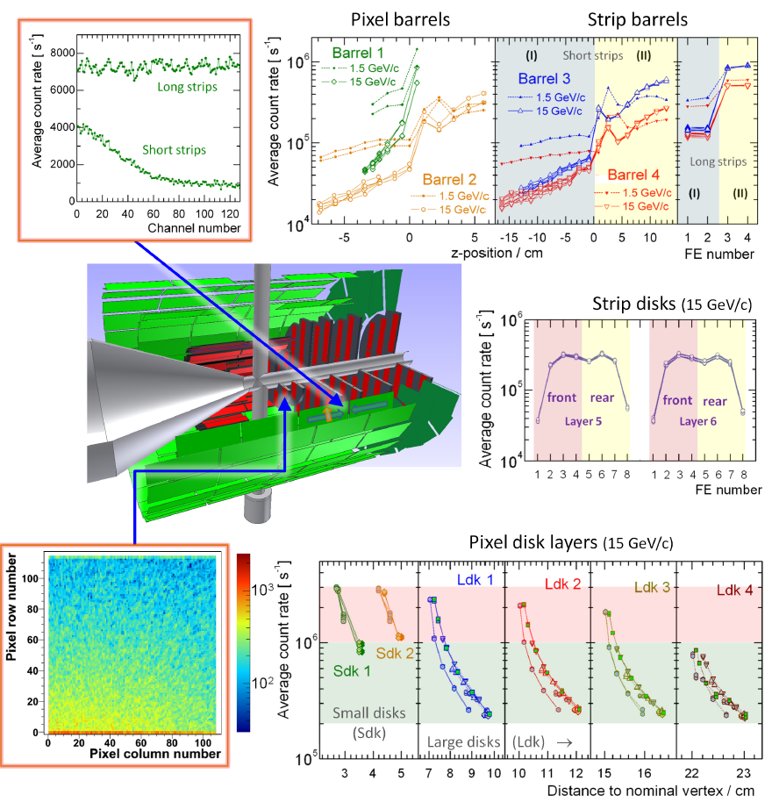
Count rate studies
Simulation of the count / data rates for the complete MVD, sensors, FE, pixel
Open point: realistic time structure for different targets

Slide 15
reconstruction

Slide 16
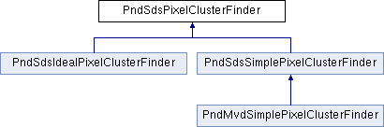

Reconstruction - Clusterizer
Available in the code:
  Ideal Cluster Task
  Radius Pixel Cluster Task
  Next Neighbors Strip Cluster Task
Simulations done:
  Test of functionality
What is missing in the code?
  Time information in cluster finder task
  for pixels
What simulations should be done?
  Time based clusterization

Slide 17
Reconstruction – Point Reconstruction
Available in the code:
  Ideal Reconstruction Task
  Charge weighted back mapping
  Head-/Tail-Algorithm
  η-Distribution
Simulations done:
  Point resolution of single hit
  Energy resolution of cluster
What is missing in the code?
  Additional reconstruction algorithms
What simulations should be done?

Slide 18
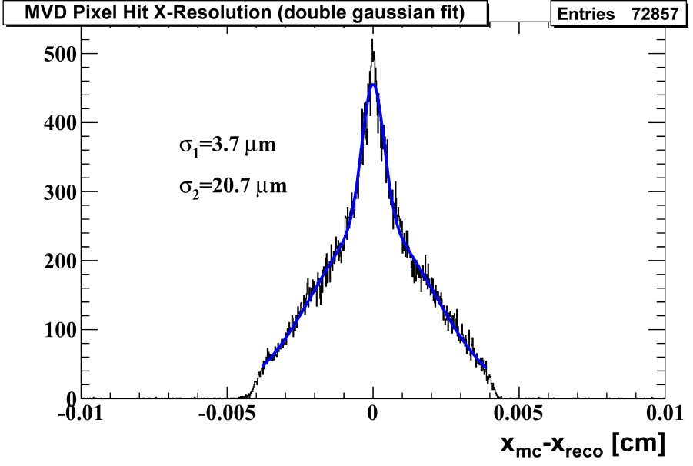
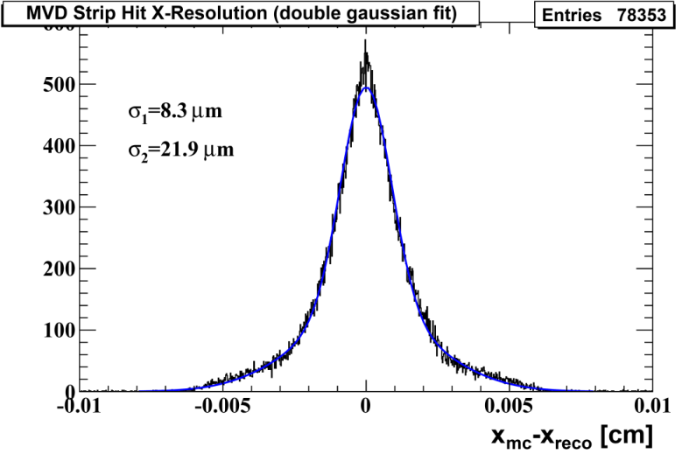
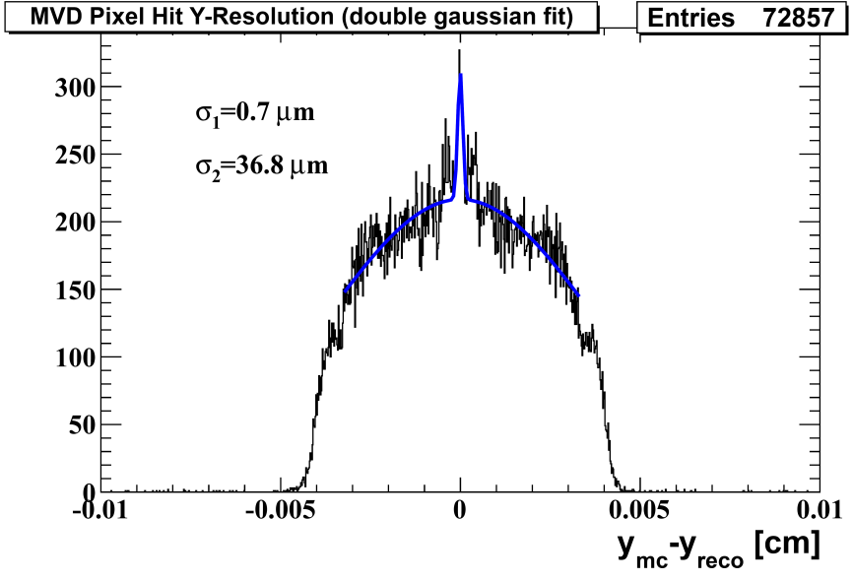
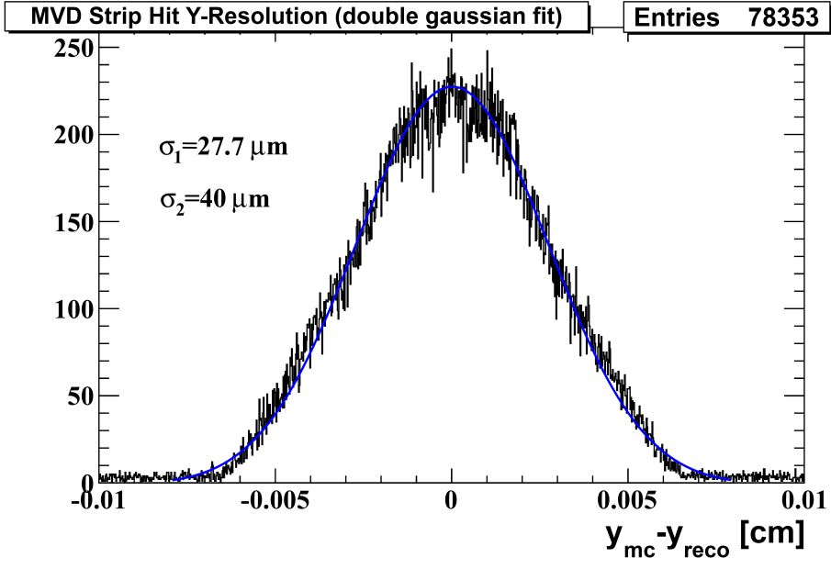
Point resolution for single 1 GeV/c Pi⁺
Pixel x-Coordinate
Strip x-Coordinate
Pixel y-Coordinate
Strip y-Coordinate
Point resolution depends on ratio of single / multiple hits

Slide 19
Reconstruction – Additional tools
Available in the code:
  TimeWalk correction
  PID with MVD
  DAQ-Interface for testbeam data
Simulations done:
  Time resolution after TimeWalk correction
  PID capabilities of MVD
  Analysis of testbeam data
What is missing in the code?
  Comparison of time resolution measurements between test beams and simulation
What simulations should be done?
  PID capabilities with thinner sensors
  Time based reconstruction

Slide 20
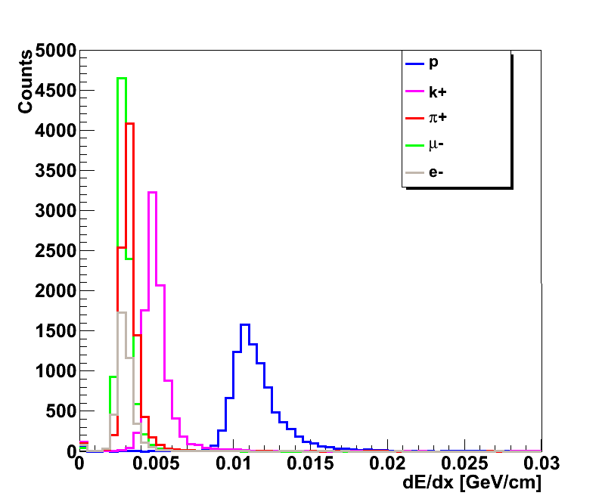
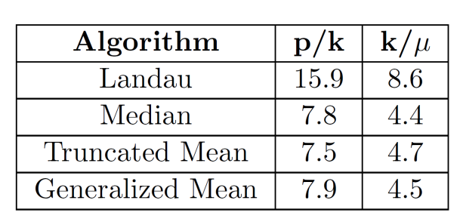
PID
Median distribution of tracks at 500 MeV/c
Separation power at 500 MeV/c
Different PID algorithms tested for momenta below 600 MeV/c

Slide 21
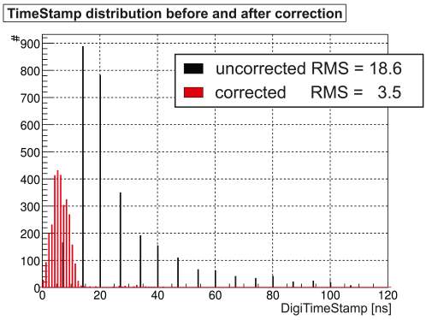
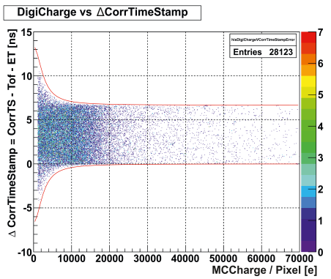
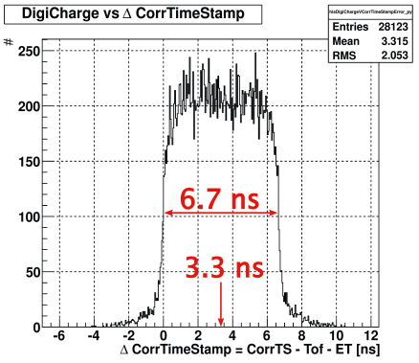
Time resolution of MVD
Time distribution before and after correction
Timing error vs. Deposited charge
Timing error vs. deposited charge

Slide 22
Reconstruction – TrackFinding
Available in the code:
  Ideal Track Finder
  Riemann Track Finder
  Combined MVD+CT+GEM Track Finder
Simulations done:
  Track finding efficiency with different parameter settings for track finders
What is missing in the code?
  Improvement of speed for Riemann Track Finder
  Finding of particles with (strongly) misplaced vertices
  Forward track finding
What simulations should be done?
  Test of new algorithms / parameter sets
  Evaluation of different track finding strategies

Slide 23
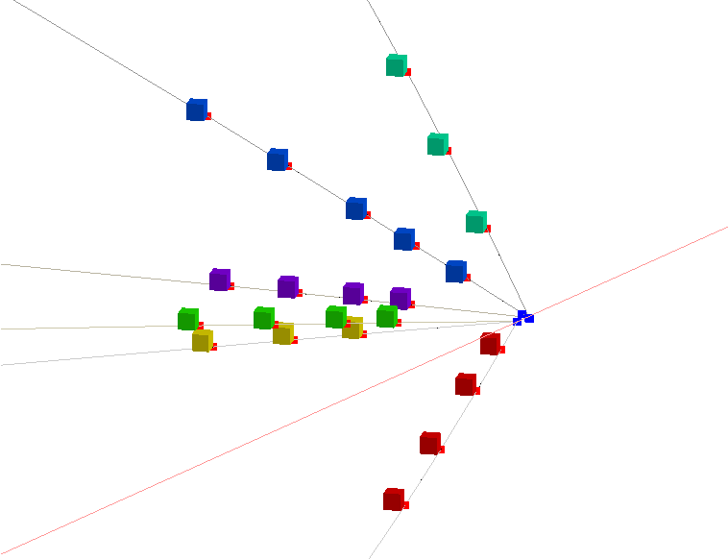
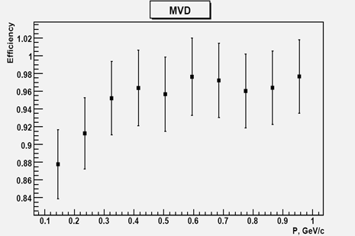
Riemann Track Finder
Efficiency for tracks with more than
three points in MVD
Very good efficiency of above 95 % of possible tracks
Track finding possible for delayed tracks

Slide 24
Reconstruction – TrackFitting
Available in the code:
  Riemann (Pre-)Fit
  Combined MVD+CT+GEM (Pre-)Fit
  Kalmanfilter Fit
  Ideal Forward Tracking
Simulations done:
  Momentum resolution
What is missing in the code?
  Realistic Forward Tracking
What simulations should be done?
  Test of forward tracking once a realistic forward fitter is available

Slide 25
Reconstruction – Vertex Finding / Fitting
Available in the code:
  Kinematic (Vertex) Fitter as part of Rho
  POCA Finder
  Linearized Fitter
Simulations done:
  Tests of fitters/finders done
  Use of fitters for physics simulations
What is missing in the code?
  Improve performance of vertex fitter
  Different (faster) algorithms
What simulations should be done?
  Validation of fitters

Slide 26
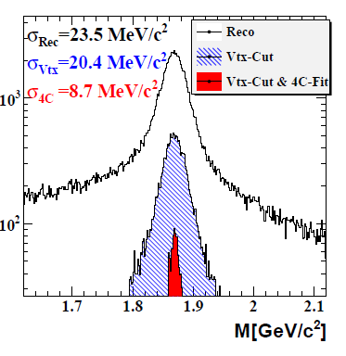
D-Meson Vertex Resolution (MVD + STT, after Vertex Fit)
x (Reco – MC) [cm]
y (Reco – MC) [cm]
z (Reco – MC) [cm]
σ_{x} = (53.75±0.02) µm
σ_{y} = (53.67±0.02) µm
σ_{z} = (103.8±0.1) µm
x (Reco – MC) [cm]
y (Reco – MC) [cm]
z (Reco – MC) [cm]
σ_{x} = (56.63±0.02) µm
σ_{y} = (53.86±0.02) µm
σ_{z} = (104.8±0.1) µm

Slide 27
Reconstruction – Event Reconstruction
Available in the code:
  Event Mixing of different signals with background data
  Time based simulation as part of FairRoot
  No need to redo lengthy MC transport simulation (old data can be reused)
Simulations done:
  Test of functionality
What is missing in the code?
  Implementation of time based simulation in subdetectors
  Algorithms to handle time stamps in reconstructions
  Algorithms to do Event Building
What simulations should be done?
  Redo digitization / reconstruction / analysis

Slide 28
Summary
The code of the MVD is in very good shape
Most of the necessary tools are available and the needed simulations were done
Some smaller optimizations of the code are on their way
Open points:
  Forward tracking
  Refactorization

