Slide 1
MVD services integration
G. Giraudo
GSI 4th July 2012

Slide 2
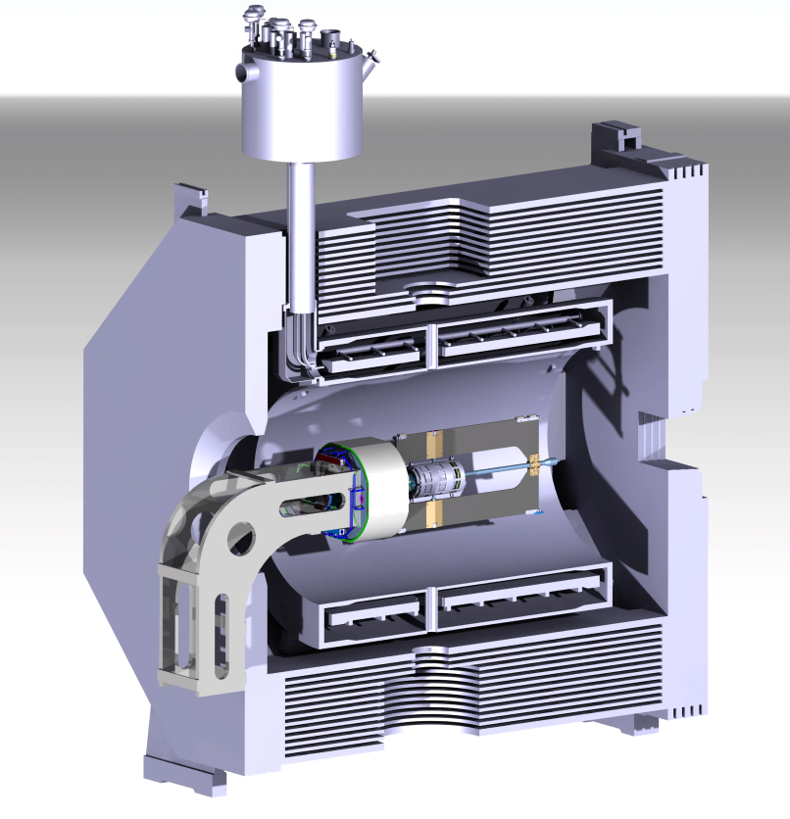
CENTRAL REGION – ACTUAL DESIGN
STT & CENTRAL SUPPORT FRAME
BACKWARDS EMC
MVD
SUPPORT FOR BACKWARDS EMC
G. Giraudo
GSI 4th July 2012

Slide 3
MVD General Properties
Parameters | Pixel | Strip
# of SuperModules # of DetectorModules # of Sensors # of FrontEndChips Total Power Volume | 66 176 176 810 1.4 kW ~6.4 dm³ | 70 140 254 1324 1.8 kW ~18 dm³
G. Giraudo
GSI 4th July 2012

Slide 4
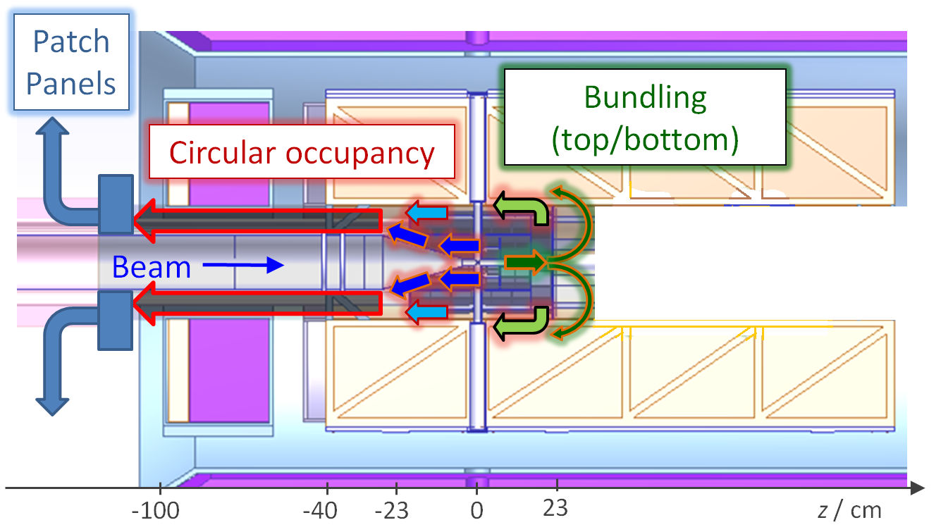
MVD services routing
G. Giraudo
GSI 4th July 2012

Slide 5
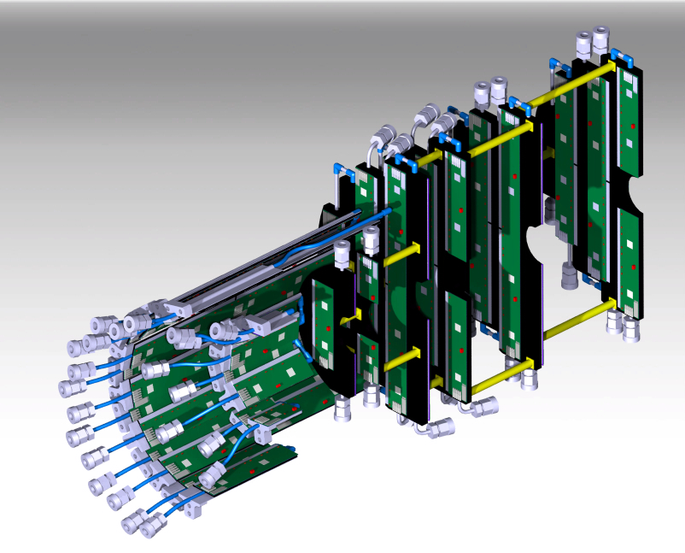
MVD Cooling
Pixel Cooling Lay-out
IN/OUT 25 channels
OUT - 21 channels
IN/OUT 25 channels
G. Giraudo
IN - 21 channels
GSI 4th July 2012

Slide 6
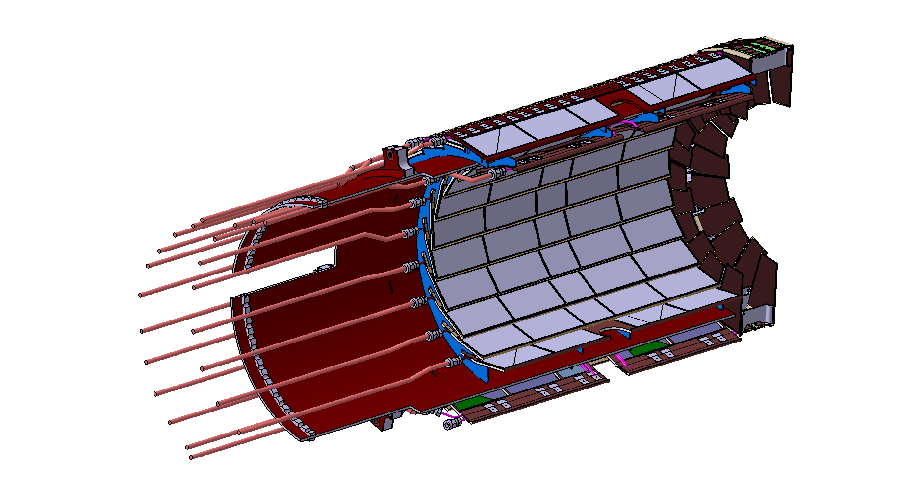
Strip Cooling Lay-out
OUT - ? channels
OUT - 23 channels
IN - ? channels
IN - 23 channels
G. Giraudo
GSI 4th July 2012

Slide 7
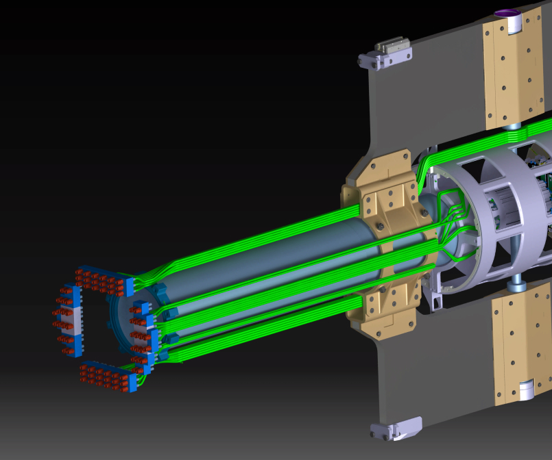
Stiffener must be reduced
Patch Panel for Cooling Manifolds
Polyurethane flex tubes Ø4xØ2.5
Pressure Sensors?
Accessible from outside.
G. Giraudo
GSI 4th July 2012

Slide 8
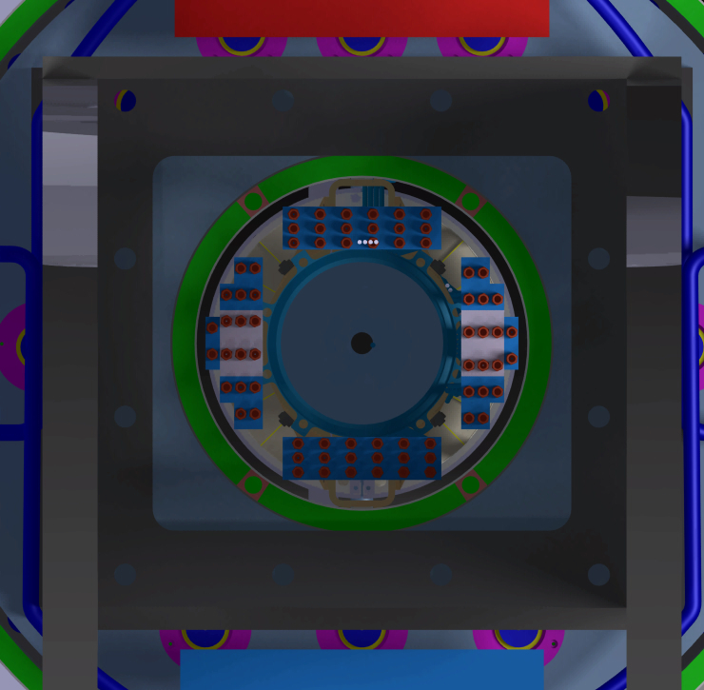
Cooling Patch Panel – dimensional constraint
Ø300 mm
Ø150 mm
G. Giraudo
GSI 4th July 2012

Slide 9
MVD Read Out Electronics
Parameter | Pixel | Strip | Power (W)
GBT | 122 | 26 | 350
DC-DC Conv. | 596 | 1322
GBT → 60 x 25 x (10÷14)
DC-DC conv. → 28.4 x 13.5 x 12
G. Giraudo
GSI 4th July 2012

Slide 10
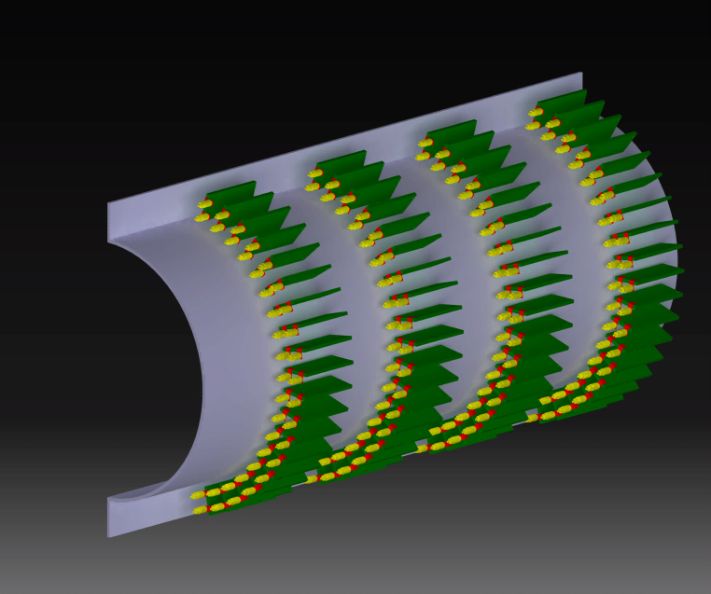
GBT Arrangement Preliminary design.
74 GBT boards in 4 lines (half MVD)
Base Support & Cover act as Thermal Screen
System coupled with the beam pipe
Routing of the optical fibres & cables must be evaluated.
Ø_{in} 222 mm
Ø_{ex} 298 mm
L 600 mm
VERY PRELIMINARY
G. Giraudo
GSI 4th July 2012

Slide 11
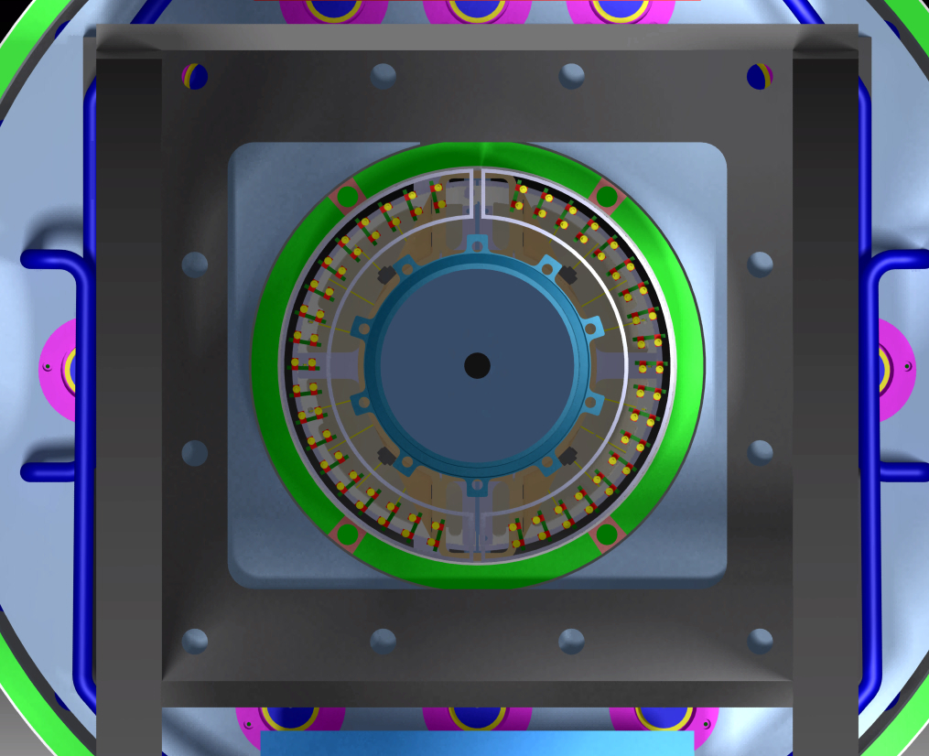
Ø222 mm
1 mm clearance
Ø298 mm
G. Giraudo
GSI 4th July 2012

Slide 12
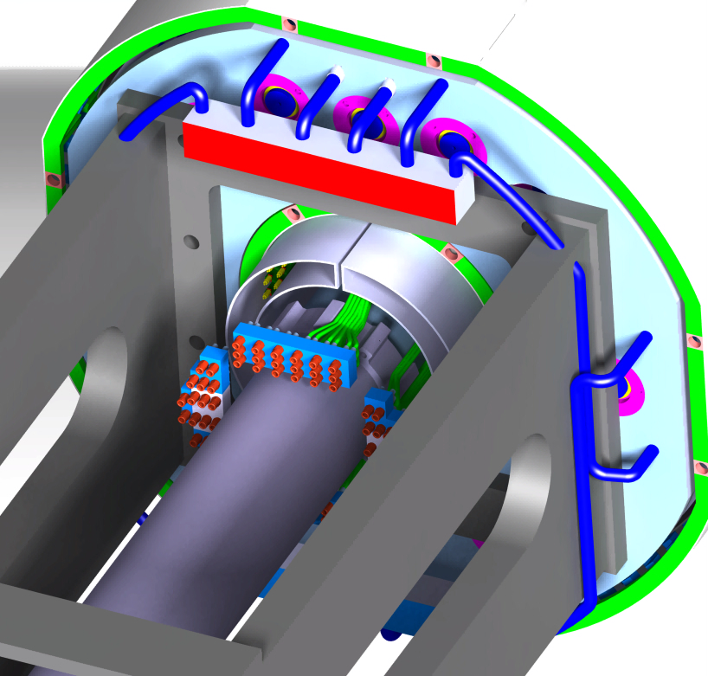
TOWARD THE PATCH PANEL
TOWARD THE PATCH PANEL
TOWARD THE COOLING
PATCH PANEL
TOWARD THE COOLING
PATCH PANEL
G. Giraudo
GSI 4th July 2012

Slide 13
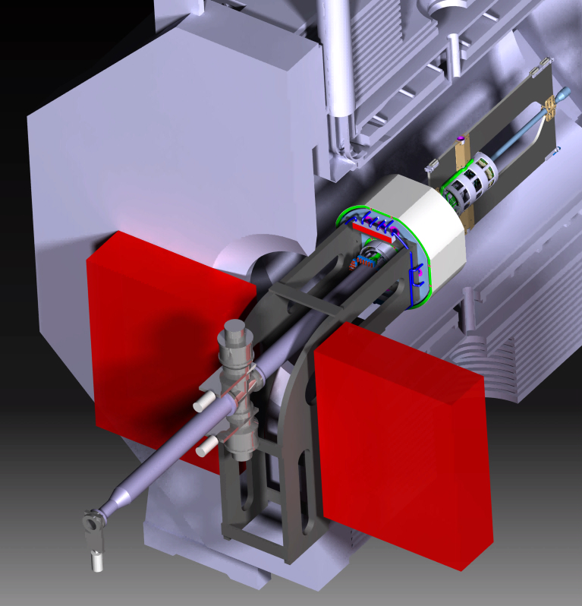
VOLUME FOR MVD SERVICES
1200x1500x400mm OUTSIDE THE MAGNET DOORS
Cooling manifolds
Pressure transmitters
DC-DC converters
Cooling for DC-DC converters
(Water at 5 bar)
Cooling manifolds
Pressure transmitters
DC-DC converters
Cooling for DC-DC converters
(Water at 5 bar)
G. Giraudo
GSI 4th July 2012

