Slide 1
MVD updates - mechanics
G. Giraudo
Paris 11 Set. 2012

Slide 2
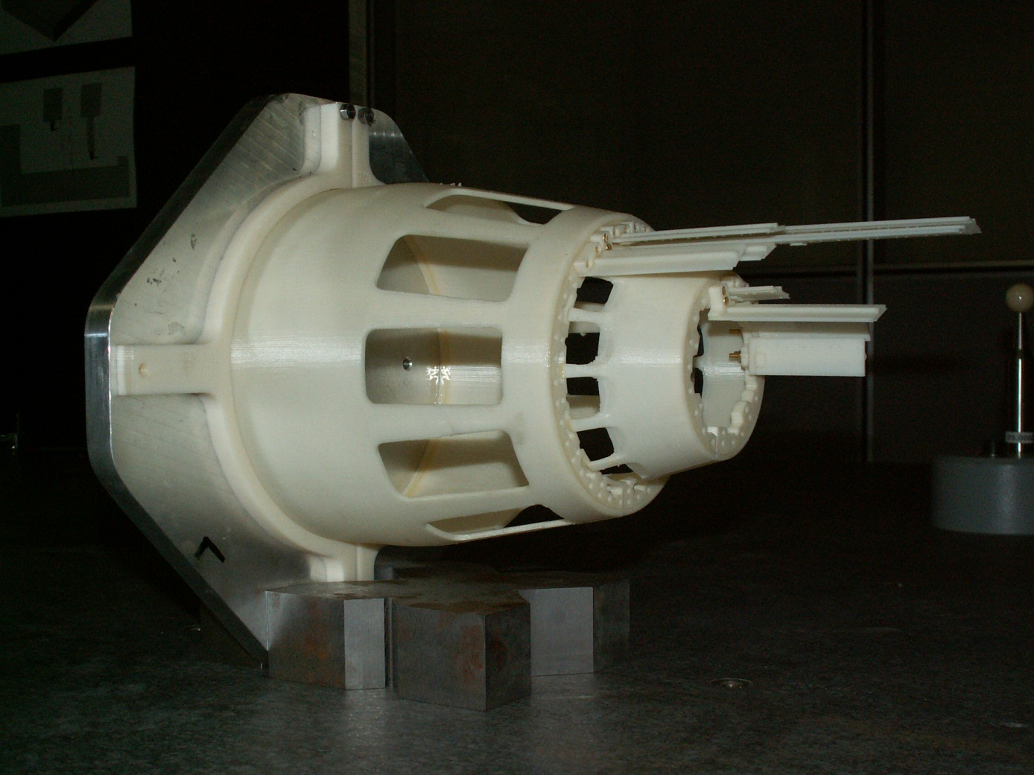
A mechanical model of the MVD’s pixel support is ready (prototype 1.0)
The model has been made in Frascati (LNF) – Rapid prototyping (3D printing)
The aim of this model → geometry (space and interferences)
assembly procedure
services routing
IT IS NOT A STRUCTURAL MODEL
ABS is a soft material.
G. Giraudo
Paris 11 Set. 2012

Slide 3
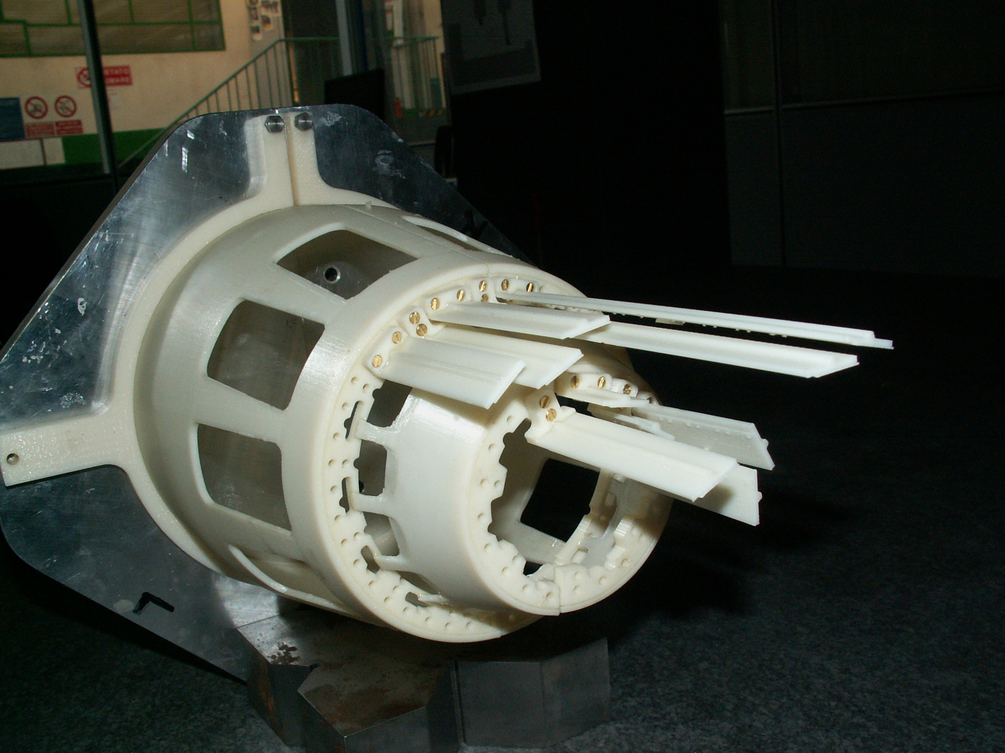
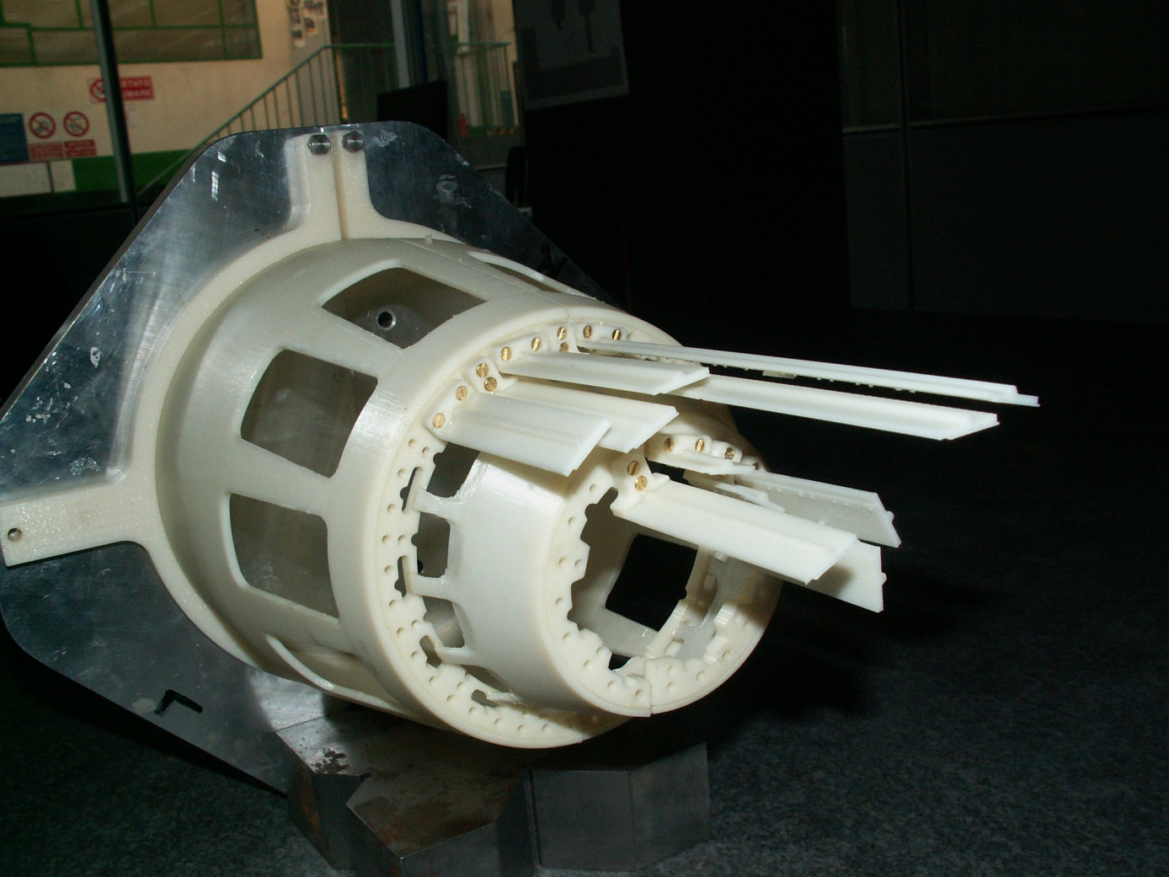
Correction of connection critical point.
NEXT STEPS
More material in the interface area
G. Giraudo
Paris 11 Set. 2012

Slide 4
The study of the MVD’s services routing started:
4th July restricted Technical Board (GSI)
Several integration problems isolated:
Backwards EMC inner diameter
Support structure for Backwards EMC
Temperature reached by the MVD’s electronics
Patch panel boxes in front of the magnet doors
Working group will start job ASAP
More in details….
G. Giraudo
Paris 11 Set. 2012

Slide 5
G. Giraudo
Paris 11 Set. 2012

Slide 6
G. Giraudo
Paris 11 Set. 2012

