Slide 1
R&D on MPGD technologies at GSI
P. Gasik

Slide 2
MPGD R&D at GSI
A test bench for R&D with MPGD structures
New prototypes (resistive MPGDs, Spark-Less Amplification Microstructures, new electrode materials)
Multi-MPGD, hybrid structures
Focus on working point optimisation (energy resolution, IBF, discharge stability) for TPCs and photon detectors
Currently, ongoing collaboration with TU Munich and TU Darmstadt
In the following: possible/ongoing R&D topics at GSI, without prioritisation

Slide 3
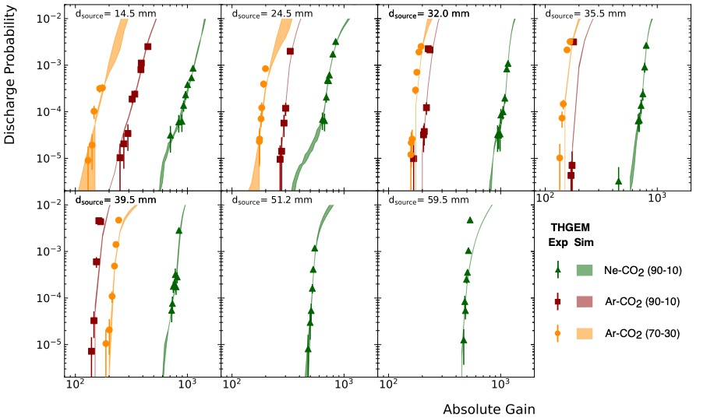
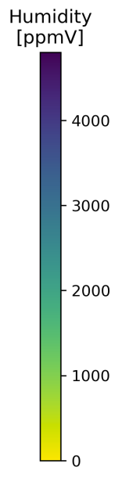
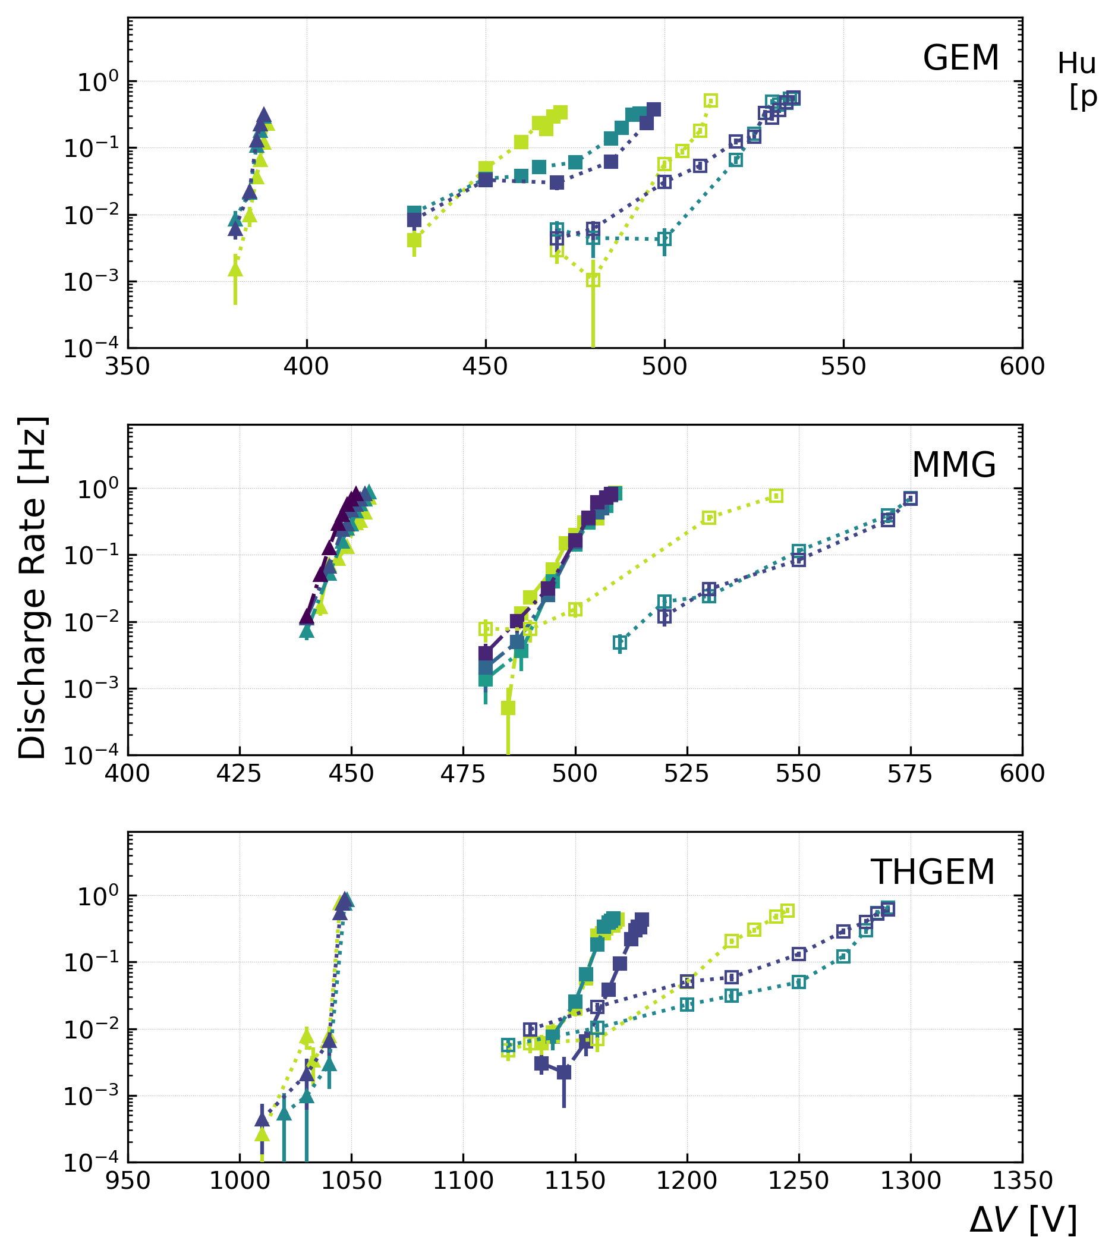
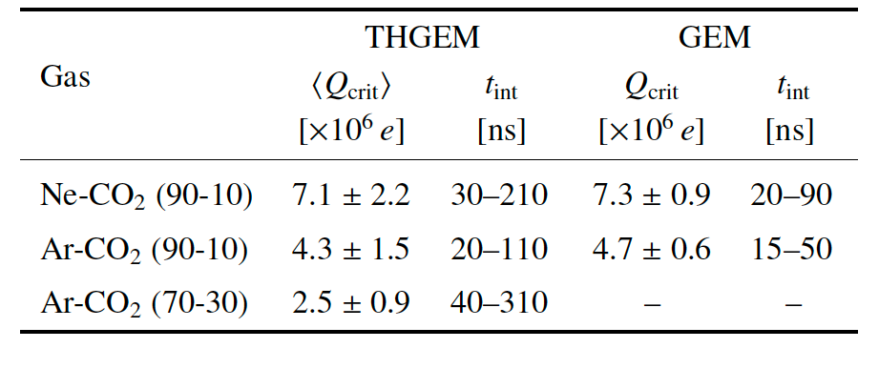
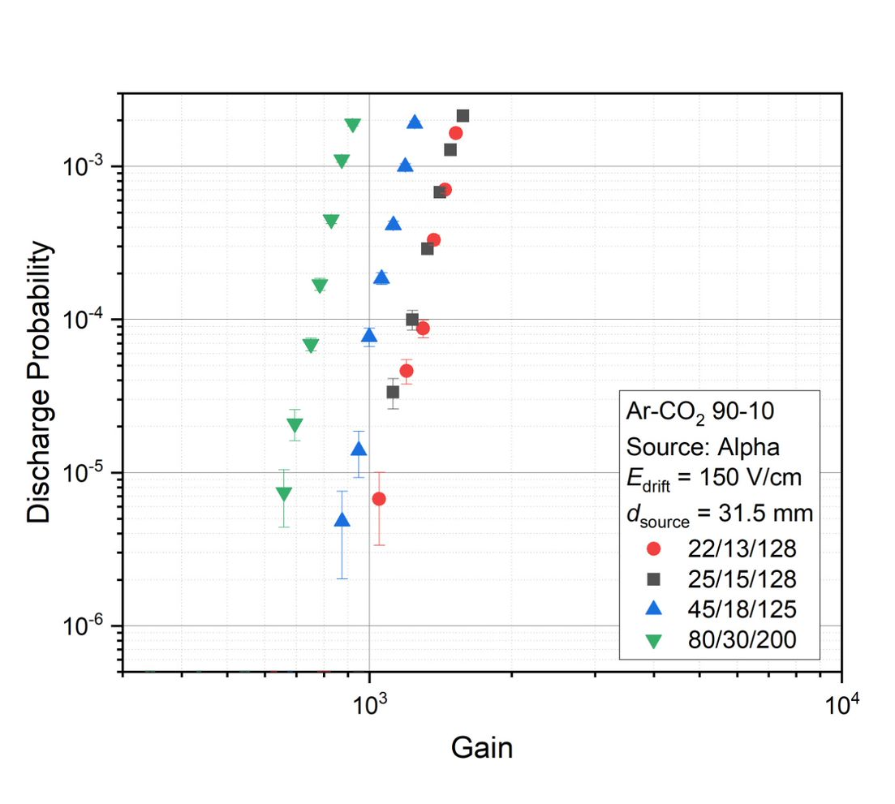
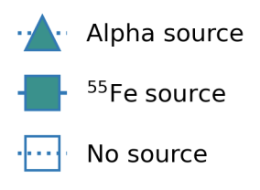
Recent activities (collaboration with TUM)
PG, L. Lautner et al., NIM A 1047 (2023) 167730
H. Fribert, PG et al. JINST 18 (2023) C06015 + RD51 Coll. Meeting
THGEM+GEM
PG, T. Waldmann et al.
JINST 18 (2023) C06011
MMG
LPI density

Slide 4
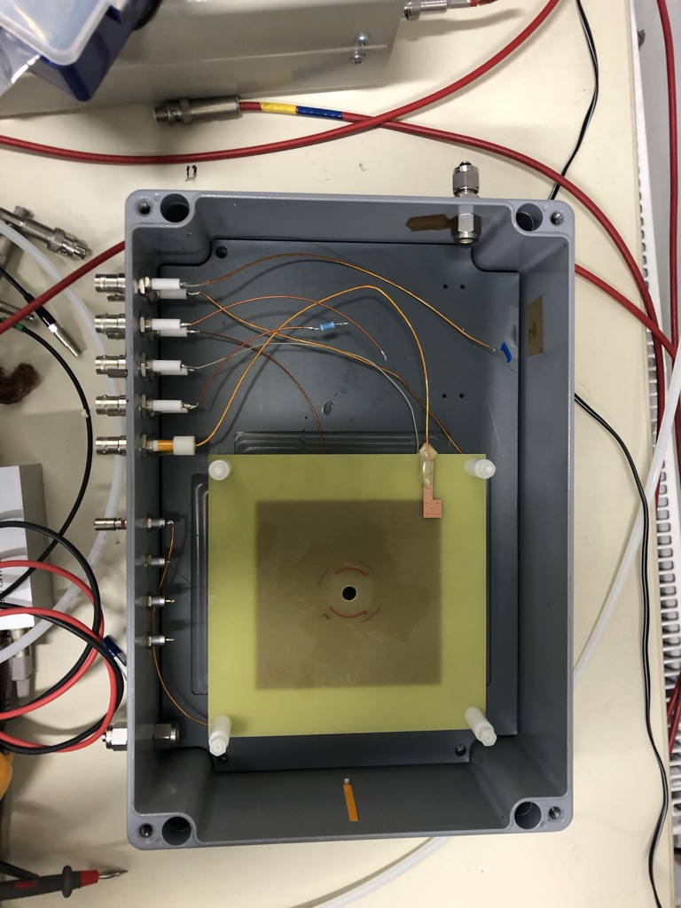
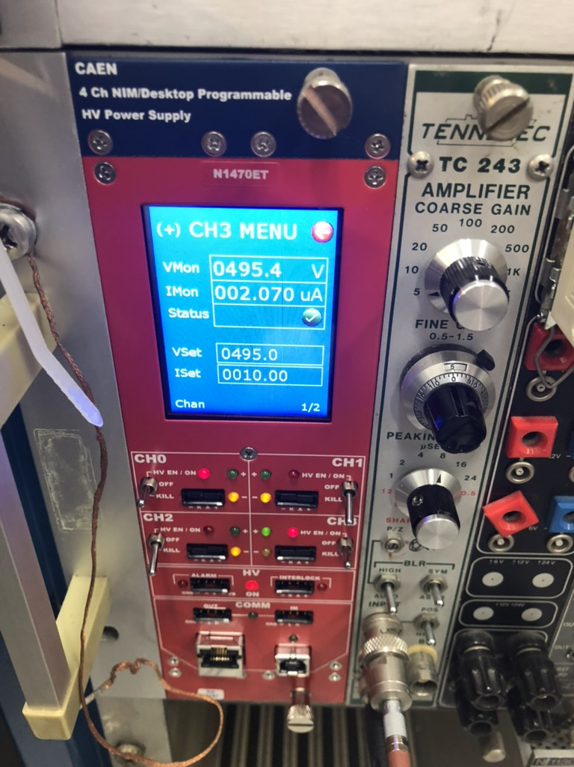
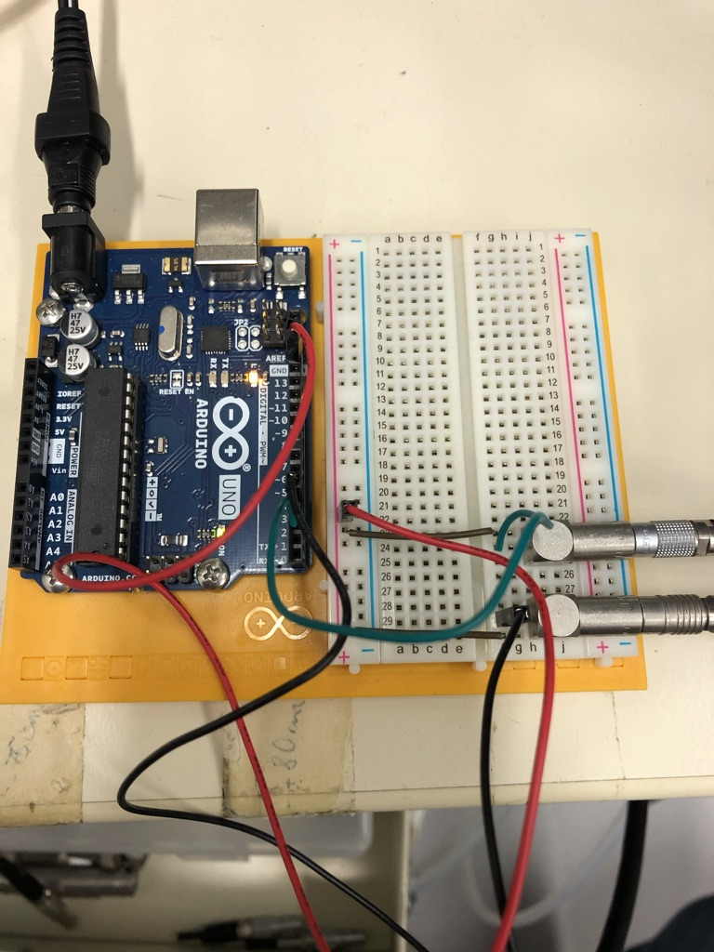
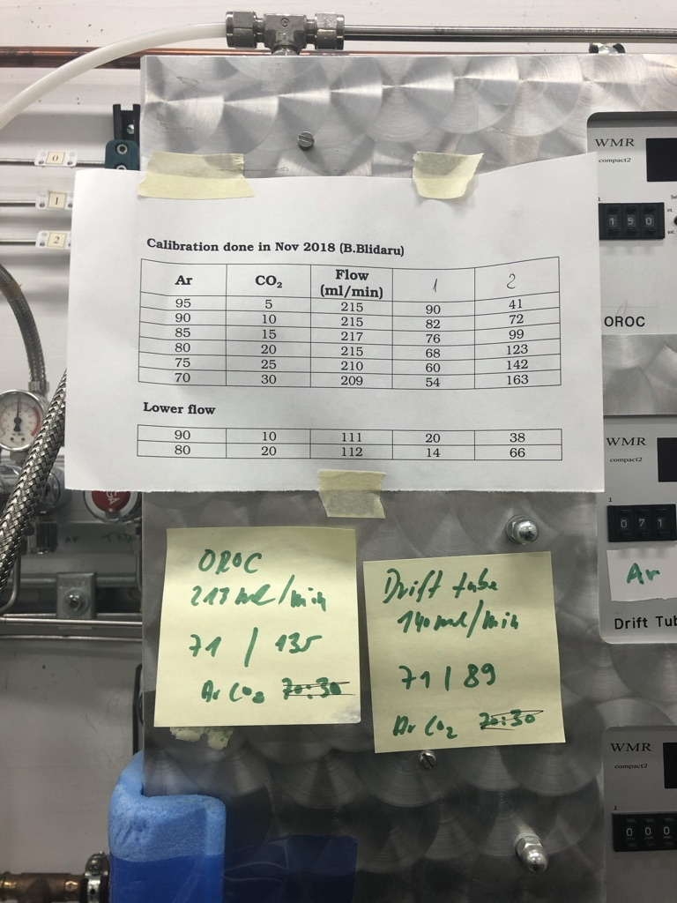
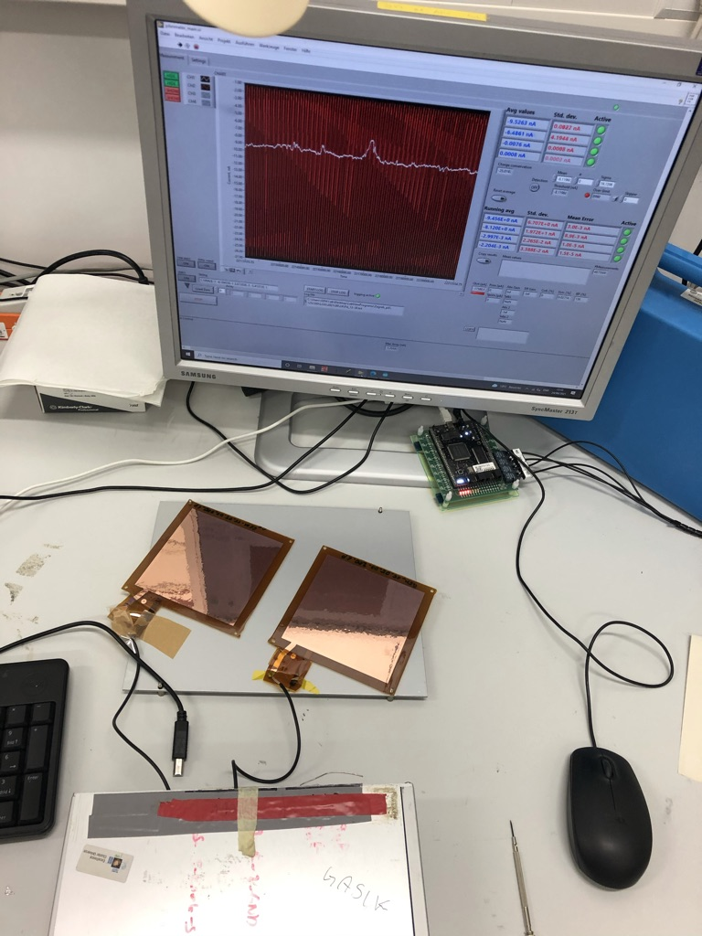
GSI R&D bench
(thanks to C.J. Schmidt, M. Kiš, J. Hehner, M. Traeger for invaluable help in organising the R&D bench)
Standard lab equipment (+ more) available
Gas lines, gas mixing unit
Oxygen meter
PC controlled:
HV system
HV pA-meter (ALICE TPC upgrade) – 24 ch
Keithley
ARDUINO controllers
Pre-amp + AMP readout
ADC, Scope
Contamination test

Slide 5
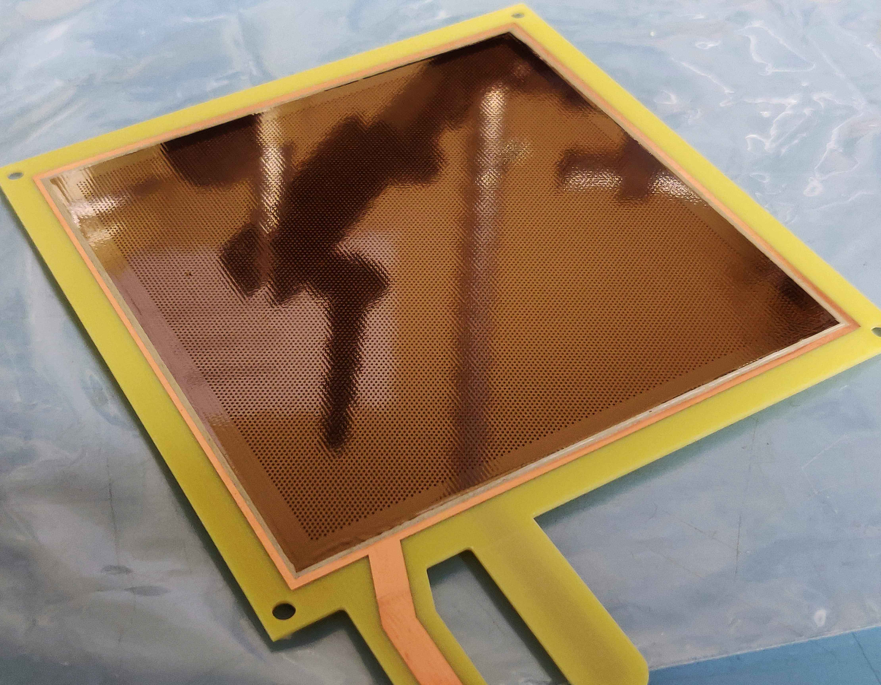
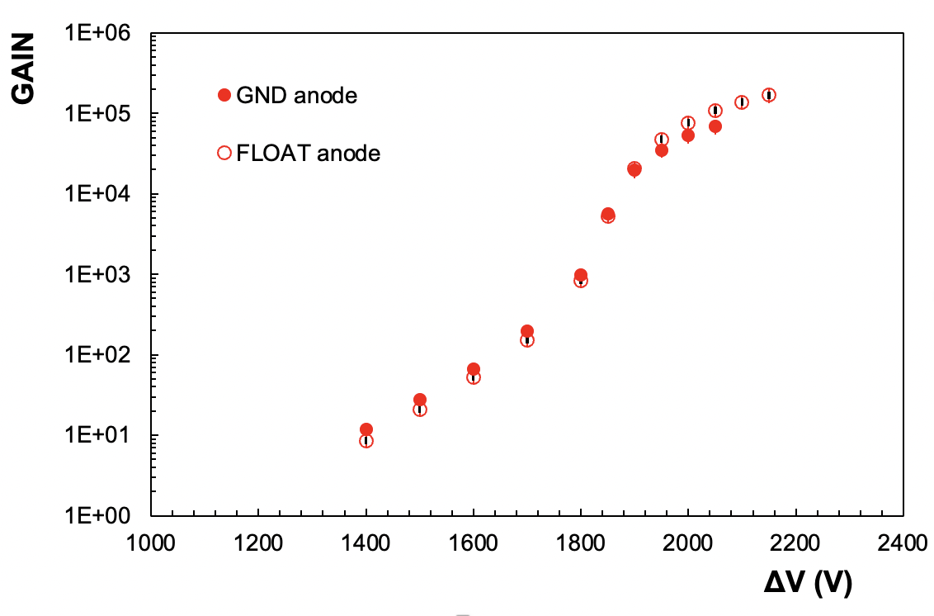
Resistive layers
Diamond-Like Carbon
Dedicated studies on resistive MPGDs launched at GSI DetLab Goal: characterise primary and secondary discharge stability of resistive DLC (TH)GEMs and micro-RWELL
An attractive option for future upgrades of, e.g. CBM MuCh system
DLC THGEM: clear quenching mechanism observed, no discharges recorded at the gains where 100% probability is expected from standard THGEM studies
Gain saturation was not observed, though!
DLC THGEM
∼20 MΩ/□
@GSI
DLC THGEM
Ar-CO₂ (90-10)

Slide 6
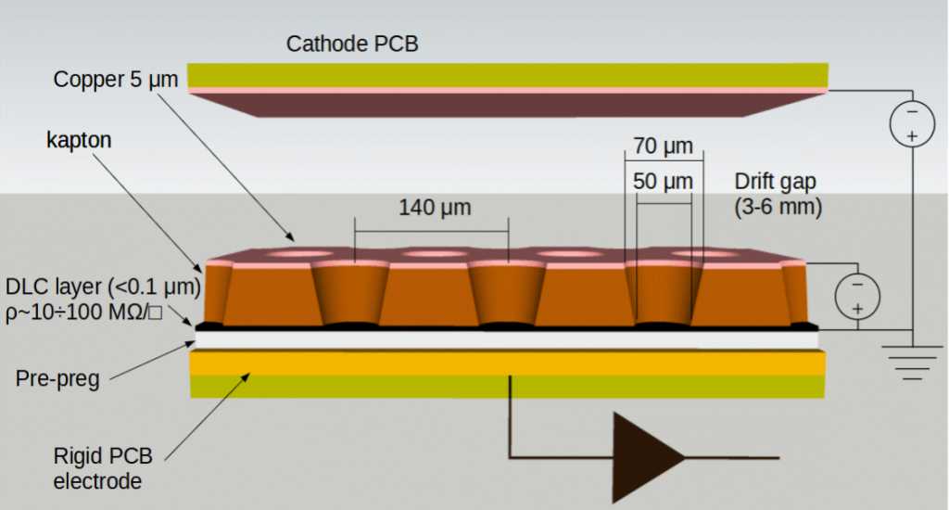
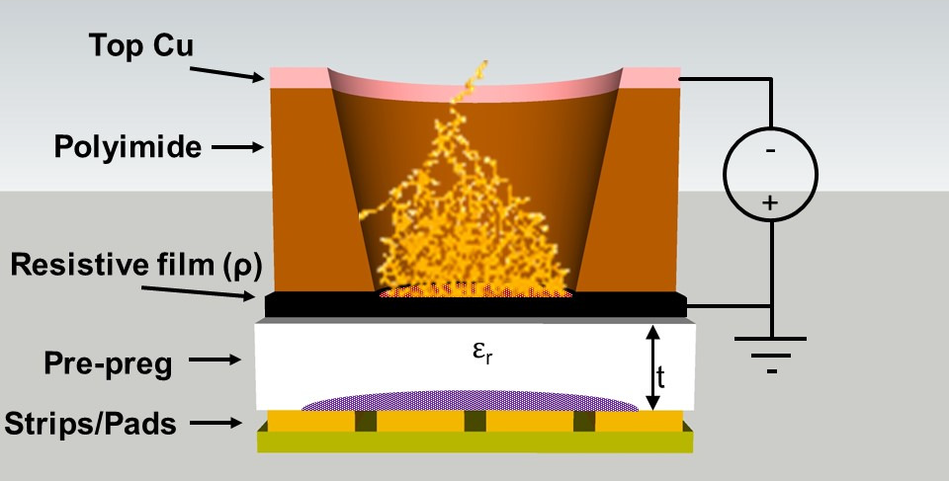
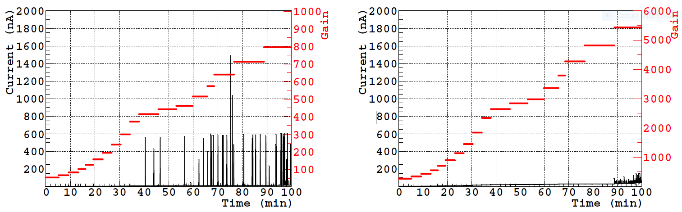
New structures: micro-RWELL
Single-sided Gaseous Electron Multiplier (GEM) coupled to the readout anode through the material of high surface resistivity
Single amplification stage ➙ material budget, simplicity, industrialization, costs!
Resistive layer ➙ suppression of the transition from streamer to spark, with a consequent reduction of the spark amplitude.
Starting soon @ GSI All components arrived!
G. Bencivenni et al., JINST 10 (2015) P02008
GEM
μ-RWELL

Slide 7
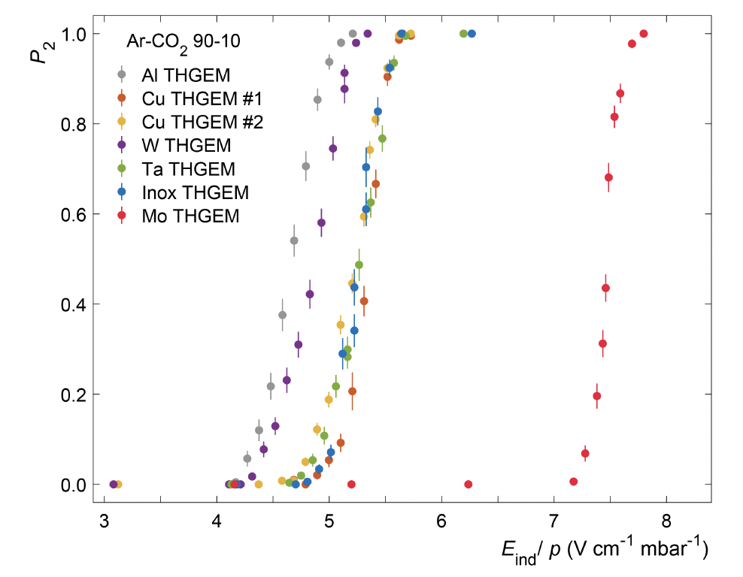
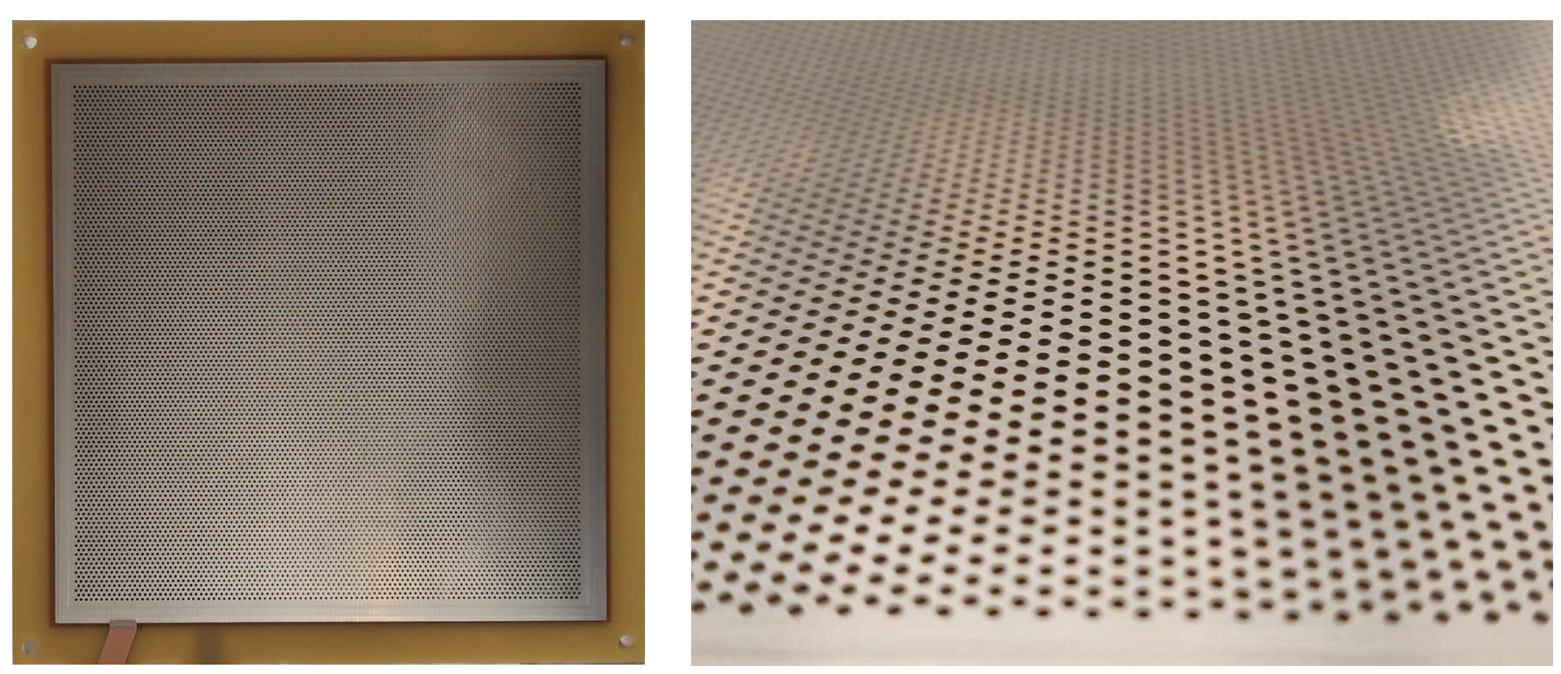
New electrode materials
Collaboration with TUM
B. Ulukutlu, PG, et al. A 1019 (2021) 165829
Mo layers promising in terms of secondary discharge stability
If confirmed, possible application in stacks using extreme HV settings
First, full-scale Mo-THGEM was produced and characterized
The preliminary results with the Mo-THGEM but also gold-coated standard THGEM point to the surface quality as a possible driving factor for enhanced secondary discharge probability (TUM + soon GSI).
Surface studies in preparation (profilometer at CERN, AFM in Pisa)
Single-hole THGEMs
Mo-THGEM @ TU München

Slide 8
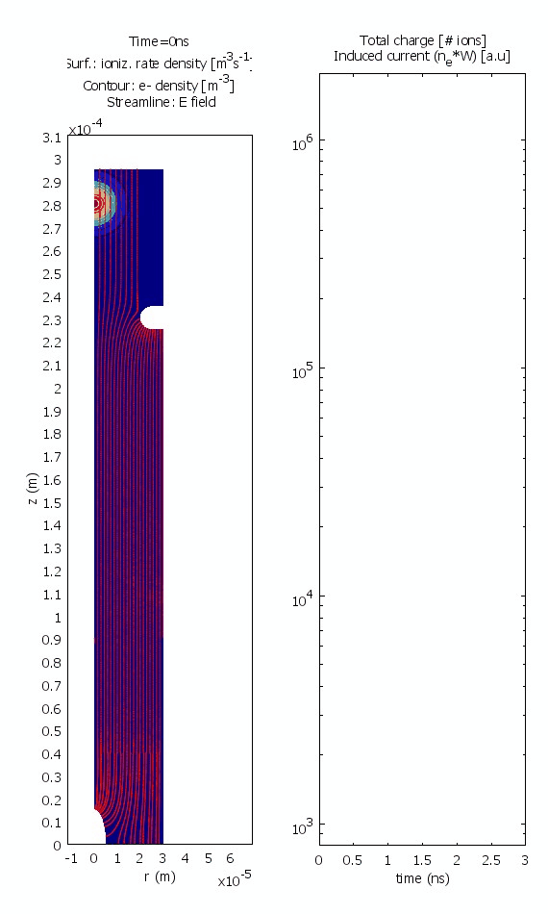
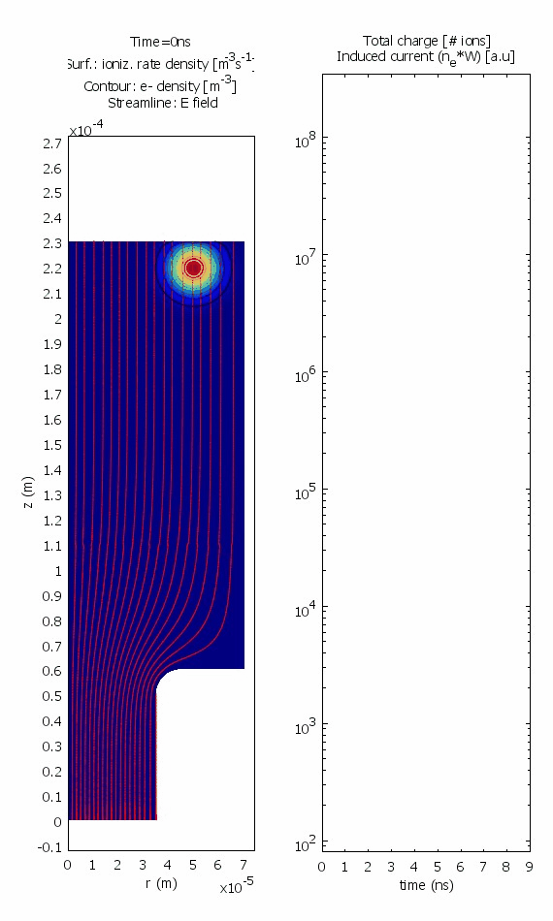
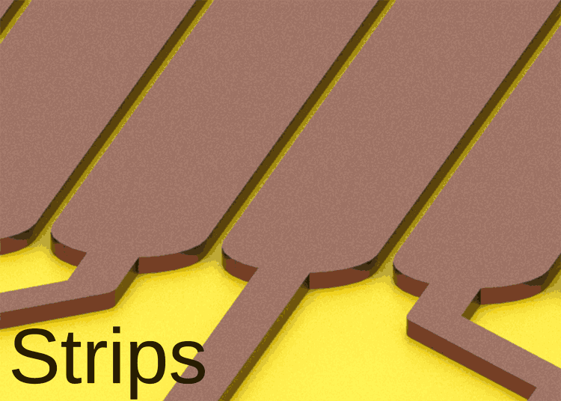
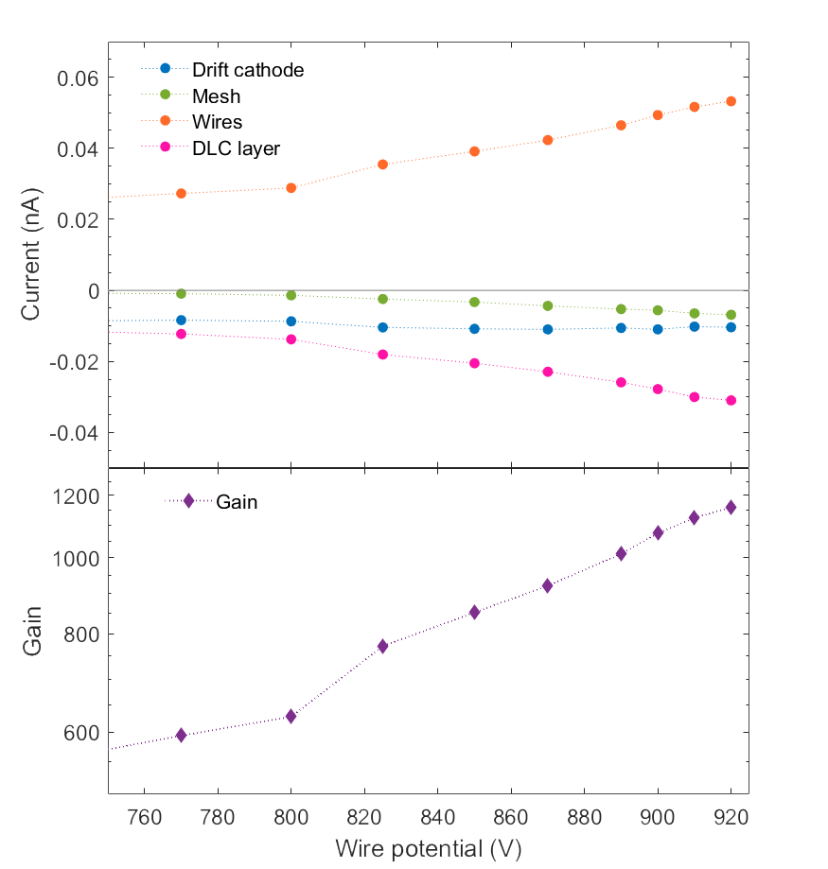
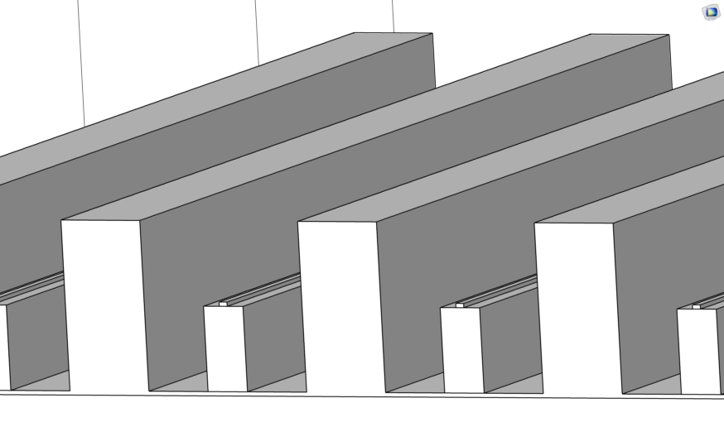
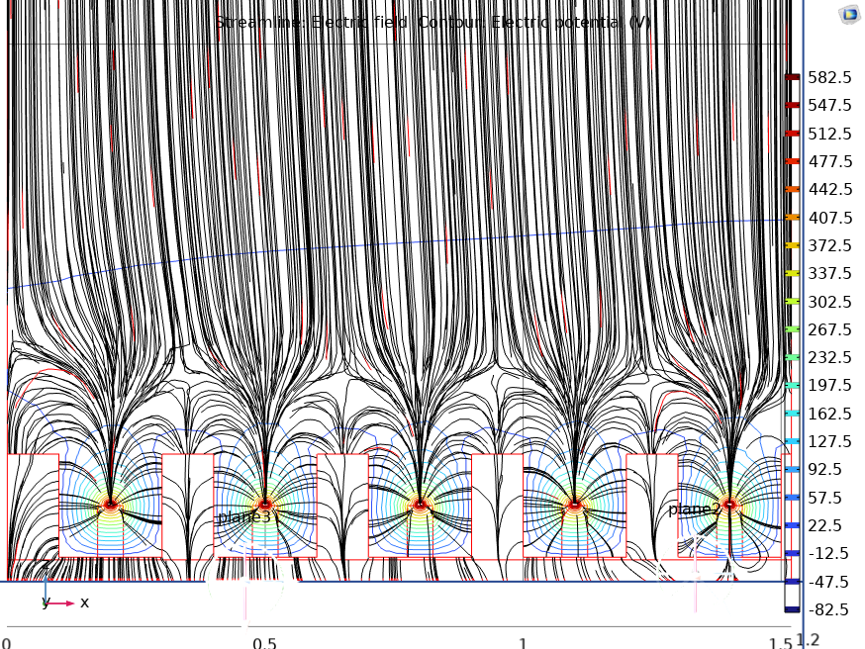
MPGDs in self-quenched-streamer mode?
Collaboration with TUM, CERN
Discharge probability could be reduced if a radial shape E-field is formed in the MPGD avalanche gap
Both simulation and R&D effort. Still need for optimization, but ideas on the market!
RD51 Common Project: Spark-Less Amplification Microstructures, V. Peskov, PG (2020-2023) – produced at CERN, measurements at GSI!
T. Waldmann, PG et al. JINST 18 (2023) C07009
Measurements at GSI and TUM
W-SLAM
Soon available
S-SLAM
Needle + InGrid
Cathodeless CAT
W-SLAM
P. Fonte, “Simulations of discharge phenomena”, RD51 Meeting, TU Munich 2018 (link)

Slide 9
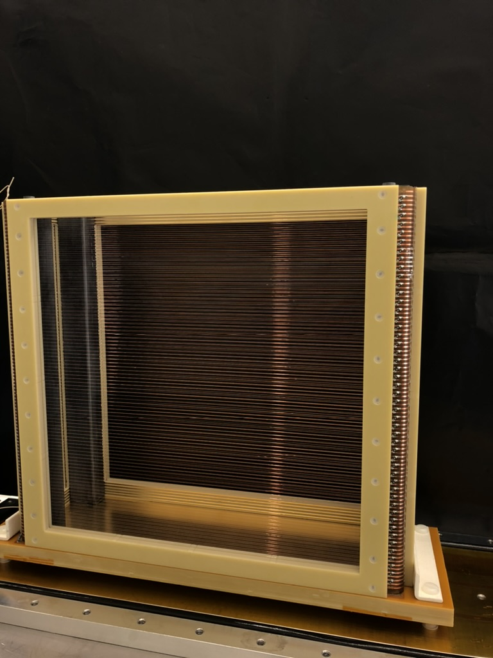
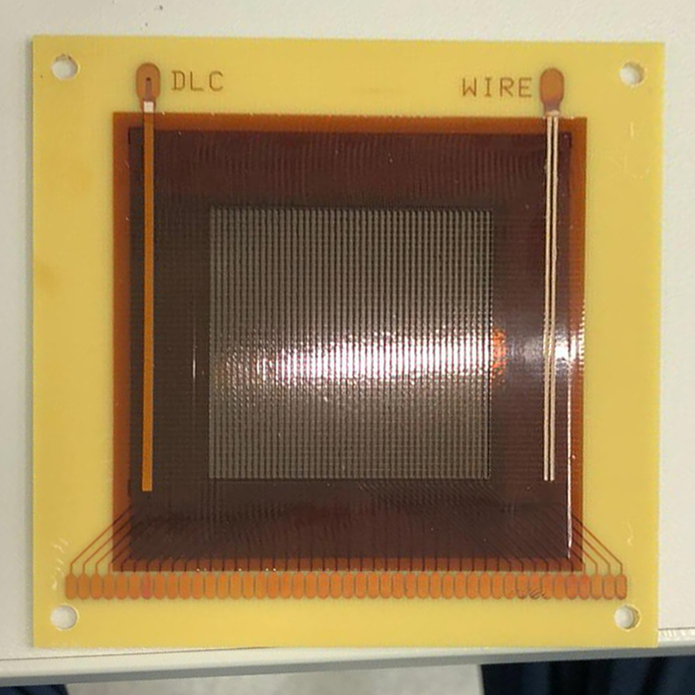
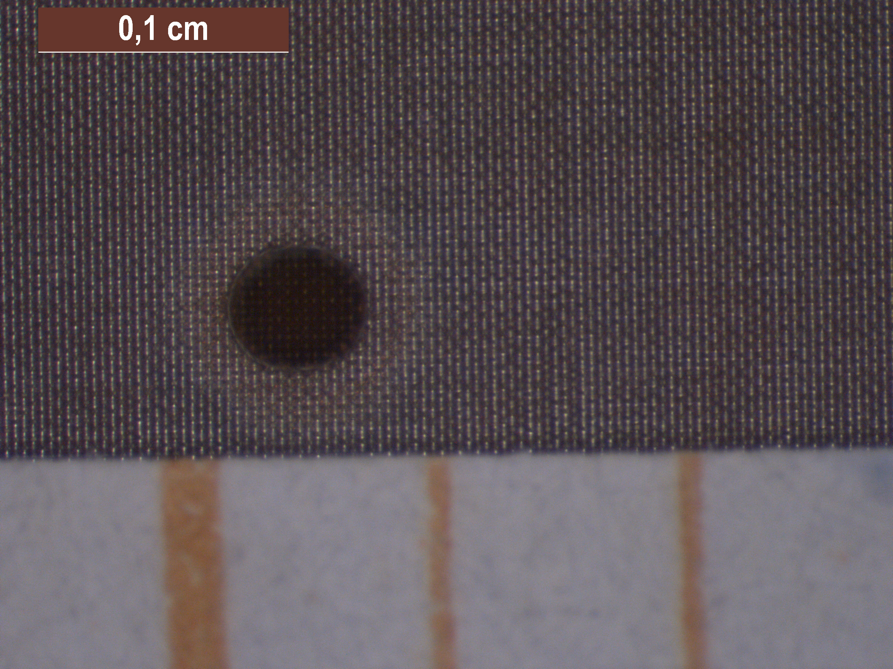
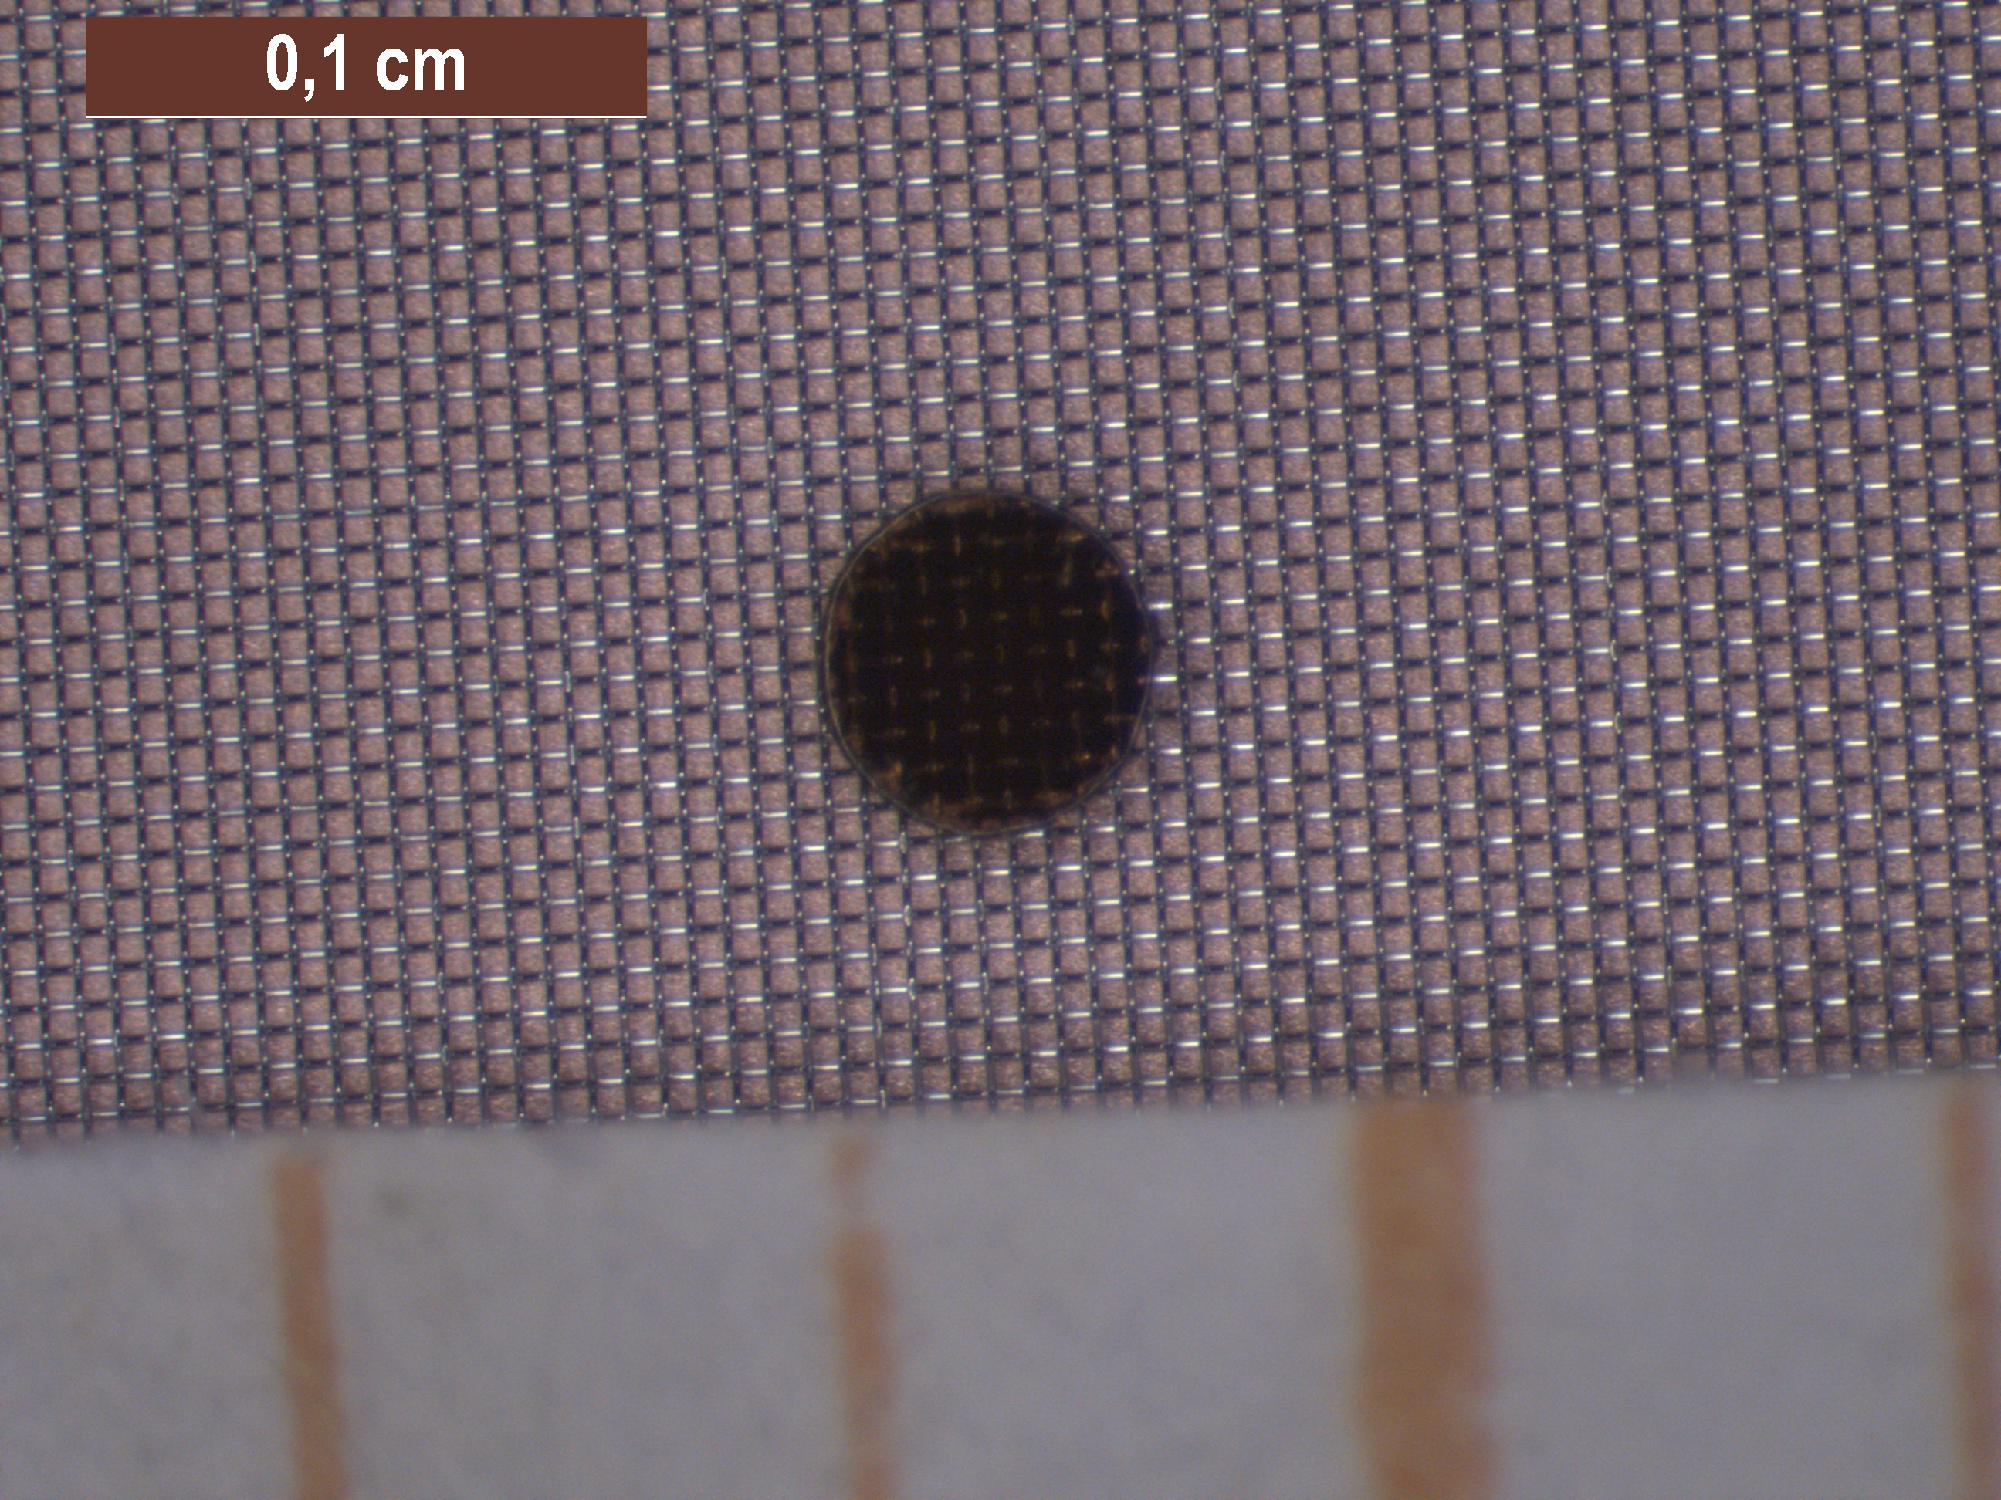
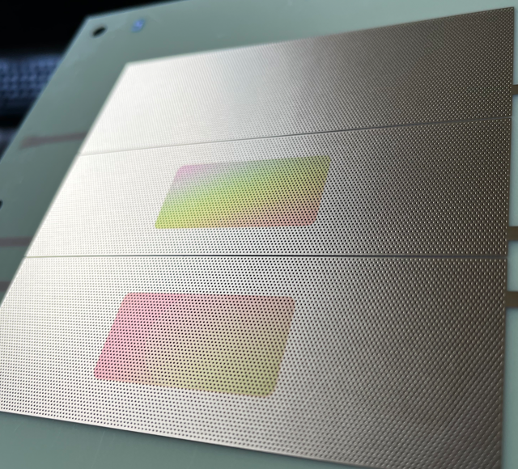
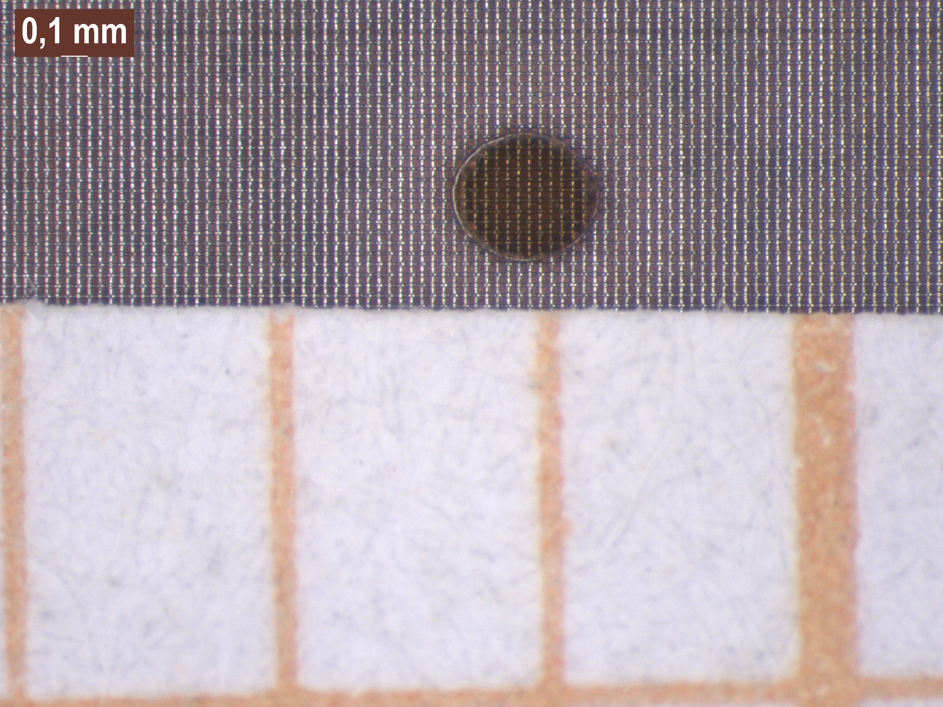
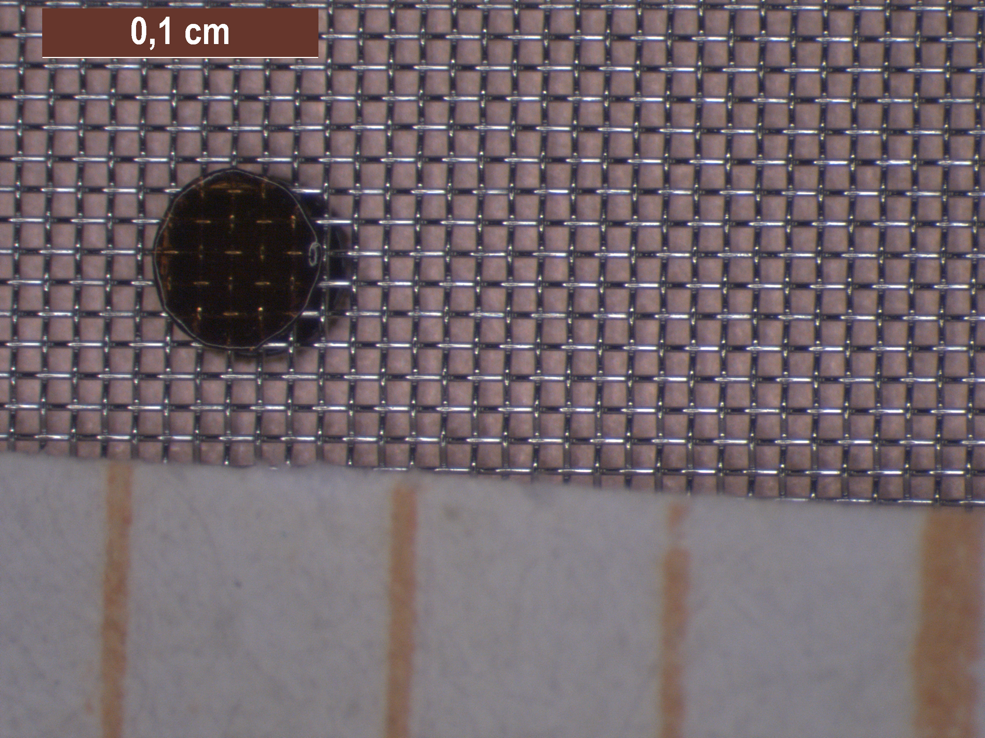
MPGD stacks
Study MPGD (hybrid) stacks focusing on the working point optimisation: energy resolution, IBF, gain, discharge stability
Wide dynamic range operation (e.g. Active Target TPCs)
Challenges wrt. loads and performance (e.g. low IBF)
Highly ionizing fragments – stability
Low/high pressure (see eg. Hyper-PUMA, operation in LP H2 → backup)
Stable operation of MPGD-based photon detectors (low-IBF for photocathode longevity)
Hybrid stacks for photo-detectors and TPCs
GEM + (R-)MMG (e.g. HYDRA)
GEM + μRWELL
(R)THGEM–based
Hybrids with SLAM
Other structures?
HYDRA FC
W-SLAM
22/13/128
45/18/125
CsI THGEM
25/15/128
80/30/200

Slide 10
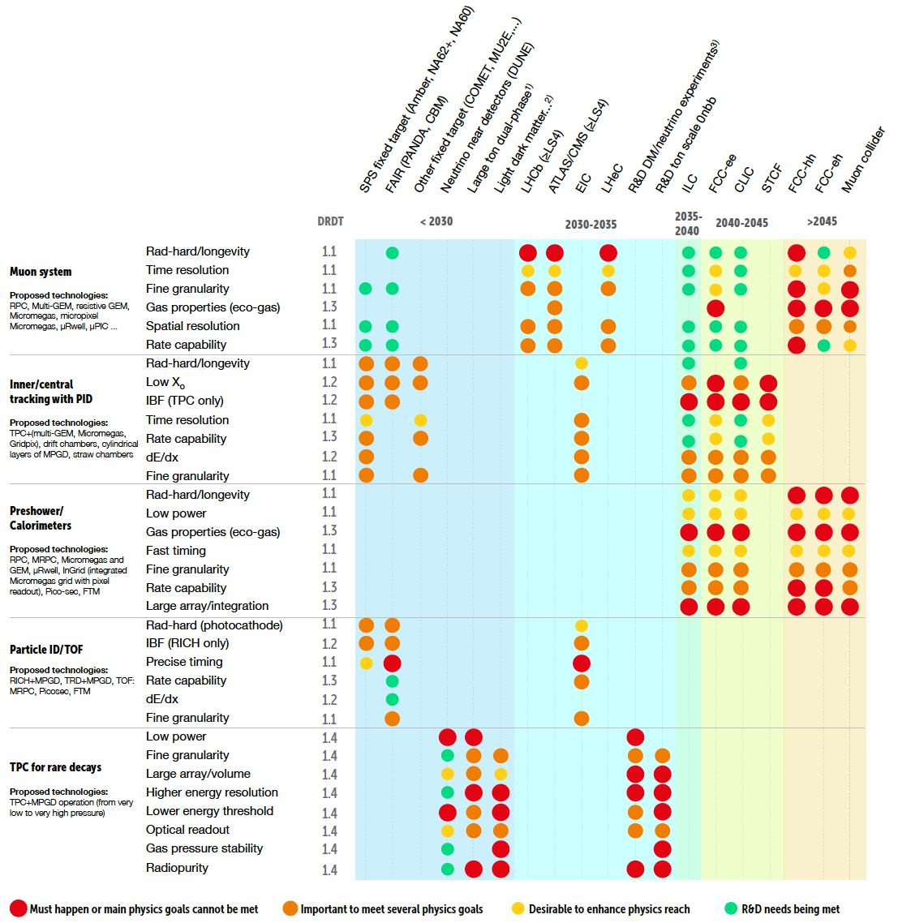
Connection to ECFA

Slide 11
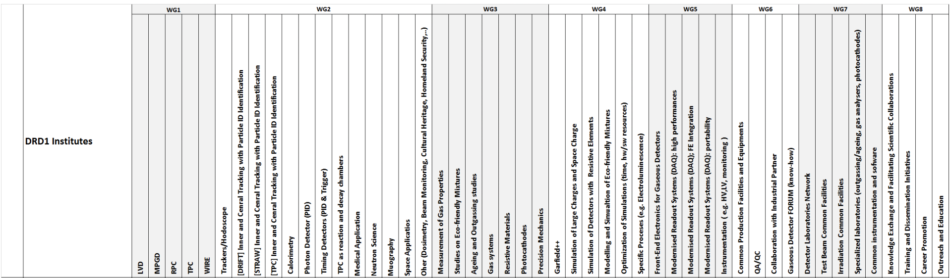
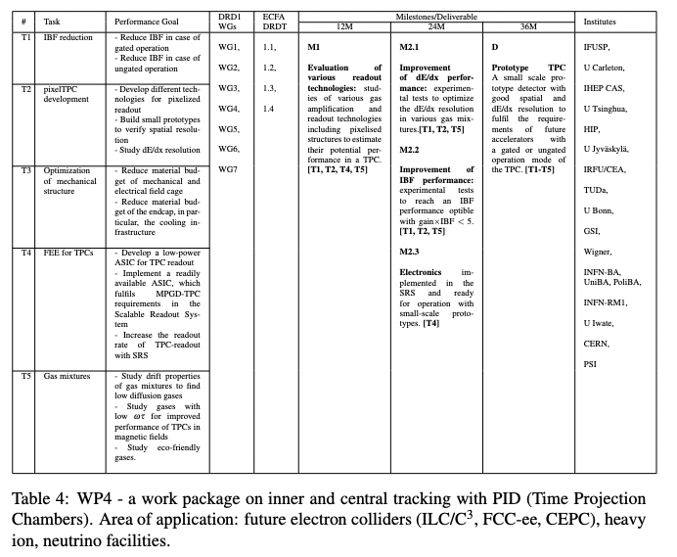
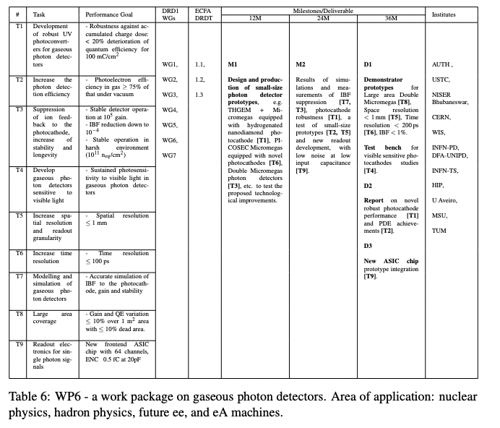
Connection to DRD1 Working Groups and Work Packages
WGs
WPs

Slide 12
Summary
MPGD R&D test bench available
Variety of topics - contribution to the worldwide effort/community within DRD1 structures
Blue-sky R&D and project-related R&D, e.g. input for various GSI projects
New structures, new stacks → attractive topics for BSc and MSc theses
HR needed! ☺

Slide 13
BACKUP

Slide 14
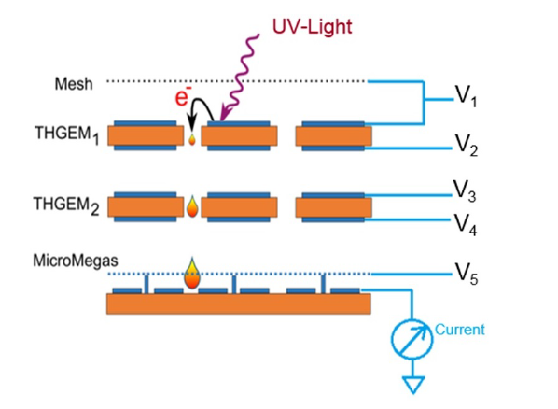
Low-pressure H₂ (THGEM+MMG)
AT-TPC Collaboration basic performance evaluation studies in low-pressure He and H₂
M. Cortesi et al., EPJ Web of Conf. 174 (2018) 01007
2-THGEM + MMG for stable operation, due to:
the extended dimension of the THGEM holes, typically several times larger than the electron mean-free path even at low pressure;
the confinement of the avalanche within the holes, resulting in smaller photon-mediated secondary effects
the quenching effect of small amounts of impurities from natural outgassing of detector components - e.g. N2 acts as wavelength shifter suppressing UV-photons emitted during the avalanche.
For low MMG voltage – loss of electron collection efficiency and thus effective gain of the structure
High x-section for radiation less processes in H₂ (excitation of vibrational and rotational levels)
Higher electric fields necessary for a substantial gas avalanche multiplication (resulting in e.g. field emission)
Higher voltages → higher discharge probability → lower max. achievable gain. Need R&D in HP H₂

Slide 15
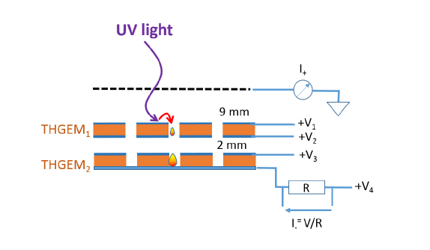
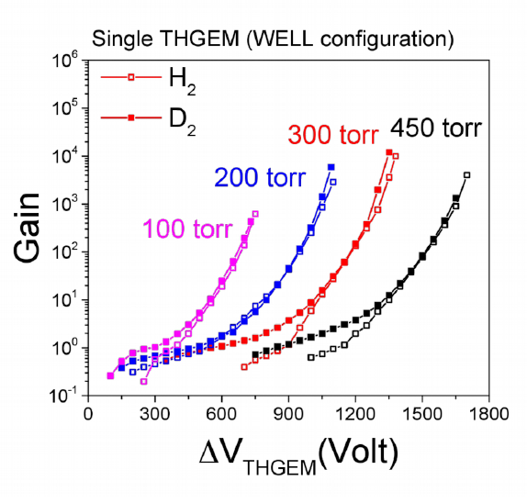
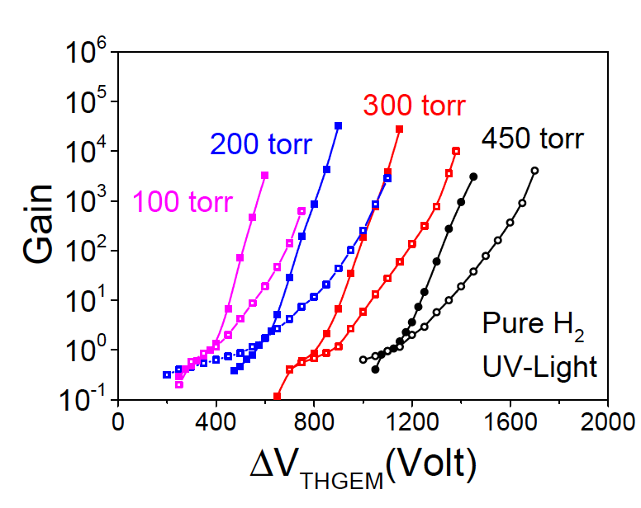
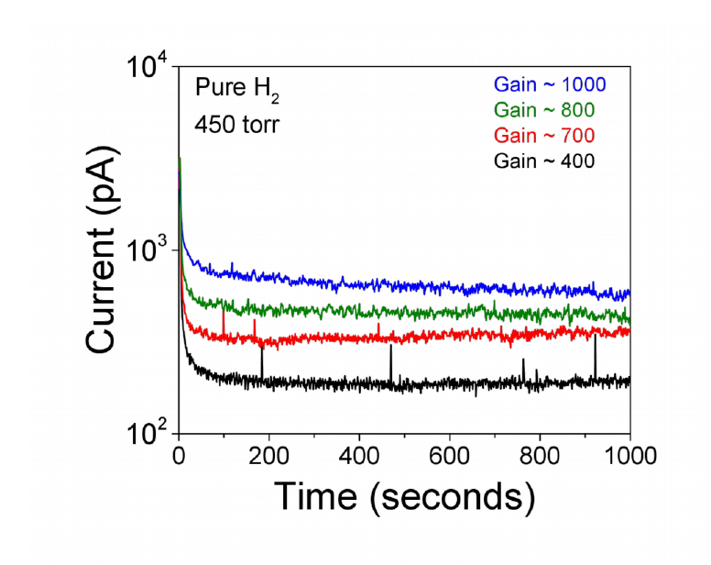
Low-pressure H₂ (WELL, THGEM and 2-THGEM)
Single THGEM (WELL) at low P – photon mediated secondary effects become relevant (lower maximum gain)
Double THGEM structure (charge/gain sharing) – improves stability
Instabilities at high pressures due to high absolute voltage
1-THGEM
2-THGEM
2-THGEM

Slide 16
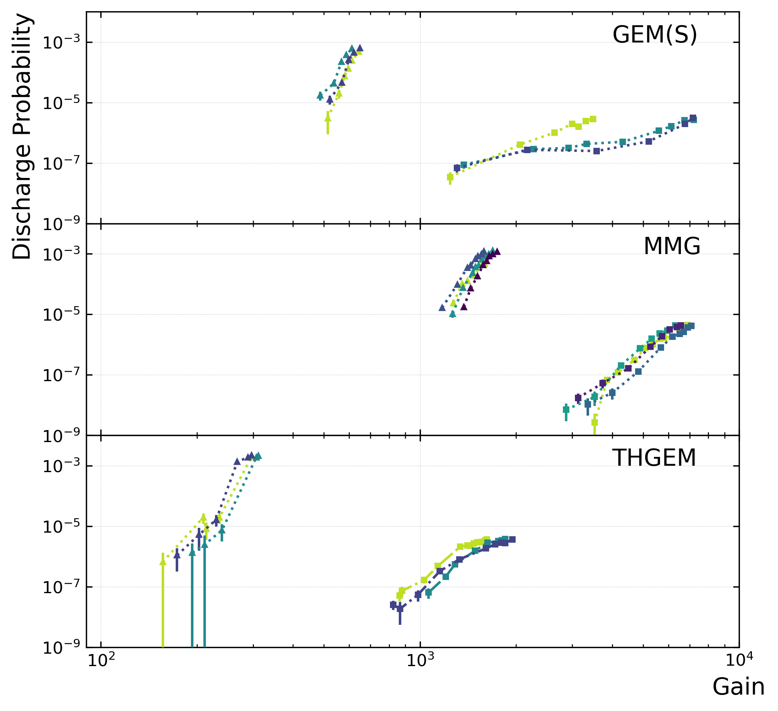
Humidity studies (TU Munich)
23
H. Fribert et al. JINST 18 (2023) C06015 + RD51 Coll. Meeting
No resistive layers!
No major deteriorating effects of humidity were observed in the performance (gain, energy resolution, and charging-up)
Adding water vapour to the gas mixture improves the discharge stability at the highest voltages
Reduction in the rate of spurious discharges related to electrode defects or charging-up of the insulating layers observed
May also help with instabilities caused by ageing effects ➙ to be studied?

Slide 17
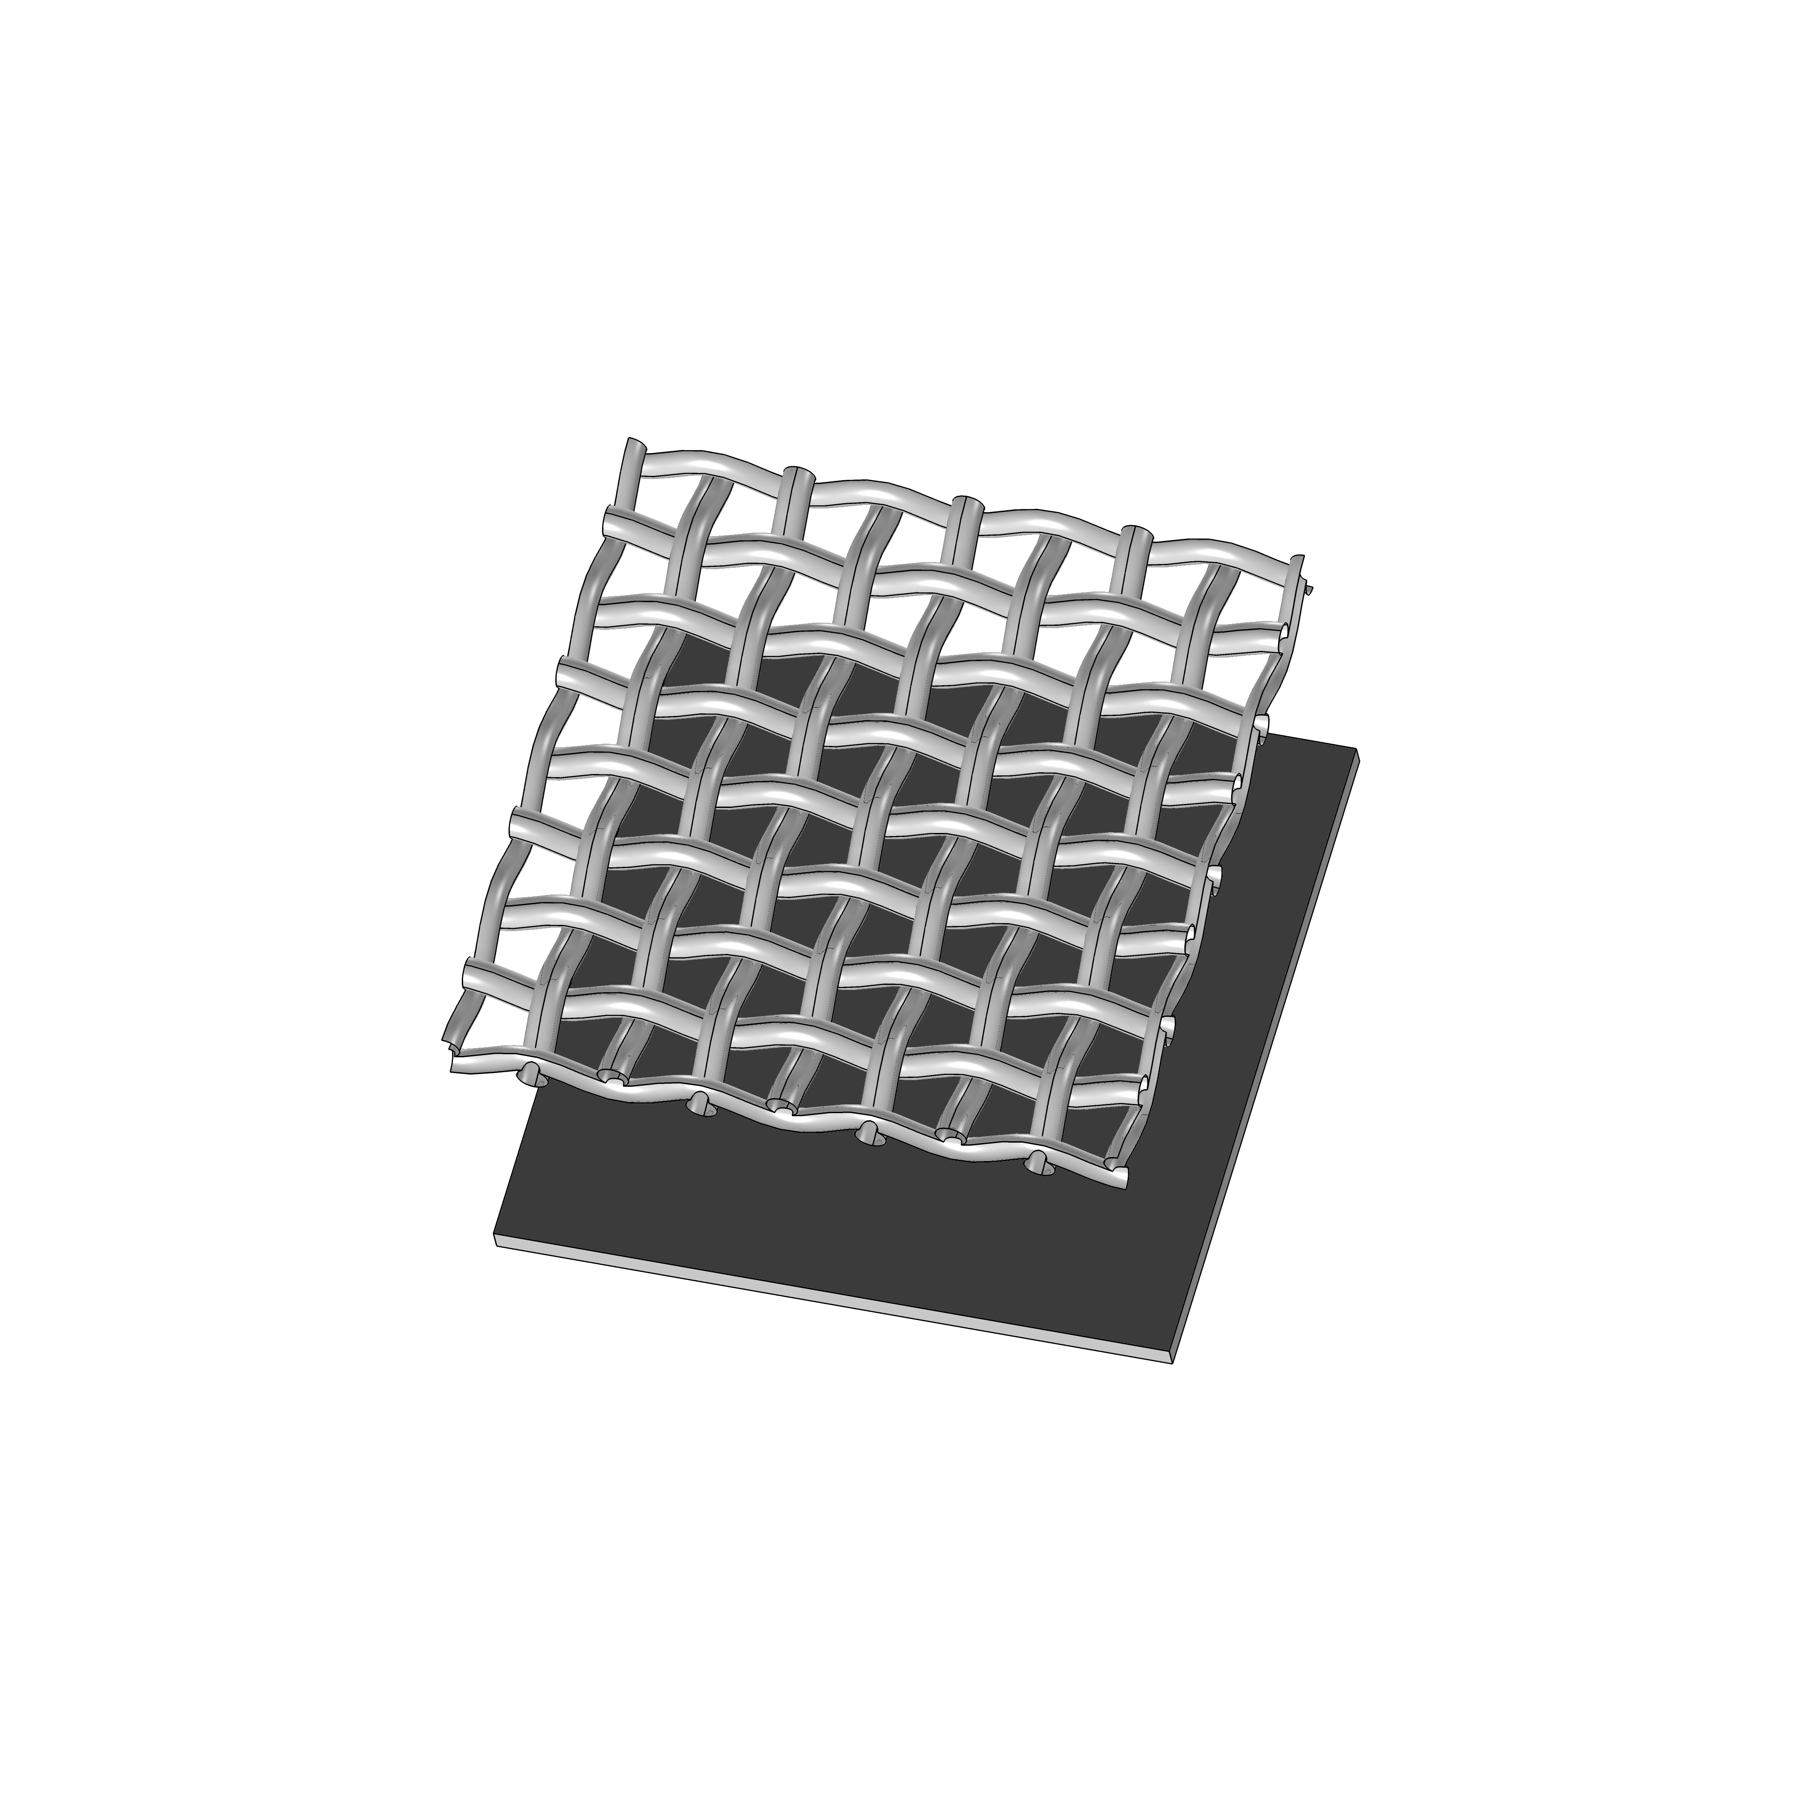
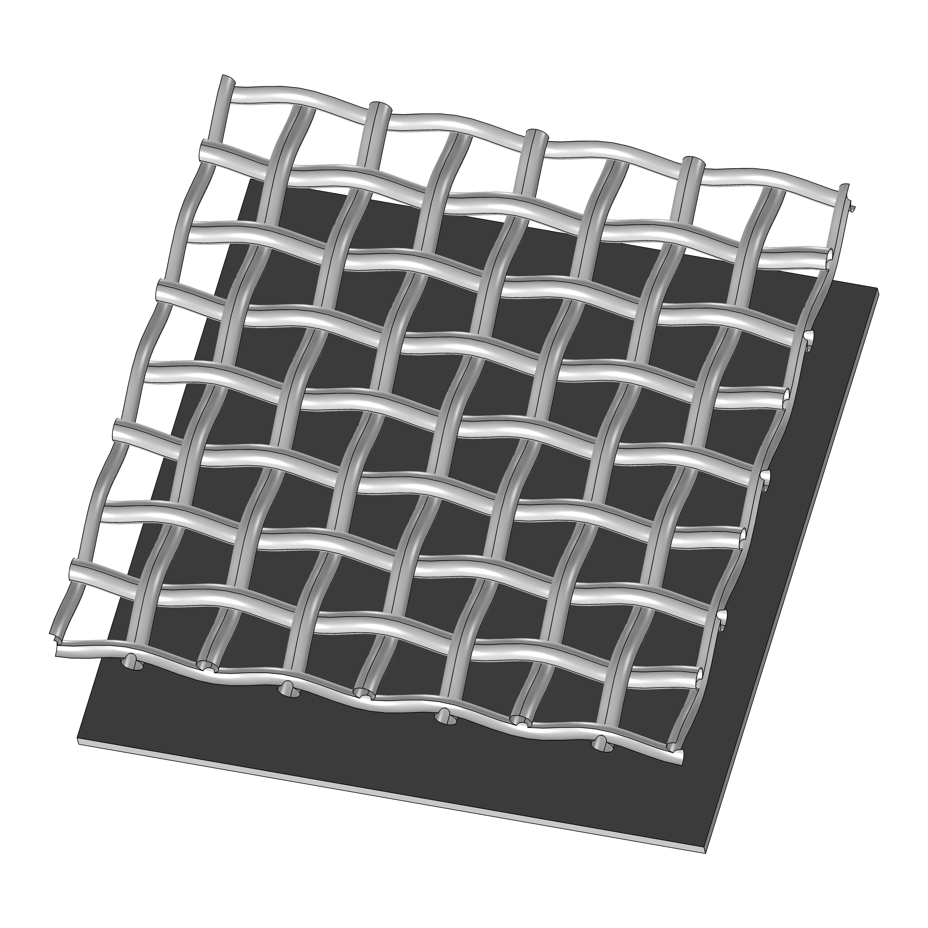
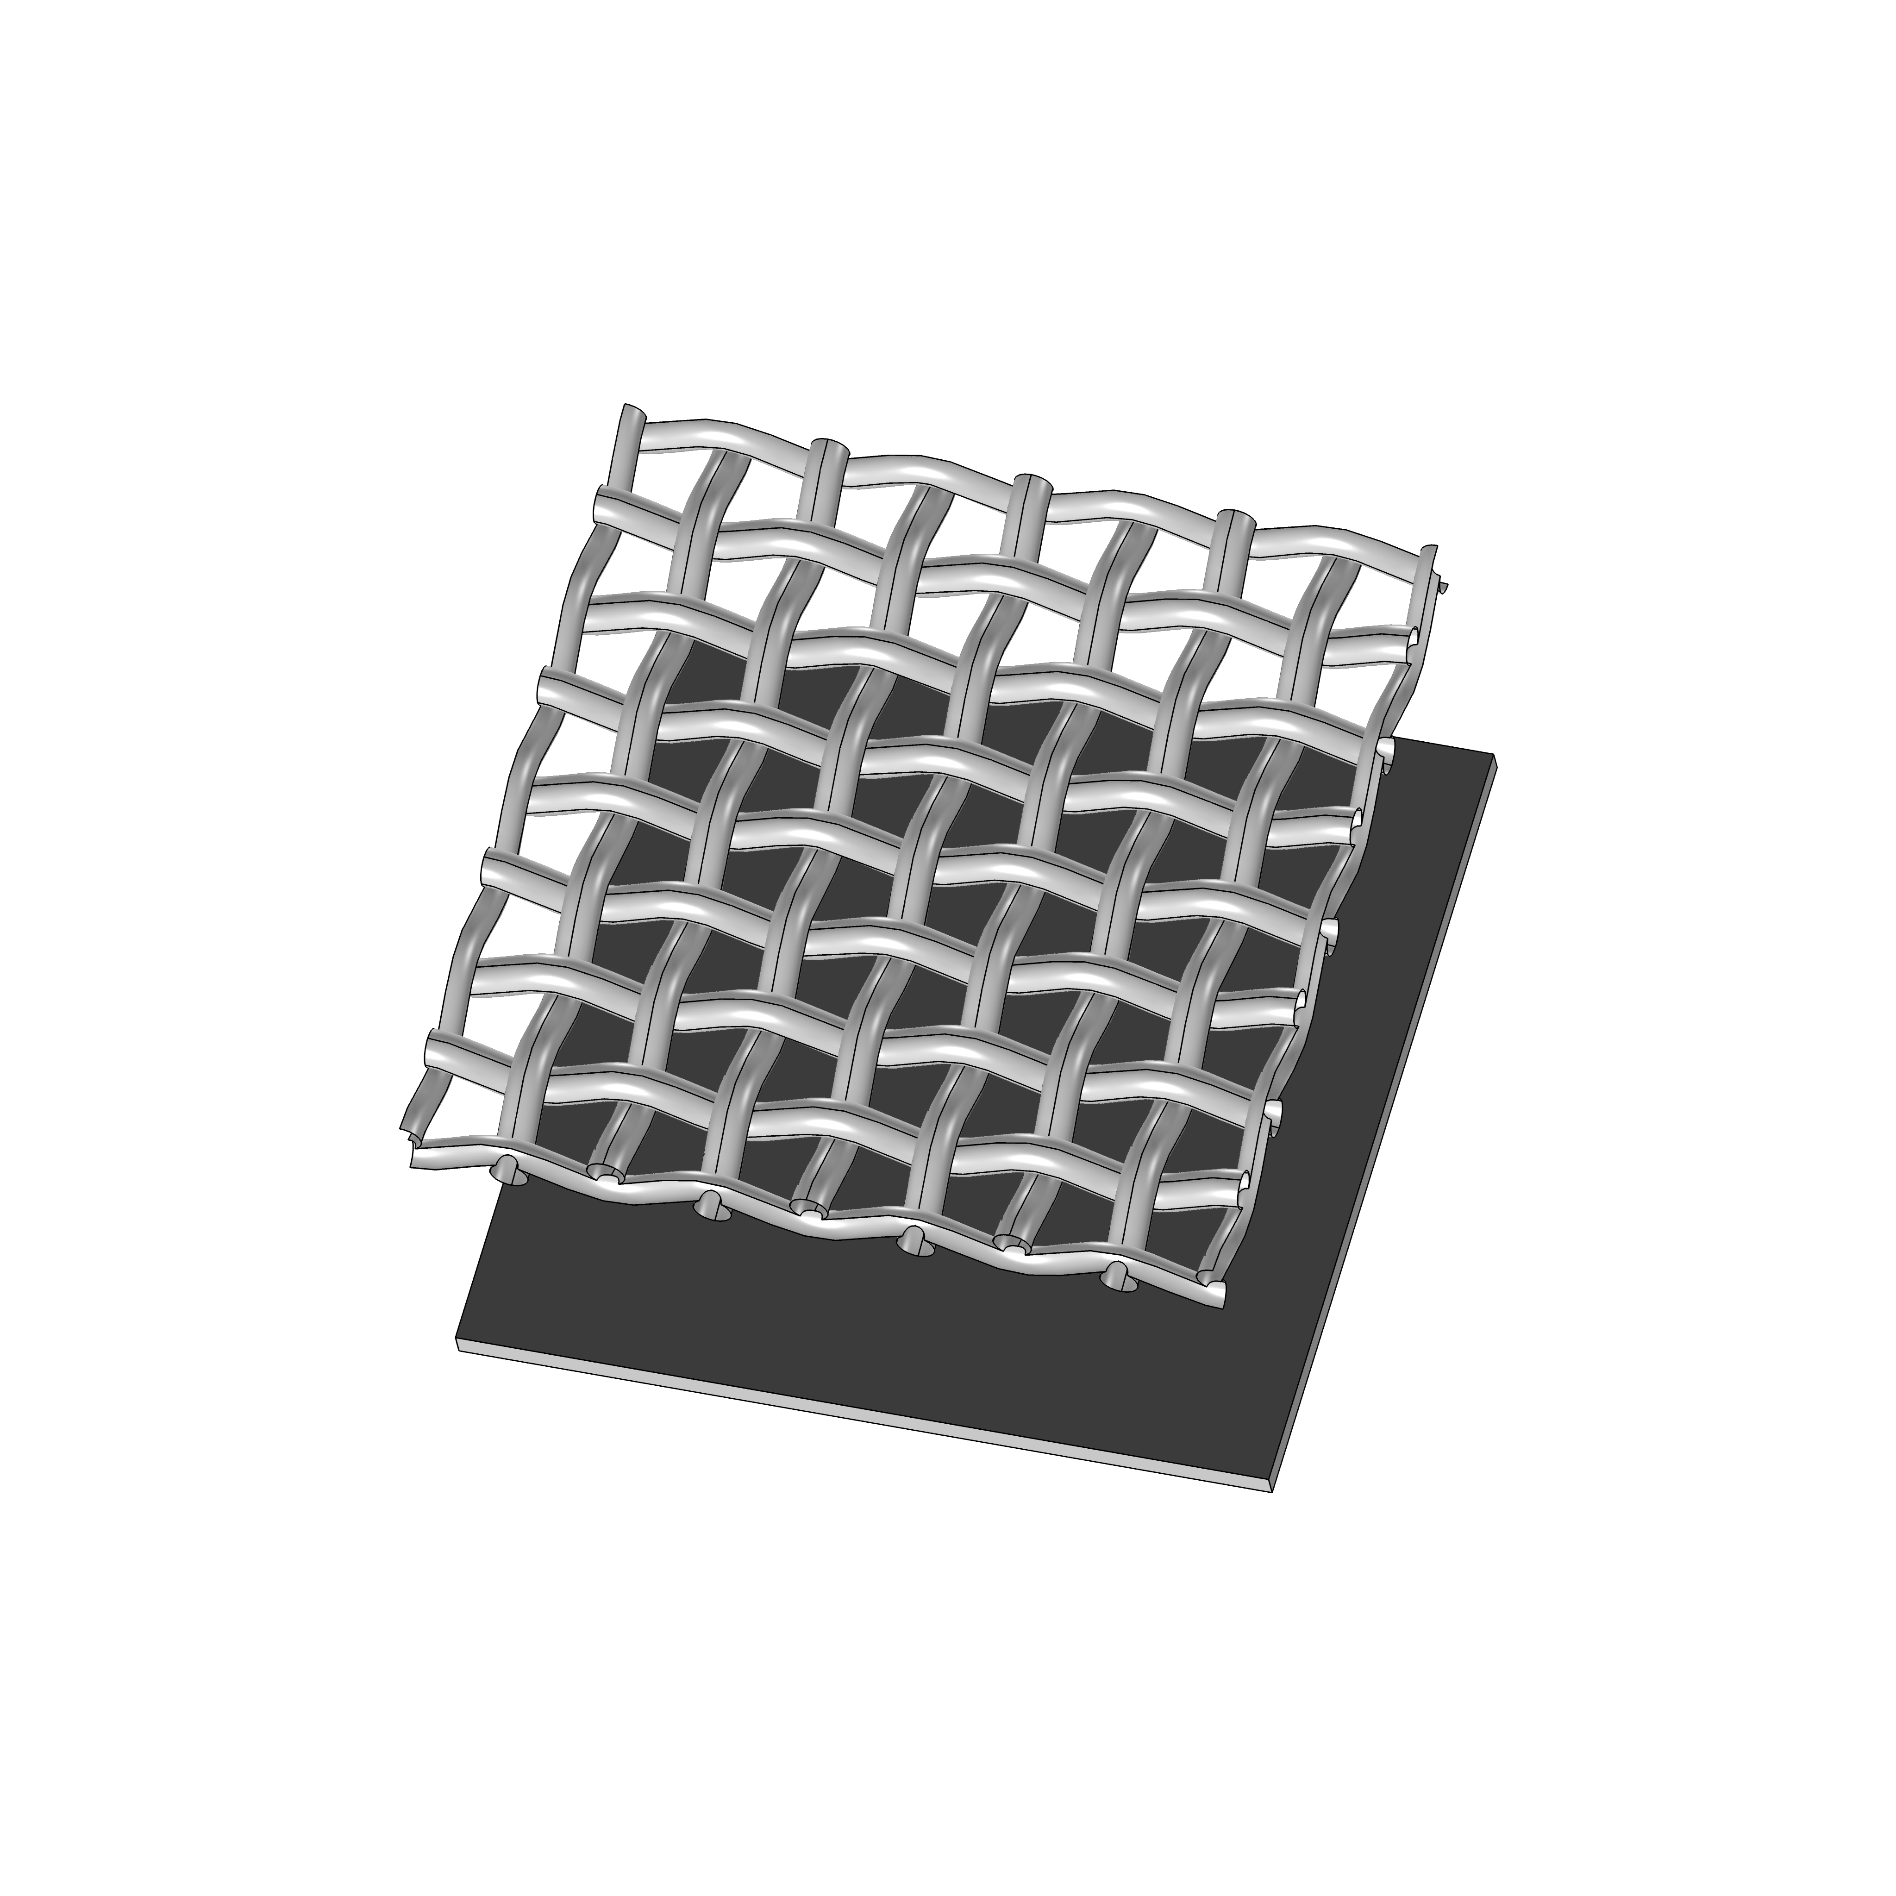
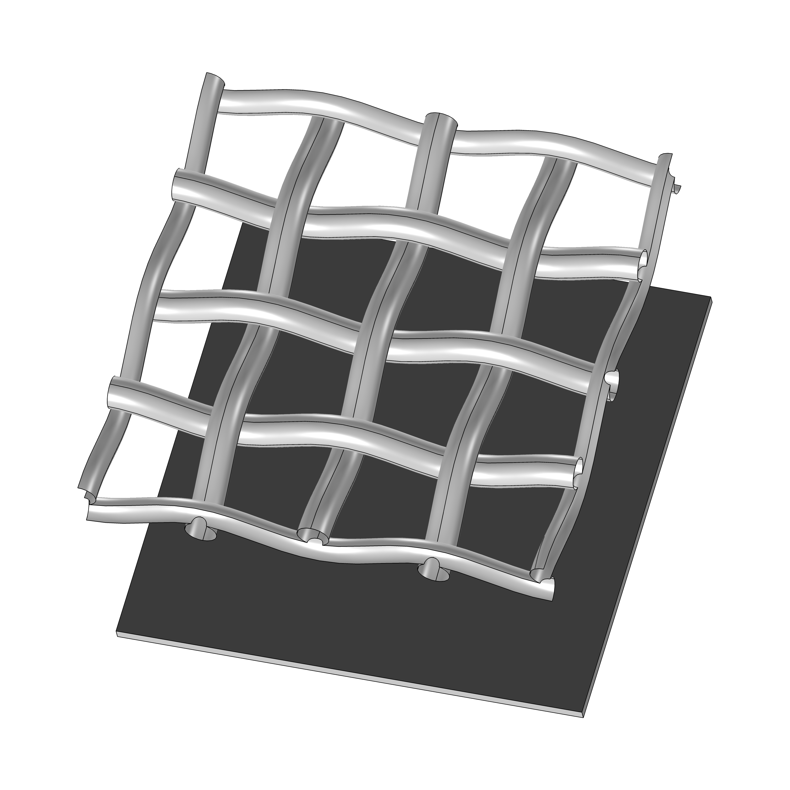
Micromegas studies
MMG1 - 22/13/128
Wire distance: 22µm, Wire thickness: 13µm
Amp. gap: 128µm, LPI: 730, T_{optical} = 39,5%
MMG2 - 25/15/128
Wire distance: 25µm, Wire thickness: 15µm
Amp. gap: 128µm, LPI: 640, T_{optical} = 39%
MMG3 - 45/18/125
Wire distance: 45µm, Wire thickness: 18µm
Amp. gap: 125µm, LPI: 400, T_{optical} = 51%
MMG4 - 80/30/200
Wire distance: 80µm, Wire thickness: 30µm
Amp. gap: 200µm, LPI: 230, T_{optical} = 52%

Slide 18
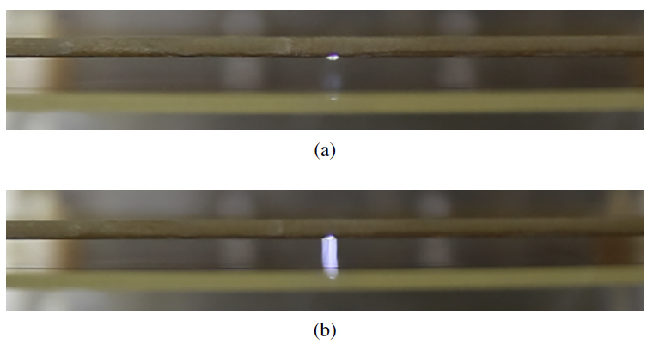
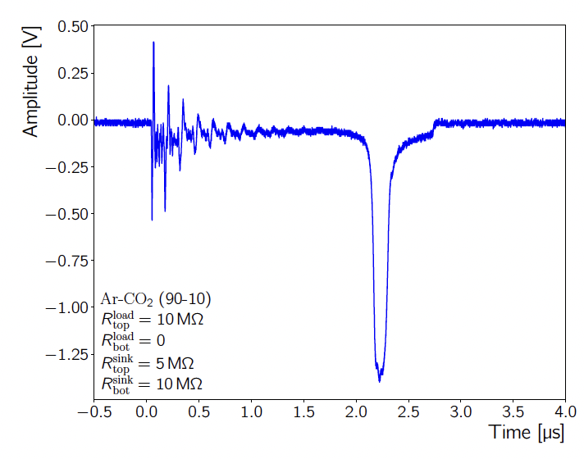
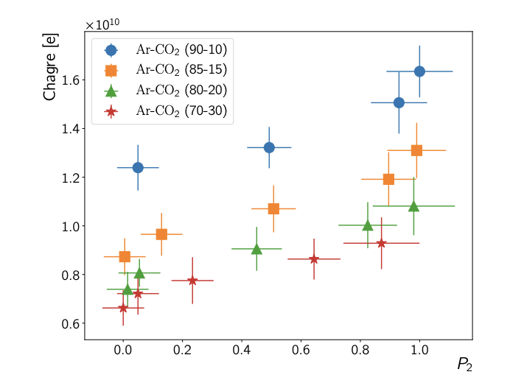
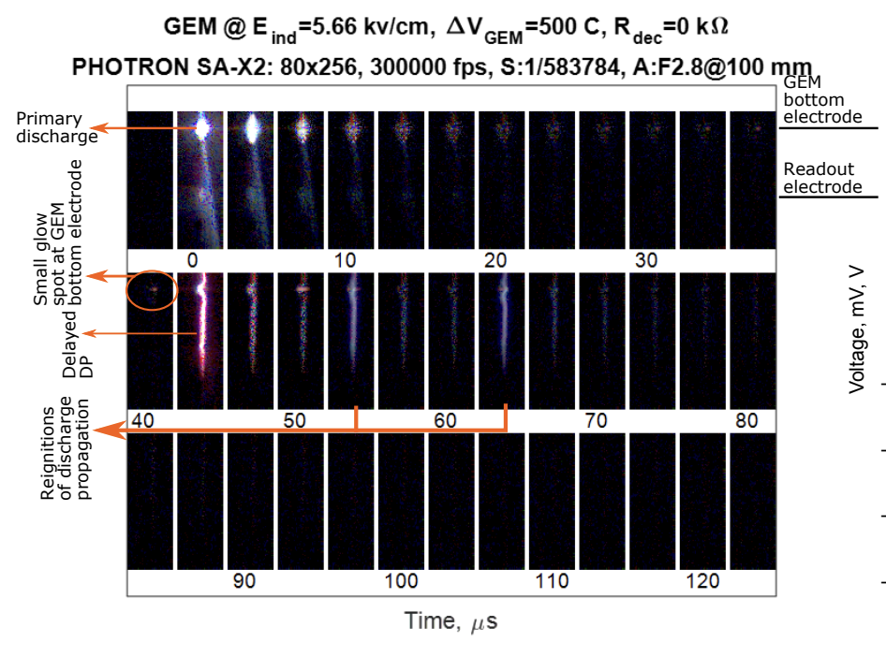
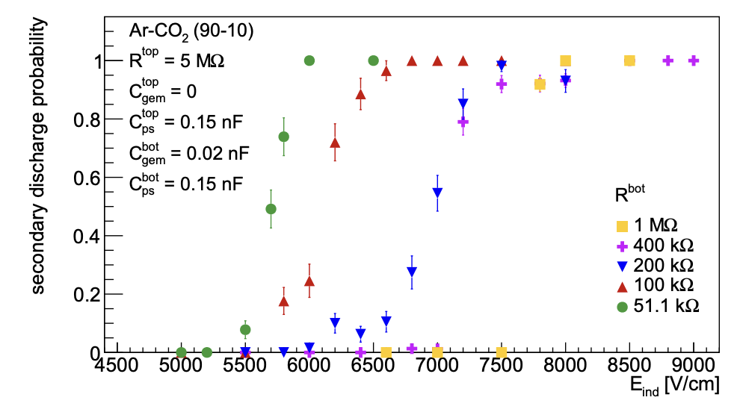

What would be good to have/answer?
Simulation model describing secondary (propagated, delayed) discharges developing in the gaps between subsequent foils in a stack.
Mechanism ➙ still a topic of a debate.
Need to understand the entire process and, if possible, to eliminate the cause of these violent events completely.
Model development of a primary discharge in a GEM hole and its subsequent transition to a gap discharge, taking into account:
Space-charge densities
Drift and amplification of charges, ion bombardment
Heating of the electrodes …
… and thermionic emission from the latter.
NIM A 937 (2019) 168
NIM A 937 (2019) 168
JINST 14 (2019) P08024
NIM A 940 (2019) 262
NIM A 1019 (2021) 165829

Slide 19




Secondary discharge formation
B. Ulukutlu, et al. NIM A 1019 (2021) 165829
The transition between Townsend discharge and Streamer discharge?
Dependence on gas (⍺ process) and cathode? (𝛾 process - feeding)
Time lag O(10 μs) with a rapid full gap breakdown
Mixed discharge mechanism at below-critical fields
Townsend mechanism initiated by electrons from a primary discharge;
Secondary emission from the heated cathode;
Space charge accumulation at the anode;
Transition to a streamer.

Slide 20



THGEMs with new materials
Investigating the first Molybdenum coated full scale THGEM
Significant mitigation of the dangerous, delayed secondary discharges
Mesh geometry of Micromegas
Systematic studies of discharge formation in Micromegas
Using Garfield++ simulations to model discharge formation

Slide 21





Secondary discharges in GEMs*
Discharge in a transfer/induction gap
Full gap voltage breakdown – can be associated with a spark development
Appears O(μs) after the primary spark
Develops at the gap fields below the amplification region
Precursor current can be measured in between two discharges ➞ Secondary emission and streamer development in the gap?
Leading theory: heating of the cathode after the primary discharge
A. Deisting C. Garabatos, PG, et al. NIM A 937 (2019) 168
A. Utrobicic, et al. NIM A 940 (2019) 262
Mitigation strategies established
L. Lautner, PG, et al. JINST 14 (2019) P08024
A. Deisting, C. Garabatos, PG, et al. NIM A 937 (2019) 168
a) Primary discharge
b) Secondary discharge
A. Utrobičić et al. MPGD 2019,
La Rochelle
A. Deisting, C. Garabatos, PG, et al. NIM A 937 (2019) 168
* See pioneering studies by S. Bachmann et al. NIM A479 (2002) 294 & V. Peskov, P.Fonte (2009) arXiv:0911.0463

Slide 22

Secondary discharges with different materials
B. Ulukutlu, PG, et al. A 1019 (2021) 165829
Secondary discharge probability
Material dependence observed!
Molybdenum displays especially high stability
Which material properties play a role?
 | Conductivity [10⁶ S/m] | Work function [eV] | Melting point [°C] | Boiling point [°C] | Thermal conductivity [W/m*K] | Density [g/cm³]
Al | 36.9 | 4.08 | 660 | 2470 | 237 | 2.702
W | 8.9 | 4.5 | 3422 | 5550 | 174 | 19.35
Cu | 58.7 | 4.7 | 1083 | 2575 | 386 | 8.96
Inox | 1.37 | 4.4 | 1510 | 2750* | 16.3 | 7.85
Ta | 7.6 | 4.22 | 3017 | 5365 | 57.5 | 16.65
Mo | 18.7 | 4.5 | 2623 | 4651 | 138 | 10.22
Less stable
More stable
*for Fe

Slide 23


Investigating improved ways of operating MPGDs
Humidity studies
First systematic studies on effects of humidity contamination on performance of MPGDs (Micromegas, GEM & THGEM)
No drawbacks of humidifying the used Ar-CO₂ (90-10) gas mixture & increased stability against spurious discharges observed
Increasing stability

Slide 24



Discharge limits, high rates
NIM A 422 (1999) 300
Critical charge limits and max-gain rate dependency
Overlap of avalanches may further reduce the stability of the detector
Unlikely even at the highest rates and moderate gains (e.g. COMPASS, LHCb trackers)
Troublemakers:
Cathode excitation, electron jets, etc.
Highly Ionizing fragments (N_{prim,α} = 10⁴ × N_{prim,MIP}), high neutron doses
Wide dynamic range operation (e.g. Active Target TPCs)
Challenges wrt. loads and performance (e.g. low IBF)
The stability of your system relies on the stability of a single amplification structure. Pin down the limits!
Plasma Sources Sci. Technol. 19 (2010) 034021
© LHCb GEM Tracker
© AT-TPC (link)

Slide 25
Micromegas studies
MMG1 - 22/13/128
Wire distance: 22µm, Wire thickness: 13µm
Amp. gap: 128µm, LPI: 730, T_{optical} = 39,5%
MMG2 - 25/15/128
Wire distance: 25µm, Wire thickness: 15µm
Amp. gap: 128µm, LPI: 640, T_{optical} = 39%
MMG3 - 45/18/125
Wire distance: 45µm, Wire thickness: 18µm
Amp. gap: 125µm, LPI: 400, T_{optical} = 51%
MMG4 - 80/30/200
Wire distance: 80µm, Wire thickness: 30µm
Amp. gap: 200µm, LPI: 230, T_{optical} = 52%

Slide 26



Photon detection with THGEMs
Combining a photosensitive material with a robust and low-cost device; THGEMs
Studies ongoing with CsI and DLC coatings as photocathode layers on the THGEM surface
Verification of the experimental setup successful
First results from aging studies of used materials under operation

Slide 27

1st prototype
Produced at CERN EP-DT-DD Micropattern Structures laboratory
Copper readout strips
DLC coating 30 MΩ/□
Micro-Pattern Walls
Thickness: 270 µm
Height: 256 µm
Pitch: 700 µm
Wires
Diameter: 50 µm
Pitch: 850-1000 µm
Microscope image (100x magnification)
Photo of the prototype

Slide 28

Very 1st measurements
Maximum stable gain reached with setup ∼1500
With higher voltages (> 900 V) current spikes (corona?) observed
At ∼950 V and continuous discharge (glow?) triggered
Cleaning with sulphuric acid to dilute residual fibres ➙ measurements soon
Further SLAM optimisation
Using pillars instead of walls
Decrease wire pitch
Decrease wire diameter
New geometries ➙ a strip-like SLAM
Source rate (Hz) | 1400
Primary current (nA) | 4.59E-05
Reached gain | 1,158.91

