Slide 1
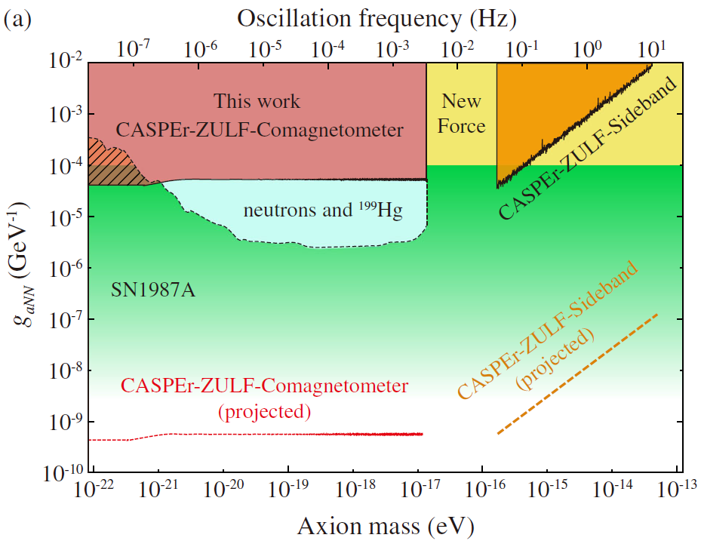
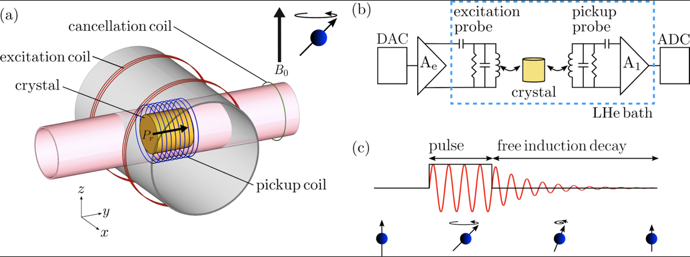
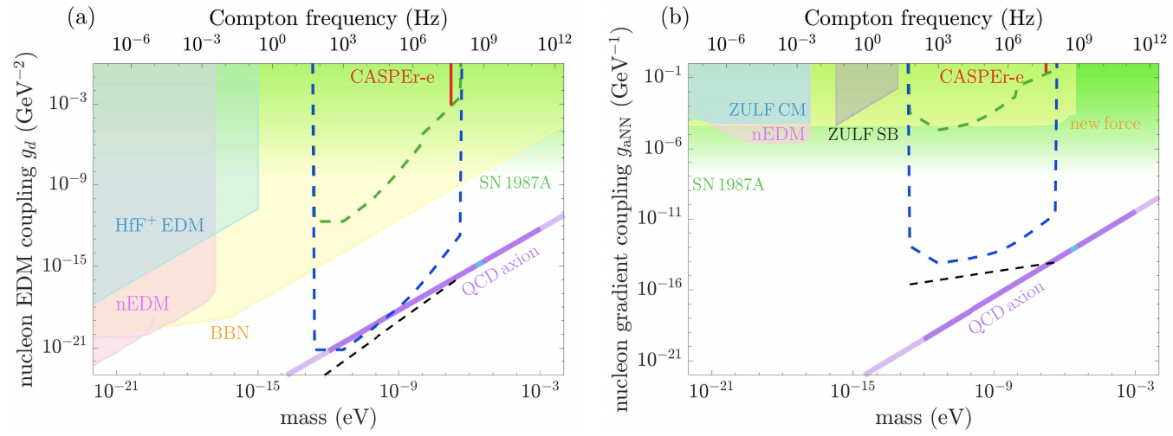
Cosmic axion spin precession experiments (CASPEr)
Constraining dark matter parameter space since 2018
Antoine Garcon, et al, Constraints on bosonic dark matter from ultralow-field nuclear magnetic resonance, Sci. Adv. 2019 5: eaax4539 (2019)
Teng Wu, et al, Search for axionlike dark matter with nuclear spins in a single-component liquid, Phys. Rev. Lett. 122, 191302 (2019)
Deniz Aybas, et al, Search for axion-like dark matter using solid-state nuclear magnetic resonance, Phys. Rev. Lett. 126, 141802 (2021),

Slide 2
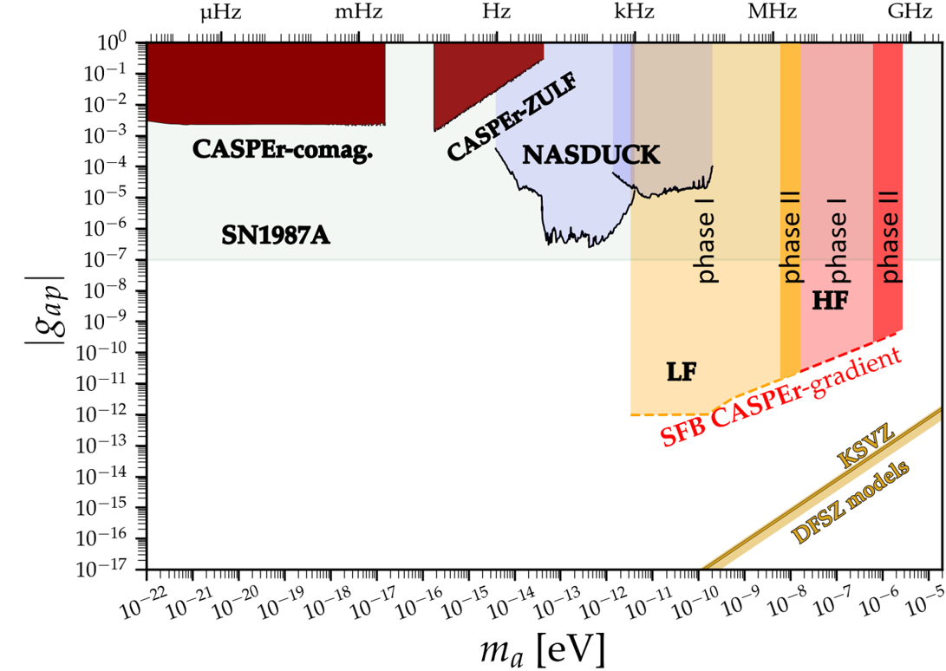
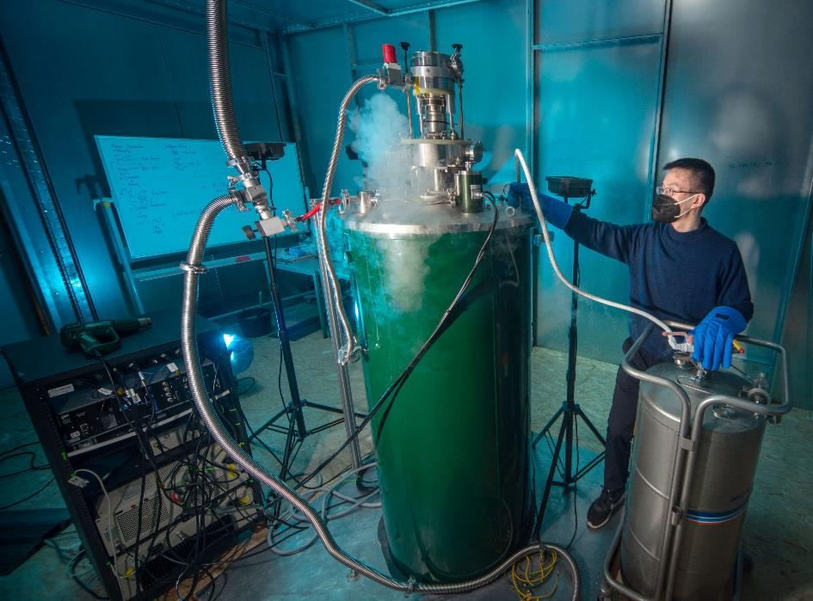
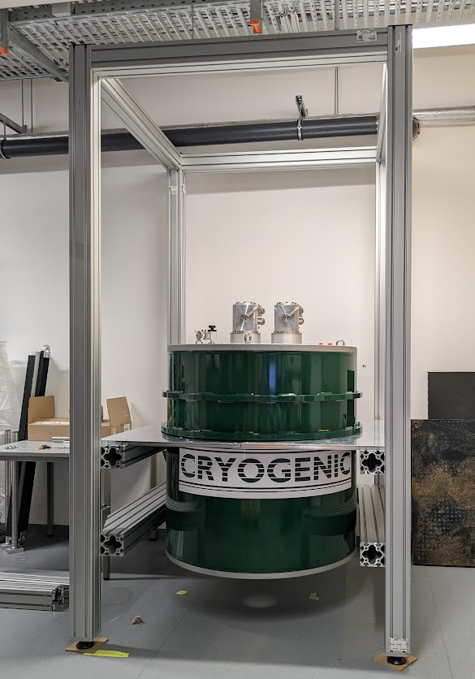
Cosmic axion spin precession experiments (CASPEr)
Low field 0.1 T magnet (< 4.2 MHz)
High field 14.1 T magnet (< 600 MHz)
First data taken; analysis underway
Future: sensitivity $∝$ sample polarization, scale it up!
Julian Walter, et al, Fast shimming algorithm based on Bayesian optimization for magnetic resonance based dark matter search,
Yuzhe Zhang, et al, Frequency-scanning considerations in axionlike dark matter spin-precession experiments
C. B. Adams et al, Axion Dark Matter (Snowmass White Paper, 2022),
Alexander V. Gramolin, et al, Spectral signatures of axionlike dark matter, Phys. Rev. D 105, 035029 (2022
Deniz Aybas, et al, Quantum sensitivity limits of nuclear magnetic resonance experiments searching for new fundamental physics, Quantum Sci. Technol. 6(3) 034007 (2021)
Will also be used for SUPAX (K. Schmieden)

Slide 3
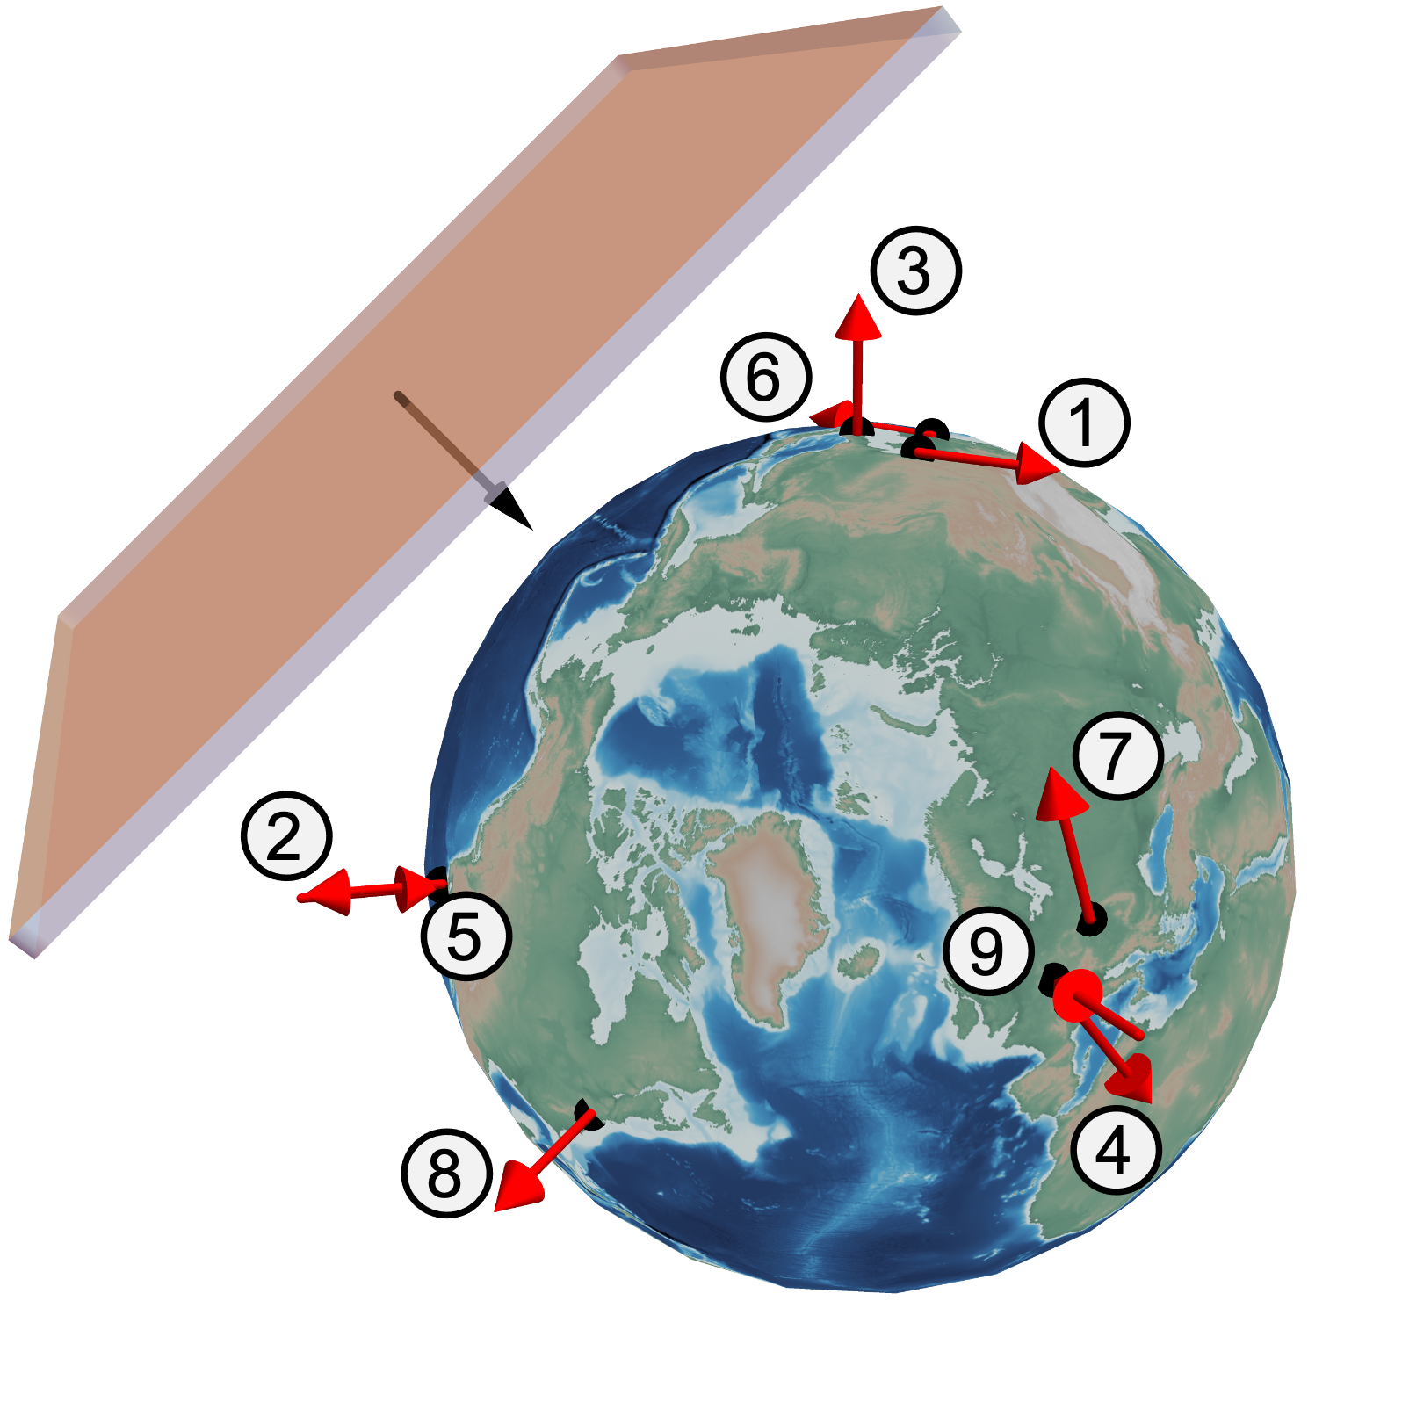
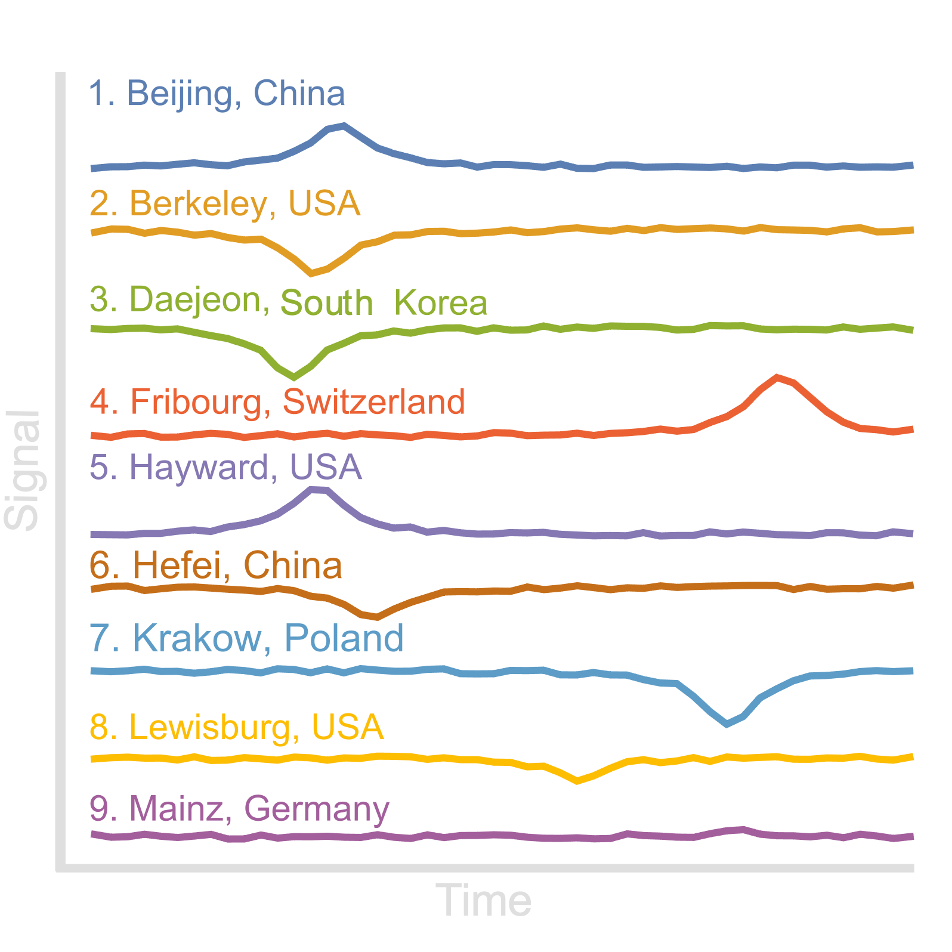
Global network of optical magnetometers for exotic physics searches (GNOME)
topological defects, boson stars, …
Advantages compared to single detector:
improved rejection of false positives
directional sensitivity
overall improvement to sensitivity
… new and evolving method
Mikhail Padniuk, et al, Universal determination of comagnetometer response to spincouplings, arXiv:2309.16000 (2023)
Afach , et al, What can a GNOME do? Search targets for the Global Network of Optical Magnetometers for Exotic physics searches, ANNALEN DER PHYSIK 2023, 2300083. https://doi.org/10.1002/andp.202300083 (2023)
Joseph A. Smiga, Assessing the quality of a network of vector-field sensors, The European Physical Journal D 76, Article number: 4 (2022)
Dongok Kim, et al, A machine learning algorithm for direct detection of axion-like particle domain walls, Physics of the Dark Universe 37, 101118 (2022)
Mikhail Padniuk, et al, Self-compensating co-magnetometer vs. spin-exchange relaxation-free magnetometer: sensitivity to nonmagnetic spin couplings, Sci Rep 12, 324 (2022)
Samer Afach, et al, Search for topological defect dark matter using the global network of optical magnetometers for exotic physics searches (GNOME), Nature Physics (2021)
Conner Dailey, et al, Quantum sensor networks as exotic field telescopes for multi-messenger astronomy, Nat. Astron. (2020). https://doi.org/10.1038/s41550-020-01242-7
Dmitry Budker, et al, Sensing a passage through the unknown, CERN Courier 60(4), 25-28 (July-August 2020)
Hector Masia-Roig, et al, Analysis method for detecting topological defect dark matter with a global magnetometer network, Physics of the Dark Universe 28, May 2020, 100494

Slide 4
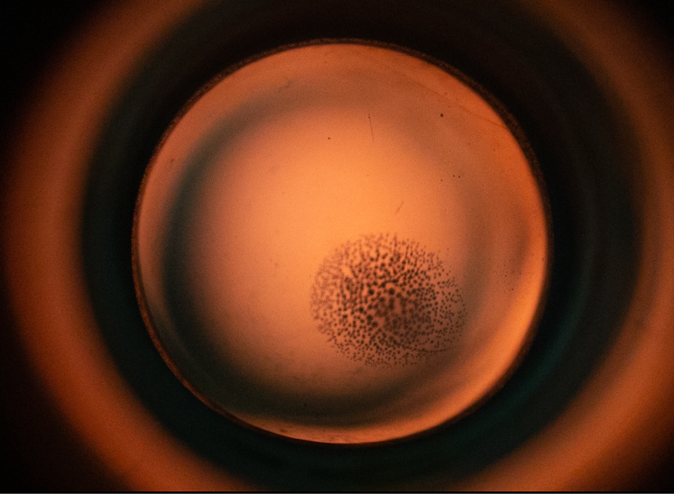
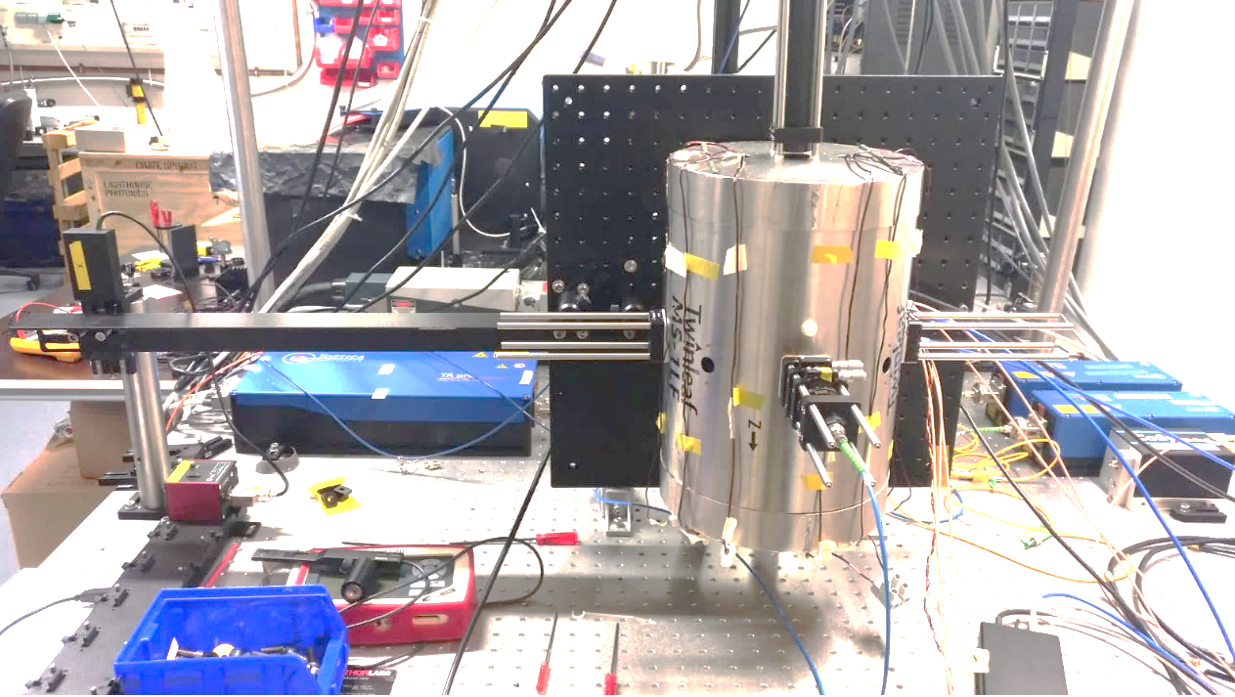
Global network of optical magnetometers for exotic physics searches (GNOME)
Spin-based Gyroscope = Advanced GNOME station = CASPEr Helium
Rb Pump beam
Motor
20mm gas cell
3 bar ³He (γ= 32 mHz/nT)
N₂
Rb
K
200°C
Mag. Shield
K Probe beam
Prequel: Demonstration of sensitivity to mass ranges 10⁻²²-10⁻⁶ eV
PRISMA++: Scaling it up! (sample development, for example: new vapor cells)

Slide 5
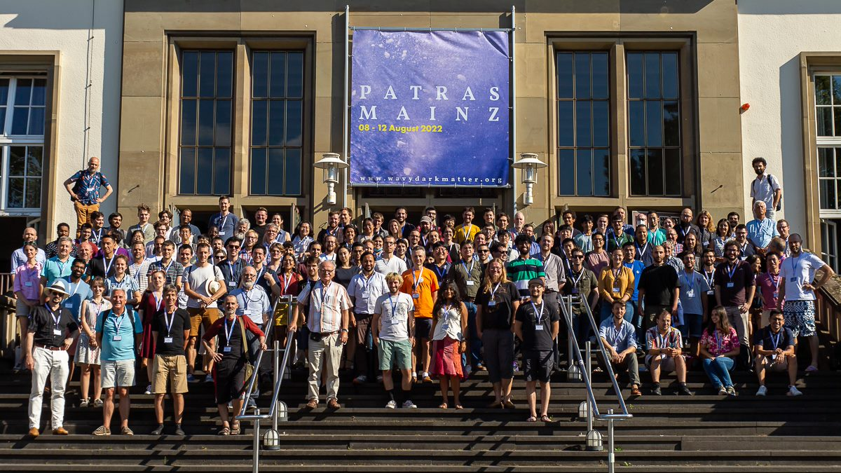
July 31- August 05, 2022 | Ultralight Dark Matter - Scientific foundations and experimental searches Summer School (Physics Center Bad Honnef, Germany)
August 08-12, 2022 | 17th Patras Workshop on Axions, WIMPs and WISPs (Johannes Gutenberg University in Mainz (JGU), Germany)
August 15-19, 2022 | Wavy Dark Matter Detection with Quantum Networks Workshop (Mainz Institute for Theoretical Physics (MITP), Germany)

Slide 6
Plans for the next 10 years “Prediction is very difficult, especially if it's about the future!” Niels Bohr and only later Yogi Berra
Breakthrough progress in Dark Matter searches: CASPEr, GNOME, atomic & molecular spectroscopy, hybrid networks. Possible extension to high-frequency gravitational waves
Development and application of novel modalities in magnetic resonance, including zero- to ultralow-field NMR
Spectroscopy 2.0: a novel approach to spectroscopy of complex systems for fundamental physics
Development of novel quantum sensors (alkali-noble-gas hybrid sensors, diamond color centers,…)
Experimental study of atomic and molecular parity violation and molecular chirality
Fundamental physics with levitated magnets (LEMAQUME)
Antimatter-on-a-chip (AMOC)
Applications of novel sensing in condensed matter physics and biomedical research
External projects: Gamma Factory @ CERN and (anti)proton EDM @ BNL(?)

