Slide 1


XYZ Exotic Mesons
Physics Opportunities with Proton beams at SIS100
Wuppertal, February 7, 2023
Abhishek Mohapatra (TU Munich)

Slide 2


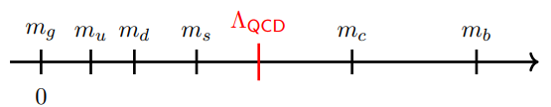
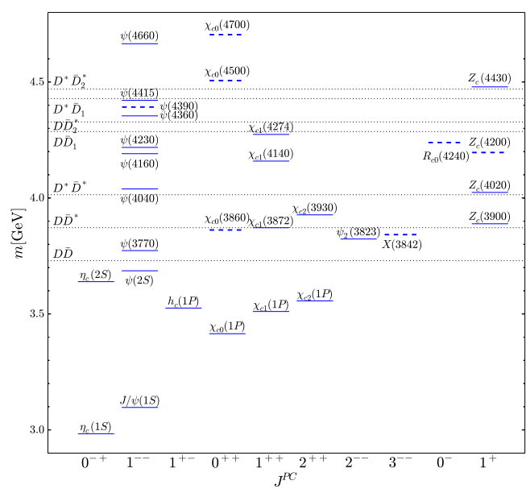
Exotic Hadron
Traditional quark model classification:
mesons and baryons
Gell-Mann & Zweig 1964
Exotic states: XYZ mesons (heavy-quark sector)
States that don’t fit traditional $\text{Q}\overline{\text{Q}}$ spectrum.
Exotic quantum numbers:
Exotic sector
J^{PC}$=0^{−−}$, $0^{+−}$, $1^{− +}$, $2^{+−}$ etc. are exotic
Charged ${\text{Z}}_{\text{c}}$ and ${\text{Z}}_{\text{b}}$ states: minimal 4-quark state:
Tetraquarks
$Z_{c}{\left(4430\right)}^{±}$ $Z_{b}{\left(10650\right)}^{±}$
For review see Brambilla et al. Phys. Reports. 873 (2020)
X(3872): First exotic state discovered in 2003 by Belle.
Phys. Rev. Lett. 91, 262001 (2003)
Physics Reports 873 (2020)
Dozens of XYZ mesons discovered since 2003.
Notes:
The quark model lies at the basis of the foundation of QCD. This framework is given by potential models that capture different aspects of this dynamics. The quark model is still essential for (i) classifying hadrons and (ii) describing some features of near- and above-open-flavor-threshold states, where more rigorous alternatives are missing.
For our case, we will focus on the heavy quark exotic states. Nature of these XYZ states still unknown.

Slide 3

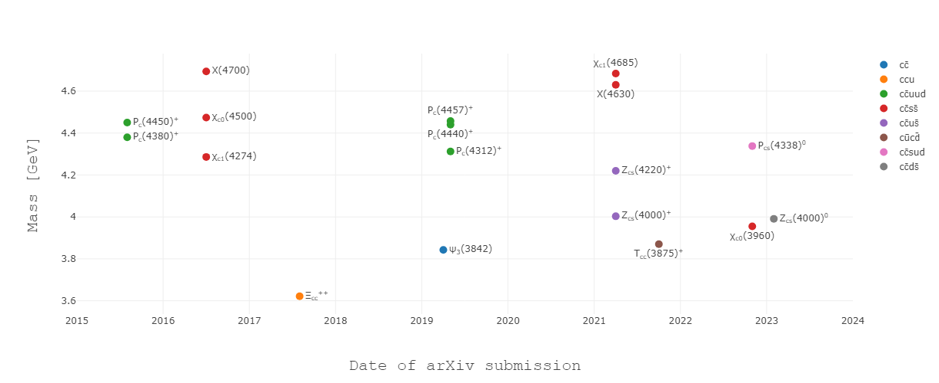
New Hadrons: XYZ mesons
LHCb experiment
CERN
https://qwg.ph.nat.tum.de/exoticshub/
Notes:
LHCb is a specialized b-physics experiment, designed primarily to measure the parameters of CP violation in the interactions of b-hadrons
The LHC primarily collides proton beams, but it can also accelerate beams of heavy ions: lead–lead collisions and proton–lead collisions. Energy around 10 TeV.

Slide 4
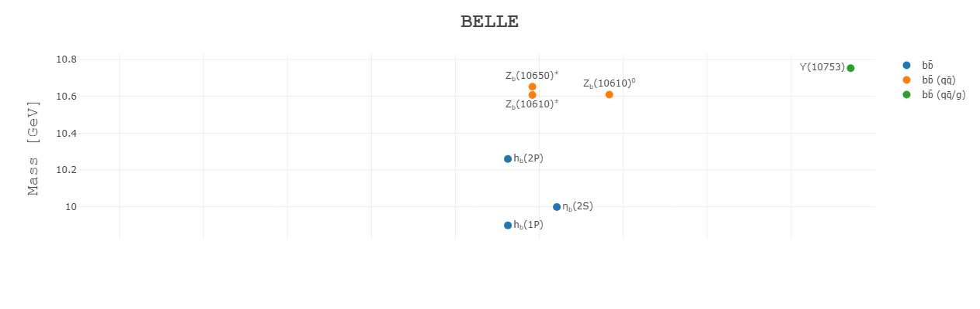
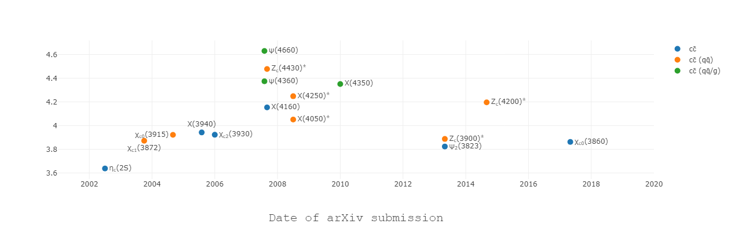
New Hadrons: XYZ mesons
BELLE experiment
Japan
https://qwg.ph.nat.tum.de/exoticshub/
Notes:
Belle detector uses electron–positron collider. Energy around 10 GeV.

Slide 5
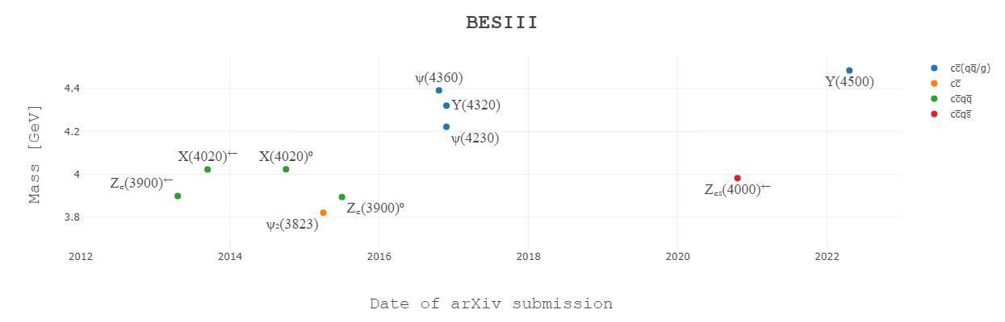
New Hadrons: XYZ mesons
https://qwg.ph.nat.tum.de/exoticshub/
BESIII experiment
China
Observation of many newer heavy hadrons are expected in the near future !!
BIG QUESTION:
How to understand XYZ states ? Can we theoretically predict the spectrum ??
Notes:
The Beijing Spectrometer III (BES III) is a particle physics experiment at the Beijing Electron–Positron Collider II (BEPC II). Energy range is less than 5 GeV.

Slide 6

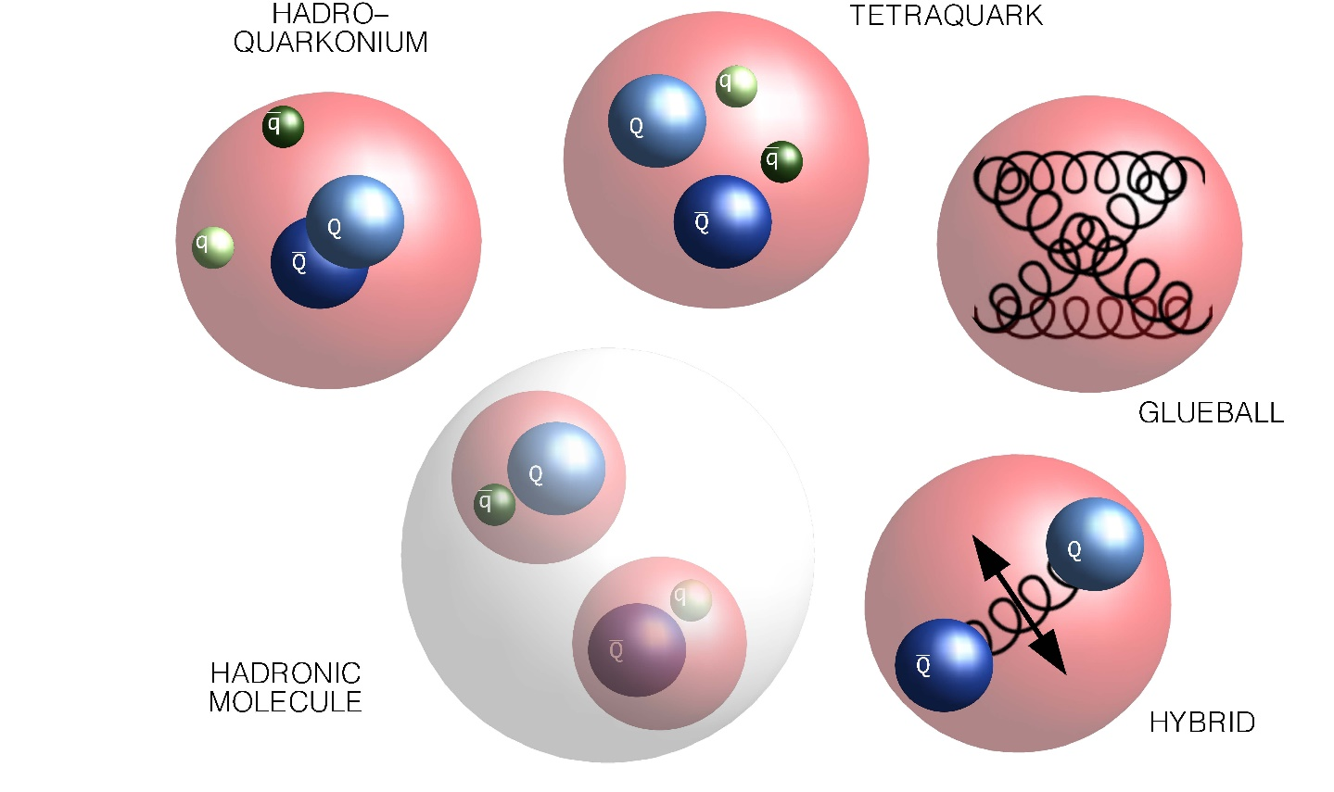

Exotic Hadron
Multiple Models for Exotics:
Major challenge to understanding of
QCD spectrum!!!
X Y Z
Figure from https://www.fz-juelich.de/en/ias/ias-4/research/exotic-hadrons/exotics_pad.jpg
Figure from Eric Braaten talk: Charm 2020 conference
……….
Individual success in describing some XYZ hadrons. No success in revealing general pattern.
BIG QUESTION:
Is there a coherent comprehensive framework based on QCD for all X Y Z hadrons ???

Slide 7

Exotic Hadron
Multiple Models for Exotics:
Hybrids $\text{(}\text{Q}\overline{\text{Q}}\text{g}\text{)}$: Isospin scalar exotic state.
Figure from https://www.fz-juelich.de/en/ias/ias-4/research/exotic-hadrons/exotics_pad.jpg
Use EFT + lattice for describing hybrid
Brambilla, Lai, AM, Vairo Phys. Rev. D 107, 054034 (2023)
Berwein, Brambilla, Castellà , Vairo
Phys. Rev. D. 92, (2015), 114019
……….
Non-zero isospin states. Can be described in the EFT.
However, lack of lattice inputs on the static energies for these states
Brambilla, AM, Vairo arXiv 2402.xxxxx

Slide 8
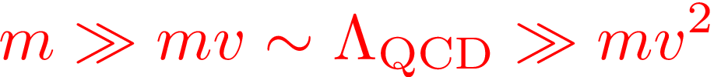



EFT Roadmap for ${Q\overline{Q}}/{QQ}$ systems
QCD
NRQCD
potential-NRQCD (pNRQCD)
Brambilla, Pineda, Soto and Vairo, Nucl. Phys. B 566, (2000) 275
Brambilla, Pineda, Soto and Vairo, Phys. Rev. D 63, (2000) 014023
(nonperturbative dynamics: Strong coupling)
(weak coupling regime)
Weak-coupling regime:
$Q\overline{Q}$ pair: color singlet & color octet fields
Photons of energy scale $m_{Q}v^{2}$ mediate interactions
Matching coefficients are potential which can be computed perturbatively
Relevant for low-lying $Q\overline{Q}$ states Ex. $J/ψ$, $Υ(1S)$.
Strong-coupling regime:
Only color singlet fields.
Matching coefficients are potential which are non-perturbative. Use Lattice inputs
Relevant for any $Q\overline{Q}$ states.
Generalized to Exotic Hadrons: Born-Oppenheimer EFT.
Power counting will be unique since only one energy scale $m_{Q}v^{2}$.
Notes:
pNRQCD situation similar to HQET in the sense that replace mv^2 with lambda_QCD.

Slide 9
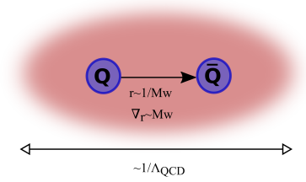
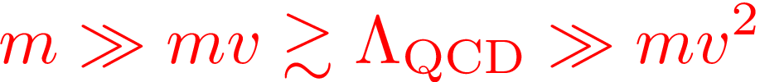
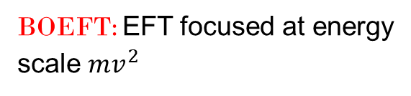
BOEFT: Exotic Hadron
Exotic hadron $(Q\overline{Q}X,QQX, …..)$, $X$: any combination of light quark and gluons
to obtain color singlet hadron
:
Example: Quarkonium hybrids $Q\overline{Q}g$, Tetraquarks $Q\overline{Q}q\overline{q}$
Hierarchy of scales:
BOEFT: Effective theory based on
Born-Oppenheimer Approximation
BOEFT: EFT focused at energy
scale $mv^{2}$
Heavy quark: slow-degrees of freedom
X: fast-degrees of freedom
Time-scale for dynamics of $\text{Q}\overline{\text{Q}}:∼\frac{\text{1}}{\text{m}{\text{v}}^{\text{2}}}\text{≫}\frac{1}{{\text{Λ}}_{\text{QCD}}}$
Castellà , Soto Phys. Rev. D. 102, (2020)
Brambilla, AM, Vairo arXiv 2402.xxxxx
Born-Oppenheimer (BO) Approximation
Braaten, Langmack, Smith Phys. Rev. D. 90, 014044 (2014)
Notes:
Non-relativistic because v~alpha<<1. This can be seen from the virial theorem.
Top quark mass ~ 180 GeV. Top quark unstable and short-lived and decays into bottom quark + W-boson.

Slide 10
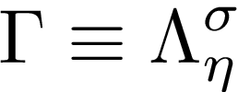





BO-Quantum #’s
$$Q$$
Static limit $\text{(}\text{m}\text{→ ∞)}$: heavy quarks are fixed in position.
$$r$$
Cylindrical symmetry due to preferred quark-antiquark axis
LDF
$$\overline{Q}$$
BOEFT potentials $( V_{Γ}\left(r\right))$: Potential between 2 heavy quarks due to
energy of LDF (light quarks, gluons) known as static energies
$V_{Γ}\left(r\right)$: $Γ$ labelled by cylindrical symmetry representation of diatomic molecules:
Absolute value of component of angular momentum of light d.o.f
$$\left|r⋅K_{light}\right|≡Λ=0, 1, 2,…….. (or Σ, Π, Δ, Φ,…..)$$
Product of charge conjugation and parity ($CP$):
$η=+1 \left(g\right),$ $−1 \left(u\right)$
$σ$: Eigenvalue of reflection about a plane containing static sources.
$$σ=P {\left(−1\right)}^{K_{light}}=±1$$
Braaten, Langmack, Smith Phys. Rev. D. 90, 014044 (2014)
$\text{r}\text{→ 0}$: Spherical symmetry restored: Labelled by LDF quantum #’s ${κ=\text{K}}^{\text{PC}}$.
Brambilla, Pineda , Soto, and Vairo Nucl. Phys. B566 (2000)
Berwein, Brambilla, Castellà , Vairo Phys. Rev. D. 92, (2015), 114019
Notes:
D_{infinity}h-→cylindrical symmetry group. O(3)*C: spherical symmetry group. In the centreof-mass system gluonic excitations between static quarks are, therefore, classified according to representations of O(3)× C, which we summarize by L, the angular momentum, CP and reflection with respect a plane passing through the quark-antiquark axes5x

Slide 11
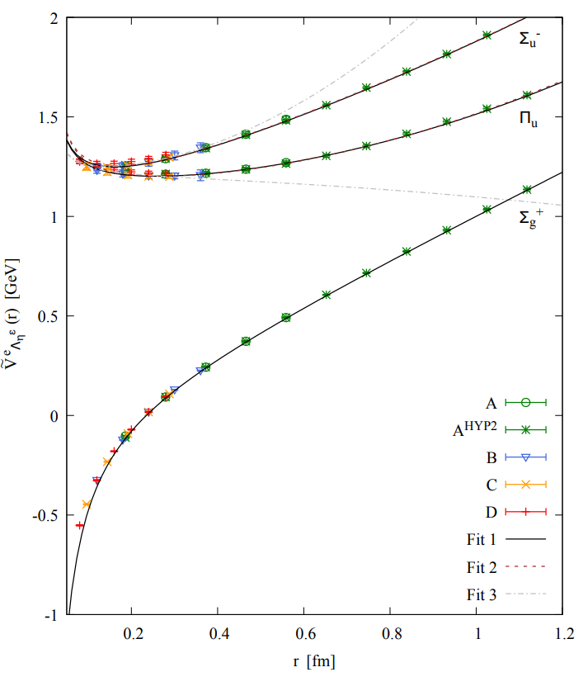
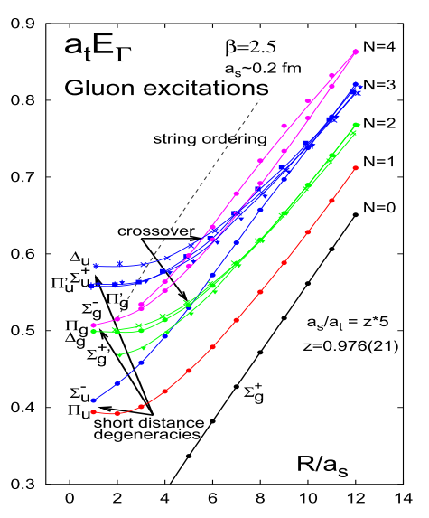
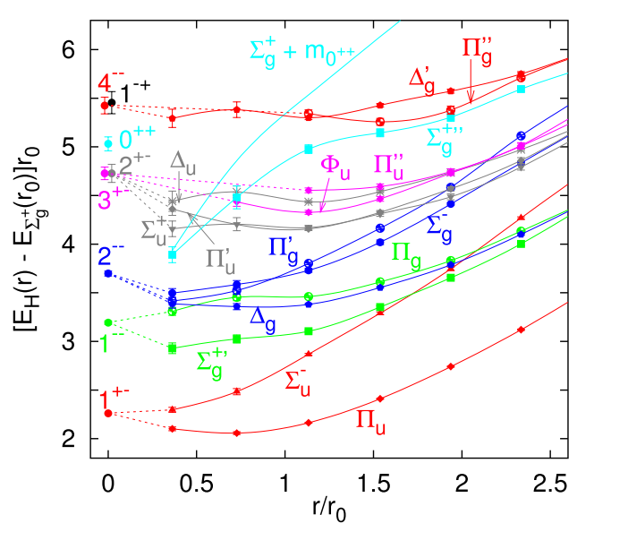
Static Energies Examples:
Static limit $\text{(}\text{m}\text{→ ∞}\text{)}$: heavy quarks are fixed in position. Interquark potential given by gluon configuration.
Schlosser and Wagner Phys. Rev. D. 105, (2022)
K. Juge, J. Kuti, C. Morningstar,
Phys. Rev. Lett. 90 (2003)
Results of nonperturbative
Gluonic Static energies from lattice:
Bali and Pineda Phys. Rev. D. 69, (2004)

Slide 12


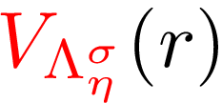








Exotic Hadron
Brambilla, AM, Vairo
arXiv 2402.xxxxx
Exotic hadron $(Q\overline{Q}X,QQX, …..)$, $X$ is light d.o.f.
$$Q\overline{Q}X$$
$$QQX$$
$Q$
$\overline{Q}$
$Q$
$Q$
BOEFT can address all these states
with inputs from Lattice QCD on
BOEFT potentials
r
r
color:
color:
X= gluon $→$ Hybrid
X= q $→$ Double heavy baryon
X= $q\overline{q}→$ Tetraquark / Molecule
X= $\overline{q}\overline{q}→$ Tetraquark
X= $q\overline{q}q→$ Pentaquark
X= $qqq→$ Pentaquark / Molecule
and so on
and so on
NRQCD
BOEFT
Matching condition discussed in Brambilla, AM, Vairo arXiv 2402.xxxxx.
Light quark operators essential for determinig BO-potentials
Notes:
Non-relativistic because v~alpha<<1. This can be seen from the virial theorem.
Top quark mass ~ 180 GeV. Top quark unstable and short-lived and decays into bottom quark + W-boson.

Slide 13
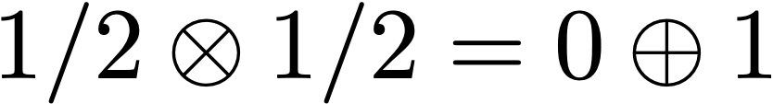



pNRQCD/BOEFT
Exotic hadron $(Q\overline{Q}X,QQX, …..)$, $X$ is light d.o.f.
spin:
$Q$
$\overline{Q}$
:
r
color:
Quantum number of light d.o.f X includes spin $Κ$, isospin, color etc….
NRQCD operator (gauge invariant) for exotic hadron $Q\overline{Q}X$:
: Operator that characterizes the light d.o.f X corresponding to quantum # $Κ$, isospin, color etc..
Let’s say $Q\overline{Q}$ pair in octet color, then the operator characterizing $Q\overline{Q}X$
NRQCD
Weakly coupled pNRQCD
BOEFT
Brambilla, AM, Vairo arXiv 2402.xxxxx
Castellà , Soto Phys. Rev. D. 102, (2020)
Notes:
Non-relativistic because v~alpha<<1. This can be seen from the virial theorem.
Top quark mass ~ 180 GeV. Top quark unstable and short-lived and decays into bottom quark + W-boson.

Slide 14


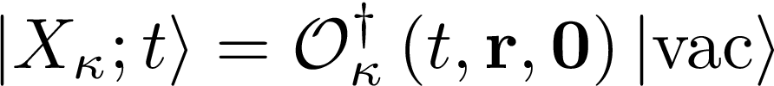
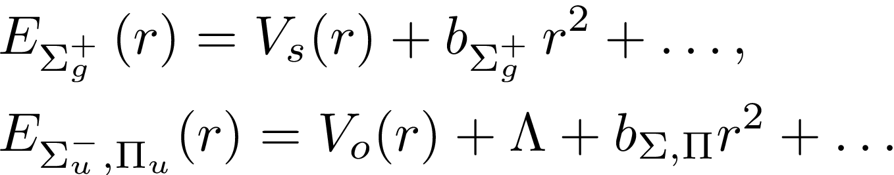


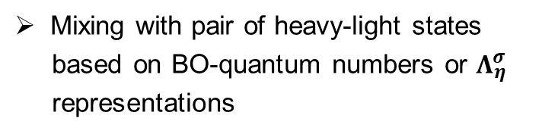
pNRQCD/BOEFT: Potentials
(Light d.o.f)
Short-distance behavior of BO-Potentials:
$${(x}_{1}, −T/2)$$
$${(x}_{1}, T/2)$$
$${(x}_{1}, −T/2)$$
$${(x}_{1}, T/2)$$
$$H(0,−T/2)$$
$$H(0,T/2)$$
Long-distance behavior of BO-Potentials:
String behavior (pure SU(3) gauge theory)
$${(x}_{2}, −T/2)$$
(a)
$${(x}_{2}, T/2)$$
$${(x}_{2}, −T/2)$$
(b)
$${(x}_{2}, T/2)$$
Mixing with pair of heavy-light states
based on BO-quantum numbers or $Λ_{η}^{σ}$
representations
Wilson loop for quarkonium
Wilson loop for exotics
Brambilla, AM, Vairo
arXiv 2402.xxxxx
K. Juge, J. Kuti, C. Morningstar,
Phys. Rev. Lett. 90 (2003)
Bali et al (SESAM collaboration),
Phys. Rev. D. 71 (2005)
Bulava et al, Phys. Lett. B. 793 (2019)

Slide 15
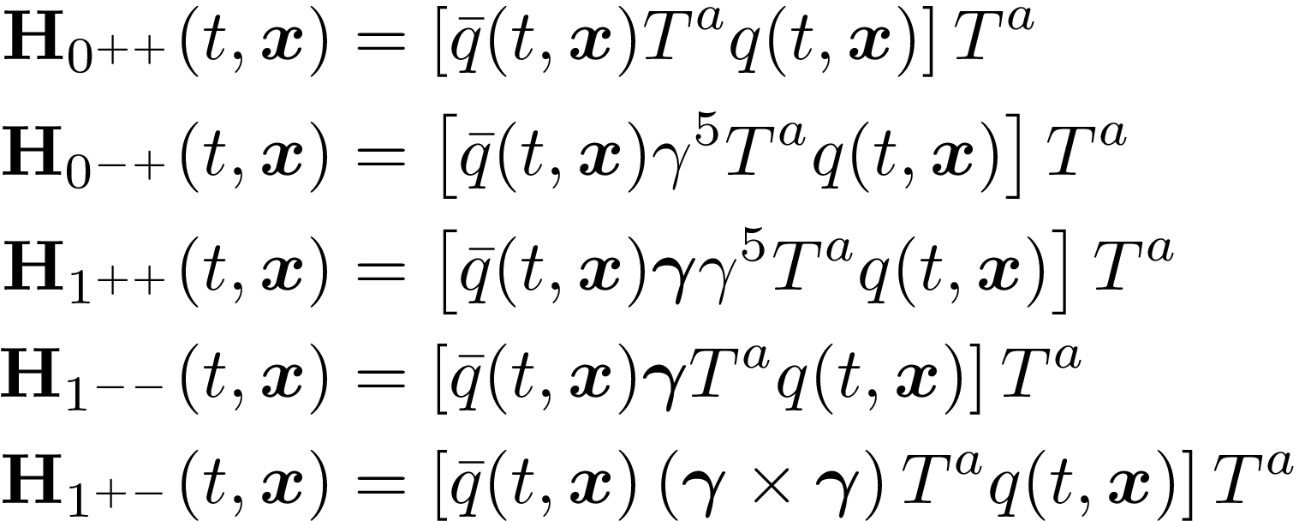
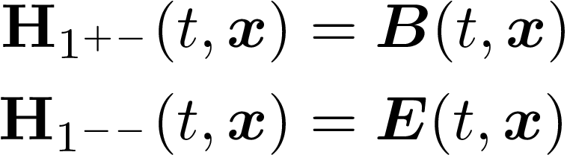
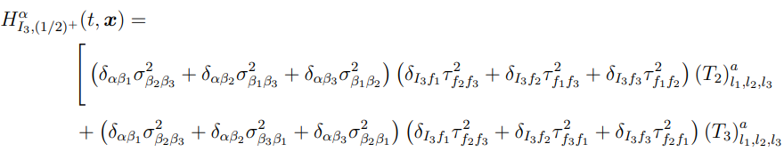
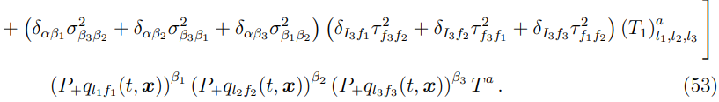
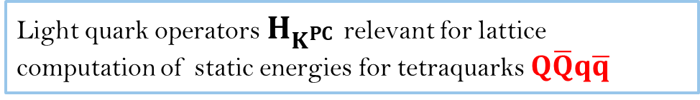
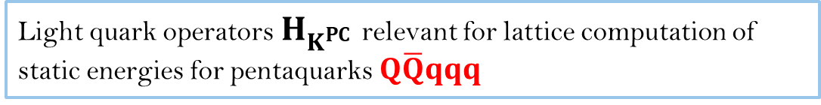
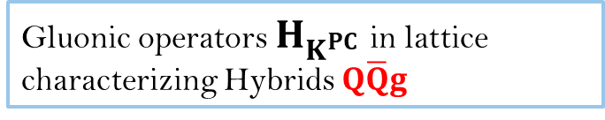
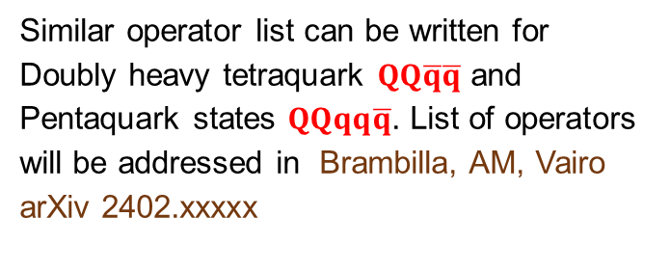
Light quark operators $H_{K^{PC}}$ relevant for lattice computation of static energies for tetraquarks $Q\overline{Q}q\overline{q}$
Gluonic operators $H_{K^{PC}}$ in lattice characterizing Hybrids $Q\overline{Q}g$
Light quark operators $H_{K^{PC}}$ relevant for lattice computation of static energies for pentaquarks $Q\overline{Q}qqq$
Brambilla, AM, Vairo arXiv 2312.xxxxx
Similar operator list can be written for
Doubly heavy tetraquark $QQ\overline{q}\overline{q}$ and
Pentaquark states $QQqq\overline{q}$. List of operators
will be addressed in Brambilla, AM, Vairo
arXiv 2402.xxxxx

Slide 16
Hybrids

Slide 17
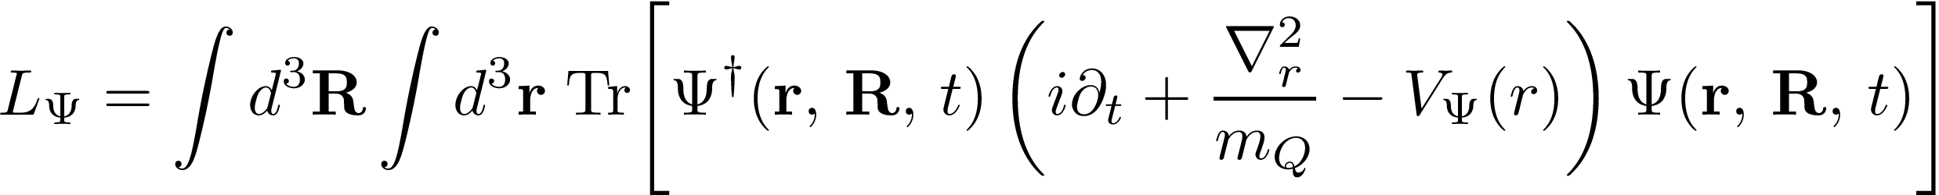
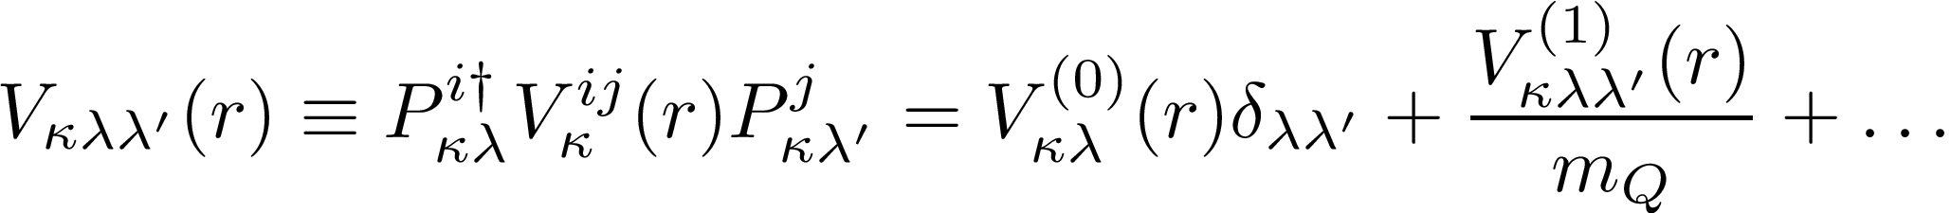
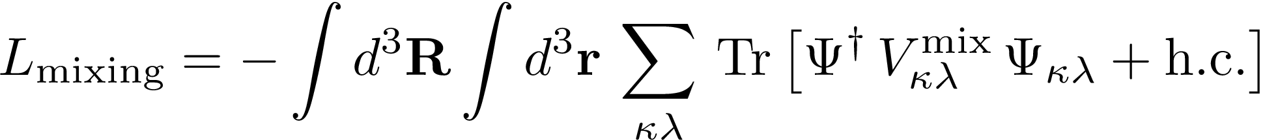
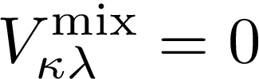


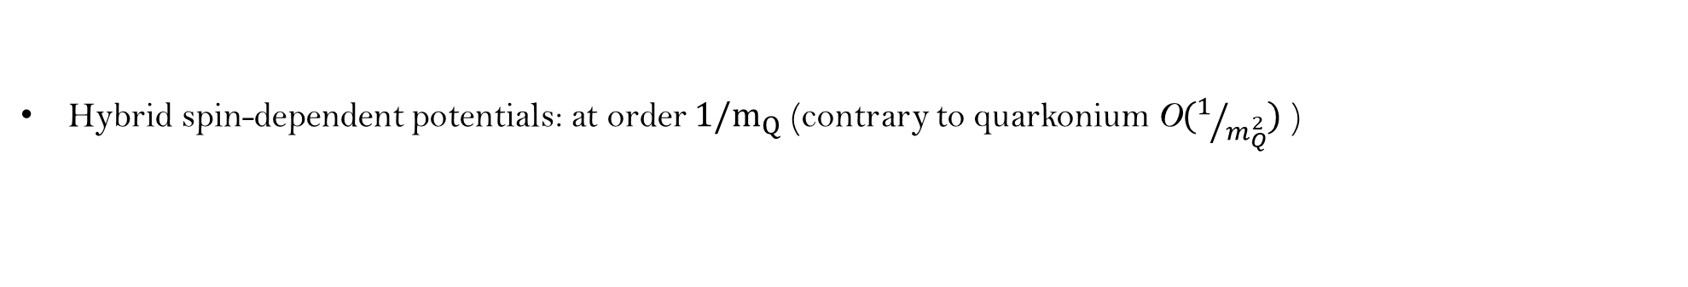
BOEFT: Hybrids
Brambilla, Lai, AM, Vairo
Phys. Rev. D 107, 054034 (2023)
BOEFT Lagrangian:
Brambilla, Krein, Castellà , Vairo Phys. Rev. D. 97, (2018)
Quarkonium:
Trace over spin indices.
$r:$ relative coordinate
Hybrid:
$R:$ COM coordinate
v
Brambilla, Lai, Segovia, Castellà, Vairo Phys. Rev. D. 101, (2020)
Hybrid potential:
Brambilla, Lai, Segovia, Castellà, Vairo Phys. Rev. D. 99, (2019)
Static potential
Spin-dependent potential
Hybrid spin-dependent potentials: at order $1/m_{Q}$ (contrary to quarkonium O$(1/{m_{Q}^{2}})$ )
Soto, Valls, arXiv 2302.01765
Hybrid-Quarkonium mixing:
No lattice calculations on mixing potential. Current work, ignore mixing,
Notes:
In the static limit, quarkonium (the lowest potential ) and heavy hybrids (the remaining potentials) do not mix by construction (they are built as orthogonal states). Hence, the mixing must be due to 1/m corrections to the Born-Oppenheimer approximation

Slide 18
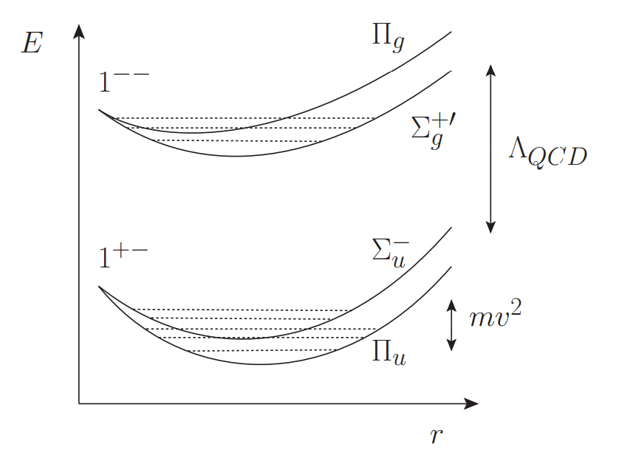
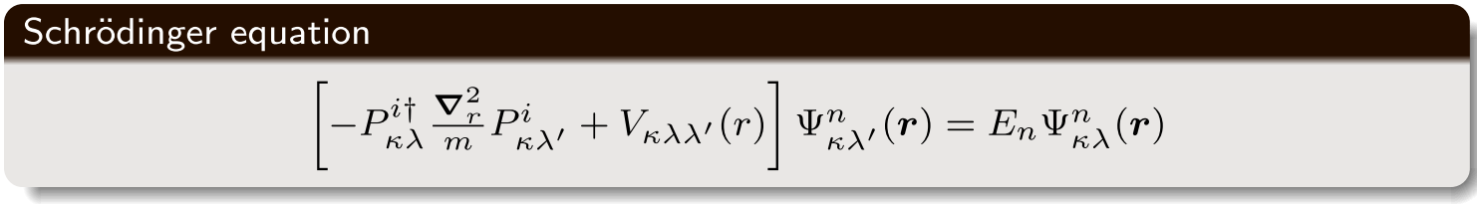
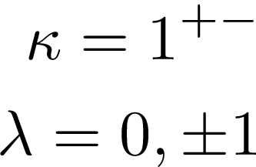
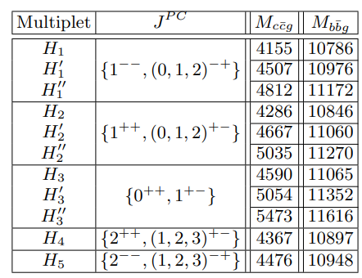
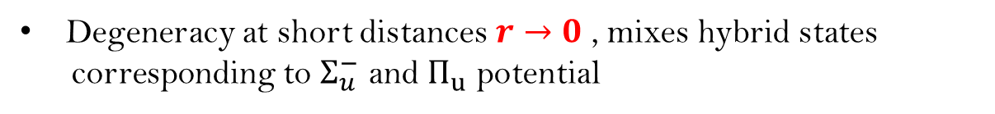
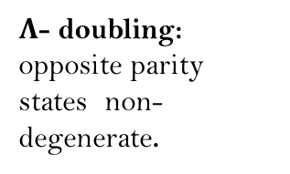
BOEFT: Hybrids
Degeneracy at short distances $r→0$ , mixes hybrid states
corresponding to $Σ_{u}^{−}$ and $Π_{u}$ potential
Coupled Schrödinger Eq: due to angular part of the kinetic term.
Brambilla, Lai, AM, Vairo Phys. Rev. D 107, 054034 (2023)
Coupled Schrödinger equation can be derived
from general principles of rigid-body dynamics
considering the pair of heavy quarks as linear
Rigid rotor. Derivation in Brambilla, AM, Vairo
arXiv 2402.xxxxx.
Hybrid
Spectrum:
$Λ$- doubling:
opposite parity states non-degenerate.
Berwein, Brambilla, Castellà , Vairo Phys. Rev. D. 92, (2015)

Slide 19
Static Energies for hybrids
Static limit $\text{(}\text{m}\text{→ ∞}\text{)}$: heavy quarks are fixed in position. Interquark potential given by LDF energy.
Schlosser and Wagner Phys. Rev. D. 105, (2022)
Degeneracy
Gluonic static energies for Hybrid
Gluonic static energies as a function of the heavy
quark-antiquark distance r
Quarkonium
Use these as potentials between heavy quark pairs to
solve the Schoedinger equation for hybrids.
Foster and Micheal (UKQCD collaboration),
Phys. Rev. D 59, 094509 (1999)
Brambilla, Pineda, Soto and Vairo, Rev. Mod. Phys 77, (2005)

Slide 20
Exotic: Hybrid candidates
Hybrids $\text{(}\text{Q}\overline{\text{Q}}\text{g}\text{)}$: Color singlet state of color octet $\text{Q}\overline{\text{Q}}$ + gluon. (Q = c, b)
Isoscalar neutral mesons (Isospin=0)
Examples of candidates based on mass and quantum numbers:
Charm sector:
$$c\overline{c}g: χ_{c1}\left(4140\right), X\left(4160\right), ψ\left(4230\right), X\left(4350\right), ψ\left(4360\right), ψ\left(4390\right), Y\left(4500\right), Y\left(4710\right),……$$
Bottom sector:
$$b\overline{b}g:Υ\left(10753\right), Υ\left(10860\right), Υ(11020)$$
Brambilla, Lai, AM, Vairo
Phys. Rev. D 107, 054034 (2023)
Studying decays can rule out or favor hybrid interpretation.
Notes:
This slide summarizes the main result of our work. Isospin conserved in strong interactions. Changing up and down quark doesn’t change QCD interaction

Slide 21
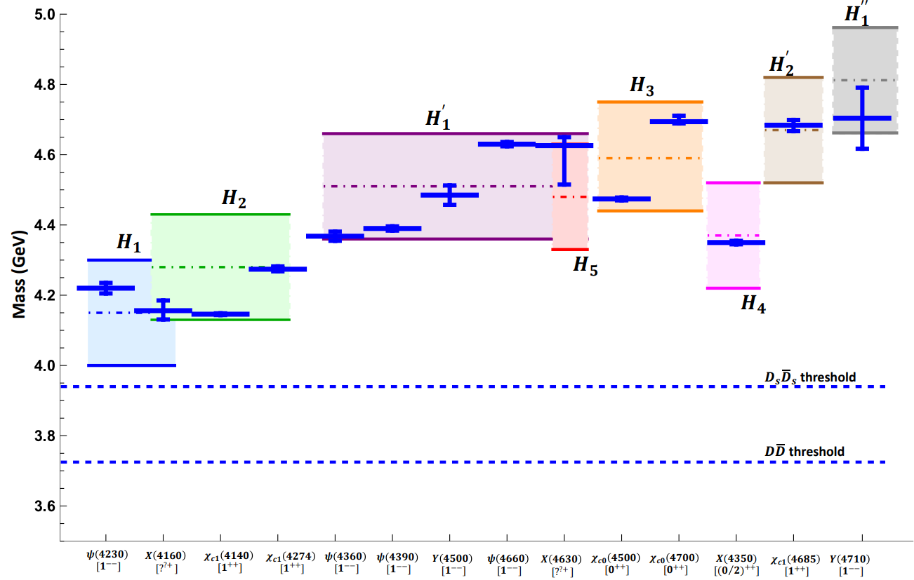
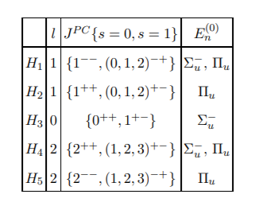
BOEFT: Hybrids
Charmonium hybrids: comparison with experimental results:
PDG 2022
Brambilla, Lai, AM, Vairo
Phys. Rev. D 107, 054034 (2023)

Slide 22
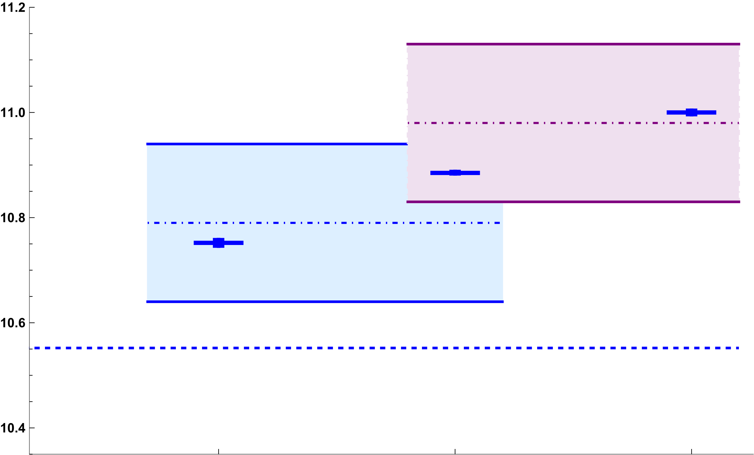






BOEFT: Hybrids
Bottomonium hybrids: comparison with experimental results:
$$H_{1}^{′}$$
$$H_{1}$$
Mass (GeV)
$B\overline{B}$ threshold
$$Υ\left(10753\right)$$
$$[1^{−−}]$$
$$Υ\left(10860\right)$$
$$[1^{−−}]$$
$$Υ\left(11020\right)$$
$$[1^{−−}]$$
PDG 2022
Brambilla, Lai, AM, Vairo arXiv:2212.09187

Slide 23
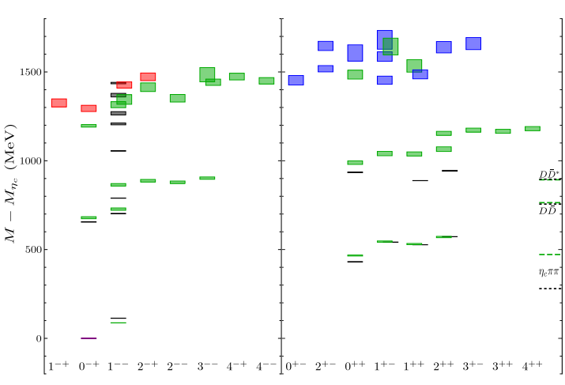

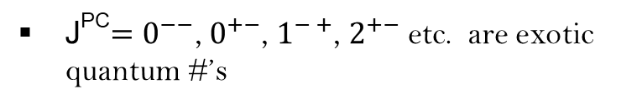

BOEFT: Hybrids
Lattice results for charm hybrids ($m_{π}≈240$ MeV) :
Results agree within error bars
Charmonium hybrids
hybrids
J^{PC}$=0^{−−}$, $0^{+−}$, $1^{− +}$, $2^{+−}$ etc. are exotic
quantum #’s
hybrids
$m_{η_{c}}=2983.9$ MeV
Berwein, Brambilla, Castellà , Vairo Phys. Rev. D. 92, (2015)
Brambilla, Lai, AM, Vairo arXiv:2212.09187
exotic
exotic
Lattice data from
Hadron Spectrum collaboration JHEP 12 (2016) 89
Box represents uncertainties
in lattice computations

Slide 24
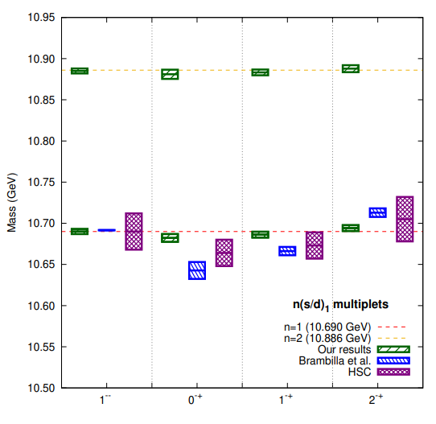
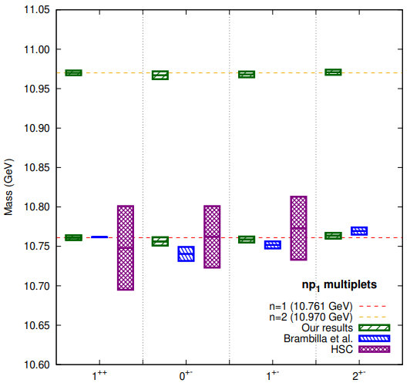


BOEFT: Hybrids
Including spin-dependent hybrid potentials:
n$H_{1}$
n$H_{2}$
Our results refer to
Soto & Valls
arXiv 2302.01765
Brambilla, Lai, Segovia, Castellà, Vairo
Phys. Rev. D. 101, (2020)
Brambilla, Lai, Segovia, Castellà, Vairo
Phys. Rev. D. 99, (2019)
Soto, Valls, arXiv 2302.01765
Lattice data from
Hadron Spectrum collaboration JHEP 02 (2021) 214

Slide 25
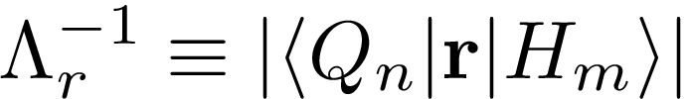
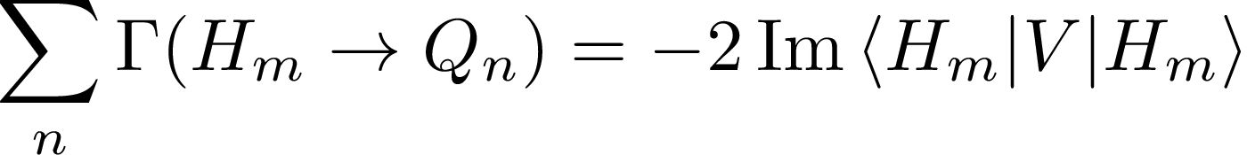
BOEFT: Hybrid Decays
Semi-inclusive process: $H_{m}→Q_{n}+X$; $H_{m}$: low-lying hybrid,
$Q_{n}$: low-lying quarkonium (states below threshold) and X: light hadrons.
$ΔE$: Large energy difference $⇒ΔE≡ E_{H_{m}} −E_{Q_{n}}≿$ 1 GeV.
Assume hierarchy of scales: $Λ_{r}\text{ ≫ ∆}\text{E} \text{≫ }{\text{Λ}}_{\text{QCD}}≫mv^{2}$
Energy scale related to decay
In BOEFT, all energy scales above $\text{m}{\text{v}}^{\text{2}}$ are integrated out. So, scale $ΔE$ must be integrated out. This gives imaginary contribution to hybrid potential:
DISCLAIMER!!!
Decay to open-flavor threshold states
not accounted here.
Optical theorem:
Imaginary piece of hybrid potential: determined from matching pNRQCD and BOEFT effective
theories.
Brambilla, Lai, AM, Vairo arXiv:2212.09187
Notes:
QFT: Im [M(a→a)]=-m Gamma, Gamma is the decay rate.

Slide 26
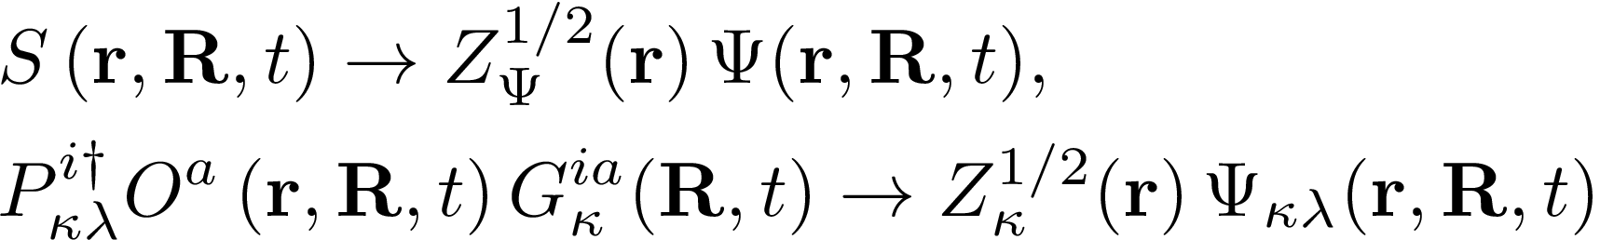
Hybrid Decays
Brambilla, Lai, AM, Vairo Phys. Rev. D 107, 054034 (2023)
Color configuration of $\text{Q}\overline{\text{Q}}$pair ($r→0$): quarkonium and hybrid in short-distance limit
$$Q$$
r
$\overline{Q}$
Quarkonium Singlet
Hybrid Octet
Quarkonium and Hybrid fields in short-distance limit $r→0$ (matching condition)
singlet (S) and octet (O)
Fields:
$G_{κ}^{ia}$: Gluon fields
$V_{s} \& V_{o}$: singlet and octet
potential
Potentials:
$Λ$: gluelump mass
For decay rate computation, start with effective theory of singlet and octet fields and match to
BOEFT of quarkonium and hybrid fields
Notes:
The potential term contains the imaginary term.

Slide 27
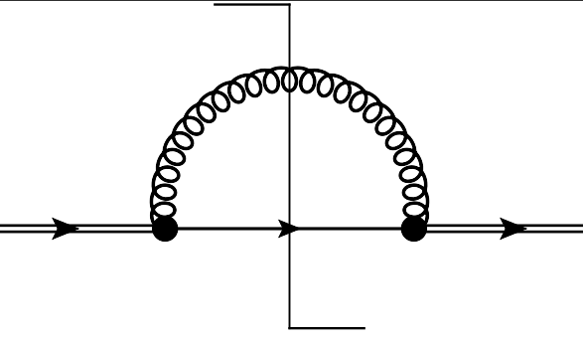










Hybrid Decays
Brambilla, Lai, AM, Vairo Phys. Rev. D 107, 054034 (2023)
Hierarchy of scales: $\text{∆}\text{E} \text{≫ }{\text{Λ}}_{\text{QCD}}≫mv^{2}$. Integrate out the scale $ΔE$ perutbatively.
matching pNRQCD and BOEFT:
Virtual gluon resolves color structure of
$\text{Q}\overline{\text{Q}}$pair ($r→0$) in quarkonium and
hybrid in short-distance limit
$≡$ Im
$$H_{m}$$
$$H_{m}$$
Quarkonium Singlet
Hybrid Octet
singlet
BOEFT
octet
octet
pNRQCD
Spin preserving decays $[O\left(r^{2}\right)]$
Spin flipping decays $[O\left(1/m^{2}\right)]$
Notes:
The exclusive decay widths Γ(Hm → Qn) may be computed by selecting a suitable decay channel in the right-hand side of the above equation.

Slide 28







Hybrid Decays
Brambilla, Lai, AM, Vairo Phys. Rev. D 107, 054034 (2023)
Spin-conserving decay due to $r⋅E$ term :
DISCLAIMER!!!
Decay to open-flavor threshold
states not accounted here.
$|S_{H}=1> −−→|S_{Q}=1>$
$|S_{H}=0> −−→|S_{Q}=0>$
R. Oncala, J. Soto,
Phys. Rev. D96, 014004 (2017).
J. Castellà, E. Passemar,
Phys. Rev. D104, 034019 (2021)
$$〈H_{m}\left|r\right|Q_{n}⟩=\sqrt{T^{ij}{\left(T^{ij}\right)}^{†}}$$
Spin-flipping decay due to $S.B$ term:
$|S_{H}=1> −−→|S_{Q}=0>$
$|S_{H}=0> −−→|S_{Q}=1>$
Depends on overlap of quarkonium and hybrid wavefunctions.
Hybrid-to-Quarkonium transition decay rate
= spin-conserving + spin-flipping decay rates.
Our estimate of decay rate are lower-bounds for the total width of hybrids

Slide 29



Brambilla, Lai, AM, Vairo Phys. Rev. D 107, 054034 (2023)
Comparison: charm exotic states with corresponding charmonium hybrid state:
$H_{m}→Q_{n}+X$
spin-conserving + spin-flipping decays
=
lower bound on the total decay widths of hybrids which is compared with inclusive rate of physical states in PDG.
Notes:
Spin singlet member of the H2 multiplet, the spin-conserving decay leads to spin singlet ηc(1S) quarkonium in the final state and the spin-flipping decay leads to spin triplet χc(1P) quarkonium in the final state. However, these 681 states: χc1(4140) and χc1(4274) only decays to ϕJ/ψ which disfavours the hybrid interpretation. It has been suggested that these states could be isospin−0 charmonium tetraquark state.
The JPC quantum number of X(4160) have not yet been determined. However, the charge conjugation and mass suggest that it can be a candidate for the spin triplet 1−+ member of the H1 multiplet or the spin singlet 1++ member of the H2 multiplet. Since, X(4160) only decays into D∗ ¯D∗ mesons, this disfavors hybrid interpretation and favors a molecular interpretation of this state

Slide 30


Comparison: charm exotic states with corresponding charmonium hybrid state:
Disfavors hybrid interpretation !
M. Ablikim et al, Chin.Phys.C,46,111002(2022).
Recent BESIII result for $ψ$(4230) decay: $72±33$ MeV
$$χ_{c0}\left(4500\right) \&χ_{c0}\left(4700\right)$$
Decay to $χ_{c}(1P)$ not seen !!!. Major contribution to theoretical estimate from this decay channel.
Brambilla, Lai, AM, Vairo
Phys. Rev. D 107, 054034 (2023)
Notes:
Spin singlet member of the H2 multiplet, the spin-conserving decay leads to spin singlet ηc(1S) quarkonium in the final state and the spin-flipping decay leads to spin triplet χc(1P) quarkonium in the final state. However, these states: χc1(4140) and χc1(4274) only decays to ϕJ/ψ which disfavours the hybrid interpretation. It has been suggested that these states could be isospin−0 charmonium tetraquark state.
The JPC quantum number of X(4160) have not yet been determined. However, the charge conjugation and mass suggest that it can be a candidate for the spin triplet 1−+ member of the H1 multiplet or the spin singlet 1++ member of the H2 multiplet. Since, X(4160) only decays into D∗ ¯D∗ mesons, this disfavors hybrid interpretation and favors a molecular interpretation of this state

Slide 31






Brambilla, Lai, AM, Vairo Phys. Rev. D 107, 054034 (2023)
Comparison: bottom exotic states with corresponding bottomonium hybrid state:
$H_{m}→Q_{n}+X$
spin-conserving + spin-flipping decays
=
lower bound on the total decay widths of hybrids which is compared with inclusive rate of physical states in PDG.
$Γ$ (MeV)
$$Υ\left(10753\right)$$
$$[1^{−−}]$$
$$Υ\left(10860\right)$$
$$[1^{−−}]$$
$$Υ\left(11020\right)$$
$$[1^{−−}]$$
Notes:
Upsilon(10753): Candidate of upsilon(3d) quarkonium state. And upsilon(10860) candidate for upsilon (5s) quarkonium state.

Slide 32






Brambilla, Lai, AM, Vairo Phys. Rev. D 107, 054034 (2023)
Hybrid-to-quarkoniunium transition widths:
Could have a significant hybrid component.
$Υ\left(10860\right)$
Inclusive rate: $37±4$ MeV. Branching fraction for decay to open-bottom mesons: 76.6%. Decay rate to quarkonium: ${8.8}_{−1.8}^{+2.6}$ MeV. Good agreement with our lower-bound estimate for $H_{1}[1^{−−}](10786)$.
Candidate for $Υ(5S)$ state
$Γ$ (MeV)
$Υ\left(11020\right) \& Υ\left(10753\right)$
Large branching fraction for decays to open-bottom mesons expected. Different quark model calculations predict large branching fraction. Need experimental input on branching fraction.
See H$\ddot{u}$sken, Mitchell & Swanson, Phys Rev D 106 (2022).
$Υ\left(10753\right)$: Candidate for $Υ(3D)$ state.
$$Υ\left(10753\right)$$
$$[1^{−−}]$$
$$Υ\left(10860\right)$$
$$[1^{−−}]$$
$$Υ\left(11020\right)$$
$$[1^{−−}]$$
Notes:
Upsilon(10753): Candidate of upsilon(3d) quarkonium state. And upsilon(10860) candidate for upsilon (5s) quarkonium state.

Slide 33








Hybrid Decays
Brambilla, AM, Vairo arXiv 2312.xxxxx
Hybrid decays to meson-pair threshold states: $ΔE ≲Λ_{QCD}$
Conventional Wisdom: Hybrid decays to two S-wave mesons forbidden!
Kou & Pene, Phys Lett B 631 (2005)
Page, Phys Lett B 407 (1997)
Farina, Tecocoatzi, Giachino, Santopinto & Swanson, Phys Rev D 102 (2020)
Decay to two s-wave mesons allowed if BO-quantum numbers for hybrids and meson-pair are same.
Hybrid
Meson-antimeson threshold
s-wave+s-wave
Ex. $D\overline{D}$ threshold
s-wave+p-wave
Ex. $D_{1}\overline{D}$ threshold
$Σ_{u}^{−}$ component in hybrids mix with $Σ_{u}^{−}$ component in s-wave+s-wave threshold!!!!
Bruschini 2306.17120
Bruschini & Gonzalez, 1912.07337
J. Castella 2401.13393
Recent lattice computation for $c\overline{c}$ hybrid $1^{− +}$ decay to
Computing these decays of hybrid to
threshold states in BOEFT framework ??
Shi et al 2306.12884
Notes:
Hybrid-quarkonium mixing can introduce corrections to the selection rules of Kou and Pene. Hybrid and meson-antimeson threshold states should have narrow avoided crossing since $g→q\overline{q}$

Slide 34








Hybrid-Quarkonium mixing and impact on
hybrid interpretation of Exotics ?
Brambilla, AM, Vairo, Wagner, Schlosser (in progress)
Hybrid states in the same energy range and with same quantum #’s as quarkonium can mix.
Mixing impacts spectrum and decay properties of hybrid. Implications for exotic hadrons !!.
Oncala & Soto, PRD (2017).
Ex.
Effect on decay:
Hybrid-quarkonium mixing through heavy-quark spin dependent operator. Mixing potential at $O(1/m)$ in BOEFT.
Matching two-point correlators in NRQCD and BOEFT:
Expression after matching:
$$H_{m}$$
$${Q′}_{m}$$
$$=$$
Above expression can be computed on lattice if we identify:
NRQCD
BOEFT
Notes:
Behavior of mixing potential at short and long distances determined from the pNRQCD and effective string theory. At short distances, pNRQCD will imply there is degeneracy.

Slide 35



Hybrid-Quarkonium mixing and impact on
hybrid interpretation of Exotics (cont’d) ?
Questions to be answered:
$$H_{m}$$
$${Q′}_{m}$$
Computing the mixing potential on lattice ??
Computing hybrid spin-dependent potential (also at $O(1/m)$) on lattice ??
Solve coupled Schrodinger equations (mixing potential included) of hybrid and quarkonium to obtain the new spectrum.
Study effect of mixing on hybrid decays.
Munich-Frankfurt collaboration:
N, Brambilla, AM, Vairo, M. Wagner, C. Schlosser
Takeaway:
A physical state could be a mixture of both quarkonium and hybrid !!!
Notes:
Behavior of mixing potential at short and long distances determined from the pNRQCD and effective string theory. At short distances, pNRQCD will imply there is degeneracy.

Slide 36
Tetraquarks &
Pentaquarks

Slide 37






BOEFT: $QQ\overline{q}\overline{q}$ multiplets
Brambilla, AM, Vairo arXiv 2402.xxxx
Defines the Born-Oppenheimer
static potentials $Σ_{g}^{+}, \{Σ_{g}^{−}, Π_{g}\}$
$J^{P}$ for $T_{cc}^{+}$
Limited lattice inputs available on Born-Oppenheimer static potentials $Σ_{g}^{+}, \{Σ_{g}^{−}, Π_{g}\}$
Bicudo, Cichy, Peters, & Wagner
PRD 93, 034501 (2016)

Slide 38





BOEFT: $Q\overline{Q}q\overline{q}$ multiplets
Brambilla, AM, Vairo arXiv 2402.xxxx
$J^{PC}$ for neutral partner of
$Z_{c},Z_{b}$ states. Probably mixing between both channels required ?
$J^{PC}$ for $X(3872)$
Limited lattice inputs available on Born-Oppenheimer
static potentials $Σ_{u}^{−}, \{Σ_{g}^{+}, Π_{g}\}$
Mixing of BO-potentials with pair of heavy-light states relevant for states near threshold. More on this mixing see Brambilla, AM, Vairo arXiv 2402.xxxx
Braaten, AM, Bruschini (in preparation)
Prelovsek, Bahtiyar, & Petkovic
Phys. Lett. B 805 (2020)

Slide 39




BOEFT: Pentaquark multiplets
$$Q\overline{Q}qqq$$
Brambilla, AM, Vairo arXiv 2402.xxxx
No lattice inputs available on Born-Oppenheimer
static potentials for pentaquarks
$$QQqq\overline{q}$$
Coupled Schrödinger equation for
These pentaquark states derived in
Brambilla, AM, Vairo arXiv 2402.xxxxx.

Slide 40

Takeaway message
Brambilla, Lai, AM, Vairo Phys. Rev. D 107, 054034 (2023)
Brambilla, AM, Vairo arXiv 2402.xxxxx
BOEFT provides a model-independent & systematic way to study heavy quark exotics.
Specific to Hybrids: BOEFT computation for decay to quarkonium involves hierarchy of energy scales :
pNRQCD and BOEFT matching
Neglect hybrids of higher gluonic
excitations and mixing.
Our results for hybrid-to-quarkonium transition widths
Hybrid-to-Quarkonium transition decay rate = spin-conserving + spin-flipping decay rates.
Our analysis disfavors: $ψ(4230)$, $χ_{c1}(4140)$, $χ_{c0}(4500)$, $χ_{c0}(4700)$, and $X(4350)$ as pure hybrid states.
DISCLAIMER!!!
All the above interpretation can differ accounting for decays to
meson-pair threshold states and hybrid-quarkonium mixing.
Our analysis suggests:
$X\left(4160\right)$ : could be charm hybrid $H_{1}[2^{−+}](4155)$.
$ψ\left(4390\right)$ : could be charm hybrid $H_{1}[1^{−−}](4507)$.
X$\left(4630\right)$ : could be charm hybrid $H_{1}[{(1/2}^{− +})](4507)$.
$ψ\left(4710\right)$ : could be charm hybrid $H_{1}[{(1}^{− −})](4812)$.
$Υ\left(10753\right)$ : could be bottom hybrid $H_{1}[{(1}^{− −})](10786)$.
Obtained new results for tetraquark and pentaquark multiplets based on BOEFT.
Notes:
the recent observation of the transition Y (4260) → X(3872)γ makes the identification of Y (4260) as a hybrid highly unlikely. Also in Soto and Oncala find Y(4260) mass to be close to the spin-1 2d charmonium state in their analysis.

Slide 41
Thank you!!

Slide 42
Backup Slides

Slide 43



BOEFT: Hybrids
Lattice results for bottom hybrids ($m_{π}≈391$ MeV):
Results agree within error bars
Bottomonium hybrids
hybrids
hybrids
hybrids
J^{PC}$=0^{−−}$, $0^{+−}$, $1^{− +}$, $2^{+−}$ etc. are exotic
quantum #’sv
$m_{η_{b}}=9398.7$ MeV
Berwein, Brambilla, Castellà , Vairo Phys. Rev. D. 92, (2015)
Brambilla, Lai, AM, Vairo arXiv:2212.09187
Lattice data from
Hadron Spectrum collaboration JHEP 02 (2021) 214
Box represents uncertainties
in lattice computations

Slide 44

Indication of new pentaquark state with isospin = 3/2 (?)
Not yet confirmed by LHCb.
Figure from Robertson talk:
LHCb 2023 conference

Slide 45

Virial theorem: Nonrelativistic Bound State
EFT lectures by A. Vairo
Notes:
In mechanics, the virial theorem provides a general equation that relates the average over time of the total kinetic energy of a stable system of discrete particles with that of the total potential energy of the system.

Slide 46






Born-Oppenheimer Philosophy
Sharp difference between time or energy scales of heavy & light degrees of freedom.
Ex. $H_{2}^{+}$ molecule: 2 protons &1 electron.
$$p$$
Protons (nuclei) move very slowly compared to electrons and can be considered static (fixed) when considering the motion of the electrons
$$r$$
electron
$$p$$
Electrons instantaneously adjust as r changes
Solve electron Schrödinger eq. for fixed r
Solve nuclei (proton) Schrödinger eq. with $E_{el}^{i}(r)$ as potential.
QCD states with 2-heavy quarks (XYZ mesons): analogous of molecules in atomic systems !!!
Heavy quarks $↔$ nuclei
Gluons & light quarks $↔$ electrons
Notes:
A complete understanding of exotic quarkonia in terms of these pictures has not yet been obtained

Slide 47






Born-Oppenheimer Philosophy
Full Hamiltonian of the system:
$H_{2}^{+}$ ion
Electron Hamiltonian:
Solve electron Schrödinger eq. for fixed R
Solve nuclei (proton) Schrödinger eq. with $U(R)$ as potential.

Slide 48


50+ New Hadrons seen at LHC
70 new hadrons with at least one heavy quark ( charm or bottom) observed till now!
Here mesons not included from other experiments BESIII, Belle etc.
More heavy hadrons are expected in the near future !!
https://www.nikhef.nl/~pkoppenb/particles.html

Slide 49

pNRQCD
Notes:
Fermi theory of weak interaction: EFT for energy scale less than W and Z-boson mass ( roughly 80 GeV). Hydrogen atom is an EFT for energy scale less than electron mass, lambda_QCD or proton mass etc.

Slide 50

pNRQCD
Notes:
Fermi theory of weak interaction: EFT for energy scale less than W and Z-boson mass ( roughly 80 GeV). Hydrogen atom is an EFT for energy scale less than electron mass, lambda_QCD or proton mass etc.

Slide 51





pNRQCD/BOEFT
Behavior of heavy quark-antiquark pair at short $(r→0)$ and large $(r→∞)$distance:
Consider example of quarkonium:
Short-distance $(r→0)$:
$$Q$$
r
$\overline{Q}$
The 2 heavy quarks are close together in color singlet configuration.
What does this tell us???
NRQCD
Weakly coupled
pNRQCD
strongly coupled
pNRQCD / BOEFT
a=1,2,3: color index
Large-distance $(r→∞)$:
$$Q$$
$\overline{Q}$
The 2 heavy quarks are far apart connected by a flux tube.
r
NRQCD
strongly coupled
pNRQCD / BOEFT
Notes:
Non-relativistic because v~alpha<<1. This can be seen from the virial theorem.
Top quark mass ~ 180 GeV. Top quark unstable and short-lived and decays into bottom quark + W-boson.

Slide 52







BOEFT
Brambilla, Lai, AM, Vairo arXiv:2212.09187
Quarkonium static potential:
Quarkonium Potential:
Hybrid static potential:
Gluonic Static energies from lattice:
Hybrid Potential:
$Λ_{RS}$ : 0.87 (15) GeV
Gluelump mass definition:
Schlosser and Wagner Phys. Rev. D. 105, (2022)
Perturbative RS-scheme potentials $V_{o}^{RS}$ upto order$α_{s}^{3}.$
Berwein, Brambilla, Castellà , Vairo Phys. Rev. D. 92, (2015)
Bali and Pineda Phys. Rev. D. 69, (2004)

Slide 53


Brambilla, Lai, AM, Vairo arXiv:2212.09187
Hybrid-to-quarkoniunium transition widths:
Could have a significant hybrid component.
Decay to open-threshold states could be significant or expected to be large (?).
See Farina, Tecocoatzi, Giachino, Santopinto & Swanson, Phys Rev D 102 (2020) for $1^{−−}$ hybrid decay to threshold states.
No information on branching ratio (BR) for decays to threshold states in PDG.
J^{PC} $={2 }^{− +}$

Slide 54





First doubly charmed tetraquark seen by LHCb
Exotic quark content $cc\overline{u}\overline{d}$
Consistent with isoscalar with J^{P}=1⁺
Mass below D^{*+}D⁰ threshold and very narrow

Slide 55
Brambilla, Lai, AM, Vairo arXiv:2212.09187
Spin-flipping transitions: suppressed by powers of the heavy-quark mass due to the heavy-quark spin symmetry;
Relative comparison between spin-conserving and spin-flipping decays: $H_{m}→Q_{n}+X$ :
Size of energy gap $ΔE$: final quarkonium states are different in both the decay process.
Depends on relative magnitude of matrix element (radial): $\left|\left\langle Q_{n}\right|r\right|H_{m}⟩|$ & $\left|\left\langle Q_{n} | H_{m}\right\rangle \right|/m$
Ratio :
No obvious hierarchy relation between the two-decay process.
For bottom hybrids: spin-flipping transitions are smaller compared to spin-conserving.
For charm hybrids: spin-flipping transitions are not necessarily small:
Spin-flipping ~ spin-conversing: indicating heavy-quark spin-symmetry violations!
Quarkonium transition: $Q_{m}→Q_{n}+X$ :spin-flipping decay suppressed by ${O\left(v\right)}^{2}$ compared to spin- conserving.
Notes:
Upsilon(10753): Candidate of upsilon(3d) quarkonium state. And upsilon(10860) candidate for upsilon (5s) quarkonium state.

Slide 56



Exotic Hadron
Figure from Nat Rev Phys 1, 480-494 (2019)
……….
Braaten, Langmack, and Smith Phys. Rev. D90, 014044 (2014)

Slide 57











Lattice: Static energies
Based on spectral decomposition:
$\left|\underline{n}\right\rangle :$ Eigenstate of static NRQCD
Hamiltonian $(m→∞)$.
Any state
In large time limit, the NRQCD correlator (Heisenberg picture) gives:
$Γ$: quantum #’s corresponding to
representation of $D_{∞h}$: $Λ_{η}^{σ}$
Quarkonium
Hybrid
Color singlet $\text{Q}\overline{\text{Q}}$pair
Color octet $\text{Q}\overline{\text{Q}}$pair + gluon
gluonic operator with quantum numbers $Γ$
r
Wilson line:
Notes:
For lattice computation, Euclidean time correlator is more useful.

Slide 58




Hybrid Decays
Connection with non-perturbative fields: quarkonium and hybrid in $r→0$
Fields:
Potentials:
$κ$: denotes quantum numbers
Gluelump mass definition:
Eigenvalue of static NRQCD Hamiltonian
Notes:
The potential term contains the imaginary term.

