Slide 1

ErUM-FSP T05
“Aufbau von APPA bei FAIR”
Status and Perspectives
Stefan Schippers
Sprecher des ErUM-FSP T05
Justus-Liebig-Universität Gießen
HFHF Campus Gießen

Slide 2
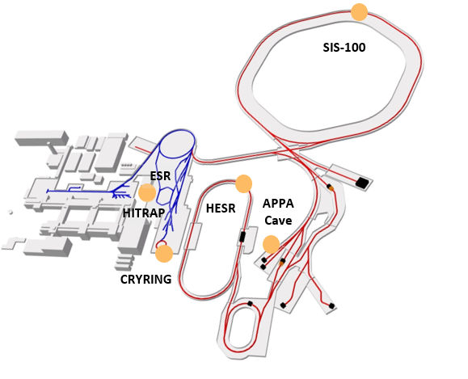


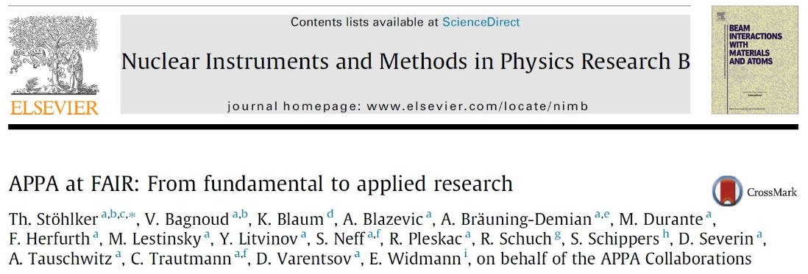
APPA: Matter under Extreme Conditions
FACILITY CAPABILITY
SCIENTIFIC CAPABILITY
Highest Charge States
Relativistic Energies
High Intensities
High Charge at Low Velocity
Extreme Static Fields
Extreme Dynamical Fields and Ultrashort Pulses
Very High Energy Densities and Pressures
Large Energy Deposition
⇔
Plasma Physics
200 members from 11 countries
Atomic and Fundamental Physics
439 members from 26 countries
APPA
White Paper
NIMB 365 (2015) 680
not in FS scenario

Slide 3
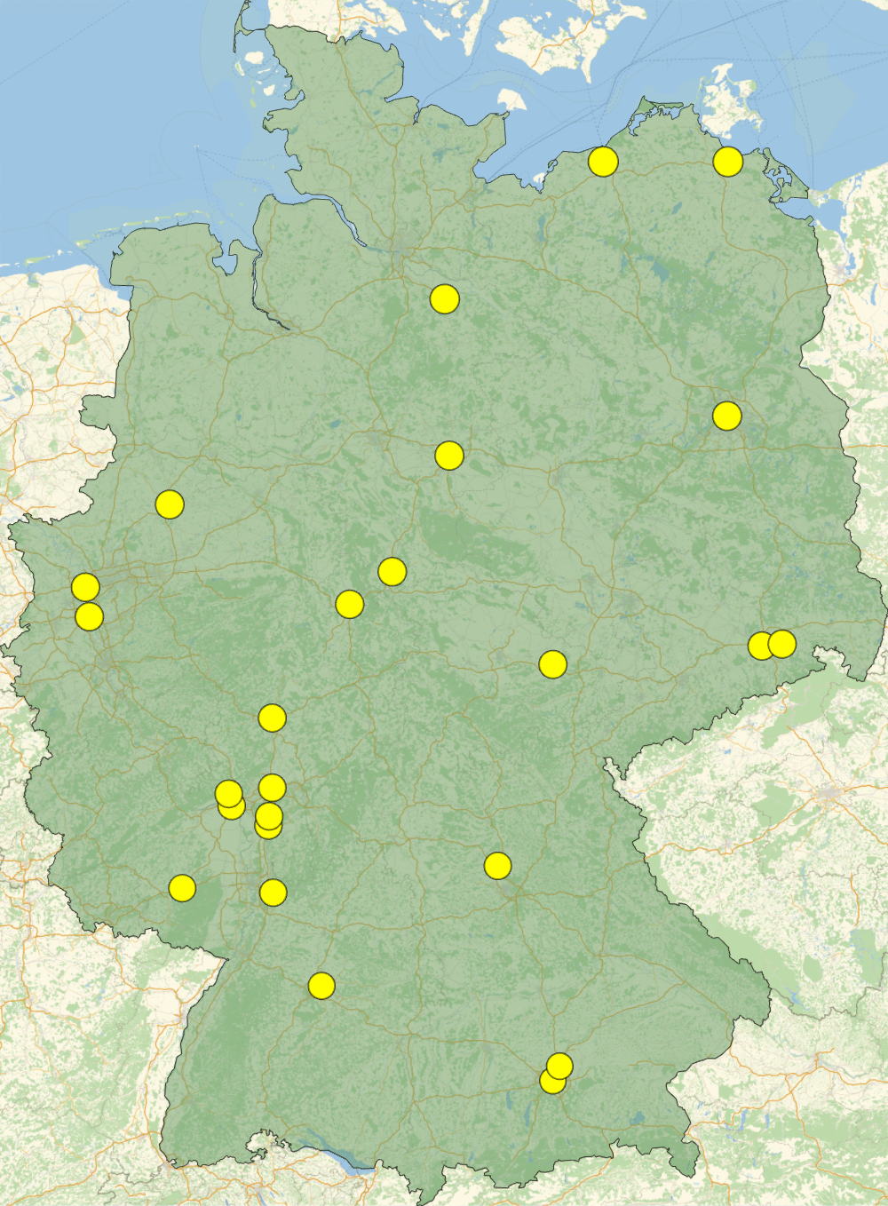











BMBF Funding of German University Groups
ErUM-FSP T05 –
„Aufbau von APPA bei FAIR“
U Greifswald
U Rostock
U Lüneburg
HU Berlin
SPARC, HED@FAIR (2024-2027)
11 projects funded (31 asked for)
4.7 M€ (14 M€ asked for)
U Münster
TU Braunschweig
U Duisburg-Essen
U Göttingen
TU Dresden
U Düsseldorf
U Kassel
HI Jena
U Jena
HZDR
U Gießen / THM
HS Rhein-Main
U Frankfurt
U Mainz
HI Mainz
FAIR / GSI
TU Darmstadt
MPIK
U Erlangen-Nürnberg
TU Kaisers-
lautern
U Heidelberg
SPARC, HED@FAIR (2021-2024)
13 projects funded
7.5 M€
U Stuttgart
TU München
U München
Funds reduced by 24%!
not all universities applied for funding

Slide 4
APPA Facilities in Operation (HED@FAIR and SPARC)
charge state
11 MeV/u
UNILAC
SIS 18
400 MeV/u
1 GeV/u
APPA fully involved in FAIR Phase 0
  ESR, CRYRING, HITRAP are part of FAIR MSV
  PRIOR (proton microscope) and Heavy-Ion Heating setup (HIHEX) commissioned at HHT
Worldwide unique experimental capabilities
  Plasma physics with combined laser and ion beams
  Atomic physics in rings and traps
FRS
HHT
ESR
Z6
PHELIX
Cave A
Plasma Physics
4 MeV/u
HITRAP
CRYRING
100 keV/u - 10 MeV/u
10 MeV/u
Atomic Physics
block diagram of relevant facilities
Notes:
need updated drawing (HHT beamline is wrong) -> who made the original?

Slide 5

A & A⁻ Rated G-PAC Proposals for 2024 - 2025
ID | Title | Facility | Grade | Shifts
G-22-00025 | High-Resolution Electron-Ion Collision Spectroscopy of Berylliumlike Heavy Ions in CRYRING@ESR | ESR-CRYRING | A | 45,0
G-22-00028 | Indirect measurements of neutron-induced reaction cross sections at storage rings | ESR | A | 36,5
G-22-00038 | Dielectronic Recombination-assisted laser spectroscopy: A new tool to investigate the hyperfine-puzzle in Bi^{80+,82+} | ESR | A | 41,5
G-22-00047 | Absolute rate coefficients from dielectronic recombination for the astrophysically relevant ions Ne³⁺ and S³⁺ | CRYRING-intern | A | 54,0
G-22-00052 | Laser Excitation of the ²²⁹Th Nucleus Using Nuclear Hyperﬁne Mixing | ESR | A | 48,5
G-22-00057 | Nanostructuring of monolayer graphene by highly charged ions | ESR-HITRAP | A | 45,0
G-22-00058 | Ion beam and level population dynamics in Mg⁺ laser spectroscopy at CRYRING@ESR | CRYRING-intern | A | 51,0
G-22-00086 | Ultra-high resolution study of the ¹⁵O(α,α)¹⁵O reaction using CARME@CRYRING | CRYRING-intern | A | 36,0
G-22-00095 | Energy determination of the 1s² 2s_{1/2} → 1s² 2p_{3/2} radiative transition in Li-like uranium ions via resonant coherent excitation | ESR-Cave A | A | 35,5
G-22-00134 | Precision x-ray spectroscopy of helium-like uranium using metallic magnetic calorimeter detectors | ESR-CRYRING | A | 32,0
 | SPARC research progam limited by availability of beamtime |  |  | 389,5
G-22-00029 | X-ray spectroscopy of slow Xe⁵⁴⁺ + Xe collisions | ESR-CRYRING | A- | 36,0
G-22-00037 | Atomic Processes in the Wake of Neutron-Star Mergers: Electron-Ion Recombination of Low-Charged Heavy Ions | CRYRING-intern | A- | 46,0
G-22-00060 | Proton-capture on ⁹¹Nb - A key to the explosive nucleosynthesis of the p nuclei | FRS-ESR | A- | 44,5
G-22-00068 | Towards testing three-loop effects of bound-state QED in heliumlike uranium | ESR | A- | 38,0
G-22-00070 | Dielectronic and trielectronic recombination in sulfur ions | CRYRING-intern | A- | 21,0
G-22-00072 | Commissioning and First Storage Ring Experiments of the CRYRING Transverse Electron Target | ESR-CRYRING | A- | 27,0
G-22-00072 | Commissioning and First Storage Ring Experiments of the CRYRING Transverse Electron Target | CRYRING-intern | A- | 54,0
G-22-00075 | Laser spectroscopy of the (1s² 2s2p) ³P₀ - ³P₁ level splitting in Be-like krypton | ESR | A- | 27,0
G-22-00087 | Astrophysical nuclear reactions between bare ions using FISIC+CARME | CRYRING-intern | A- | 18,0
G-22-00093 | Influence of hyperfine interaction on the nuclear electron capture decay in ¹¹¹Sn | FRS-ESR | A- | 20,5
G-22-00130 | Cooling and precision spectroscopy of ²⁰⁹Bi⁸²⁺ ion ensembles with the ARTEMIS and SPECTRAP experiments at the HITRAP facility | ESR-HITRAP | A- | 63,0
G-22-00140 | High-resolution measurement of the exotic Two-Electron One-Photon decay (TEOP) of the 1s 2s² state in Li-like uranium. | ESR | A- | 24,0
G-22-00152 | Systematic measurement of electron capture cross sections in the unexplored low collision energy regime | ESR-CRYRING | A- | 45,0
G-22-00159 | Fast Ion – Slow Ion Collisions @ CRYRING: Exploring quantum dynamics of N-body systems | ESR-CRYRING | A- | 71,0
G-22-00165 | Heavy Ion Storage Ring Experiments of Nuclear Excitation by Electron Capture (NEEC) | ESR | A- | 27,5
G-22-00172 | Exploring the limits of bunched beam laser cooling of relativistic stored ions, using 3 laser beams (pulsed and cw) | ESR | A- | 39,5
Orange shaded entries: Spearheaded by or with strong participation of groups from the ErUM-FSP APPA

Slide 6
A & A⁻ Rated P-PAC Proposals for 2024 - 2025
ID | Title | Facility | Grade | Shifts
P-22-00044 | Semiconductor doping and annealing with intense ion pulses from laser-plasma acceleration | PHELIX-PTA | A | 10
P-22-00048 | The enhanced TNSA boosted by the direct laser accelerated electrons | PHELIX-PTA | A | 20
P-22-00089 | Particle acceleration in a laser-driven magnetized plasma | Z6 | A | 20
P-22-00125 | First compression experiments of carbon with SIS-18beams | HHT-HIHEX | A | 18
P-22-00131 | Verification and calibration measurements of I-BEAT 3D V2.0 for measuring the energy distribution of laser accelerated protons at the PHELIX facility | PHELIX-PTA | A | 6
P-22-00135 | Investigation of the fountain field during ion acceleration by intense laser | PHELIX-PTA | A | 20
P-22-00137 | Detection of ion-beam heating induced melting and graphitization by laser-driven x-ray probing | HHT-HIHEX | A | 32
 |  |  |  | 126
P-22-00035 | Time dependent focusing of laser driven proton beams in hemispherical-cone shaped target geometry | PHELIX-PTA | A- | 20
P-22-00066 | Non-linear Compton scattering from intense laser pulse interactions with expanding foil targets | PHELIX-PTA | A- | 20
P-22-00106 | Effect of Microstructural Heterogeneities on Material Damage and Failure | HHT-PRIOR | A-
P-22-00124 | Polarization Measurements of Laser-Accelerated 3He Ions from Polarized 3He-Gas Target (Continuation) | PHELIX-PTA | A- | 20
P-22-00144 | Understanding liquid-liquid phase transformations by temperature-dependent density and viscosity measurements at high pressures using high energy proton microscopy | HHT-PRIOR | A-
Orange shaded entries: Spearheaded by or with strong participation of groups from the ErUM-FSP APPA
In addition, there are stand-alone PHELIX beam times which are called for on a yearly basis.

Slide 7
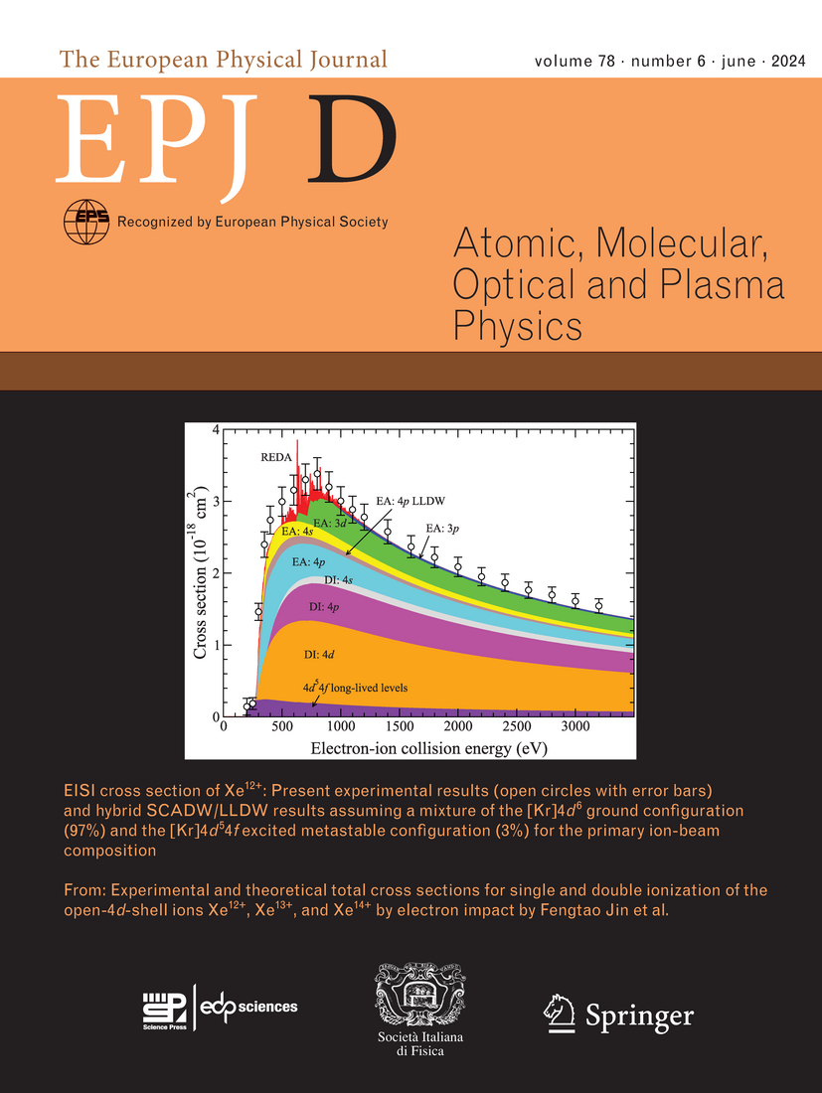
Highlights 2024

Slide 8
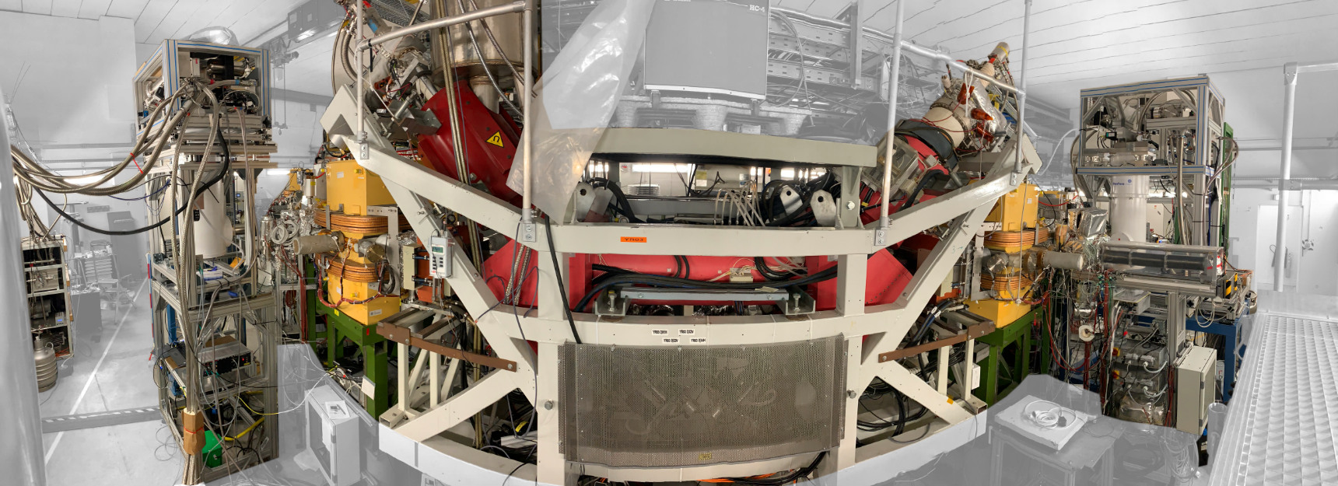
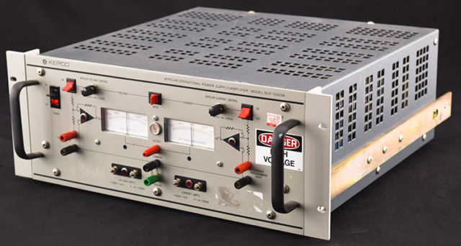


Experimental Setups at the CRYRING@ESR Electron Cooler
experimental equipment highly integrated into accelerator hardware
superconducting magnet
CRYRING electron cooler providing ultra-cold electrons
particle
detector
precise control of electron energy
precision HV divider (10⁻⁶ accuracy)
8

Slide 9
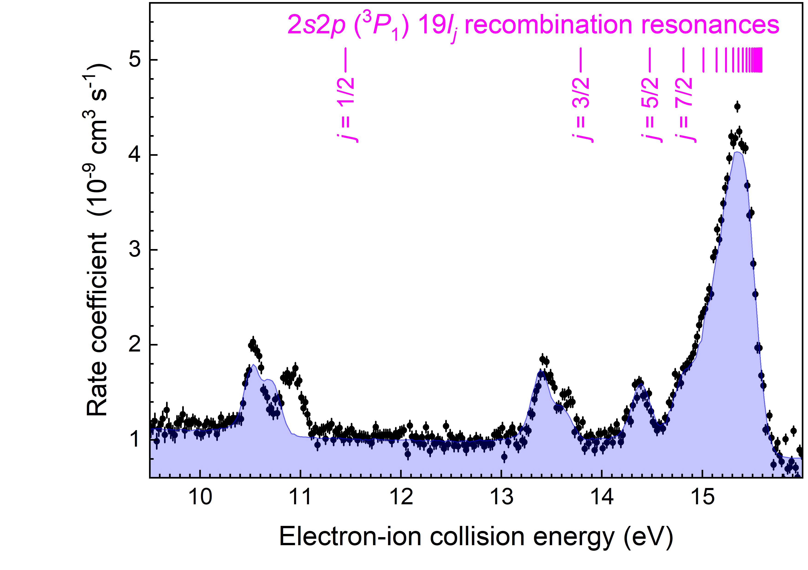
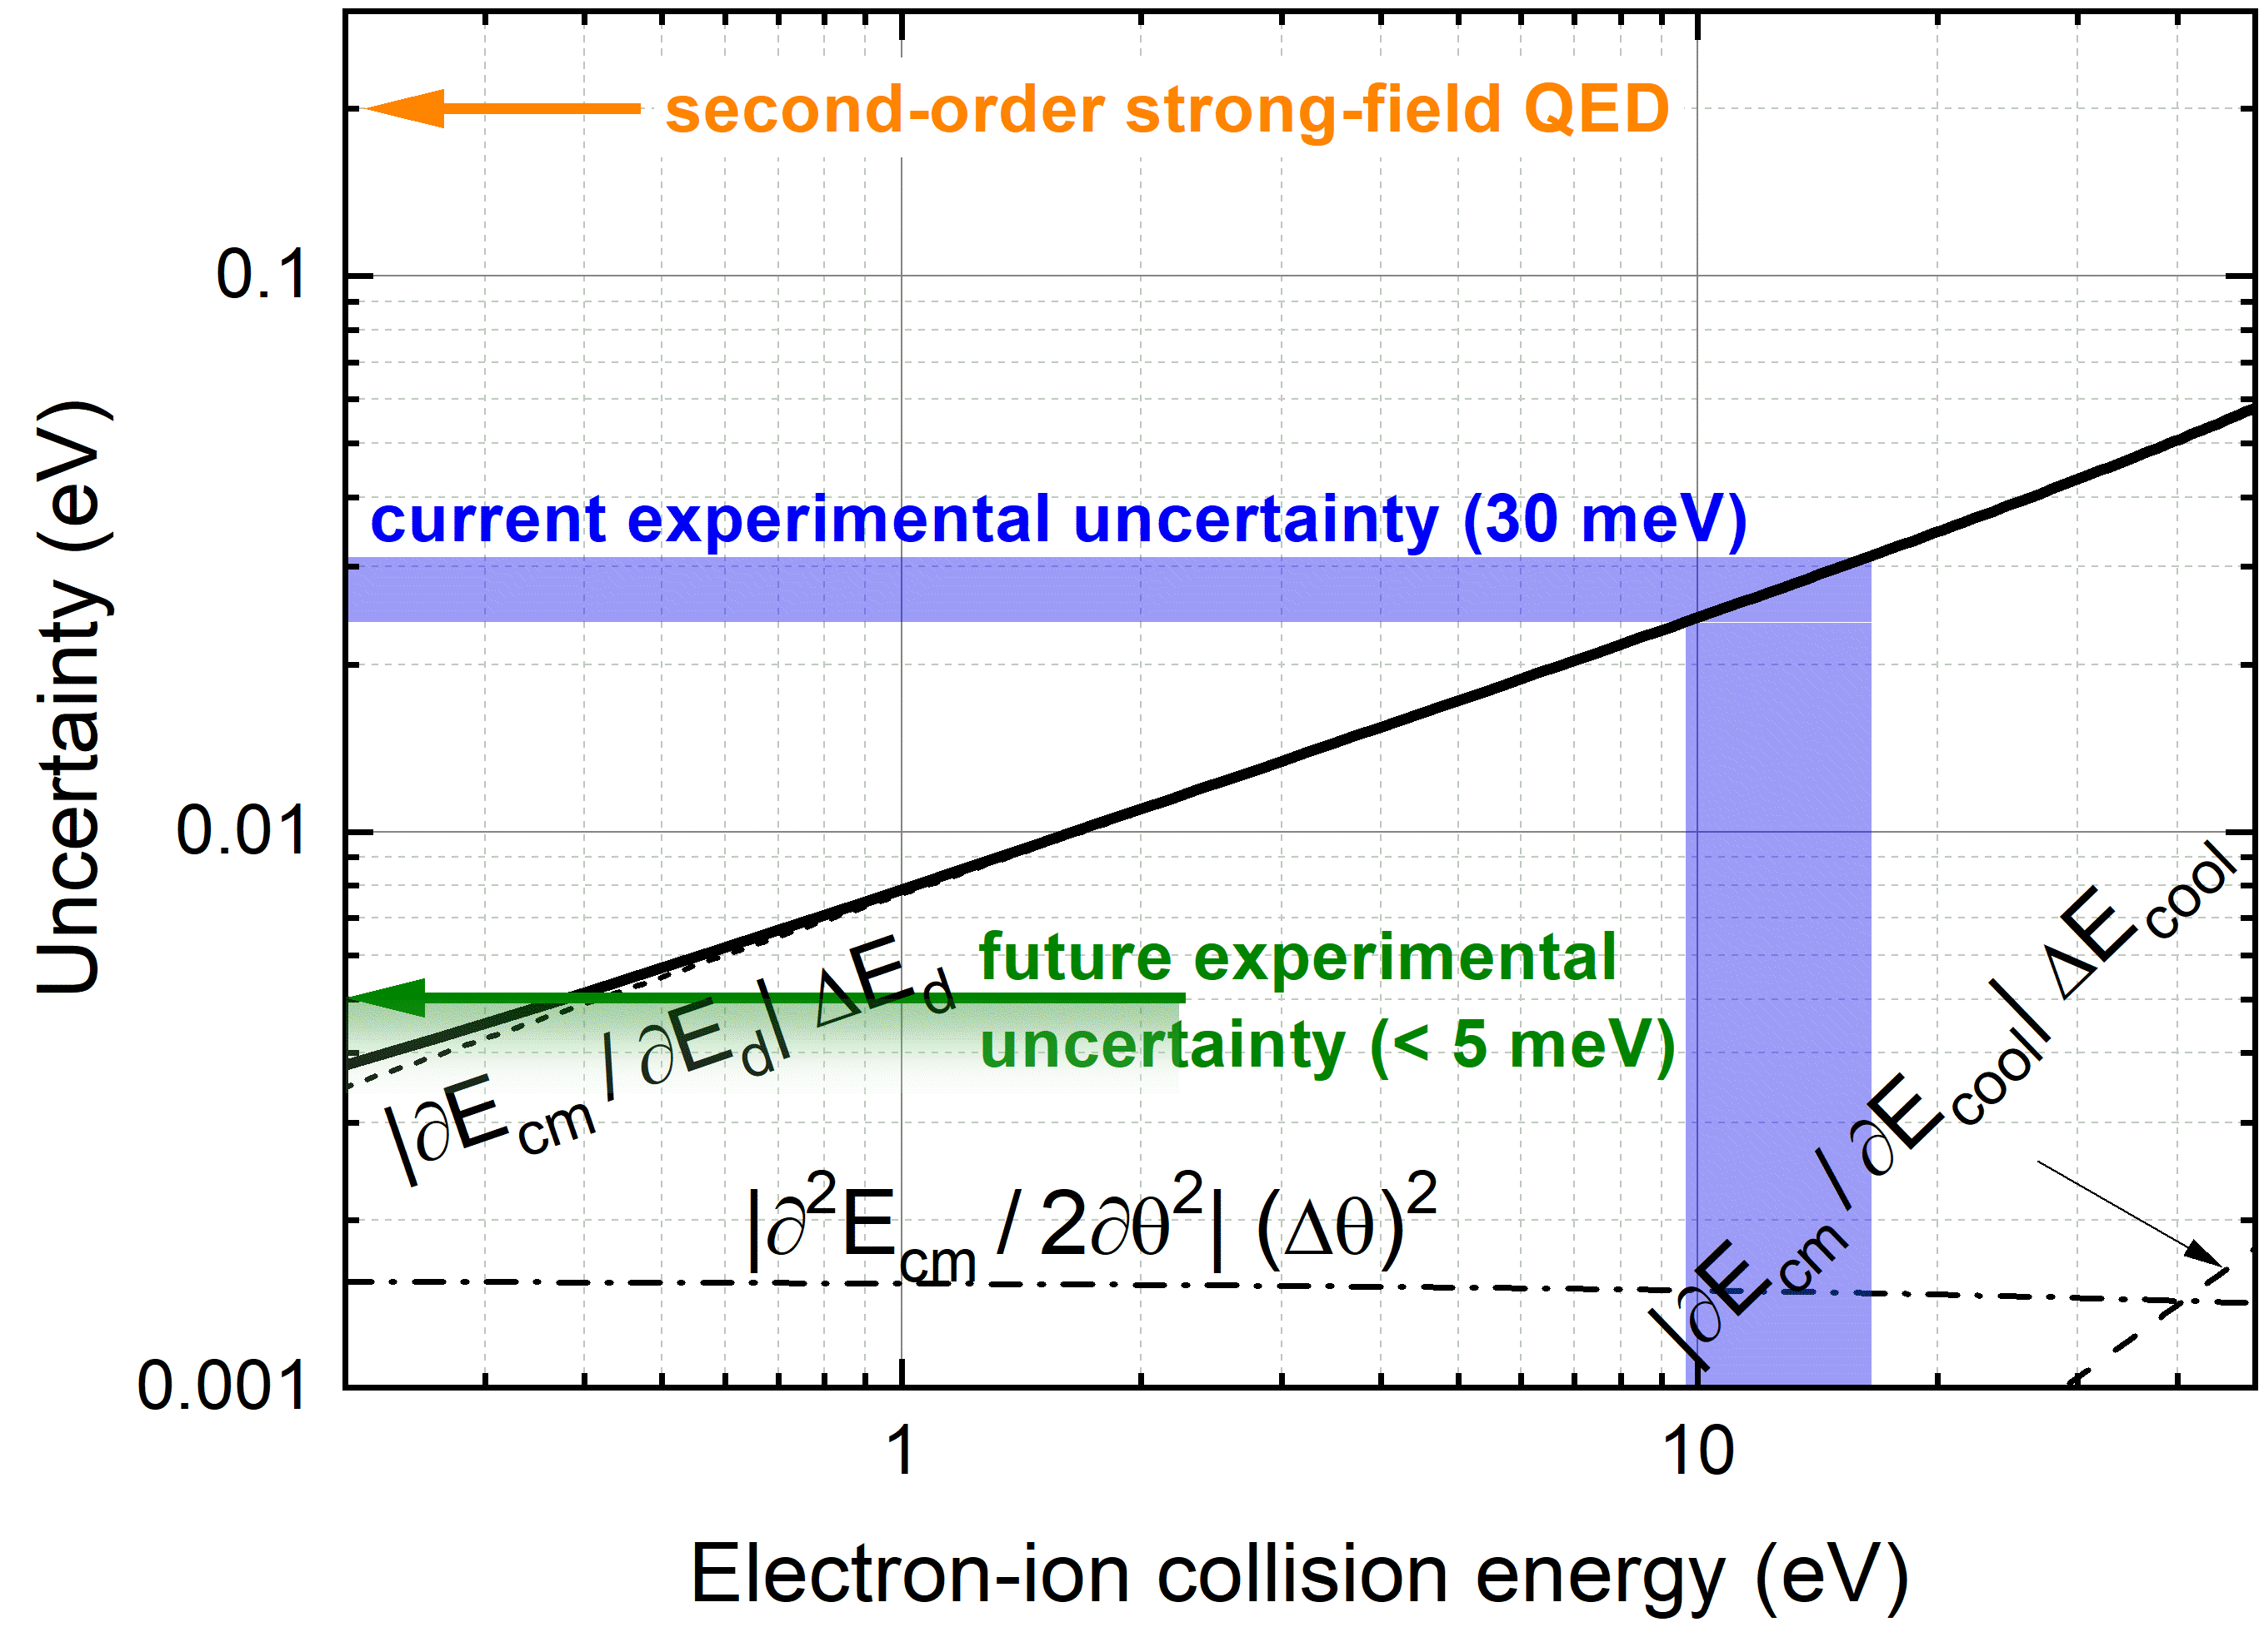




Electron-Ion Collision Spectroscopy at the
CRYRING@ESR Electron Cooler
Record low experimental uncertainty
thanks to the ultra-cold electron beam
Decelerated Be-like Pb⁷⁸⁺ ions from the ESR
Merged-beams kinematics: Extremely low collision energies are accessible with highest precision
to be submitted to PRL

Slide 10
Experimental Setups at the CRYRING@ESR Electron Cooler
180° x-ray detector
CRYRING electron cooler
0° x-ray detector
3.5 m
10

Slide 11
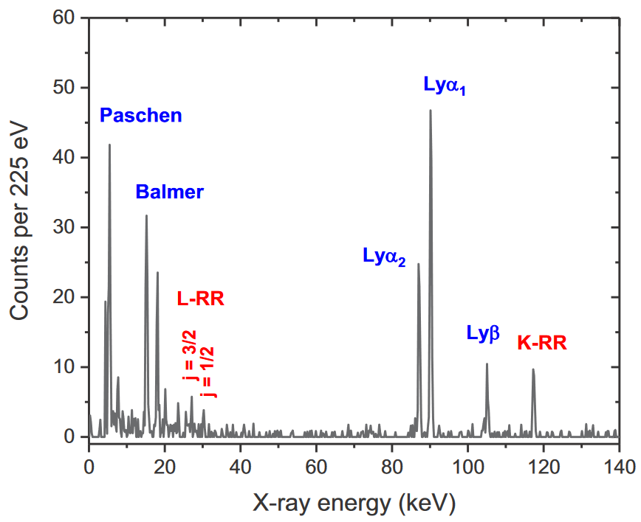
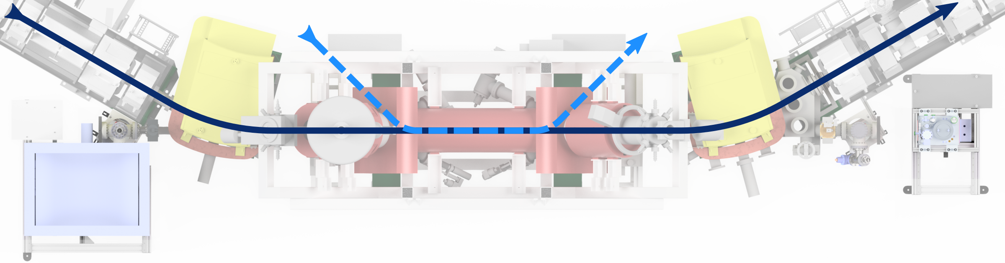
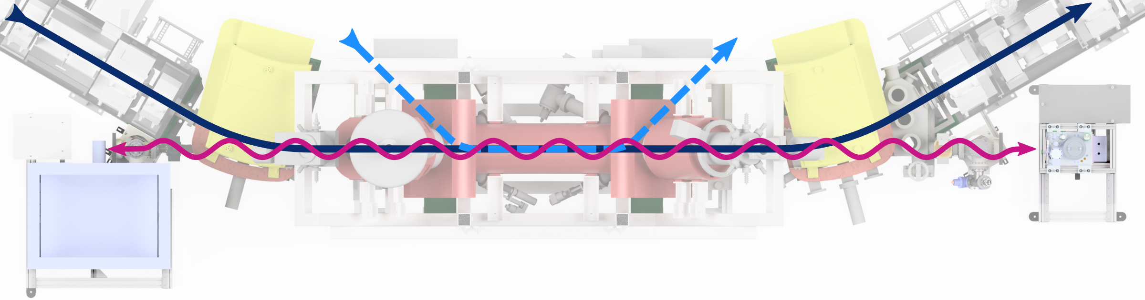
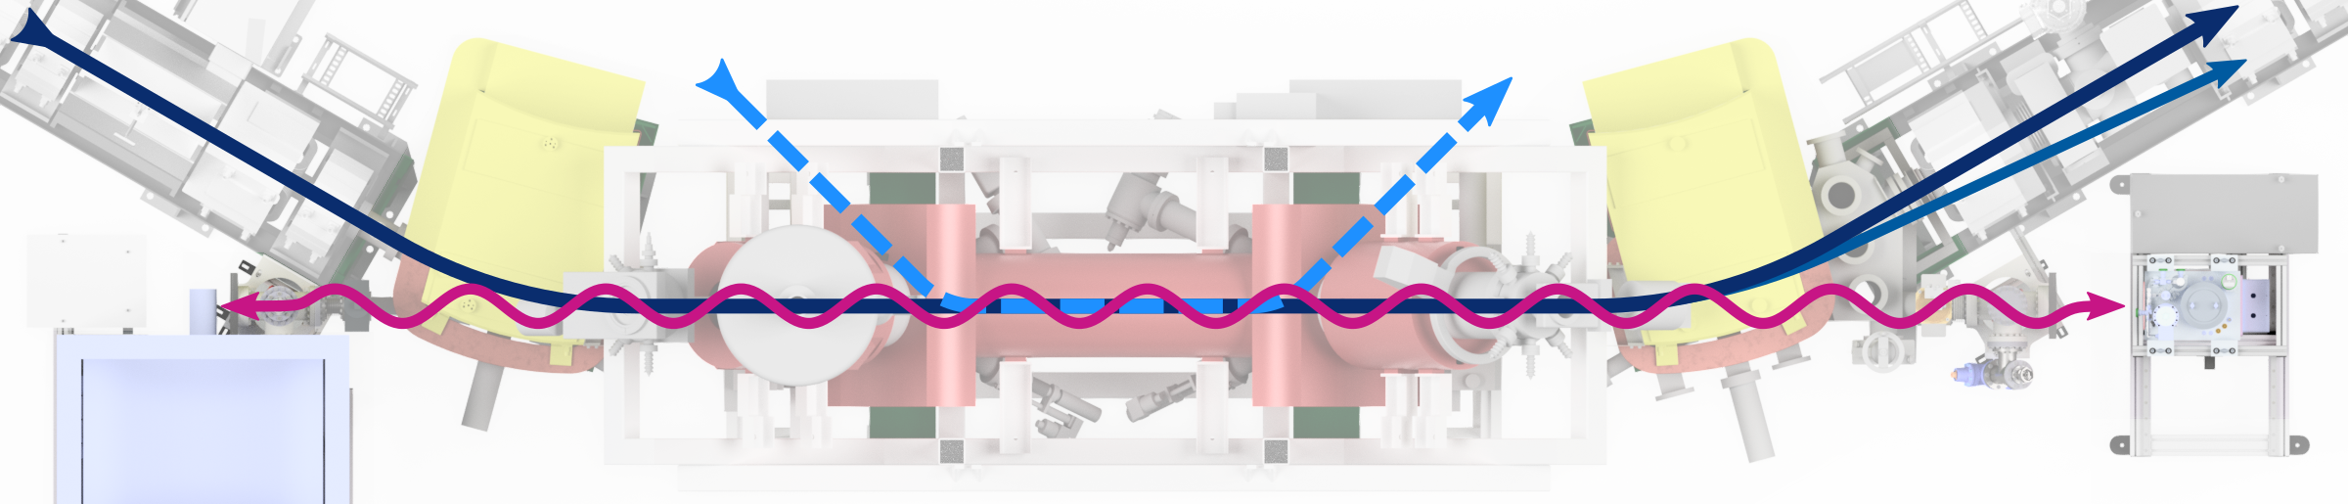
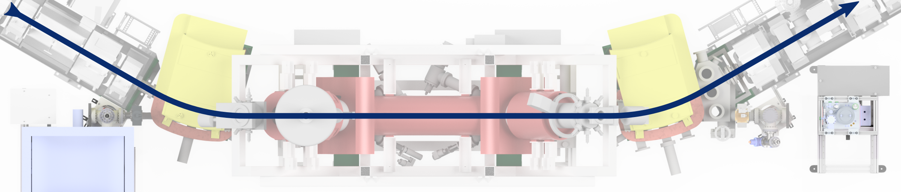


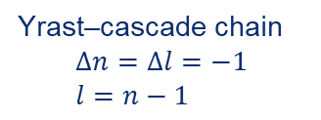
Photon Spectroscopy at the CRYRING@ESR Electron Cooler
s
p
d
f
l=96
l=97
l=98
l=99
B. Zhu et al., Phys. Rev. A 105, 052804 (2022)
free electron
n =100
Pb⁸²⁺
n = 99
E_{kin}
continuum
n = 4
M-shell
n = 3
Yrast–cascade chain
$$Δn=Δl=−1 \\ l=n−1$$
L-shell
n = 2
particle detector
ħω
K-shell
n = 1
electron beam
U⁹¹⁺
Pb⁸¹⁺
U⁹⁰⁺
x-ray detector
x-ray detector
11

Slide 12
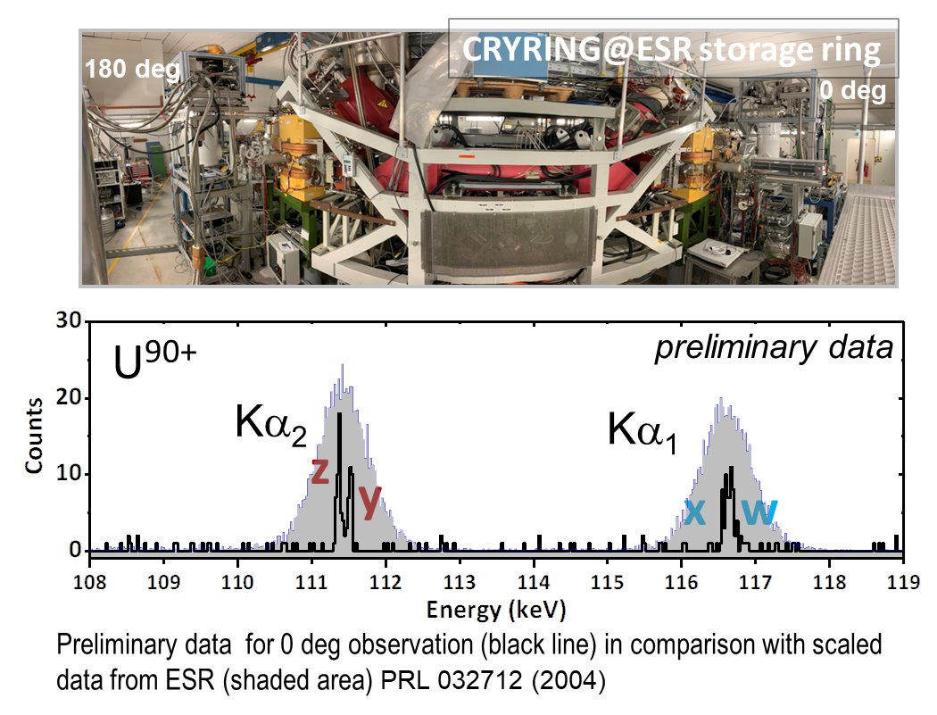
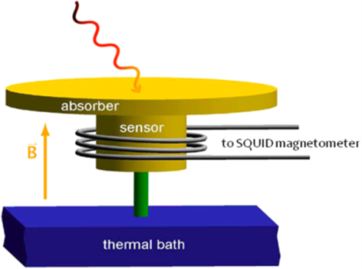
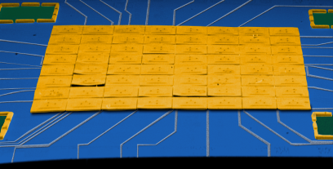
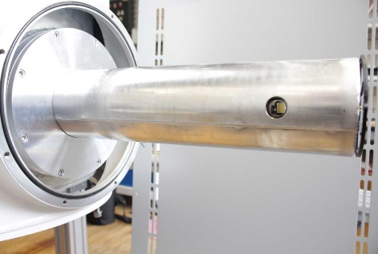
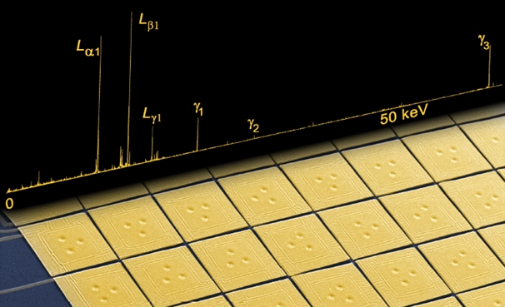
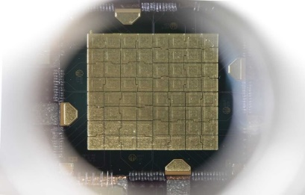



First high-resolution spectra for ground-state transitions in the heaviest helium-like ion (U⁹⁰⁺)
Metallic magnetic microcalorimeter
X-ray photon or particle
Sensor
SQUID magnetometer
Weak thermal link
Thermal bath (T = 20-50 mK)
Microcalorimeter arrays for high-resolution X-ray spectroscopy (maXs)
Philip Pfäfflein et al., in preparation

Slide 13
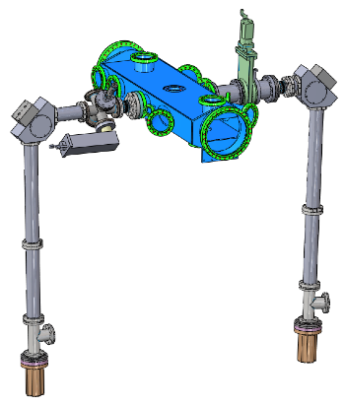
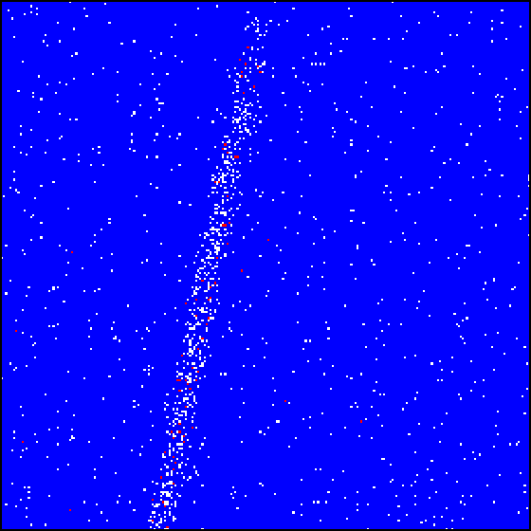
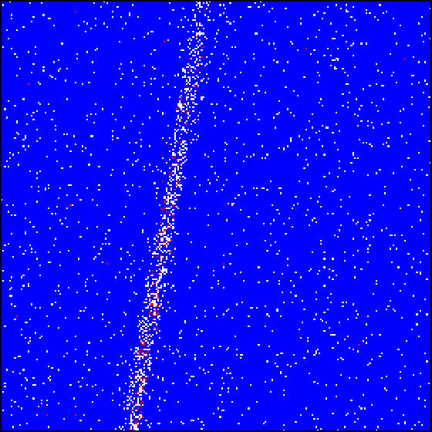
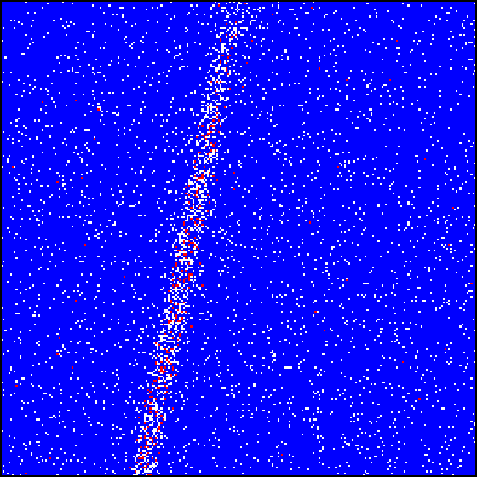
High-Precision X-ray Spectroscopy of He-like Uranium at the ESR
Moving ref.
Li-like U
Moving ref.
Be-like U
Gas jet
He-like U
Crystal support
Ge (220) X-ray
crystal reflection map
X-ray tube for stationary reference line
Twin Bragg spectrometers
X-ray CCDs
2048 x 2048 x 13,5 µm pixels
R. Loetzsch et al., Nature (2024)

Slide 14
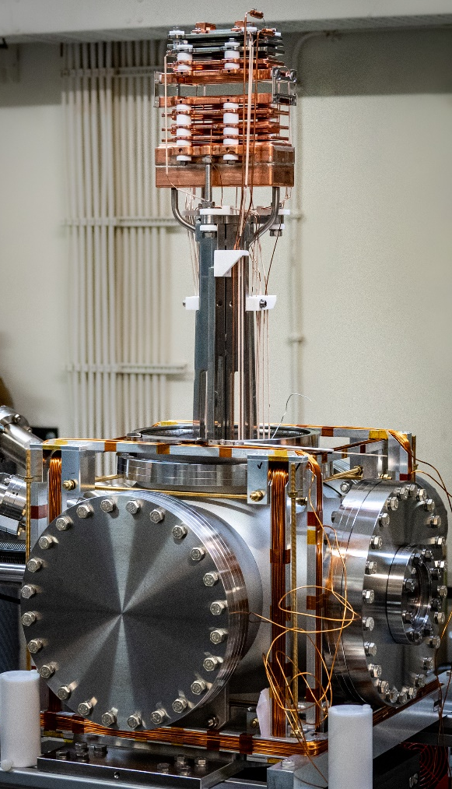
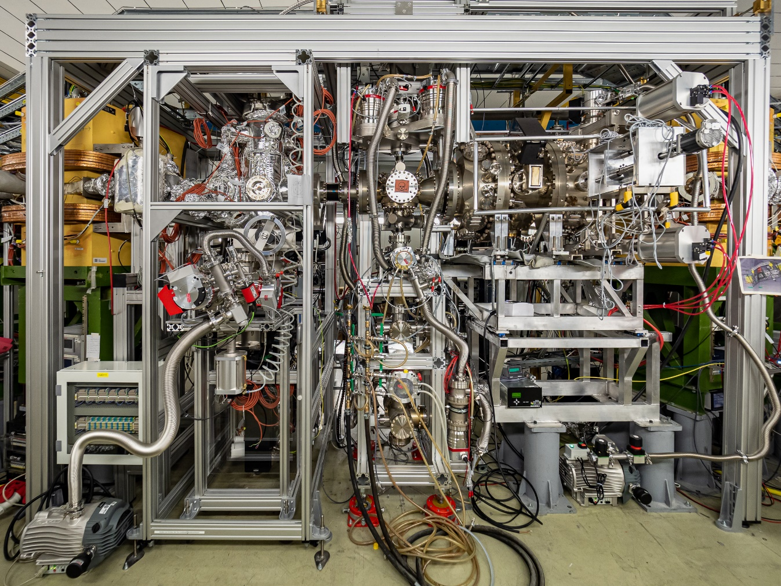


Commissioning of CRYRING Electron Target
CRYRING experimental section
Commissioning beamtime with a Ne⁷⁺ ion beam from the local injector in May 2024
For the first time successful operation of a transverse target in a storage ring!
The target introduces a
14 mm x 53 mm aperture into the ions’ orbit.
Electron Target
and associated ion and photon detectors
gas jet
CARME setup

Slide 15

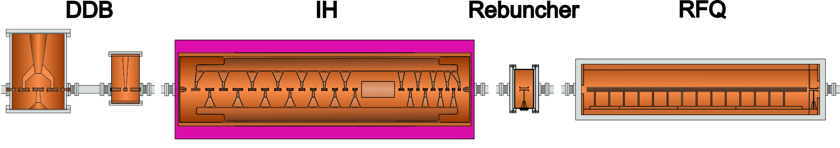
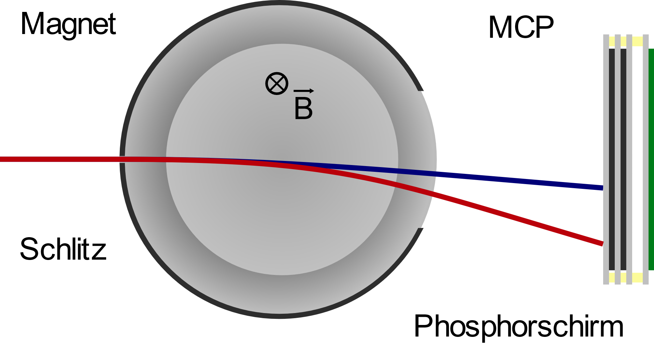
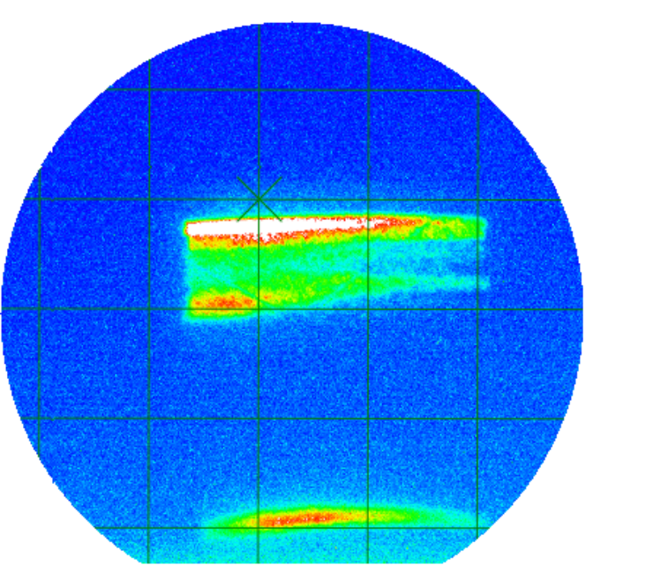
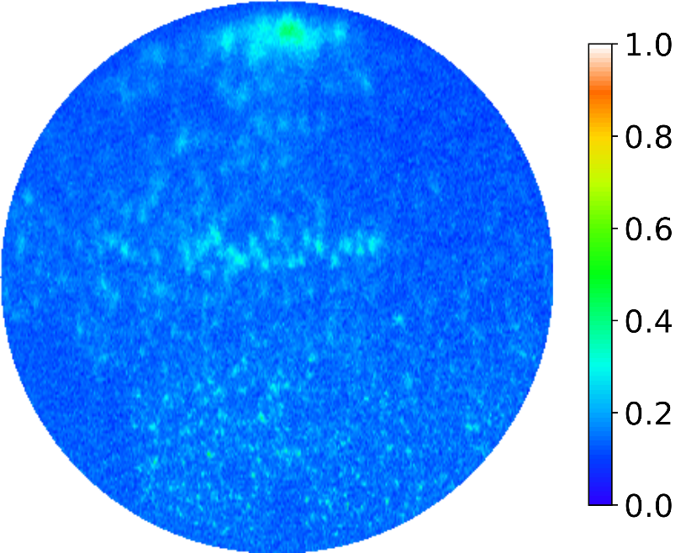



HITRAP: Deceleration of ³⁶Ar¹⁸⁺ to 6 keV/u
Beamtime in March 2024
0.5 MeV/u
4 MeV/u
6 keV/u
$$\sqrt{E}$$
4 MeV/u
6 keV/u
0.5 MeV/u
Notes:
Beamtime March 2024:
Bare Ar ions decelerated in the ESR down to 4 MeV/u and then through the IH and the RFQ to 6 keV/u

Slide 16
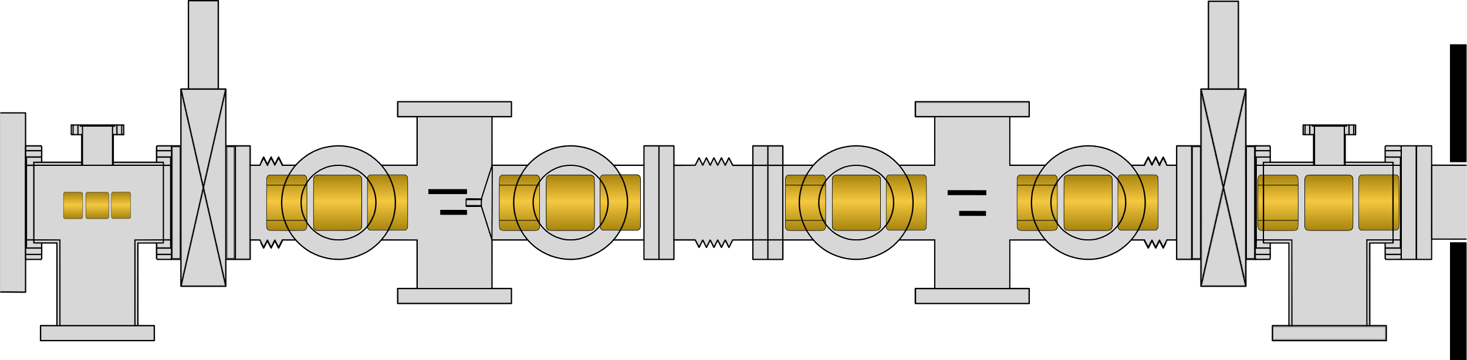


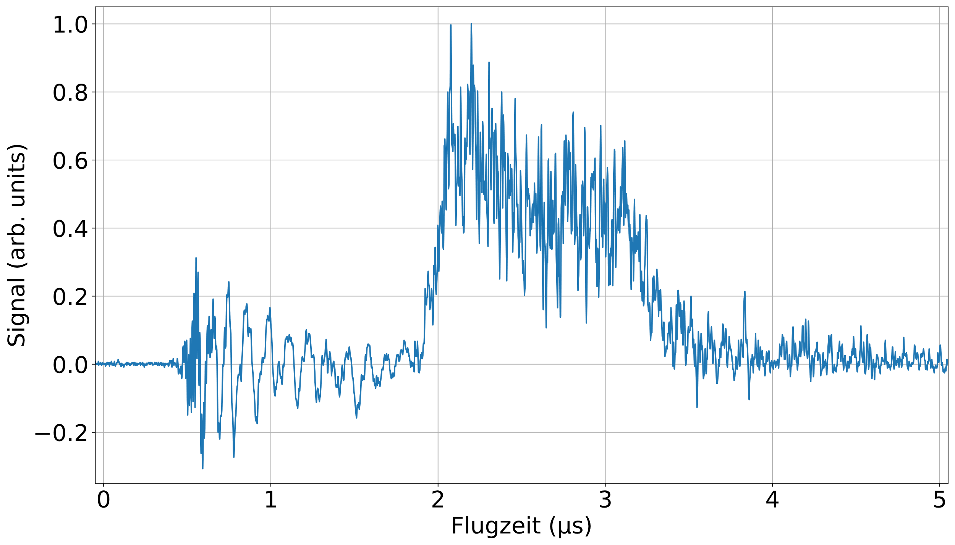
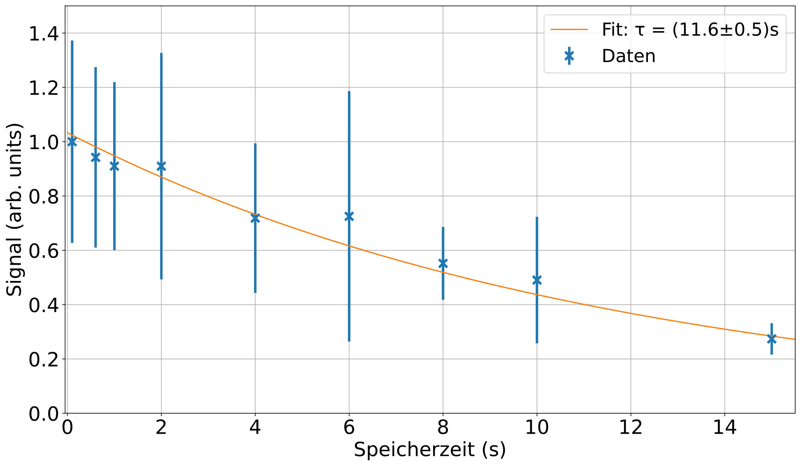
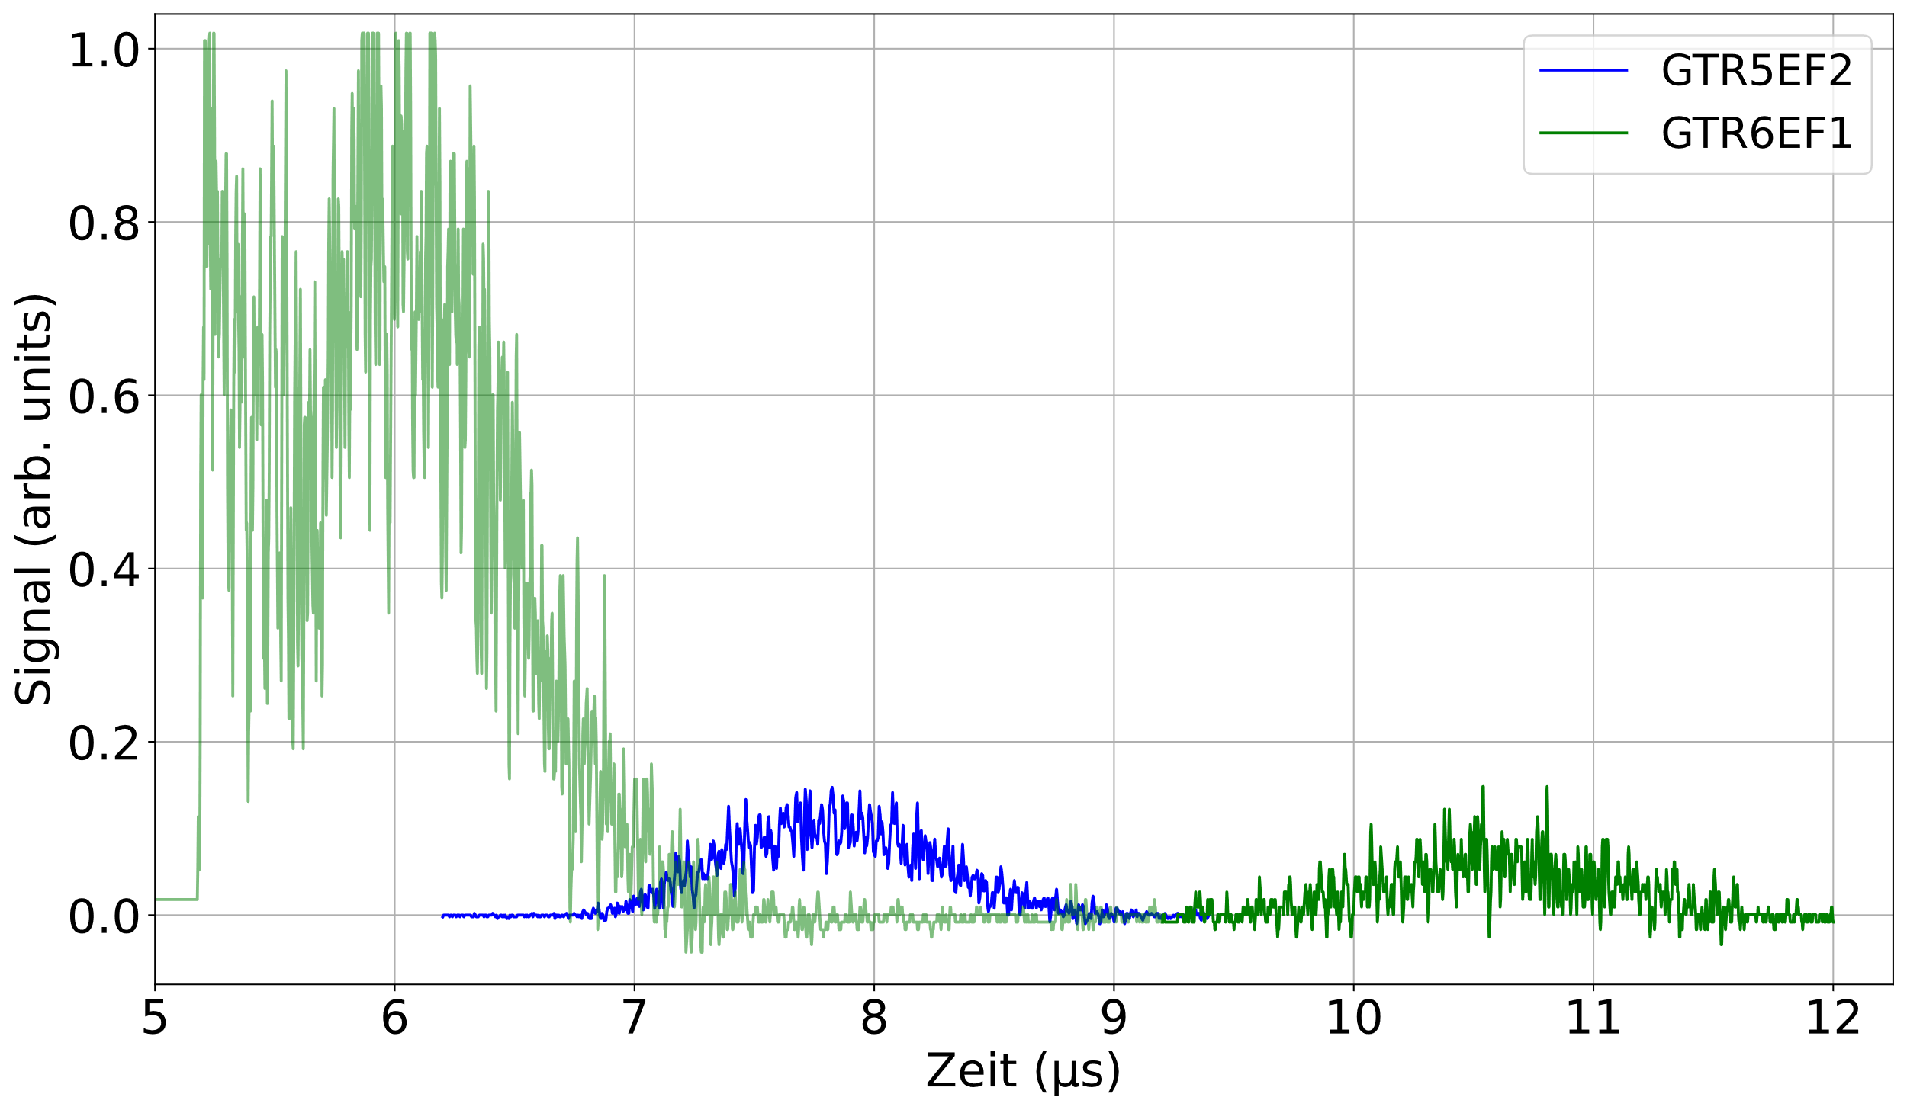
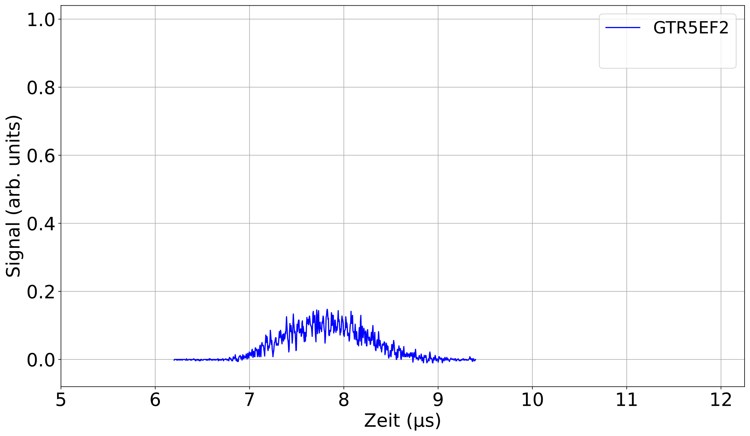


HITRAP: First Trapping of Decelerated Ions
05P21RDFA1
05P24RD5
RFQ
Cooling Trap
MCP
Deflector plate
First Storage of Accelerator-Produced Highly Charged Ions in a (Penning) Trap
4 & 0.5 MeV/u
6 keV/u
MCP
Dissertation
Simon Rausch
27.11.2024
Notes:
Dark Blue: slow ions shortly before the Penning trap
Green: signal observed behind the Cooling Trap. The signal induced by the primary beam is displayed in a lighter colour to separate it from the signal of interest, corresponding to the decelerated ion bunch
Shape and length of the peaks correspond to those of the bunch coming from the ESR.
Next signal in the animation is the first signal of trapped accelerator-produced ions after ejection from the Cooling Trap. The
ions were stored for 100 ms
Finally: Ion signal plotted over various storage times. Exponential decay fit: particle lifetime of the ³⁶Ar-ions in the trap is calculated to (11.6±0.5) s.

Slide 17
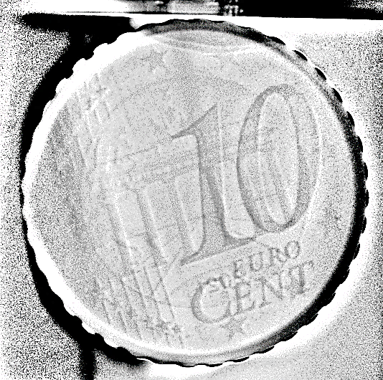
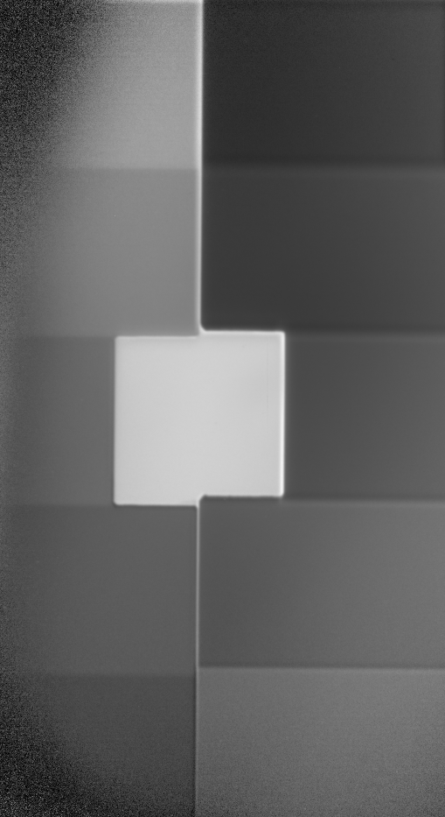
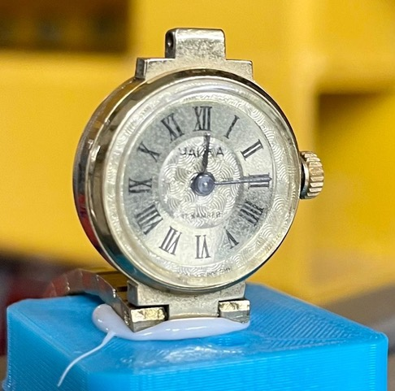
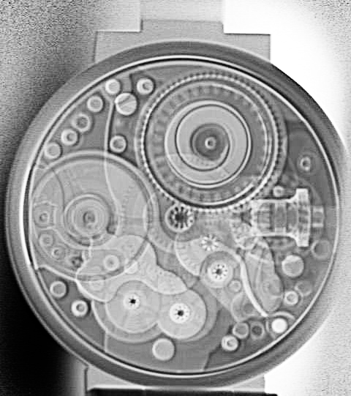

PRIOR-II – Heavy-Ion Radiography
Carbon is better
Protons are better
▲ Carbon image of copper step wedge.
▲ 10 cent coin (Germany 2021) imaged with 975 MeV/u Carbon beam (2mm mono CsI, PCO Dimax).
Radiography tests with carbon ions from SIS-18
Spatial resolution performance of heavy-ions worse than protons but still sufficient for physics experiments
Improved density contrast for 975 MeV/u Carbon for certain target areal densities
Contrast advantage depends on beam energy
Can be visualized with coins – areal density difference through embossing between 0.5 – 1.5%
▲ Small wrist watch (left) imaged with 975 MeV/u Carbon beam (right). (2mm mono CsI, PCO Edge 5.5 CLHS).
▲ 50 Pfennig imaged with 2500 MeV Proton beam (2mm mono CsI, PCO Edge 5.5 CLHS).

Slide 18
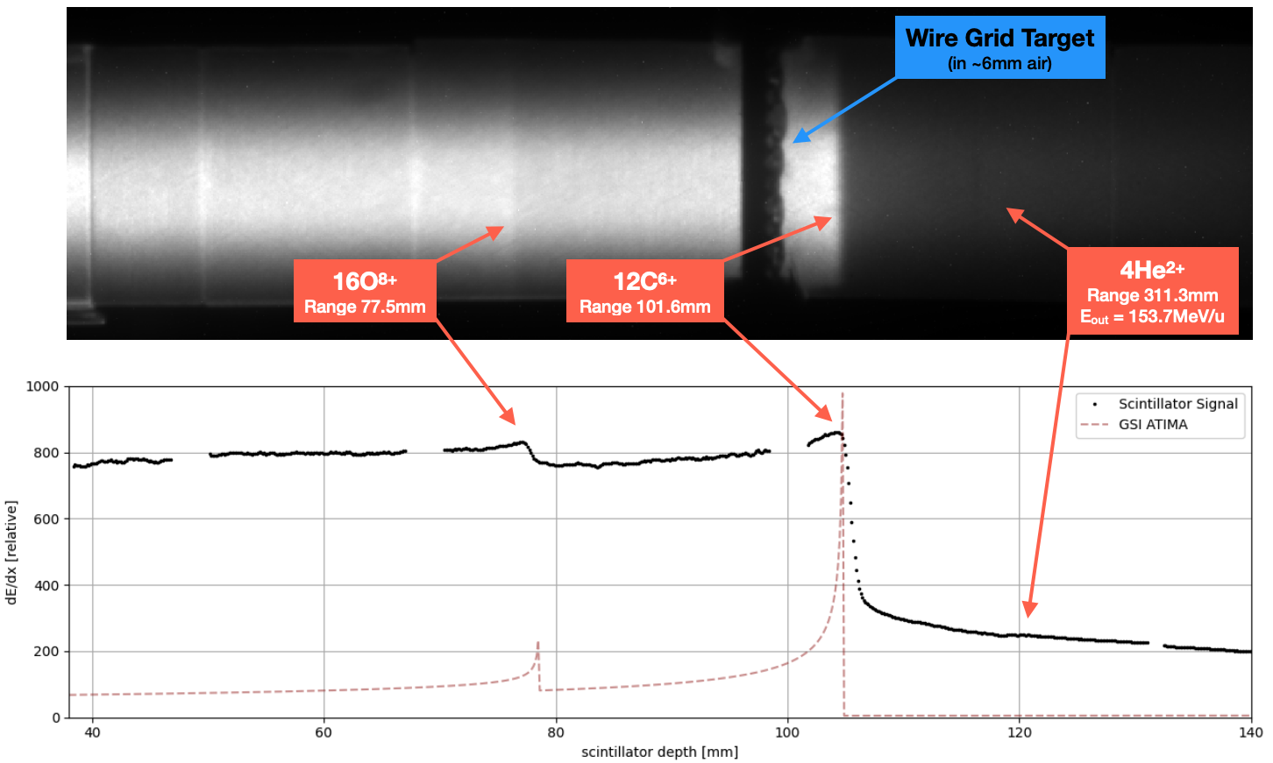
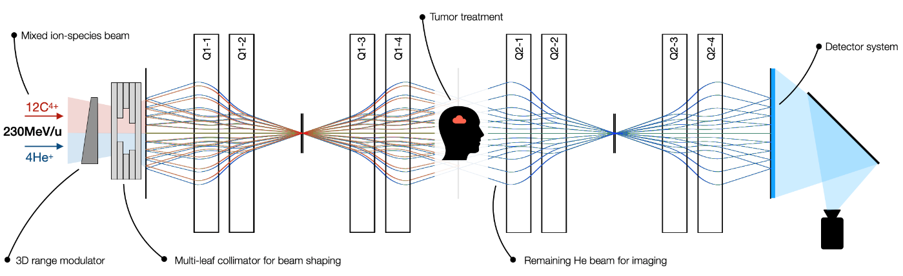
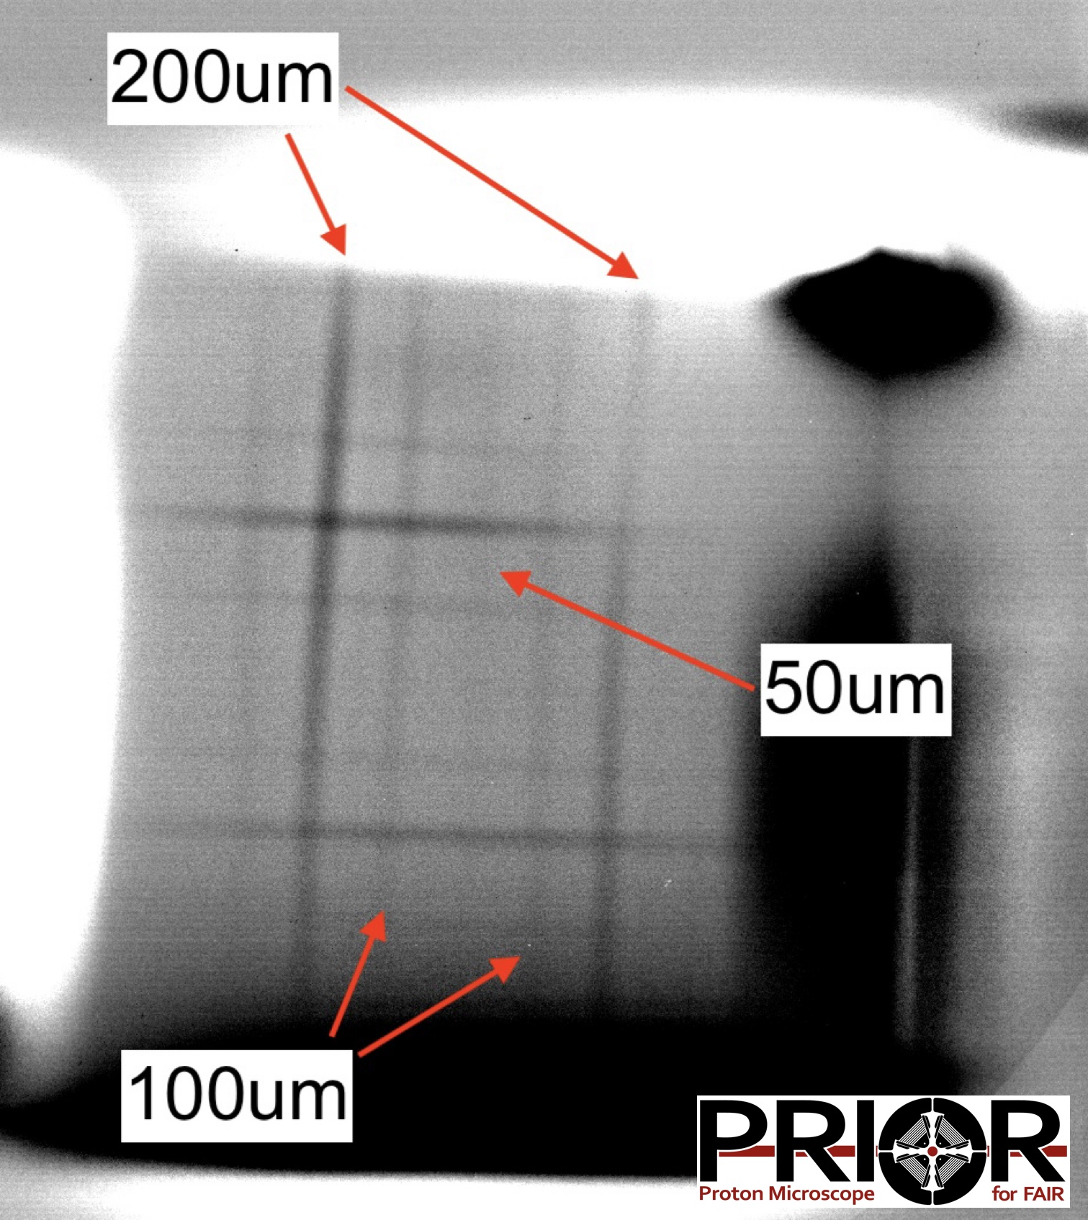
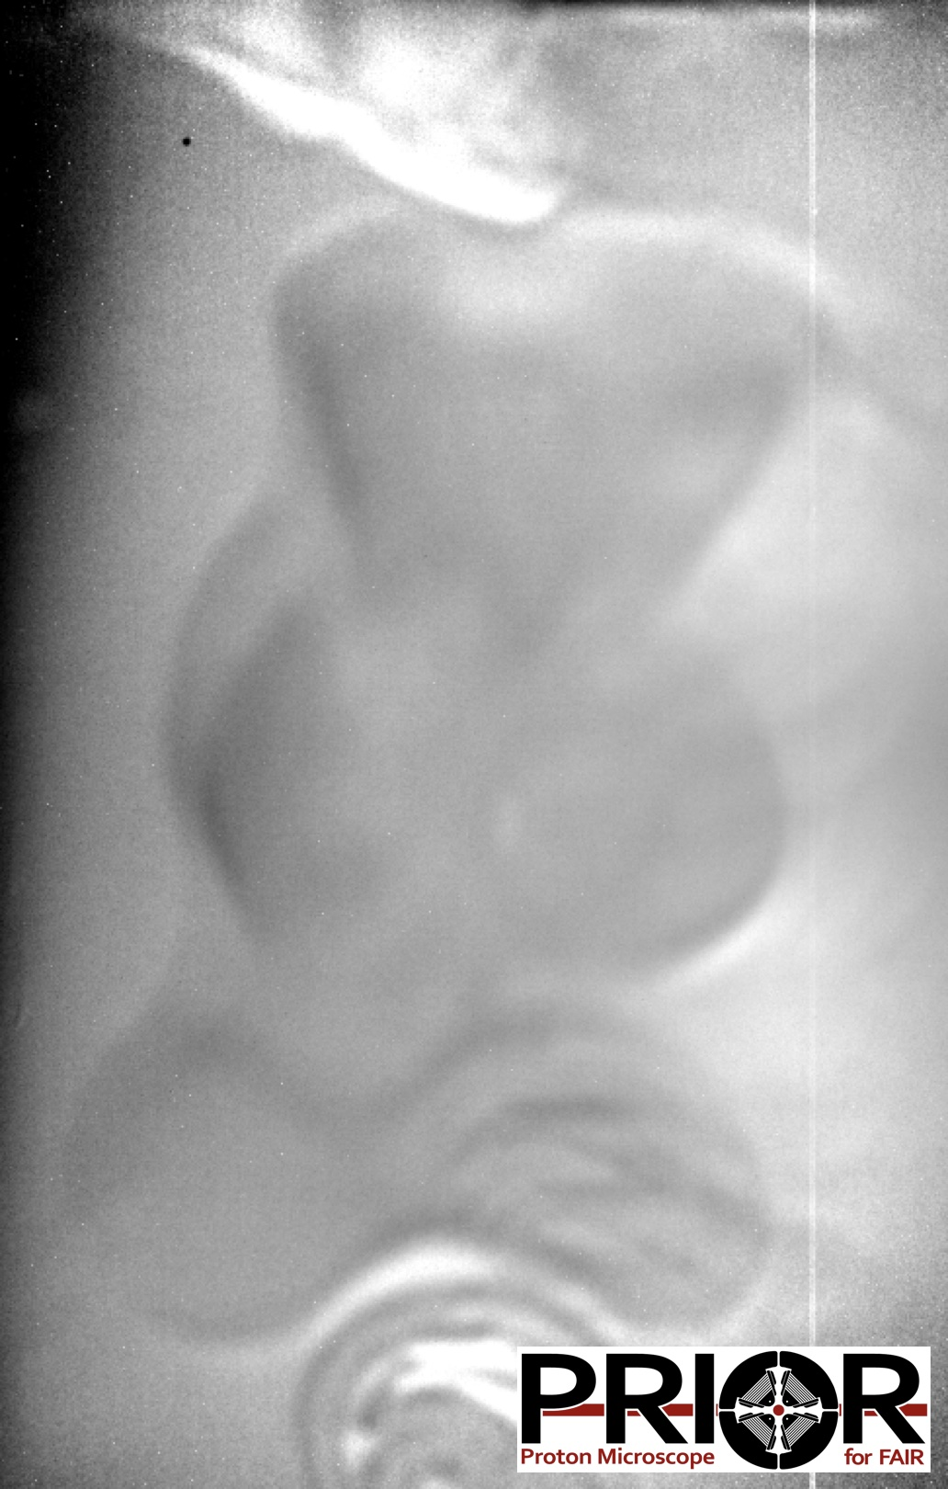
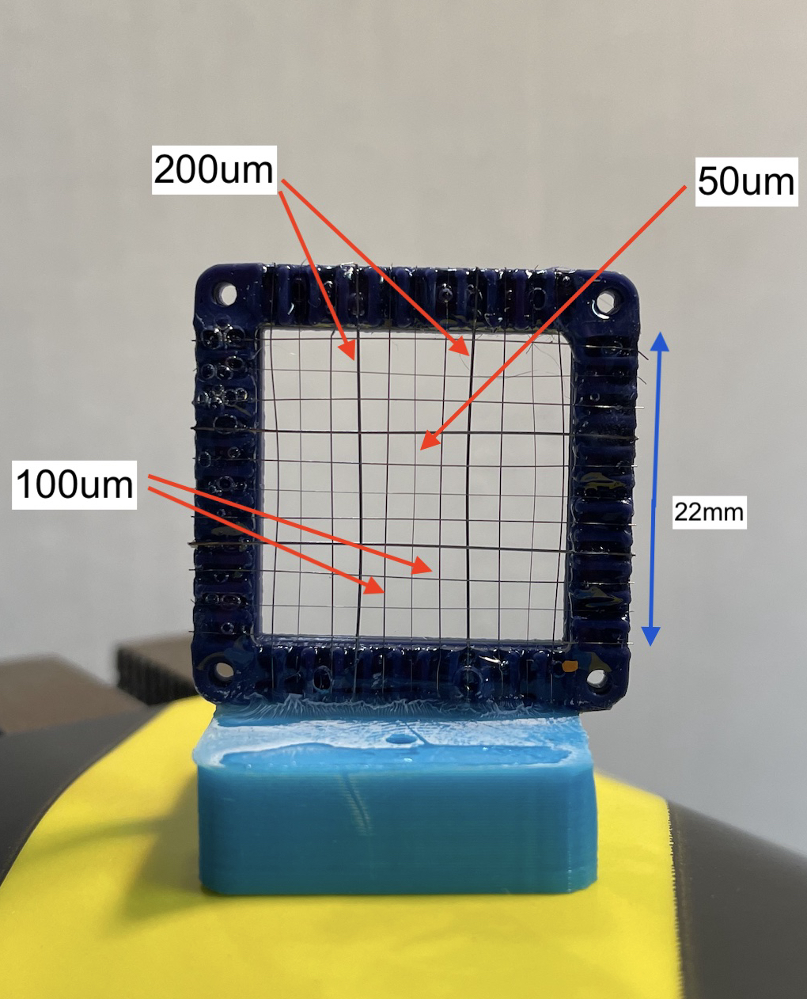
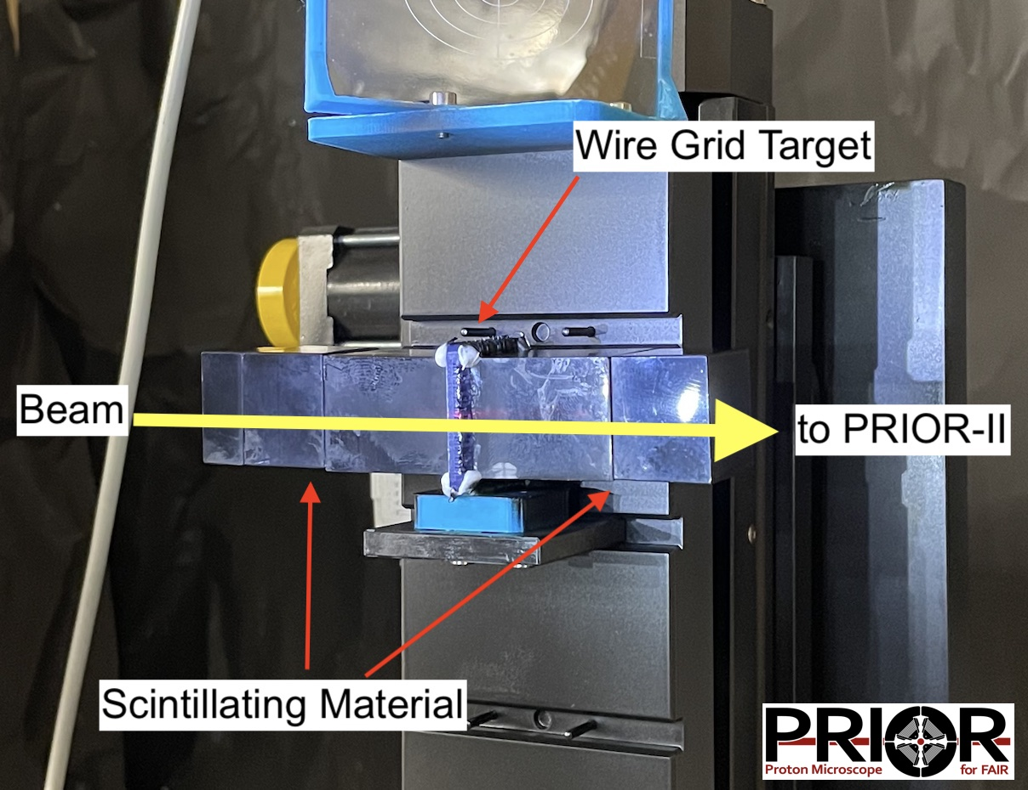
PRIOR-II – C-He Medical Imaging
General Idea of mixed He-C beams:
FLASH treatment with shaped Carbon beam, enable online position verification through He-imaging using lens-based charged particle radiography techniques.
▲ Mixed-ion species beam stopping in UPS-923A captured with a PCO Dicam (intensified CMOS camera).
▼ Radiographic image of the wire grid target (left), structures as fine as 50 um can be resolved. Low-density-gradient scenario (right): gummy bear submerged in a block of gelatin.
▲ Schematic concept for mixed-ion species FLASH therapy and imaging.
Experiment Concept:
Stop Carbon beam in scintillator for FLASH treatment simulation
Image structure target with exiting helium portion of beam
Dose dependent spatial resolution of PRIOR-II for medical FLASH imaging can be determined later from FCT & PRIOR data - TBD
▼ Plain Tungsten wire grid target (50-200µm) (left) and grid target embedded in 150mm of UPS-923A plastic scintillator on PRIOR-II actuator (right).

Slide 19
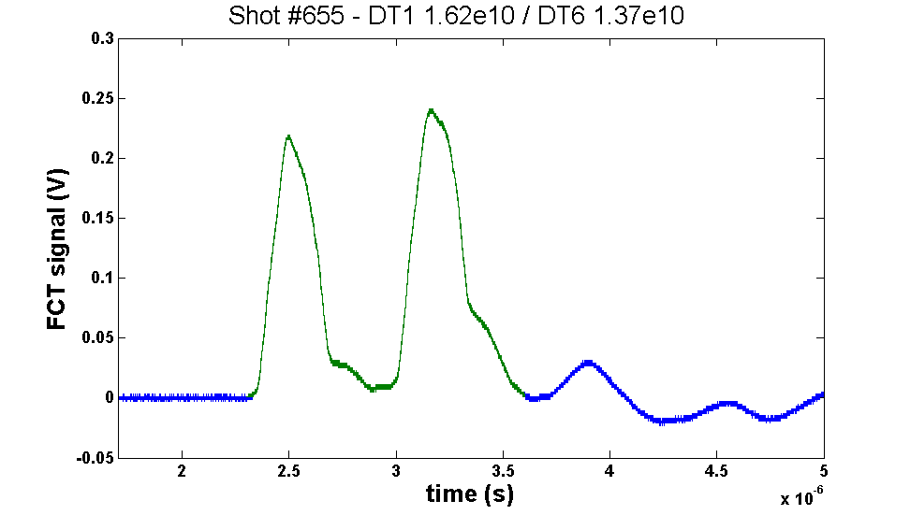
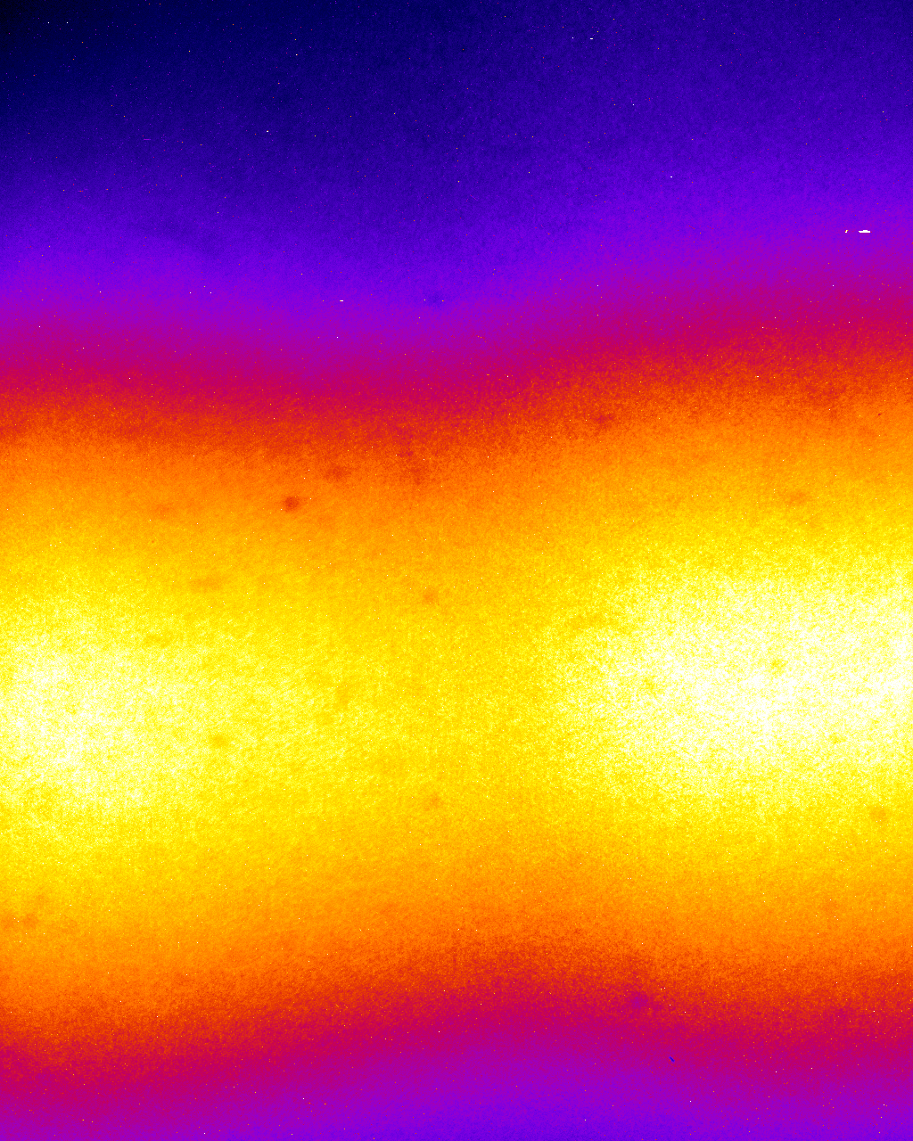
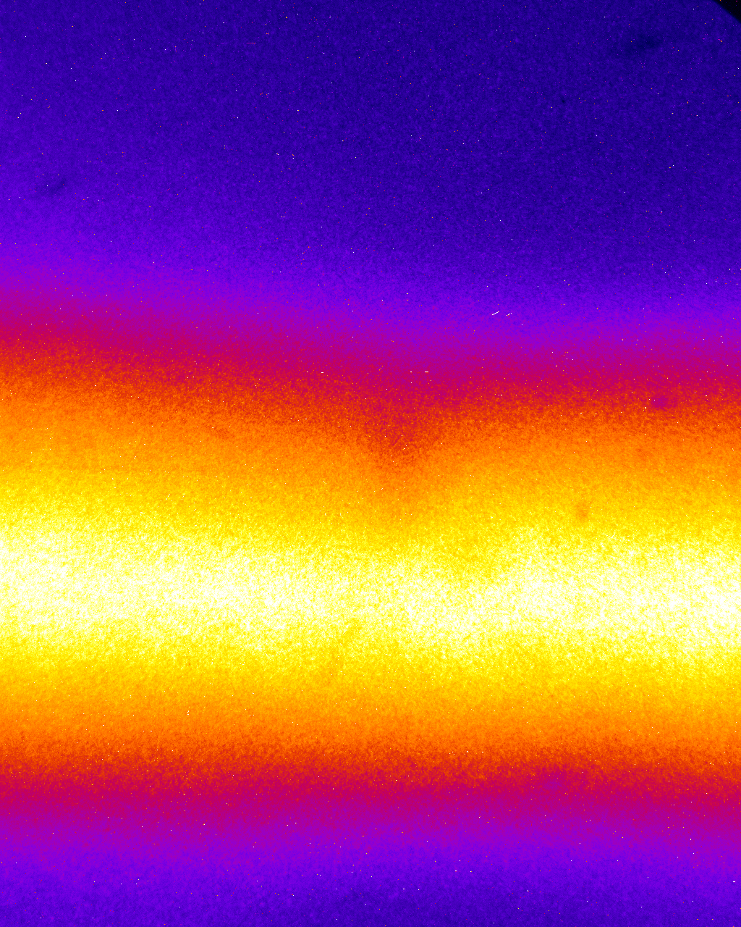
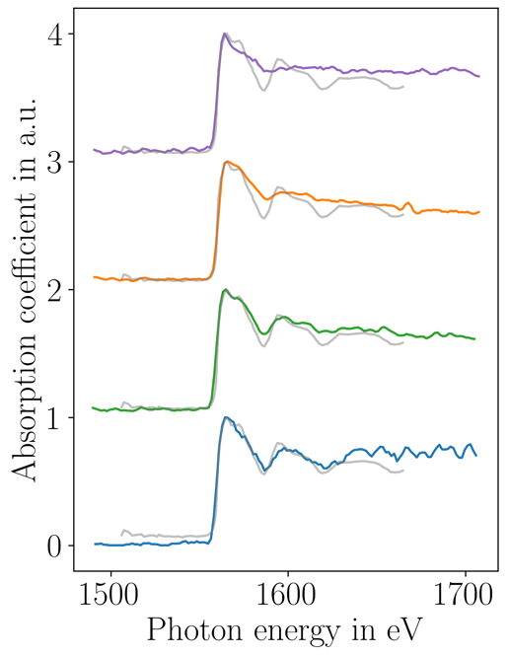
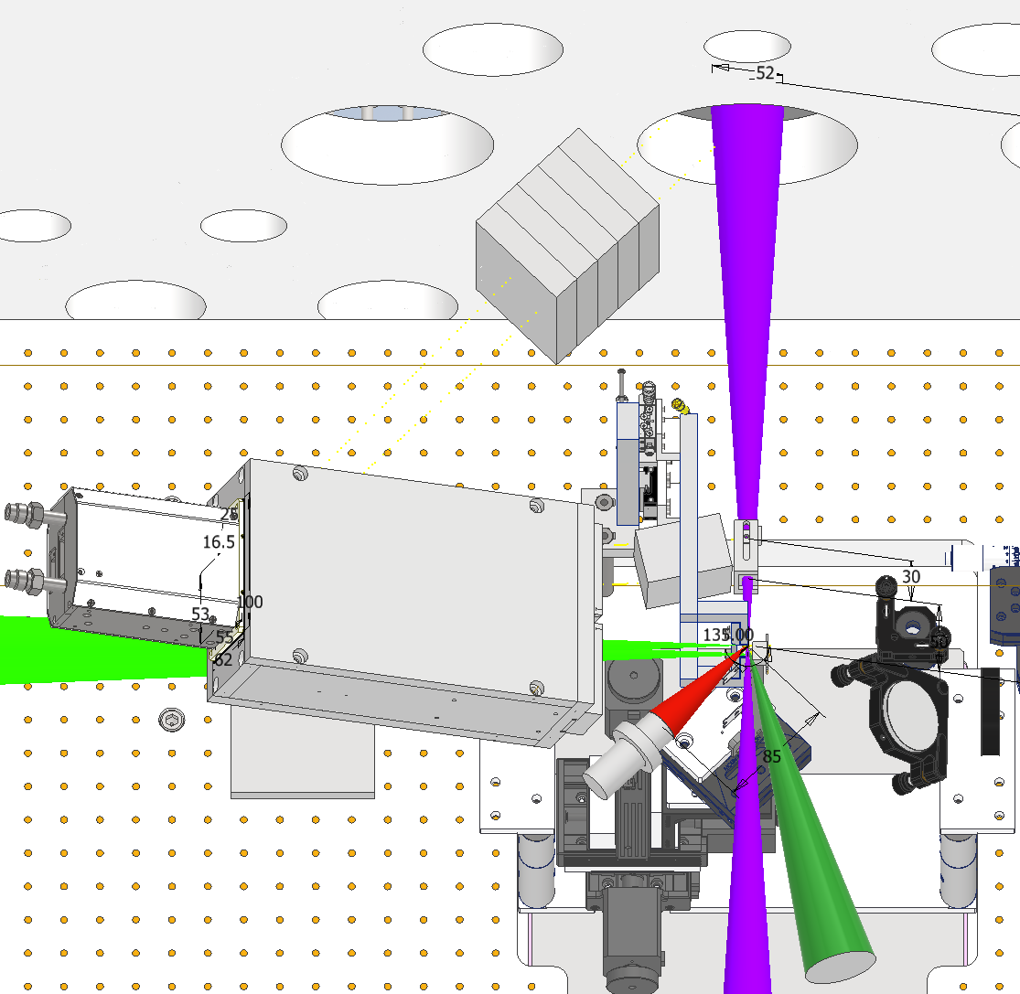

Progress in heavy-ion heating experiments
Progress on combined experiments with SIS-18 beams and PHELIX pulses
Record-high ion beam intensities at HHT
Fluorescence trace in argon at best focus
Commissioning of new fast current transformer
Absorption spectra of cold Aluminum
(gray: data from literature)
horizontal
vertical
Setup of combined ion/laser experiment
increased laser energy
7.2 mm
5.3 mm
>2×10¹⁰ particles/bunch from SIS-18 transported to HHT target chamber
Focusability of U²⁸⁺ limited by NC-magnets in HHT-cave (would allow accessing strongly-coupled plasma regime at APPA-cave!)
N. Tahir et al., Scientific reports 13, 1459 (2023)
High energy laser experiments at HHT are conducted to develop x-ray based probing techniques for HI-heated samples
Combined laser/ion experiments in 2024
New calculations indicate that diamond phase can be reached with SIS-100 parameters over macroscopic volumes
First indirect heating/compression (LAPLAS-scheme) tests will be performed with U28+ in 2025

Slide 20

Novel Research Opportunities based on
Sophisticated and Versatile Instrumentation
SPARC/APPA: Besides its facilities, instrumentation is of utmost importance. Already the large portfolio of novel FAIR instrumentation guarantees for a rich science research program at the existing facilities HITRAP, CRYRING@ESR, and ESR.
Continuous R&D is required for keeping the instrumentation at the cutting edge.
Notes:
do we need to repeat the details on the PAC?

Slide 21

Website https://fsp-appa.fair-center.eu

Slide 22
Next Annual Meeting of the ErUM-FSP APPA
16/17 January 2025
at GSI
https://indico.gsi.de/e/APPA_FSP_2025
Thank you for your attention!

Slide 23
Seven SPARC Projects in 2024-2027
Development and application of laser-based methods at HITRAP, CRYRING, and ESR
Technische Universität Darmstadt (Wilfried Nörterhäuser)
Development and application of laser-based methods at HITRAP, CRYRING, and ESR
Technische Universität Dresden (Ulrich Schramm, Michael Bußmann)
Electron-ion collision spectroscopy of highly-charged heavy ions at the FAIR storage rings
Justus-Liebig-Universität Gießen (Stefan Schippers)
Integration of a VUV-EUV photon spectrometer with VLS gratings at the gas target of CRYRING at FAIR Universität Kassel (Arno Ehresmann)
Adaption of an array of metallic magnetic calorimeters for the use at the CRYRING electron target
TH Mittelhessen (Saskia Kraft-Bermuth)
Theoretical excitation and recombination cross sections for experiments with highly-charged ions at ESR/CRYRING and FAIR
Friedrich-Schiller-Universität Jena (Stephan Fritzsche)
World-wide first energy dispersive x-ray spectrometer with photon acceptance up to 100 keV, with > 5000 resolving power, and with calibration on the ppm-level
Ruprecht-Karls-Universität Heidelberg (Christian Enss, Andreas Fleischmann)

Slide 24
Four HED@FAIR Projects in 2024-2027
Numerical and theoretical investigation of 'Super Charge' TNSA and its application for the nuclear and
plasma physics research at FAIR
Heinrich-Heine-Universität Düsseldorf (Alexander Pukhov)
Development of diagnostics and experimental possibilities for APPA@FAIR: Ultrafast pyrometry and
semi-dynamical proton microscopy
Goethe-Universität Frankfurt (Björn Winkler)
Development of diagnostics for plasma-physics experiments at FAIR
Friedrich-Schiller-Universität Jena (Malte Kaluza, Christian Spielmann)
Iono-akustische Messung der Energieverteilung von Ionen in strukturierten Feststoffen
Ludwig-Maximilians-Universität München (Jörg Schreiber)

Slide 25

SPARC Core-Invest via ErUM-FSP T05
PSP-Code | Component | Core Invest (k€, PB 2005) |  |  |  |  |  | University | Year of Completion
 |  | Total | 2015-2018 | 2018-2021 | 2021-2024 | 2024- 2027 | Still available
1.3.1.1.1.1 | Laser cooling 1 | 192 |  |  |  | 192 |  | Dresden | 2027
1.3.1.1.1.2 | Laser cooling 2 | 235 |  |  |  | 244 |  | Darmstadt | 2027
1.3.1.3.5.1.1 | Calorimeter 1 | 92 | 92 |  |  |  |  | Heidelberg | 2018
1.3.1.3.5.1.2 | Calorimeter Electronics | 87 |  |  |  |  | 87 | Heidelberg/Jena
1.3.1.3.10 | Lepton spectrometer | 99 |  |  |  |  | 99 | N.N. | obsolete
1.3.1.3.11.2 | XUV laser | 367 | 256 | 42 | 69 |  |  | Jena | 2024
1.3.1.3.12.3 | VUV/VIS spectrometer | 194 |  | 117 | 72 |  |  | Kassel | 2024
1.3.1.5.1.2 | 2D X-ray detectors | 29 |  |  |  |  | 29 | Lüneburg | obsolete
1.3.1.5.4.1 | X-ray optics | 19 | 19 |  |  |  |  | Jena | 2018
1.3.1.5.5 | Reaction microscope | 236 |  |  | 236 |  |  | Frankfurt | 2024
1.3.1.5.7.1 | Ion detectors 1 | 111 | 111 |  |  |  |  | Frankfurt | 2018
1.3.1.5.7.4 | Ion detectors 3 | 114 |  |  | 104 | 10 |  | Gießen | 2027
1.3.1.5.8.1 | Laser spectroscopy 1 | 148 | 148 |  |  |  |  | Darmstadt | 2018
1.3.1.5.8.2 | Laser spectroscopy 2 | 42 | 42 |  |  |  |  | Münster | 2018
1.3.1.5.9 | Electron target | 375 | 133 | 147 | 63 | 33 |  | Gießen | 2027
1.3.1.5.10.1 | Cooler voltage control | 32 | 20 | 12 |  |  |  | Gießen | 2019
1.3.1.5.10.3 | Laser view ports | 8 | 8 |  |  |  |  | Darmstadt | 2018
Sums | foreseen by BMBF: 2380 | 2380 | 829 | 318 | 544 | 471 | 215

Slide 26
HED@FAIR Core-Invest
PSP-Code | Component | Core Invest (k€, PB 2005) |  |  |  |  |  | University | Year of Completion
 |  | Total (for Day 1) | 2015 -2018 | 2018 - 2021 | 2021 - 2024 | 2024 - 2027 | Still available
1.3.2.2.1 | Target Chamber for Day-1 | 545 |  | 184 | 53 |  | 82 | Darmstadt | 2027
 |  |  |  | 88 | 81 |  |  | Frankfurt
 |  |  |  | 57 |  |  |  | Jena
1.3.2.3.1 | Detectors for Day-1 | 394 | 83 |  |  |  | 24 | Darmstadt | 2027
 |  |  | 56 |  | 56 | 22 |  | Frankfurt
 |  |  | 69 |  | 84 |  |  | Jena
1.3.2.4.1 | Diagnostic Laser for Day-1 | 359 | 235 |  |  |  | 18 | Darmstadt | 2027
 |  |  |  | 51 | 54 |  |  | Jena
Sums | foreseen by BMBF: 1300 | 1298 | 443 | 380 | 328 | 22 | 124

Slide 27
ErUM-FSP T05: Priorities for 2024 - 2027
Use the still available FAIR Core-Invest (committed by BMBF) for the completion of the instrumentation (largest item: Laser cooling at SIS-100)
Carry out the research within FAIR Phase-0 (granted G/P-PAC beamtimes & supporting theory).
R&D for further advancing the technologies.
FSP-Activities: Outreach (JOO of FAIR & ErUM FSPs, http://fsp-appa.fair-center.eu), training of young researchers, scientific meetings.
U Greifswald
U Rostock
U Lüneburg
HU Berlin
U Münster
TU Braunschweig
U Duisburg-Essen
U Göttingen
TU Dresden
U Düsseldorf
U Kassel
HI Jena
U Jena
HZDR
U Gießen/THM
TUB Freiberg
HS Rhein-Main
U Frankfurt
U Mainz
HI Mainz
FAIR / GSI
TU Darmstadt
TU Kaisers-
lautern
U Erlangen-Nürnberg
U Heidelberg / MPIK
U Stuttgart
TU München
U München
SPARC & HED@FAIR applications for 2024-2027: 31 projects applied for (14 M€, 31 FTE)

