Slide 1

News from KET
KHuK Annual Meeting, 5.12.2024, Bad Honnef
Lutz Feld (RWTH Aachen University, KET Chair)
www.ketweb.de

Slide 2
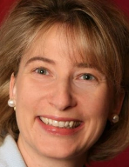
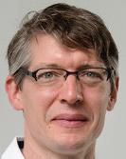
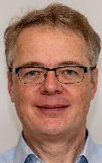
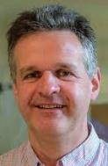
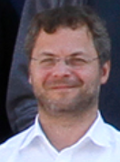
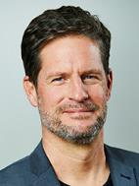

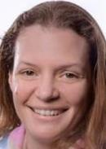
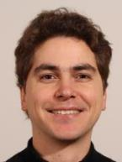
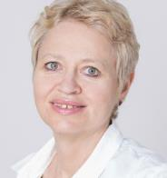

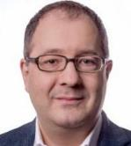
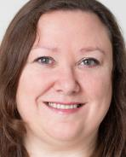


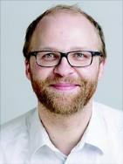
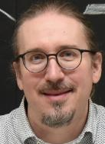

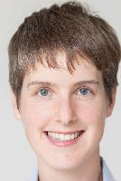
A new KET has been elected for the period 2024-2027
Prof. Dr. Ariane Frey Göttingen University KET Member | Prof. Dr. Johannes Albrecht Dortmund University KET Member | Prof. Dr. Lutz Feld RWTH Aachen University KET Chair | Prof. Dr. Klaus Desch Bonn University CERN Council Delegate | Prof. Dr. Heiko Lacker Humboldt University Berlin RECFA Representative | Prof. Dr. Johannes Haller Hamburg University DPG-FV Chair
Prof. Dr. Thomas Kuhr LMU Munich KET Member | Prof. Dr. Monica Dunford Heidelberg University KET Member | Dr. Michael Dührssen-Debling CERN KET Member | Prof. Dr. Beate Heinemann Hamburg DESY Director | Prof. Dr. Marumi Kado MPP Munich MPP Director | Prof. Dr. Hans-Christian Schultz-Coulon Universität Heidelberg GA Co-Chair
Prof. Dr. Freya Blekman DESY KET Member | Prof. Dr. Gudrun Hiller Dortmund University KET Member | Prof. Dr. Margarete Mühlleitner KIT Karlsruhe KET Deputy Chair | Dr. Marc Wenskat Hamburg University KfB Representative | Prof. Dr. Daniel Mohler Darmstadt Tech. University KHuK Representative | Prof. Dr. Manfred Lindner MPI-K Heidelberg KAT Representative | Dr. Ruth Jacobs DESY yHEP Representaive
ex-officio

Slide 3
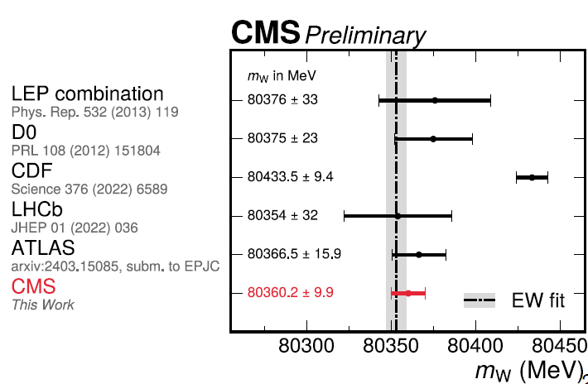
Recent KET Physics Highlights
LHC: 2024 was the best data taking year so far
CMS: W mass measured with 9.9 MeV uncertainty
ATLAS and CMS Phase 2 upgrades in full swing
ATLAS: triple Higgs coupling < 2.9xSM
LHCb: first run-3 result, to be published soon

Slide 4
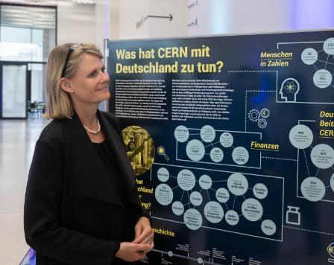
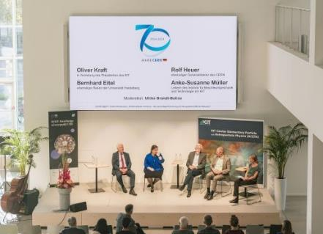
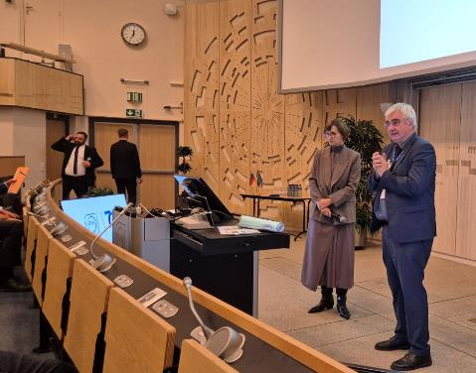
CERN70
Festakt at FUTURIUM Berlin
  with Staatssekretärin Judith Pirscher
  many thanks to Sascha Schmeling, Heiko Lacker, Marius Hoffmann, Sophia Haves, Uta Bilow, Barbara Warmbein, many more, and the BMBF!
at all particle physics sites in Germany
  43 events at 20 sites
  cern70.de
  many thanks to Uta Bilow and Barbara Warmbein
Festakt at CERN
  with Ministerin Bettina Stark-Watzinger
  enthusiastic speech of Ursula von der Leyen
„Draghi report“ on strengthening European competitiveness published a few days earlier: https://commission.europa.eu/topics/strengthening-european-competitiveness/eu-competitiveness-looking-ahead_en

Slide 5

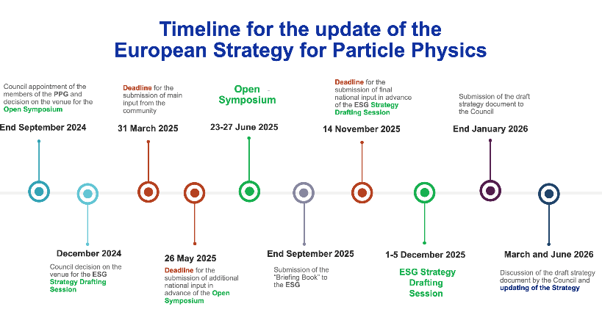
Update of the European Strategy for Particle Physics
  current strategy was adopted in 2020
  update driven by physics and strategic considerations
    fundamental questions need to be answered
    many important new physics results from LHC and other experiments
    HL-LHC program will finish in 2041
    exploration of the Higgs sector and its relation to many of the
    open fundamental questions remains most important
    and requires the construction of a Higgs factory
    very good progress on the feasibility study for the FCC at CERN
    worldwide developments (Japan, P5@US, China)
    Europe‘s leading role in particle physics as a
    pillar of its international competitiveness
    long approval/construction timescale (25 years for LHC)
  process set up by CERN Council in March 2024
    Karl Jakobs appointed as Strategy Secretary
    Klaus Desch, Beate Heinemann in European Strategy Group
  National inputs are due by March 31, 2025
    https://europeanstrategy.cern/
https://home.cern/news/news/knowledge-sharing/updating-european-strategy-particle-physics

Slide 6
Remit of the 2026 ESPP Update
https://europeanstrategyupdate.web.cern.ch/sites/default/files/spc-e-1239-Rev2-c-e-3834-Rev2-ESG%20remit.pdf
The aim of the Strategy update should be to develop a visionary and concrete plan that greatly advances human knowledge in fundamental physics through the realisation of the next flagship project at CERN. This plan should attract and value international collaboration and should allow Europe to continue to play a leading role in the field.
The Strategy update should include the preferred option for the next collider at CERN and prioritised alternative options to be pursued if the chosen preferred plan turns out not to be feasible or competitive. The Strategy update should also indicate areas of priority for exploration complementary to colliders and for other experiments to be considered at CERN and at other laboratories in Europe, as well as for participation in projects outside Europe.
The ESG should review and update the Strategy and add other items identified as relevant to the field, including accelerator, detector and computing R&D, the theory frontier, actions to minimise the environmental impact and to improve the sustainability of accelerator-based particle physics, the strategy and initiatives to attract, train and retain the young generations, public engagement and outreach.
The ESG should submit the proposed Strategy update to the Council by the end of January 2026.

Slide 7
ECFA Guidelines for National Inputs to the ESPPU
https://ecfa.web.cern.ch/ecfa-guidelines-collecting-input-european-high-energy-physics-community-2026-update-european
3) Questions to be considered by countries/regions when forming and submitting their “national input” to the ESPP:
  a) Which is the preferred next major/flagship collider project for CERN?
  b) What are the most important elements in the response to 3a)?
    i) Physics potential ii) Long-term perspective iii) Financial and human resources: requirements and effect on other projects
    iv) Timing v) Careers and training vi) Sustainability
  c) Should CERN/Europe proceed with the preferred option set out in 3a) or should alternative options be considered:
    i) if Japan proceeds with the ILC in a timely way?
    ii) if China proceeds with the CEPC on the announced timescale?
    iii) if the US proceeds with a muon collider?
    iv) if there are major new (unexpected) results from the HL-LHC or other HEP experiments?
  d) Beyond the preferred option in 3a), what other accelerator R&D topics (e.g. highfield magnets, RF technology, alternative accelerators/colliders) should be pursued in parallel?
  e) What is the prioritised list of alternative options if the preferred option set out in 3a) is not feasible (due to cost, timing, international developments, or for other reasons)?
  f) What are the most important elements in the response to 3e)? (The set of considerations in 3b should be used).
4) The remit given to the ESG also specifies that “The Strategy update should also indicate areas of priority for exploration complementary to colliders and for other experiments to be considered at CERN and at other laboratories in Europe, as well as for participation in projects outside Europe.” It would thus be most useful if the national inputs explicitly included the preferred prioritisation for non-collider projects. Specific questions to address:
  a) What other areas of physics should be pursued, and with what relative priority?
  b) What are the most important elements in the response to 4a)? (The set of considerations in 3b should be used).
  c) To what extent should CERN participate in nuclear physics, astroparticle physics or other areas of science, while keeping in mind and adhering to the CERN Convention? Please use the current level and form of activity as the baseline for comparisons.

Slide 8

National input to the European Strategy for Particle Physics
  KET, together with representatives from KHuK, KfB, and KAT, has organized
  a series of workshops to facilitate discussions in Germany and
  to prepare the input document
    Future Collider @ CERN Community Event, Bonn, 22.-24.05.2024
    The Future of Non-Collider Particle Physics, Bad Honnef, 22.-24.11.2024
    The Future of Collider Physics, DESY, 27.-29.11.2024
    Drafting Workshop in preparation of the input to the ESPP update, Bad Honnef, 19.-22.01.2025
  The drafting workshop is the last opportunity to discuss with the full community before the March 31 submission
  Committee chairs have agreed to be coherent on common topics: physics topics, computing, detector R&D,
  the role of CERN,…
    national input regarding the future of CERN will be agreed on at the January drafting workshop
    a presentation at the drafting workshop of KHuK statements regarding CERN would be most welcome
  after the drafting workshop, the input document will be
    iterated in KET and provided for information to the chairs of the other committees
    iterated among participants of the drafting workshop
    finally approved and submitted by KET
  please register and participate in the January workshop if you wish to provide input
    communication on the input document will be restricted to the registered participants
    https://europeanstrategy.cern/

