Slide 1

S179 - First test of MNT reactions with secondary beams at the FRS Ion Catcher
Timo Dickel Super-FRS EC Meeting, Walldorf, 18/19.01.2024
Ali Mollaebrahimi (spokesperson), Timo Dickel (co-spokesperson), Christoph Scheidenberger (GSI contact) for the Super-FRS Experiment Collaboration
Long-term goal: establish MNT reactions with slowed-down radioactive beams at the Super-FRS to produce
and measure ground-state properties of heavy (A=190-260) neutron-rich isotopes
Supported by the supernumerary G-PAC report (February 2022)
S117 experiment in May 2024: in-cell MNT reactions with slowed-down ²³⁸U beam on targets inside CSC
proof-of-principle measurements: 30 cross sections ²³⁸U+⁶⁴Ni
23 new masses and 60 new cross sections: ²³⁸U+²³⁸U
13 main shifts scheduled: 24 – 27 May 2024
This proposal is a 1-day test for MNT reaction with a near stable secondary beam

Slide 2
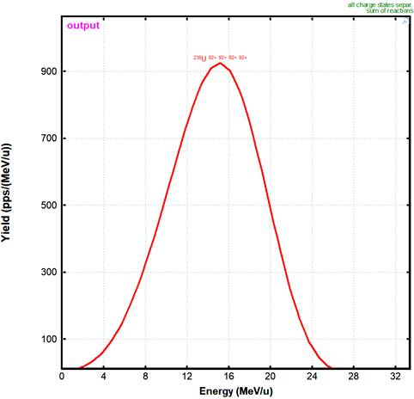
MNT reactions with secondary beams at the FRS IC
Timo Dickel Super-FRS EC Meeting, Walldorf, 18/19.01.2024
Experimental plan and objectives
FRS setting:
1 GeV/u ²³⁸U, centered on ²³⁶U
6.4 g/cm² Pb target, reaction ED ~ 1 barn
S1 slits +-5 mm
S2 slits +-15 mm, S2 Wedge 2 g/cm² and -4 mrad (between mono- and achromatic)
S3 slits +-5 mm
S4 slits +-5 mm (in Lise to simulate the MNT target, optics with correct focusing to be done)
5E5 ²³⁶U / s on MNT target with 3.3E8 ²³⁸U / s on target
Optimze range, range distribution and focusing on MNT target: 1 shifts
Idea is to use same Brho in second half of FRS as in stable beam experiment to make this easier
proof-of-principle: 2 shifts
CSC extraction tuning with ²³⁶U+²⁰⁹Bi: α spectroscopy of ²¹¹Po,^{211m}Po in DU1
method validation with ²³⁶U+²⁰⁹Bi/⁶⁴Ni: compare ~10 cross sections against data from S117 / Legnaro

Slide 3
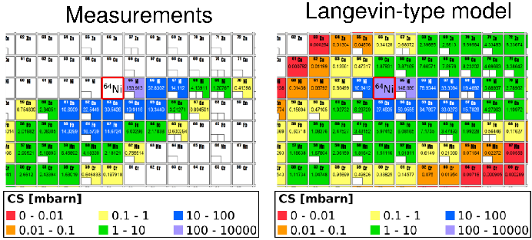
MNT reactions with secondary beams at the FRS IC
Timo Dickel | JLU Gießen Super-FRS EC Meeting April 27 – 28, 2023
Proof-of-principle: ²³⁸U+⁶⁴Ni
Comparison to primary beam:
Factor 2 loss in energy spread
Factor 2 loss in focusing (LISE is to optimistic)
5E5 (LISE++) correspond to 1E5 ²³⁶U/s (reality),
so factor 100 lower
Sensitivity limit for S117: 0.1 mbarn
→ sensitivity limit 10 mbarn
more than 10 isotopes on reach above the sensitivity limit
L. Corradi et al.
Phys. Rev. C 59, 261 (1999)
A. V. Karpov, V. V. Saiko
Phys. Rev. C 96, 024618 (2017)
Timo Dickel Super-FRS EC Meeting, Walldorf, 18/19.01.2024

Slide 4
MNT reactions with secondary beams at the FRS IC
Timo Dickel | JLU Gießen Super-FRS EC Meeting April 27 – 28, 2023
Other Issues for both MNT experiments
All detectors (S2 and S4) have to be on drives, because they are needed to setup the beam, but for the experiment they have to be removed due to the high rate
S4 roof has to be closed to allow operation up to 10⁷ ²³⁸U / s
Before and after the experiment
no other changes
calibrations needed as shown but does not influence other experiments
Timo Dickel Super-FRS EC Meeting, Walldorf, 18/19.01.2024

