Slide 1
The importance of students in Innovations
Dr. Pradeep Ghosh
Head International Cooperations

Slide 2
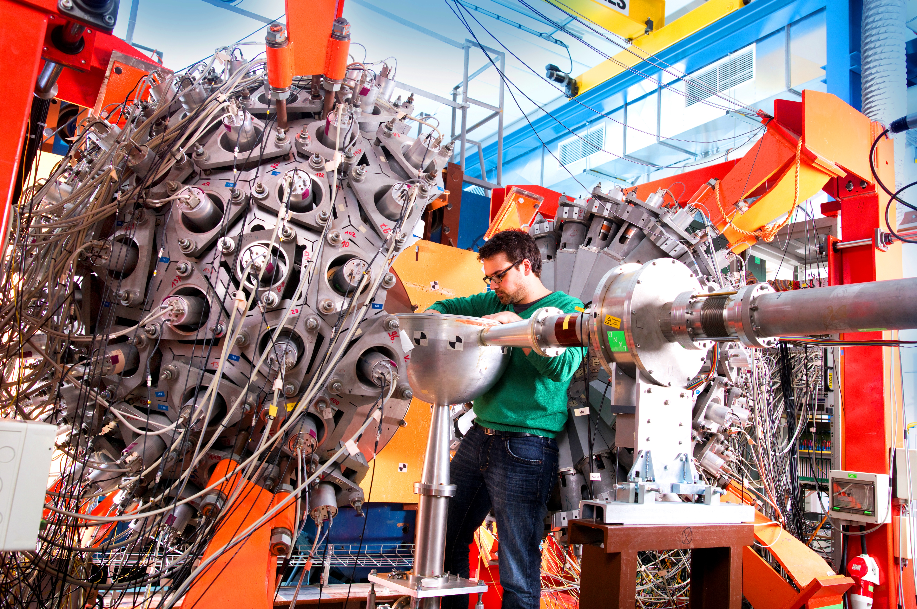
Students are the architects of our future, and innovation is the blueprint that shapes it. Their creativity, curiosity, and unbridled enthusiasm are the driving forces behind the progress of our world.

Slide 3
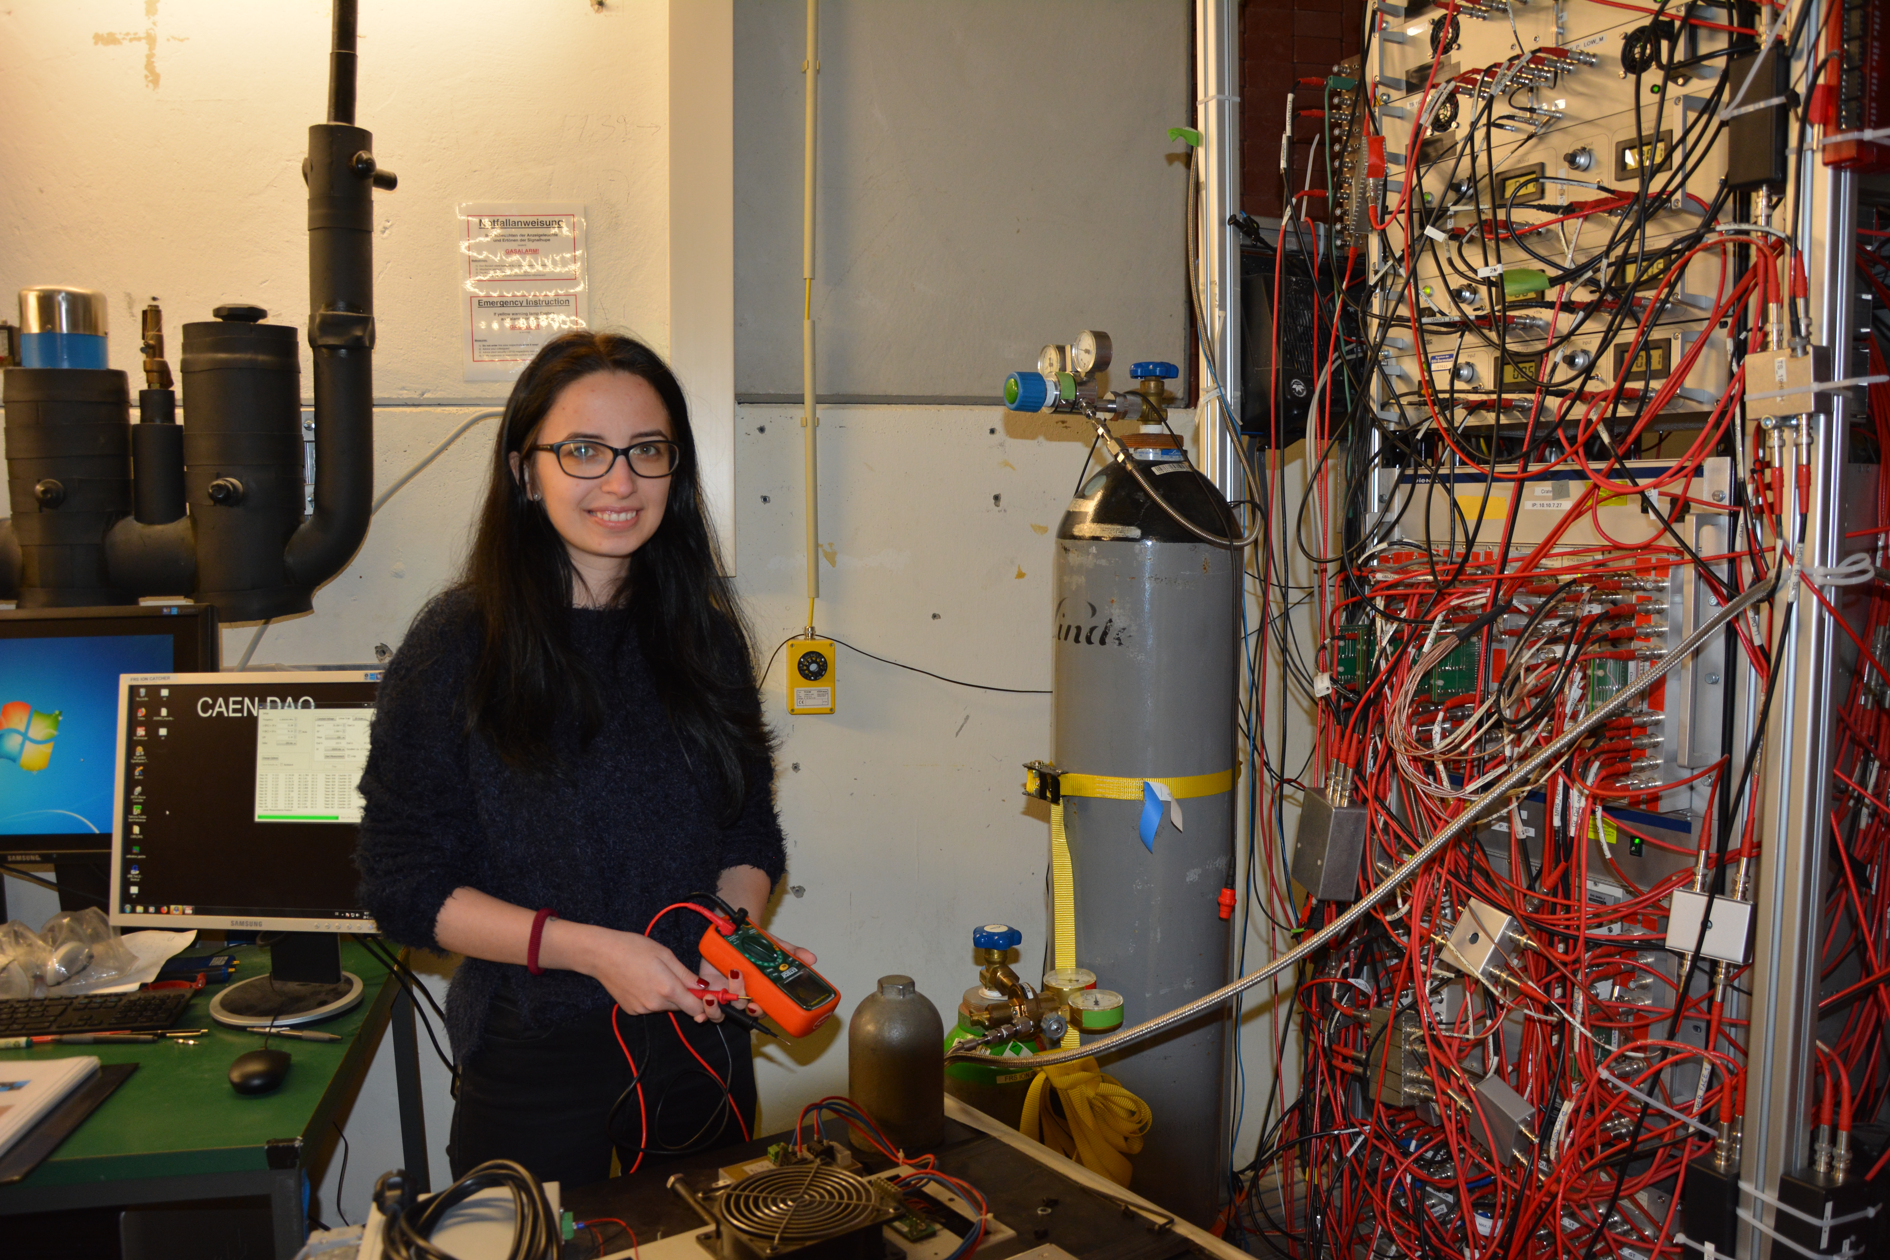
Stories
Bachelor Student – Engineering - India
Doctoral Student – Physics - Romania

Slide 4
Stories
Post Doc Researcher – Material - China
Post Doc Researcher – FRS - Finland

Slide 5
Key Benefits (I can imagine)
Make a great investment for your career
Get a competitive advantage
Improve your skills
Improve the capabilities as researcher
Managing time efficiently
You Don't reinvent the wheel.
Learn how to optimize and analyse your costs.
Become aware about how innovation is to be handled
Get free support and advice

Slide 6
THANK YOU!

