Slide 1
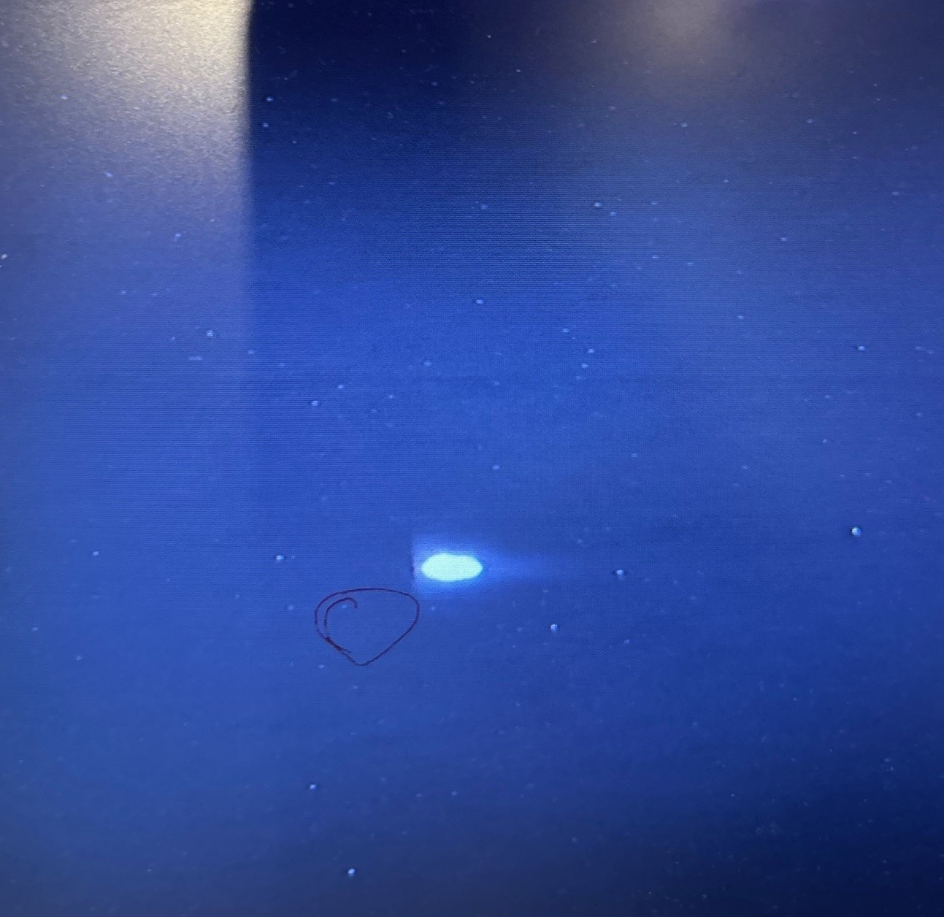
High-Current Study for HADES Pion Run
During 2014 pion run the beam intensity had to be limited due to high radiation dose levels observed in the target hall, which were caused by beam losses in the extraction region and in HEST.
Improvements in HEST to overcome this issue:
Quadrupole vacuum chambers with increased apertures
Installation of BLMs
New transfer line optics for pion production
During the high-current study the transmission from SIS18 to the pion production target could be significantly increased by a factor 3-4 to 80% (incl. extraction efficiency).
Analysis of radiation dose data is on-going.
@ pion target
8.5E10 ions in SIS18
pion
target
HADES
SIS18

