Slide 1



Discover #ErasmusDays @ FAIR/GSI
Presented by
Dr Pradeep Ghosh
Head, International Cooperation Office

Slide 2


Plan for the Day
Introduction
Opportunities
Success and Challenges
Sustainability in Mobility

Slide 3
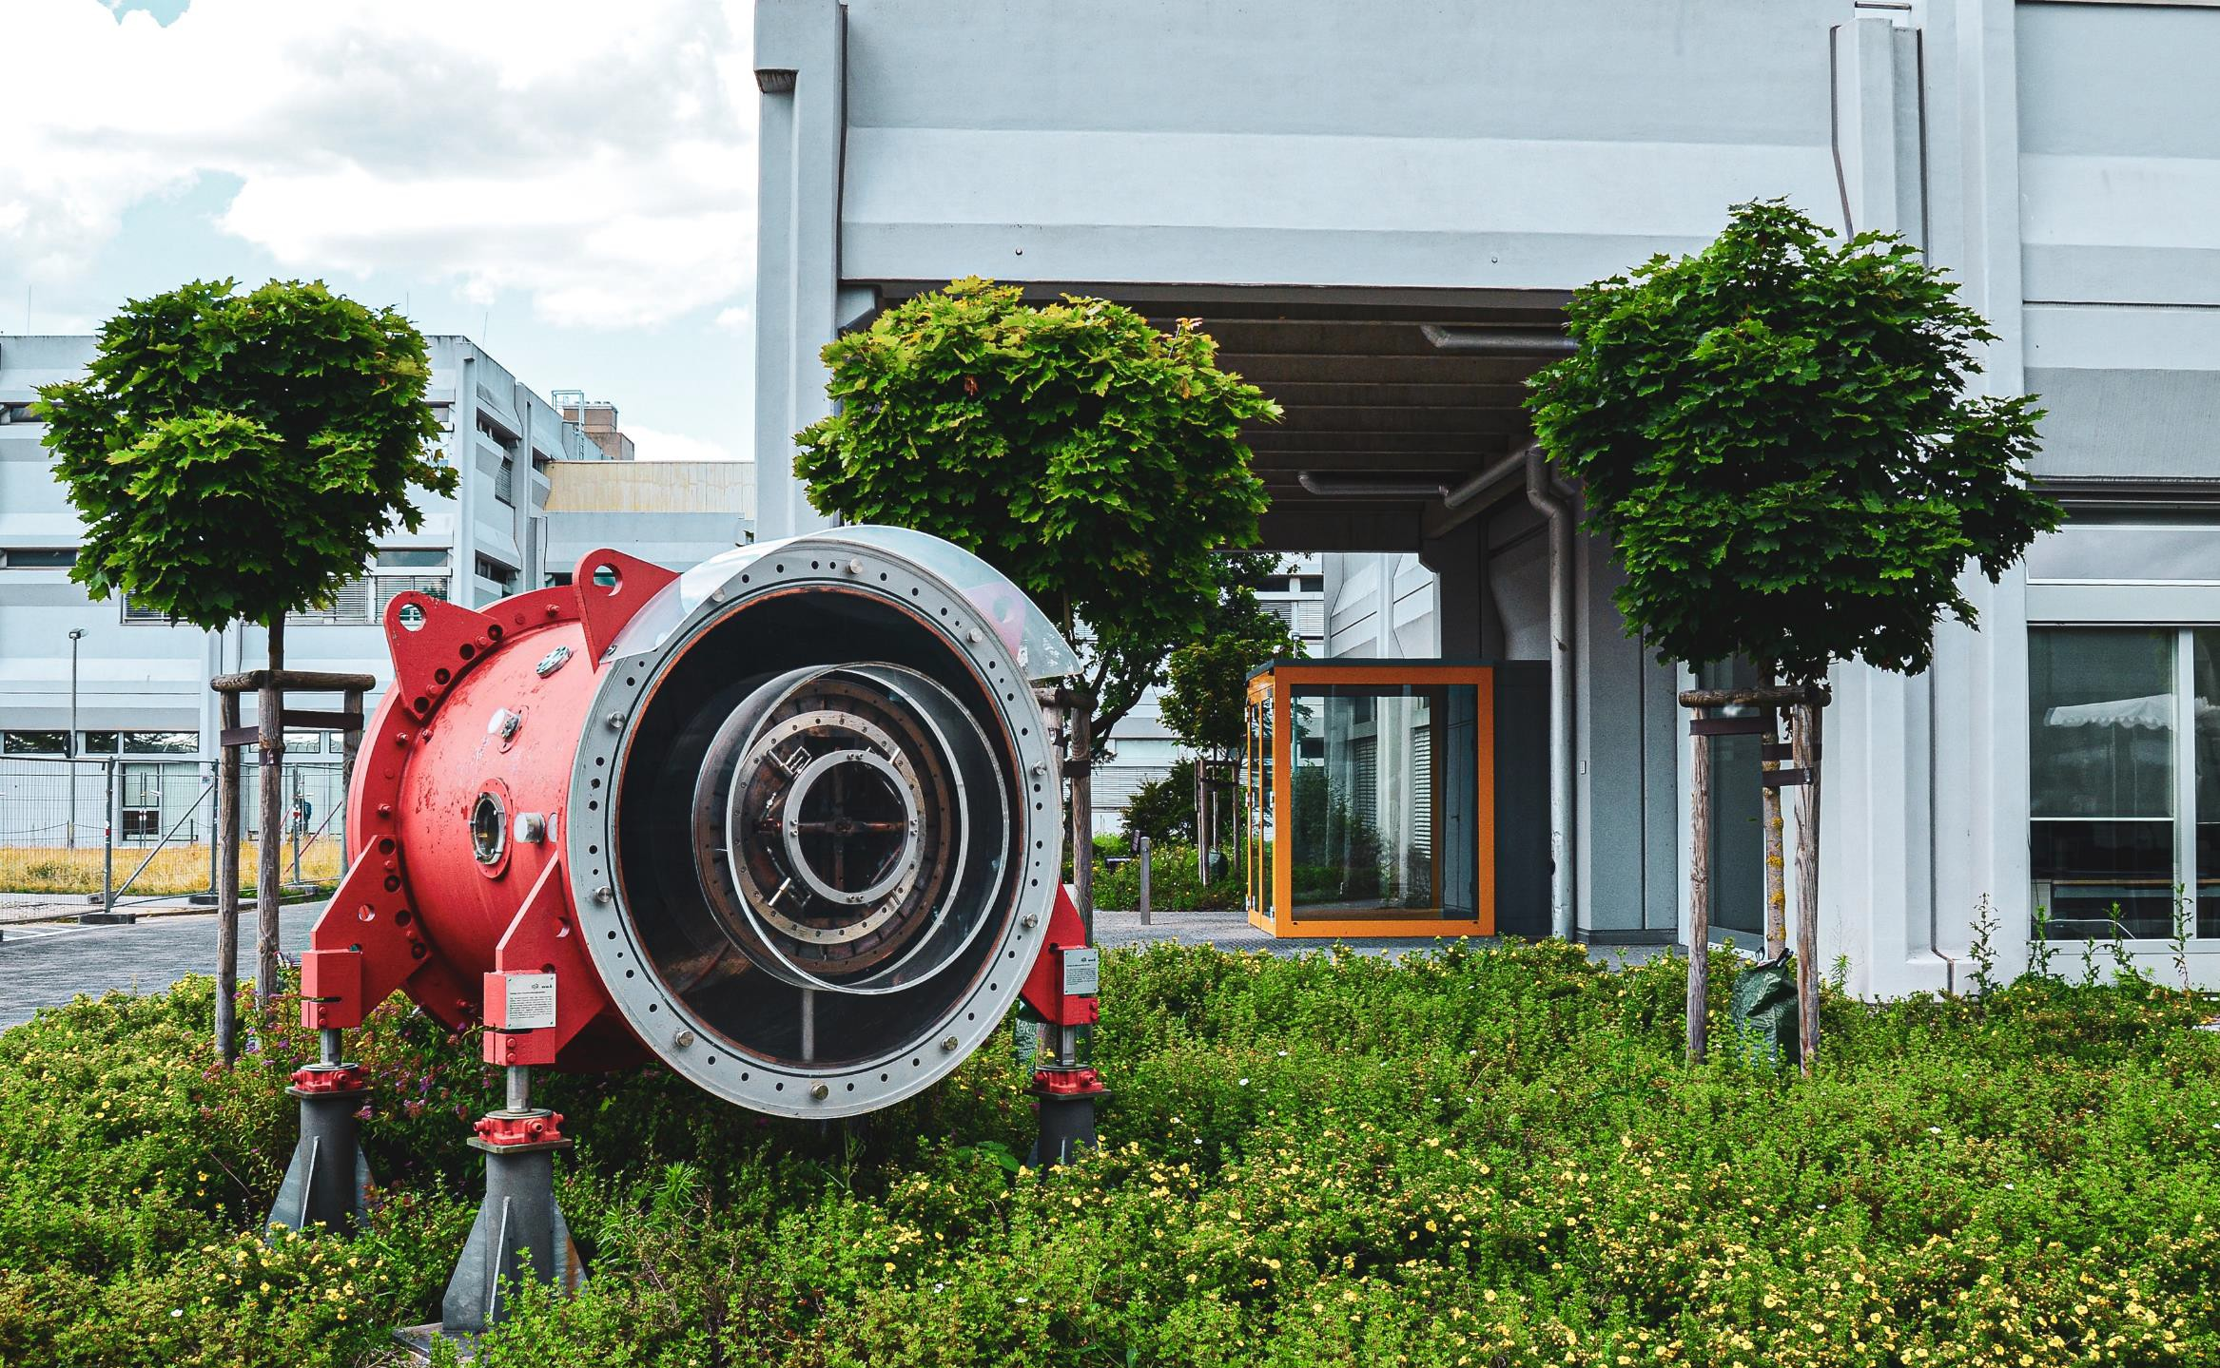
Who are we?
The International Cooperations Office at FAIR/GSI Darmstadt, Germany, provides international students and early stage researchers with opportunities to perform internships, traineeships and early-stage research experience in order to get involved in the international FAIR accelerator project while receiving scientific and technical training. In addition to this, we develop meaning partnerships with stakeholders.

Slide 4



What are we working on?
Outreach for FAIR
Mobility
Strategic partnerships
Dissemination of Information at strategic events to generate interests in FAIR research pillars
Knowledge Transfer through Project oriented Research Mobility programs
Creating meaningful and sustainable partnership with a clear vision of mutual growth

Slide 5

Why are we celebrating Erasmus Days now
Milestones
05 years of Erasmus+ Traineeships
110 Erasmus Traineeship administered
Trainees from 15+ Countries in the EU
15+ partnerships in the framework of Erasmus+ Programme

Slide 6
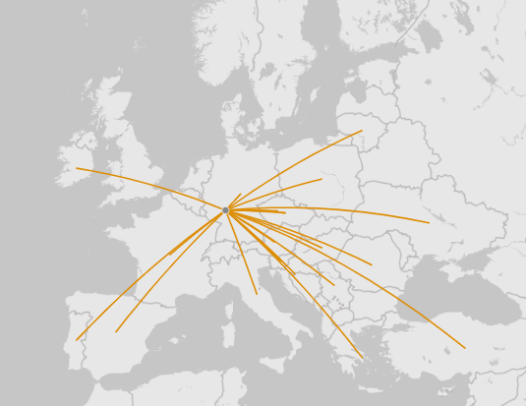
International Cooperation Office is working with more than 20 countries and more than 50 educational institutions in the EU.
1/4 Incoming students or researchers are not from EU or not affiliated to any institute from EU.
Czech Republic, France, Poland, Romania, Slovenia are strong partners of the FAIR project.
Scientists and institutes in the EU countries have been visiting and collaborating with GSI scientists since decades.
Erasmus+ programs to support mobility of young talented students who we need for future operations of FAIR.

Slide 7
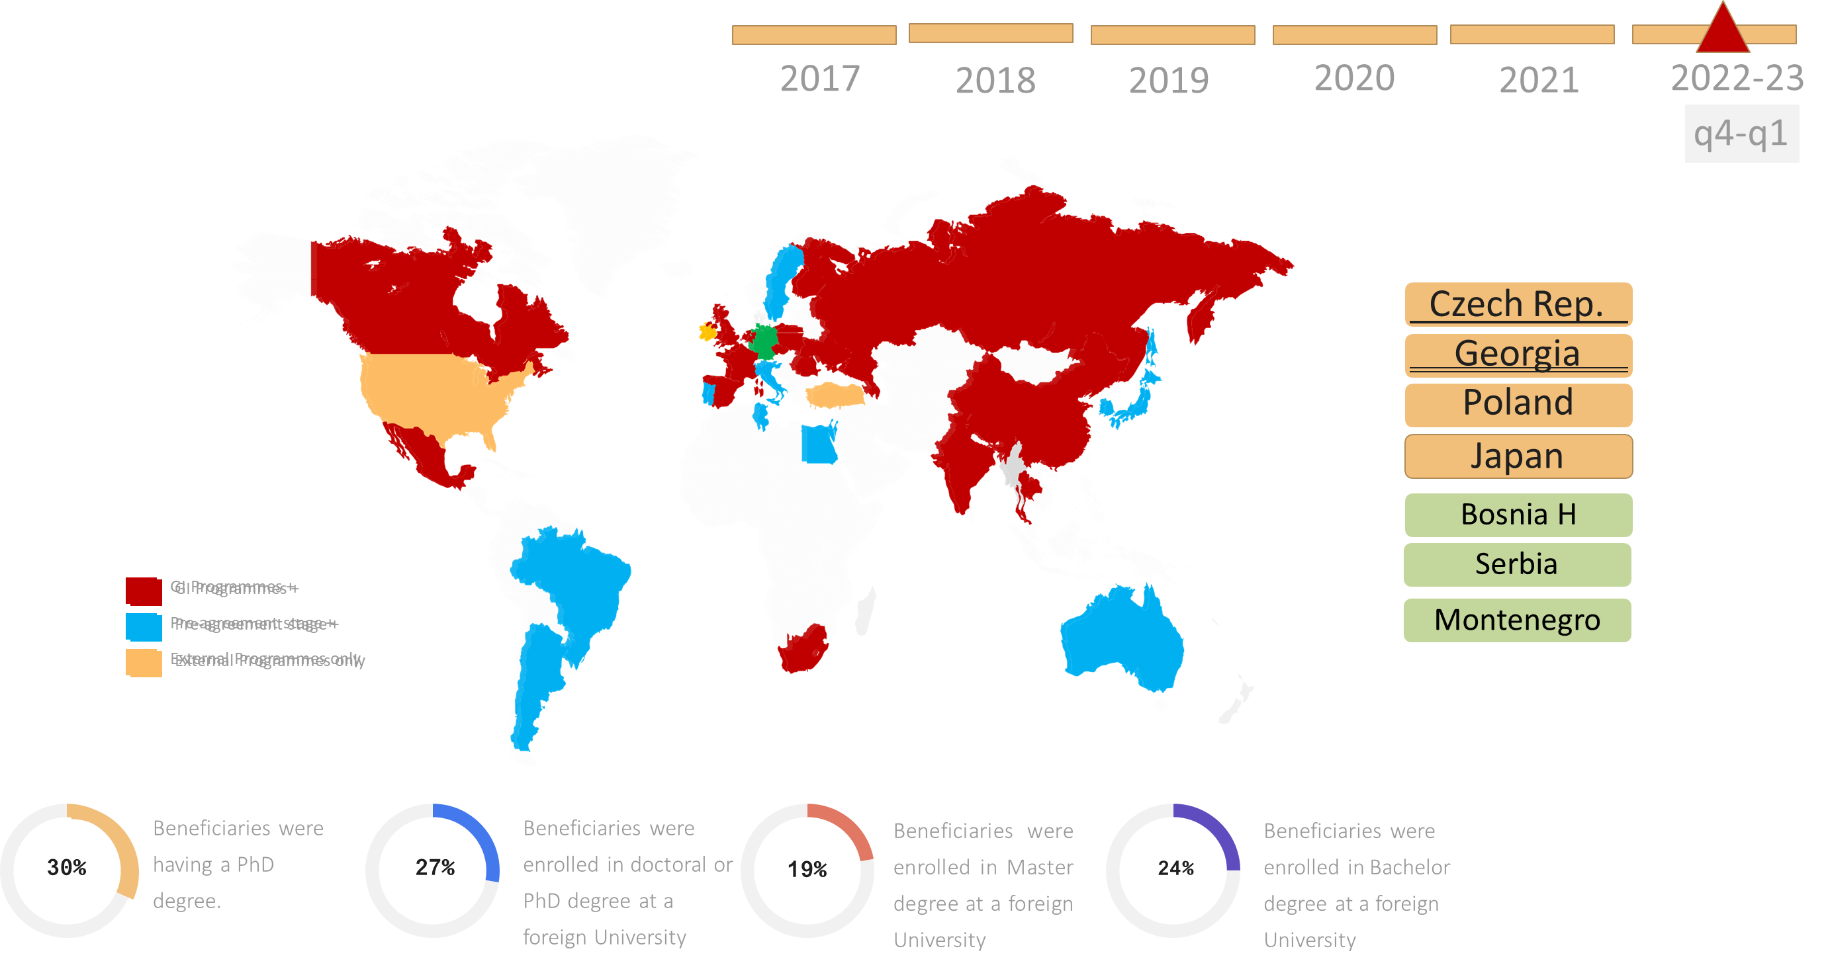
A short glimpse on the extent to which the GET_INvolved Programme has gained progress and momentum to acquire the talent and working on ahead for partnerships

Slide 8
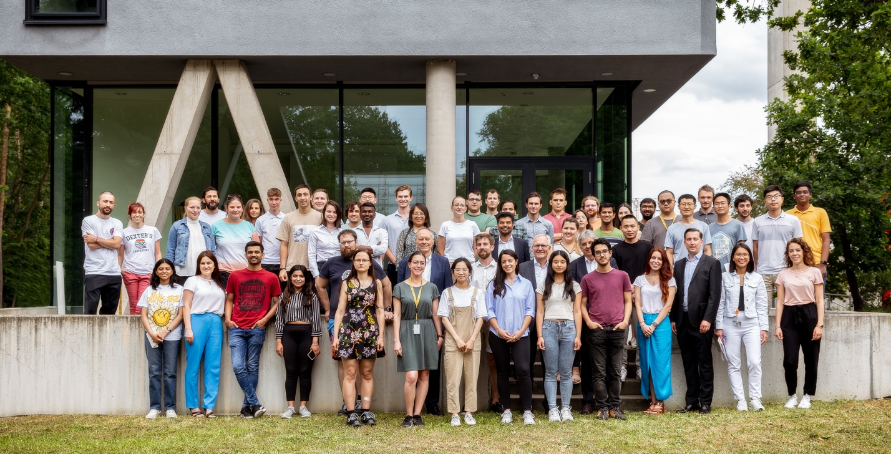
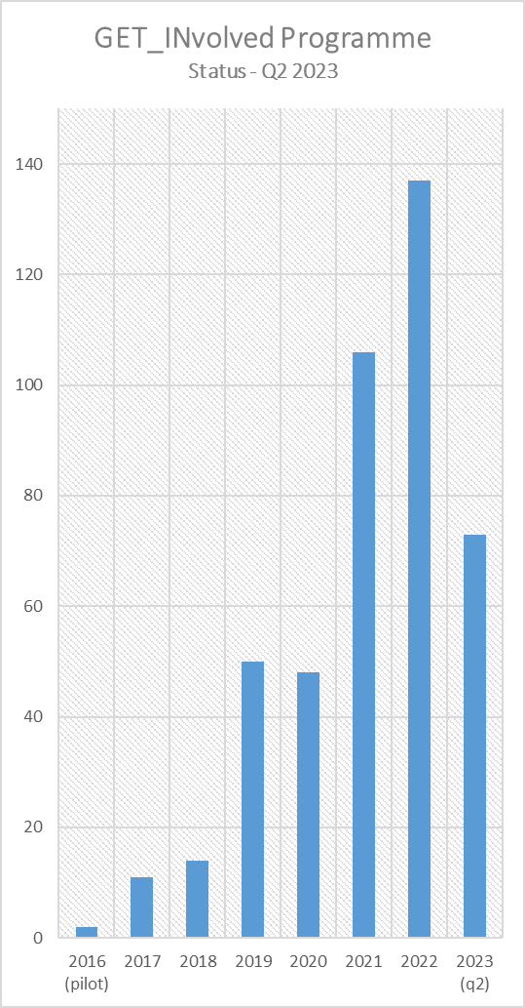
In the 06+ years of the GET_INvolved Programme, 350+ young & talented students/researchers have benefited of the GET_INvolved Programme. (45% females, 50+ Nationalities)
Year-wise intake of participants administered with in the GET_INvolved programme by International Cooperations Unit. [data: 30 June2023]

Slide 9


Thank you!
Discover. Connect. GET_INvolved!
international-cooperations@fair-center.eu
www.fair-center.eu/get_involved

