Slide 1
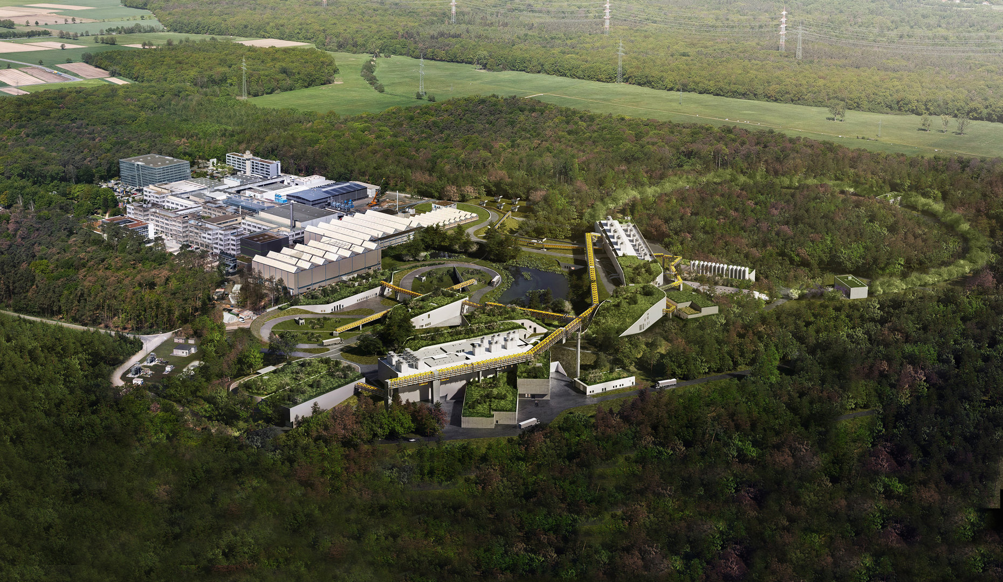
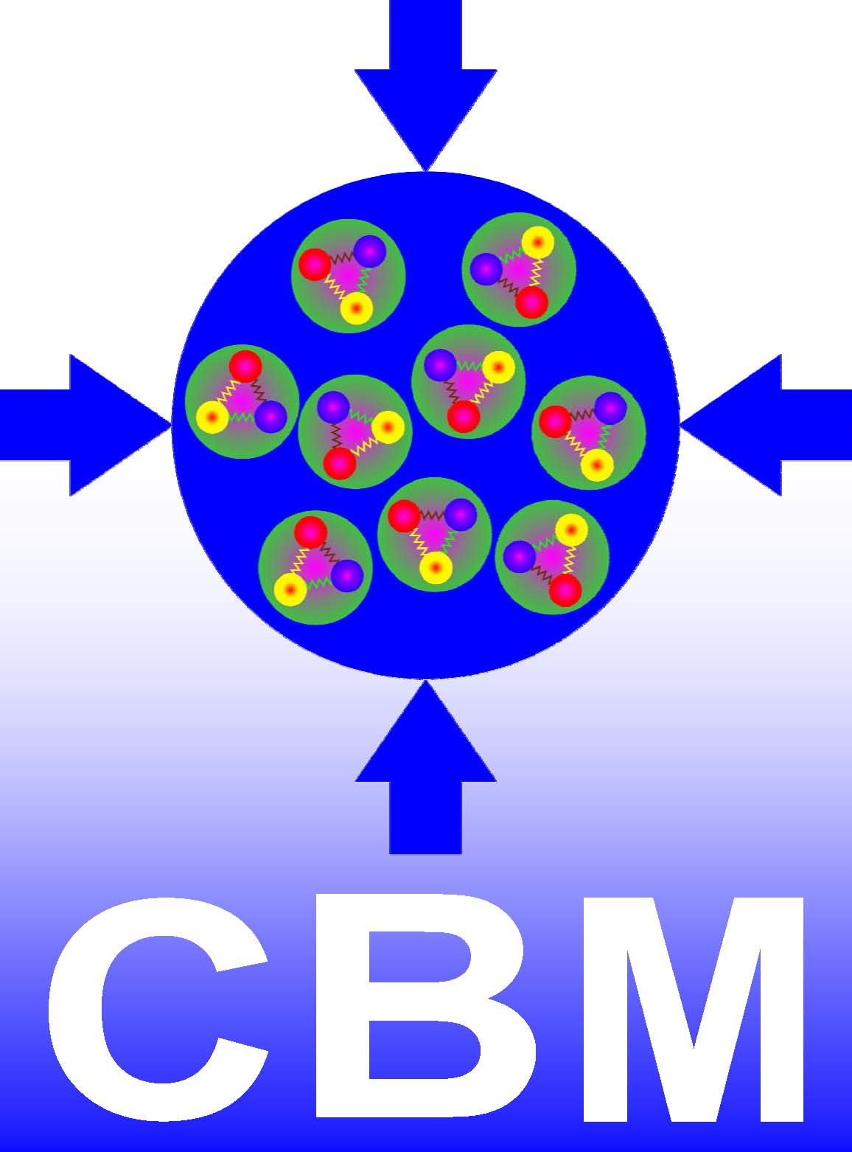
Exclusive Reactions with
Proton Beam from SIS100

Slide 2
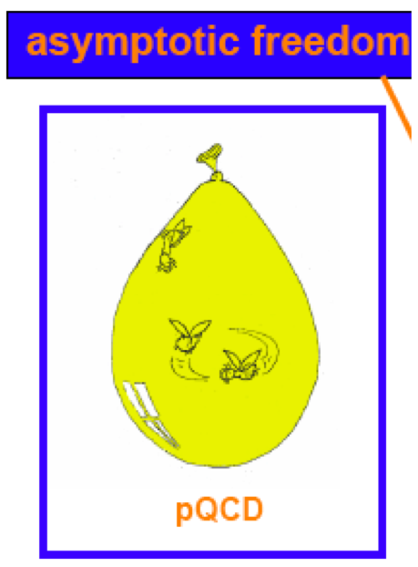
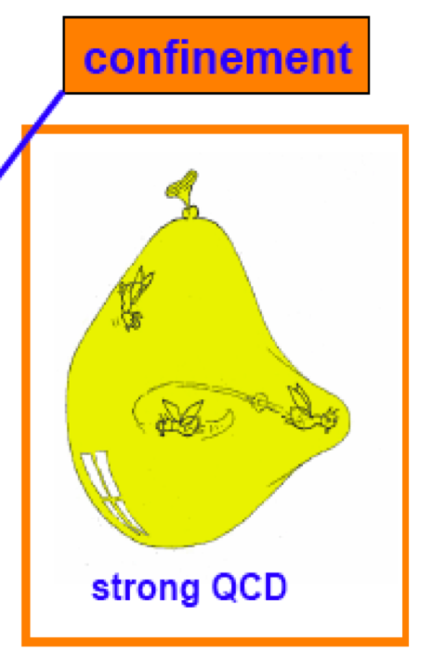
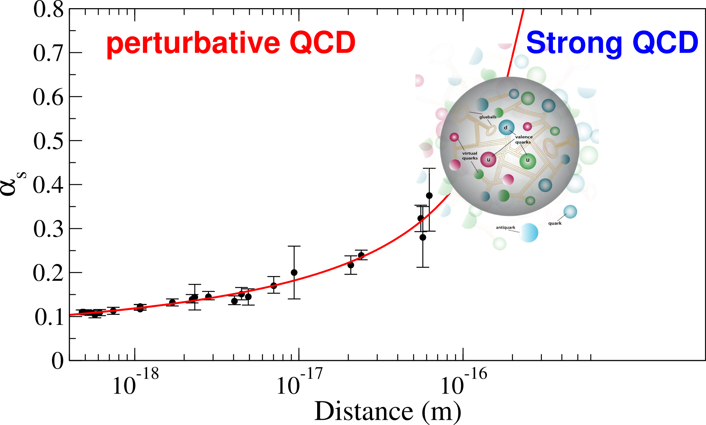
Overarching Physics Objectives
…from hadron to heavy-ion physics
Properties of strongly interacting matter?
Formation of hadronic matter?
Underlying symmetries
Degrees of freedom: from quarks/gluons to baryons/mesons?
Origin of mass?
Strong coupling
Nucleon radius
QCD Physics at FAIR
Particles
Hadrons
Nuclei

Slide 3
Physics with 30 GeV/c Proton Beams at FAIR
There are two main foci for proton beam from SIS100
(N.B. not really separate topics)
pp (pn) and pA as input for AA reaction studies
Hadron physics studies outright
  (Multi-)strange baryon production and properties
  Open/hidden charm hadrons

Slide 4
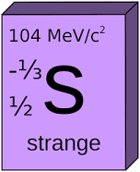
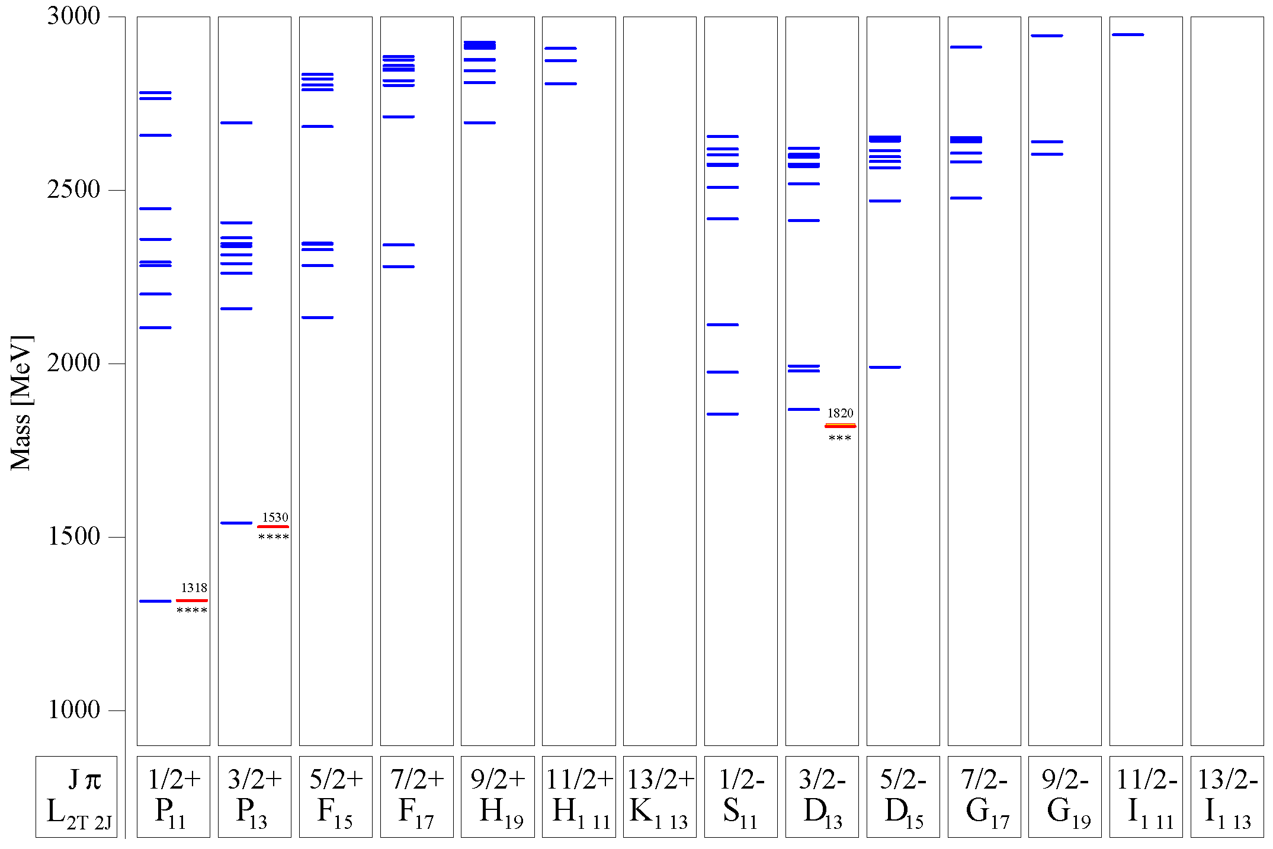
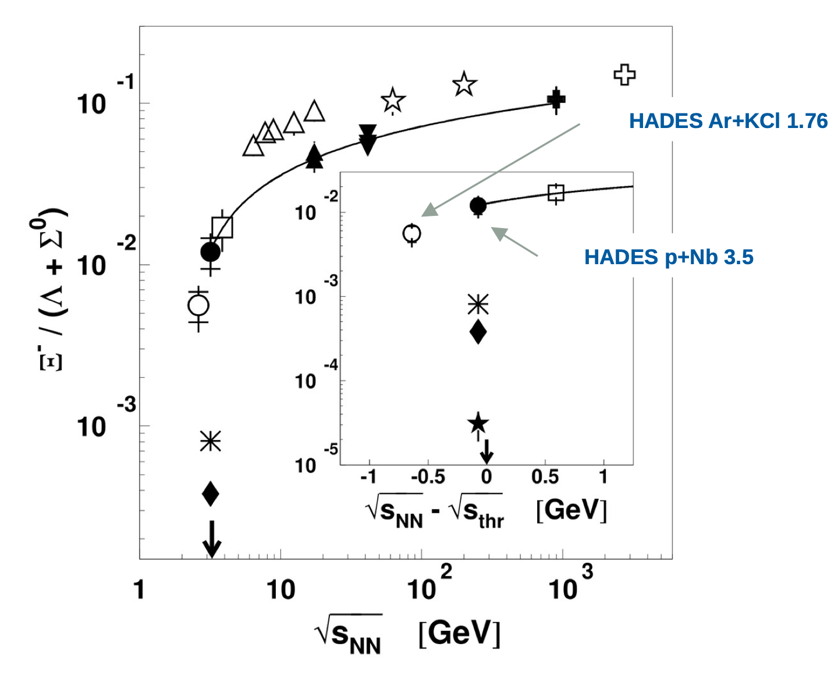
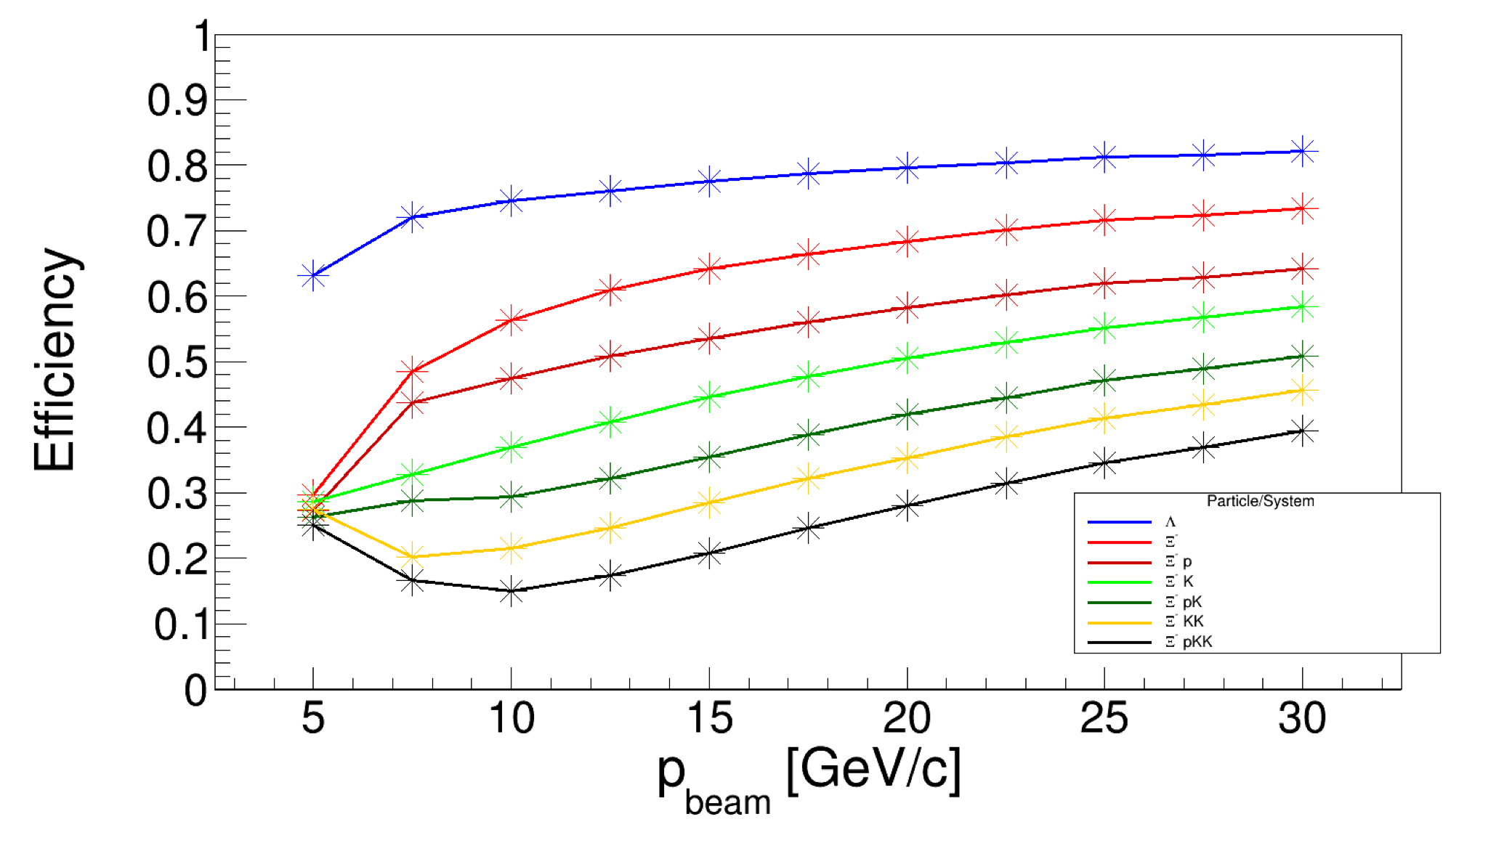
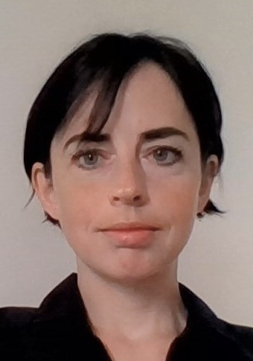
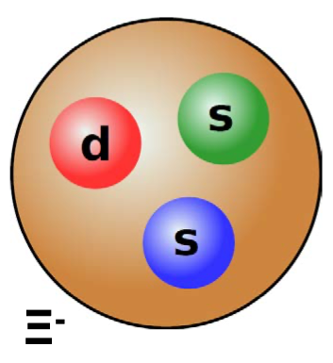
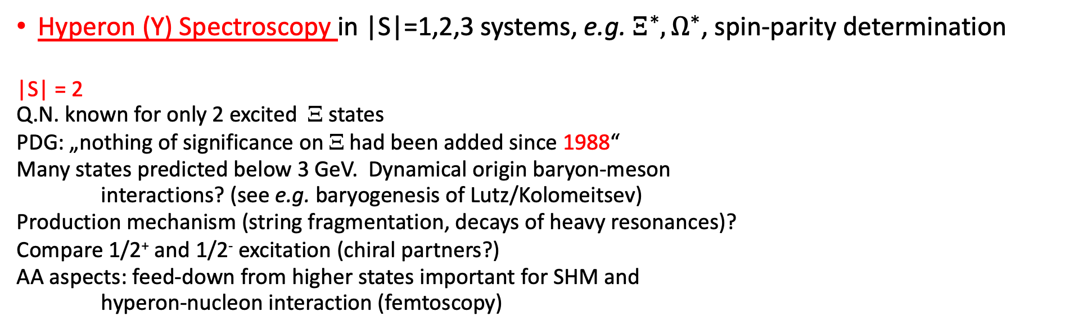
Strangeness Physics with Proton Beam at SIS100
Hyperon (Y) Spectroscopy in |S|=1,2,3 systems, e.g. $Ξ^{∗},Ω^{∗}$, spin-parity determination
|S| = 2
Q.N. known for only 2 excited Ξ states
PDG: „nothing of significance on Ξ had been added since 1988“
Many states predicted below 3 GeV. Dynamical origin baryon-meson
interactions? (see e.g. baryogenesis of Lutz/Kolomeitsev)
Production mechanism (string fragmentation, decays of heavy resonances)?
Compare 1/2⁺ and 1/2⁻ excitation (chiral partners?)
AA aspects: feed-down from higher states important for SHM and
hyperon-nucleon interaction (femtoscopy)
Quark models: U. Löring et al., EPJA 10 (2001) 447
Jenny Taylor, fast simulation, CBM acceptance
Jenny Taylor
Also pilot studies Ξ with HADES

Slide 5
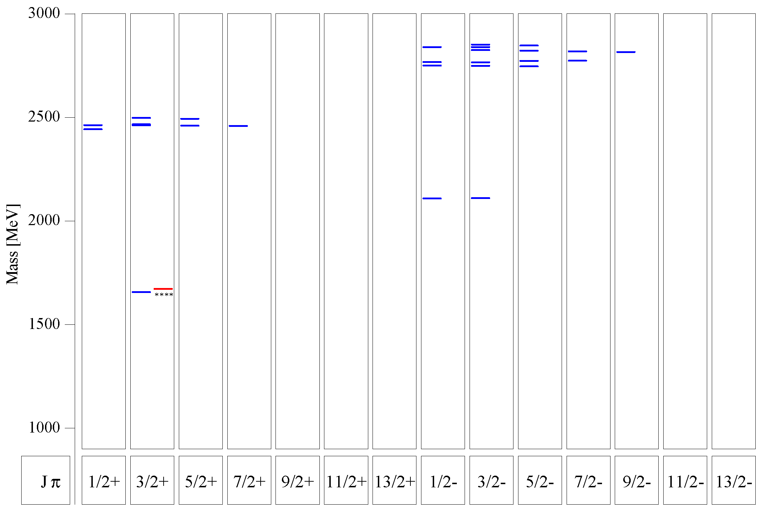
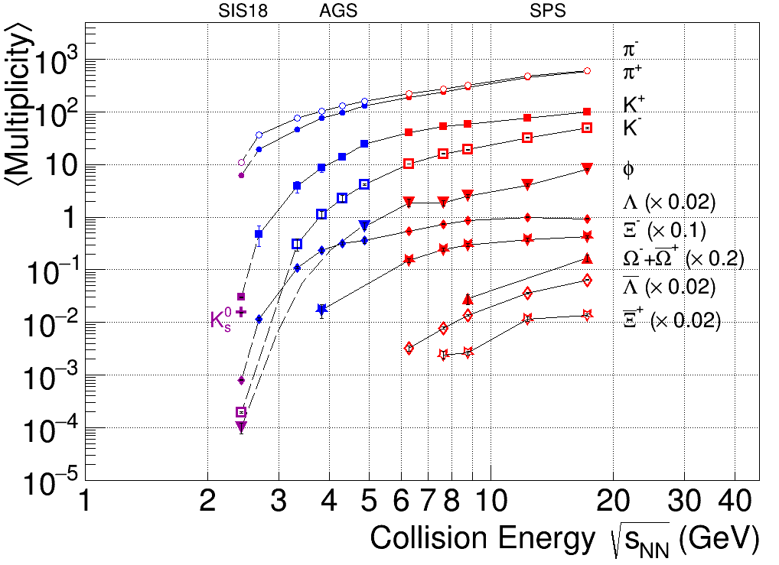
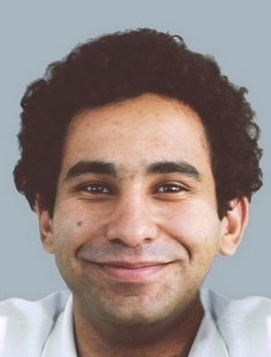
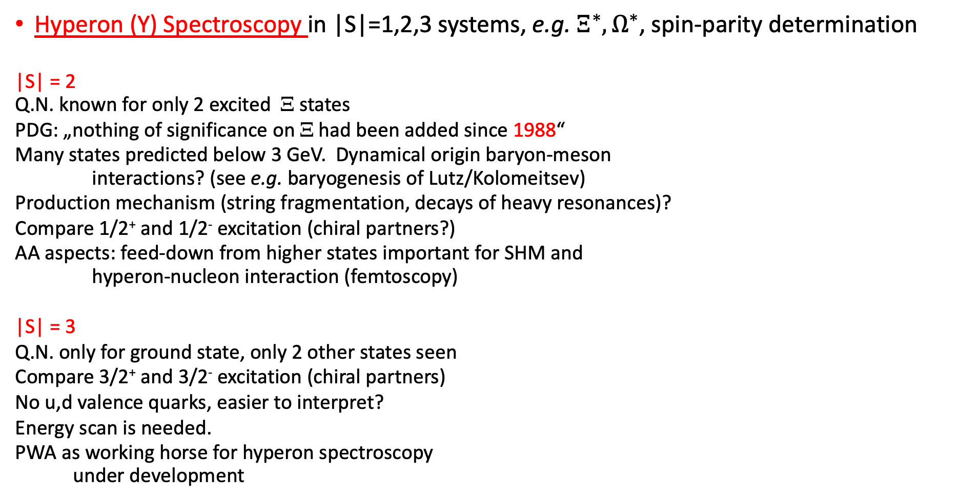
Strangeness Physics with Proton Beam at SIS100
Hyperon (Y) Spectroscopy in |S|=1,2,3 systems, e.g. $Ξ^{∗},Ω^{∗}$, spin-parity determination
|S| = 2
Q.N. known for only 2 excited Ξ states
PDG: „nothing of significance on Ξ had been added since 1988“
Many states predicted below 3 GeV. Dynamical origin baryon-meson
interactions? (see e.g. baryogenesis of Lutz/Kolomeitsev)
Production mechanism (string fragmentation, decays of heavy resonances)?
Compare 1/2⁺ and 1/2⁻ excitation (chiral partners?)
AA aspects: feed-down from higher states important for SHM and
hyperon-nucleon interaction (femtoscopy)
|S| = 3
Q.N. only for ground state, only 2 other states seen
Compare 3/2⁺ and 3/2⁻ excitation (chiral partners)
No u,d valence quarks, easier to interpret?
Energy scan is needed.
PWA as working horse for hyperon spectroscopy
under development
Quark models: U. Löring et al., EPJA 10 (2001) 447
Ahmed Foda
PWA dev.

Slide 6
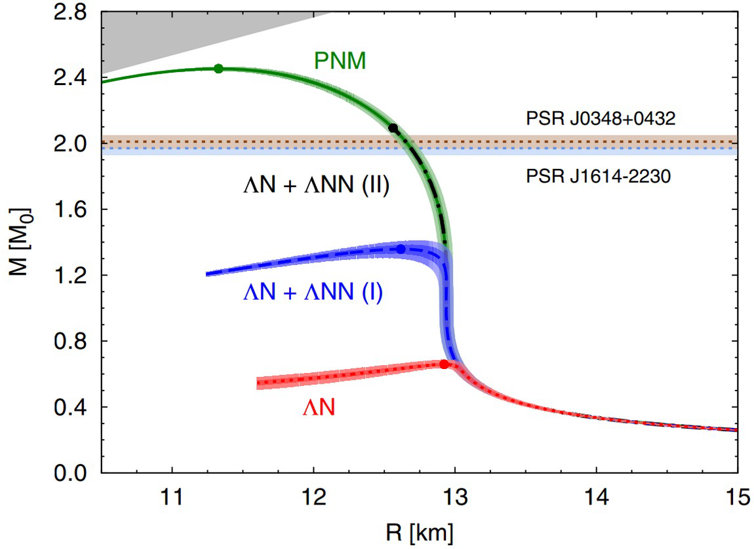
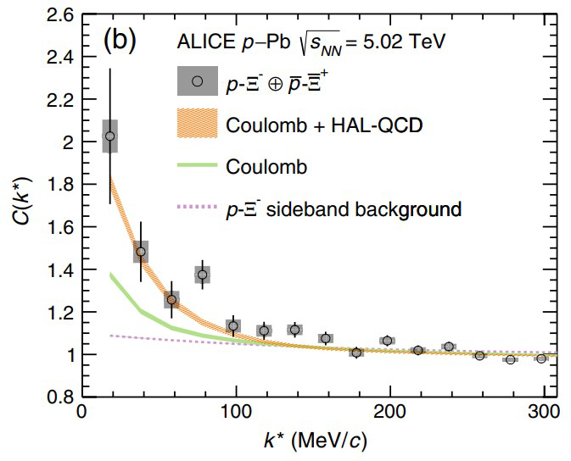
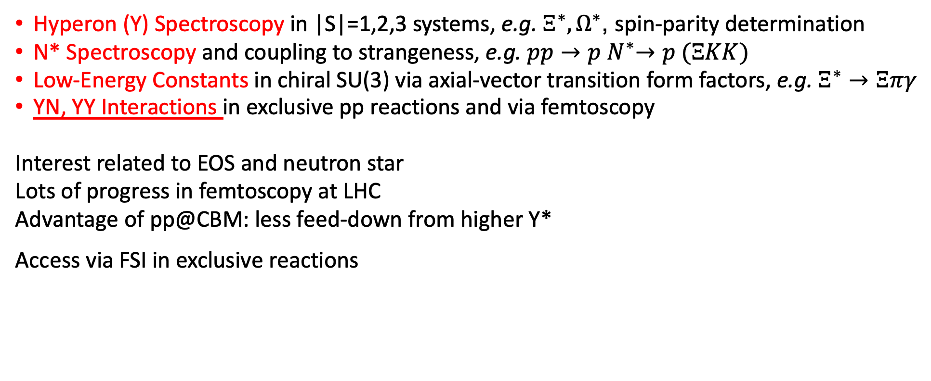
Strangeness Physics with Proton Beam at SIS100
Hyperon (Y) Spectroscopy in |S|=1,2,3 systems, e.g. $Ξ^{∗},Ω^{∗}$, spin-parity determination
N* Spectroscopy and coupling to strangeness, e.g. $pp{→p N}^{∗}→p (ΞKK)$
Low-Energy Constants in chiral SU(3) via axial-vector transition form factors, e.g. $Ξ^{∗}→Ξπγ$
YN, YY Interactions in exclusive pp reactions and via femtoscopy
Interest related to EOS and neutron star
Lots of progress in femtoscopy at LHC
Advantage of pp@CBM: less feed-down from higher Y*
Access via FSI in exclusive reactions
PRL114, 092301 (2015)
PRL123, 112002 (2019)

Slide 7
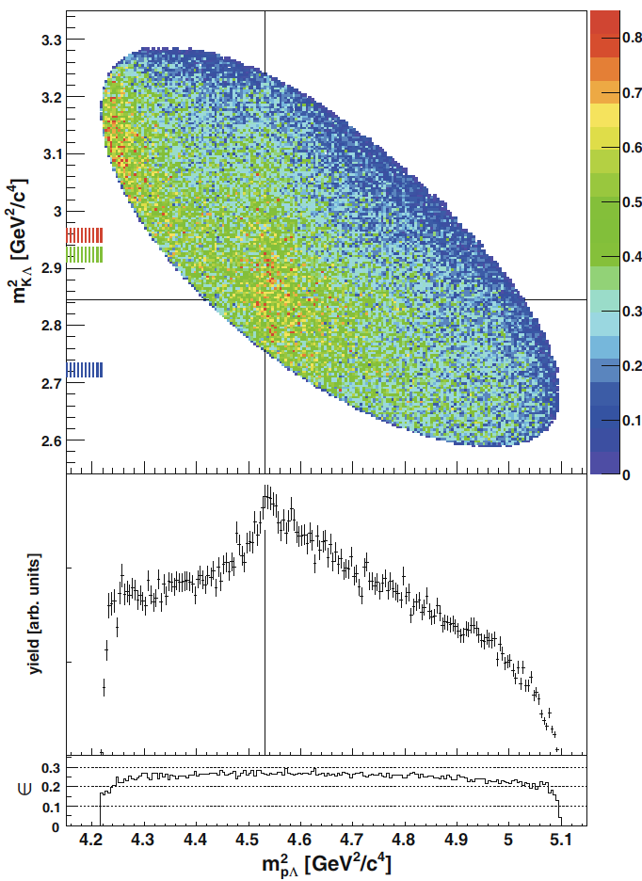
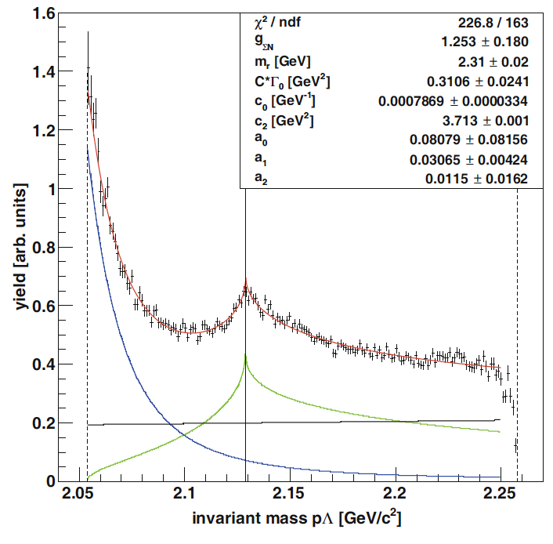

Strangeness Physics with Proton Beam at SIS100
Hyperon (Y) Spectroscopy in |S|=1,2,3 systems, e.g. $Ξ^{∗},Ω^{∗}$, spin-parity determination
N* Spectroscopy and coupling to strangeness, e.g. $pp{→p N}^{∗}→p (ΞKK)$
Low-Energy Constants in chiral SU(3) via axial-vector transition form factors, e.g. $Ξ^{∗}→Ξπγ$
YN, YY Interactions in exclusive pp reactions and via femtoscopy
Interest related to EOS and neutron star
Lots of progress in femtoscopy at LHC
Advantage of pp@CBM: less feed-down from higher Y*
Access via FSI in exclusive reactions
p p → p K Λ
pΛ
Flatte

Slide 8
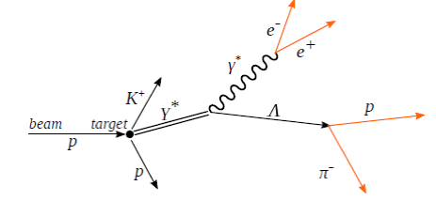
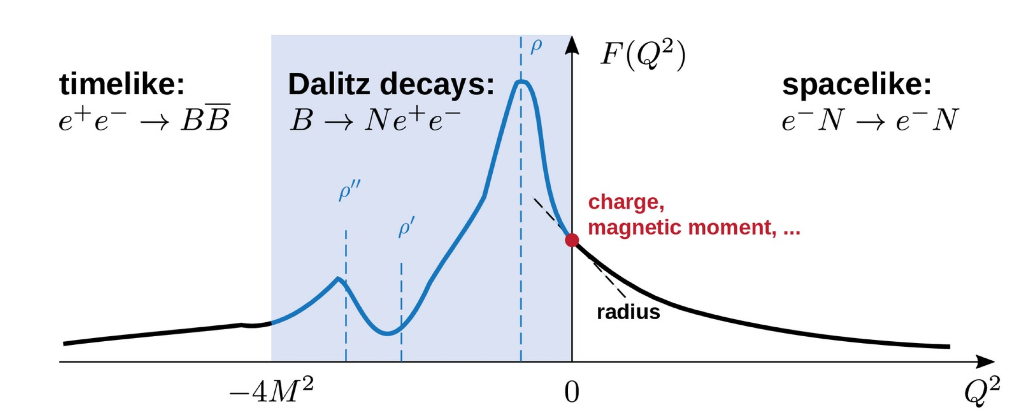
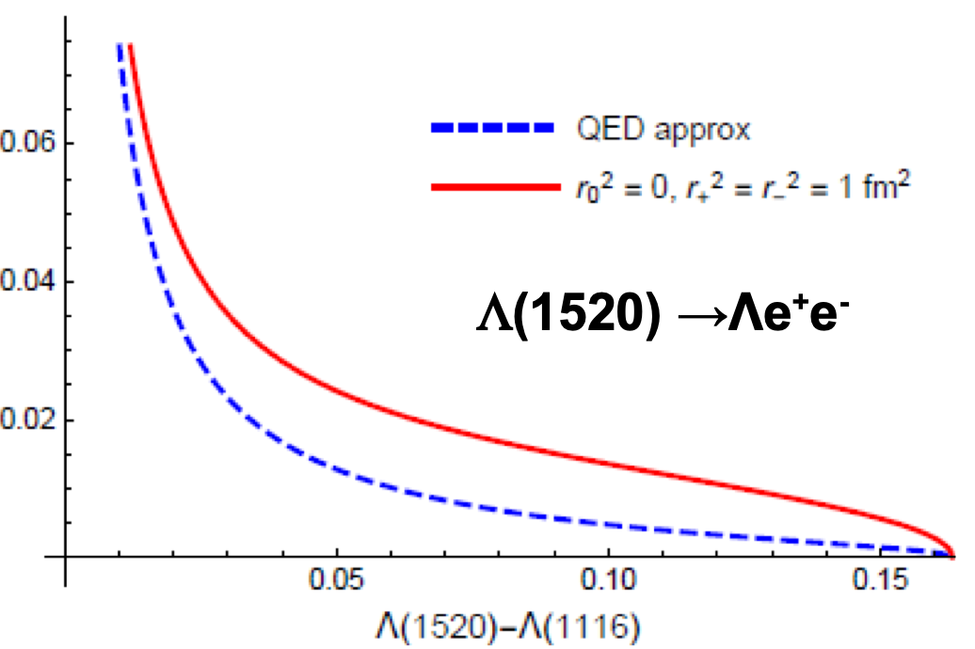


Strangeness Physics with Proton Beam at SIS100
Hyperon (Y) Spectroscopy in |S|=1,2,3 systems, e.g. $Ξ^{∗},Ω^{∗}$, spin-parity determination
N* Spectroscopy and coupling to strangeness, e.g. $pp{→p N}^{∗}→p (ΞKK$)
Low-Energy Constants in chiral SU(3) via axial-vector transition form factors, e.g. $Ξ^{∗}→Ξπγ$
YN, YY Interactions in exclusive pp reactions and via femtoscopy
Hyperon Structure, e.g. $Y^{∗}→Yℓ^{+}ℓ^{−}$, precision eTFF studies
Information on hadron structure (e.g. size of hyperon)
Dalitz decays of e.g. Λ(1405), Σ(1385), Λ(1520),..(narrow states)
Radiative BR about 10⁻⁵
Large rates needed (→ CBM and SIS100) (First attempt, HADES in pp@4.5 GeV)
G. Ramahlo Phys.Rev.D 102

Slide 9
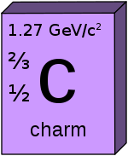
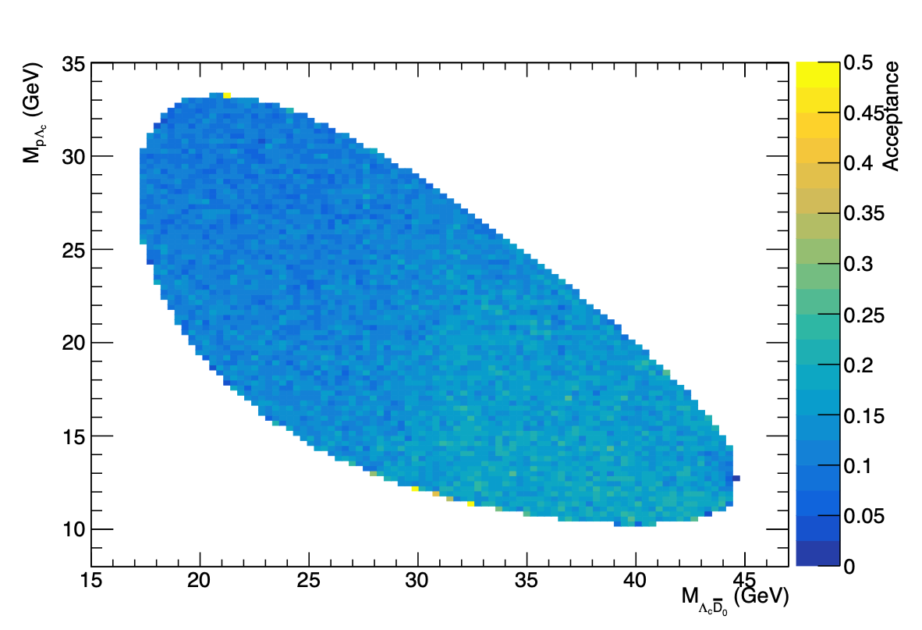
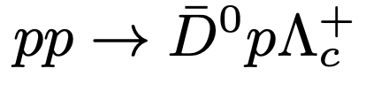
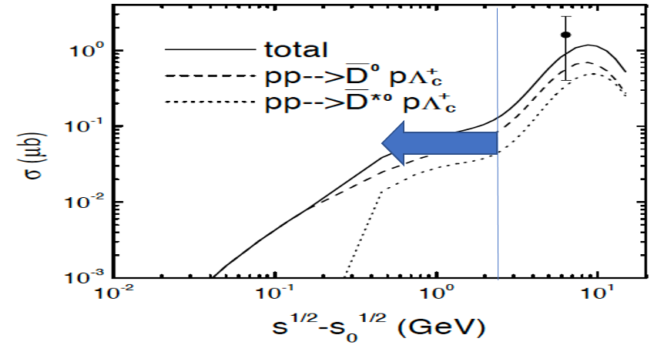
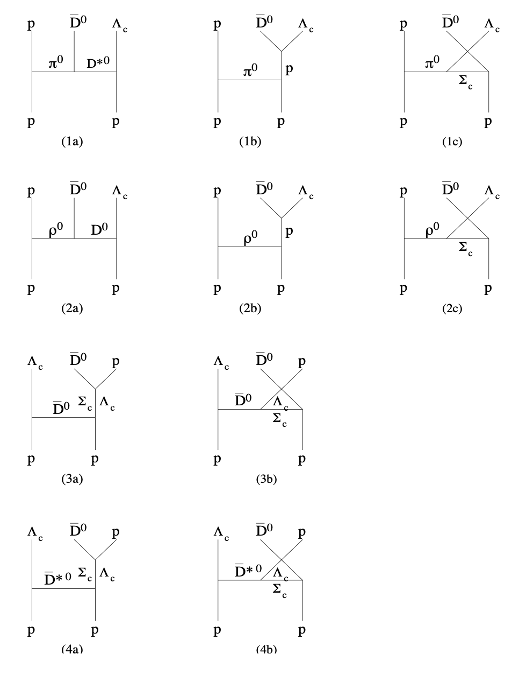

Charm Physics with Proton Beam at SIS100
2
Acceptance CBM
Fast simulation
  Charm-N Interactions : SU(4) dynamics!
2
Hadronic model with interaction Lagrangian based on SU(4) flavor symmetry
2
2
SVD collaboration, Phys. Atom.
Nucl. 64, 891 (2001)]
Liu, Ko, Lee

Slide 10
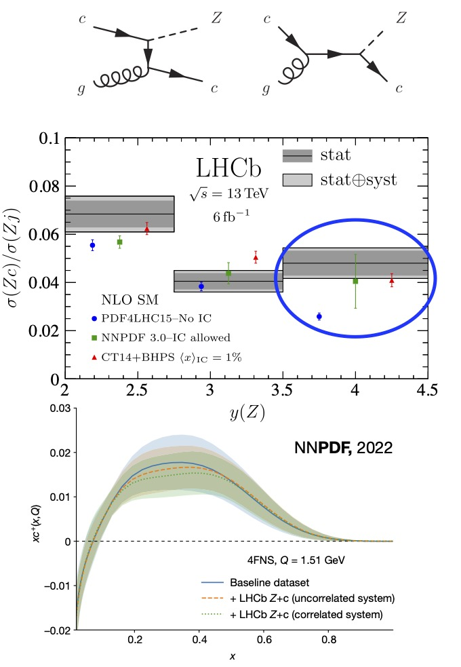
Charm Physics with Proton Beam at SIS100
  Charm-N Interactions : SU(4) dynamics!
  Intrinsic Charm component of the nucleon
  Long standing debate: "does the proton wave function
  contain an intrinsic charm (IC) component?”
  Brodsky et al.: IC manifest as valence-like charm
  content in PDFs
  LHCb hints towards observation of IC via Z+charm jets
  [PRL128, 082001, 2022]
  Evidence claimed by NNPDF collaboration based on
  global analysis + ML methods
  [Nature608, 483, 2022]
  Can IC in proton increase charm production
  close to threshold?

Slide 11
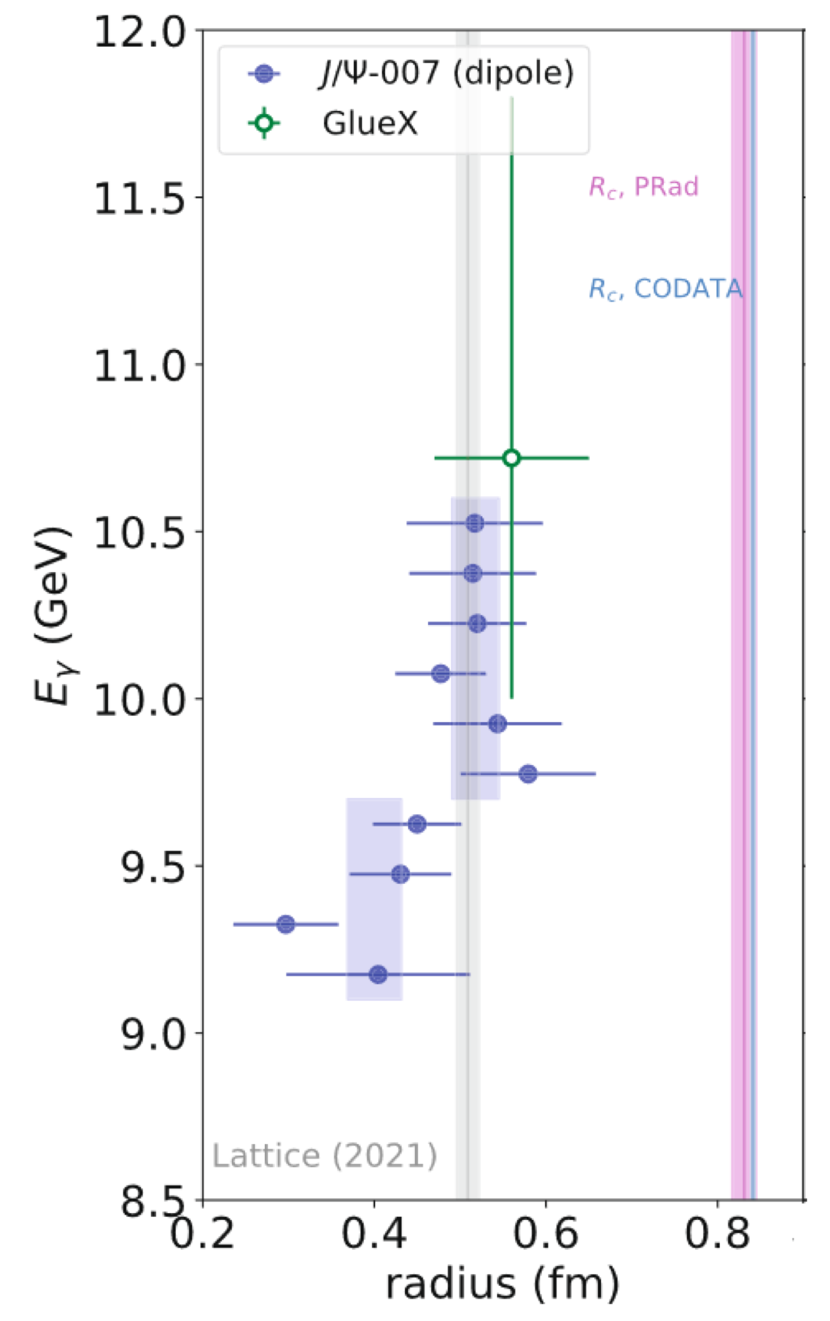
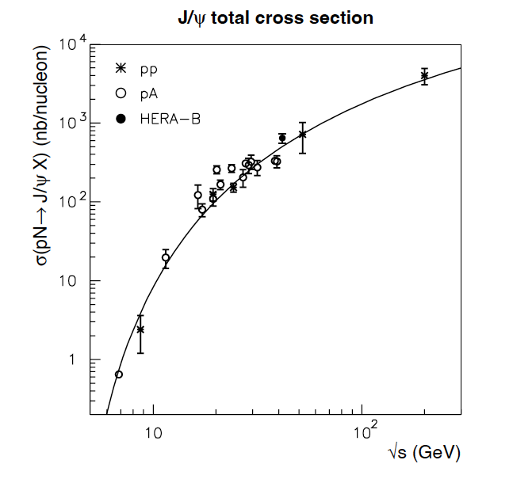
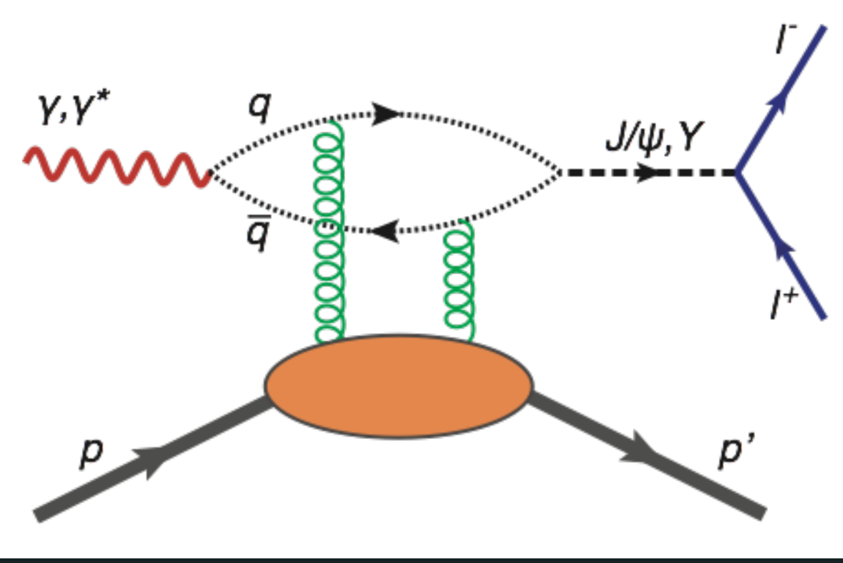
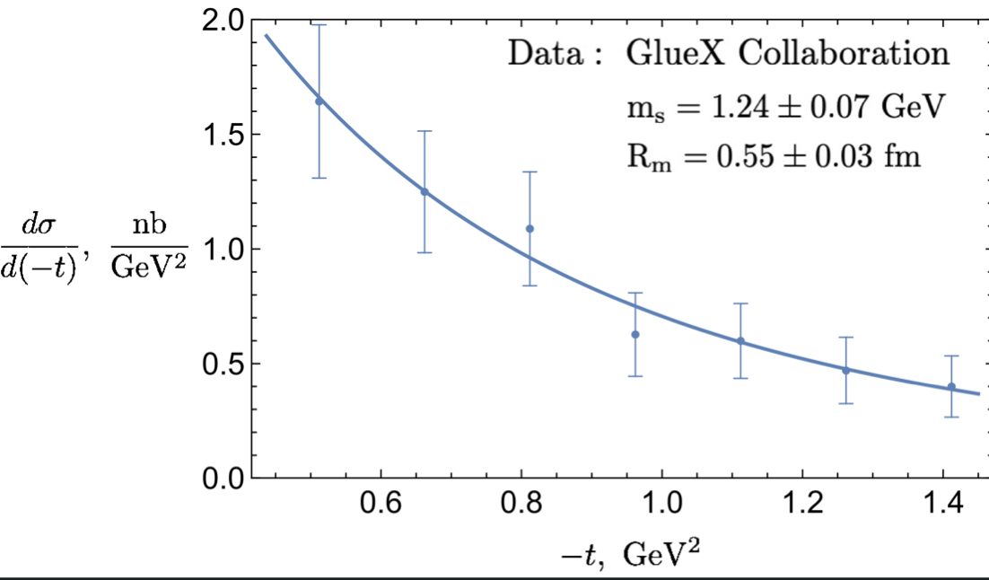
Charm Physics with Proton Beam at SIS100
  Charm-N Interactions : SU(4) dynamics!
  Intrinsic Charm component of the nucleon
  Mass Structure of the proton
Duran et al., Nature 615, 813 (2023),
“Determining the gluon gravitational form factor of the proton”
GlueX
Cedric Lorce
SIS100

Slide 12
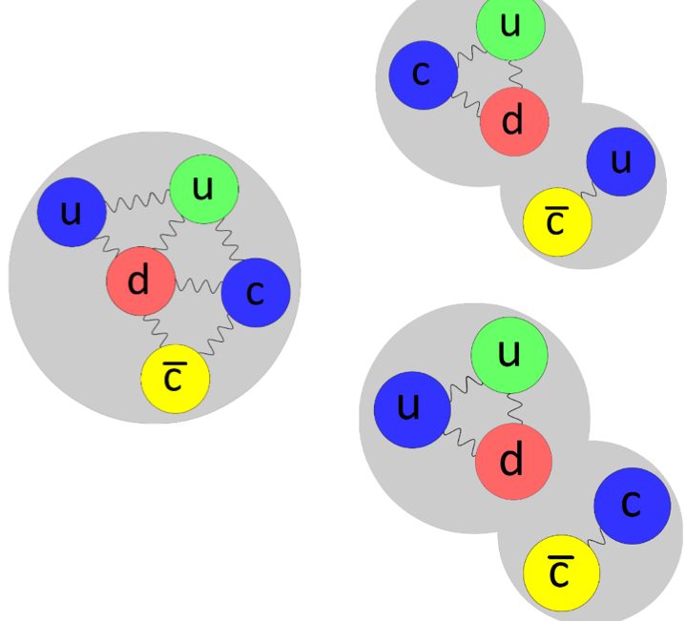
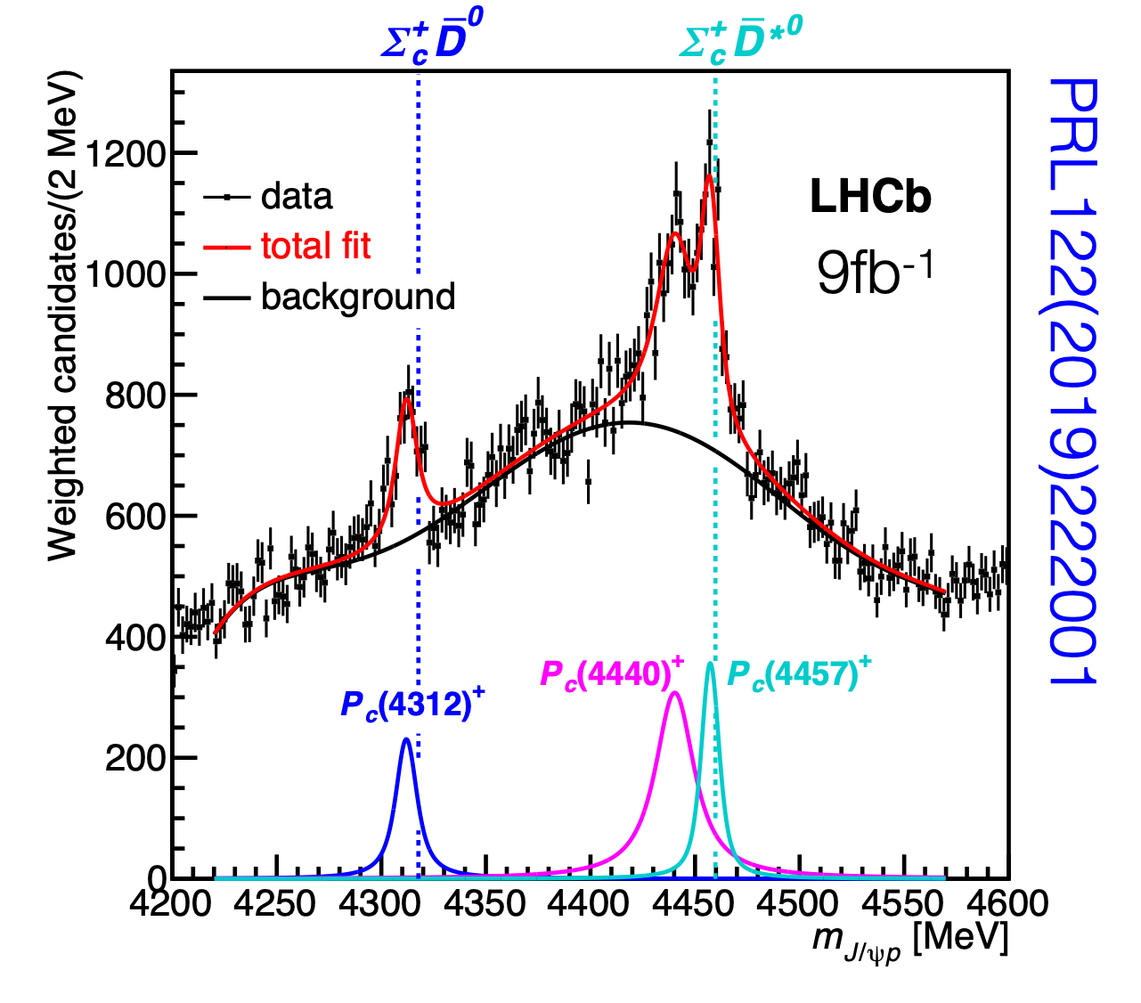
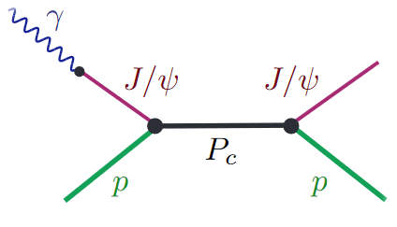

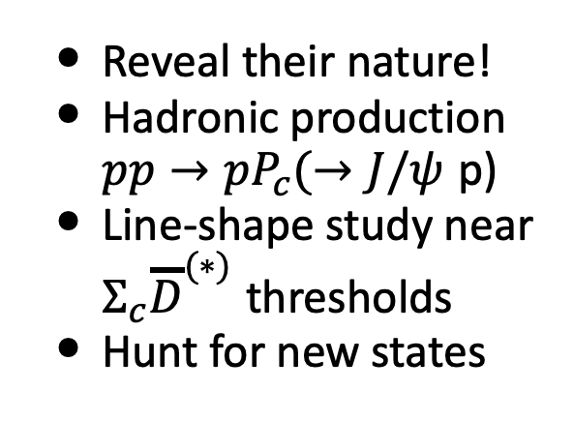
Charm Physics with Proton Beam at SIS100
  Charm-N interactions : SU(4) dynamics!
  Intrinsic Charm component of the nucleon
  Mass Structure of the proton
  Exotic baryonic-like states with hidden charm
?
  Reveal their nature!
  Hadronic production $pp→pP_{c}(→J/ψ$ p)
  Line-shape study near $Σ_{c}{\overline{D}}^{(∗)}$ thresholds
  Hunt for new states
SIS100 scan up to 6.6 GeV
Gluon rich production
Measure pJ/Ψ and ΣD

Slide 13
Day-1 Physics with Proton Beam at SIS100

Slide 14
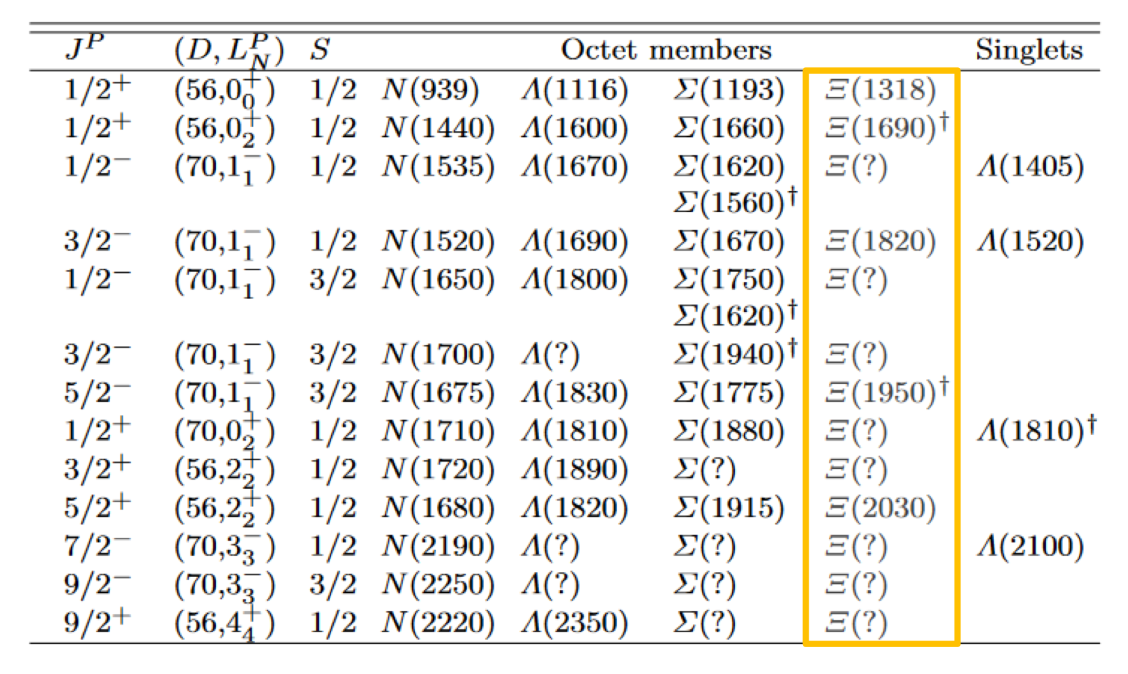
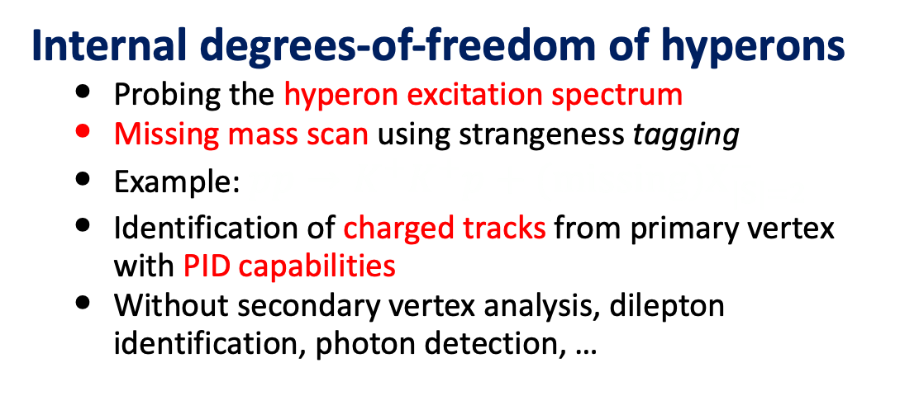
Day-1 Physics with Proton Beam at SIS100
Internal degrees-of-freedom of hyperons
  Probing the hyperon excitation spectrum
  Missing mass scan using strangeness tagging
  Example: $pp→K^{+}K^{+}p+(missing)X_{|S|=2}^{−}$
  Identification of charged tracks from primary vertex with PID capabilities
  Without secondary vertex analysis, dilepton identification, photon detection, …
Experimental conditions
  10 GeV protons (max MX=2.6 GeV)
  ~ 10⁸ protons/spill (duty cycle 50%)
  LH2 target (5 cm)
  CBM Dipole magnet+TRD+TOF+FSD
Estimates @MX=1.32 GeV
  Objective ~ 4k counts/day
  Resolution ~ 30 MeV
  Eff. x accept. 75% x 60% = ~ 45%
  —> Cross section sensitivity ~ 100 nb

Slide 15
Thank You !

Slide 17
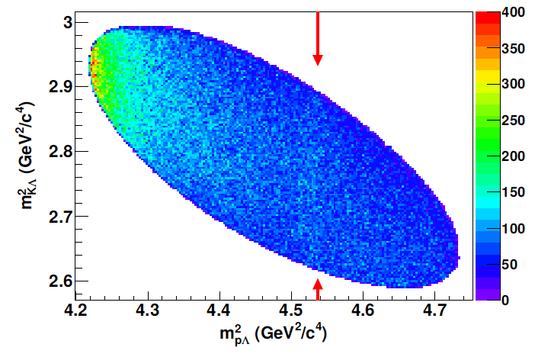
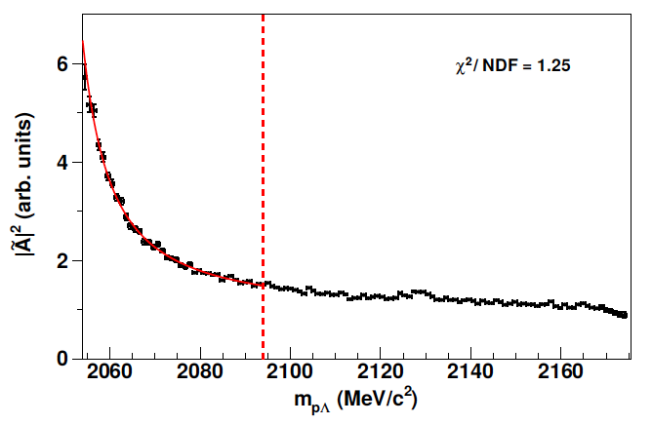
Strangeness Physics with Proton Beam at SIS100
Hyperon (Y) Spectroscopy in |S|=1,2,3 systems, e.g. $Ξ^{∗},Ω^{∗}$, spin-parity determination
N* Spectroscopy and coupling to strangeness, e.g. $pp{→p N}^{∗}→p (ΞKK)$
Low-Energy Constants in chiral SU(3) via axial-vector transition form factors, e.g. $Ξ^{∗}→Ξπγ$
YN, YY Interactions in exclusive pp reactions and via femtoscopy
Interest related to EOS and neutron star
Lots of progress in femtoscopy at LHC
Advantage of pp@CBM: less feed-down from higher Y*
Access via FSI in exclusive reactions
PRL114, 092301 (2015)
Phys. Rev. C 95, 034001 (2017)
Λ/Σ cusp
PRL123, 112002 (2019)
pp→pKΛ

Slide 18
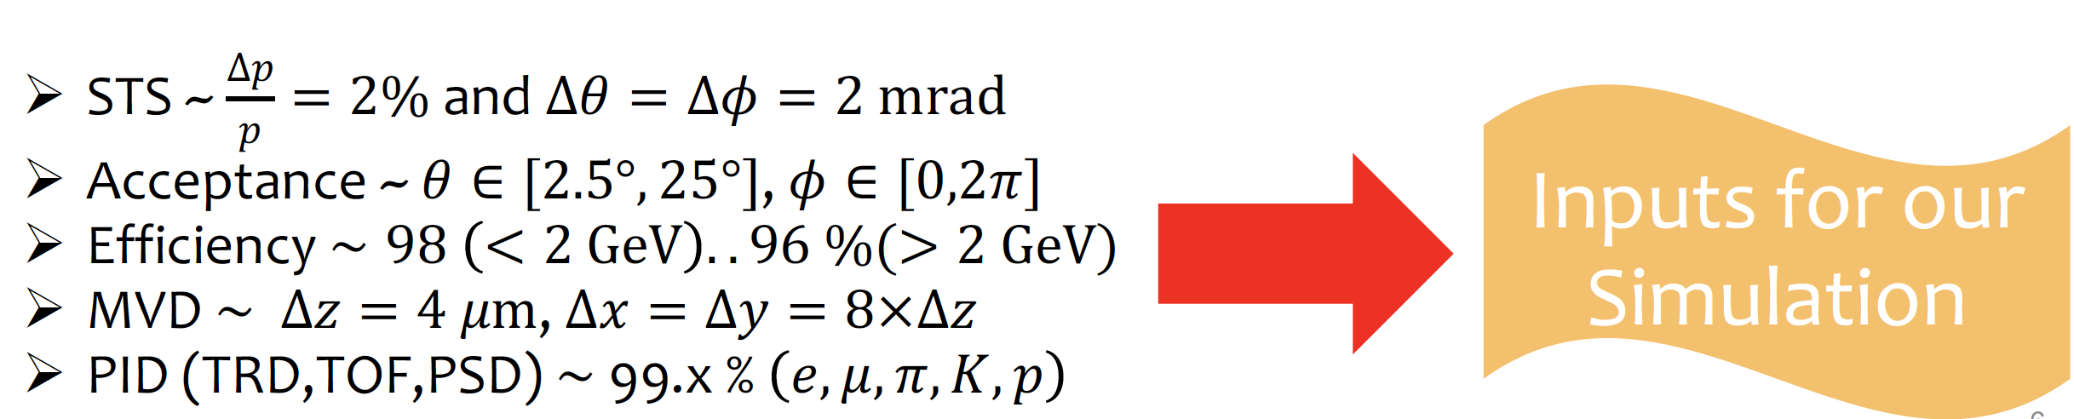
Charm Physics with Proton Beam at SIS100
  Fast Simulation

Slide 19
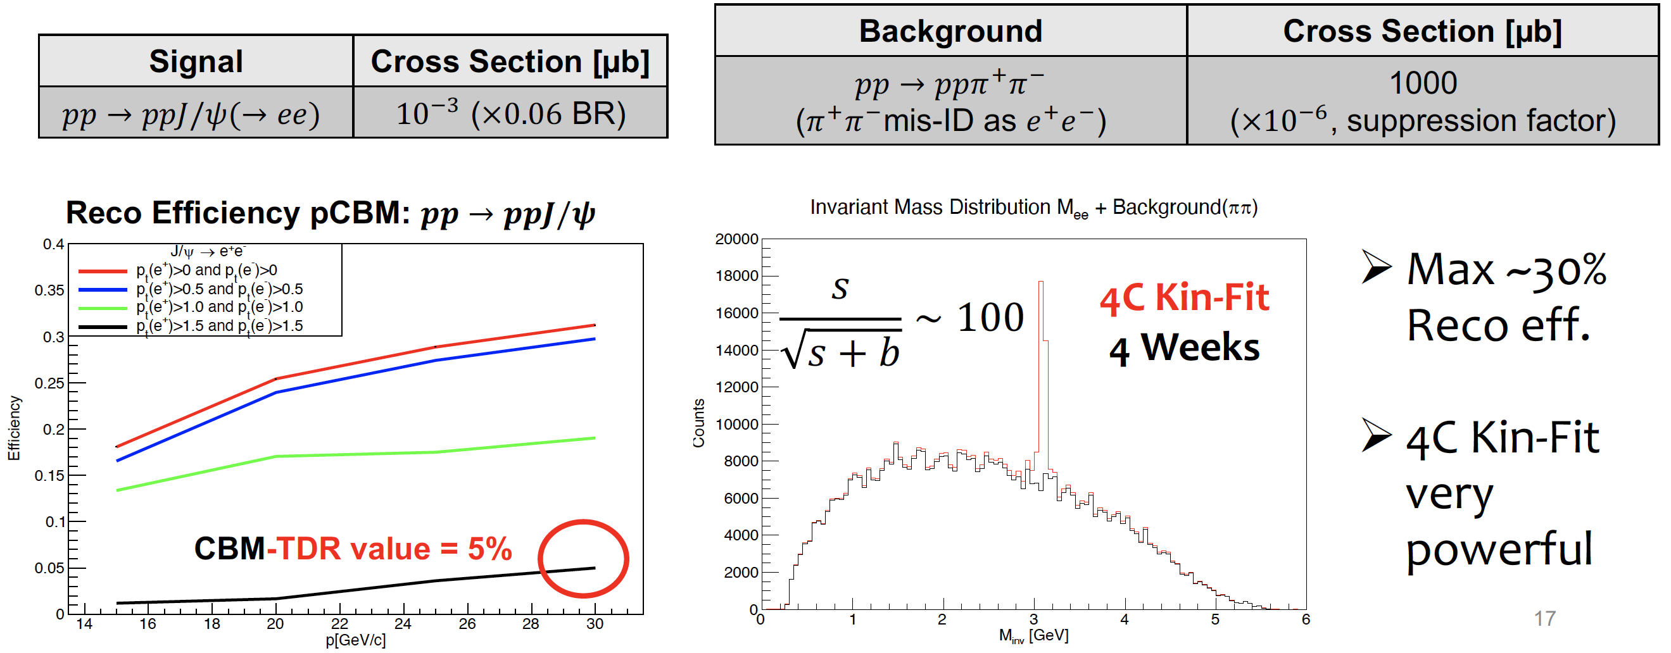
Charm Physics with Proton Beam at SIS100
  Fast Simulation
  Signal: 𝑝𝑝 → 𝑝𝑝𝐽/𝜓(→ 𝑒𝑒) 10⁻³𝜇b x 0.06 (branching ratio)
  Background: 𝑝𝑝 → 𝑝𝑝𝜋⁺𝜋⁻ (ppπ⁺π⁻π⁰) 10³𝜇𝑏 x 10⁻⁶(misID 𝜋⁺ & 𝜋⁻)
  10¹⁰ protons per spill (= 10 seconds)

Slide 20
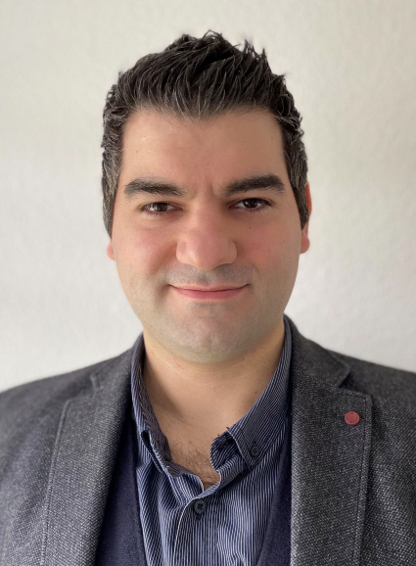
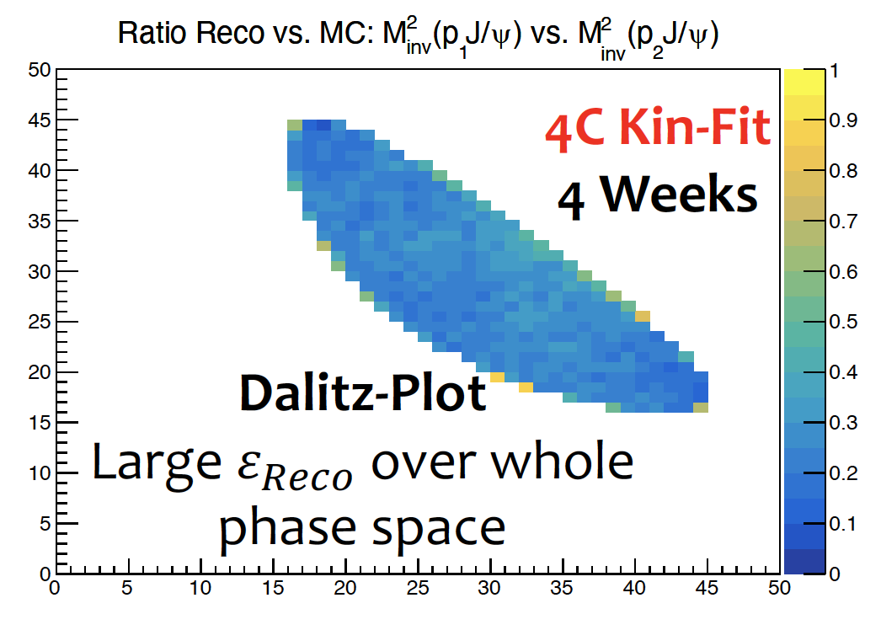
Charm Physics with Proton Beam at SIS100
  Fast Simulation
  Signal: 𝑝𝑝 → 𝑝𝑝𝐽/𝜓(→ 𝑒𝑒) 10⁻³𝜇b x 0.06 (branching ratio)
  Background: 𝑝𝑝 → 𝑝𝑝𝜋⁺𝜋⁻ (ppπ⁺π⁻π⁰) 10³𝜇𝑏 x 10⁻⁶(misID 𝜋⁺ & 𝜋⁻)
  10¹⁰ protons per spill (= 10 seconds) → 1100 reco events per day
Ömer Pennek
Ömer Pennek:
CBM FastSim

Slide 21
Physics Interest:
Exclusive Channels with Proton Beams
We need to measure high energy electrons → TRD
We need to measure particles with low momentum transfer → FSD
Basic /fast simulations ongoing, CBMROOT-simu started

Slide 22
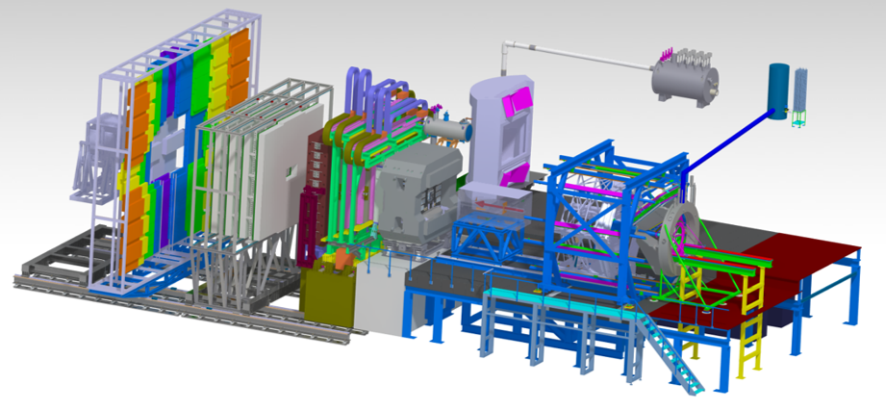
Detector Configuration Assumed
LH2 Target at entrance of Dipole (Uni Münster contacted)
Dipole
STS (MVD…)
RICH
TRD
TOF
FSD
Beamline…
Additional trackers ?

Slide 23
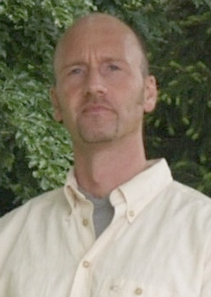
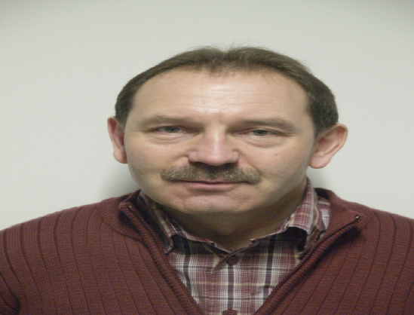

Contributions of FFN to CBM
Gas system for the TRD Detector
- ongoing communication with Uni-MS, Uni-F
Light Readout and Calorimeter for the FSD
- ongoing communication with Prague groups
Simulation/Analysis Software Framework
Peter Wintz
+(Nikolay P.)
Dieter Grzonka
+Dachi Okropiridze
Tobias Stockmanns
+ many

Slide 25
Σ/Λ CUSP
pΛ
Flatte

