Slide 1

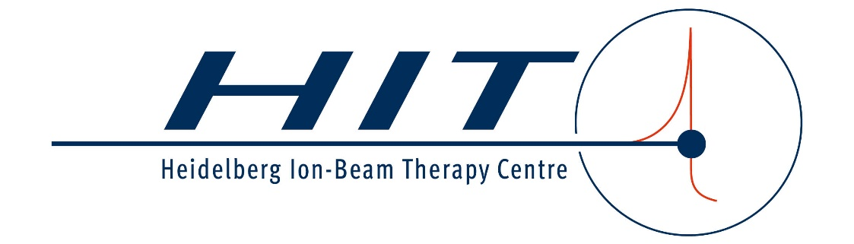
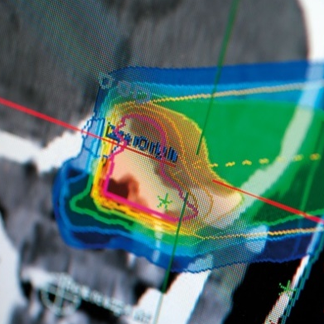
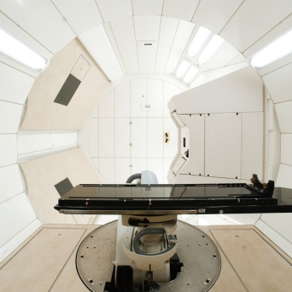
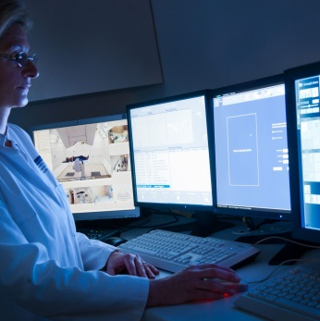

Heidelberg Ion-Beam Therapy Centre
Overview
SX-Workshop 02/2024

Slide 2
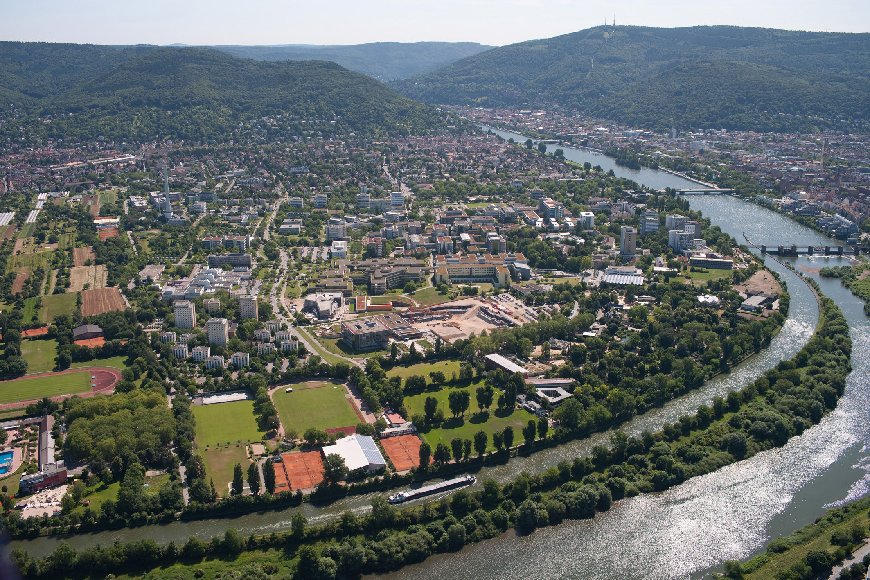

Slide 3
HIT
History – beam parameters – patients
Successor of GSI pilot project (> 400 pat.)
1st hospital based IMPT-facility in Europe
≈ 700 patients/year since 2009
Total No. of patients treated > 8000
≈ 40 % gantry, 60 % horizontal
Large variation of beam parameters
Carbon / Protons:
  50 / 50 (patients)
  1⁄3 / 2⁄3 (fractions)
Helium:
  3 Patients have been treated with until end of 2023 (compassionate use)
  Regular treatments with Helium will most likely start in 2024.
Therapy Beams | Energy [MeV/u] | Intensity (typical) [particles/s] | Beam Size (FWHM) [mm]
Protons | 48 – 221 | 3.2 ∙ 10⁹ | 8 – 33
⁴Helium²⁺ | 50 – 221 | 8 ∙ 10⁸ | 5 – 21
¹²Carbon⁶⁺ | 89 – 430 | 8 ∙ 10⁷ | 3 – 13
¹⁶Oxygen⁸⁺ | 104 – 430 | 4 ∙ 10⁷ | 3 – 13

Slide 4
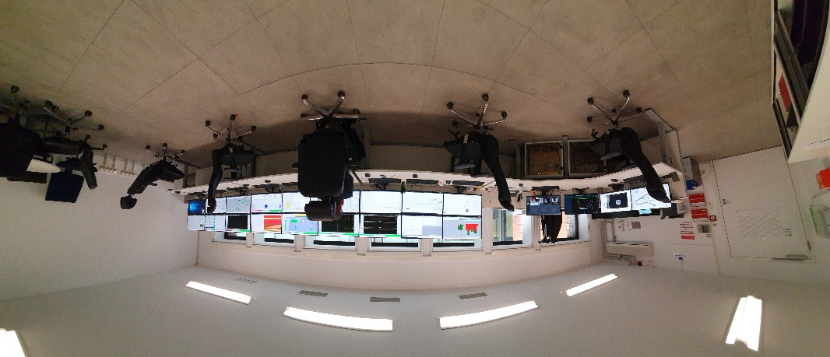
HIT – Operating concept
Accelerator team: ~20 people
  Physicists, engineers, technicians
  2 accelerator operators on-site, 24/7
  On-call duty for each maintenance group
Availability of accelerator:
  > 330 days of operation per year
  1 shutdown Christmas – 1st week in January
  5 maintenance blocks 2 days each
  12 single maintenance days

Slide 5
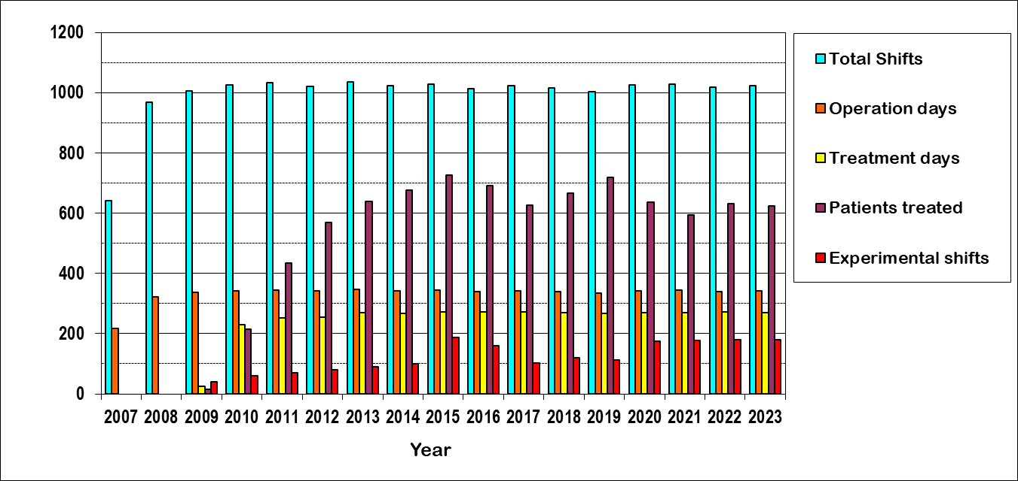
HIT statistics days, shifts, patients
Constant high number of
  Total shifts
  Operation days
  Patients
  Experimental shifts
Patient dips:
  MIT-dip
  Covid-19
  Lack of skilled personnel

Slide 6
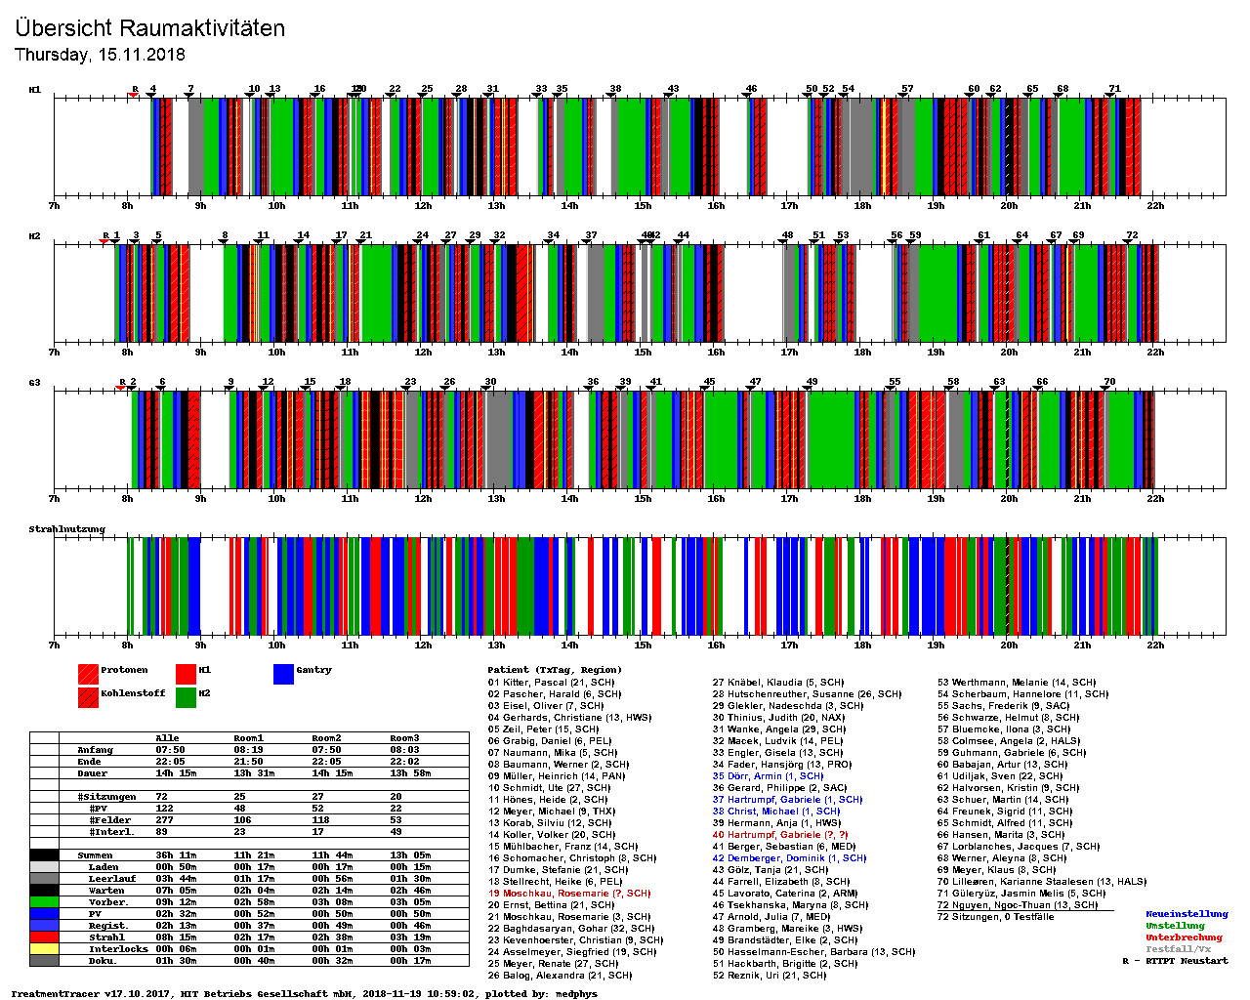

Typical therapy day @HIT
AccQA
Med. Phys.QA
Patient treatment
QA,
Plan Verific.
R & D
or
Beam adjustment
6h 8h 10h 12h 14h 16h 18h 20h 22h 24h 2h 4h
H1
H2
Gantry
Room activity
(15th Nov. 2018)
71 patients

Slide 7
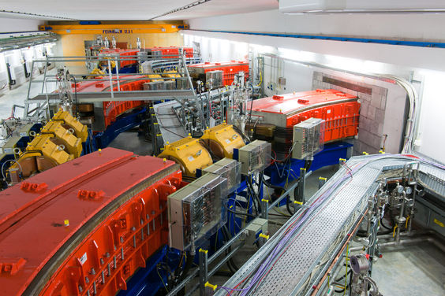
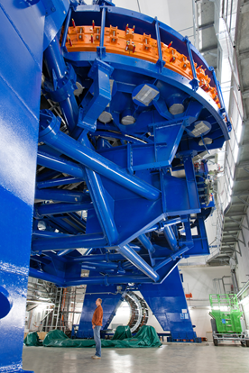
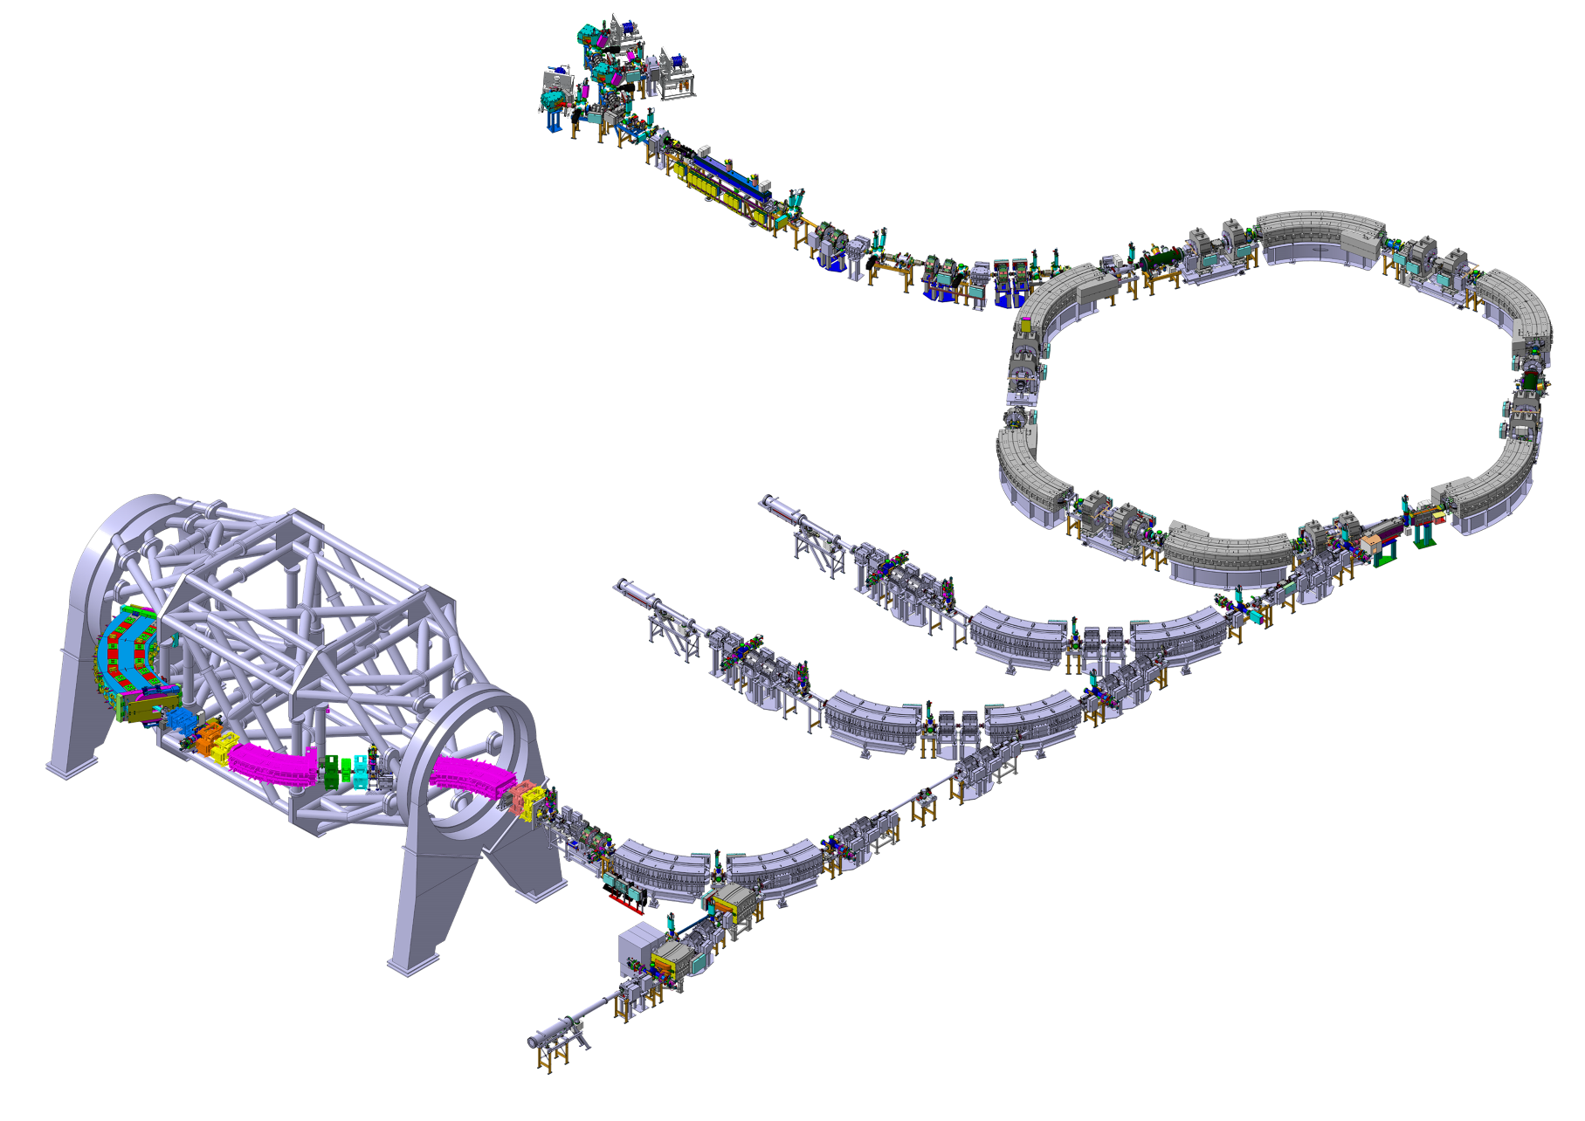
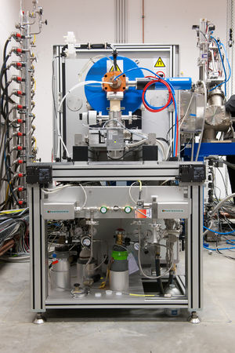
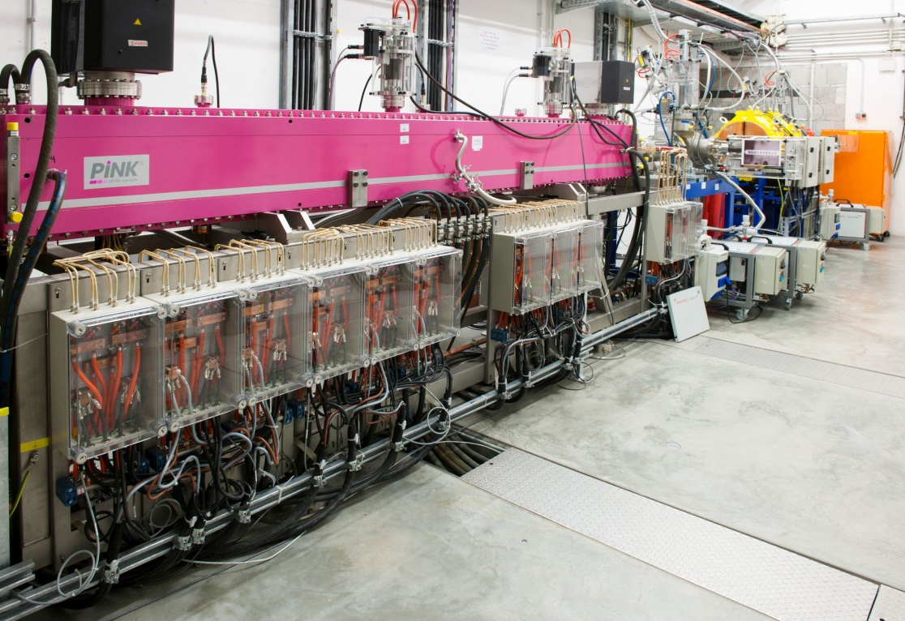
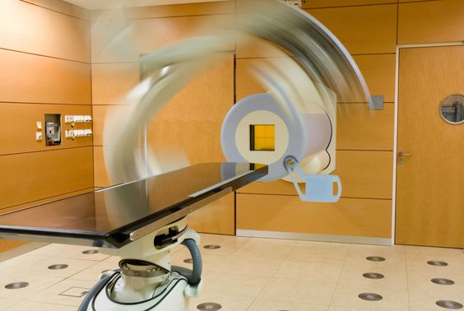
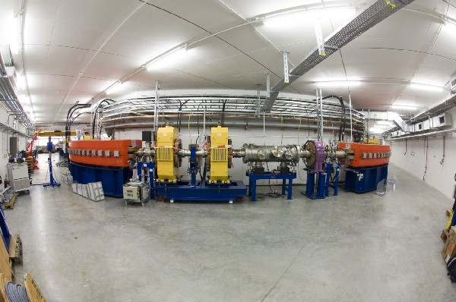
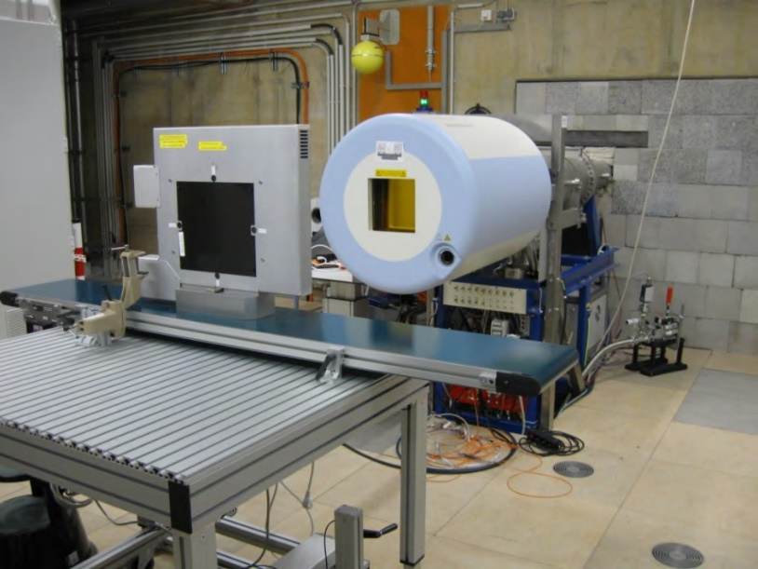
Facility design
Accelerator layout
Sources
Injector LINAC
Treatment room
Synchrotron,
(48 - 430 MeV/u)
Beam transport Beam shaping
Abort systems
Experimental room

Slide 8
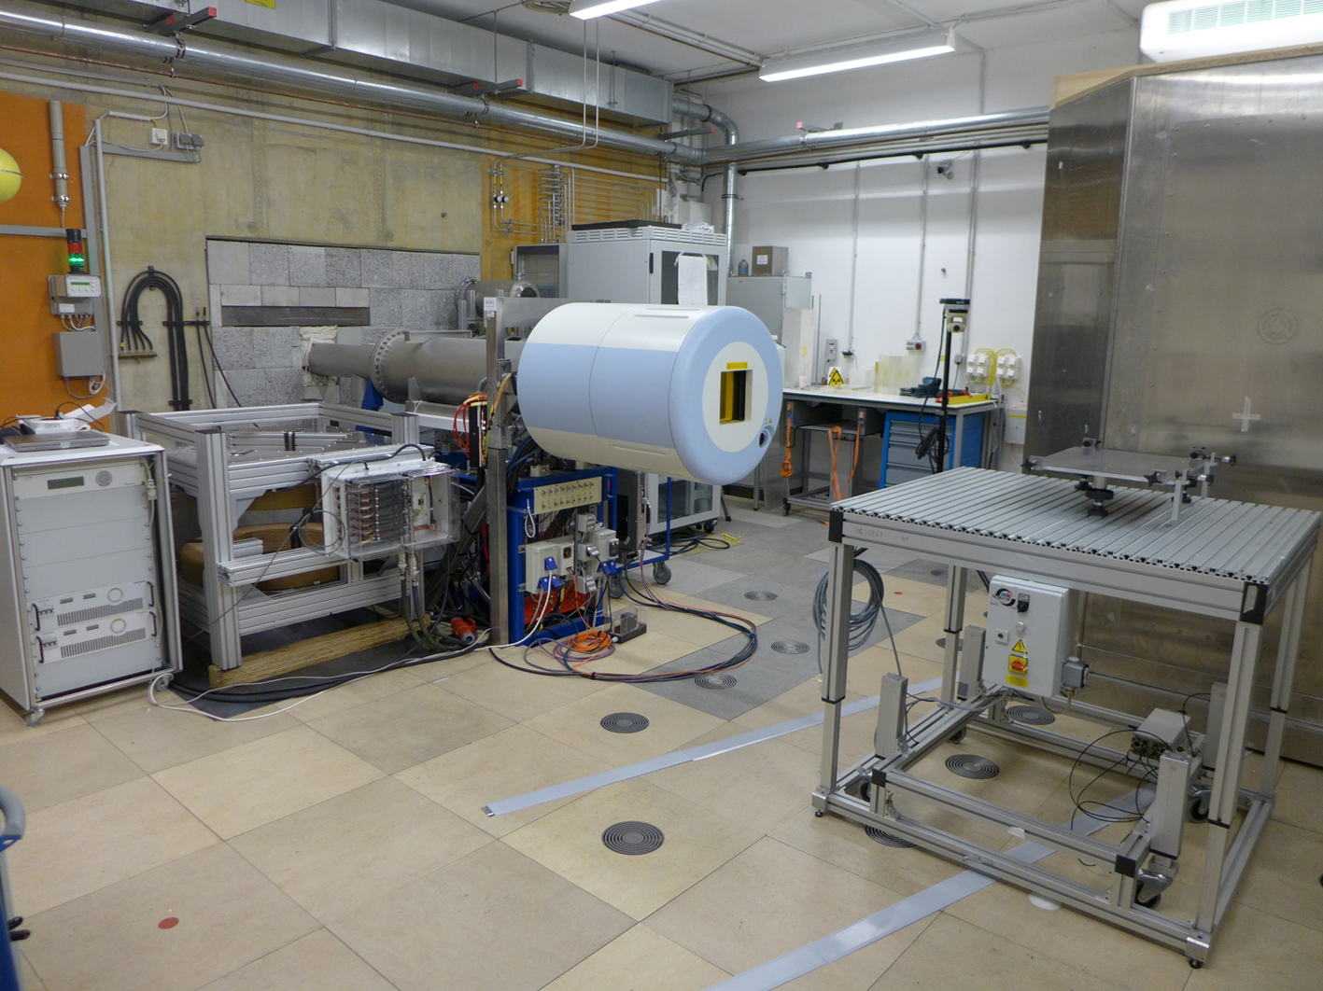
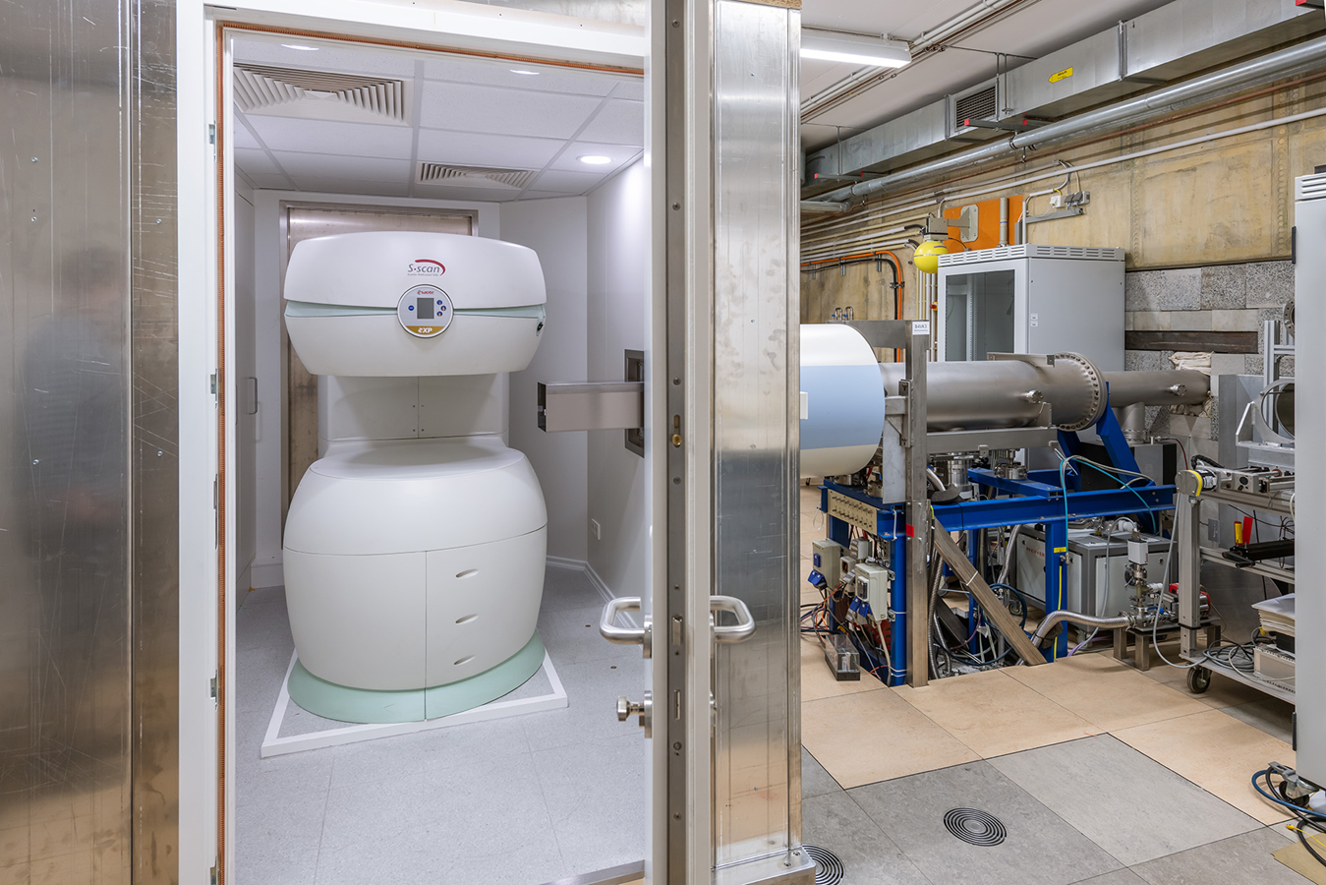
HIT accelerator serving experiments
BUT: More flexibility allowing for non therapeutic settings:
User specific beam parameters (energy, intensity, width, …)
Interlock-masking
Settings in dose delivery system (e.g. gas supply)
Higher energy than used in therapy (e.g. Protons up to 480 MeV)
The experimental room
Equipment widely identical to horizontal treatment rooms:
Raster scanning system
Position correction, dynamic intensity control
Beam application and monitoring system (BAMS)
In-room laser positioning system
Selection of
experiments @ HIT
Detector research
Radiation hardness
Cell / animal irradiation
Dosimetry and radiography
Nuclear fragmentation and cross-sections
…
0.1 T big bore 60 cm Helmholtz coil
0.25 T movable device for MRI (magnetic resonance imaging)
Both to study MR guided ion beam therapy.

Slide 9
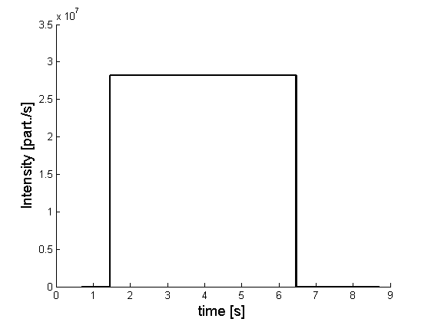
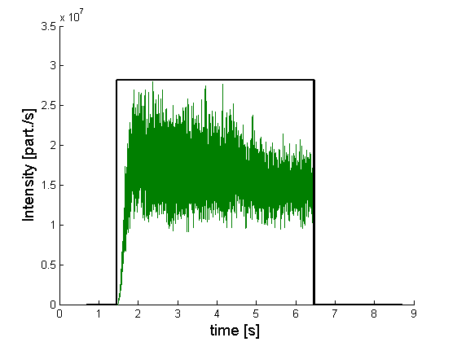
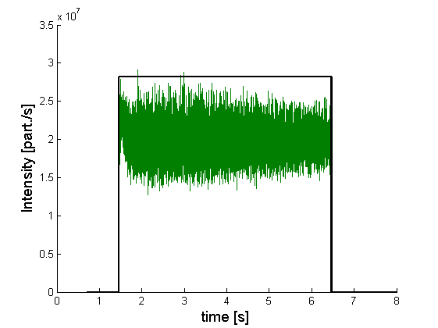
Extraction system: RF knock-out
More Details about the particular excitation, frequencies, hardware and
recent improvements achieved in the spill structure in the talks of Eike Feldmeier and Cristopher Cortés this afternoon.
RF-Knockout-Exciter parameters
Horizontal resonance tune: 1.67
RF-KO electrode length: 0.7 m
RF-KO electrode distance: 0.15 m
Maximum exciter power: 400 W
Intensity feedback system implemented (dose delivery system ↔ RF-KO exciter)
Ideal - flat
Typical RF-KO
Intensity controlled

Slide 10
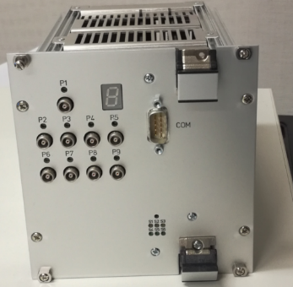
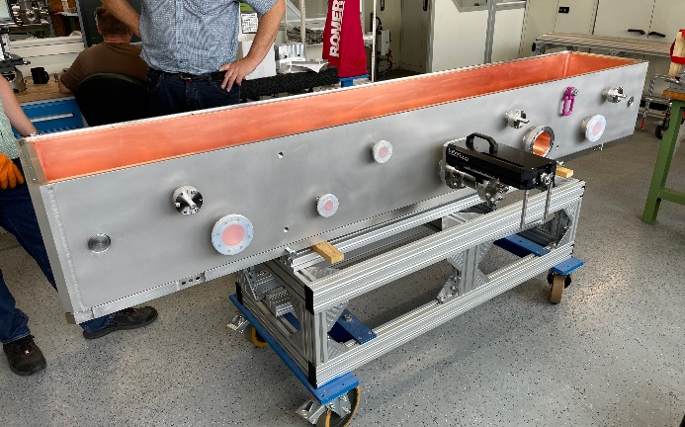

HIT – other current projects
B
IES #3
IES #2
IES #1
t
Control system upgrade
  To allow for multi energy operation
  Necessary: new frontend controllers
New RFQ
B
IES #2
IES #3
IES #1
t
Order given to BEVATECH GmbH end of Nov. 2022
Project duration: 3 years
Electrode design in progress
Input beam (twiss parameter) provided by HIT (based on pepper pot measurements in LEBT)
H. Höltermann†, H. Hähnel, B. Koubek, H. Podlech, U. Ratzinger TUNING AND RF MEASUREMENTS OF THE LILAC RFQ Proc. of 15th Int. Conf. on Heavy Ion Acc. Technology HIAT2022, Darmstadt, Germany
LILac/NICA-RFQ

Slide 11
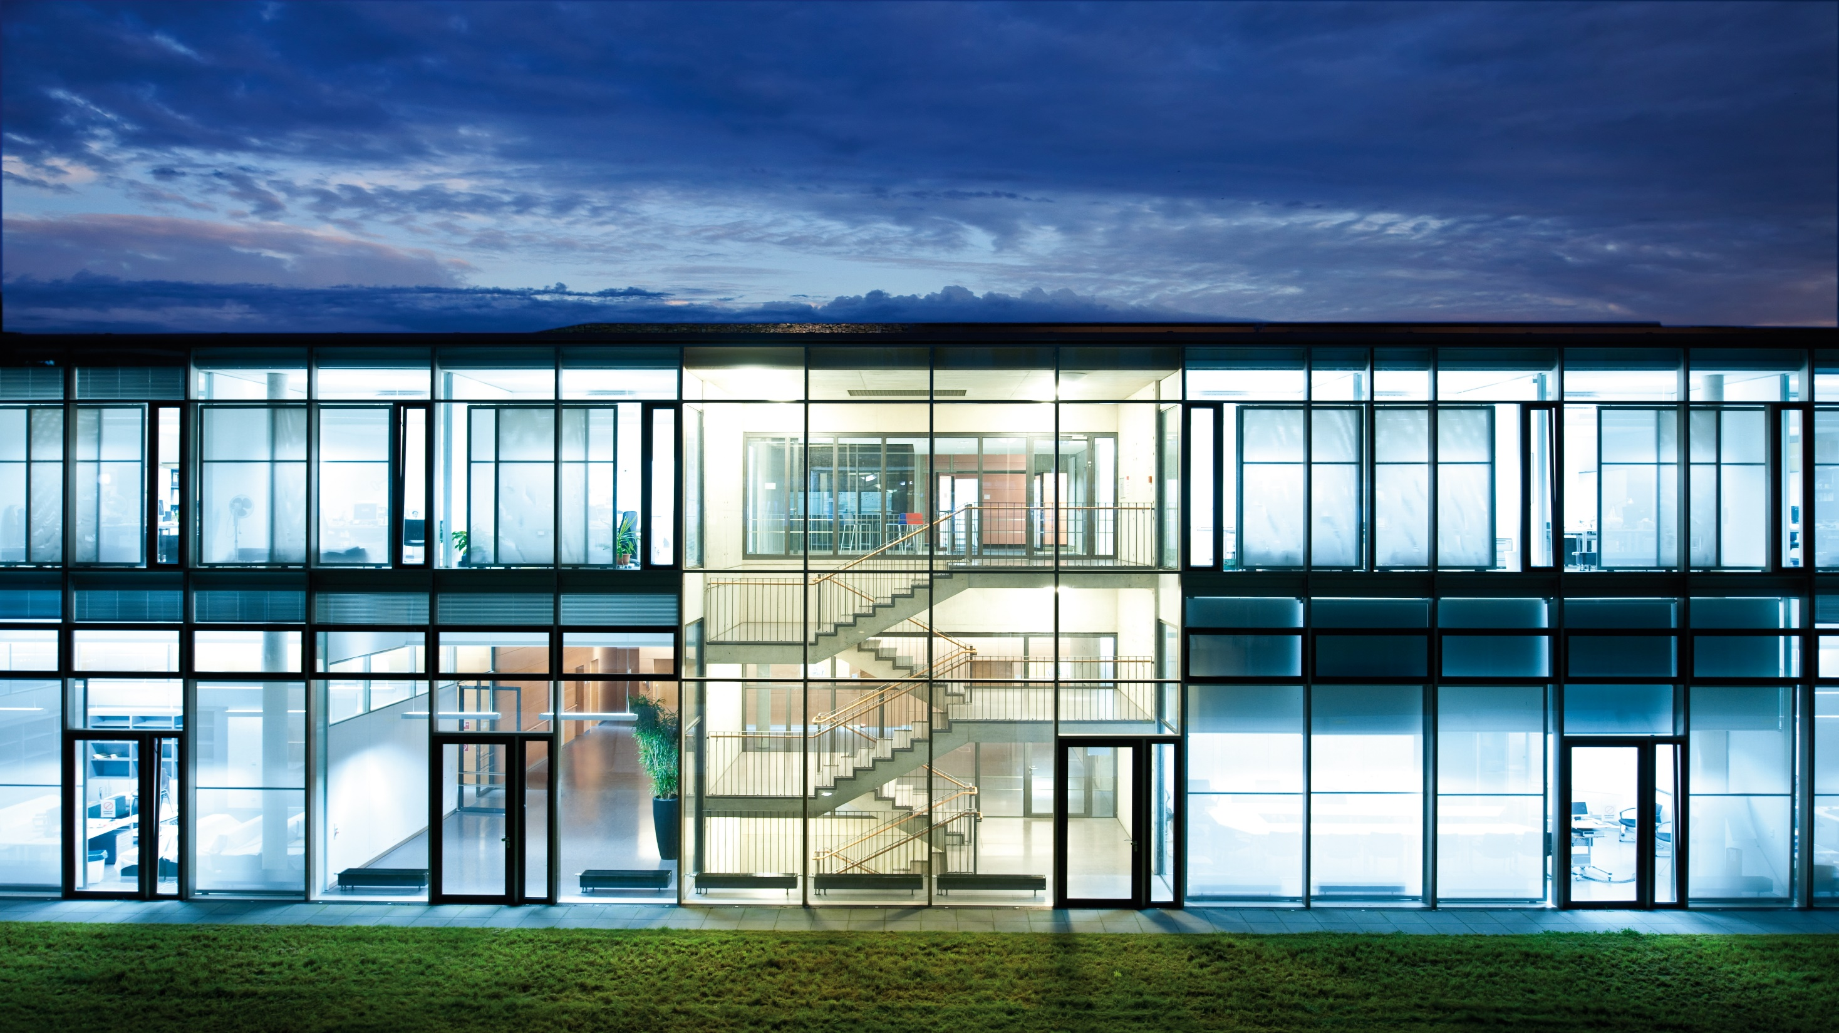
Thank you!
M. Galonska et al. "Multi-Energy Trial Operation of the HIT Medical Synchrotron: Accelerator Model and Data Supply." Proc. of IPAC2017, Copenhagen.
C. Schoemers et al. "Reacceleration of ion beams for particle therapy." Proc. of IPAC2014, Dresden.
H. Höltermann†, H. Hähnel, B. Koubek, H. Podlech, U. Ratzinger TUNING AND RF MEASUREMENTS OF THE LILAC RFQ Proc. of 15th Int. Conf. on Heavy Ion Acc. Technology HIAT2022, Darmstadt, Germany

