Slide 1
Bmad Based Particle Tracking Simulation for Slow Resonant Extraction
Presenter : Bhawin Dhital¹ bdhital@bnl.gov
Thanks to : Kevin Brown¹, David Sagan², Eiad Hamwi², Georg Hoffstaetter², Lucy Lin²
¹Brookhaven National Laboratory, Upton NY 11973
²Cornell University, Ithaca, NY 14850
Date : February 14, 2024
2024 Slow Extraction Workshop, MedAustron

Slide 2
Outline
Booster Synchrotron and NASA Space Radiation Facility
Third integer Resonant Extraction
Bmad
  Introduction
  Slow Extraction Simulation: Long term tracking based on Bmad ecosystem
Future Work

Slide 3
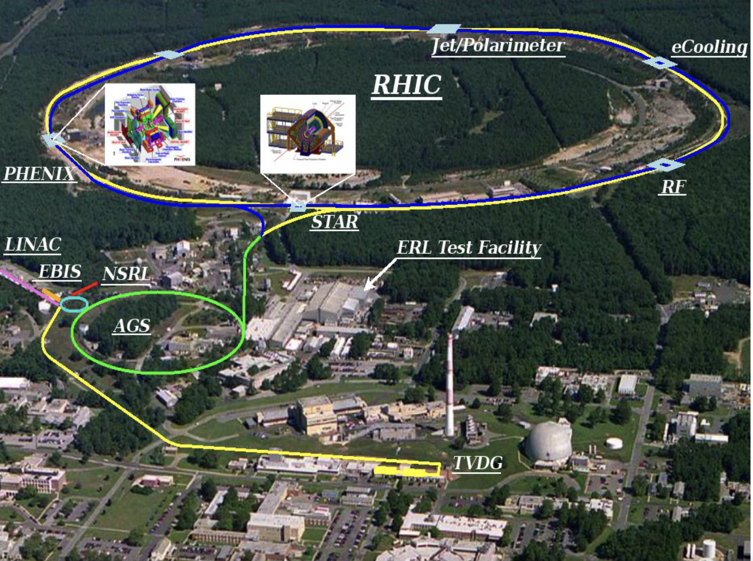
BNL C-AD Complex

Slide 4
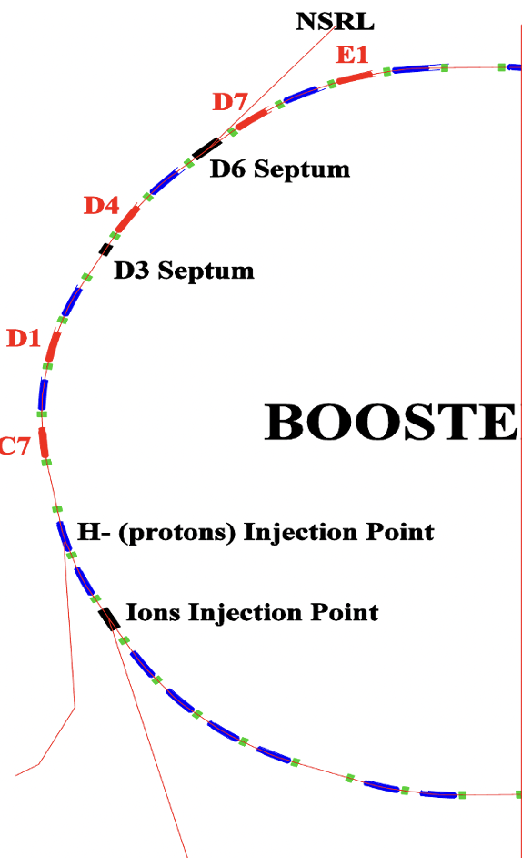
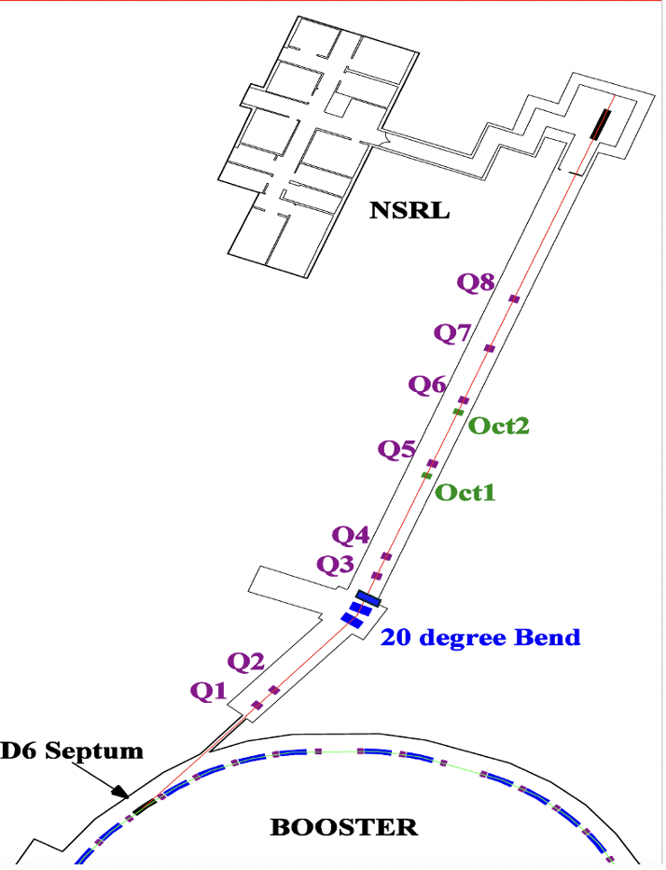
Booster Synchrotron and Slow Extraction

Slide 5
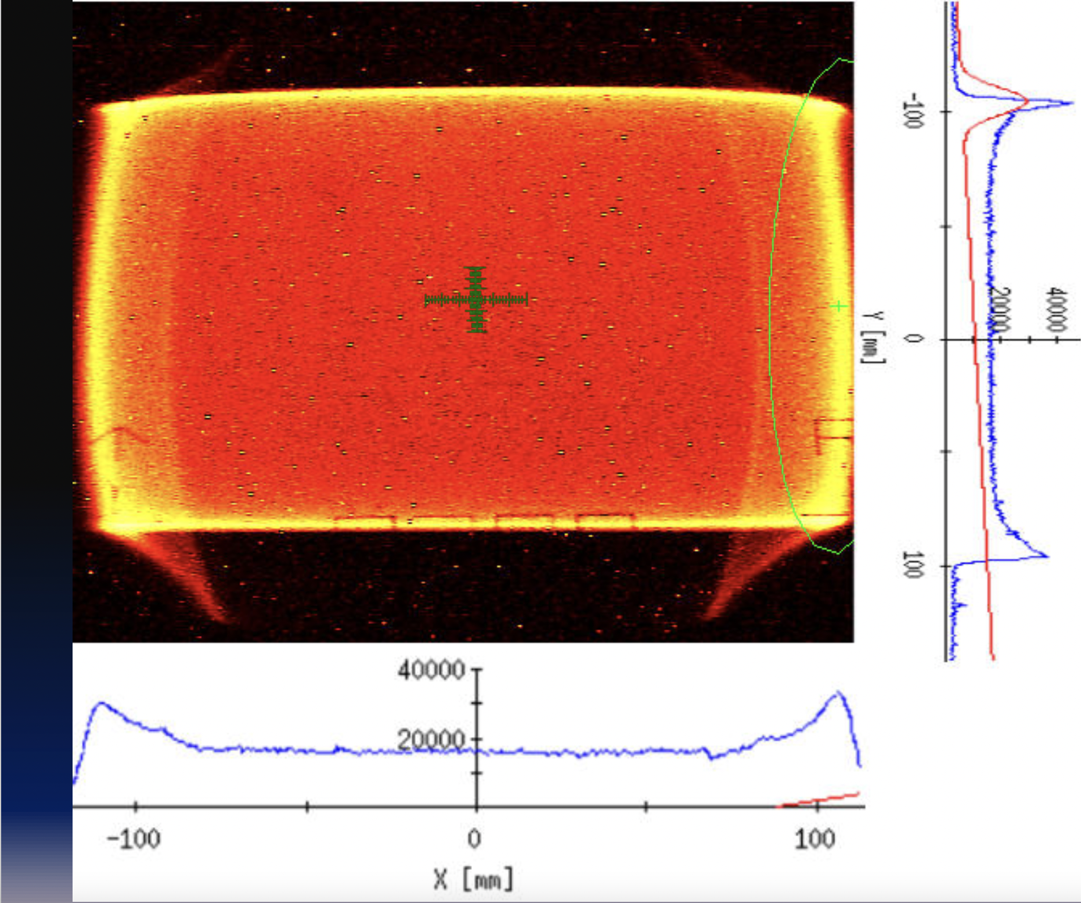
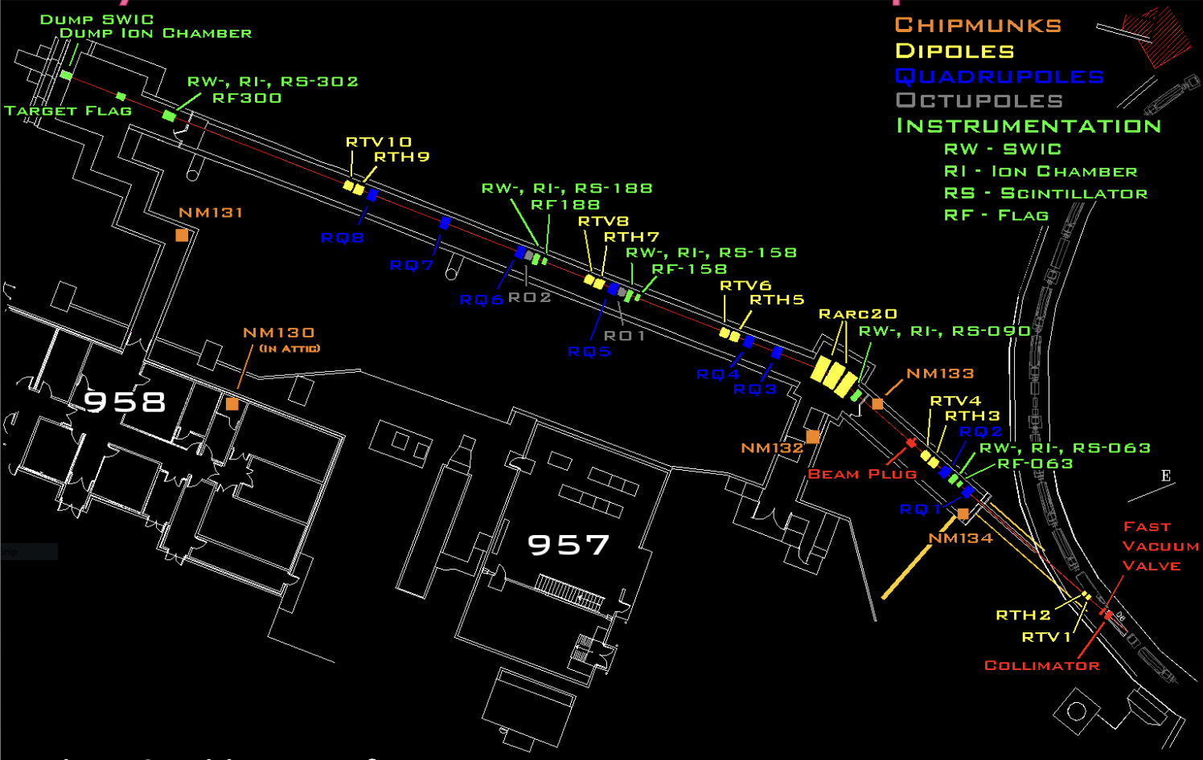
NSRL Transport Line and Uniform Beam
Uniform beam at the target
Layout of NSRL Transport Line
A pair of octupoles to create a uniform beam.
9 quadrupoles to focus the beam.
3 bends magnets providing 20-degree bends.
Dipole correctors to center the beam profile along the transport line

Slide 6
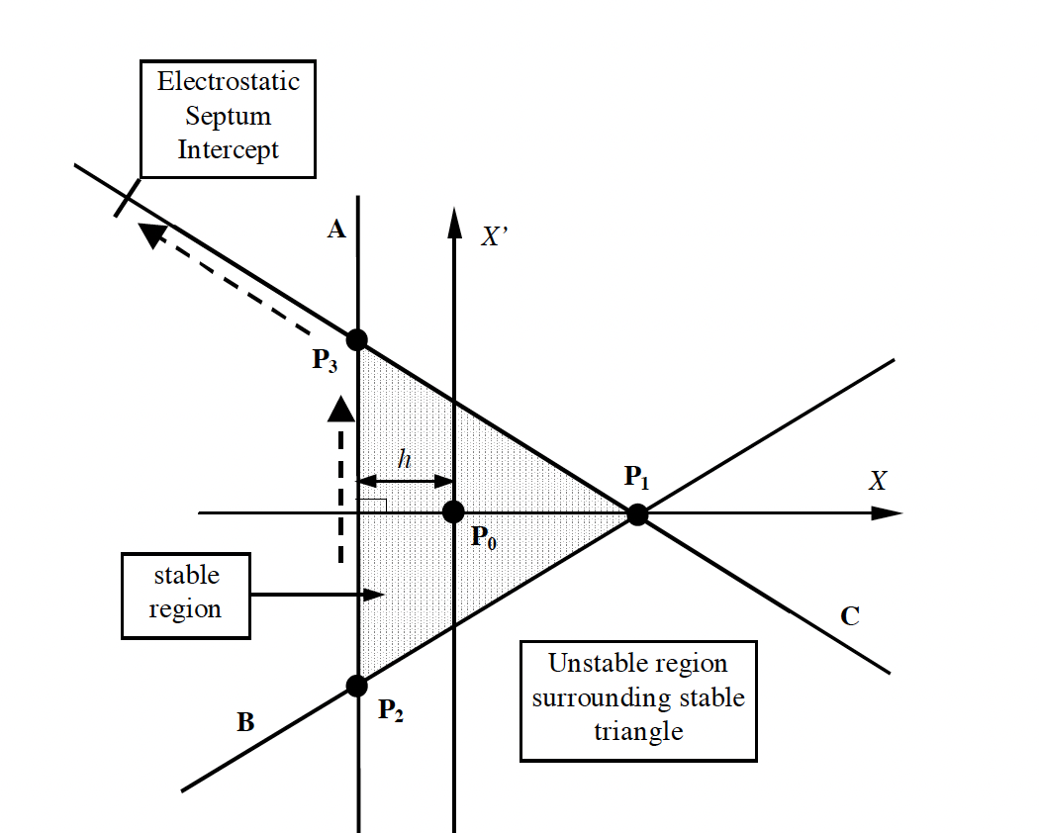
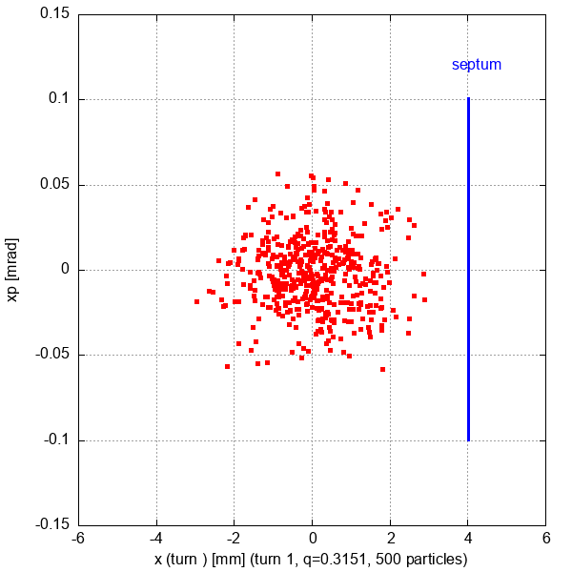
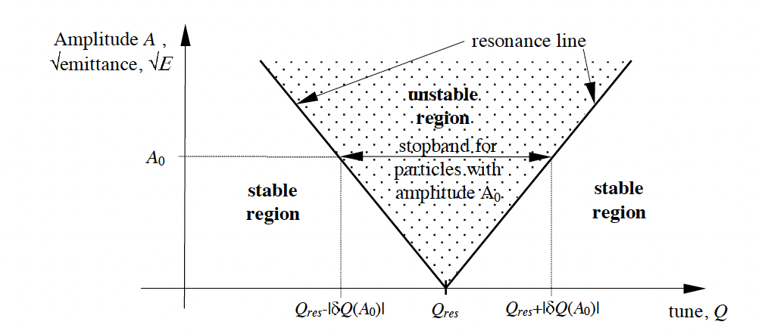
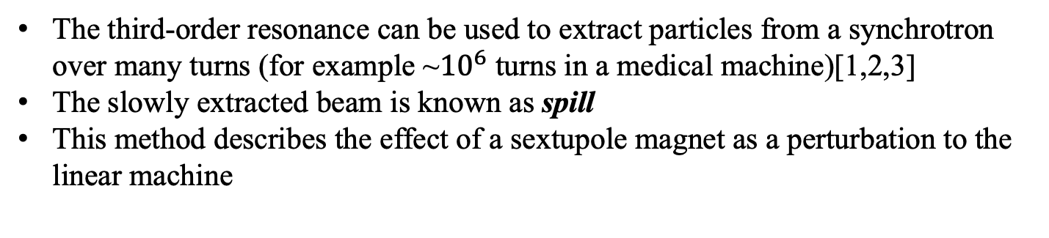
Third Order Integer Resonance
The third-order resonance can be used to extract particles from a synchrotron over many turns (for example ~${10}^{6}$ turns in a medical machine)[1,2,3]
The slowly extracted beam is known as spill
This method describes the effect of a sextupole magnet as a perturbation to the linear machine
Courtesy of Todd Satogata

Slide 7
What is Bmad?
Bmad (otherwise known as “Baby MAD” or “Better MAD” or just “Be MAD!”)
Bmad is an ecosystem of toolkit (subroutine library) for charged-particles and X-Ray simulations in accelerators and storage rings.
Bmad can be used to study both single and multi-particle beam dynamics as well as X-rays.
Bmad modules have been developed for simulating a wide variety of phenomena including intra beam scattering (IBS), coherent synchrotron radiation (CSR), higher order mode (HOM) resonances, etc., etc.
https://www.classe.cornell.edu/bmad

Slide 8
Long Term Tracking Program
Long term-tracking program based on Bmad is for long term (over many turns) tracking of a particles or a beam in a ring.
This program can track spin as well as simulate such things as element misalignment, wake fields, higher order mode cavity resonances, energy ramping, beta squeezing, etc.
More on long-term tracking program:
  https://github.com/bmad-sim/bmad-ecosystem
  https://www.classe.cornell.edu/bmad/manuals/long_term_tracking.pdf
Long-term tracking program comes in two versions:
  Long_term_tracking !single threaded version
  Long_term_tracking_mpi ! Multi-threaded version

Slide 9
Slow Extractions Simulation Set-Up
Tune ramping : It is the situation where the lattice tune (horizontal) is changing as a function of time over many turns (Increase the lattice tune close to the 1/3rd resonance tune, 4.333).
For the given sextupole strength, we ramp quadrupoles only
RAMP_V: ramper = { &
QV*[k1]: {-0.55745759507754+0.01065, -0.55745759507754+0.01067}}, &
x_knot={0, 1500*1.53446684E-06}, &
var = {time}, interpolation = linear !(dk=0.00002)
RAMP_H: ramper = { &
QH*[k1]: { 0.5634045207707-0.037, 0.5634045207707-0.0374}}, &
x_knot={0, 1500*1.53446684E-06}, &
var = {time}, interpolation = linear !(dk=0.0004)
DRIVE_SEXTUPOLES: group = {SHB4[k2]:dk, SHC8[k2]: -dk, SHE4[k2]:-dk, SHF8[k2]: dk}, var ={Dk}, dk = 26

Slide 10
Long Term Tracking: Simulation Modes
1. Simulation mode = ‘SINGLE’
2. Simulation mode = ‘INDIVIDUAL’
Simulation mode = ‘SINGLE’
  - We take a single particle with certain amplitude and run for many turns.
  - For a small amplitude particle, we need longer tracking (large number of turns).
2. Simulation mode = ‘INDIVIDUAL’
- Many particles are taken in simulation.
- Define beam emittance, beam position, and dp/p.
- Define septum location where extracted particles are collected.
- Output file has (x,xp) coordinate of the extracted particles.

Slide 11
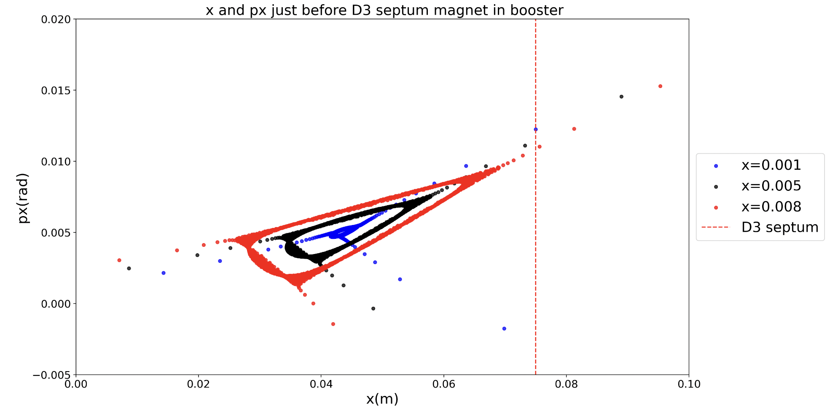
Simulation Mode = “Single”
3 particles passing into resonance at the booster D3 septum

Slide 12
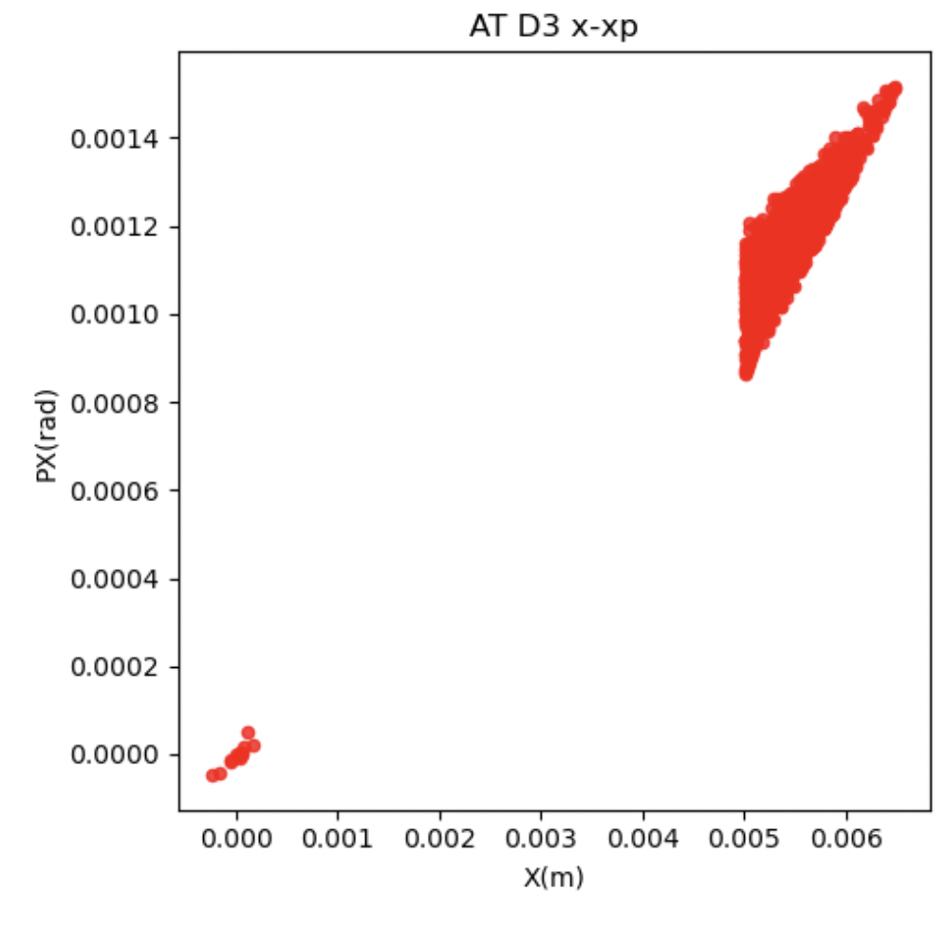
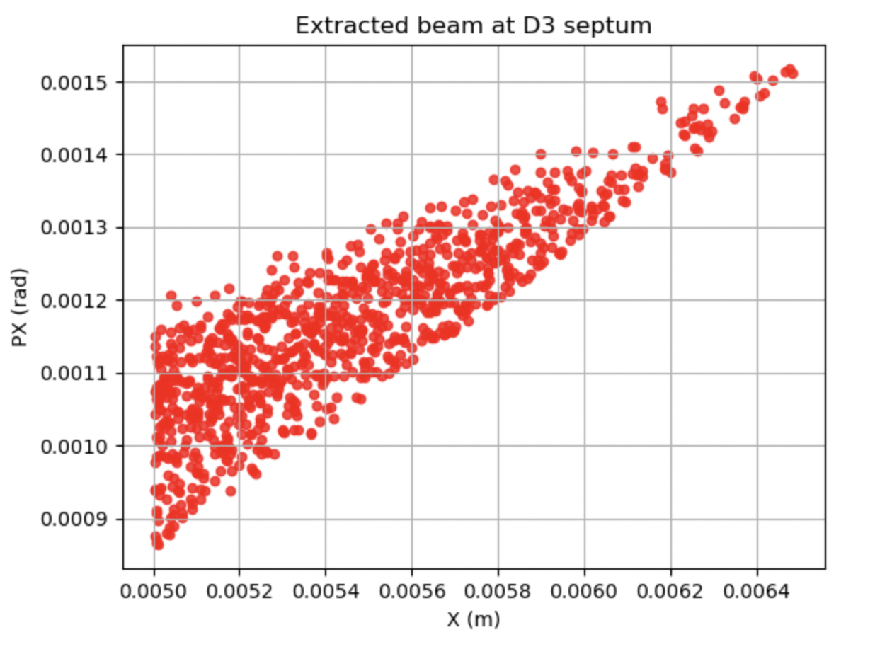
Simulation Mode = “INDIVIDUAL”
D3 thin septum
Extracted particles at D3 septum location in the booster ring

Slide 13
Extraction Simulation
An extraction simulation involves tracking particles for some number of turns in a ring and then tracking particles through an extraction line.
Extraction simulation can be used with “BEAM” or “INDIVIDUAL” mode.
“INDIVIDUAL” simulation mode assumes there is a septum and that particles outside of the aperture set for the septum are to be tracked through the extraction line.
Extraction simulations provides the complete simulations: starting from the synchrotrons (multi-turn)→extraction at septum →transfer towards transfer line (single turn).

Slide 14
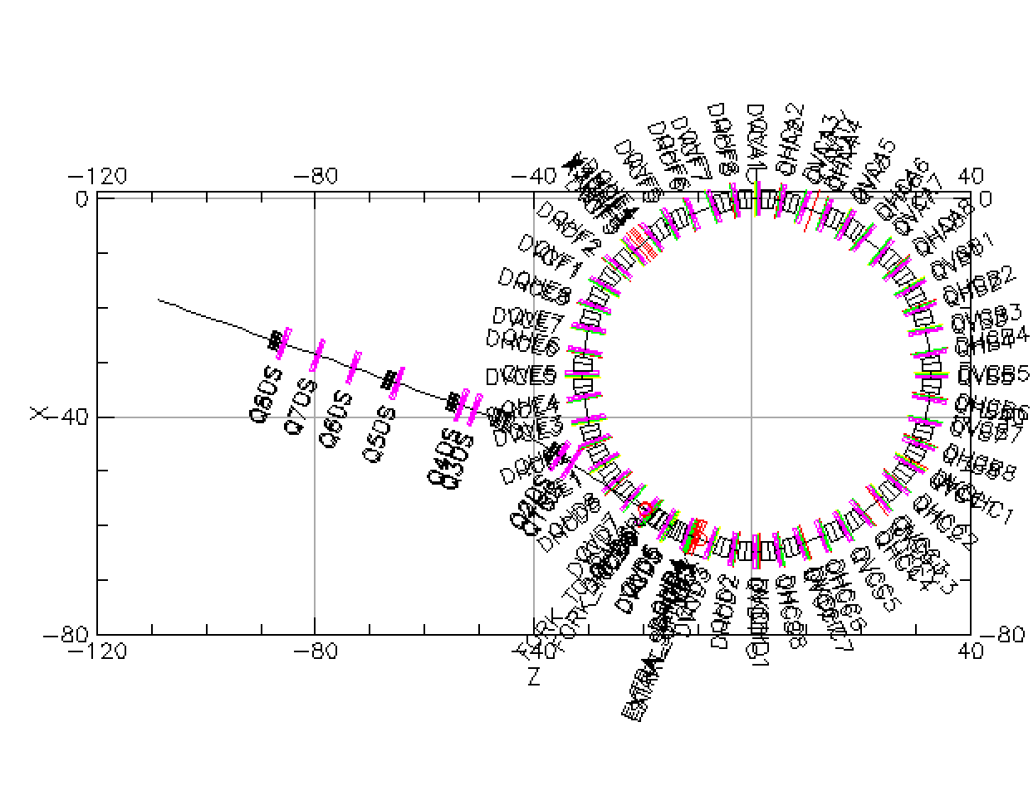
Branch, Fork and Patch
A lattice contains an array of branches and can be interconnected using forks: used to simulate forking beam lines such as a connections to a transfer line, dump line, or an X-ray beam line
Fork marks the start of a new/downstream branch for the beam
Downstream branch inherits the beam information at the end of the root/base branch
Patch element is used to shift the reference orbit
Connecting booster ring with transfer line using fork and patch elements in Bmad

Slide 15
Future Work using Bmad
A complete slow resonant extraction simulation using a long- term tracking program based on Bmad.
Implementing scattering foil in the beam line and particle tracking through foil.
NSRL beam line model optimization using Bmad.

Slide 16
References
[1] https://www.osti.gov/servlets/purl/1805240
[2] https://www.classe.cornell.edu/bmad/
[3] https://www.classe.cornell.edu/bmad/manuals/long_term_tracking.pdf
[4] https://www.bnl.gov/nsrl/
[5] https://journals.aps.org/prab/abstract/10.1103/PhysRevSTAB.10.024701
[6] https://www.bnl.gov/rhic/booster.php

