Slide 1
Development of an RF system
Slow Extraction Signal Generation and Measurement

Slide 2
The story Behind the DeveloPment
New project in the middle east in need of RF cavity and beam regulation
End of Life notifications for old LLRF systems
Multiple designs with different interfaces to the MedAustron Control System
A new LLRF design is needed!

Slide 3
Wishlist
One LLRF to rule them all
Off the Shelf Hardware
Increased Diagnostic Capabilities
Injector
Cavity Regulation at 216MHz
Reflected power Interlock
Cavity Tuning Control
RF Knockout
Signal generation close to the Tune frequency
Modulation schemes
AM, FM, PM
Cavity regulation?
Intensity modulation/regulation?
Synchrotron
Cavity Regulation at 400kHz – 10MHz
Beam Control (phase loop, radial loop)
Beam Diagnostic
Injection Energy (Time of Flight)
Synchrotron Longitudinal Phase
Synchrotron Beam Position
Schottky Measurements?
Synchrotron Beam Tomography?

Slide 4
What we came up with

Slide 5
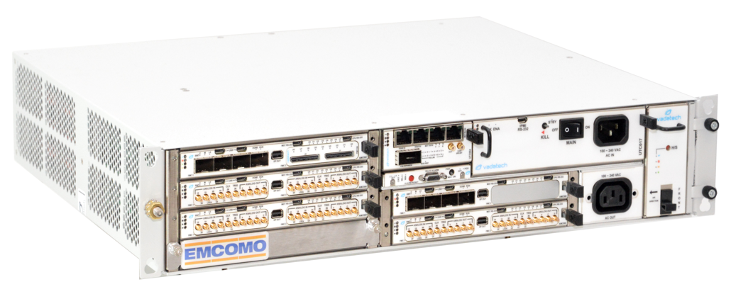
Hardware
Off the Shelf Vadatech mTCA based
AMC560 Carrier Boards
Zynq Ultrascale+ SOC
FMC231 AD/DA conversion boards
4 Channel 1GSps ADC
4 Channel 2.5GSps DAC
FMC155/FMC105 communication boards
SFP/SFP+
GPIO/LVDS
RS485/Modbus

Slide 6
System architecture Implemented together with Instrumentation Technologies

Slide 7
Signal Sampling / Generation
Direct Sampling, Direct Digital Synthesis
NCO Based Frequency Generation
Multiple Harmonics available for each NCO
I/Q Modulation/Demodulation for Baseband Signal treatment
Translated to Amplitude and Phase for the User
Sequencers / Function Generators available for all modulation inputs (frequency, amplitude, phase)
Update rates up to 10MSps for the Function Generators
Scaling and adjustment of modulation inputs available (e.g. frequency adjustment from the radial loop)
PI Controllers for Cavity, Beam Phase and Radial Position regulation

Slide 8
Time of Flight – Beam Energy measurement

Slide 9
Position Measurement

Slide 10
Schottky Measurement

Slide 11
RF Knockout Modulation Examples
Pseudo Random Phase Shift Keying
Base Frequency 1MHz
Feed Forward signal generation
Function Generator „randomly“ updates the phase to ±90° at a 2kHz update rate

Slide 12
RF Knockout Modulation Examples

Slide 13
RF Knockout Modulation Examples
Dual Frequency Modulation
Base Frequency 1MHz
Feed Forward signal generation with fixed amplitudes and phases
1 Function Generator generates a frequency sweep from 0.995 to 1.005 MHz
1 Function Generator generates a frequency sweep from 1.005 to 0.995 MHz
Signals are digitally added and sent out to one DAC

Slide 14
RF Knockout Modulation Examples

Slide 15
Questions to the Audience
Which modulation signals do you actually want?
I am especially interested in crazy ideas!

