Slide 1
Position and beam size measurements for unbunched beams in transfer lines
Akihisa Toyoda (KEK/IPNS)
on behalf of the J-PARC hadron beamline group

Slide 2
Outline
Overview of the J-PARC Hadron beamline and its monitors
Features of the Hadron beamline profile monitors
Performance of the Hadron beamline profile monitors
Summary

Slide 3
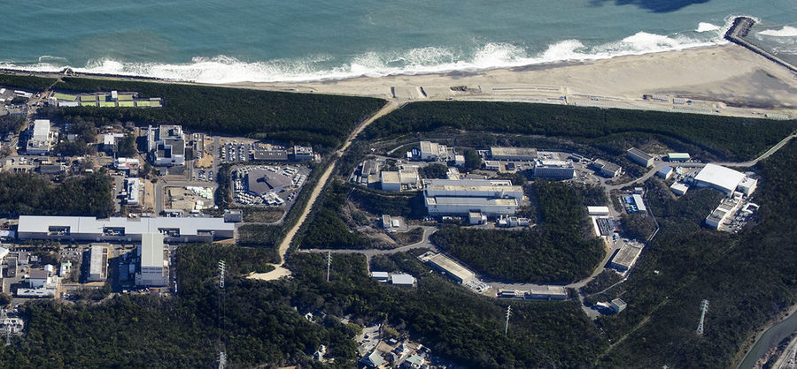
J-PARC Hadron Experimental Facility
J-PARC Web page
Inj.
Acc.
Ext.
MR PS pattern
2 s
5.2 s
time
RCS 3 GeV
Linac 0.4 GeV
MR 30 GeV
Hadron
Experimental
Facility
30 GeV proton beam from the Main Ring (MR) is slowly extracted to the Hadron (HD) Experimental Facility.
  Current operating cycle: 5.2 s
  Current spill length: 2 s

Slide 4
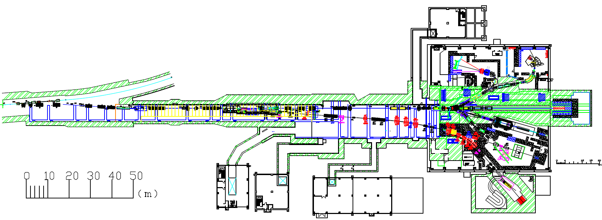
J-PARC Hadron Primary Beamline
Ext. point
Vacuum foil
A-B branch point
T1 target
Dump
A line
B line
C line
A line 30 GeV 65 kW (7.0 x 10¹³ protons/spill)
  3 experimental areas using secondary beam from the T1 target
B line 30 GeV 24 W (2.6 x 10¹⁰ protons/spill)
  Branching out part of A line beam.
  1 experimental area using primary proton beam directly
C line 8 GeV 0.33 kW (2.5 x 10¹² protons/spill, 9.6 s cycle, 0.5 s spill length)
  Bunched slow extraction beam
  1 experimental area using secondary muon beam from the target

Slide 5
Beam Diagnostic Devices in Primary Beamlines
High vacuum
(about 10⁻⁷ Pa)
Low vacuum
(about 1 Pa)
Beam Loss Monitors
Profile Monitors (OTR: Optical Transition Radiation)
Profile Monitors (RGIPM: Residual Gas Ionization Profile Monitors)
Profile Monitor (Ion Chamber)
Target Monitor
Spill Monitor
Beam Intensity Monitor (Scintillation)
Beam Intensity and Short Pulse Monitor (RGICM)
Beam Intensity Monitor (Ion Chamber)

Slide 6
RGIPM: Residual Gas Ionization Profile Monitor
Type-100
Permanent Magnet
(Sr Ferrite)
Negative electrode
(-100 V)
280
Beam
Electric field shaping electrodes
100
uniform magnetic field
(400 gauss)
32 channel readout electrodes
(1 mm pitch)
0.3 Pa vacuum
Y. Sato
3rd IPM WS
280

Slide 7
Features of Hadron Beam Profile Monitors(RGIPM)
Non-destructive
Maintenance free
  Use the Sr ferrite permanent magnet
  No amplification devices
  High radiation resistant materials: inorganic resistances, ceramic or glass epoxy substrate, and so on.
  Operating in high radiation environments such as 1 m upstream of A line target called T1(50 % loss)
    about 2 MGy/year (10¹⁴ protons/s, 2500 h/year operation)
  No maintenance and replacement since the first beam in 2009.
Shot by shot or time division (about 8 division) measurement
  Monitor beam width and beam position and stop abnormal beams
Different types of RGIPM depending on beam size
  Beam detection region: 100 mmφ, 300 mmφ, and 400 mmφ
  Readout electrode pad pitch: 1 mm, 3 mm, 6 mm, 10 mm

Slide 8
Using the RGIPM as the HD Profile Monitors
Solve small S/N ratio problem
  Slow extraction and single pass beamline: Signal per unit time is much smaller than that of pulsed and circulating beam Small S
  Large background: foil, target, dump, SX devices, and so on Large N
  MCP to enhance signal amount cannot be used: Large background causes large noise, and saturate MCP signal.
  Successfully enhance signal by controlling vacuum to about 1 Pa level
  Successfully improve S/N ratio by integrating the signal.
Suppress beam width broadening effect
  Relatively low vacuum causes the beam width broadening due to the diffusion of drifting electron.
  Successfully suppress this effect by applying a magnetic field about 200 to 400 Gauss depending on the beam size.

Slide 9
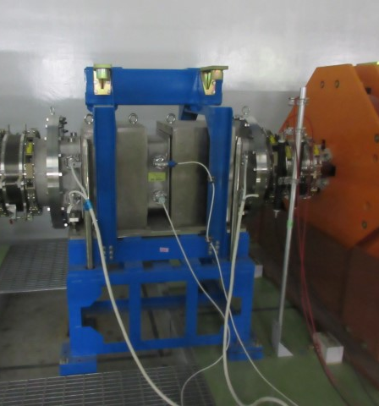
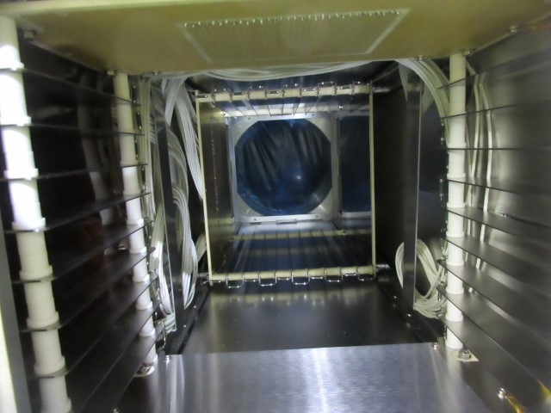
Photos of the Installed RGIPM
Type-300
Type-300 rear view of internal electrode
readout
Vertical
Horizontal
electrodes
Horizontal
Vertical
Permanent Magnet
No destructive material on beam
1140

Slide 10
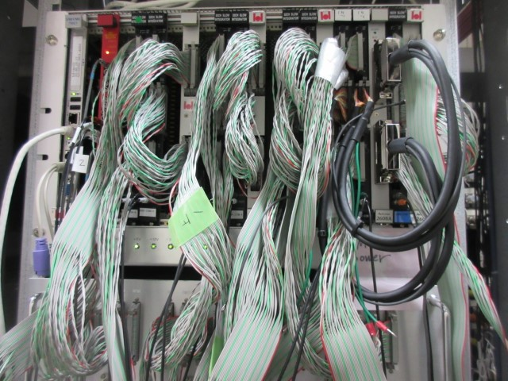
Readout Electronics and DAQ
Beam extraction 2 s
charge
integration
A/D
conversion
time
0 s
off-beam
measurement
on-beam
measurement
5.2 s
background subtraction to enhance S/N
32 ch charge integrator board on VME
  Input: 1, 4, 40, 400 nC / 5 V
64 ch scanning A/D board on VME
EPICS IOC is running on the VME CPU board
  EPICS records are provided.
  EPICS channels are recorded by the EPICS Archiver Appliance
time
0 s
off-beam
measurement
on-beam
measurement
5.2 s
Time division profile is also in use by using multi-scanning

Slide 11
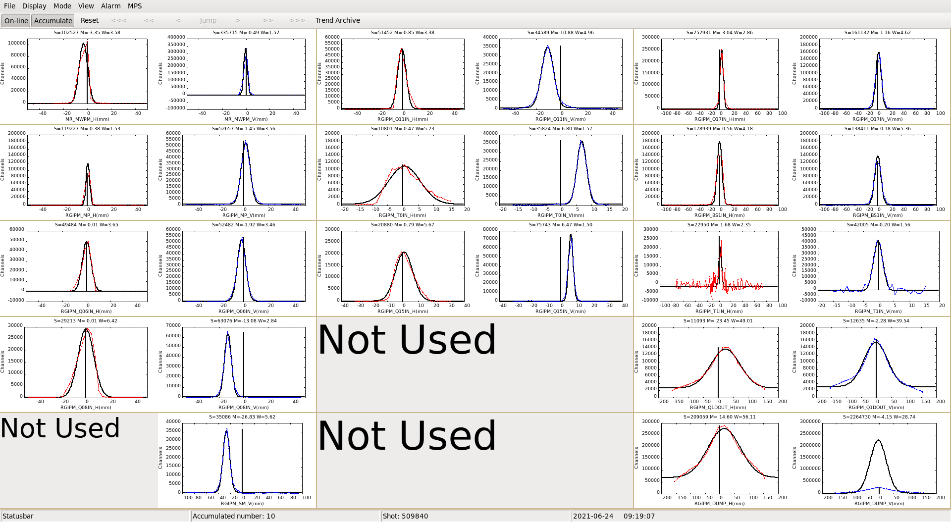
Display Screen of the RGIPM
Horizontal
Vertical
Sigma
3.6 mm
Sigma
2.4 mm
T1
GUI using wxPython + pyepics
On-line gaussian fitting provides width, position, and max values.

Slide 12
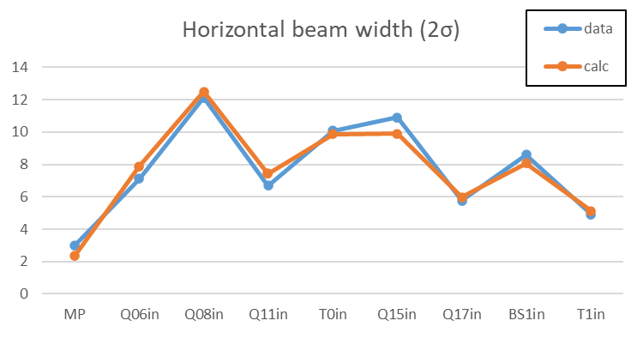
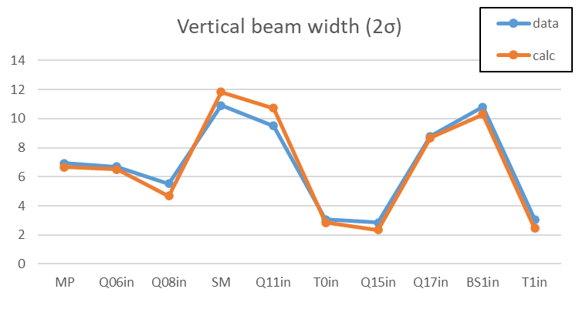
Emittance Measurement @A line 30 GeV beam
[mm]
[mm]
RGIPM position
RGIPM position
[kW] | [yymmdd] | ε_{H}(2σ) | ε_{V}(2σ) | T1 σ (H [mm],V [mm])
64.5 | 210602 | 1.25 | 1.11 | 2.56 x 0.89
Beam optics calculated by the TRANSPORT
Beam emittance is evaluated by fitting the beam envelope.

Slide 13
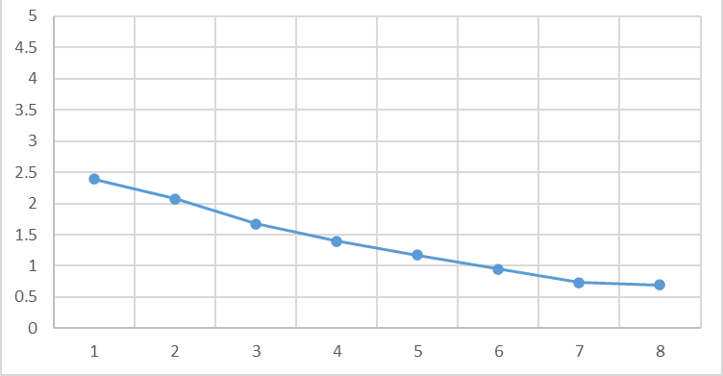
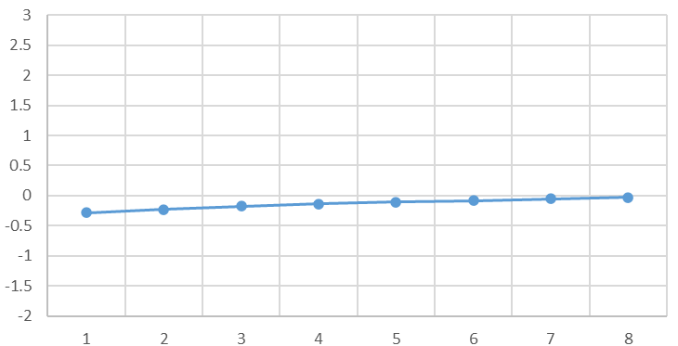
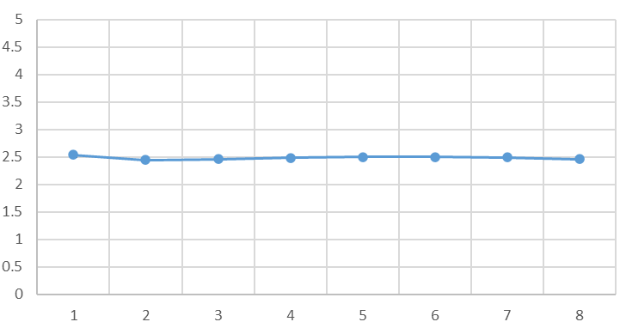
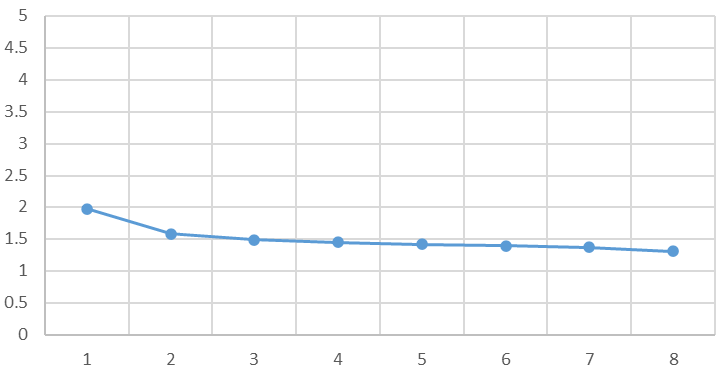
Profile Drift in Typical One Spill@T1
X
Y
Mean X
Mean Y
[mm]
[mm]
Spill Start
Spill End
Spill Start
Spill End
SX
Sigma X
SY
Sigma Y
[mm]
[mm]
Time Division #
Time Division #
Profile drift can be observed on the RGIPM monitor.
X drifts about 2 mm, Y drifts about 0.3 mm.
SX is stable and SY is gradually narrowing.
Profile stability in one spill is sufficient to maintain target health.
Secondary beam quality (K/π ratio) is also stable enough for the experiments to use.

Slide 14
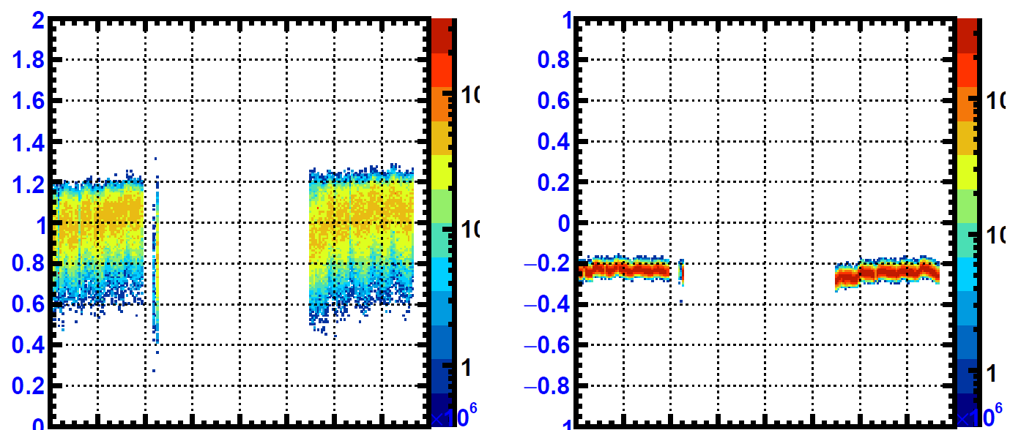
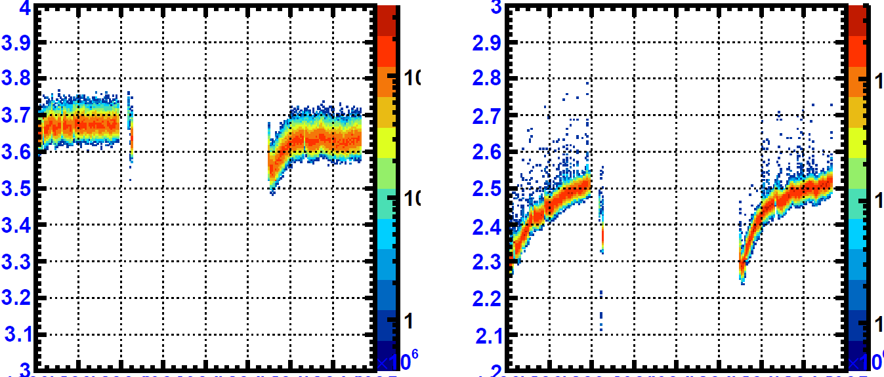
Long-Term Profile Stability@T1
[mm]
[mm]
Mean X
Mean Y
The Y position which is the most important parameter for the target health and secondary beam quality has enough good long-term stability.
The other three parameters are also stable enough for the experiments.
±0.63 mm
±0.11 mm
5 sigma level
5 sigma level
[mm]
[mm]
Sigma X
±0.19 mm
Sigma Y
＋0.33 mm
5 sigma level
5 sigma level
Jun. 11, 2021
Jun. 30, 2021
Jun. 11, 2021
Jun. 30, 2021

Slide 15
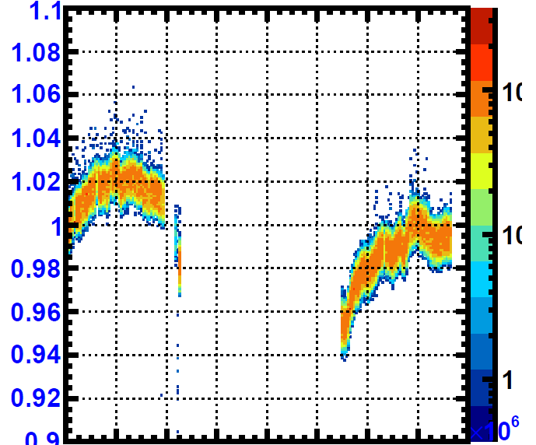
Long-Term Profile Yield Stability@T1
Normalized Profile Sum divided by Beam Intensity
+4% level
Sum divided by beam intensity has the stability of about ±4% level.
-4% level
Jun. 11, 2021
Jun. 30, 2021

Slide 16
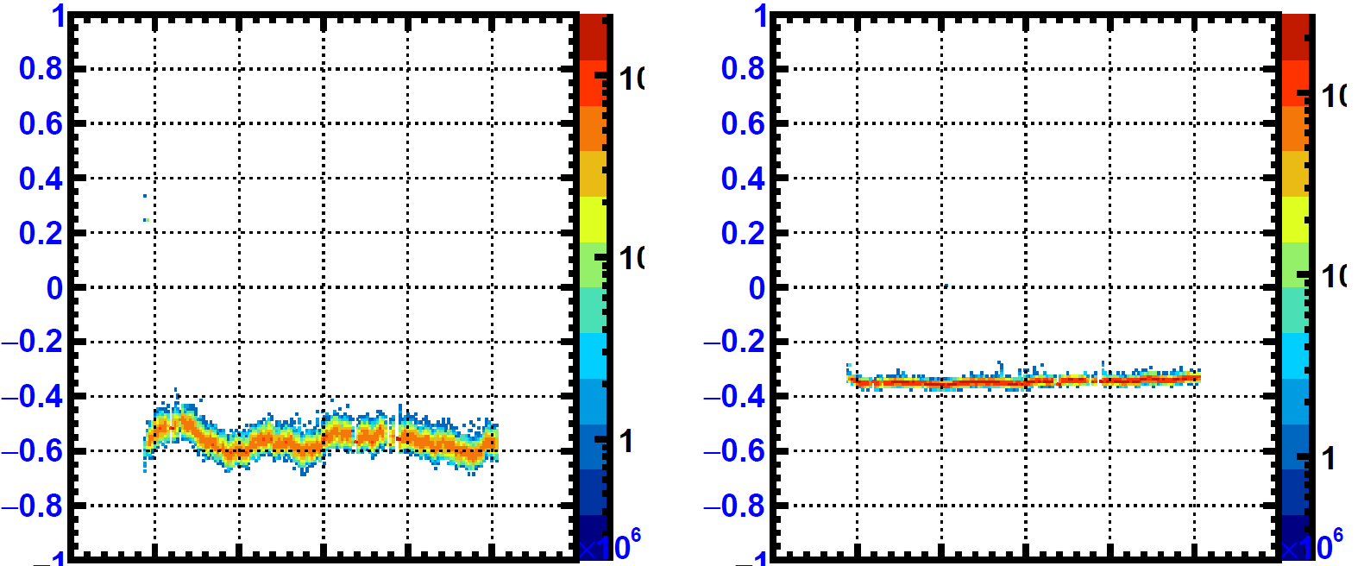
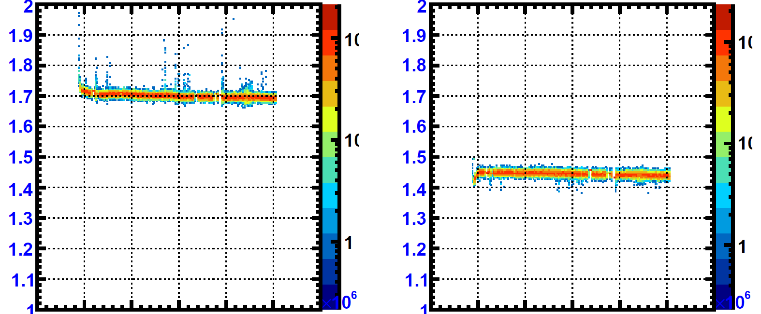
Long-Term Profile Stability for 8 GeV Bunched Beam @B line Collimator
[mm]
[mm]
Mean X
Mean Y
Beam profile stability is better than that of the 30 GeV A line beam.
Stability of the beam profile is good enough for the experiments.
±0.19 mm
±0.05 mm
5 sigma level
5 sigma level
[mm]
[mm]
Sigma X
±0.055 mm
Sigma Y
±0.040 mm
5 sigma level
5 sigma level
Mar. 9, 2023
Mar. 16, 2023
Mar. 9, 2023
Mar. 16, 2023

Slide 17
Summary
Hadron RGIPMs are stably running for the 30 GeV 65 kW slow extraction beam and the 8 GeV bunched slow extraction beam.
  Short and long-term profile stability is good enough for the target health and secondary beam quality.
Maintenance free and no replacement since the first beam in 2009.
Operating even in high radiation environments such as 1 m upstream of the T1 target.
  No performance degradation is observed yet.

Slide 18
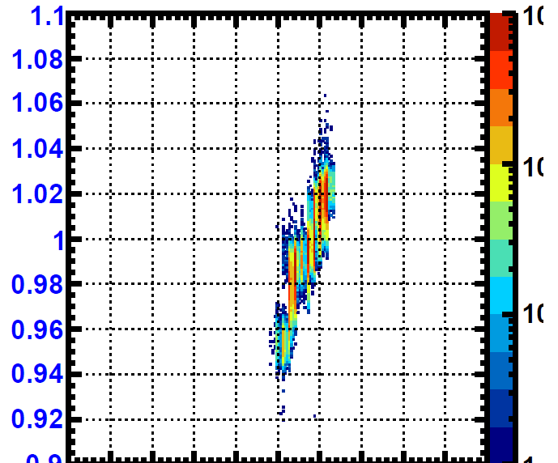
Vacuum dependence
Normalized Profile Sum divided by Beam Intensity
Clear dependence of the profile sum on the vacuum.
One of the reason why the profile sum trend fluctuates is due to the vacuum change.
0.3
Vacuum [Pa]
0.4

Slide 19
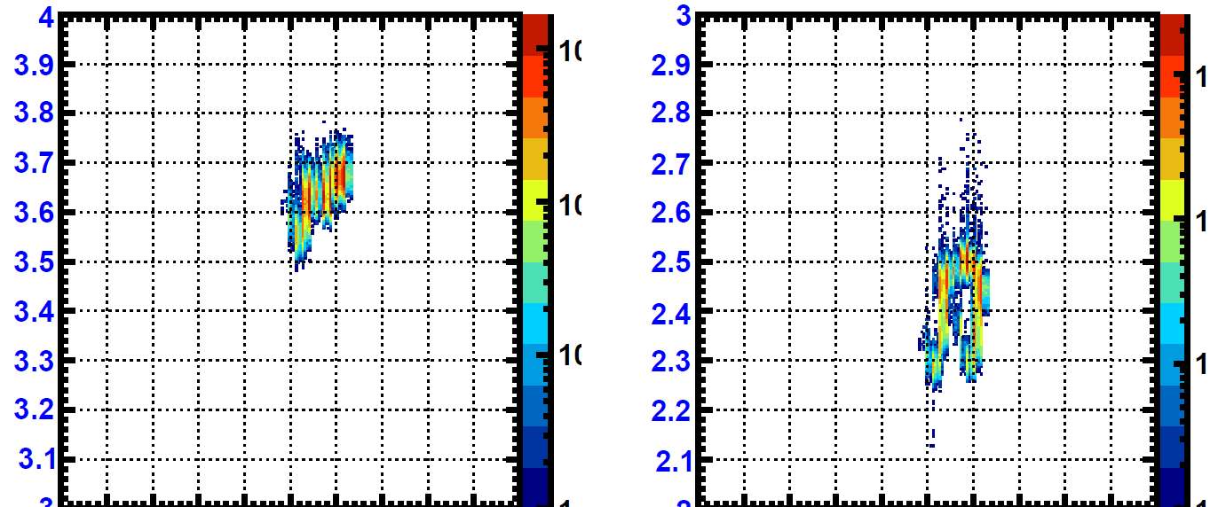
Vacuum dependence of profile width
[mm]
[mm]
Sigma X
Sigma Y
0.3
Vacuum [Pa]
0.4
0.3
Vacuum [Pa]
0.4
Profile width is less dependent on the vacuum compared to that of profile sum.
This indicates that the effect of profile broadening due to vacuum is sufficiently small compared to the profile width.

Slide 20
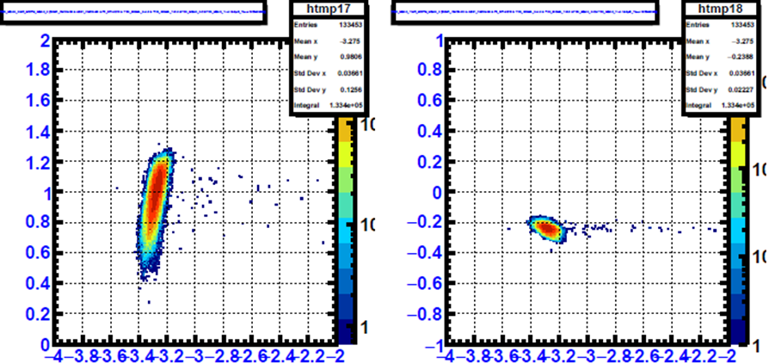
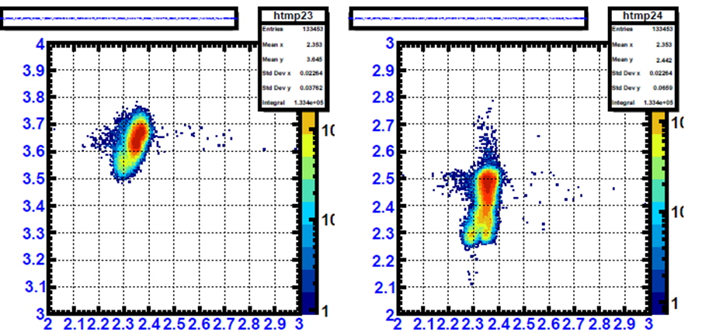
Correlation between MR MWPM and T1 RGIPM
Small dependence of the profile position of the T1 RGIPM on that of the MR MWPM.
The dependence for the Sigma X is small, and the dependence for the Sigma Y is not clear.
Mean X
Mean Y
T1 RGIPM
MR MWPM
MR MWPM
Sigma X
Sigma Y
T1 RGIPM

Slide 21
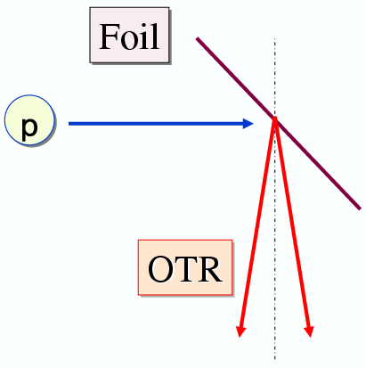
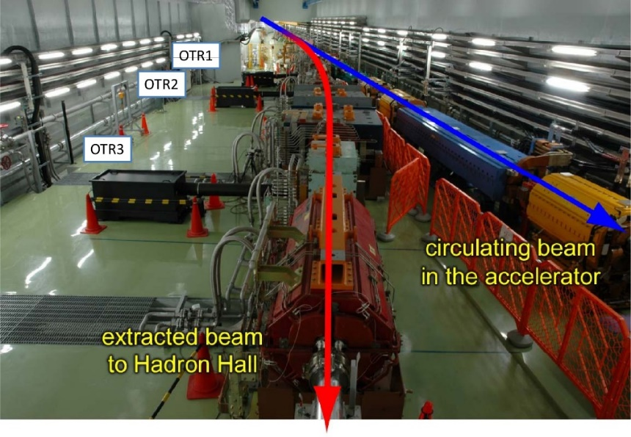
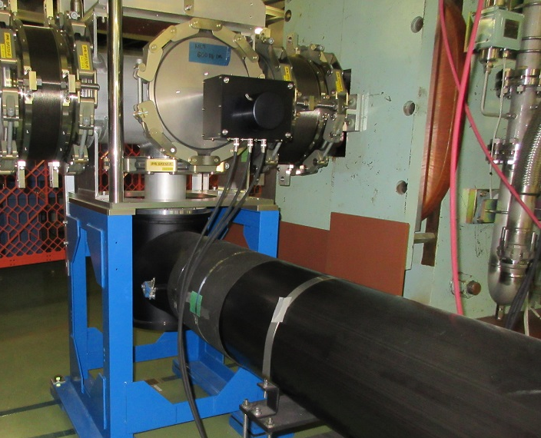
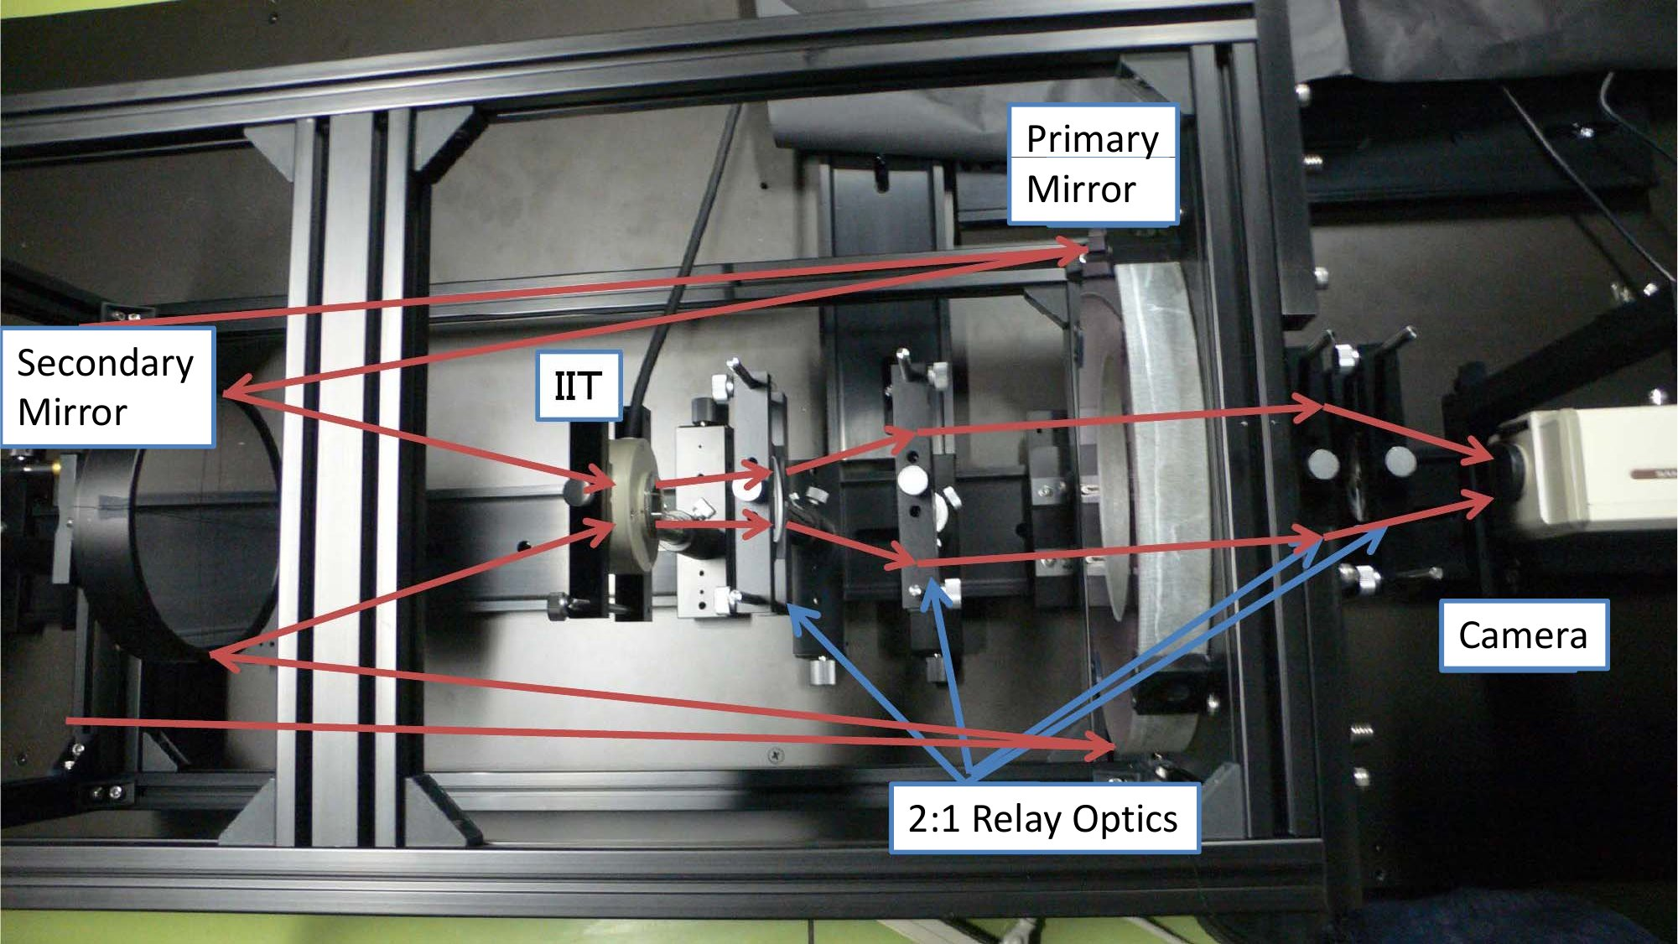
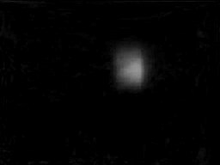
OTR(Optical Transition Radiation)
rotary drive
mechanism
OTR monitor is a profile monitor utilizing the transition radiation generated at the thin foil.
The foil is made of Ti (thickness 5 mm) and can be inserted or removed as needed by the drive mechanism.
Transition radiation light is focused by the optical system, amplified by the Image Intensifier (IIT), and measured by the radiation-tolerant camera.
The near maintenance-free operation is achieved by relocating equipment relatively sensitive to radiation approximately 5 m away from the beamline.

Slide 22
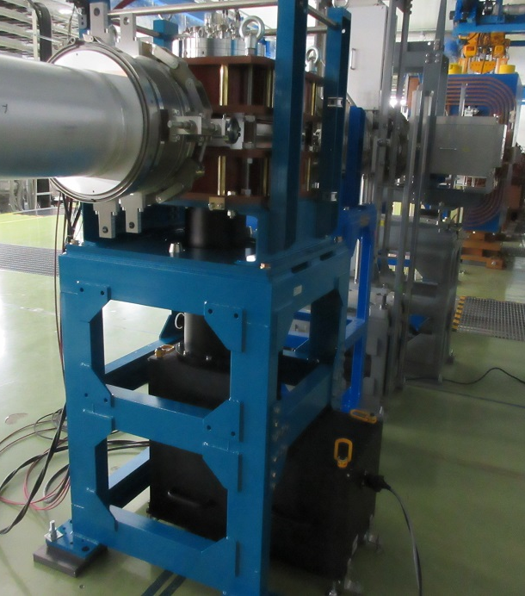
HGRGPM (High Gain Residual Gas Profile Monitor)
N
Phosphor
Screen
Duct
Beam
magnet
Ground
magnet
electrons
Negative
S
Optics
Optics+IIT+camera
Observe the light from the phosphor using an optical system, IIT, and camera
Achieves signal amplification by converting the signal into light with less background and transmitting the light away from the beamline.
Improve S/N by preparing a thin phosphor(Gd₂O₂S(Tb), 20 μm^{t}, no coating)
R&D work in progress

Slide 23
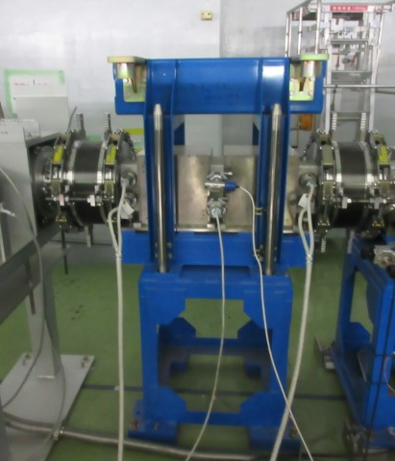
Photos of the Installed RGIPM
Type-100
Type-300
Vertical
Horizontal
Vertical
Horizontal
900
1140

Slide 24
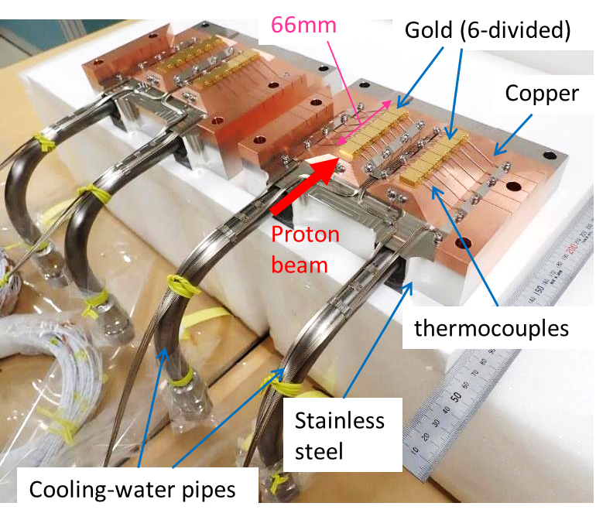
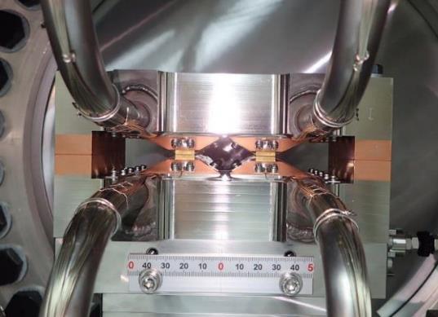
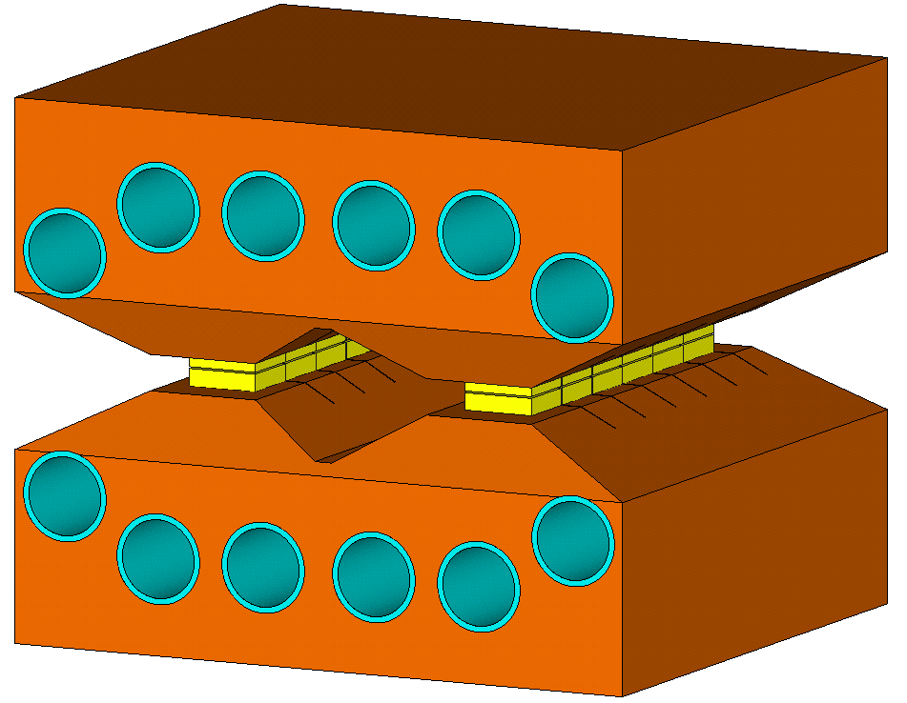
T1 Target
Phys. Rev. Accel. Beams 25, 063001
H. Watanabe, HPTW2023
beam
Indirectly water-cooled fixed type target divided into upper and lower parts
Vertical beam position stability is important to suppress the target temperature rise

Slide 25
Magnetic Pole Cross Section of the Lambertson Magnet
Y. Komatsu et al.
Proceedings of the 17th Annual Meeting of Particle Accelerator Society in Japan
To B line
Magnetic field
Yoke
To A line
Field free hole
The beam that passes through the field free hole goes straight to the A line, and the beam that passes through the magnetic field region is bended and heads towards the B line.
Vertical beam position stability is important for B line intensity stability.

