Slide 1
Operational experience with electrostatic septa at CERN
B. Balhan, J. Borburgh, M. Fraser, F. Lackner, A. Prost, F Velotti
13/02/2024

Slide 2
Outline
Introduction, ZS general overview
Operation
non-straightness investigation
Improvement for LS3
13 February 2024 B.Balhan, SX Workshop MedAustron

Slide 3
SPS and ZS general overview
The electrostatic septa ZS are used for the slow extraction from the SPS towards the North Area.
In the framework of the LHC Injector Upgrade (LIU) project, an upgrade of the ZS was decided and aimed at reducing:
the Break Down rate (increased over the year when the LHC beam circulated in the SPS),
the vacuum activity in presence of high intensity, high frequency beams (LHC 25ns).
Of note: the 25ns LHC beam is not extracted by the ZS.
The upgraded ZS were installed in 2020 and operational since 2021.
13 February 2024 B.Balhan, SX Workshop MedAustron

Slide 4
SPS and ZS general overview
The ZS upgrade addressed the challenges holistically with the following measures:
Increasing the vacuum pumping speed,
Reducing any possible electron cloud activity,
Beam impedance reduction:
shield the ZS high field area better from the orbiting beam wake fields,
reduced the electron cloud activity,
Anode direct grounding,
Diagnostics improvements (Cleaning electrode direct voltage measurement).
13 February 2024 B.Balhan, SX Workshop MedAustron

Slide 5
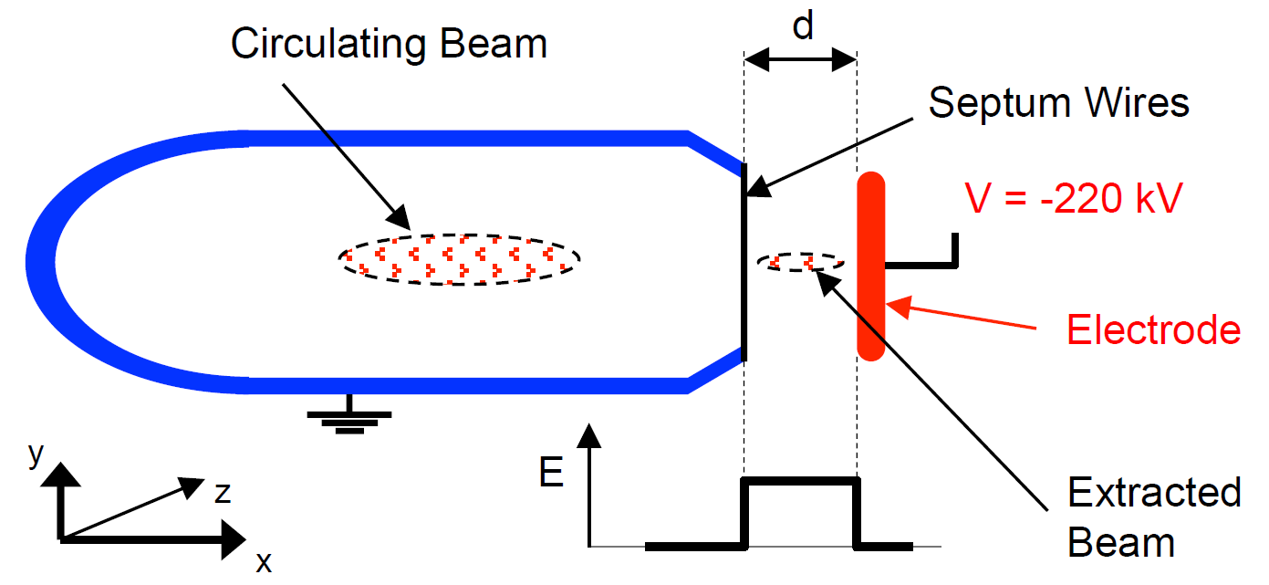
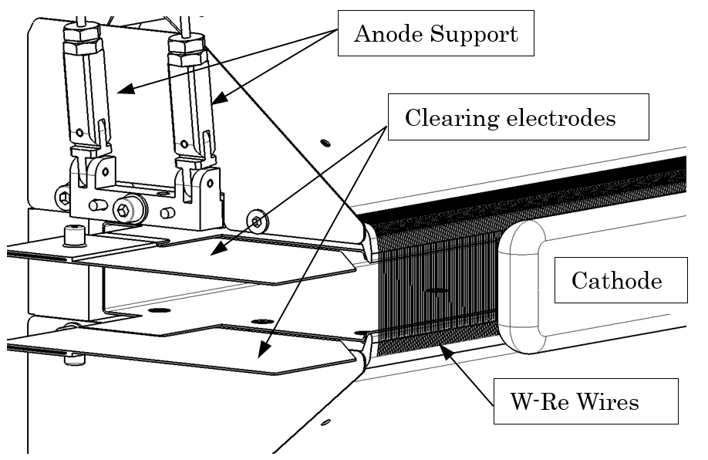
Electrostatic septum layout
Cleaning electrodes
High Field Region 11 MV/m
13 February 2024 B.Balhan, SX Workshop MedAustron

Slide 6
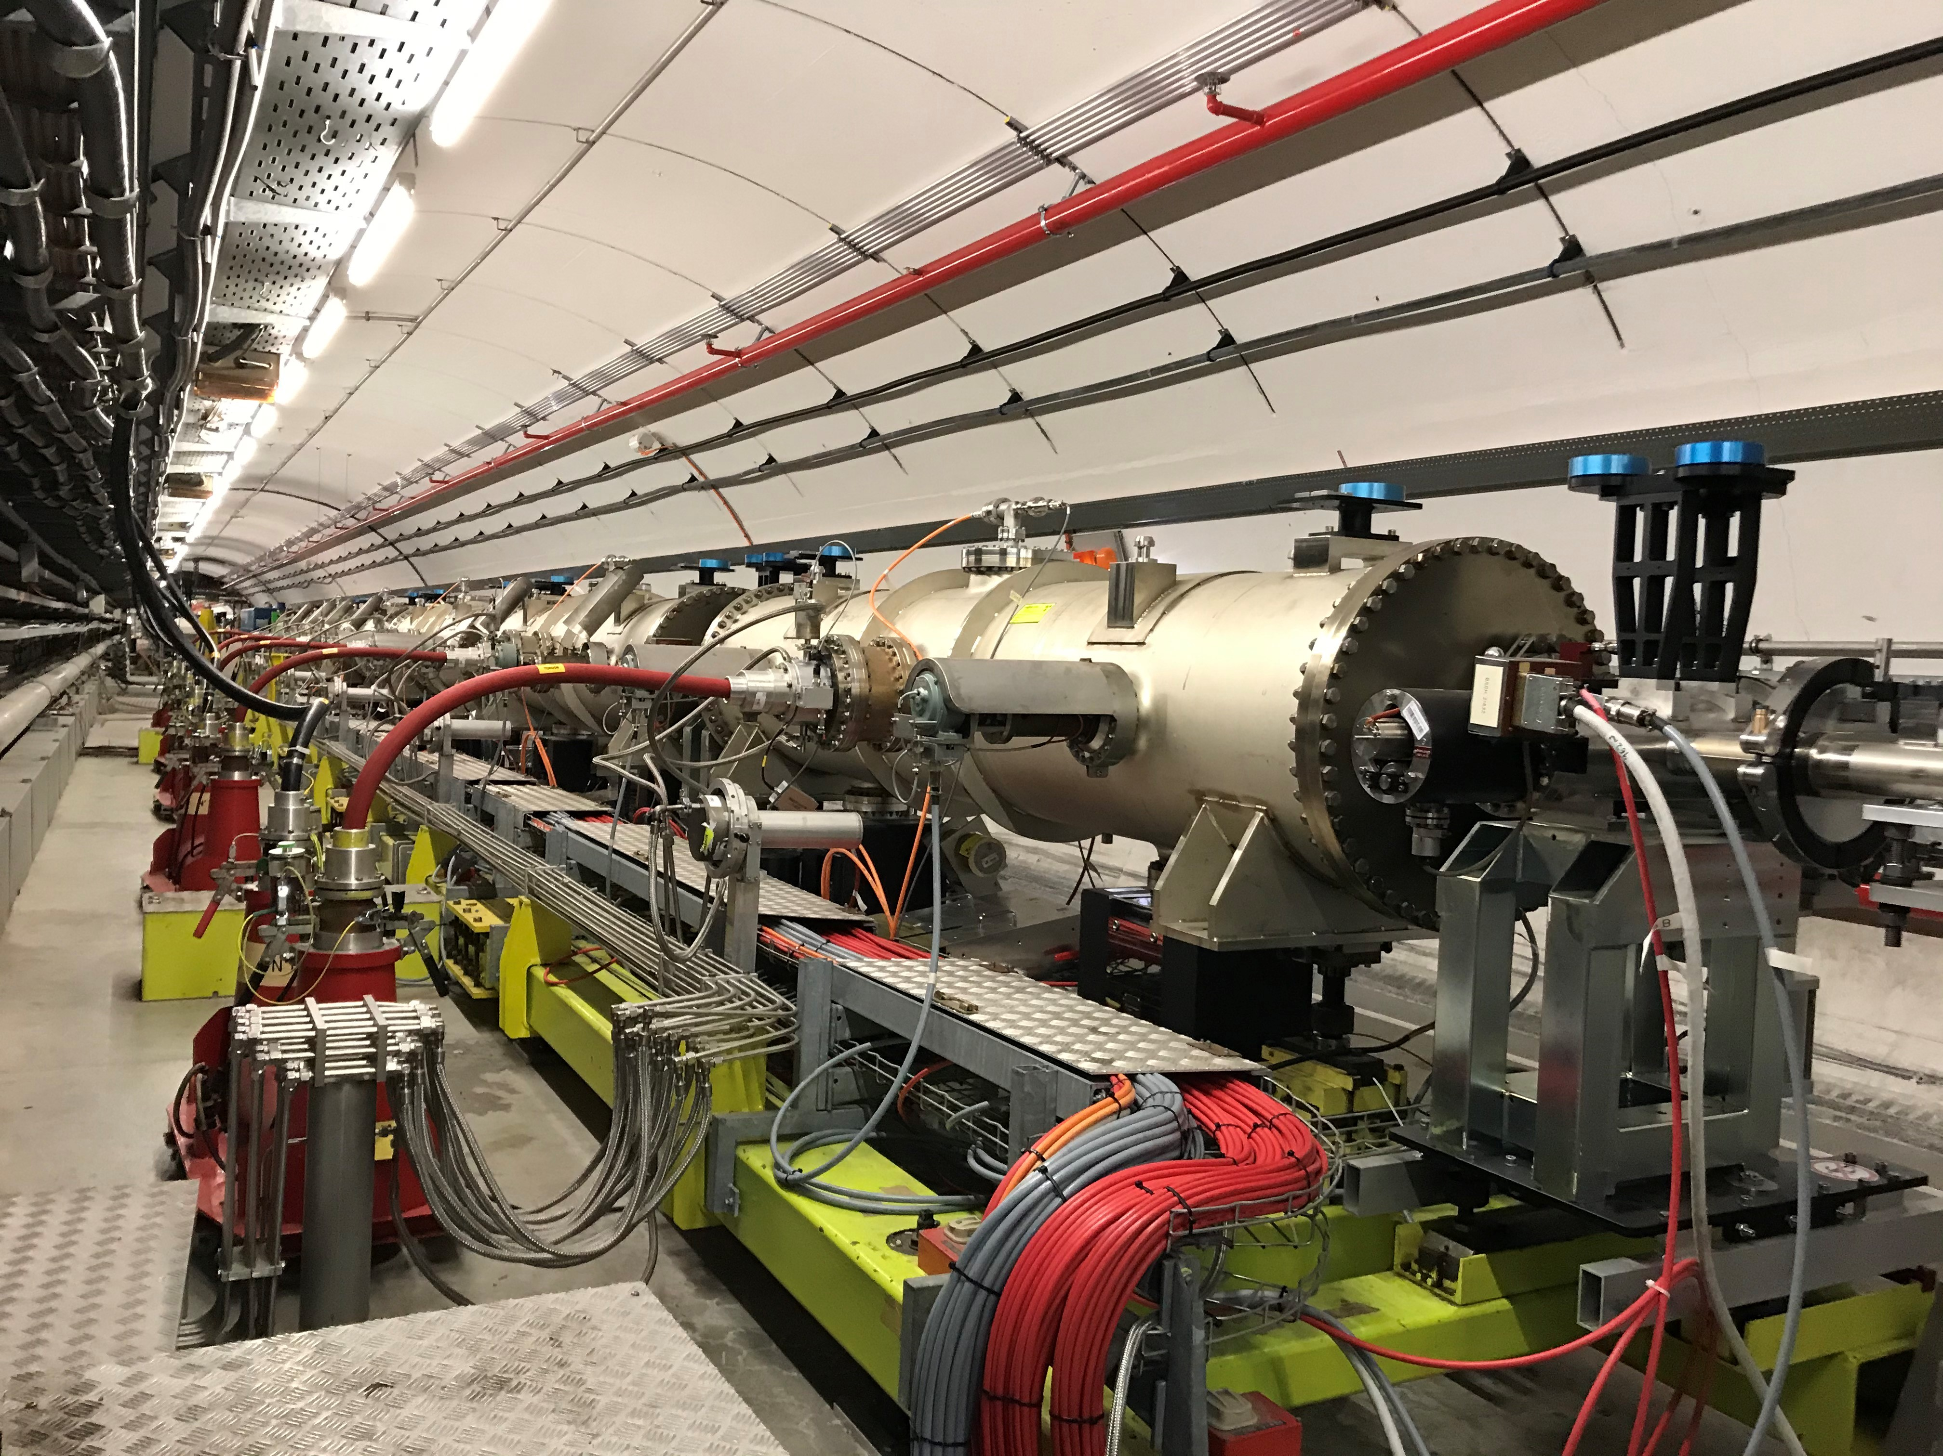
SPS ZS Layout
5 ZS installed of each 3.0 m long
Individual anode positioning range
+/- 2 mm
Individual cathode displacement range
17- 40 mm
Common HV generator 0 - 300 kV
Individual clearing electrode power supplies
0 - 10 kV
Nominal operational Field 11 MV/m
All 5 ZS installed on a common motorised girder . Displacement range +/- 30 mm.
13 February 2024 B.Balhan, SX Workshop MedAustron

Slide 7
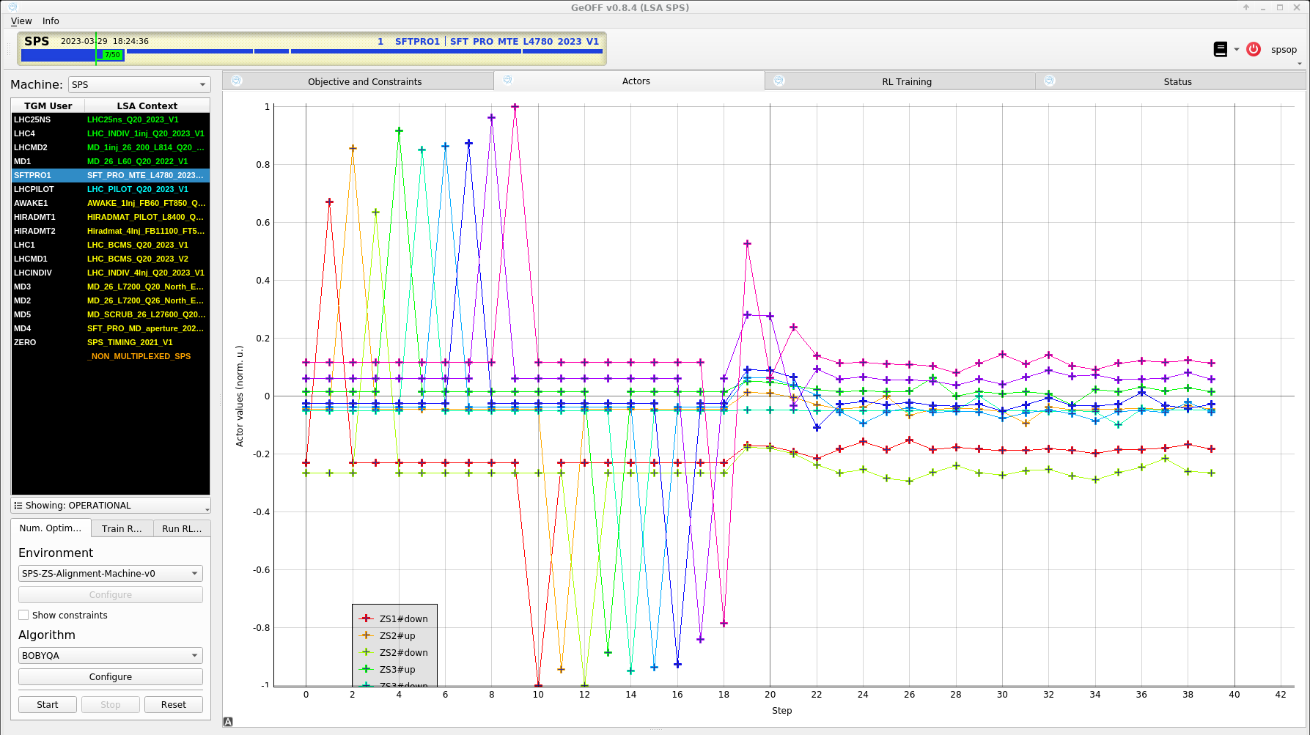
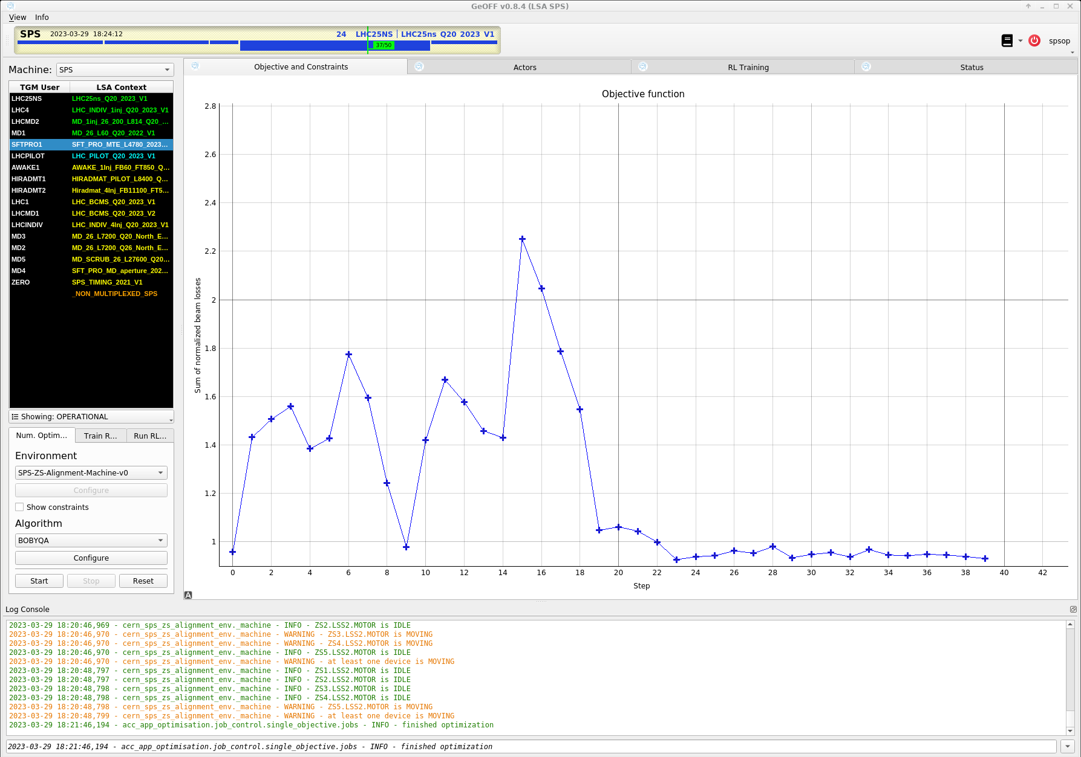
Scan and alignment optimisation [1]
During routine operation, a regular loss scan is performed,
The improved anode motorization works very well, however, the installed potentiometers need regular cleaning after a period of nonoperation,
At the beginning of the run, all anodes were set to the mid-position.
Using ZS automatic alignment, convergence of the optimizer in about 30 steps !
13 February 2024 B.Balhan, SX Workshop MedAustron

Slide 8
Crystal [2]
13 February 2024 B.Balhan, SX Workshop MedAustron

Slide 9
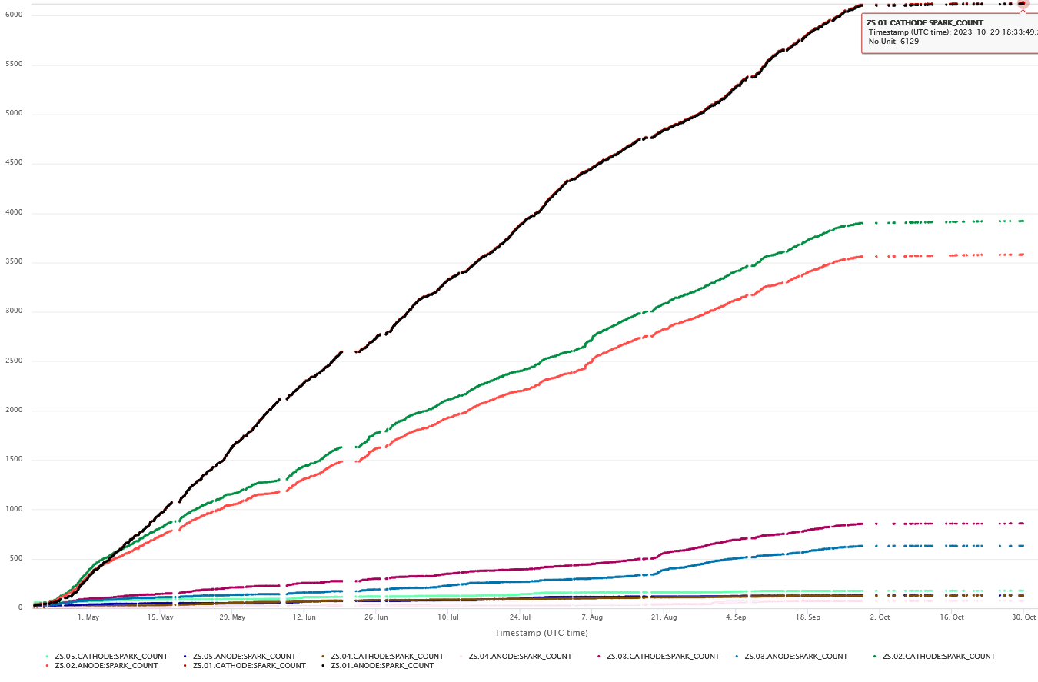
ZS break down count evolution 2023
Cathode & Itrap top electrode Spark Counts
Compared to ZS before upgrade, the total spark count has been reduced, especially the number of high spark rates.
Although the beams are not identical (now use the crystal upstream of the ZS), we tend to believe this is at least partly due to the upgrade.
The favoured hypothesis is that the loss reduction contributes partially to the spark rate reduction.
13 February 2024 B.Balhan, SX Workshop MedAustron

Slide 10
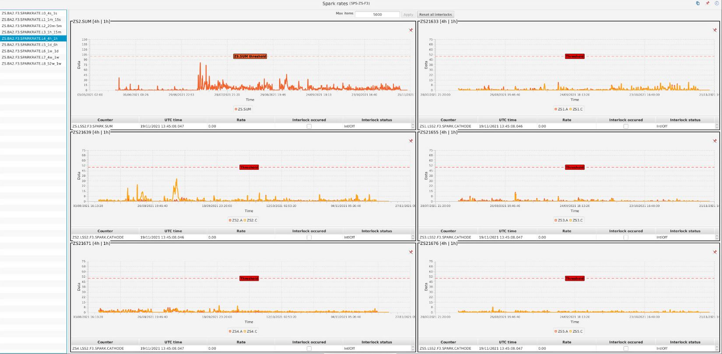
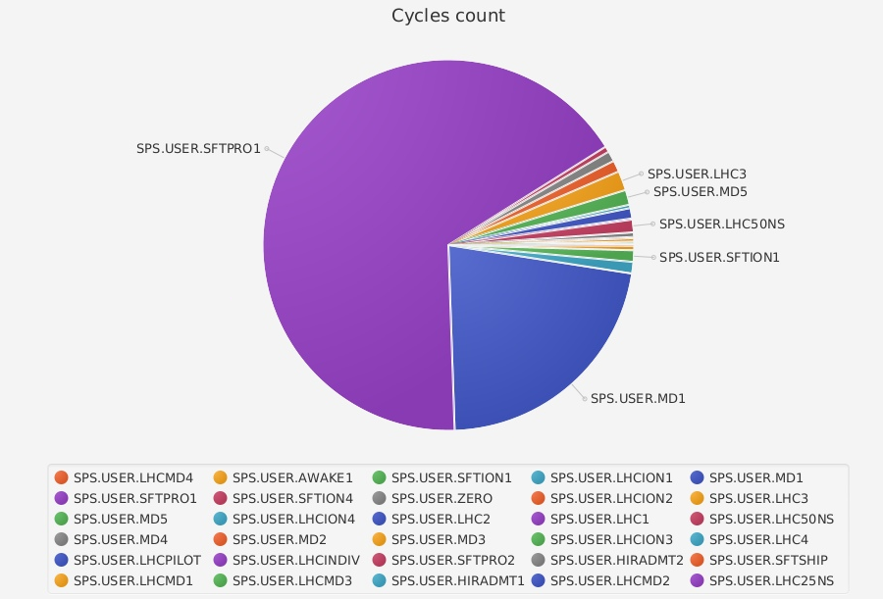
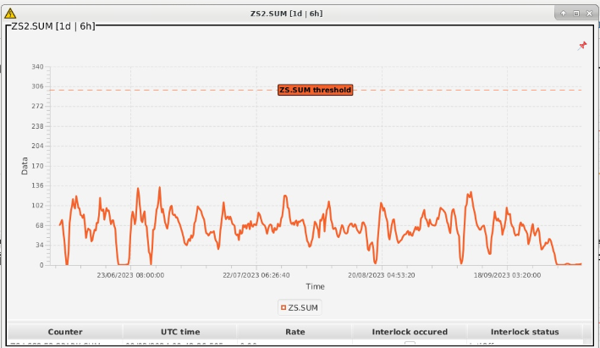
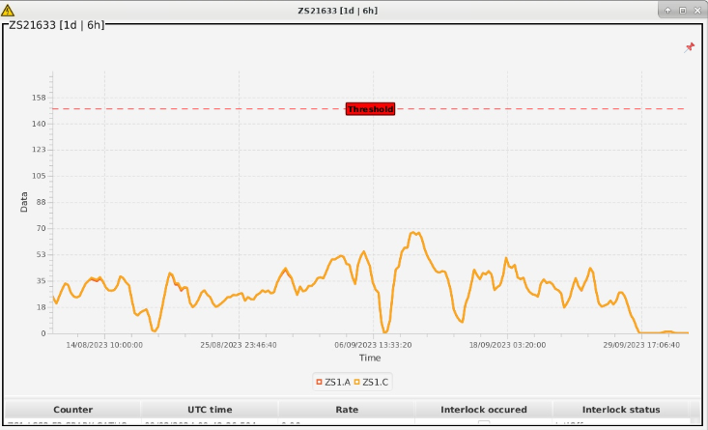
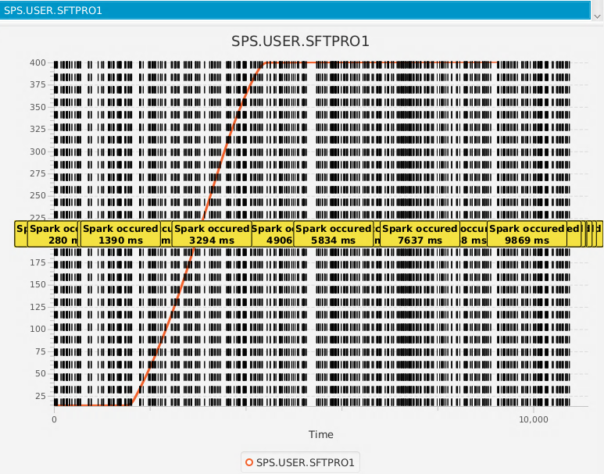
Spark rate over the time
Sum all ZS Sparks rate / day
ZS1 Sparks rate / day
Sparks occurs mainly during SFTPRO cycles
Sparks homogeneously distributed during cycle
2 interlocks from spark monitoring system in 2023 (max rate / 1hour).
13 February 2024 B.Balhan, SX Workshop MedAustron

Slide 11
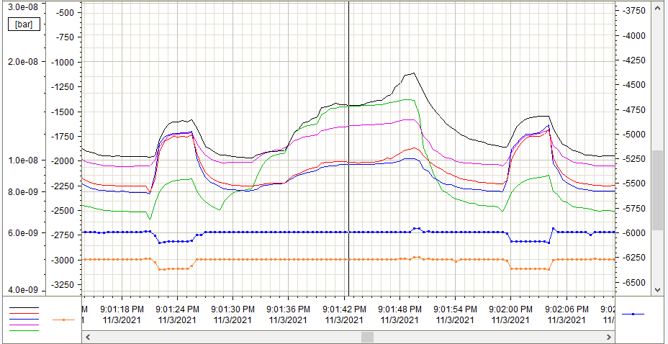
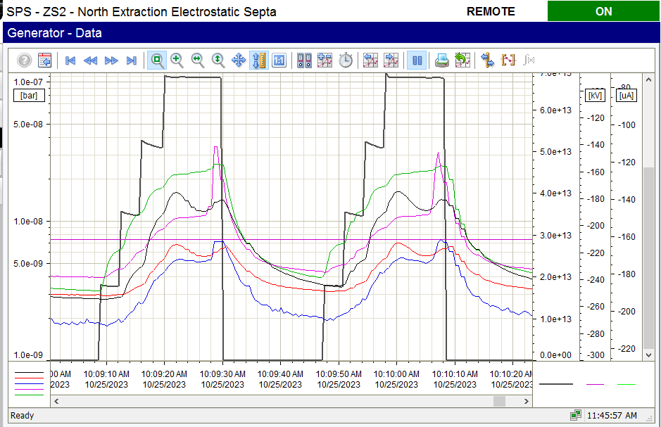
Clearing electrode voltage monitoring
[V]
Slow extraction
LHC beam 25 ns
Slow extraction
[V]
2.3e11 p/b / 4 trains of 72 bunches at 450 GeV
Trip level: 1.10⁻⁷ mbar
Vacuum
Zs1-5
U monitoring
Zs1- Itrap Top
U monitoring
Zs1-Itrap Bot
Vacuum
Zs1-5
Beam intensity
Ion Trap voltage measurement stable during LHC high intensity beam,
Electron cloud vacuum spikes still present, but without reaching vacuum interlock level,
With the improved diagnostics, the electrode voltage can now be measurement directly on the electrodes and variations were observed.
13 February 2024 B.Balhan, SX Workshop MedAustron

Slide 12
Anode straightness investigation [3]
~500 µm deformation!!!
13 February 2024 B.Balhan, SX Workshop MedAustron

Slide 13
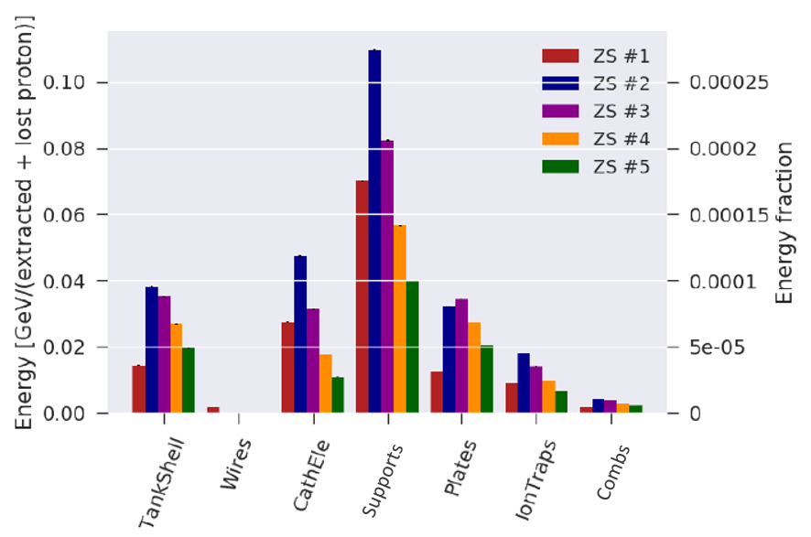
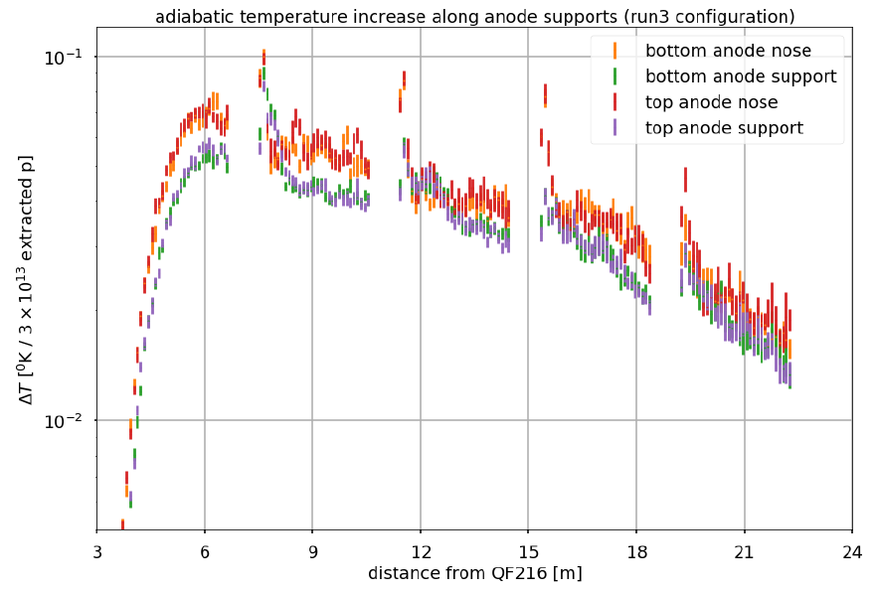
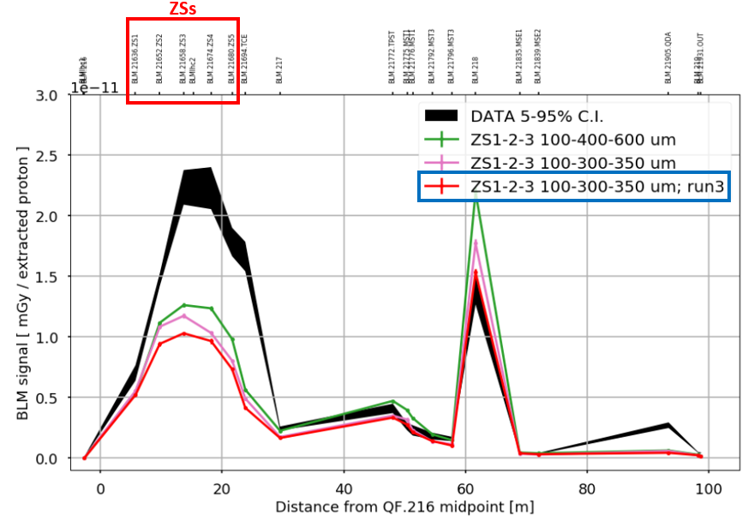
Activation study in FLUKA [4]
Mis-match
ZS2 anode support is the most activated component
Highest thermal gradient for the ZS1
BLM data → reduction factor 2-2.5
13 February 2024 B.Balhan, SX Workshop MedAustron

Slide 14
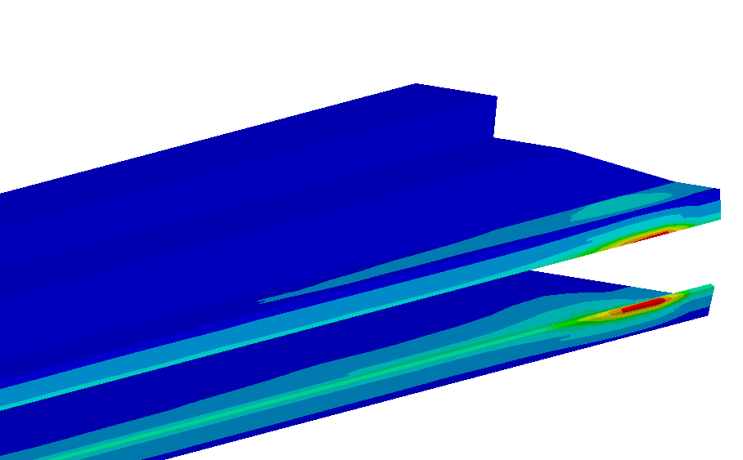
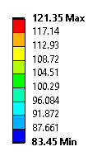
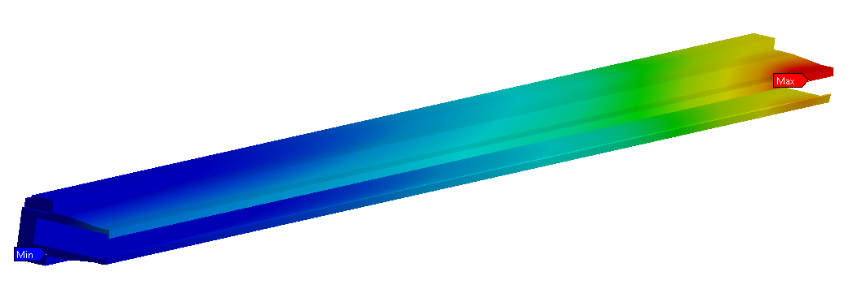
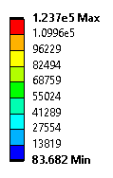
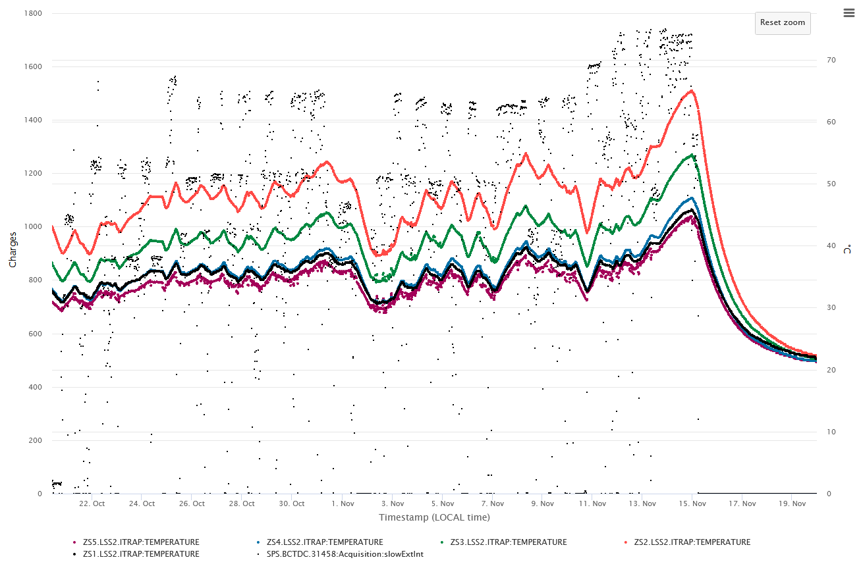
Anode temperature distribution in ANSYS
ZS2 Fluka Energy Deposition imported in Ansys $[W/m^{3}$]
(single extraction)
Computed steady-state temperature distr. [$°$C]
Beam direction
Sensor
Installed thermal sensor incapable to measure a gradient,
Backward deformation in steady-state conditions → ${CTE}_{st. steel> }{CTE}_{Invar}$
A transient effect could clarify the observations → Energy deposition concentrated at tip during extraction
Measured temperature did not yet reach a stable equilibrium.
Anode temperature measurement ZS1-5 (midpoints)
13 February 2024 B.Balhan, SX Workshop MedAustron
14

Slide 15
Anode support straightness variation
Computed static-deformations in nominal condition (no beam impact) → Max vertical sag = 1.33 mm (with $ϕ$100 μm W26Re wires strung on anode support),
Simulation confirmed anode straightness deformation < 20 μm,
Max. stress induced by beam energy deposition cannot explain the plastic deformation observed on ZS,
Measured vertical sag about 40% larger than value from FEA (plastic deformation)→ Invar material properties not stable over time (aging, beam impact, radiation..?).
13 February 2024 B.Balhan, SX Workshop MedAustron

Slide 16
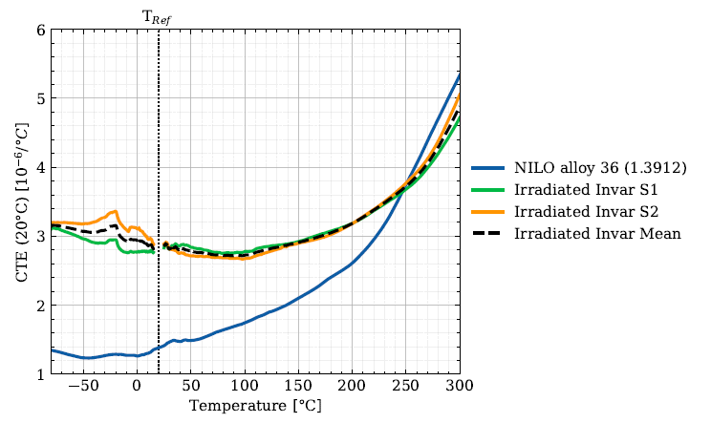
CTE measurements on irradiated Invar samples
Samples have been taken on existing Invar Anode
CTE plot (vs. temperature) of the used Invar is significantly different than the CTE of the standard NILO36 alloy
13 February 2024 B.Balhan, SX Workshop MedAustron

Slide 17
Anode straightness variation on ZS2 [5]
The observed plastic anode deformation cannot be explained by the computed stresses, which all remain below the plastic deformation limit.
Legend:
Static loads (self-weight + wires effect)
+ Computed FLUKA Energy Deposition
FLUKA ED x 2.5 (BLM data)
+ Measured CTE
Possibly, the anode straightness deformation is higher in-beam than measured in the lab,
would be good if this could be monitored on-line.
If an elastic deformation is confirmed, Invar is not effective ?
could consider anode cooling and/or low-Z anode.
Thermal gradients expected to be higher during transient → larger thermal-deformations.
Beam
Straightness computed as averaged horizontal deformation of top and bottom edge
13 February 2024 B.Balhan, SX Workshop MedAustron
17

Slide 18
Proposed additonal diagnostics
Adding an intermediate position measurement
Anode equipped with upstream – middle - downstream temperature sensors
13 February 2024 B.Balhan, SX Workshop MedAustron

Slide 19
Outlook
Next long stop (LS3) planned for 2026-2027. The following works are scheduled:
SPS LSS2 full re-cabling campaign (irradiated cable replacement control/power),
Global equipment removal for ALARA considerations,
Propose to use this opportunity to install Low-Z ZS [6]:
intermediate positioning measurement (evolution of straightness of new machined Invar anodes)
add Upstream and Downstream temperature sensors to determine real temperature and gradient
Improve conditioning process using Machine Learning,
New main HV generator (SF6 elimination).
13 February 2024 B.Balhan, SX Workshop MedAustron

Slide 20
References:
[1] Routine operation plot from CERN Op logbook F.Velotti .
[2] Crystal shadowing F.Velotti 5th Slow extraction Workshop TFZ Wiener Neustadt
[3] Summary of recent investigations on ZS anode straightness B.Balhan SLAWG #56
[4] Estimate of temperature profile along ZS anodes from FLUKA simulations SLAWG #58
[5] low-Z SPS electrostatic septa F.Pirozzi ABTEF aug 23
[6] Development of Low-Z septa for CERN's future FT programme F.Lackner 5th Slow extraction Workshop TFZ Wiener Neustadt
13 February 2024 B.Balhan, SX Workshop MedAustron

