Slide 1
Crystal assisted slow extraction in the SPS – focus on latest progress
Seidenbinder
F. M. Velotti, L.S. Esposito, M. Fraser, P. Arrutia, S. Gilardoni, B. Goddard, V. Kain, E. Matheson, S. Solis Paiva, R. Seidenbinder

Slide 2
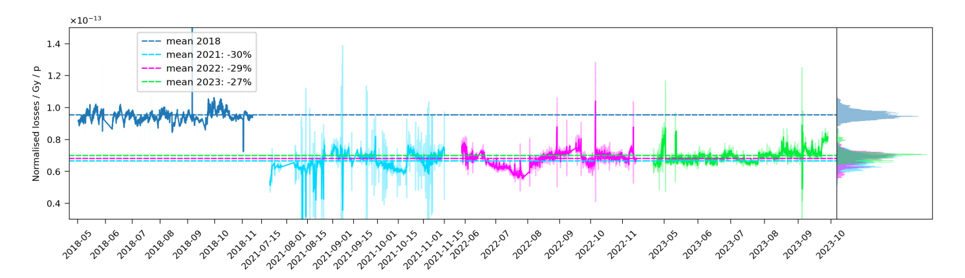
Routine operation with local shadowing
Since 2021, TECS (local crystal) in operation in VR with intensities [1e13, 4e13] protons per extraction
Consistent ~30% loss reduction: crystal 2/3 and new ZS 1/3
Cannot use crystal in channeling as beamlet lot in transfer line to targets
Clearly visible in residual activation measurements of the area

Slide 3
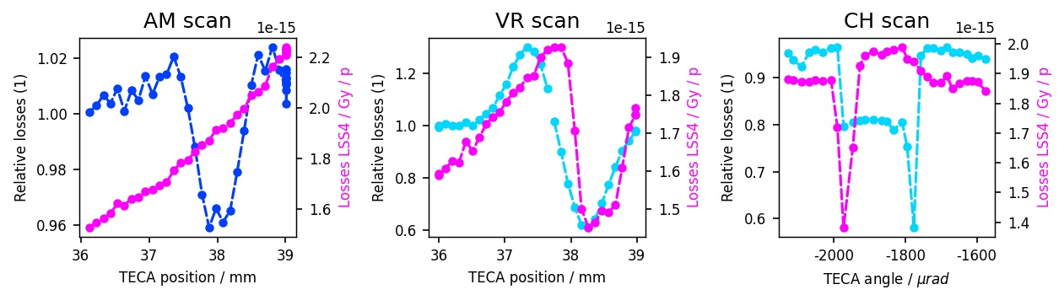
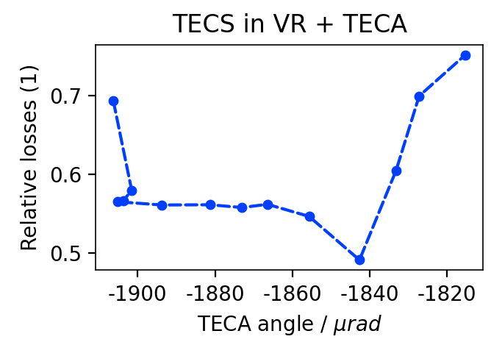
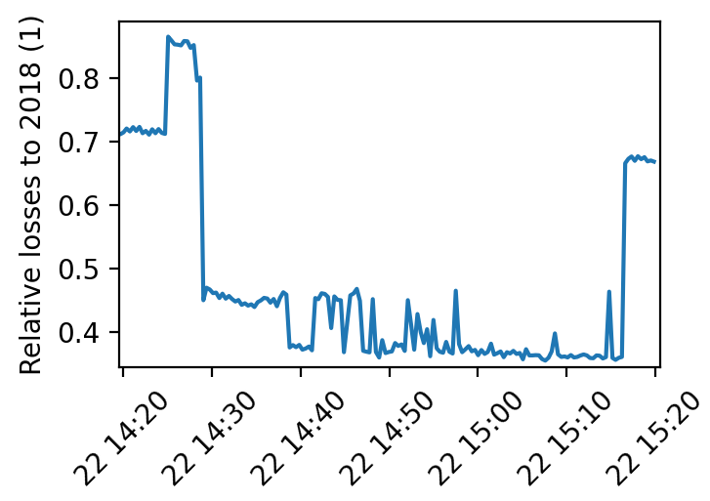
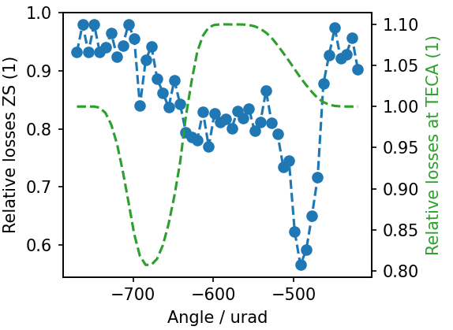
Non-local shadowing machine results
Simulations agree very well with data (needed some iterations though)
Still to explore fully the combination of 2 crystals: one local and one non-local ➔ first results in the machine were rather good
Almost x3 loss reduction wrt 2018 losses at ZS
Data
No crystals
TECA
TECA + TECS
Simulations

Slide 4
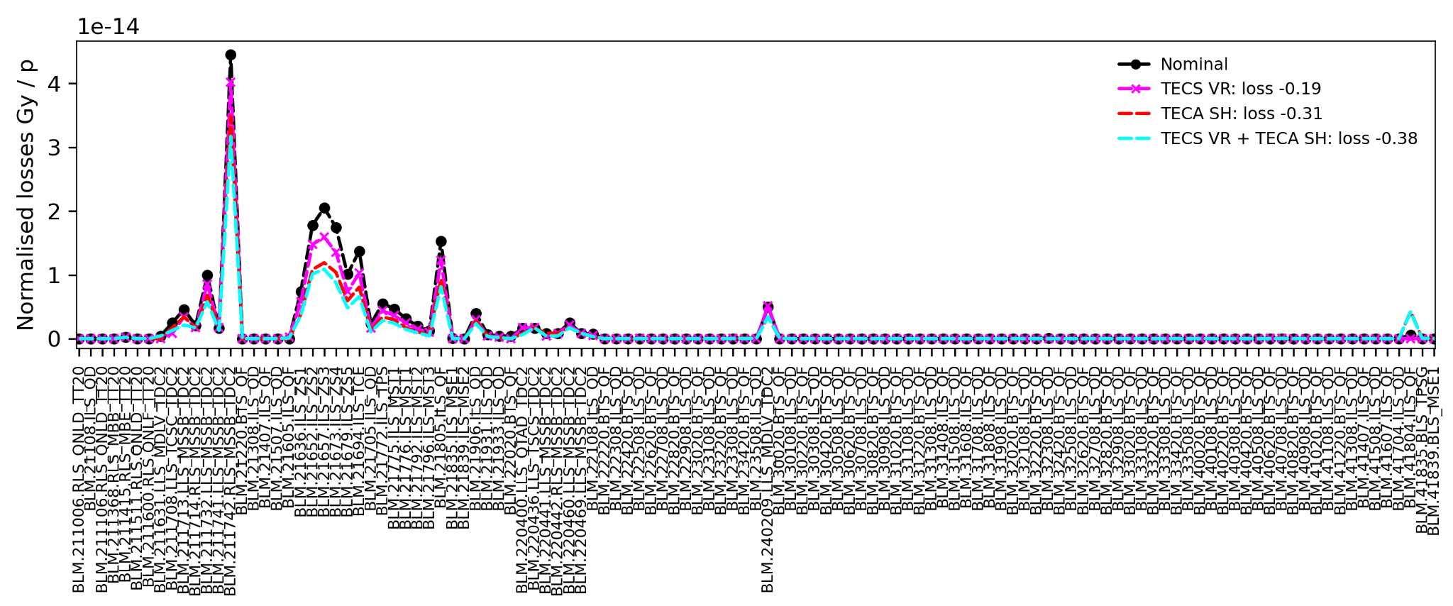
Non-local shadowing machine results
Clearly seen local loss reduction and no increase elsewhere (except at the crystal, as expected)
Transfer line + extraction region
SPS
ES
Non-local
crystal

Slide 5
Practical problems
Design:
Large parameter space and simulations are rather lengthy – need to simulate SX process
Crystal widths, bending angle, (angle, position), number of crystals…
Operation:
SPS closed orbit changes in time – hysteresis, magnets variations, non-ideality of converters, etc.
Pulsed machine inherently less stable than a coasting one
TECS and TECA suffer of backlash
Active backlash compensation already hidden in the low-level controls, but still error between CTRL and LVDT changes in time (depending on history of movement also)
Resolution of movement lower than loss reduction acceptance
Crystals have small acceptances
For shadowing, this a 2D problem: angle and position wrt ZS ➔ scans are too slow
Wrong settings of crystal can deflect beamlet on ZS or SPS aperture and cause losses/damages ➔ need low intensity for setting up

Slide 6
Design

Slide 7
Crystal parameter optimization
Relatively large parameter space to explore ➔ for each configuration, need to find optimum angle and position for shadowing
It gets rather complicated for MVRA – also need to optimize for relative alignment of each crystal of the MVRA
Bayesian optimization is the perfect tool for this: derivative-free optimization, designed to be optimal for noisy objective function, can include prior knowledge easily
Extensively used in ML for hyper-parameter optimization
Extensively used in industry for complex system design
We used both simple BO and multi-fidelity Bayesian optimization
MFBO help to significantly reduce the time needed for optimisation → also leads to better accuracy (just because longer exploration possible/feasible)

Slide 8
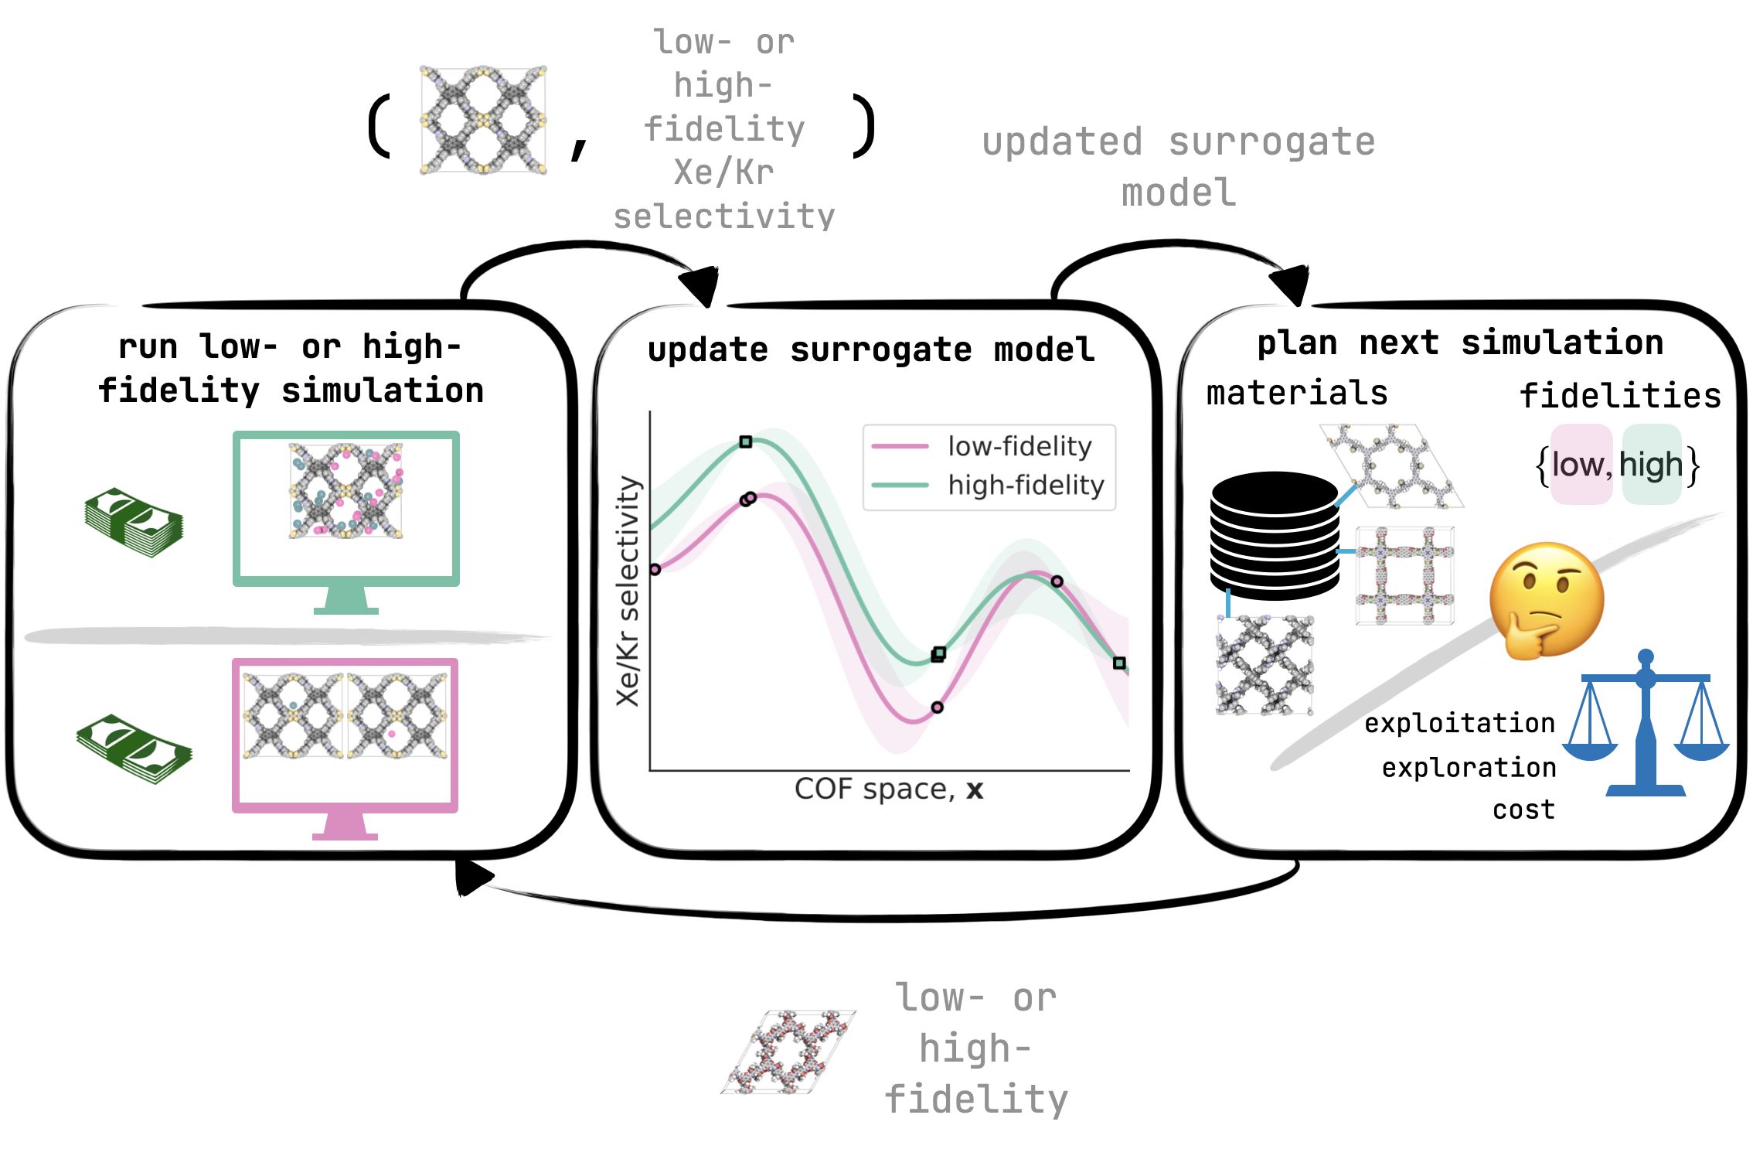
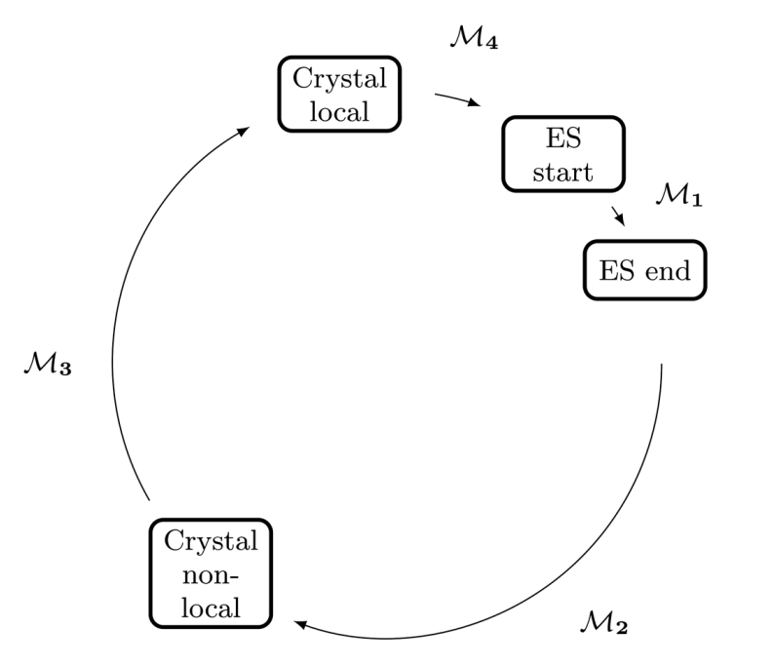
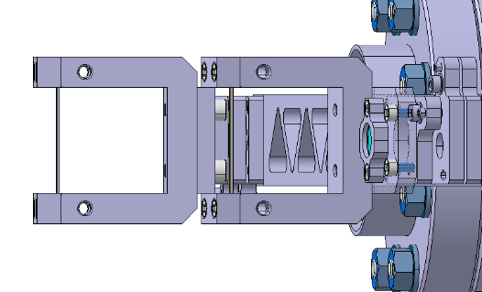
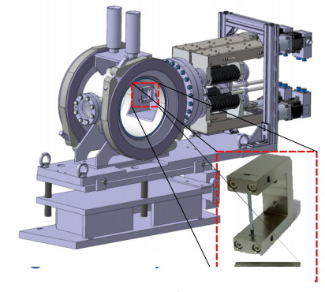
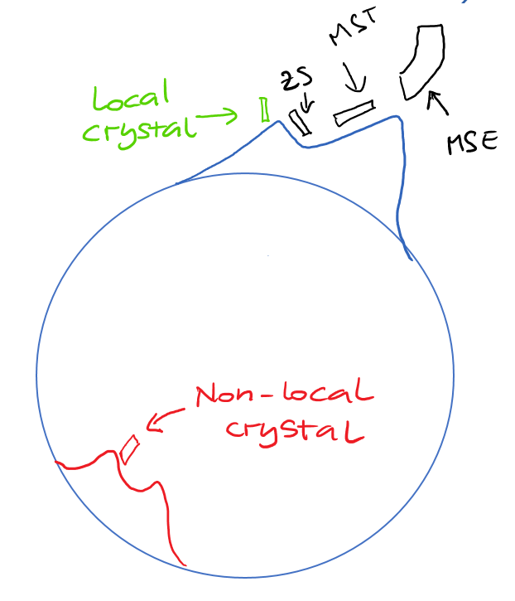
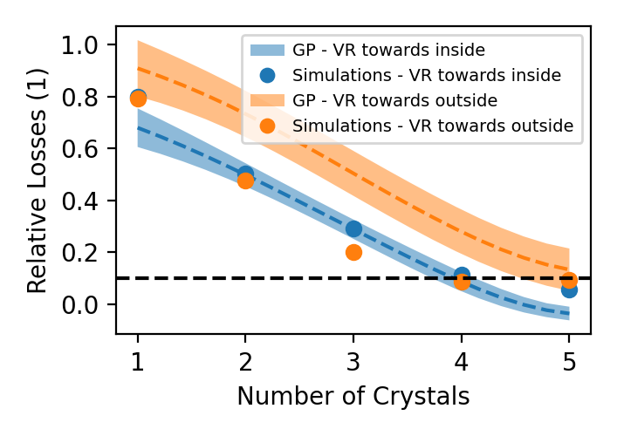
Crystal parameter optimization
Add low or high-fidelity data to dataset
Accurate simulation take ~ 10 min → just a waste of time/resources to run a full grid scan in a 6D space
Made cheap surrogate (NN) with a few low-particles simulations
Run multi-fidelity optimization to get optimal configuration for MVRA
Basically, optimization done on simulations with very large number of particles as only run a few times
Update surrogate model
parameters
ZS losses
MVRA parameters
Get next point: low or high fidelity
Direction | Angle (urad) | Position (mm) | Width (mm) | Relative angle (urad) | N. Crystals (1)
VR to inside | -789 | -16.03 | 1.4 | -7 | 5
VR to outside | -562 | -15.96 | 1.3 | -9 | 5

Slide 9
Commissioning

Slide 10
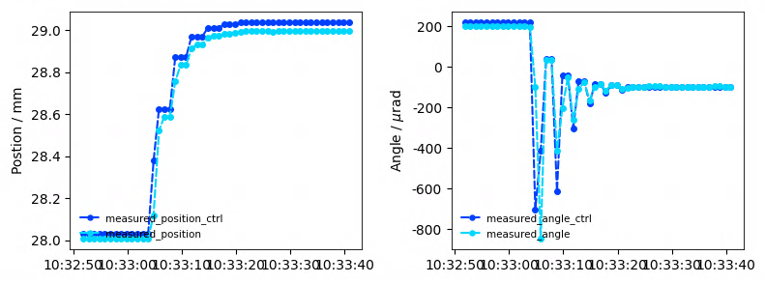
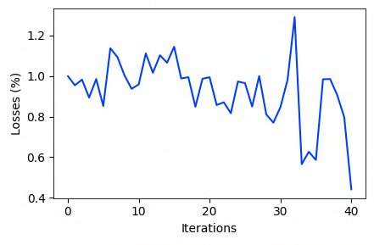
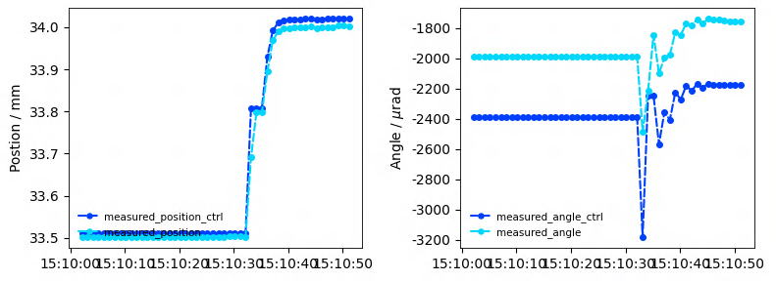
Control crystal in LVDT “settings”
High level controller (simple PID) developed and tested in the SPS
We could control the TECA using its LVDT (absolute position and angle measurement) instead of motor control ➔ not affected anymore by non-reproducibility of position and angle of the crystal
It allows to properly use numerical optimizers

Slide 11
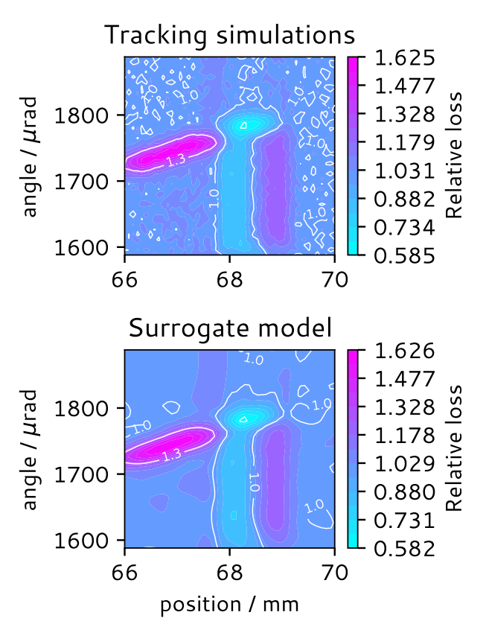
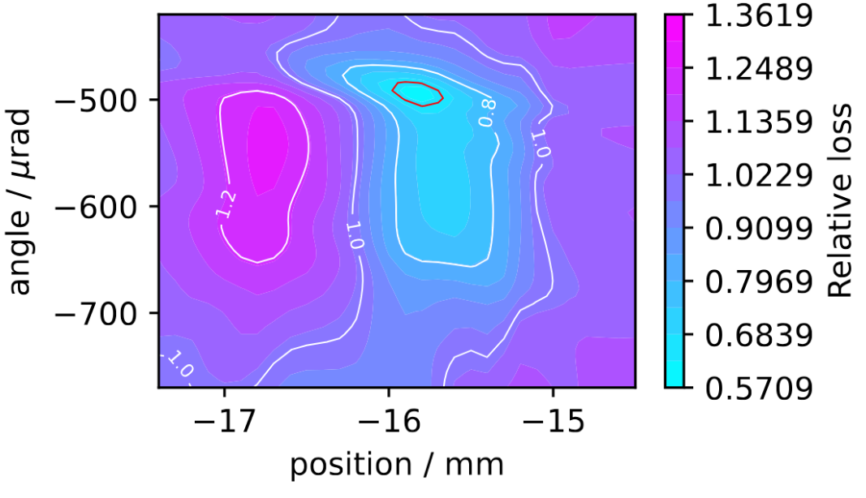
Optimum acceptance for shadowing
The main complexity to deploy shadowing in operation is given by the small optimum acceptance
For the SX shadowing, this is true both in angle and position
Easier when working in full VR, as for the local crystal ➔ ~160 urad acceptance
For the non-local one, it goes down to ~10 urad (this NOT channeling!!)
TECS
TECA
Acceptance for loss reduction

Slide 12
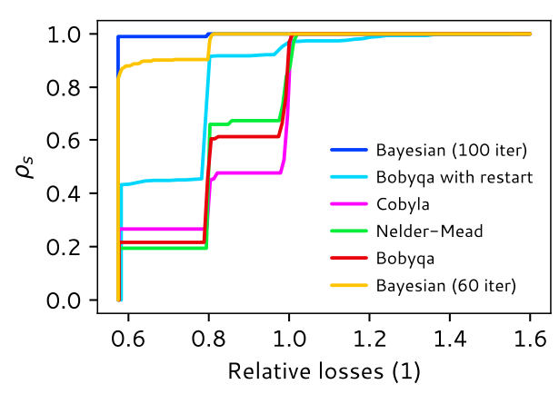
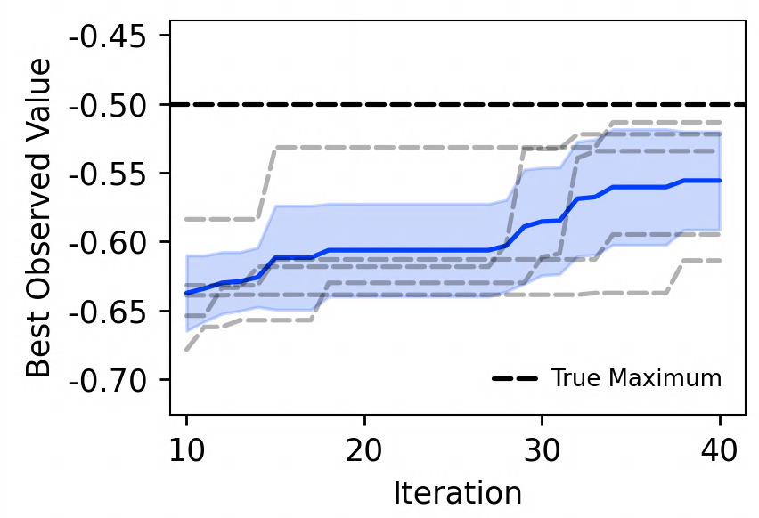
Crystal setting up
For shadowing, we need to optimize 2 parameters: angle and position
Can do with scans, but rather lengthy – SPS cycles are expensive!
Need to low intensity – in some configurations, higher losses on ZS
Prepared NN to emulate simulations:
NN(angle, position) = Loss at ZS
Bayesian optimization clearly best algorithm to use
Real machine data (TECA)

Slide 13
Operation

Slide 14
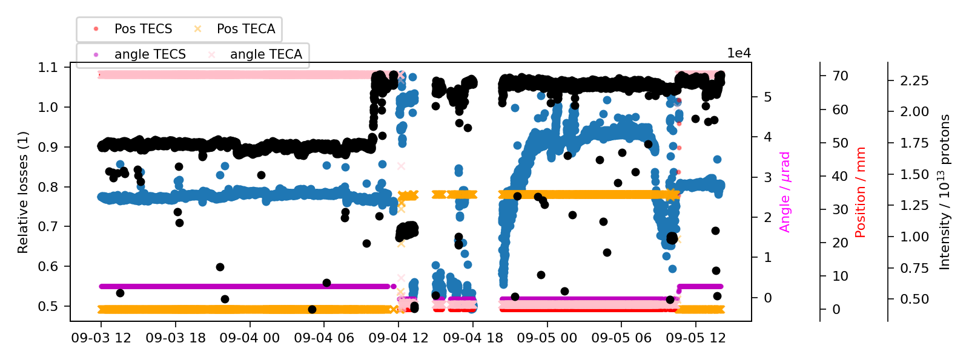
Operational test with nominal intensity
Operational test carried out → very important results:
TECA can reduce losses x2 in this configuration also with high intensity
Loss reduction is not resilient to machine stops or changes
Major difference before and after long stop for MKDH cable replacement
The good news is that the beam “drifts away”, hence we could catch this with “simple” feed-forward controller!
Drift from nominal loss reduction

Slide 15
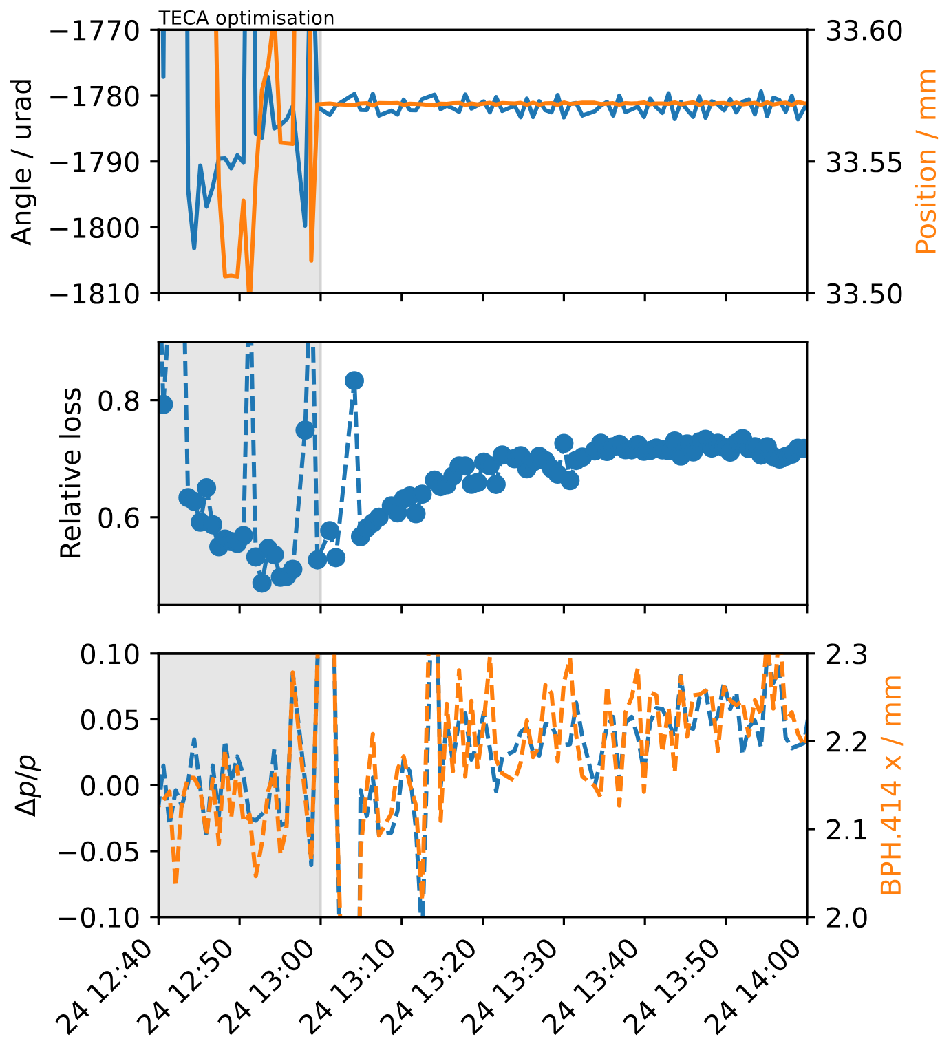
Continuous controller
Local shadowing with the TECS in VR has been working rather OK since re-start after LS2
Angular acceptance is rather large, hence only once a month re-alignment needed: can do with numerical optimizer
Non-local shadowing with TECA has a very tiny angular acceptance: ~10 urad
Showed already that cannot maintain loss reduction without adjusting for standard orbit drifts
Clearly seen the orbit drifting ➔ change in loss reduction at the ZS

Slide 16
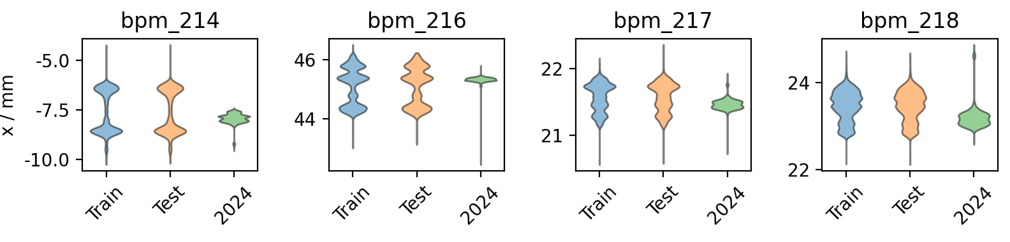
CO distribution along the years
The CO seems the main contributor to the loss of shadowing during operation
The orbit seems to change quite a lot during the years and not possible to fully correct for it
Only thing we could do is to flatten the extraction…but it is rather lengthy process → need to reduce intensity, remove extraction bump, stop extraction and then correct
Not really feasible to do this often in operation

Slide 17
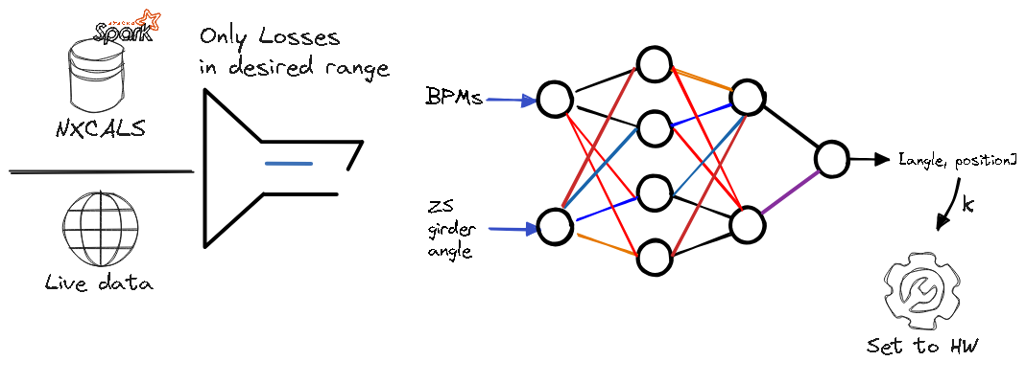
Continuous control: models
The control problem is complex → no obvious way to know the direction in (angle, position) space of the optimum
The idea then is to use the BPMs in extraction regions (LSS4 and LSS2), ZS girder angle and to fit a model to predict optimal crystal alignment
Gaussian process/Gradient Boosting/NN used for TECA: very high accuracy and uncertainty estimation
+ LVDT very accurate, + many points in separated in time of optimum, - small acceptance, - small dataset, - motor resolution
NN for TECS: much more complicated due to the non-unicity of the solution (VR plateau)
+ loads of data, + large acceptance, - non-injective response, - very large LVDT noise

Slide 18
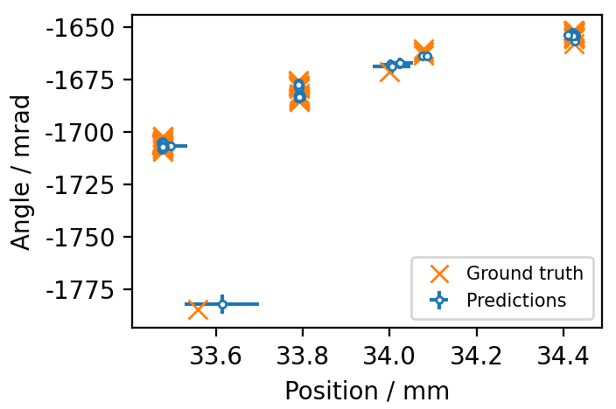
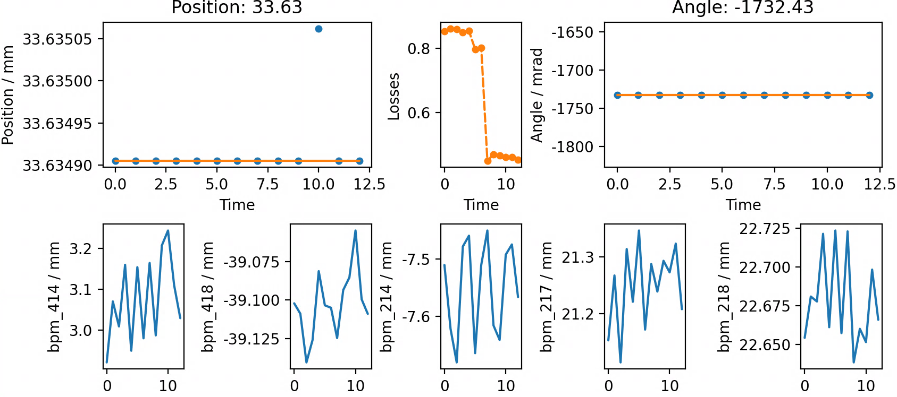
Continuous control: models
TECA
Solved with a NN and partially with Gaussian Process and Gradient Boosting ➔ NN better at finding good estimation far from training data
GB tested in MD and first results very successful ➔ expected NN to be better!
Need to collect more data to make it robust – so far tested only in 1 MD
TECS
Needed quite large NN – finally had to compromise on output
Robust solution seems to predict position of crystal and the estimate angle – pretty much linear relation
Not so critical as TECA but still would be good to have
TECA

Slide 19
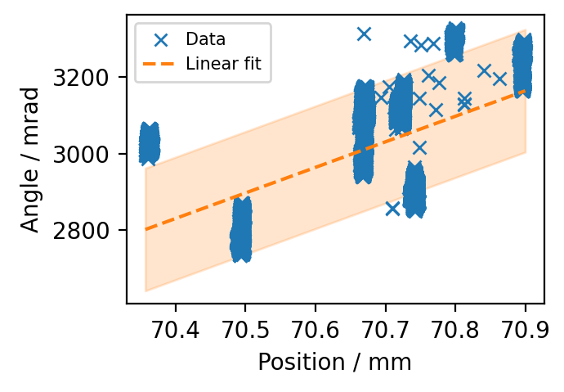
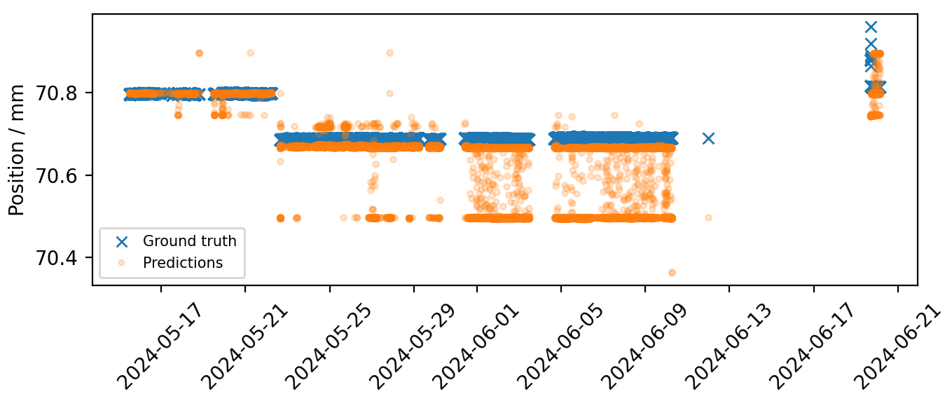
Continuous control: models
TECA
Solved with a NN and partially with Gaussian Process and Gradient Boosting ➔ NN better at finding good estimation far from training data
GB tested in MD and first results very successful ➔ expected NN to be better!
Need to collect more data to make it robust – so far tested only in 1 MD
TECS
Needed quite large NN – finally had to compromise on output
Robust solution seems to predict position of crystal and the estimate angle – pretty much linear relation
Not so critical as TECA but still would be good to have
TECA
TECS

Slide 20
Next steps
Keep improving f(BPMs, ZS) ➔ TECS/A model:
Need to test a few more models and methods to ensure high accuracy
VAE to reduce dimensionality of BPMs for final model fitting
Different NN architecture
Collect data with deliberate orbit change (trim on orthogonal knobs in LSS4 and LSS2, change radial position at flat top) and find new crystal optima (next MD on shadowing)
Test MPC fitting NN on: f(BPMs, ZS, TECS/A) ➔ losses
It should be more robust → less sensitive to NN errors
Data available should be enough
Make a simple simulation model and test this approach
Test model on TECS and TECA

Slide 21
Summary and outlook
Crystal shadowing offered many application for automation, advanced numerical optimization and machine learning
Used for both design stage and deployment in operation
Main issue so far is to deal with change over time of SPS closed orbit
Fast numerical optimization models to quickly set up the crystal in shadowing → mostly operational, but more work ongoing to push performance
Predictive models to build live controllers for both TECA and TECS on the way → first PoC done, but still quite some work to make them work consistently for long period of time
Aim to have online controller working this year and be able to test for long periods next year

Slide 22
Thank you!

Slide 23
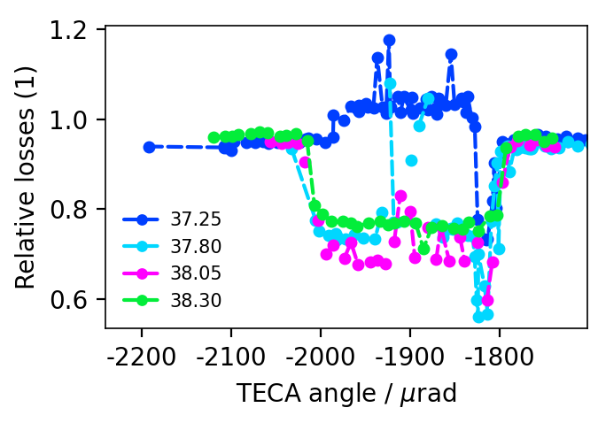
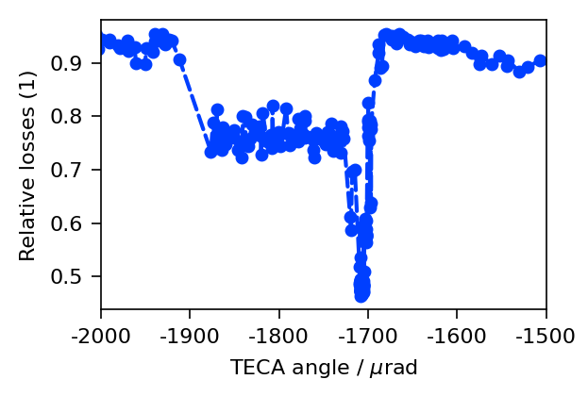
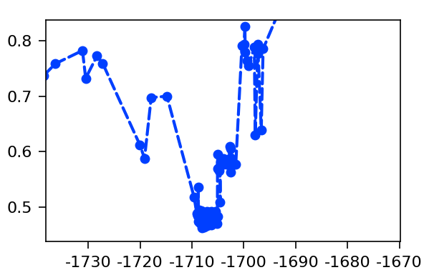
Non-local shadowing machine results
Dedicated measurements with non-local crystal (TECA) started in 2022
Shadowing angle found rather quickly → 55% loss reduction!!
Shadowing position clearly visible in AM scan ➔ NOT channelling but only VR!
Configuration very reproducible using LVDT measurements of position and angle of the crystal
2022
33.5 mm

Slide 24
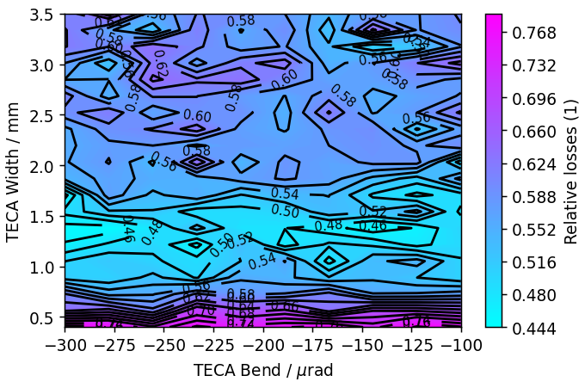
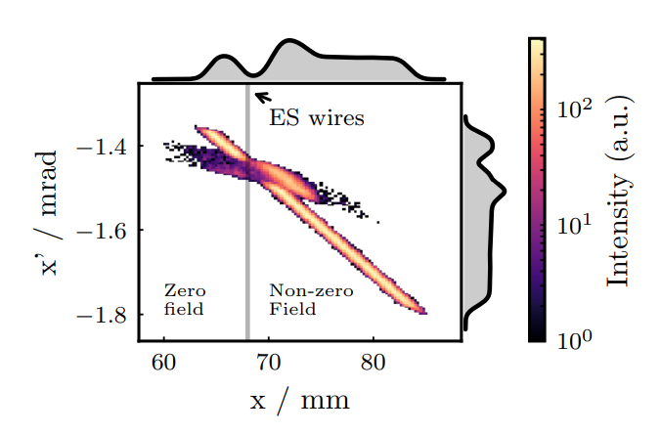
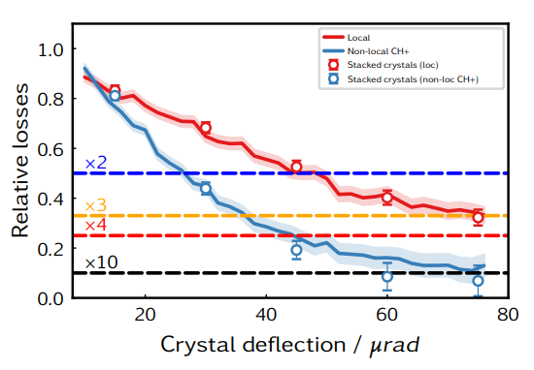
Non-local shadowing - simulations
Optimal configuration for single crystal: 1.25 mm crystal with > 100 urad bend
Main advantage is that we exploit VR, hence easier to transport beam in transfer line
Today we struggle to transport channelled beamlet to target in case of local shadowing
To reduce losses further, need to use Multi Volume Reflection Array (MVRA) crystals (see last workshop slides)
Further simulations ongoing to evaluate the best configuration also considering local crystal
Up to x10 loss reduction with 4-5 MVRA oriented (CH) towards the outside of the ring

Slide 25
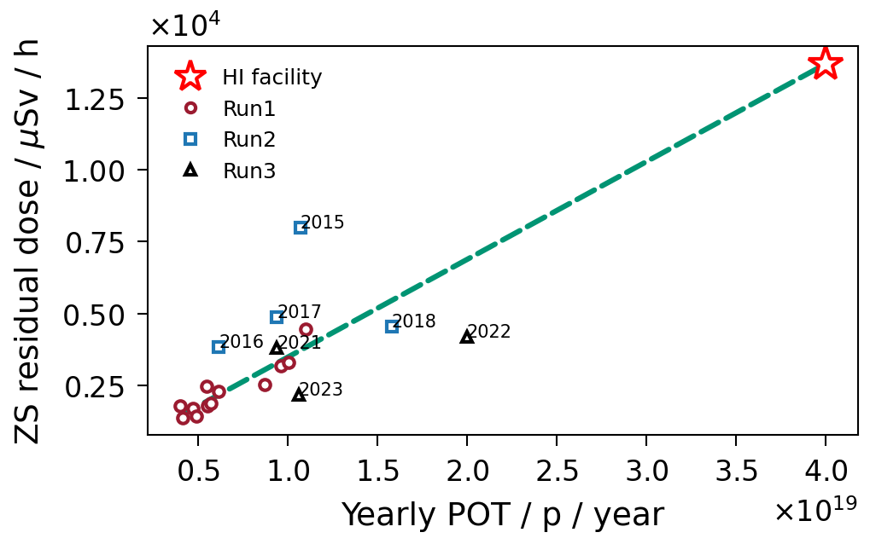
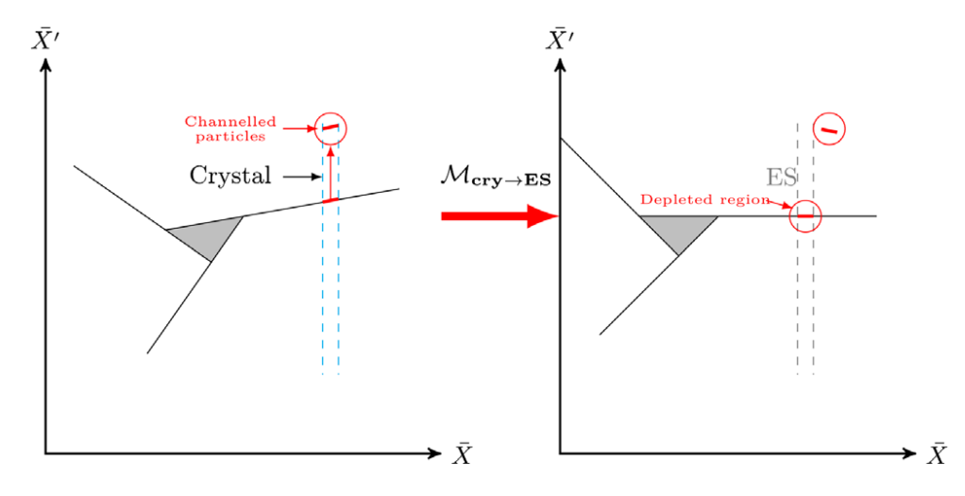
Introduction to crystal shadowing
SPS main physics users served with 4.8 s spill via 3rd integer resonant slow extraction
About 3% of the beam lost on the ES
Loss ➔ activation ➔ limit to the max proton on target (POT)
Crystal shadowing very promising
Shadow the ES with thin bent crystal
Already very good results obtained with local shadowing ➔ x2 loss reduction in MDs and 20% reduction during physics (see later)
New facilities (hidden sector physics, Kaon physics…) require much larger POT than today → ~x4
Goal > Run 3

Slide 26



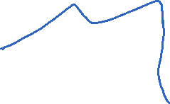


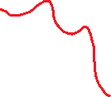
Non-local shadowing - simulations
From normal slow extraction to crystal shadowing
From local shadowing to non-local shadowing
Non-local shadowing concept developed in simulations [1]
Gain in efficiency using volume reflection (~98% vs ~45%) and exploit amplitude dependent phase-advance
Extraction sextupole in between

Slide 27
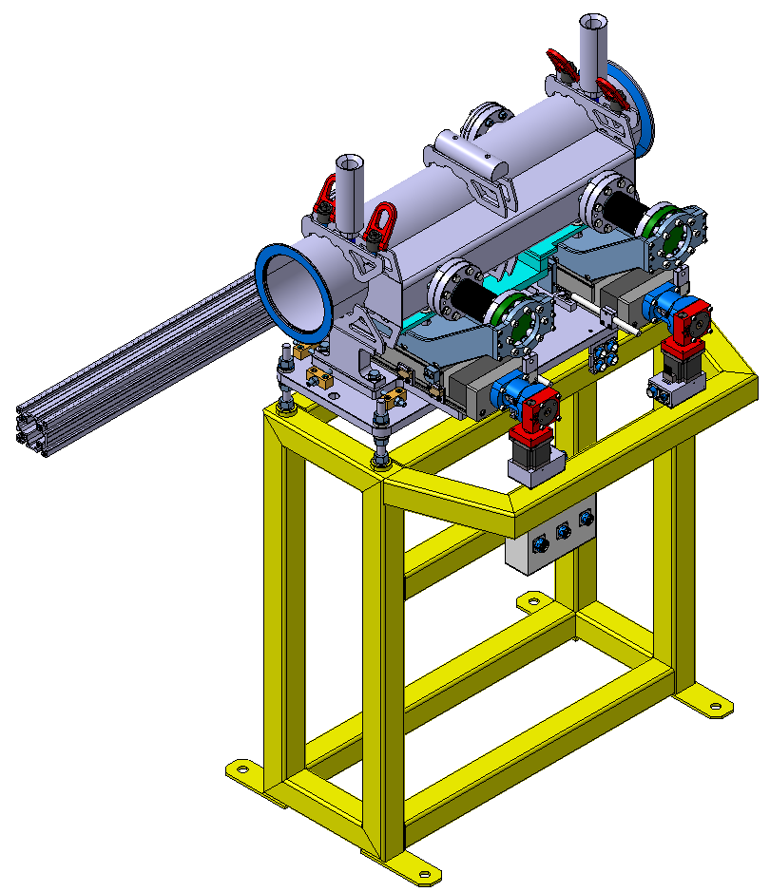
Today in the SPS
TECS
Installed crystal for non-local shadowing in LSS4: TECA
Same crystal as in LSS2: 0.8 mm width with 160 urad bending angle
Goniometer differences LSS2 vs LSS4:
Actuating from the inside of the SPS
Crystal oriented towards the inside
Space for 2 crystals but only one used
Both crystals can only be reached with a closed orbit bump at high energy
Enough aperture for injected beam
TECA

Slide 28
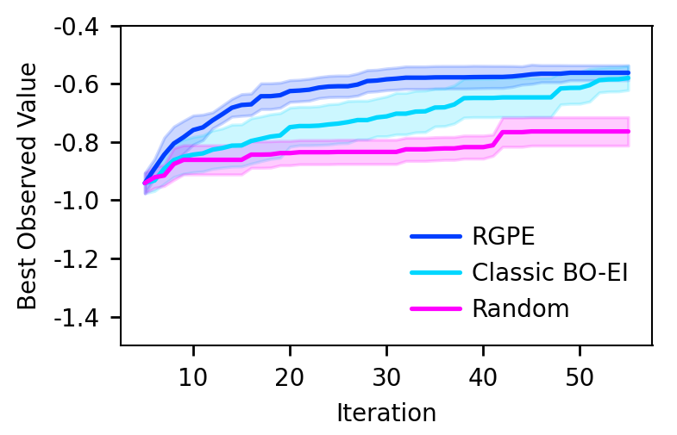
Faster alignment – meta-Bayesian optimisation
RGPE Bayesian optimisation for TECS alignment tested in simulations
Promising x2 speed up to find channelling (~10 urad large minimum)
During machine tests, showed we can align TECA via BO in ~50 cycles
Very reproducible and robust
Only issue is the minimum step size the crystal can do
Test RGPE on machine → this year!
Real machine data (TECA)
Simulations (TECS)

Slide 29
Faster crystal alignment: can we do better?
Alignment with BO demonstrated with local and non-local installation in 40-60 machine cycles…can we do better?
This can be between 20 and 50 minutes, depending on machine configuration
Crystal alignment ➔ very accurate model (from tracking)
Uncertainty on absolute value of input parameters (angle and position): it could be shifted, scaled…

Slide 30
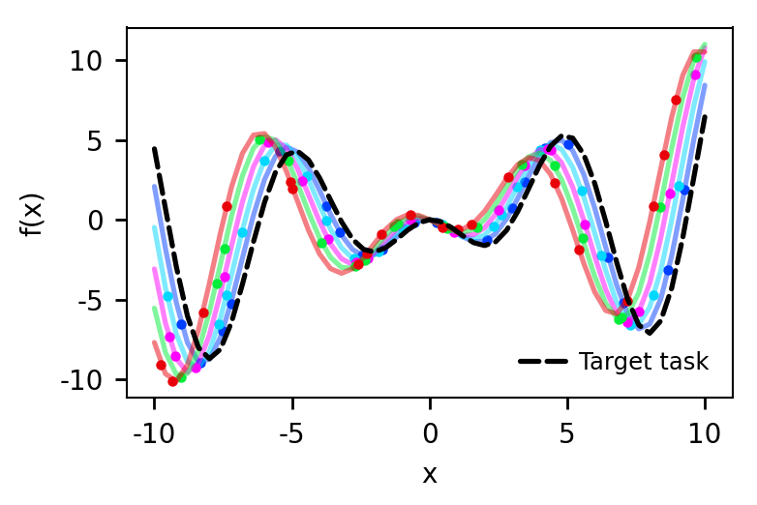
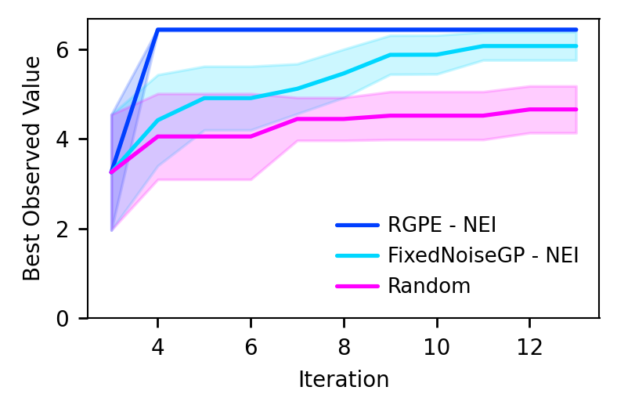
Faster alignment – meta-Bayesian optimisation
Rank-Weighted GP-Ensemble [2]
Usage of multiple Gaussian Process (GP) models to represent the underlying function
Each GP represents the target function with a give difference (shift, scale, rotation…)
The final prediction is made by combining the predictions of all the GPs using a weighting scheme that considers the quality of the predictions of each GP

Slide 31
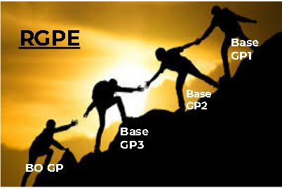
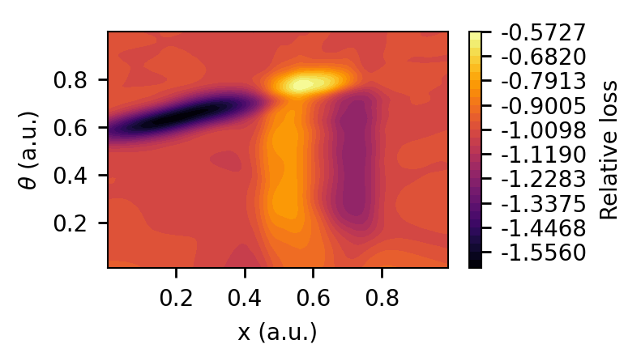
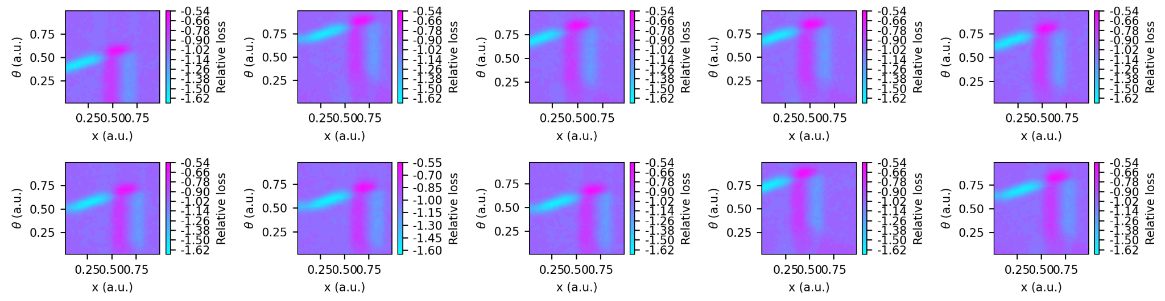
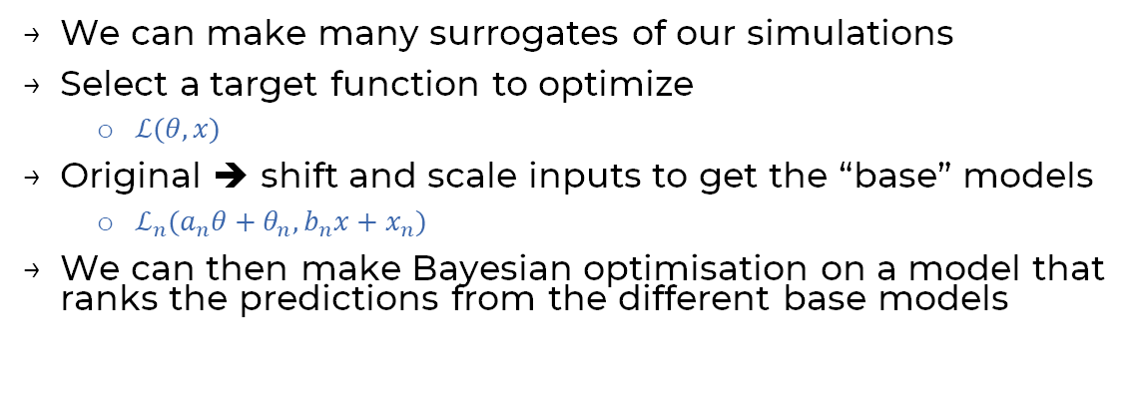
Faster alignment – meta-Bayesian optimisation
We can make many surrogates of our simulations
Select a target function to optimize
$ℒ(θ, x)$
Original ➔ shift and scale inputs to get the “base” models
$ℒ_{n}(a_{n}θ+θ_{n}, b_{n}x+x_{n})$
We can then make Bayesian optimisation on a model that ranks the predictions from the different base models

Slide 32
Summary
SPS operated with crystal in VR with ~30% loss reduction for the last 3 years
Intensity extracted from 1e12 to 4e13 ppp
Loss reduction of x2 are within reach for operational beams
x2 loss reduction demonstrated with non-local installation in LSS4 in physics conditions
Need controller to be able to operate in this regime for long
Proposed method to align crystals in ~30 machine cycles
RGPE ready to be tested in the machine
Simulations improved to properly reproduce results and extrapolate:
Performance reach with single crystal seems between x2 and x3 (and not the hopped x4)…need something more to get to x4 target!

Slide 33
Example of orbit drift
Operational test carried out → very important results:
TECA can reduce losses x2 in this configuration also with high intensity
Loss reduction is not resilient to machine stops or changes
Major difference before and after long stop for MKDH cable replacement
The good news is that the beam “drifts away”, hence we could catch this with “simple” feed-forward controller!
Loss reduction with TECS

Slide 34
Operational test with nominal intensity
Operational test carried out → very important results:
TECA can reduce losses x2 in this configuration also with high intensity
Loss reduction is not resilient to machine stops or changes
Major difference before and after long stop for MKDH cable replacement
The good news is that the beam “drifts away”, hence we could catch this with “simple” feed-forward controller!
TECA setting up

Slide 35
Operational test with nominal intensity
Operational test carried out → very important results:
TECA can reduce losses x2 in this configuration also with high intensity
Loss reduction is not resilient to machine stops or changes
Major difference before and after long stop for MKDH cable replacement
The good news is that the beam “drifts away”, hence we could catch this with “simple” feed-forward controller!
TECA in shadowing with HI beam

Slide 36
Operational test with nominal intensity
Operational test carried out → very important results:
TECA can reduce losses x2 in this configuration also with high intensity
Loss reduction is not resilient to machine stops or changes
Major difference before and after long stop for MKDH cable replacement
The good news is that the beam “drifts away”, hence we could catch this with “simple” feed-forward controller!
Long machine stop

Slide 37
Operational test with nominal intensity
Operational test carried out → very important results:
TECA can reduce losses x2 in this configuration also with high intensity
Loss reduction is not resilient to machine stops or changes
Major difference before and after long stop for MKDH cable replacement
The good news is that the beam “drifts away”, hence we could catch this with “simple” feed-forward controller!
Re-start and beam slowly drifting away

Slide 38
Operational test with nominal intensity
Operational test carried out → very important results:
TECA can reduce losses x2 in this configuration also with high intensity
Loss reduction is not resilient to machine stops or changes
Major difference before and after long stop for MKDH cable replacement
The good news is that the beam “drifts away”, hence we could catch this with “simple” feed-forward controller!
Shadowing lost – TECA in AM

Slide 39
Operational test with nominal intensity
Operational test carried out → very important results:
TECA can reduce losses x2 in this configuration also with high intensity
Loss reduction is not resilient to machine stops or changes
Major difference before and after long stop for MKDH cable replacement
The good news is that the beam “drifts away”, hence we could catch this with “simple” feed-forward controller!
Shadowing lost – TECA in AM

Slide 40
Operational test with nominal intensity
Operational test carried out → very important results:
TECA can reduce losses x2 in this configuration also with high intensity
Loss reduction is not resilient to machine stops or changes
Major difference before and after long stop for MKDH cable replacement
The good news is that the beam “drifts away”, hence we could catch this with “simple” feed-forward controller!
Attempt to re-optimize but TECA blocked due to motor inaccuracy

