Slide 1
Medical facilities in Japan
Hikaru Souda¹⁾, Takayuki Kanai¹⁾²⁾, Sung Hyun Lee¹⁾, Yuya Miyasaka¹⁾, Hongbo Chai¹⁾, Miyu Ishizawa¹⁾, Takeo Iwai¹⁾, Shun Sawamura³⁾, Kyohei Nagai³⁾, Fumihisa Ouchi³⁾, Takayuki Taguchi³⁾, Michitaro Sei³⁾, Yohei Kanto³⁾, Azusa Sato³⁾, Masashi Katsumata³⁾ , Izumi Kobayashi³⁾, Koji Noda⁴⁾
1) Yamagata University
2) Tokyo Women’s Medical University
3) Accelerator Engineering Corporation
4) The Wakasa Wan Energy Research Center
Notes:
Thank you chair for introduction, My name is Hikaru Souda from Yamagata university, Japan. I would thank the International Advisory Committee for invitation. This talk is an application of ion source, medical accelerator. I will talk about Commissioning and first operation of East Japan Heavy Ion Center at Yamagata University.

Slide 2
Outline
Medical Synchrotrons in Japan
Slow Extraction of Carbon Ion Therapy Synchrotron
Operation Experience at Yamagata University
Summary
Notes:
This is outline of my talk. First, I will introduce Carbon Ion Radiotherapy. Then, our Facility and Treatment Machine. Next is Commissioning, for clinical irradiation, and for rotating gantry. Next is first operation experience, treatment statistics and accelator and ion source. The last is future development.

Slide 3
Medical Synchrotrons in Japan
Notes:
Introduction of Carbon Ion Radiotherapy

Slide 4
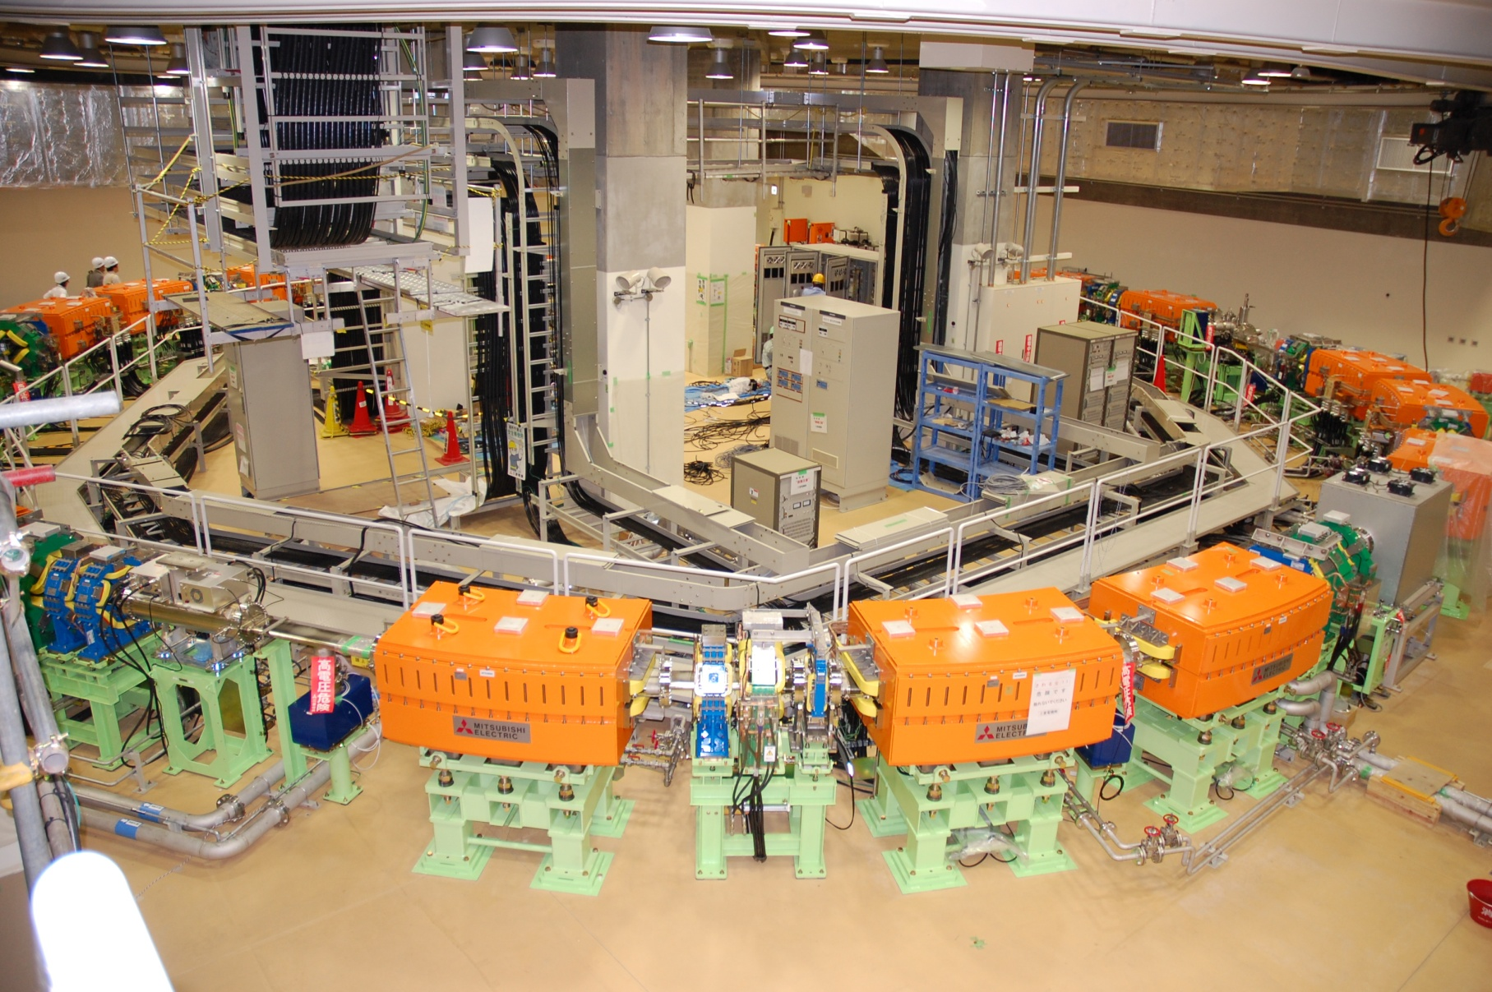
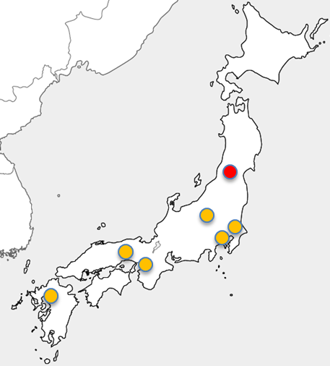
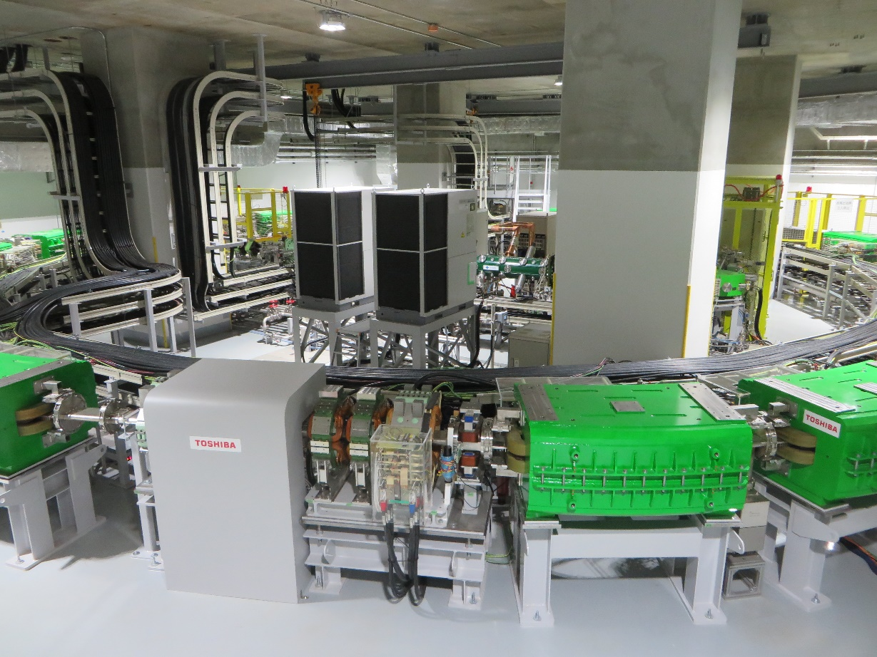
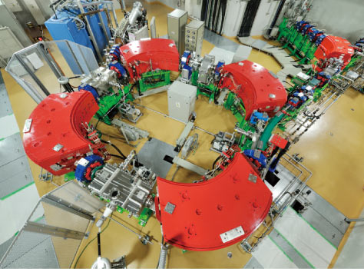
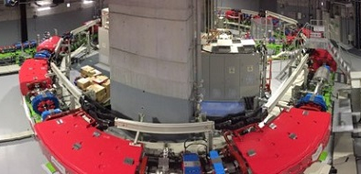
Medical Synchrotrons in Japan
7 Synchrotrons for Carbon Ion Therapy
  (incl. 1 P/C compatible)
12 Synchrotrons for Proton Therapy
Mitsubishi: C 400 MeV/u
(discontinued)
Mitsubishi: p 230MeV
(discontinued)
Toshiba: C 430 MeV/u
Yamagata
Hitachi: p 220MeV
Carbon Synchrotron
Proton Synchrotron
Hitachi: C 430 MeV/u

Slide 5
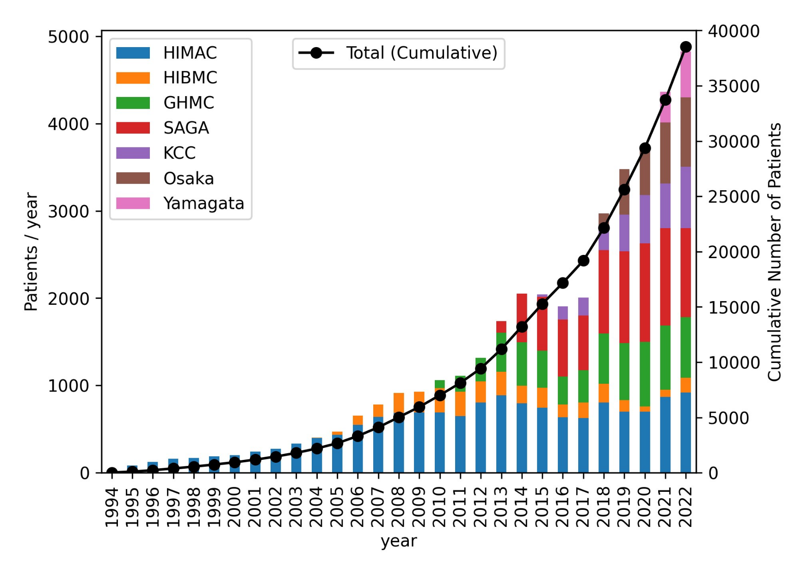

Carbon Ion Therapy in Japan
1975-1992 Ion therapy (He, Ne, etc.) at Bevatron, LBL ,USA
1994- Carbon Ion Therapy at HIMAC, Japan
2010- Compact Carbon Ion Treatment Facilities
>35000 patient treated by 7 facilities in Japan
Head & Neck
2%
● Covered by National health Insurance
Liver
11%
Lung
2%
Pancreas
7%
Prostate
69%
Kidney
1%
Uterus
1%
Bone
3%
Cancer sites treated in
Yamagata University
Oct. 2022 – Jul.2023
Rectum
2%
Carbon Ion Radiotherapy is a necessary technology in Today’s Medicine
Notes:
This is the progress of carbon ion therapy. It started in LBL with Helium and neon beams, but shutdown in 1992. On 1994, Carbon Ion Therapy started at HIMAC, Chiba, Japan. It gave very good clinical result. From 2010, Compact Carbon Ion Treatment Facilities increased in Japan. 35,000 patient were already treated by 7 facilities in Japan.
It is a necessary technology in Today’s Medicine

Slide 6
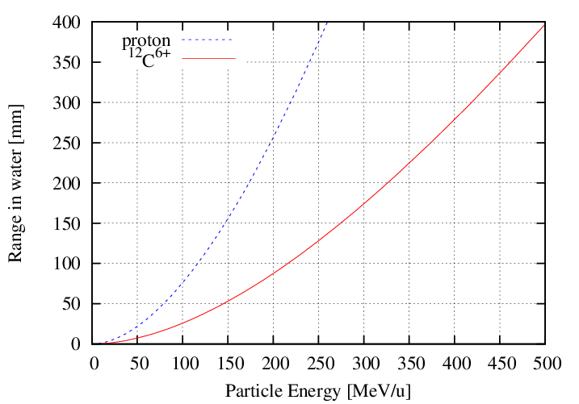
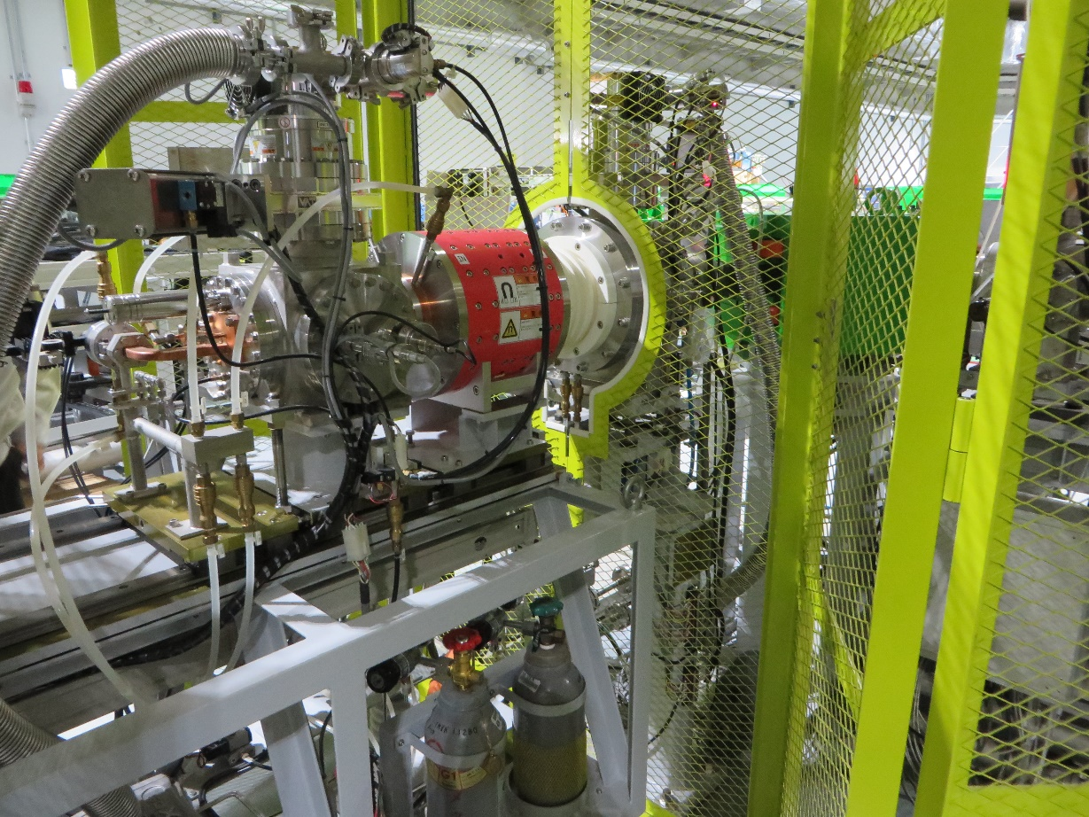
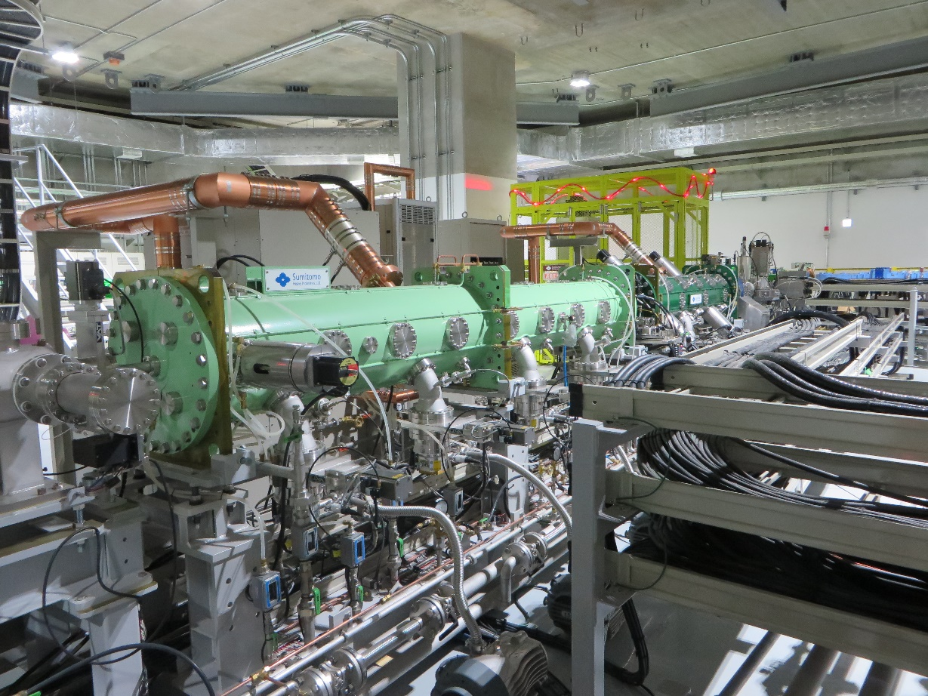
Compact Carbon Ion Accelerator
430 MeV/u ¹²C⁶⁺, range 300 mm
4 MeV RFQ+ IH-DTL for injector
Synchrotron w/ slow extraction
ECR Ion Source
C⁴⁺ 10 keV/u 170μA
RFQ + IH-DTL Injector
C⁶⁺ 4 MeV/u 160μA
Synchrotron (C ~ 63 m)
C⁶⁺ 55.6-430 MeV/u
Notes:
To realize carbon ion therapy, we need 430 MeV/u carbon beam, for 300 mm beam range.
The accelerator is synchrotron with slow extraction because we need precise dose control.
And injector linac and ECR ion source. I will show the details of accelerator.

Slide 7
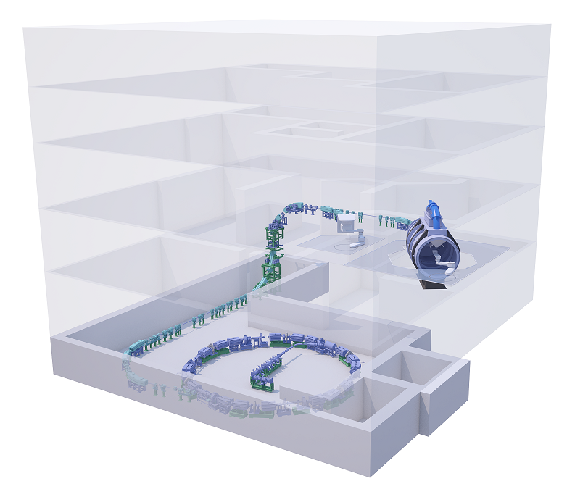
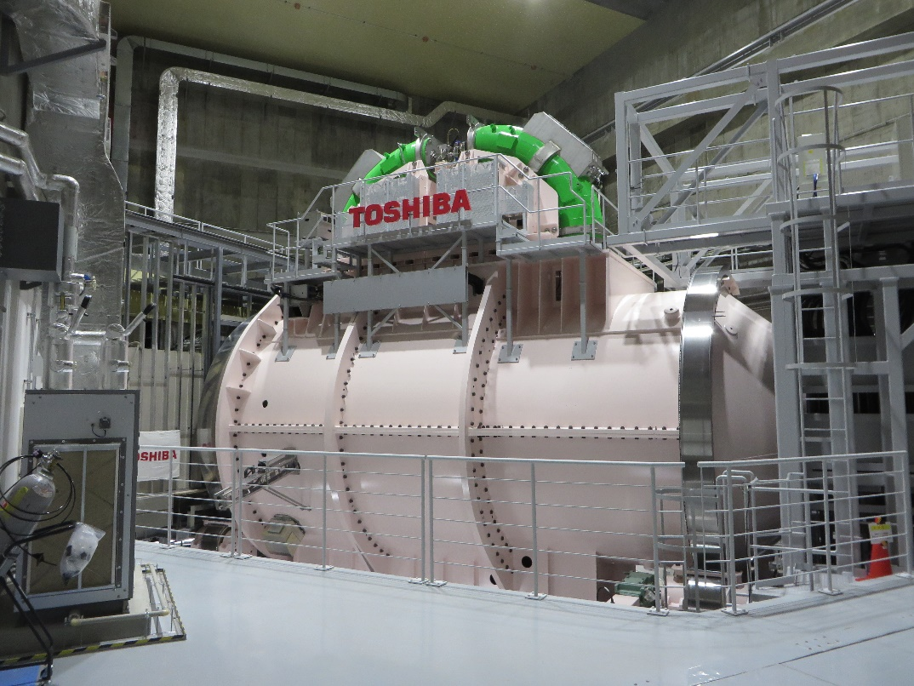
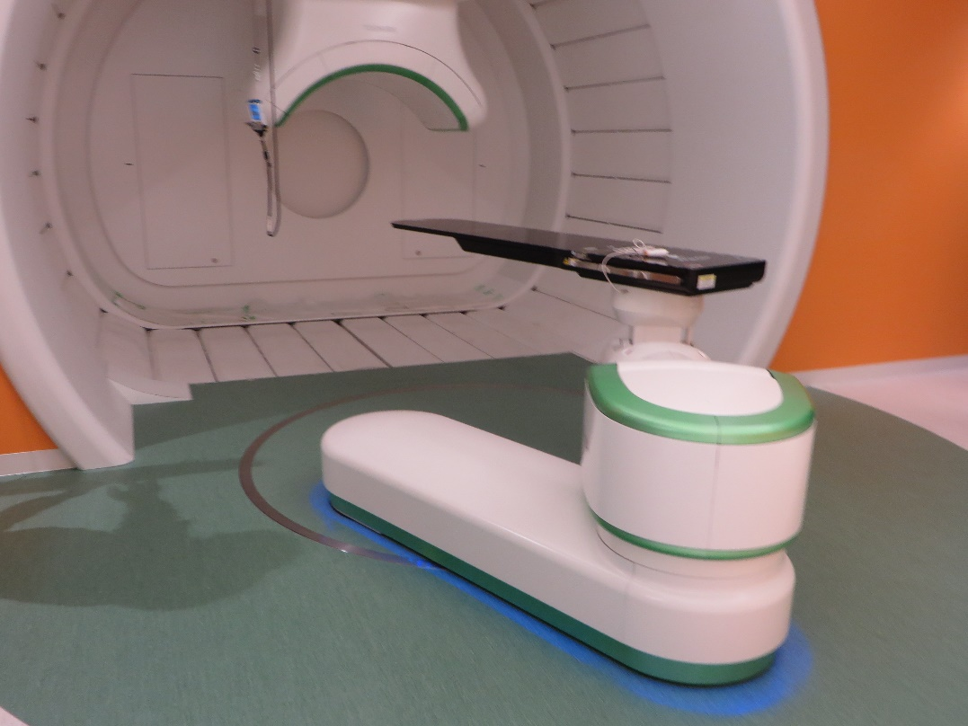
Compact Facility with Gantry
East Japan Heavy Ion Center (EJHIC), Faculty of Medicine, Yamagata University
  World Smallest Carbon Ion Facility (45 x 45 m)
  Full energy Scanning Irradiation
  Superconducting Rotating Gantry
Exported to Yonsei University and Seoul University in Korea
(Commercially Available)
Manufacturer: Toshiba Energy Systems & Solutions Co.
6m
~200 t
10m
New Standard model of Today’s Compact Carbon Ion Therapy Facility
Notes:
The facility name is East Japan Heavy Ion Center, Faculty of Medicine, Yamagata University. It is world smallest carbon Ion therapy Facility, its area is 45 x 45 m. The treatment machine including the accelerator was made by Toshiba. It has new technology, full energy scanning irradiation and Superconducting Rotating Gantry. These systems are exported to overseas, Yonsei University and Seoul University in Korea. I'd like to say, this is a New Standard model of today’s Compact Carbon Ion Therapy Facility.

Slide 8
Slow Extraction of
Carbon Ion Therapy Synchrotron

Slide 9
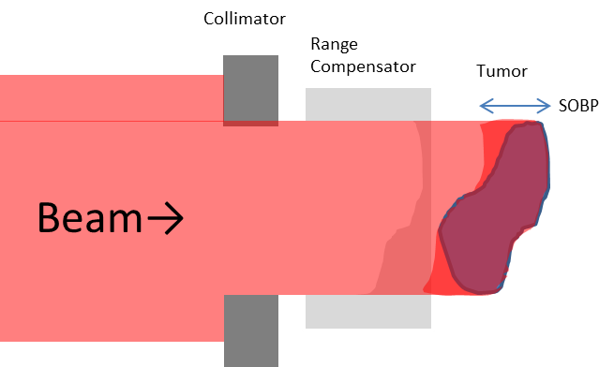
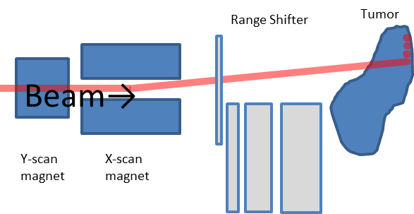
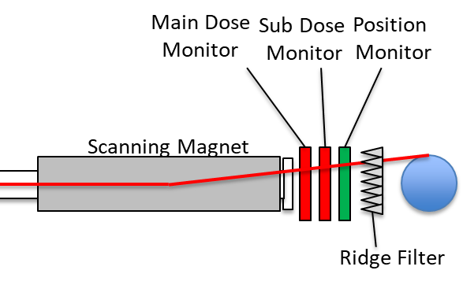
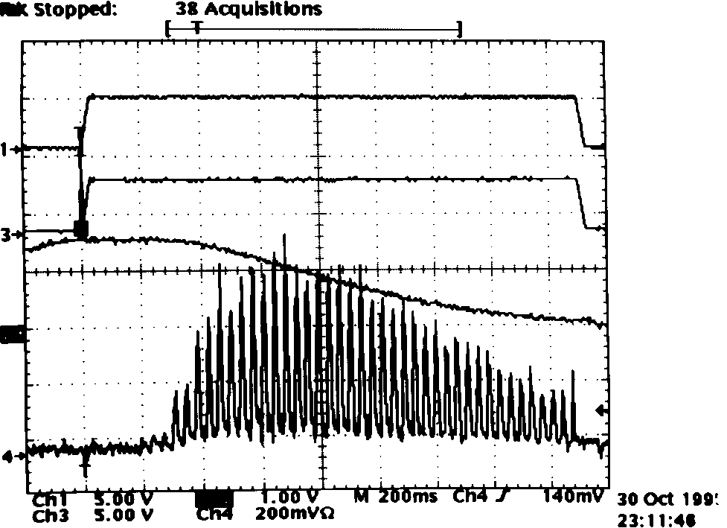
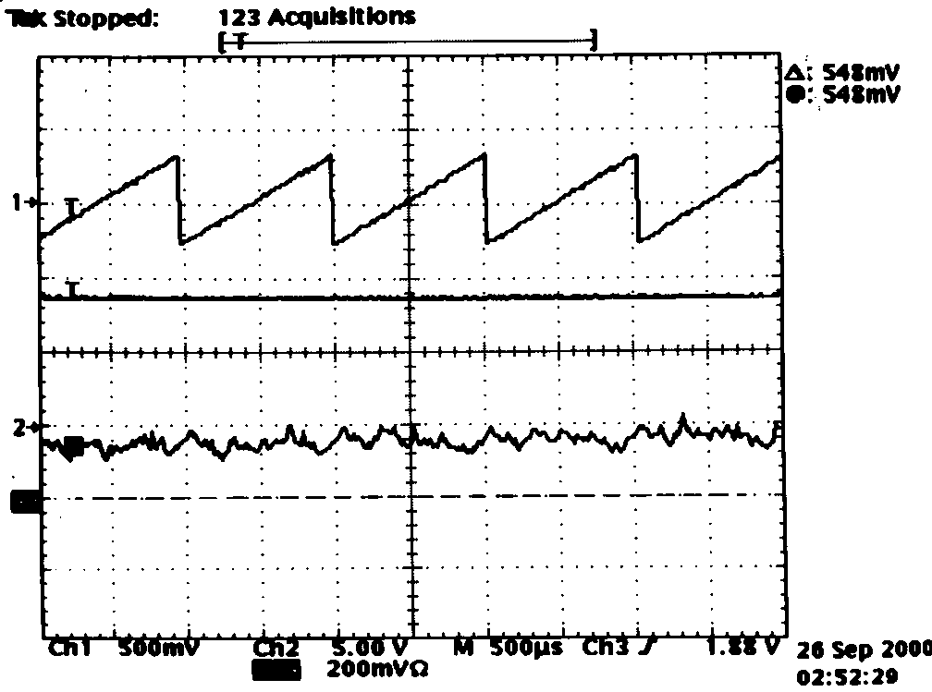
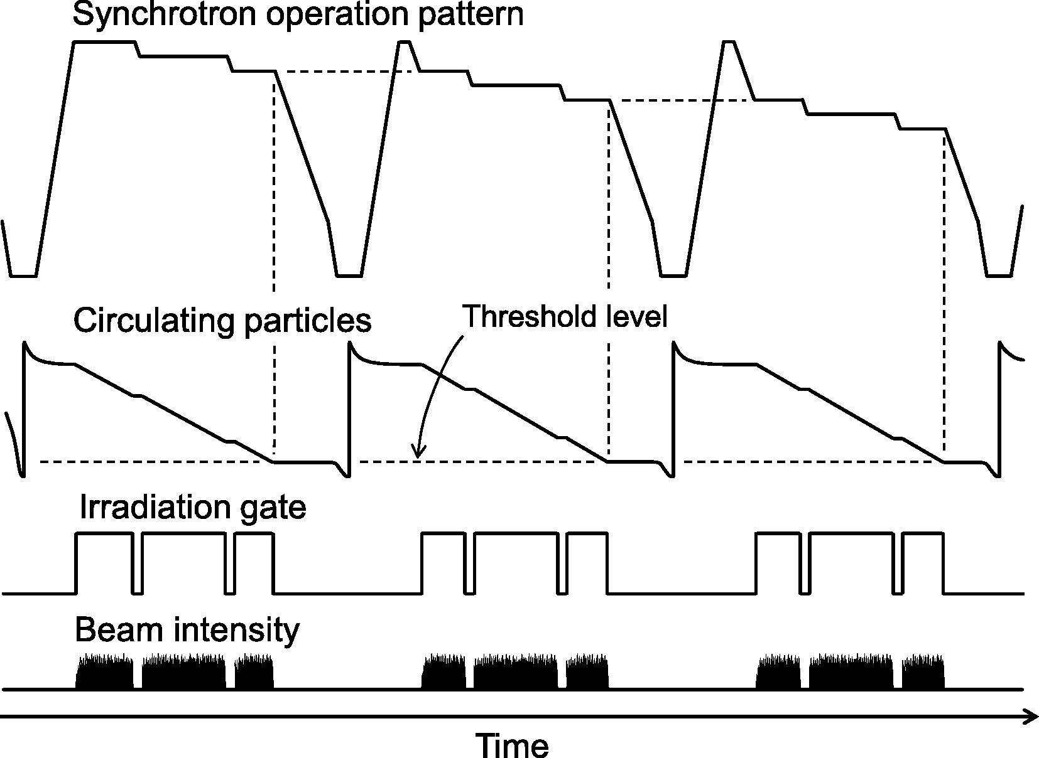
Evolution of Slow Extraction for Therapy
Broad Beam
Hybrid Scanning
Full Energy Scanning
1994
2011
2017
Large Spill Ripple Acceptable
No Need for Intensity control
Low Spill Ripple by Dual FM
Intensity Feedback by AM
No space for range shifter
200-600 extraction energy
Single RF-KO using FM with 777 Hz
K. Noda, 4th Slow Ext. Workshop
K. Noda et al., NIM A492, 253
(2002)
9
K. Mizushima et al., NIM B406, 347 (2017)

Slide 10
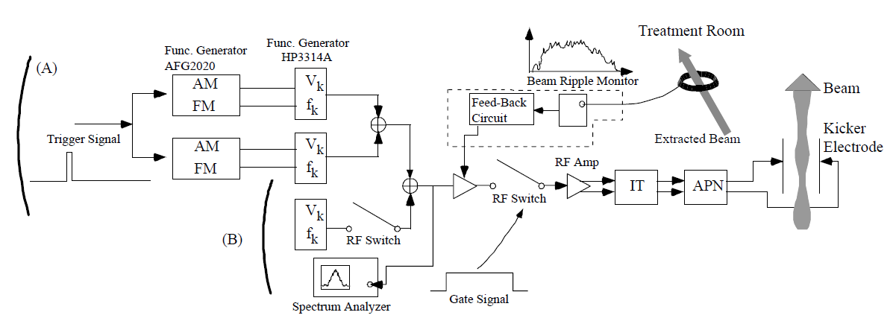
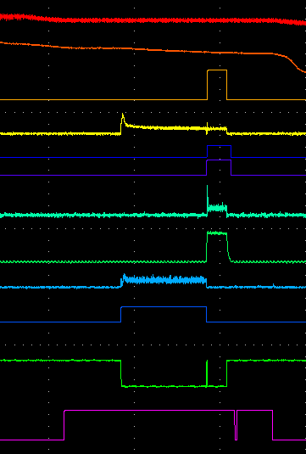
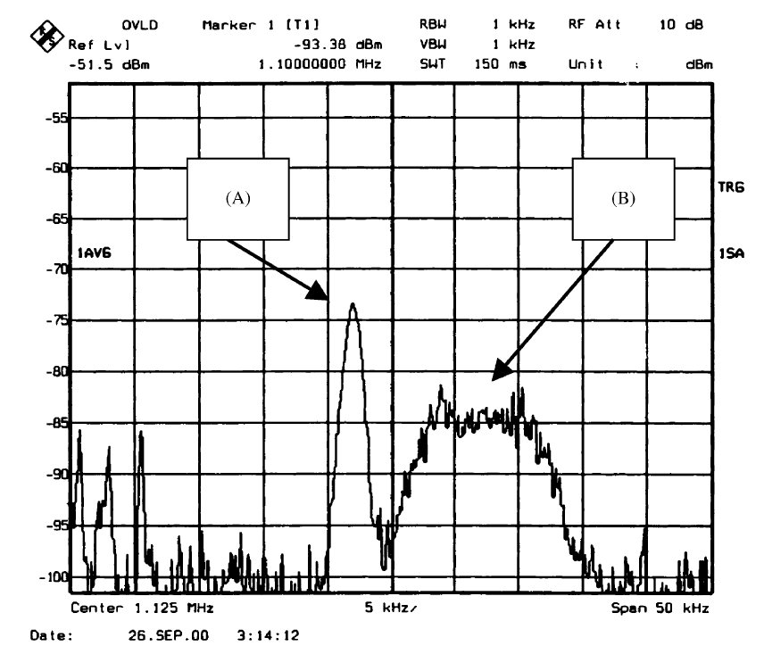
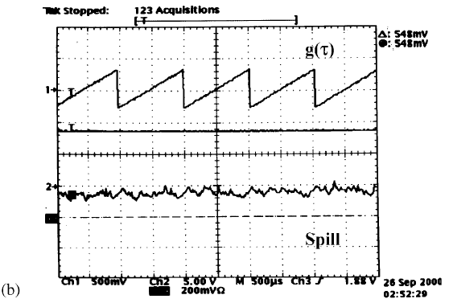
Extraction Control
Based on HIMAC Advanced RF-KO system
F1
AM
Pre-heat extraction to reduce spike after deceleration
F2
F3
RFKO AM
Treatment Room
Beam Dump
F3
F1,F2

Slide 11
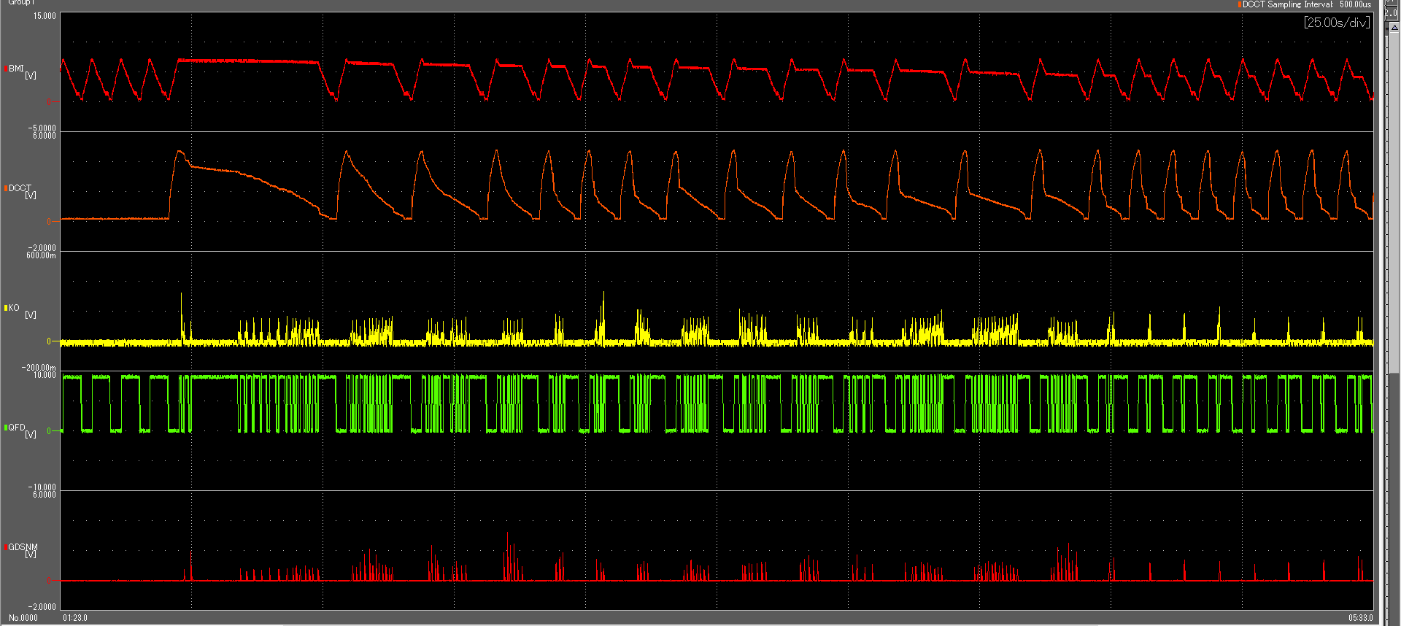
600 Energy Operation
Beam range is fully controlled by synchrotron energy
No range shifter … effective to downsize gantry
Extended Flattop Operation was developed in QST (200 energies for 1.5 or 2 mm step)
In Yamagata, 600 energies for 0.5 mm step
Bending Magnet Current (Beam Energy)
Beam Current
Extraction control signal
Extraction gate signal
Dose on treatment room
K. Mizushima et al. Nucl. Instrum. Meth. B406, 347 (2017)
11

Slide 12
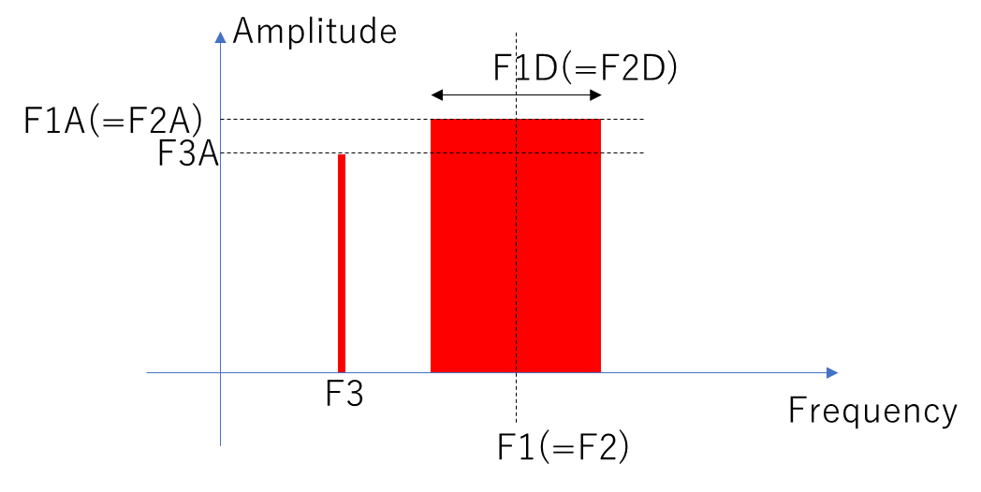
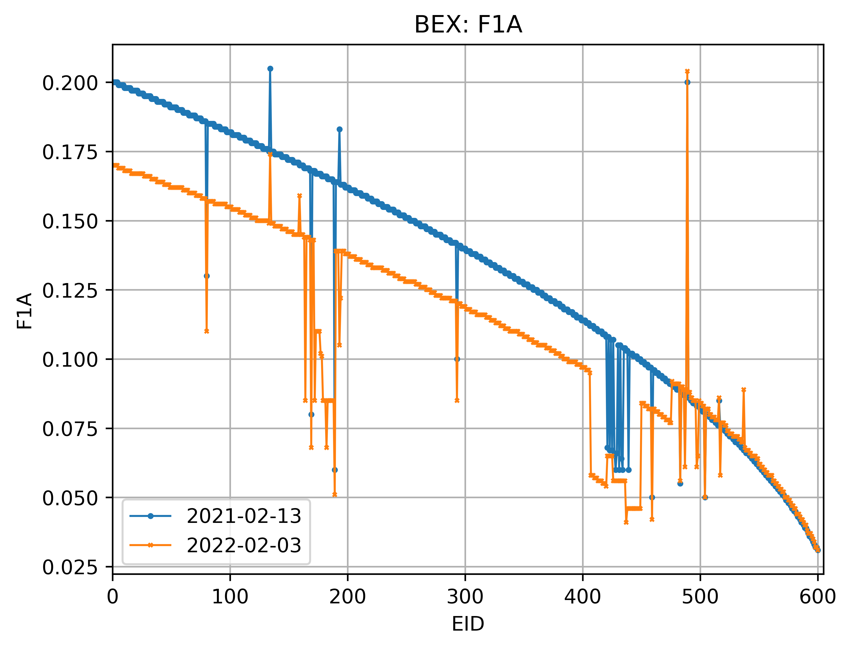
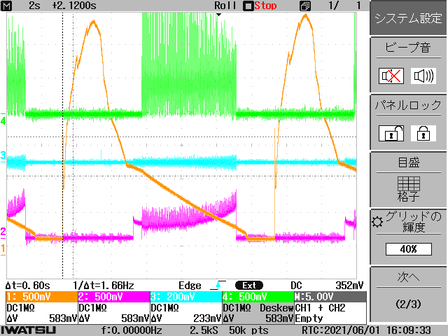
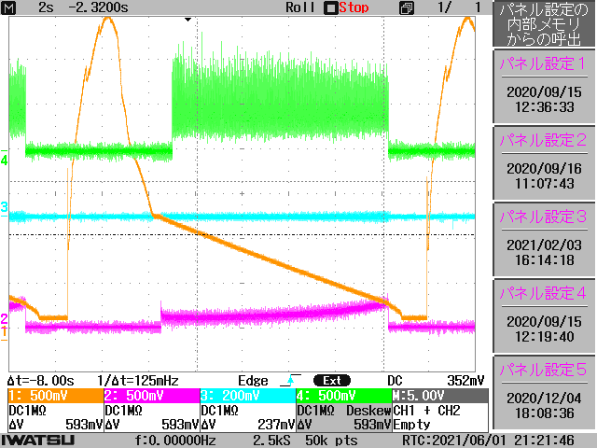
Spill Improvement
Reduce Ripple
  Change F1(=F2) lower to excite low number of particle
  Change F1A(=F2A) lower to kick weaker
Increase Efficiency
  Change F3A larger to increase turn separation
For 600 Energies…
  Manual optimization for several energy and interpolate
Amplitude [arb. U.]
Small ripple =stable
Long spill = high efficiency

Slide 13
Operation Experience at Yamagata University

Slide 14
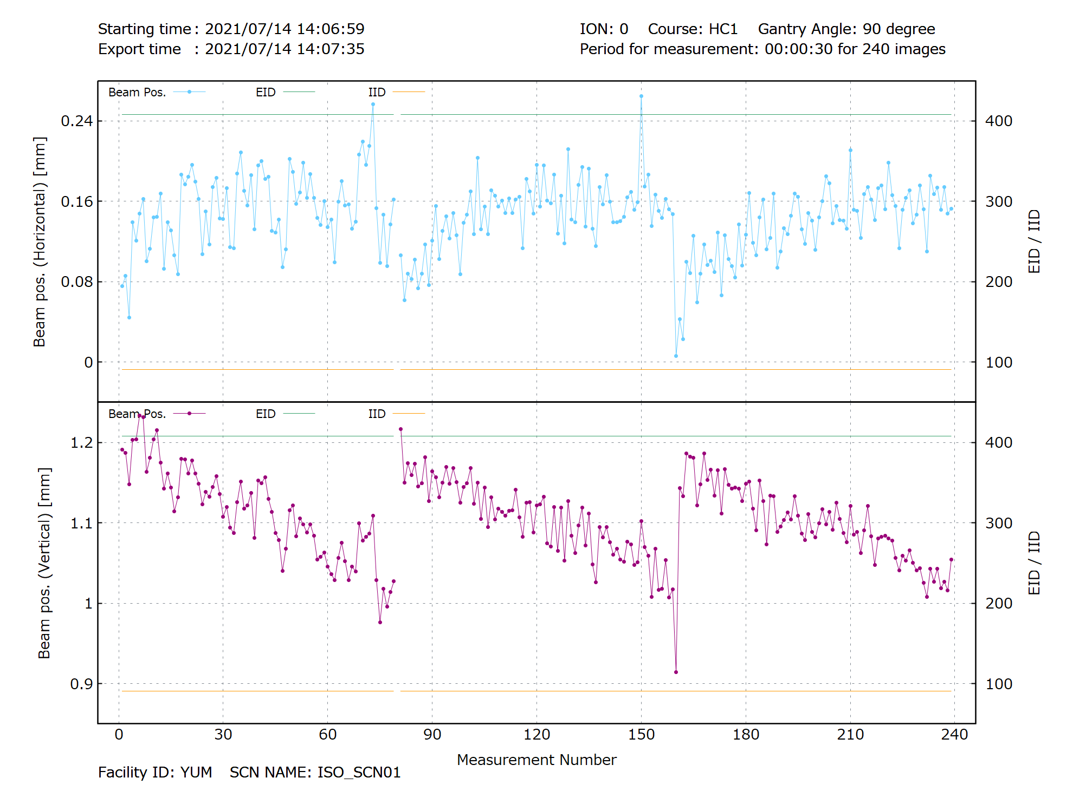
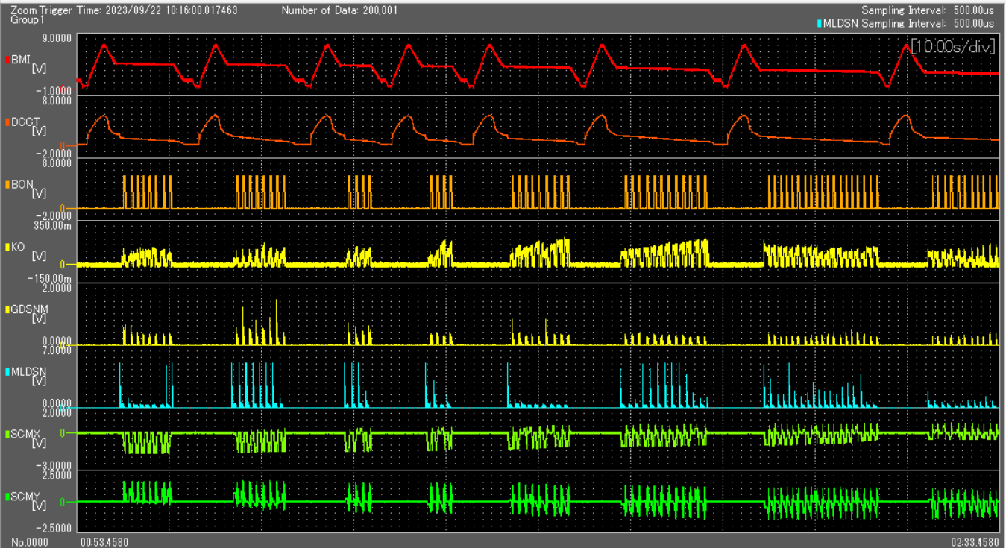
Beam Stability
Beam Position Drift < 0.5mm
Position Ripple < 0.1mm
Intensity 3x10⁷ – 4x10⁸ pps
Ripple: Average <±20%

Slide 15
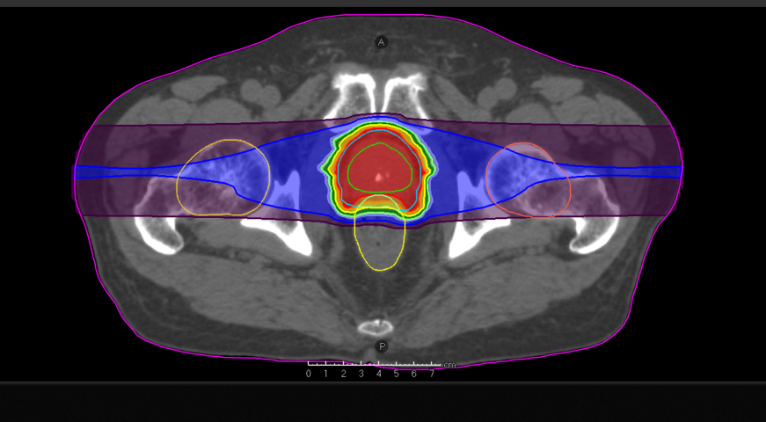
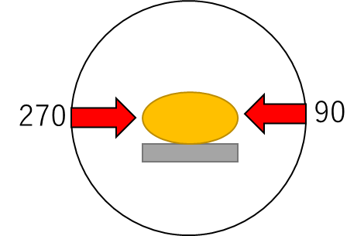
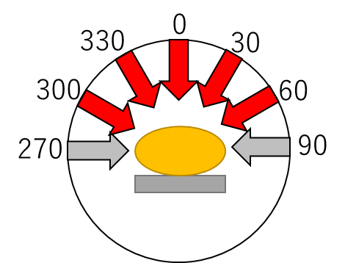
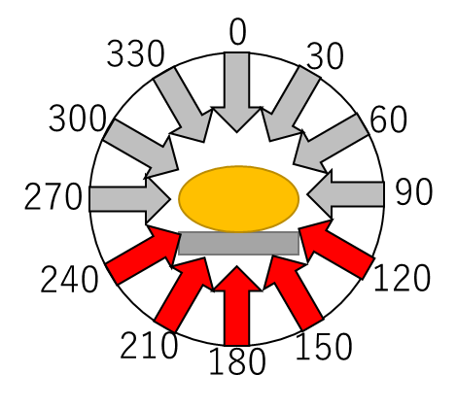
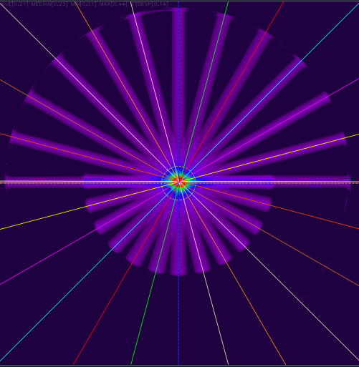
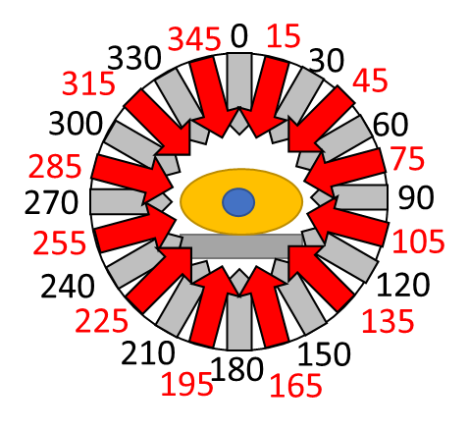
Treatment Usage
Feb 2021 Fixed Beam Port Treatment
  for Prostate Cancer
Mar 2022 Gantry 2 Angles
  for Prostate Cancer
May 2022 Gantry 7 Angles
  for Head & Neck Cancer
Jul 2022 Gantry 12 Angles
  for Pelvis Cancer
Sep 2022 Respiratory Gating
  for Lung, Liver, Pancreas
Mar 2023 Gantry 24 Angles

Slide 16
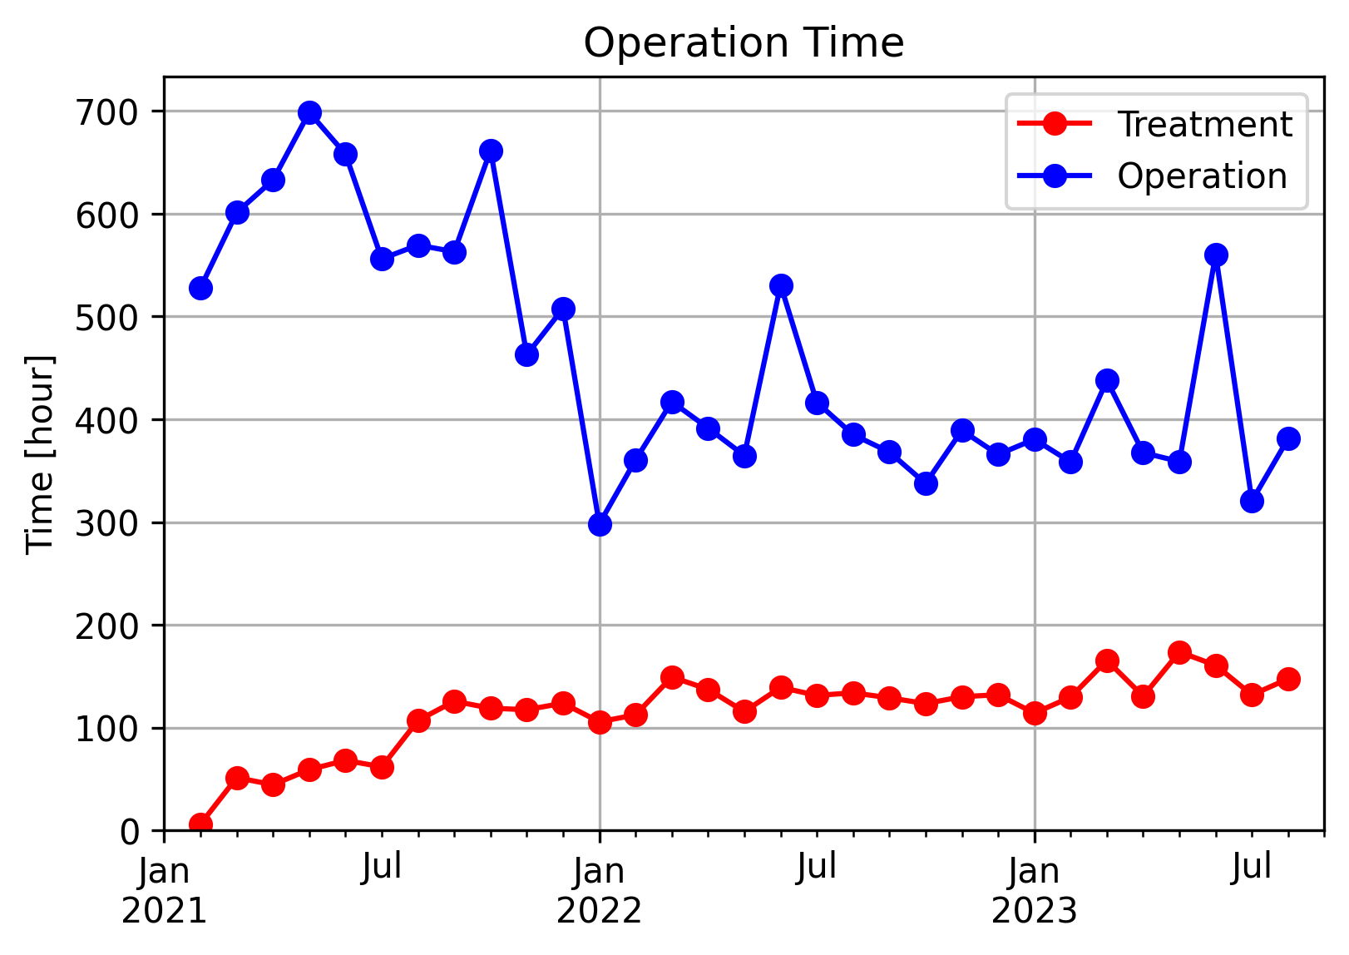
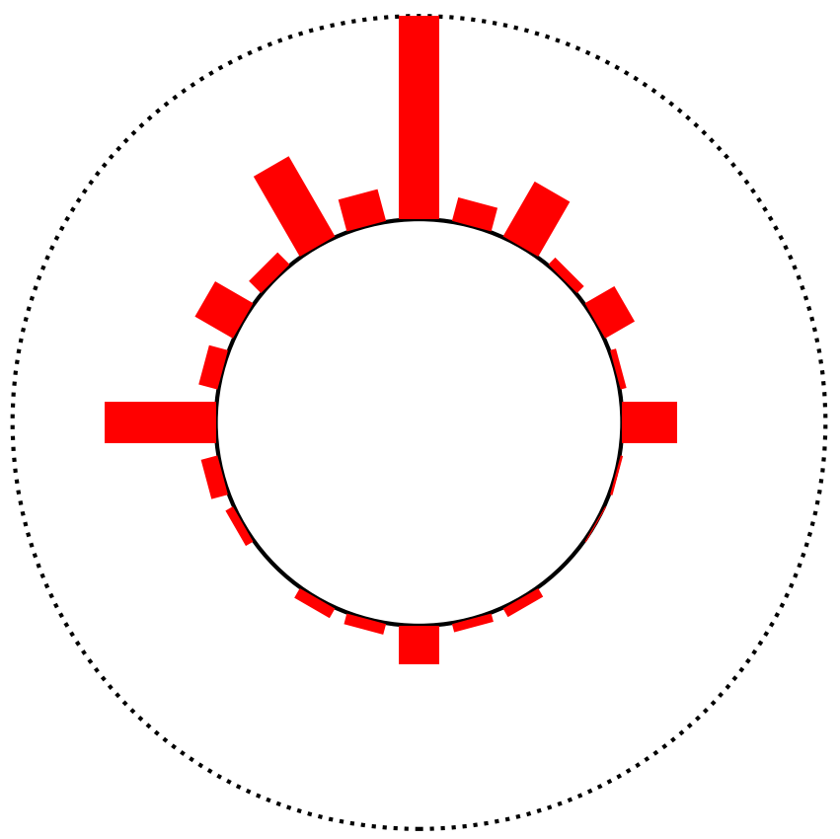
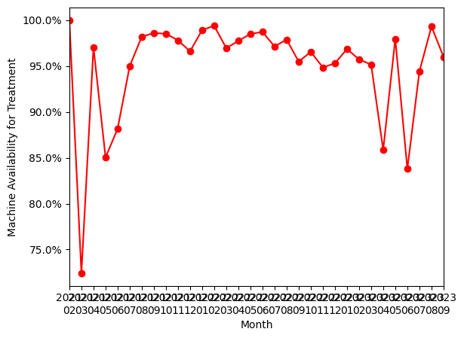
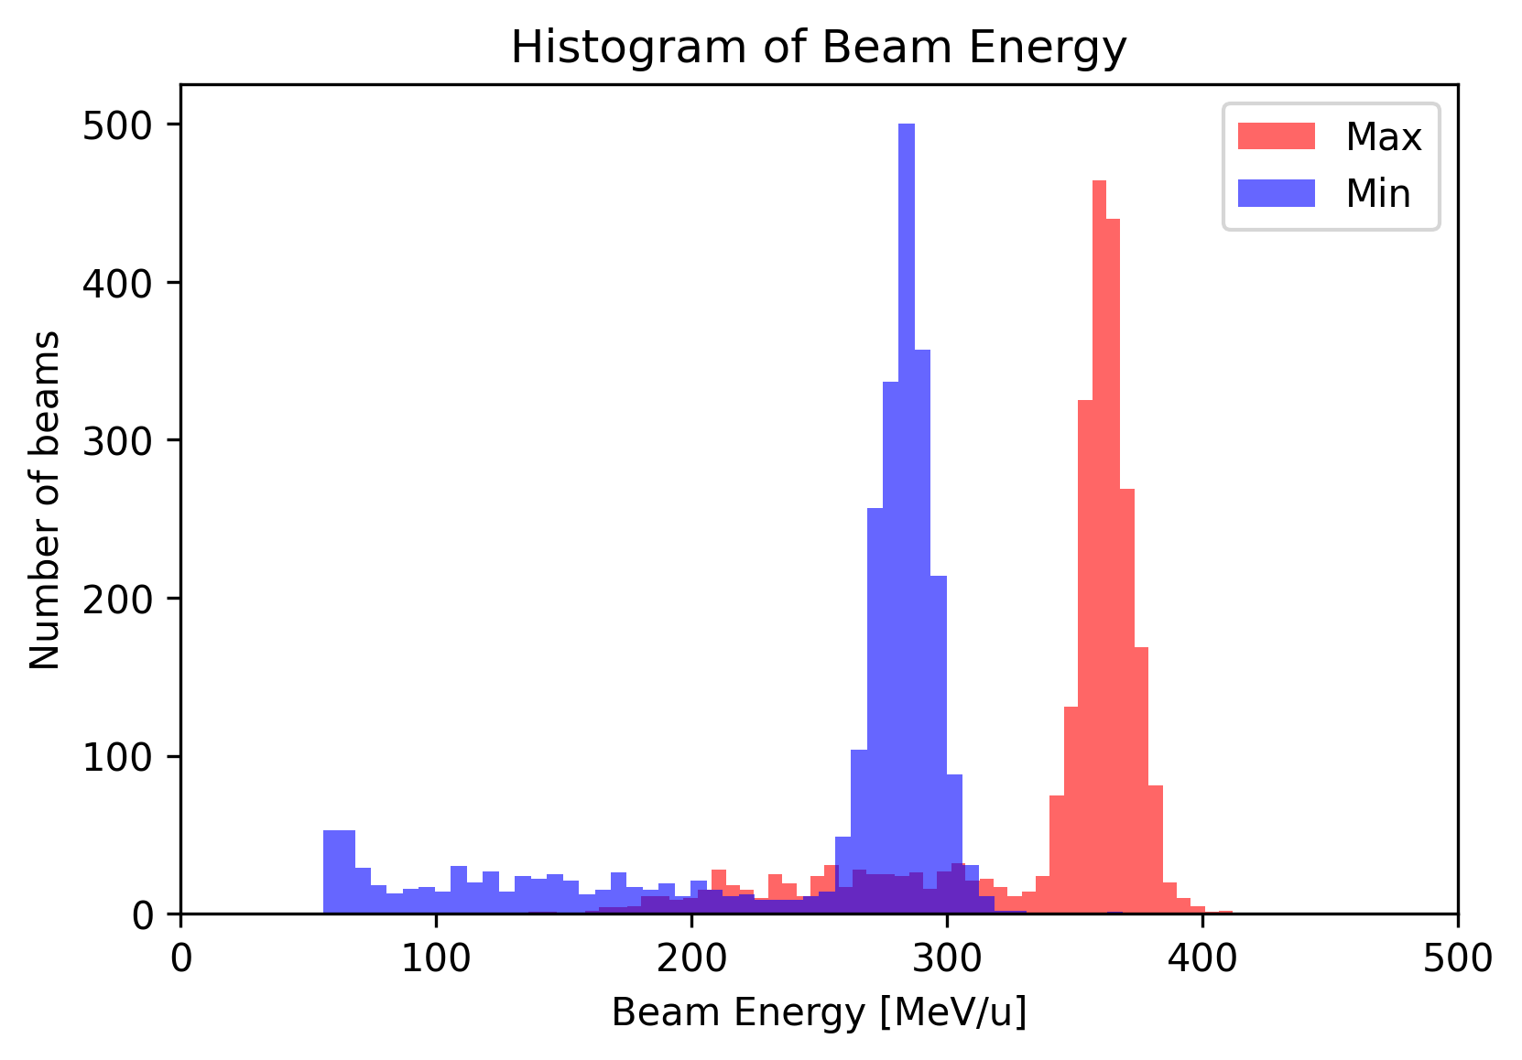
Operation statistics
0 deg
270
90
24h operation
by vendor beam commissioning
180
Gantry angle statistics of treatment beams (except prostate)
May 2022 – Jul 2023
Prostate plan
Total machine availability for treatment operation is 95.4%
Min
55.6 MeV/u
Max
411 MeV/u
2021 2022 2023
Notes:
This is the machine operation statistics, operation time is about 5,000 hours in a year and 30% is treatment operation. Machine availability is 95%, I think this is not so good, This is due to initial problems for new irradiation system and the gantry, need further improvement. Gantry angles distribute like this, 0 degree, from upside of patient is the most frequent. Energy distributions shown here, the peak is by prostate. Maximum is 411 MeV/u.

Slide 17
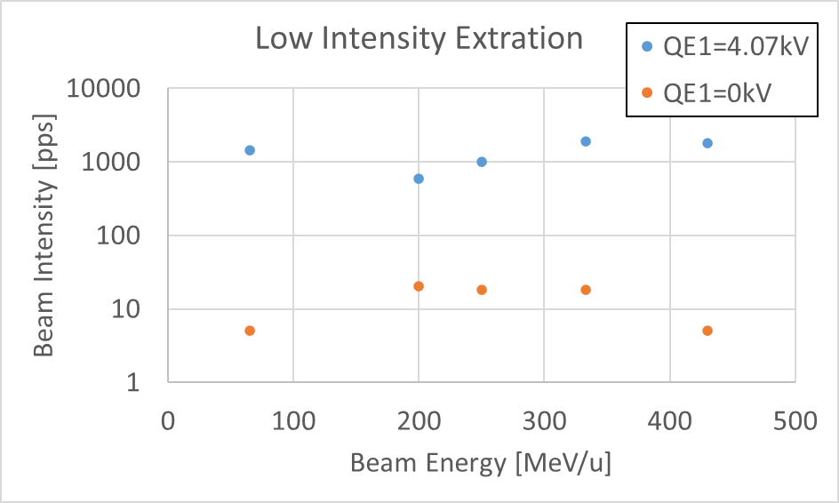
Ultra Low Current Beam for Experiment
Used for physics experiment for detector development
Needs 100~1000 pps (Machine spec: 1x10⁷ ~3x10⁹ pps)
Reduce Injection beam current by…
  reducing RF power, Gas Flow of ECR Ion source
  Changing electrostatic quadrupole and solenoid in LEBT
10~100 particles per second of beam intensity was achieved with same extraction parameter for treatment

Slide 18
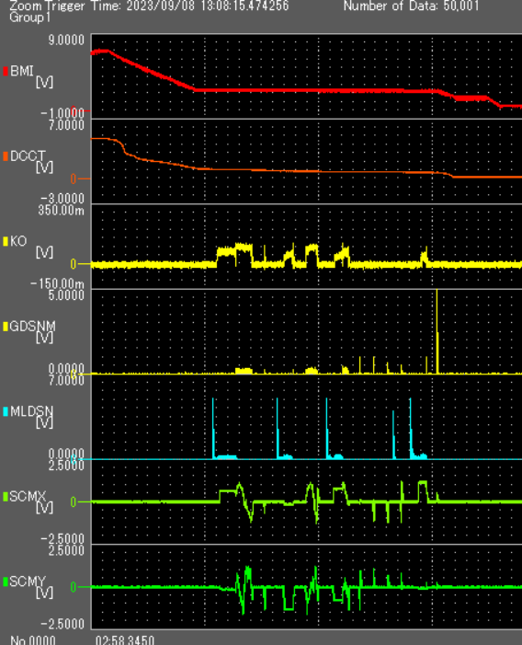
Future Improvement
For Treatment
  Improve extraction efficiency by betatron tune optimization
  Prevent intensity interlock caused by spike at re-extraction in the same energy after short-time beam off
    Will need pre-heat control
For Experiment
  Ultra low current beam for multiple energy
  Extremely high intensity extraction for FLASH experiment

Slide 19
Summary
Slow Extraction of Carbon Ion Synchrotron has been developed at HIMAC in QST-NIRS.
Based on the advanced RF-KO method, compact synchrotron with full-energy scanning is available for a commercial treatment machine.
Extraction stability is satisfactory for 600 beam energies used in Yamagata University.
Ultra low current extraction of ~100 pps was achieved and used for experiment.

