Slide 1
A VHE ion beam irradiation facility at CERN (CHIMERA/HEARTS)
E. Johnson (SY-ABT-BTP)
With thanks to M. Fraser, P. Arrutia, M. Delrieux, R. Taylor, B. Mikulec, F. Velotti, D. Banerjee, D. Cotte, R. Garcia Alia, F. Ravotti, J. Mccarthy, S. Danzeca, M. Coly and many others
5th Slow Extraction Workshop at MedAustron, Wiener Neustadt, Austria
Monday 12th February 2024

Slide 2
Outline
What is CHIMERA / HEARTS
Facility Overview
Slow extraction and technical aspects

Slide 3
CHIMERA / HEARTS
Ion irradiation activities at CERN
CHIMERA funded by ESA
HEARTS funded by the EU
High-Energy Accelerators for Radiation Testing and Shielding
Objective: Accessible and available VHE ion beams to enable breakthrough space applications
SEE testing to qualify electronic components for radiation hardness assurance
Shielding and radiobiology studies for human spaceflight missions to the moon and mars

Slide 4
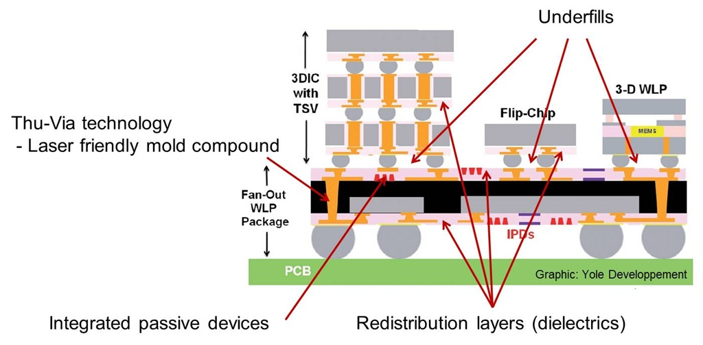
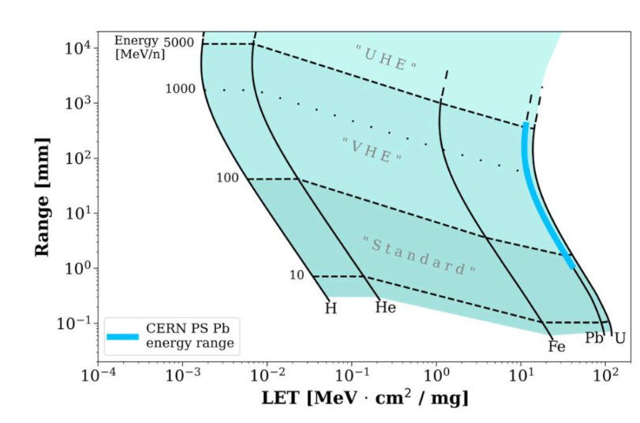
Why High-energy heavy ions ?
Space agencies and industry wish to test non-de-lidded chips
Requirement: High penetration range
Ideal solution: Pb82+ high range (>1mm in Si), high LET
Lower LET ions are of interest but only if able to quick swap
Use case: test components sensitive to the lowest LET achievable with Pb82+, around 10 MeV·cm²/mg
Idea: decelerate protons to 500 MeV as a bonus offer during irradiation
https://polymerinnovationblog.com/polymer-challenges-in-electronic-packaging-overview/
72 MeV/u

Slide 5
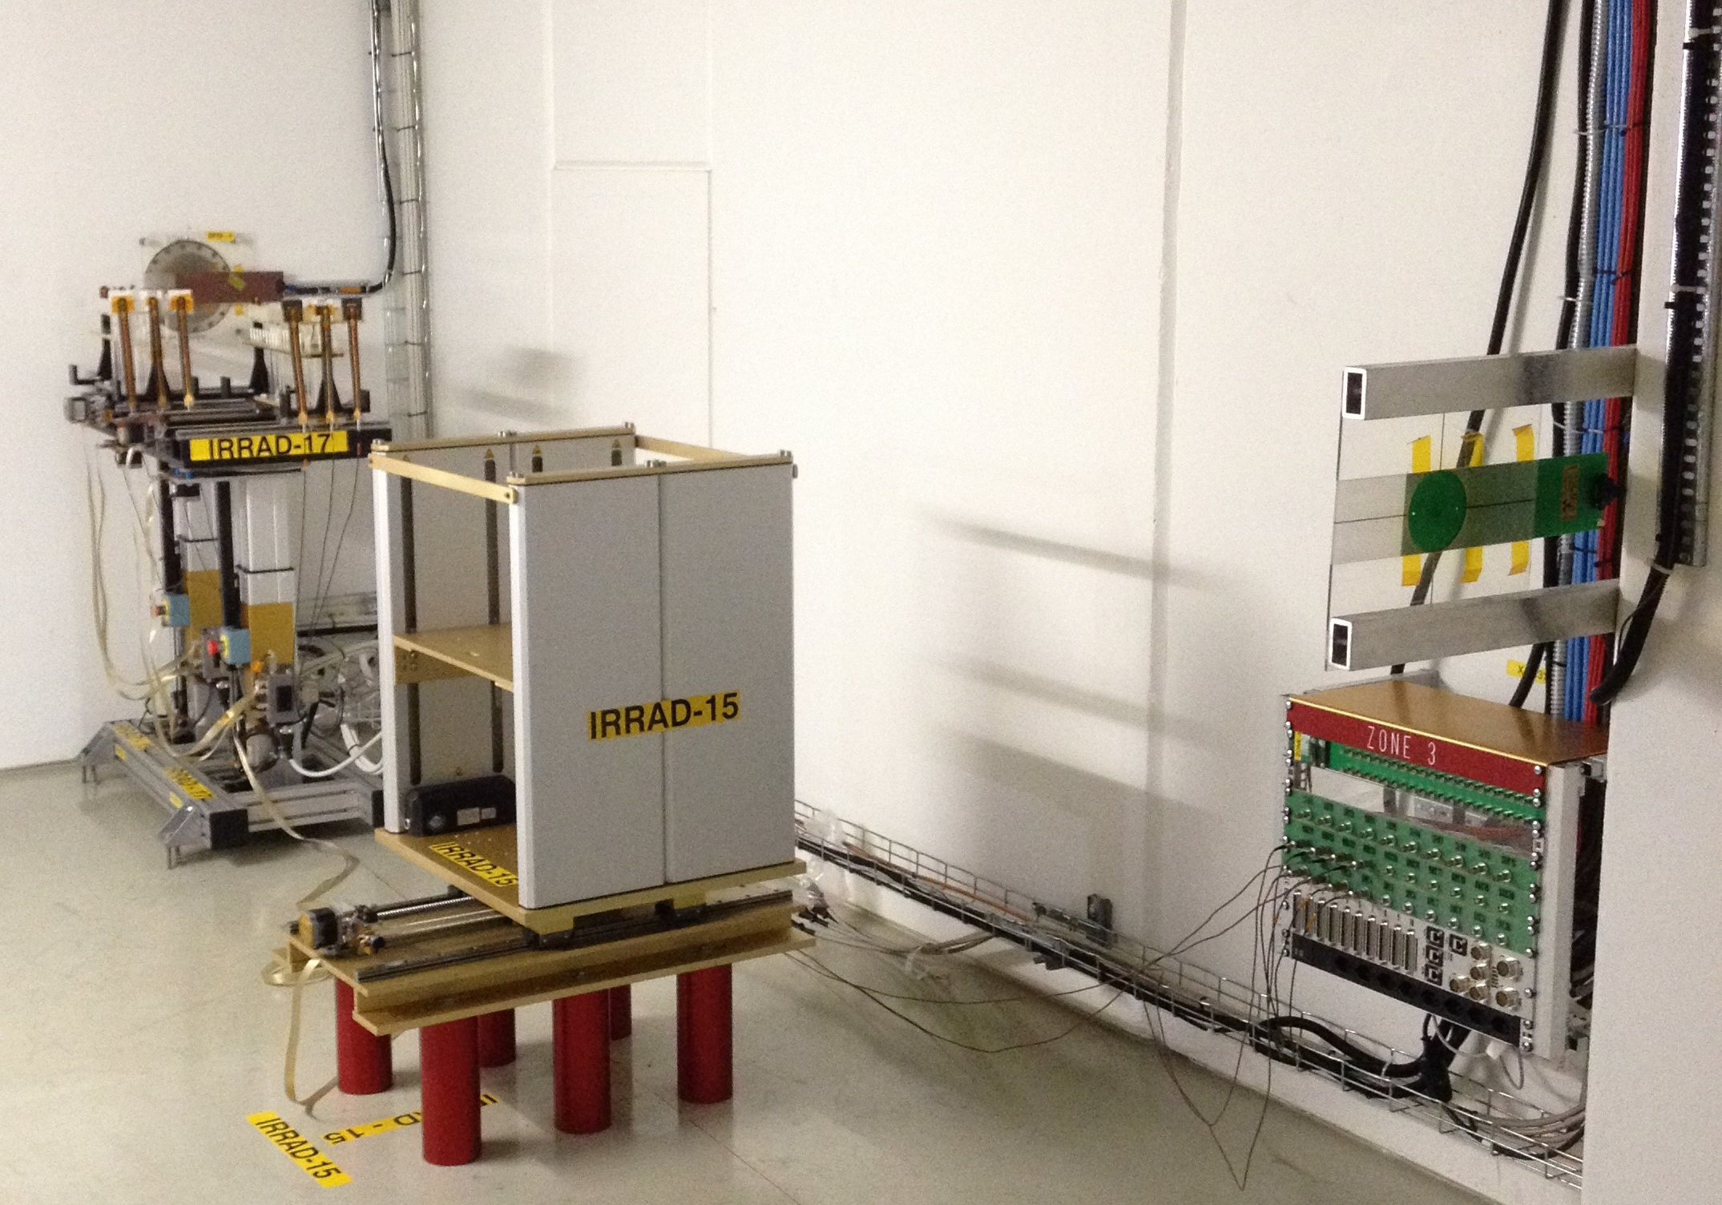
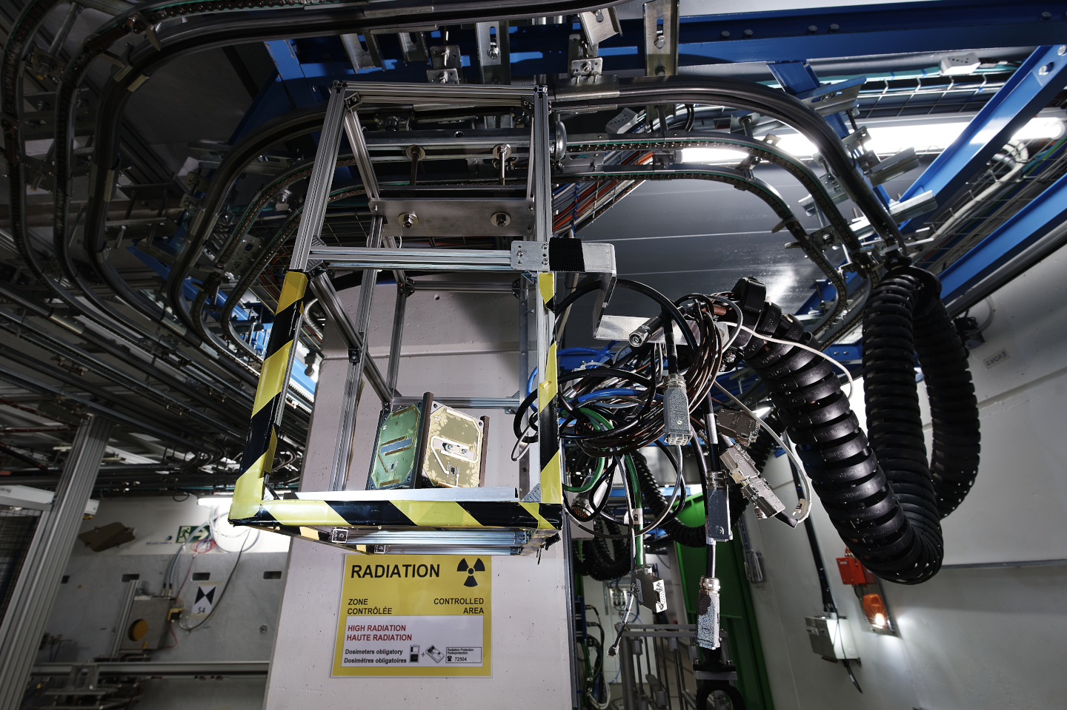
Why CERN ?
Other labs
Very scarce number of infrastructures that offer high-energy heavy ions for electronics testing
Whereas the demand is increasing rapidly
CERN PS
Transfer line from PS to East Area (F61 + T8) available which allow different optics
Existing irradiation infrastructure
IRRAD
CHARM
Large energy range (72 MeV/n – 5.4 GeV/n)
Flux tuning through slow extraction

Slide 6
Timeline
2021
1-day Pb run
(efficiency, ion charge state, beam instrumentation)
2022
5 days Pb run
(variable energy, intensity, beam size)
2023
HEARTS kick-off meeting
15 days Pb run
2024
First external users at CHARM
2025
TRL 6-7 for electronics testing at CERN and GSI
2026
Routine access for external users at CERN and FAIR
Deliverables 5/31
Milestones 6/23

Slide 7
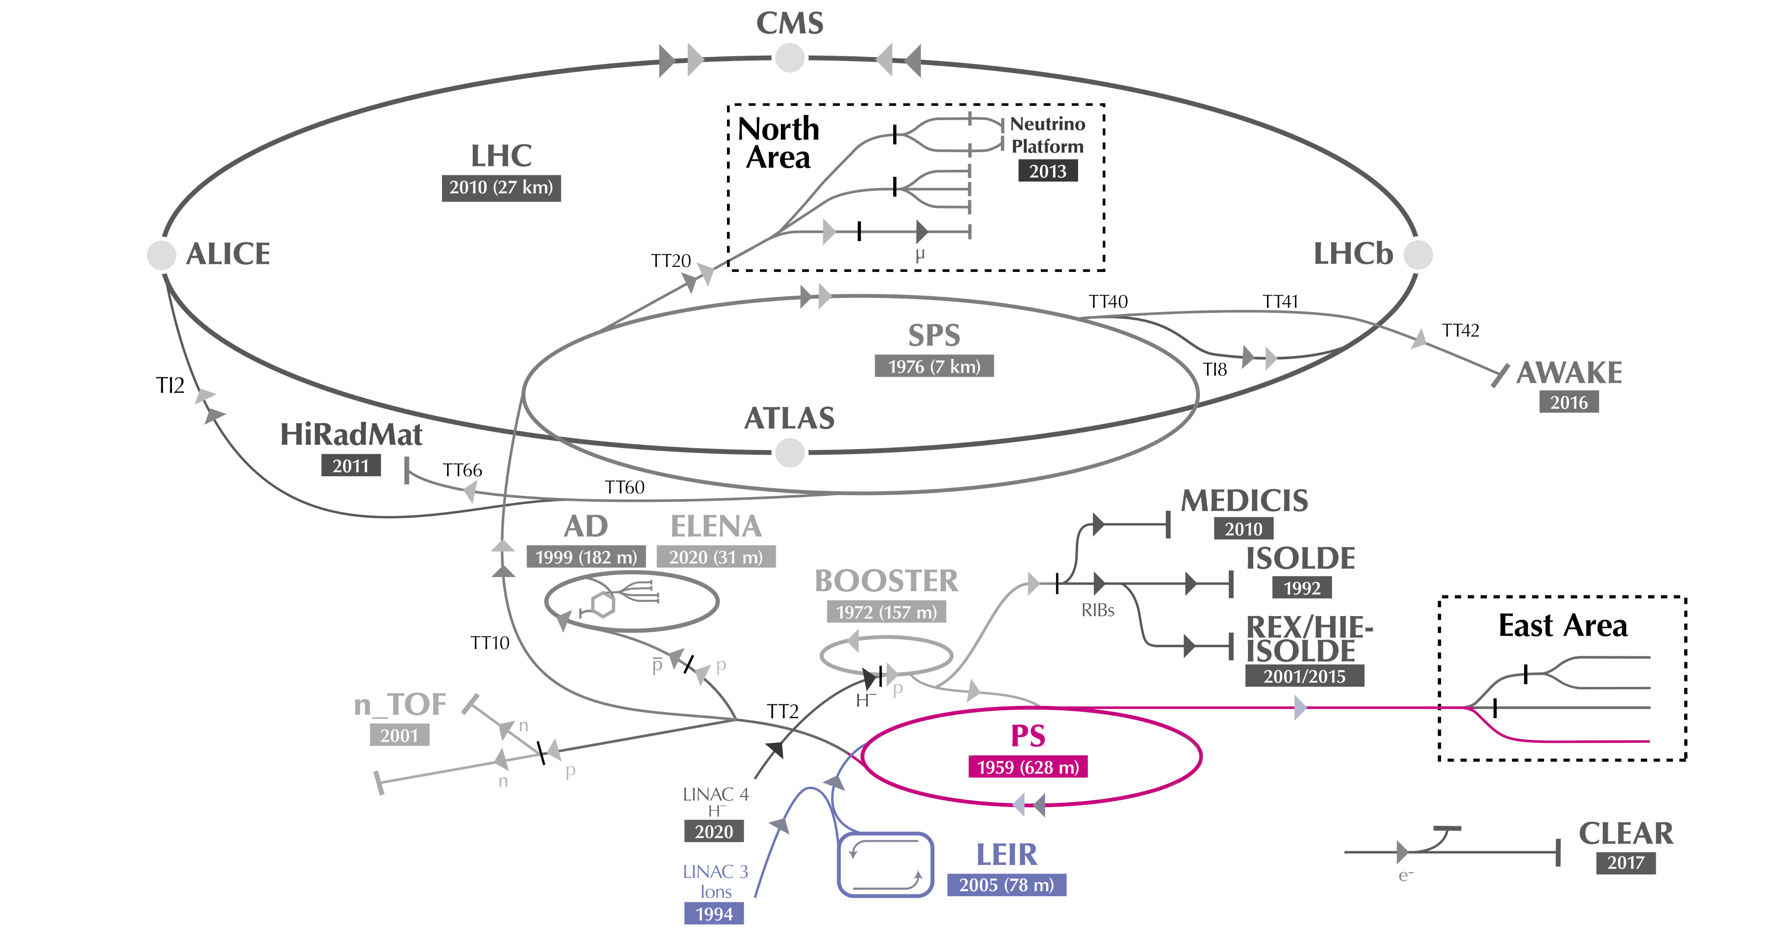
Facility overview
LINAC 3
LEIR
PS
East Area

Slide 8
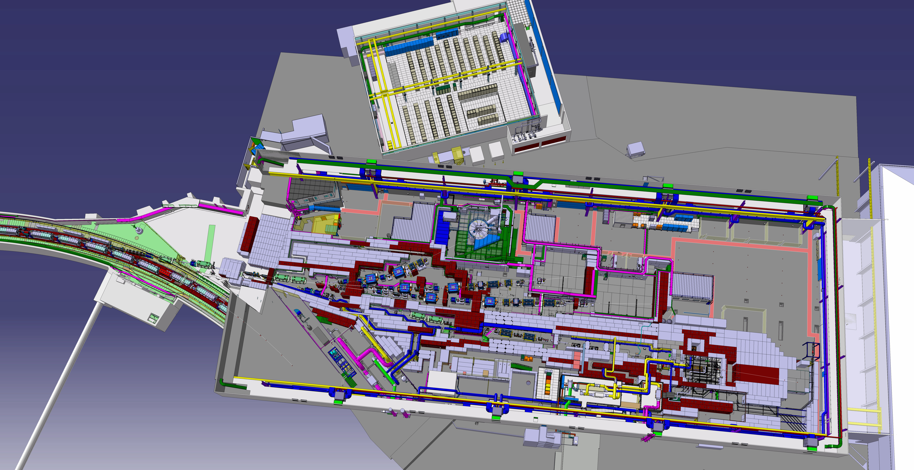
East Area
F61
PS
T08
IRRAD
CHARM

Slide 9
East area – F61 transfer line
F61
Dump Bending Dipole

Slide 10
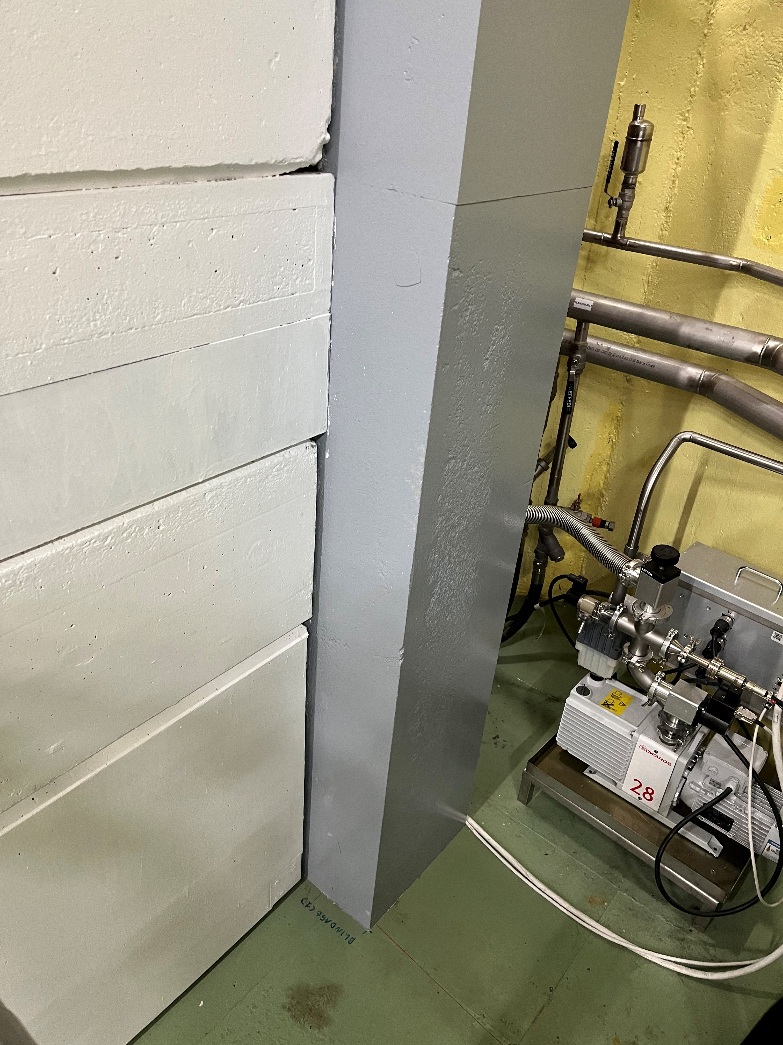
East Dump
Extremely useful for parallel optics measurements
Quadrupole scans and beam size measurements using BTV
Initial parameter reconstruction
Spill improvements
Slow extraction studies

Slide 11
DUT
CHARM

Slide 12
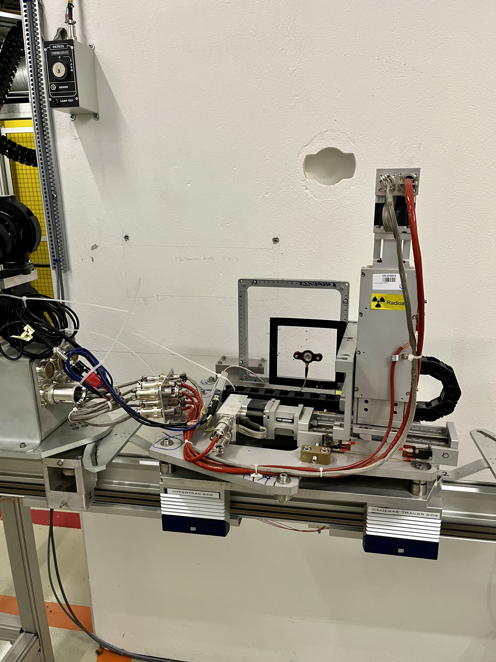
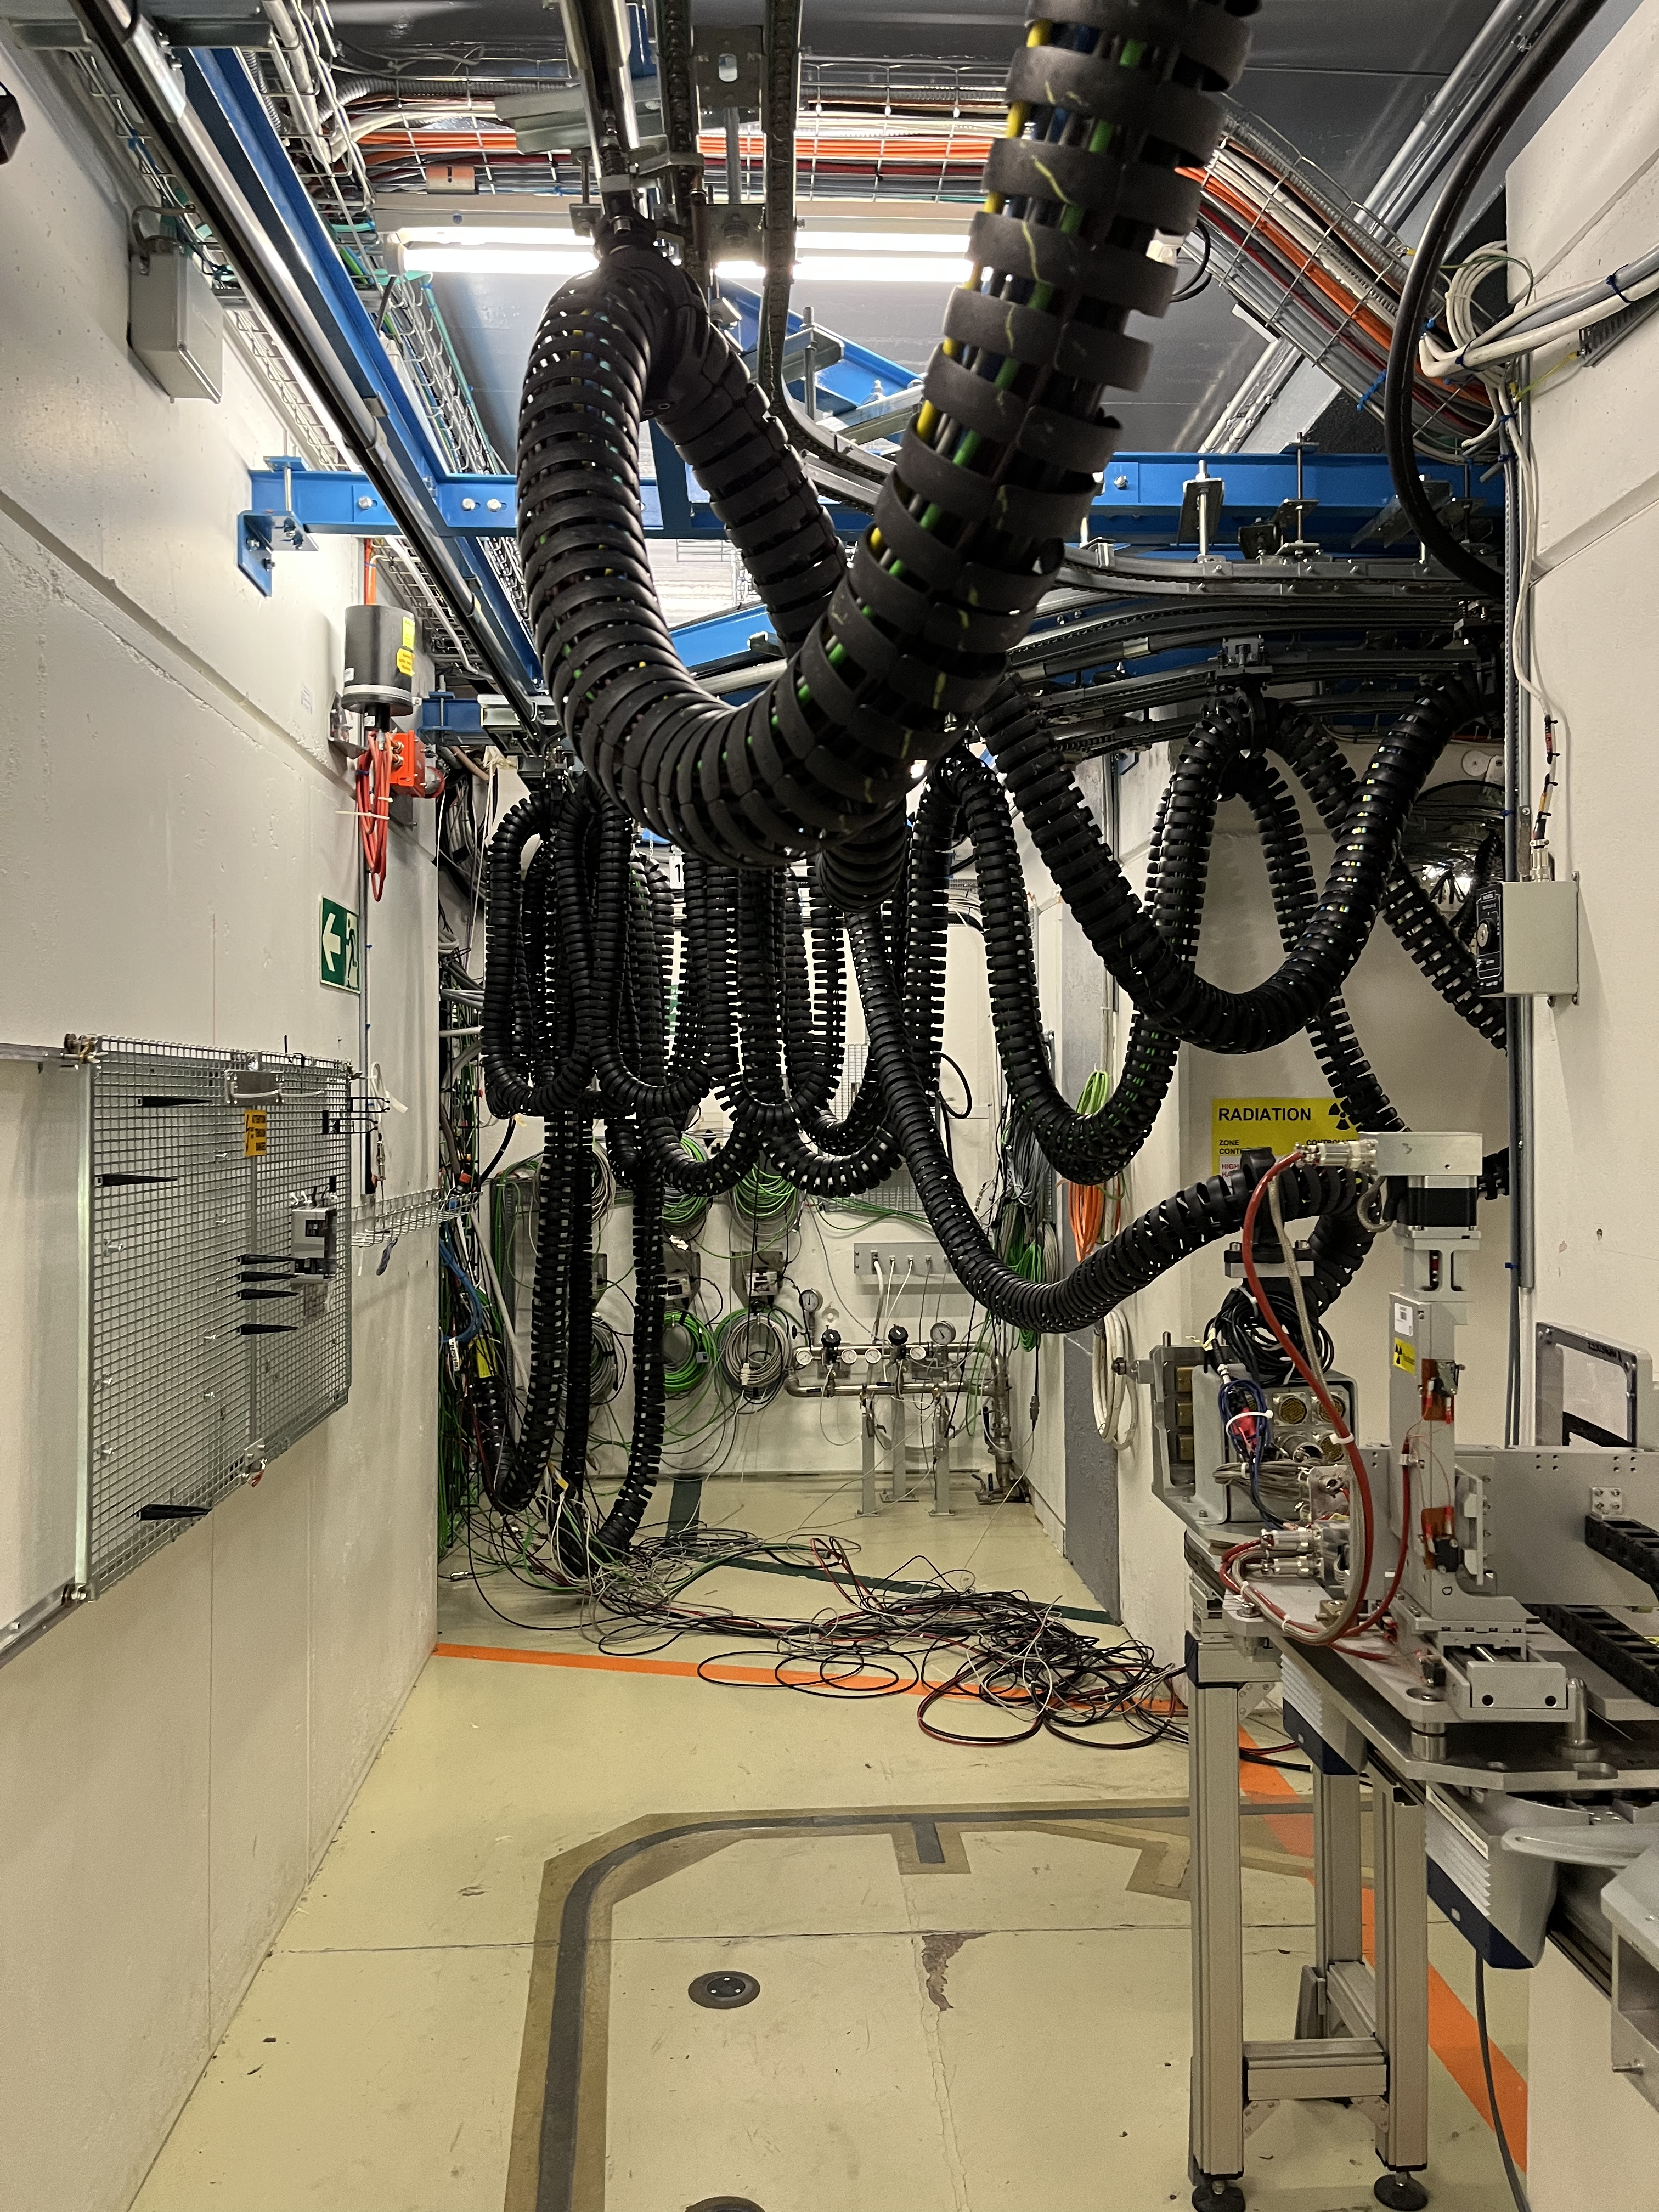
Mechanical & electrical integration
MONTRAC
Diode
Preamplifier
Cable chain
Movable table
on MONTRAC
Diode setup ready on the movable table
Diode on the movable table inside CHARM
https://indico.cern.ch/event/1211404/

Slide 13
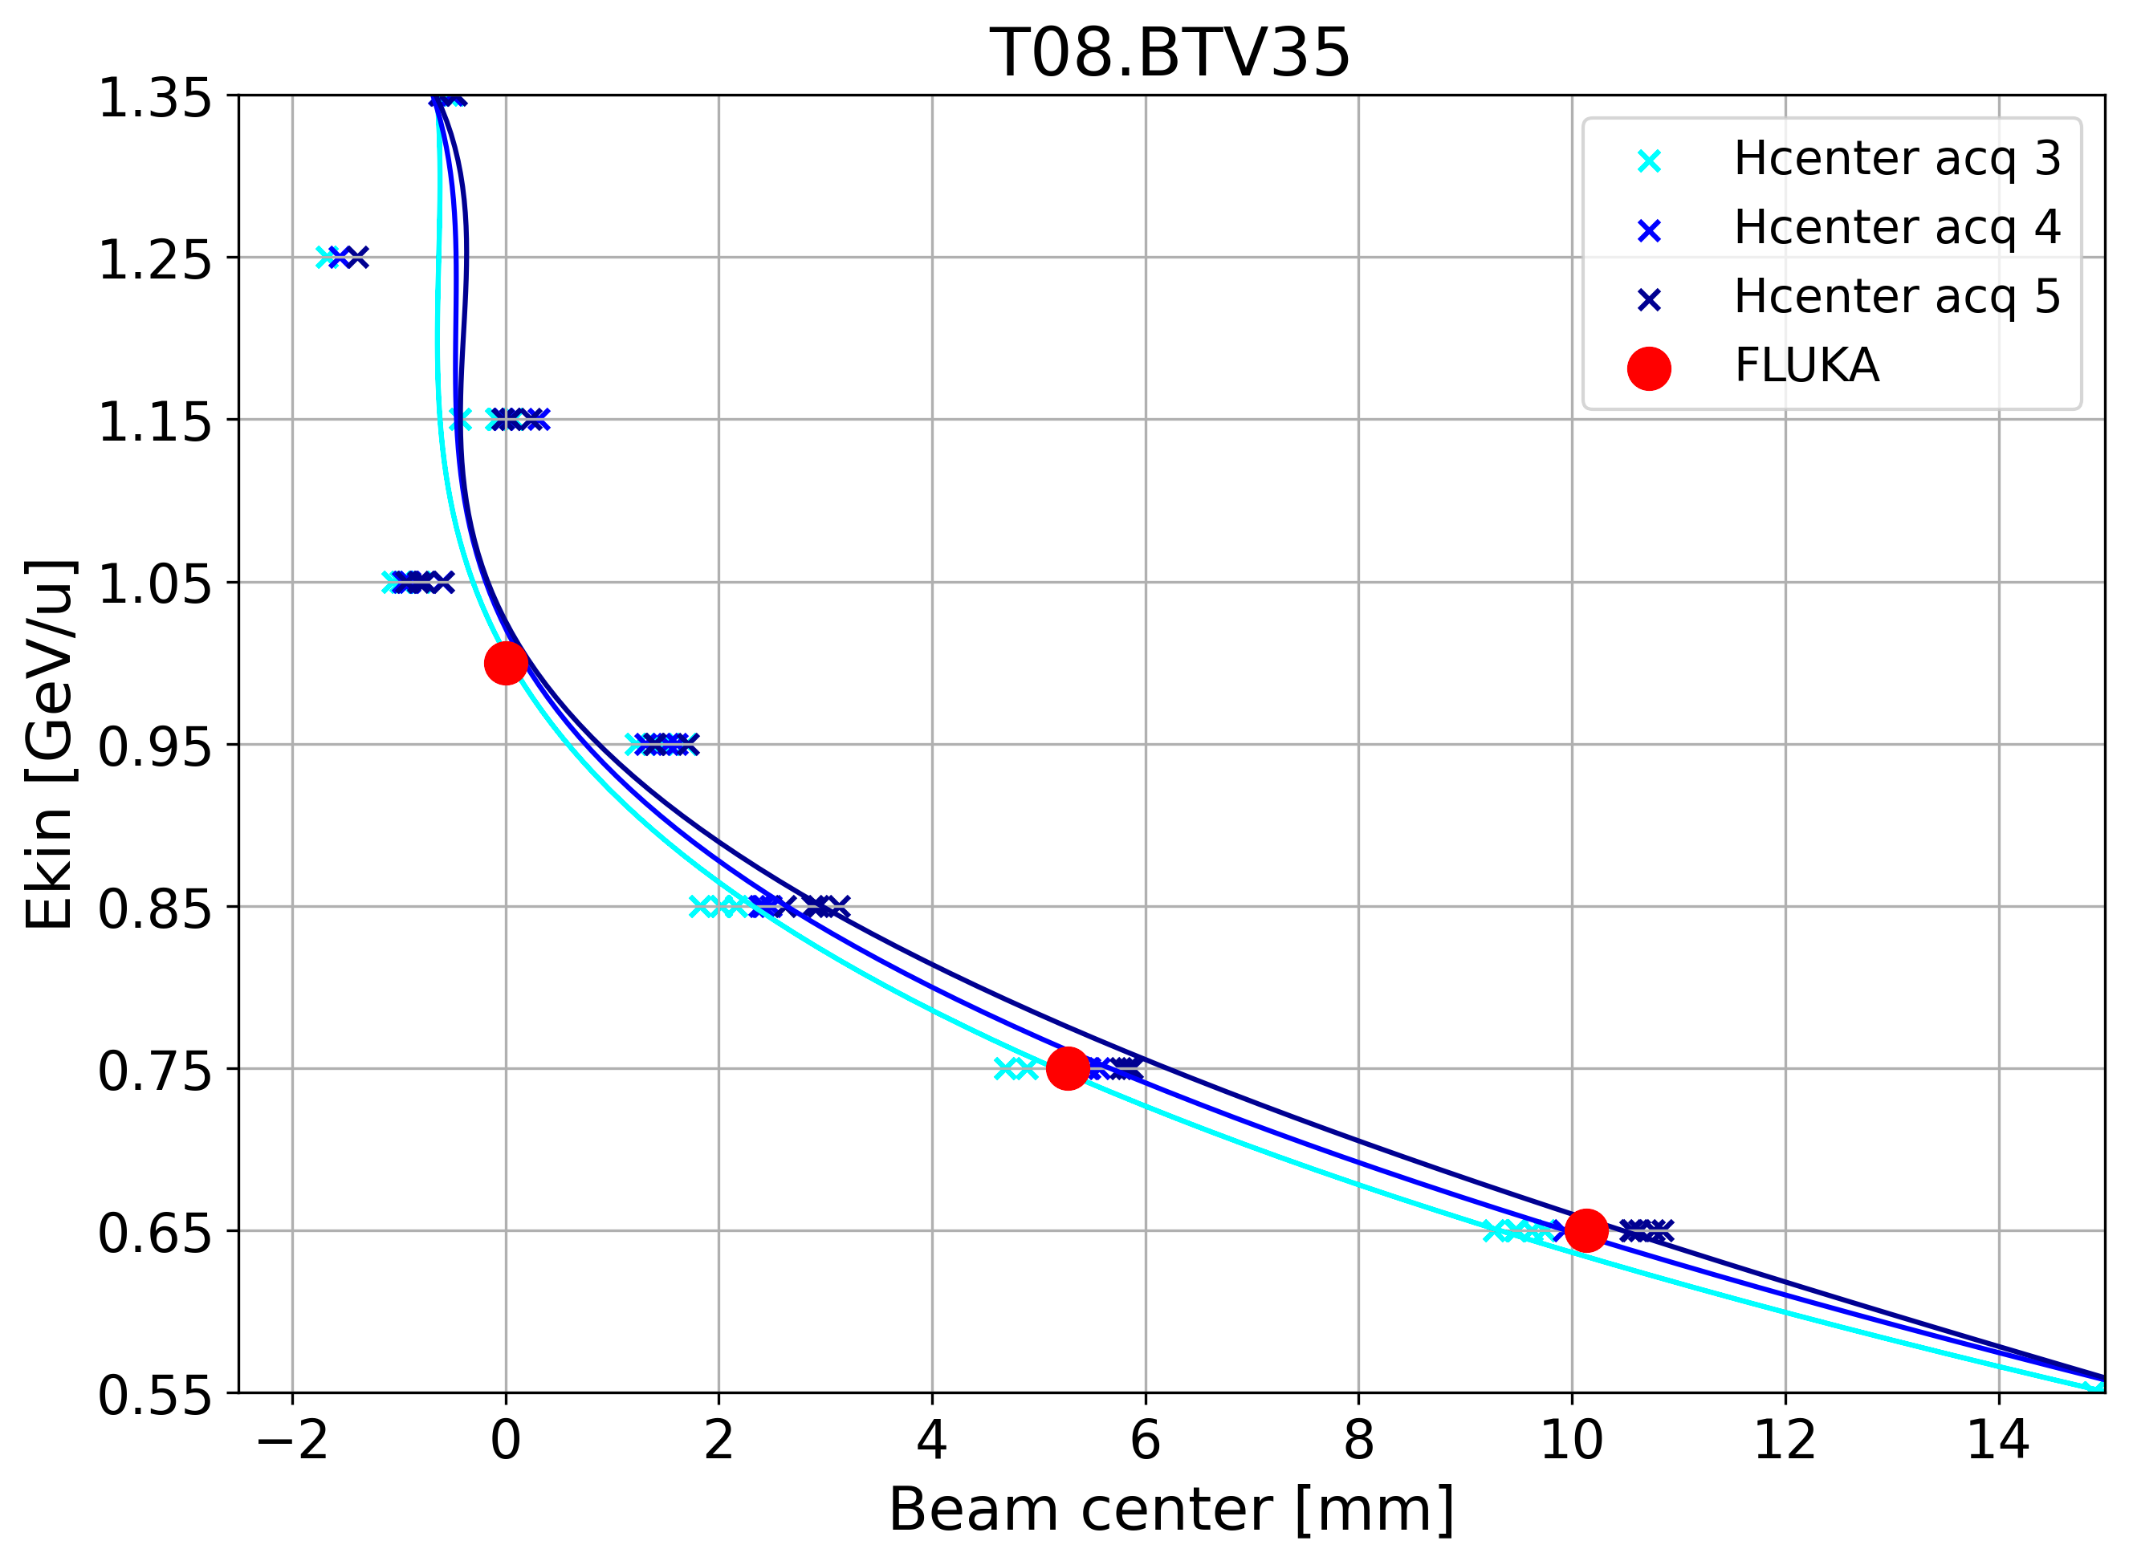
Air scattering
Transfer line to IRRAD/CHARM has large air regions
The transfer line is scaled with energy but does not account for straggling effect (i.e. energy loss)
Increase of beam size through Multi-Coulomb Scattering
Transmission difficulty of low energy beam
Thanks Gianni and Frederik for Xsuite example ! 😊

Slide 14
IRRAD
Move from CHARM to IRRAD Table 1

Slide 15
Slow Extraction and technique
Uses magnetic septum SMH57 and SMH61
Bypass SEH23 (used only for p+)
Windows would fully strip the beam
Amplitude growth done with third order integer resonance and SX

Slide 16
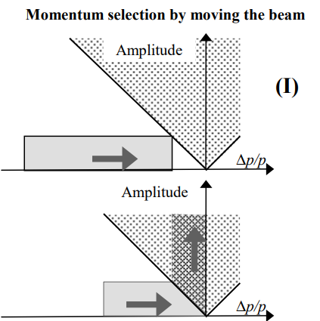
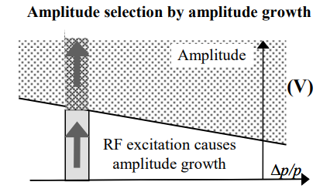
Iteration on SX
Change tune Q with PFW, QSE, LEQ
OK for high energy beams (5.3 GeV/u)
≤ 2 GeV/u no PFW
Bunch rotation
Flat QSE under resonance
Ramp tune with LEQ
RF Knock-Out (RFKO)
Constant extracted beam optics
RF Excitation with transverse damper
No bunch rotation (small dp/p)
More stable at different energy (no PFW and chirp on damper excitation freq)
Easier control of the beam intensity
Bare machine tune
Extraction
[1]
L. Badano et al., “Proton-Ion Medical Machine Study (PIMMS), 1,” CERN Document Server. Accessed: Dec. 16, 2022. [Online]. Available: https://cds.cern.ch/record/385378

Slide 17
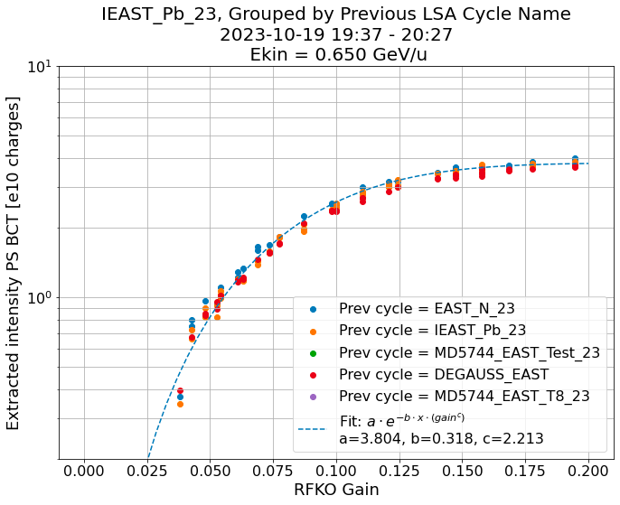
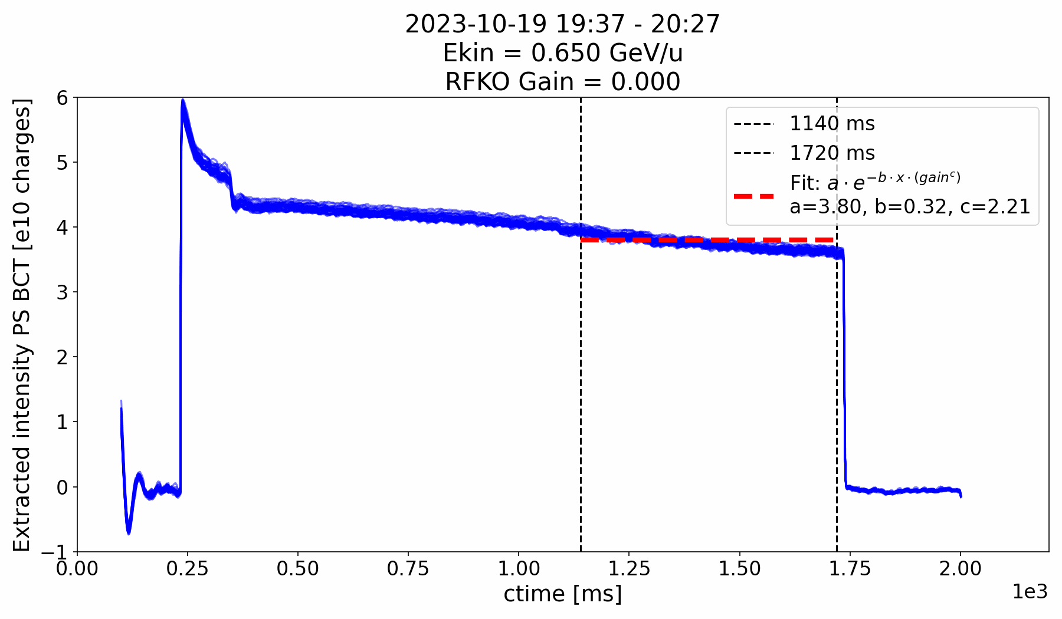
Intensity PS
Extracted intensity modulated with RFKO gain
Equation to apply to the TFB to keep the intensity uniform as a function of time → Idea for next run to have PID controller
Spill structure: 1kHz (RFKO) and 130kHz (frev/3)

Slide 18
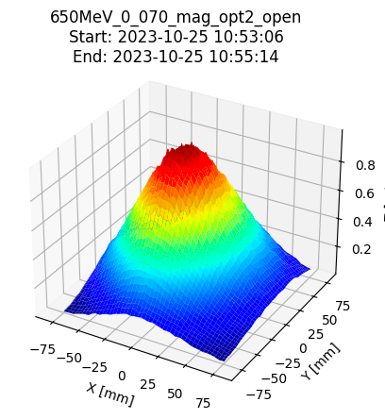
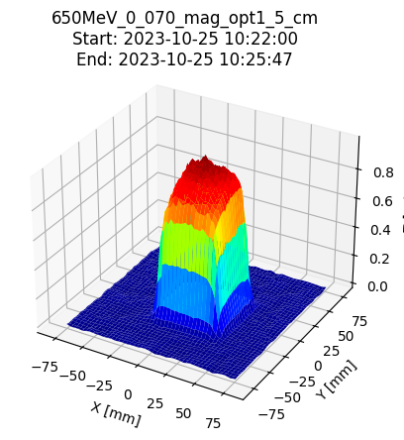
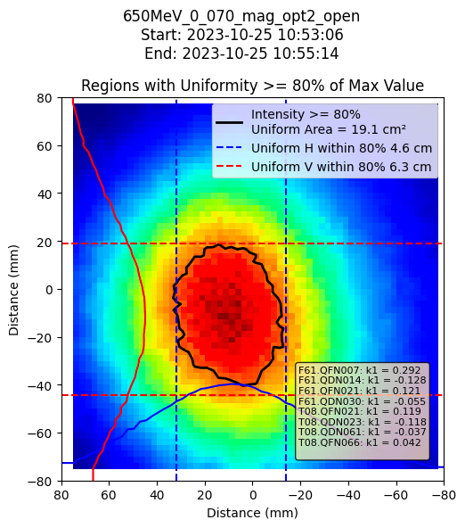
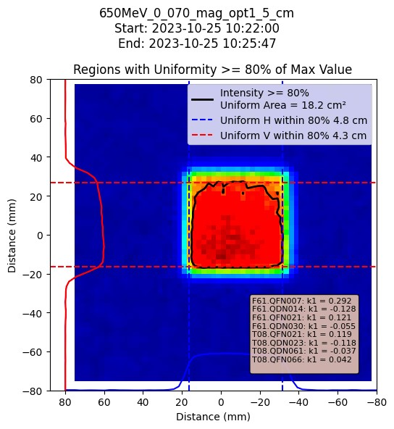
Degrader + Mask system
Degrader system
Used to lower beam energy
Measure the Bragg Peak
Mask system
Shape beam into uniform regions
Cheaper and easier than octupoles or rastering

Slide 19
2024 timeline
Beam and FLUKA studies
Experimental area integration studies (cables for ext. users)
Design and manufacturing of remotely movable degrader/mask system
Activity scheduling
MDs:
Priority preparation of user Pb run
IRRAD optics
RFKO MDs
Decelerate protons
Magnesium ?
Beam development and commissioning to East Dump
2024 HEARTS@CERN run, including commissioning completion and beam characterization
Beam development and commissioning to T8
T8 commissioning could be extended through upstream move and compatibility with IRRAD cryostat
Ions in PS
Cryostat installation in IRRAD
Start of run
End of run
Analysis, reporting…
Jan
Aug
Sept
Oct
Nov
2024

Slide 20
Conclusion
CERN has a Very High Energy Ion irradiation campaign called HEARTS
Sending Pb ion beam during two-weeks in November each year
Offers wide range of energy at different intensities
Available for external user
Close collaboration with GSI such as to be two interchangeable facilities

Slide 22
Extra

Slide 23
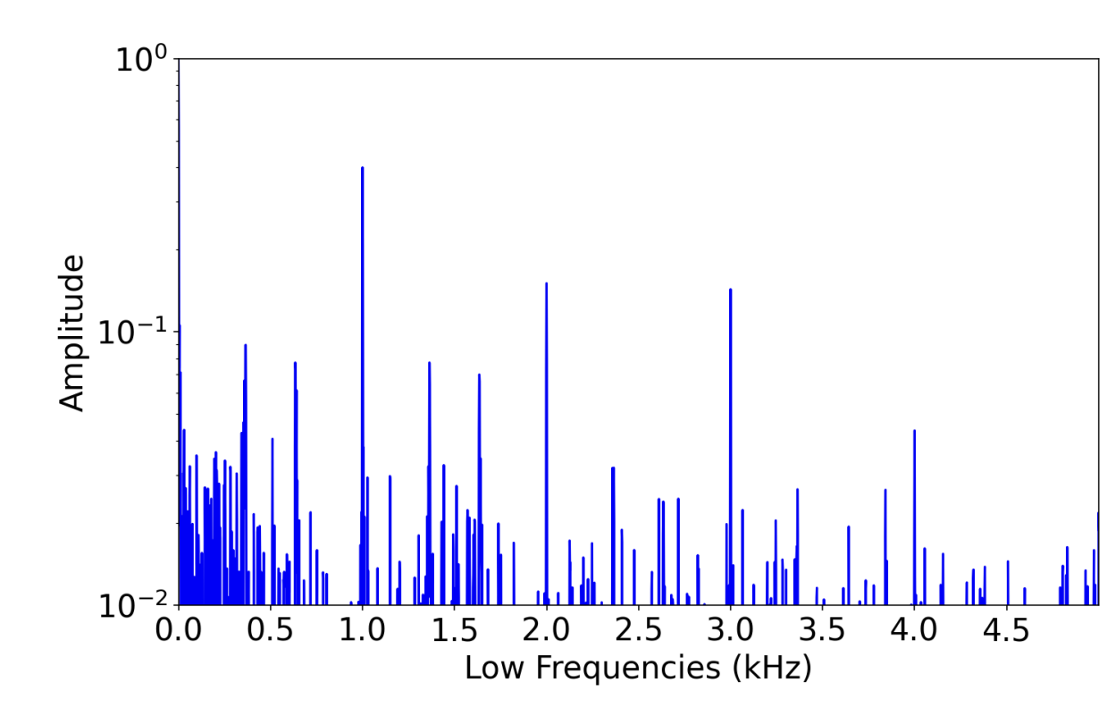
Spill structure
Slow and fast frequencies time structure
Slow because of RFKO technique
Software limitation to max chirp rep rate of 1 ms intervals
1 kHz
Could exploit low-pass filter effect of beam (transit time) by exciting at higher frequencies

Slide 24
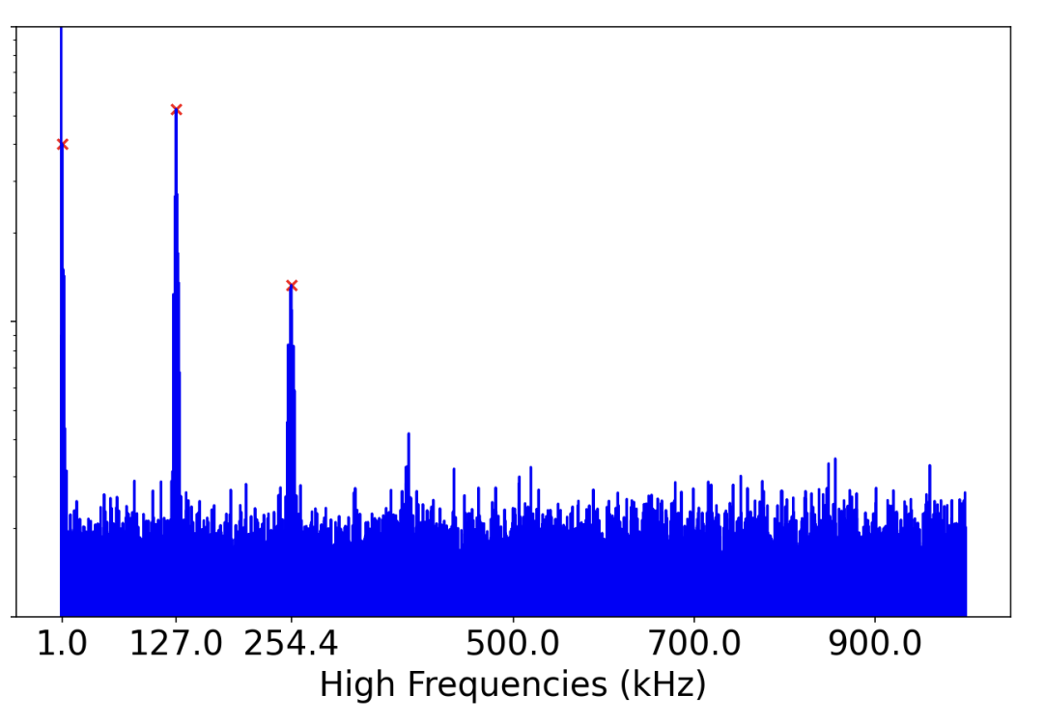
Spill structure
650 MeV/n
Fast spill structure at the fractional tune of third integer
Frev/3
~ 130 kHz
(beam still bunched and debunching during extraction)

Slide 25
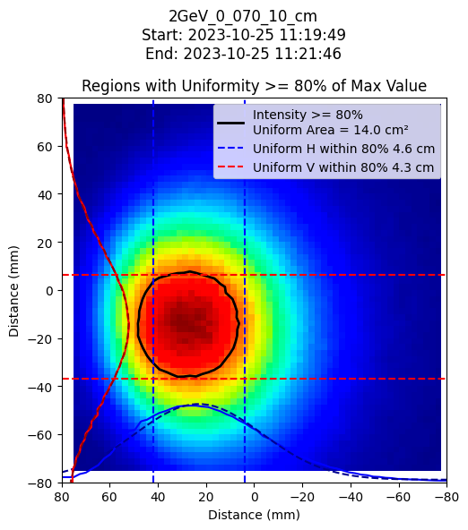
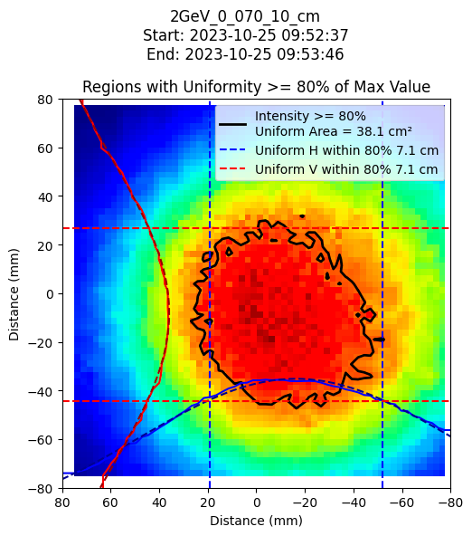
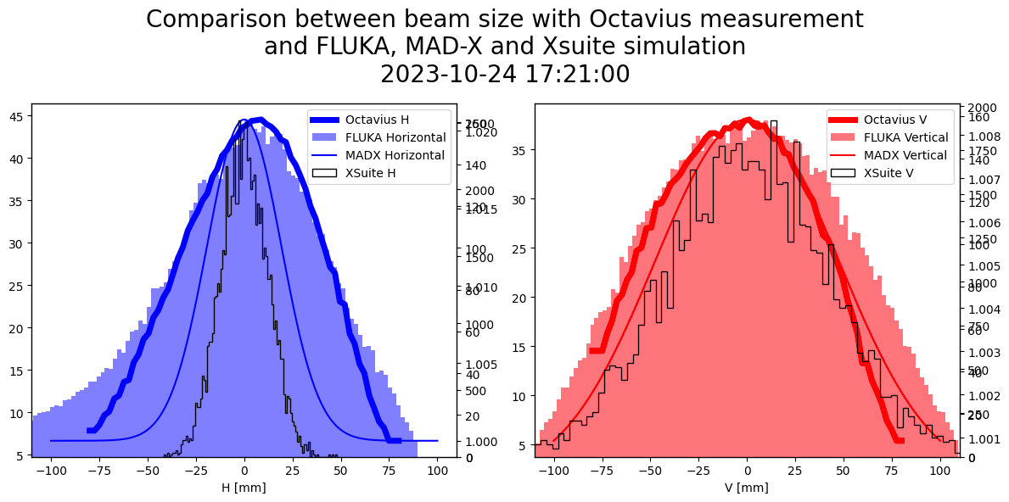
Beam profile
Optics model of the line
Different beam sizes
MAD-X
used for optimization
FLUKA
for a more in-depth study

Slide 26
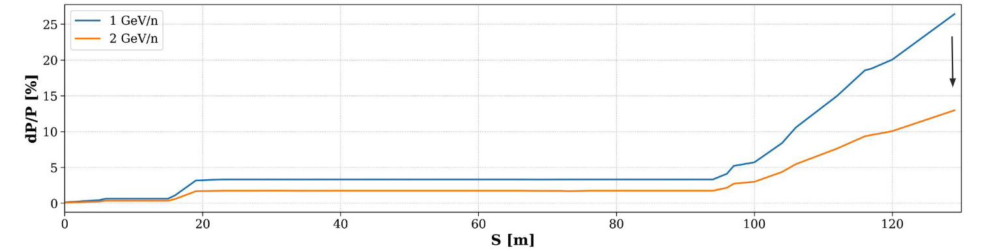
Energy / momentum straggling
Air region in cyan
Non-linear straggling effect
Installation of vacuum chamber could become necessary
Courtesy: Andreas Waets

Slide 27
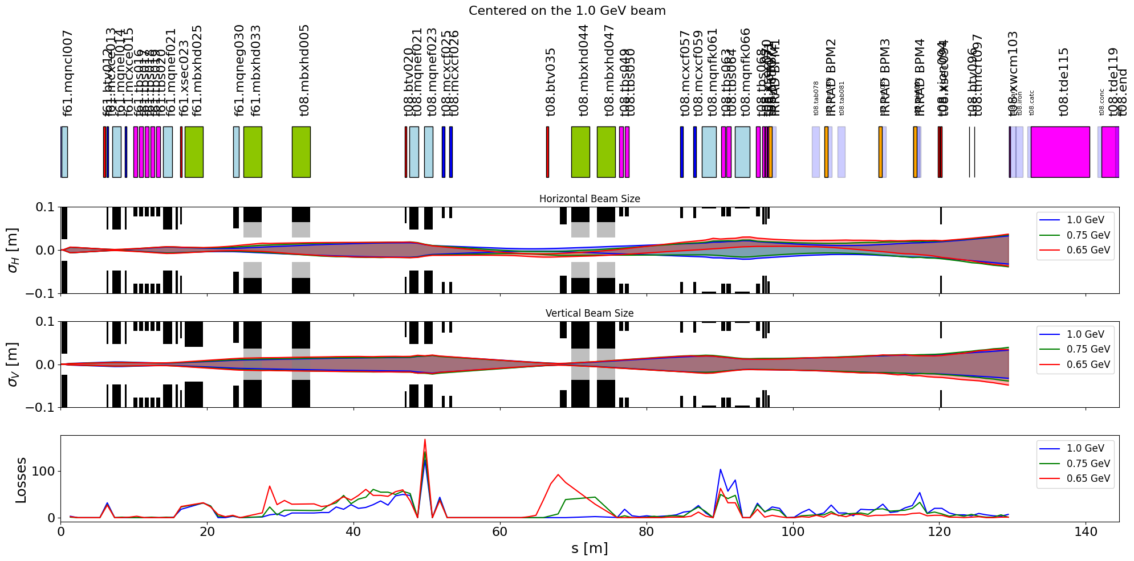
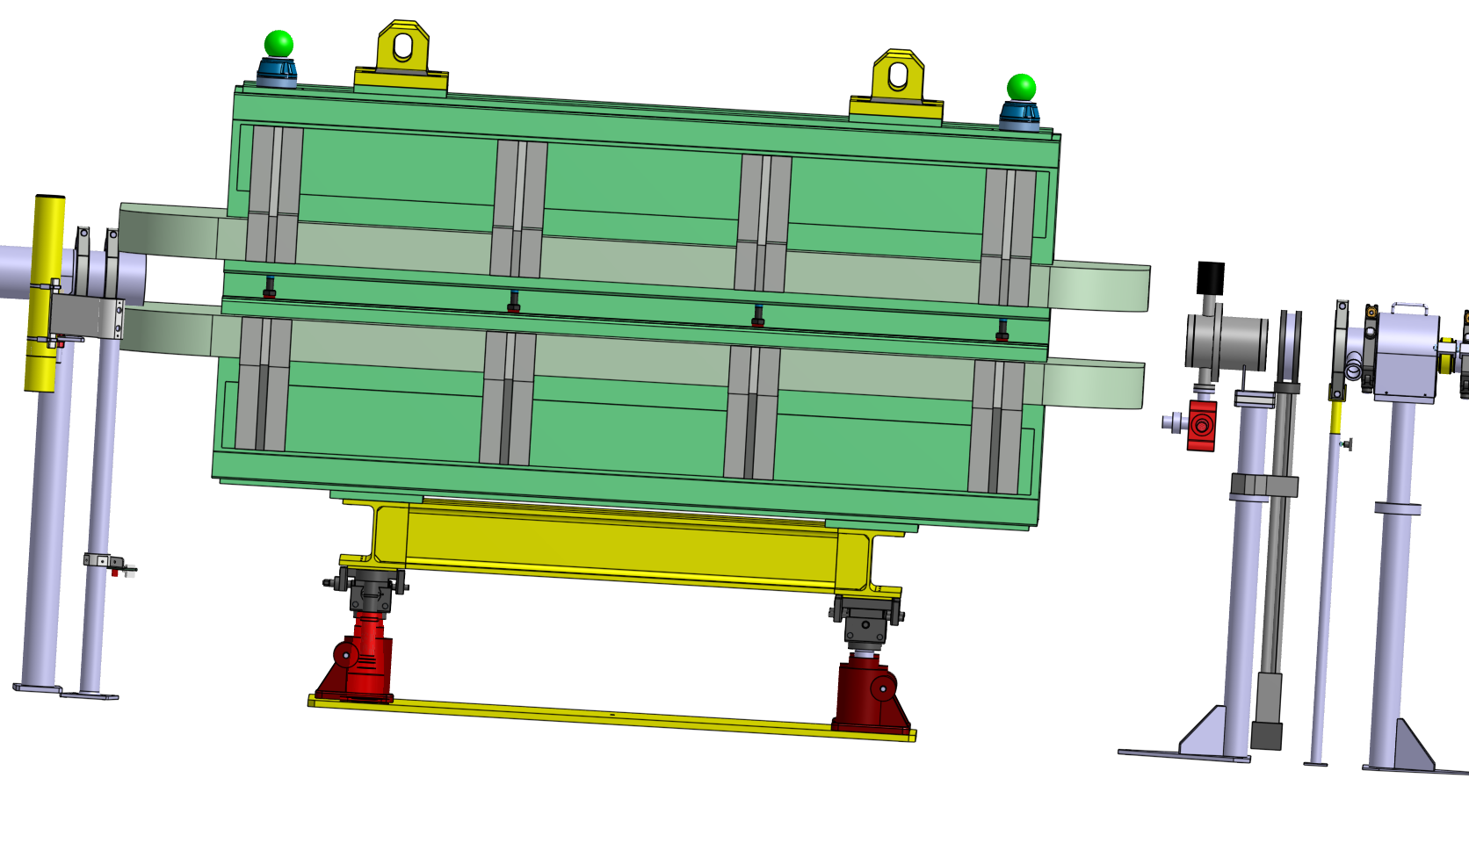
Energy / momentum straggling
IRRAD Table 1
CHARM
BTV035
Air region in cyan
Non-linear straggling effect
Installation of vacuum chamber could become necessary
Courtesy: Andreas Waets

Slide 28
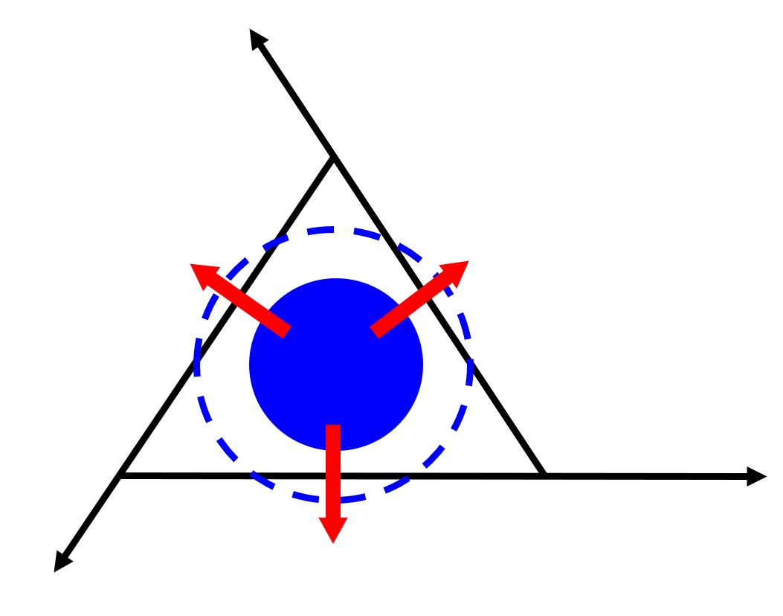
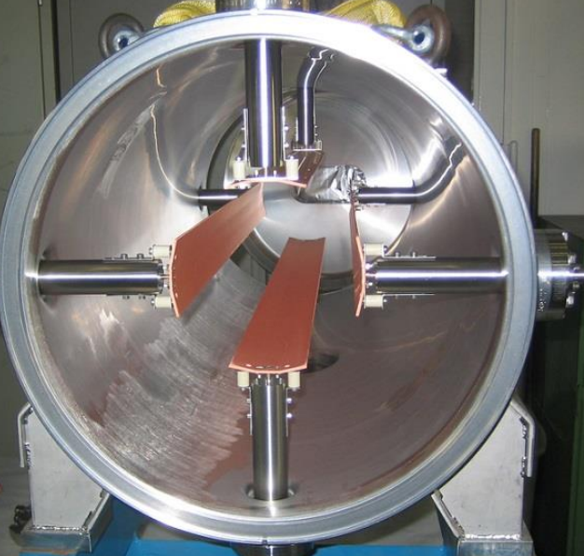
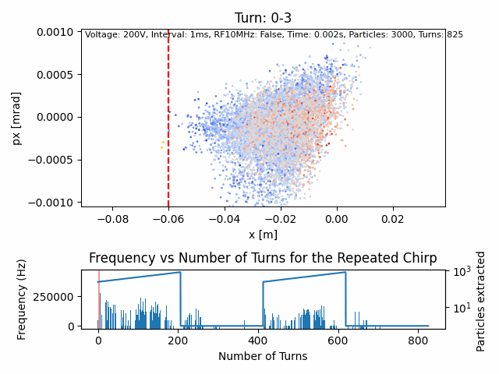
RFKO
Emittance increase through RF excitation
Transverse Damper used as exciter
Notes:
Chromaticity: tune dependence on momentum

Slide 29
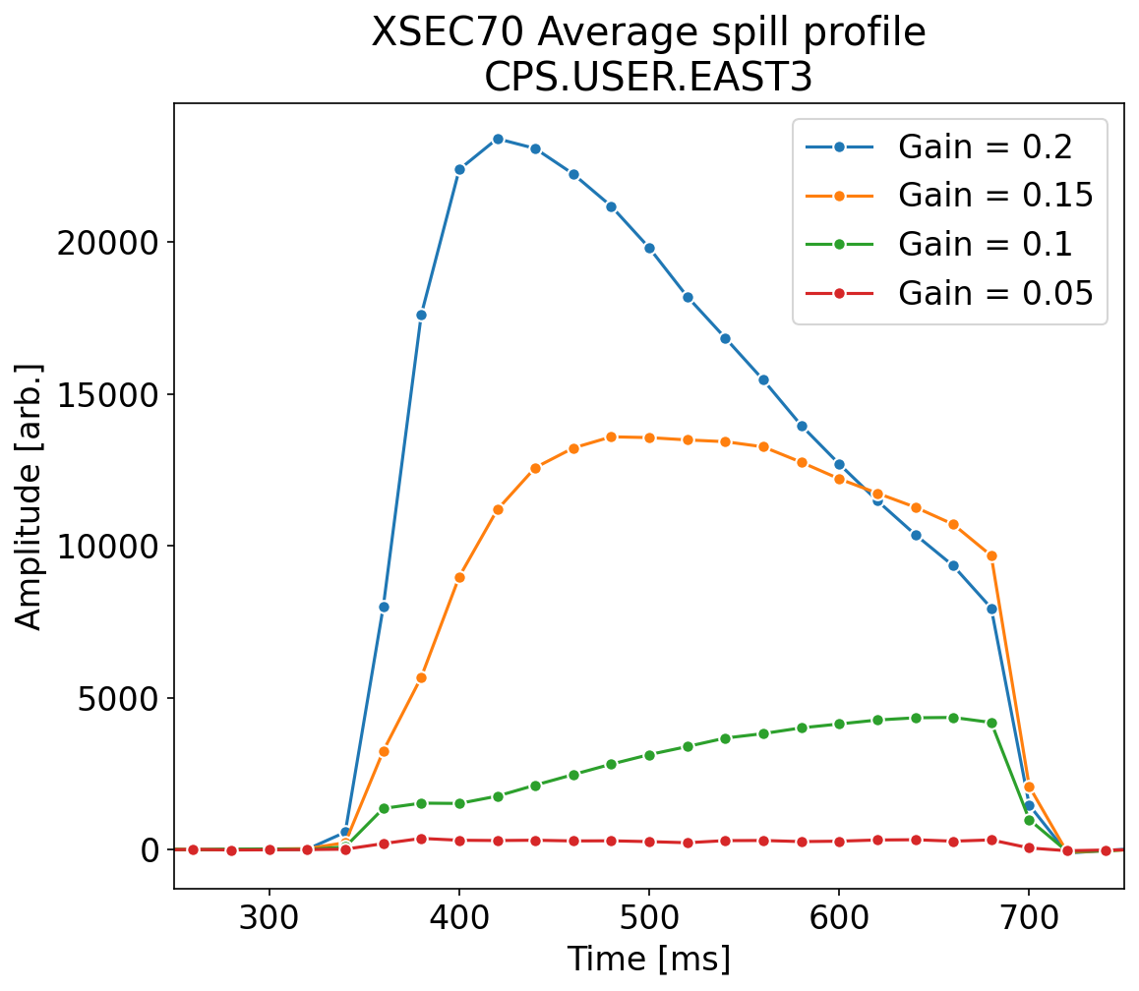
Comparison between gain
Intensity $\text{∝}$ gain
Reproducible shape per gain
Peak shifts with gain
Dynamic effect
True for range of gains
Amplitude Modulation with feedback
$${gain}_{low}$$
$${gain}_{high}$$

Slide 30
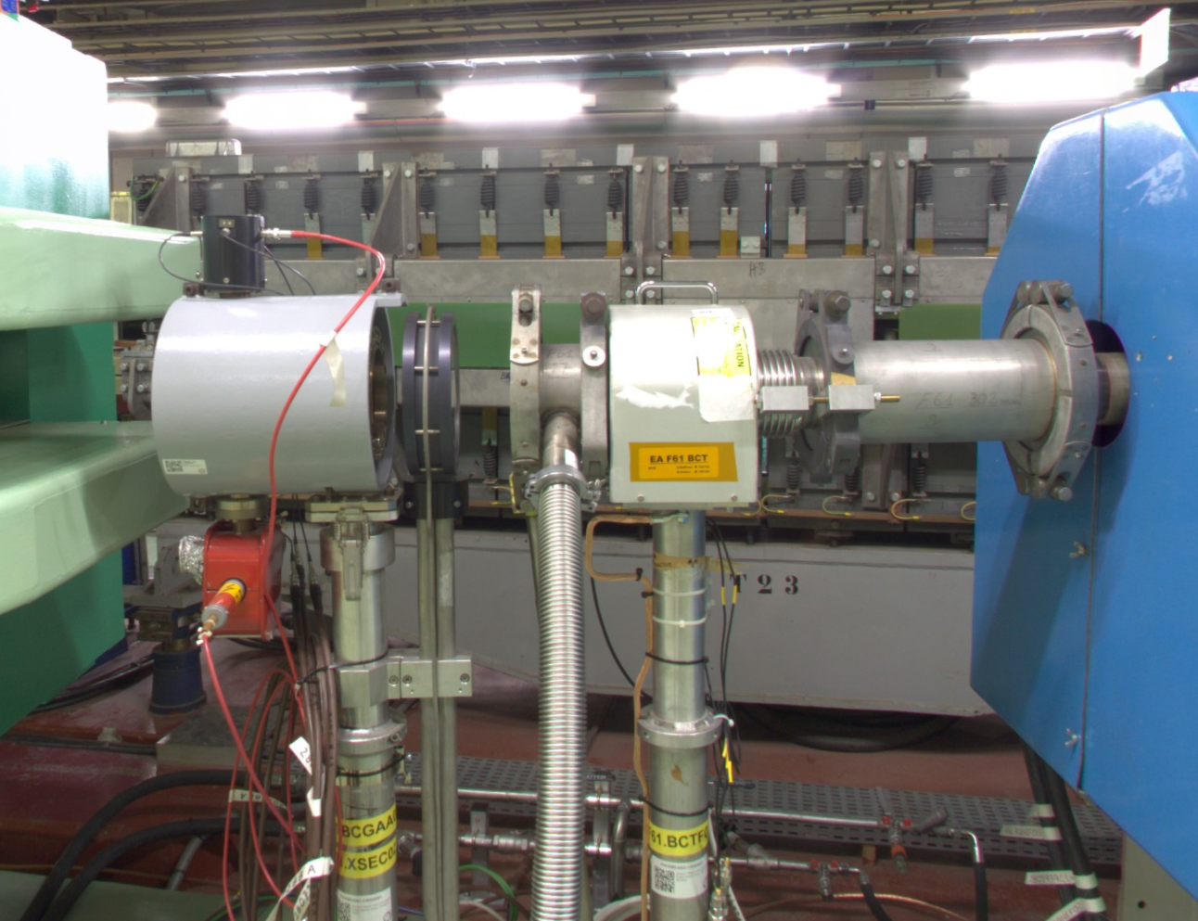
Spill time profile
> 7 instruments to measure spill time profile
Gas scintillator (BCGAA/BXSCINT)
XSEC 23/70/94
XION 71/94
Diode
(BLM, SRAM, …)
BCGAA023
XSEC023

Slide 31
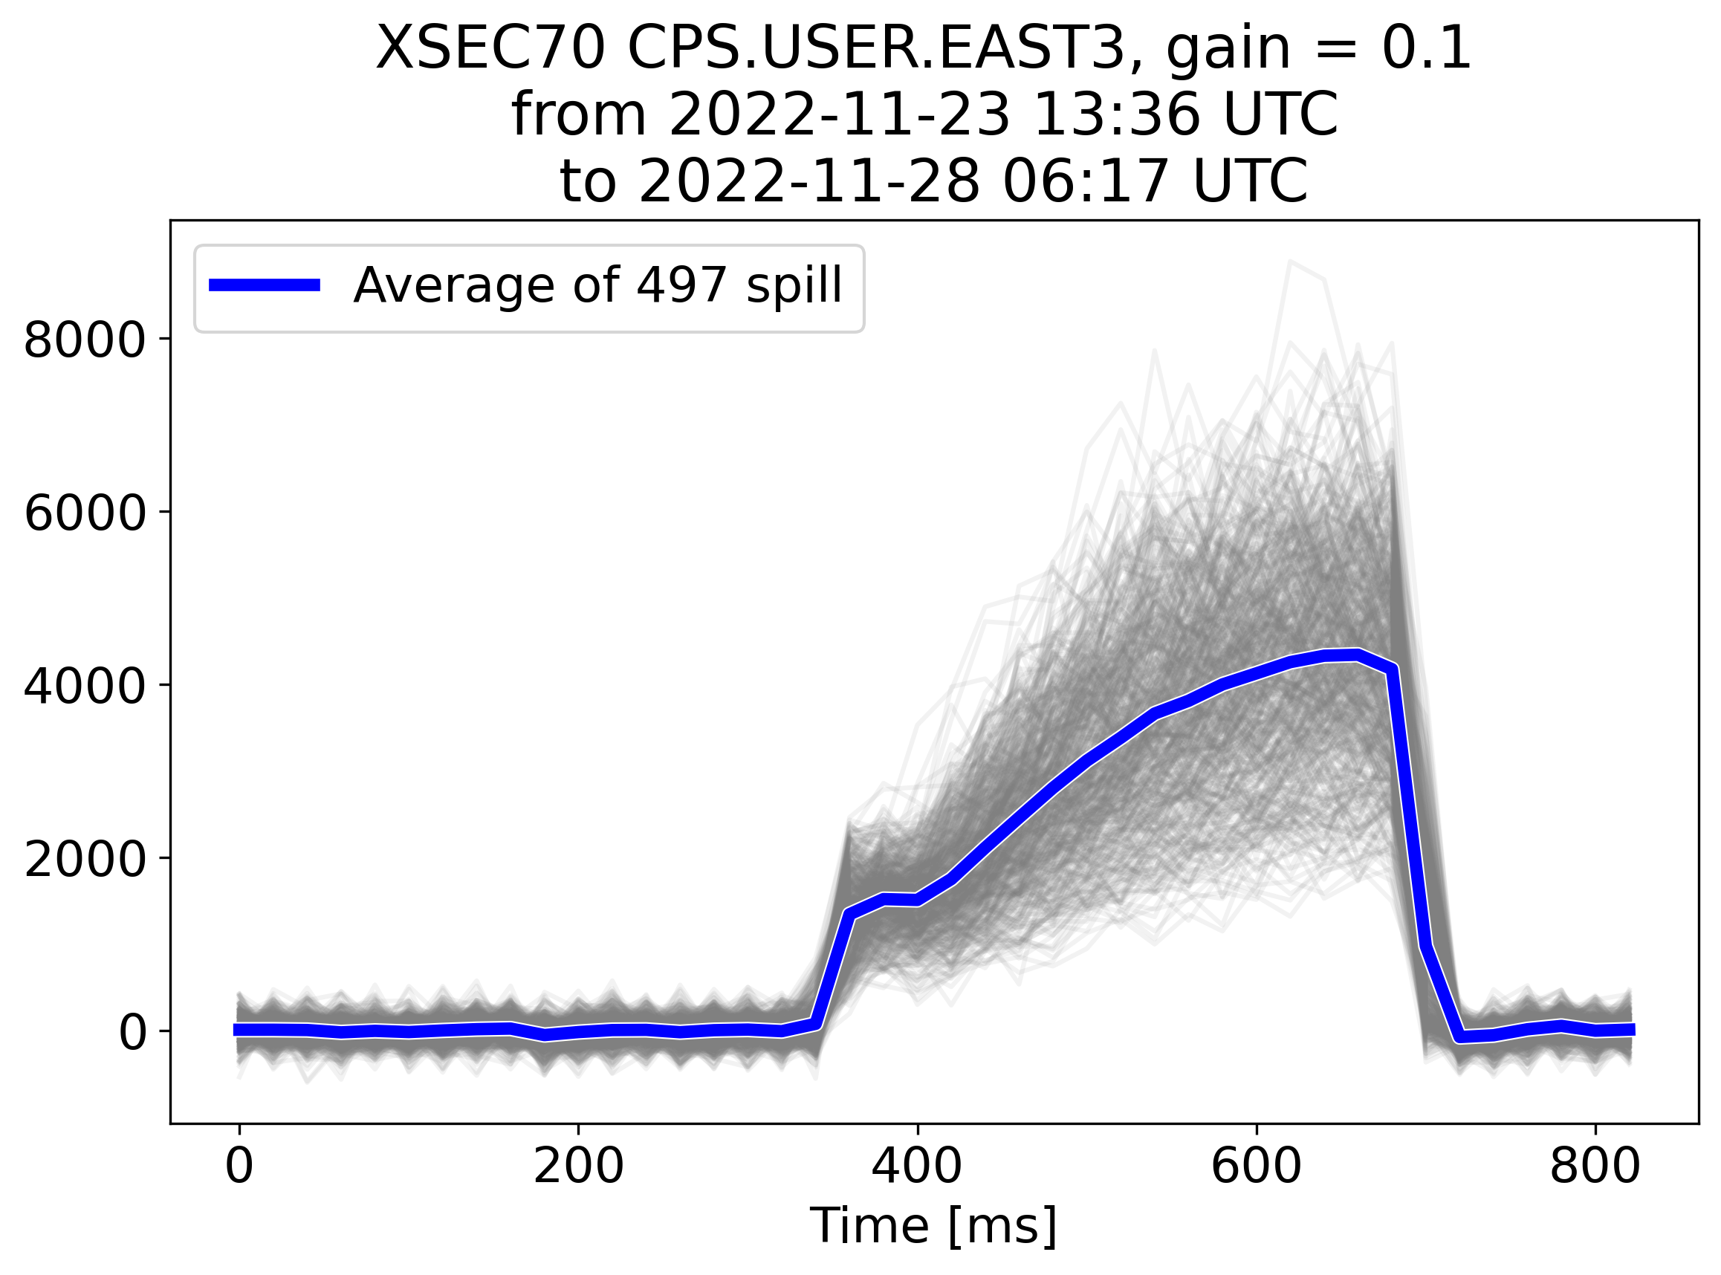
Spill profile
Time resolution:
20 ms for XION, XSEC
2-3 ms for Diode
0.5 ms for BXSCINT
Finer sampling possible with BXSCAL (0.3-0.04 ms) and white rabbit (not logged) in F61 and Diode up to 0.5 µs
Notes:
Mention that this is for a single gain and energy

Slide 32
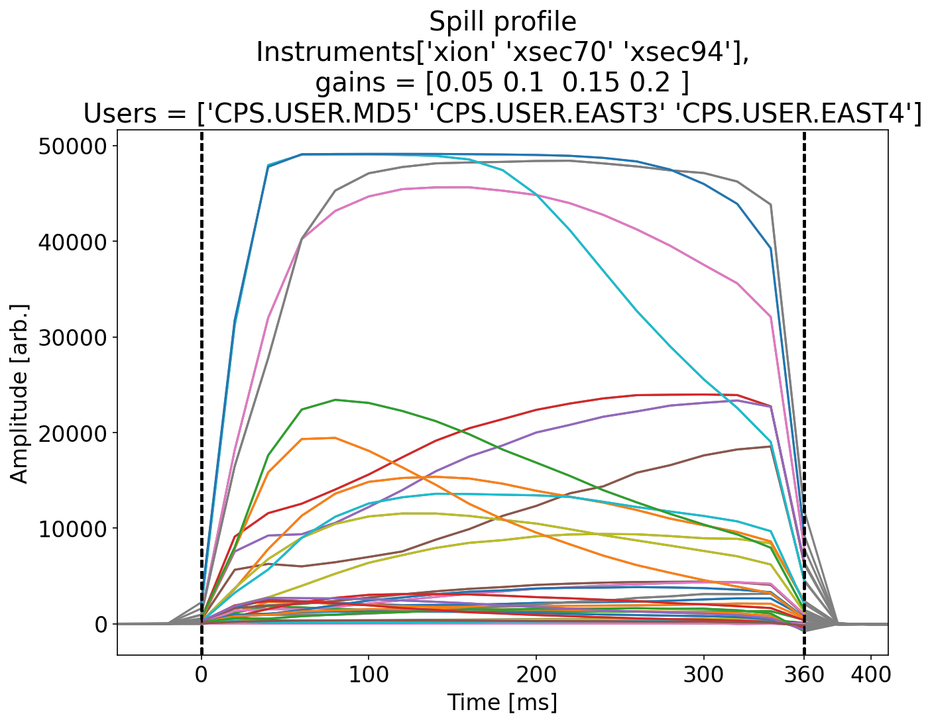
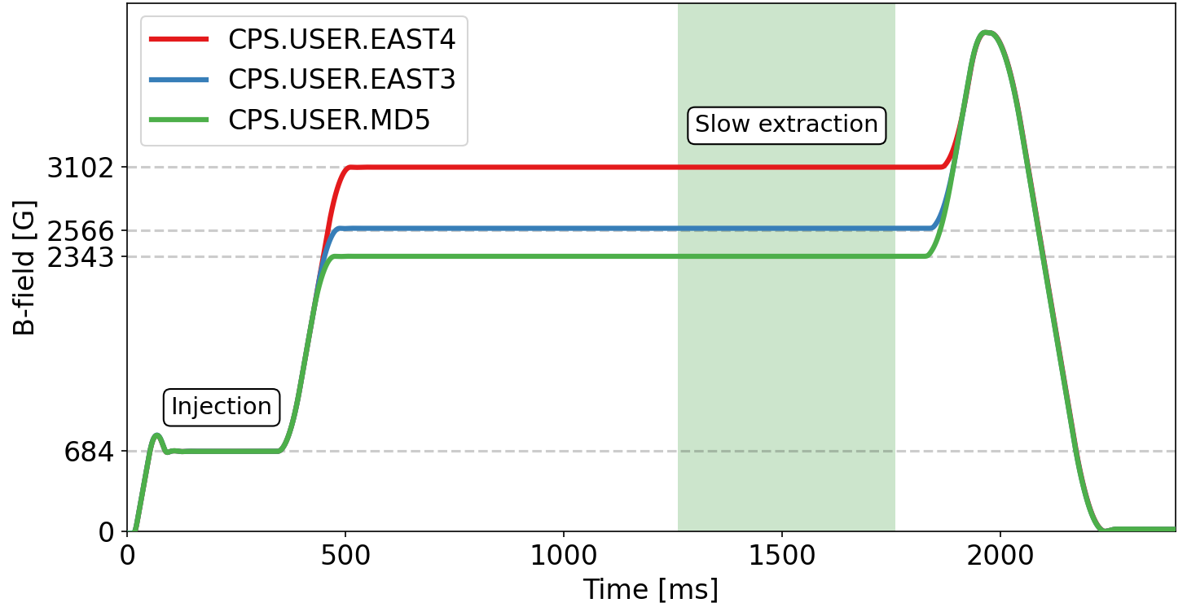
Spill time profile
Average time 360 ms
Longer spill time (~1000 ms) could be tested if needed
Long flat top
No bunch rotation
Only GRPOS tune shift

Slide 33
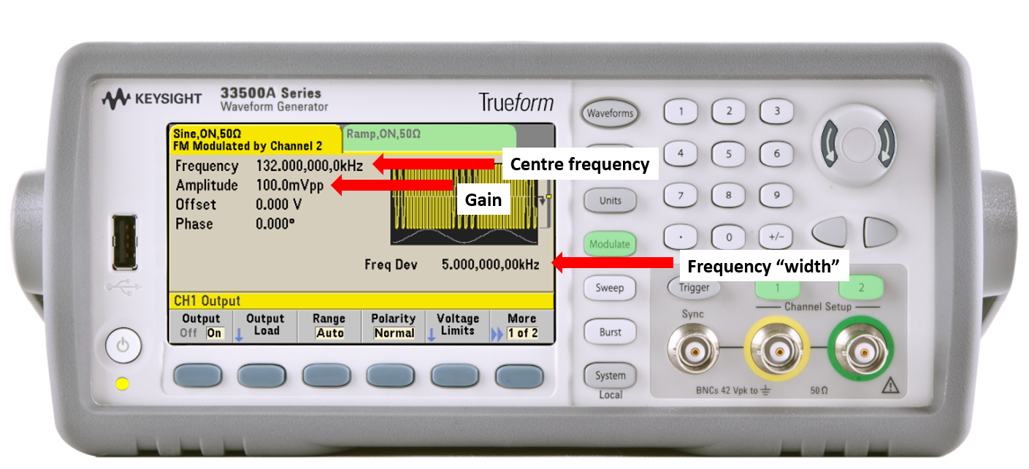
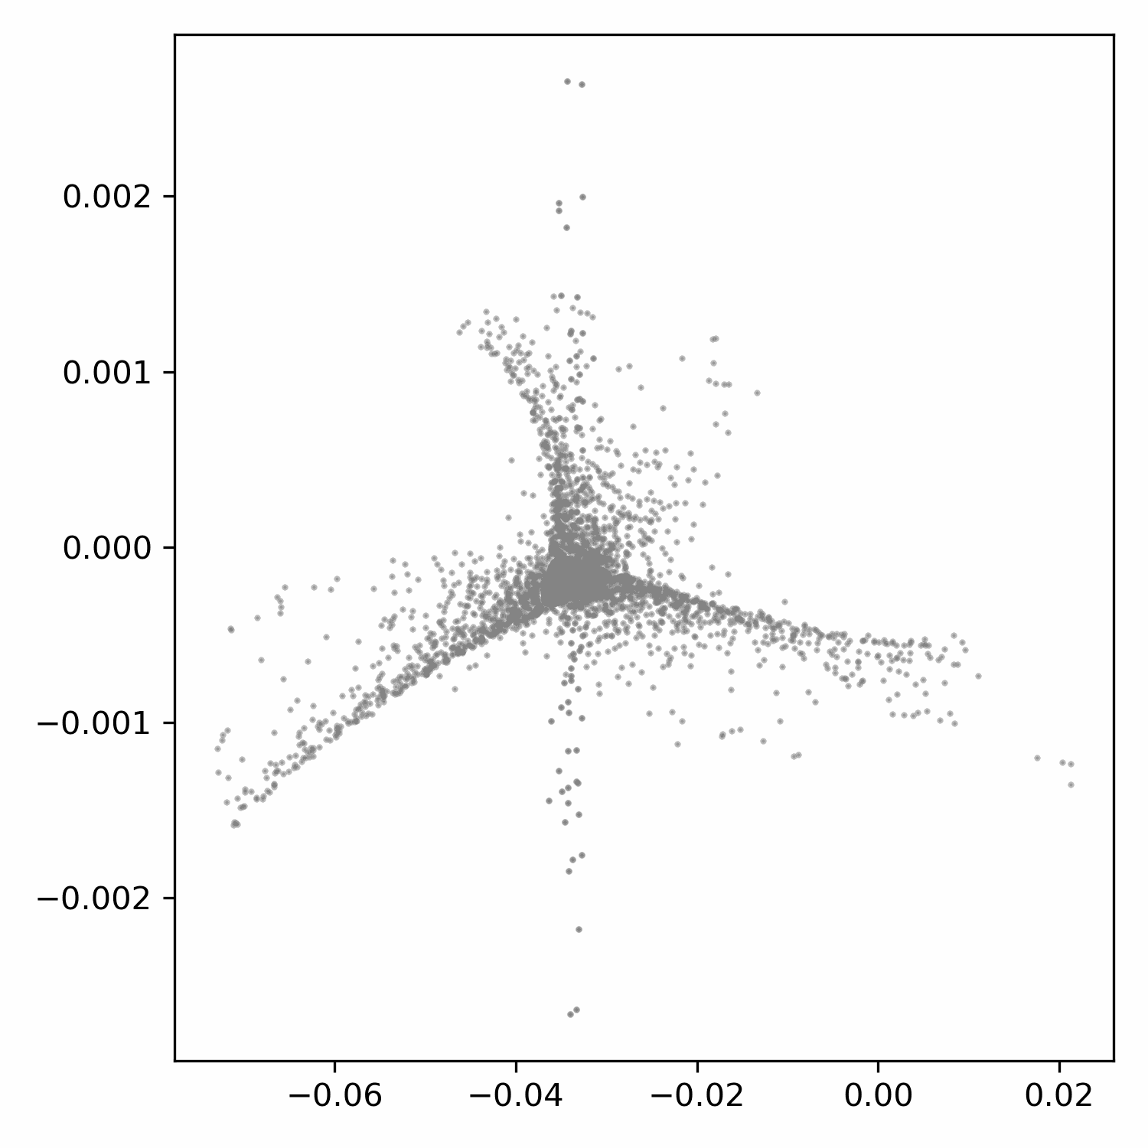
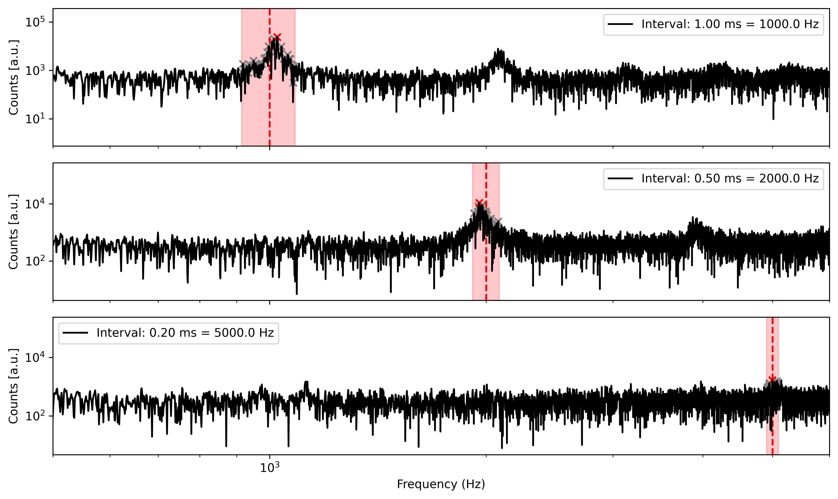
R&D
Remote app
Send python commands
Continuous chirp
Signal generator
Exploit low-pass filter effect of beam (transit time) by exciting at higher freq
Variable gain during spill
Transit time (10-100 turns)

Slide 34
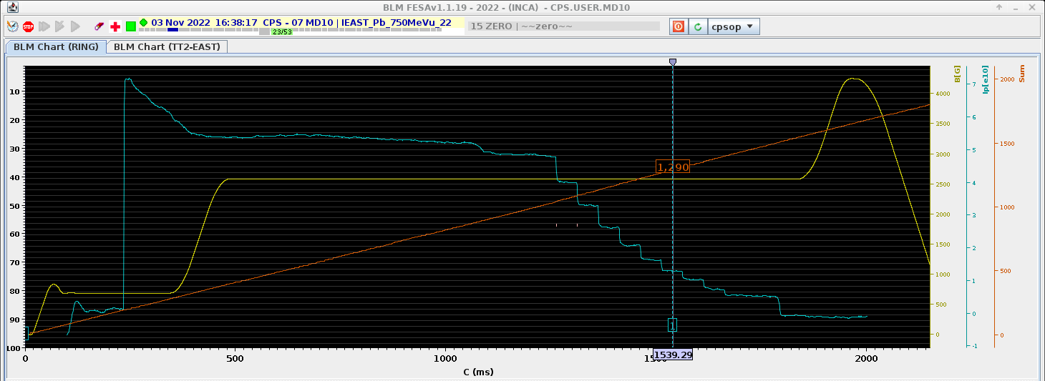
RFKO amplitude control
RFKO Turn ON and OFF

Slide 35
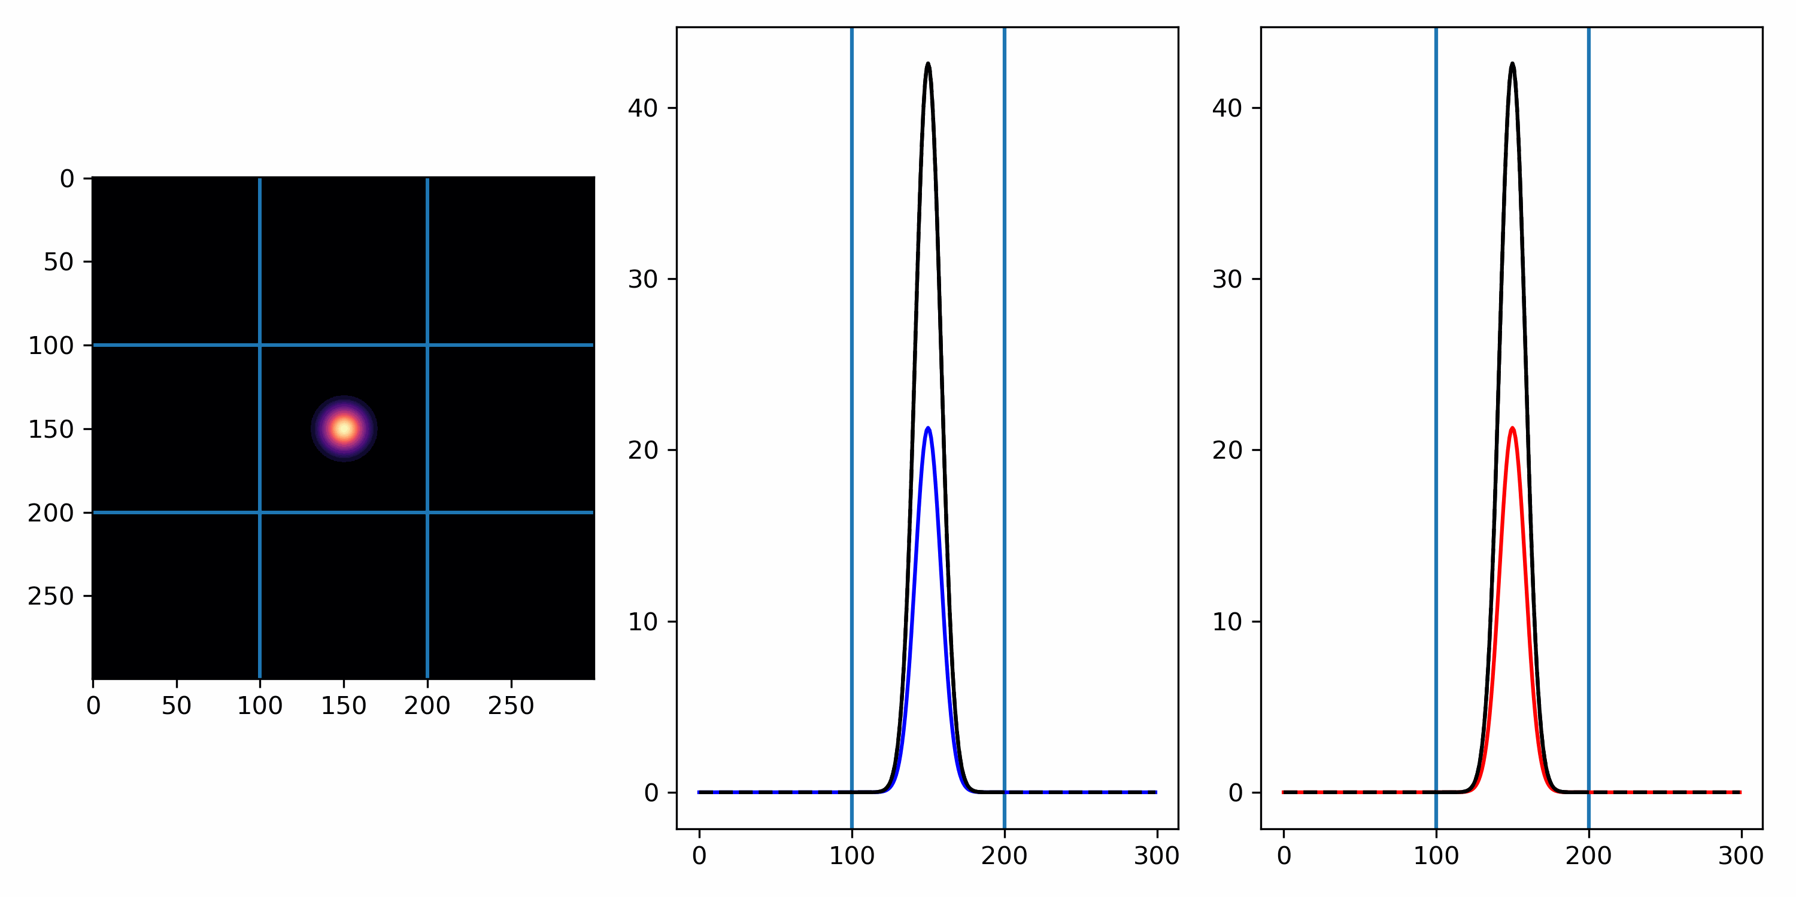
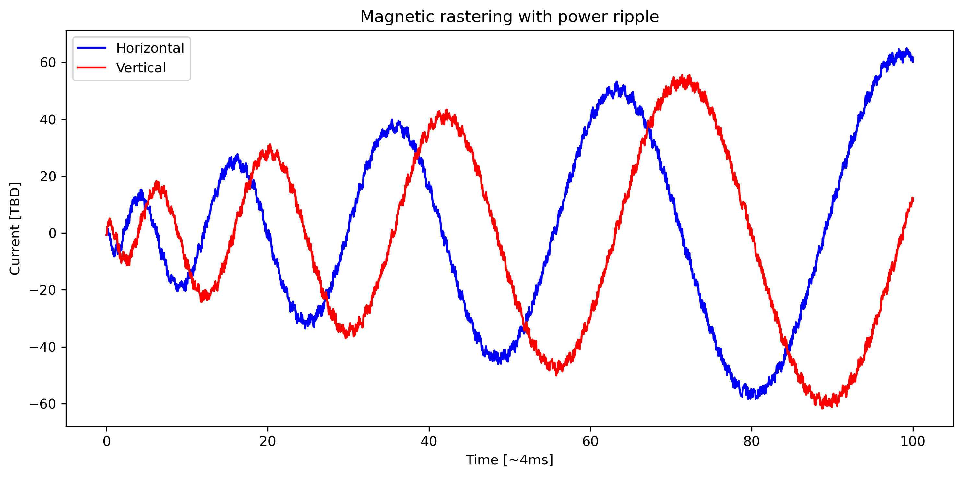
Magnetic rastering
Horizontal and vertical deflection using dipole magnets
Spiral inwards/outwards
TBD requirement on
Sample size
Uniformity (+- 5% ?)
Drawback
Constant intensity needed
Constant optics during the spill
Complexity of the power converter to pulse at positive and negative current
Optics TBD
Beam size for painting

Slide 36
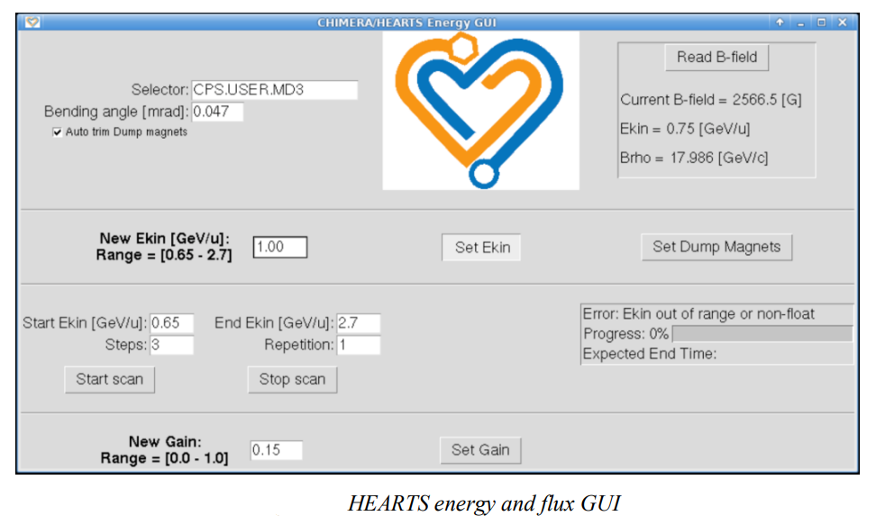
Beam energy and flux operator GUI

Slide 37
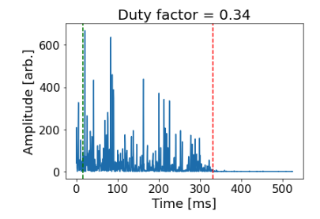
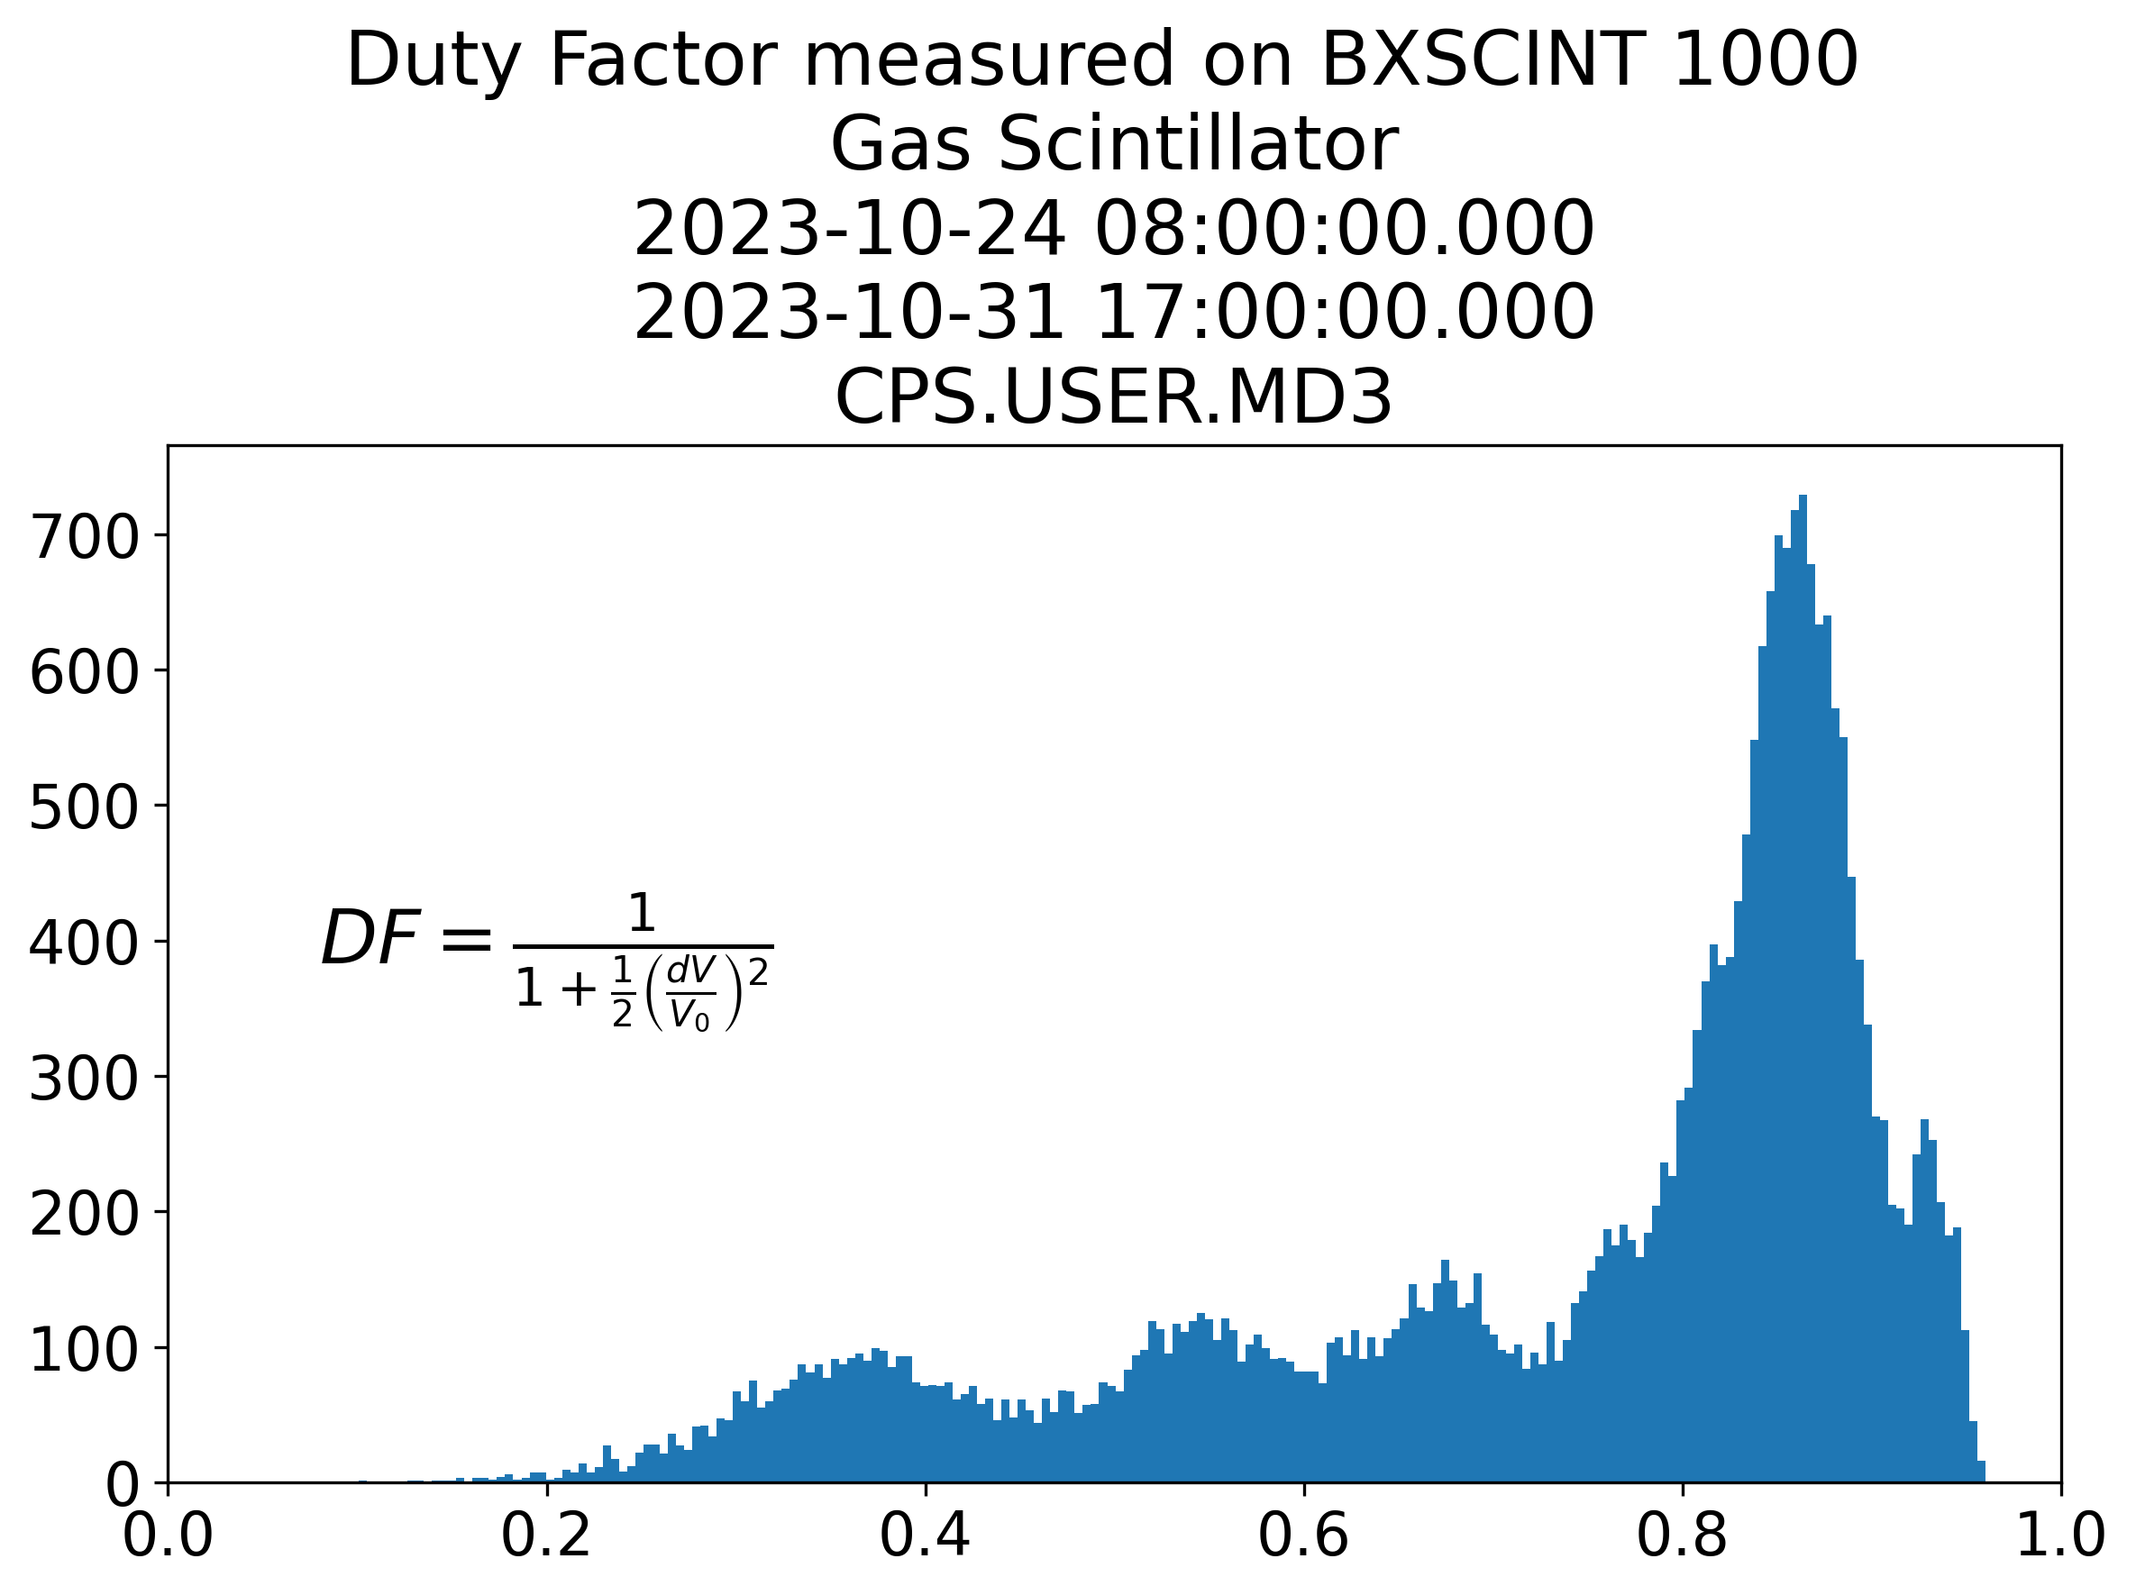
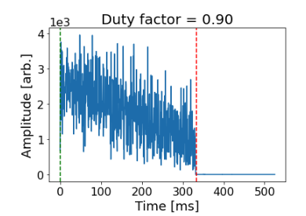
Duty Factor

Slide 38
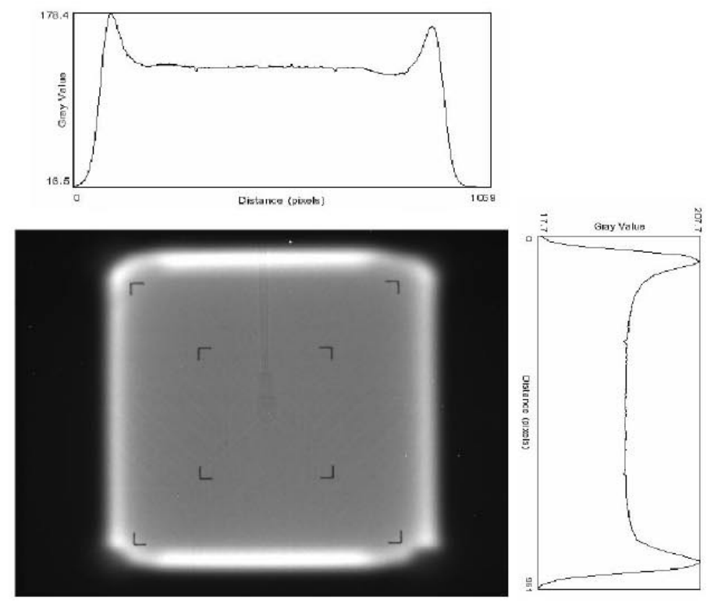
Octupoles
Use of octupoles at NASA Space Radiation Laboratory (NSRL)
Third order magnetic optics
Uniform beam of 10x10 to 20x20 cm^2
Clean and simple process
No collimation or interaction with matter
Requirement: gaussian distributed beam
Jang, Ji-Ho, Hyeok Jung Kwon, Yong Sub Cho, and Wha Ryun Lee. 2011. “Uniform Irradiation in a PEFP 100-MeV Beam Line with Octupole Magnets.” Journal of the Korean Physical Society 59 (2(2)): 604–9. https://doi.org/10.3938/jkps.59.604.
Tsoupas, N., L. Ahrens, S. Bellavia, R. Bonati, K. A. Brown, I-Hung Chiang, C. J. Gardner, et al. 2007. “Uniform Beam Distributions at the Target of the NASA Space Radiation Laboratory’s Beam Line.” Physical Review Special Topics - Accelerators and Beams 10 (2): 024701. https://doi.org/10.1103/PhysRevSTAB.10.024701.
Tsoupas, N, L Ahrens, and K A Brown. 2007. “Uniform Beam Distributions at the Target of the NSRL Beam Transfer Line,” 3.
Tsoupas, N, S Bellavia, R Bonati, K Brown, I-Hung Chiang, C J Gardner, S Jao, et al. n.d. “Uniform Beam Distributions at the Target of the NSRL Beam Transfer Line,” 23.

