Slide 1
Update on Installation Planning
Petra Hofmann
R3B Collaboration Meeting Nov. 2023

Slide 2
Topics
Installation planning
LCM Workshops High Energy Cave
Update on media supply and mobile walls
Relevant Routes into and inside the FAIR Buildings

Slide 3
Installation High Energy Cave

Slide 4
Installation Order
Starting Point is a milestone from SFRS, telling that the cave is now empty from stored SFRS magnets / multipletts.
Installation works start with the completion of the mobile wall between the tunnel and the cave and the installation of the cryo distribution line coming from the low energy cave.
Next steps are the installation of the local cryo components, racks and cables and the FHF2 multiplett.
When those components are installed (as soon as multiplett is positioned), the installation of the experimental equipment can follow.

Slide 5
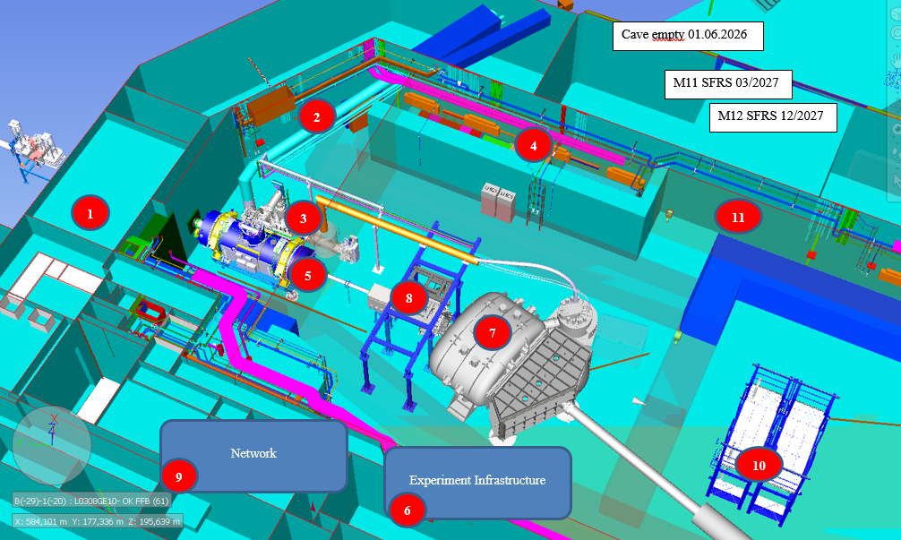
Current Installation Dates
Cave empty 01.06.2026
Mobile wall 06-07/26
Cryo Distribution Line 08/26
Local Cryo 08-09/26
Racks and cables (machine) 08/26
Multiplet (inc. connections to media) 09-11/26
Experiment Infrastructure
GLAD
CALIFA
Network
NEULAND
Closing of outside wall 03/27
R3B Commissioning w/o beam 11/26 – 09/27
10-12/26 (..03/27)

Slide 6
LCM Workshop High Energy Cave
Interface Workshop with SFRS and specific departements
Overall installation order
Dependencies
(Durations)
Preconditions
Who is doing it ?
Work instructions
Open questions -> list of open points for tracking
Results of LCM triggers update of Planisware installation plan

Slide 7
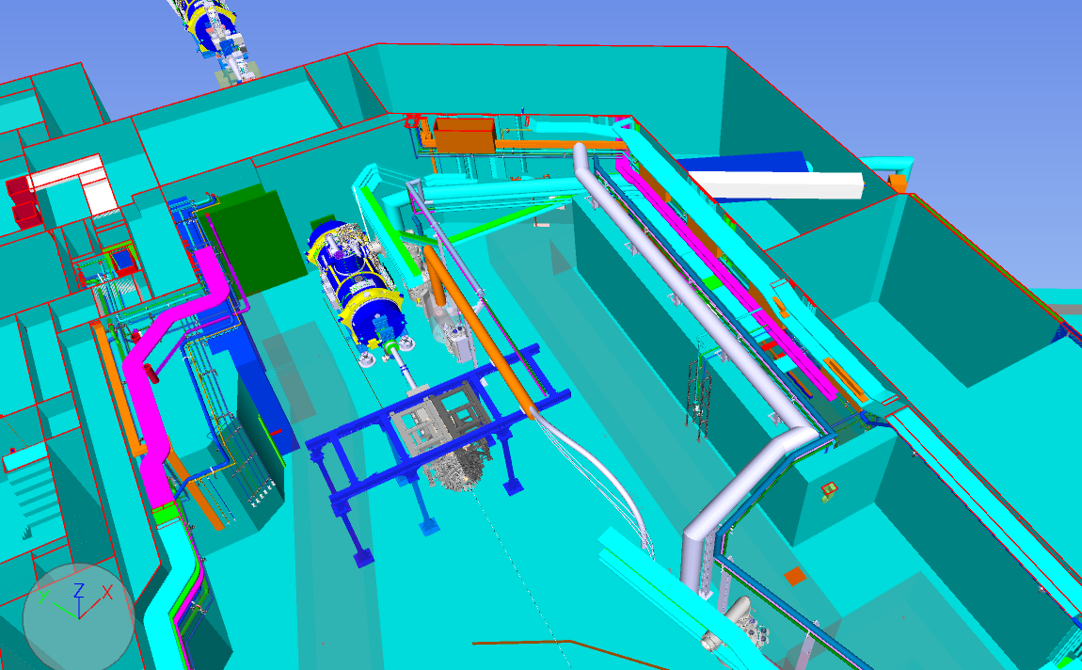
Media supply
Available media at several supply points:
Pressurized air
Cooling water
Vacuum exhaust pipes
Technical gas supply
different detectorgases, LN2 and N2 for flushing of detectors. The according exhaust pipes will be provided as well
Gaseous nitrogen
for usage of vacuum breaking of the accelerator components, the quality is lower than the quality of the N2 for flushing of detectors

Slide 8
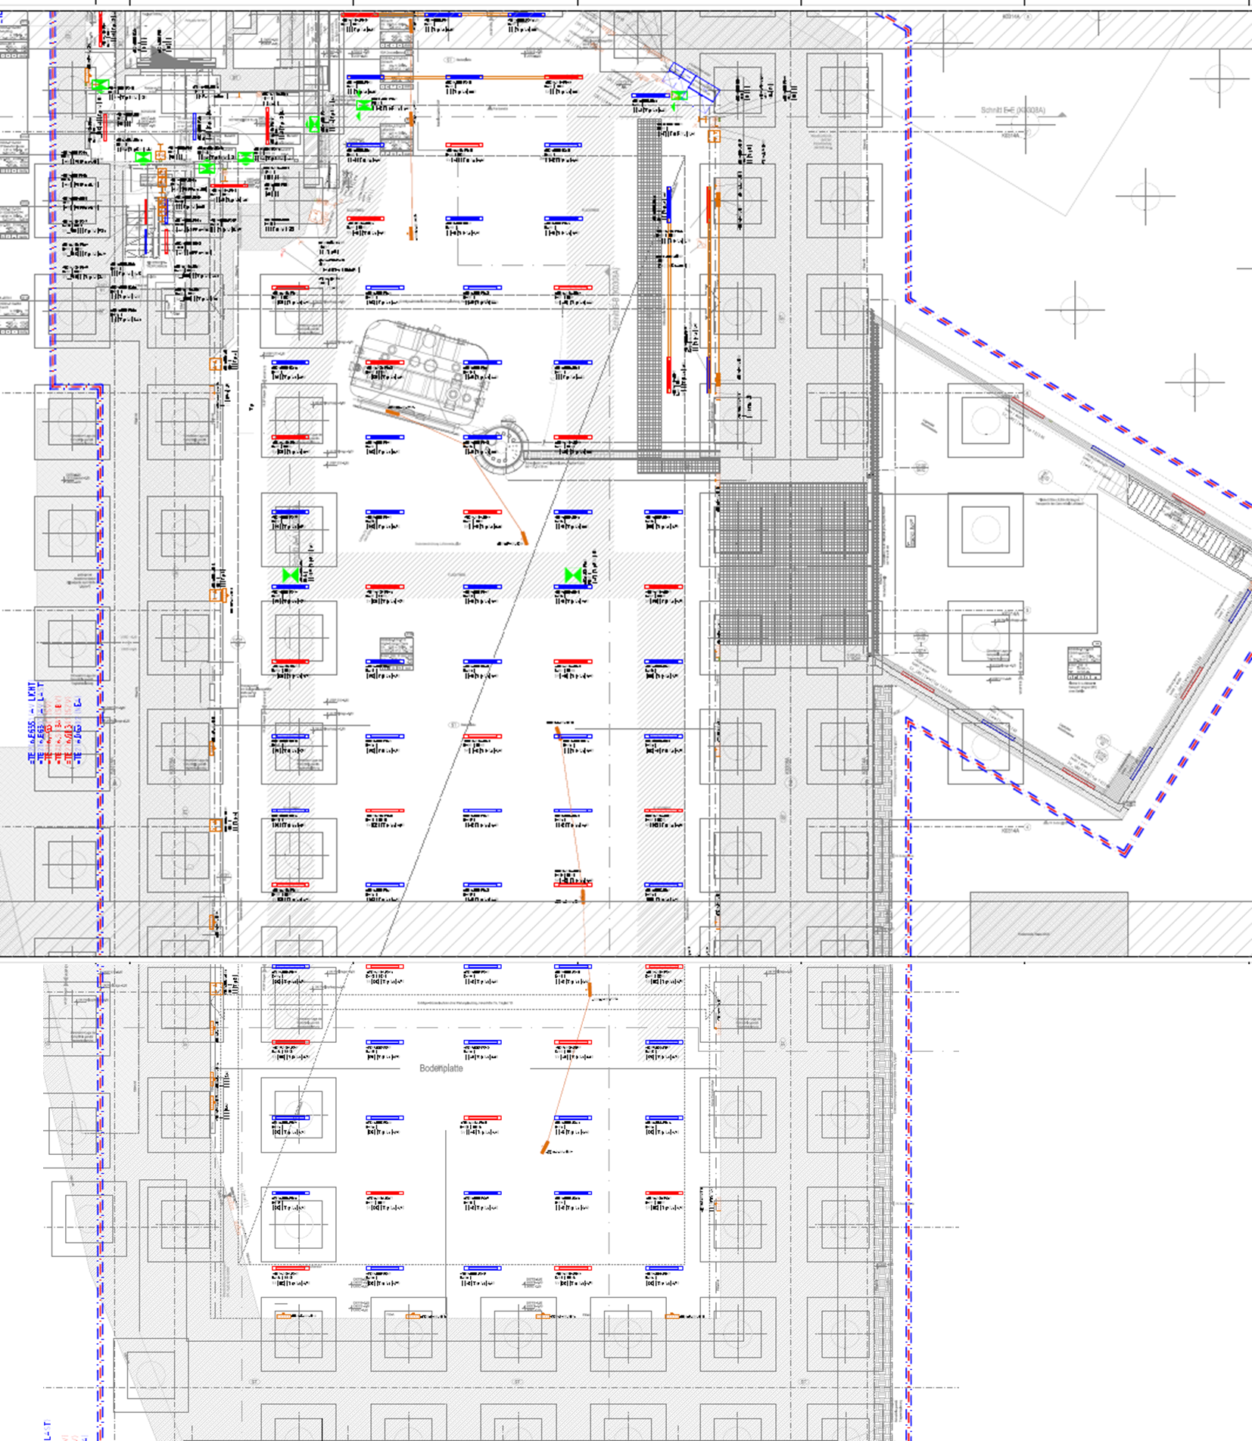
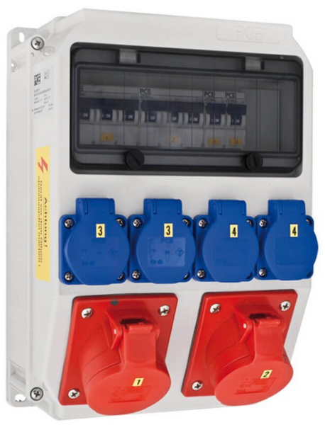
Electrical power
Power distributors of Type A and B
Type A: 4xSchuko + 1x16A CEE + 1x32A CEE
Type B: 4xSchuko + 1x16A CEE
Extra supply for racks in niche
150 kW requested for experimental units
currently in detailed discussion with FSB
proposal to install sub distribution box with direct connection for GLAD power supplies and further power distributors (type A) for other units
B
B
A
B
A
B

Slide 9
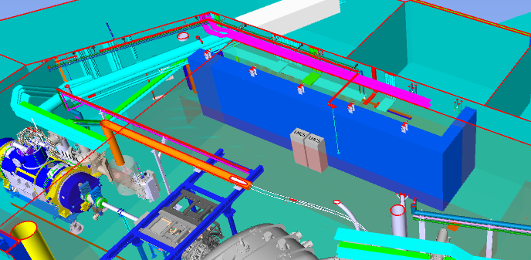
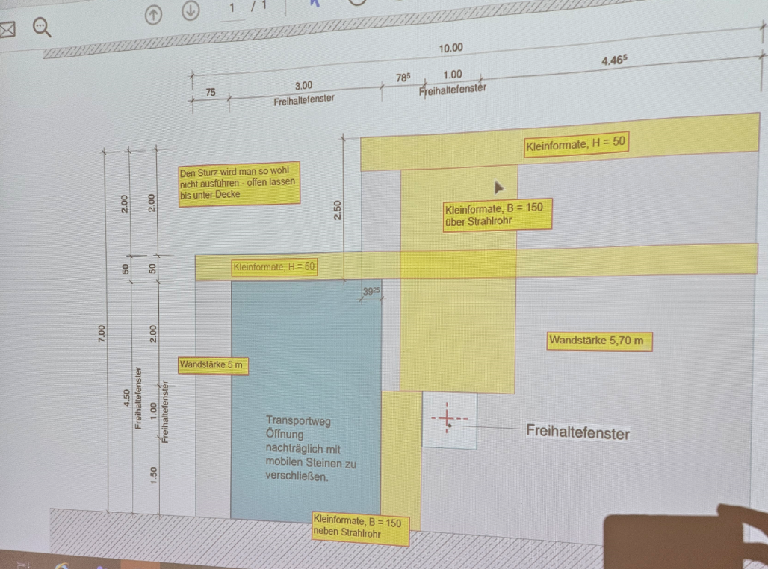
Mobile walls
Wall between HEC and tunnel
Detailed plannning in progress
how ?
when ?
Nishe Wall
we will receive ca. 40m³ of blocks for our own usage as required

Slide 10
Routes into and inside the FAIR buildings
Document has been created with information how to access the NUSTAR caves from in- and outside the buildings
Recently the information for the access to the tunnel focal planes was added
Document contains:
Description of routes
3D and 2D views of routes
Measures
Document currently in german, translation into english will follow
Closer investigation of how to transport experimental components if necessary

Slide 11
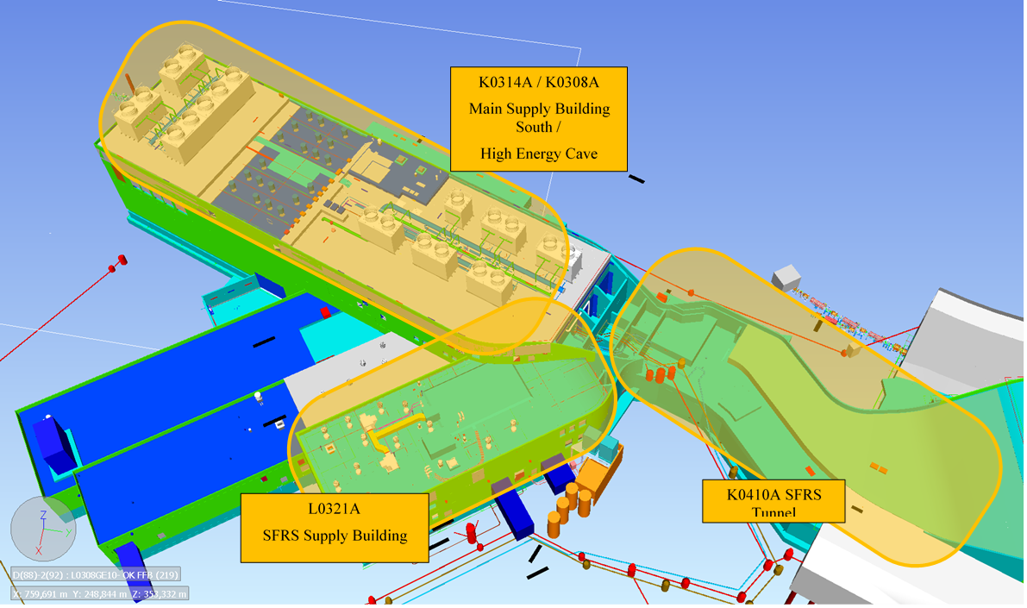
Buildings overview
L0321A: SFRS supply building with
NUSTAR labs
NUSTAR control room
K0308A: High Energy Cave
K0314A: Main supply building south on top of K0308A
K0410A: SFRS Tunnel with
main seperator
high engergy branch
(low energy branch)
(ring branch)

Slide 12
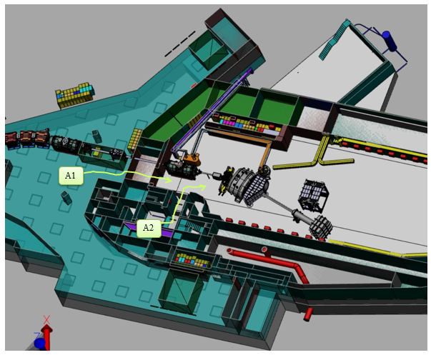
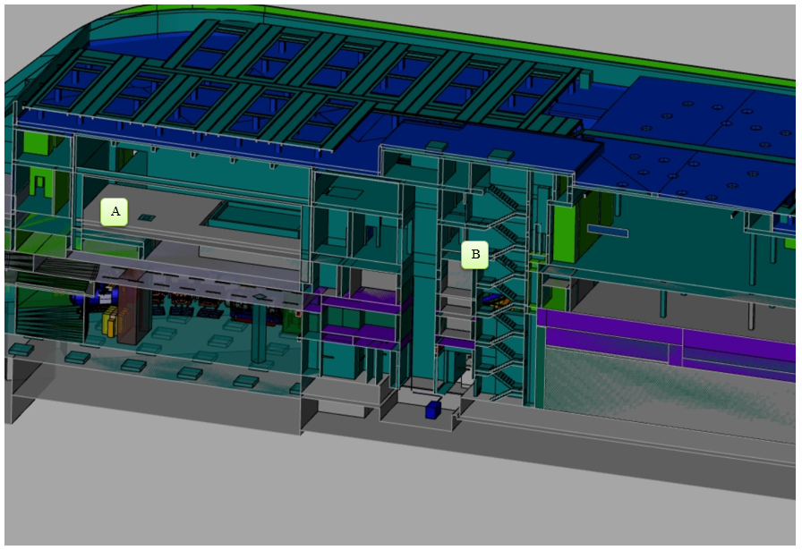
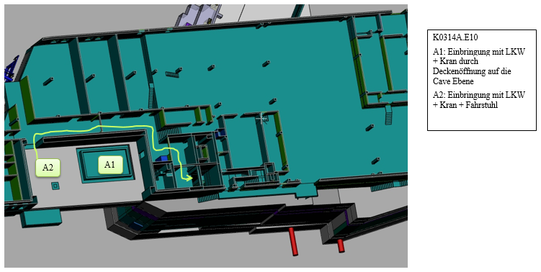
Examples from routes document – Access from outside west

Slide 13
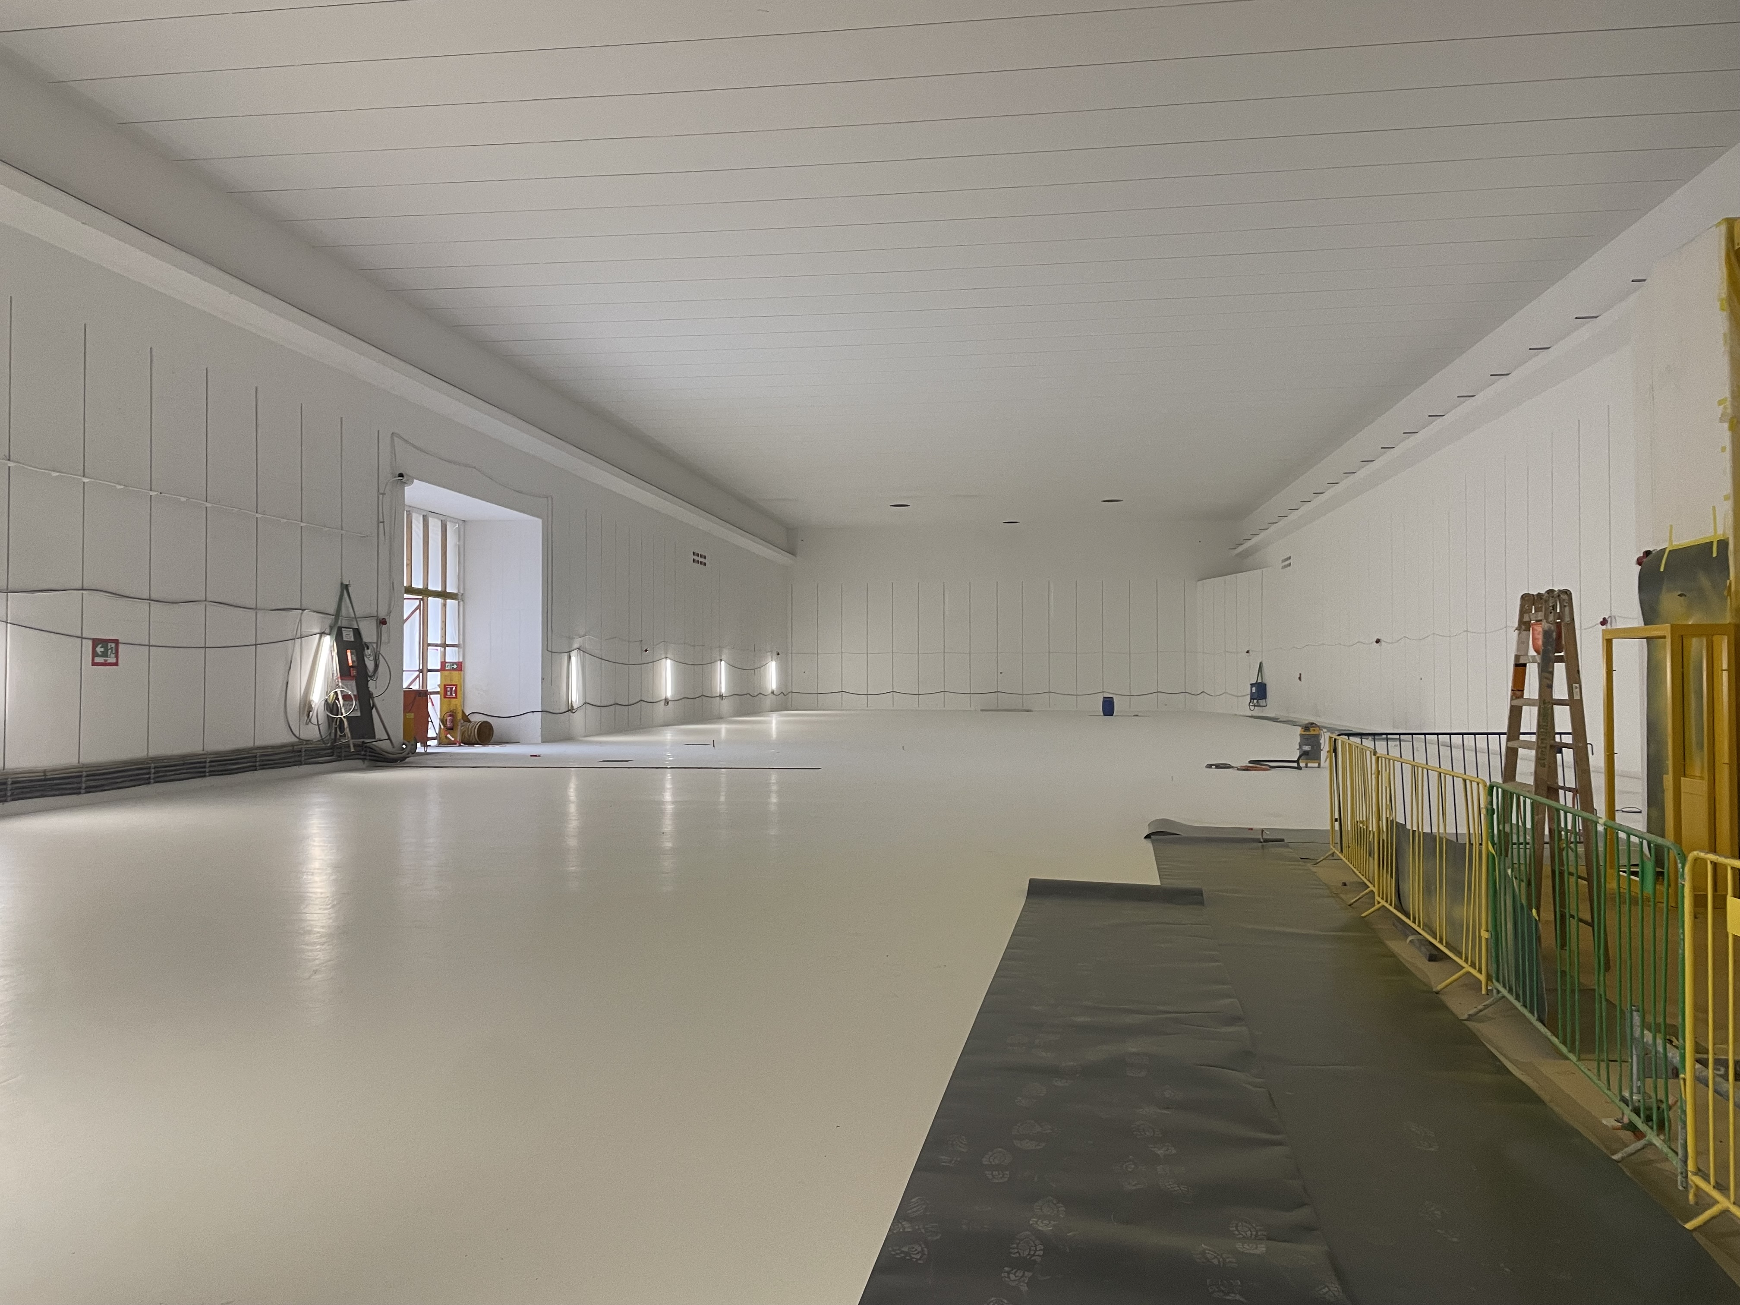
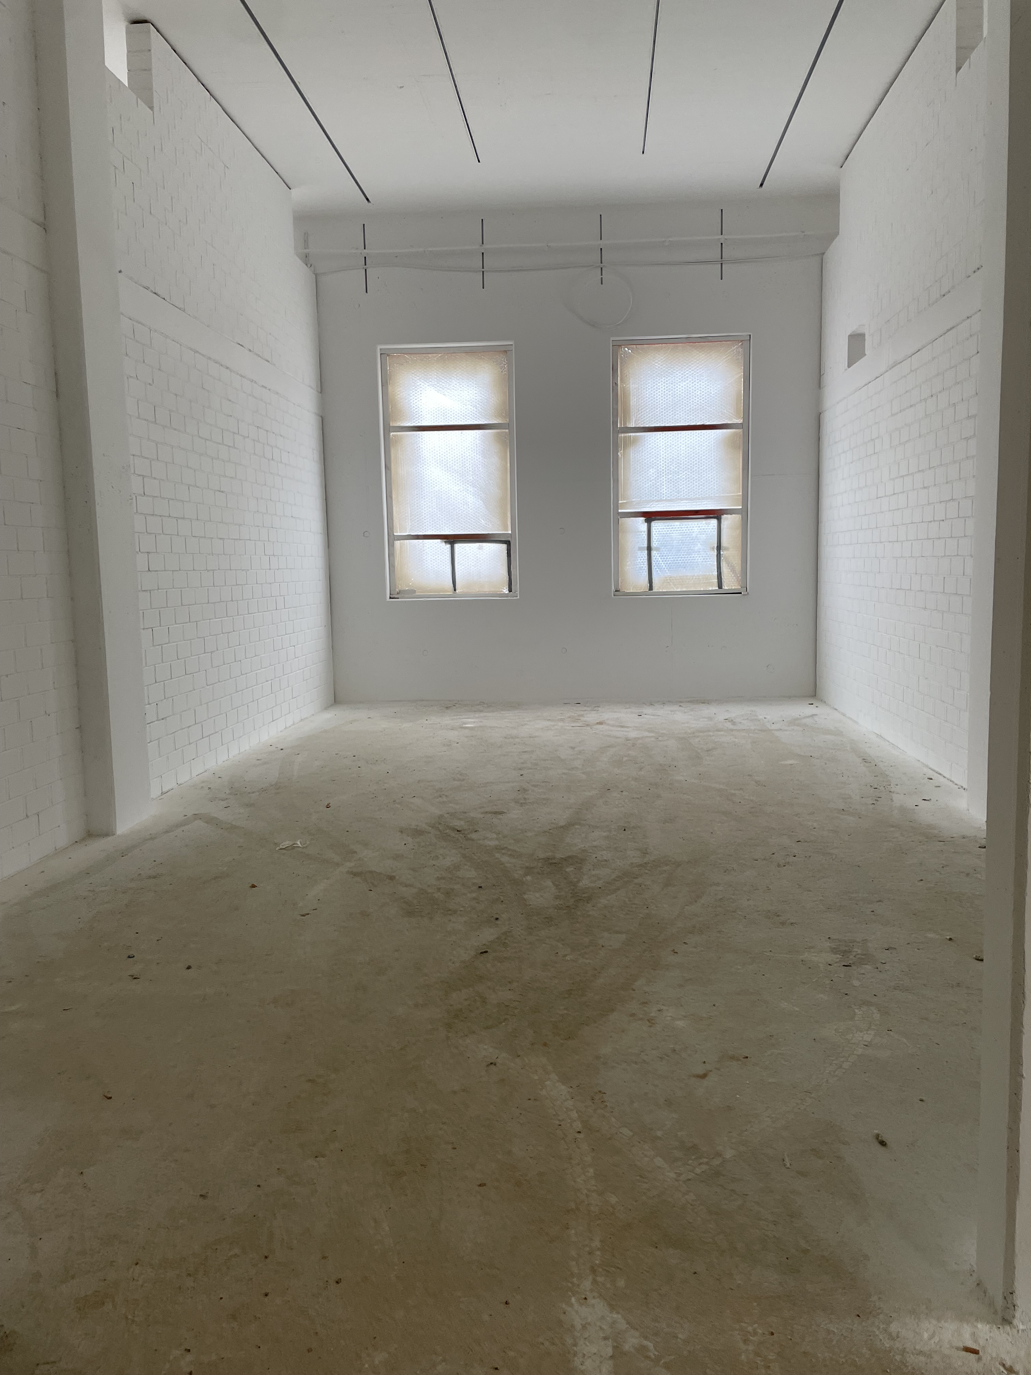
Recent pictures from construction site
pictures: Helena Albers, 30th Oct. 2023

Slide 14
Thank you for your attention

Slide 15
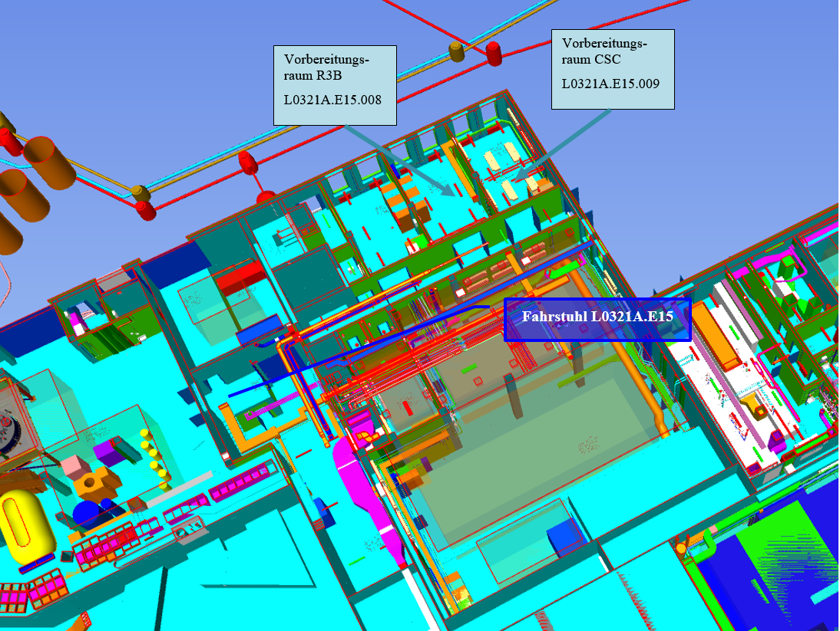
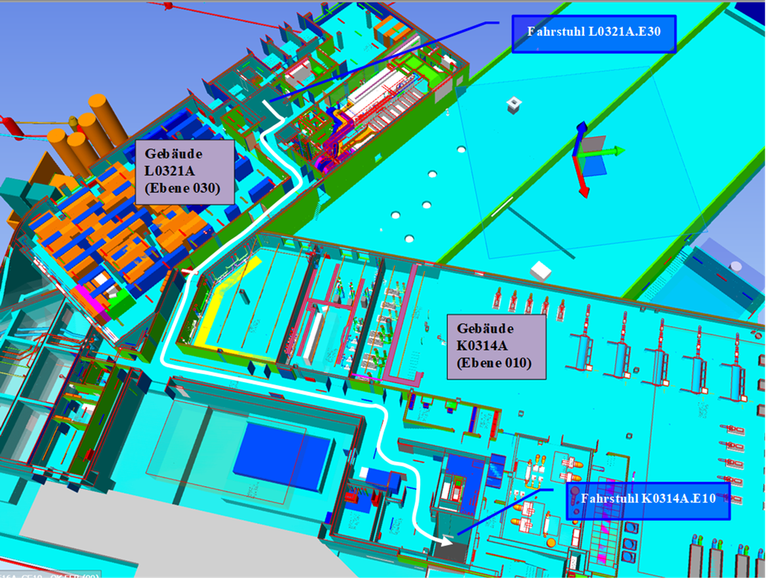
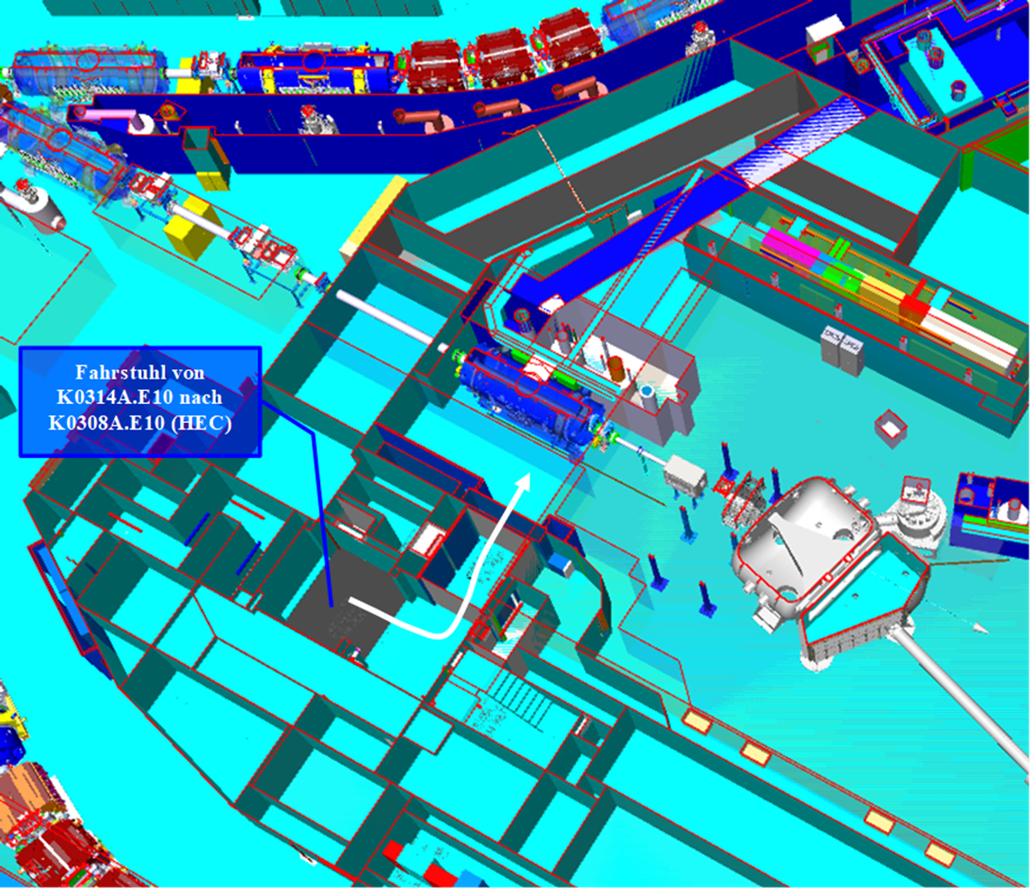
Examples from routes document – Routing in the Interior
From the labs /NUSTAR control room to the HEC

Slide 16
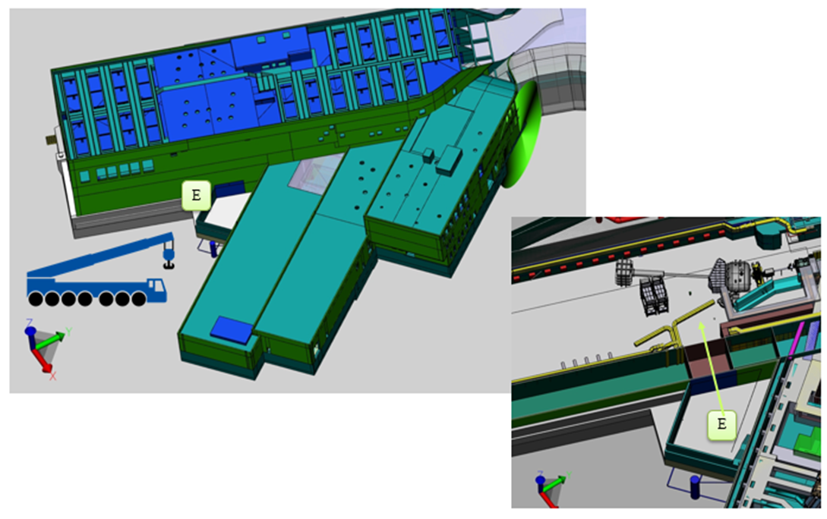
Examples from routes document – Access from outside east

