Slide 1
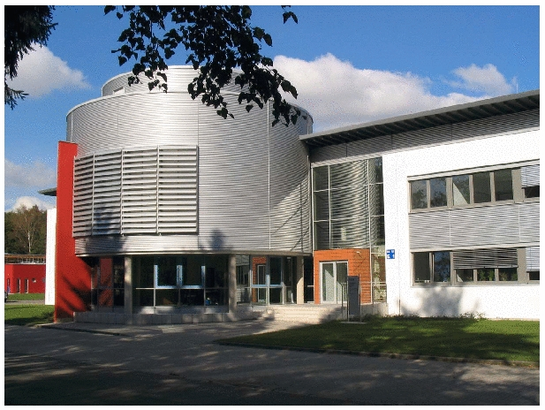
Laser Plasma interactions at Relativistic Intensities
supported by EMMI
Anupam Karmakar
Jülich Supercomputing Centre
Forschungszentrum Jülich, Germany
EMMI Physics Days, Nov. 13-14, GSI, Darmstadt

Slide 2
SimLab Plasma Physics at JSC: EMMI cooperation
People:
Mathias Winkel (EMMI PhD student)
Laura Di Lucchio (Postdoc)
Anupam Karmakar (EMMI Postdoc)
Dirk Brömmel, Paul Gibbon
Theory & Simulations:
Laser-ion acceleration & strong B-field generation
K-α and novel radiations from laser irradiated matter
Support for EMMI experiments at GSI, HIJ
Simulation Codes:
Particle-in-cell:
EPOCH: 3D-PIC U. Warwick
JuSPIC: HPC customized scalable 3D-PIC
BOPS: 1D3V-PIC in Lorentz ‘boosted’ frame
Tree code: PEPC + flavours
Notes:
2

Slide 3
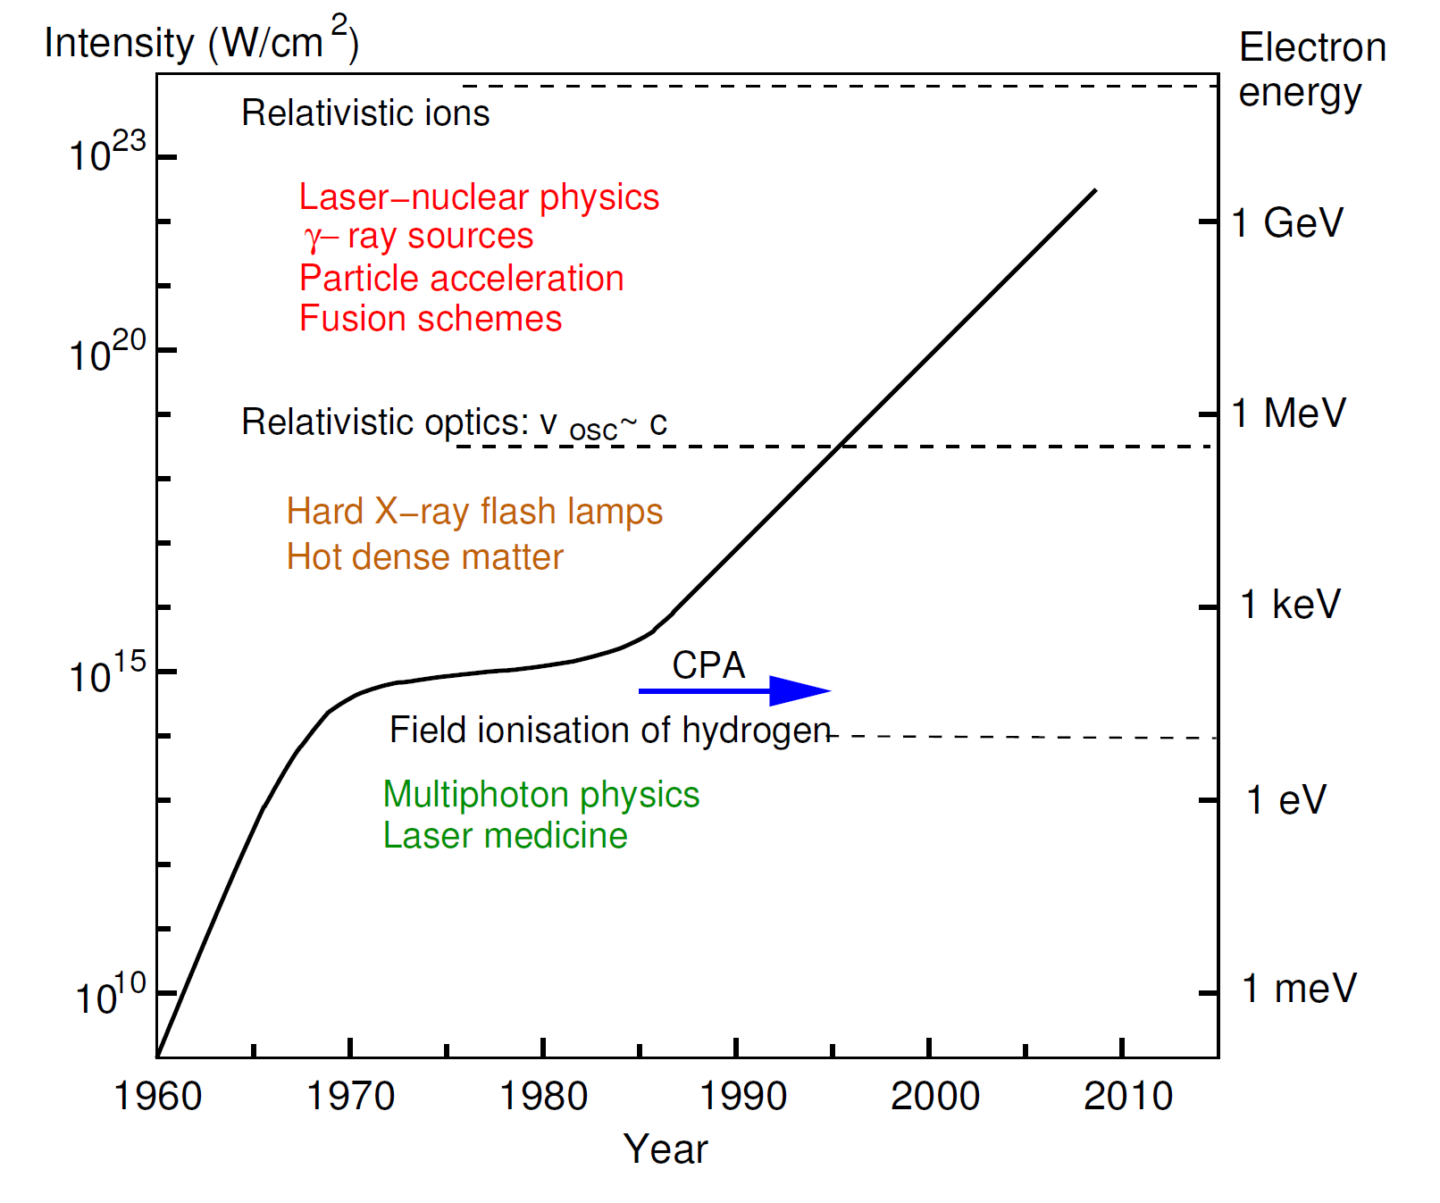
Laser technology progress: Various regimes of interaction
Courtesy:
SPLIM, P. Gibbon

Slide 4
Short pulse laser interactions with solid targets
laser
ionization
B-field
high energy
B-field
protons
ablation
absorption
energy
fast particle
transport
generation
B-field
& trajectories
radiation
Curtesy: K. Krushelnick

Slide 5
How big or small our present day particle accelerators are?
Conventional accelerator
Tabletop laser particle accelerator
Part of the LINAC beamline
Science Mag.

Slide 6
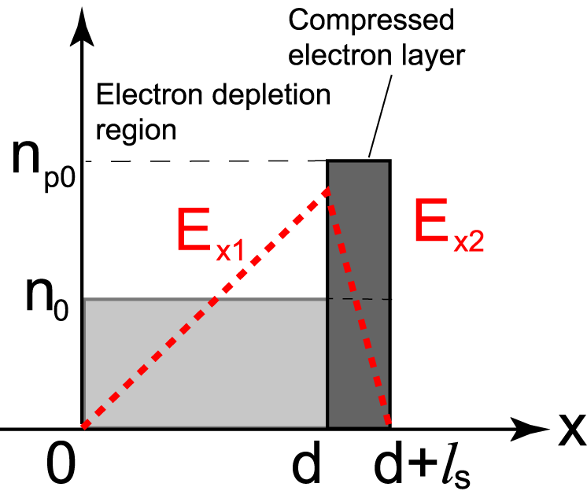
Ion acceleration from thin foil: Radiation pressure acceleration (RPA)
Macchi et al., PRL (2005)
Robinson et al., NJP (2008)
A
B
Circularly polarized or high-intensity LP lasers
No oscillating jxB, so electrons compressed but not heated
Ions are accelerated by the charge-separation, forming bunched layer.
Pressure balance P_{es} = P_{laser}: ion and electron layers accelerated together as quasi-neutral slab.
High beam density & efficiency; mono-energetic spectrum
Notes:
6
6

Slide 7
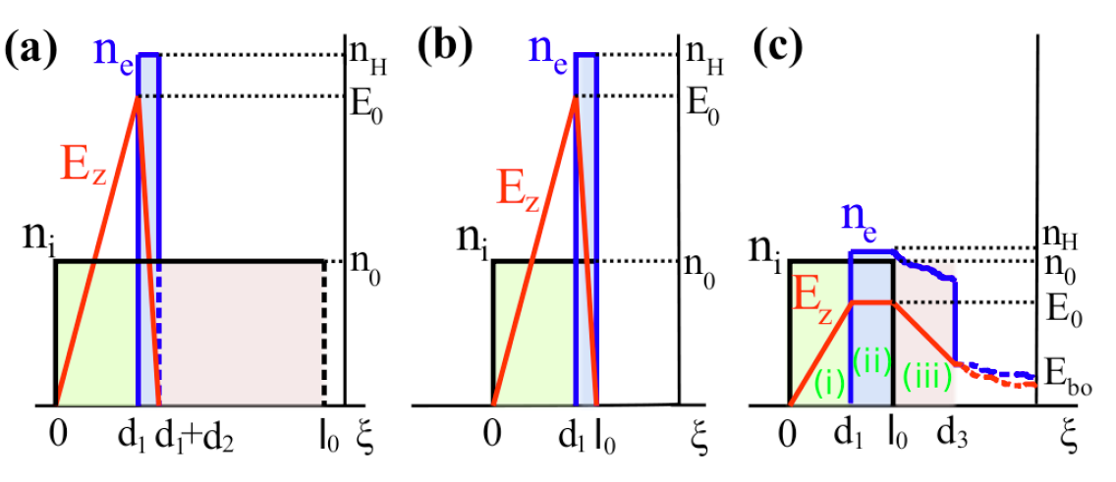
RPA scenarios
l
Hole-Boring
Light Sail
Leaky Light Sail
Notes:
7
7

Slide 8
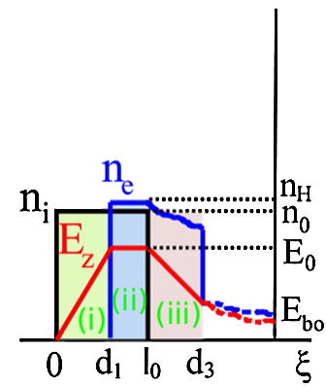
Ion acceleration from thin foil: Thick vs. Thin Foils RPA scenarios: The Leaky Light Sail regime
Condition:
d₀ ≈(λ/π)(n_{c} /n₀) a₀ < c/ω_{p}
The laser field does not completely decay within the foil (d₀ < c/ω_{p})
=> imperfect pressure balance
All foil electrons are accelerated and those near the rear side leak out into vacuum since the laser field does not vanish there.
Stable acceleration sacrificing heavy ions!
leakage
region
quasi-neutral region
depletion region
Leaky Light Sail
Notes:
8
8

Slide 9
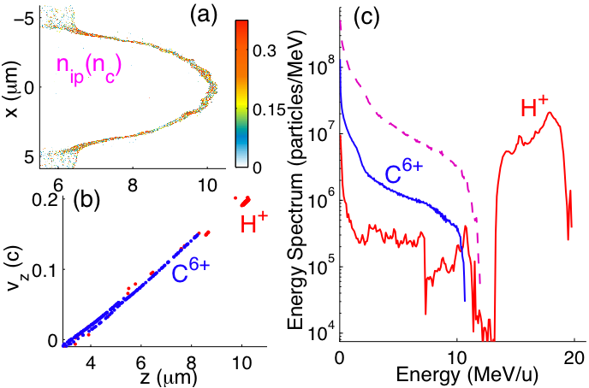
Ion acceleration from thin foil The Leaky Light Sail: few nm foil
Nanofoil target:
electron density n_{e0}=200n_{c}, thickness l₀=8nm<l_{s}
C⁶⁺ and H⁺ : n_{ic0}=32.65 n_{c}, n_{ip0}=4.1n_{c} with n_{ic0}:n_{ip0}=8:1
Sacrifice heavy ions to create mono-energetic proton bunch
A quasi-monoenergetic proton beam is obtained with density about 0.25n_{c},peak energy 18MeV, and particle number 10⁸
Qiao, Karmakar, Gibbon, PRL 105, 155002 (2010)

Slide 10
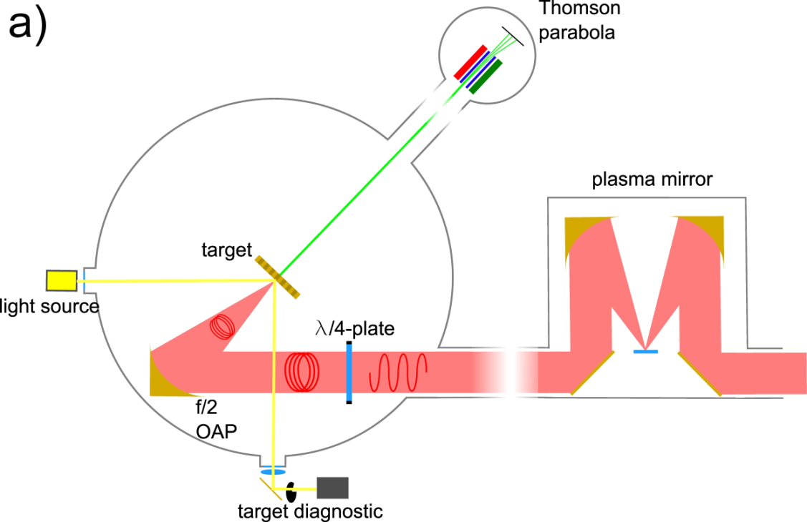
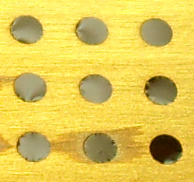
Probing the LLS regime of RPA GSI-Jena Expt with multi-species nanofoils
JETI laser:
0.8 J
27 fs
Contrast ~10⁻⁹
FWHM ~√6 μm
I₀ = 6x10¹⁹ Wcm⁻² (CP)
Targets:
15 nm parylene foils
2-100 nm DLC

Slide 11
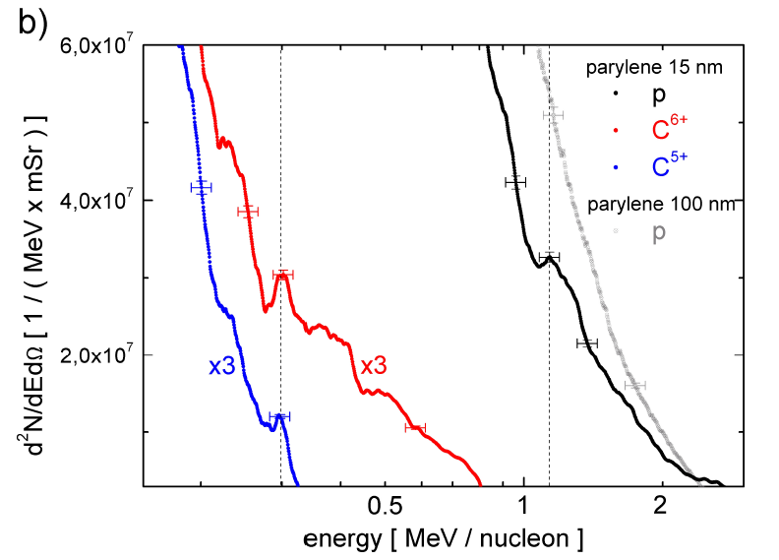
Probing the LLS regime of RPA Ion energy spectra from parylene foils

Slide 12
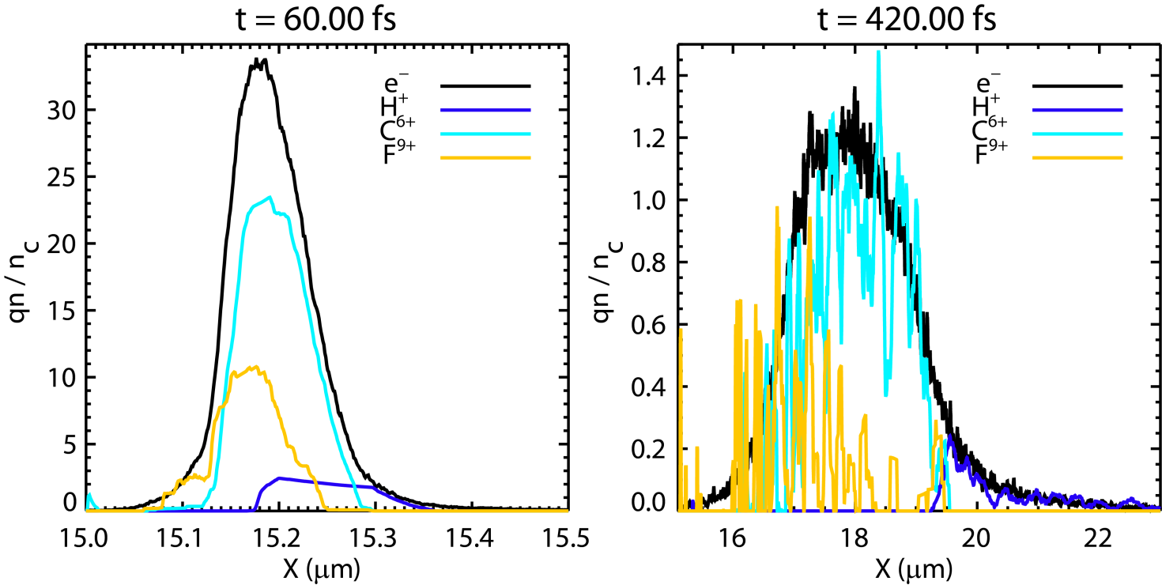
Probing the LLS regime of RPA: 2D EPOCH simulations Analysing ion densities near laser axis
Box: 30μ x 12μ
Δx = 1nm
Δy = 2.5nm
C:H:F = 4:3:1
Ne = 230 Nc
6.5 x 10⁶ particles
Pulse length too short to maintain electron layer: protons lose neutralising
electron envelope back to heavy ions (reverse LLS) and suffer Coulomb explosion (CE).
Notes:
Put the right plot

Slide 13
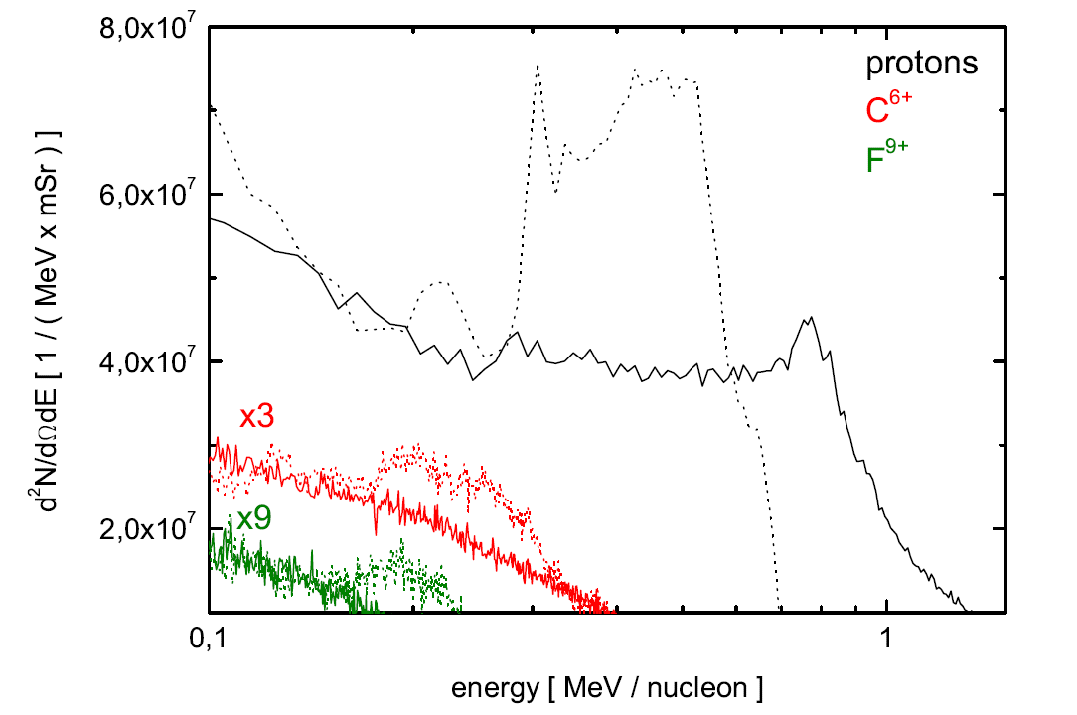
Probing the LLS regime of RPA: 2D EPOCH simulations Ion energy distribution
Initial RPA peaks @ 60 fs in heavier species washed out by 420 fs

Slide 14
RPA with long pulse: Phelix proposed expt.
GSI-HIJ-FZJ collaboration
Accelerate proton and carbon ions using PHELIX laser pulses to several 10’s of MeV via RPA
Special 8 nm ultra-thin multi-species Parylene foil target
Heating of the electrons is strongly suppressed in CP
Polarization state of the driving laser pulse has a profound effect of shape of the spectra and maximum ion energy.
Laser intensities ~10²⁰ W/cm², FWHM = 13 µm, λ = 1054 µm, τ = 600 fs
Notes:
14

Slide 15
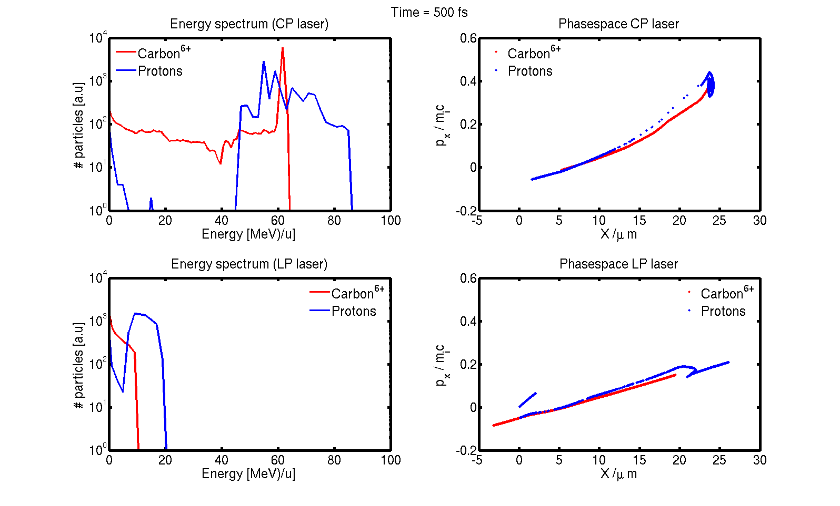
RPA with long pulse: Phelix proposed expt.
GSI-HIJ-FZJ collaboration
C. Pol.
Lin. Pol
Notes:
15

Slide 16
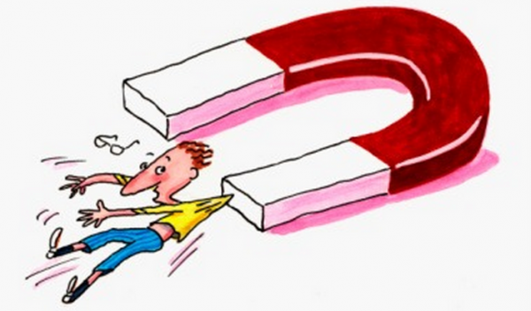
How powerful is World’s strongest available magnet?
What is the highest magnetic field reported by laser-matter interactions so far?
Existence of magnetic field strengths of 0.7±0.1 GG in the dense plasma reported in Wagner et al. PRE, 70(2), 026401
Getty images, LANL

Slide 17
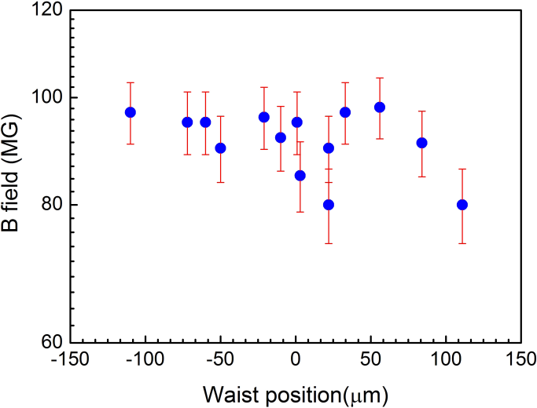
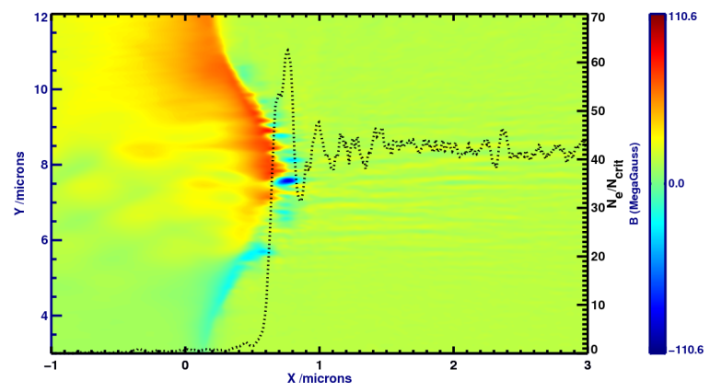
Magnetic field generation: ultra-short pulse Laboratory astrophysics conditions
Short pulse scenario (LUND) analysed with 2-D PIC simulations
I ~ 8 x10¹⁹ W/cm², τ ~ 35 fs, 45° deg incident on optical glass target
Peak B ~ 100 MG compared to 340 MG in long (ps) pulses
Expt: Magnitude of self-generated DC magnetic field due to laser ponderomotive force at the interaction region
PIC Simulation: Self-generated DC magnetic field topology, peak value ~ 100 Megagauss
Gopal, Karmakar, Gibbon et al., PPCF, in press

Slide 18
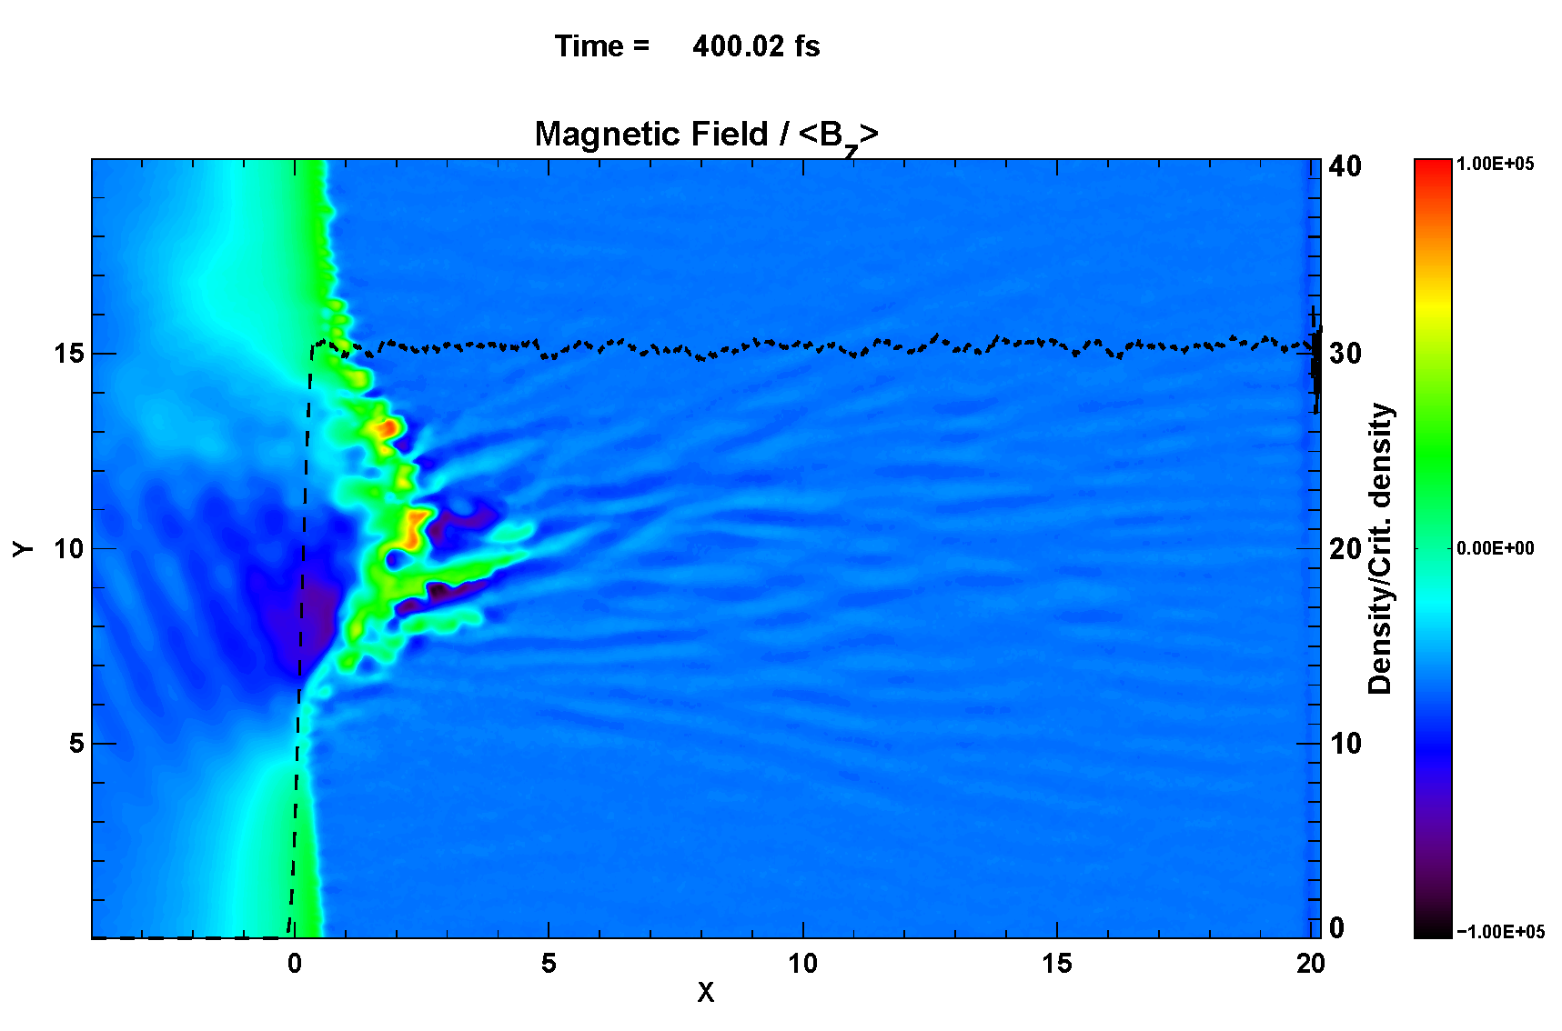
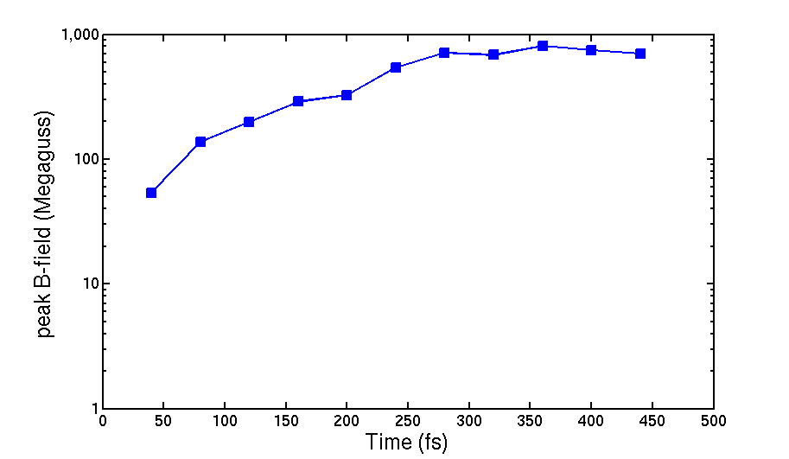
Strong magnetic field generation: long pulse Laboratory astrophysics conditions
Long pulse scenario (PHELIX) investigated with 2-D PIC simulations
I ~ 10²⁰ W/cm², τ ~ 600 fs, 45° deg incident on optical glass target
a Gigagauss is attainable
DC magnetic field generated at the interaction area with peak value ~ 1 Gigagauss
Evolution of peak B-field during the interaction reaching to Gigagauss range
Gopal, Karmakar, Gibbon et al., PPAC

Slide 19
How many of you passed through this?
How does laser-matter interaction physics is related?
Wiki image

Slide 20
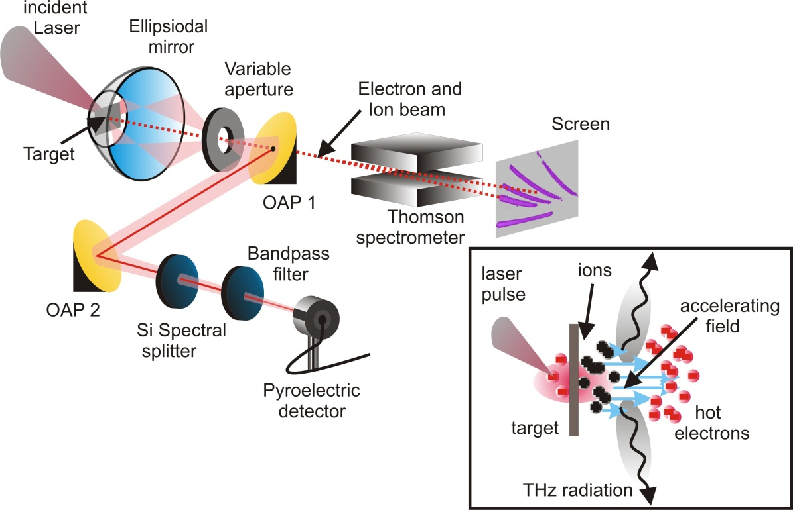
Laser Driven High-Power T-ray sources
submitted, (2012)
Sub-ps T-ray with energies ≥ 0.46 mJ
High conversion efficiency > 7 x 10⁻⁴
Gopal, Brömmel, Karmakar, Gibbon et al., HIJ-FZJ collaboration

Slide 21
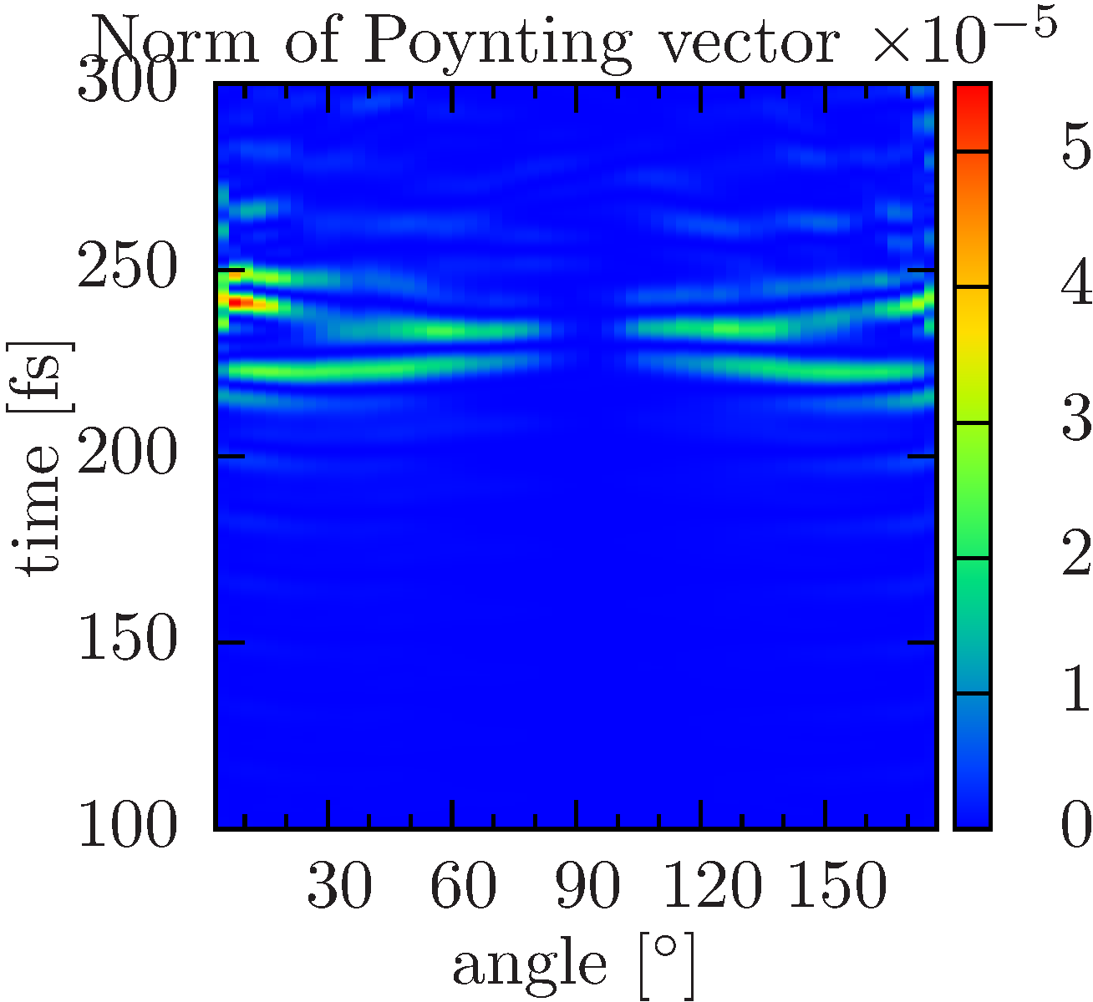
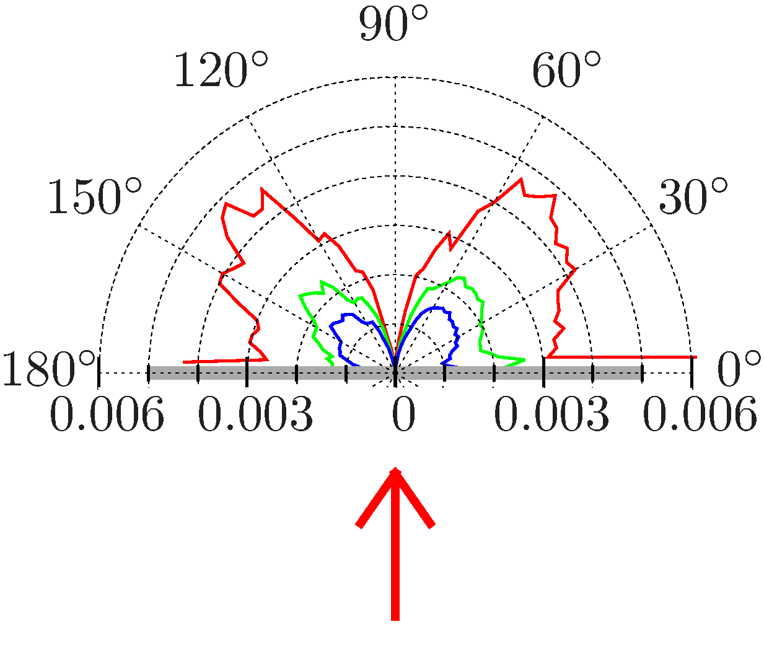
Laser Driven High-Power T-ray sources Investigating the source of THz radiation
Time trace of the THz radiation (60 ± 30THz) on the observation semicircle
Directionality consistent with the experimental results
Transient source of THz
Time gated polar plot of the THz (60 ± 30THz) radiation
Ring like radiation pattern
High resolution PIC simulations with JusPIC

Slide 22
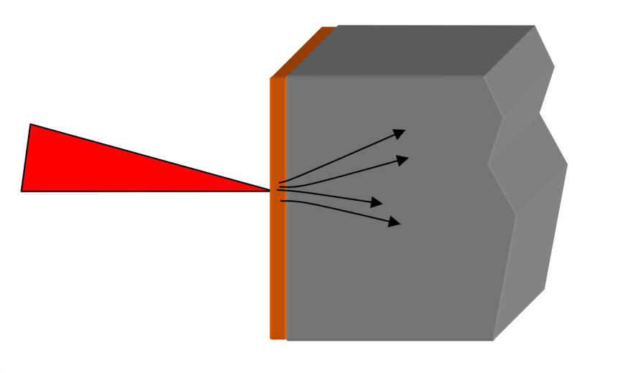
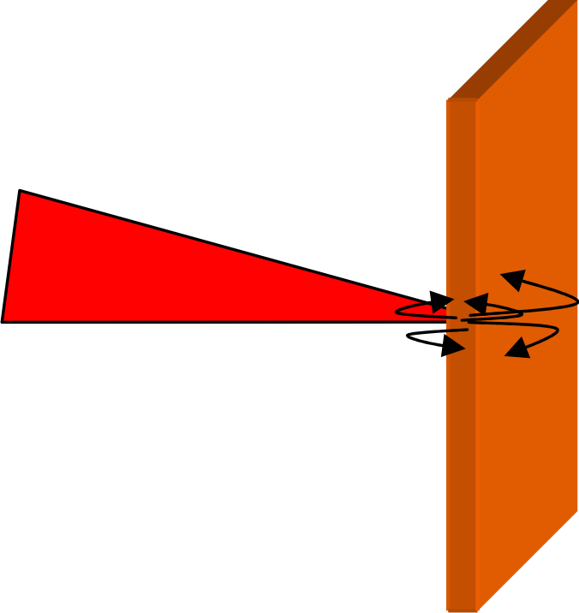
Laser driven K-alpha generation: Effect of hot electron refluxing
Phys. Plasmas 17, 103103 (2010)
Refluxing
Non-refluxing (Single-pass )
Al block
Hot electron refluxing suppressed using a large Al block.
Hot electron refluxing in backlighter target Cu foil.
Foil thickness: 10 µm Cu foil, Exponential ramp = 7 µm
Focused laser intensities: I~ 1.5×10¹⁹ – 10¹⁷ W/cm² , τ = 700 fs
Experimental observations:
K-alpha yield independent on target thickness, laser intensity for tight focus
Courtesy: Neumayer, GSI-FZJ collaboration

Slide 23
Laser driven K-alpha generation: Effect of hot electron refluxing
Phys. Plasmas 17, 103103 (2010)
conversion: 2%
conversion: 7%
conversion: 14%
Hot electron energy distribution predicted by PIC simulations (red) and compared to best fit HXRD data (shaded)
Total 10⁶ electrons and ions were modelled 10⁴ grid points, 7 µm pre-plasma scale-length
700 fs laser incident at 5^o emulated with Lorentz “boost” using BOPS PIC code.
Strong increase in the energetic electrons for increasing intensity
Simulation predicts colder and hotter fraction, less pronounced than experiement
Courtesy: Neumayer, GSI-FZJ collaboration

Slide 24
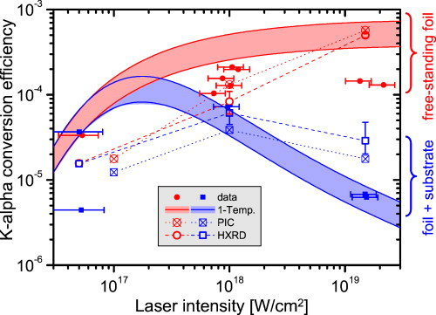
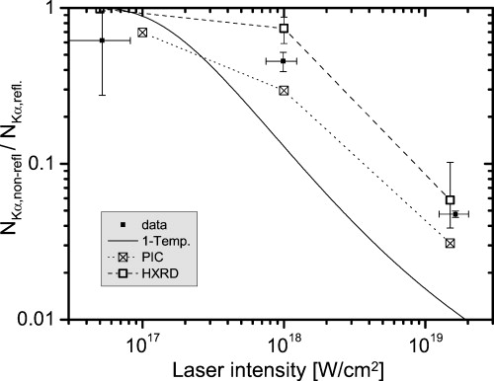
Laser driven K-alpha generation: Effect of hot electron refluxing
Phys. Plasmas 17, 103103 (2010)
Large enhancements in conversion efficiencies (CE) of laser energy into K-alpha radiation in refluxing target at different laser intensities.
Experimental findings and PIC simulation results for non-/refluxing cases are in decent agreement.
Refluxing electrons can make up > 95% of the total K-alpha yield!
Electron refluxing will play dominant role in designing laser-driven high flux and significantly faster K-alpha sources.
Courtesy: Neumayer, GSI-FZJ collaboration

Slide 25
In a nutshell
Summarised recent highlights in laser-plasma interactions physics within the EMMI collaborations.
Laser-plasma physics as an evolving brunch has enormous possibilities in compact (table-top) particle accelerator, laboratory astrophysics, high-power radiation generations
Future medical applications, imaging technology are already in progress.
Improvements needed in particle counts, energy distribution and shot-to-shot consistency.

Slide 26
JUQUEEN @Juelich - the 5th fastest supercomputer in the world.

