Slide 1

"Nuclear Matter" Studies with fast* RI Beams
-- RIKEN RI Beam Factory (RIBF): 5 years since the first beam T. Motobayashi
(RIKEN Nishina Center)
Nuclear matter
EMMI -- Neutron matter / Neutron-rich matter
RIKEN RIBF
Experiments
halo, n-mode excitation
low-energy E1
disappearance / appearance of magic numbers
* v/c ~ 0.3-0.6
Notes:
30+5 / about 20 slides
我田引水でゆく
Nuclear chart
2D => 3D adding one axis i.e. the energy (difference from the “standard” ?)
Nuclear matter (never reached in real life cf. neutron stars)
matter properties ⬄ finite nucleus
One of the interest: neutron-rich matter e.g. Again neutron stars
RIBF, (FAIR NUSTAR, FRIB…）：changing n-p difference or ratio of “nuclear matter” in a broad sense
A Naïve thought: from study of n-rich nuclei e.g. energy of (isoscalar) monopole resonance – failed
--- related to neutron halo mechanism => decoupling

Slide 2
Nuclear matter
an idealized system …… not matter in a nucleus, but a hypothetical substance consisting of a huge number of proton and neutrons interacting by only nuclear forces and no Coulomb forces (Wikipedia)
useful: a test bench / neutron stars, early universe, …
But,
Experimental studies ⬅ Nuclear properties / reactions
e.g. incompressibility ← locations (energies) of E0 Giant resonances
oscillation frequency ←→ stiffness

Slide 3
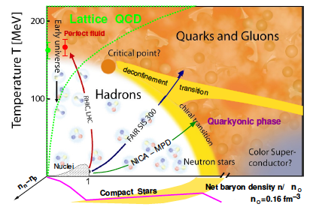
EMMI – neutron matter
Neutron Matter as an extreme in isospin or p/n ratio
ExtreMe Matter Institute
Studies of neutron-rich matter in a broader sense
cf. nuclear phase diagram
Naïve approach:
neutron-rich nuclei (by RI -- radioactive isotope -- beams)
        RIKEN-GSI collaboration

Slide 4
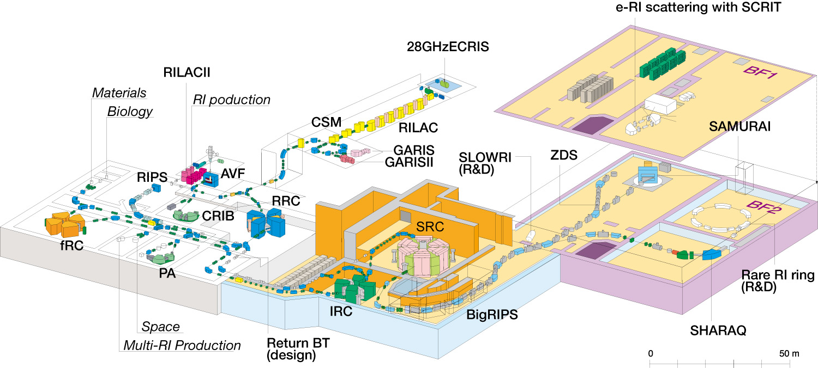
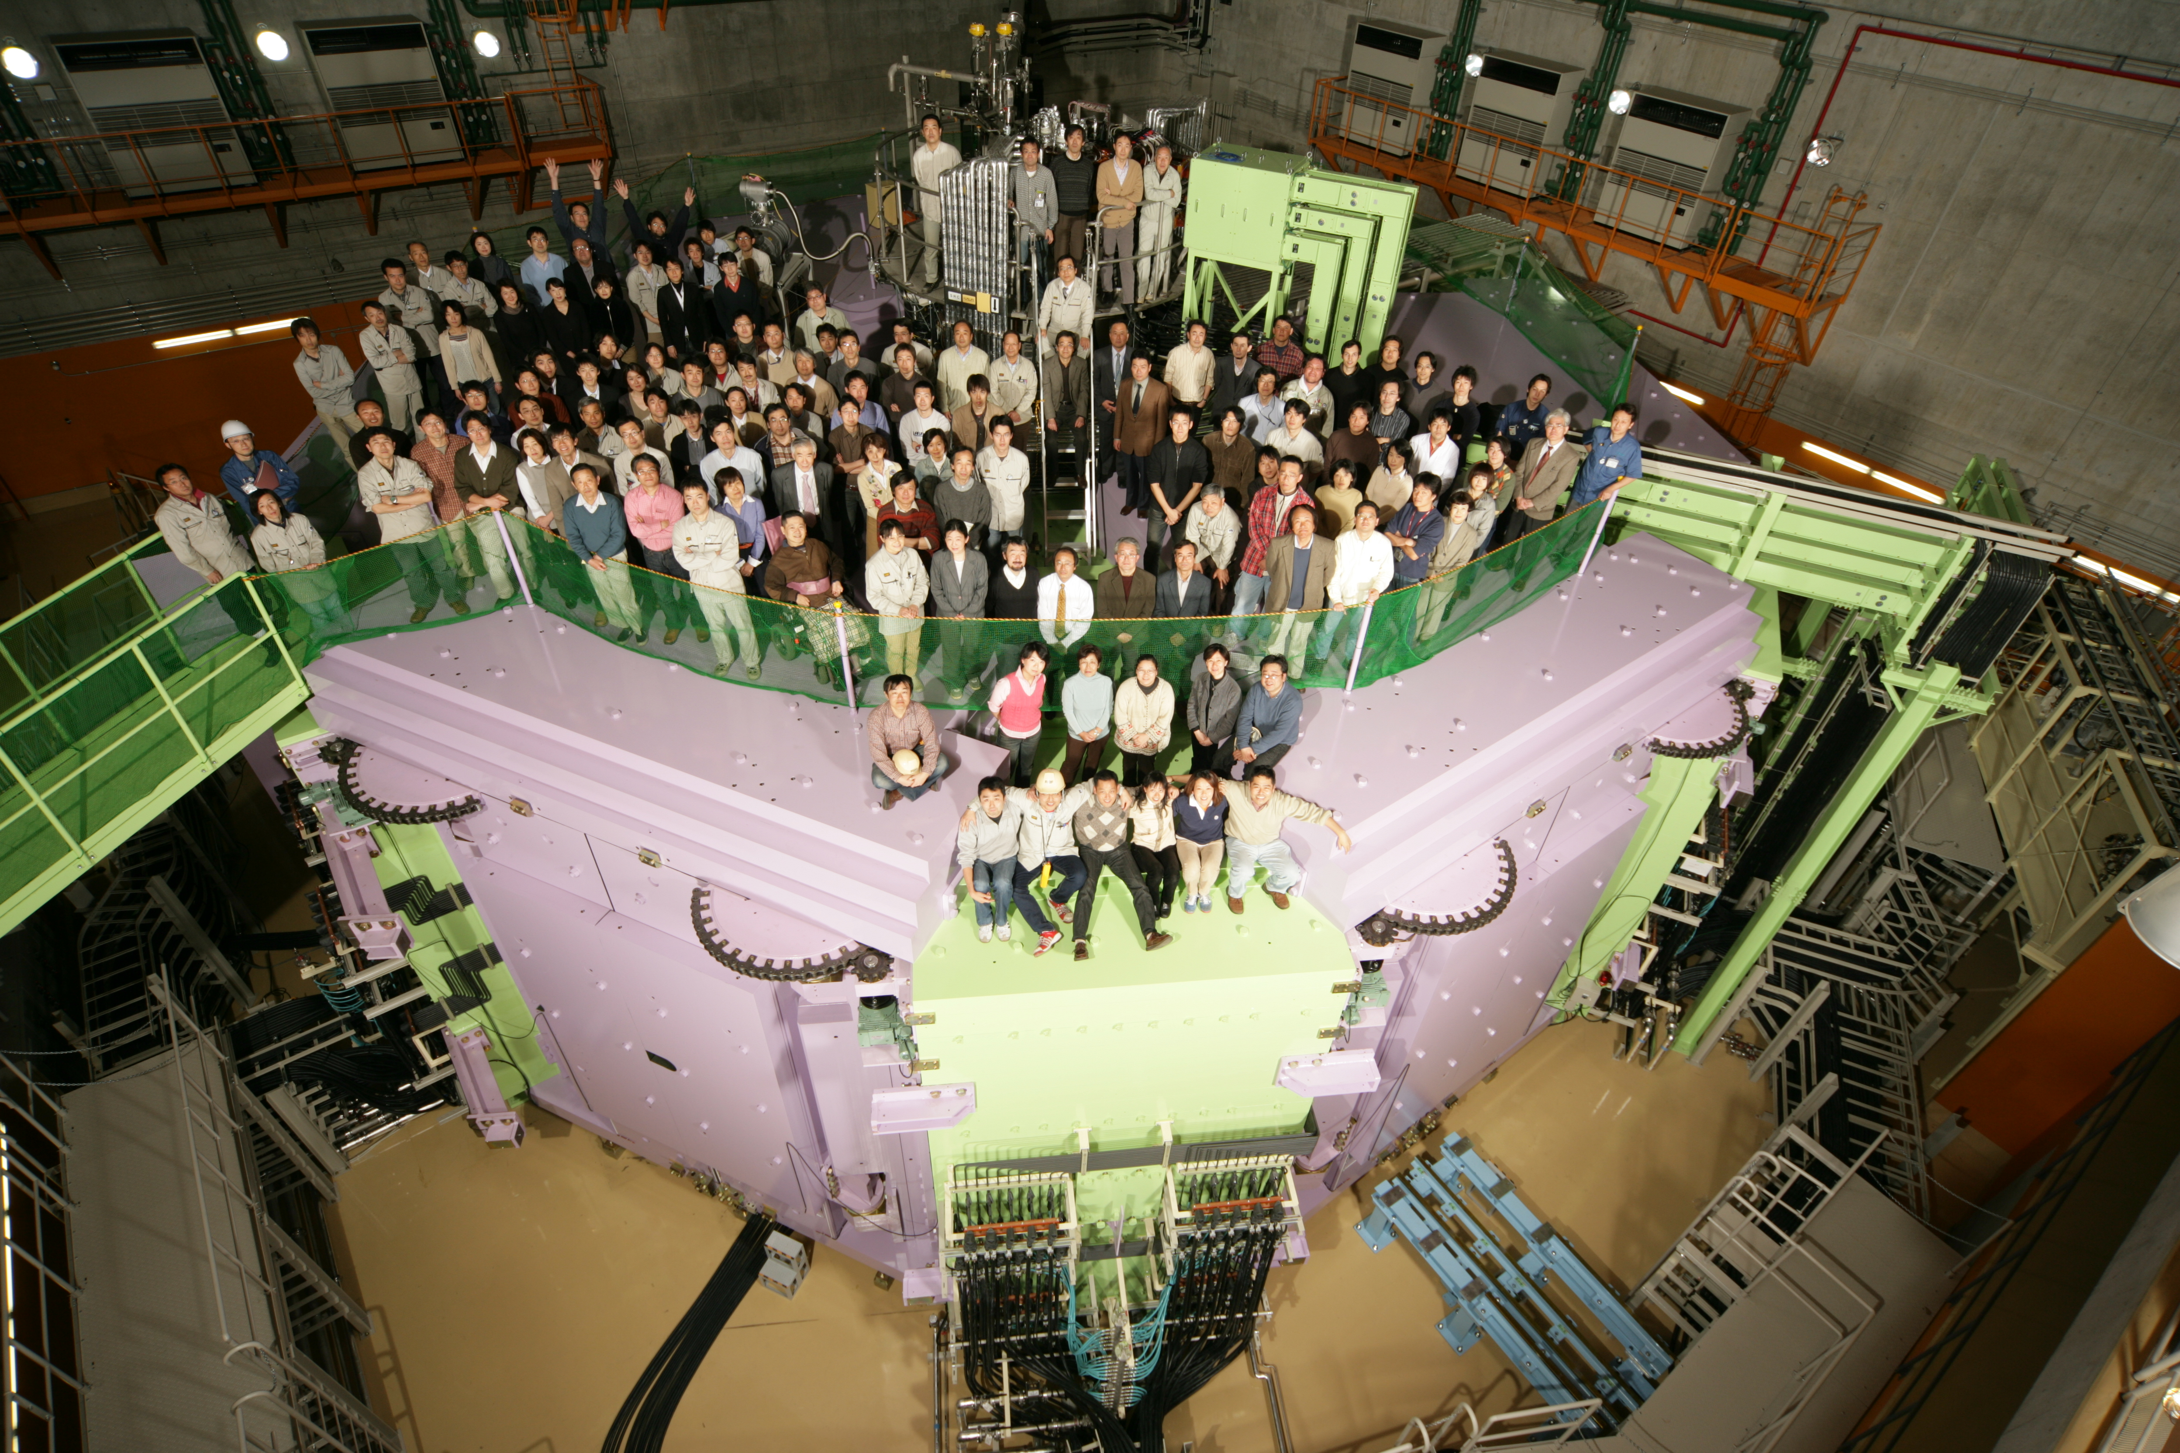
RIKEN RIBF (RI Beam Factory) -- fragmentation-based RI bemas (1990- / 2007-)
RIBF – a new generation RIB facility in operation
with world highest capability of producing exotic nuclei in coming years!
BigRIPS (2007-)
~200 MeV/nucleon
RIPS (1990-)
~50 MeV/nucleon
(construction)
SRC (8300 t)
(construction)
160 M$
400 M$
135 MeV/nucleon
for light nuclei (1986-)
(R&D)
345 MeV/nucleon
up to U (2006-)
experimental
equipment

Slide 5
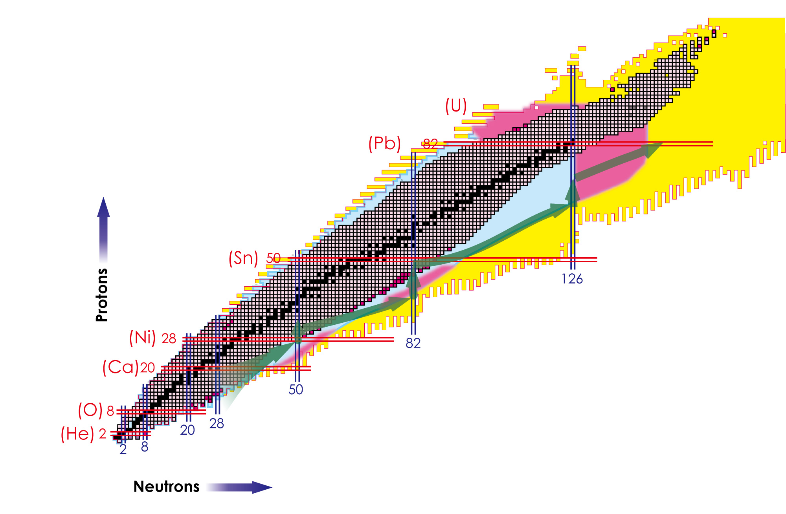
Nuclear chart – “nuclear periodic table” in 2D with p- and n-axes
stable: approx. 300
known so far: approx. 3,000
expected: approx. 10,000
RIBF w. 1pμA
Projectile Fragmentation
In-flight U fission / fragmentation

Slide 6

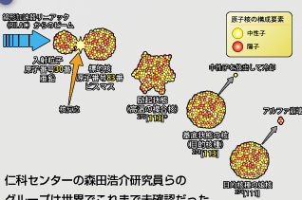
113番元素は日本（理研）で発見（生成） ３例目を確認
既知のα崩壊
Z=113
111
109
107
105
103
Dr. Morita
101
²⁰⁹Bi + ⁷⁰Zn → ²⁷⁸113 + n

Slide 7

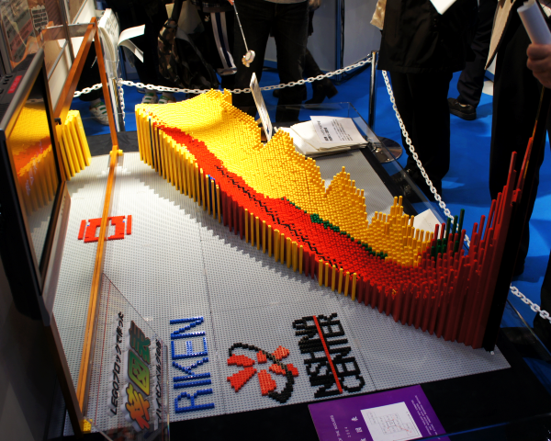
3D nuclear chart 3rd axis by energy or mass
more stable
for n-p symmetry（β decay）
（the Heisenberg valley）
in addition
shell stabilities like atoms
instable by surface effect ⬅ Fe ➔ instable by Coulomb repulsion
(energy gain by fusion) （energy gain by fission, α decay）

Slide 8
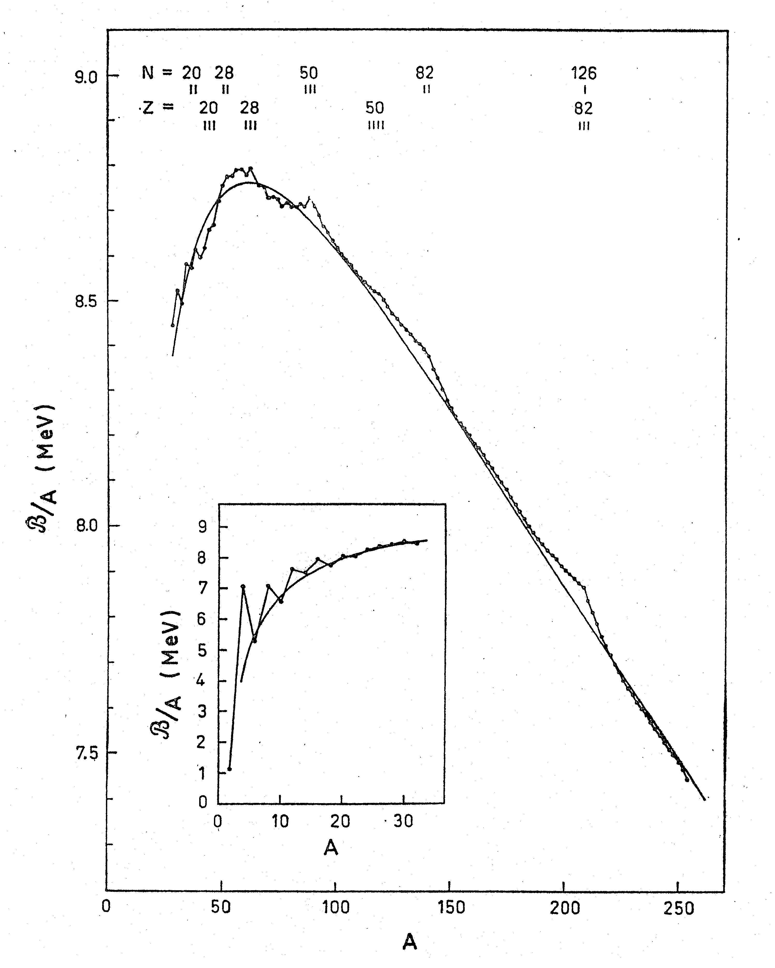
in addition
shell stabilities like atoms
magic n.
N=50
Fe
N=82
8.5
liquid drop
²⁰⁸Pb
N=126
Z=82
7.5

Slide 9
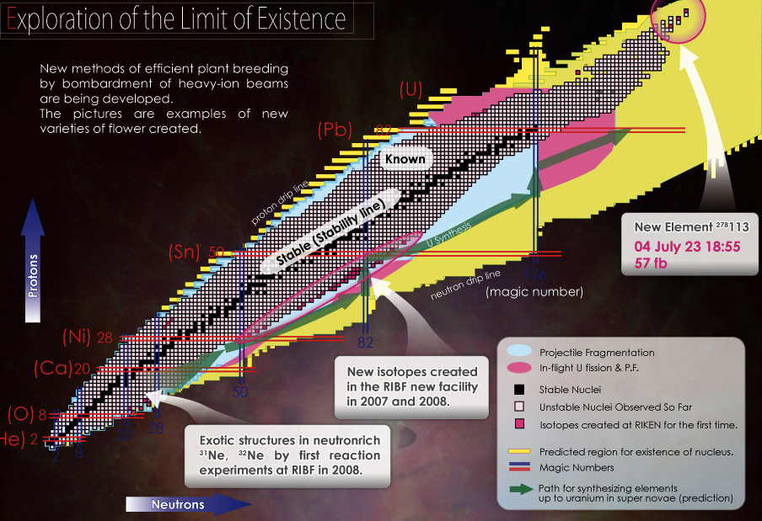
Increase of known nuclei in the nuclear chart
3rd event of
Z=113
Aug. 2012
47 new isotopes
T. Onishi et al., J. Phys. Soc. Jpn. (2011) 073201
²³⁸U beam
New Isotopes
Isomers
T_{1/2} of r-process nuclei
⁴⁸Ca beam
New halo nuclei (σ、ｂreakup)
Island of inversion, magicisty
(γ w. direct reactions)
⁴He beam
IVSM by (t,³He)

Slide 10
18 new (μs) isomers identified (54 isomers observed)
D. Kameda et al. Phys. Rev. C, in print.

Slide 11
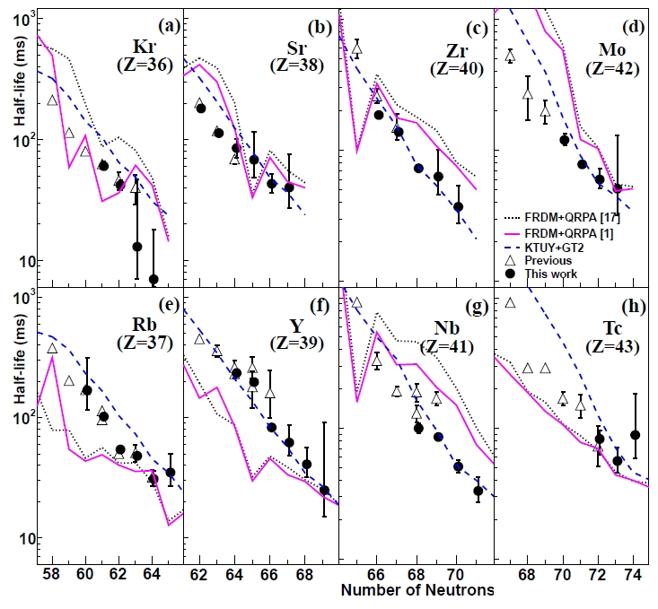
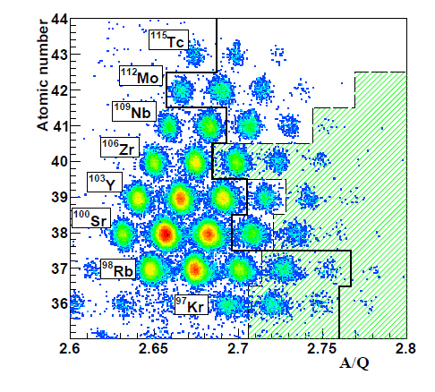
Toward the r-process path - β decay half-life around A=110
Systematic studies of T_{1/2} ←→ Mass, Q_{β}, S_{n}
Nishimura et al. PRL106, 052502 (2011)
T_{1/2} unknown
8 hours data acquisition
T1/2 data of 38 isotopes including
first data for 18 isotopes
T_{1/2} are shorter for Zr/Nb compared with FRDM theories!
→ more rapid r-process flow

Slide 12
Neutron-rich nuclei
Neutron halo / neutron modes
Low-energy E1 strength
Rise and fall of the shell closure

Slide 13
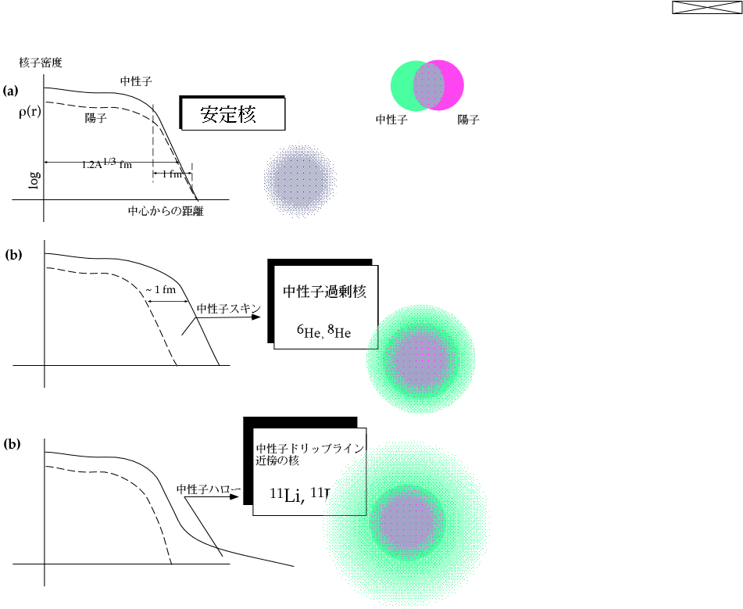
Neutron skin / halo
neutron skin
Neutron-rich matter?
neutron halo
neutron matter?
by Tanihata.

Slide 14
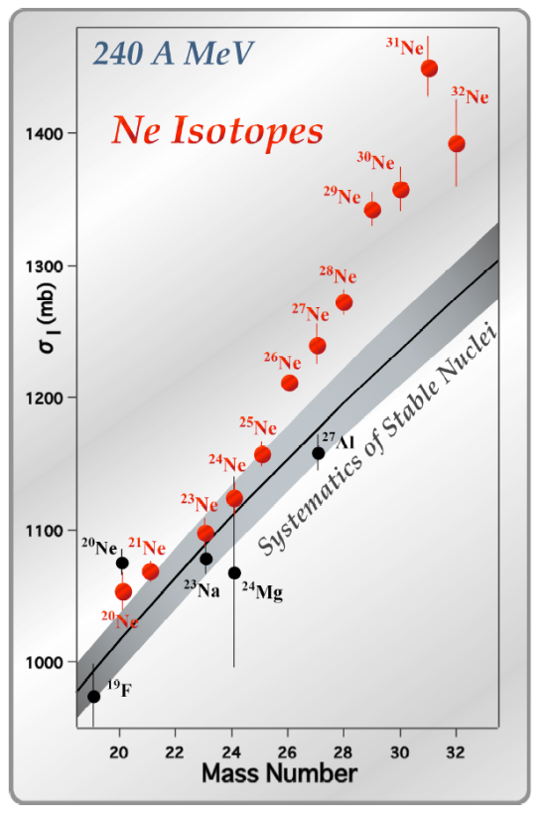
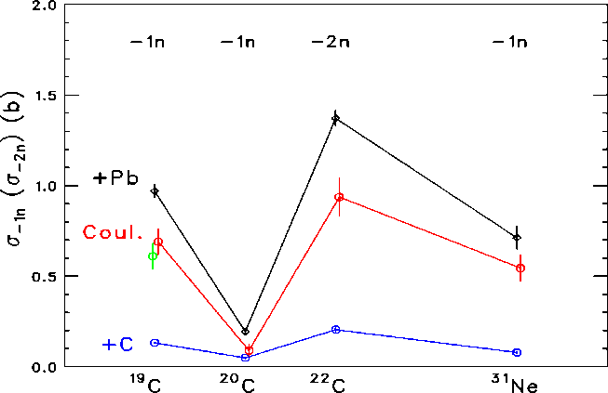
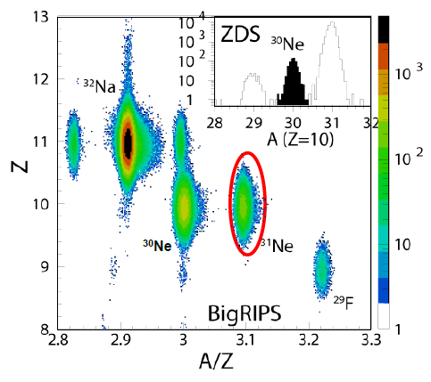
Approaching the Neutron-Dripline: Ne- Isotopes
Transmission &
Interaction Cross Section Measurements
M. Takechi^{EMMI} et al., Phys. Lett. B707 (2012) 357
Large Coulomb breakup cross section
for ³¹Ne
¹⁹C
²⁰C
²²C
³¹Ne
Nakamura et al., PRL 103, 262501(2009)
RIBF: 10 cts/s
RIPS: 4 cts/d

Slide 15
Elekes et al., Phys. Lett. B586 (2004) 34
Japan-Hungary (ATOMKI) collaboration
neutron excitation
in ¹⁶C (0⁺-2⁺)
Suppression of Cuolomb (proton) excitation

Slide 16
Neutron-rich nuclei
Neutron halo / neutron modes
Low-energy E1 strength
Rise and fall of the shell closure

Slide 17
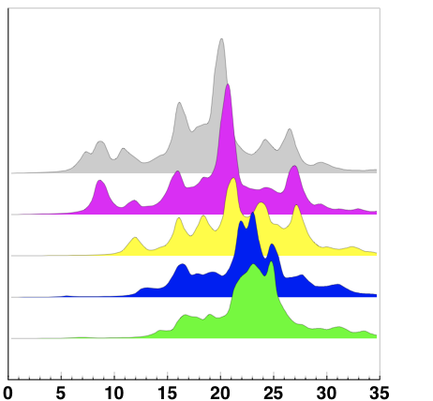
Low-energy component of E1 excitation
31.2 A^{-1/3} + 20.6 A^{-1/6}
1.2
Oscillation of n-rich matter?
The n-mode strength.
S [e²fm²/MeV]
²⁸Ne
0
²⁶Ne
0
²⁴Ne
0
²²Ne
0
²⁰Ne
0
Prediction: Cao L.-G. and Ma Z.-Y., PRC 71, 034305 (2005)
E* [MeV]

Slide 18
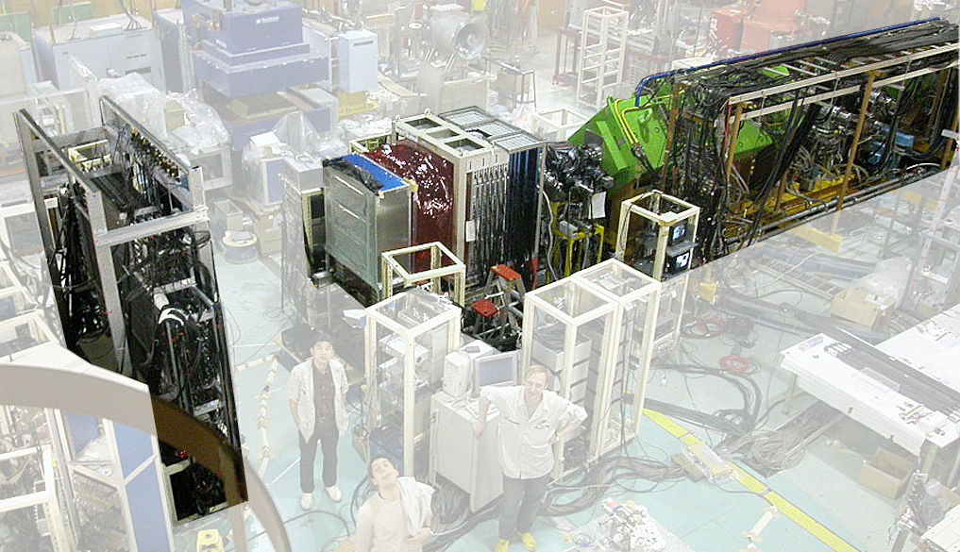
Coulmob excitation of ²⁶Ne
Neutron Wall
RIPS
γ array
Silicons
PPAC
He bag
Gebelin et. al., Phys. Rev. C75 (2007) 057306

Slide 19
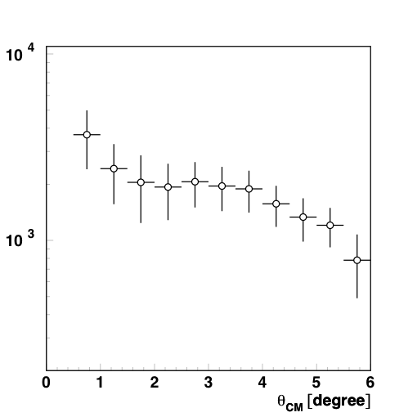
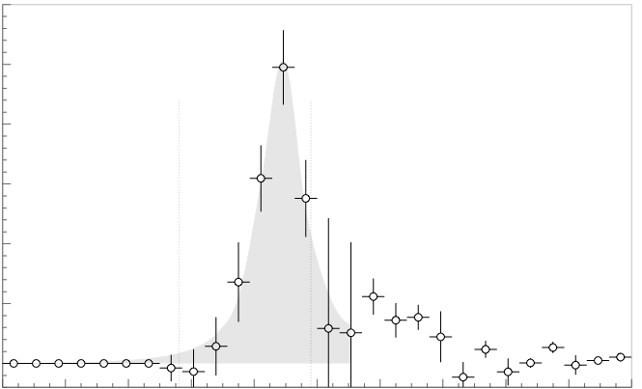
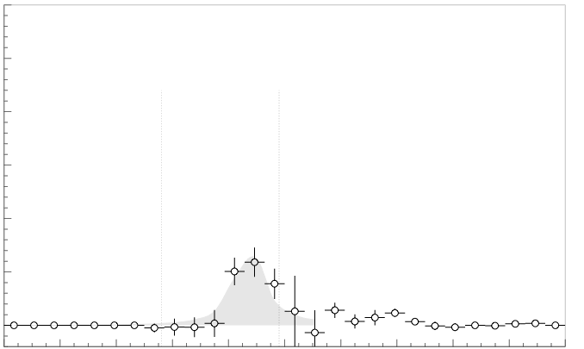
Results for E1 strength
Lead
30
▬▬ | L=1
▬▬ | L≥2
▬▬ | SUM
S_{1n}
S_{2n}
Pb Target
3.3
20
σ_{int}(L=1) = 50.1 ± 4.9 mb
background
subtracted
2.0
10
x~1.85
1.7
0
background
subtracted
30
0
4
6
8
10
12
16
20
E* [MeV]
Al Target
gs
1.85 factor obtained from ECIS total cross section comparison, with the hypothesis that Al excites only L=2 transition.
MeV
20
gs
θ_{CM} [degree]
10
4.9 ± 1.9% of TRK sum rule
²⁶Ne
²⁵Ne
0
We deduced: B(E1) = 0.60 ± 0.06 e²fm²
or 5.9 ± 1.0% of TRK sum rule @ 9 MeV
0
4
6
8
10
12
16
20
E* [MeV]
Gebelin et. al., Phys. Rev. C75 (2007) 057306

Slide 20
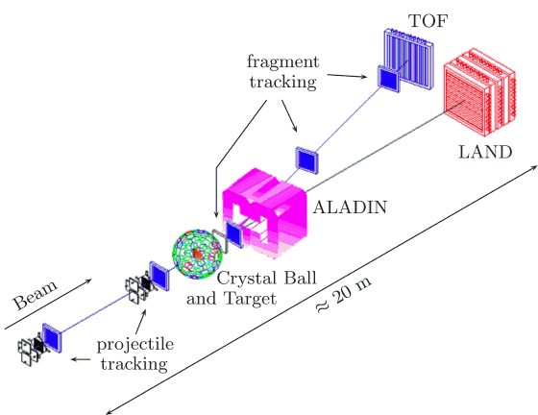
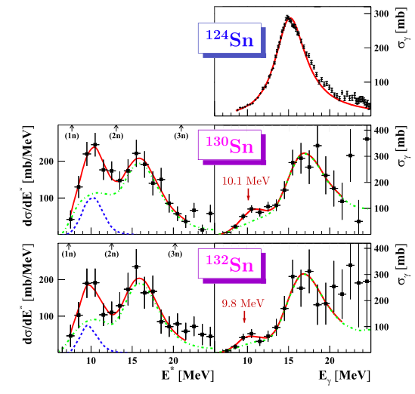
Results for Sn isotopes at GSI
P. Adrich, PRL 95 (2005) 132501
[500 MeV/n]
S_{TRK}=7(3)%
low-energy E1 strength: general
hope: strength
⬄ neutron matter property
S_{TRK}=4(3)%

Slide 21
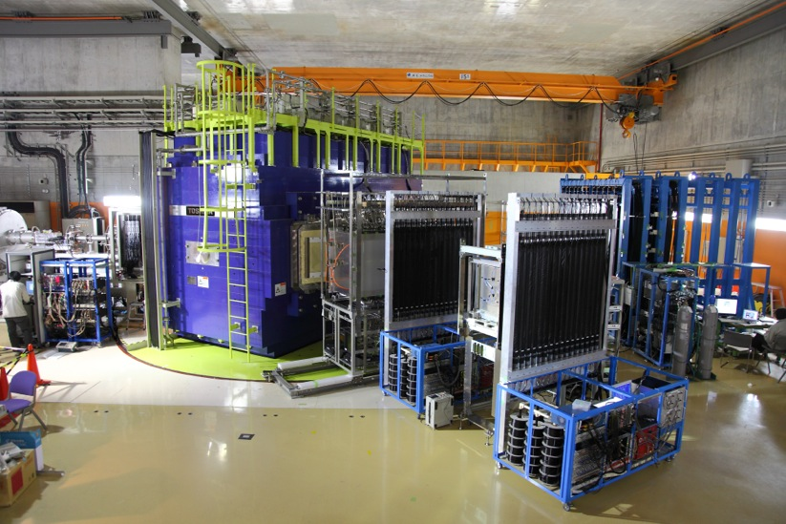
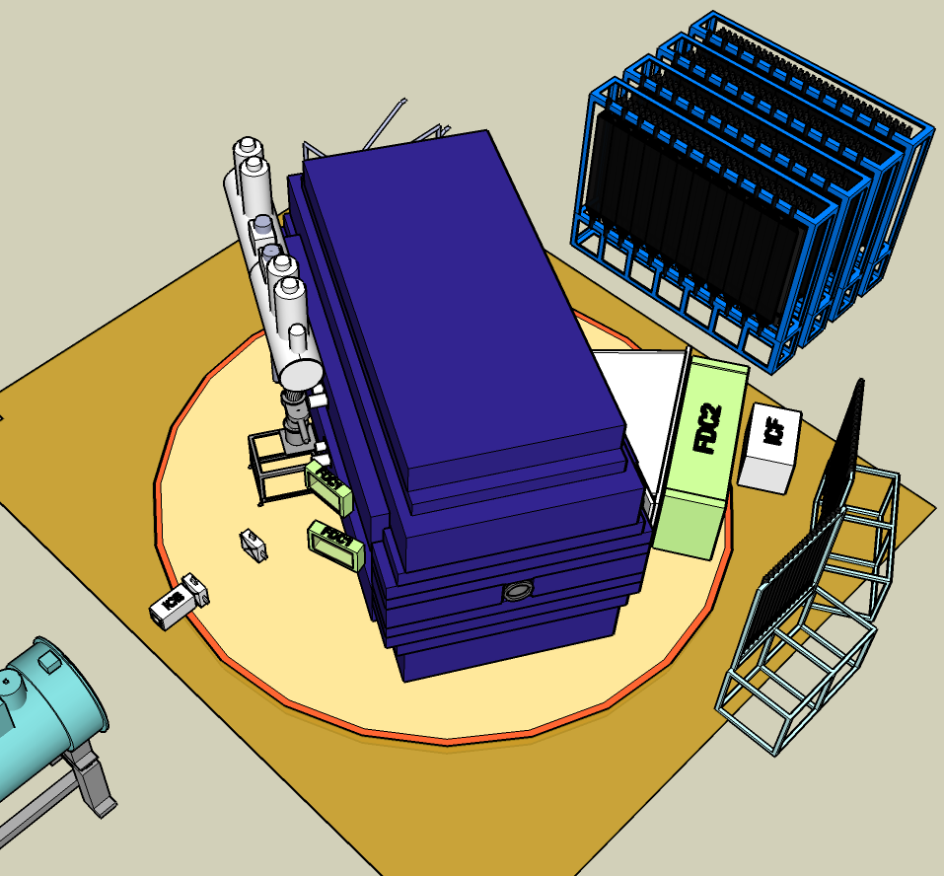
Detector System - (γ, n) measurement (CD) mode
Detectors for Heavy Ion
  Position measurement
    Drift Chambers
    Beam
    Fragments before/after
  Charge measurement
    Ion Chambers
    Beam / Fragments
  Velocity measurement
    Plastic hodoscope
    Cherenkov counter
  Total E measurement
    Pure CsI detector
Neutron Detector
  Plastic scintillator
    240 modules
    (120mm x120mm x1.8m / module)
    Effective Area: 3.6 m (H) × 1.8 m (V)
    ~ 100 % coverage @ E_{rel} < 3 MeV
    ~ 40 % coverage @ E_{rel} ~ 10 MeV
    Efficiency ~ 66 % (Harf: ~40 %)
(γ, n) reaction: neutron-rich side
Neutron Detector
Detectors for Heavy Ion
Pb target
RIKEN-GSI collaboration: planned

Slide 22
Neutron-rich nuclei
Neutron halo / neutron modes
Low-energy E1 strength
Rise and fall of the shell closure

Slide 23
stable: approx. 300
known so far: approx. 3,000
expected: approx. 10,000
RIBF w. 1pμA
Projectile Fragmentation
In-flight U fission / fragmentation

Slide 24
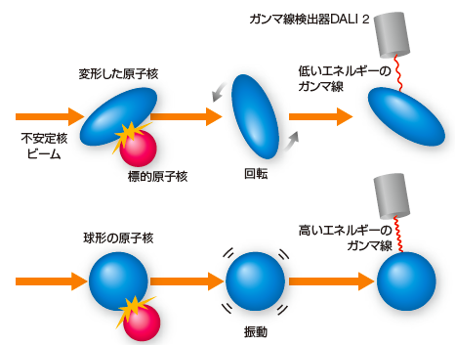
In-beam gamma measurements in reversed kinematics
energy: low
（RI beam）
energy: high
excitation energy ⬄ gamma energy

Slide 25
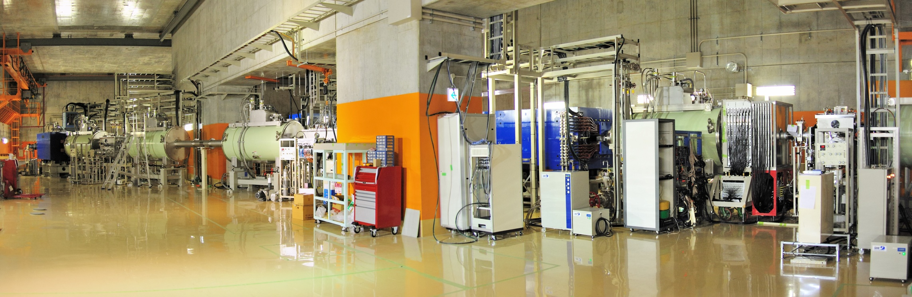
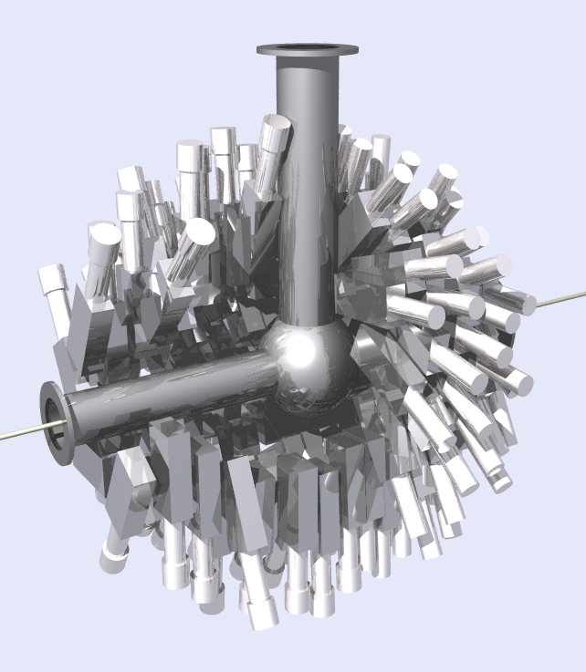
Secondary reaction studies with ZeroDegree
In-beam γ-ray spectroscopy with direct reactions
DALI2
160 NaI(Tl)s
* 4.5 x 8 x 16 (cm³)
for 1MeV γ ray（v/c=0.3）
efficiency ~21%
energy resolution ~8%
Notes:
25
25

Slide 26
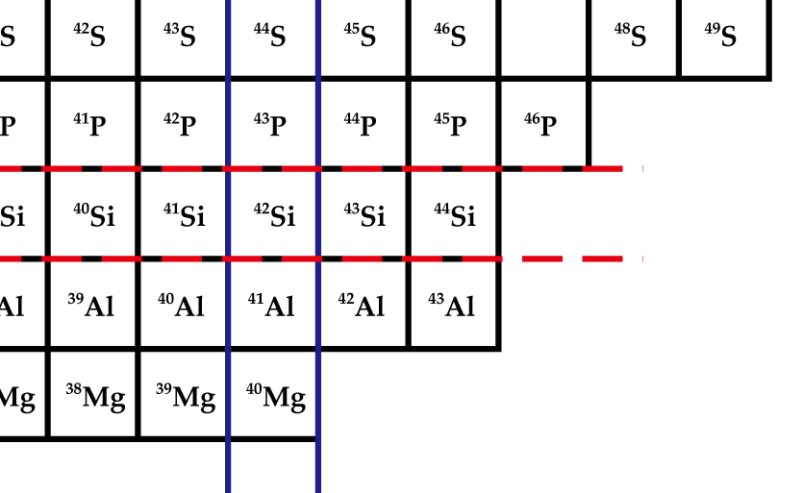
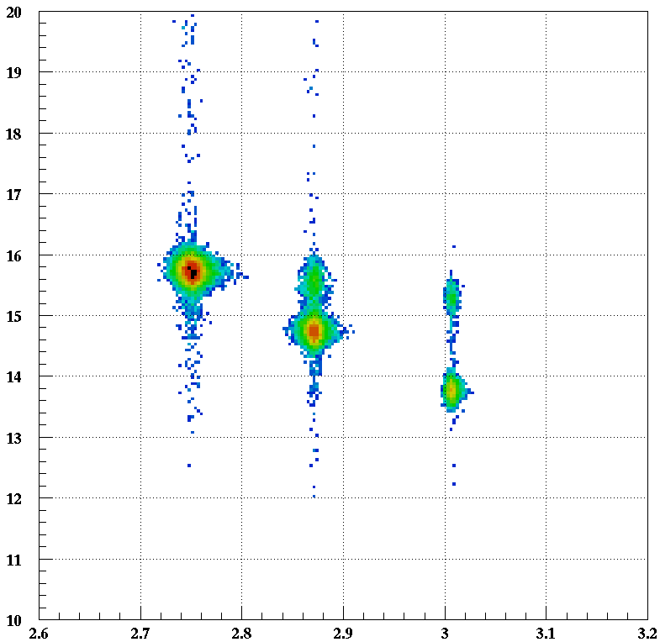
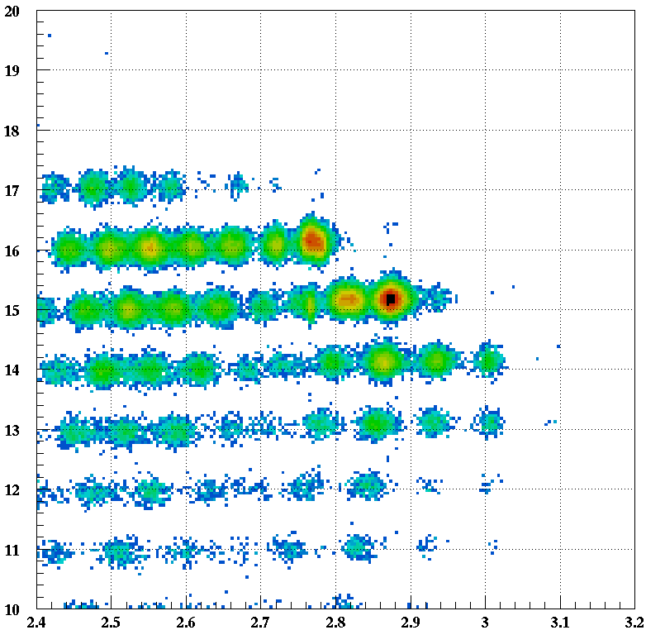
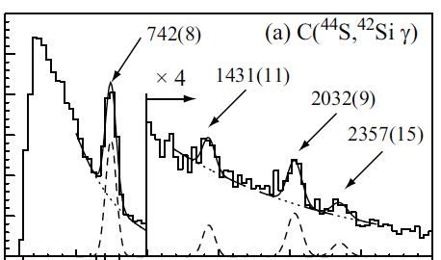
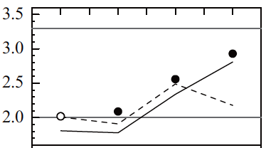
Well-developed deformation of ⁴²Si Takeuchi et al. Phys. Rev. Lett. 109 (2012) 182501
ZeroDegree
Spectrometer
BigRIPS
Z=14
⁴⁴S
D(A/Q) /(A/Q): 0.3% (1s)
⁴²Si
N=28
E_{γ}(2⁺→0⁺) = 742(14) keV
⁴⁴S → ⁴²Si + γ
R_{4/2}
1000
⁴²Si
⁴⁰Si
³⁶Si
³⁸Si
T.Otsuka et al.,
NPA 805 (2008) 127c
0
Eγ (keV)
1000
2000
3000

Slide 27
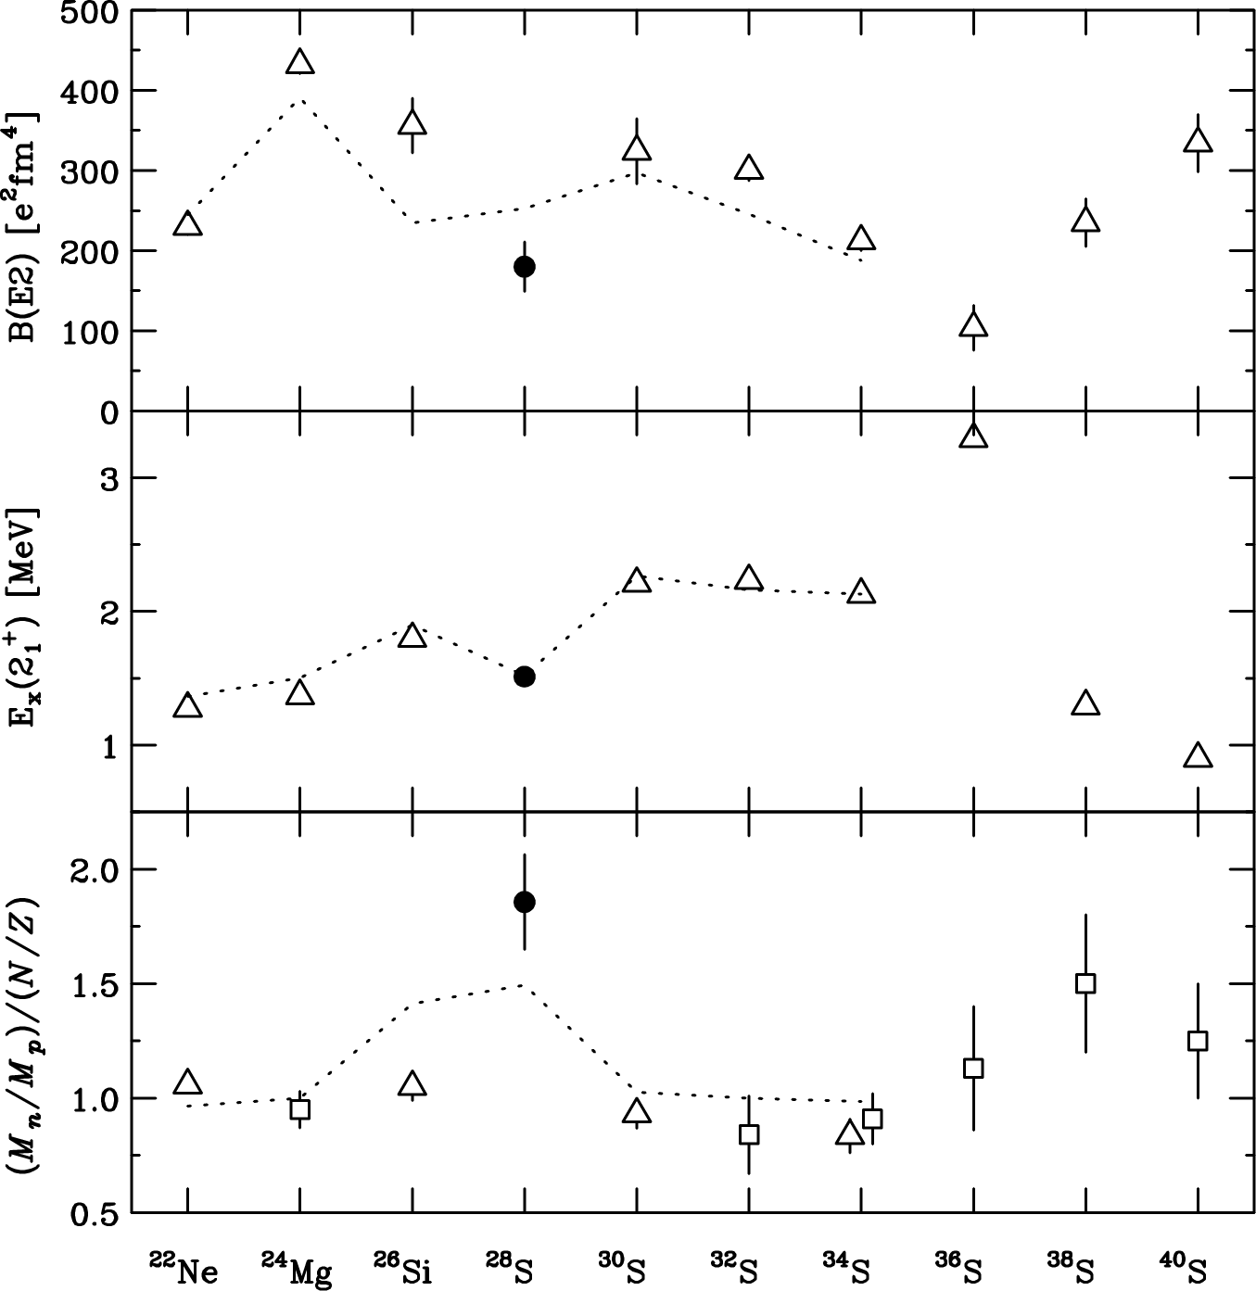
Double ratio |M_{n}/M_{p}|/(N/Z) : measure of p/n excitation
Z=16 magic number appears at ²⁸S?
Togano^{EMMI} et al., Phys. Rev. Lett., 108 (2012) 222501
N=12 isotones
Z=16 isotopes
N=12 isotones, ³⁰⁻³⁶S
    ratio ~ 1
^{38,40}S
ratio >1
  neutron skin effect
    N=20 shell + n’s
²⁸S
  Sudden increase
Neutron-mode excitation
due to
the Z=16 shell closure
Notes:
Here the isotope and isotone dependence of B(E2), 2+ energy, and the double ratio. Again the double ratio of 28S is much larger than unity, indicating the emergence of new magic number Z=16. For N=12 isotones, and 30-36S, the double ratios are almost unity, showing the normal collective excitations.At 38S and 40S, the they are larger than unity. They are caused by the neutron skin effect originated from the Z=16 subshell closure emerging at around this sulfur isotopes. At 28S, you can see sudden increase of the double ratio. It shows a sudden change of the structure at 28S. As I mentioned before, the neutron dominance in 28S can be understood if 28S is the singly magic nucleus. And this sudden increase may corresponds to the emergence of new magic number Z=16 at the proton-rich nucleus 28S.

Slide 28
Neutron-rich nuclei
New neutron-rich regions by RIBF
new isotopes, isomers, lifetime, …
Neutron halo / neutron modes
heavier halo nuclei e.g. ³¹Ne, neutron mode in ¹⁶C
Low-energy E1 strength
²⁶Ne, (^{A}Sn)
Rise and fall of the shell closure
deformed ⁴²Si, Z=16 shell closure in ²⁸S
More collaboration!
e.g. EURICA
Neutron-rich matter studies: not simple as the primary thought.
more experiments ⬄ equipment, theory, ….

Slide 29
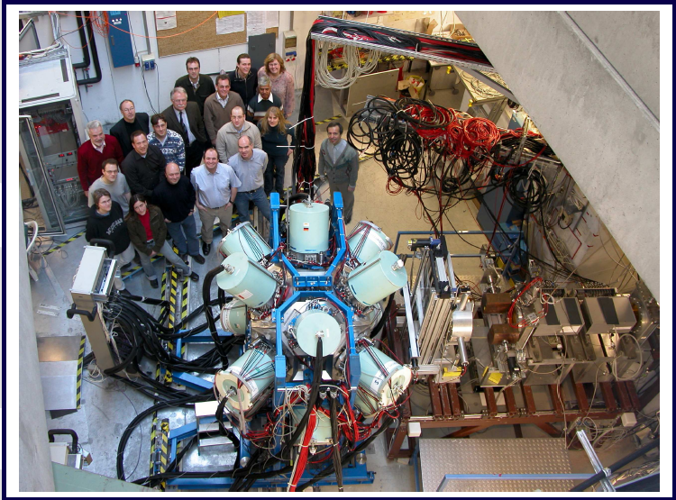


EURICA Project (2012-)
Now running!
GSI RISING
Euroball Cluster detectors
Support structure
- Readout electronics
RIKEN RIBF
(Japan)
Courtesy of S. Nishimura

Slide 31
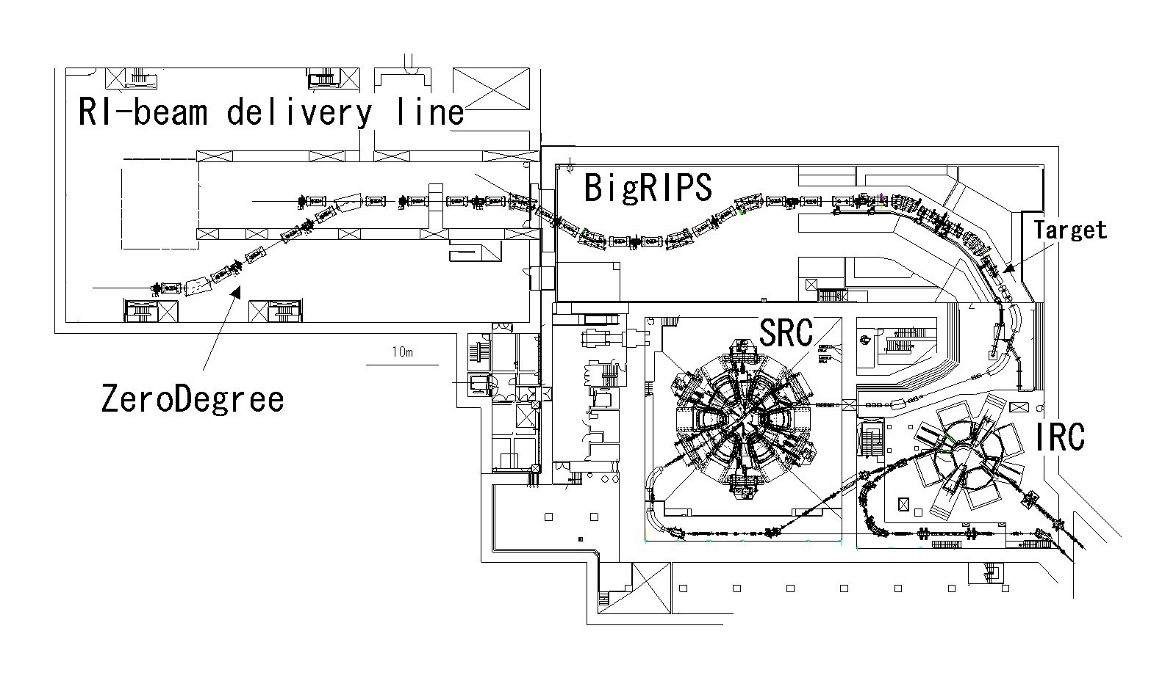
In-beam γ-ray spectroscopy with direct reactions cf. Aoi
Secondary reaction studies with ZeroDegree
IRC
SRC
photo (next page)
Production
Target
F11
F5
F1
F2
F3
F7
F7
F8
Target
γ
F12
1st stage
separation
2nd stage
analysis
ZeroDegree
analysis of 2ndary
reaction products
Notes:
31
31

Slide 32
Secondary Beam Intensity with primary ⁴⁸Ca beams (2009)
Present (BigRIPS) Previous (RIPS) gain
²²C 10 cps 6 mcps 1,700 ➔ 3,600 (2012)
³⁰Ne 300 cps 0.2 cps 1,500
³¹Ne 10 cps 20 c/4days 1.7x10⁵
³²Ne 5 cps
⁴²Si 15 cps
Aoi

Slide 33
Secondary Beam Intensity with primary ⁴⁸Ca beams (2009)
Present (BigRIPS) Previous (RIPS) gain
²²C 10 cps 6 mcps 1,700 ➔ 3,600 (2012)
³⁰Ne 300 cps 0.2 cps 1,500
³¹Ne 10 cps 20 c/4days 1.7x10⁵
³²Ne 5 cps
⁴²Si 15 cps
Aoi

Slide 34
Secondary Beam Intensity with primary ⁴⁸Ca beams (2009)
Present (BigRIPS) Previous (RIPS) gain
²²C 10 cps 6 mcps 1,700 ➔ 3,600 (2012)
³⁰Ne 300 cps 0.2 cps 1,500
³¹Ne 10 cps 20 c/4days 1.7x10⁵
³²Ne 5 cps
⁴²Si 15 cps
⁴⁴Si 4x10⁴ cps
Aoi

Slide 35
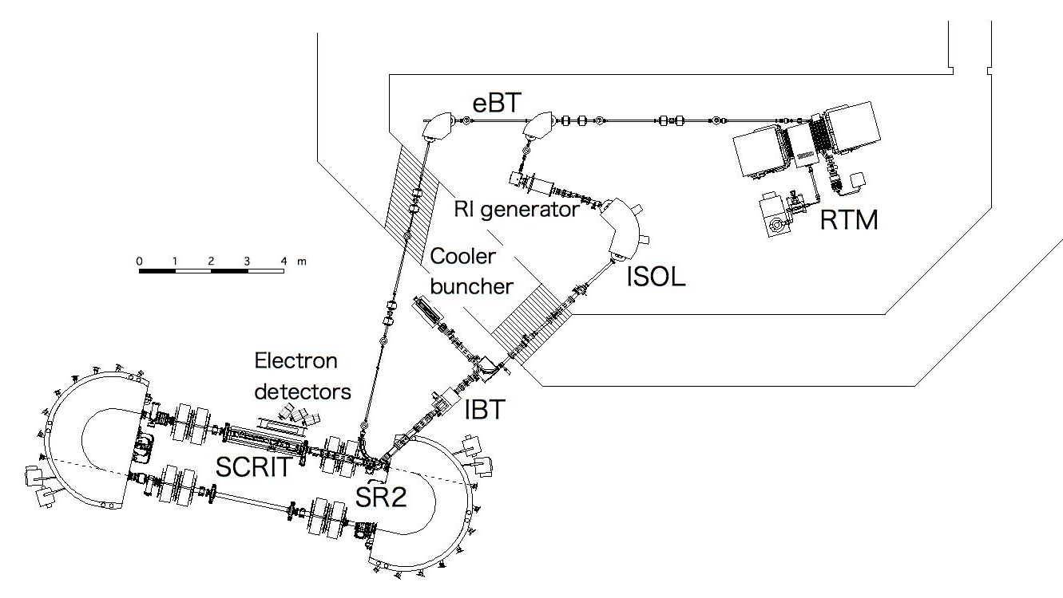
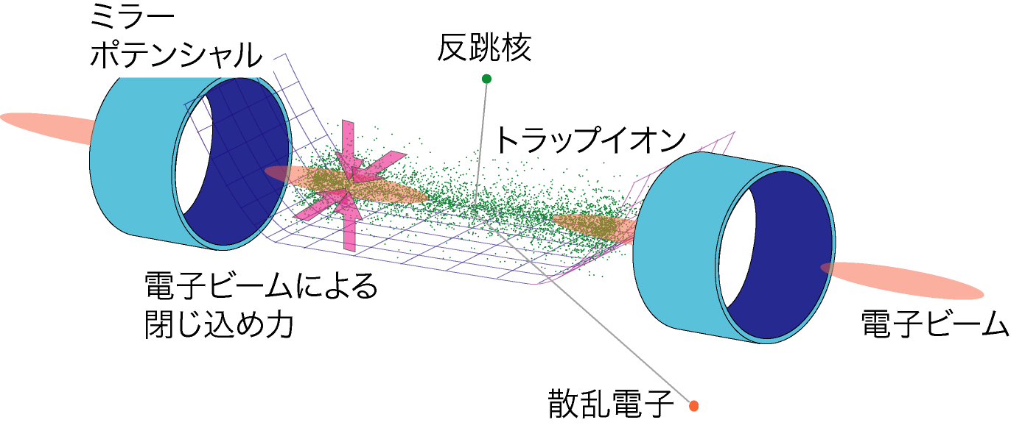
Equipment under construction I - SCRIT for electron scattering
Mirror
potential
Recoil
nuclei
Trapped ions
e-beam
Scattered e
2009
2010
2011
2012
2013
2014
Facility constructions
Tuning of accelerators
Installation of SCRIT
SCRIT performance test
ISOL commissioning
Test of RI production
Tuning of ISOL
Upgrade RTM
Construction e-Spectrometer
Full-scale RI production
Start Experiments for RI’s

Slide 36
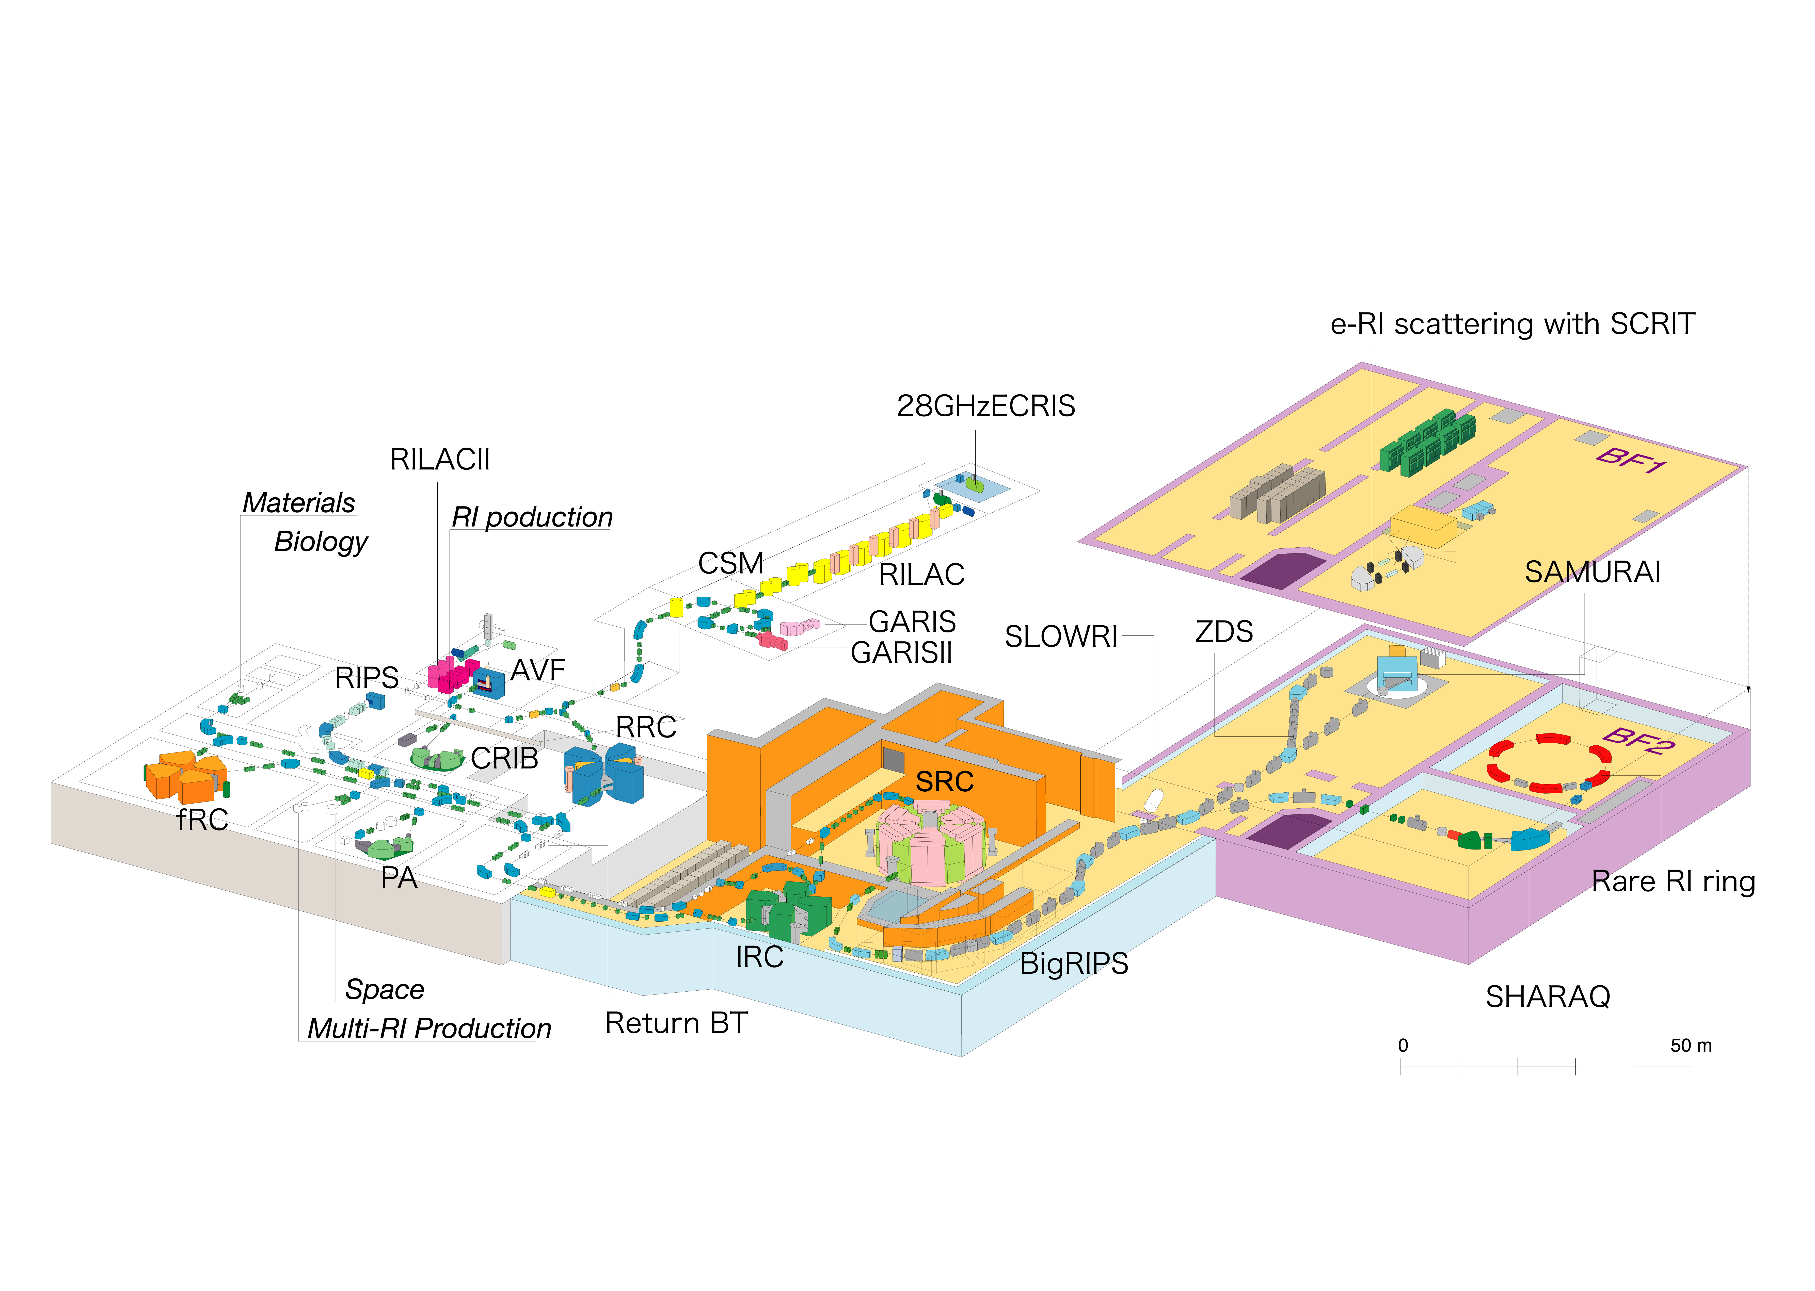
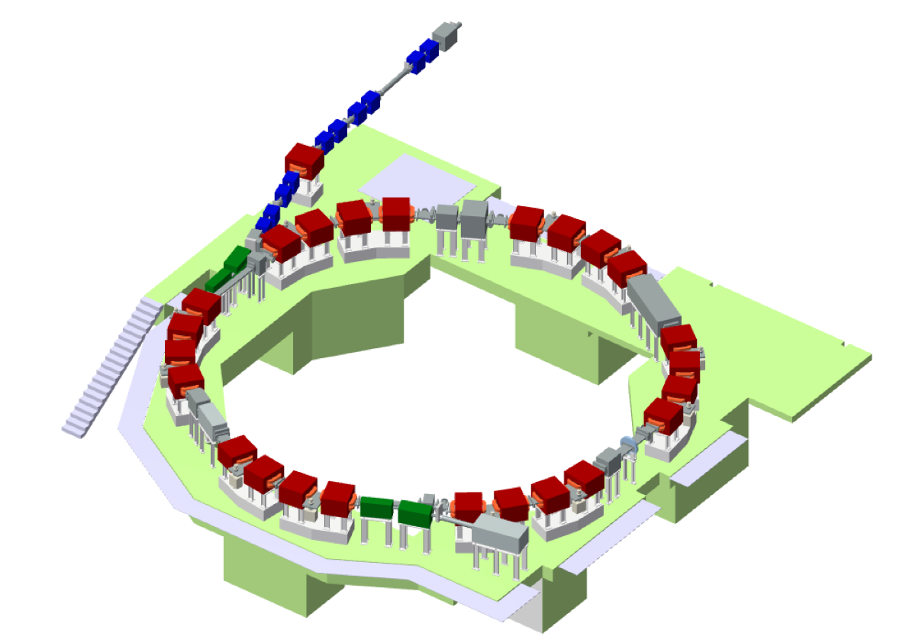
Equipment under construction II - Rare RI Ring
FY2011.3 : President’s Discretionary Budget was approved
RIBF
precision mass measurements
for extremely rare RI’s
Isochronous Storage Ring
RI Beams
TOF detector
2012
2013
2014
2015
Injection
Septum
Construction
Commissioning
Tuning
Start mass measurement
Kickers
Schottky
Extraction
Septum
PID

Slide 37
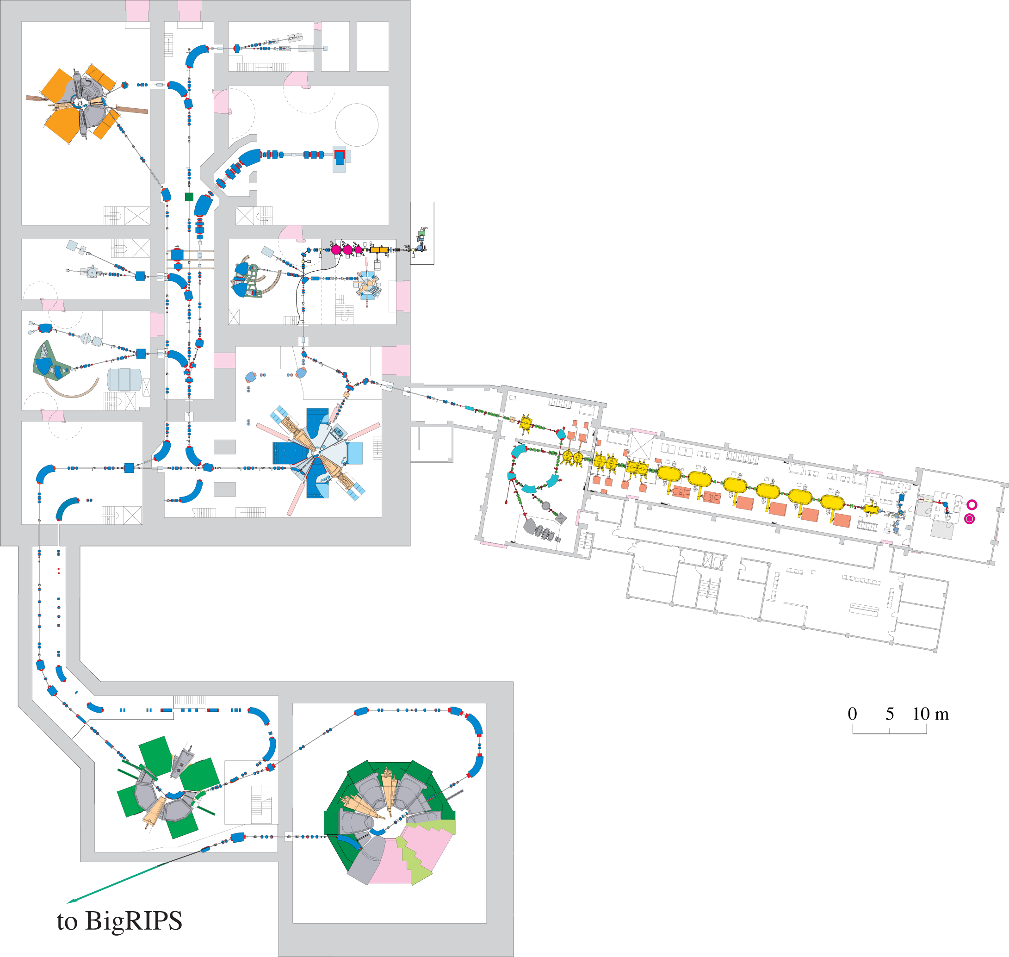
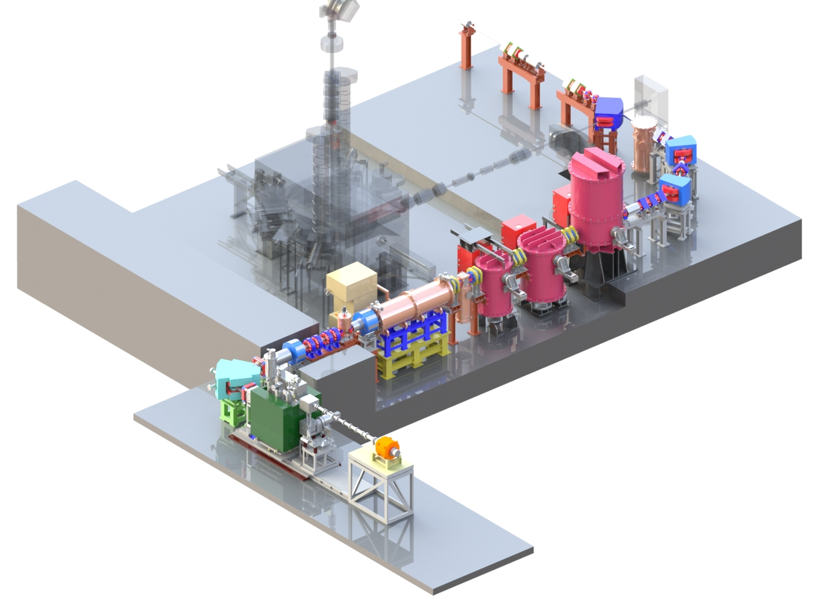
Simultaneous operation of 3 accelerators - accelerator upgrade
fRC
RILAC2
AVF (⁴He)
RRC
RILAC
GARIS (⁷⁰Zn)
IRC
2011-
Big-RIPS (²³⁸U)
SRC
Notes:
37

Slide 38
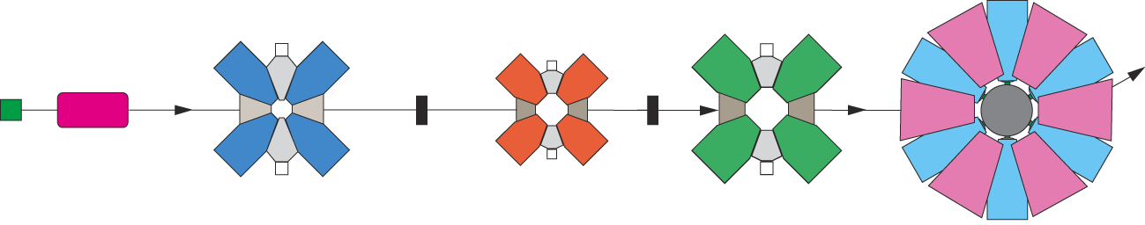
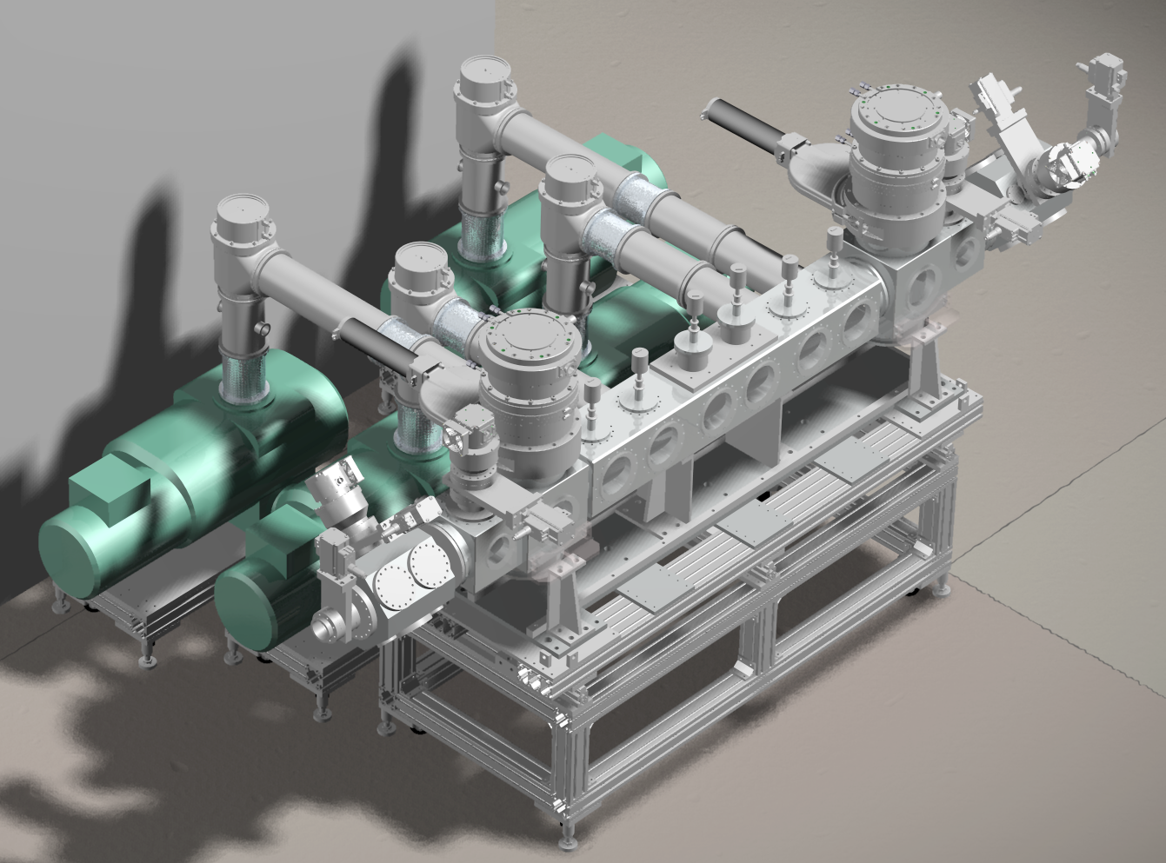
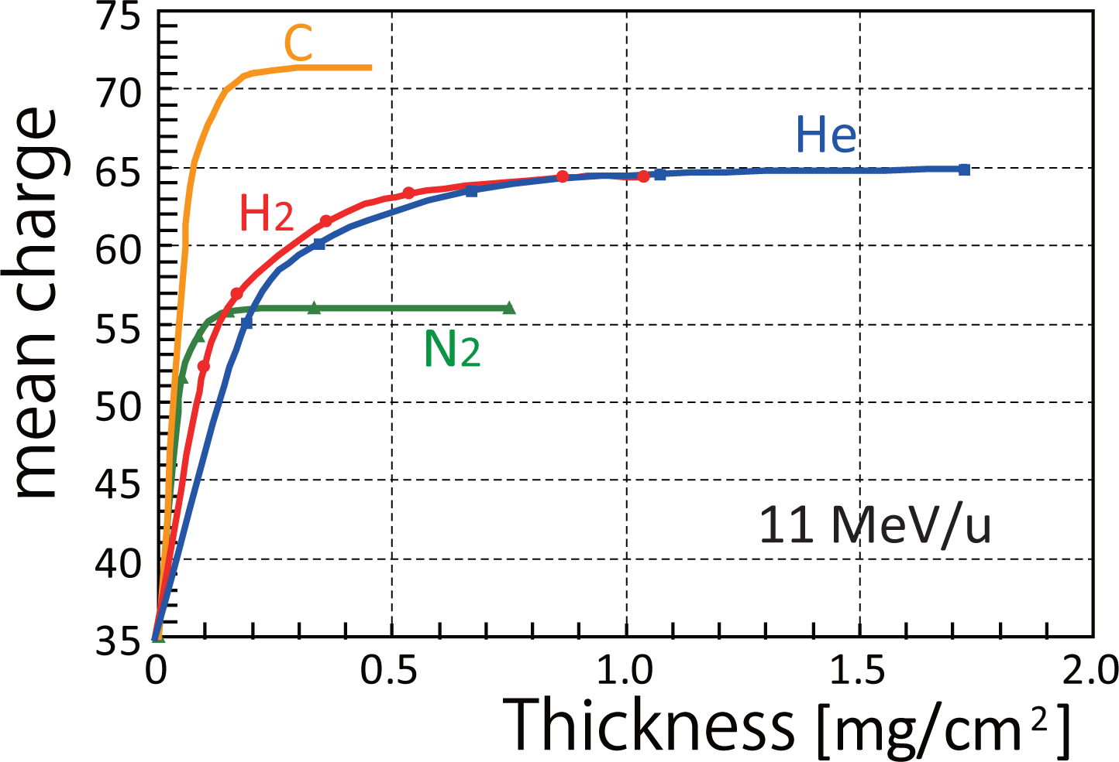
Near-term accelerator Upgrade : He charge strippers
SRC
RRC
fRC
IRC
RILAC2
SCECR
11 MeV/u
50 MeV/u
Atom | Q1 | CS1 | Q2 | CS2 | Q3 | Available @ | Intensity
²³⁸U | 35 | CNT+EV | 71 | C | 86 | Present | 3.5
 | 35 | He gas | 65 | C | 86 | Oct 2012 | (5)
Present fRC: 69+
Upgraded fRC: 65+
Acceptable charge state of U
(Imao)

Slide 39
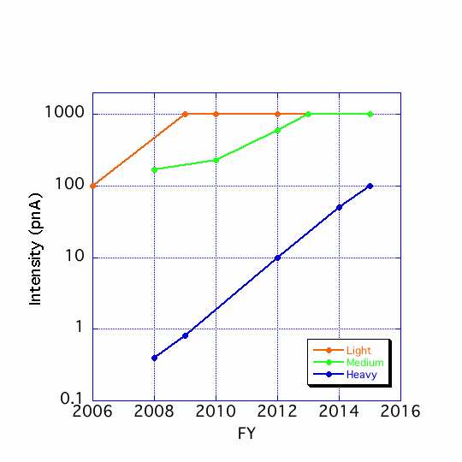
Intensity upgrade in 5 years (plan)

Slide 40
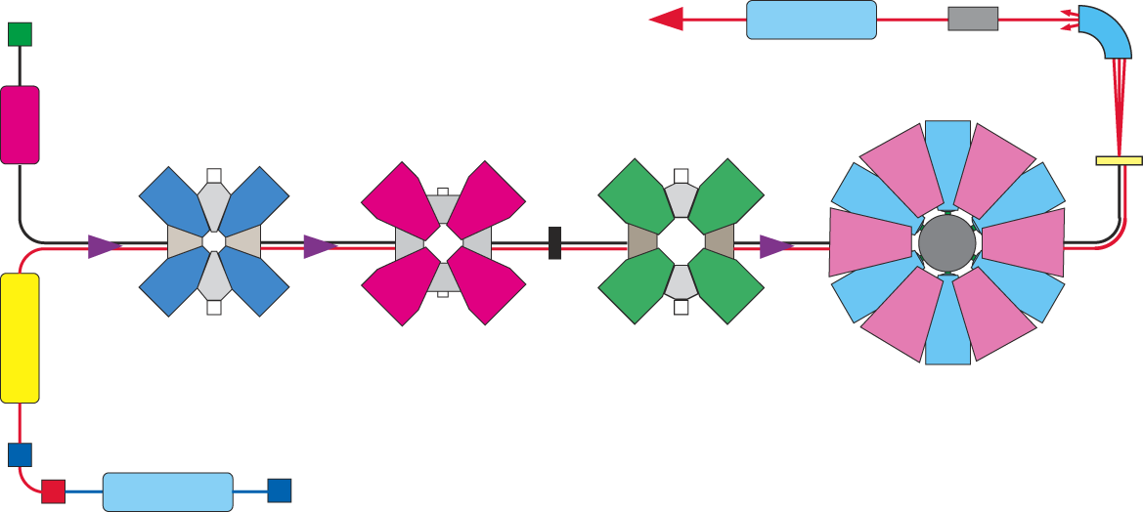
RIBF Upgrade Optins – Long-term plan
HE RIBs
Post-Acc.
SLOWRI
Big-RIPS
RILAC2
S-fRC
SRC
RRC
IRC
N2
RILAC1
35+
35+
86+
27%
27%
ISOL
SRF (d 40MeV/2mA)

Slide 41
SLOWRI in preparation
SLOWRI as the basis
for ISOL reaccelerated
low-energy precision
RI beams:
Gas stopper cells:
- He gas RF ion cell
(no chemical dependence)
- Ar gas laser cell
(high chemical selectivity
and isobar separation)
SRF linac
(for precision beams)
Dual parallel beams
(Fragmentation and ISOL)
Minimize radioactive waste
and shielding issues

Slide 42
RIBF Upgrade Optins – Long-term plan
HE RIBs
Post-Acc.
SLOWRI
Big-RIPS
RILAC2
SRC
WORK IN PROGRESS …
RRC
S-fRC
IRC
N2
RILAC1
35+
35+
86+
27%
27%
ISOL
SRF (d 40MeV/2mA)

Slide 44
Double ratio |M_{n}/M_{p}|/(N/Z)
M_{n(p)}: neutron (proton) transition matrix amplitude
|M_{n}/M_{p}|/(N/Z)
  Relative contribution of p/n to a transition
  > 1.0: Neutron dominance ← Singly p magic nuclei
    cf. ^{18,20}O, Sn isotopes (A. M. Bernstein, PLB 103, 255)
|M_{p}|= sqrt(B(E2)/e)
|M_{n}|: M_{p} of the mirror partner ← B(E2) of ²⁸Mg
|M_{n}/M_{p}|/(N/Z) = 1.9(2)
²⁸S: Singly p magic nucleus ← Z=16
Notes:
To evaluate this hypothesis, we extracted the double ratio Mn/Mp/(N/Z). Mn and Mp are the neutron or proton transition matrix amplitude, and N, neuron number, Z the atomic number. This double ratio corresponds to the relative contribution of p/n to a transtion. If it’s larger than unity, the transition is neutron dominant. And neutron dominat excitation is typical phenomena for the singly magic nuclei. Mp is related to B(E2) by this formula, and Mn is obtained from the Mp value of mirror partner 28Mg, assuming the isospin symmetry.

Slide 45
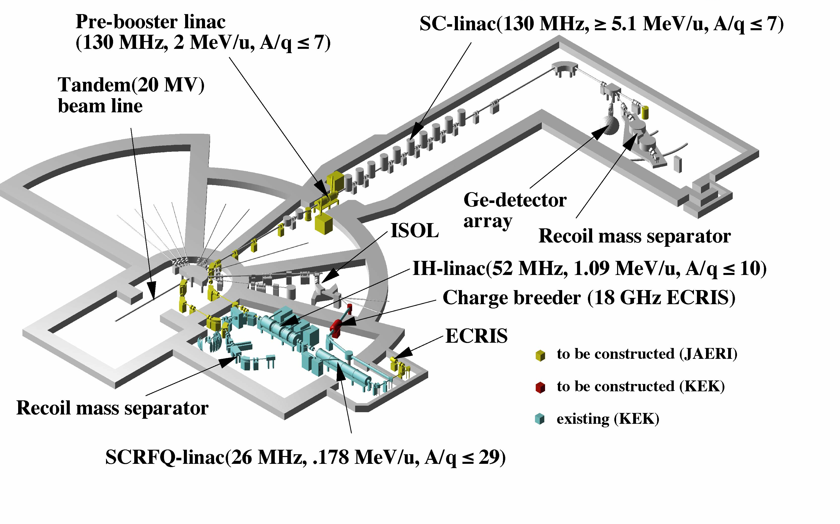
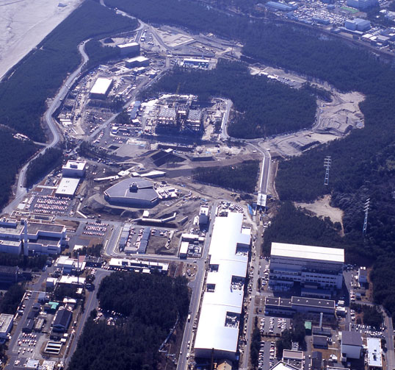
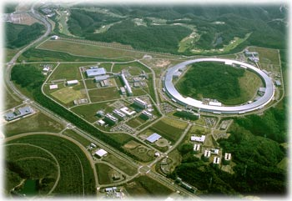
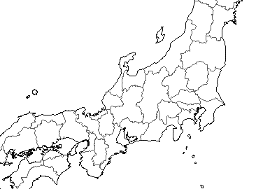
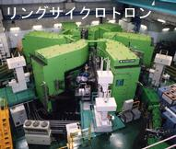


nuclear physics facilities in Japan
a few MeV/u RI
J-PARC
SPring-8
Ｋ, π, ν, n,…
TRIAC
photon
RCNP cyclotron
NIRS
HIMAC
p, α, ..
HI, fast RI
RIKEN
RI Beam Factory
fast RI
a few MeV/u RI
fast HI, RI

Slide 46
・K-nucleus, hyper nucleus
・ν-mass / mixing
a few MeV/u RI
J-PARC
・laser Compton γ
・(material and life)
SPring-8
Ｋ, π, ν, n,…
TRIAC
Ikezoe
(Wednesday PA2)
photon
RCNP cyclotron
Fukuda
(Monday PA5)
Mihara
(Monday PA1)
Nisimura
(Tuesday PA4)
Murakami
(Wednesday PA7)
NIRS
HIMAC
p, α, ..
HI, fast RI
RIKEN
RI Beam Factory
fast RI
a few MeV/u RI
fast HI, RI
・high-resolution particle spectroscopy
・exotic nuclei
・origin of elements
・medicine (therapy)
Takada (Friday)

Slide 47
a few MeV/u RI
J-PARC
SPring-8
Ｋ, π, ν, n,…
TRIAC
photon
facility with the highest capability
for RI beam production
RCNP cyclotron
NIRS
HIMAC
p, α, ..
HI, fast RI
RIKEN
RI Beam Factory
fast RI
a few MeV/u RI
fast HI, RI
・exotic nuclei
・origin of elements

Slide 48

Performance of RIBF new facility
fragmentation
+ projectile (U) fission
p~U
345 MeV/u
1 pμA (6x10¹² /sec)
(goal)
345 MeV/nucleon
light-to-heavy RI beams
200-300 MeV/nucleon
with great intensities
June 2012
Notes:
48

Slide 49


New isotope search using a ²³⁸U beam at BigRIPS
Nov. 2008
U-beam intensity (averaged)
~1.8 x 10⁹ pps (Nov. 2008) ⬅ 4 x 10⁷ pps (2007)
➔ decay studies
27
Unknown
Pd (Z=46)
¹²⁴Pd
45 more new isotopes
3
¹²⁵Pd (~2200 events)
¹²⁶Pd (~300 events)
¹²⁷Pd(new)
¹²⁸Pd(new)
Preliminary
Kubo

Slide 50





a latest example at RIPS
³²Mg(p,p’) with high statistics ⬅ DALI2, liq H₂ target (157 mg/cm²), ..
S. Takeuchi et al. PRC79 (2009) 054319
➔ γγ, γγγ / angular distribution
properties of ³²Mg (N=20)
in “island of inversion”
³²Mg beam
450 cps
γ-ray detector DALI2

Slide 51

RIPS
³²Mg(p,p’) with high statistics ⬅ DALI2, liq H₂ target, ..
S. Takeuchi et al. PRC79 (2009) 054319
➔ γγ, γγγ
³²Mg beam
γ-ray detector DALI2
5 new transitions
5 (4) new states

Slide 52

spin of X (2321 state in ³²Mg)?
³²Mg(p,p’) with high statistics ⬅ DALI2, liq H₂ target, ..
S. Takeuchi et al. PRC79 (2009) 054319
➔ (p,p’) angular distribution
dσ/dΩ_{exp}
  peak yield
  with feeding correction
  ⬅ level scheme
dσ/dΩ_{exp}
  coupled channel (ECIS)
  e.g. 0⁺ - 2⁺ - 4⁺
2+ (885 keV)
3⁻
2⁺-0⁺
4⁺
X-2⁺
X (2321 keV)
X = 4⁺
R_{2/4} = 2.6
scattering angle
=> “soft” deformation
c.f. R = 3.1 (~3.33) for ³⁴Mg

Slide 53
Pushing outward the frontiers --- also for excited states
Gas phase
Giant resonance
Excitation energy
Cluster correlation
N >> Z
Soft mode
Separation energy
Disappearance/Appearance
of magicity
2n correlation
Egg
low density
weak (no) binding
N＜Z
N＝Z
Stable
Skin
N≫Z
p/n decoupling
Halo
Neutron star
Explosive hydrogen burning
Heavy element synthesis
Neutron excess

