Slide 1
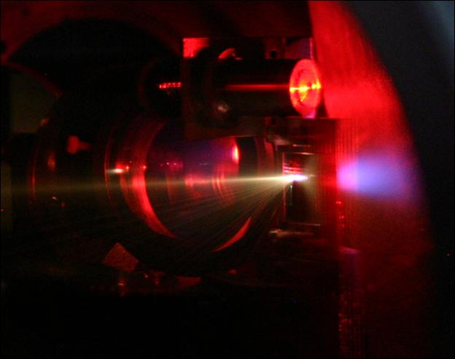
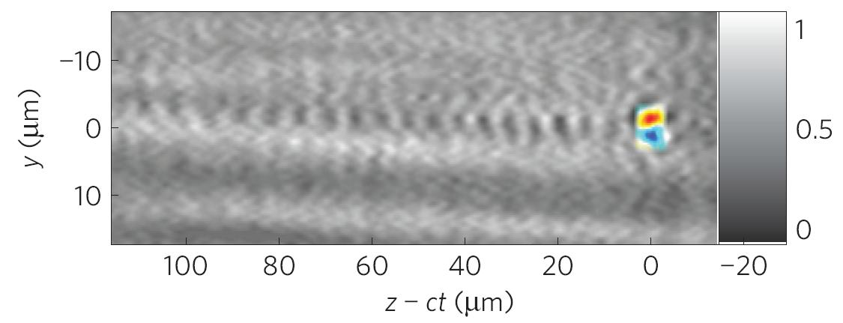
Electron acceleration with laser-driven plasma waves: a potential future alternative to conventional accelerators
Malte C. Kaluza
Institute of Optics and Quantum Electronics and Helmholtz-Institute Jena,
Friedrich-Schiller-University Jena

Slide 2
Outline
Particle acceleration with lasers
Motivation: machine size and specific applications in contrast to conventional particle accelerators.
Laser-driven electron acceleration
Laser-wakefield acceleration: towards ultra-short,
quasi-monoenergetic GeV electron bunches,
Visualization of accelerating plasma structure and acceleration fields.
Summary

Slide 3
Outline
Particle acceleration with lasers
Motivation: machine size and specific applications in contrast to conventional particle accelerators.
Laser-driven electron acceleration
Laser-wakefield acceleration: towards ultra-short,
quasi-monoenergetic GeV electron bunches,
Visualization of accelerating plasma structure and acceleration fields.
Summary

Slide 4
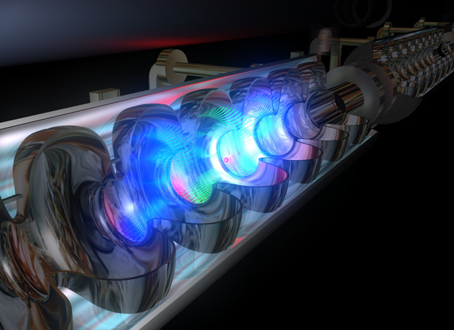
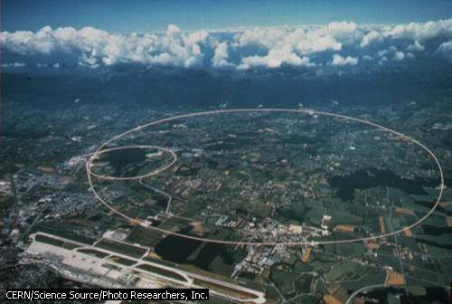
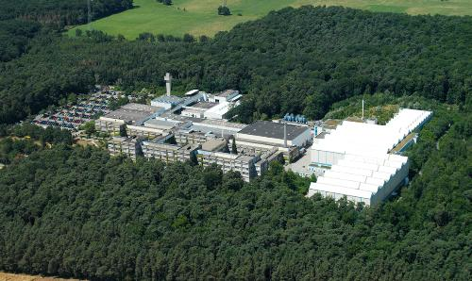
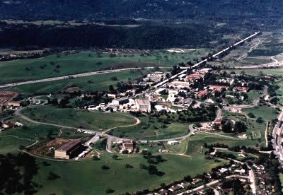
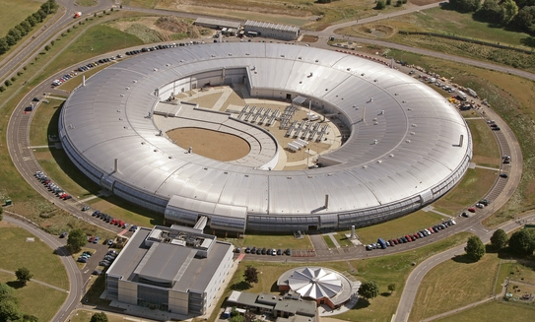
Conventional Particle Accelerators
High-energy particle accelerators
for protons,
heavy ions,
electron linacs,
electron synchrotrons,
are large because of limited acceleration field strength:
avoid break-through or ionization
⇒ use fully ionized laser-generated plasma as acceleration medium
CERN
GSI
SLAC
Diamond
DESY
JETI

Slide 5
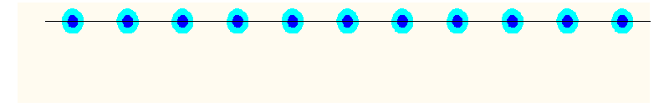
Oscillations in a Plasma
negative electrons
(mobile)
positive ions
(immobile)

Slide 6
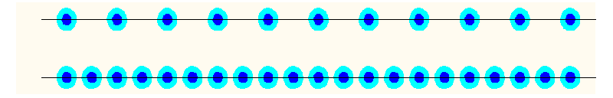
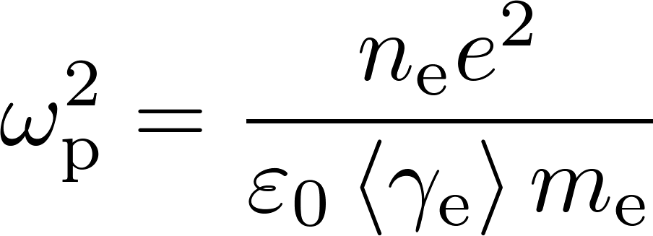


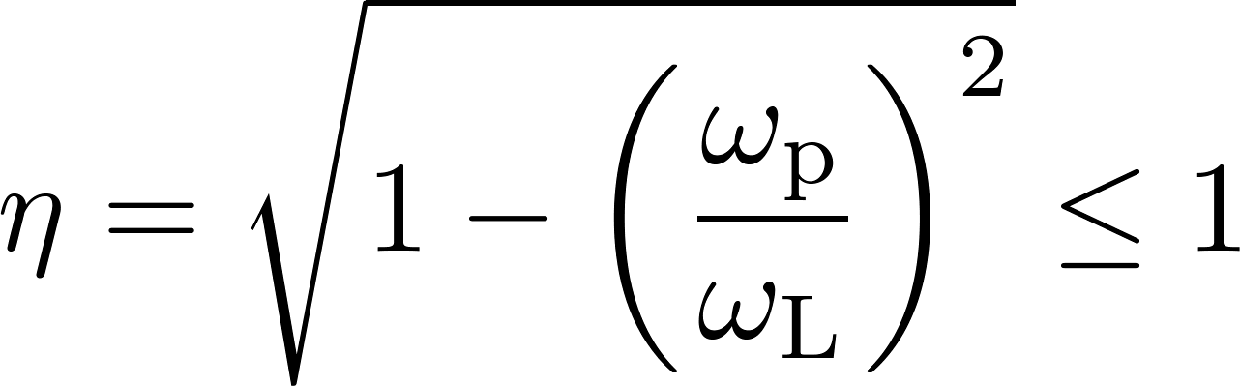
Oscillations in a Plasma
negative electrons
(mobile)
positive ions
(immobile)
Plasma frequency:
light is reflected (overdense plasma)
light can propagate (underdense plasma)
refractive index of the plasma

Slide 7


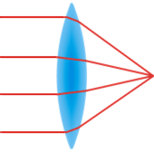
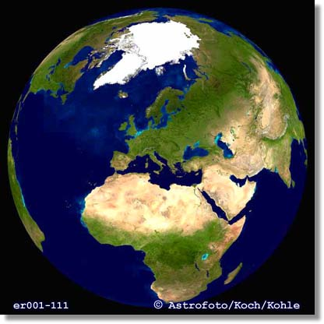
What are Ultra-High Intensities?
I_{L} ~ 10²¹ W/cm²

Slide 8
What are Ultra-High Intensities?
I_{L} ~ 10²¹ W/cm²
?
Focus to a spot with
(1 cm)²: I = 10¹⁷ W/cm²
(1 mm)²: I = 10¹⁹ W/cm²
(0.1 mm)²: I = 10²¹ W/cm²

Slide 9
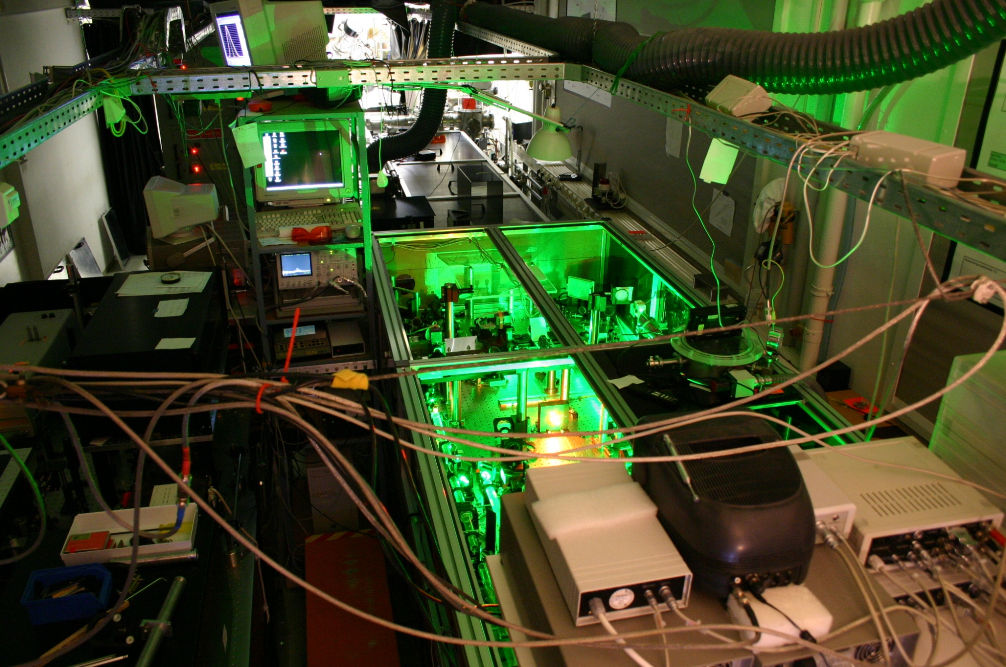
JETI – the JEna Multi-TW TI:Sapphire Laser
Ultra-Short Pulse CPA Ti:Sapphire Laser
wavelength: 800 nm
pulse duration: 30 fs
pulse energy: 900 mJ
peak power: 30 TW
focal spot area: <5 μm²
repetition rate: 10 Hz
max. intensity: > 10²⁰ W/cm²

Slide 10
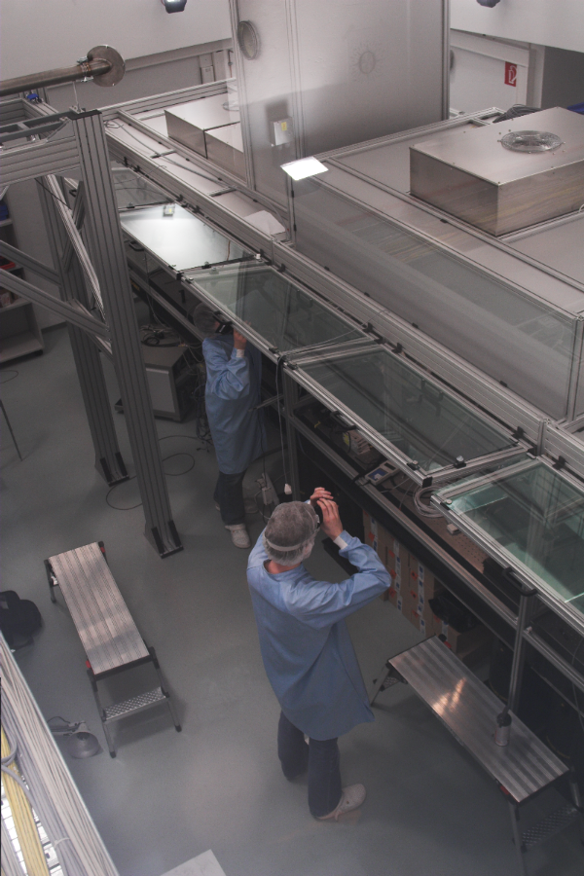
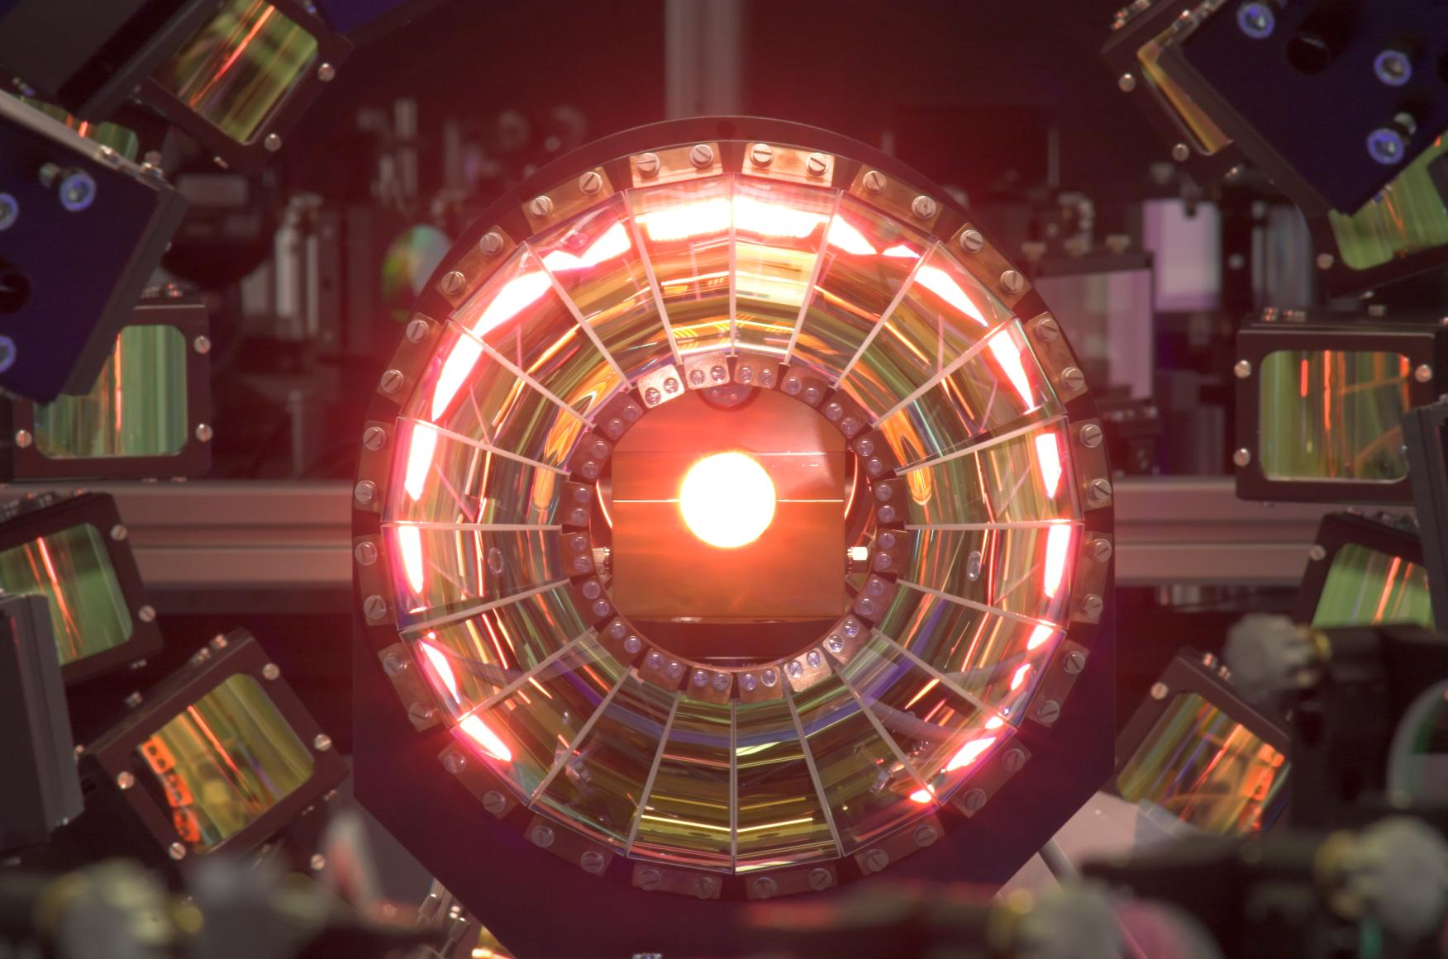
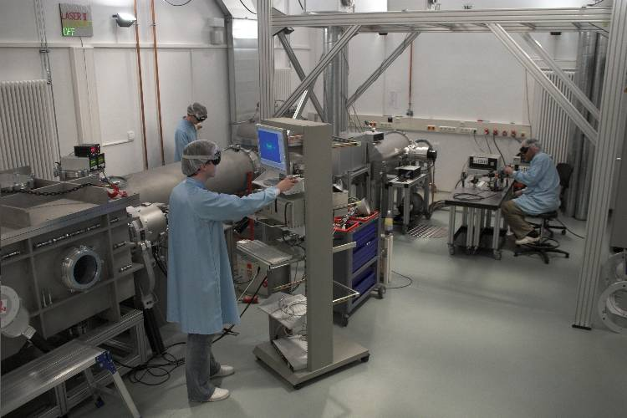
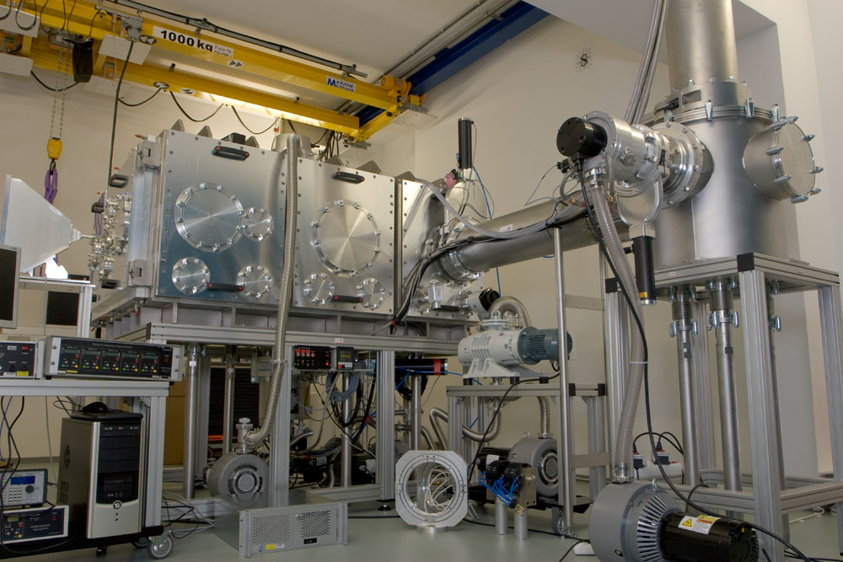
POLARIS – Petawatt Optical Laser Amplifier for Radiation Intensive experimentS
Ultra-Short Pulse CPA Yb:Glass Laser
wavelength: 1030 nm
pulse duration: 150 fs
pulse energy: 10…75 J
power: 50 TW…0.5 PW
focal spot size: <10 μm²
repetition rate: 1/40 Hz
max. intensity: ~10²¹ W/cm²

Slide 11
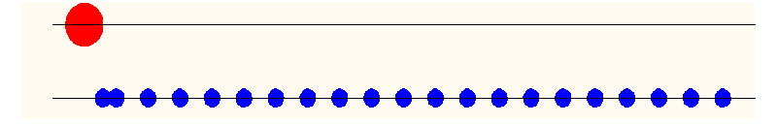
Generation of Plasma Waves
Laser pulse exerts ponderomotive force on plasma electrons:
laser
pulse
plasma
electrons

Slide 12
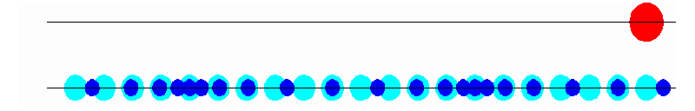
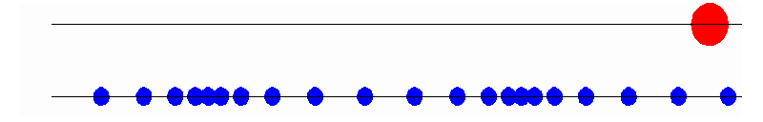
Generation of Plasma Waves
Laser pulse exerts ponderomotive force on plasma electrons:
laser
pulse
plasma
electrons
The propagating pulse generates a
plasma wave in its wake.
A co-moving longitudinal electric field is generated due to
the associated charge separation.
Field strength: E ~ 0.1…1 TV/m = 10¹¹…10¹² V/m
(conventional accelerators: E ~ 10⁷ V/m)

Slide 13
Outline
Particle acceleration with lasers
Motivation: machine size and specific applications in contrast to conventional particle accelerators.
Laser-driven electron acceleration
Laser-wakefield acceleration: towards ultra-short,
quasi-monoenergetic GeV electron bunches,
Visualization of accelerating plasma structure and acceleration fields.
Summary

Slide 14


Acceleration with Waves

Slide 15
Laser-Wakefield Acceleration
Interaction of a high-intensity laser pulse with a plasma
⇒ generation of a plasma wave via its ponderomotive force
Image courtesy of A.G.R. Thomas
plasma wave (v_{ph,plasma} = v_{gr,laser} = η ⋅ c < c) ≡ modulation of n_{e},
very strong charge separation and longitudinal E-fields (~ 0.1...1 TV/m)
⇒ acceleration of quasi-monoenergetic electron bunches

Slide 16
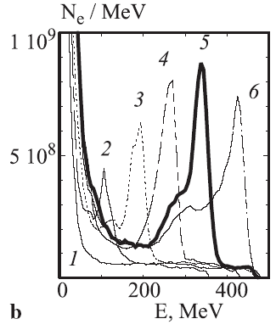
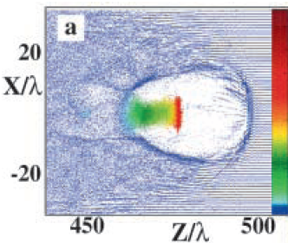
Laser-Wakefield Acceleration
Poineering (theoretical) work by
A. Pukhov and J. Meyer-ter-Vehn: Appl. Phys. B (2002)
formation of a “plasma bubble” (broken plasma wave) by laser pulse
⇒ “Bubble acceleration”, generation of quasi-monoenergetic electron pulses

Slide 17
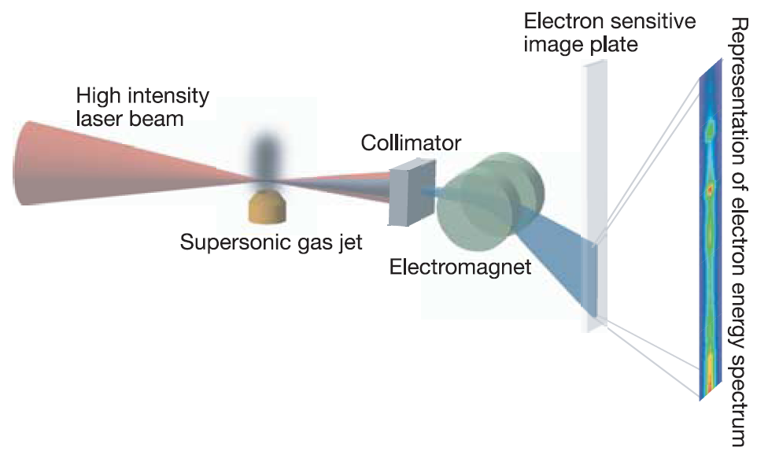
Laser-Wakefield Acceleration
ASTRA laser parameters:
E_{L} ~ 500 mJ, τ_{L} ~ 40…45 fs (P_{laser}~ 11 TW)
Focusing optic: f/20 off-axis parabola
Focal spot ~ 20 µm FWHM, I_{L} ~ 10¹⁸ W/cm²
S.P.D. Mangles et al., C. Geddes et al.,
J. Faure et al., Nature (2004)

Slide 18
Laser-Wakefield Acceleration
For the first time monoenergetic spectra
E_{peak} ~ 70 MeV (with 11-TW laser!),
ΔE/E = 3%
Well-collimated electron beam (divergence < 1°)
Ultra-short pulse duration (50…170 fs)
However:
Fluctuation in electron beam parameters:
  energy of the monoenergetic peak,
  total beam charge measured,
  shape of overall spectrum
Limited peak energy (J. Faure et al.:170 MeV) over 2-5 millimeters
S.P.D. Mangles et al., C. Geddes et al.,
J. Faure et al., Nature (2004)

Slide 19
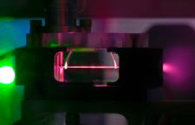
Laser-Wakefield Acceleration
To reach higher peak energies:
increase acceleration/interaction length,
⇒ use pre-ionized plasma channel to guide the laser pulse over centimeters: plasma capillary
l_{acc} ~ 3 cm
E_{max} ~ 1 GeV
3 km
LOASIS @ LBNL
W. Leemans, Nature Physics (2006)

Slide 20
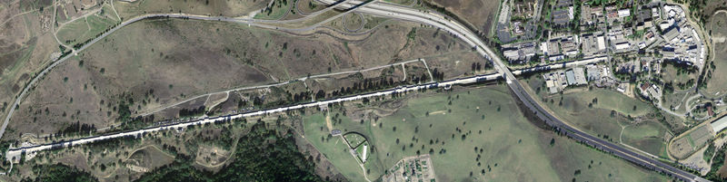
Laser-Wakefield Acceleration
SLAC
E_{max} ~ 50 GeV
l_{acc} ~ 3 km
l_{acc} ~ 3 cm
E_{max} ~ 1 GeV
LOASIS @ LBNL
W. Leemans, Nature Physics (2006)

Slide 21
Further Improvements
Experimental challenges:
stability: peak energy, pointing, charge, energy width,…
measure pulse duration, emittance,…
Laser-generated electrons suitable for applications? (realization of secondary radiation sources,
injector for conventional post-accelerators,…)
Find suitable diagnostics for interaction:
high spatial and temporal resolution,
non-invasive,
⇒ polarimetry with optical probe: Faraday effect

Slide 22
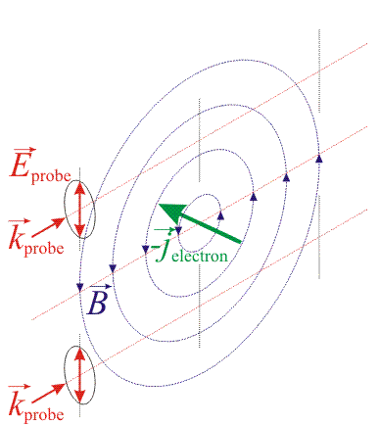
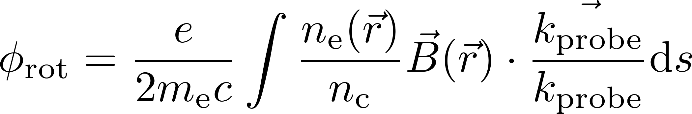
The Faraday Effect
Transverse probing of B-fields in underdense plasma with linearly-polarized probe pulse:
if ⇒ B-field induced difference of η for circularly- polarized probe components
⇒ rotation of probe polarization:
⇒ measure φ_{rot} to get signature of
B-fields!
J. A. Stamper et al. PRL (1975)

Slide 23
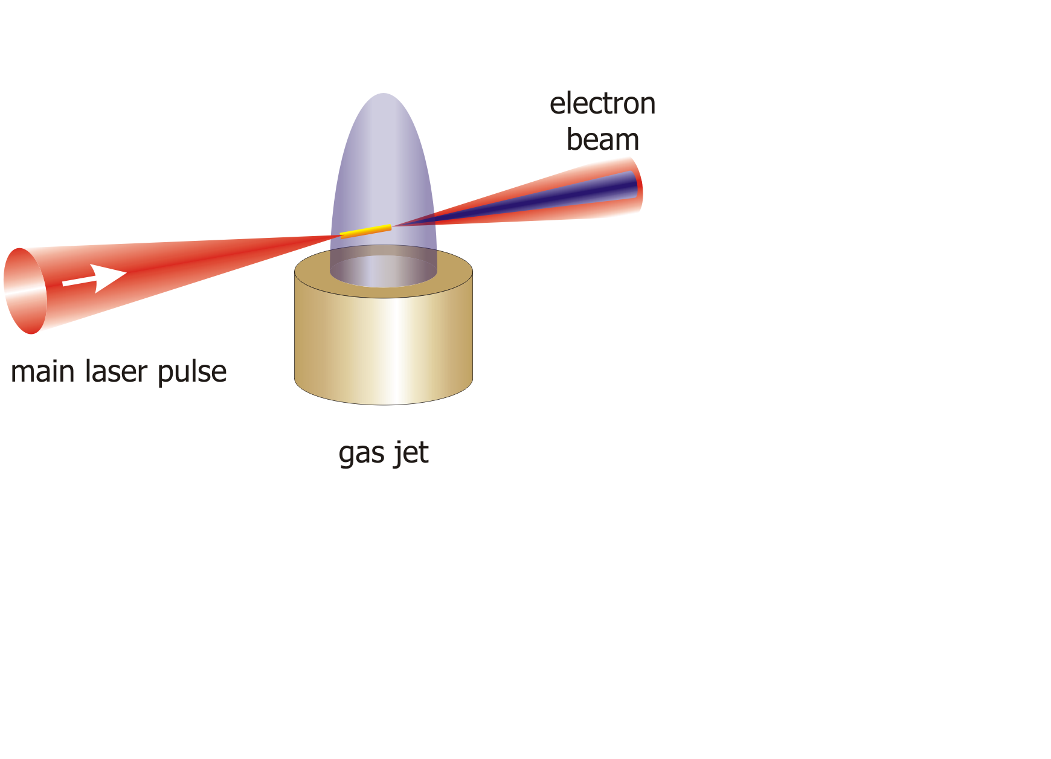
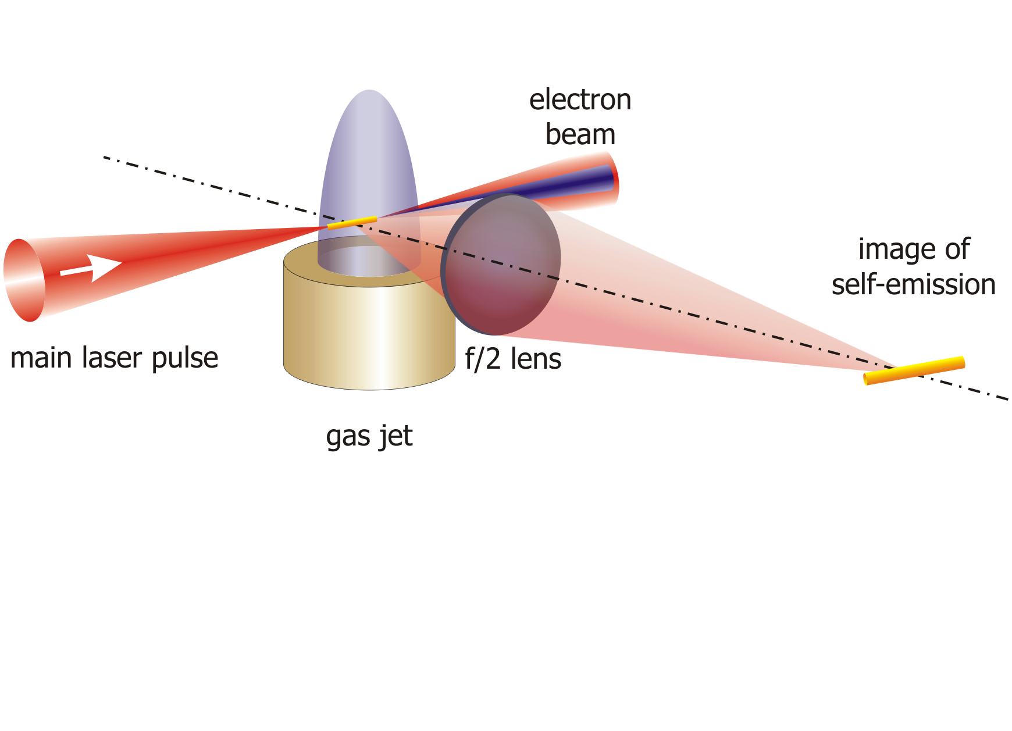
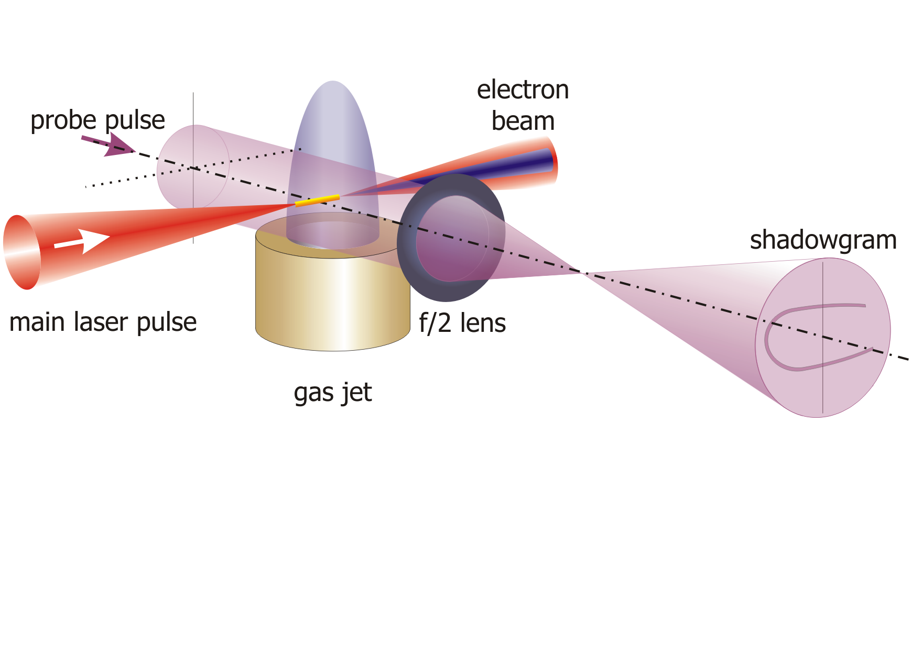
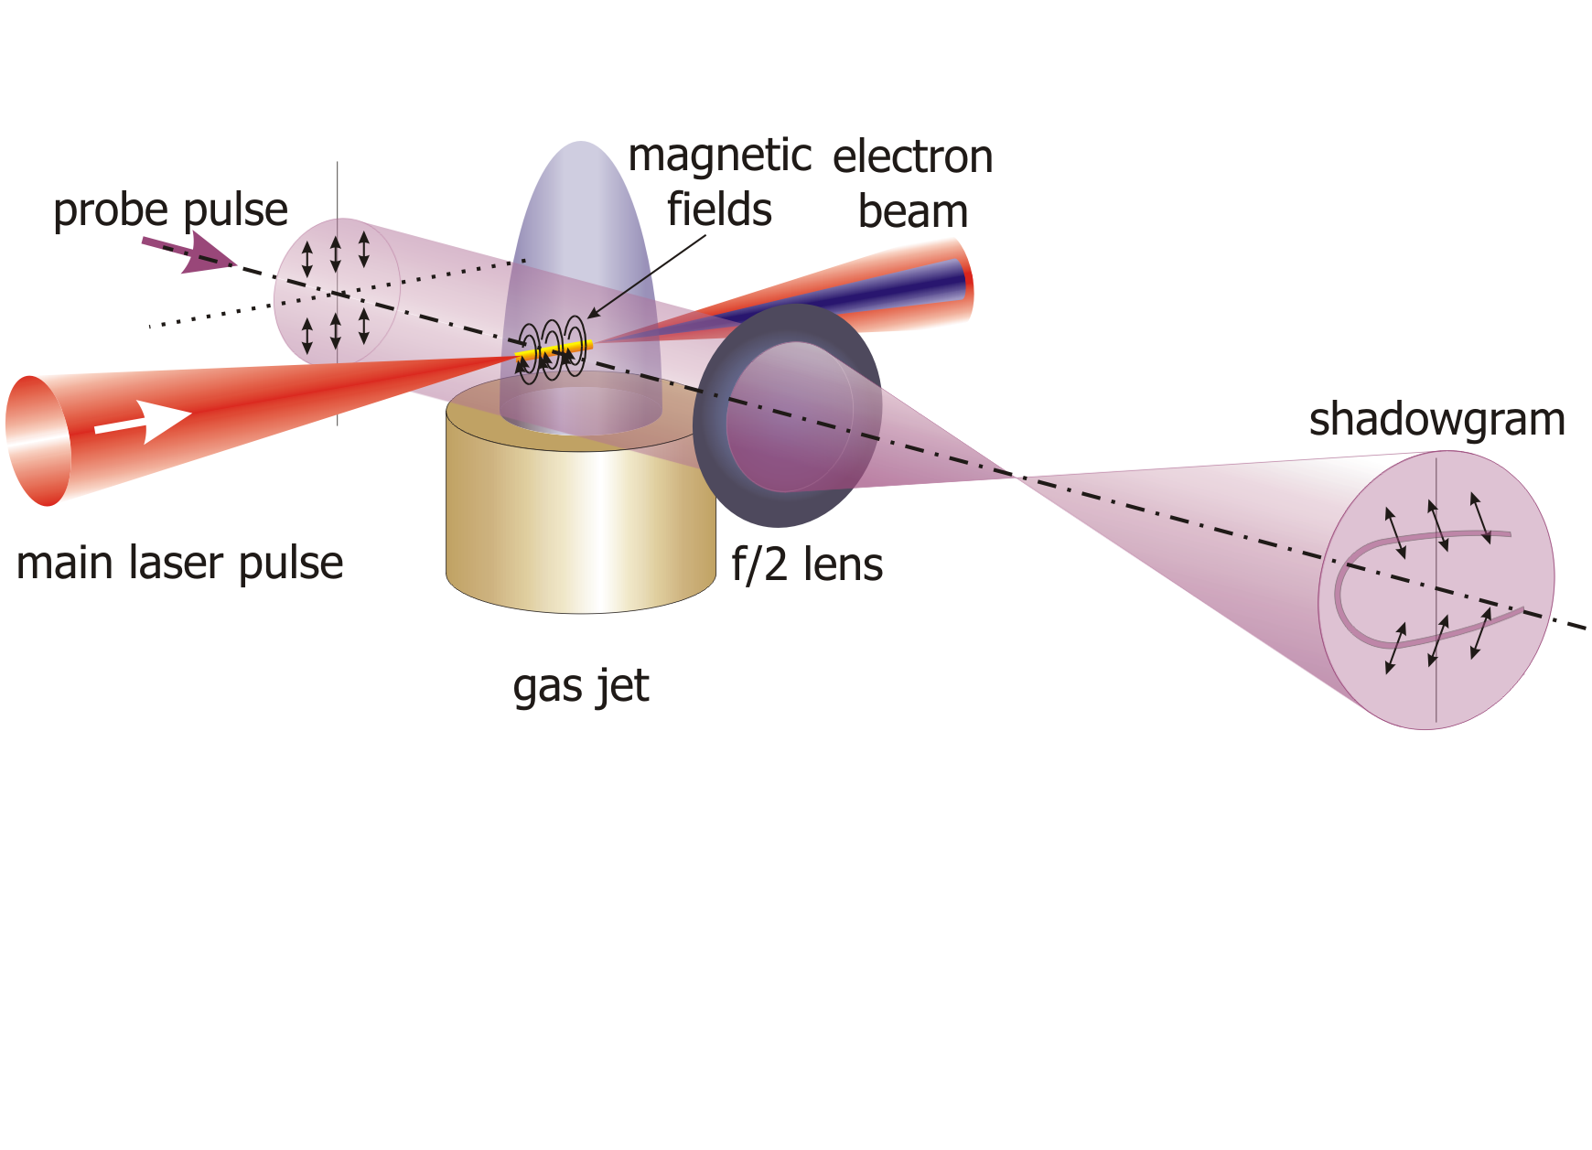
Experimental Setup
JETI laser parameters:
E_{laser} = 700 mJ, τ_{laser} = 85 fs,
f/6 OAP, I_{laser}  3…4×10¹⁸ W/cm²
probe pulse:
τ_{probe}  100 fs, λ_{probe} = 800 nm

Slide 24
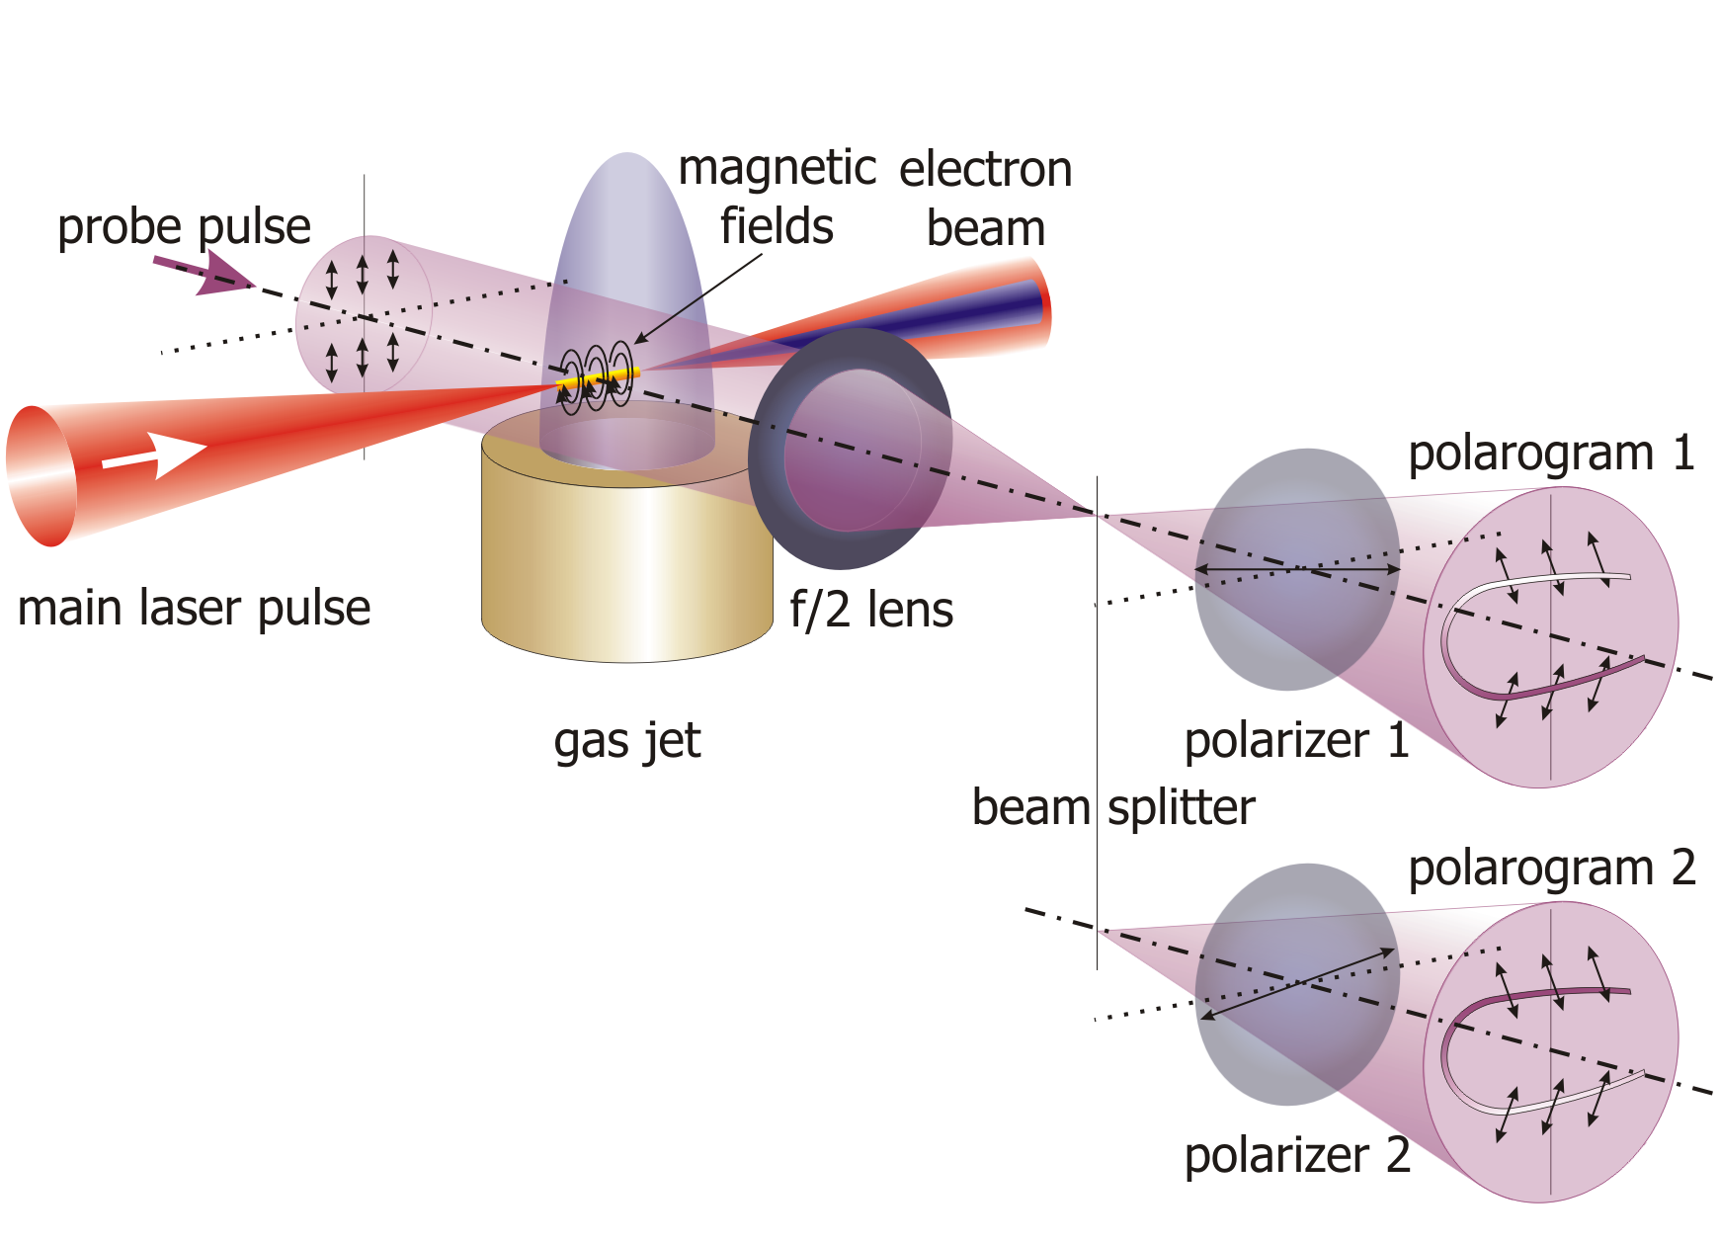
Experimental Setup
JETI laser parameters:
E_{laser} = 700 mJ, τ_{laser} = 85 fs,
f/6 OAP, I_{laser}  3…4×10¹⁸ W/cm²
probe pulse:
τ_{probe}  100 fs, λ_{probe} = 800 nm

Slide 25
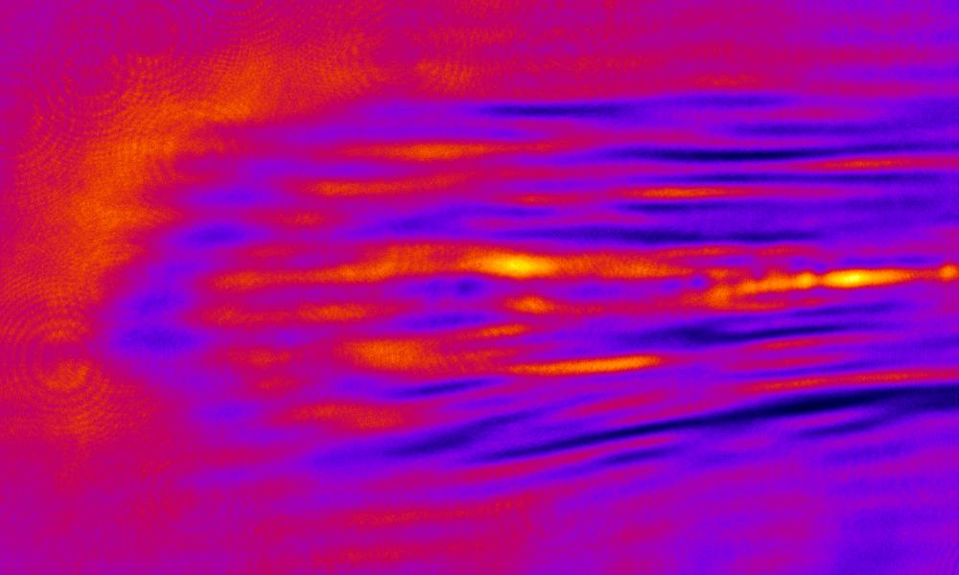
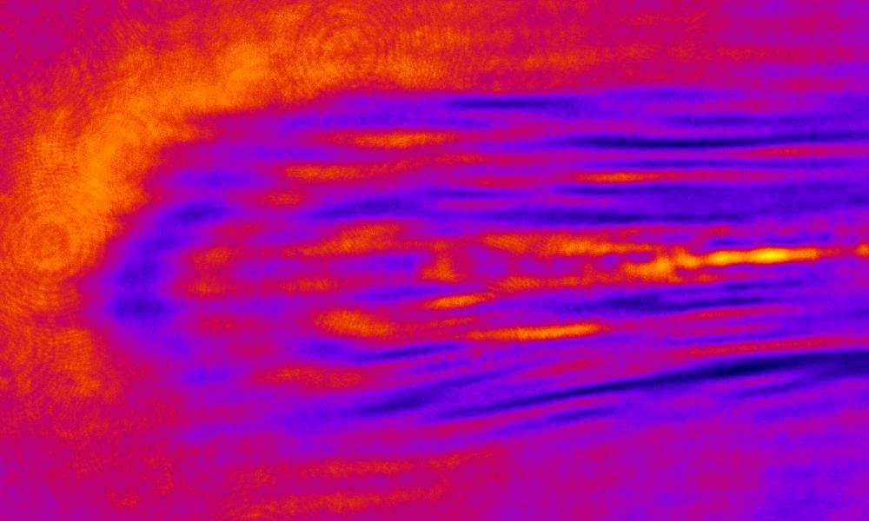

Results: Faraday-Rotation
Two polarograms from two (almost) crossed polarizers:
ionization front
340 µm
polarogram 1
polarogram 2
560 µm
Deduce rotation angle φ_{rot} from pixel-by-pixel division of polarogram intensities:
25

Slide 26
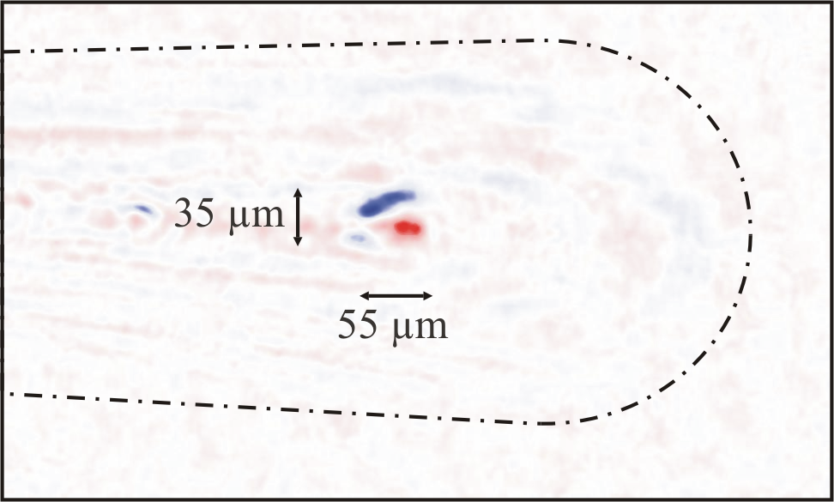
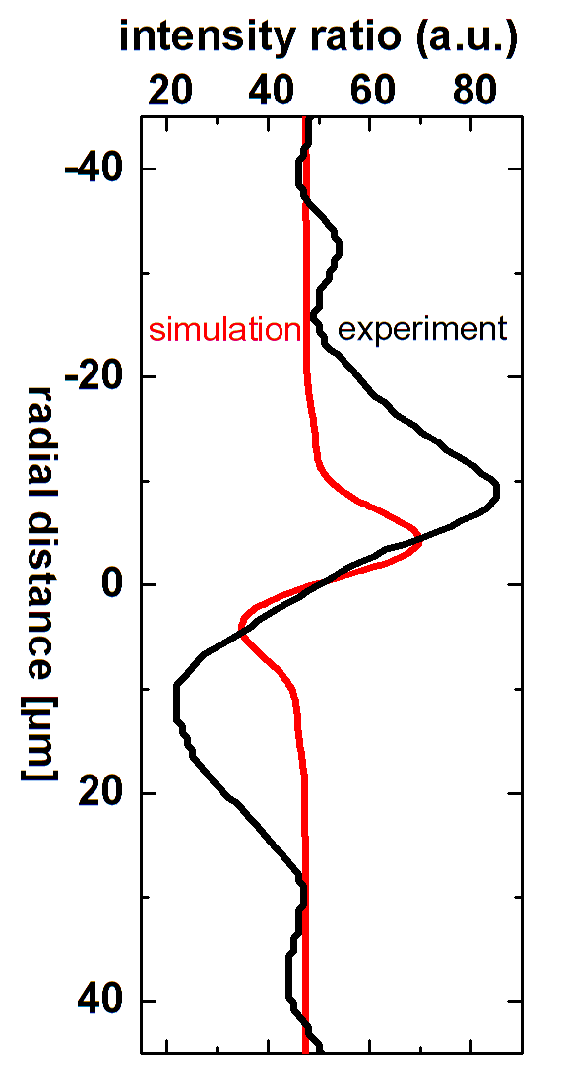

Results: Faraday-Rotation
simulated
feature
experimental Faraday feature
First experimental evidence for B-fields from MeV electrons and plasma bubble!
M. C. Kaluza et al. PRL (2010)
26

Slide 27
Ultra-Short Probe Pulse
JETI parameters:
E_{laser} = 800 mJ, τ_{laser} = 85 fs,
f/6 OAP, I_{laser}  3×10¹⁸ W/cm²
LWS-20 parameters:
E_{laser} = 80 mJ, τ_{laser} = 8.5 fs,
f/6 OAP, I_{laser}  6×10¹⁸ W/cm²
probe pulse:
τ_{probe}  100 fs @ 1ω
probe pulse:
τ_{probe}  8.5 fs @ 1ω
27

Slide 28
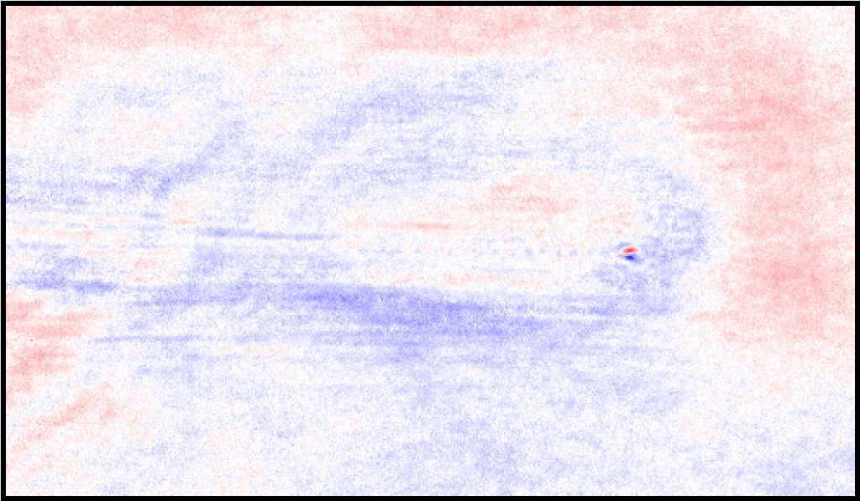
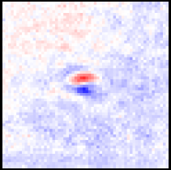
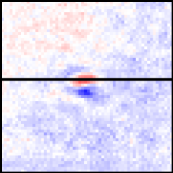
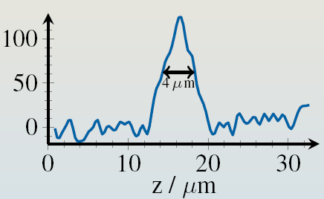
Ultra-Short Probe Pulse
polarogram 1
polarogram 2
Electron bunch length:
Δz = 4 µm ⇒ Δτ = 13 fs (FWHM)
⇒ Δτ_{deconvolved} = (6.0±2.0) fs (FWHM)
28

Slide 29
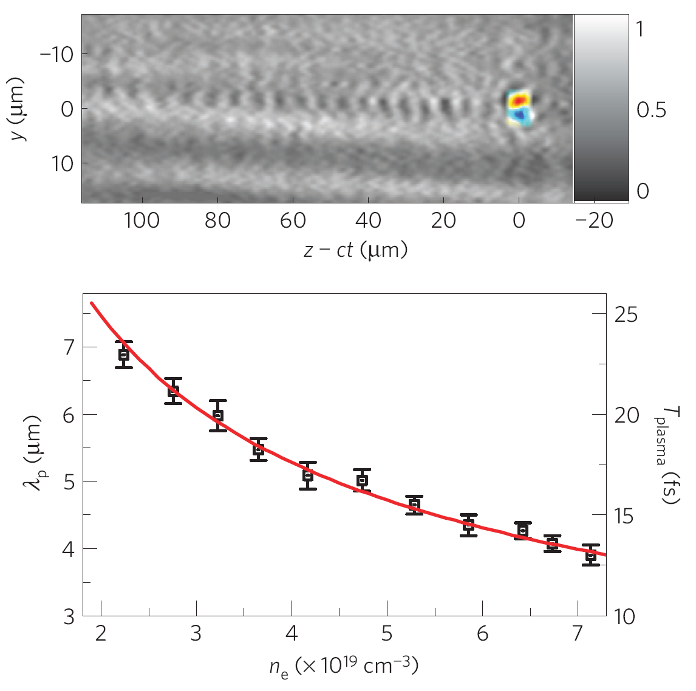
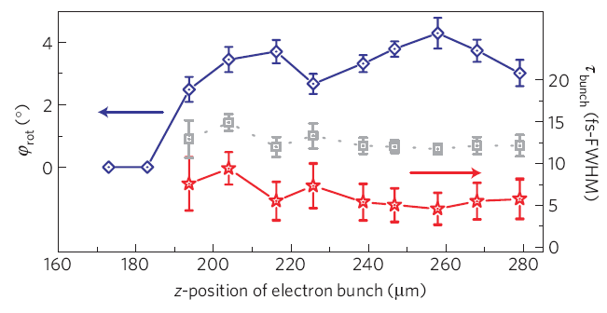
Ultra-Short Probe Pulse
Polarimetry:
visualize e-bunch via associated B-fields
change delay between pump and probe
⇒ movie of e-bunch formation
observe electron acceleration on-line!
29

Slide 30
Ultra-Short Probe Pulse
Polarimetry:
visualize e-bunch via associated B-fields
change delay between pump and probe
⇒ movie of e-bunch formation
Shadowgraphy:
visualize plasma wave
change electron density ⇒ change plasma wavelength
observe electron acceleration on-line!
30

Slide 31
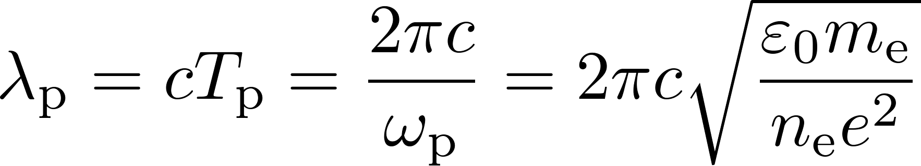
Ultra-Short Probe Pulse
Shadowgraphy:
visualize plasma wave
change electron density ⇒ change plasma wavelength
Shadowgraphy:
visualize plasma wave
change electron density ⇒ change plasma wavelength
31
A. Buck, M. Nicolai, M.C.Kaluza et al. Nature Physics (2011)

Slide 32
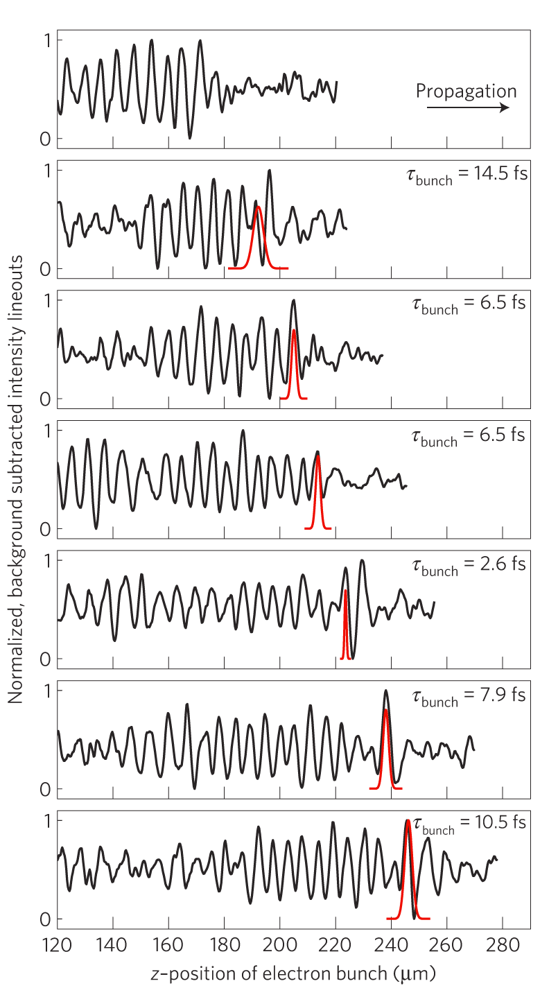
Ultra-Short Probe Pulse
Shadowgraphy:
visualize plasma wave
change electron density ⇒ change plasma wavelength
Shadowgraphy:
visualize plasma wave
change electron density ⇒ change plasma wavelength
32
A. Buck, M. Nicolai, M.C.Kaluza et al. Nature Physics (2011)

Slide 33
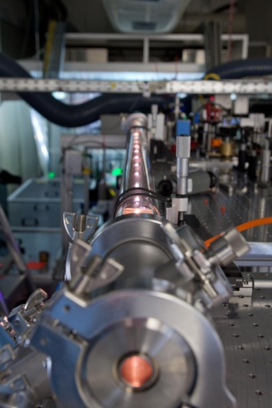
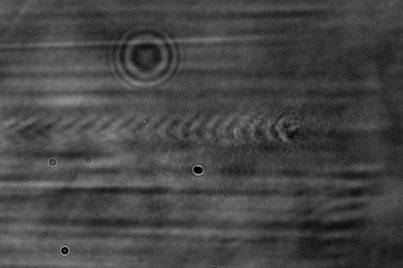
Ultra-Short Probe Pulse
Further development of probing:
frequency-broadening of probe pulse
(in gas-filled hollow fiber) ⇒ shorter τ_{probe}
  sub-main pulse resolution
  resolve sub-structures in
    plasma wave (non-linear evolution?),
    e-bunch (longit. or transv. shape?)
© J. Polz, FSU Jena
33

Slide 34
Outline
Particle acceleration with lasers
Motivation: machine size and specific applications in contrast to conventional particle accelerators.
Laser-driven electron acceleration
Laser-wakefield acceleration: towards ultra-short,
quasi-monoenergetic GeV electron bunches,
Visualization of accelerating plasma structure and acceleration fields.
Summary

Slide 35
Summary
Laser-driven electron acceleration
Ultra-short τ_{bunch} = (6.0±2.0) fs, quasi-monoenergetic
(ΔE/E ~ few %), high-energy (E ~ 1GeV) electron pulses
now available in university-scale labs,
suitable optical diagnostics allow insight and improvement of acceleration process.
probing with sub-main-pulse duration becomes possible: visualize internal structure (density or energy distribution) of electron bunch
Applications start to become realistic!

Slide 36
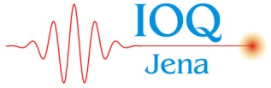









Thanks to all Collaborators
A. Sävert, M. Nicolai, O. Jäckel, M. Schwab M. Reuter, H.-P. Schlenvoigt,
J. Polz, T. Rinck, M. Hornung, S. Keppler, R. Bödefeld, M. Hellwing,
A. Kessler, H. Liebetrau, J. Hein, F. Schorcht, P. Mämpel, H. Schwoerer,
B. Beleites, F. Ronneberger, C. Spielmann, T. Stöhlker, G.G. Paulus
Institute of Optics and Quantum Electronics, Friedrich-Schiller-University Jena and
Helmholtz-Institute Jena
A. Buck, K. Schmid, C.M.S. Sears, J.M. Mikhailowa, F. Krausz, L. Veisz
Max-Planck-Institute of Quantum Optics, Garching
S.P.D. Mangles, A. E. Dangor, Z. Najmudin
Imperial College London, UK
A.G.R.Thomas, Z. He, K. Krushelnick
Center for Ultrafast Optical Science, Michigan, US
36

