Slide 1
Hyperfine structure measurement of the atomic ground state in ²²⁹Th using RIS
V. Sonnenschein², S. Raeder¹, A. Hakimi¹, Ch. Mattolat¹, Iain Moore²
K. Wendt ¹ and N. Trautmann³
¹Institute of physics, Johannes Gutenberg-University Mainz
² University of Jyväskylä, Finland
³Institute of nuclear chemistry, Johannes Gutenberg-University Mainz

Slide 2
Outline
Motivation: Isomeric state of thorium
Technique: Laser-based Spectroscopy & Ionization
Setup: Mainz University Laser System
and Mass-Spectrometer MABU
Results: Hyperfine structure of ²²⁹Th
Outlook & Conclusion

Slide 3
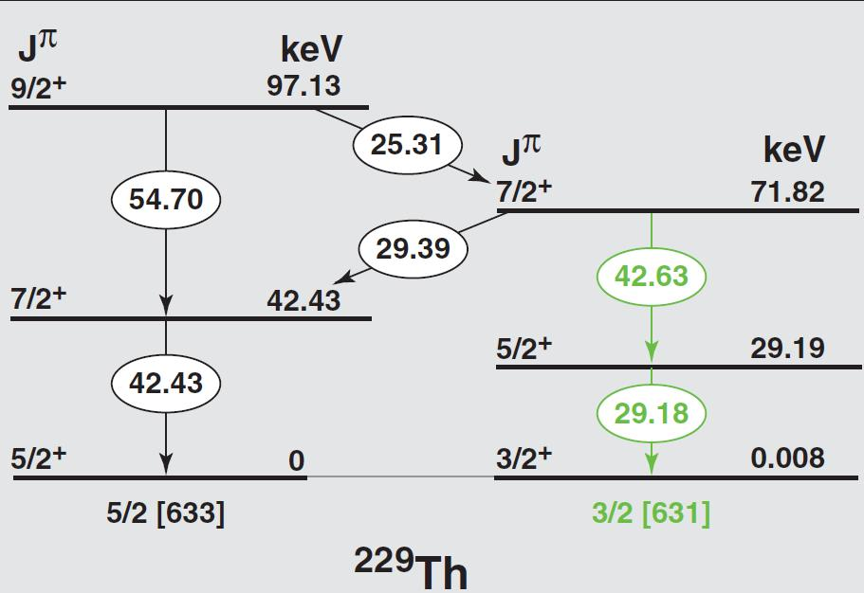
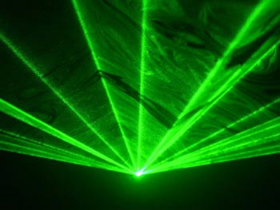
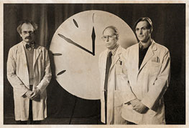
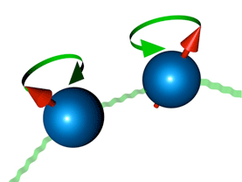
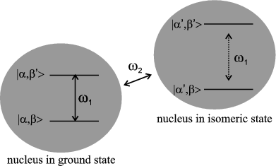
Motivation
Nuclear clock
Gamma ray laser
Peik and Tamm
Europhys. Lett. 61 (2003) 181
Campbell et al., PRL 108 (2012) 120802
S.L. Sakharov. Th. Phys. At. Nuc., 73:(1-8), 2010.
Tkalya, PRL 106 (2011) 162501
^{229m}Th
µ ≈ -0.08 µ_{N}
Q ≈ 1.8 eb
3/2 [631]
ΔE ≈ 7.8 eV
τ ≈ 25 mins?
?
Qubit: quantum
computing
Nuclear Excitation by
Electron Transition
5/2 [633]
µ = 0.45 µ_{N}
Q = 3.11 eb
Evolution of
fundamental constants
Izosimov, J. Nucl. Sci. Tech. Supp.
6 (2008) 1
Beck et al. Phys. Rev. Lett. 98 (2007)
Litvinova et al., PRC 79 (2009) 064303
Flambaum & Wiringa, PRC 79 (2009) 034302
P&T, Europhys. Lett. 61 (2003) 181
Need for verification of isomeric state

Slide 4
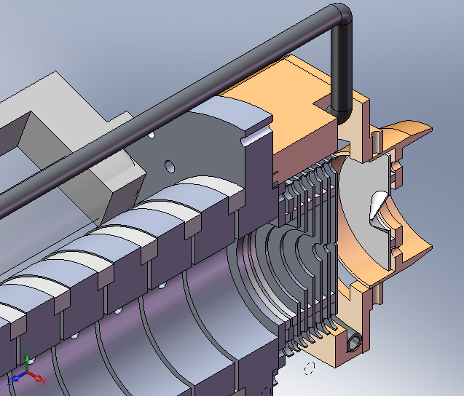
Identification of the Isomeric State
Collinear fluorescence spectroscopy
HR-RIS
„detection“ efficiency = 1/6000
+ A and B factors for ion known
+ high resolution
+ ion detection efficiency ≈ 100%
Doppler reduction required
A and B factors for ground state unknown
Enhance ion current
by efficient laser ionization
find suitable high resolution scheme
and get ground state template
AI 51762.84 cm⁻¹
DC electrodes
IP 50867 cm⁻¹
Cooling tube
38700.25 cm⁻¹
J=4
Skimmer
26878.16 cm⁻¹
J=3
Electron emitter
0 cm⁻¹
6d² 7s² ³F₂
²³³U → ^{229g,m}Th + α
S Raeder et al 2011 J. Phys. B:
At. Mol. Opt. Phys. 44 165005
Notes:
Detection eff. From earlier experiment on stable 232Th.accelerated ion beam, reduced Linewidth close to natural linewidth of transition

Slide 5
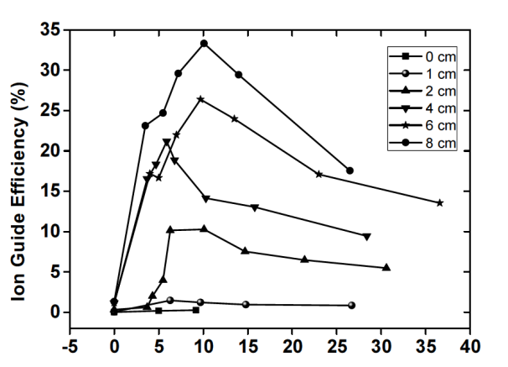
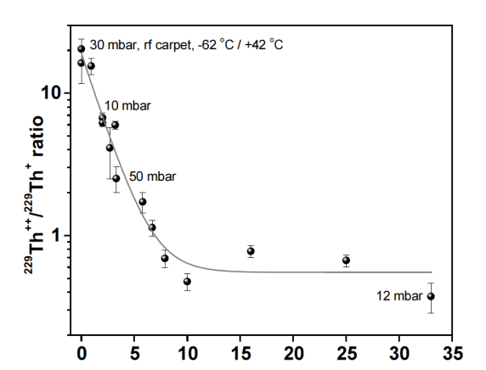
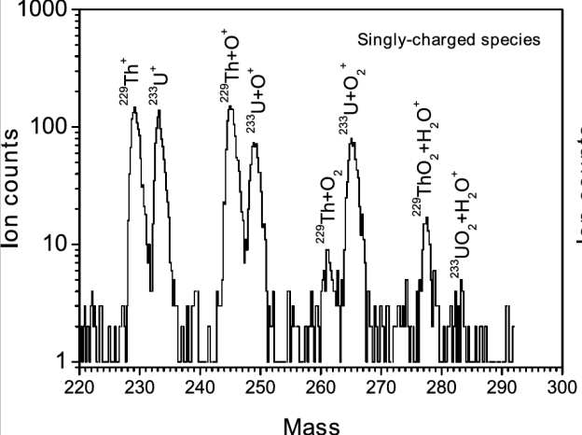
Recoil Ion Source
Alpha-recoil source in Jyväskylä University
Expected 2% branching ratio to ^{229m}Th
Source strength: ≈1.4 x10⁵ recoils /s
Recoil ions stopped in helium buffer gas (50 mbar) and guided to exit nozzle
by gas flow and electric field
Emitter current (µA)
Emitter current (µA)
Efficiency:
(T_{1/2}= 32 ms)
Extraction efficiency for thorium ions (1.6%) is a factor of 10 lower
compared to At and Fr ions – possible neutral fraction?

Slide 6
Spectroscopic Basis of RIS
non-resonant
ionization
search for auto-
ionizing states
ionization via
Rydberg-states
E
~6 eV
(5-9 eV)
ionization potential
FIR
E_{IP}
higher
excited
states
> 10 W
1 W
~100 mW
E₂
~ 10 mW
Energy
first excited state
E₁
Z
Lasers
~ 1 mW
Mass
Separator
0 eV
ground state
E₀
N
Notes:
High cross section for resonant photon absorption
Photon (flux) can be calculated (photons/sec/cm^2) to be in the order of
Bottleneck is the last ionization step with relatively low cross section
Therefore: auto ionizing resonances, bound atomar structures above the ionisation limit
or rydberg states and fieldionisation
This leads to element selective (excitation and) ionization and addes therefore a selectivity to the ionization process itself
Combination of element selective ionization with „conventional“ mass spectrometry increases the selectivity for the isotope of interest

Slide 7
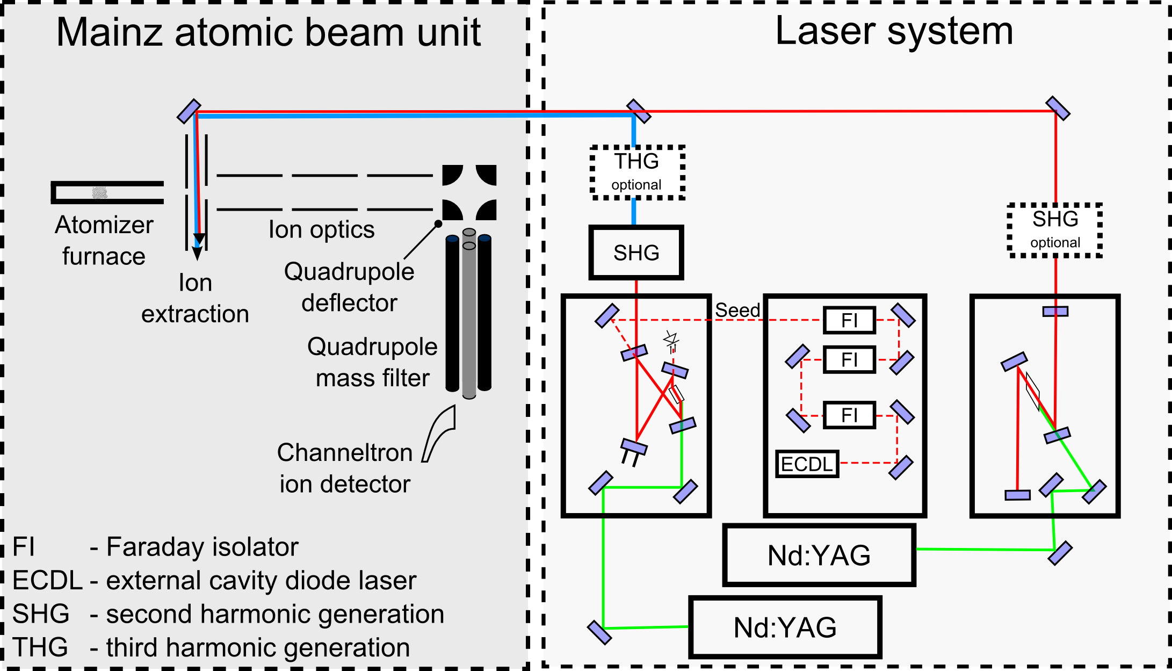
Experimental Setup
20 MHz
5 GHz
Notes:
Graphite furnace,sample of 229Th supplied by nuclear chemistry, ~10^11atoms samplesize, 2000K linewidth, crossed beam or in-source, Doppler, 20MHz /5GHz, 10kHz rep. Injection seeding, stabilization, piezo,

Slide 8
Hyperfine structure
of ²²⁹Th
Notes:
8

Slide 9
RIS Schemes
14 transitions investigated for HFS in-source (~1.5GHz linewidth)
3 transitions scanned using crossed beam technique (~200 MHz linewidth)
(a)
(b)
(c)
51 763.8 cm⁻¹
51 426.0 cm⁻¹
AI
51 333.0 cm⁻¹
50 867 cm⁻¹
IP
765.53 nm
762.55 nm
38 700.964 cm⁻¹
38 219.028 cm⁻¹
J=2
38 278.875 cm⁻¹
J=1
793.40 nm
826.05 nm
26 113.270 cm⁻¹
J=2
26 096.986 cm⁻¹
J=3
261.241 nm
A = 3.5x10⁷/s
383.186 nm
A = 3.4x10⁶/s
382.947 nm
A = 1.97x10⁷/s
0 cm⁻¹
ground state
6d² 7s² ³F₂

Slide 10
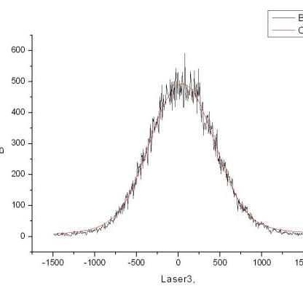
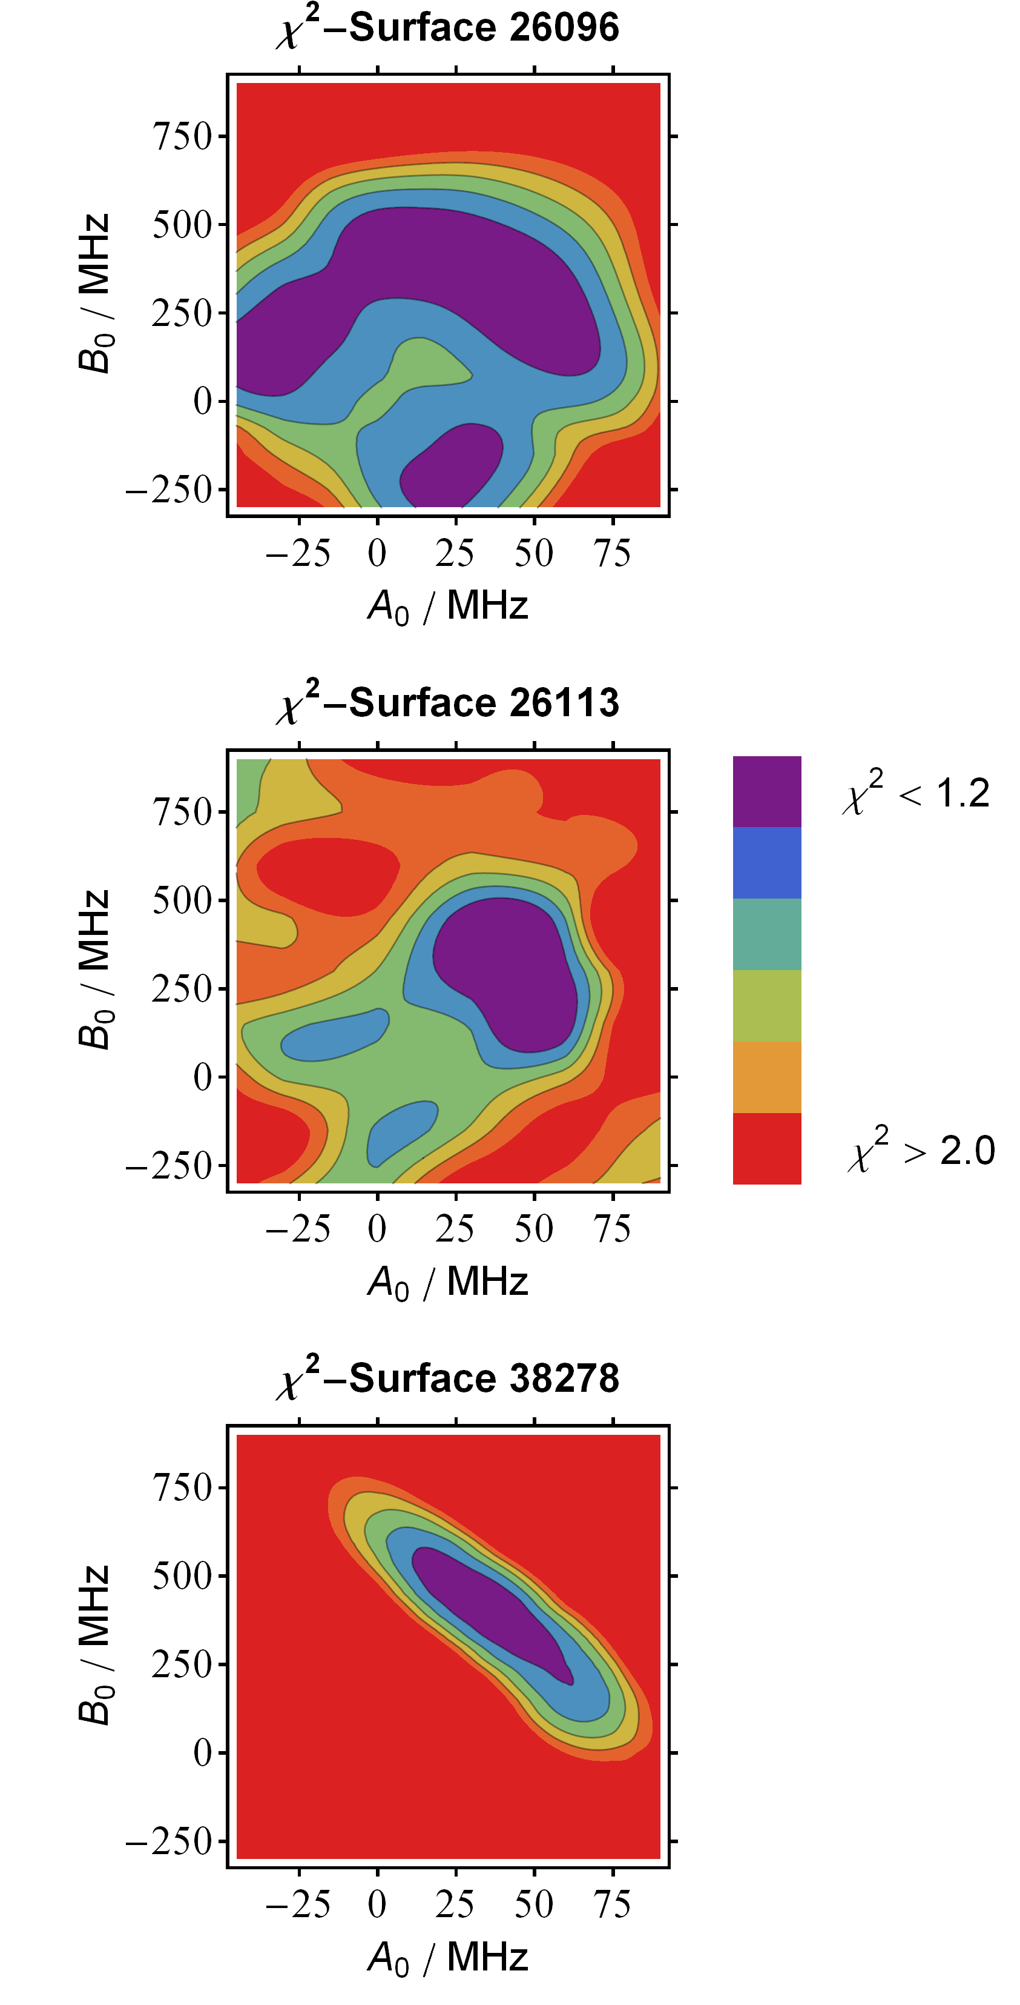
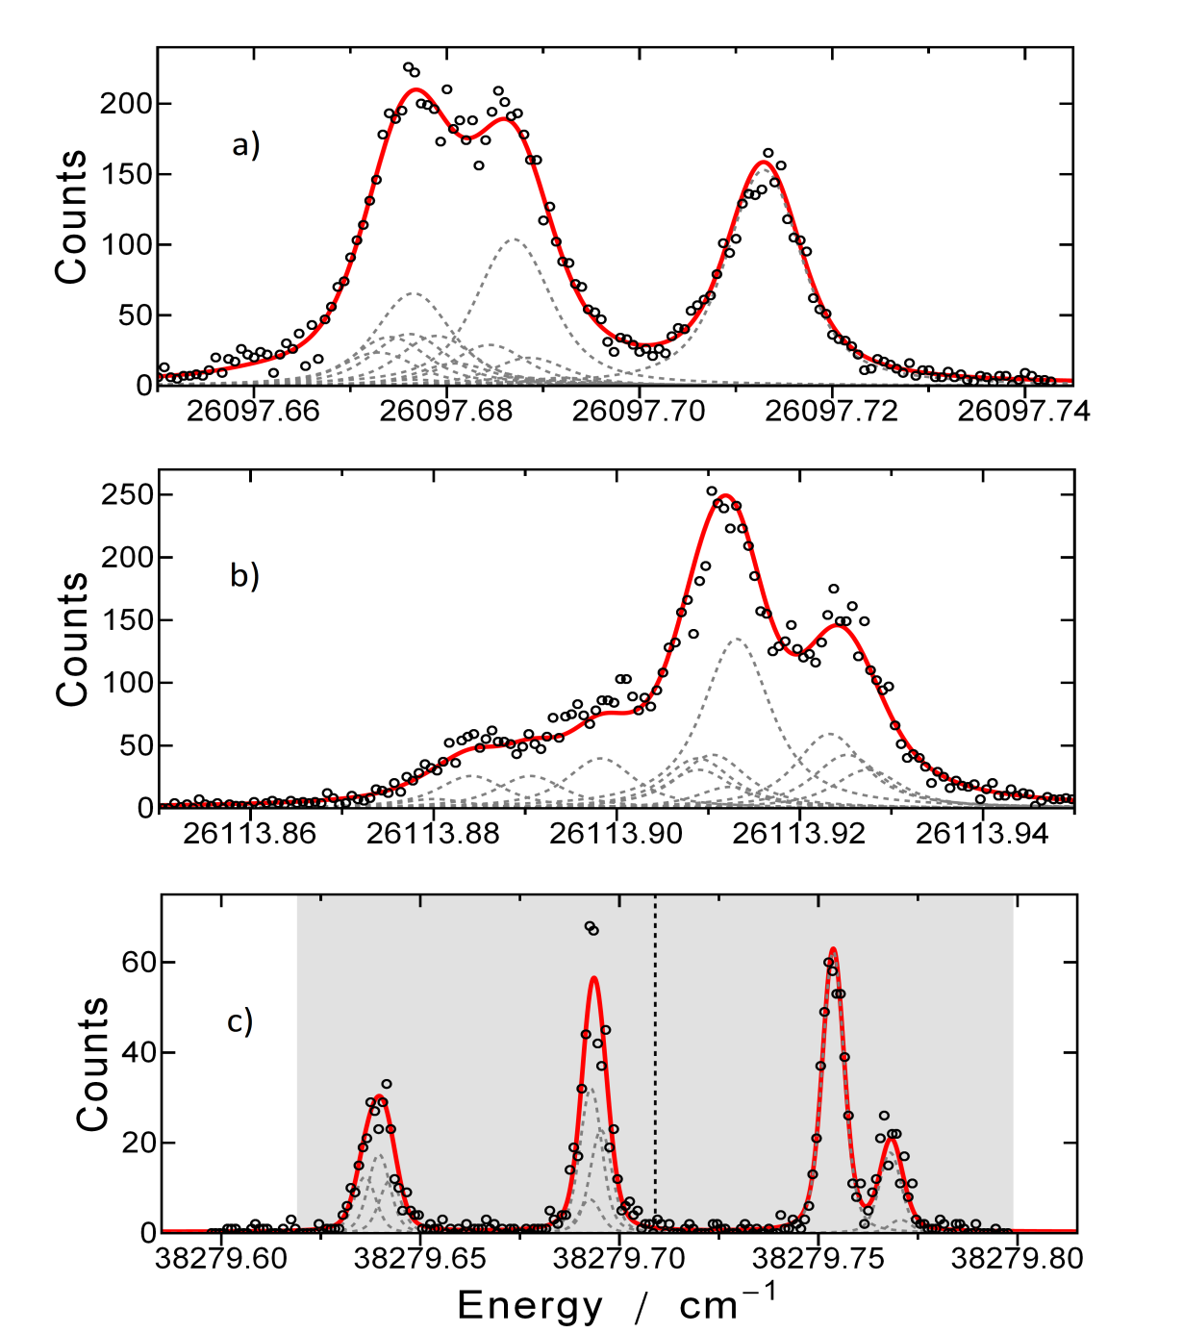
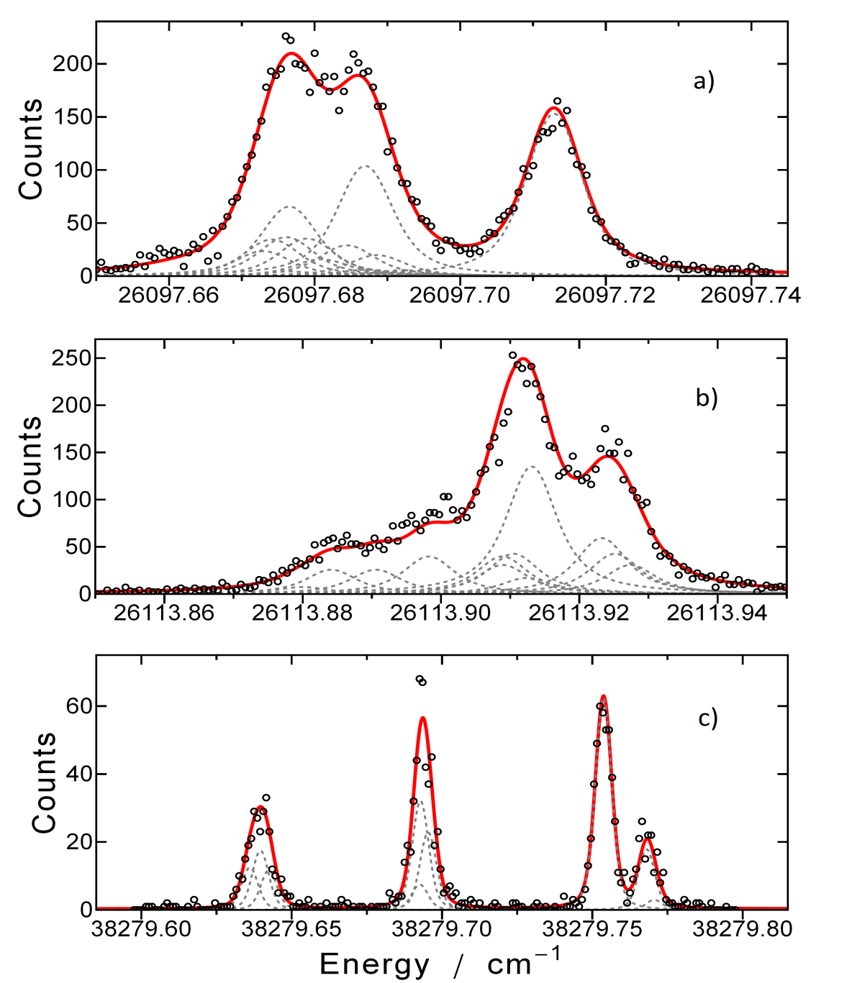
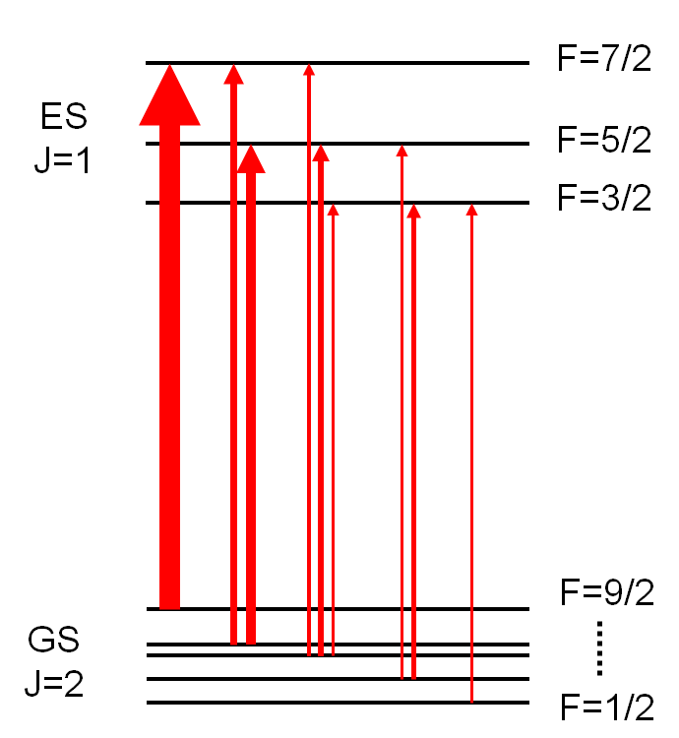
High resolution HFS spectra using seeded Ti:sa laser
in-source
Theoretical intensities
Isotope shift of transition ~74GHz/fm²
Change in mean square nuclear
charge radius ±0.04fm²[1]
→ isomeric shift ~ 3 GHz
[1] Livinova et al., Phys. Rev. C, 79:064303, 2009.
Sonnenschein et. al, J Phys B (2012) 45 165005
Notes:
In-source no spliting visible(1.5GHz linewidth), Free parameters for fits, Amplitude, linewidth(gaussian, lorentian), centroid, hyperfine coupling constants

Slide 11
Final results
[11] Kälber et al., Z. Phys. A, 334(1):103-108, 1989.
[13] Campbell et al., Phys. Rev. Lett., 106:223001, 2011.

Slide 12
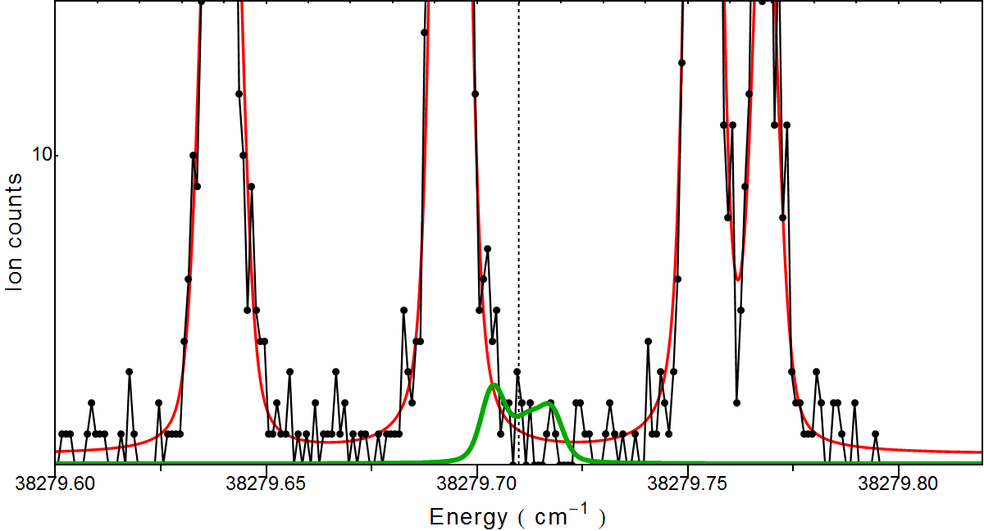
Outlook
collinear flourescence
spectroscopy
source strength : 4 x10⁵/s ²²⁹Th
branching ratio : 2%
extraction eff. : 1.6%
total ^{229m}Th : 150/s
photons : 0.025/s
AI 51762.84 cm⁻¹
IP 50867 cm⁻¹
(16%)
(1500/s)
(0.25/s)
38700.25 cm⁻¹
J=4
26878.16 cm⁻¹
J=3
Extraction eff. for Th ions is a factor 10 lower
compared to At and Fr ions – neutral fraction?
0 cm⁻¹
6d² 7s² ³F₂
in jet efficiency : 0.01-0.1%
total ^{229m}Th : 1-10/s
offline studies → long experiments possible
in-jet Resonance ionization

Slide 13
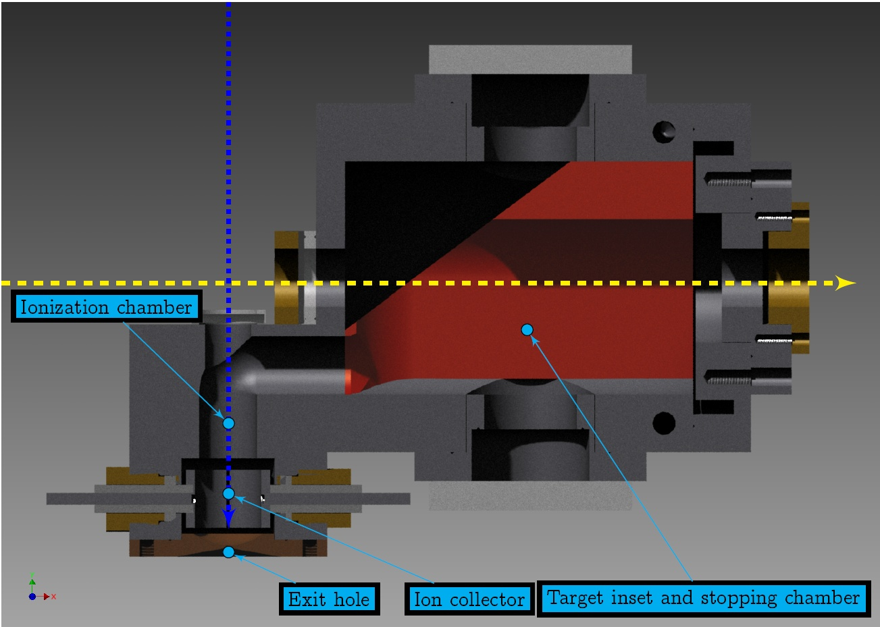
Online production
First brief test in 2006
Reaction: ²³²Th (p, pxn) ^{232-x}Th with 50 MeV protons
1 µA beam current, ~50 mbarn cross-section → 50000 ions/sec
Detection: collinear fluorescence on two different Th⁺ transitions
Result: except for ²³²Th, no other isotopes seen
35156.91 cm⁻¹
J=5/2-
30972.16 cm⁻¹
J=5/2-
297.309 nm
1/64000
Fission cross section
very high (2 barn)
Dense plasma causes neutralization?
(1/13000)
322.871 nm
1/5500
374.225 nm
1521.89 cm⁻¹
J=5/2⁺
Th⁺ metastable
Th⁺ g.s.
J=3/2⁺
Notes:
50% feed to isomer?

Slide 14
Conclusion
Determination of efficient ionization schemes for Ti:sa Laser RILIS
Ionization scheme will be applied at JYFL Thorium recoil source
High resolution spectroscopy for HFS of ²²⁹Th
First determination of A & B values of the ^{229,g}Th atomic ground state
small width of HFS in neutral thorium ground state
collinear spectroscopy more likely to succeed than in-jet RIS
renewed online production tests in early 2013

