Slide 1
Cooling Supply for the STS Detector: Lessons Learned for the Future
Engineering Design Report

Slide 2
Agenda
The final vision on the cooling supply for STS detector - power dissipation and heat gains - installation layout - specs for the final cooling plant
The pilot cooling supply system - introduction to the set-up - trial-run results
Details on 3M NOVEC 649 usage as a coolant - is there a problem with acidity? - dealing with precipitation due to solubility falling w/ temperature - NOVEC production discontinuation

Slide 3
The final vision on cooling supply for STS detector

Slide 4
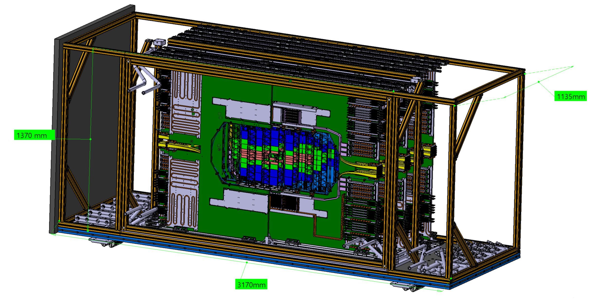
STS Detector Overview
Silicon sensors
Electronic boards are the main contributor to the power dissipation
Silicon sensors require a specific temperature to operate, which is related to nominal outlet temperature of the cooling plant: ca. -20 ºC
The casing (thermal enclosure) acts as an additional source of heat gains
Front end boards
(FEBs)
Casing
(fragment)
Read-out boards (ROBs)
and
Power boards (PoBS)

Slide 5
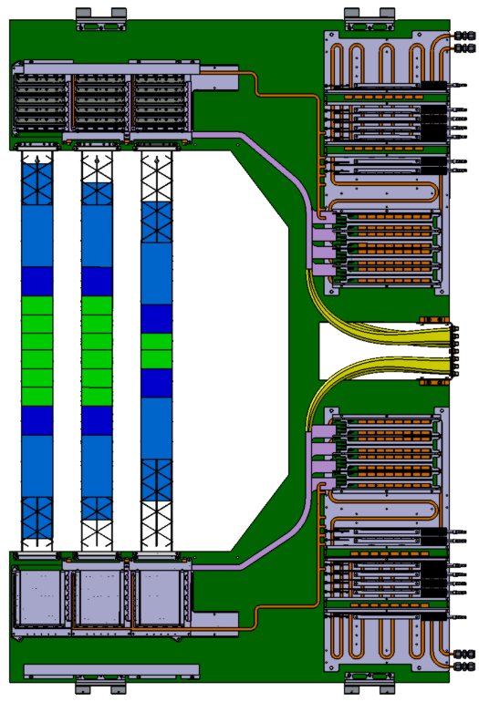
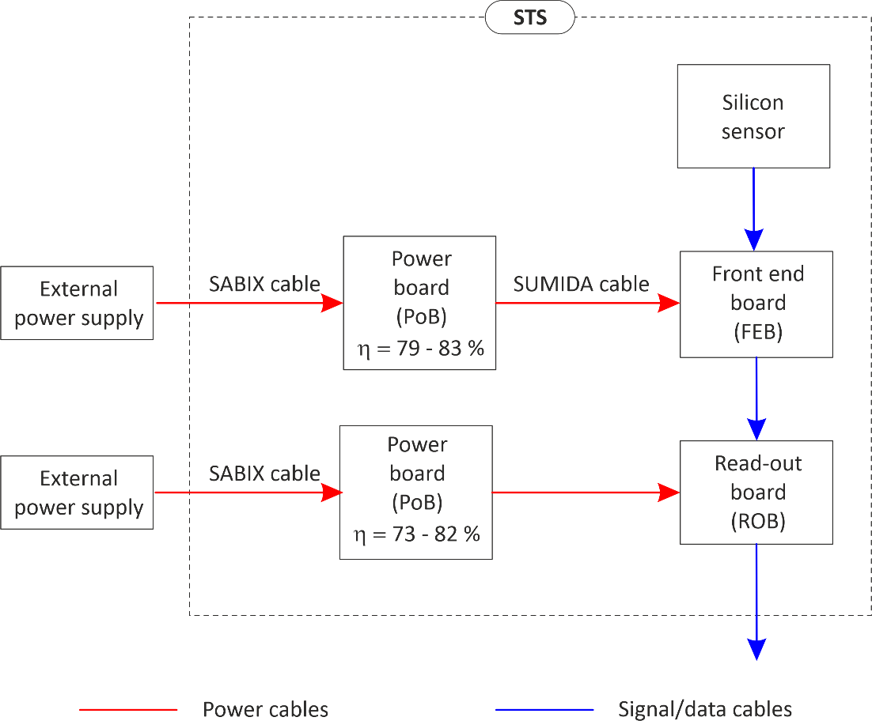
Electronic Boards Power Dissipation
FEBs
ROBs
PoBs
Silicon
sensors
C-Frame, unit 4
SUMIDA cable
(enclosed in metal duct)
Electronic boards power dissipation per type
FEB 8 ASICS + 4 LDO | ROB 3 FPGA | FPoB per FEB 16 FEAST | RPoB per ROB | SUMIDA cable for one FEB, L=1,6 m
12,20 W | 4,89 W | 5,75 W | 2,04 W | 1,28 W

Slide 6
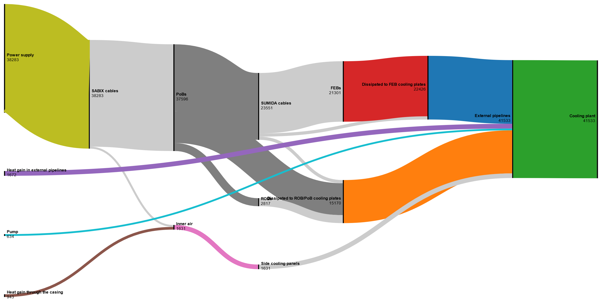
Power Flow Summary

Slide 7
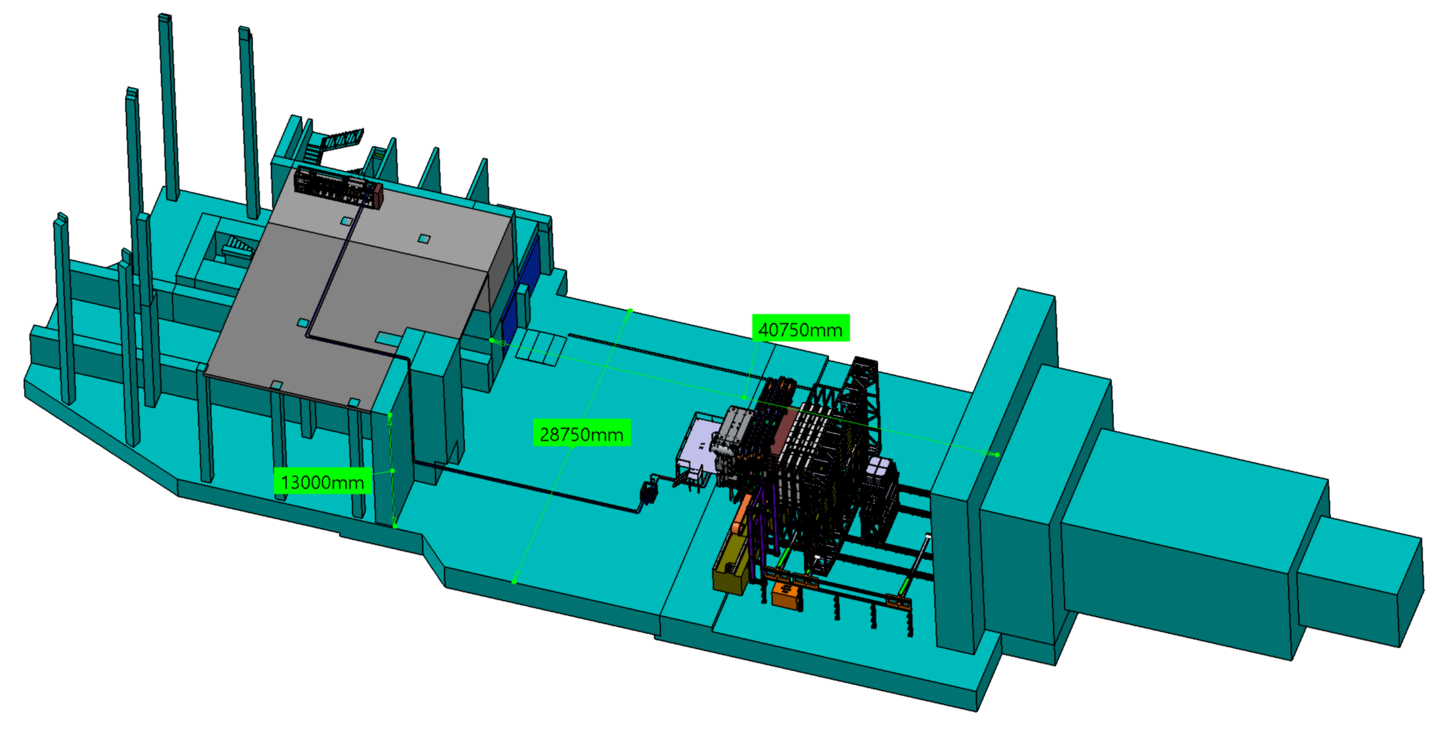
Cooling Supply Installation Layout
Cooling plant
STS detector
in magnet
E30 level
technical building
Pipelines
2x∅76
L=160 m
2 x circulation
pump

Slide 8
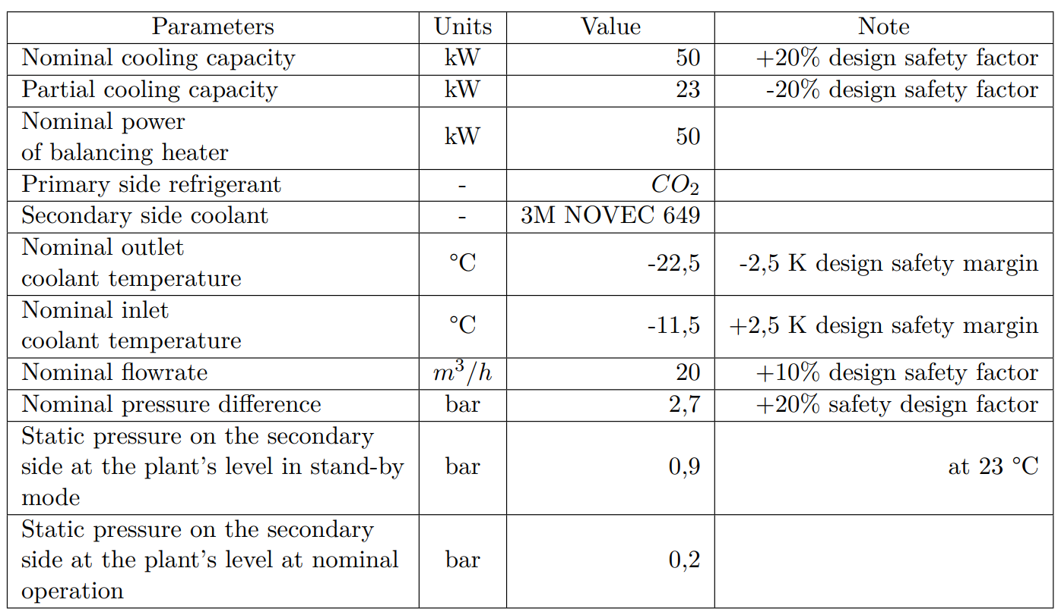
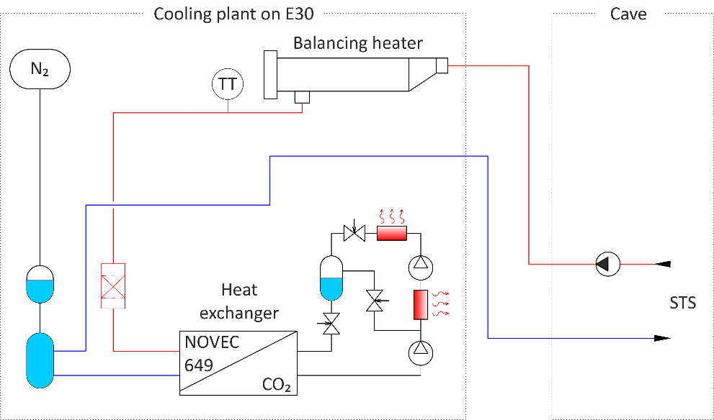
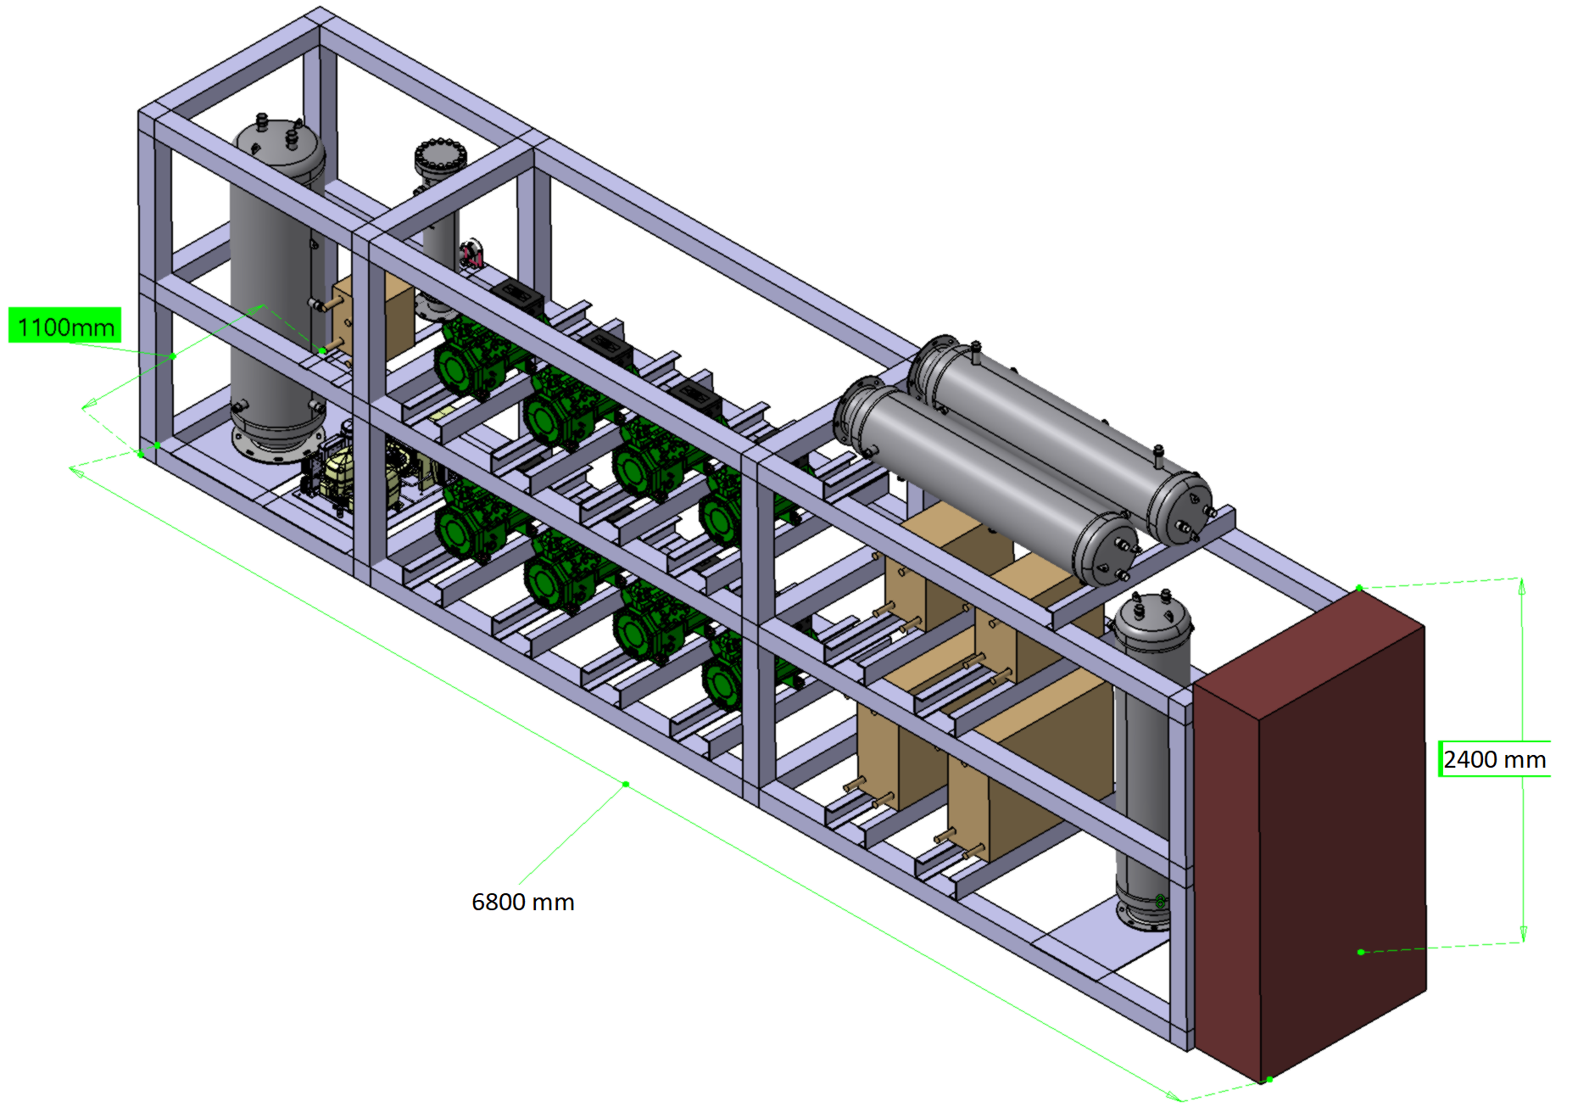
The Final Cooling Plant Specs
From 2022, the last EU legislation imposes global warming potential (GWP) limit of 150 on multipack refrigeration with a capacity of 40 kW, except for cascade systems.
The refrigeration industry is shifting towards usage of low GWP refrigerants, one of which is CO₂ itself.
CO2 has disadvantage of high expansion coefficient, high operation pressure, toxicity, and requires qualified personell for the maintenance.
3M NOVEC 649 or perfluoro(2-methyl-3-pentanone) has advantage of low operating pressure, non-toxicity, low GWP (equals one), and being easy to use.
The STS cooling supply makes use of CO2 and NOVEC 649 simultaneously to take advantage of the both.
Outline

Slide 9
The Final Cooling Plant Render
Outlook
Specs finalization, tender documentation | Ready by Sep, 2023
EU tendering | Sep, 2023 – Feb, 2024
Ordering | Mar, 2024

Slide 10
The pilot cooling supply system

Slide 11
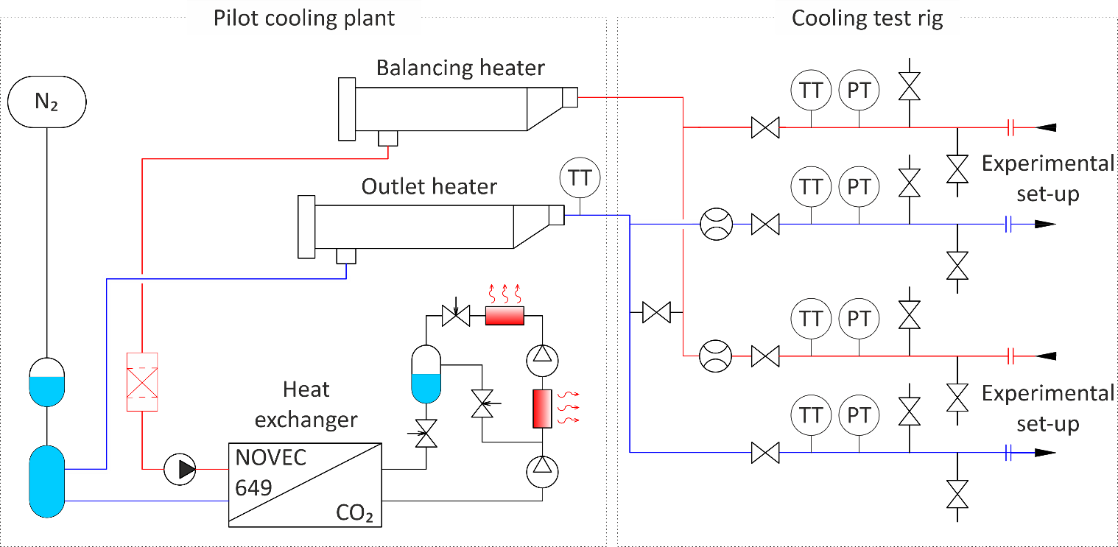
The pilot cooling supply
A pilot cooling supply system has been built at GSI to verify its suitability for the STS detector electronics cooling.
The pilot cooling is a booster-type CO2 refrigeration system that extracts heat from the secondary side coolant through a heat exchanger (evaporator).
Outlet heater extends temperature range of the pilot cooling plant.
Balancing heater covers the mismatch between the minimum cooling demand of the plant and experimental set-ups.
With the cooling test rig, various experimental set-ups and the drainage system can be connected to the cooling supply.

Slide 12
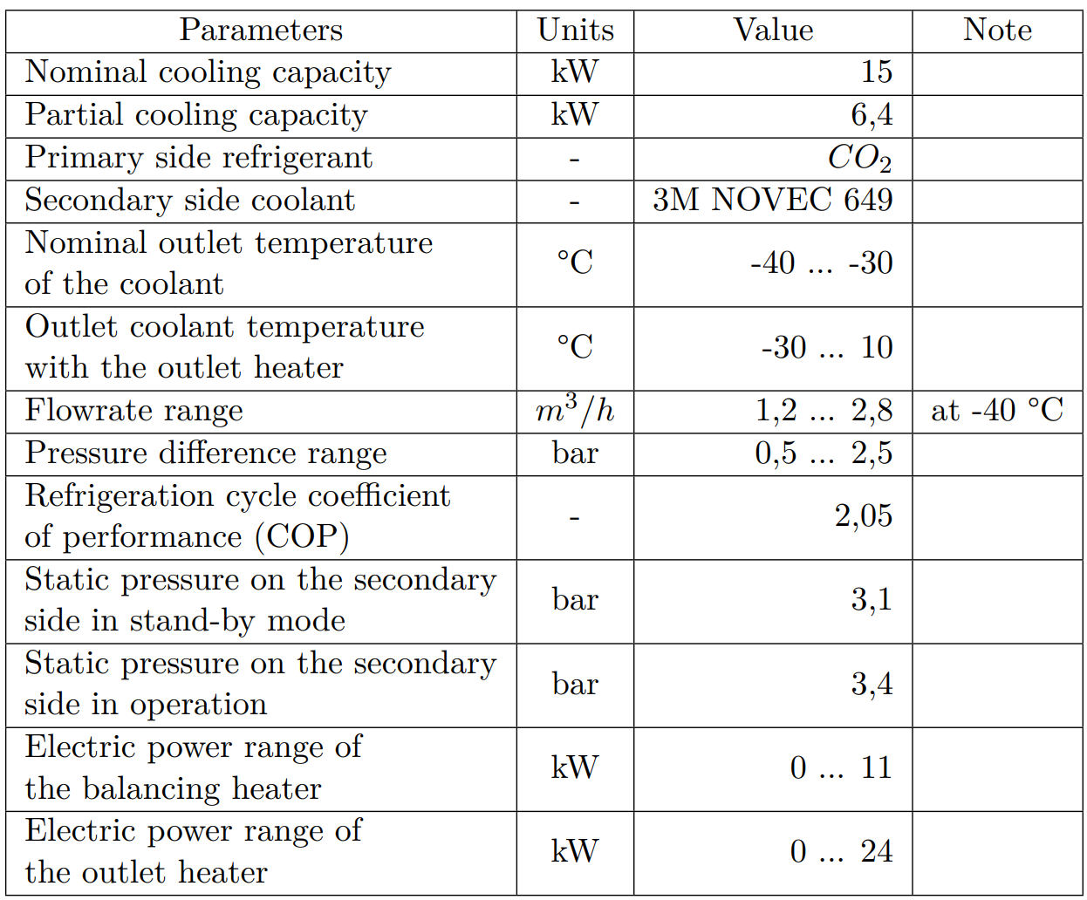
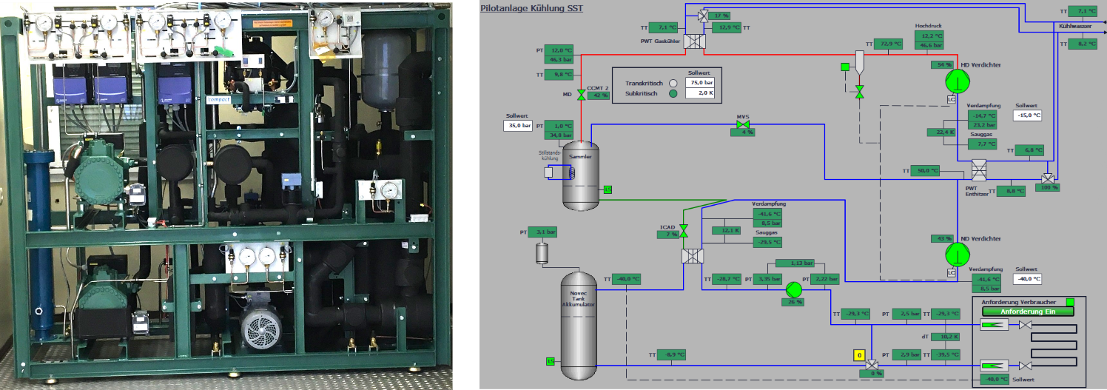
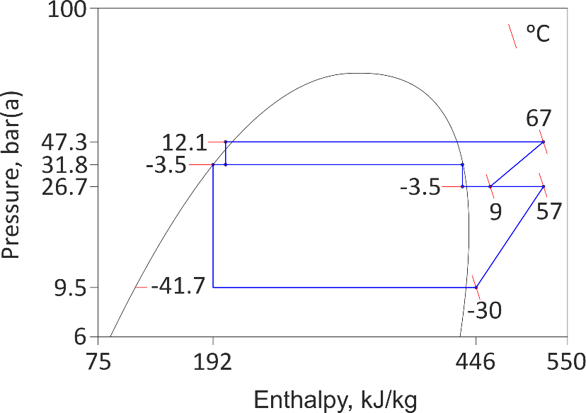
The Pilot Cooling Plant Specs

Slide 13
Pilot Cooling Plant: Trial-Run
A trial-run was performed to test the performance of the pilot cooling plant: electric power of the heaters was increased in steps to check if the plant can keep up the temperature set-point -40 ºC.
Steady-state operation is only possible with the heat gain equal to partial cooling capacity of the plant
The set-point can be maintained with maximum heat gain from the heaters of 11 kW - nominal capacity was achieved

Slide 14
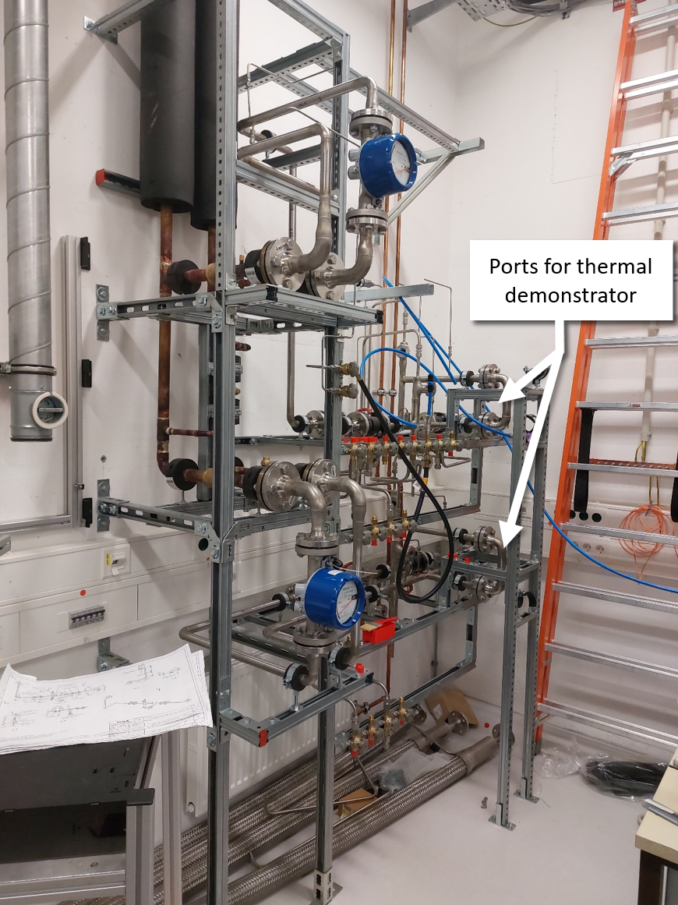
Cooling Test Rig
Supports connecting the liquid cooling system of various experimental set-ups through a standard flange connection DN25
Supports connecting the thermal demonstrator.
Supports connecting the STS detector for testing without a beam.
Monitors flow parameters:
- flow rate;
- inlet and outlet temperature;
- inlet and outlet pressure.
Supports connecting the drainage system.
The cooling test rig was built to allow connecting various experimental set-ups, including the thermal demonstrator, for testing cooling concept for the STS detector
Supports standard DN 25 flange connection
The STS detector can be connected for testing without a beam
Monitors flow parameters: - flow rate; - inlet and outlet temperature; - inlet and outlet pressure.
Supports connecting the drainage system

Slide 15
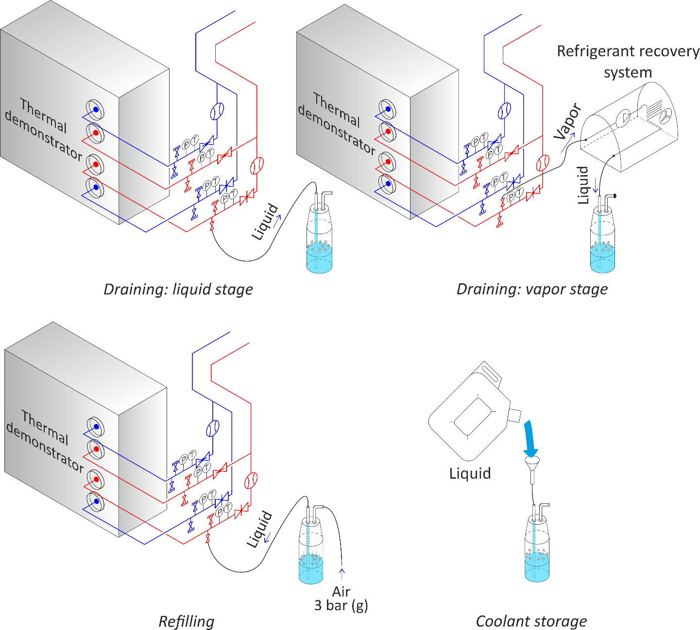
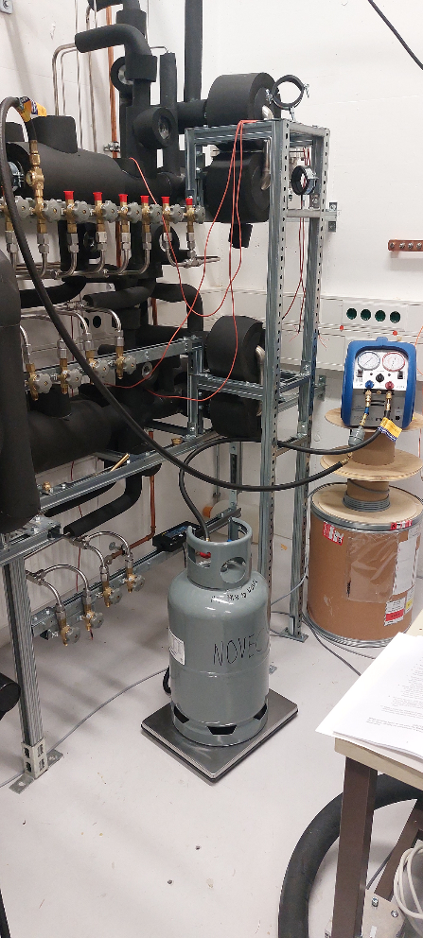
Drainage System
The drainage system connected to the cooling test rig
The drainage system allows for draining and refilling experimental set-ups with NOVEC 649 without losing the liquid.
The drainage system connected to the cooling test rig

Slide 16
Details on NOVEC 649 usage in the cooling supply system

Slide 17
Acid Formation Mechanism
NOVEC undergoes a hydrolysis reaction with dissolved in it water:
The consequence of the reaction depends whether water is added to NOVEC from an external source:
NOVEC
water
NOVEC
Reaction without excess of water
Reaction with excess of water
(two separate phases are formed due to poor solubility)
Some acid can be present from off-the-shelf NOVEC, up to 3 mg/kg according to the datasheet - cannot cause corrosion
Water solubility in NOVEC is poor 10 mg/kg at 25 ºC
NOVEC has extremely low water solubility
10 mg/kg at 25 ºC

Slide 18
Reaction without Excess of Water
No acid is formed during water precipitation when NOVEC is cooled
H₂O
Separate phase
NOVEC
molecule
Acid
Cooling
to 0 ºC
H₂O
dissolved
In NOVEC
Due to the decrease in water solubility in NOVEC,
water molecules start to leave NOVEC solution forming
a separate water phase into which acid can migrate.
NOVEC, water and acid concentration are kept in equilibrium.
Miniscule acid concentration in NOVEC is
in equilibrium with dissolved water

Slide 19
Reaction with Excess of Water
Acid is only created in presence of water excess from external source
H₂O
from
the excess of water
Acid migrates into water
H₂O
dissolved
In NOVEC
Acid
NOVEC
molecule
When excess of water is added to NOVEC, the equilibrium of hydrolysis reaction is broken
Used water molecules are replaced
with those from the excess of water. Acidity of water is increased.
More NOVEC molecules
are subjected to hydrolysis

Slide 20
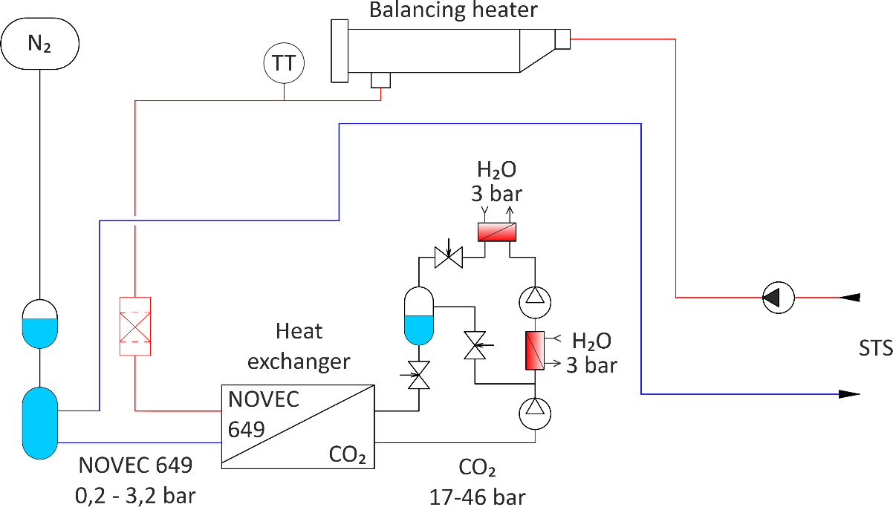
Acid Formation Mechanism: Conclusion
Since our cooling supply system has no possibility for water to be added inside the system from an external source, no acid formation will occur in the system under any circumstances or operational modes
The maximum acid concentration off-the-shelf NOVEC is 3 mg/kg, no more will be synthesized inside the cooling supply system
The acidity of 3 mg/kg is equivalent to weight share 3·10^{-6,} which is so miniscule, that it cannot case any noticeable corrosion inside the piping system
The piping system of CO₂ cooling plant is at the pressures that prevent water to enter CO₂ circuit even if evaporator and desuperheater started to leak.
In case of noticeable CO₂ pressure loss, a controller will inform about this failure and stop the plant.
This is true under assumption
if the heat exchanger is leaking as well.
As a result, measures against acid formation are not required for our cooling supply system, e.g. acid concentration monitoring, acid absorption devices

Slide 21
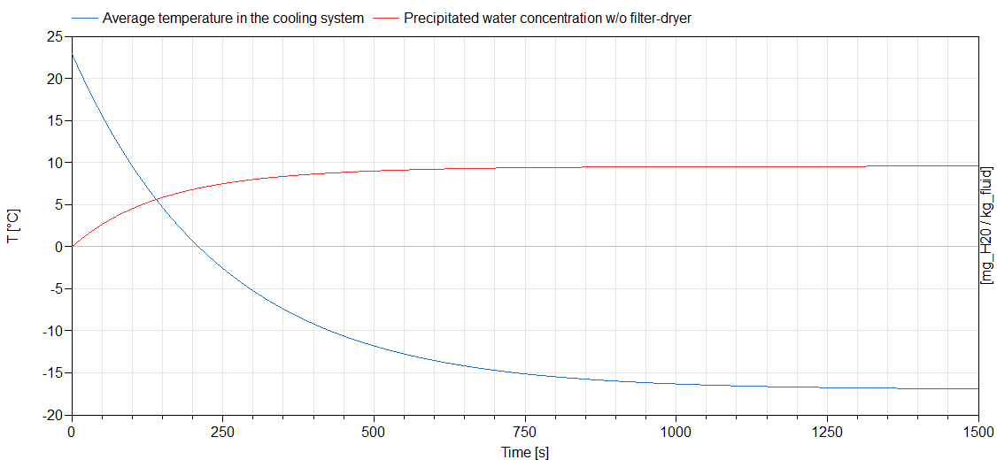
Precipitated Water Freezing
While the NOVEC temperature is reaching the nominal set-point -22,5 ºC at the cooling plant, water from NOVEC will principate and freeze. The amount of frozen water is extremely low due to the poor solubility in NOVEC.
10 mg/kg solid water concentration is approximate equal to three snowflakes per liter
The minimum solid water sediments size is 500 µm
Forming precipitates can be eliminated during formation process by drying and filtered
The share of water content that can be extracted in liquid phase is 78%

Slide 22
Eliminating Precipitated Water
Drying NOVEC at room temperatures trying to extract dissolved in it water is ineffective with molecular sieve filter dryers (99% share of industrial refrigeration). However, molecular sieve driers are very effective for absorbing water as a separate phase.
As a result, for an effective drying process NOVEC must be brought to 0 ºC, when most of the water content precipitates as water. After most of the water is absorbed, a 15 µm filtering material remaining solid water particles. No precipitations are left after the cooling plant – the piping system of the detector cannot be clogged.
This method is highly reliable and, thus, does not require humidity monitoring system.
Water elimination in this way naturally occurs during the system start-up.
H₂O
as a separate phase
(solid)
H₂O
as a separate phase
(liquid)
Felt gasket 15 µm
Molecular sieve
dessicant

Slide 23
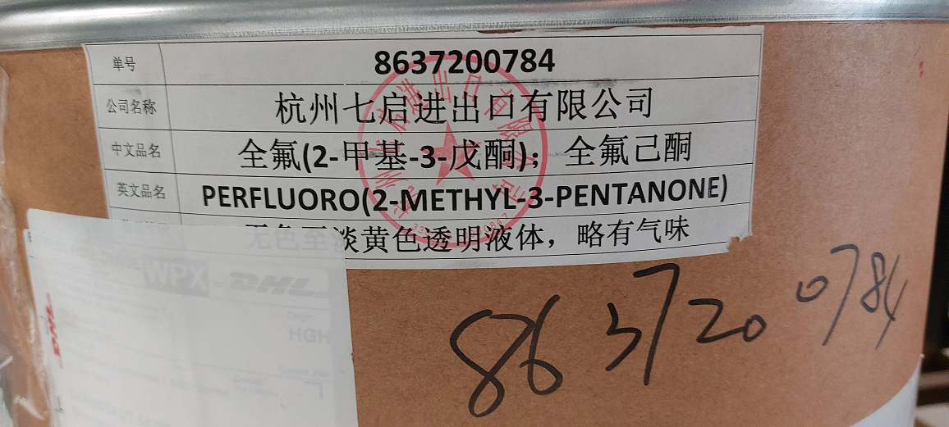
NOVEC Substitution
3M corporation announced that it plans to discontinue per- and polyfluoroalkyl substance (PFAS), including include NOVEC 649 and its variation for fire-extinguishing application NOVEC 1230, by the end of 2025
NOVEC 649 is a trademark for perfluor(2-methyl-3-pentanon)
An extensive search for alternative suppliers that can provide us with industrial quantities and acceptable purity 99,9% was made
After careful considerations, one company was selected, and a trial purchase of 35 kg was made

Slide 24
Thank you for your attention

