Slide 1
BIOPHYSICS status report
Research retreat
19.7.23
Marco Durante

Slide 2
1. Biophysics in FAIR-phase-0
Space radiation protection
Particle therapy
1998 2022
First European center to treat patients with high energy ¹²C-ions (440 patients treated on site)
Now extensive research program in particle therapy covering from nuclear physics to molecular biology
Work supported by BMBF, EU (INSPIRE, HITRI, ERC AdG), NIH
ESA reference facility for ground-based space radiation protection studies
Current ESA-supported programs ongoing: IBER/IRES/ROSSINI/GCRsim
ESA/FAIR Summer School in Darmstadt
EU programs: RADNEXT-HEARTS

Slide 3
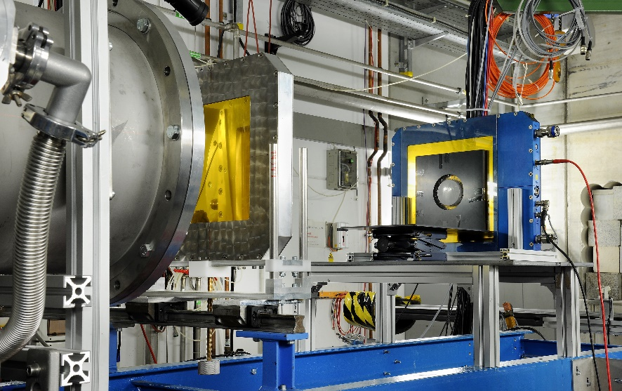
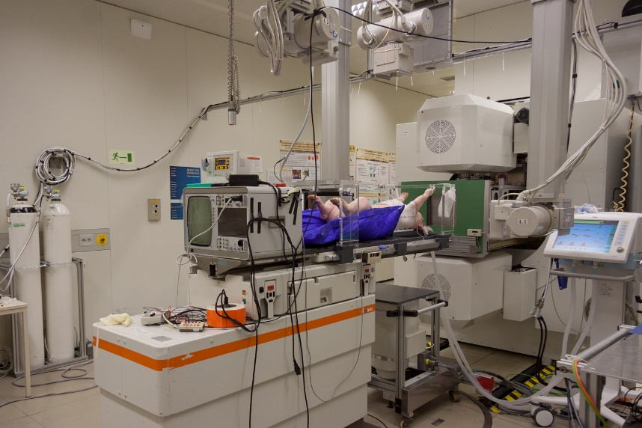
Biophysics at present facilities
Cave A
Cave M

Slide 4
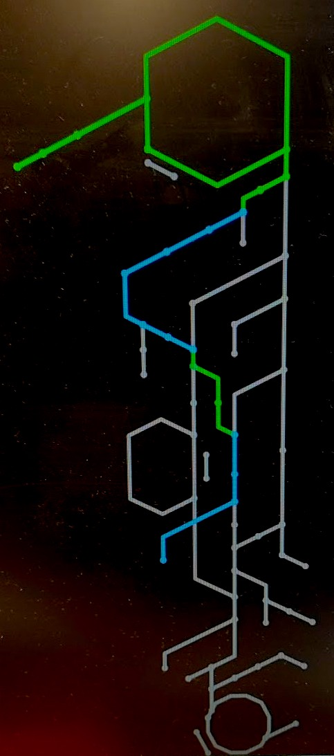
FRS-Cave M branch for RIB in biology & medicine
RIBs at GSI-FAIR
RIBs candidates at FRagment Separator (FRS):
SIS18
Isotope | ¹²C | ¹¹C | ¹⁰C | ¹⁶O | ¹⁵O | ¹⁴O
Half-life, min | stable | 20.4 | 0.32 | stable | 2 | 1.17
Intensities | ~ 10⁶–10⁹ particles per spill
FRS
Commissioning of FRS-CAVE M (medical cave) beam line:
oxygen beams (June 2021):
Transmission FRS-Cave M ¹⁵O: 6%
¹⁵O in Cave M per ¹⁶O in SIS18: 6e-4
Cave M
Haettner et al., NIM-A, 2023

Slide 5
Bio-PAC Beam Time Request (June 2022 – beamtime available in 2024-2025)
Year | Proposals (approved) | External (%) | Shifts | SIS18/ UNILAC (%) | Available (% of requests)
2017 | 12 (12=100%) | 5 (40%) | 77,8 | 91% | 29,8 (38%)
2020 | 27 (21=77%) | 16 (60%) | 118,5 | 90% | 50,7 (42%)
2022 | 28 (10=35%) | 16 (57%) | 81,4 | 98% | 23 (28%)
“Basic” beam request is ¹²C and ⁵⁶Fe at 0.15-1 GeV/n
Notes:
Proposals asking for UNILAC and for SIS beam are counted as one.

Slide 6
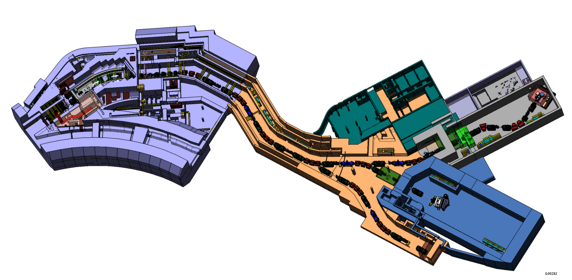
2. Biophysics Collaboration in ES/FS
BIOMAT

Slide 7
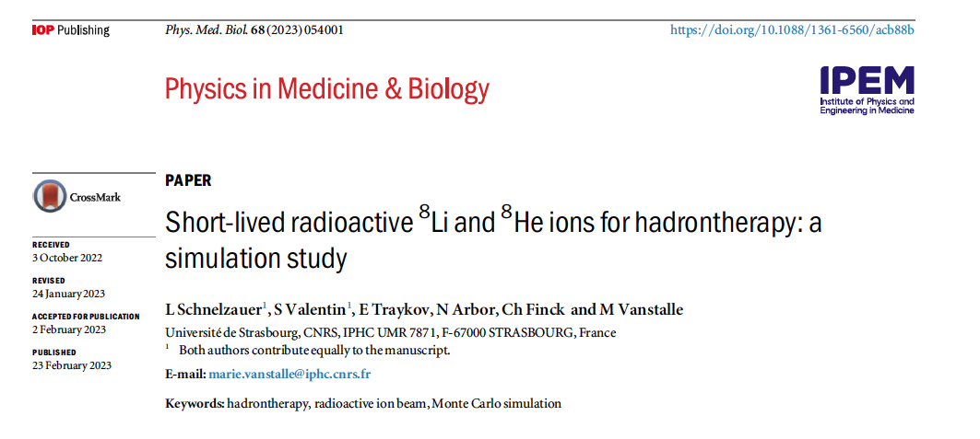
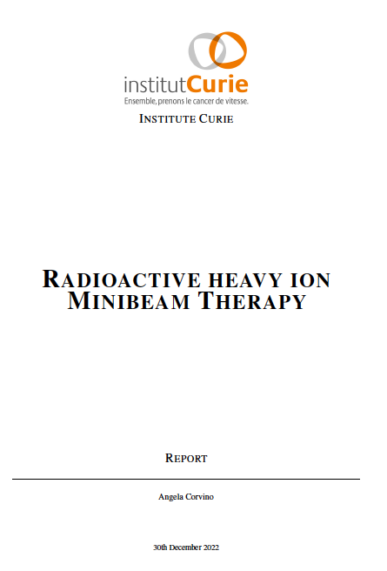
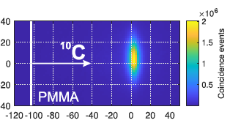
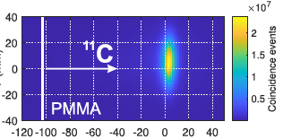
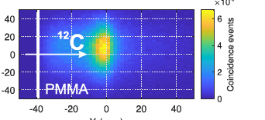
Biophysics @S-FRS: the science case
The ERC AdG BARB elicited a large interest in exploitation of RIB in biology and medicine
BARB results show that ¹⁰C would provide the best range resolution, but its intensity at FRS-Cave M is too low for experiments
Institut Curie in the Biophysics Collaboration has proposed the use of RIB for minibeam radiotherapy
Recently, collaborators form the University of Strasbourg published a simulation on potential enhancement of biological effects using short-lived ⁸Li or ⁸He-ions
0.04 mm
0.7 mm
119 ms
1.4 mm
837 ms
Synergy with NuSTAR tetraneutron experiment
4 spills, 19 s (Kostyleva et al., Phys. Med. Biol. 2023)

Slide 8
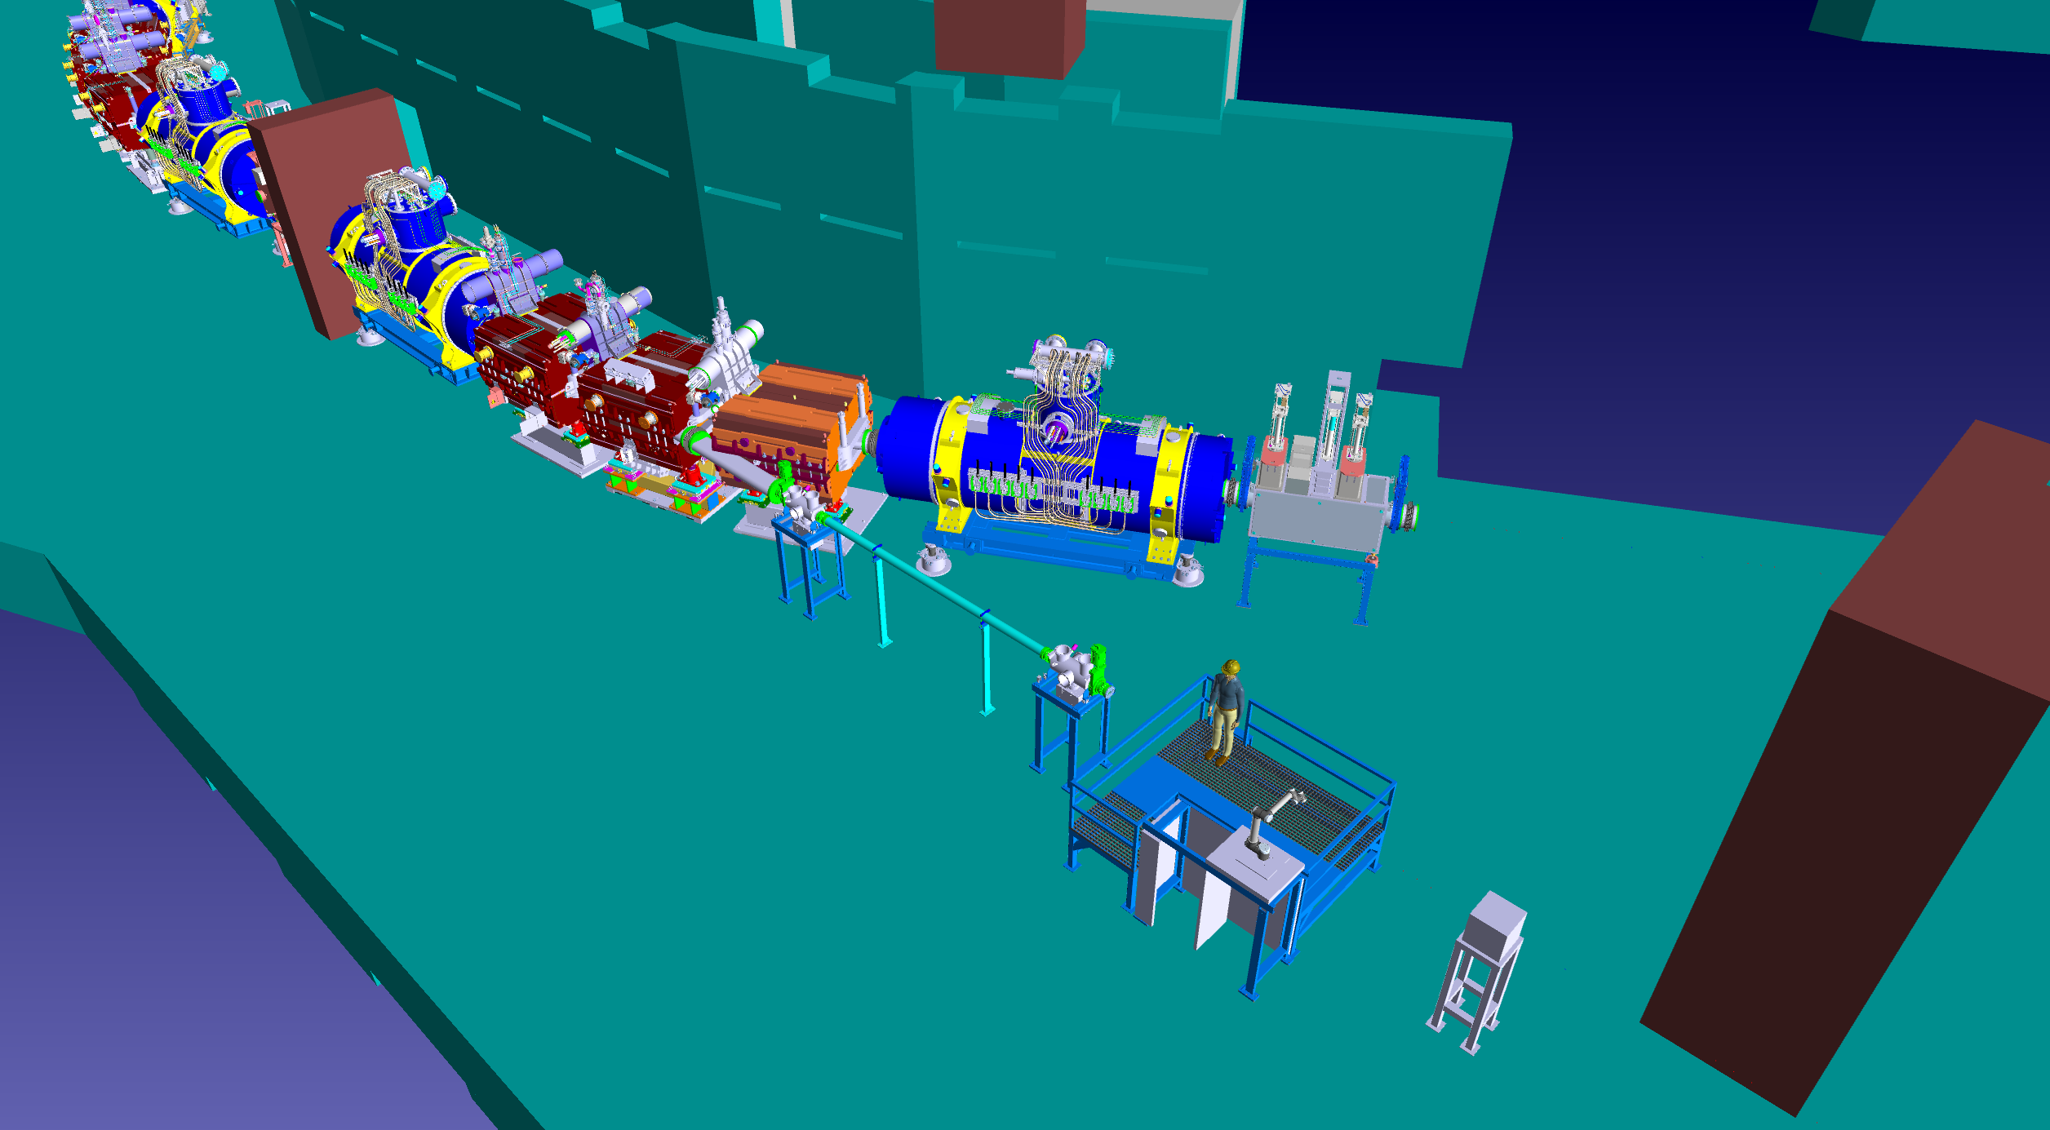
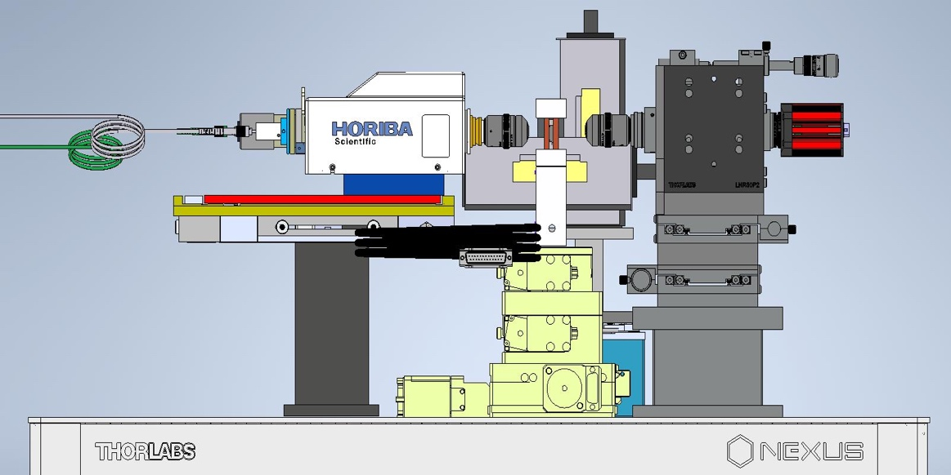
BIOMAT setup at ring branch tunnel
BIOMAT@S-FRS: beamline with exit window + 2 diagnostic chambers (originally planned for APPA) + BIO & MAT setups
main separator
Valve (reference point)
ring branch
HEB/LEB
Beam pipe
Diagnostic chamber 1
Diagnostic chamber 2
Beam dump
Robotic arm with magazine

Slide 9
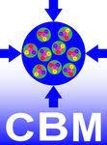
3. Biophysics Collaboration in FS+

Slide 10
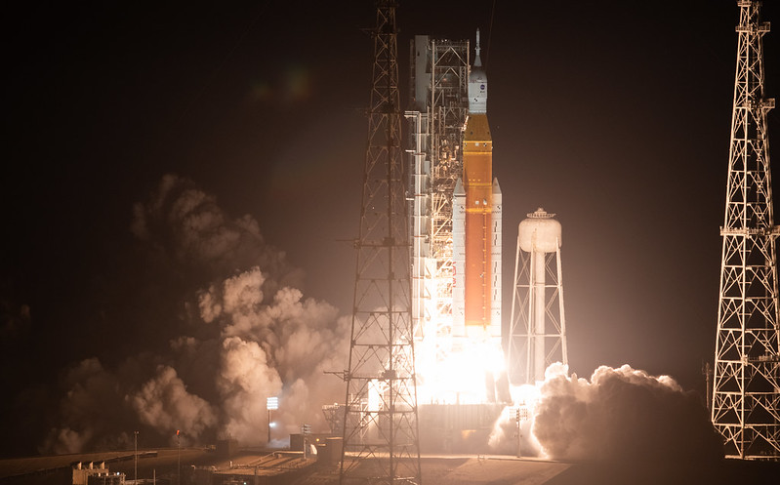
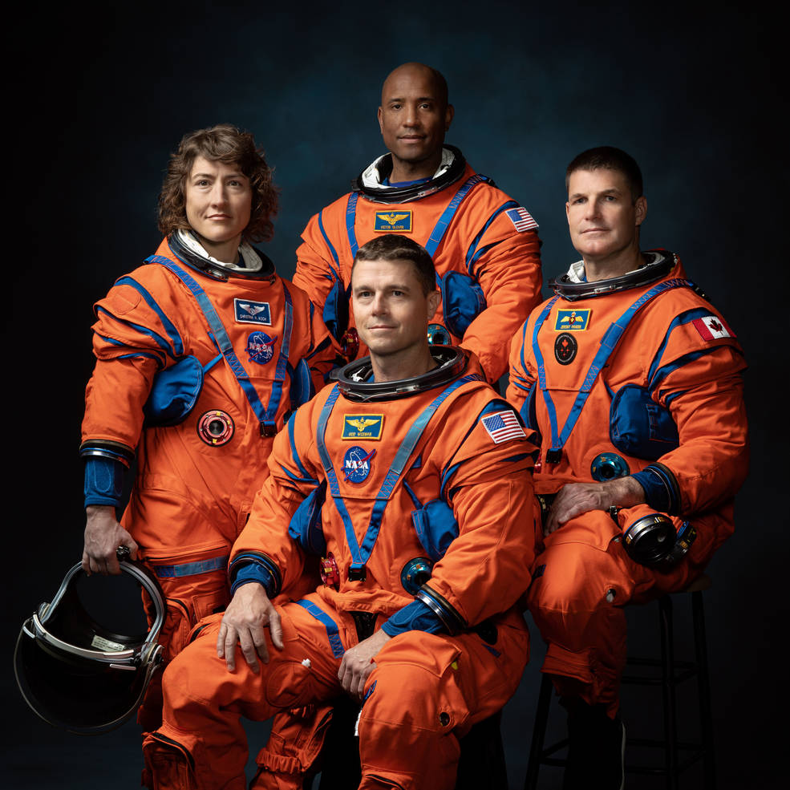
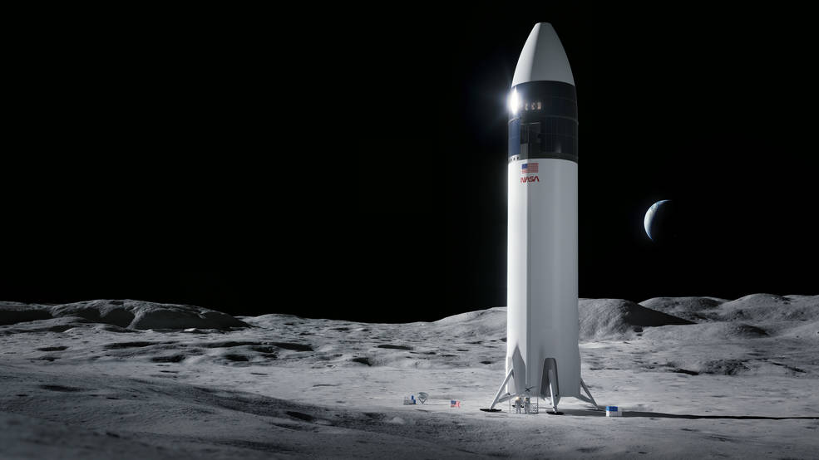
Human exploration program
Artemis 1
Launch: 16.11.2022
Splashdown: 15.12.2022
Artemis 3: December 2025
Artemis 2: November 2024

Slide 11
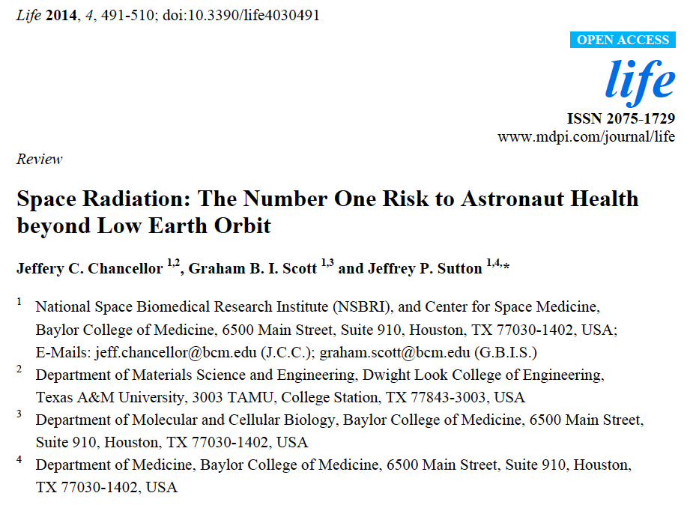
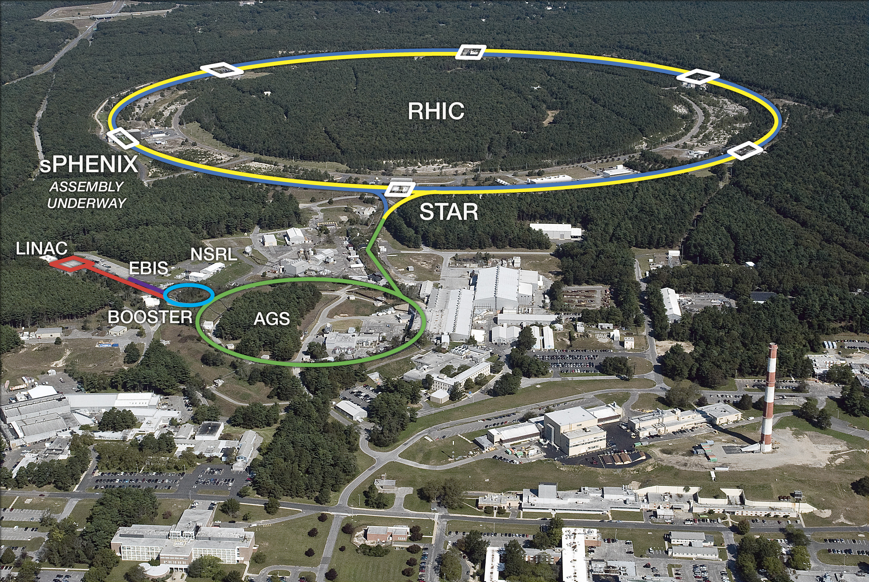
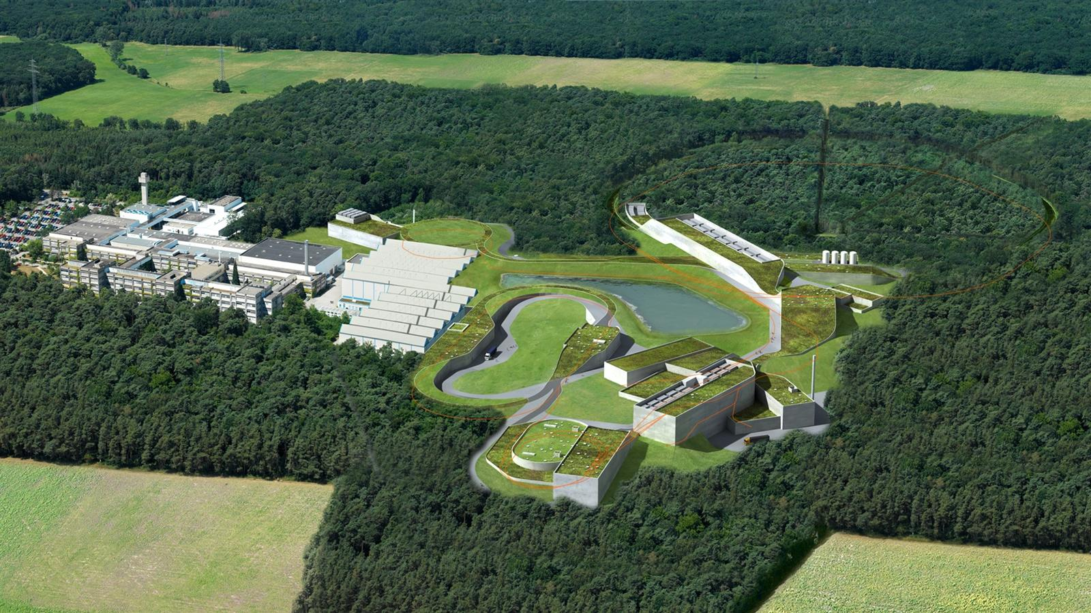

Slide 12
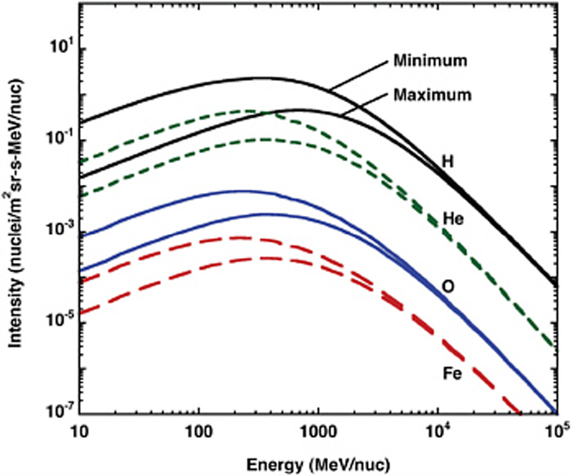
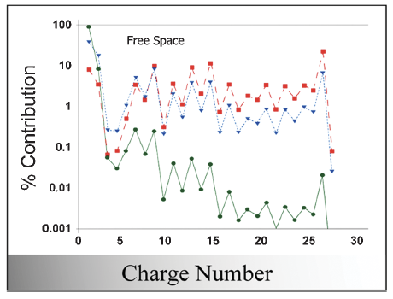
Galactic cosmic radiation: a potential showstopper for exploration
Durante & Cucinotta, Rev. Mod. Phys. 2011

Slide 13
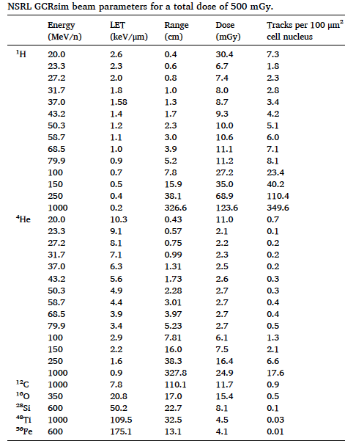
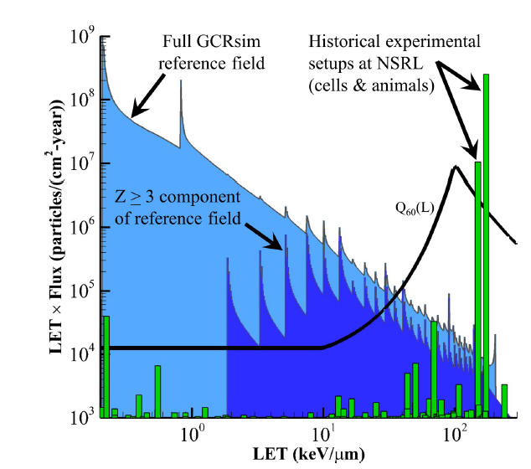
The NASA GCR simulator
33 beams
150 min/Gy
Simonsen et al., PLoS Biol. 2020

Slide 14
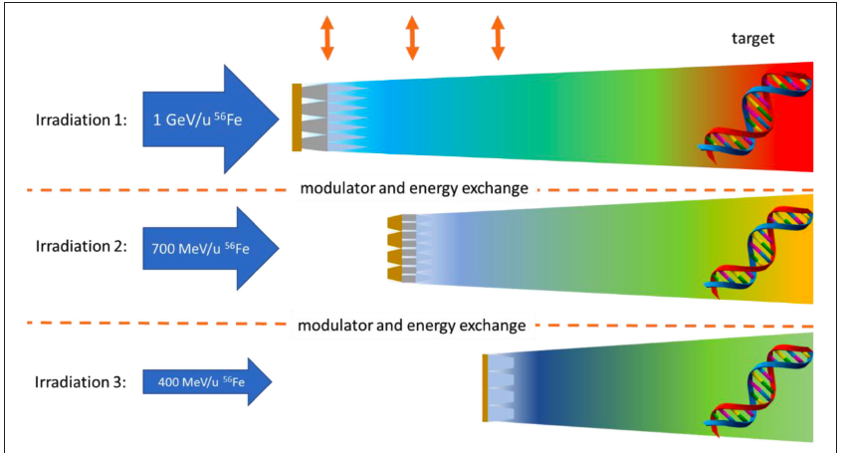
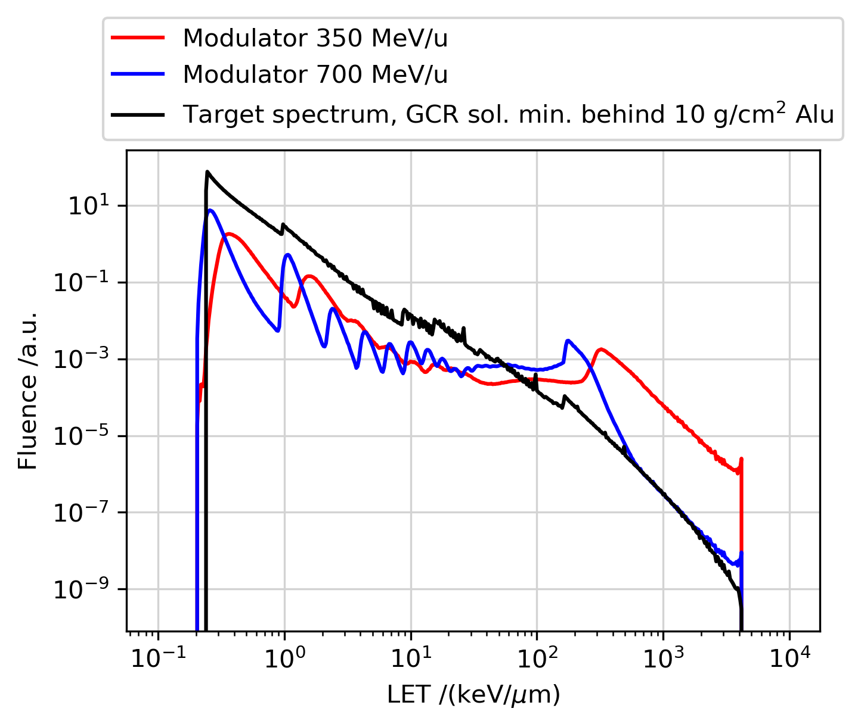
The GSI GCRsim
Schuy et al., Front. Phys. 2020

Slide 15
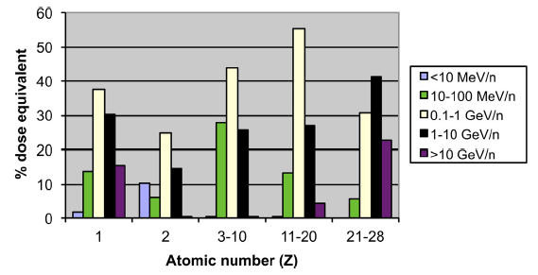
Energies >1 GeV/n
The GSI range modulator with the 10 GeV/n ⁵⁶Fe-ion beam will set a world record in GCR simulation quality
Durante et al., Phys. Rep. 2019

Slide 16
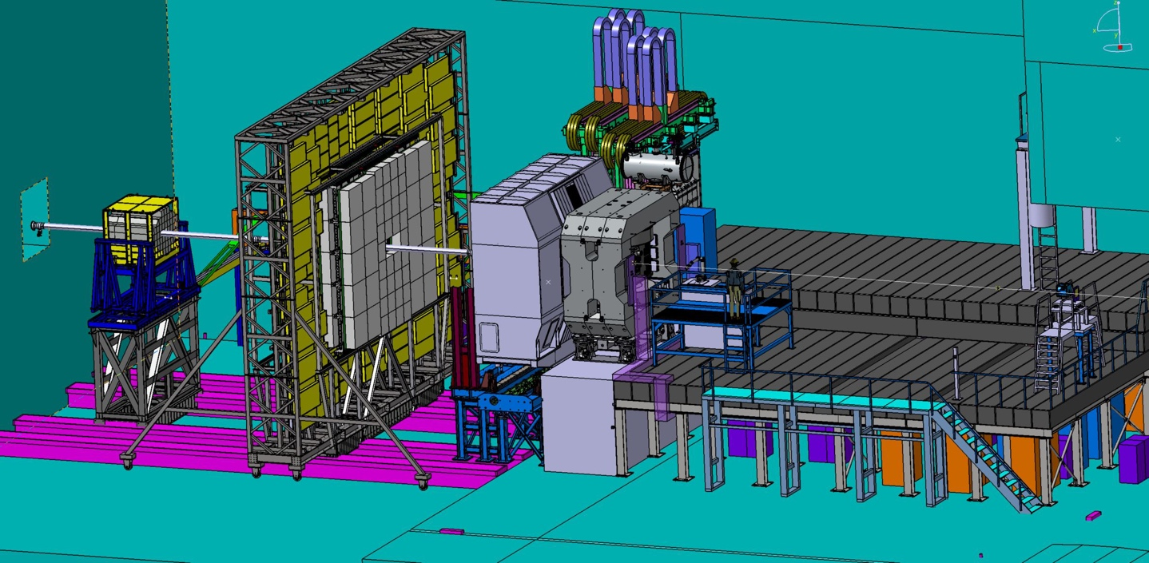
BIOMAT setup at the CBM cave
Irradiated targets
GCR simulator

Slide 17
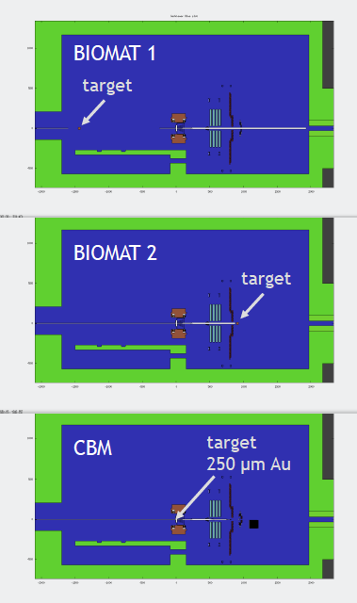
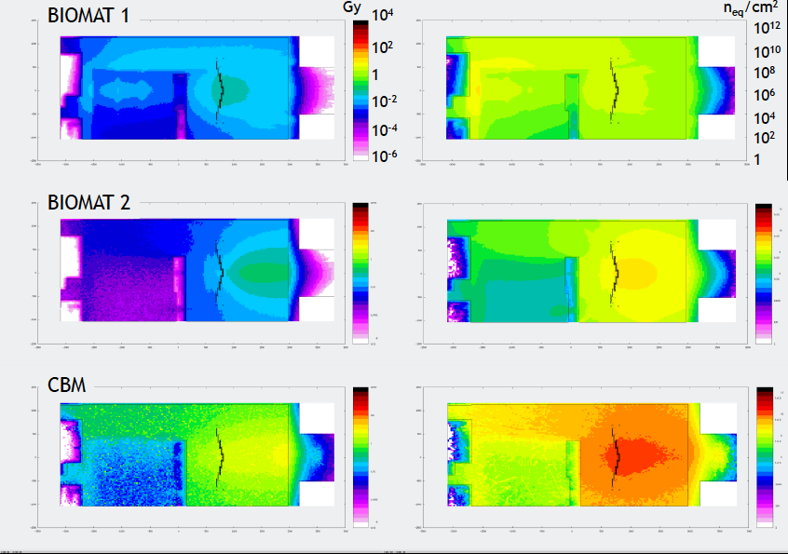
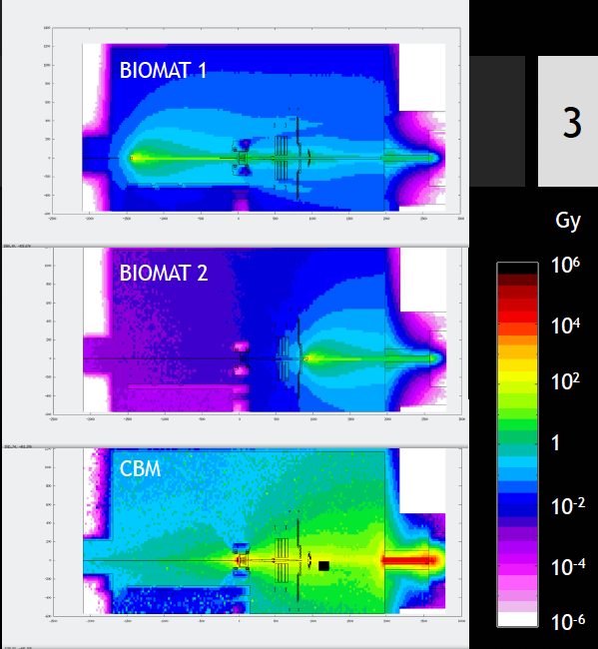
FLUKA simulations (courtesy of Anna Senger)
STS (inner Si-tracker

Slide 18
Conclusions –(FAIR-phase-0)
The Biophysics Collaboration suffers from insufficient beamtime
It will be very important to have enough beamtime in 26-27 also to fulfill the many commitments in third-party projects
With the current outlook, a Bio-PAC is not necessary

Slide 19
Conclusions –(ES/FS)
The Biophysics Collaboration has a strong scientific motivation in using S-FRS, which allows tests with very exotic beams whose intensity is too low at the FRS-Cave M beamline
Along with MAT, support can come from the already planned GSI in-kind contribution for the APPA cave + external funds (HI-Acts)
Setup is simple but new TDR can be prepared and submitted

Slide 20
Conclusions – II (FS+)
The space radiation research program needs access to the maximum energy of SIS100 heavy ion beam
SIS100 energy will set a world record in GCR simulator quality
Support comes mostly from ESA and EU-HEARTS contracts
Setup is simple but new TDR can be prepared and submitted

Slide 21
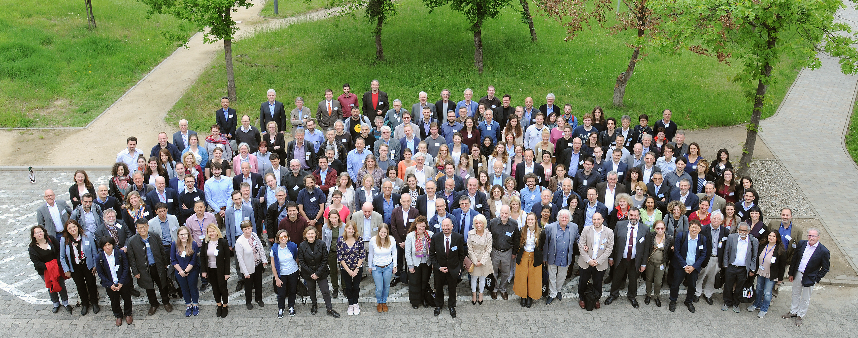
Thank you very much!
www.gsi.de/bio-coll

Slide 22
4. Resources for FAIR2028

Slide 23
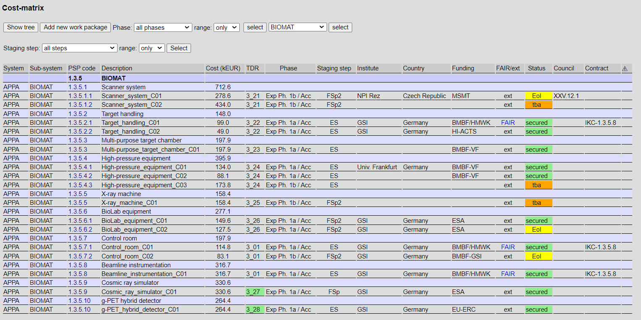
Cost-matrix APPA cave
531 k€
for BIO+MAT
Entirely already in the APPA budget

Slide 24
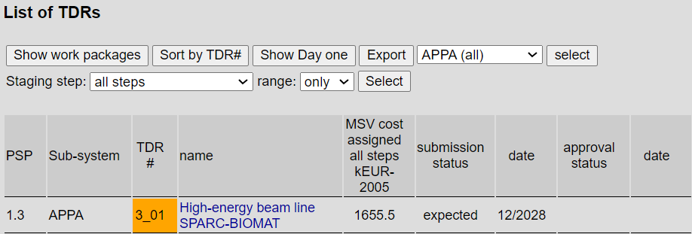
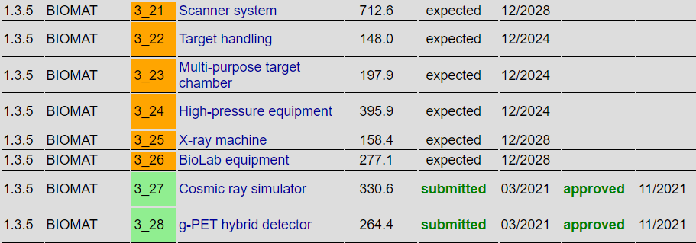
TDR

Slide 25
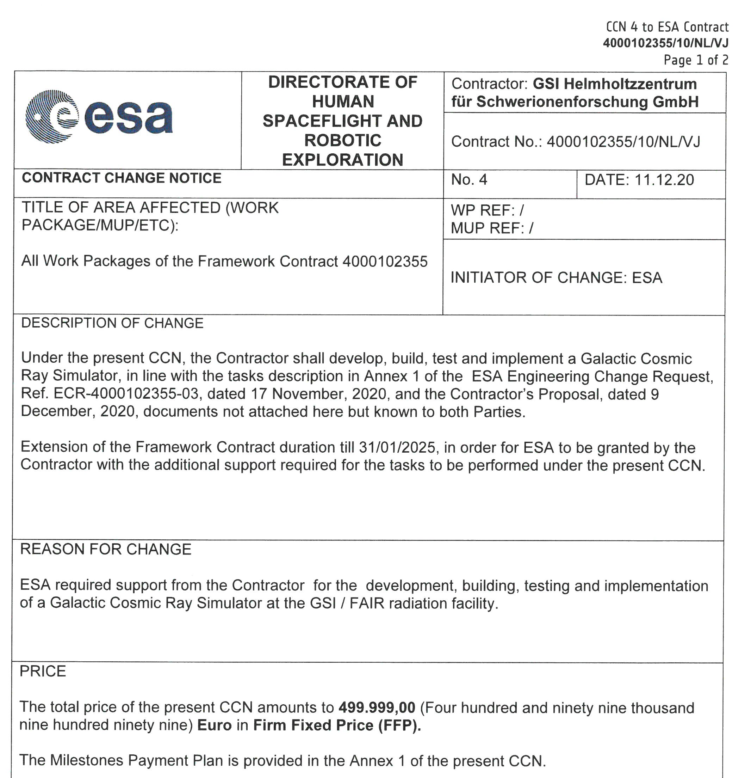
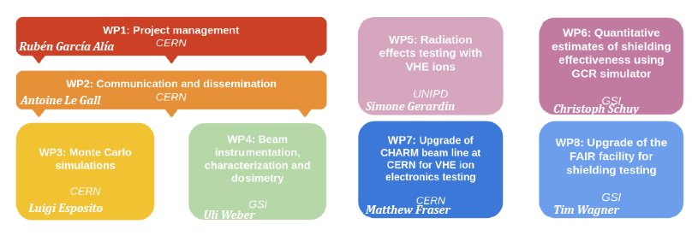
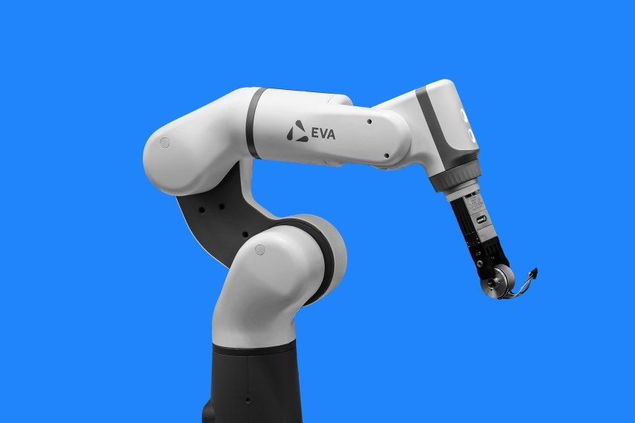
Additional funding for FS+/CBM cave

