Slide 1



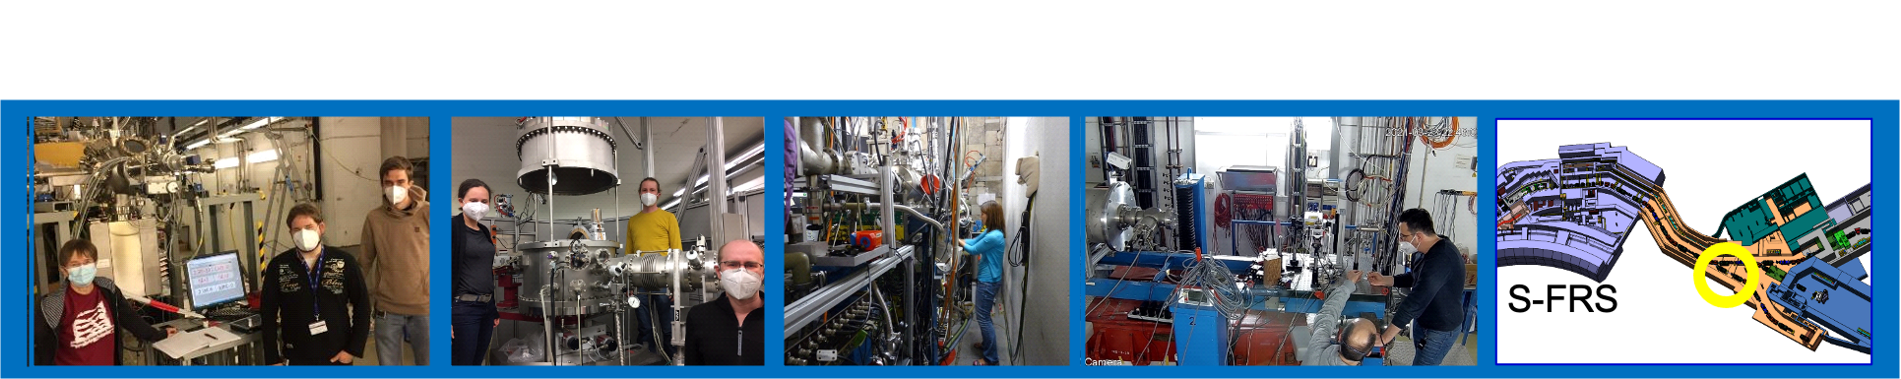
MATerials Research
(FAIR Phase 0, ES, FS, FS+, FS++...)
María Eugenia Toimil-Molares – Research Retreat – July 2023

Slide 2


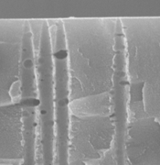
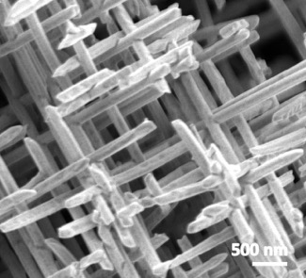
Materials Research with Swift Heavy Ions
I. Ion-Track Nanotechnology
Functional Isoporous membranes
Single-nanochannel sensors
Size-dependent properties of nanowires
Nanowire assemblies
for energy applications
Activities included in POF – Matter – MML – RT2 (Complex and functional materials, quantum materials)

Slide 3

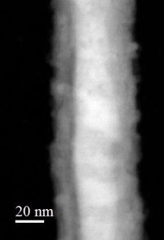


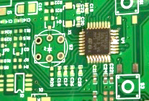
Materials Research with Swift Heavy Ions
I. Ion-Track Nanotechnology
II. Heavy-Ion-induced modifications
Functional Isoporous membranes
Functional materials
from
bulk
Single-nanochannel sensors
Space electronics
Size-dependent properties of nanowires
Nanomaterials
to
nano
Nanowire assemblies
for energy applications
Molecules
ions
Activities included in POF – Matter – MML – RT2 (Complex and functional materials, quantum materials)

Slide 4
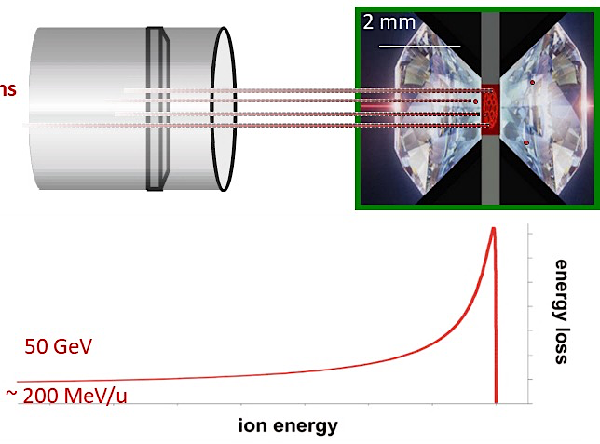

Materials Research with Swift Heavy Ions
I. Ion-Track Nanotechnology
II. Heavy-Ion-induced modifications
III. Materials under Extreme Conditions
Functional Isoporous membranes
Functional materials
from
bulk
High-pressure irradiation
Single-nanochannel sensors
Space electronics
Radiation hardness of functional materials
Size-dependent properties of nanowires
Nanomaterials
to
nano
Nanowire assemblies
for energy applications
Molecules
ions
Pressures of up to ~50 GPa
Ion Irradiation
High Pressure
Energy loss
Temperature
Ion penetration range
Activities included in POF – Matter – MML – RT2 (Complex and functional materials, quantum materials)

Slide 5
Materials Research with Swift Heavy Ions
I. Ion-Track Nanotechnology
II. Heavy-Ion-induced modifications
III. Materials under Extreme Conditions
Functional Isoporous membranes
Functional materials
from
bulk
High-pressure irradiation
Single-nanochannel sensors
Space electronics
Radiation hardness of functional materials
Size-dependent properties of nanowires
Nanomaterials
to
nano
Nanowire assemblies
for energy applications
Molecules
ions
Pressures of up to ~50 GPa
Ion Irradiation
High Pressure
Energy loss
Temperature
Ion penetration range
MAT-program at existing facilities
Cave A → APPA Cave

Slide 6
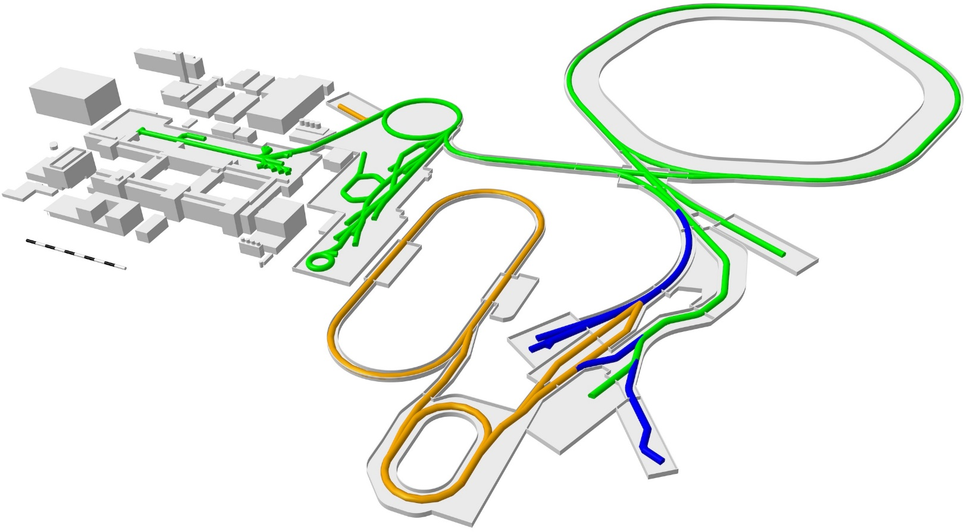
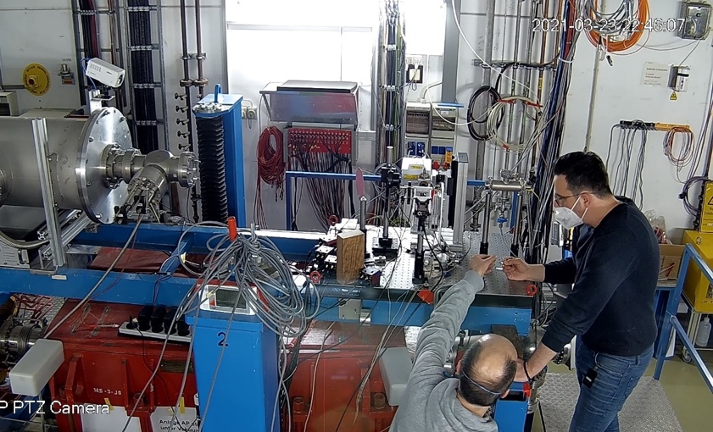
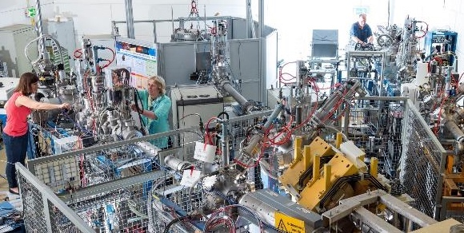
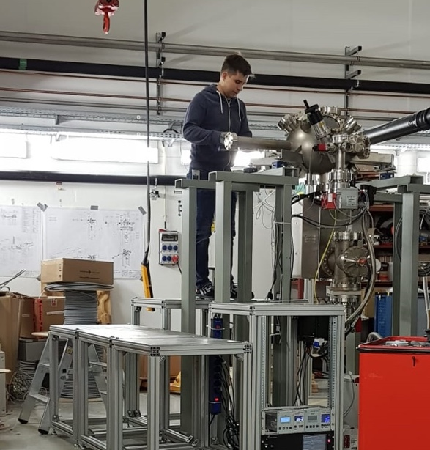
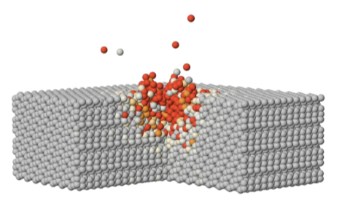


Science at existing facilities
High energy / ion range
Highest ion energy loss
SIS18
UNILAC
M-branch
SIS100
UNILAC
SIS18
X0
Cave A
CBM
SIS18 (80-1000 Mev/u)
Ion range ~mm-cm
UNILAC (3-11.4 MeV/u)
Ion range up to 100 µm
MAT@CRYRING
Super-FRS
tests of space electronics and materials
irradiations at high-pressures
radiation hardness of materials
ion-track nanotechnology
ion-induced materials modifications
astrochemistry
NUSTAR HEB
CRYRING: Highly charged ions
at low kinetic energies
ion-surface interaction

Slide 7
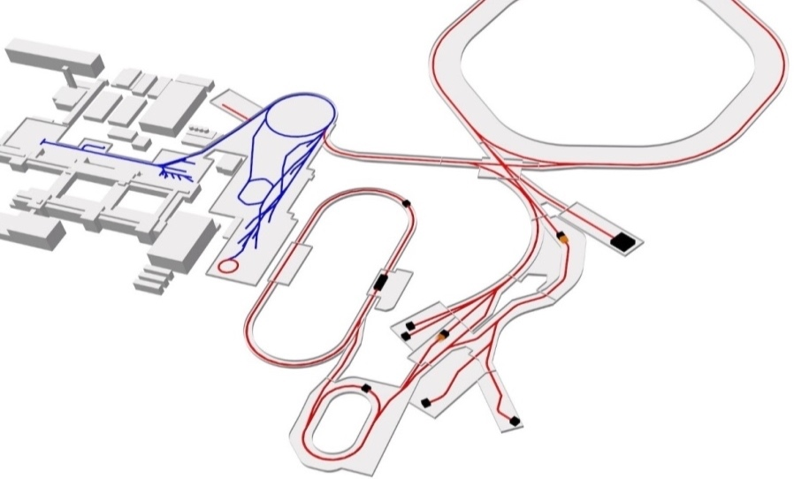
Facilities
MAT Collaboration:
~ 200 collaboration members from 27 countries
~ 40 groups served per beamtime
~ very interdisciplinary (materials science, chemistry, geology, biology, nanosciences,…)
Highest ion energy loss
Important for MAT collaboration:
flexible beam conditions
various ion species, energies, fluxes….
versatile target stations
online and in-situ analysis
efficient sample irradiations
Large ion penetration range
Higher intensities
Higher energies
Highly charged ions
at low kinetic energies
Worldwide largest combination of swift heavy ion beams for Materials Research

Slide 8

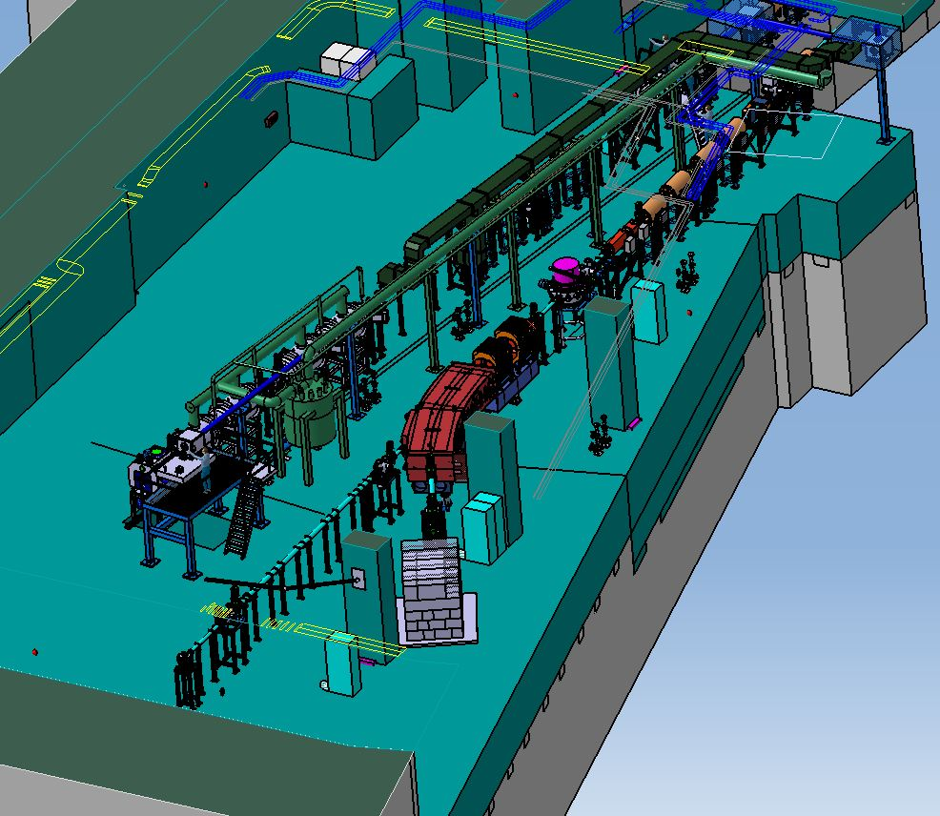
Materials under extreme conditions
SIS100
APPA cave
Required beams
Cave A
SIS18
yes
Higher ion flux > 1e9 U-ions/s
no*
CBM
High intensity pulsed beams
?
yes
APPA cave
yes
Higher ion energy
no
Super-FRS
NUSTAR HEB
Betriebsgenehmigung for all GSI caves *1e9 U-ions/s
APPA cave
High-pressure irradiation setups
Development and testing with SIS-18 beams
HED@FAIR
SPARC
Multipurpose-target station with in-situ and online analytics
BIOMAT beamline
MAT stations

Slide 9
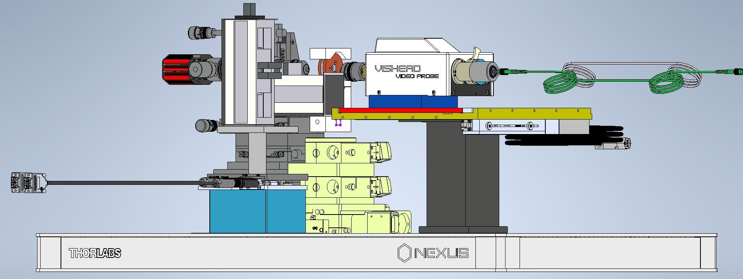

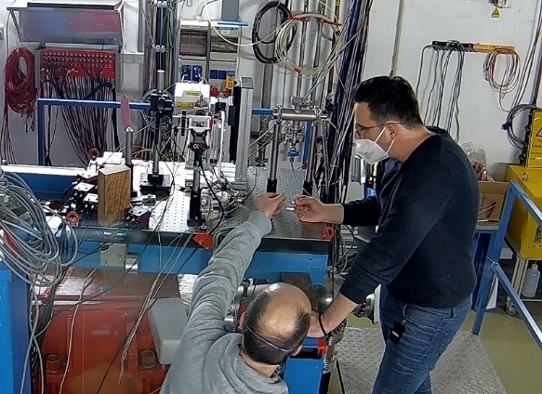

High-pressure irradiation setup I
Collimator
Camera
DAC
Raman Head
Optical fibers to spectrometer
Ion beam
Motorized axes
Mobile setup
Laser table (1 x 1 m)
Prototype setup with online Raman spectroscopy ready
Total space: ~ 2 x 3 m²
Further developments in 2023-2025 (collimation, automatic sample exchange system, remote control of motors …)
Ready for FAIR day-1 exp
Prof. B. Winkler, Bayarjargal, Liang, Merges, Schröck

Slide 10
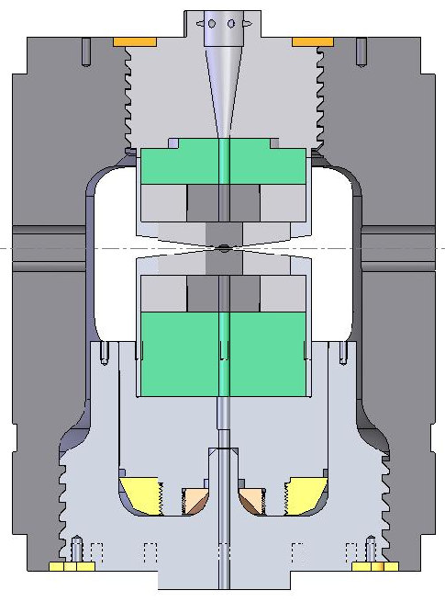
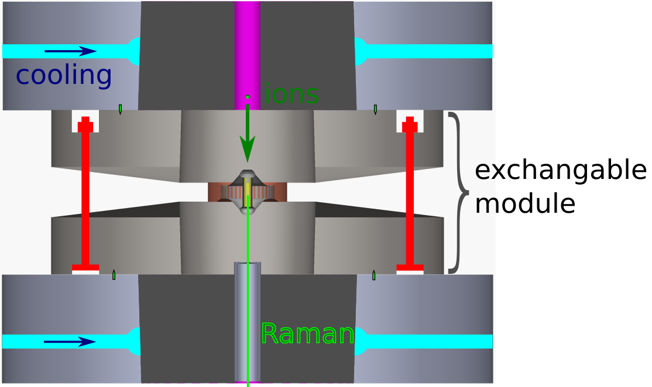
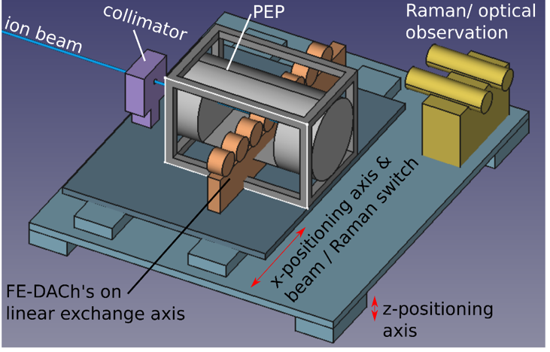

High-pressure irradiation setup II
Paris-Edinburg Cell (PEC)
Sample size ~ mm²
Pressure up to ~12 Gpa
T_{max} ~ 600 °C
Exchange magazine and positioning platform
Automatized exchange of inner pressure cell
Irradiation and in-situ analysis of up to 12 samples
2023-2025: design, collimation, positioning and cooling systems,…
Ready for FAIR-day 1 experiments
Prof. L. Tacjmanova, Cionoiu, Glasmacher, Blum, Faller (Uni Heidelberg)

Slide 11
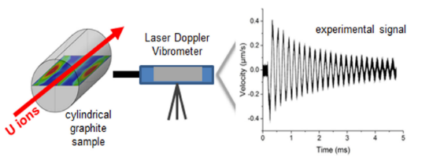




Radiation hardness setup
APPA cave or intermediate locations:
New facility to study dynamic response of beam-facing materials on site
Fast extraction of high-intensity pulsed beams (intensities up to 10¹⁰ pps)
High energy – larger volumes of radiation damaged and thermally excited material
Multipurpose chamber:
Radiation resistant carbon fiber composite windows
Remote-controlled sample exchange system
In-situ analysis techniques
Space: 2 x 1 m²
Monitoring of ion-pulse induced stress waves
Applications:
High-power accelerators: targets, collimators, beam windows and beam dumps
High temperature reactor materials
Space materials
Shock and Vibration (2021) 8884447
BMBF VF application in 2024 (Univ. of Münster)

Slide 12


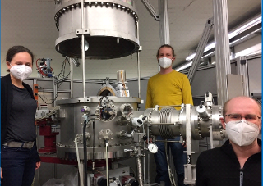
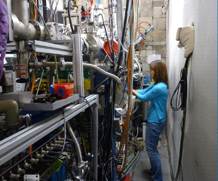
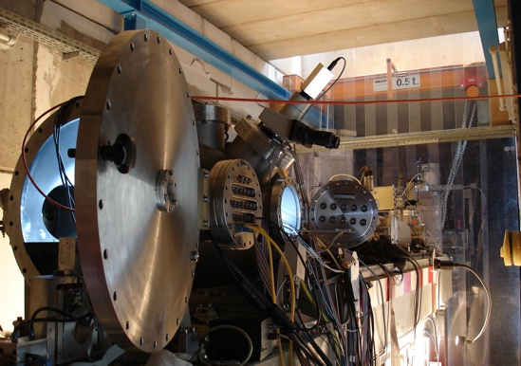
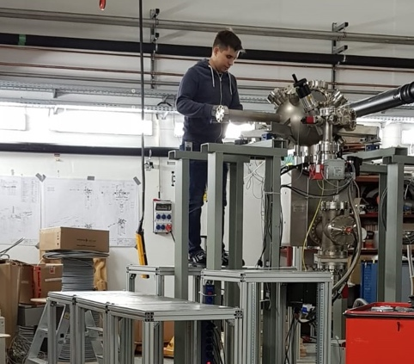

Timeline
2024
2025
2026
2027
2028
2029
2030
> 2030
Preparation/ testing of new setups for APPA cave
Experimental program of MAT collaboration at existing facilities (UNILAC & HELIAC / SIS 18)
M-branch
X0
Microprobe
MAT @ CRYRING
Cave A
María Eugenia Toimil-Molares – Research Retreat – July 2023

Slide 13
Timeline
2024
2025
2026
2027
2028
2029
2030
> 2030
Preparation/ testing of new setups for APPA cave
SIS100 → APPA Cave
Experimental program of MAT collaboration at existing facilities (UNILAC & HELIAC / SIS 18)
M-branch
X0
Microprobe
MAT @ CRYRING
Cave A
María Eugenia Toimil-Molares – Research Retreat – July 2023

Slide 14
Timeline
> 2030
2024
2025
2026
2027
2028
2029
2030
SIS100 → APPA Cave
Preparation/ testing of new setups for APPA cave
SIS18 → SFRS → Ring branch
SIS100 → SFRS → Ring branch
SIS100 → CBM
Possibilities for BIOMAT presented to ECE and JSC last June
Experimental program of MAT collaboration at existing facilities (UNILAC & HELIAC / SIS 18)
M-branch
X0
Microprobe
MAT @ CRYRING
Cave A
limited intensity ☹
María Eugenia Toimil-Molares – Research Retreat – July 2023

Slide 15
Intermediate MAT locations in ES/FS/FS+
SIS100
2 possible locations identified
SIS18
MAT beam requests:
    intensities > 1e9 U-ions/s
heavy beams (Z ≥ Au, preferred U)
slow and fast extraction
energy range 180 - 500 MeV/u
“small” beam focus < 5 mm
Space: 2 x 3 m²
CBM
APPA cave
Ring-branch @S-FRS
Discussions with colleagues A. Senger, P. Gasik, S. Ratschow, H. Simon, and H. Weick are thankfully acknowledged.

Slide 16
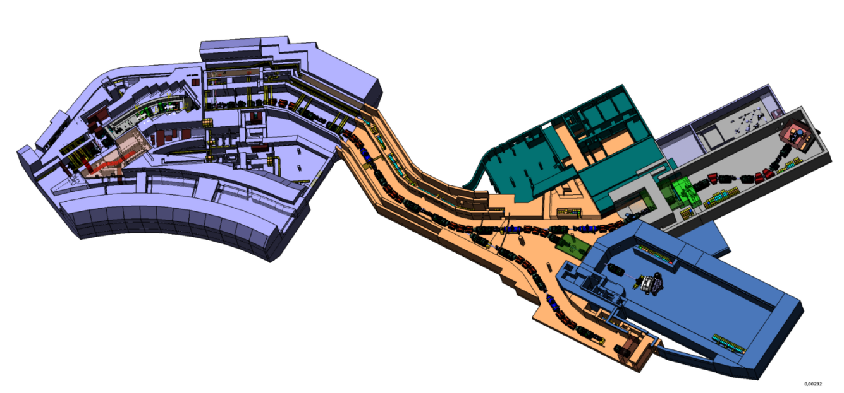
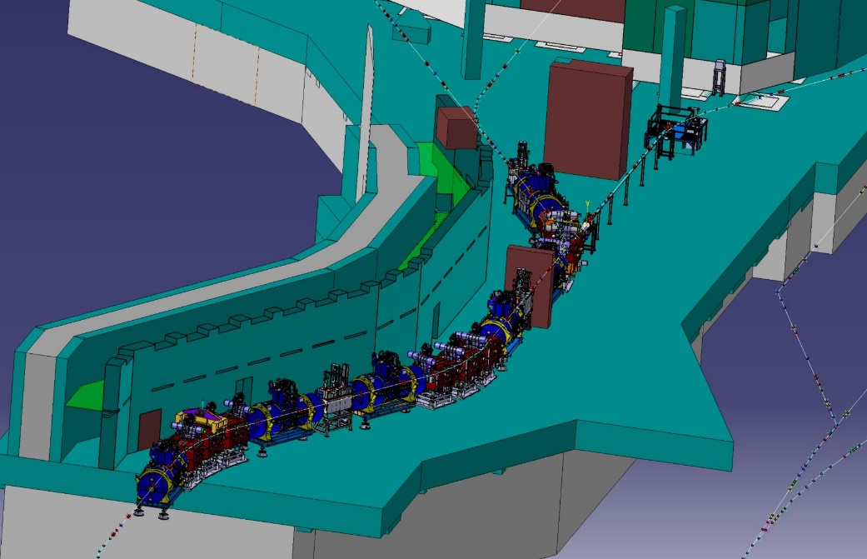
Early Science (ES) and FS at ring branch
Advantages for MAT:
high flux beam available
sufficient space available
MAT and BIO setups compatible
beam focus ~ few mm for 200-600 MeV/u U ions
access to SIS-18 and SIS-100 beams
More detailed plans in progress (ECE recommendation):
FLUKA calculations for MAT beam parameters → local shielding needed?
planning of common beamline for BIOMAT
access to site for sample exchange or other needs?
(it is a tunnel, not a cave…)
S-FRS
Ring branch
BIOMAT
María Eugenia Toimil-Molares – ECE Meeting - May 4th 2023
María Eugenia Toimil-Molares – Research Retreat – July 2023

Slide 17
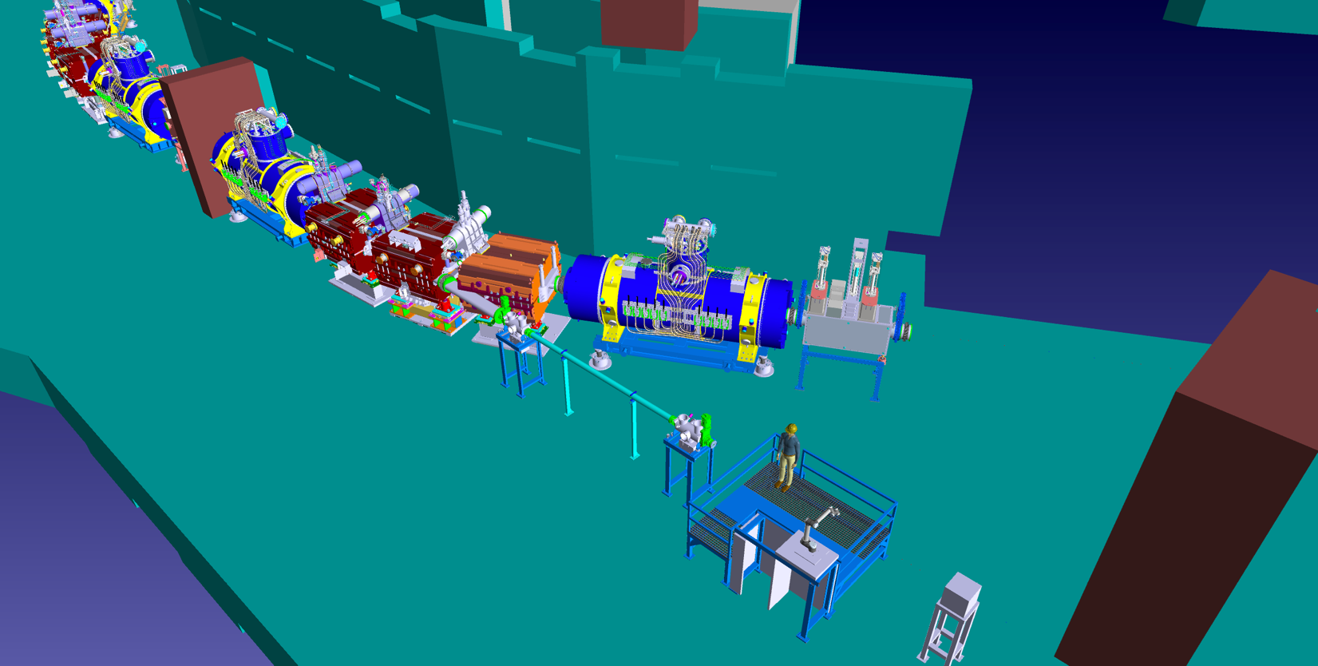
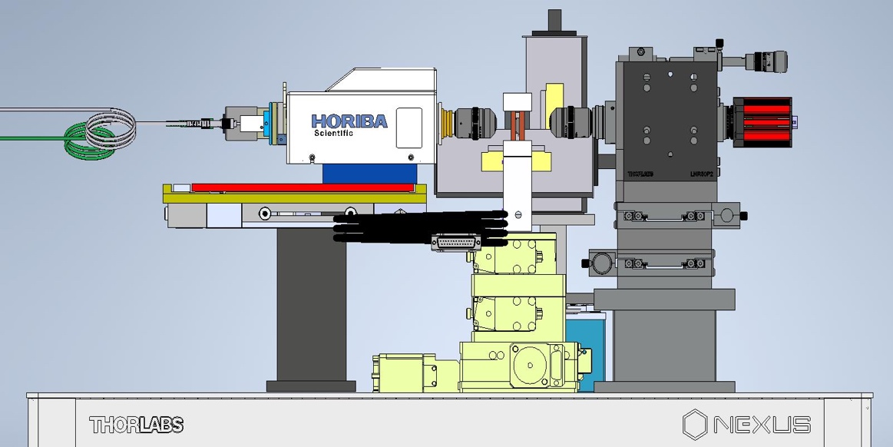
Early Science (ES) and FS at ring branch
MAT Setup
Mobile
In preparation
BMBF ErUM funded
Diagnostic chambers (BIOMAT)
MAT Setup
Beam dump
Planning of common BIOMAT beamline until the next ECE in November 2023:
Ionoptic calculations
Design of BIOMAT beamline (beamline, diagnostic chambers, instrumentation…) such that they can be transferred to the APPA Cave once it becomes operational.
Cost estimate for beamline.
In-kind GSI contribution for BIOMAT in APPA Cave:
Target handling (1.3.5.2) + Control room (1.3.5.7) + Beamline instrumentation (1.3.5.8) → 531 k€ (in 2005 prices)

Slide 18
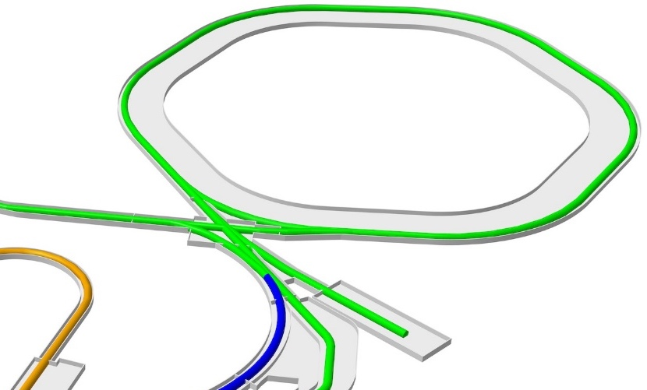
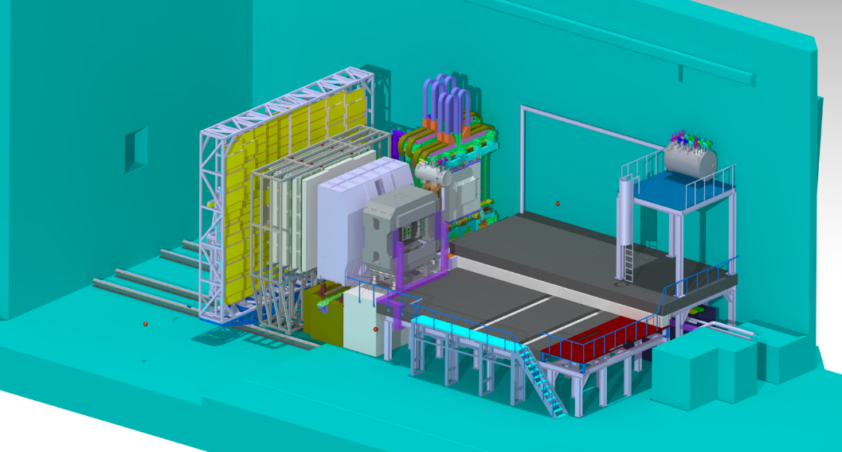

Intermediate location in CBM cave
SIS100
MAT@CBM: explored as backup option if ring branch would not work
Advantages for MAT:
high flux beam available before FS++
sufficiently small focus at HADES target position for 400 MeV/u U ion beam.
Discussions ongoing:
FLUKA calculations to estimate MAT experimental conditions that do not affect CBM detector or electronics.
CBM
2 x 2 m²
HP setup
María Eugenia Toimil-Molares – ECE Meeting - May 4th 2023
María Eugenia Toimil-Molares – Research Retreat – July 2023

Slide 19
Beamtime requirements in 2026/27
> 2030
2024
2025
2026
2027
2028
2029
2030
SIS100 → APPA Cave
Preparation/ testing of new setups for APPA cave
SIS18 → SFRS → Ring branch
SIS100 → SFRS → Ring branch
SIS100 → CBM
Possibilities for BIOMAT presented to ECE and JSC last June
Continuation of experimental programs at MAT existing facilities (UNILAC / HELIAC / SIS 18)
M-branch
X0
Microprobe
MAT @ CRYRING
Cave A
María Eugenia Toimil-Molares – Research Retreat – July 2023

Slide 20
Beamtime requirements in 2026/27
> 2030
2024
2025
2026
2027
2028
2029
2030
SIS100 → APPA Cave
Preparation/ testing of new setups for APPA cave
SIS18 → SFRS → Ring branch
SIS100 → SFRS → Ring branch
SIS100 → CBM
More access to SIS18 beams to commission and test new setups, and support and enlarge the pillar III community.
UNILAC and CRYRING beams for continuation of experimental programs.
Sufficient beamtime for third-party funding projects, PhD students, young scientists, and users of the MAT collaboration.
Possibilities for BIOMAT presented to ECE and JSC last June
Continuation of experimental programs at MAT existing facilities (UNILAC / HELIAC / SIS 18)
M-branch
X0
Microprobe
MAT @ CRYRING
Cave A
María Eugenia Toimil-Molares – Research Retreat – July 2023

Slide 21



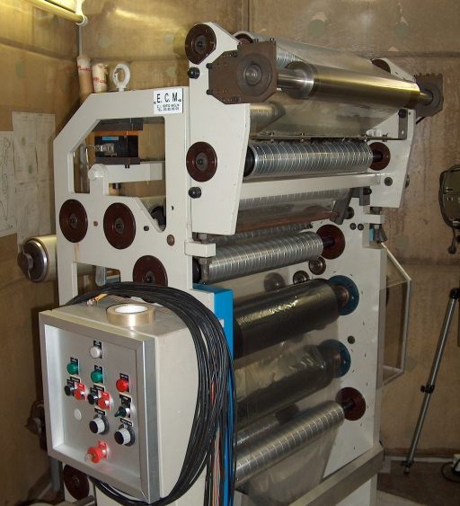
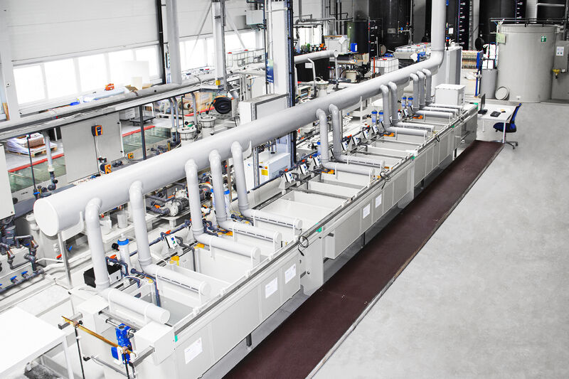
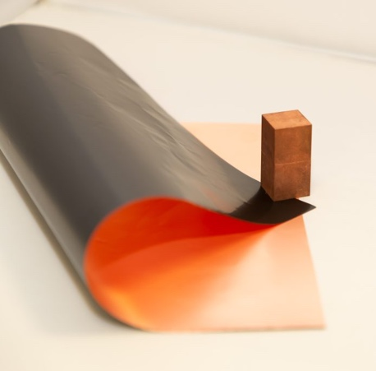


MAT & HELIAC
MAT activities would profit from access to HELIAC: stable beam, higher efficiency.
MAT research activities at HELIAC at ~ 7 MeV/u.
Opportunity for technology transfer:
  - nanotechnology
  - heavy ion microprobe for nanostructuring, electronics and detectors tests,…
Interest in roll production of etched ion-track membranes at GSI expressed by:
Jon de Tech pilot line for nanowire plating in Hofstetter PCB Plating in Herrenberg.
Roll irradiation device
@ GANIL
https://www.it4ip.be
María Eugenia Toimil-Molares – Research Retreat – July 2023

Slide 22
Summary
All MAT activities continue at the current facilities.
Activities will profit from access to HELIAC: stable beam, higher efficiency, and possible technology transfer.
Materials under extreme conditions experiments require higher ion fluxes than currently available in cave A.
    In Cave A: limited flux, high-intensity pulsed beams for radiation hardness not possible, and high-pressure irradiations are very inefficient (very long times for fluence accumulation)
Temporal locations for MAT prior to APPA cave: Ring branch at S-FRS and CBM cave.
Diagnostics and setups for BIOMAT to be transfered to APPA cave as soon as it is available.
Addtitional core personnel requested for installation and operation of new FAIR MAT facilities.
Very limited lab space. Labs in APPA cave won’t be accessible soon.
María Eugenia Toimil-Molares – Research Retreat – July 2023

Slide 24
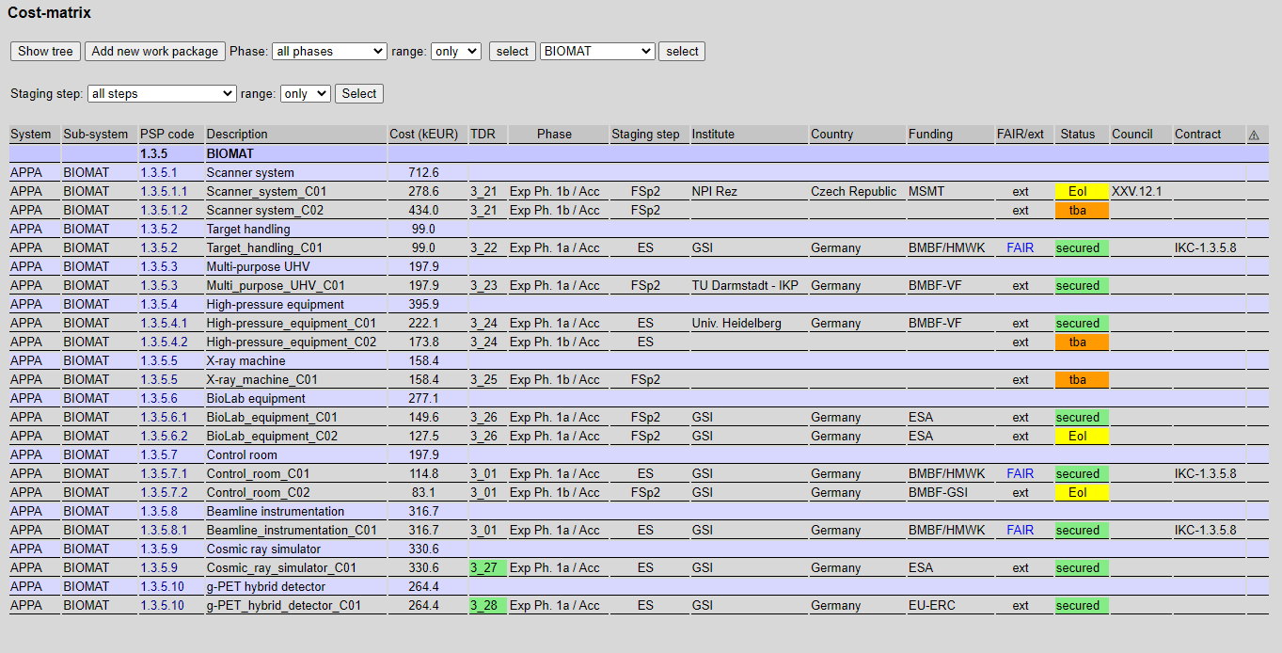

Slide 25
Summary
All MAT-stations will remain in operation as the large variety of ion species as well as a wide range of energies, beam intensities, and analytical tools are essential for the MAT collaboration.
Alternative locations for MAT-program in APPA Cave (Materials under extreme conditions):
Cave A (HTA):
    - Limited flux conditions (max. 1e9 ions/s) by the GSI Operating Permit.
                - High-intensity pulsed beams for radiation hardness tests not possible.
                - High-pressure irradiations very inefficient (very long times for fluence accumulation).
Ring-branch at S-FRS is a very suitable intermediate location.
CBM Cave is an alternative in case ring-branch would not work. Ionoptics for E < 400 MeV/u needs to be clarified.
Both provide early access to high-flux beams for experiments under multiple extreme conditions.
Diagnostics and beamline shared by BIOMAT and covered by in-kind GSI contribution to BIOMAT in APPA cave.
Designed to be transferred to APPA cave once it is operational.

Slide 26

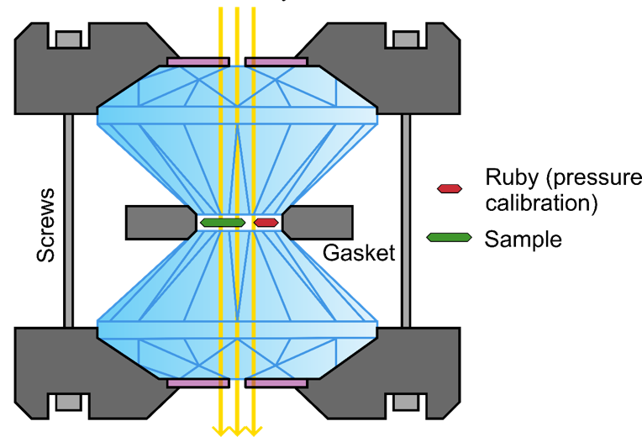



High pressure
Ion Irradiation
Coupling extreme conditions
Temperature
High static pressures
Up to 100 GPa
Ion Irradiation
Energy density ~ eV/atom
GeV heavy ions deposit enormous amount of energy in very localized volumes and in very short times
Pressures of up to ~100 GPa
Ion fluence up to 10¹³ i/cm²
Penetration depth (mm)
Diamond anvil cells
Formation and stabilization of high-pressure phases - new properties!
Study of phases in Earth’s & rocky planet’s interiors
New thermodynamic paths for phase-transitions of bulk materials and nanomaterials
PRL (2006)
Nature Materials (2009)

Slide 27
MAT Beamtime 2024 / 2025
UNILAC, M-branch and X0 beamline:
Sample irradiations for internal and external user groups
ion species: any ions between ~Ca and U
3.6 – 11.4 MeV/u
long pulses (1-4 ms) preferred
duty cycle (5 – 50 Hz)
Parallel operation of UNILAC beamlines

Slide 28
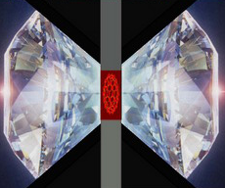
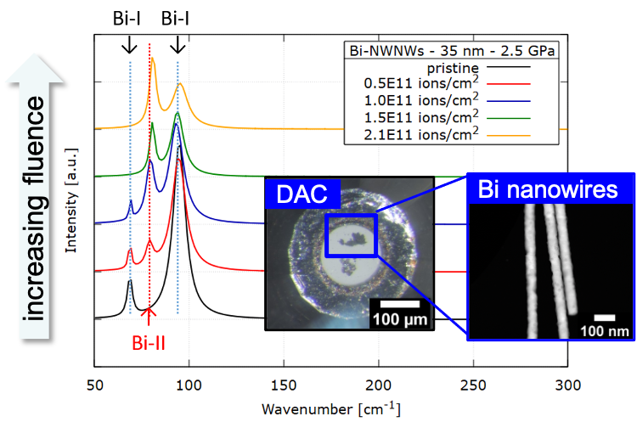

High-pressure irradiation setup I
Raman spectrometer
Beamtime 2022
Cave A
Setup for irradiation of DACs
(diamond anvil cells)
Ion-induced B_{I}-B_{II} phase transformation of 35 nm diameter Bi nanowires
New nanomaterials properties expected
beam
collimator
250 µm aperture
200-500 MeV/u ions
goniometer
Beam stops in sample

