Slide 1
Plasma physics 2028 plan
& update on ICF developments
V. Bagnoud for the plasma physics department
and the HED@FAIR collaboration

Slide 2

Outline
Plans FAIR 2028: science, equipment
  2023 - Applications for collaborative research
  PRIOR program
  HED program at HHT
  Laser Developments
Requirements
  beamtime
  budget and personnel
Update on Discussion on Inertial Fusion Energy and its impact on our activities

Slide 3

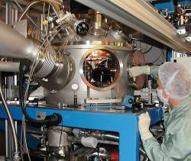
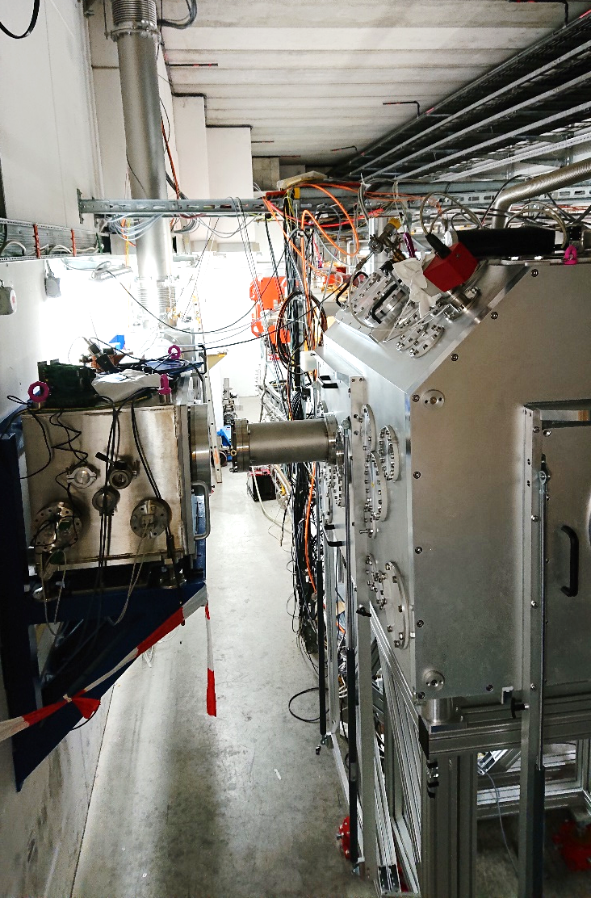
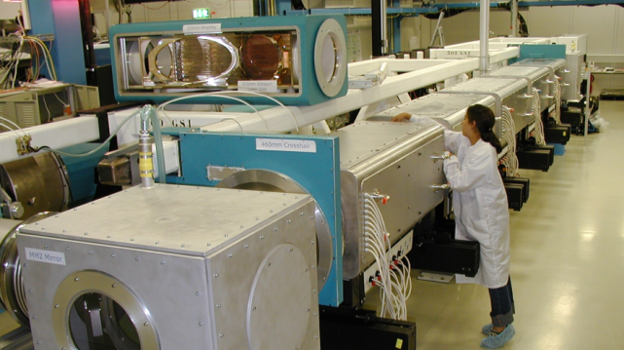
Experimental Sites at GSI for APPA-PP in 2028
Z6
Ion energy:
3 - 12 MeV/u
Intensity:
~1 pmA
SIS
HHT
Ion energy:
350 Mev/U U⁷³⁺
Intensity:
2 10⁹ ion/bunch
Heavy ion interaction with plasma
Charge states of projectile ions in ionized and cold matter
iLIGHT
Z6
PHELIX
HHT
UNILAC
PHELIX
High Energy / High Intensity Laser
Proton microscopy - PRIOR
Heavy ion heating - HIHEX
Fusion related studies
short pulse: 0.5 PW: 200 J in 400 fs
long pulse: 200 J, nanosecond
Narrow band x-ray
sources
Proton acceleration
(imaging, injection
in accelerator)
High field effects in
highly charged ions

Slide 4
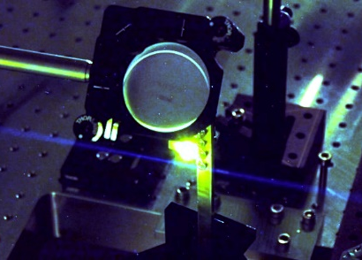
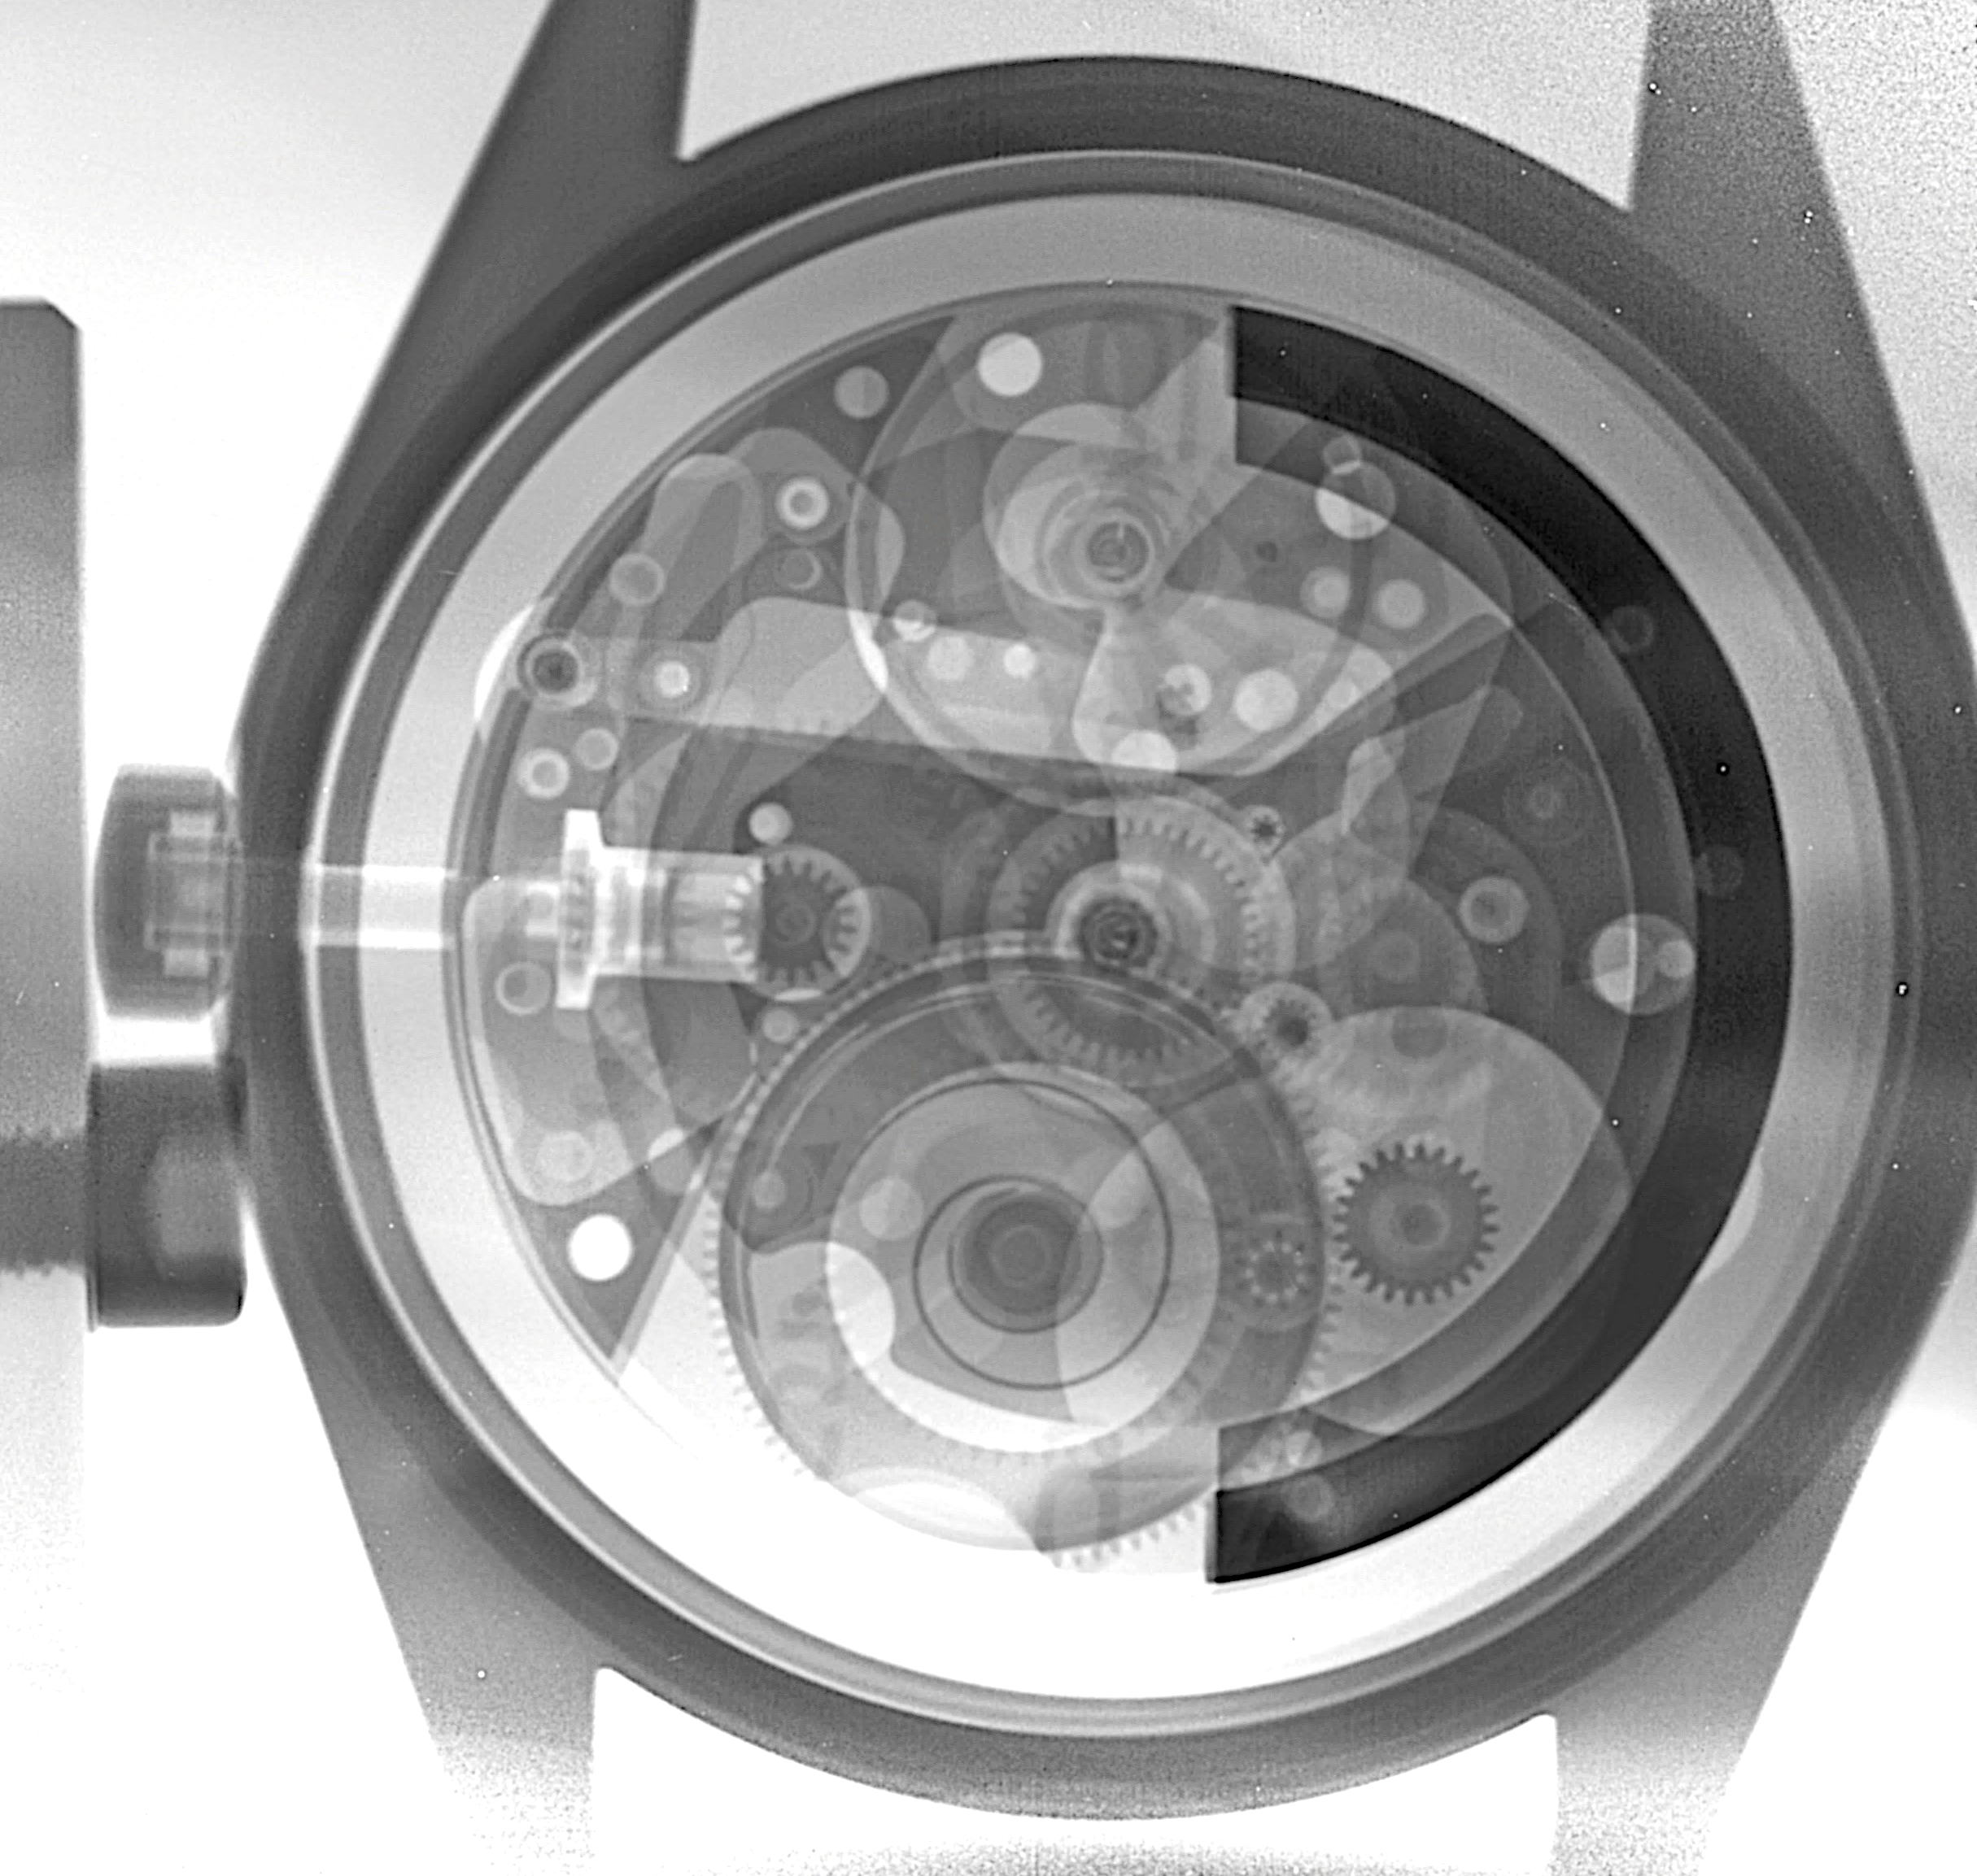
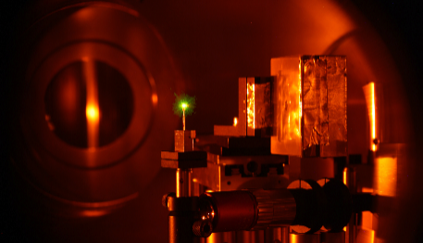
Overview of plasma physics activities in view of the collaborative research
Experiment University | HIHEX | PRIOR | PHELIX | iLIGHT
TU Darmstadt |  |  | X | X
HHU Düsseldorf |  |  | X
FAU Erlangen |  |  | X
GU Frankfurt | X | X |  | X
TU Freiberg |  | X
U Rostock | X
FSU Jena | X |  | X
LMU Munich |  |  | X

Slide 5
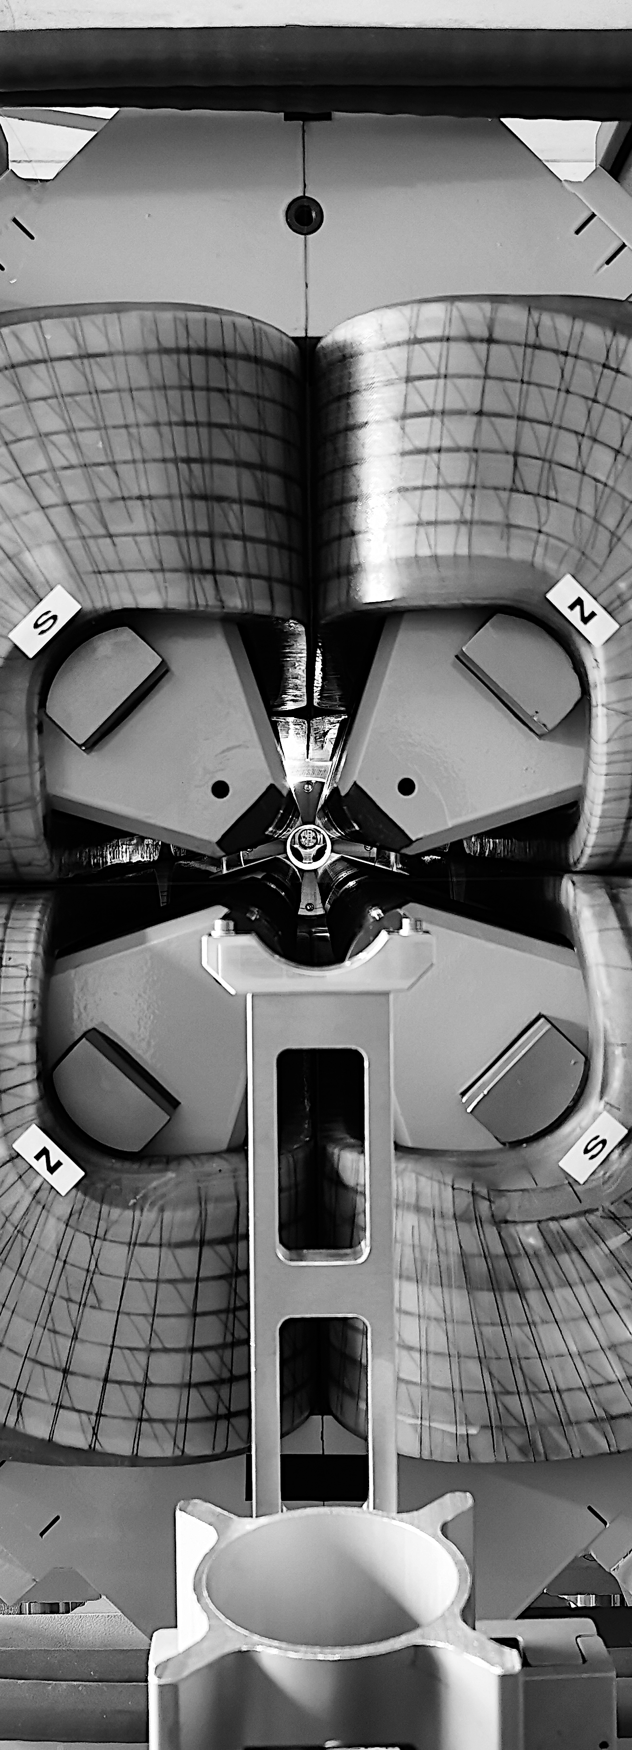
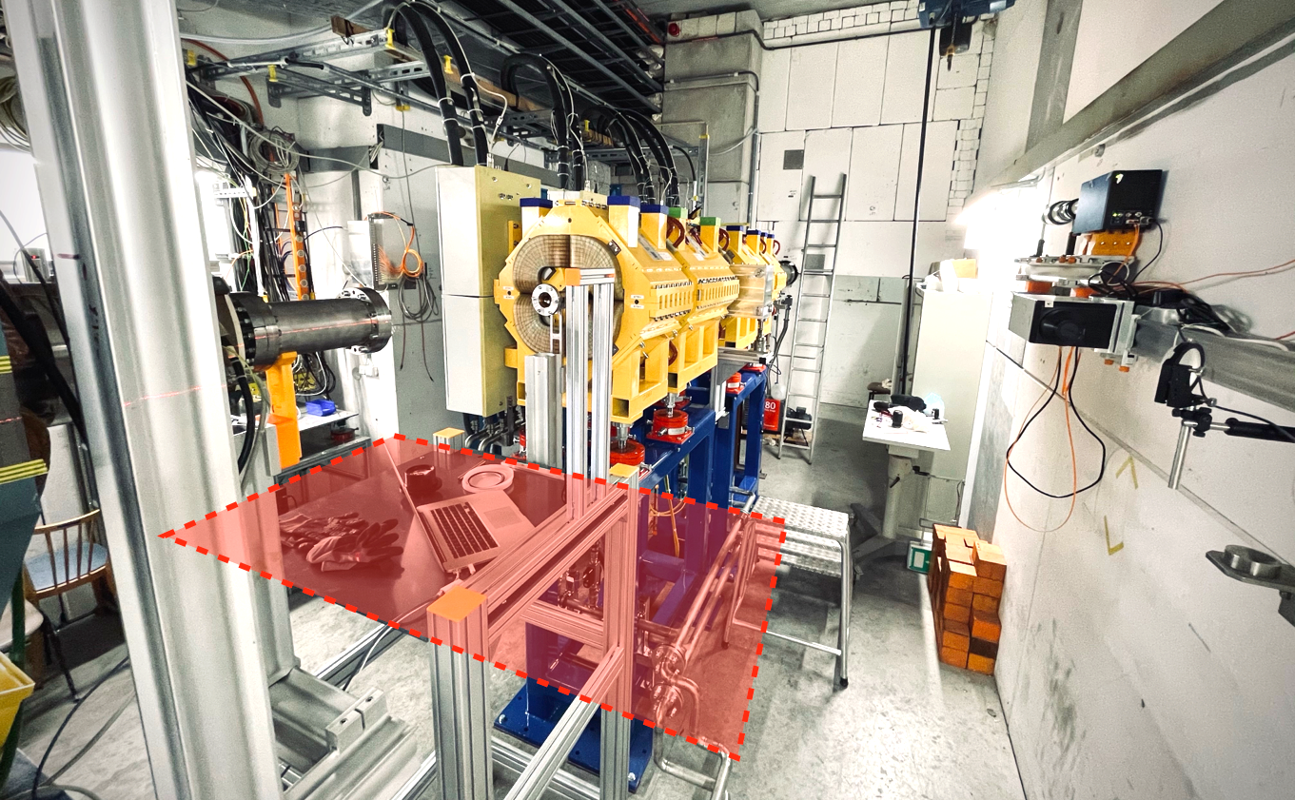
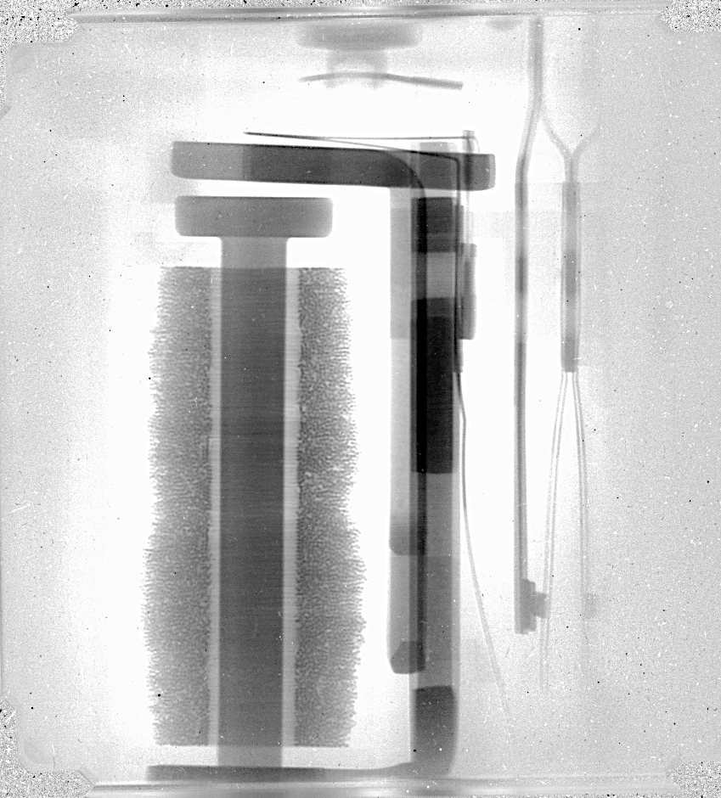
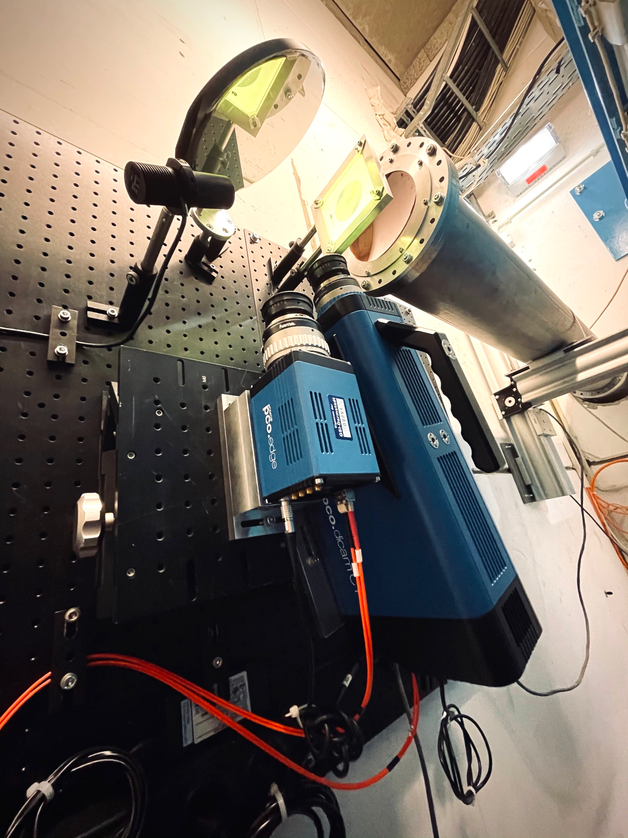
PRIOR-II user Facility at HHT
Experiment constraints imposed by HHT
Maximum experiment footprint ~ 1.2 x 2.0 m2
limited magnification
Current System Performance
40-50 mm Field of View (FOV)
20 µm spatial resolution
< 1% density resolution
Machine Timing
Slow Extraction
  Up to 2e10 over ~10 ms to 6 s
Fast Extraction
  Up to 5e10 in a single pulse
  Up to 5e10 in four pulses over 0.6 – 1.0 µs
40-50mm

Slide 6
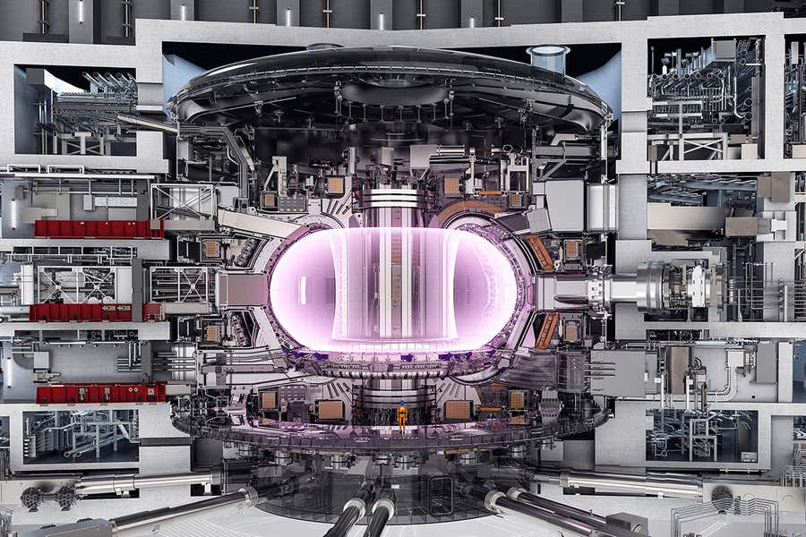
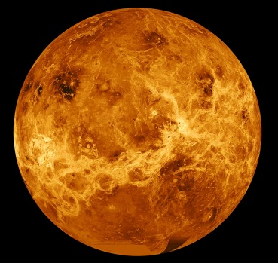
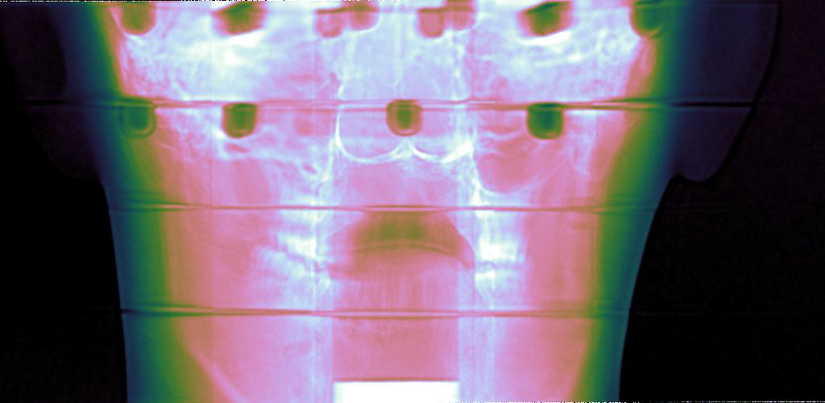
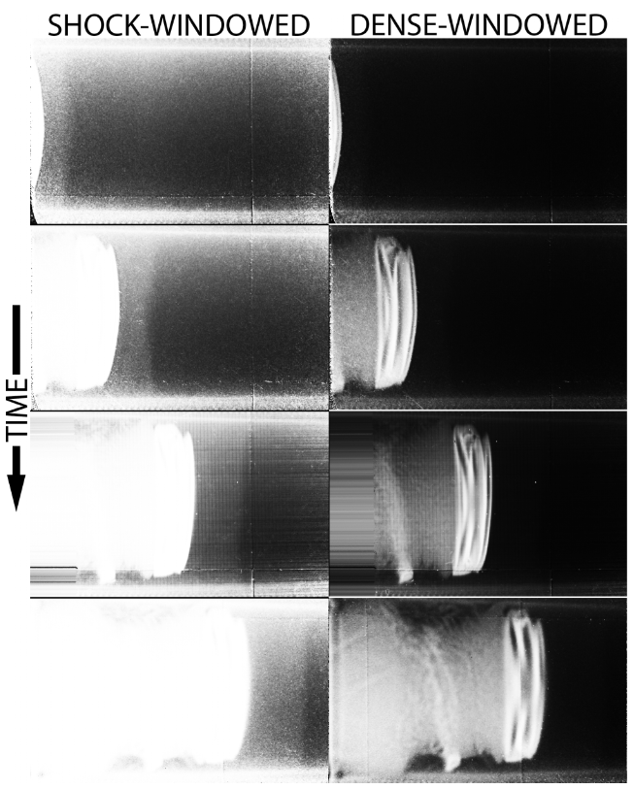
PRIOR-II development path (2023 – 2025) and program for 2026 +
HE driver development
Functional material studies (HE drivers)
  magnetic fusion reactor walls
  Shielding materials for spacecraft and space travel
Materials science & synthesis (HE drivers)
Planetary sciences (e.g. properties of molten metals and alloys)
High-Speed Industry Applications (e.g. injection & fuel mixing)
Medical Applications
  Ultra precise dual-Ion species FLASH radiotherapy through online position verification
(Offline) commissioning at HHT
Start tender for confinement
Driver experiments
Licensing
1st scheduled experiments
Start manufacturing
chamber
Schematics of the ITER fusion reactor.
Courtesy: ITER
High resolution image of Venus.
Courtesy: NASA/JPL-Caltech
2023
2024
2025
2026
PoF IV
Transition PoF V
Flash-Proton CT of a human head.
Proton radiographs of an aluminum flyer plate (bright white) propagating through xenon gas.
Courtesy: M. Freeman (LANL)

Slide 7





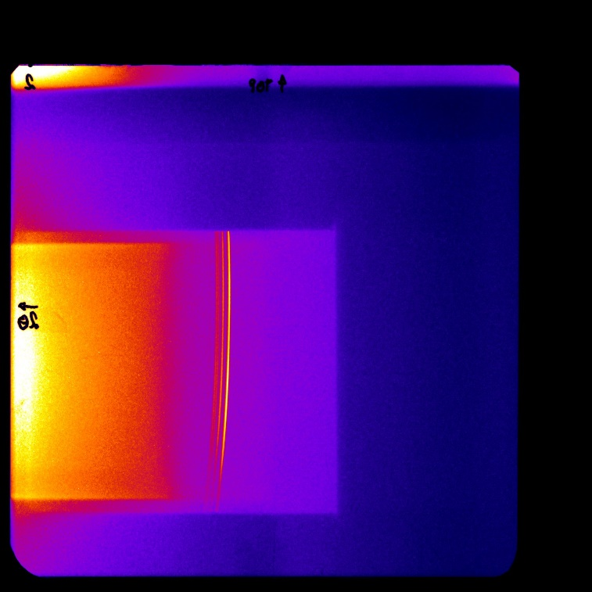
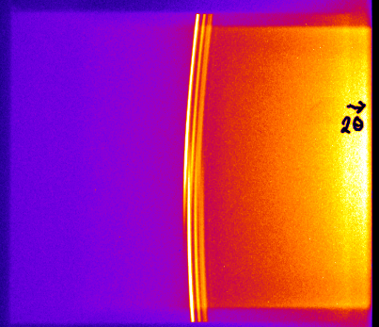
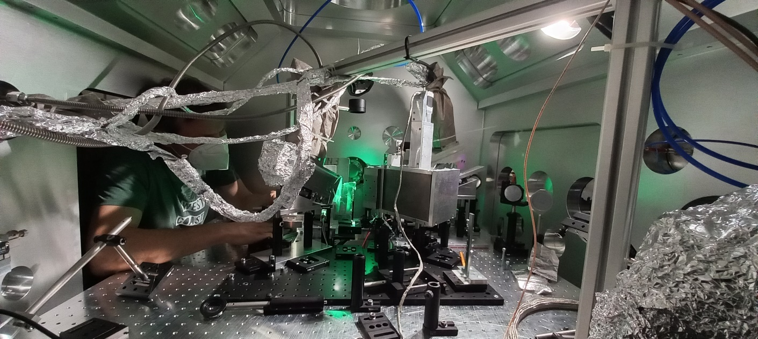
HED experiments at HHT with ion and laser beams
Experiment target chamber (FAIR core invest) and laser beamline (GSI contribution) installed at HHT
Waiting for APPA cave to be ready…
First experiments ongoing in FAIR Phase-0
  graphitization of Diamond (U. Rostock)
  superheating of Iron (U. Belfast)
  compression of graphite (GSI)
heated region
X-ray diffraction
Ti-He_{α} (4.75keV)
Source
Scattering
energy
X-ray Thomson scattering
Demonstration of laser-driven X-ray probing of HI-heated
targets revealing microscopic properties of HED samples

Slide 8
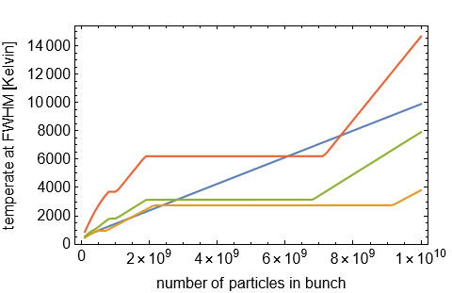
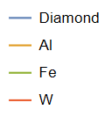
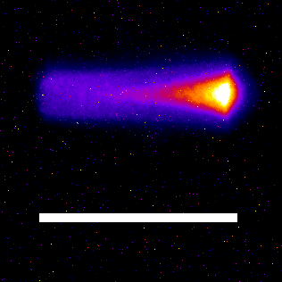
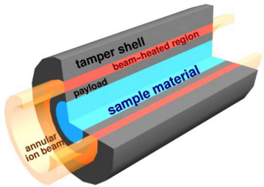
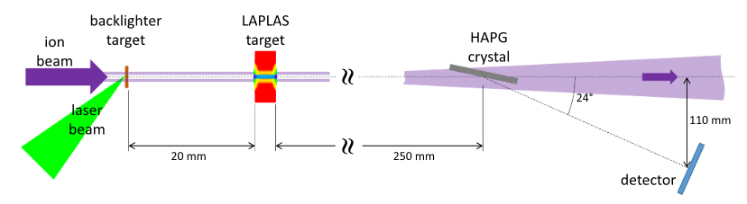
Challenges with HHT experiments (2024 – 2028)
optimize ion beam from SIS-18 and focusing in HHT for highest intensity
work closer to the Bragg peak of the heavy ions:
  loss of uniformity of heating!
  but higher temperatures
extend laser-driven X-ray diagnostics:
X-ray absoption spectroscopy
LAPLAS (Laboratory Planetary Science) scheme:
  heating of high-Z shell for compression of sample:
  high pressures, moderate temperatures
  e.g. carbon sample in tungsten shell
  to study diamond production
  preparatory experiments at
  HHT in FAIR phase
→ heating comparable to 10¹⁰ ions/pulse
Thermal emission
D294
3.3 mm
= range of Pb@450MeV/u in W
N. Tahir et al., Scientific Reports 13, 1459 (2023)
proposed experimental scheme for on-axis X-ray radiography
Notes:
LAPLAS hier! ringförmiger Fokus
x-ray radiography
bild im proposal!

Slide 9
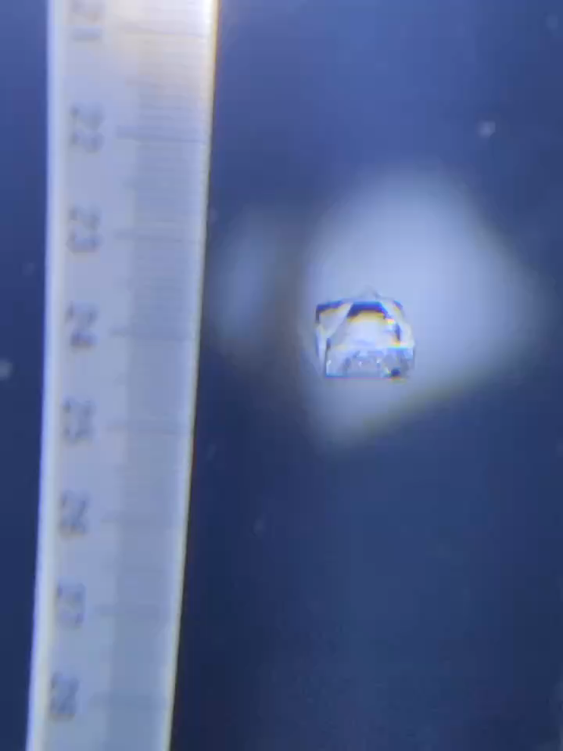
PHELIX developments for 2023-2028
Goal: avoid that PHELIX becomes obsolete
2022 – 2026 Optimize PHELIX for ICF research (third party financed: ~ 500 k€)
  optimized laser source
  new frequency conversion scheme
  develop experience with foam as target materials
2023 – 2026: Major EU investment in technology development via THRILL (~3 M€, mostly man power)
  large amplifier cooling – x10 improvement in shot rate
  translation of latest astronomy wavefront control techniques to high-energy lasers for beam quality
  blue print for a high-energy laser at FAIR
new DKDP crystal type
(European Source)

Slide 10
Requirements for Plasma Physics (2023 – 2028)
for all activities: beamtime – beamtime – beamtime – beamtime ….
Some specifics:
  PRIOR:
    recurring proton beams,
    ~500 k€ HE chamber + license
  HIHEX:
    highest intensities at HHT – beamline optimization
    ultimately: new focusing system (depending on delay of APPA cave)
  PHELIX:
    Urgent detailed assessment of required safety measures (cost and shut down time)
    Mid-to-long term plan (incl. financing of upgrades)
    More stable access to HPC resources for experiment support (PIC simulations)
  iLIGHT:
    SIS-18 access (beamtime)

Slide 11
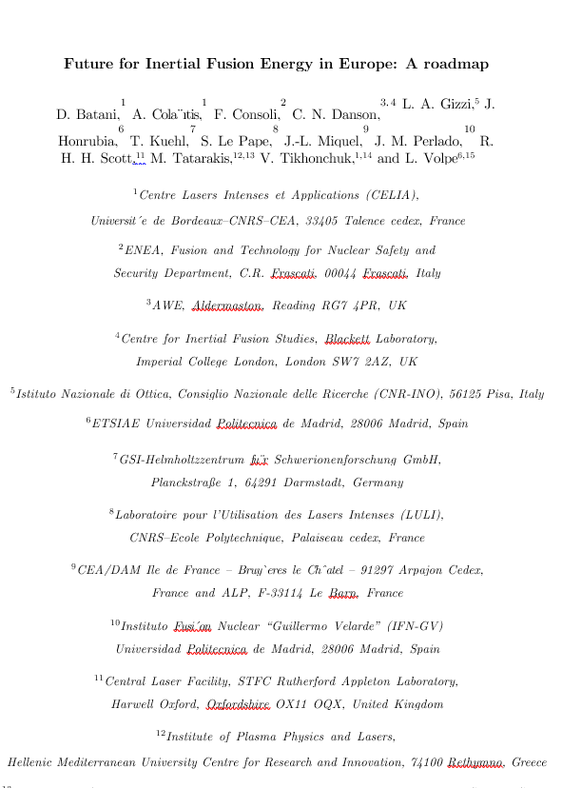
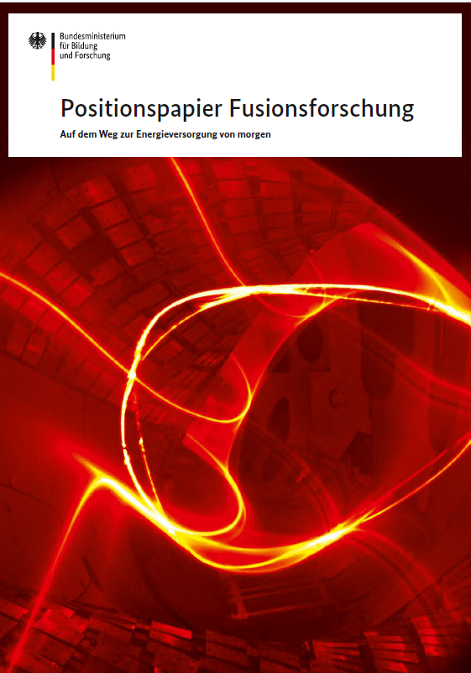
Germany’s reaction to the fusion’s hype
Helmholtz Association
position paper
09/2023 ?
Germany’s main focus and expertise remains on MCF
Clear interest exists to push German’s industry where it can make the difference in ICF related technology: laser companies (Trumpf), IFE materials and Fusion startups
Germany recognizes its handicaps
  no education program on IFE
  no active research, in particular no simulation expertise in IFE
Pulsed Light Technologies GmbH (90 M€/5Y) was grounded with the purpose to support two laser-fusion startups
On the European level, the HIPER+ initiative is discussed
08/2023
06/2023
05/2023

Slide 12
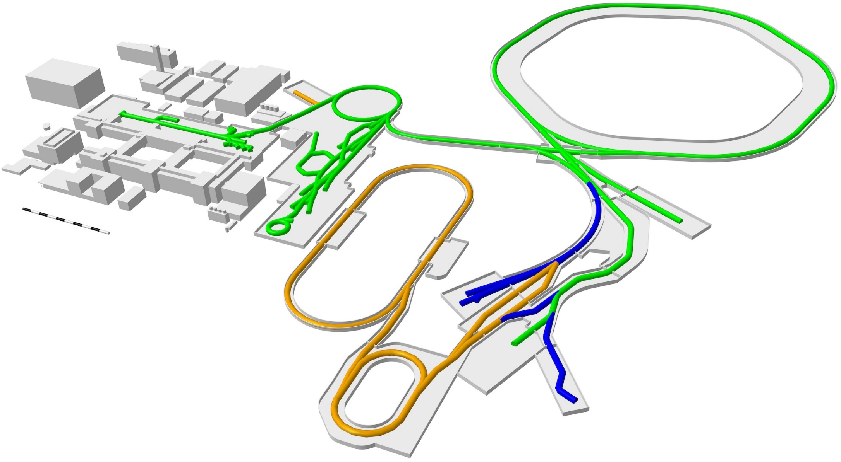
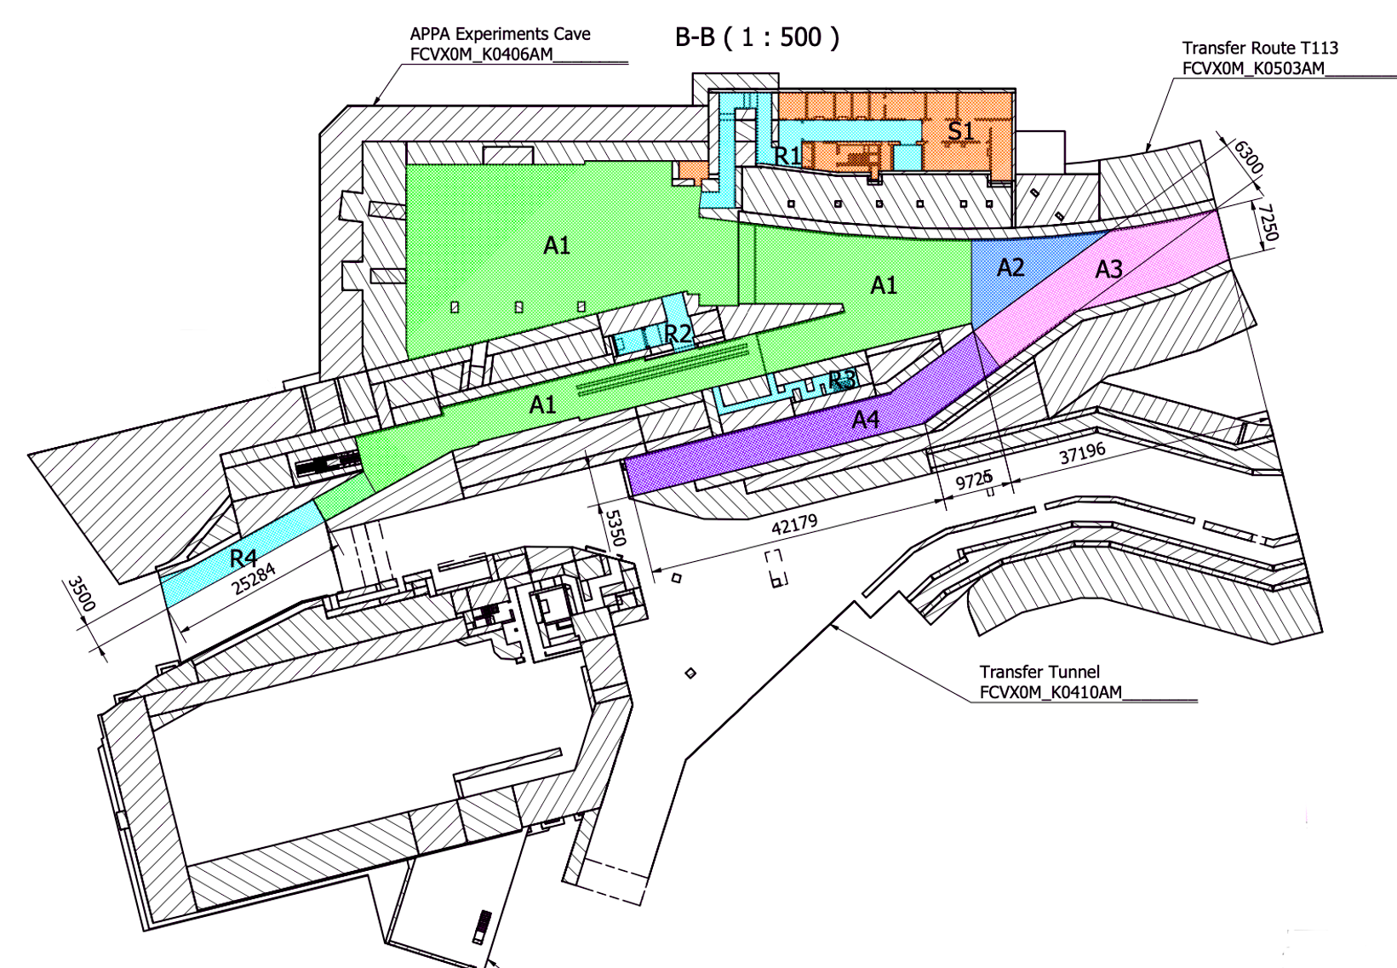
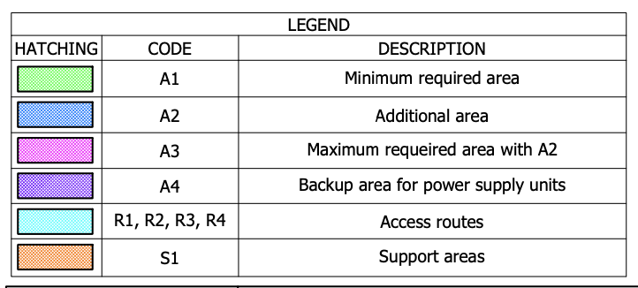
Temporary use of FAIR facility by Focused Energy
Focused Energy (FE) has approached GSI to use some of the FAIR facilities, until FAIR needs them.
An expression-of-interest between GSI and Focused Energy has been signed, underlining synergies and benefits for both.
GSI
FAIR
A1
(new building)

Slide 13
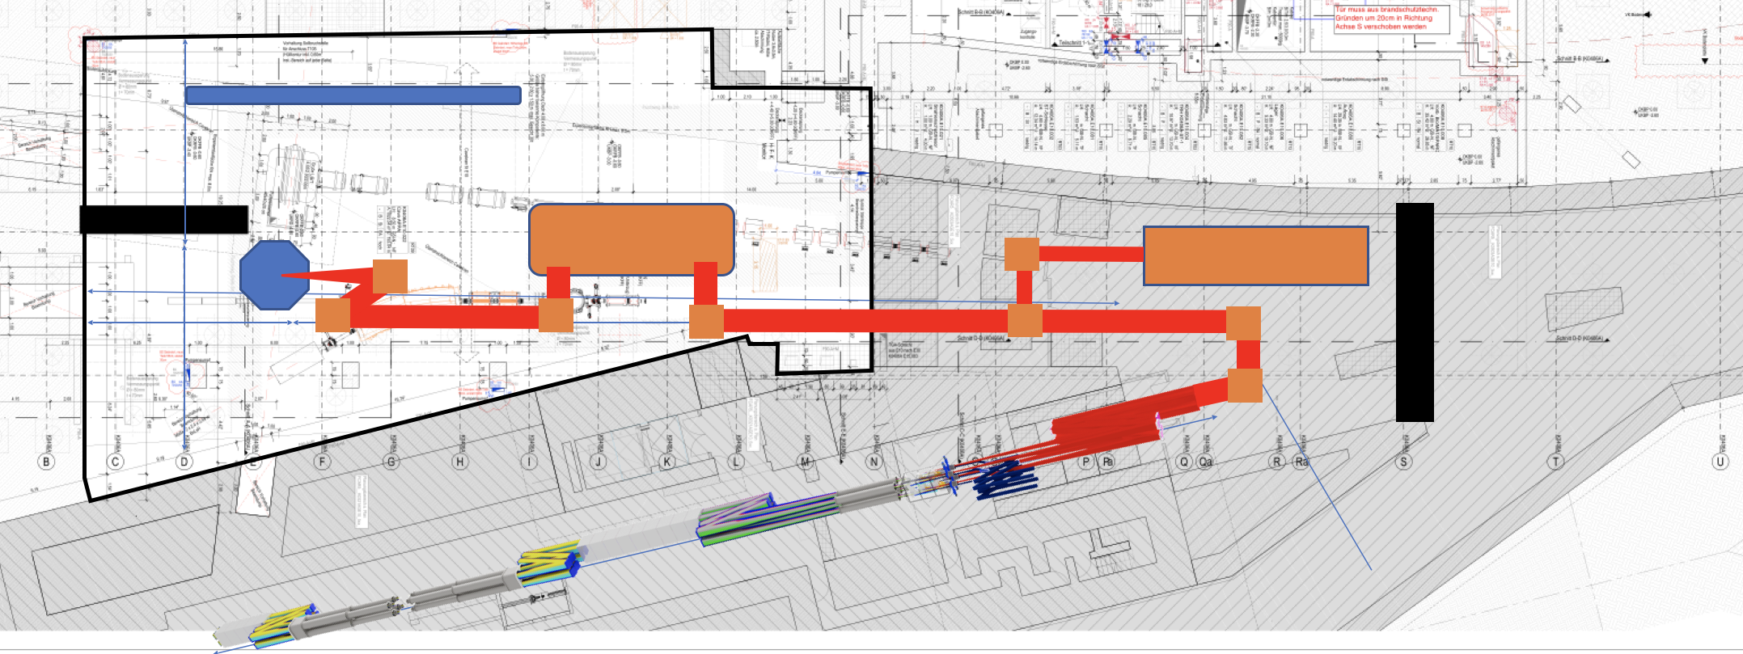
Focused Energy is currently working on a feasibility study
A MoU is in preparation.
Focused Energy aims to finish a feasibility study for the setup in the APPA cave by the end of September.
Details discussions are on-going on cost assessment:
  Costs for the technical building infrastructure (TBI) for APPA cave and P-bar tunnel
  Cost of an additional laser building
  Cost of operation (5 year basis)
proposed implementation
Advantages for FAIR
  indirect financing of the TBI for APPA and p-bar caves, via “third party”
Advantages for HED@FAIR
  scientific and technical
APPA cave
FE experiment
beam transport
p-bar tunnel
FE laser

Slide 14
Conclusion
Plasma physics has a good plan for its activities until 2028 (POF, third-party) using existing GSI facilities.
Beamtime availability is of existential importance for research
Without clear plans and timeline for the APPA cave, plans beyond 2028 remain very hypothetical und have poor scientific credibility and community back-up.
  Plasma physics is a fast evolving field – Interest may be shifting
  Competition is growing –
  Generation change –
In about 18 months, there has been a shift in German policy towards fusion from “ban to hype”.

Slide 15













Thank you
our collaborators
our sponsors

