Slide 1

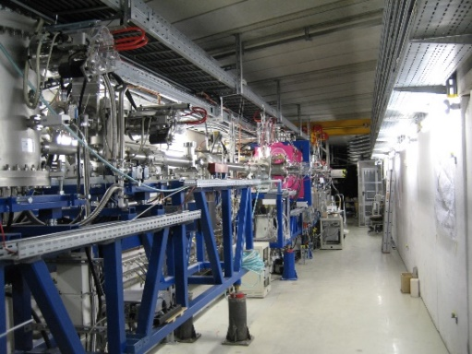
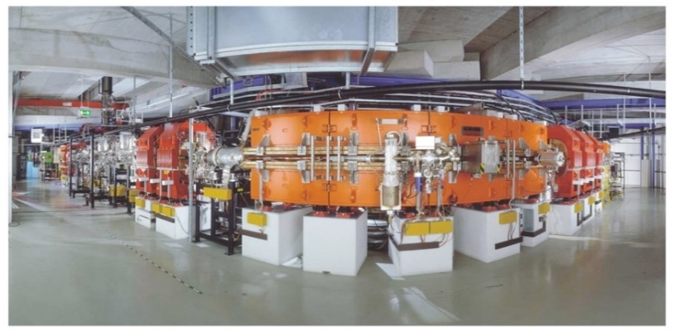
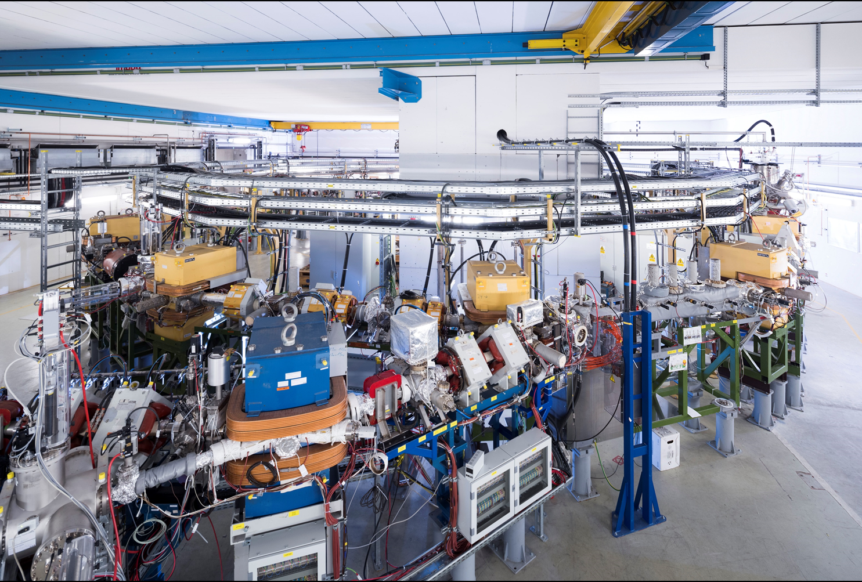
Research Strategy of the
Stored Particles Atomic Physics Research Collaboration
Atomic, Quantum, and Fundamental Physics
SPARC plans, experiments at HITRAP, CRYRING, ESR for 2026/2027 and 2028
Thomas Stöhlker
Helmholtz Institute Jena and Friedrich-Schiller University, Jena, and GSI

Slide 2

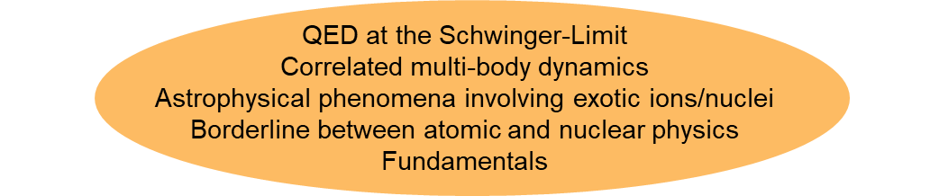
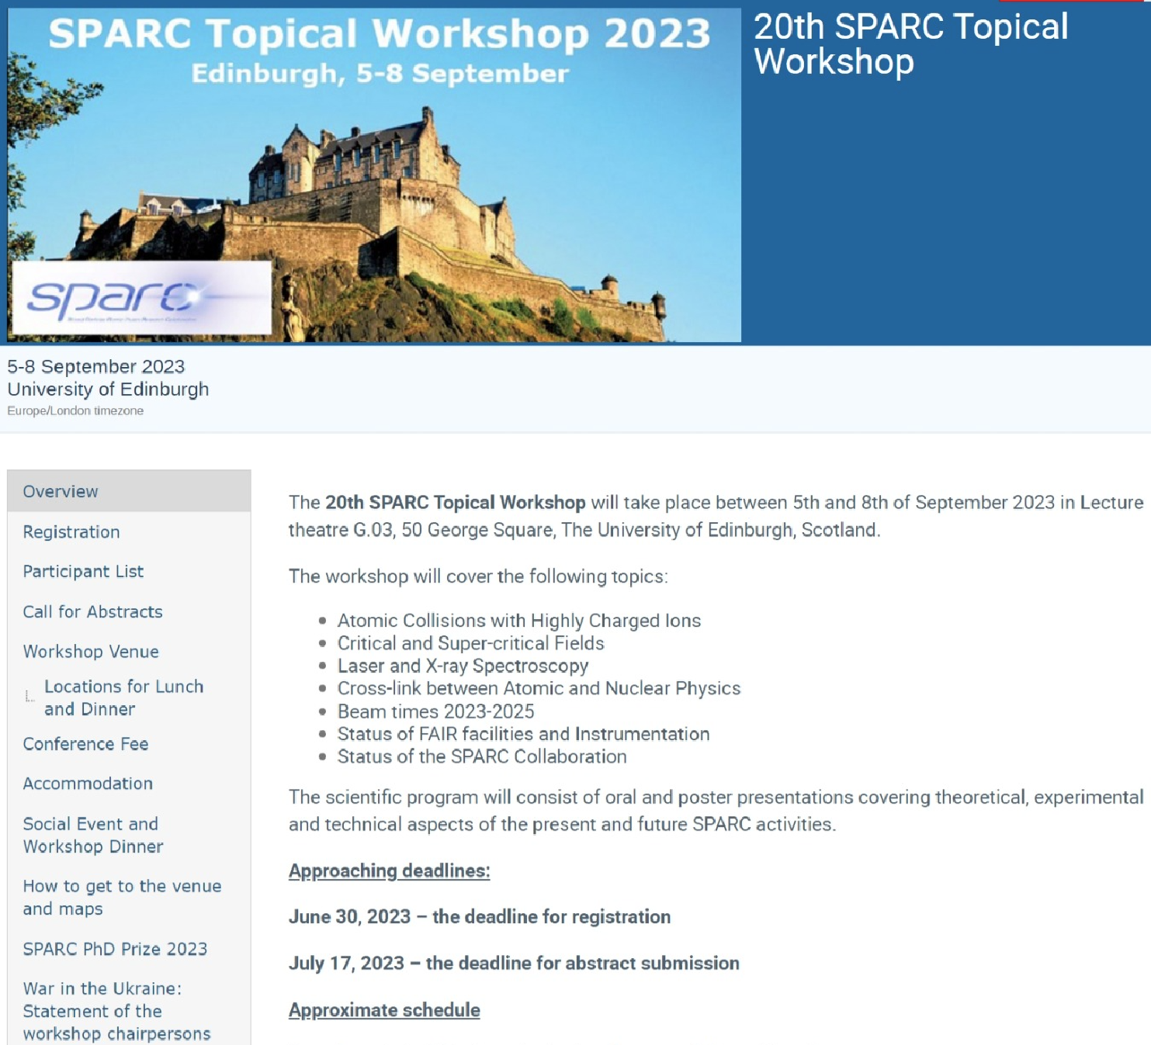
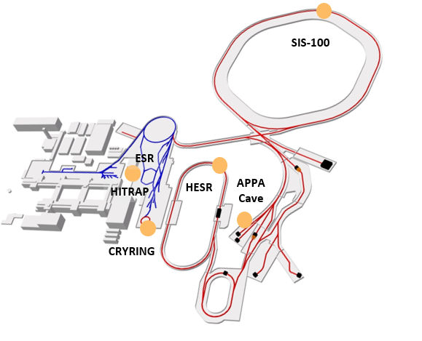
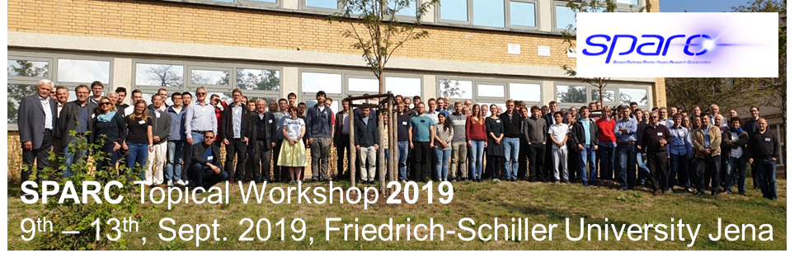
SPARC
Precision Physics, Trapping & Storage of Ions
Atomic, Quantum, and Fundamental Physics
439 members from 26 countries
(SPARC founded in 2003)

Slide 3
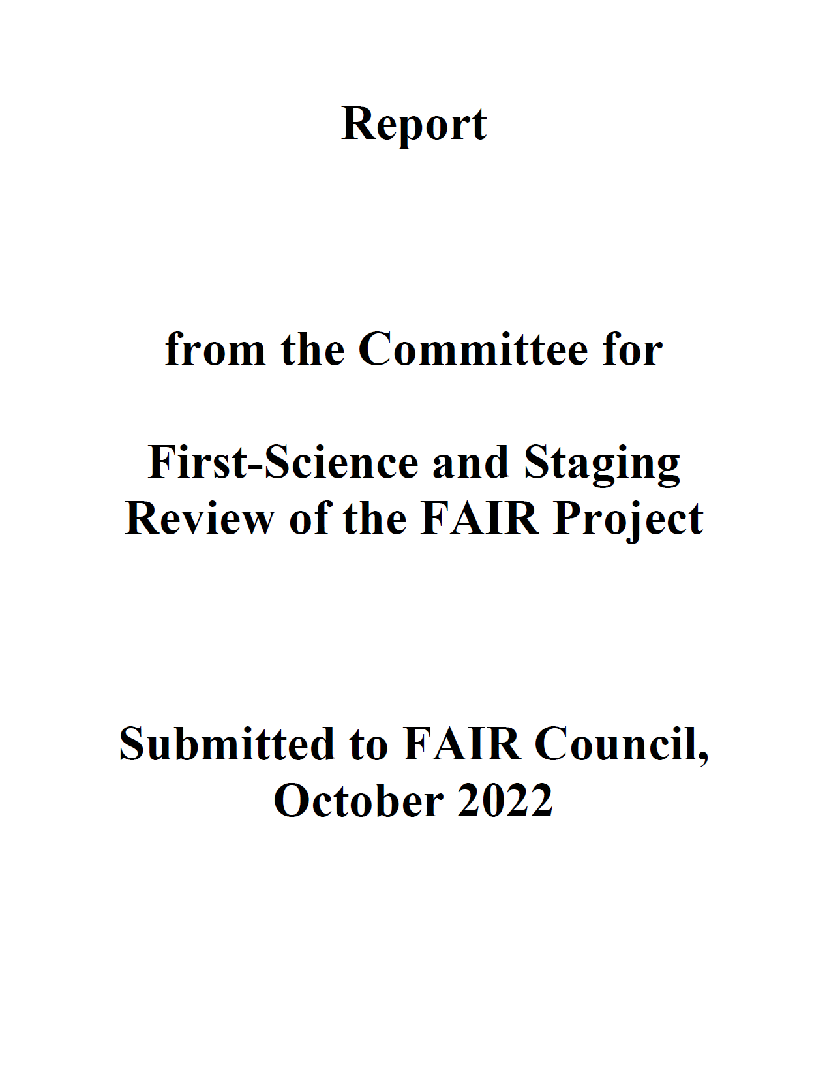
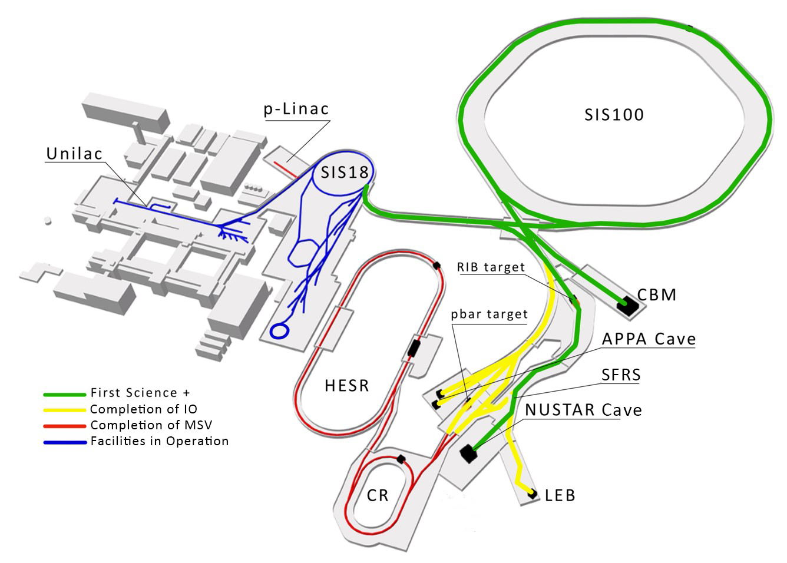
First-Science and Staging Review (2022)
“For the APPA pillar [and parts of NUSTAR], it is important for the near term that support for FAIR Phase-0 research continues at the current level. In addition to producing scientific discoveries and developing important applications, the on-going collaborations will also grow the next-generation workforce for the future of FAIR science. For the longer term, it is important that SIS100 and the APPA cave be completed in a timely manner.”
“The APPA program, as noted earlier, can continue carrying out important science with its present facilities. Moving the program into the APPA Cave will open new avenues of discovery by using the SIS100 beams with new instrumentation.” FAIR review, 2022

Slide 4
Updated Strategy of SPARC for
2023 to 2033
All activities related to APPA cave and HESR are suspended
(goodbye for atomic physics at relativistic collision energies);
Laser cooling and spectroscopy is currently the only SPARC activity at SIS100;
Clear focus on the MSV facilities ESR, CRYRING@ESR, and HITRAP;
New mid-term projects for ESR, CRYRING@ESR, and HITRAP in order to be prepared for the next 10 to 20 years.
Reliable beam time provision for the years to come – including 2026 to 2028 – is of utmost importance to stay nationally and internationally competitive as well as for the preservation of the collaboration.
To make the point clear: all physics topics related to relativistic ion beams (> 2 GeV/u) such as resonant coherent excitation, sub-femtosecond x-ray laser spectroscopy, “Heisenberg`s Dream“, test of time dilation etc. are not in the scope of our current strategy. It will be difficult to maintain our expertise, if it will be possible at all.

Slide 5
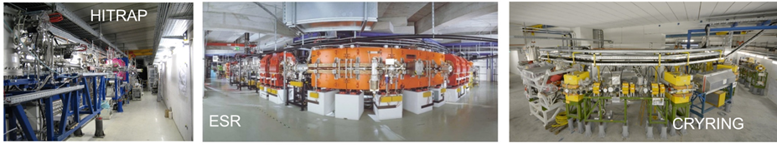
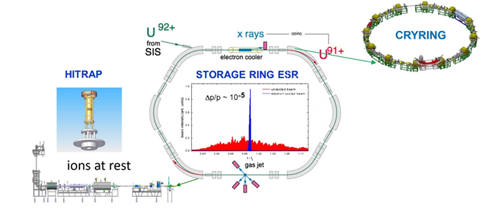
SPARC at Present GSI & FAIR Facilities
Precision Domain of FAIR: Atomic, Quantum, and Fundamental Physics
MSVc
HITRAP, CRYRING, ESR are part of the MSV
For the years to come, the current MSV facilities of SPARC/APPA are highly competitive and worldwide unique.
Notes:
need to improve slide -> who has the original?

Slide 6
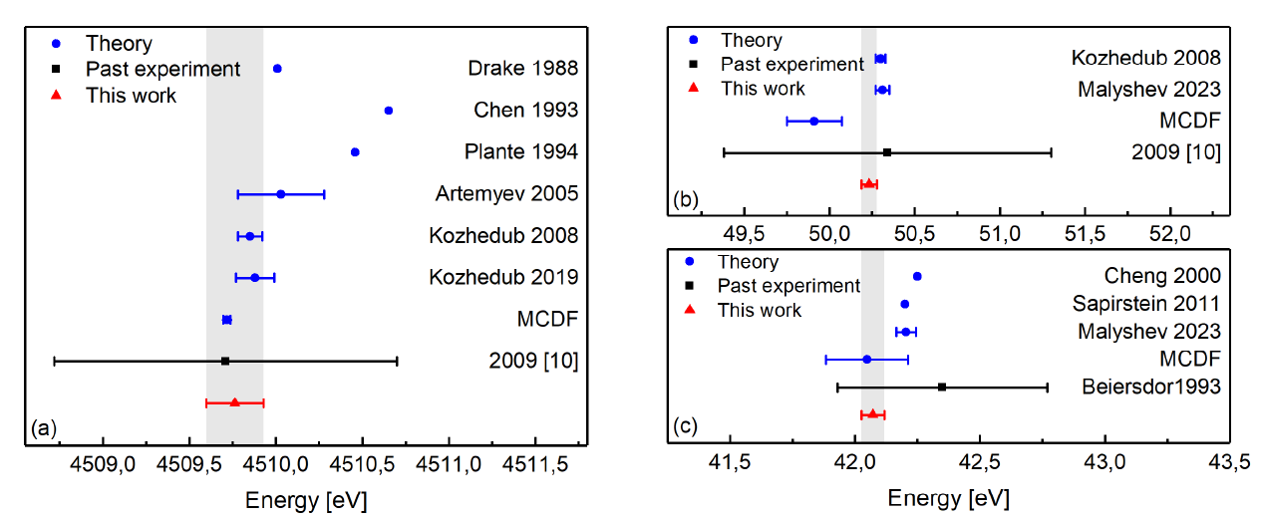
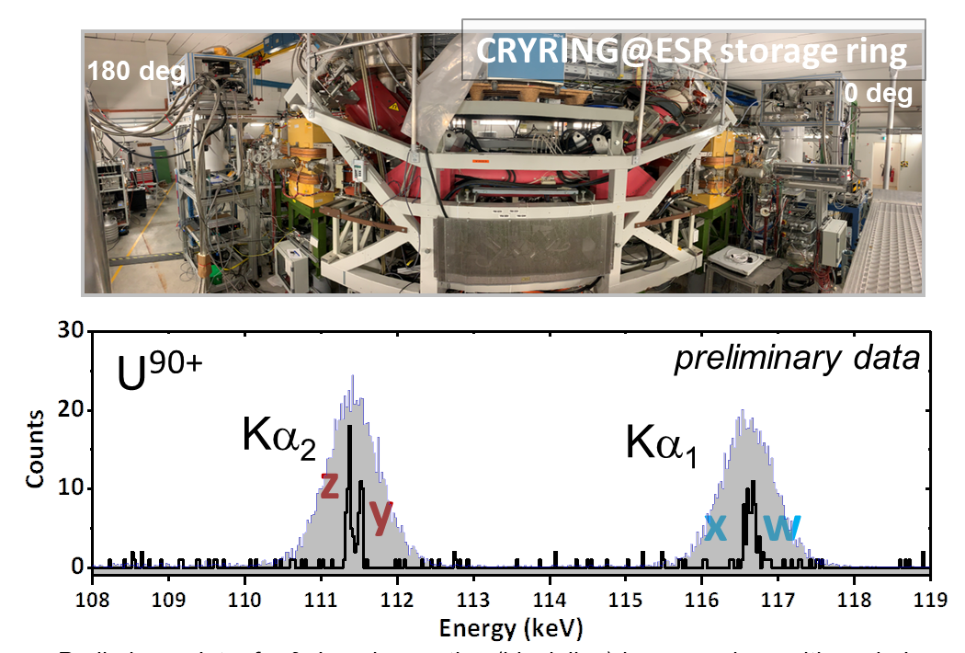
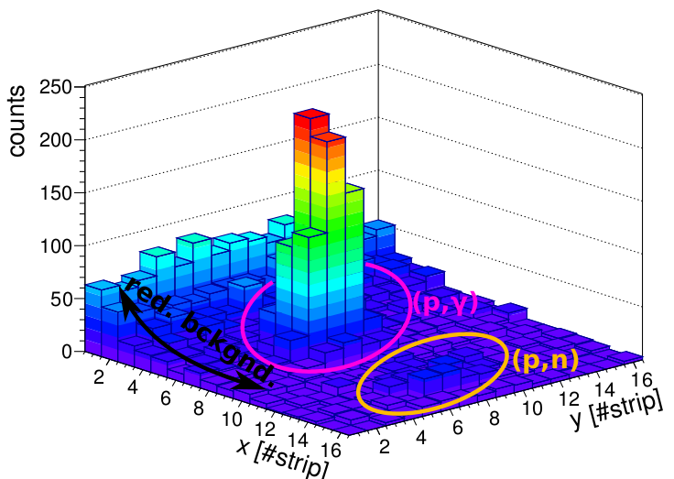
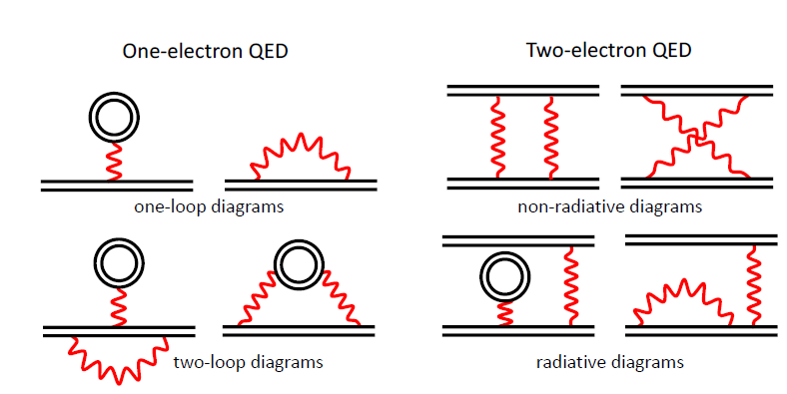
New Highlights From SPARC
Intrashell transitions
in He-like U / ESR
Groundstate transitions in He-like U / CRYRING
(p,γ) and (p,n) @ ESR
transition in He-like U (37 ppm)
First simultaneous measurement of (p,γ) and (p,n) reaction channels for astrophysical gamma process
Precision test of strong-field QED
L. Varga et al.,
submitted to PRL
R. Loetzsch et al.,
submitted to Nature
P. Pfäfflein et al.,
In preparation for Nature

Slide 7
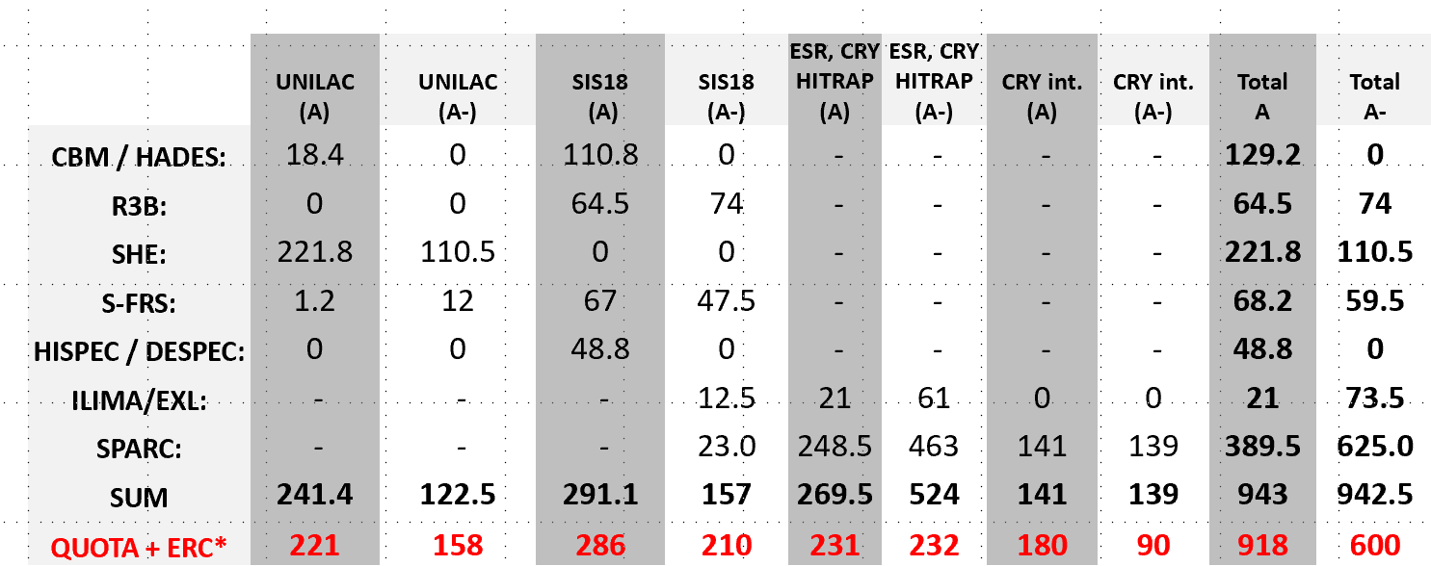
SPARC at Present GSI & FAIR Facilities
Huge demand of beam time for storage rings! The amount of available beam time is way to low.
Overbooking factor for the rings: 4.5
SPARC
A rated experiments:
10 / 425 shifts
A- rated experiments:
16 / 592 shifts
Notes:
need to improve slide -> who has the original?

Slide 8

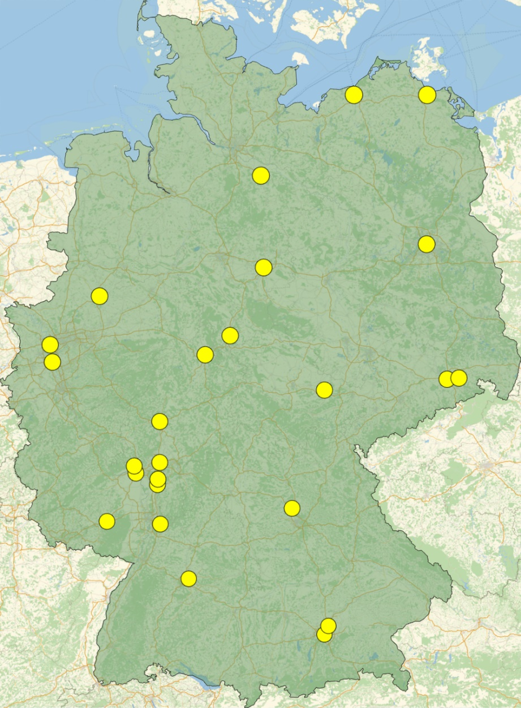
ErUM-FSP T05
“Aufbau von APPA bei FAIR”
The strategy of the national network of SPARC university groups is closely aligned to the overall strategy of the SPARC collaboration:
U Greifswald
U Rostock
Priorities for 2024-2027
Use the still available FAIR Core-Invest (committed by BMBF) for the completion of the instrumentation.
Carry out the research within FAIR Phase-0
(granted GPAC beamtimes & supporting theory).
R&D for further advancing the technologies.
U Lüneburg
HU Berlin
U Münster
TU Braunschweig
U Duisburg-Essen
U Göttingen
TU Dresden
U Düsseldorf
U Kassel
HI Jena
U Jena
HZDR
U Gießen/THM
HS Rhein-Main
U Frankfurt
U Mainz
HI Mainz
FAIR / GSI
TU Darmstadt
TU Kaisers-
lautern
U Erlangen-Nürnberg
SPARC in 2021-2024: 5.2 M€
19 funded projects
U Heidelberg / MPIK
U Stuttgart
TU München
U München
SPARC & HED@FAIR in 2024-2027: applied for 8.6 M€

Slide 9
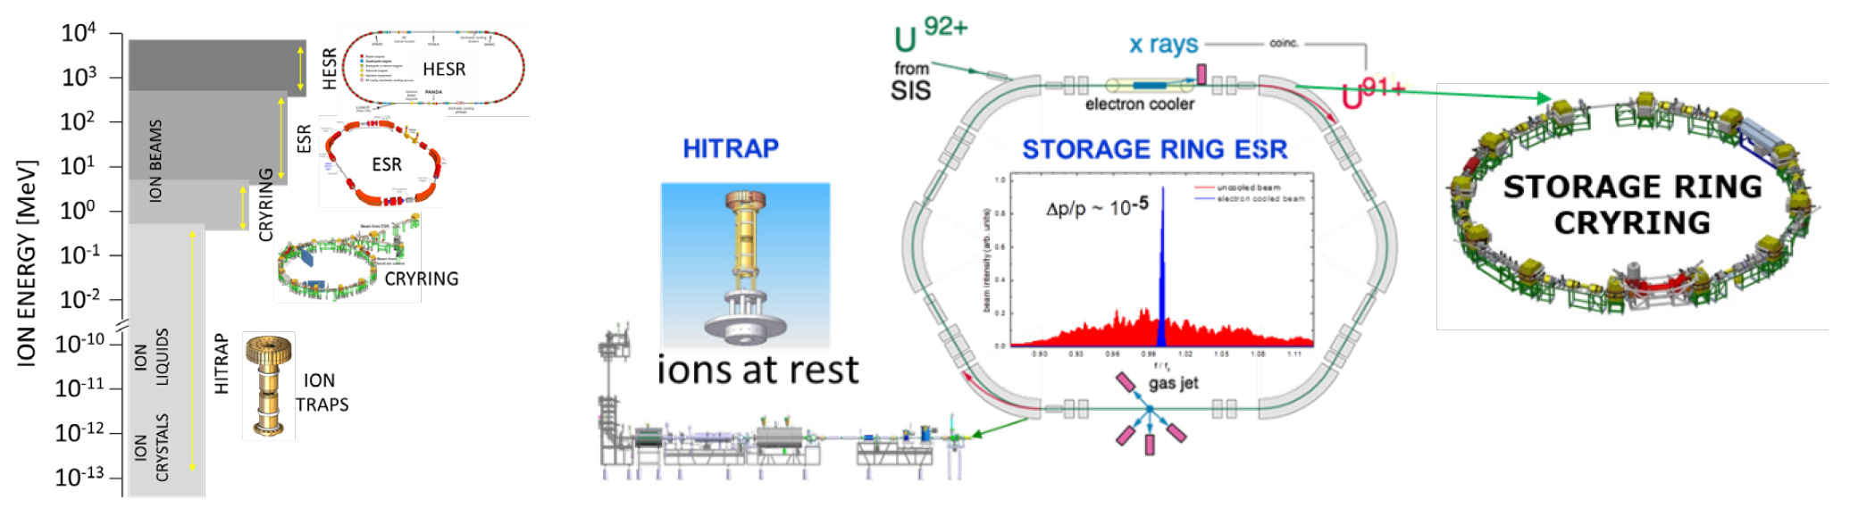

Experimental Storage Ring (ESR)
Unique facility for experiments with heavy ions in the precision domain
ESR
HITRAP, CRYRING@ESR, and ESR are part of the MSV
Challenges
ESR: e-cooler repair
Improvement of the deceleration capability / efficiency

Slide 10
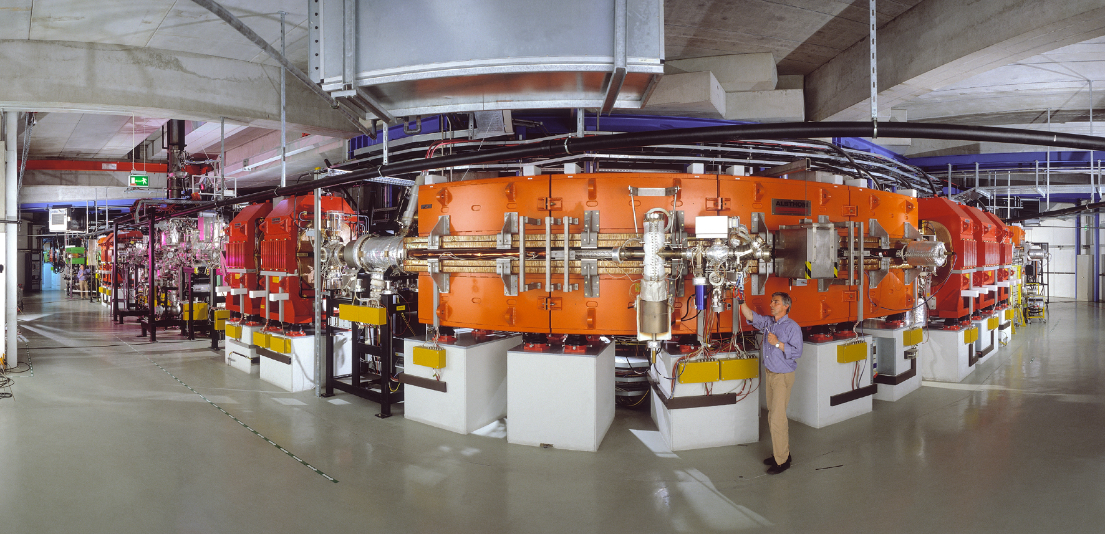



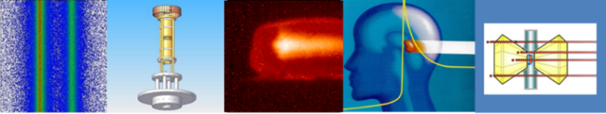




Towards Storage Ring Studies of Highly Charged ²²⁹Th using Nuclear Hyperfine Mixing
APPA
G-22-00052: A rated / C. Brandau et al.

Slide 11
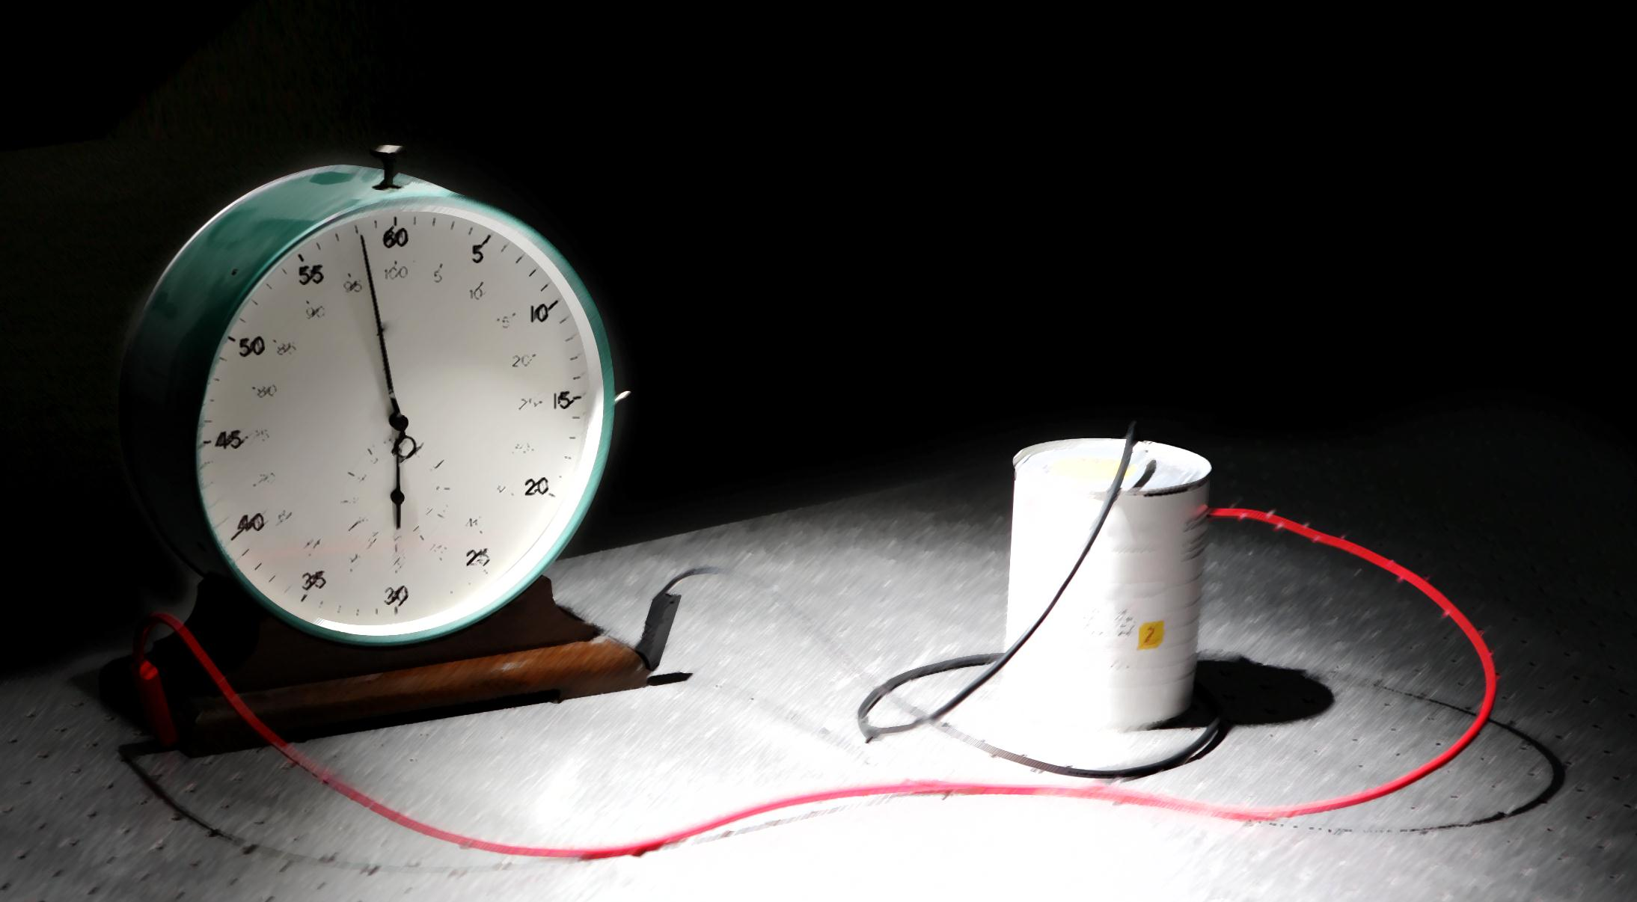
^{229(m)}Th: A Unique Candidate for a
Nuclear Optical Frequency Standard
Concept: E. Peik and C. Tamm, Europhys. Lett. 61, 181 (2003)
I^{π} = 3/2⁺ [631]
ΔE = 8.338 (0.24) eV
M1 - transition
I^{π} = 5/2⁺ [633]
“Metrology at the19th Decimal Place”
C.J. Campbell, et al.,PRL 108,120802 (2012)
© Th.Schumm/C.Brandau

Slide 12
Effect of Atomic Electrons: Nuclear Hyperfine Mixing of ^{229m}Th⁸⁹⁺
NHM as the door
opener for nuclear
laser spectroscopy
Excitation:
~10⁶ more probable
and:
~10⁶ more decay γ‘s
All the values are well
within the parameter
space of the many
laser experiments
at the ESR (since 1994)
E. Kankeleit and M. Tomaselli, Phys. Lett. 32B (1970) 613; J. Szerypo et al., NPA 507(1990) 357, S. Wycech & J. Zylicz, Ac.Phys.Pol. 24(1993)637;
F.F. Karpeshin, et al., PRC 57(1998)3085; K. Pachucki, et al., PRC 64(2001)064301; S. Wycech, EMMI Workshop 2012;
E.V. Tkalya and A. V. Nikolaev, .PRC 94(2016)014323
V.M. Shabaev, D.A. Glazov, A.M. Ryzhkov, C. Brandau, et al., PRL 128, 043001 (2022)

Slide 13

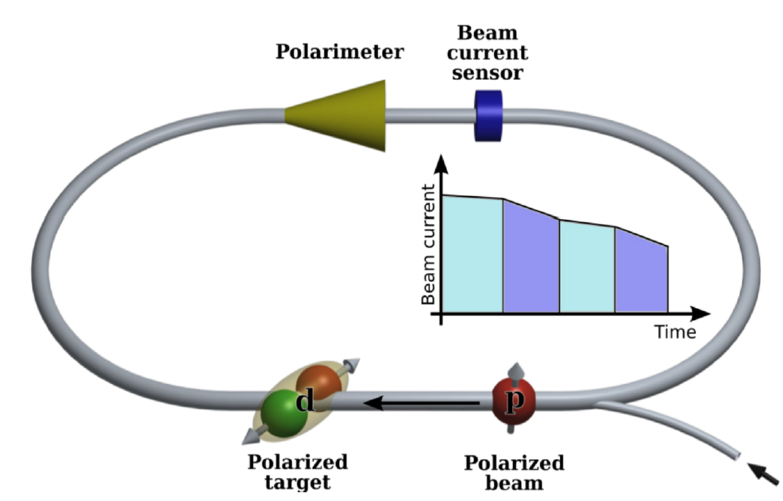
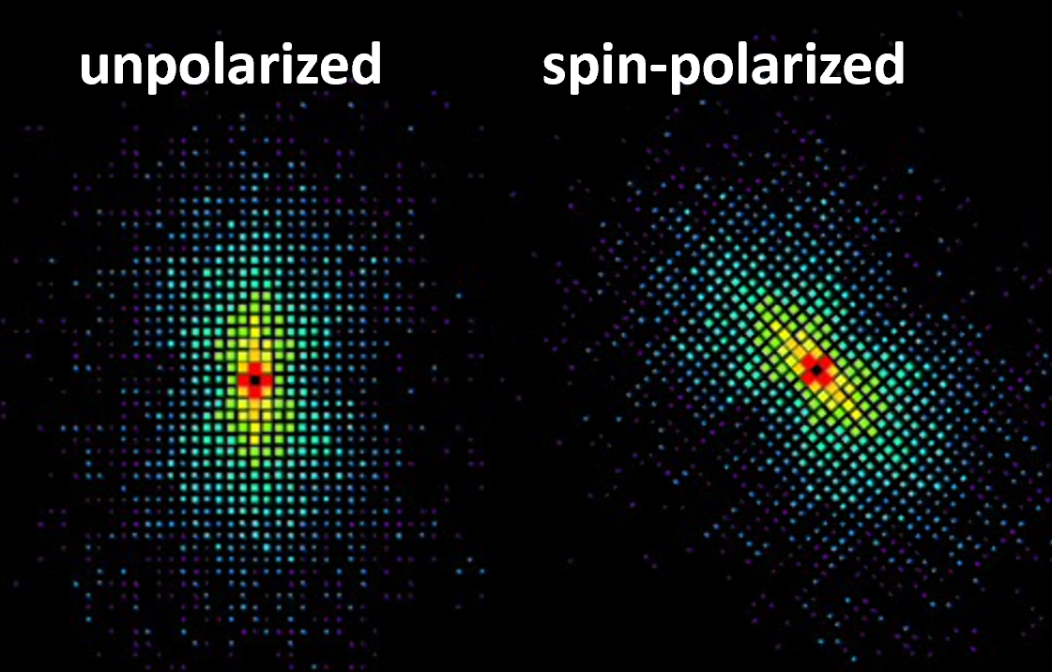
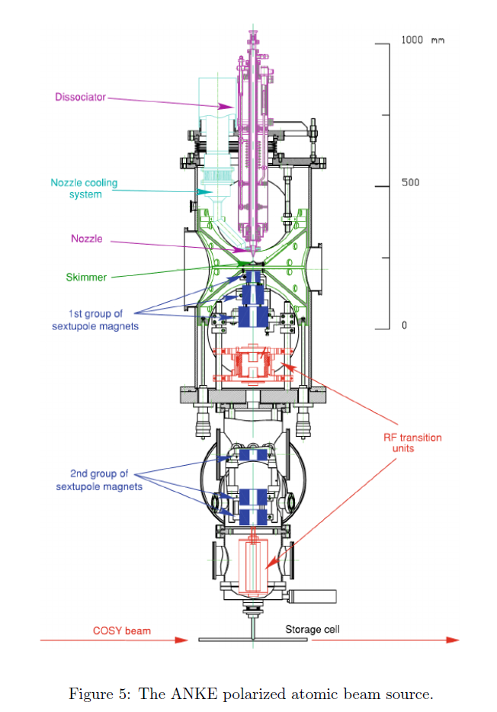
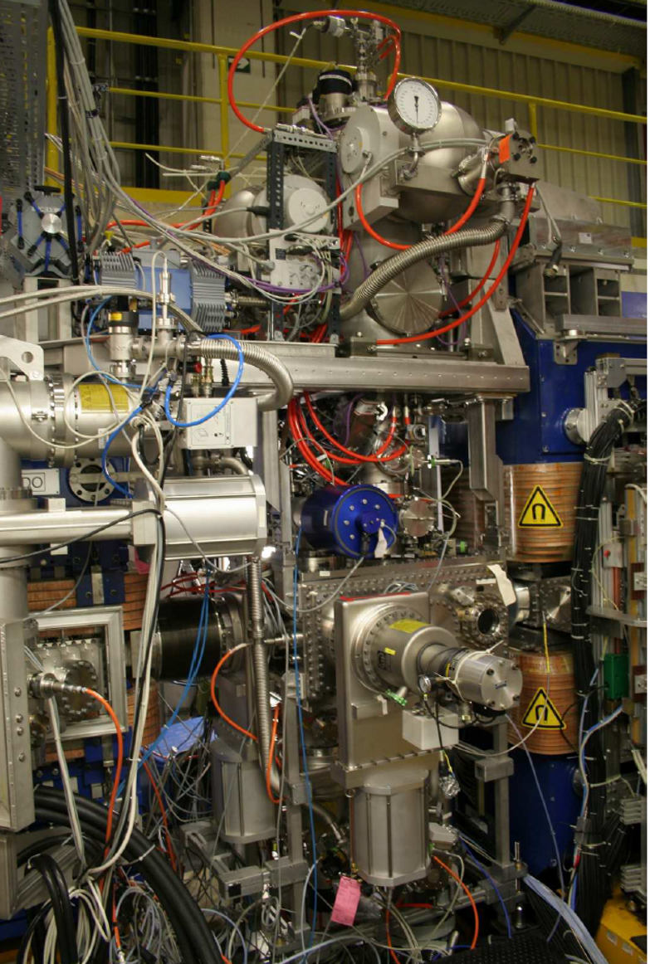
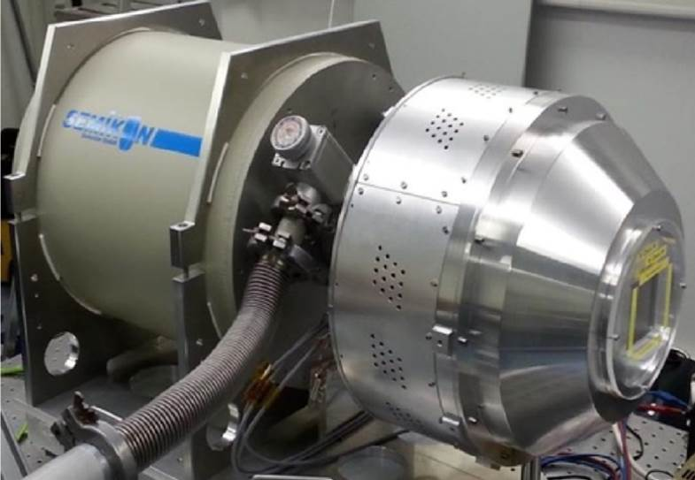




Towards polarized beams and targets at the GSI/FAIR storage rings
Exploiting synergies with IKP FZJ/GSI
Targets
Diagnostics
Topics
GPAC 2022:
LOI0073
✓
Step 1: Diagnostics
electron spin dependent x-ray radiation
neutrino recoil for bound-state beta decay
Step 2: Spin preservation
absolute capture cross-section / photon emission (Pauli blocking)
Step 3: Spin-transfer to nuclei
ions with magnetic moment ⇔ spin transfer to the nucleus)
Goal: Experiments with spin-controlled stored particles
Search for physics beyond the SM
EDM / Axion search
Atomic PNC experiments at high-Z
S. Karanth et al., PRL X in press, https://arxiv.org/abs/2208.07293
Compton imaging of x-rays
Polarized target,
atomic beam source (ABS) at COSY:
thickness of 1 × 10¹² atoms/cm²
Radiative recombination of highly charged ions with polarized electrons
A. Maioriova et al., PRA A 107, 042814 (2023)

Slide 14




CRYRING@ESR
SPARC at FAIR:
Stored and cooled ions: from relativistic energies to rest
MSVc
CRYRING is in operation since 2021 and offers beams for production runs
A continuous process of improvement (hardware, controls) and optimization (operation) is pursued
Available in stand-alone (local ion source) and in connection with ESR (especially for the heaviest highly charged ions)
Continuous development work at the local ion source: new ion species are tested
High beam time request: new setups and new topics: asto-physical reaction, ion-ion, precision spectroscopy ….
SPARC FS

Slide 15

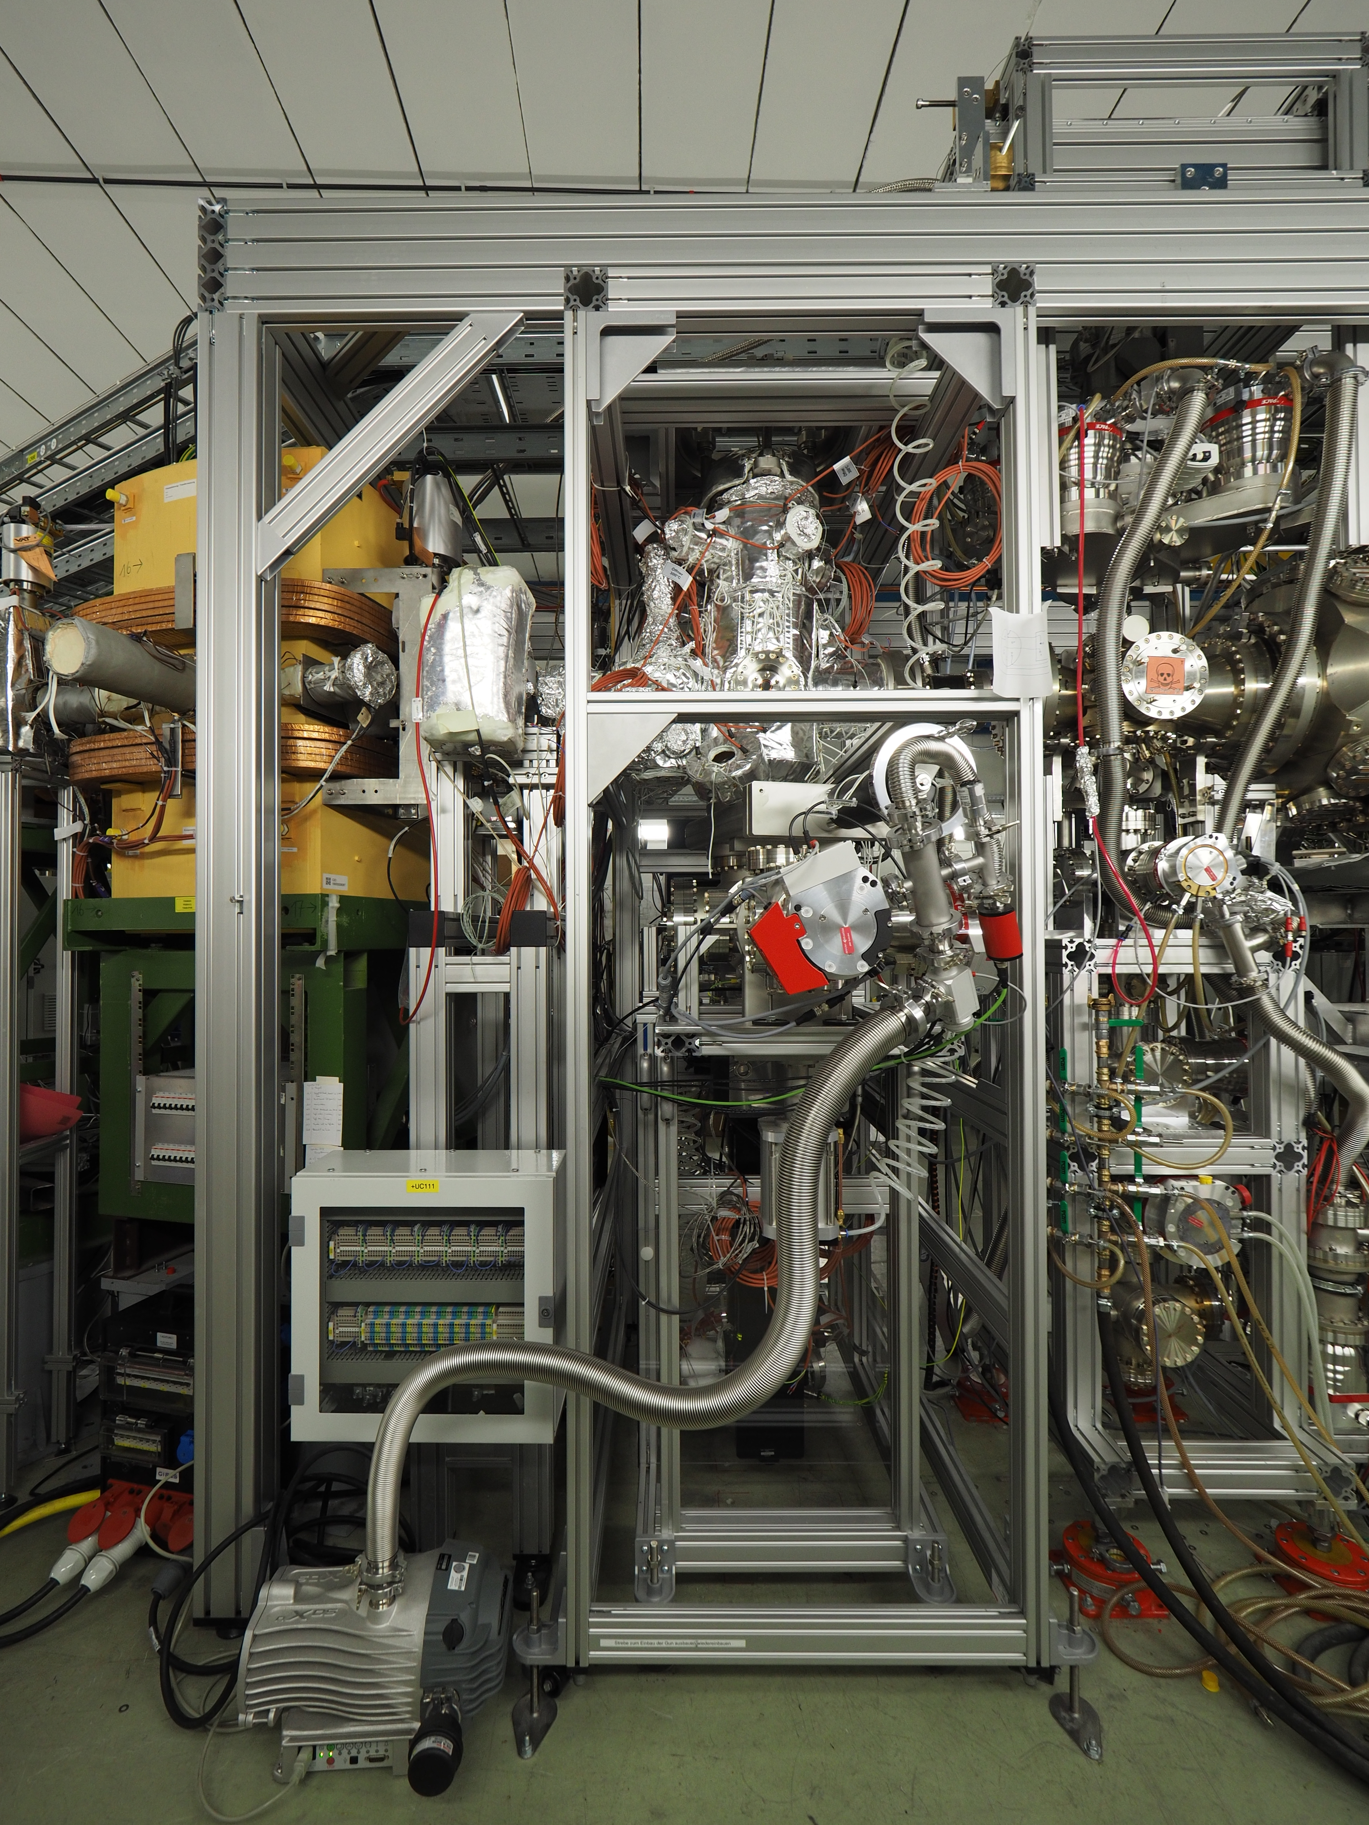

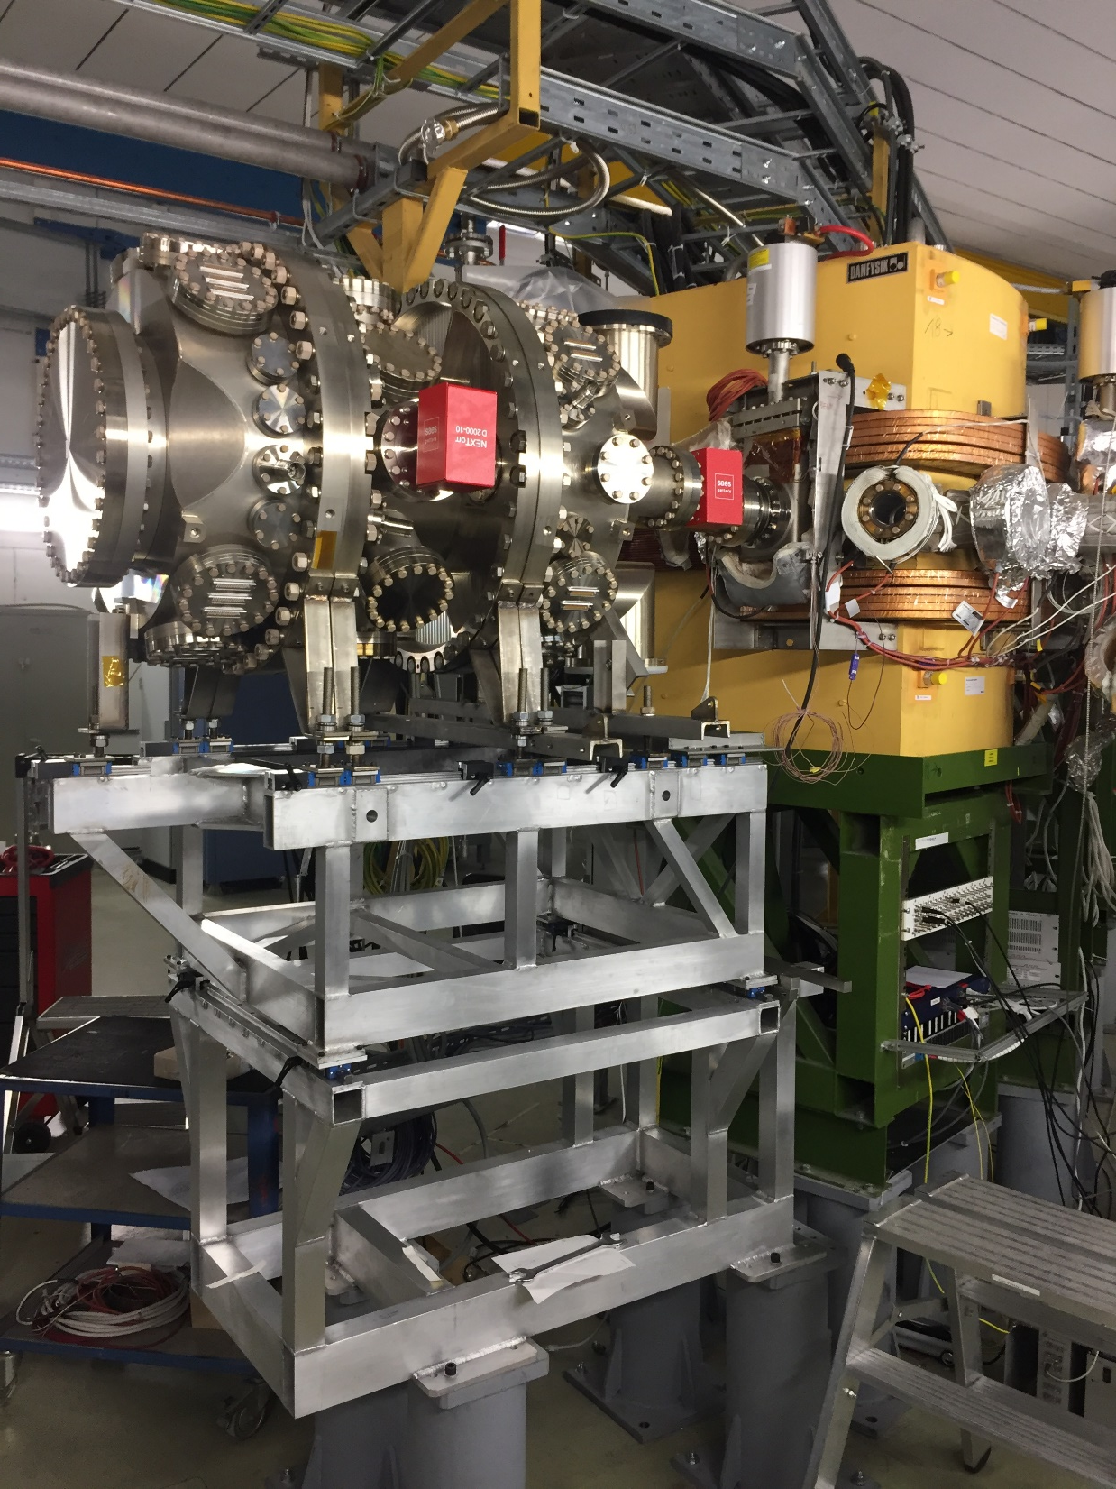
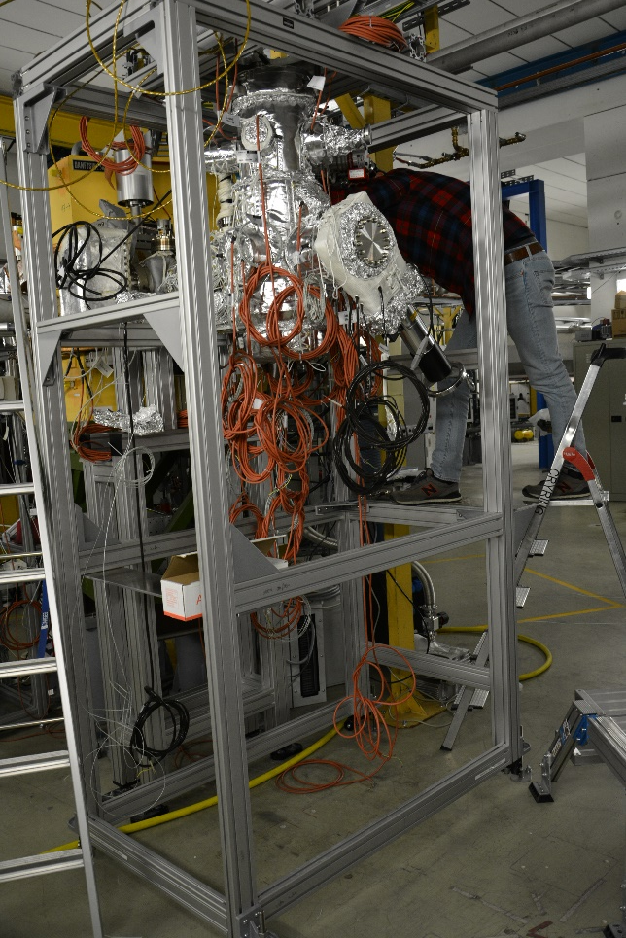
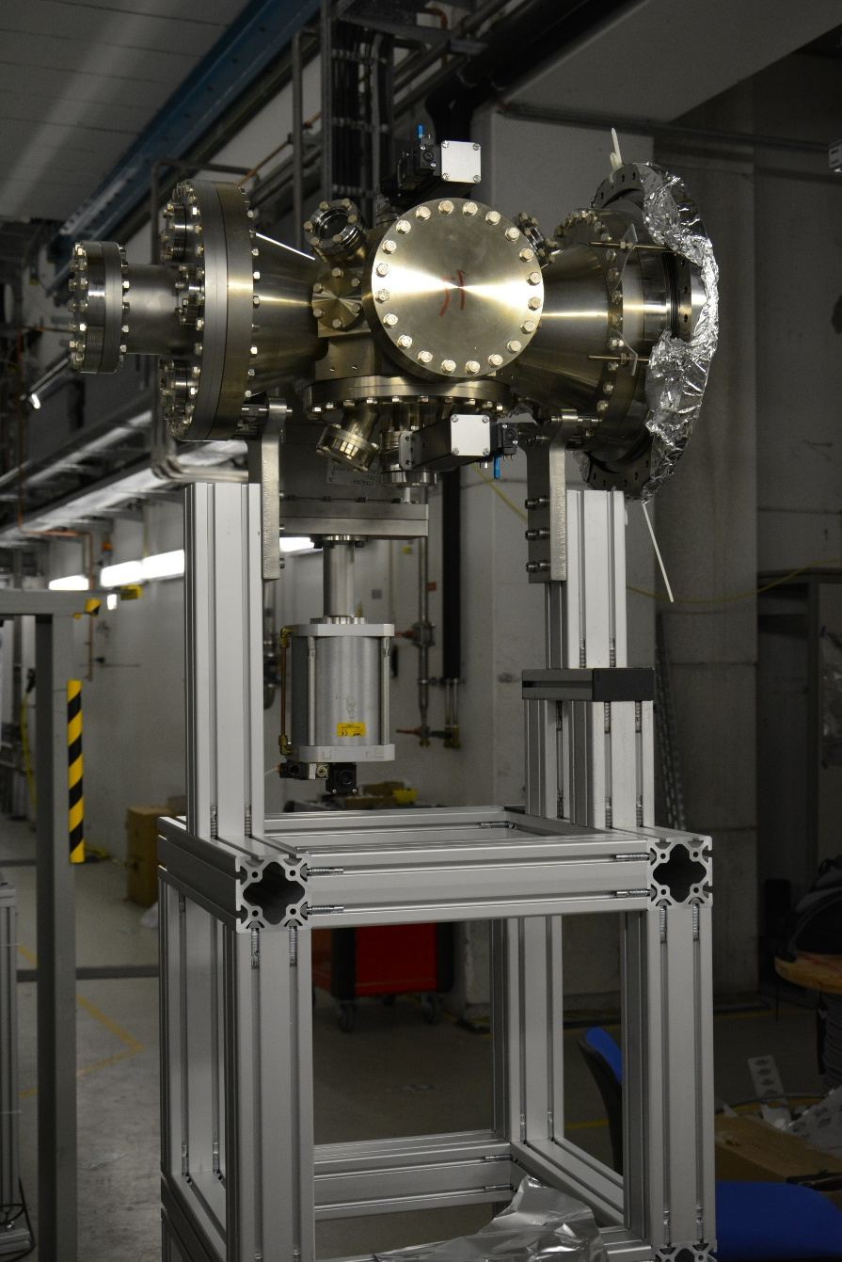



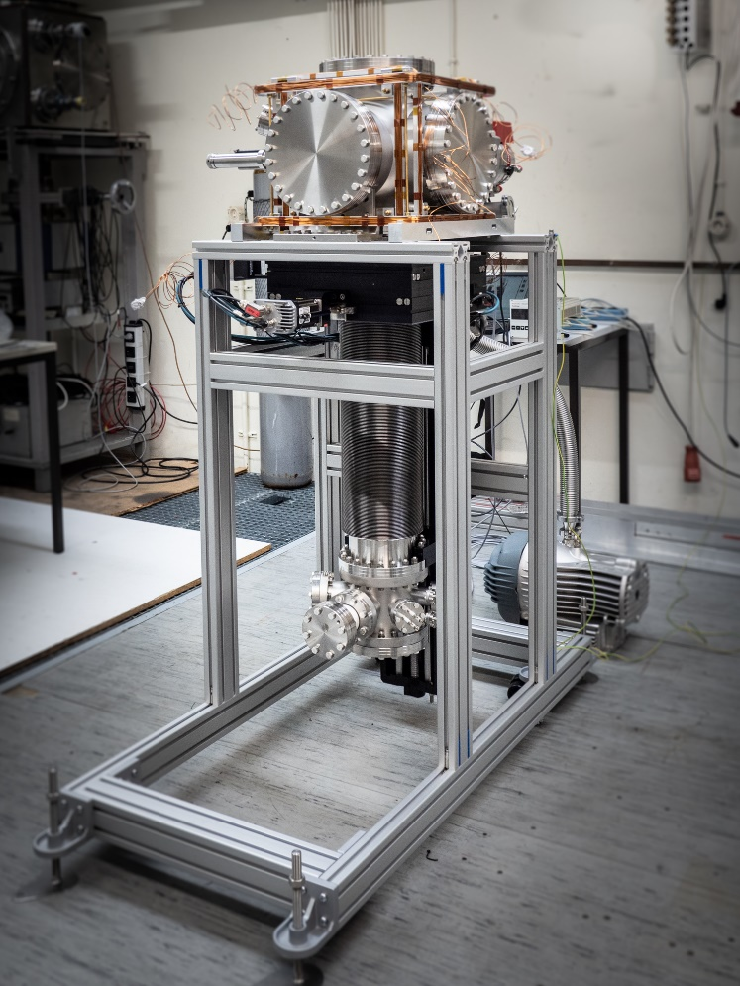
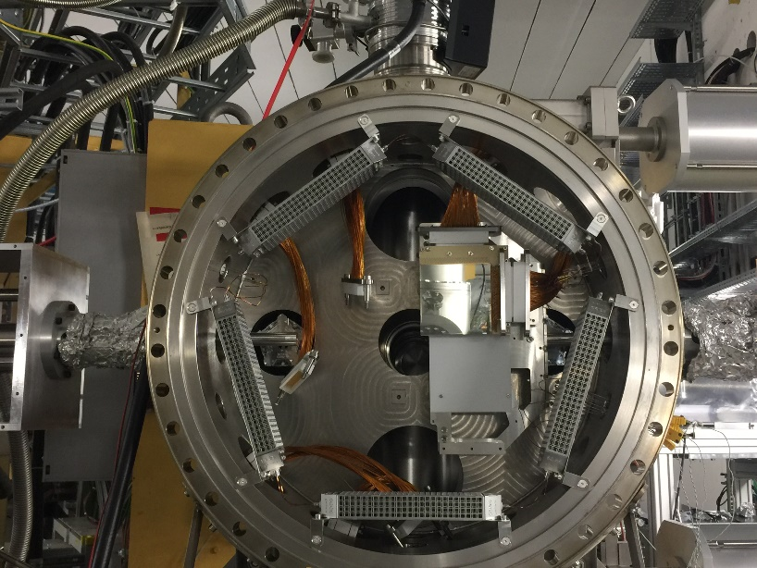


Experiment installation and testing at CRYRING
CARME spectrometer
E- transversal Target
Gas-Jet Target
Top interaction Chamber:
Gas inlet
e-target
CARME
Jet dump
e-gun

Slide 16
SPARC Experiments in 2024 and 2025
Concentration of A rated experiments at ESR, CRYRING@ESR, HITRAP & Cave A
G-PAC “A” proposals at CRYRING@ESR:
2024: 63 days of “Machine operation”,
but approved proposals only for 18 days.
2025: approved G-PAC proposals for 7 days
“A-” list fills in only partly
Mitigation: requesting machine beamtime for commissioning of experimental setups. But…
… shift allotment for G-PAC proposals at CRYRING is far to small, additional
(CRY-)PAC urgently needed!
CRYRING with local beam can run in parallel to ESR.

Slide 17
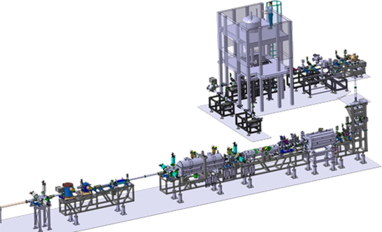
SPARC Experiments in 2024 and 2025: Setting the stage for the years to come
Concentration on A rated experiments at ESR, CRYRING@ESR, HITRAP & Cave A
HITRAP:
Finalize the commissioning of the facility. The extent of the commissioning activities will be defined according to the beam properties requested for the proposed experiments.
First pilot experiments on the g-factor and hyperfine splitting of highly-charged, heavy ions at ARTEMIS and SpecTrap.
First test experiments towards Quantum logic spectroscopy for frequency metrology of heavy and simple ions (new Helmholtz Young Investigator Group)
General remark: For regular user operation of HITRAP, beam time for machine development is needed and implies at least a 7-day machine tests per year.

Slide 18
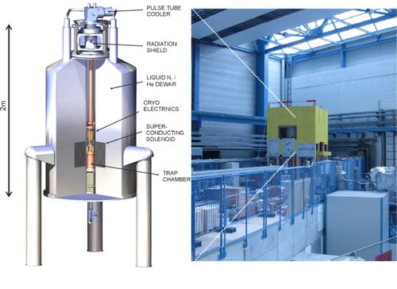
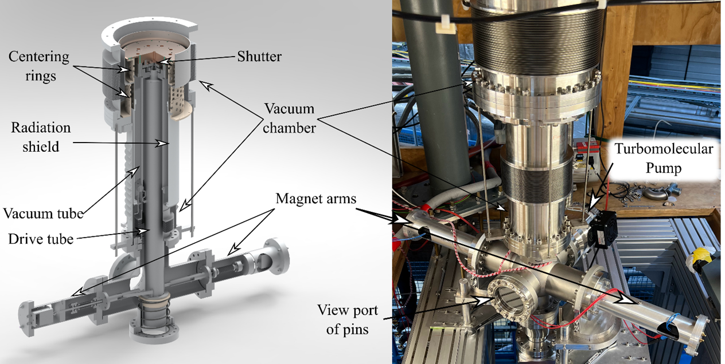
HITRAP Experiments 2024-2025
Penning Trap Experiment ARTEMIS
Preparation of ARTEMIS for beam time in 2024:
g-Factor measurements on ²⁰⁹Bi⁸²⁺
Commissioning of the cryogenic valve
Opening times of cryogenic valve: < 100 ms
Measured vacuum pressure inside the trap: 10⁻¹⁵ mbar by means of N⁴⁺ ions life time
Achieved storage time: several days
Injection of highly charged ions from HITRAP facility is needed
Alternative for first measurements: A¹³⁺ or Ca¹⁵⁺ from EBIT.
Precise measurements of magnetic moments and transition wavelength of forbidden transitions in highly charged ions.

Slide 19

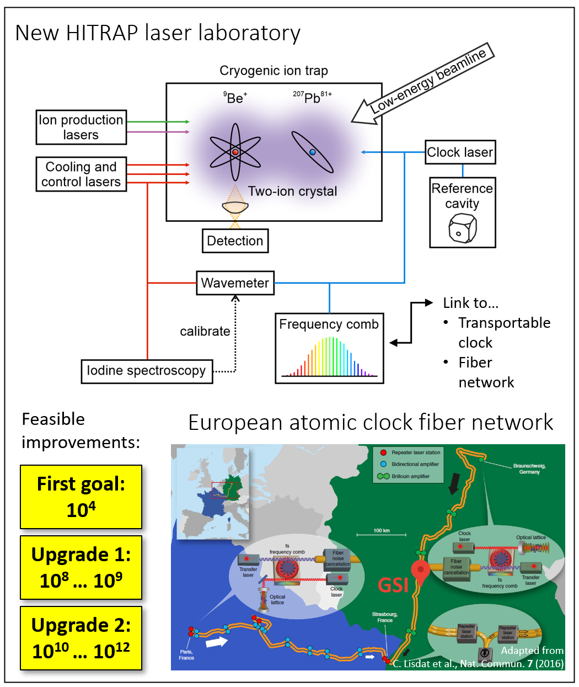

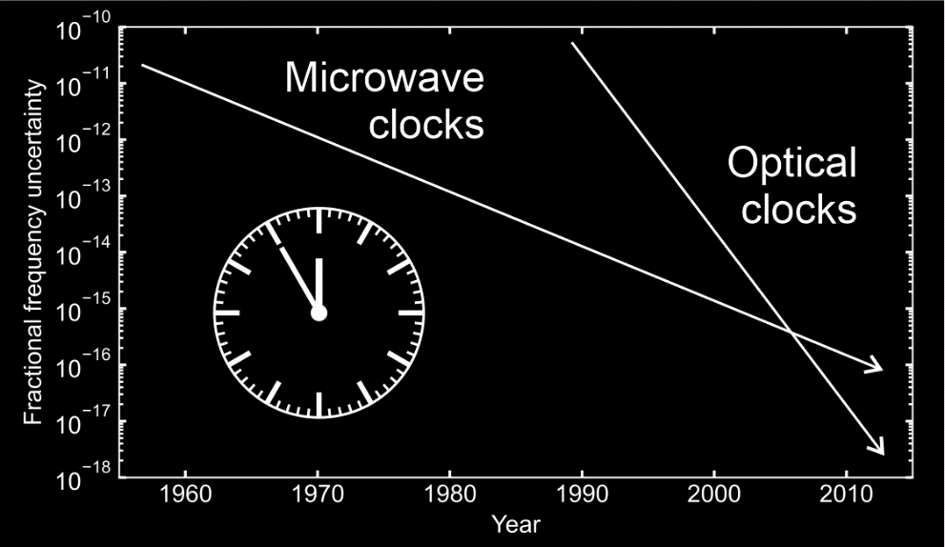

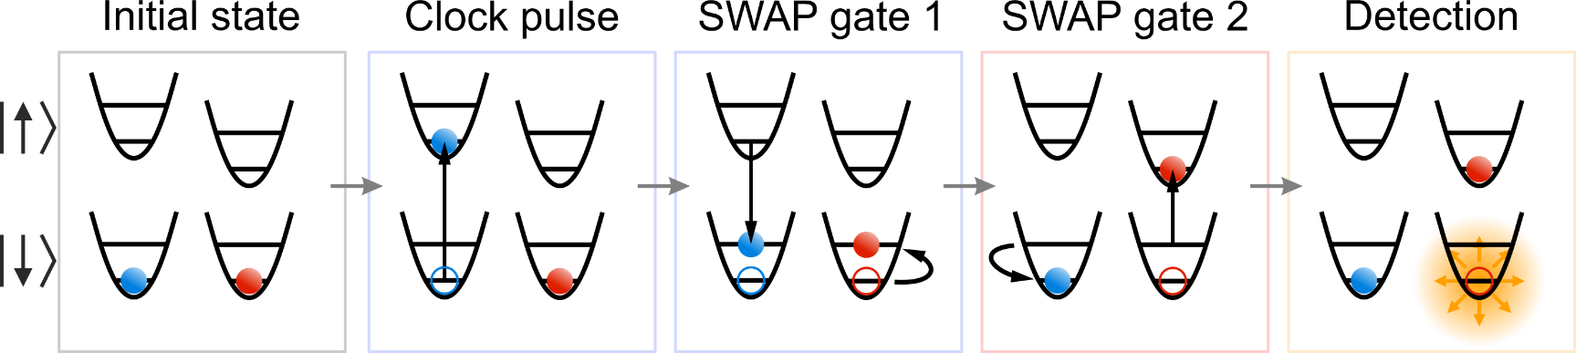
Quantum logic clock / Peter Micke HYIG
(start mid 2023 till mid 2028)
Enables unprecedented measurements of sensitive atomic or even nuclear systems that can serve as clock ions
Optical transitions in (heavy) highly charged ions
Nuclear transition
Transitions in molecular ions
Photograph
Objective:
Tests of fundamental,
atomic, and nuclear physics
Sensitive quantum sensors for beyond Standard Model physics
Future perspective:
Link to other optical clocks or even European atomic clock fiber network
Optical clocks are the most accurate measuring instruments
Quantum algorithm
Clock ion
Be⁺

Slide 20
Strategy and Requirements Beyond 2024-2025
The SPARC activities beyond 2025 will follow two lines:
continuation of the SPARC experiments rated with A and A- and possibly new experiment proposals.
installation, commissioning and use of new setups which are ready for use or already funded and in construction.
New mid-term projects (partly already initiated)
For HITRAP, CRYRING@ESR and ESR further technical improvements are expected beyond 2025 (e.g. ECR source for CRYRING@ESR).
Support by the host lab for the operation of accelerators is required. Also support by the various technical groups for e.g. installation of equipment and experiments is necessary.
Most important: Experimental areas for the preparation of equipment to be used in the experiments.

Slide 21
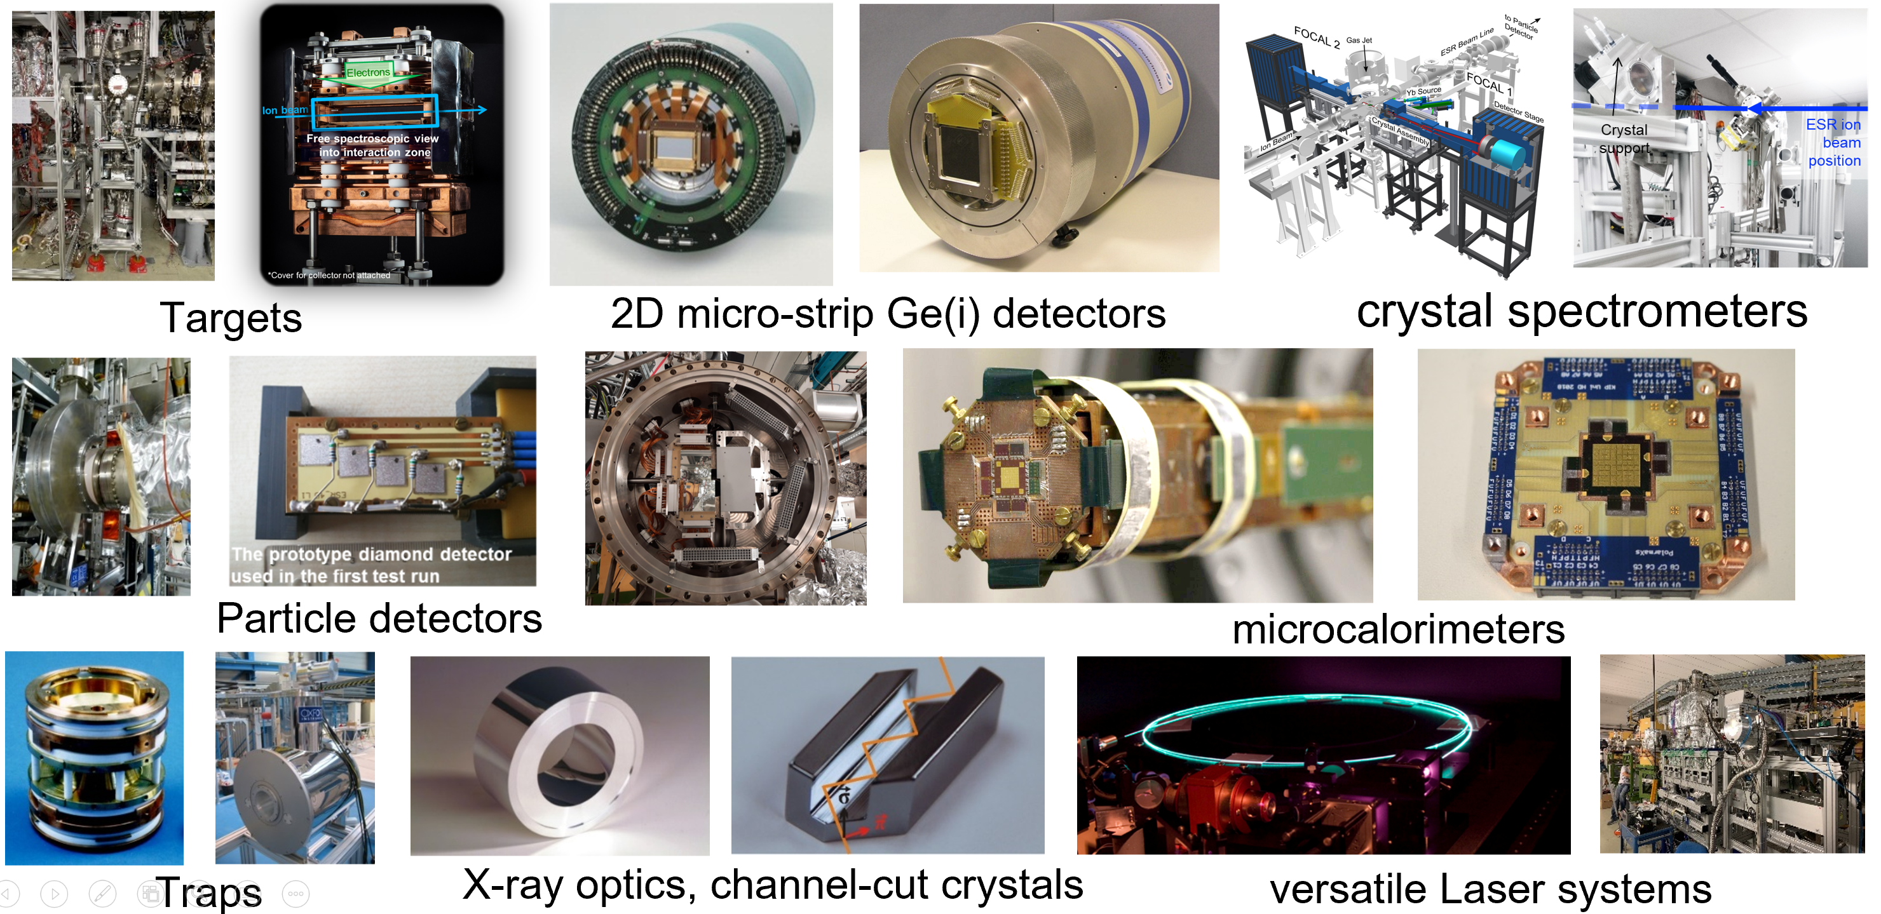
Sophisticated and Versatile Instrumentation
SPARC/APPA: Besides the facilities, instrumentation is of utmost importance. Already the large portfolio of novel FAIR instrumentation guarantees for a rich science research program at the existing facilities HITRAP, CRYRING@ESR, and ESR.
Most equipment is stored and maintained by university groups outside the campus of GSI/FAIR.
For setup assembly and testing, a work area outside CRYRING@ESR is an absolute necessity.
Notes:
do we need to repeat the details on the PAC?

Slide 22
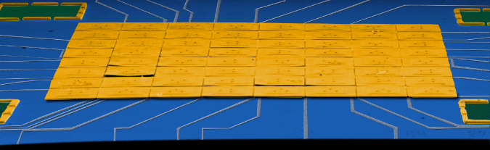
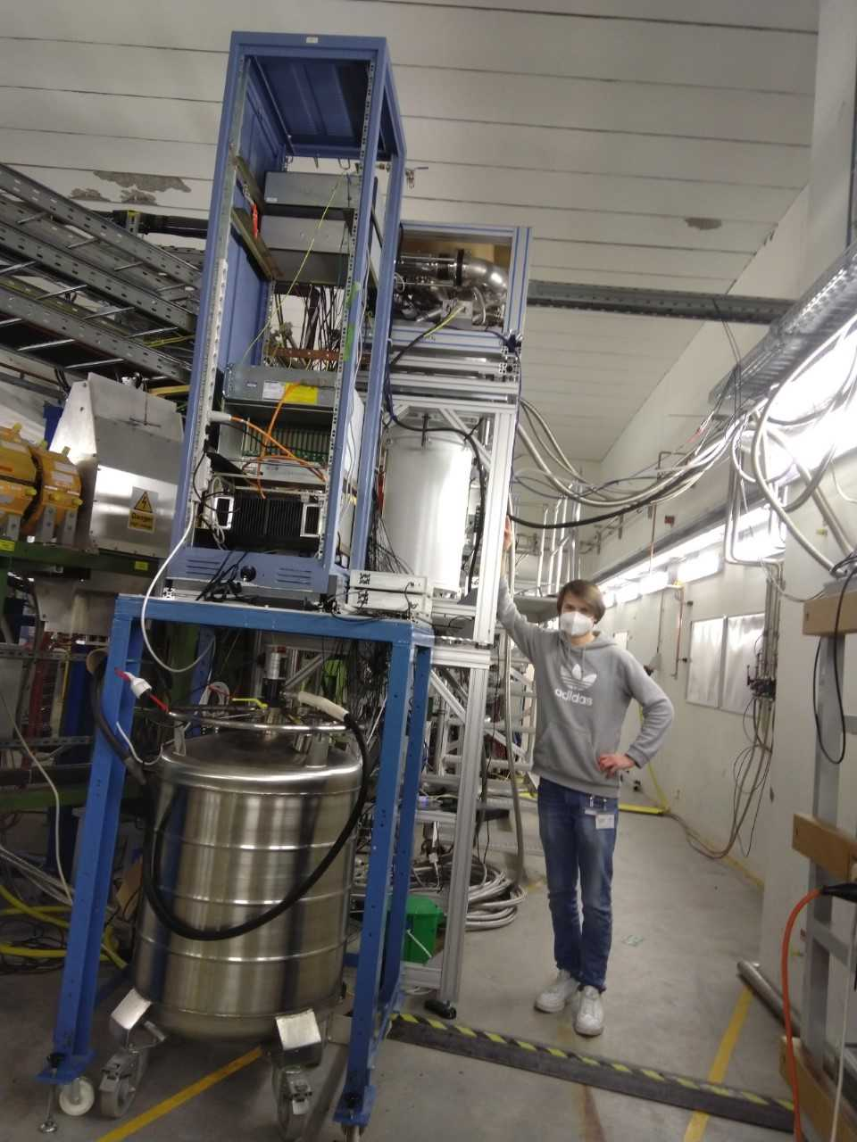
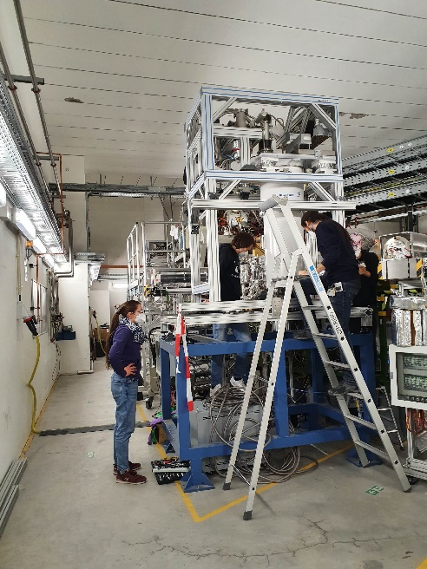
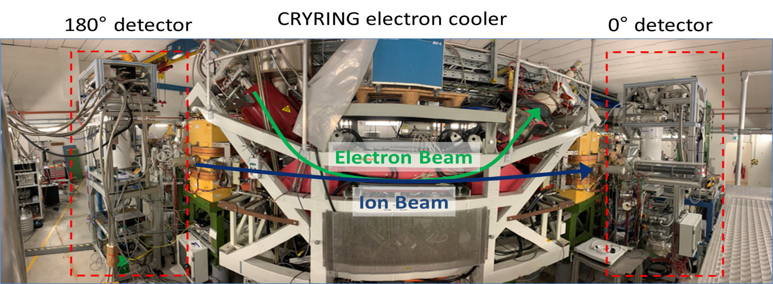



E138 1s Lamb Shift in H-like uranium
(test of non-perturbative QED in the Schwinger limit)
High resolution performance of the detector not affected by the electronic environment of CRYRING (resolution ≈ 70 eV@ 100 keV)
Quantum sensors @50 mK currently extended from 64 to 1000 pixels via multiplexing (cryogenic electronics) // collaboration between KIT, U Heidelberg, IPHT, GSI, HI-Jena
But Δt between experiments 4 years: find other places e.g. AD, ISOLDE, PSI, DESY
Implementation of two novel high-resolution, cryogenic μ-calorimeters with 64 pixel each. Rigorous digital signal processing required.
X-ray emission at CRYRING@ESR (electron cooler)
c Michael Lestinsky
Günter Weber et al.

Slide 23
Concluding Remarks
For the years to come and until APPA cave and HESR are online, sufficient beam times at HITRAP, CRYRING and ESR are of utmost importance:
          Producing scientific results on highest international level to compete with new emerging research fields.
          Preservation of the collaboration and strengthening SPARC related university networks.
          Training, education and promotion of next generation of scientists.
          Continuous development of the science program, including theoretical concepts and novel instrumentation.
          R&D to keep instrumentation on highest technological level.
          Also important:
          To fulfill our commitments related to SPARC activities: ERC grants, Young investigator groups, 3rd party projects such as BMBF-Verbundforschung etc.
          Cooperation and competition between research programs and centers within Helmholtz (milestones) => GSI base budget.
Reliable support by the host lab for the operation of accelerators is required. Also support by the various technical groups for e.g. installation of equipment and experiments is necessary.

Slide 24
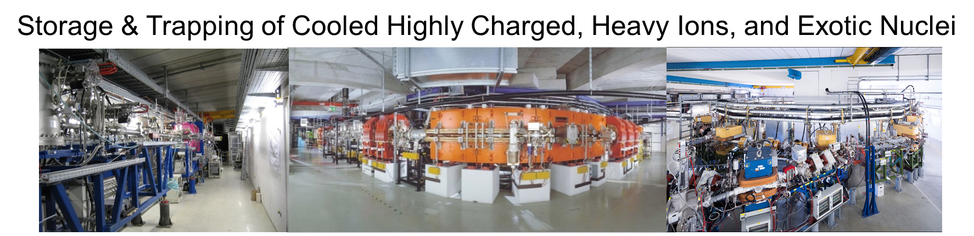
“Decisions and resource allocations for GSI and FAIR need to be optimized across the whole GSI and FAIR complex, so that the imperatives of scientific discovery, FAIR beam commissioning, and affordable facility operation can be achieved.” … “Delivering on fewer than all three imperatives will not meet scientific, public, and political expectations”. FAIR review, 2022
Thank You for Your Attention !

Slide 25
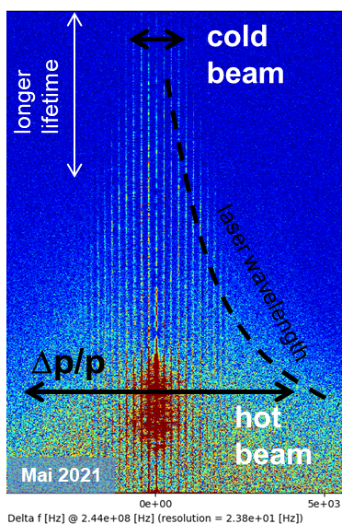
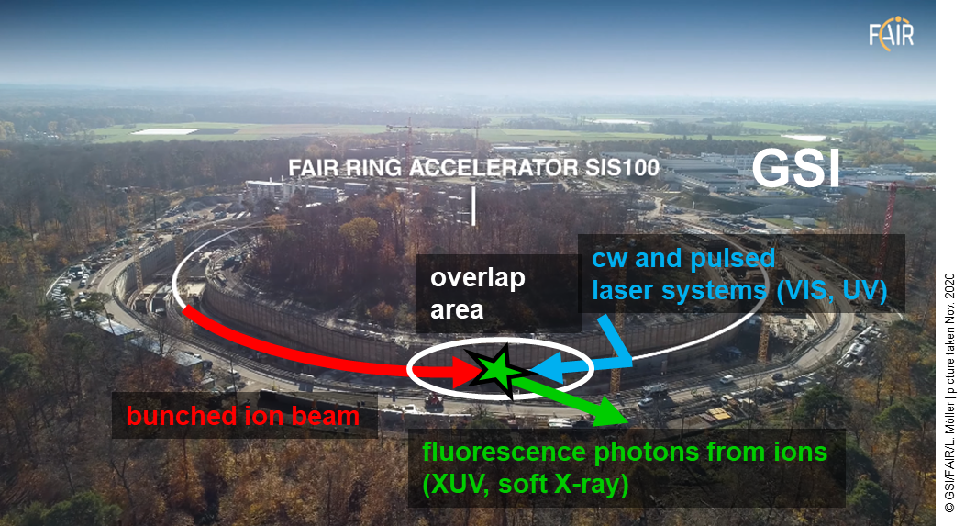
Added science with additional facilities
SPARC Experiments at SIS100
Laser Cooling of Bunched Relativistic Ion Beams at SIS100 with γ ~ 13
Laser-cooled relativistic heavy-ion beams (Z = 10 - 60)
Only cooling method at SIS100 energies (Δp/p down to 10⁻⁷ in a few sec.)
Extraction of very cold and very short ultra-relativistic ion bunches
World-wide unique!

Slide 27
Engineering Run 2023
Make ESR, CRYRING@ESR, HITRAP & Cave A fit for A rated experiments in 2024/2025
Electron cooler at ESR and CRYRING need to be back in operation in 2023
(repair of drift tubes – accomplished!).
ESR: Further optimization of deceleration capability (e.g. vacuum, power supply stabilization with drift tubes)
ESR: DR- assisted laser spectroscopy (DRALS) the accumulation of Li-like RIBs (Bi80+) with a different method (ecool-stacking) should be tested
CRYRING: optimize/increase the intensity of soft beams (e.g. Ne³⁺)
CRYRING: new ion species (e.g. W¹⁴⁺)
HITRAP: Around 7 days of further commissioning with beams from ESR (commissioning blocks scheduled in the beginning of 2024&2025)
Cave A: Test of transfer of cooled beams from the ESR to Cave A with the new control system

Slide 28
Possible Experiments at CRYRING@ESR in 2023
CRYRING@ESR run with local source: Beams of Ne^{3+, 7+} and Mg⁺ are requested.
Three experiments are ready to run already in 2023:
Absolute rate coefficients from dielectronic recombination for the astrophysical relevant ions (18 shifts).
Ion beam and level population dynamics in Mg+ in laser spectroscopy at CRYRING@ESR (36 shifts).
Commissioning and first storage ring experiments of the CRYRING@ESR transversal e-target (42 shifts).
2024?

Slide 29
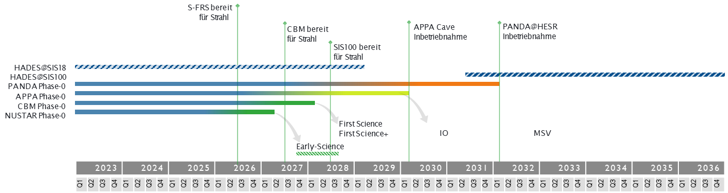
Delayed Realization of APPA Cave & HESR
For APPA, the substantial delay of its dedicated new facilities (APPA cave and HESR) needs to be compensated by sufficient beam times at HITRAP, CRYRING and ESR for the years to come!
          Producing scientific results on highest international level
          Training, education and promotion of next generation of scientists
          Continuous development of the science program
          R&D to keep instrumentation on the highest technological level
          Preservation of the collaboration
Notes:
Since the MSV remains our ultimate goal, we have to make sure that activities are paused in such a way to be resumable.
Additional components will progressively be authorized construction when funds will be made available.
It is likely that this will will happen in the order APPA Cave, then LEB, then rest of IO, then CR, HESR and pLinac.

Slide 30
FAIR Phase Zero 2024-2025: beam time applications 2022
ID | Title | Facility | Grade | Shifts
G-22-00025 | High-Resolution Electron-Ion Collision Spectroscopy of Berylliumlike Heavy Ions in CRYRING@ESR | ESR-CRYRING | A | 45,0
G-22-00028 | Indirect measurements of neutron-induced reaction cross sections at storage rings | ESR | A | 36,5
G-22-00038 | Dielectronic Recombination-assisted laser spectroscopy: A new tool to investigate the hyperfine-puzzle in Bi^{80+,82+} | ESR | A | 41,5
G-22-00047 | Absolute rate coefficients from dielectronic recombination for the astrophysically relevant ions Ne³⁺ and S³⁺ | CRYRING-intern | A | 54,0
G-22-00052 | Laser Excitation of the ²²⁹Th Nucleus Using Nuclear Hyperﬁne Mixing | ESR | A | 48,5
G-22-00057 | Nanostructuring of monolayer graphene by highly charged ions | ESR-HITRAP | A | 45,0
G-22-00058 | Ion beam and level population dynamics in Mg⁺ laser spectroscopy at CRYRING@ESR | CRYRING-intern | A | 51,0
G-22-00086 | Ultra-high resolution study of the ¹⁵O(α,α)¹⁵O reaction using CARME@CRYRING | CRYRING-intern | A | 36,0
G-22-00095 | Energy determination of the 1s² 2s_{1/2} → 1s² 2p_{3/2} radiative transition in Li-like uranium ions via resonant coherent excitation | ESR-HTA | A | 35,5
G-22-00134 | Precision x-ray spectroscopy of helium-like uranium using metallic magnetic calorimeter detectors | ESR-CRYRING | A | 32,0
A grade:
10 experiments, 425 shifts

Slide 31
FAIR Phase Zero 2024-2025: beam time applications 2022
ID | SPARC research progam limited by availability of beamtime
G-22-00029 | X-ray spectroscopy of slow Xe⁵⁴⁺ + Xe collisions | ESR-CRYRING | A- | 36,0
G-22-00037 | Atomic Processes in the Wake of Neutron-Star Mergers: Electron-Ion Recombination of Low-Charged Heavy Ions | CRYRING-intern | A- | 46,0
G-22-00060 | Proton-capture on ⁹¹Nb - A key to the explosive nucleosynthesis of the p nuclei | FRS-ESR | A- | 44,5
G-22-00068 | Towards testing three-loop effects of bound-state QED in heliumlike uranium | ESR | A- | 38,0
G-22-00070 | Dielectronic and trielectronic recombination in sulfur ions | CRYRING-intern | A- | 21,0
G-22-00072 | Commissioning and First Storage Ring Experiments of the CRYRING Transverse Electron Target | ESR-CRYRING | A- | 27,0
G-22-00072 | Commissioning and First Storage Ring Experiments of the CRYRING Transverse Electron Target | CRYRING-intern | A- | 54,0
G-22-00075 | Laser spectroscopy of the (1s² 2s2p) ³P₀ - ³P₁ level splitting in Be-like krypton | ESR | A- | 27,0
G-22-00087 | Astrophysical nuclear reactions between bare ions using FISIC+CARME | CRYRING-intern | A- | 18,0
G-22-00093 | Influence of hyperfine interaction on the nuclear electron capture decay in ¹¹¹Sn | FRS-ESR | A- | 20,5
G-22-00130 | Cooling and precision spectroscopy of ²⁰⁹Bi⁸²⁺ ion ensembles with the ARTEMIS and SPECTRAP experiments at the HITRAP facility | ESR-HITRAP | A- | 63,0
G-22-00140 | High-resolution measurement of the exotic Two-Electron One-Photon decay (TEOP) of the 1s 2s² state in Li-like uranium. | ESR | A- | 24,0
G-22-00152 | Systematic measurement of electron capture cross sections in the unexplored low collision energy regime | ESR-CRYRING | A- | 45,0
G-22-00159 | Fast Ion – Slow Ion Collisions @ CRYRING: Exploring quantum dynamics of N-body systems | ESR-CRYRING | A- | 71,0
G-22-00165 | Heavy Ion Storage Ring Experiments of Nuclear Excitation by Electron Capture (NEEC) | ESR | A- | 27,5
G-22-00172 | Exploring the limits of bunched beam laser cooling of relativistic stored ions, using 3 laser beams (pulsed and cw) | ESR | A- | 39,5
A- grade:
16 experiments,
592 shifts

Slide 32
SPARC Experiments in 2024 and 2025: Setting the stage for the years to come
Concentration on A rated experiments at ESR, CRYRING@ESR, HITRAP & Cave A
ESR & CRYRING@ESR (ESR beams)
CRYRING@ESR: For the production runs the experiments will use mostly beams transferred from the ESR. Main requests are for Uranium in different charge states (bare, He-like and Be-like) and for bare Xe.
CRYING@ESR: Possibility for commissioning of the setup FISIC (POF milestone).
ESR: Tight schedule of E095+E052+E028 in 2024 (risk: limited set-up time)
ESR: E052: Test of the accumulation in ESR of RIBs produced (stripping foil): stacking supported by stochastic cooling (risk: scheduled parallel to machine experiments)
ESR: ²²⁹Th studies (installation of dedicated vacuum windows – many failed vacuum testing! )
ESR: Delayed delivery of experimental components (risk: late installation)
ESR: Test of new laser systems to be built for the laser cooling experiment in SIS100 (FAIR-FS).
ESR/Cave A: RCE experiment with Li-like uranium

