Slide 1
Research Retreat
SHE
Content:
Scientific program
Engineering run 2023
Beamtime 2024 & 2025
SHE beamtime 2026+
First POF-V plans
M. Block for the SHE Sub-collaboration in NUSTAR
18.07.2023 @ TU Darmstadt

Slide 2

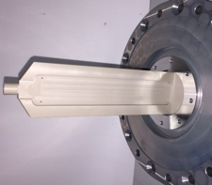






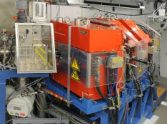
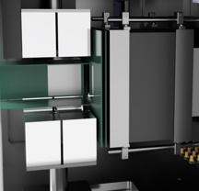
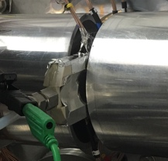




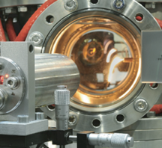

The GSI superheavy element program in PoF IV
Recoil separators
Ancillary setups
120
Production and Nuclear Structure of SHE: decay spectroscopy: Z ~ 100-118 mass measurements: Z ~ 98-106
Z
114
Chemical Properties
of Transactinides Z ~ 113-116
SHIP
SHIPTRAP
108
miniCOMPACT
SF
Laser Spectroscopy Z ~ 100-103
184
α
100
β⁺ EC
N
β⁻
152
162
172
TASCA
Lundium
ANSWERS
Comprehensive investigation of production and of atomic, chemical and nuclear properties of elements Z ~ 100 – 118 using novel techniques and GSI-unique suite of experimental setups around recoil separators SHIP and TASCA
Not included: search for new elements during FAIR construction phase
RADRIS
UniCELL

Slide 3
Focus of SHE program: beamtime 2024/25
Approved for 2024 & 2025 (main beam)
Nuclear properties
Decay spectroscopy
High-precision mass measurements
Laser spectroscopy (hyperfine structure)
Atomic properties
Laser spectroscopy of atomic levels
Chemical properties
Chemical reactions, surface interactions
L.G. Sarmiento et al. (G-22-00123; resubmiss.)
N-deficient Pu isotopes with LUNDIUM
A⁻: 15 shifts
J. Khuyagbaatar et al. (G-22-00040)
SHE decay spec. with ANSWERS
A: 63 shifts
F. Giacoppo et al. (G-22-00154)
SHE (₁₀₅Db) masses and isomer energies
A: 25 shifts
A⁻: 45 shifts
S. Raeder et al. (G-22-00051)
₉₈Cf, ₁₀₀Fm, ₁₀₂No, ₁₀₃Lr laser spectroscopy
A: 65 shifts
A⁻: 36 shifts
A: 42 shifts
A. Yakushev et al. (G-22-00034)
₁₀₆Sg and ₁₀₇Bh carbonyl complexes
A*: 21 shifts

Slide 4
Engineering Run 2023 – Beamtime 2024 & 2025

Slide 5
Engineering Run 2023
Optimization of intense ⁵⁴Cr beam (long-pulse 5 ms, 4.8 MeV/u) on target @ TASCA.
Verification of the shielding factor of the new shielding in TASCA cave
Verification of upgraded TASCA control system
Verification of full functionality of new cabling bypassing Messstation to SHIP and TASCA
Recommissioning SHIP with newly installed SHIP magnet power supplies and control

Slide 6
Beamtime schedule 2024 (V3)
Masses
Mass
Chem.
Chemistry
54-Cr
Laser

Slide 7
Beamtime schedule 2025 (v2)
Laser
Nucl. Spec.
Nucl. Sp.
Laser
Timely exchange of damaged
triplet at (HLI) injector crucial!
Laser
Nucl. Sp.

Slide 8
Open points
How is the allocation of remaining 2025 beamtime determined?
-> Only A- proposals?
-> Internally, based on PAC recommendations?
-> New PAC meeting (needed for experiments where part 1 was recommended and part 2 would get a recommendation after
part 1 is successfully executed)?

Slide 9
Adapted from Research Retreat Feb. 2023
SHE beamtime 2026+
UNILAC / SHE program …
After several years that allowed only for experiments with short beamtime requirements,
a ramping up is needed to remain internationally competitive.
A staged approach could include:
2026 : 3 months of SHE beamtime for SHIP & TASCA
2027: 6 months of SHE beamtime for SHIP & TASCA
2028+: 9 months of SHE beamtime for SHIP & TASCA
This will allow us to maintain a comprehensive research program with detailed investigations of atomic, chemical and nuclear properties of known SHEs and to restart the search of new elements beyond oganesson (Z=118) with HELIAC in POF V.

Slide 10

cw-Linac@SH2/3 (>2030)
Slide from W. Barth
Research Retreat Feb. 2023
min.1.5 years
PSU commissioning
no beam from UNILAC!

Slide 11
cw-Linac@SH2/3 (>2030)
Slide from W. Barth
Research Retreat Feb. 2023
min.1.5 years
PSU commissioning
no beam from UNILAC!
HELIAC can provide 10x higher beam intensity
with 10% power consumption compared to UNILAC

Slide 12
Time schedule HELIAC
2023 BIG “HELIAC-Strahlenschutzbunker”
2025 Start Aufbau/HELIAC-Bunker
2026 HELIAC-Bunker bezugsfertig
2026 Ionenquelle + HELIAC-Injektor Installation und Inbetriebnahme
2027 CM1 Aufbau+Inbetriebnahme + Link2UNILAC
2028 CM2&3 Aufbau+Inbetriebnahme + Start Nutzerbetrieb
>2028 HELIAC Vollausbau + Anschluss M1-M3
Slide from W. Barth
Research Retreat Feb. 2023
Decision for civil construction in 2024 required to keep this schedule!

Slide 13
Strategic PoF V timeline
2023
2024
2025
2026
2027
2028
2029
2030
2031
2032
2033
2034
Today
PoF IV
PoF V
FAIR
UNILAC
HELIAC (optimistic)
ES FS /FS+ FAIR MSV
25% d.c. → c.w. .
Irrespective of the exact starting year, HELIAC will deliver beams for SHE during most of PoF V

Slide 14

The long-term view
The “Island of stability of superheavy elements” at the end of the periodic table
Island of stability in the chart of nuclei
The periodic table: elements beyond ₁₁₈Og
184
extending the region of known nuclei to higher Z (new elements) and N using intense stable beams
determine the center, the extension, and the topography of the Island of Stability
chemical classification of heaviest known elements to elucidate the validity of the periodic table
expect disruptive, unplanned findings in the field of superheavy elements
linking laboratory experiments to astrophysical studies
new opportunities with HELIAC
More detailed discussion on POF-V science in dedicated CML workshop

Slide 15
Beyond Og – The center of the „Island“ in different models
Valley of β-stability
Predicted shells
Boxes show the predicted longest-lived nuclei in six different nuclear models
For comparison, the calculated T_{1/2}(SF) for known ²⁸⁴Cn is given
These T_{1/2}(SF) span
11 orders of magnitude!
Half-lives increase with N
O. Smits, Ch.E. Düllmann et al., submitted

Slide 16
Beyond the current frontier: SHE research in POF V
continue and extend comprehensive program
studying atomic, chemical, and nuclear properties
of SHE with versatile suite of experimental devices
search for new elements beyond oganesson
using HELIAC combined with new superconducting
recoil separator (R&D@HIM)
access more neutron-rich SHN
develop sensitive detection systems capable of
detecting electron capture decays
establish detection / identification of long-lived
isotopes of superheavy elements with traps
longest-lived SHN according to
model m3 – see previous slide
(A. Karpov et al., IJMPE 2012)

Slide 17

SHE beamtime 2026+
  SHE requirements:
maintain current level of personnel in SHE departments
improve laboratory situation (incl. experiment preparation)
longer beamtime blocks (> 3 month) from UNILAC
critical item: HELIAC
gradual transition to HELIAC operation with long beamtime
blocks (ca. 9 month)
procure rare stable isotopes such as ⁴⁸Ca

Slide 18
Conclusions
Beamtime 2024 & 2025
        high intensity ⁴⁸Ca, ⁵⁰Ti and ⁵⁴Cr beams are crucial
        ⁴⁸Ca shall be used with „isotope crisis“ in mind
        ⁵⁰Ti, ⁵⁴Cr beams: further development/verification, potentially isotope procurement
Outlook 2026+
      successively ramping up SHE beamtime towards POF V
      timely HELIAC completion will strengthen basis for competitive POF-V program
      expand science program with new opportunities provided by longer beamtimes
      and resume search for new elements with improved methods and better setups
Enriched isotope crisis
    Steps underway that may lead to GSI/HIM-based ⁴⁸Ca enrichment capabilities

Slide 19
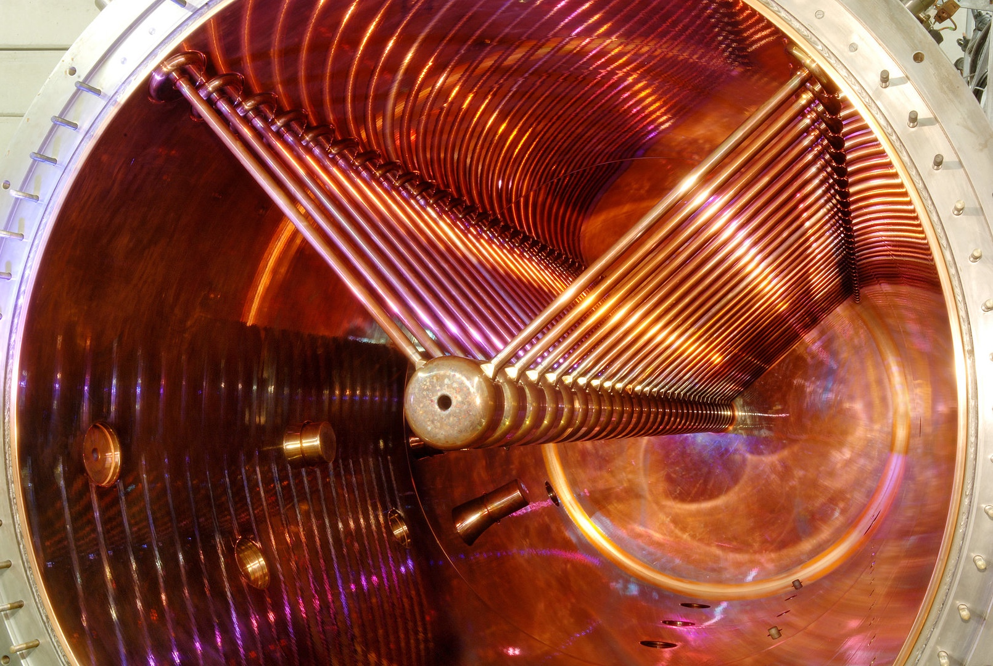
Input to this talk from
Ch. Düllmann (GSI, HIM, JGU)
W. Barth (GSI/HIM)
S. Reimann (GSI)
is gratefully acknowledged
Thank you for your attention!

Slide 20
This page is left blank inentionally

Slide 21
Backup: BMBF applications
SHC: towards Lv chemistry and molecular speciation studies
funding request:
3 PhD students
205 kEUR investments
required beams: ⁴⁸Ca, ⁵⁴Cr
beamtime: 3 months/year
SHP: nuclear structure investigations around N = 152
by mass spectrometry and laser spectroscopy ay GSI/SHIP
funding request:
2.5 PhD students
243 kEUR investments
required beams: ⁴⁸Ca, ⁵⁰Ti , ⁵⁴Cr
beamtime: 3 months/year

Slide 22

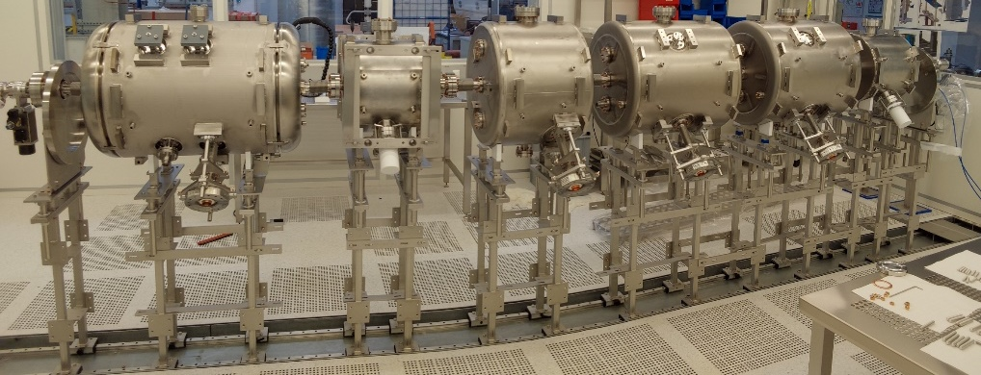
Adapted from Research Retreat Feb. 2023
SHE beamtime 2026+
Maintain science program at UNILAC and prepare for use of future HELIAC beams
HELIAC in current KHuK recommendations:
5.3 F&E-Beschleuniger
[…]Entwicklungen im Bereich Beschleunigertechnologien im Fokus des Interesses von KHuK.
• Supraleitende Dauerstrich-Teilchenbeschleuniger für Elektronen (MAMI, MESA/Univ. Mainz) bzw. Protonen (PSI/Schweiz) und Schwerionen (FRIB/U.S.A., SPIRAL/Frankreich, HELIAC/GSI) sind weltweit Gegenstand generischer Beschleunigerentwicklung.
Diese Entwicklung von Schlüsseltechnologien sollte weiter vorangetrieben werden“
https://indico.gsi.de/event/13777/contributions/67280/attachments/42456/59231/KHuK_Empfehlungen_Strategiegespr%C3%A4ch02022023.pdf
Outcome of GSI Research Retreat 2021:
[…] the timely installation of minimal config.
cw-linac (HELIAC) delivering long-duty cycle, comprising a new (18 GHz) ECR ion source
and LEBT, existing 25%-duty-cycle injector
and three accelerator cryomodules […]

Slide 23
Approved beamtime (GPAC 45)
Beams Main shifts Parasitic shifts
L.G. Sarmiento et al. (G-22-00123; resubmission) ⁴⁸Ca A- 15 A- 27
N-deficient Pu isotopes with Lundium
J. Khuyagbaatar et al. (G-22-00040) ⁴⁸Ca A 63 A 61
SHE decay spec. with ANSWERS ³⁶⁻⁴⁰Ar/⁴⁸Ca/⁴⁸⁻⁵⁰Ti/⁵⁰⁻⁵⁴Cr/⁵⁸⁻⁶⁴Ni
F. Giacoppo et al. (G-22-00154) ⁵⁰Ti A 25 A 21
SHE masses and isomer energies ⁴⁸Ca A- 45
⁴⁰Ar/⁴⁸Ca/⁵⁰Ti/⁵⁴Cr A- 18
S. Raeder et al. (G-22-00051) ⁴⁸Ca A 65 / A- 30 A 42
₉₈Cf, ₁₀₀Fm, ₁₀₂No, ₁₀₃Lr laser spectroscopy ³⁶S A- 6
⁴⁰Ar/⁴⁸Ca/⁵⁰Ti/⁵⁴Cr
A. Yakushev et al. (G-22-00034) ⁵⁴Cr A 42
₁₀₆Sg and ₁₀₇Bh carbonyl complexes ⁴⁸Ca/⁵⁰Ti/⁵⁴Cr/⁵⁶Fe/⁵⁸Ni A 24
Approved shifts A 195 A 148
A- 96 A- 45

Slide 24
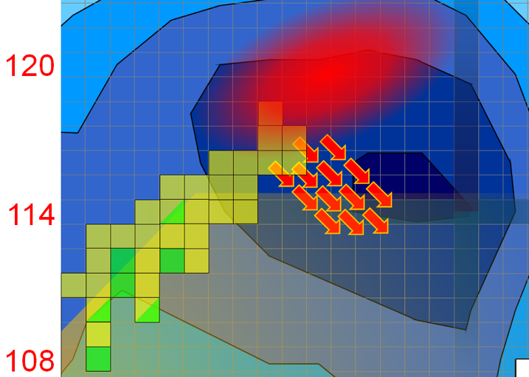

SHE research 2030+
New elements
New elements
EC?
Transfer
atomic structure beyond No (Z=102)
experiments with single SHE-ions
(e.g., chemistry, mass & ion mobility spectrometry)
chemical studies towards Eka-Rn
new SHE molecules, their stability, formation kinetics
new period in the periodic table
184
Mapping the island of stability:
Search for new elements with Z>118
Access more neutron-rich isotopes in transfer reactions
Use weak EC decay channels towards center of island
Direct mapping of shell evolution towards N = 184

Slide 25
Measurement of new SF observables
(manuscript in preparation)
Predicted fragment mass distribution of known Cn-284 in different models
-> helps to discriminate!

Slide 26

The “Island of stability of superheavy elements” at the end of the periodic table of the elements
Island of stability in the chart of nuclei
The periodic table: elements up to ₁₁₈Og
184
-extending the region of known nuclei to higher Z (new elements) and N using intense stable beams
-fixing the center, the extension and the of the Island of Stability
-strength of shell closures from high-precision mass measurements
-extent of stability from complete multi-coincidence spectroscopy
-chemical classification of heaviest known elements to elucidate the validity of the periodic table
-studies of atomic reactivities; synthesis, stability and reactions of SHE-containing molecules up to Og
-opening up of the 8th period of the periodic table via synthesis of new elements
-expect disruptive, unplanned findings in the field of superheavy elements
-recent examples: production of elements beyond Z=112 at almost constant cross sections, providing all elements up to Og
-the kilonova observation of the neutron-star merger clarifying the location of the synthesis of the heavy elements in nature
-linking laboratory experiments to astrophysical studies
-laser spectroscopy of identify atomic transitions of superheavy nuclides: basis for identifying SHE in astrophysical spectra

Slide 27
FAIR/GSI strategic operation scenario towards FS+
Update 2023 (DRAFT – S. Reimann)
beam time
Acc. Operation total / days
134
44
140
140
restricted shutdown
90
restricted shutdown
90
90
200
240
240
beam time
Physics beam time/ days
107
0
100
100
60
min
30*
min
30*
min
100*
180
180
*number of days for PAC call parallel to commissioning is presently under discussion
Project phases (ES, FS, FS+)
FAIR Installation of Accelerator Components
FAIR Hardware Commissioning
FAIR Beam Commissioning
FCC needed
PCP reached
Facility availability
early science (ES) →
SIS18 → SFRS → NUSTAR
first science (FS) →
SIS100 → SFRS → NUSTAR
first science + (FS+) →
SIS100 –> CBM
UNILAC → EH, SIS18 → TH, EX, FRS, ESR → HITRAP, Cryring
2022
2023
2024
2025
2026
2027
2028
2029
2030
FAIR Phase 0
Early Science
Early Science & First Science+
27

Slide 28
FAIR/GSI strategic operation scenario towards FS+
2023 (FAIR Re-Baselining update)
beam time
Acc. Operation total / days
134
44
140
140
90
restricted shutdown
90
90
200
240
240
beam time
Physics beam time/ days
107
0
100
100
60
min 30*
min 30*
min 100*
180
180
*number of days to be announced for PAC call
(share is reduced due to FAIR commissioning)
Project phases (ES, FS, FS+)
FAIR Installation of Accelerator Components
FAIR Hardware Commissioning
FCC OP ready
UNILAC CS ready
FAIR Beam Commissioning
PCP reached
Facility availability
early science (ES) →
SIS18 → SFRS → NUSTAR
first science (FS) →
SIS100 → SFRS → NUSTAR
first science + (FS+) →
SIS100 –> CBM
UNILAC → EH, SIS18 → TH, EX, FRS, ESR → HITRAP, Cryring
2022
2023
2024
2025
2026
2027
2028
2029
2030
FAIR Phase 0
Early Science
Early Science & First Science+
28

Slide 29
FAIR/GSI strategic operation scenario towards FS+
DRAFT (opportunity for more physics)
beam time
Acc. Operation total / days
134
44
140
140
90
restricted shutdown
100
90
200
240
240
beam time
Physics beam time/ days
107
0
100
100
60
70
min 30*
min 120*
180
180
run to fail
*number of days to be announced for PAC call
(share is reduced due to FAIR commissioning)
Project phases (ES, FS, FS+)
FAIR Installation of Accelerator Components
FAIR Hardware Commissioning
FCC OP ready
UNILAC CS ready
DR
FAIR Beam Commissioning
PCP reached
Facility availability
early science (ES) →
SIS18 → SFRS → NUSTAR
first science (FS) →
SIS100 → SFRS → NUSTAR
first science + (FS+) →
SIS100 –> CBM
UNILAC → EH, SIS18 → TH, EX, FRS, ESR → HITRAP, Cryring
2022
2023
2024
2025
2026
2027
2028
2029
2030
FAIR Phase 0
Early Science
Early Science & First Science+
29

Slide 30
FAIR/GSI strategic operation scenario towards FS+
DRAFT (ACC proposal for engineering run in 2026)
beam time
Acc. Operation total / days
134
44
140
140
90
restricted shutdown
100
90
200
240
240
beam time
Physics beam time/ days
107
0
100
100
0
70
min 30*
min 120*
180
180
engineering-runs
run to fail
*number of days to be announced for PAC call
(share is reduced due to FAIR commissioning)
Project phases (ES, FS, FS+)
FAIR Installation of Accelerator Components
FAIR Hardware Commissioning
FCC OP ready
UNILAC CS ready
DR
FAIR Beam Commissioning
PCP reached
Facility availability
early science (ES) →
SIS18 → SFRS → NUSTAR
first science (FS) →
SIS100 → SFRS → NUSTAR
first science + (FS+) →
SIS100 –> CBM
UNILAC → EH, SIS18 → TH, EX, FRS, ESR → HITRAP, Cryring
2022
2023
2024
2025
2026
2027
2028
2029
2030
FAIR Phase 0
Early Science
Early Science & First Science+
30

Slide 31
FAIR/GSI strategic operation scenario towards FS+
DRAFT (possible compensation)
beam time
Acc. Operation total / days
134
44
140
140+30
90
90
100
90
200
240
240
beam time
Physics beam time/ days
107
0
100
100+30
0
50
70
min 30*
min 120*
180
180
engineering-runs
run to fail
*number of days to be announced for PAC call
(share is reduced due to FAIR commissioning)
Project phases (ES, FS, FS+)
FAIR Installation of Accelerator Components
FAIR Hardware Commissioning
FCC OP ready
UNILAC CS ready
DR
FAIR Beam Commissioning
PCP reached
Facility availability
early science (ES) →
SIS18 → SFRS → NUSTAR
first science (FS) →
SIS100 → SFRS → NUSTAR
first science + (FS+) →
SIS100 –> CBM
UNILAC → EH, SIS18 → TH, EX, FRS, ESR → HITRAP, Cryring
2022
2023
2024
2025
2026
2027
2028
2029
2030
FAIR Phase 0
Early Science
Early Science & First Science+
31

Slide 32
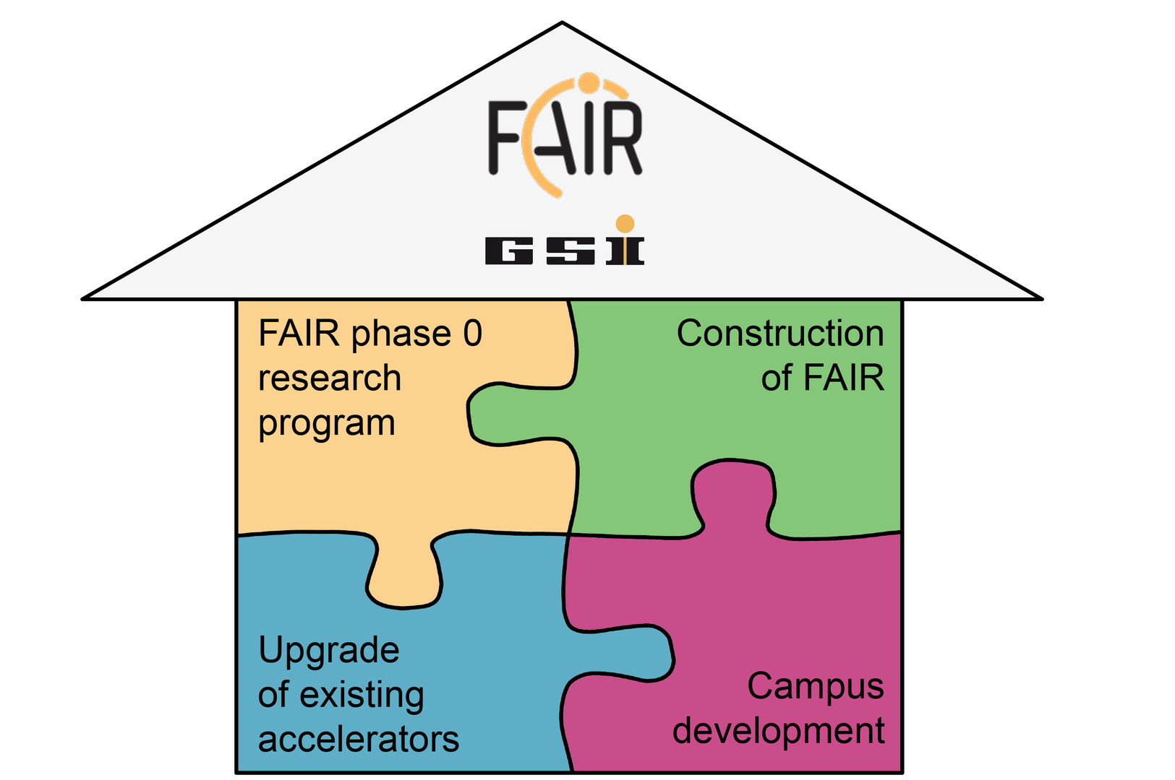
FAIR/GSI strategic operation scenario towards FS+
DRAFT (fire protection renovation EH)
beam time
Acc. Operation total / days
134
44
140
140+30
8 months
fire protection renovation
EH
90
90
100
90
200
240
240
beam time
Physics beam time/ days
107
0
100
100+30
0
50
70
min 30*
min 120*
180
180
engineering-runs
run to fail
*number of days to be announced for PAC call
(share is reduced due to FAIR commissioning)
Project phases (ES, FS, FS+)
FAIR Installation of Accelerator Components
FAIR Hardware Commissioning
FCC OP ready
UNILAC CS ready
DR
FAIR Beam Commissioning
PCP reached
Facility availability
now
included
early science (ES) →
SIS18 → SFRS → NUSTAR
still
missing
first science (FS) →
SIS100 → SFRS → NUSTAR
first science + (FS+) →
SIS100 –> CBM
UNILAC → EH, SIS18 → TH, EX, FRS, ESR → HITRAP, Cryring
2022
2023
2024
2025
2026
2027
2028
2029
2030
FAIR Phase 0
Early Science
Early Science & First Science+
32

