Slide 1


KSP
Nuclear Spectroscopy Activities at GSI/FAIR
The way towards ES, FS and FS++ for HISPEC/DESPEC
Magda Górska

Slide 2
Scientific goals, tools and specialities
Spectroscopic studies of KSP attracted an international community and initiated
both in-beam (HISPEC) and stopped ion (DESPEC) collaborations
(spokespersons: G. Benzoni, P. Reiter)
Several dedicated spectrometers organized in campaigns e.g. AGATA, DEGAS, FATIMA, DTAS, PARIS,…
Evolution of the shell structure, emerging collectivity, deformation and exotic nuclear shapes in uncharted nuclear territory
Spectroscopic information for the nucleosynthesis of heavy nuclei
Comprehensive decay information from identified key nuclei at secondary beam yields as low as one ion per hour
Primary focus on GSI-FAIR uniqueness around N~126 nuclei, while providing competitive data on key nuclei in lighter regions: around ¹⁰⁰Sn and ¹³²Sn

Slide 3
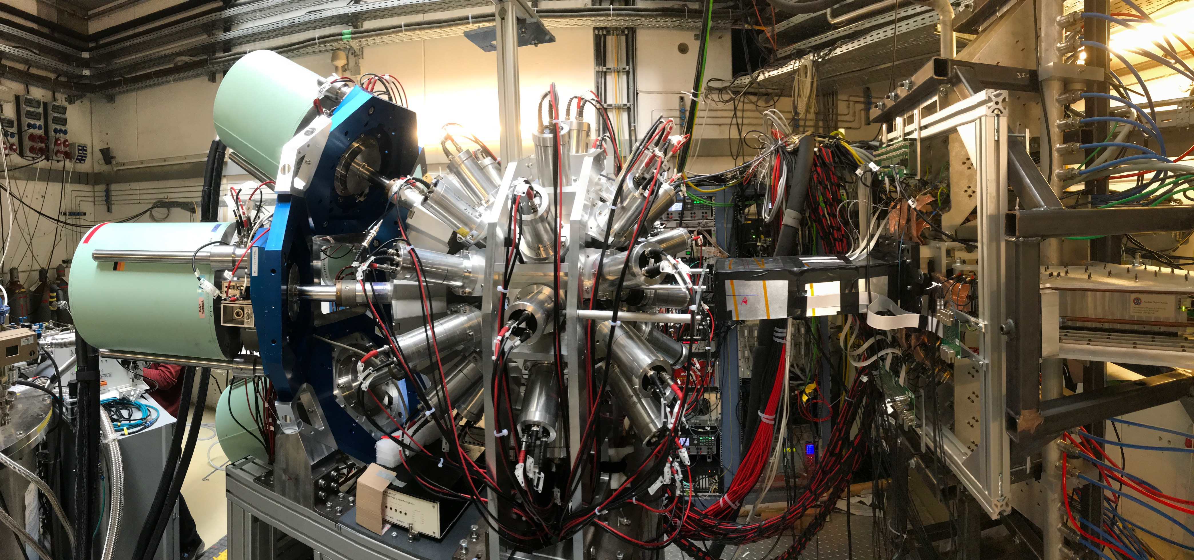
HISPEC-DESPEC experimental program for FAIR Phase-0 and beyond
Phase-0
2020-2022
Restarted experimental program @ GSI thanks
to the improved performances of developed detectors
DESPEC campaign on isomeric and β decays
Levels lifetimes; decay half-lives; new spectroscopic data
¹⁰⁰Sn, rare-earths and N=126 regions
Parasitic runs to test DESPEC and first HISPEC equipment
Phase-0
2024-2025
Decay and isomer spectroscopy around N=126: multifaceted approach
A~195 r-process abundance peak fed by nuclei around N=126
Half-lifes (and P_{n} ) values
Role of first forbidden β-decay transitions
Access to GT strength with Total Absorption Spectroscopy
Measurements possible down to nb level
Other competitive measurements
Phase-0
2026-
Prerequisite:
- steadily increasing beam intensity!!!
- available space for detector installation (neutron detector, etc)
- PMA constr. funds availability, funds for det. maintenance as time stretches
- Personnel: maintain local expertise and guarantee detector support
- IT support for network Linux PC

Slide 4

HISPEC-DESPEC experimental program for FAIR Phase-0
Phase-0
2020-2022
Restarted experimental program @ GSI thanks
to the improved performances of developed detectors
DESPEC campaign on isomeric and β decays
Levels lifetimes; decay half-lives; new spectroscopic data
¹⁰⁰Sn, rare earths and N=126 regions
Parasitic runs to test DESPEC and first HISPEC experiments
Phase-0
2024-2025
Decay and isomer spectroscopy around N=126: multifaceted approach
A~195 r-process abundance peak fed by nuclei around N=126
Half-lifes (and P_{n} ) values
Role of First Forbidden β-decay transitions
Access to GT strength with Total Absorption Spectroscopy
Measurements possible down to nb level
Other competitive measurements
Phase-0
2026-
Prerequisite:
- steadily increasing beam intensity!!!
- available space for detector installation (neutron detector, etc)
- PMA constr. funds availability, funds for det. maintenance as time stretches
- Personnel: maintain local expertise and guarantee detector support
- IT support for network Linux PC

Slide 5
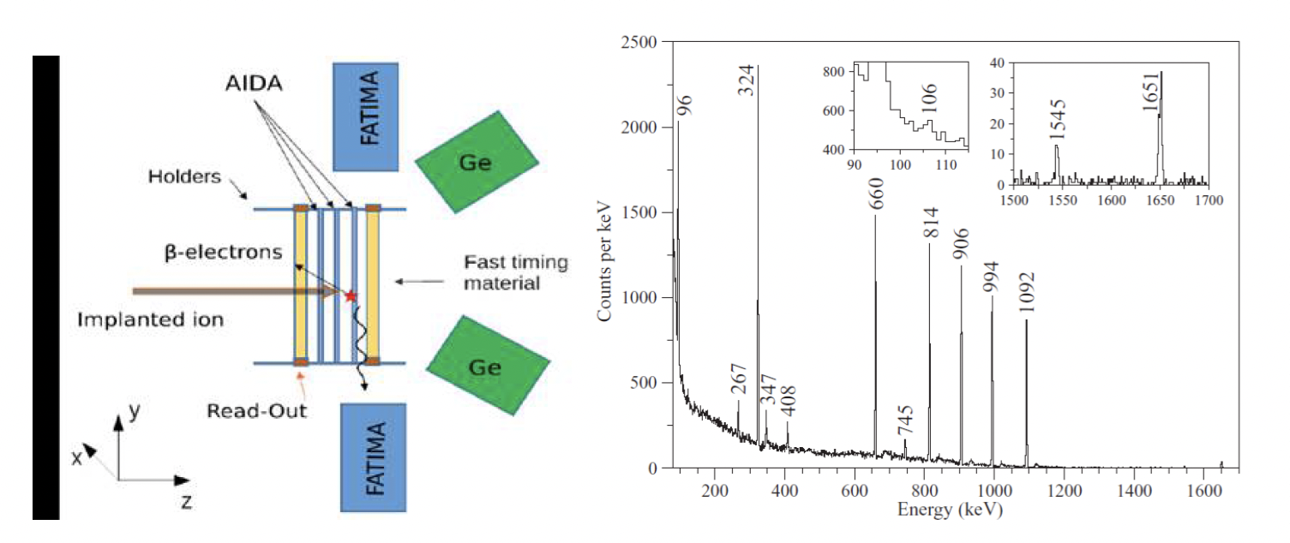
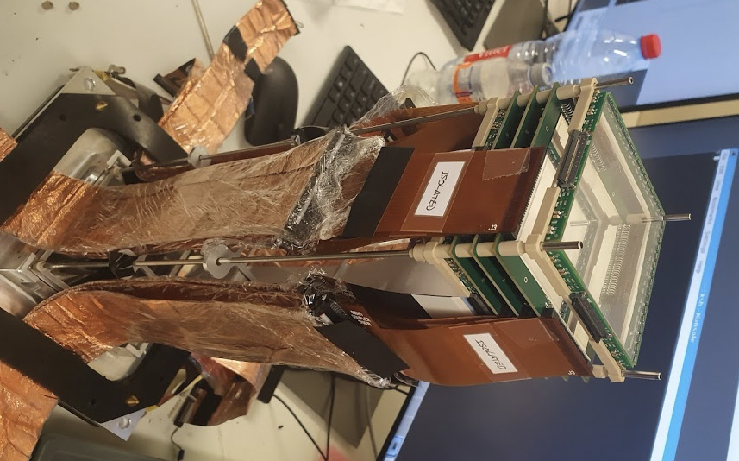
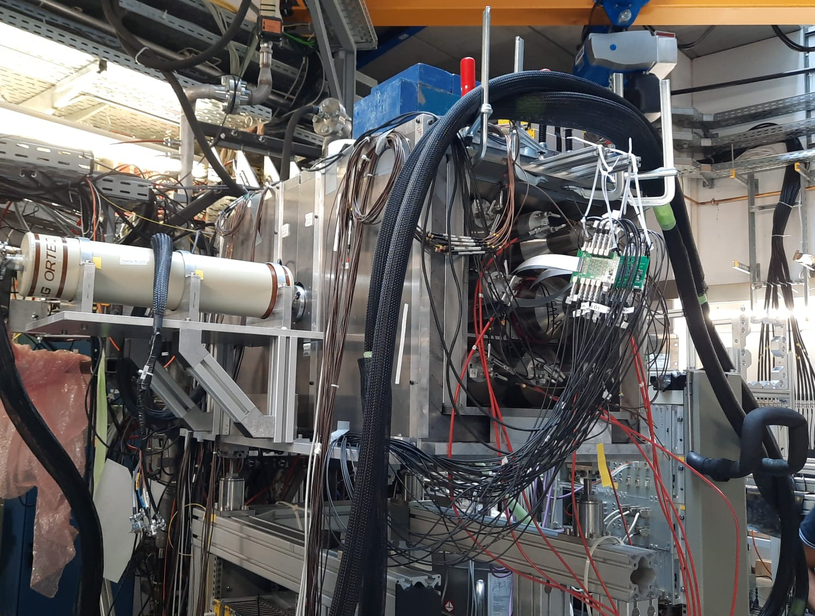
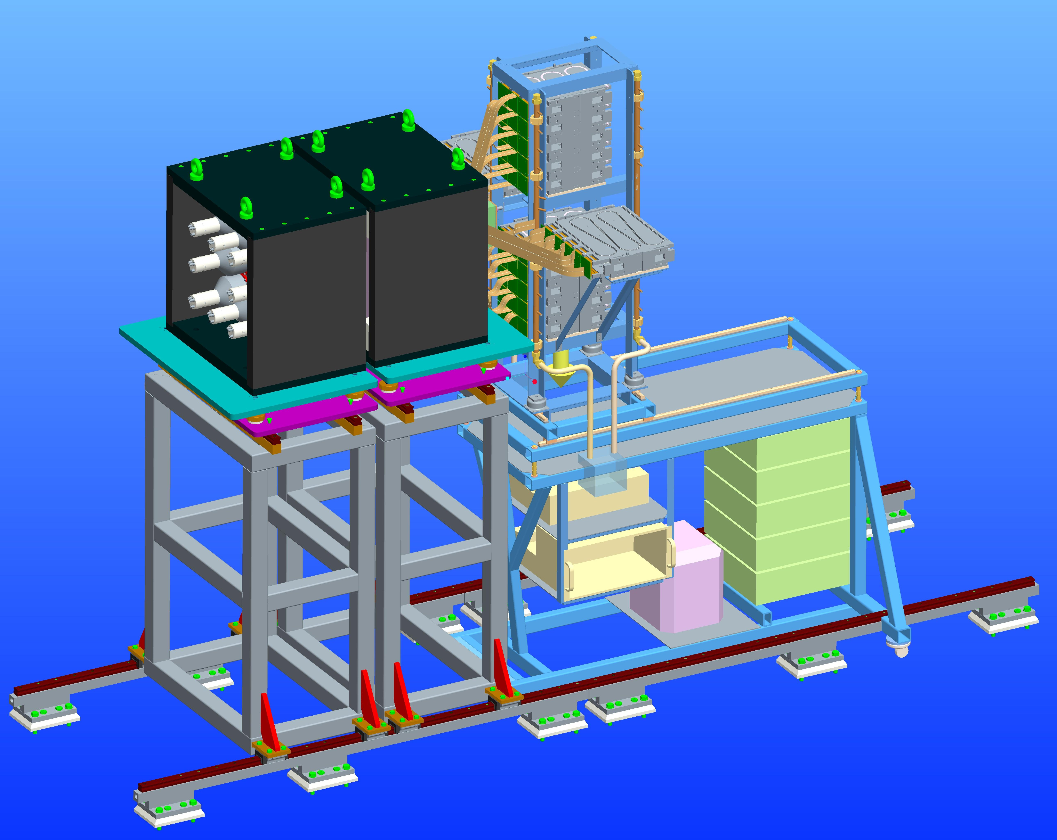
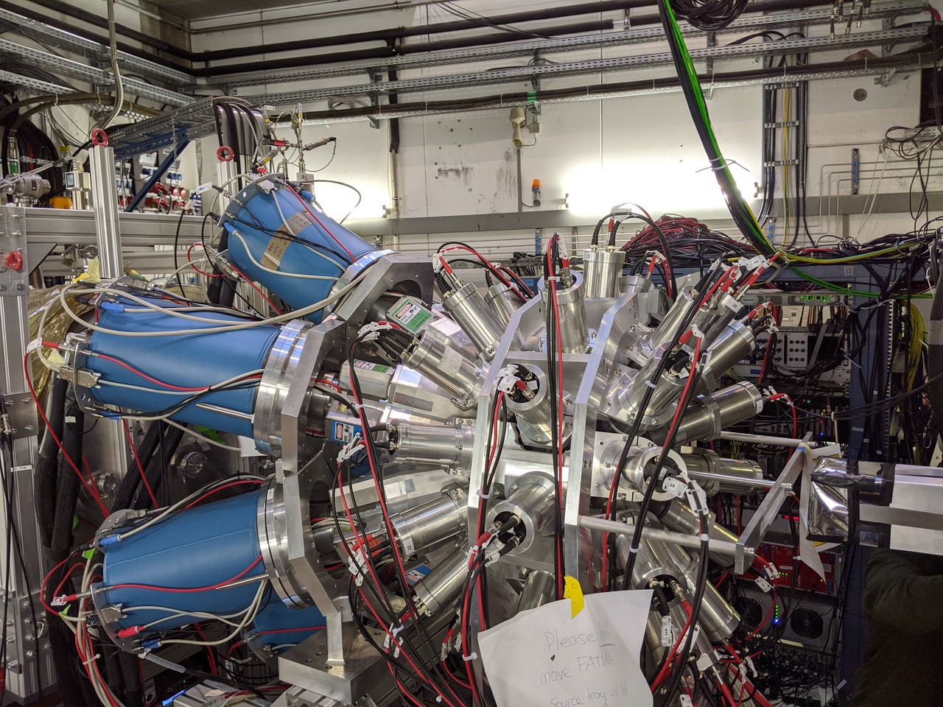
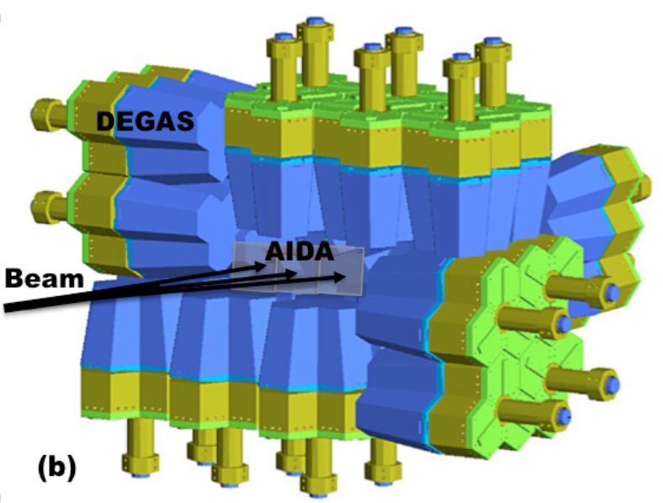
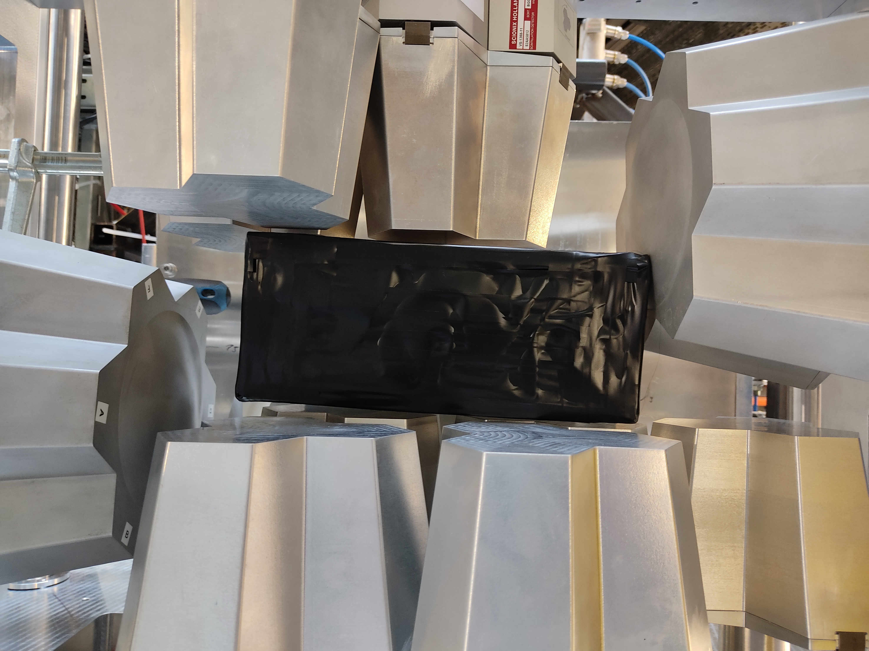
DESPEC SETUPS for 2020-2025
A.K. Mistry et al., NIM A 1033 (2022) 166662
The core of DESPEC : AIDA coupled to γ-ray detectors
Energy and lifetime of isomeric states and states below them
Beta-decay
Lifetimes ➔ Fast-timing approach
Level schemes
Beam in
S. Saha et al. NIMA 975, 164196 (2020)
FAST TIMING
FATIMA eff. 2.9% at 1 MeV
DEGAS or GALILEO
eff. 3-5% at 1 MeV
HIGH RESOLUTION
DEGAS eff. 18% at 1 MeV
HIGH EFFICIENCY DTAS
FULL-DEGAS

Slide 6
DESPEC SETUPS for 2020-2025
A.K. Mistry et al., NIM A 1033 (2022) 166662
The core of DESPEC : AIDA coupled to γ-ray detectors
Energy and lifetime of isomeric states and states below them
Beta-decay
Lifetimes ➔ Fast-timing approach
Level schemes
DESPEC sensitive to:
the very exotic nuclei including proton drip-line
extract nuclear structure information
  for each state of which lifetime can be measured (10 ps -100 s) 13 orders of magnitude!
  for each type of the decay (according to the available technical conditions)
Beam in
S. Saha et al. NIMA 975, 164196 (2020)
FAST TIMING
FATIMA eff. 2.9% at 1 MeV
DEGAS or GALILEO
eff. 3-5% at 1 MeV
HIGH RESOLUTION
DEGAS eff. 18% at 1 MeV
HIGH EFFICIENCY DTAS
FULL-DEGAS

Slide 7
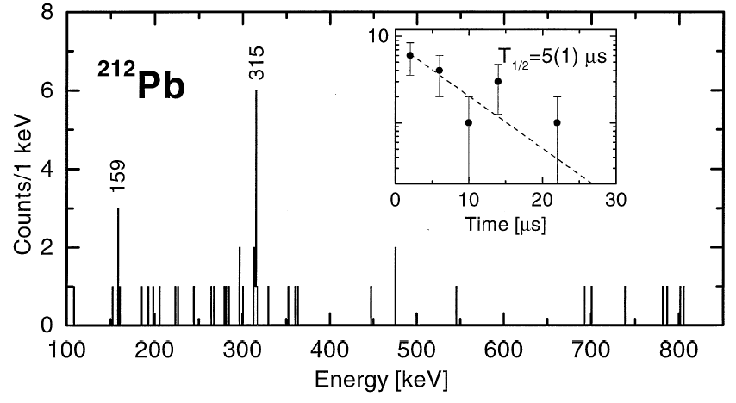
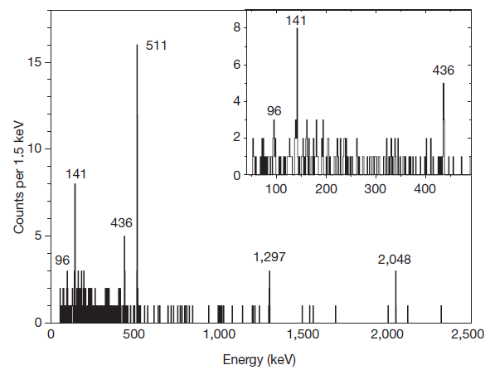
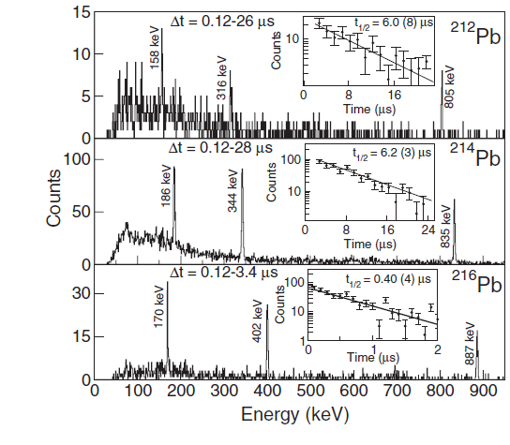
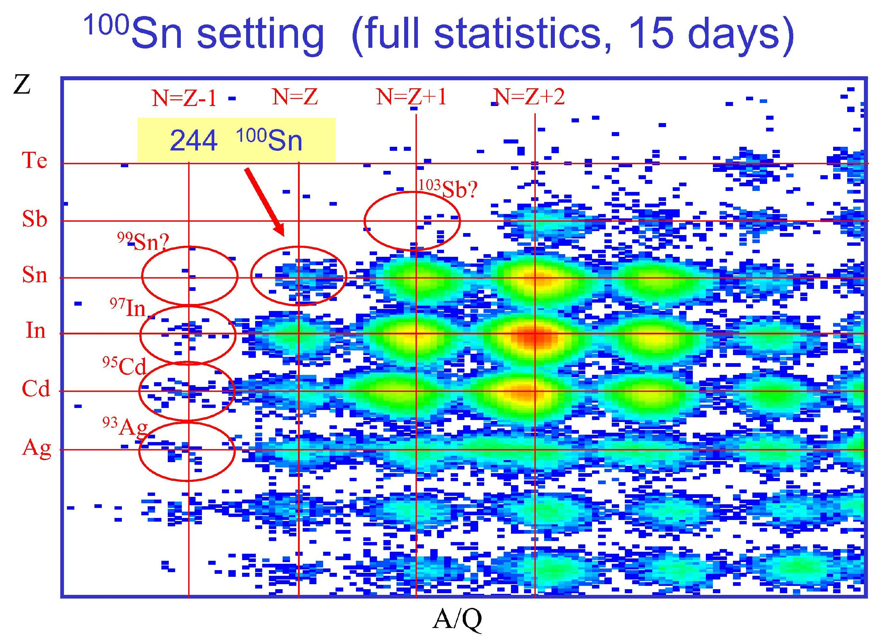
DESPEC: very sensitive!
370 implanted ²¹²Pb ions!
244 ¹⁰⁰Sn ions, < 1 ion / hour !
M. Pfützner et al., Phys. Lett. B 444 (1998) 32
C. B. Hinke et al, Nature 486 (2012) 341
RISING setup 15% Ge det. array efficiency
A. Gottardo et al., PRL 109, 162502 (2012)

Slide 8
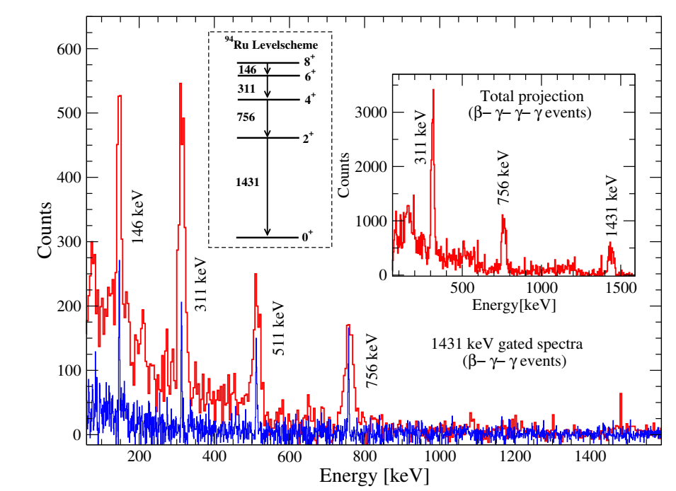
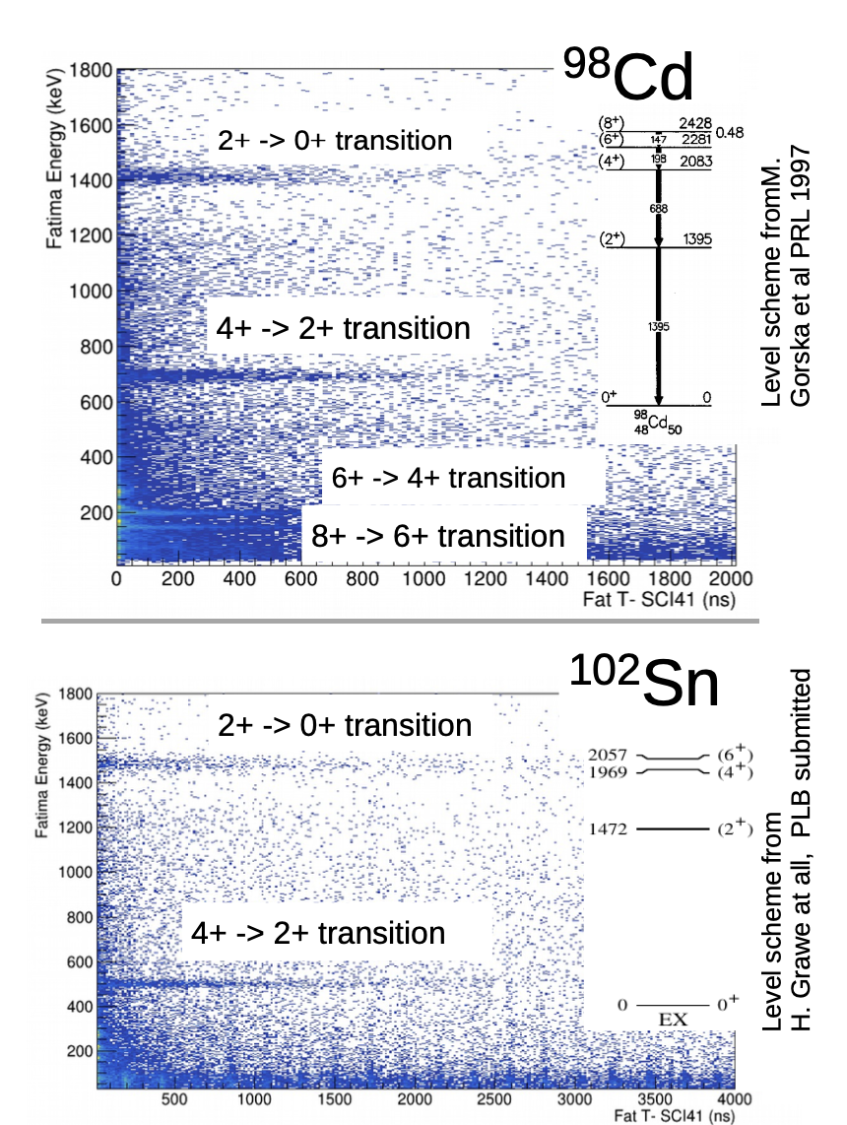
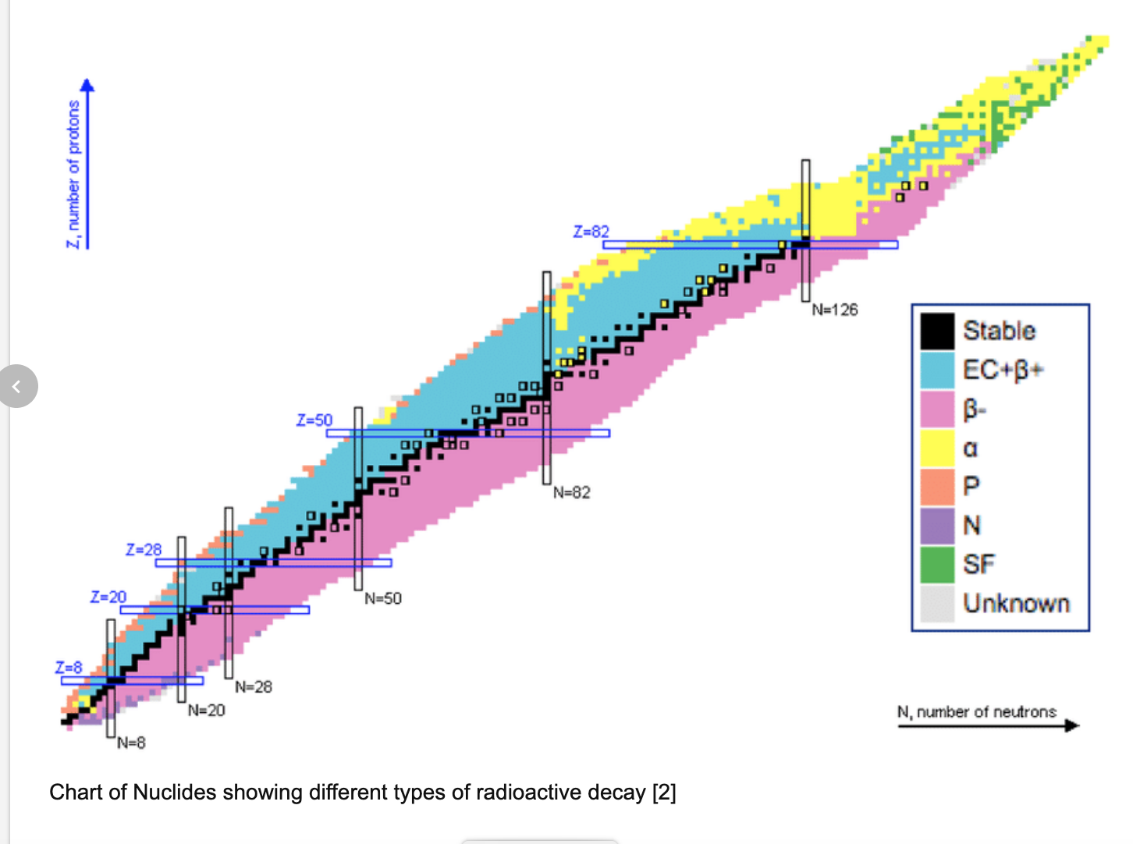
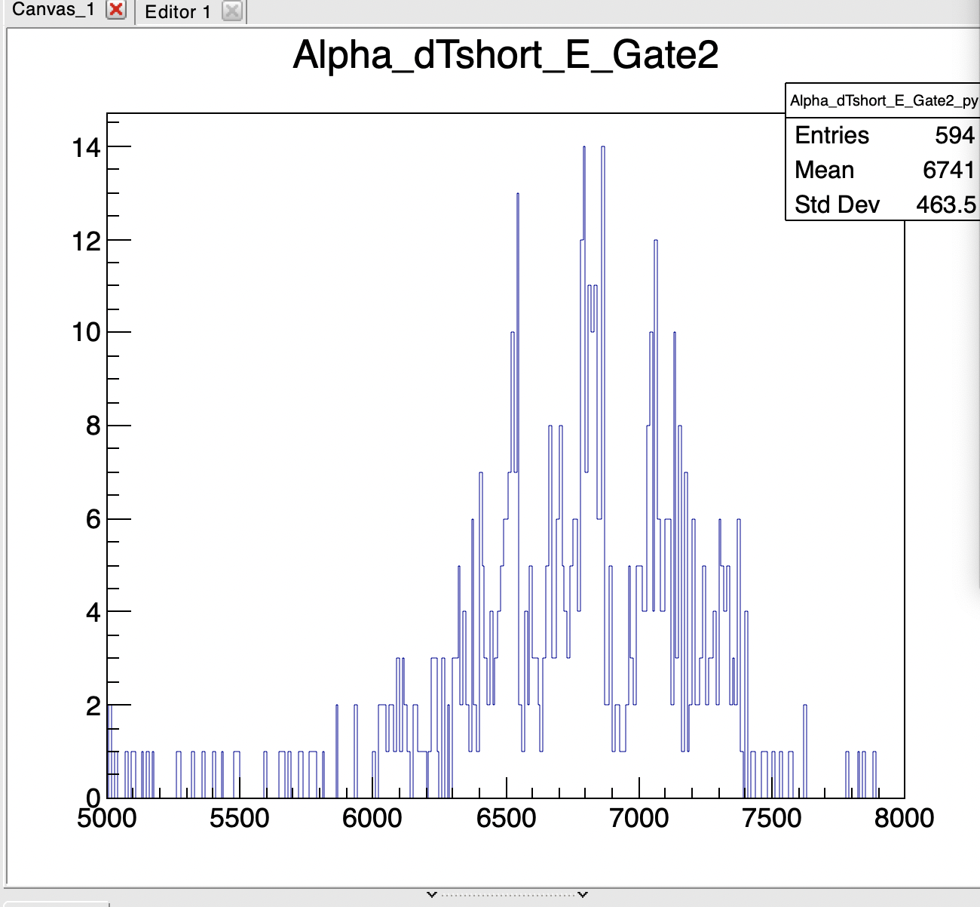
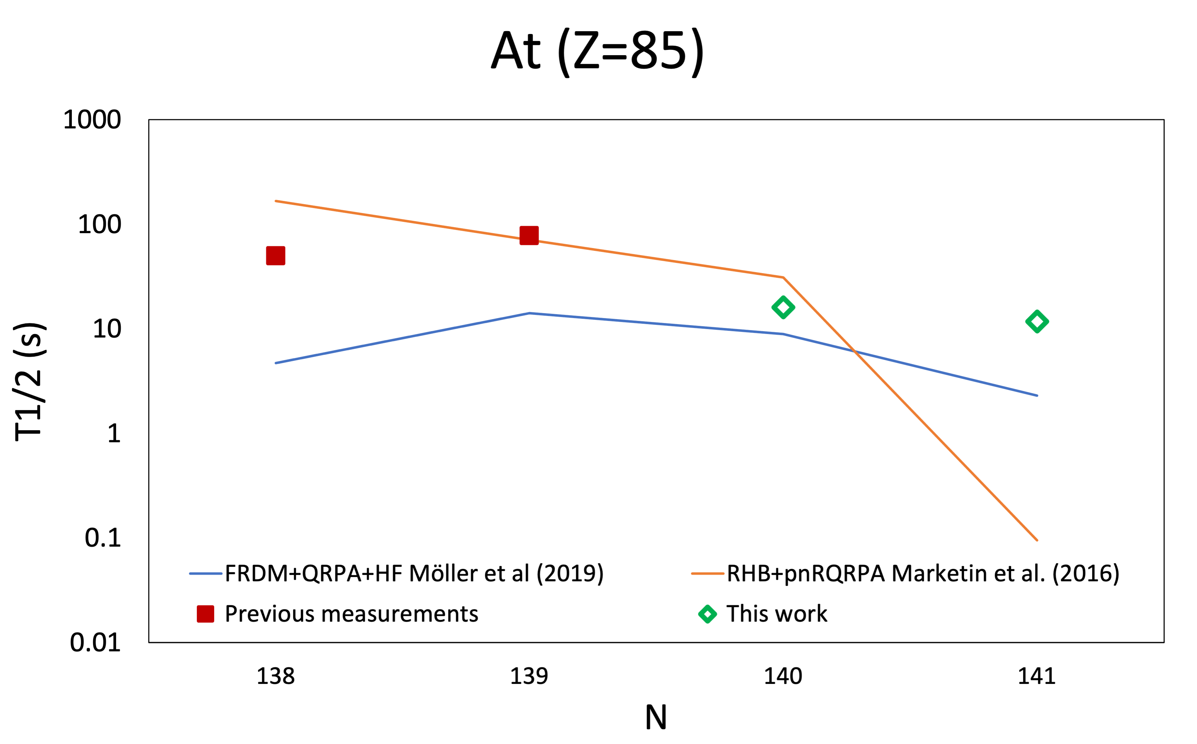
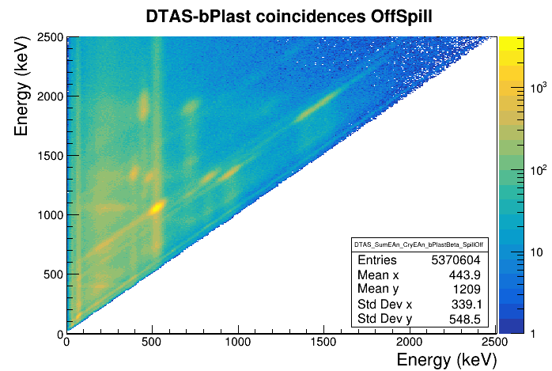
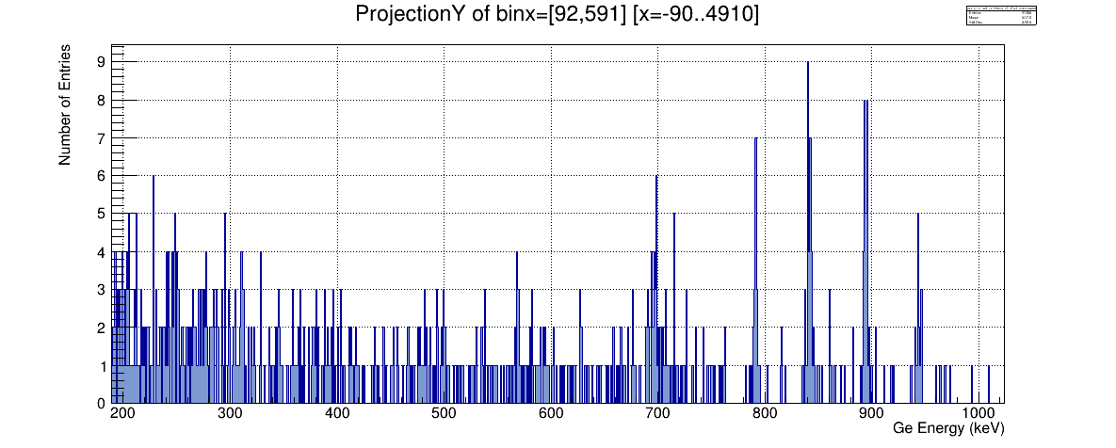
Experimental campaigns in 2020-2022
S480: Seniority Transitions below ¹⁰⁰Sn
S496 Core-breaking in ¹⁰⁰Sn (in preparation)
S460: A~225 island of octupole deformation
AIDA
S452 Shape Evolution at A~190 (in preparation)
S450 Shell evolution at N~126
S505: β-strength across N=126
Os-202 setting only
841
895
791
944
^{Counts per keV}
^{Ge Energy (keV)}

Slide 9
Experimental campaigns in 2020-2022
KSP publications 2022-2023
[1] Zago L et al., 2022 Phys. Lett. B 834, 137457.
[2] Das B et al., 2022 Phys. Rev. C 105, L031304.
[3] Iimura S et al., 2023 Phys. Rev. Lett. 130, 012501.
[4] Kowai K et al., 2022 Phys. Lett. B 887, 136953.
[5] Enciu M et al., Phys. Rev. Lett. 129, 262501 (2022)
[6] Morrison L et al., Phys.Lett. B 838, 137675 (2023)
[7] Mollaebrahimi A et al., Phys. Lett. B 839, 137833 (2023)
[8] Hellgartner S et al., Phys. Lett. B 841, 137933 (2023)
[9] Chen S et al., Phys. Lett. B 843, 138025 (2023)
[10] Gerst R-B et al., 2022 Phys.Rev. C 105, 024302
[11] Górska M, 2022 Physics 4(1), 364.
[12] Mistry A K et al., 2022 Nucl. Inst. Meth. A 1033, 166662.
[13] Jazrawi S et al., 2022 Rad. Phys. Chem. 200, 112234.
[14] Banerjee A et al., 2022 Nucl. Inst. Meth. A 1028, 166357.
[15] Valiente-Dobón J J et al., 2023 Nucl. Instr. Meth. A 1049, 168040.
[16] Das B et al., submitted, ⁹⁵Rh data
[17] Górska M et al., conf. proc. Ischia, in print
[18] Yaneva A, Jazrawi S et al., in preparation
[19] Zhang G, Mengoni D et al., in preparation
[21] Polettini M, Benzoni G et al., in preparation
[22] Sahin E et al., in preparation
S480: Seniority Transitions below ¹⁰⁰Sn
S496 Core-breaking in ¹⁰⁰Sn (in preparation)
S460: A~225 island of octupole deformation
AIDA
S452 Shape Evolution at A~190 (in preparation)
S450 Shell evolution at N~126
S505: β-strength across N=126
Os-202 setting only
841
895
791
944
^{Counts per keV}
^{Ge Energy (keV)}

Slide 10
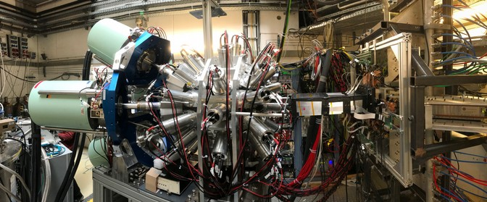
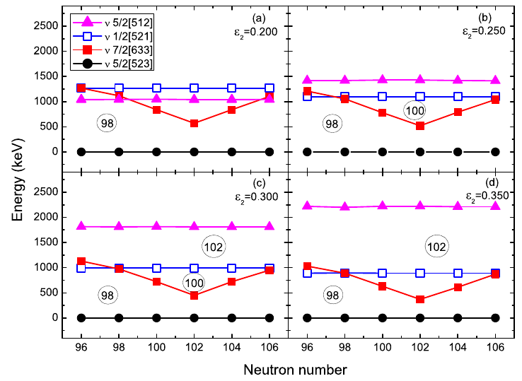
DESPEC plans for the near future:
Structure of neutron-rich, rare-earth nuclei far from stability
H.M. Albers (GSI), T. Grahn (Jyskl), C.M. Petrache(Paris) and V. Werner(TUD)
New approach in FAIR Phase-0: Beams of ¹⁷⁰Er increasing the cross section
Recent PSM calculations indicate
modified Nilsson parametrisation
needed for correct SP ordering
Location and size of deformed shell
gaps highly-dependent on N and
deformation parameter
Effect of ν7/2[633] most apparent at
N=98-104
DEGAS (⁸⁴Mo isomer search) + test experiments: FIMP, g-DEGAS…
HISPEC plans : Slow Down Beams tests, LISA tests

Slide 11
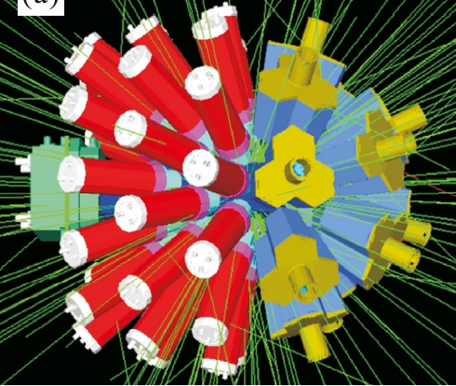
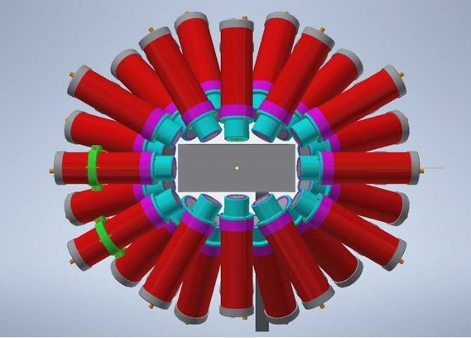
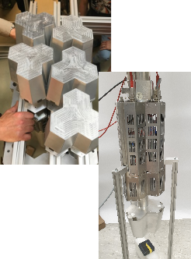
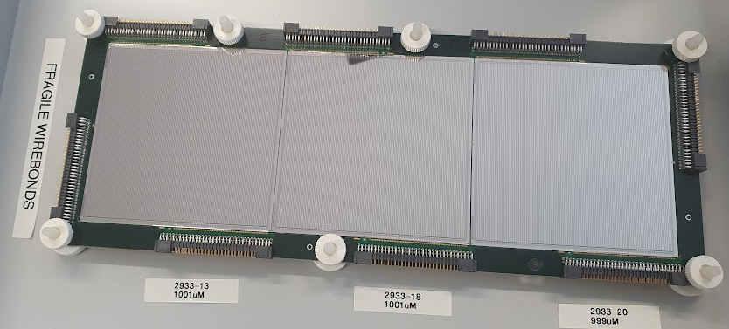
HYBRID array
New DESPEC hybrid γ-ray detector array
12 DEGAS HPGes for high-precision spectroscopy
+ 36 FATIMA LaBr₃s for fast-timing measurements
Compatible with ‘wide’ 24x8-cm² AIDA Active Stopper + βPlast fast scintillators
Improved efficiency compared to 2021 setup
Plans for front-end improvement of TAMEX electronics for low-energy γ rays

Slide 12
HISPEC type: In-beam experiments
(at RIBF)
Motivating international collaboration
Collecting available segmented HPGe detectors
spokespersons: P. Doornenbal and K. Wimmer

Slide 13
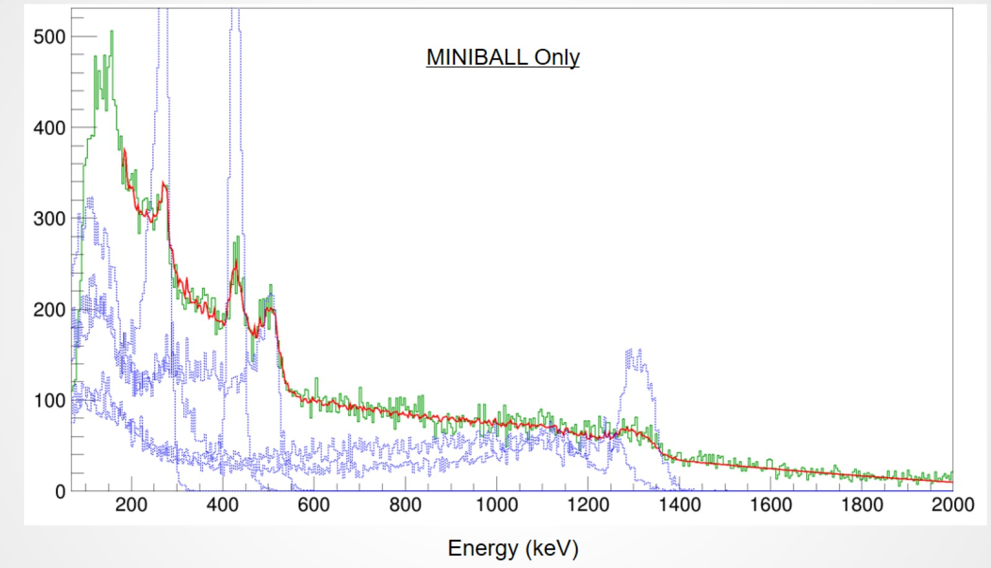
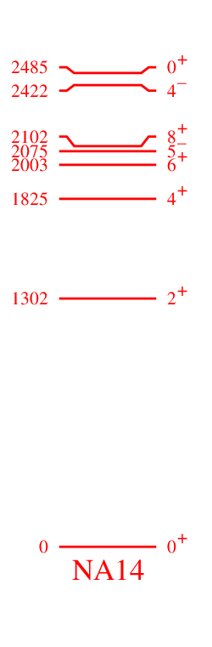
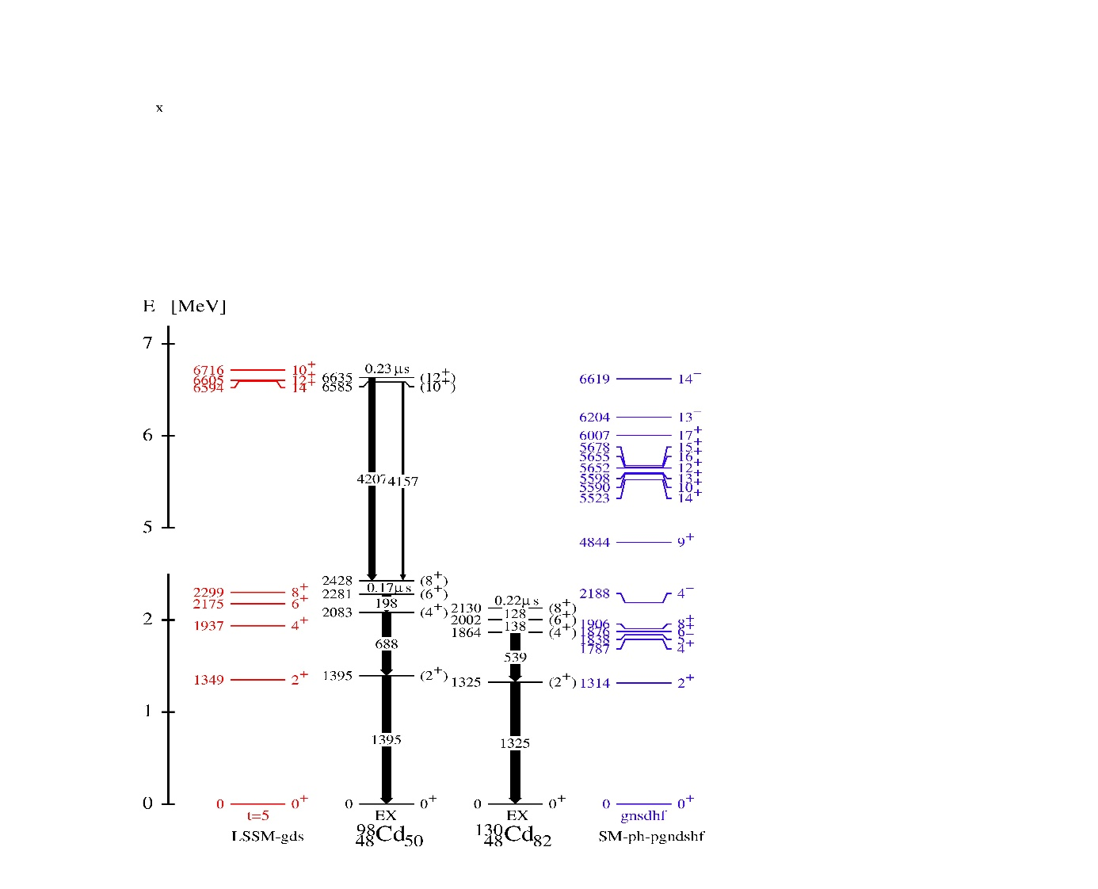
HISPEC type experiment:
HICARI campaign at RIBF Single proton knockout to ¹³⁰Cd
Originally a case for FAIR
A. Jungclaus et al., Phys. Rev. Lett. 99, 132501, 2007
PRELIMINARY
New states + lifetimes!
Analysis: Tom Parry (U. of Surrey), Michael Armstrong (GSI/U. Cologne), Zs. Podolyak, M.G.

Slide 14
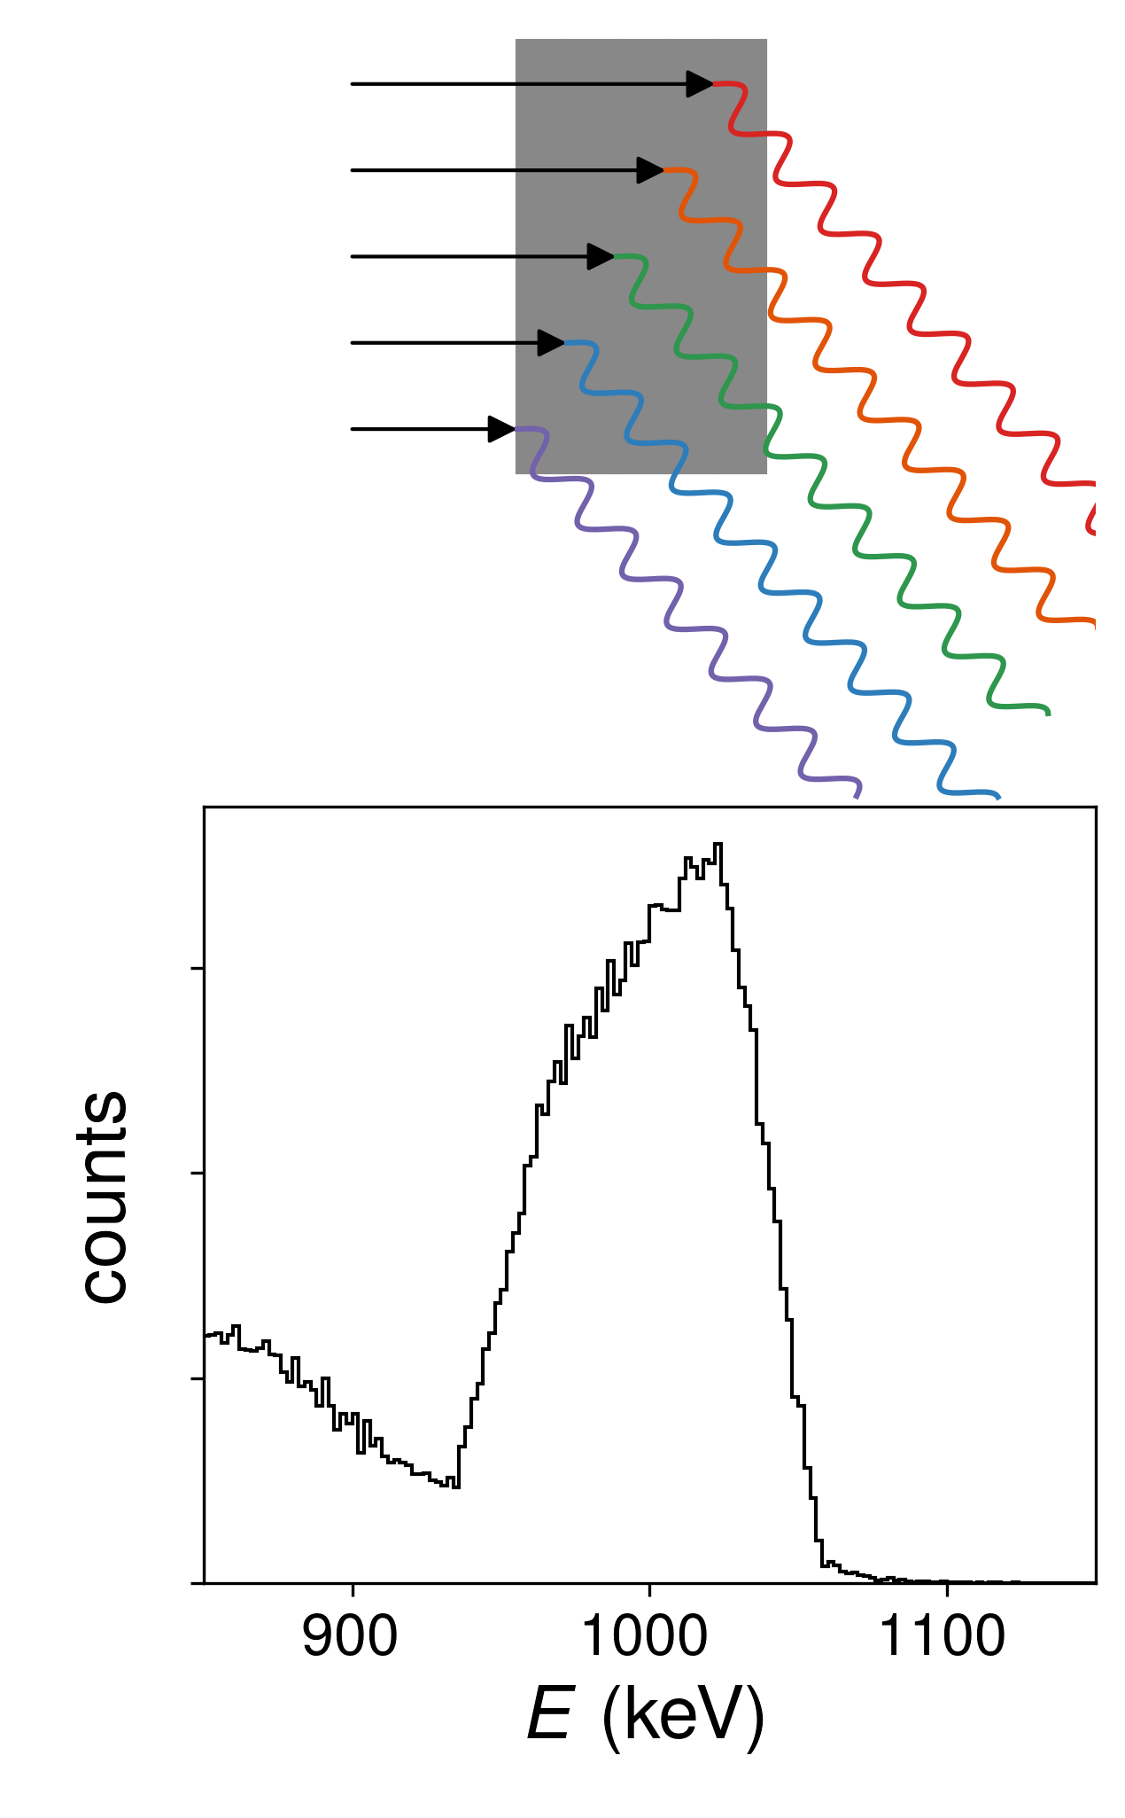
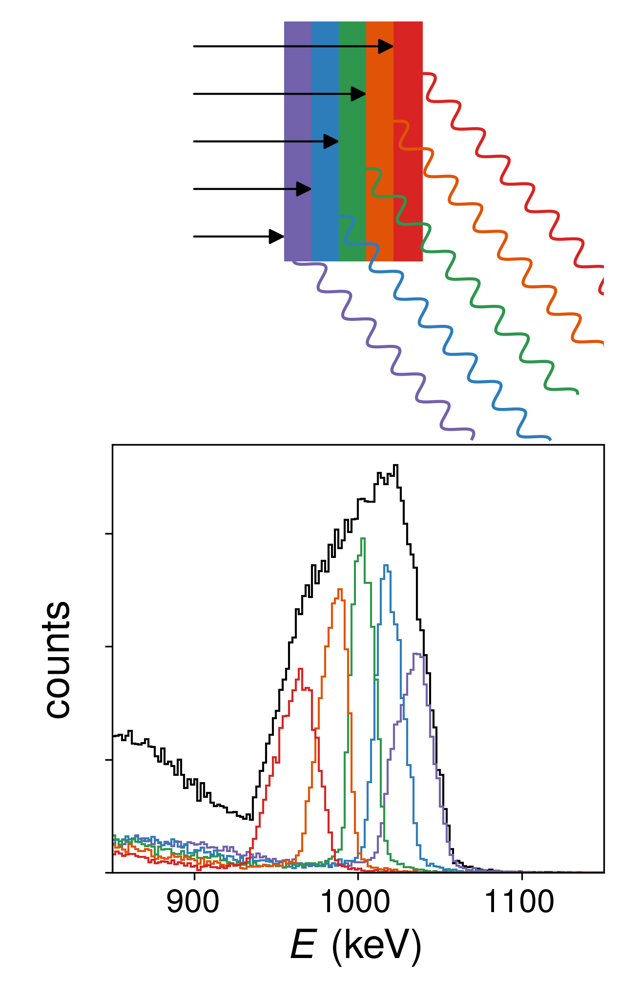
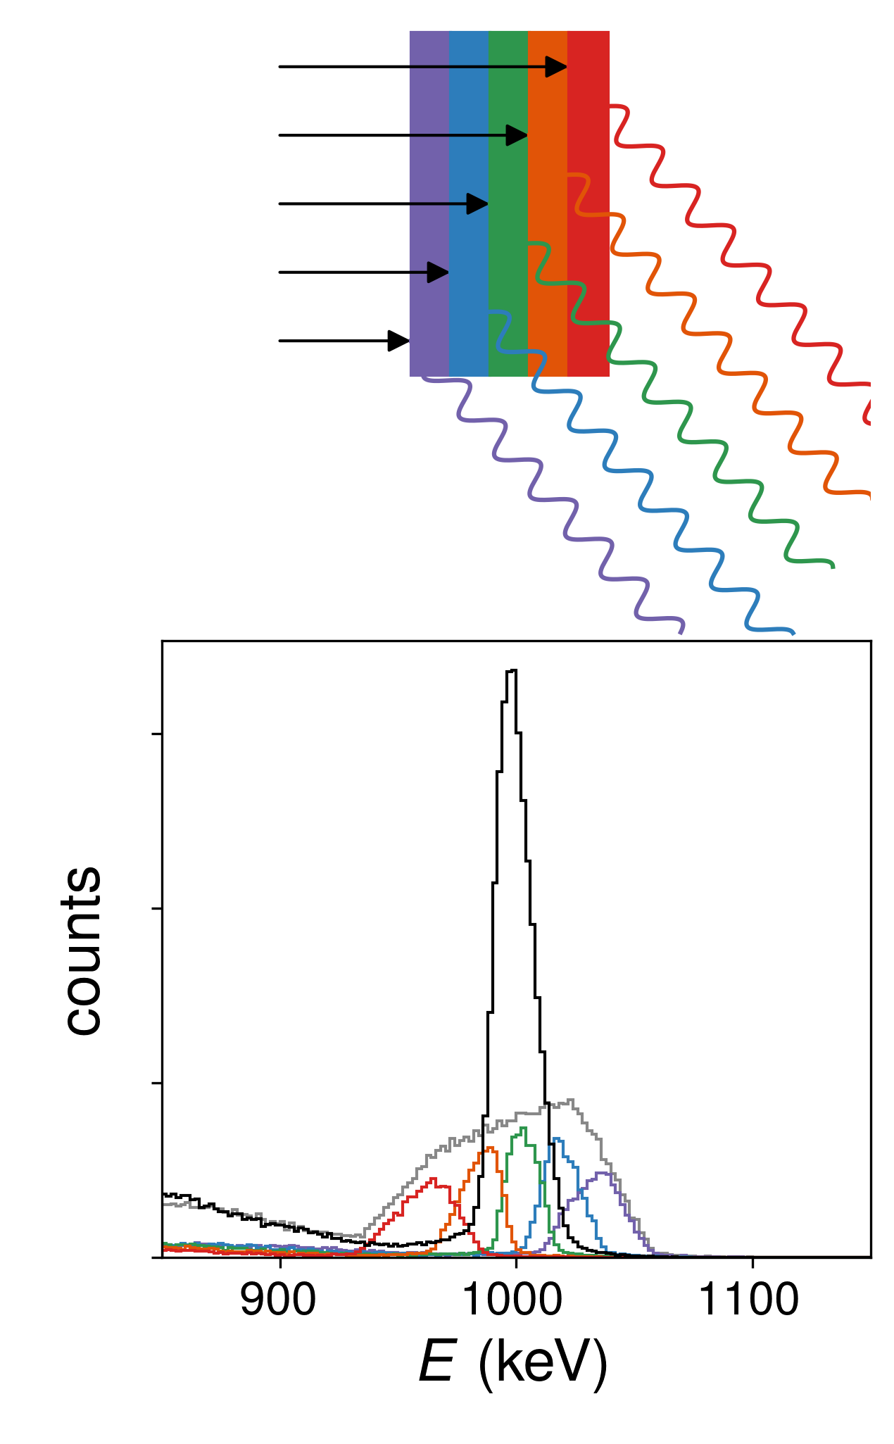
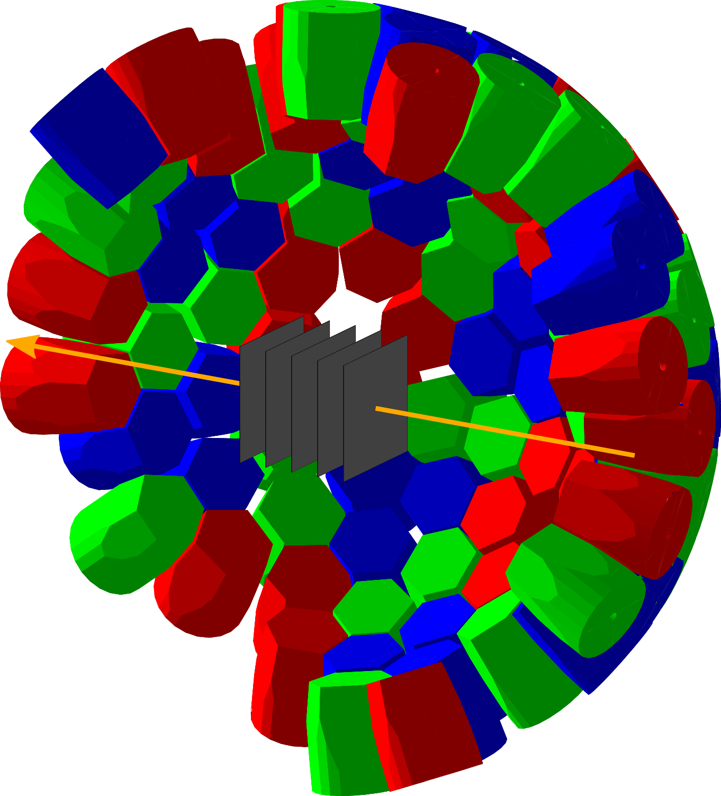
LISA: LIfetime measurements with Solid Active targets
PI: K. Wimmer, No 101001561
Test run 2024 with a prototype
Physics run with AGATA @FAIR>2028
Principle:
Energy resolution determined by unknown velocity in the target
Several layers of active targets
Event-by-event determination of reaction position → (β,z)
Compact array of active target detectors inside AGATA

Slide 15
Additional local team projects
Accompanying Detector developments/activities:
Ge Planar detector response
Timing of Ge detectors
LISA active target detector array
Fiber implanter
Finger scintillator for high rate beam tracking
Beta particle scintillators
Detector performance improvement using AI/ML
Ongoing (physics) experiments at other facilities:
IDATEN and SHARAQ RIBF, AGATA LNL, MINIBALL and ISS at HIE-Isolde, ILL Grenoble
Third party funding:
LISA (ERC) active diamond target (K. Wimmer)
ARTEMIS (EU) Earth quake pre-warning system (J. Gerl)
EUROLABS:
- REMOTE OPERATIONS of experiments (H. Albers)
- coordinating INTRANS: traveling detectors campaigns in Europe (M.G.)

Slide 16
Summary
KSP investigates the structure of exotic nuclei
and hosts HISPEC/DESPEC international collaboration
Several DESPEC Phase-0 experiments produced the first results, many publications in preparation in ¹⁰⁰Sn and N=126 regions
Flexible concept of operation at GSI/FAIR to optimize the physics outcome with DESPEC setups from the available infrastructure
    flexible in its simplest configuration
    more space demanding in the full configuration including neutron detectors etc.
    HISPEC: further strong delay must be avoided since it represents a large fraction of the collaboration
    AGATA: a major investment of many European countries with one of the primary goals to run at FAIR!
    Need to define the time when AGATA can come to FAIR
    Start tests of ancillary equipment and strategy discussions on:
        AGATA accommodation plans
        Availability of LEB and/or magnetic analyzer for the reaction products

Slide 17
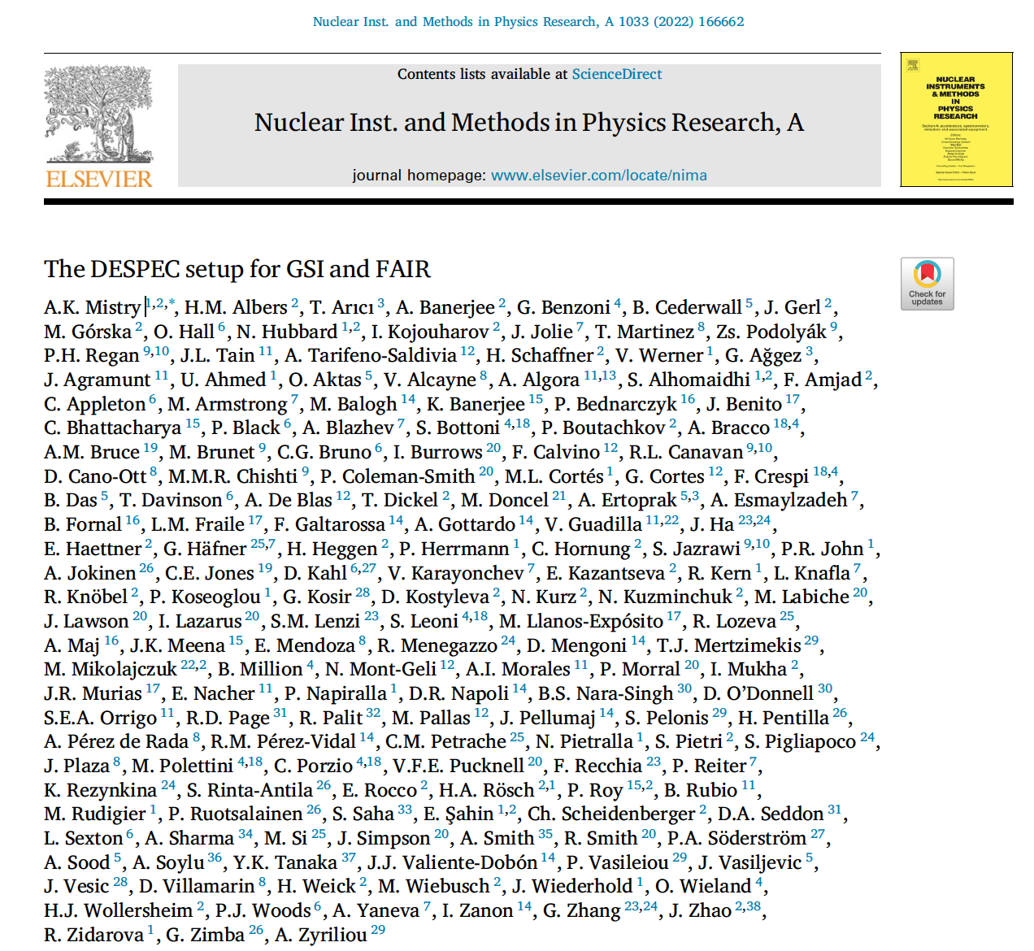

Slide 18
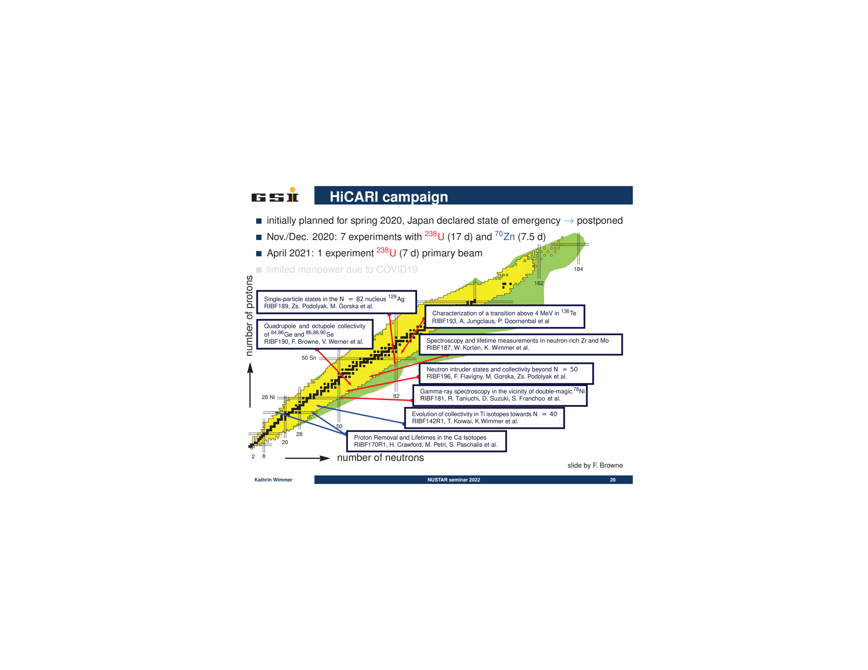
HISPEC TYPE: Physics goals example from RIBF
spokespersons: P. Doornenbal and K. Wimmer

Slide 19
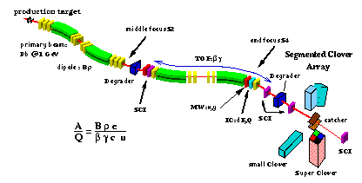
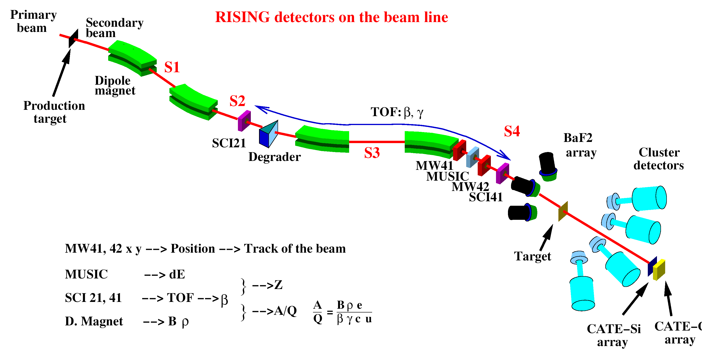
DESPEC:
Experiments with Stopped Beams
production
selection
spectroscopy
identification
stopping
~300MeV/u

Slide 20
Nuclear Structure in the ¹⁰⁰Sn region
N=50
νd_{5/2}g_{7/2}s_{1/2}d_{3/2}h_{11/2}
νg_{9/2}p_{1/2}
p-drip line
Z=50
¹⁰⁰Sn
Nucleus with only T_{1/2} known
Nucleus with an excited state known
πg_{9/2}p_{1/2}
N=Z

Slide 21
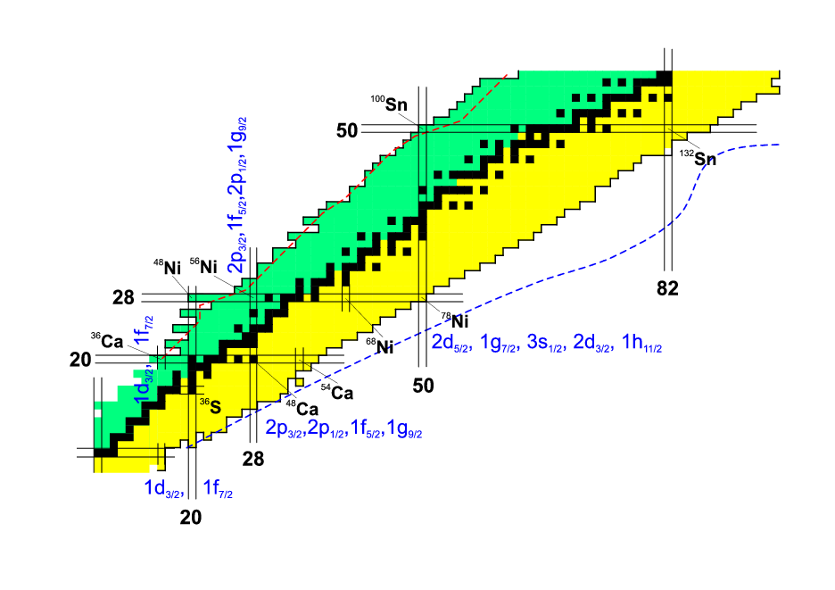
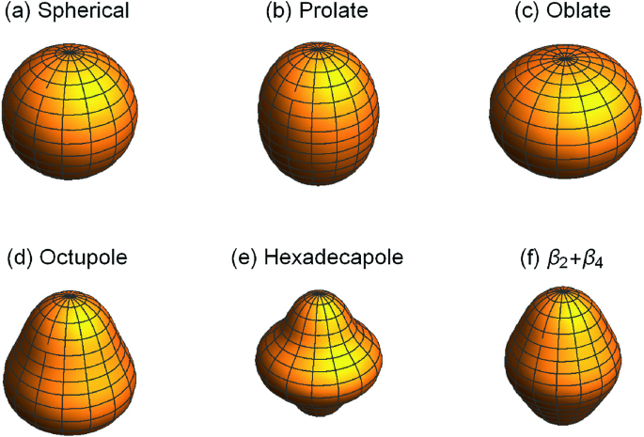
South West: ¹⁰⁰Sn vs ¹³²Sn
2f_{7/2},3p_{3/2},1h_{9/2},
3p_{1/2},2f_{5/2},1i_{13/2}
1f_{5/2},2p_{3/2},2p_{1/2},1g_{9/2}

Slide 22
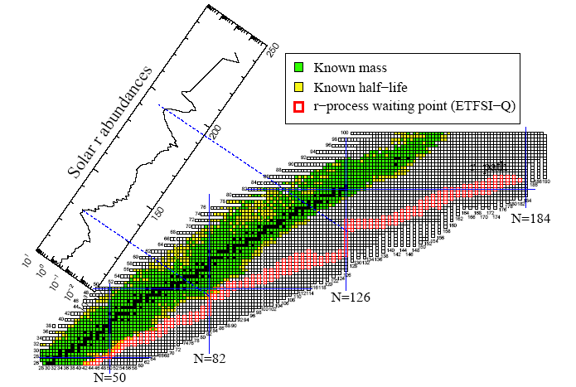
Astrophysics relevance for n-rich nuclei
204Pt
98Cd
130Cd
β:Dillman et al., PRL, 91, 162503 (2003)
2+:Kautzsch, T. et al. Eur. Phys. J. A 9, 201-206 (2000)
Langanke, K. & Martínez-Pinedo, G. Rev. Mod. Phys. 75, 819-862 (2003)

