Slide 1
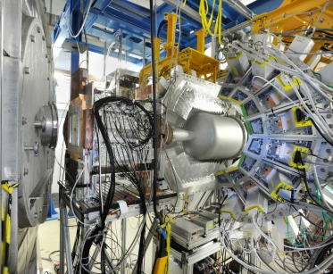
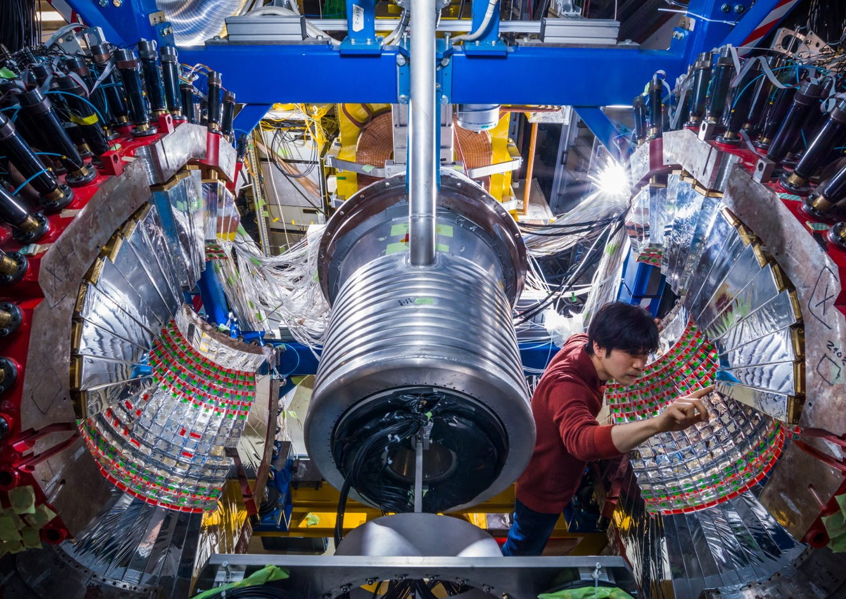
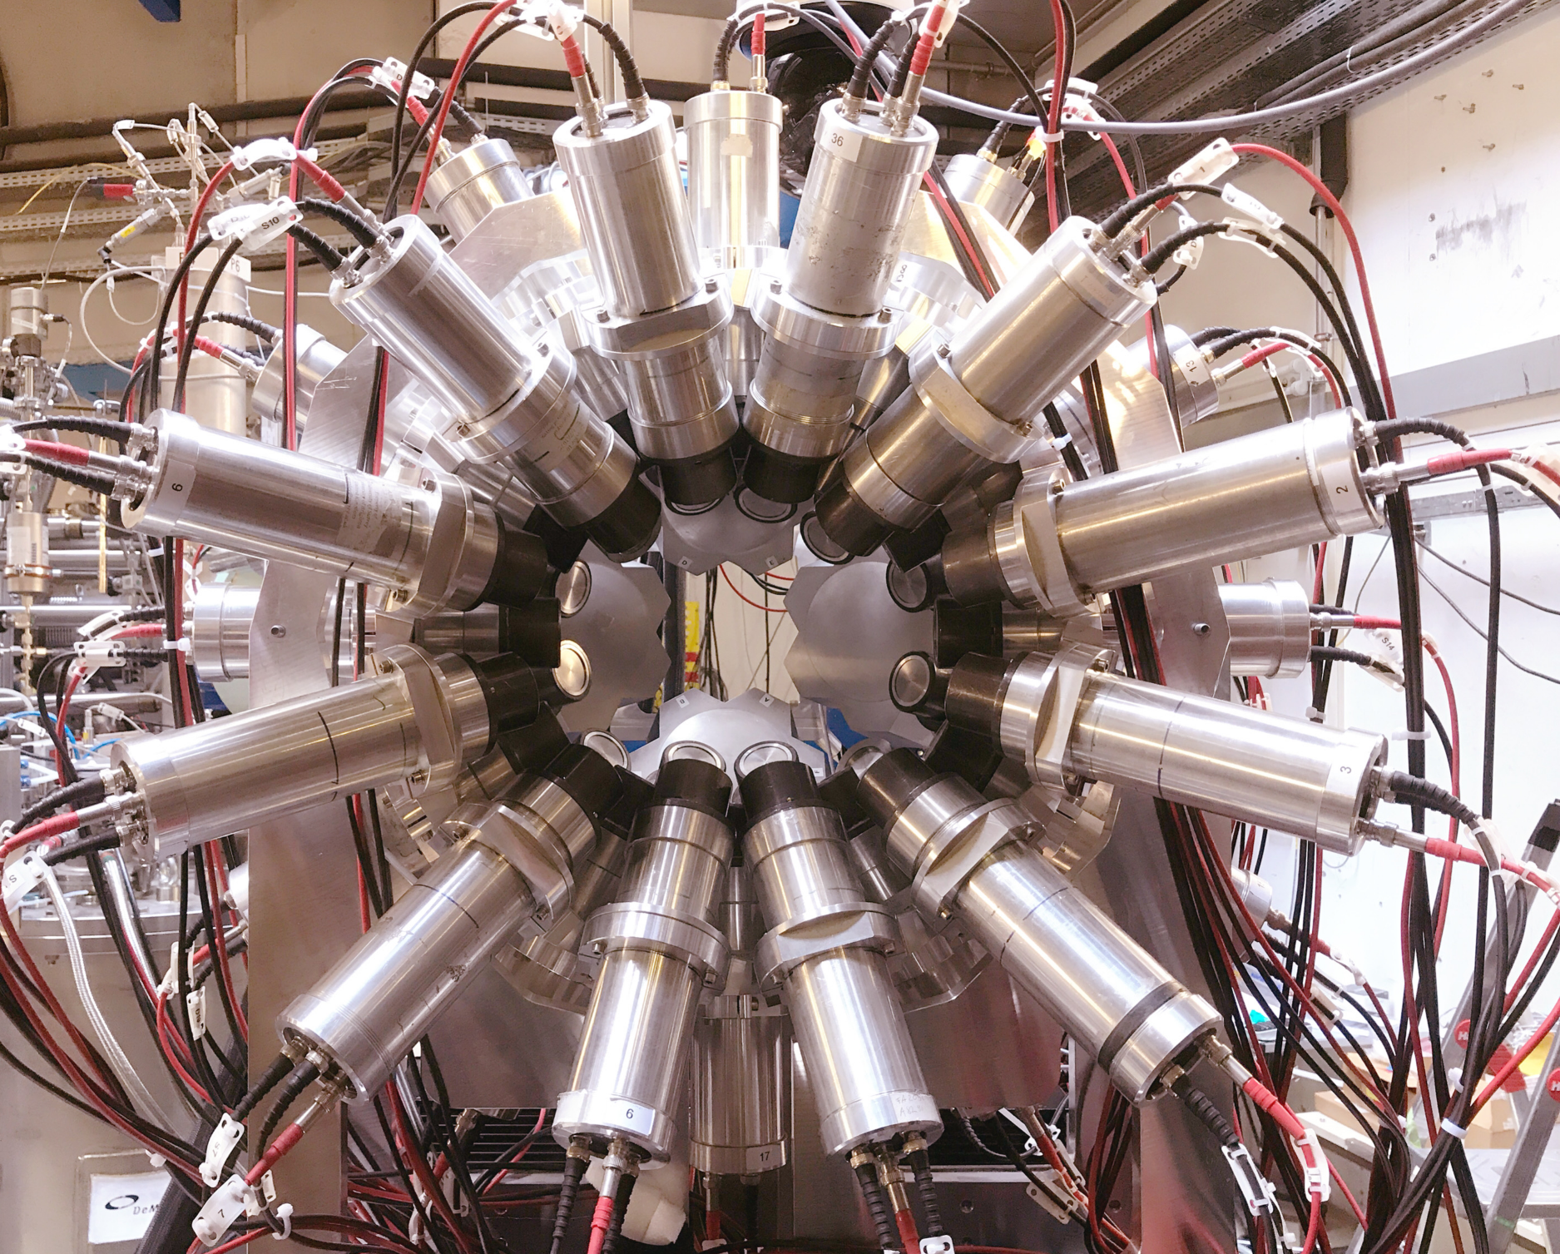

NUSTAR Technical Status
with a focus on NUSTAR ES/FS startup @ HEB
FAIR/GSI Research Retreat
18th-19th July 2023
H.M. Albers

Slide 2
Critical Path towards NUSTAR ES/FS
Completion of High-Energy Cave TBI
Completion of relevant radiation safety infrastructure
Operating acceptance (Abnahme) awarded
HE Cave ready
S-FRS ready to deliver beam
S-FRS beam delivery (M12)
Required SIS-18/SIS-100 beam parameters reached
NUSTAR
Early and First Science
Sub-collaboration specific infrastructure
Platforms for detector subsystems at HE Branch focal planes
Experiment-specific media and other infrastructure
Detector systems ready
Demonstrated readiness of NUSTAR setups
In-use setups commissioned during Phase-0
Expert resources available
Expert resources (local + external) from collaboration required for installation and commissioning phases

Slide 3
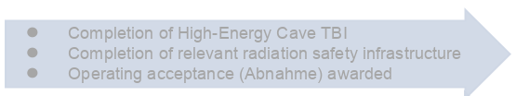
Critical Path towards NUSTAR ES/FS
HE Cave ready
S-FRS ready to deliver beam
S-FRS beam delivery (M12)
Required SIS-18/SIS-100 beam parameters reached
Risk: beam parameters not achieved
Sub-collaboration specific infrastructure
Platforms for detector subsystems at HE Branch focal planes
Experiment-specific media and other infrastructure
Low-impact scientific output
Detector systems ready
Demonstrated readiness of NUSTAR setups
In-use setups commissioned during Phase-0
Expert resources available
Expert resources (local + external) from collaboration required for installation and commissioning phases

Slide 4
Critical Path towards NUSTAR ES/FS
HE Cave ready
S-FRS ready to deliver beam
S-FRS beam delivery (M12)
Required SIS-18/SIS-100 beam parameters reached
Sub-collaboration specific infrastructure
Platforms for detector subsystems at HE Branch focal planes
Experiment-specific media and other infrastructure
Risk: dependency on Common Fund (CF)
established through NUSTAR MoU. Risk of non or late availability of CF. Risk of non-payment from communities no longer served in ES/FS
Detector systems ready
Demonstrated readiness of NUSTAR setups
In-use setups commissioned during Phase-0
Expert resources available
Expert resources (local + external) from collaboration required for installation and commissioning phases
Mitigation: Bilateral discussions with funding agencies
Buffer: No critical components
with long lead times foreseen

Slide 5
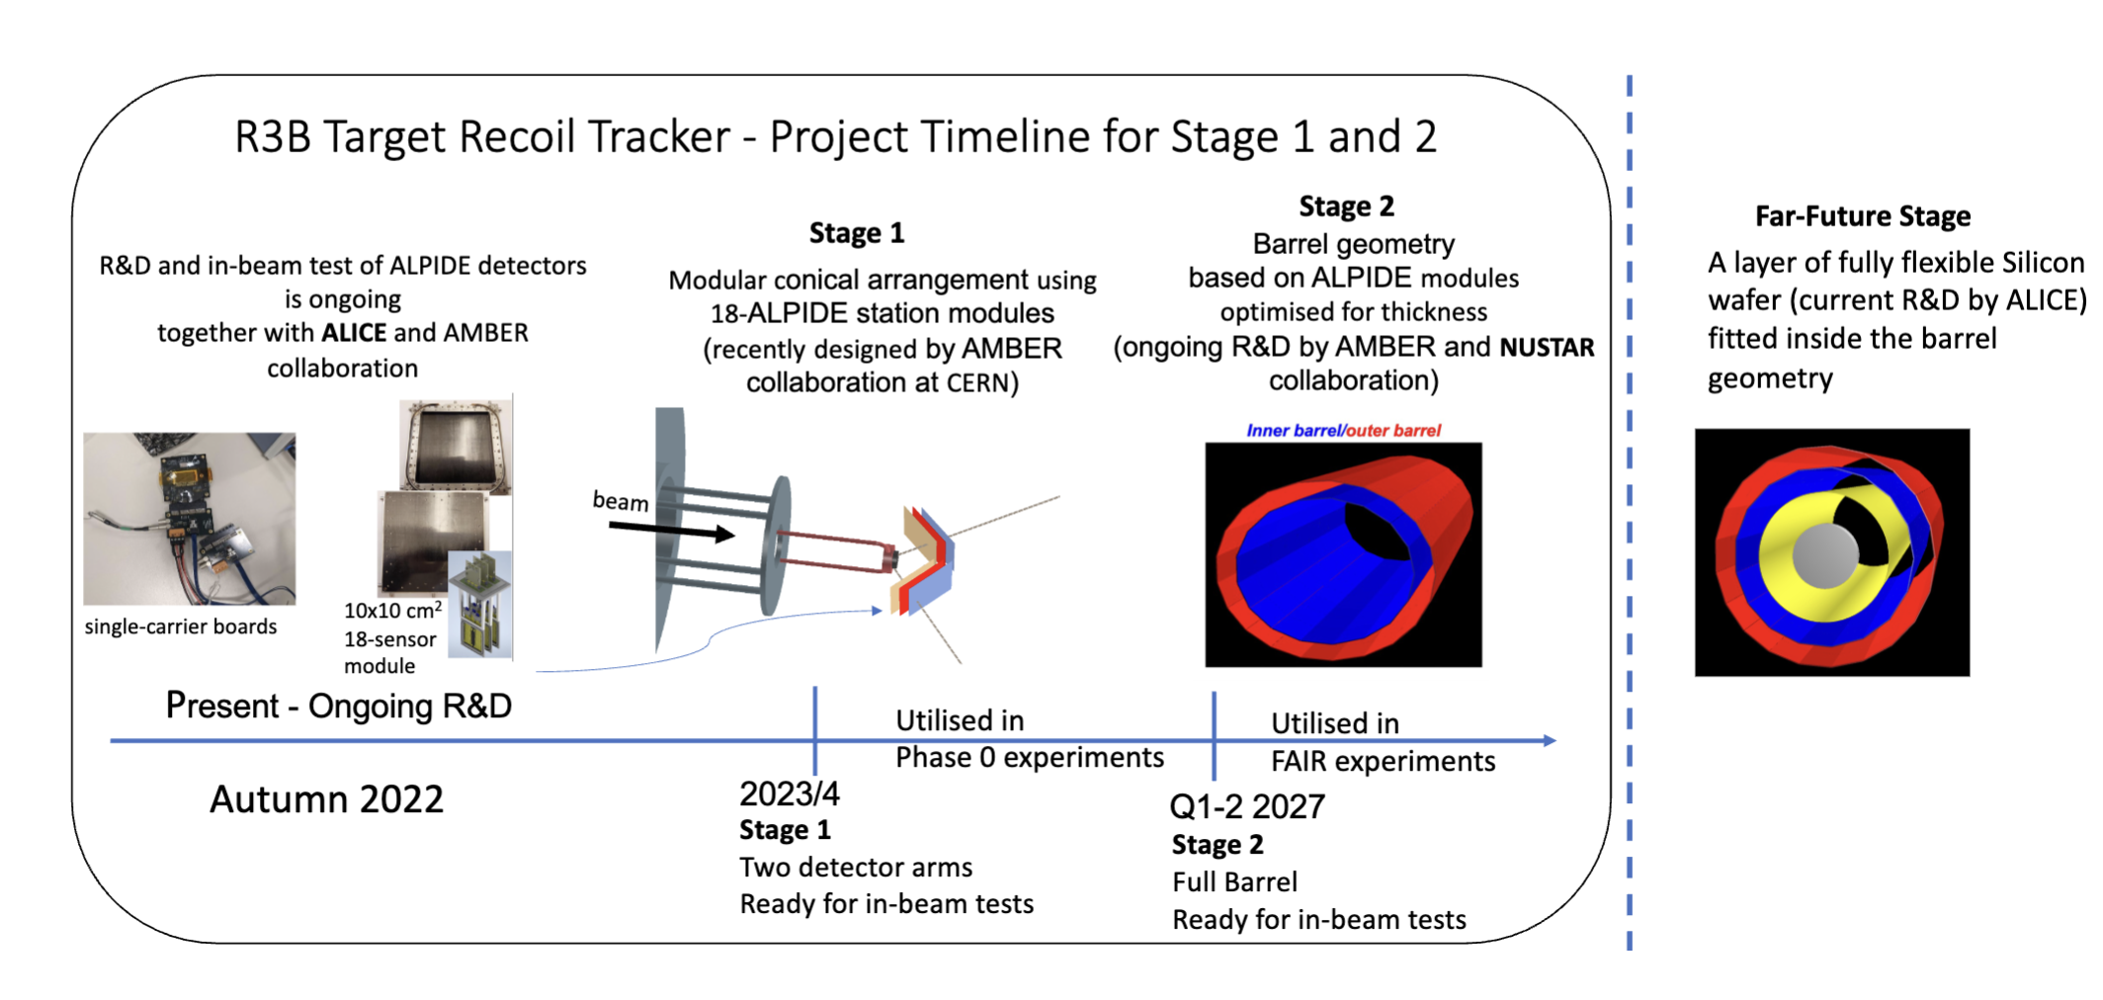
Technical developments: R³B
present
TDR expected 08/23

Slide 6
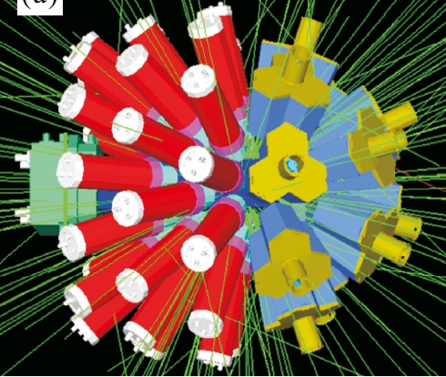
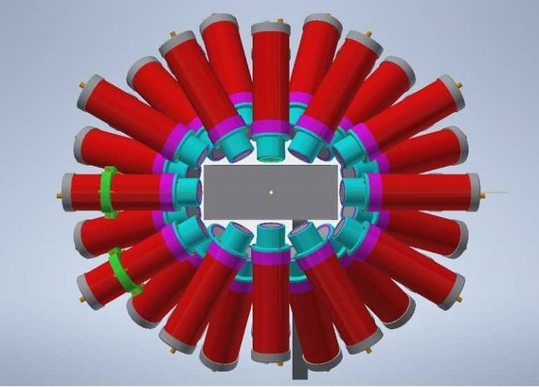
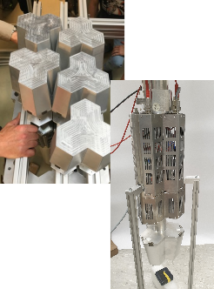
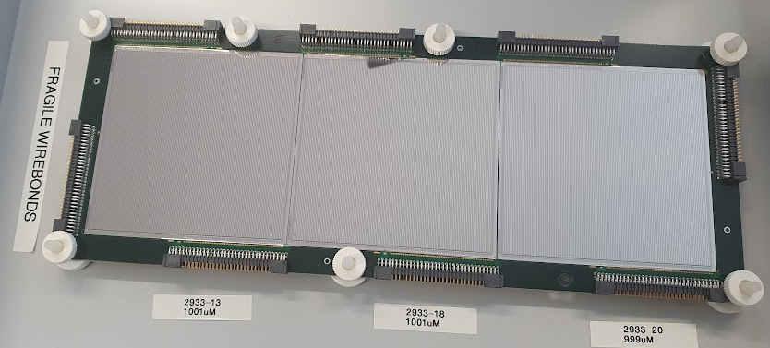
Technical developments: HISPEC/DESPEC
New DESPEC hybrid γ-ray array
12 DEGAS HPGes for high-precision spectroscopy
+ 36 FATIMA LaBr₃s for fast-timing measurements
Compatible with ‘wide’ 24x8-cm² AIDA Active Stopper + βPlast fast scintillators
Improved efficiency compared with 2021 setup
Plans for front-end improvement of TAMEX electronics for low-energy γ rays

Slide 7
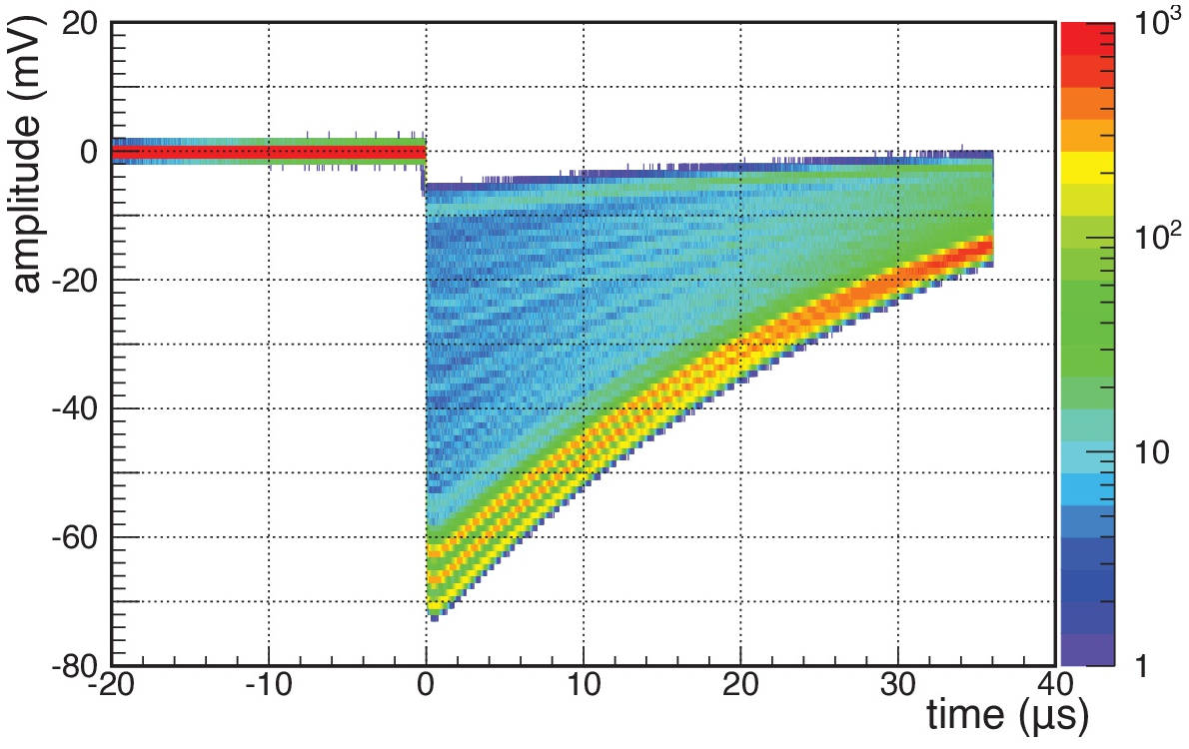
Technical developments: HISPEC/DESPEC
LISA: LIfetime measurements with Solid Active targets
wave forms recorded by high bandwidth oscilloscope
diamond detectors offer the necessary energy resolution and radiation hardness
sc-CVD diamond detectors testing in collaboration with GSI detector lab
triple-α source: energy resolution 0.8%
energy resolution sufficient for identification of one-proton removal events
design and construction of 2×2×2 prototype
ongoing optimization of charge sensitive pre-amplifiers and FEBEX4 DAQ system

Slide 8
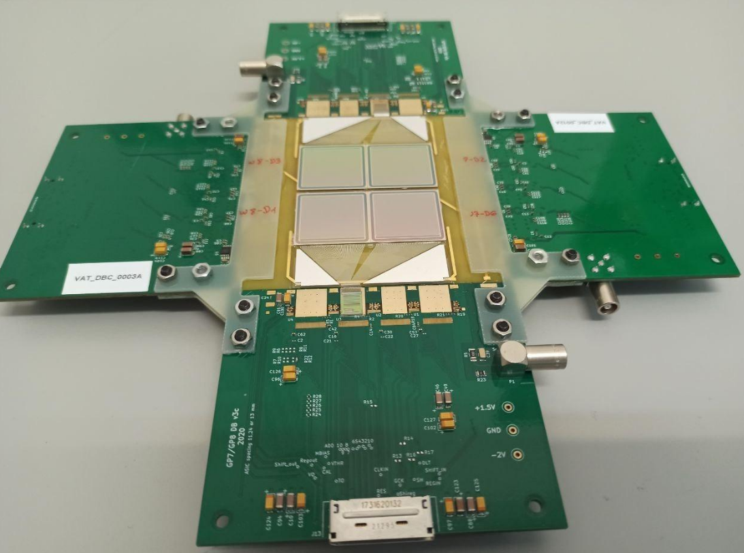
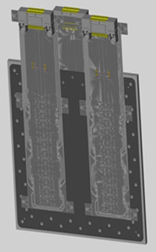
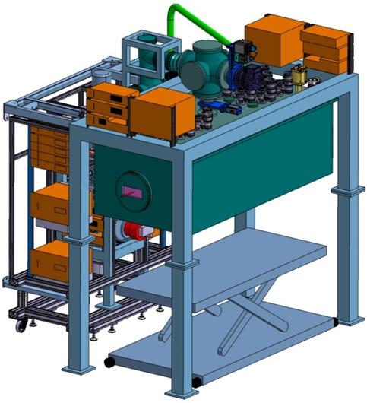

Technical developments: Super-FRS EC
Micro calorimeters for PID
Micro vertex detector for WASA@FRS
Test at the FRS
Design of an array with 4x4 crystals (active detector area 40x40 mm²)
Test with off-line sources and with stable-ion beams: efficiency, tracking capability, IP measurement of nucleus-nucleus collisions
Cryogenic Stopping Cell
Tracking detectors for EXPERT
GSI-FAIR In-Kind Contract signed
First procurements completed, construction started
Construction / assembly will be continued in 2024
Tests with p-beams at COSY Jülich
FOOT micro-strip detectors (combined R3B activity)
ALPIDE tracking station
(combined R3B activity)
GADAST readout system
Tracking station with
18 ALPIDE detectors
8

Slide 9


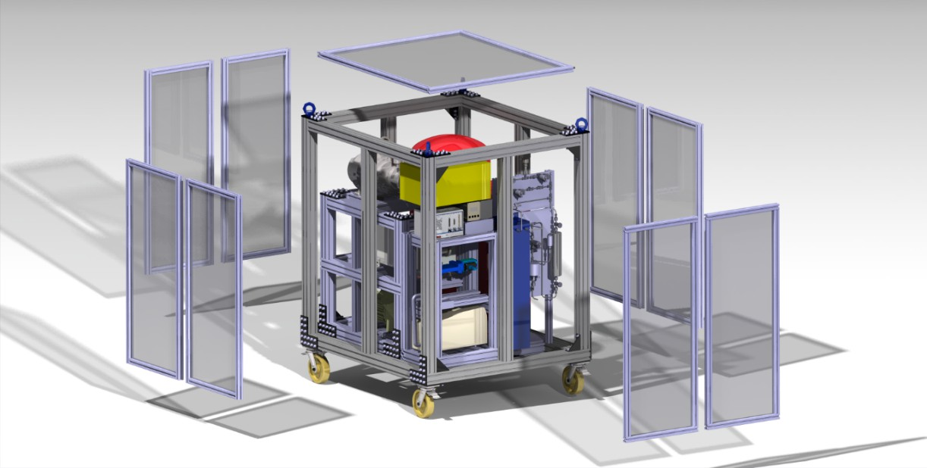
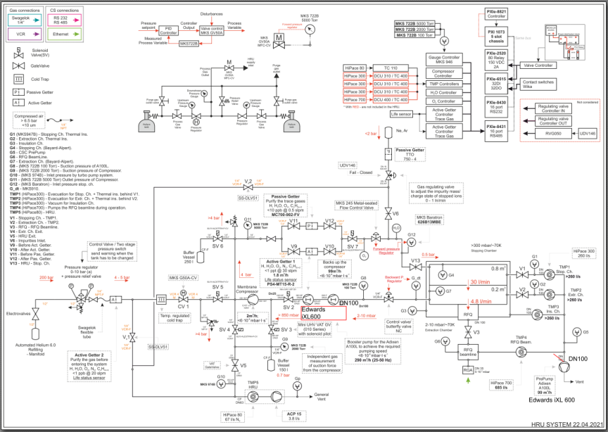
Technical developments: Super-FRS EC
Helium Recovery Unit (HRU) for Super-FRS Cryogenic Stopping Cell
Recovers >98% of (precious!) buffer gas He 6.0; purifies buffer gas at each cycle
Final design report accepted; purchasing under way; test and assembly of first components will start in next weeks
GSI engineering run in Q4 2023: test with beams
9
9

Slide 10
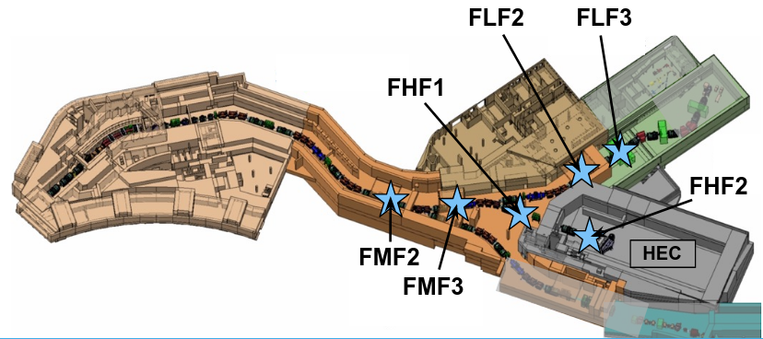
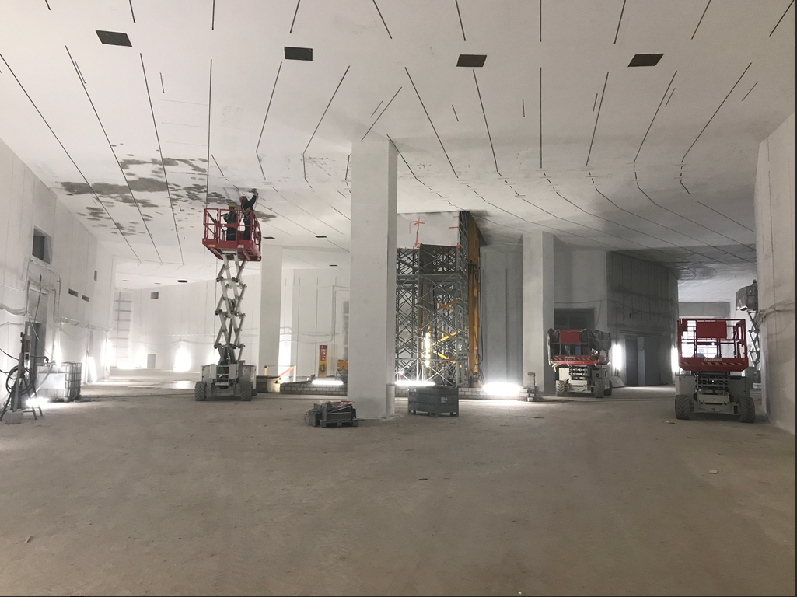
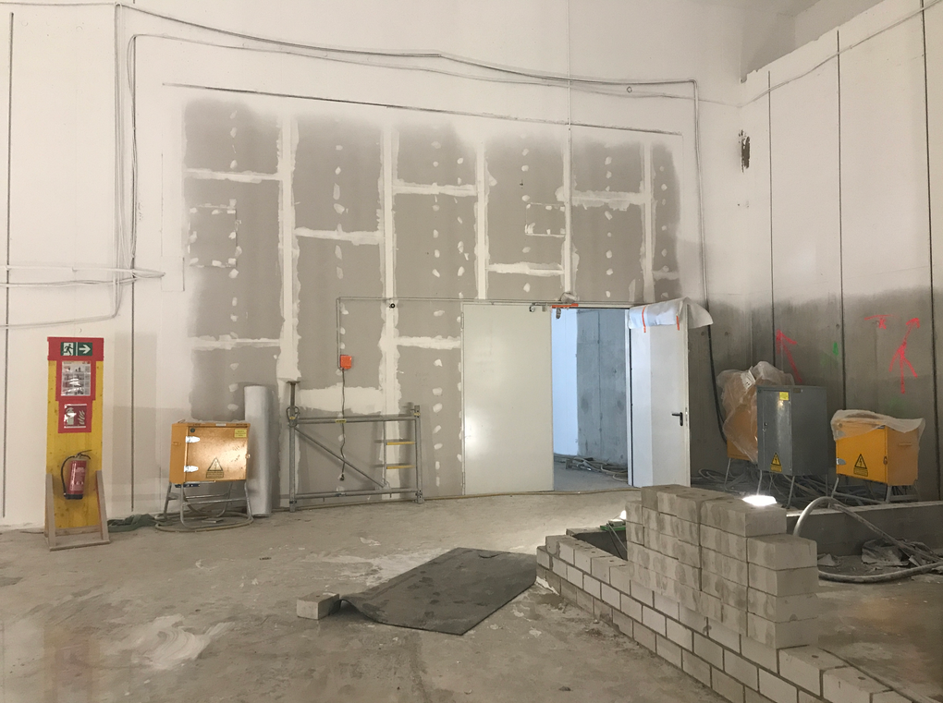
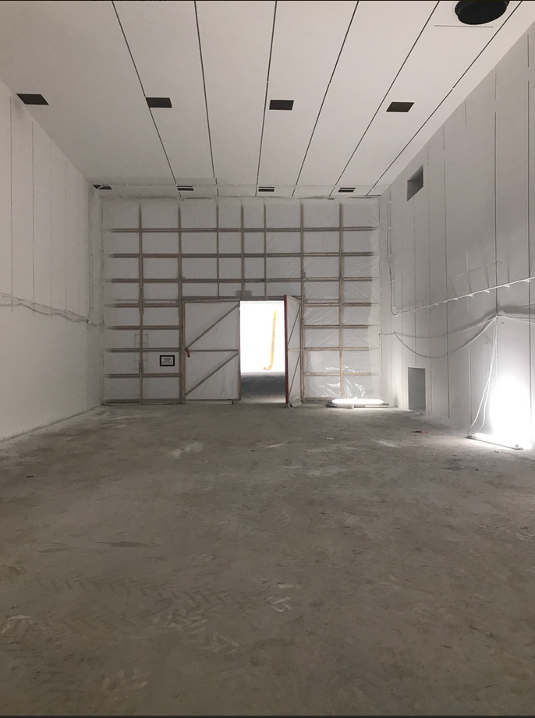
On-site construction update - April 2023
FHF1
FLF2
Low-energy
Branch
High-energy
Branch
Ring
Branch

Slide 11
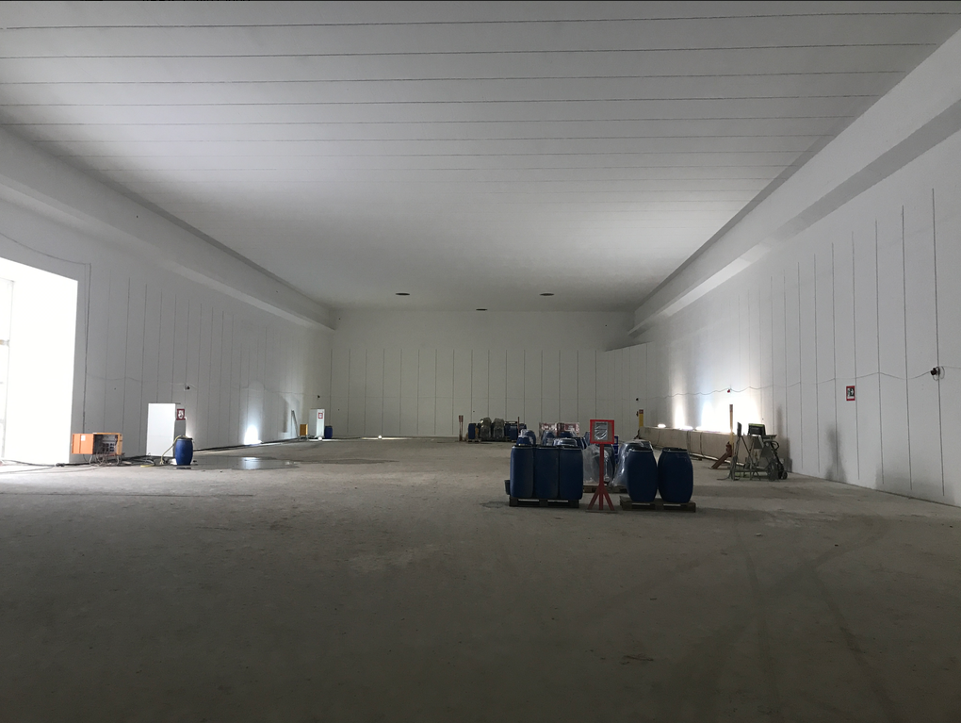
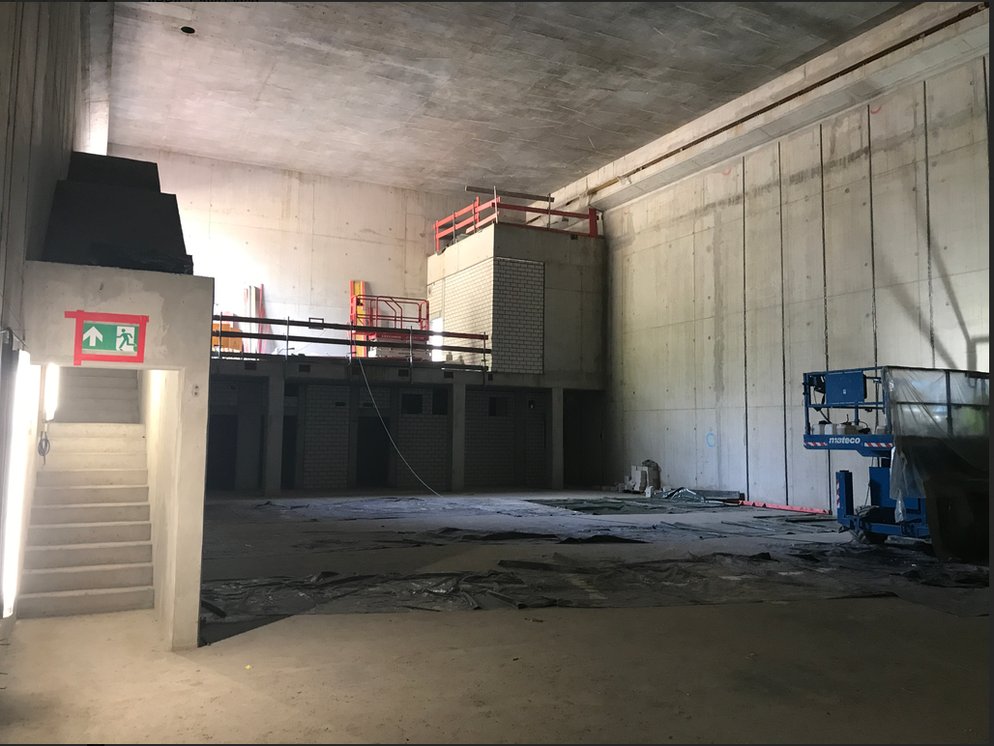
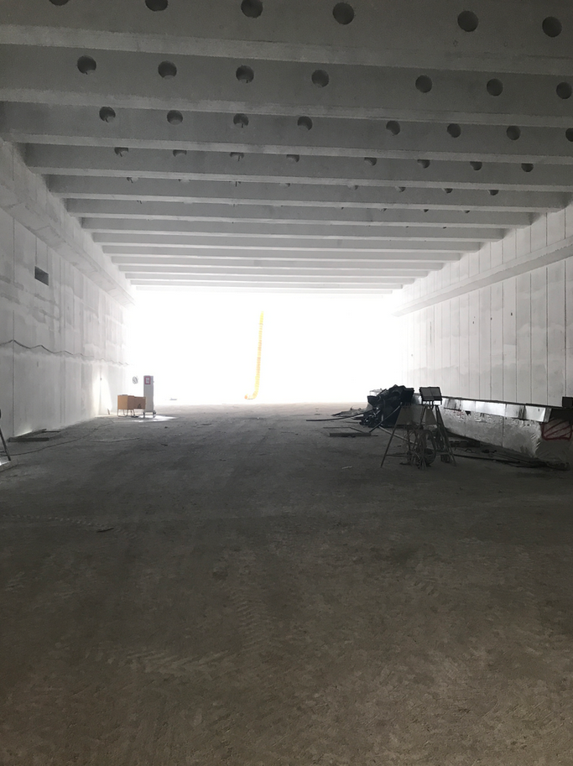
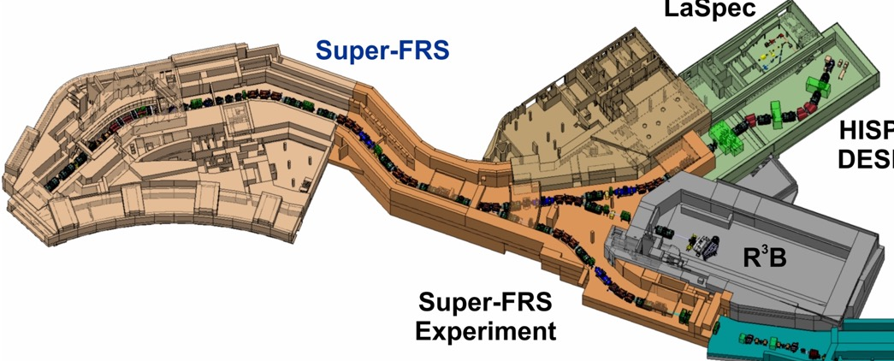
On-site construction update - April 2023
High-energy Cave
MATS/LaSPEC
Low-energy Cave
MATS/LaSPEC
LEC
HEC

Slide 12
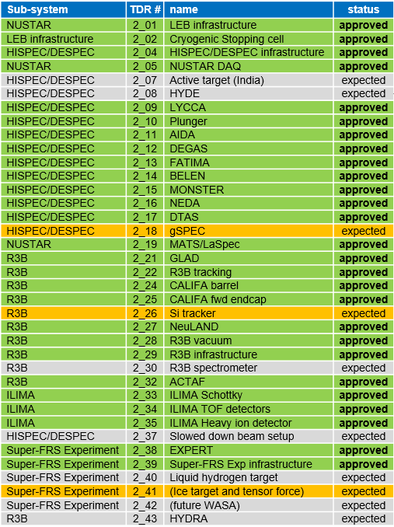
Status of TDRs
approved
27 | approved
0 | submitted
3 | expected
7 | beyond “Day one”
11/2025
submitted
11/2025
Expected TDRs:
11/2023
gSPEC:
  Grant request submitted
Si tracker:
  Funding granted by STFC
  Re-design complete
  TDR expected 08/23
Ice-target and tensor force detection:
  Funding available
  TDR expected 08/23
08/2023*
07/2024
11/2025
07/2024
08/2023*
07/2025
*funding available/secured
07/2024
*Funding available/secured
12

Slide 13
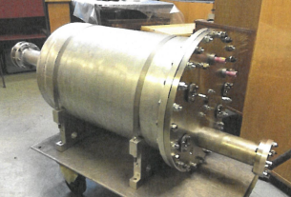
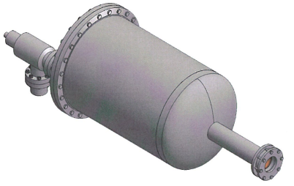
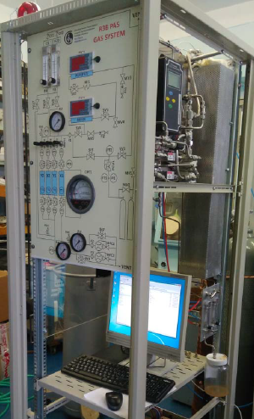
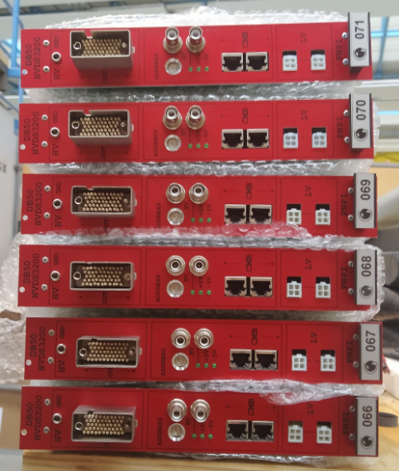
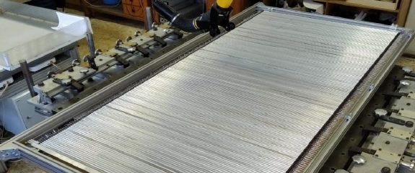
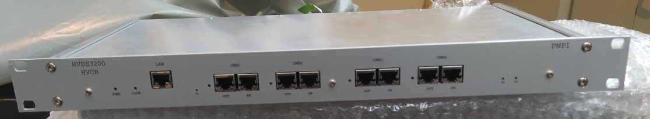
Status of re-procurement for Russian in-kind
Active target ACTAF2
Status: nothing delivered
ACTAF1 will be combined with parts of ACTAF2
Electronics from ACTAF2 might need revision
Revised vacuum and gas systems
Support and alignment systems
required
226 kEUR (2005) requested for full
re-procurement
Proton Arm Spectrometer (PAS)
Status: nothing delivered
New design and (likely) TDR needed
R3B investigating technical solutions
587 kEUR (2005) requested for full re-procurement
chamber at PNPI
NeuLAND HV
Status: all modules and control boards delivered
Quality issue - repair required
GSI EEL reverse engineering
31.4 kEUR (2005) requested for repair
straw tubes at PNPI
straw tubes at PNPI
gas system for PAS at PNPI

Slide 14
NUSTAR Strategy towards FS
Handover “cave ready for installation”
As soon as building is ready for installation, some infrastructure items can be installed (limited due to work on Super-FRS)

Slide 15
NUSTAR Strategy towards FS
Handover “cave ready for installation”
HE Cave Handover from Super-FRS
As soon as HEB cave is “empty”, handover MS from Super-FRS, installation of R3B can start

Slide 16
NUSTAR Strategy towards FS
Handover “cave ready for installation”
HE Cave Handover from Super-FRS
S-FRS M12
Q4
2027
Final S-FRS commissioning Milestone 12, Particle ID validation with simple detector setup inside HE Cave @ FHF2

Slide 17
NUSTAR Strategy towards FS
Handover “cave ready for installation”
HE Cave Handover from Super-FRS
S-FRS M12
Q4
2027
Common NUSTAR experiment @ FHF2
Common NUSTAR experiment involving ALL NUSTAR subcollaborations. S-FRS settings and setup likely to overlap with M12
Simple, compact setup, fast results needed!
NUSTAR collaboration to decide on the physics goal(s)
HEC
Common NUSTAR Experiment @ FHF2

Slide 18
NUSTAR Strategy towards FS
Handover “cave ready for installation”
HE Cave Handover from Super-FRS
S-FRS M12
Q4
2027
Common NUSTAR experiment @ FHF2
NUSTAR Early Science
NUSTAR First Science
NUSTAR ES and FS:
individual sub-collaborations (Super-FRS EC, partial HISPEC/DESPEC and R3B) running PAC-approved experiments at S-FRS focal planes, continuation of the SHE program at UNILAC and ILIMA at the ESR and CRYRING
HISPEC/DESPEC
Super-FRS EC
Detailed installation timelines to be developed and refined in LCM workshops
New “NUSTAR Technical Integration for ES” team planned
Super-FRS EC

Slide 19
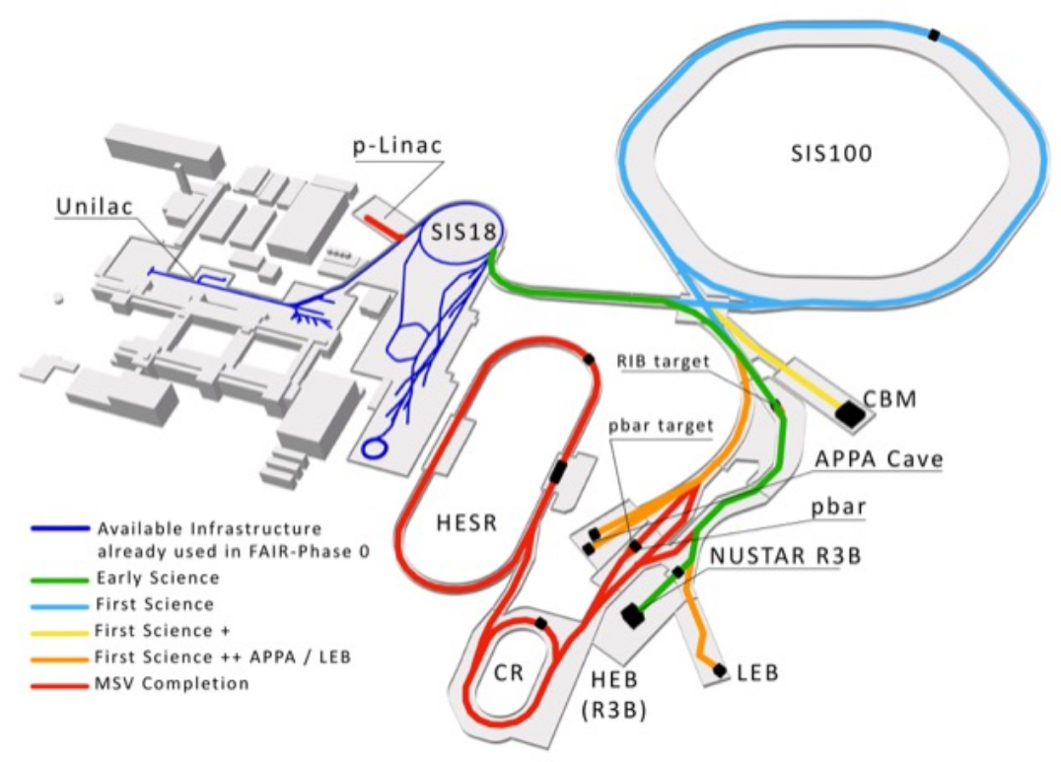
NUSTAR Strategy beyond FS (2028+)
Handover “cave ready for installation”
HE Cave Handover from Super-FRS
S-FRS M12
Q4
2027
Common NUSTAR experiment @ FHF2
NUSTAR Early Science
NUSTAR First Science
Funding decision on FS++ (Low Energy Branch) aimed for in 2025
Low Energy Branch operation beginning 2030

Slide 20
NUSTAR Strategy beyond FS (2028+)
Handover “cave ready for installation”
HE Cave Handover from Super-FRS
S-FRS M12
Q4
2027
Common NUSTAR experiment @ FHF2
NUSTAR Early Science
NUSTAR First Science
Funding decision on FS++ (Low Energy Branch) aimed for in 2025
Low Energy Branch operation beginning 2030
Full MSVc (including rings) 2032

Slide 21
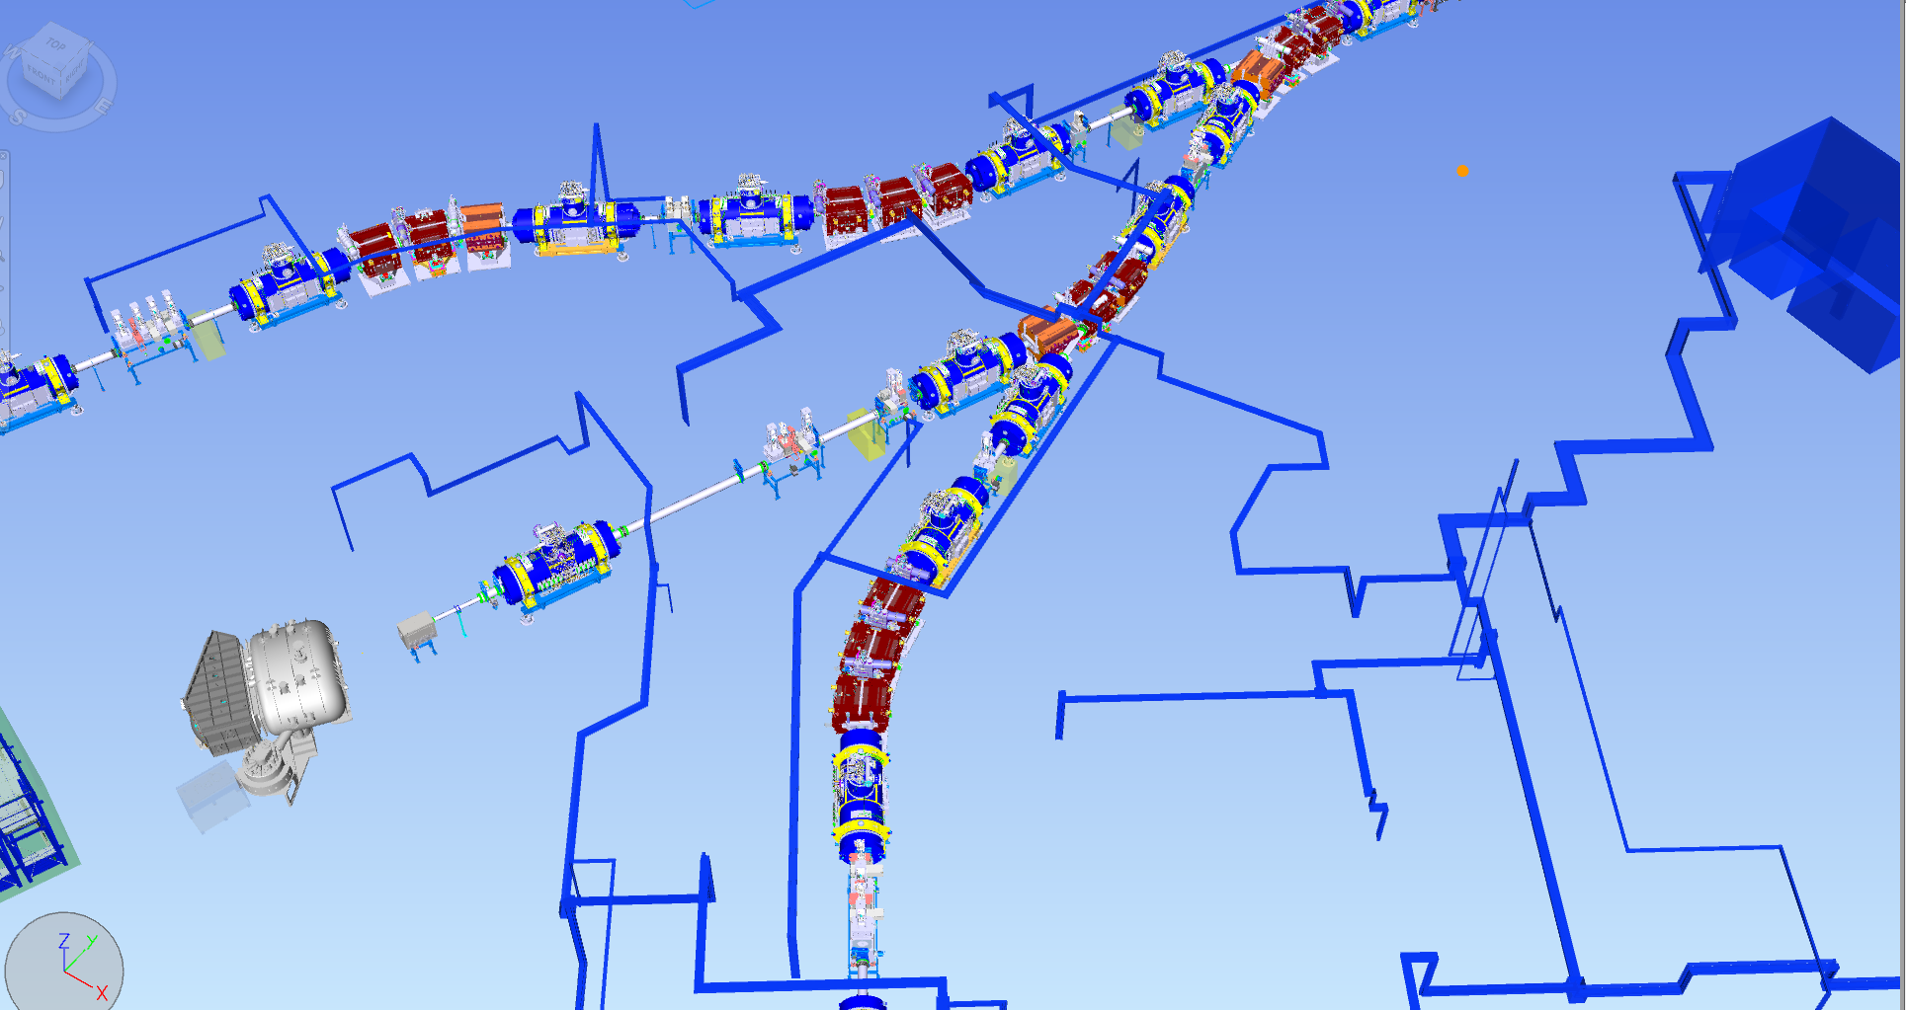
Gas and LN2 planning for NUSTAR ES
FHF1
N2, LN2, He…
Outside supply building: gas lager
FHF2 point 2
gas for R3B
FHF2 point 1 LN2
labs
Slide: S. Pietri
magnets of MSV are shown together with magnets of ES for clarity

Slide 22
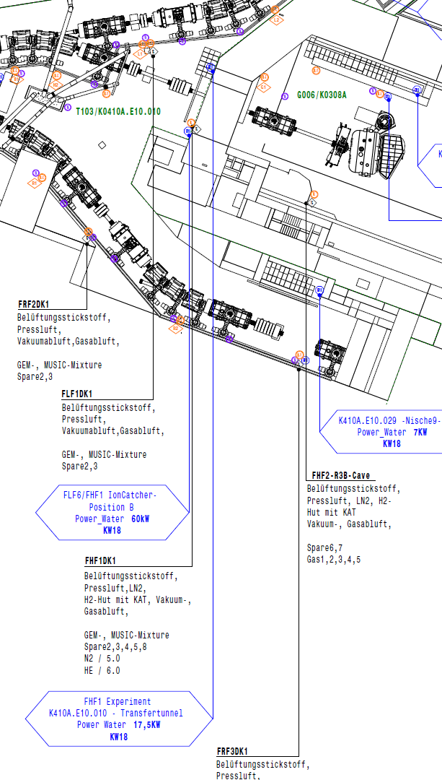
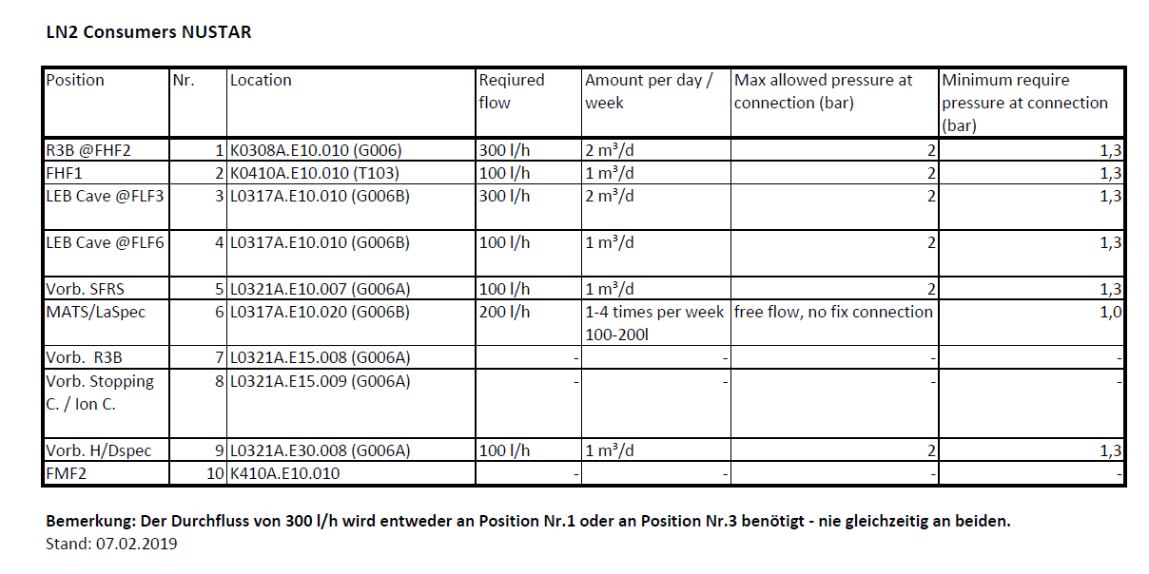
Infrastructure at FHF1
FHF1 was always planned as Super-FRS focal plane for
  high-intensity experiments
  higher transmission
Infrastructure planned since 2016+ for operation of Super-FRS EC Ion Catcher and gamma array at FHF1
Slide: S. Pietri

Slide 23
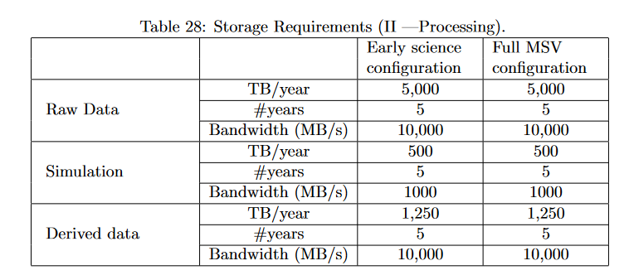
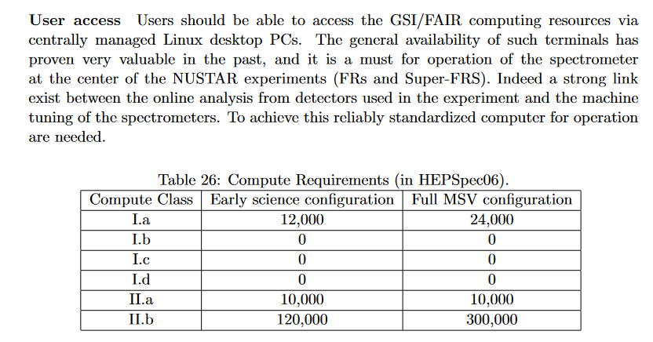
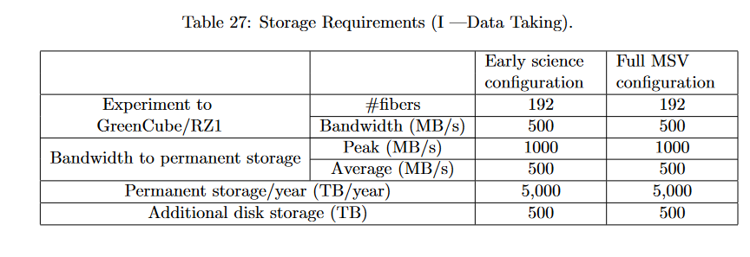
NUSTAR input to the FAIR IT CDR (highlights)
at the experiment
anywhere in facility
at Green cube
Slide: S. Pietri

Slide 24
Personnel resources
Personnel requirements for all FAIR pillars were collected and presented to the Operating Costs Working Group
  Exp. Core (FTEs needed to operate experiments)
  Exp. Operation (consumables related to operation of equipment)
  Research (FTEs for experimental output, core group on site)
A further iteration with updated estimates was made
  Increased request compared to 2014
  MSVc and IO considered
  40 fellows and associates included
Outcome of the “Staging Review of the FAIR Project”
Current NUSTAR personnel: 41 FTE
Updated detailed request considering new staging and realistic perspective urgently needed. NUSTAR operation to begin in 2027. Request expected to be presented to AFC Q2 2024
2014
2021
2022

Slide 25
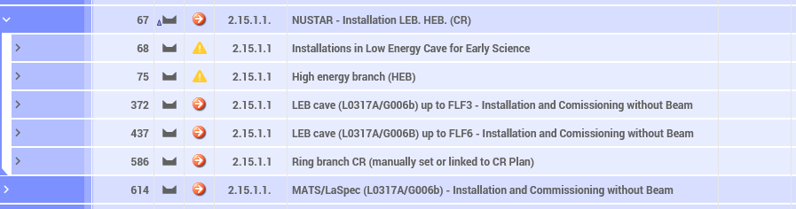
Installation Planning – NUSTAR Status
new
updated
Project rebaselining completed
New block: operation of the high-energy branch requires installation of components in the low-energy Cave (e.g., cryo components, racks,...)
HEB block: updated to include installation of Super-FRS EC, HISPEC/DESPEC and R3B

Slide 26
Thank you

