Slide 1

NUSTAR Overview
Wolfram KORTEN
CEA Paris-Saclay
FAIR/GSI Research Retreat July 18-19, 2023

Slide 2

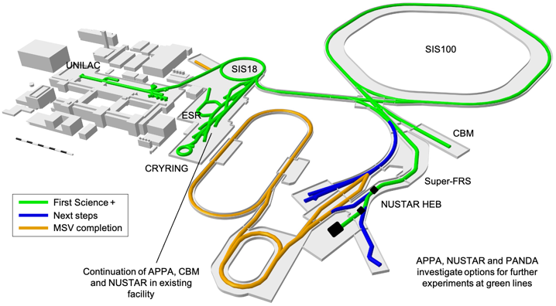
Recommendations of the FAIR Review Committee (Oct 2022)
(1) Early Science with SIS18, NUSTAR in HEB and parts of APPA
(2) First Science with SIS100 replacing SIS18
(3) First Science+ with CBM in addition
(4) First Science++ in the APPA Cave in addition
Finalize IO (LEB, pbar-Target)
Finalize MSV (Rings, PANDA)
provide +500 M€ cost cap to realize this part first
make a funding plan and realize in sequence accordingly
FAIR and NUSTAR management requests planning on „Early/First Science+ (ES, FS, FS+)“, and on freeze actions for remaining IO (LEB) and MSV (Rings) to start now!
Recommendations are to be respected!

Slide 3


NUSTAR Overall schedule (optimistic scenario):
From Phase-0 to FAIR MSV
2019 | 2020 | 2021 | 2022 | 2023 | 2024 | 2025 | 2026 | 2027 | 2028 | 2029 | 2030 | 2032
Super-FRS
Early Science
First Science
FS ++ (LEB)
FAIR MSV
Q4/2027: Super-FRS with SIS18 beams
construction and installation
commissioning
full operation
Q4/2028: SIS100 beams
NUSTAR caves
civil construction & infrastructure
NUSTAR experiments
construction/operation „outside“ FAIR
installation
commissioning
operation at FAIR
Phase 0
Phase 1
3

Slide 4
NUSTAR requirements:
From Phase-0 to Early and First Science
High intensity for SIS18 beams on (Super)FRS target, especially for ²⁰⁸Pb and ²³⁸U:
  Optimise transmission from UNILAC to SIS18 and to (S-)FRS target for highest rigidities
  Pulsed Hydrogen stripper as standard operation for experiments
  Higher spill rate: 1 per second at 100 ms slow extraction.
Improvement to the Micro and Macro spill structure from SIS18
  In routine operation for all experiments and beams.
Optimizing transmission from FRS to ESR.
Provide fast ²³⁸U beam pulses enabling 2.7Hz operation of SIS 100.
→ Balanced priorities between FAIR construction and Injector optimisation needed.

Slide 5
NUSTAR requirements from Phase-0 and Early Science
Facility | U beam intensity/spill at production target
Today at GSI with FRS (Phase 0) | 1...2x10⁹
Early science with Super-FRS and UNILAC/SIS18 | 2x10⁹
First Science with SIS100 (after commissioning) | 2x10¹⁰
First Science++ with SIS100 (full intensity) | 3-4x10¹¹
Luminosity
[fb⁻¹]
~0,1
1-2
5
100
Preparation → discovery → detailed studies
0.1 fb⁻¹ → 2-5 fb⁻¹ → 100 fb⁻¹
(near) stability → exotic → very exotic nuclei
5

Slide 6
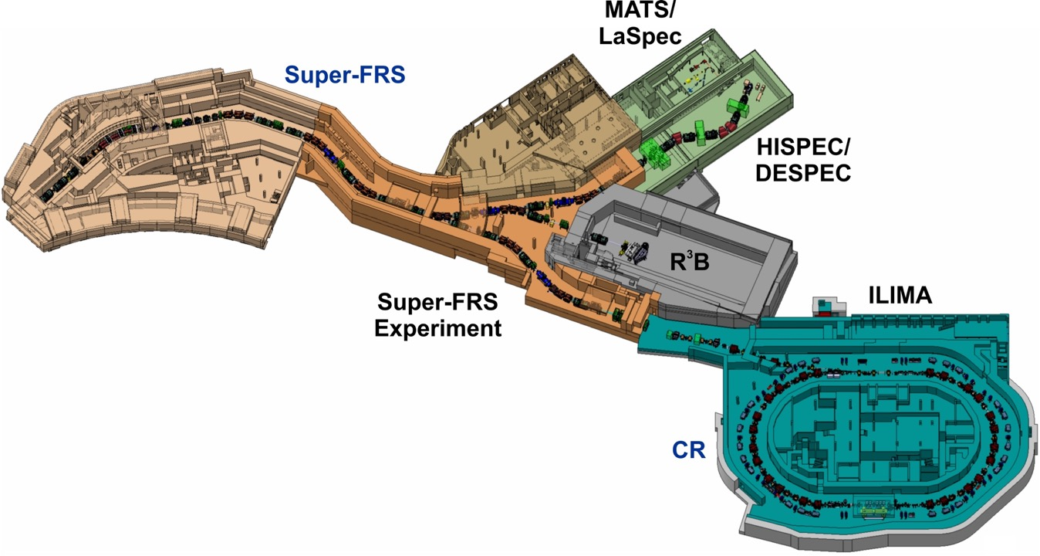
NUSTAR Physics start up at FAIR
3
2
1
1) Early & First Science: DESPEC, R3B, S-FRS EC (2027/8)
2) HISPEC, (MATS, LaSpec)
3) First Science ++: Full low-energy branch (2030)
4) FAIR MSVc: ILIMA@CR (2032)
Continue NUSTAR program at SIS18/FRS/ESR and UNILAC
in particular using ESR and CRYRING until MSV completion
4
6

Slide 7

Early/First Science Scenario with only the Super-FRS High-Energy Branch available
v
No Low-Energy
Buncher and TGI
FHF1
v
FHF2
FMF2
v
v
No ring branch

Slide 8
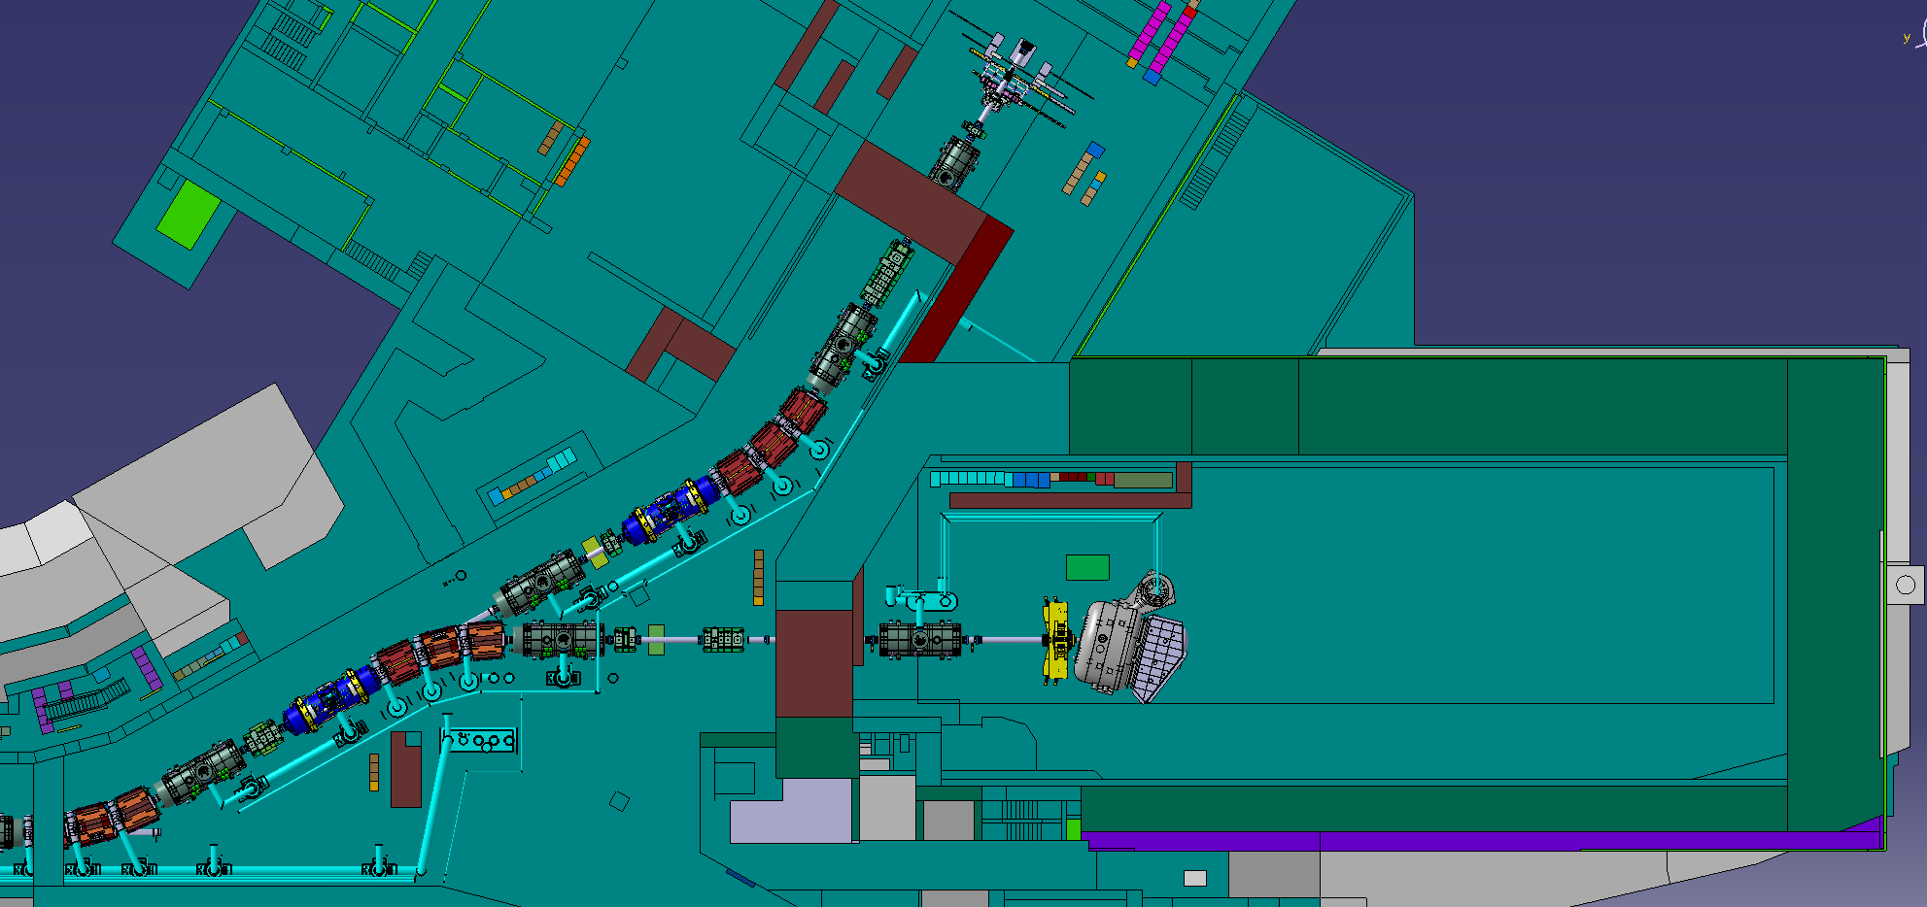
NUSTAR First Common Experiment(s) in the high-energy cave of the Super-FRS
As soon as HEB of Super-FRS is commissioned (Q3/2027)
1
Common NUSTAR set-up
(to be defined)
Will allow demonstration of readiness and first scientific results:
Isotope search, lifetimes, masses, … a working group has been established.

Slide 9
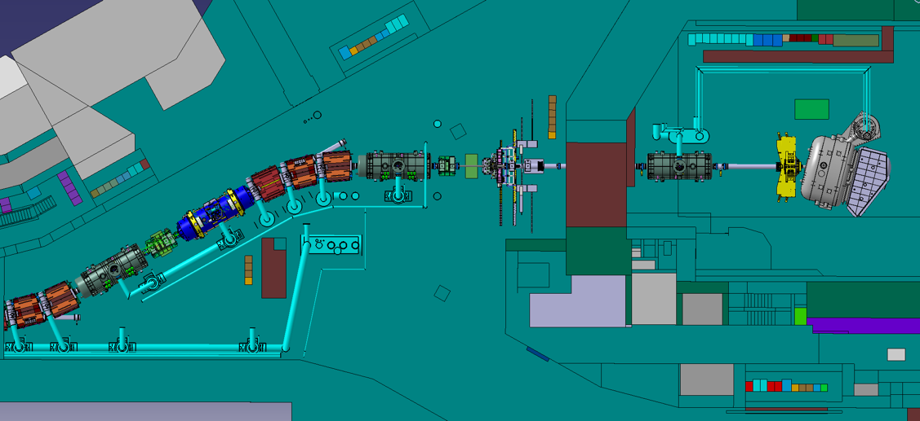
NUSTAR Early and First Science: in the high-energy cave (FHF2) and in front of it (FHF1)
As soon as HEB of Super-FRS is fully operational (2027/28)
DESPEC
Super-FRS EC
R³B
FHF1
FHF2
← FMF2
Super-FRS EC
Operation of DESPEC/Super-FRS EC at FMF2/FHF1 and R3B at FHF2 (as planned):
No full parallel operation, limited operation time (set-up changes, unique radiation area)

Slide 10
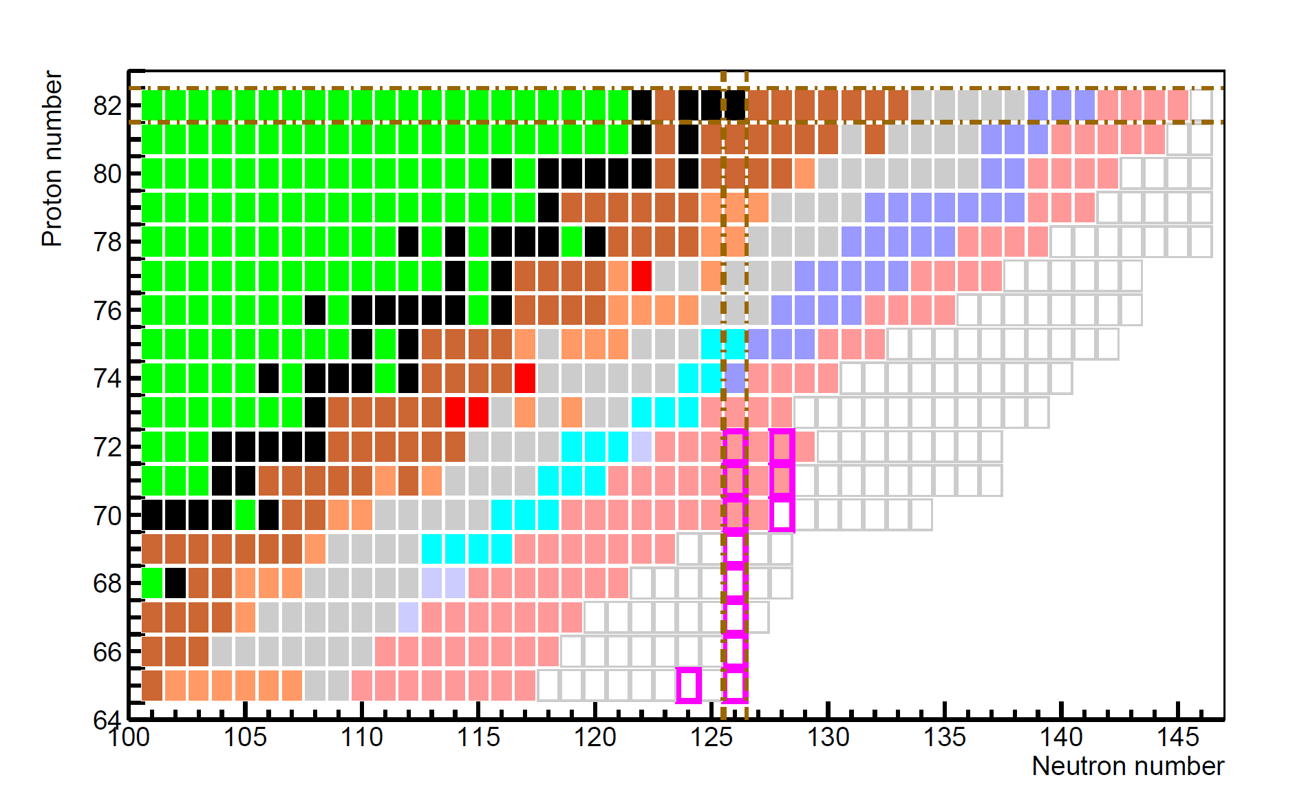
NUSTAR Early Science: New isotopes towards the r-process waiting points at the N=126 shell closure
Understanding the 3rd r-process abundance peak by studying neutron-rich isotopes towards the N=126 shell closure and their ground-state and decay properties
FAIR MSV
First Science
stable isotopes
mass & half-life known
half-life known
mass known
existence known
unknown isotopes
r process waiting point
ES (SIS18 Pb 2x10⁹ /cycle)
FS (SIS100 U 2x10¹⁰ /cycle)
FAIR MSV
Early Science
FAIR MSV
1 atom/d
Notes:
Let me start with the search for and study of new isotopes. On this plot the different colour codes indicate the level of knowledge for neutron-rich isotopes below 208Pb which becomes more and more sparse. The light blue nuclei indicate those which we are rather confident to study already in phase-0 using a Pb beam. Once we can perform experiments at the Super-FRS we will be able to use a U beam for this type of experiments (in view of the better suppression of fission fragments) and attack the dark blue region. We will still need the full FAIR MSV properties to go deeply into the region of the r-process nuclei.

Slide 11
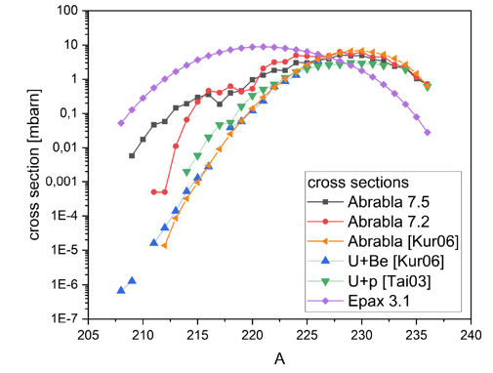
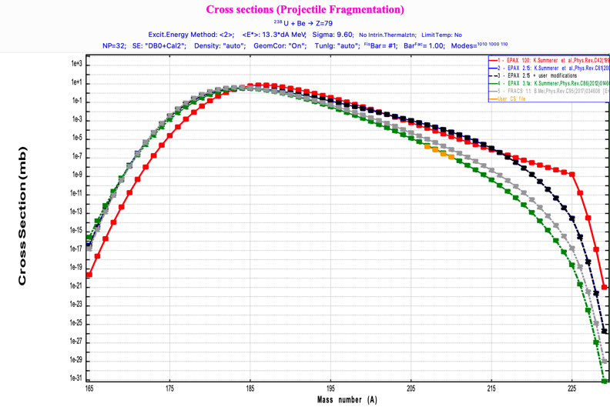
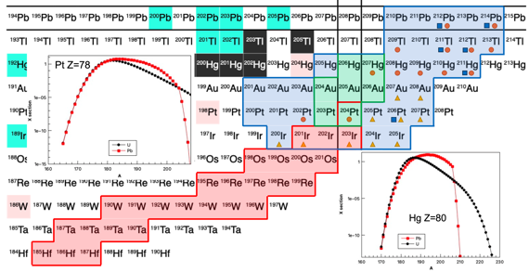
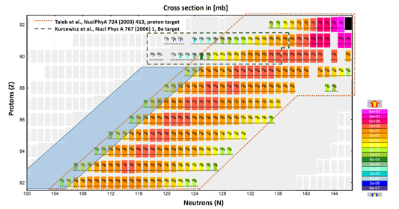
FAIR Phase-0:
Verification of cross section predictions
Neutron-deficient Th isotopes
Neutron-rich Au isotopes beyond N=126

Slide 12
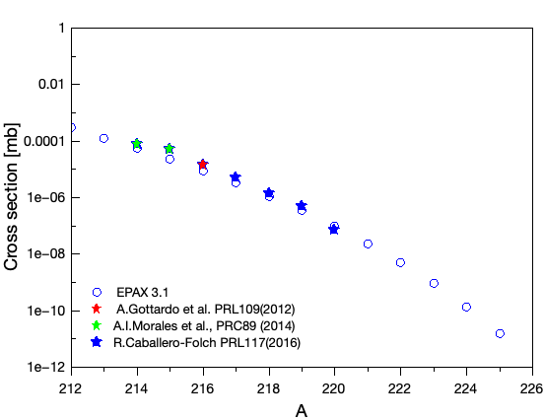
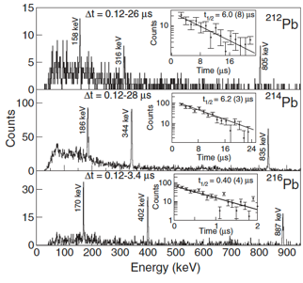
DESPEC Early and First Science:
Properties of new isotopes
Observation limit
A.Gottardo et al., PRL 109, 162502 (2012)
Pb isotopic chain from ²³⁸U beam
e_{γ} = 21% @ 1 MeV
e_{β}= 50%
RISING (2009)
β−γ corr.
isomeric
states
T_{1/2} β-n
DESPEC Phase-0 (2022)
no γ corr.
Early Science (2x10⁹ pps)
First Science (2x10¹⁰ pps)
H.Alvarez-Pol PRC82(2010)
Pushing the observational
limit to more exotic species !
Higher S-FRS transmission and improved selectivity, improved γ–ray efficiency, faster DAQ, …
in combination with increasing primary beam intensity (need for SIS100)
12

Slide 13
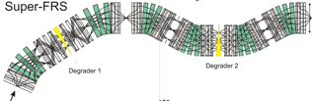
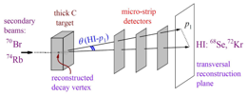
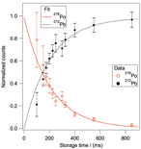
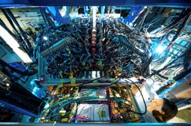

Super-FRS EC Early and First Science:
Search for new isotopes, radii and momentum distributions
In-flight decay studies beyond
the proton dripline
Super-FRS „per se“
EXPERT (start version) at FMF2
Beta-delayed multi-neutron emission probabilities and MNT reaction studies
Hypernuclei, nucleon
resonances, mesic atoms
Super-FRS IC at FHF1
WASA II at FRS (or Super-WASA)
Notes:
The experiments will benefit from
* 2-stage separation scheme (pre- and main separator) → increased purity, lower background, rarer processes
and from
* increased transmission → higher rates, increased intensity resp. better statistics and/or faster measurements
The experiments/cases are selected such, that there is a particularly high gain compared to existing experiment conditions (despite the same primary-beam intensity)

Slide 14
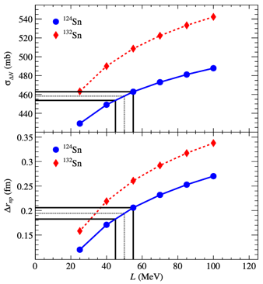
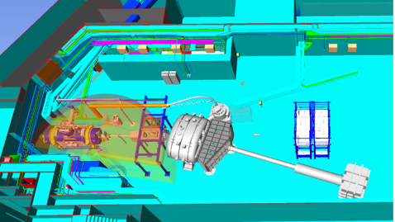
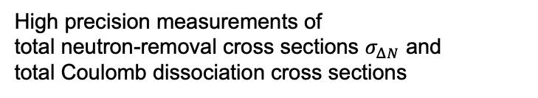
R3B Early and First Science:
Neutron-skin and EoS of n-rich nuclear matter
T. Aumann et al., PRL 119 (2017) 262501
  Improved heavy fragment mass (larger ToF compared to Cave-C)
  New beam line and TOF-D detectors in vacuum
  Neuland moved to nominal position (larger ToF)
  Improved transmission of S-FRS and to HEC as compared to Cave-C
  ¹¹⁴Sn, ²⁰⁸Pb (stable) and ¹³²Sn and ¹⁸⁸Pb from ²³⁸U (2x10⁹ /cycle)
  High precision measurements of
  total neutron-removal cross sections $σ_{ΔN}$ and
  total Coulomb dissociation cross sections
    Very precise determination of neutron skin thickness
    Most precise and accurate constraint on density dependence L
    Significant improvement to recent PREX result from JLAB
    Determination of neutron-star mass-radius relation

Slide 15
NUSTAR ES/FS opportunity: two separate areas in the Super-FRS building (FLF2)
DESPEC or
Super-FRS EC
(2028+)
FLF2: Last Super-FRS focal plane
FLF2
Will allow full parallel operation of DESPEC, Super-FRS EC, R3B:
No loss of operation time for set-up changes if shielded by movable wall

Slide 16
NUSTAR ES/FS opportunity: two separate areas including 1st focal plane in LEB (FLF3)
Super-FRS EC
(2028+)
HISPEC
(2029+)
FLF3
FLF2: Last Super-FRS focal plane
FLF3: First focal plane in LEB building
FLF2
Full parallel operation of HISPEC, Super-FRS EC, R3B, MATS & LaSpec:
No loss of operation time for set-up changes

Slide 17
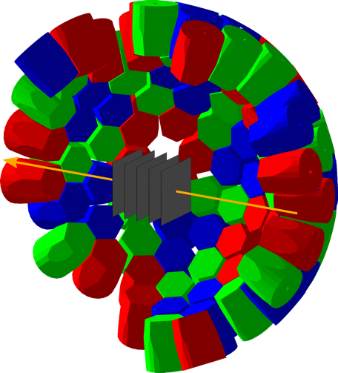

HISPEC First Science:
Picosecond lifetime measurements of exotic nuclei with AGATA
LISA: Compact array of active target detectors inside AGATA to determine interaction position
Pilot experiment: Picosecond lifetimes
with the Miniball Ge detectors at RIBF
Simulation for ¹³⁰Cd₈₂
with AGATA and LISA
Unknown energies
and lifetimes are
simultaneously
accessible

Slide 18
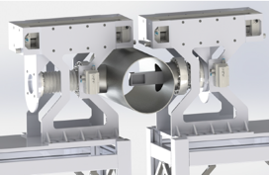
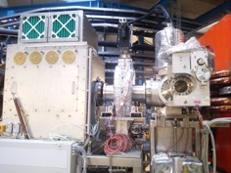
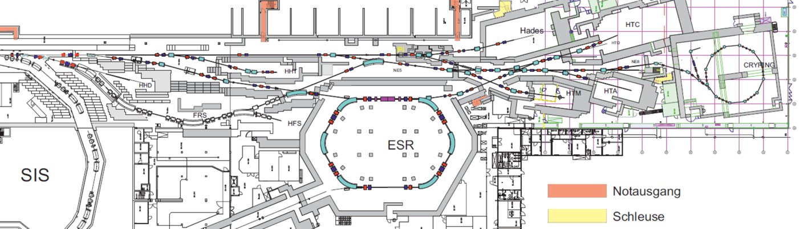
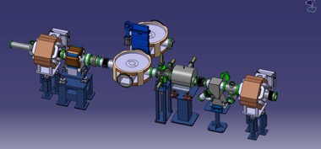
ILIMA Early and First Science:
Unique experiments at the ESR (often in collaboration with SPARC)
Masses
  Isomers and masses of n-rich Hf isotopes
  Beta-delayed neutron detection of iodine isotopes + in-ring pocket detector
Lifetimes
  Two-photon decay of ⁹⁸Mo, ⁹⁸Zr + SMS-IMS: G-PAC A
  Bound-state pair creation of ¹⁹⁴Pb
  Bound-state beta decay of ²⁰⁵Tl (w. SPARC)
  HFI in beta decay of ¹¹¹Sn (w. SPARC)
  NEEC@CRYRING of ¹²⁹Sb (w. SPARC)
Canadian contribution at FAIR
Phase-0 2024
In-ring detectors
2 setups@ESR
Schottky
Ongoing/planned developments
FRS-ESR transmission
Isochronous Schottky Mass Spectroscopy
Transverse Schottky + DAQ
TOF detector updated
TOF detectors

Slide 19

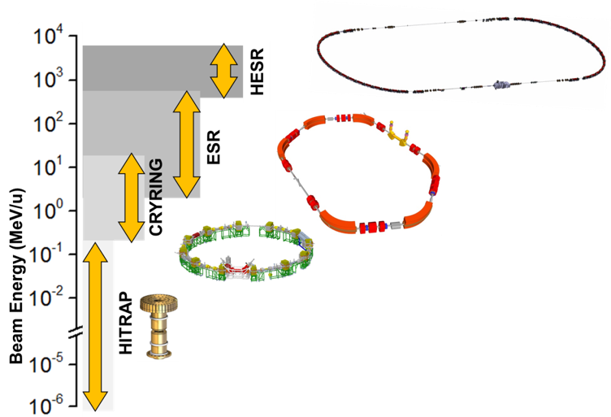
Scattering experiments of exotic nuclei using storage rings strongly broadening the NUSTAR physics program
  Storage rings must also be optimised for use with heavy ions
Elastic scattering
(p,2pN) or (γ,pn)
500-5000
MeV/u
Form factors/radii
Short range N-N
High-energy dipole
20-500
MeV/u
Inelastic scattering
Charge-exchange
reactions
5-20
MeV/u
Giant monopole
GT strength
Transfer and capture reactions for nuclear astrophysics
Single-particle structure, ANC
(p,γ) cross sections

Slide 20
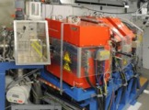
Superheavy Elements:
Experiments at UNILAC and later at HELIAC
Next generation setups to study production, nuclear, atomic, and chemical properties at SHIP and TASCA
≈
2022
2023
2024 - 2025
Day-1
Beamtime
Eng. run
Beamtime
Beamtime
Beamtime
Production and nuclear structure (decay spec.)
TASISpec → Lundium
ANSWERS Setup
Day-1 Setups
SHIP
TASCA
SHIP PS test
RADRIS test
SHIP PS test
⁵⁴Cr beam test
Construct
Finalize Lundium
 ₁₁₅Mc decay chains
 ₁₀₅Db
 ₉₈Cf, ₁₀₀Fm – ₁₀₃Lr
 ₁₀₂No
 ₁₀₆Sg carbonyls
Construct / commiss.
 Commiss. (₉₄Pu)
✓ Commiss. (Z=82-94):
Recoil-α-/γ-/CE-spec.
✓ (ran in 2021)
✓ ₁₀₀Fm/₁₀₂No/₁₀₃Lr
✓ Online Commiss.
✓ Homologs (parasitic)
Design
Lundium
ANSWERS
SHIPTRAP
RADRIS
In-Gas-Jet
miniCOMPACT
UniCell
Atomic properties:
Masses (SHIPTRAP)
Laser spec in gas-cell
in gas-jet
Lundium
SHIPTRAP
miniCOMPACT
Chemical properties:
RTC-based (T_{1/2} >500 ms)
UniCell (T_{1/2} >2 ms)
RADRIS
ANSWERS
 Beamtime goals not reached (problems with ⁴⁸Ca beam)
✓ Successful beamtime
 Beamtime in schedule
UniCell
Laser Gas-Jet
Notes:
SHIP PS test = test of power supplies

Slide 21

Summary and conclusions
Preparation of Early and First Science ongoing
  Preparation of first common NUSTAR experiment(s) has started.
  How can we optimize and maximize the scientific output of ES&FS ?
  How can we ensure that most/all NUSTAR sub-collaborations can be served ?
Phase-0 is very successful and needs to run continuously until Early Science
  Unique scientific opportunities due to SIS18/FRS performance and novel detectors.
  Needed to develop and test detectors, but also to keep NUSTAR internationally competitive.
  Further detector developments ongoing (see talk of Helena Albers).
FAIR MSV must remain the ultimate goal and be realized without major delays
  FAIR uniqueness is largely based on storage rings.
  CR replacement must be optimised for use with heavy ions including isochronous mode.
  Low-energy cave is vital for a large fraction of the NUSTAR collaboration and needed to assure an optimal use of the Super-FRS.

Slide 22
Thank you for your attention
FAIR/GSI Research Retreat July 18-19, 2023

Slide 23
NUSTAR - The Experiments (or sub-collaborations)
PSP code | Super-FRS | RIB production, separation, and identification
1.2.2 | HISPEC/ DESPEC | In-beam γ-spectroscopy at low and intermediate energy, n-decay, high-resolution γ-, β-, α-, p-, spectroscopy
1.2.3 | MATS | In-trap mass measurements and decay studies
1.2.4 | LaSpec | Laser spectroscopy
1.2.5 | R³B | Kinematically complete reactions with relativistic radioactive beams
1.2.6 | ILIMA | Large-scale scans of mass and lifetimes of nuclei in ground and isomeric states
1.2.10 | Super-FRS EC | High-resolution spectrometer experiments
1.2.11 | SHE (#) | Synthesis and study of super-heavy elements
1.2.8 | ELISe(*) | Elastic, inelastic, and quasi-free e⁻-A scattering
1.2.9 | EXL(*) | Light-ion scattering reactions in inverse kinematics
(#) NUSTAR experiments using FAIR MSV accelerators – preparing formal approval by council
(*) Experiments requiring NESR – alternative solutions within FAIR MSV under consideration
Notes:
Reference for ECE/ECSG
Our field makes it necessary to create dedicated experiments to perform different types of measurements, which are here briefly described. As all FAIR pillars, NUSTAR is organised as a project, but with different experiments (or sub collaborations) dealing with the different and often complementary techniques.

Slide 24
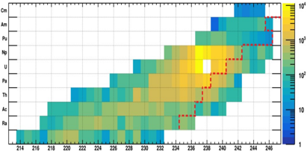
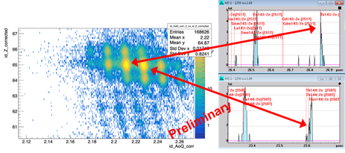
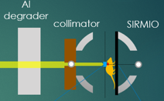
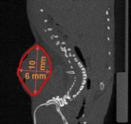
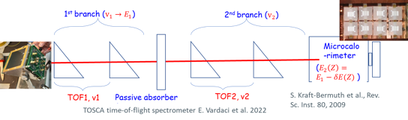
Super-FRS EC experiments scheduled for 2024
S117, P.Constantin, T.Dickel et al.,
In-cell multi-nucleon transfer reactions at the FRS Ion Catcher
Pilot study for Super-FRS with slowed-down primary beams at FRS
S160, C.Scheidenberger, E.Haettner et al.,
FRS performance improvements and R&D with heavy-ion beams
Improvement of separation and identification capabilities
Transmission increase
Improvement of identification and rate capabilities
Test of newly developed detectors
Bio-BARB M.Durante, K.Parodi, C.Scheidenberger
Radioactive beams for the animal tumor treatment
First tumor treatment with RIBs
S174: E.Vardaci, S.Kraft-Bermuth et al.,
In-beam test of a ToF-ΔE-E method for MNT reactions
New ID scheme (A,Z) for low-E beams
¹¹C

Slide 25

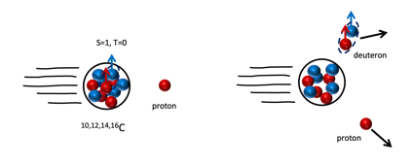
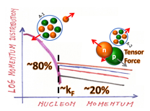
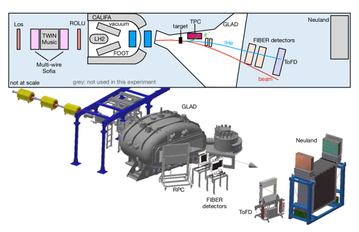
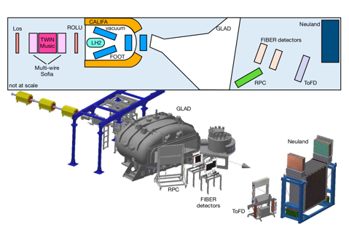
R3B Phase-0 in 2024/25
Experiment S091, M. Petri et al., (14 shifts A+)
Probing short range nucleon-nucleon correlations in atomic nuclei via (p,pd) QFS Reactions
Experiment S073, A. Obertelli et al. (LoI in 2020)
Matter radius of hypertriton at R3B via interaction cross section method
new time-projection chamber (TPC) under completion (GSI, TUDa, USC, CEA Bruyères)
long-term program with a large TPC inside GLAD
quasi-elastic removal of deuterons to confirm deuteron correlations for small relative distances
Notes:
Quasi-elastic knock-out of deuterons along the C isotopic chain to probe the number of quasi-deuterons in a nucleus and their isospin dependence.
Kinematically complete measurements at R3B using high purity beams from the FRS at high energies (justifying the quasi-elastic assumption).

Slide 26
Mass Resolving Power in Isochronous Mode
High-resolving power through limiting momentum acceptance
No space for 2 detectors at the ESR
Solution: Position measurement in a location with large dispersion
Position-sensitive Schottky cavities
Experiment E143 @ ESR
Advantages: non-destructive detection – enables lifetime studies
no restriction of acceptance
single-ion sensitivity
Status: prototype is being installed in RIKEN
designs for the ESR and CR are completed.
Courtesy: D. Fernandez

Slide 27


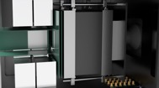
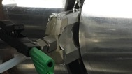
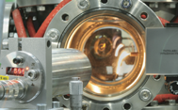
SHE outlook 2023-2025:
Technical developments, farther scientific reach
Ongoing technical developments will yet broaden the suite of available setup
LUNDIUM decay station nearing completion
physics-driven commissioning 2022 (U319)
will embark on rare-isotope decay-spectroscopy
ANSWERS Adsorption-based Nuclear Spectroscopy Without Evaporation Residue Signal
prototype commissioning (U318) was successful
upgrade to state-of-the-art detectors started
UniCELL design being finalized, construction starts
will allow chemical studies at <0.1 s lifetimes with miniCOMPACT
SHIPTRAP in “production” mode.
Next steps include ^{257m}Db and ^{258m}Db
RADRIS in “production” mode, gas-jet laser studies getting there
search for atomic levels in Lr (Z=103)
high-resolution spectroscopy in gas jet, e.g. for ^{254m}No

Slide 28
Mass Resolving Power in Isochronous Mode
Regions covered in a single setting
Velocity unmeasured
Velocity measured
Large region covered =
large distribution of velocities
Two time-of-flight detectors at IMP Lanzhou
Single time-of-flight detector at IMP Lanzhou
Courtesy: S. Litvinov, M. Wang and Y. H. Zhang
A. Heinz - ECE17 & ECSG08 Meeting
28
Notes:
Right figure: 10% acceptance.

Slide 29
Stochastic cooling (SC) at the ESR (Needs in FAIR Phase-0)
Fast cooling of hot beams is required for many experiments in FAIR Phase-0
The present functionality of SC must be preserved and further improved!
Future upgrade/R&D options:
Presently, SC does NOT cover the entire injected momentum spread!
possible enlargement of the bandwidth -> increase in efficiency
uncooled ions may hit and damage detectors and/or cause background
Presently, SC requires 5-8 seconds for cooling a secondary beam (record was 3-4 s)
reduction of cooling time -> access to shorter-lived nuclides, faster accumulation
Presently, SC operates at a fixed energy of 400 AMeV
Operation at variable/several energies will increase flexibility
Especially essential for production and deceleration of not-bare ions
Notes:
We had a 10-year upgrade freeze for ESR upgrades.

