Slide 1
Accelerator operation and beam time 2023 – 2028…
S. Reimann, D. Severin

Slide 2
Outlook
2023 Shutdown and engineering run
Next physics beam time blocks 2024+25
Operation perspectives

Slide 3
Shutdown Status
LA16 Air Cooling System finished and commissioning is ongoing
Roots pumps stand (UNILAC stripper area)
Unilac super lens rods are exchanged
SIS18 µ-Spill Cavity is installed and ready for first test in Eng.-Run
SIS18 e-Septum is repaired
Cryring will be ready for operation by end of October
ESR will be ready for operation by Dec. 18th
this is our main risk, so the process is closely controlled by operations
management

Slide 4
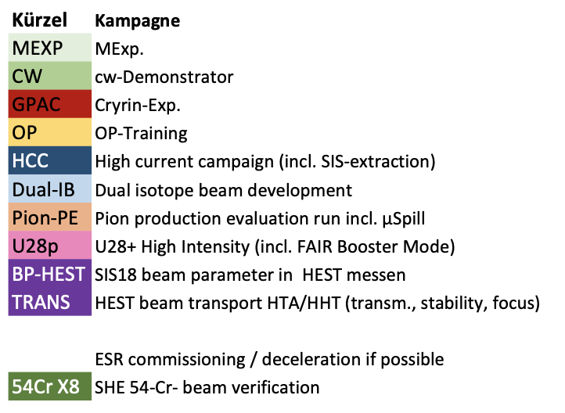
Engineering Run 2023
framework plan coordinated
machine studies proposals evaluated and prioritized
detailed planning is ongoing

Slide 5
RED input for Engineering run 2023
Er-beam verification
208-Pb high rate (1Hz)
SHE: 54-Cr beam verification
High current campaign ( incl. extraction)
Dual isotope beam development for medical physics
Pion production evaluation run for HADES incl. µ-spill
Spill structure
HEST beam transport HTA, HHT (transmission, stability, focus)
FRS re-commissioning
ESR – HTA beam transport
FRS-ESR beam transport
SIS-ESR beam transport for 2nd beams
ESR deceleration and isochronous mode
SIS-ESR-CRY optimization aiming for CRY int. increase
HITRAP commissioning
DESPEC: detector tests
parallel beam for Cryring experiments with local source
ACC Topics
operator training and Trans FAIR integration
FAIR booster mode
test operation for FAIR in-kind contributions
measurement of standard beam parameters behind SIS18
open slots for prioritized machine experiments
parallel beam for cw-demonstrator operation
Last RED retreat

Slide 6
Outlook
2023 Shutdown and engineering run
Next physics beam time blocks 2024+25
Operation perspectives

Slide 7
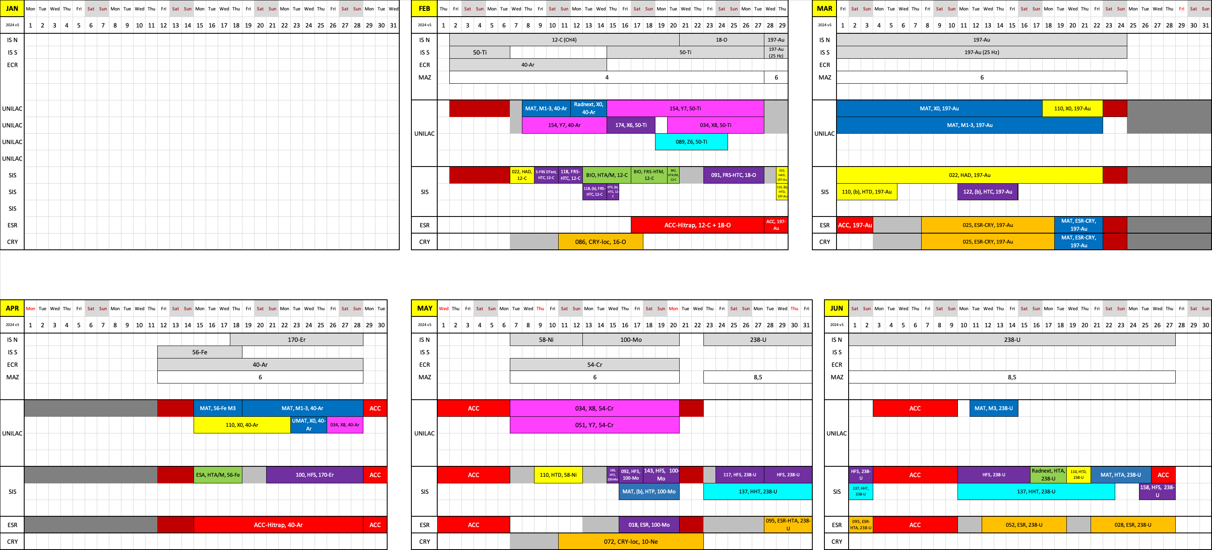
Beam time schedule 2024 v5

Slide 8
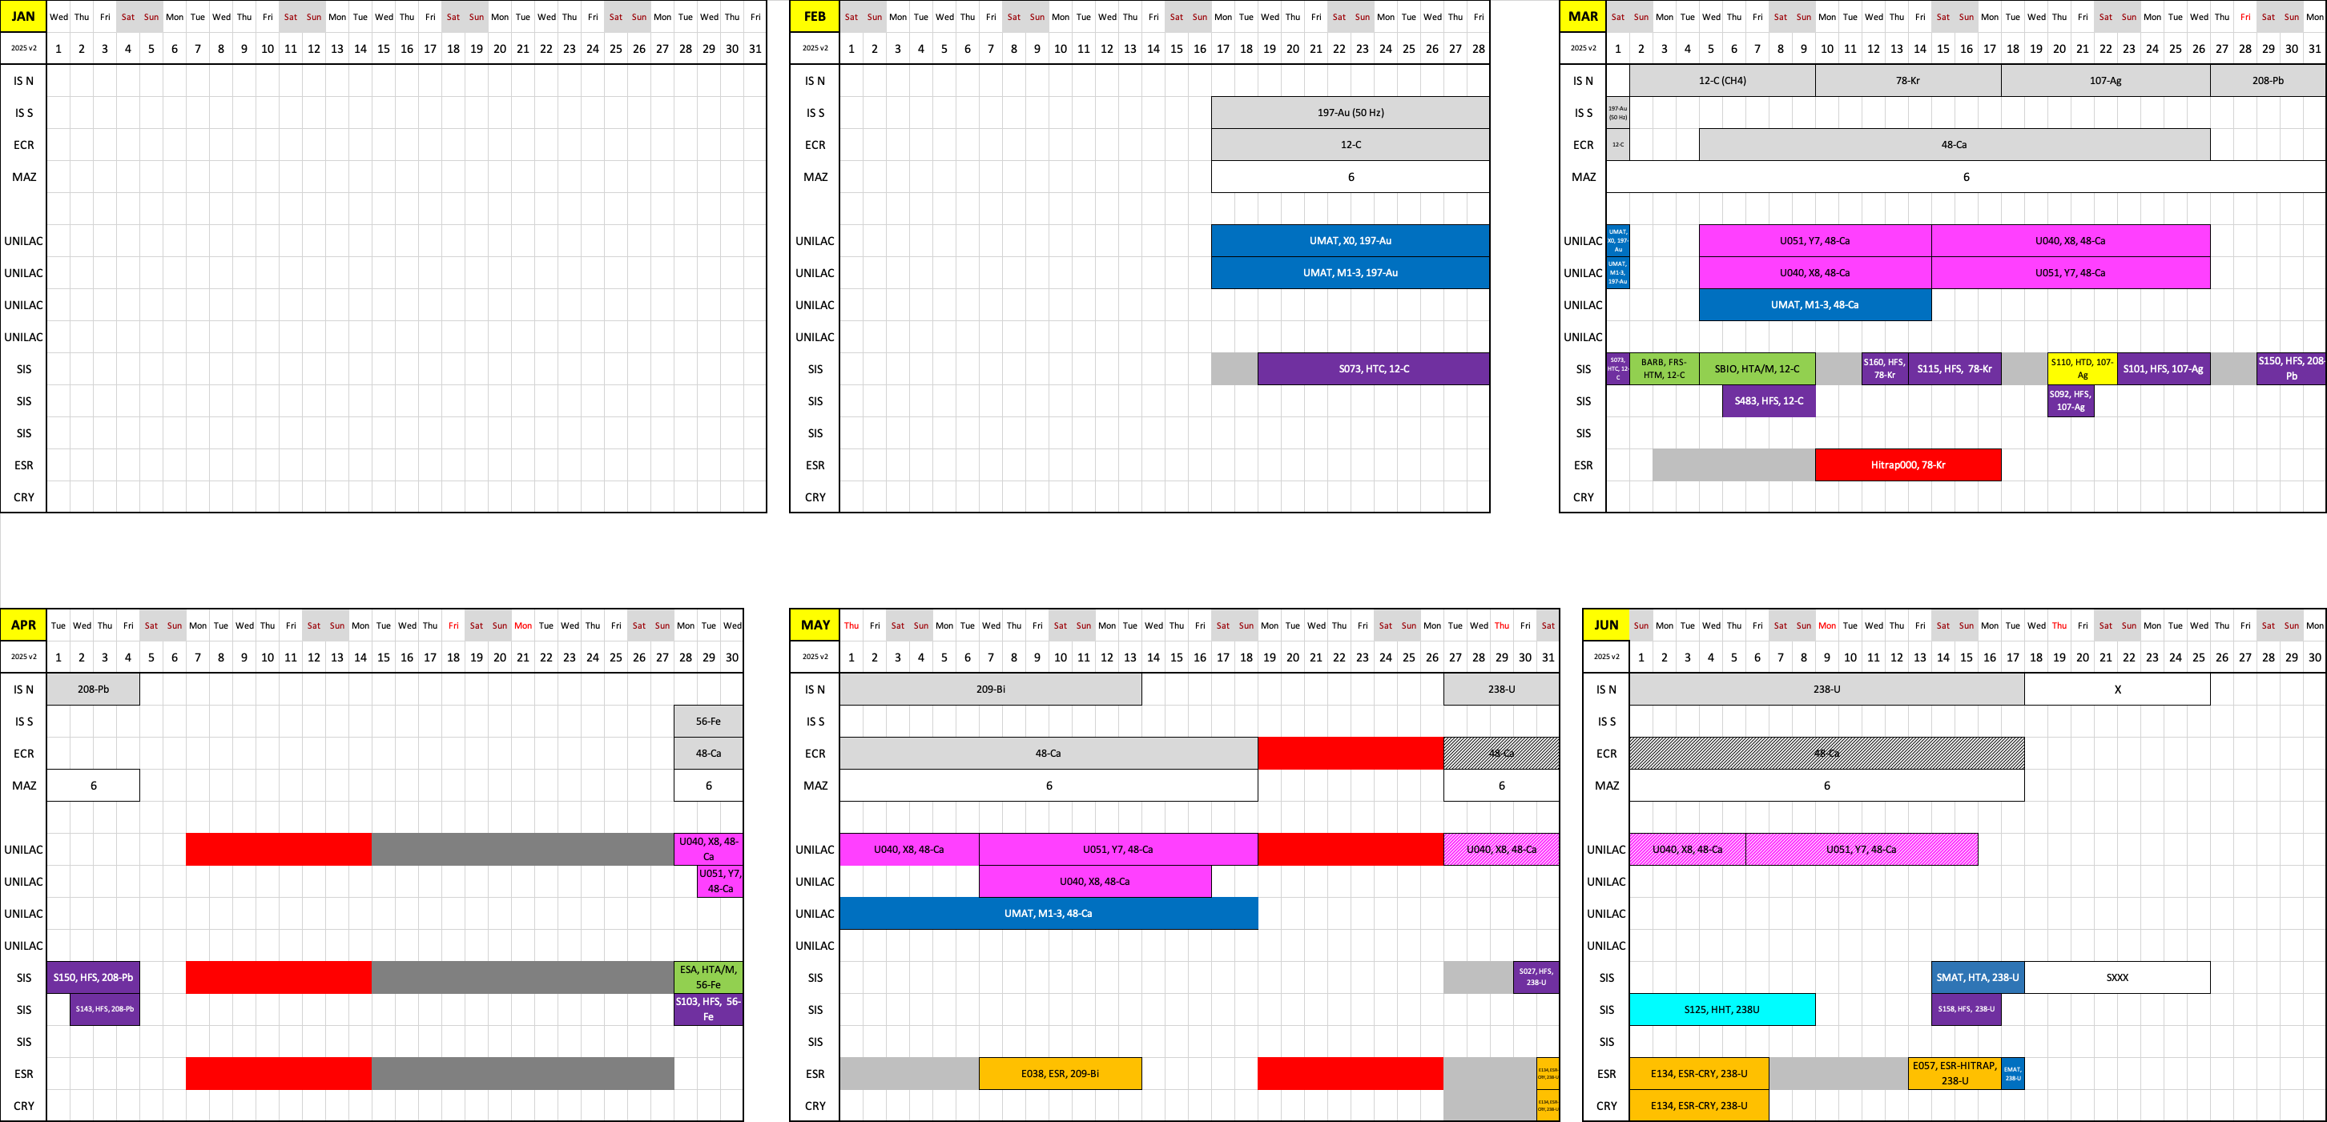
Beam time schedule 2025 v2

Slide 9
Outlook
2023 Shutdown and engineering run
Next physics beam time blocks 2024+25
Operation perspectives

Slide 10
FAIR/GSI strategic operation scenario towards FS+
Draft!
Update 2023 (proposal RED)
Acc. Operation total / days
134
44
140
140
100
restricted shutdown
90
90
200
240
240
Main physics beam time/ days
107
0
100
100
80
30
30
100
180
180
m
Parasitic physics beam time/ days
107
30
30
40
Project phases
FAIR Installation of Accelerator Components
FAIR Hardware Commissioning
PCP reached
FCC needed
FAIR Beam Commissioning
Facility availability
SIS18 → SFRS → NUSTAR
SIS100 → SFRS → NUSTAR
SIS100 –> CBM
Last RED retreat
UNILAC → EH, SIS18 → TH, EX, FRS, ESR → HITRAP, Cryring
2022
2023
2024
2025
2026
2027
2028
2029
2030
FAIR Phase 0
Early Science
Early Science & First Science+
10

Slide 11
FAIR/GSI strategic operation scenario towards FS+
Update 2023 (proposal RED)
beam time
Acc. Operation total / days
134
44
140
140
100
restricted shutdown
90
90
200
240
240
beam time
Physics beam time/ days
107
0
100
100
80
120*
140*
180
180
*includes shared blocks with parallel FAIR com.
Project phases (ES, FS, FS+)
FAIR Installation of Accelerator Components
FAIR Hardware Commissioning
FCC needed
FAIR Beam Commissioning
PCP reached
Facility availability
early science (ES) →
SIS18 → SFRS → NUSTAR
first science (FS) →
SIS100 → SFRS → NUSTAR
first science + (FS+) →
SIS100 –> CBM
Last RED retreat
UNILAC → EH, SIS18 → TH, EX, FRS, ESR → HITRAP, Cryring
2022
2023
2024
2025
2026
2027
2028
2029
2030
FAIR Phase 0
Early Science
Early Science & First Science+
11

Slide 12
FAIR/GSI strategic operation scenario towards FS+
2023 (ACC proposal from last research retreat)
beam time
Acc. Operation total / days
134
44
140
140
90
restricted shutdown
90
90
200
240
240
beam time
Physics beam time/ days
107
0
100
100
60
min 30*
min 30*
min 100*
180
180
*number of days to be announced for PAC call
(share is reduced due to FAIR commissioning)
Project phases (ES, FS, FS+)
FAIR Installation of Accelerator Components
FAIR Hardware Commissioning
FCC needed
FAIR Beam Commissioning
PCP reached
Facility availability
early science (ES) →
SIS18 → SFRS → NUSTAR
first science (FS) →
SIS100 → SFRS → NUSTAR
first science + (FS+) →
SIS100 –> CBM
Last RED retreat
UNILAC → EH, SIS18 → TH, EX, FRS, ESR → HITRAP, Cryring
2022
2023
2024
2025
2026
2027
2028
2029
2030
FAIR Phase 0
Early Science
Early Science & First Science+
12

Slide 13
ACC/FAIR Developments in schedule since last research retreat
FAIR project Re-baselining lead to changes in commissioning timeline
FCC is planned to be ready for operation Q1 2026
In 2026 new UNILAC control system will be in operation for the first time in a production run
adoptions →

Slide 14
FAIR/GSI strategic operation scenario towards FS+
2023 (FAIR Re-Baselining update)
beam time
Acc. Operation total / days
134
44
140
140
90
restricted shutdown
90
90
200
240
240
beam time
Physics beam time/ days
107
0
100
100
60
min 30*
min 30*
min 100*
180
180
*number of days to be announced for PAC call
(share is reduced due to FAIR commissioning)
Project phases (ES, FS, FS+)
FAIR Installation of Accelerator Components
FAIR Hardware Commissioning
FCC OP ready
UNILAC CS ready
FAIR Beam Commissioning
PCP reached
Facility availability
early science (ES) →
SIS18 → SFRS → NUSTAR
first science (FS) →
SIS100 → SFRS → NUSTAR
first science + (FS+) →
SIS100 –> CBM
UNILAC → EH, SIS18 → TH, EX, FRS, ESR → HITRAP, Cryring
2022
2023
2024
2025
2026
2027
2028
2029
2030
FAIR Phase 0
Early Science
Early Science & First Science+
14

Slide 15
FAIR/GSI strategic operation scenario towards FS+
DRAFT (opportunity for more physics)
beam time
Acc. Operation total / days
134
44
140
140
90
restricted shutdown
100
90
200
240
240
beam time
Physics beam time/ days
107
0
100
100
60
70
min 30*
min 120*
180
180
run to fail
*number of days to be announced for PAC call
(share is reduced due to FAIR commissioning)
Project phases (ES, FS, FS+)
FAIR Installation of Accelerator Components
FAIR Hardware Commissioning
FCC OP ready
UNILAC CS ready
DR
FAIR Beam Commissioning
PCP reached
Facility availability
early science (ES) →
SIS18 → SFRS → NUSTAR
first science (FS) →
SIS100 → SFRS → NUSTAR
first science + (FS+) →
SIS100 –> CBM
UNILAC → EH, SIS18 → TH, EX, FRS, ESR → HITRAP, Cryring
2022
2023
2024
2025
2026
2027
2028
2029
2030
FAIR Phase 0
Early Science
Early Science & First Science+
15

Slide 16
FAIR/GSI strategic operation scenario towards FS+
DRAFT (ACC proposal for engineering run in 2026)
beam time
Acc. Operation total / days
134
44
140
140
90
restricted shutdown
100
90
200
240
240
beam time
Physics beam time/ days
107
0
100
100
0
70
min 30*
min 120*
180
180
engineering-runs
run to fail
*number of days to be announced for PAC call
(share is reduced due to FAIR commissioning)
Project phases (ES, FS, FS+)
FAIR Installation of Accelerator Components
FAIR Hardware Commissioning
FCC OP ready
UNILAC CS ready
DR
FAIR Beam Commissioning
PCP reached
Facility availability
early science (ES) →
SIS18 → SFRS → NUSTAR
first science (FS) →
SIS100 → SFRS → NUSTAR
first science + (FS+) →
SIS100 –> CBM
UNILAC → EH, SIS18 → TH, EX, FRS, ESR → HITRAP, Cryring
2022
2023
2024
2025
2026
2027
2028
2029
2030
FAIR Phase 0
Early Science
Early Science & First Science+
16

Slide 17
FAIR/GSI strategic operation scenario towards FS+
DRAFT (possible compensation)
beam time
Acc. Operation total / days
134
44
140
140+30
90
90
100
90
200
240
240
beam time
Physics beam time/ days
107
0
100
100+30
0
50
70
min 30*
min 120*
180
180
engineering-runs
run to fail
*number of days to be announced for PAC call
(share is reduced due to FAIR commissioning)
Project phases (ES, FS, FS+)
FAIR Installation of Accelerator Components
FAIR Hardware Commissioning
FCC OP ready
UNILAC CS ready
DR
FAIR Beam Commissioning
PCP reached
Facility availability
early science (ES) →
SIS18 → SFRS → NUSTAR
first science (FS) →
SIS100 → SFRS → NUSTAR
first science + (FS+) →
SIS100 –> CBM
UNILAC → EH, SIS18 → TH, EX, FRS, ESR → HITRAP, Cryring
2022
2023
2024
2025
2026
2027
2028
2029
2030
FAIR Phase 0
Early Science
Early Science & First Science+
17

Slide 18
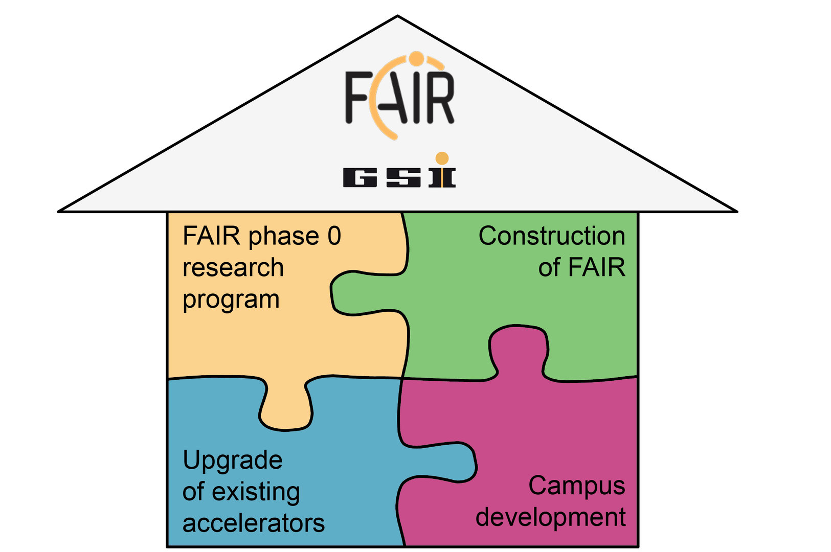
FAIR/GSI strategic operation scenario towards FS+
DRAFT (fire protection renovation EH)
beam time
Acc. Operation total / days
134
44
140
140+30
8 months
fire protection renovation
EH
90
90
100
90
200
240
240
beam time
Physics beam time/ days
107
0
100
100+30
0
50
70
min 30*
min 120*
180
180
engineering-runs
run to fail
*number of days to be announced for PAC call
(share is reduced due to FAIR commissioning)
Project phases (ES, FS, FS+)
FAIR Installation of Accelerator Components
FAIR Hardware Commissioning
FCC OP ready
UNILAC CS ready
DR
FAIR Beam Commissioning
PCP reached
Facility availability
now
included
early science (ES) →
SIS18 → SFRS → NUSTAR
still
missing
first science (FS) →
SIS100 → SFRS → NUSTAR
first science + (FS+) →
SIS100 –> CBM
UNILAC → EH, SIS18 → TH, EX, FRS, ESR → HITRAP, Cryring
2022
2023
2024
2025
2026
2027
2028
2029
2030
FAIR Phase 0
Early Science
Early Science & First Science+
18

