Slide 1
Research Retreat 18.07.2023
TU Darmstadt
FAM_BAU

Slide 2
Necessary construction measures to achieve building permission/ conformity
Presentation of the construction projects that have an impact on the scientific operations (clashes of dates, spatial limitations, etc. )
  GaF-Measure Nr.11 Upgrade SIS18
  Building permission and fire protection measures:
    Linear accelerator BH-VR/TU/SH1-4 + (EH)
    Building BG
    Experimental halls TR/EX/TH
  Refurbishment of EH and replacement of LA24

Slide 3
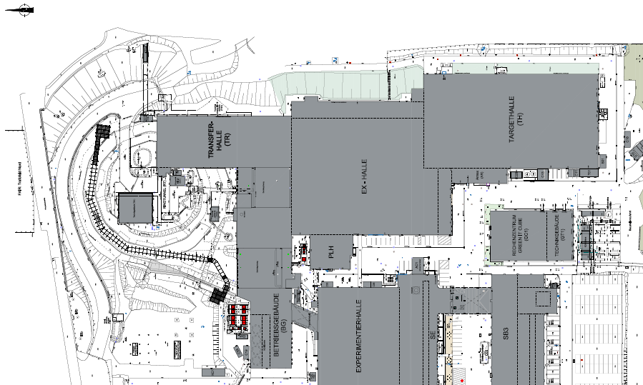
Upgrade SIS18 inside the transfer hall
Upgrade SIS18
radiation protection for higher intensities

Slide 4
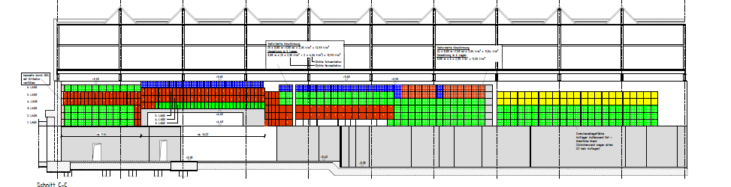
GaF-Measure Nr.11 Upgrade SIS18
Reinforced ceiling shielding SIS18 /TR Nord
A total of 643 shielding beams must be moved within the hall/s
321 to the outside
279 new manufactures beams
and 43 intermediately stored beams have to be brought inside the TR
Transport time per beam 2 hours.
N
Notes:
reinrot = Hämatitbalken neu rd ca.2fache Dichte
grün schmal direkt über RT= Hämatit bestand
Grüne und blaue Balken = Bestand, teilweise raus und an anderer Stelle wieder rein, oder Überschuss
gelb= nicht relevant für upgrade SIS18, werden nicht angefasst

Slide 5
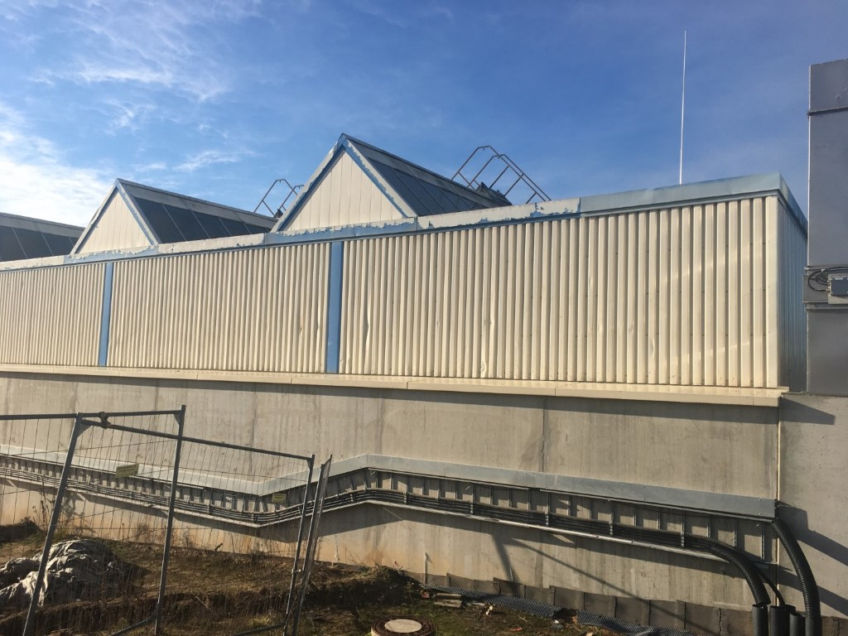
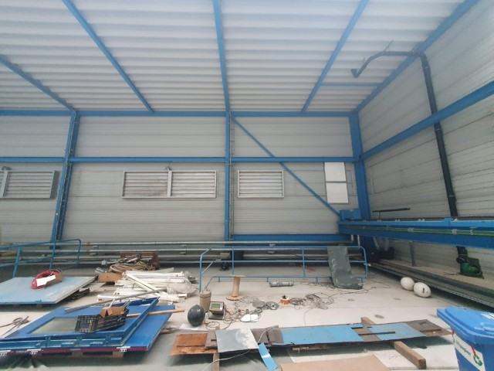
Variant 1: Removal and installation via facade opening
(east and north) - rejected -
due to the concrete wall located in front of the outside wall (opening of the facade only possible with a height h = approx. 3. 50 m).
none of the possible facade panels has the required height or width – concrete beam width 12m –
The mobile crane cannot lift the the ceiling beams, with approx. 20t, horizontally into the hall
The resulting lever forces at 20to load are not manageable under the local conditions.
Fassadenfeld OST
Fassadenfeld Nord
Fassadenfeld OST
Notes:
Aufgrund des möglichen Mobilkran-Standplatzes (mit entsprechender Standfestigkeit in ca. 25-30m Entfernung) ist die Einbringung - Auslegerlänge von mindestens 25m, eines Abschirmbalken-Gewichtes von ca. 19 t und in Verbindung mit der lediglich ca. 3,50m hohen Aussparungsöffnung) durch die Fassade nicht möglich. ->Gemäß Angabe BKL- Mobilkrane

Slide 6
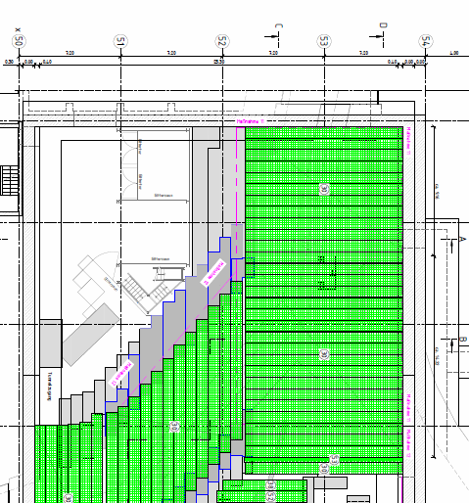
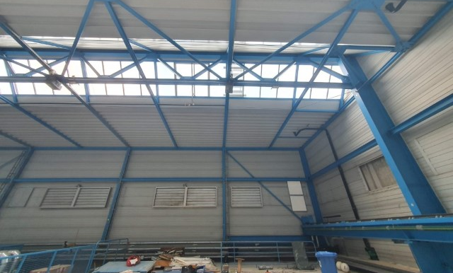
Variant 2: Mounting window in the roof north side (approx. 14,00m x 5,00m)
This variant has to be checked for feasibility by the planner and structural engineer
Disadvantages
Necessary weather protection roof (openable) during execution.
Statics and planning for opening and closing the existing roof is required
Structural engineering and planning for protective roofs
Roof opening over approx. 4 months
Benefits
Disassembly and lifting of the „last five rows“ without special construction
faster handling in the northern area of the hall (TR)
Installation directly from the „P-Linac“ parking storage area by crane
most of the deliveries can be made via Prinzenschneise-> less stress on the campus of GSI
Scientific activities are possible in the rest of the halls

Slide 7
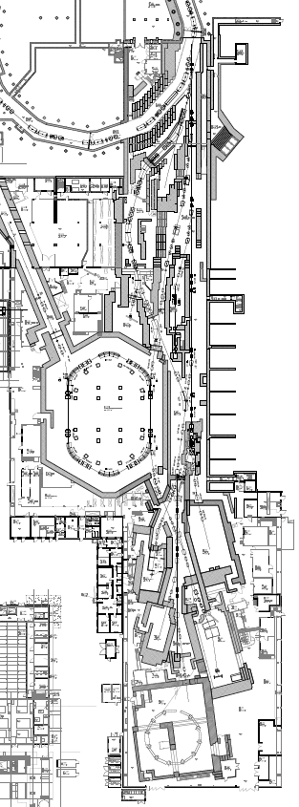
Variant 3 Complete transport through all three halls TR-EX-TH
Levels 1 and 2 are locked during assembly time
Level 2 is locked during transports for assembly
Level 1 is locked during delivery and transport
Level 1 and 2 ist fully usable

Slide 8
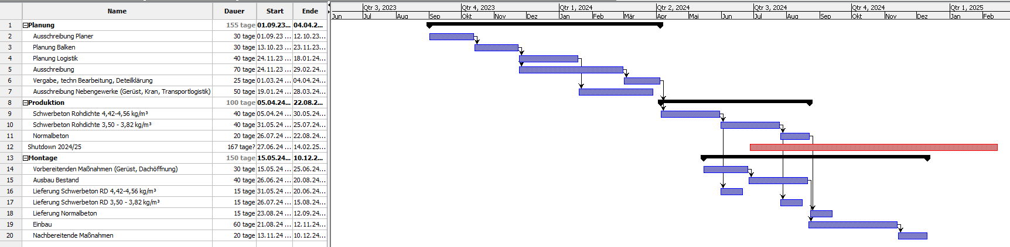
  Schedule for upgrade SIS 18 (both variants)
Removal and installation time is calculated on the assumption that three crane teams will be installed, one team each hall
optimizable by opening the roof, if feasible
schedule without any time buffer
without taking account other planned activities
construction phase 6 months

Slide 9
Next steps Upgrade SIS 18
BAU_Björn Benz
requirements:
Construction time of approx. 6 months
Full-Shutdown required for both variants
Variant Transport through hall only possible with complete construction freedom in the halls
secured financing by FAIR approx. 5,2 million EUR
recommendation BAU:
Implementation of the variant transport via roof opening, if possible
Definition of the time window for “Full Shutdown” in 2024/2025
next steps:
Shopping cart and procurement planning Q3 2023
Decision on the variant after verification of static feasibility and cost-effectiveness comparison

Slide 10
Overview of building permit status Campus GSI
FAIR
Q3-2023
Legend
RED
Permit situation deviates from construction status Fire protection qualification in building construction and TGA in buildings around the linear accelerator (BH1-3, TU, VR, SH1, 2, 4), experimental halls (TR, EX, TH), BG, PHL and SB1 to achieve compliance with building regulations
ORANGE
Building permit with small deviations
Buildings in final processing to achieve building permit conformity BK1, SB-2-3, BR1-3, GaF, GL, PH-E charging stations
GREEN
Permit situation in accordance with construction status
Not complaint from the building authority
YELLOW
Building permit in progress
Approval will take place with implementation of the planned measures in SE+EH, EZ
GaF
Baurechtliche
Instandsetzung
Experimentier-Hallen
Baurechtliche Instandsetzung
BG
Baurechtliche Instandsetzung
Linear-Beschleuniger ab 2026
SL in BS+TGA
FAIR
Q3-2023
Q3-2023

Slide 11
AR 110 Baumaßnahmen > 2,5 Mio. €
Heiztrasse FAIR
Neubauten
Sanierungen
Projektiert
FAIR
Upgrade SIS18 aus GaF
Baurechtliche
Instandsetzung
Experimentier-Hallen
Anbindung
FAIR
Baurechtliche Instandsetzung
BG
Baurechtliche Instandsetzung
Linear-Beschleuniger ab 2026
Sanierung
SE – P1/ EH
2027-2028
SE – P2
ab 2029
C39
SE-C38
SE- C32
SE-C35
Fertiggestellt
Nbau
BE42

Slide 12
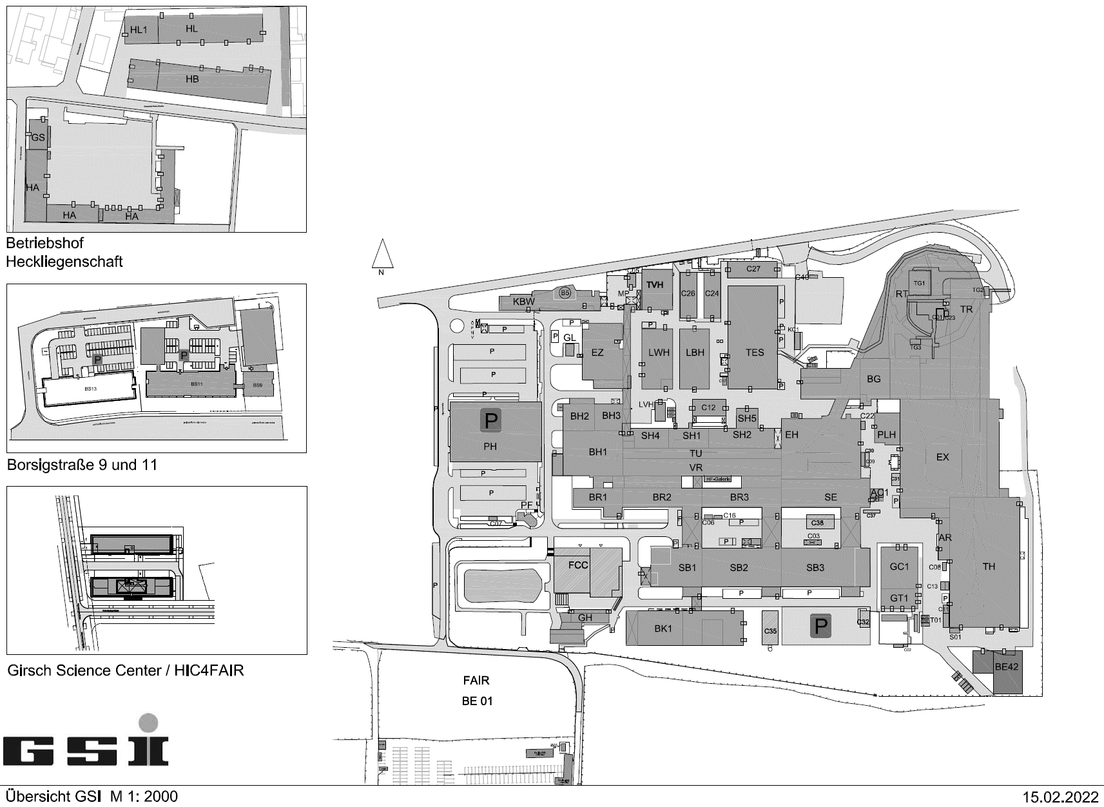
  Building law refurbishment_linear accelerator
  BAU_Maria Martin Pelaéz / N. N.
Refurbishment of Buildings around the accelerator:
Halls (BH1-3), tunnel (TU), utility rooms (VR) und stripper halls (SH1, 2 und 4)
Measures: Fire safety measures: construction of locks, enclosure of stairs,
fire doors, fire dumpers, fire bulkheads, fire walls, replacement of transformers,
low-voltage main distributions and sub-distributions, electrifications of new locks,
fire alarm systems (BMA), safety lighting (SiBel), BOS-radio, measurement control technology (MSR), renewal of drinking water supply, repair of basic lines, renewal of ventilation systems
User: Linear accelerator and Power supply
Costs: 8 Mio. € inkl. risk (1,0 Mio. €)
construction: 2,2 Mio. EUR
TBE: 2,9 Mio. EUR
( 2,1 Mio. EUR ETS und ETE!)
Construction time: 2026 – 2028 (commissioning FAIR)
Status: AR 111 proposal for a decision
8,0 Mio. €
incl. risk
Baurechtliche Instandsetzung
Linear Accelerator
Notes:
WI Plan, GFP
Brandschutz

Slide 13
  Building law refurbishment_experimental halls
  BAU_Maria Martin Pelaéz / N. N.
Refurbishment of the experimental halls:
Transfer hall (TR), New experimental hall (EX), Target hall (TH)
Measures: Fire protection and safety measures
renewal and refurbishment of tecnical building equipment
User: Scientific experiments
Costs: 7 Mio. € incl. risk (0,75 Mio. €)
construction: 2,7 Mio. EUR
TBE-tecnical building equipment: 2,0 Mio. EUR
( 1,65 Mio. EUR ETS_fire alarm systems (BMA),
safety lighting (SiBel), BOS-radio,)
Planning/
Permit: ?– 2028 min. building permission untill commissioning FAIR
Construction time: from 2028
Status: AR 111 proposal for a decision
Baurechtliche
Instandsetzung
Hallen
7,0 Mio. €
inkl. Risiko

Slide 14
  Building law refurbishment_building BG
  Bau_Maria Martin Pelaéz / N. N.
Refurbishment Building BG and safety measures Phelix Gebäude (PH)
Measures: Fire protection measures
Renewal and refurbishment of tecnical equipment
User: Operation GSI and science
Costs: 7,5 Mio. € incl. risk (0,9Mio. €)
determined with cost characteristics on m² BGF
Planning: ?– 2028 min. concept of fire protection
untill commissioning FAIR
Construction: from 2030
Status: AR 111 proposal for a decision
Baurechtliche Instandsetzung
BG
7,5 Mio.€
inkl. Risiko
PLH

Slide 15
  Refurbishment SE – P1_
  Advance measures to maintain scientific excellence
  BAU_Uwe Fabig / Anne Giesler
New construction
Refurbishment
Projected
EH_LA24
C39
necessary preliminery projekt for SE P1 EH_new LA 24
BEA
SE Sanierung P1
Rückbau
SE P1
Advanced measure II
C38 Control-container SIST + SHP
C39 Bio laboratory BMD
C38
Advanced measure III
Renewal Beam diagnostics
SE 1.124a
Replacement area for NUSTAR
C35
C32
NUE
C36
Advanced measure I
C35 Interim office building
FAIR

Slide 16
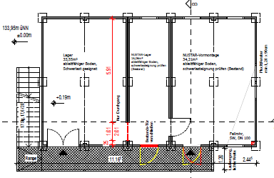
  Refurbishment SE – P1 Dismantling |
  Advanced measures
  BAU_Uwe Fabig / Anne Giesler
Advanced measure I (C35)
comissioning completed
Advanced measure II (C38 und C39)
User: SWM a.o. C38/ Biologie C39
Construction: 06/2023 – 01/2024
Commissioning: Q1/2024
Status: Containers were ordered, TGA partially
Advanced measure III (SE 1.124a)
Bauzeit: 11/2022 – 11/2023
Commissioning: Q2/2023 → Q4/2023
Critical path: Beamt time in EH is endangered!
Status: Dismantling 95% completed
Construction work 90% completed
FAIR supplement for scientific cables, (14km scientific cables) under negotiation GSI/FAIR
Interim for NUSTAR (C32) Construction of a modular office and warehouse building
User: NUSTAR replacement area
Construction: Q2/2024 – Q2/2025
Commissioning: Q3/2025
Status: Building permit is available
VOB tenders are available
C32_Groundloor plan, Level1

Slide 17
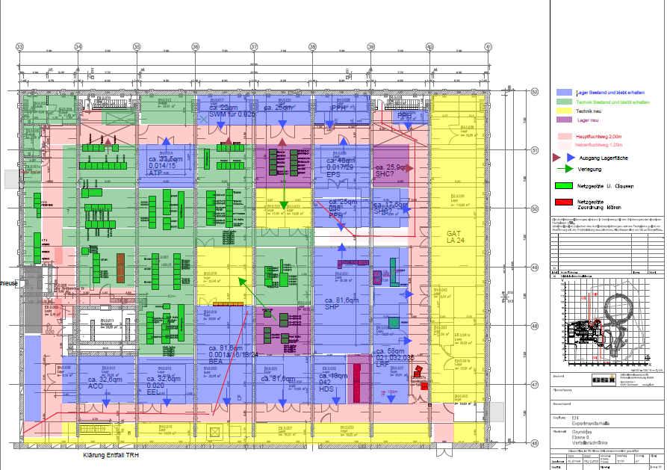
  Refurbishment SE – P1 Dismantling – EH_new LA24
  BAU_Uwe Fabig / Anne Giesler
Measures: Separation of LA24 (old system) and construction of a replacement ventilation system for the EH (new LA24), Fire protection measures, building permit with new fire protection concept
User: The LA24 – refurbishment EH is necessary for the approval of accelerator operation under radiation
protection law
Costs: ca. 4,0 Mio. €
Construction: Q1/2026 – Q3/2027
Commissioning: 2027
Status: Determination of user needs Q4/2022 to Q2/2023
Call for tenders for planners Q3/2023
Planning up to request building permit Q4/2024
Building permit Q3/2025 (3er Set 14 months!)
Start of construction 2026,
construction time approx. 18 Months!
Collision with current planning science
and accelerator
Notes:
Hinweis LA24, Altanlage hängt an seidenem Faden. Keine Wartung mehr, kleinere Ertüchtigungsmaßnahmen für die Überbrückung in Planung. Dann nur noch Notbetrieb EH + Abklinganlage möglich…
Vorab notwendige Sanierung der Krananlage in 2024/2025 (Halle ca. 9 Monate ohne Kranfunktion). Krananlage wird für die Einbringung der neuen LA24 benötigt.

Slide 18
Construction law upgrading acceleration-buildings
(construction from 2026-20xx)
Reasons for the repair measures:
During the special construction inspections (SBK) and hazard prevention shows (GVS) carried out by the authorities from 2019, significant fire protection and safety deficiencies on the GSI Campus were revealed.
Due to the year of construction of the “Ur-GSI”, the building stock and the permit documents clearly differ from today’s fire protection and safety standards. The building inspectorate and fire brigade require the GSI to correct these significant safety deficiencies “immediately” in order to ensure safe operation.
The resulting construction measures must have commenced before FAIR is put into operation.
What has been achieved to date:
Some of the defects identified and logged by the fire brigade could be rectified in small emergency measures.
For some of the buildings and facilities on the campus, building permits have already been updated and necessary structural measures have been implemented (LWH,TVH,AR,G01 etc. ).
Notes:
Hallo Maria,
dieses action item adressiere ich an dich, da ich nicht weiß wer hier PL (PLs) wird/werden.
• 3 neue AI Maßnahmen in die 5_Baukon aufnahmen (Beschleuniger, Hallen und BG)
• [VORAB für den AR111 →Beschluss Vorlage (Erläuterung, Termine, Kosten)]
Am Montag habe ich für uns einen Arbeitstermin eingestellt, um sodann mit dem BMBF einen Vorab Infotermin zu vereinbaren. Ggf. können wir den 16.03.2023 hierfür nutzen (bin mit Hr. Schwarzenberg in Abstimmung).
Maria hat Kosten zusammengetragen
\\campus\Groups\GA\Projekte-laufend\00_AI-neu_Beschleuniger_BH bis VR-TU_Ertüchtigung+Genehmigung\20230201_Kostenschätzung_BH-VR-TU-SH1-4_MMa.xlsx
\\campus\Groups\GA\Projekte-laufend\00_AI-neu_Hallen_TR-EX-TH Ertüchtigung+Genehmigung\20230202_Kostenschätzung_Hallen TR-EX-TH_MMa.xlsx

Slide 19
Construction law upgrading acceleration-buildings
(construction from 2026-20xx)
Next steps:
In the next step, BAU will continuously work hard on updating the building permits and safety technology, especially in the accelerator areas.
FAM_BAU developed a comprehensive fire protection concept for the first section (ion sources in the BH building up to the old EH experimental hall) and finalized it with the authorities.
note: The resulting measures in EH are located in the SE project due to the need to replace the LA24 and are not included in this new AI measures. (“Verursacherprinzip”)
The fire protection and safety concepts of the new measures 2 and 3 will be successively commissioned.
Estimated cost of approx. €22. 5 million
“Further remediation measures” (so far amounting to €20 million) have been included in the WI-Plan_2024 and will be taken into account in the GFP_2023; funding has yet to be secured
Background and reasons have already been set out in previous AR reports (see “short-term measures up to 2025”)
Presentation in the Management Board at the 5_Baukonferenz
AR 111 Proposal for a decision

Slide 20
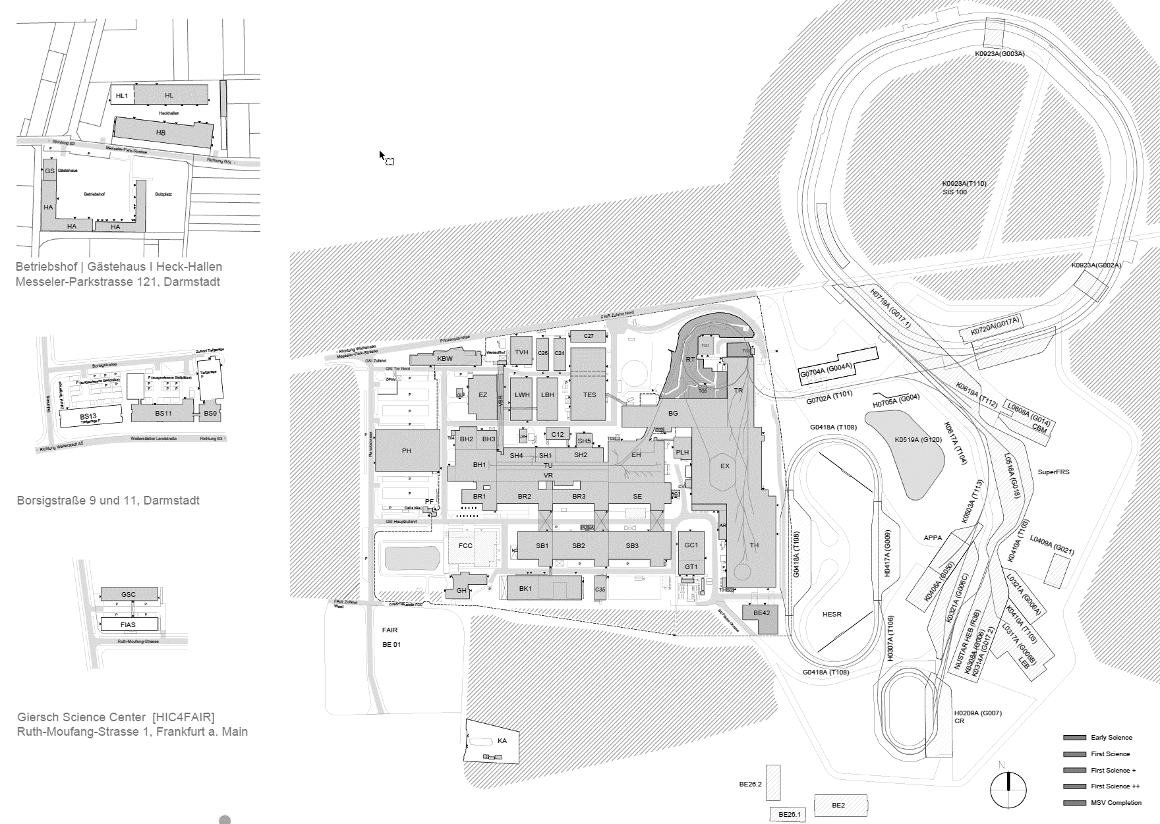
Thank you very much for your attention!

