Slide 1

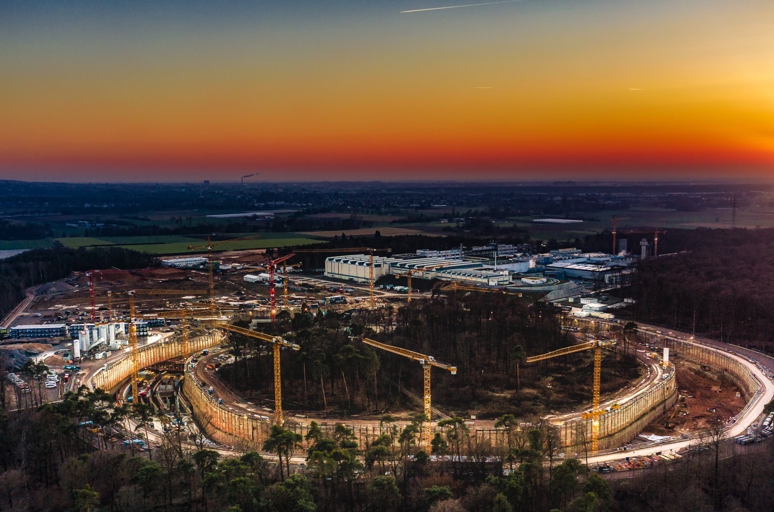
Program Oriented Funding at
Helmholtz:
Timeline and
Milestones
GSI-Darmstadt & Helmholtz Institute Jena,
Friedrich-Schiller University Jena
Thomas Stöhlker

Slide 2

Program-oriented Funding
Research activities in 18 centers
are organized in long-term programs,
pooling unique research competences
of the centers in a complementary
approach to jointly tackle long-term
challenges with a strategic focus
Provision of large-scale scientific
equipment and platforms for international scientific user communities (“user facilities”)
PoF provides the financial, strategic and scientific framework for coherent multi-year research programs within each research field.

Slide 3
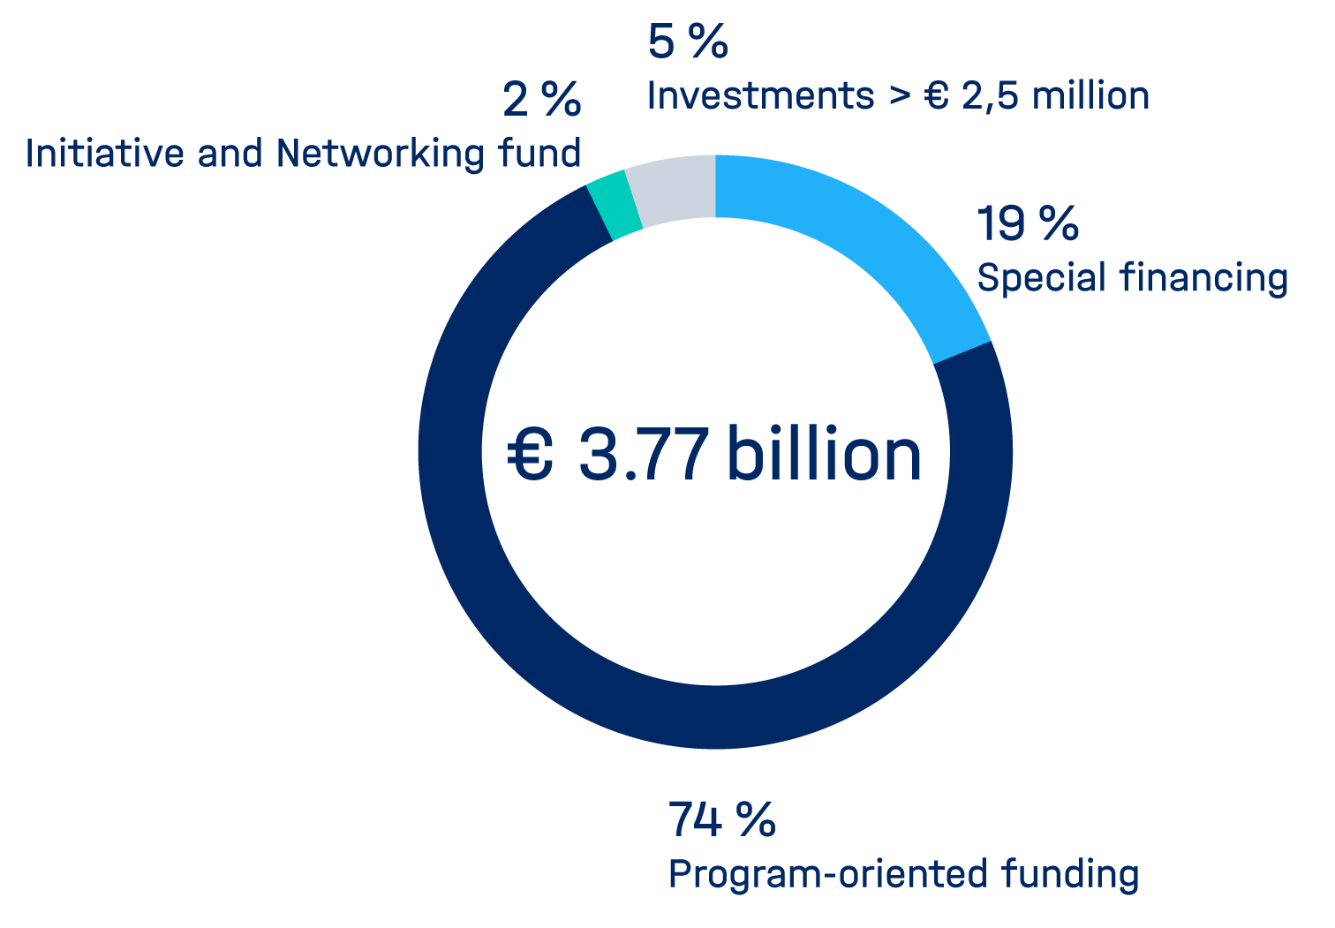
Facts and Figures
Strategy Processes
Basic Funding Budget 2021
Helmholtz-Roadmap Research Infrastructures
Helmholtz Incubator Information & Data Science
As of July 2021

Slide 4
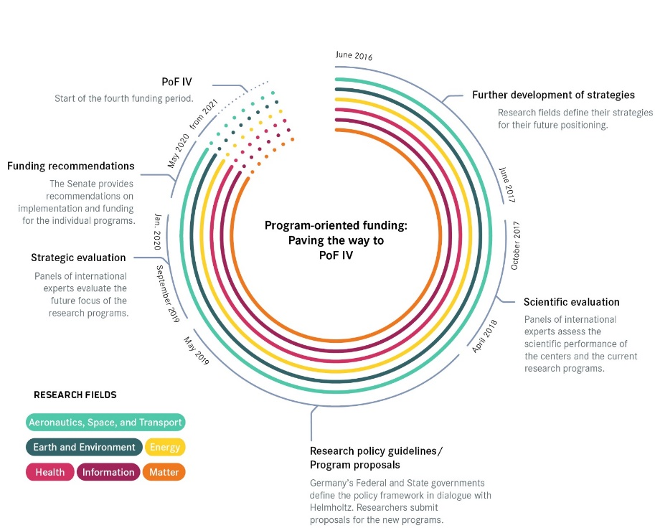
Key Steps of Program-oriented Funding
Strategic planning process based on the criteria of
    achieving a global leadership position,
    covering a spectrum of innovation from
    basic research, R & D to applications and
    vice versa
Scientific evaluation of the centers and programs
Research policy objectives of the federal and state
ministries for the strategic positioning of the research
field and proposals for new research programs.
Strategic evaluation of each research field and programs
Recommendations of the senate for implementation and funding of the new programs
Notes:
4

Slide 5




Funding of Helmholtz Centers – now
Programs within the research fields
A
B
C
A
C
A
B
C
€€€
€€€
€€€
€€€
€€€
€€€
€€€
€€€
€€€
€€€
€€€
€€€
Budget of the center = sum of its shares in
the programs
Ministries

Slide 6
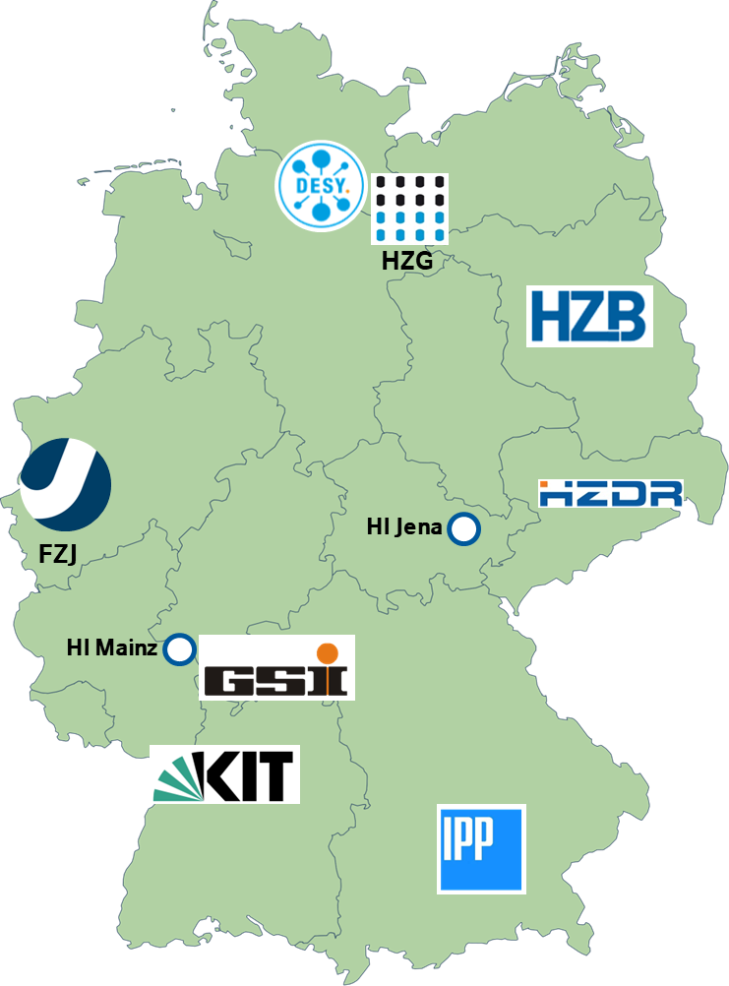
Research Field Matter: Who We Are a powerful alliance of world-class laboratories
Deutsches Elektronen-Synchrotron
DESY, Hamburg and Zeuthen
Forschungszentrum Jülich
FZJ, Jülich
Helmholtzzentrum für Schwerionenforschung
GSI, Darmstadt
HI Jena Helmholtz-Institut Jena, HIM Helmholtz-Institut Mainz
Helmholtz-Zentrum Berlin für Materialien und Energie
HZB, Berlin
Helmholtz-Zentrum Dresden-Rossendorf
HZDR, Dresden
Helmholtz-Zentrum Hereon
Hereon, Geesthacht
Karlsruhe Institute of Technology
KIT, Karlsruhe
Deutsches Elektronen-Synchrotron
DESY, Hamburg and Zeuthen
Forschungszentrum Jülich
FZJ, Jülich
Helmholtzzentrum für Schwerionenforschung
GSI, Darmstadt
HI Jena Helmholtz-Institut Jena, HIM Helmholtz-Institut Mainz
Helmholtz-Zentrum Berlin für Materialien und Energie
HZB, Berlin
Helmholtz-Zentrum Dresden-Rossendorf
HZDR, Dresden
Helmholtz-Zentrum Hereon
Hereon, Geesthacht
Karlsruhe Institute of Technology
KIT, Karlsruhe

Slide 7
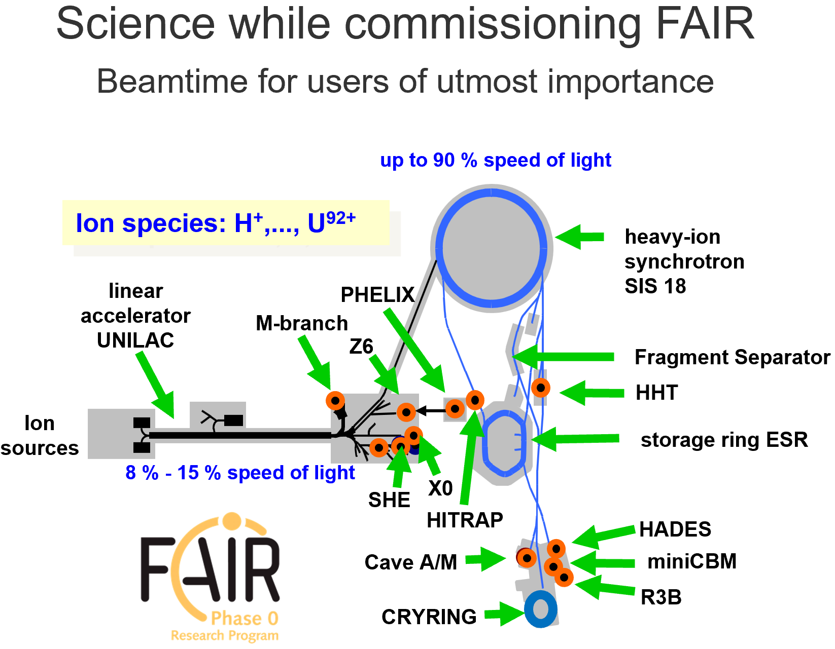
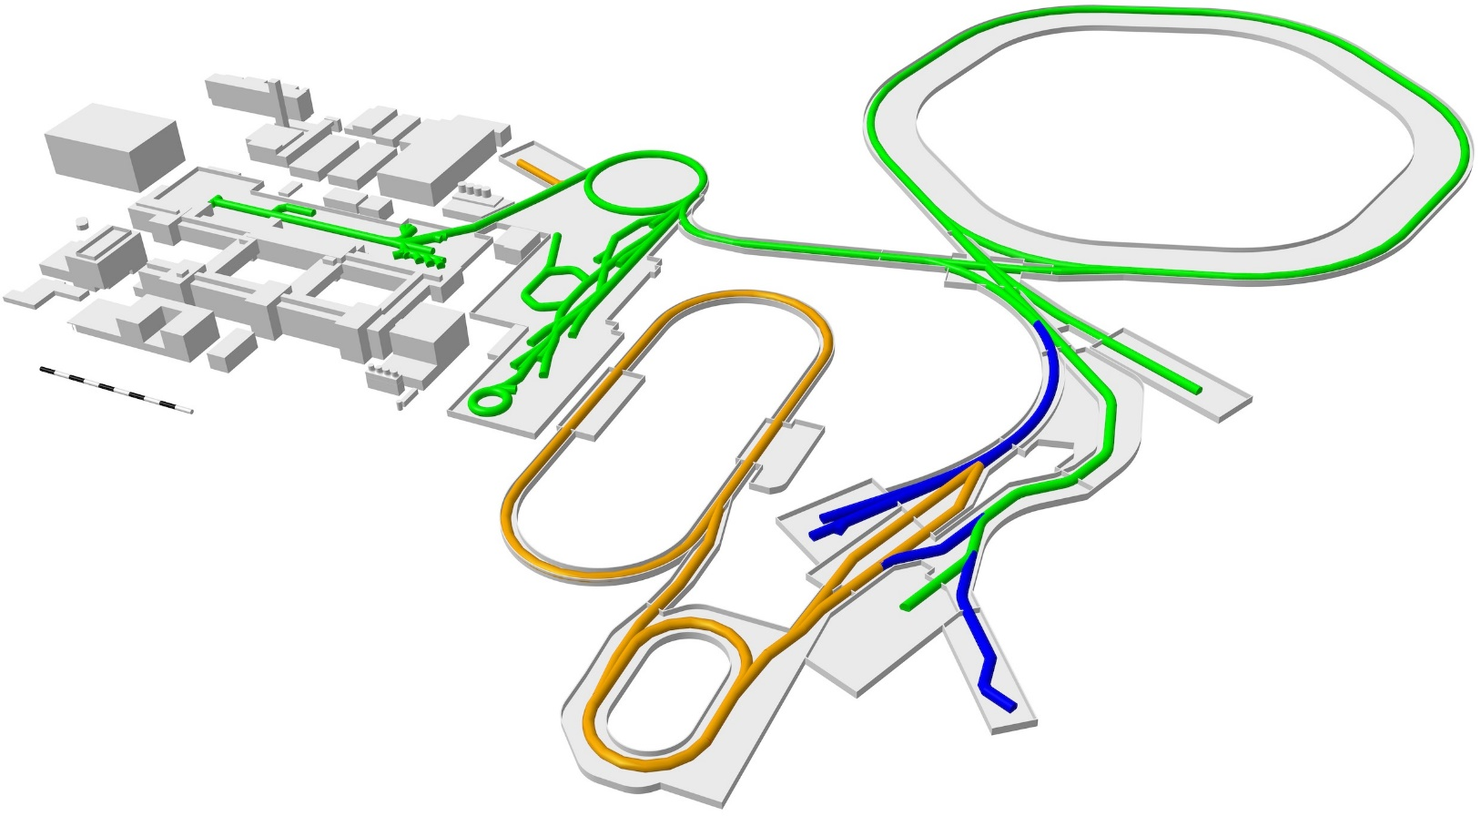
Our challenging goal is the realization of FAIR 2028 and at the same time to perform high level research
SIS100
UNILAC
SIS18
HITRAP
ESR
CBM
CRYRING
Super-FRS
First Science +
Next steps
MSV completion
NUSTAR HEB
APPA, NUSTAR and PANDA investigate options for further experiments at green lines
Continuation of APPA, CBM and NUSTAR expriments at existing facilities
7

Slide 8
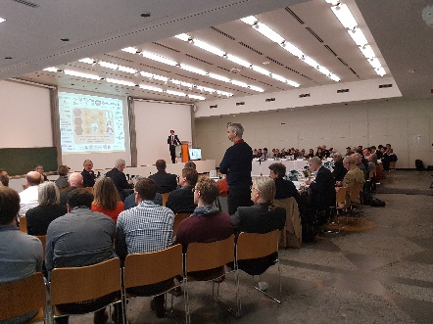
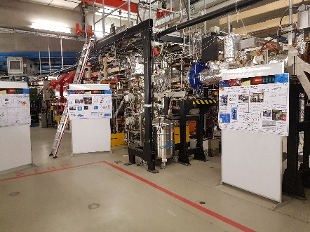
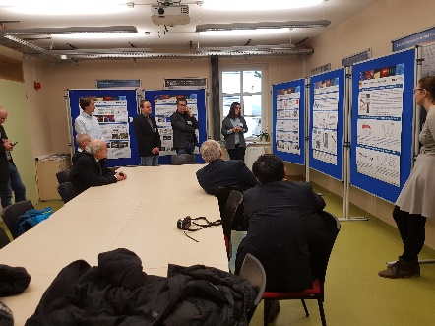
Helmholtz: Program Oriented Funding (POF)
POF periods
Research at Helmholtz is strategically structured.
Centers of one Research Field agree in common Research Programs.
Research programs are subject of a rigorous two-step scientific evaluation:
a) Center evaluation
b) Strategic evaluation
POF I: 2005 – 2009
POF II: 2010 – 2014
POF III: 2015 – 2019*
POF IV: 2021 – 2027
POF V: 2028 – 2034
* During POF III, campus GSI Darmstadt (except BIO) was exempted from the POF scheme.
Oct. 2017
Funding for the next POF period !
8

Slide 9
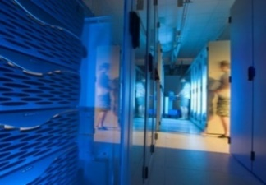
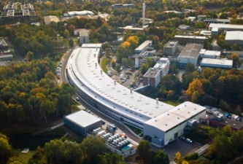
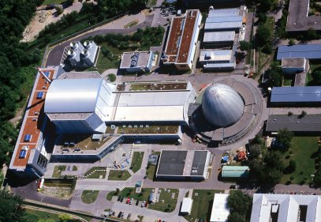
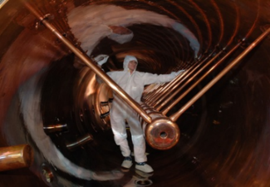
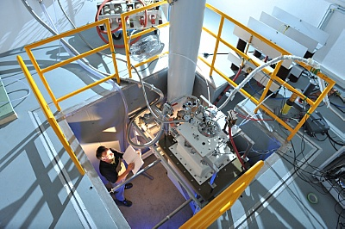
Program Structure designed to address critical questions and capitalize on our facilities
MU
M
Matter
and the Universe (LK I)
MML
From Matter
to Materials and Life (LK I)
MML
CBM, PANDA, NUSTAR
APPA
MT
Facilities (LK II)
Ions
GridKa
Facilities (LK II)
Photons, Neutrons, Ions
High-Fields
Facilities (LK II)
IDAF
Matter
and Technologies (LK I)
Facilities
GridKa
PETRA III
FRM II / MLZ
GSI
HLD

Slide 10
Program and Topic Structure (LK I: 272 Mio €/y; GSI 39 Mio €/y) designed to address critical questions and capitalize on our facilities
MU
M
Matter
and the Universe (LK I)
MML
From Matter
to Materials and Life (LK I)
MML
Fundamental Particles
and Forces
FPF
Matter
Dynamics, Mechanisms
and Control
Matter
MT
Cosmic Matter in the
Laboratory
CML
Materials
Complex and
Functional Materials
Materials
Matter and Radiation
from the Universe
Matter
and Technologies (LK I)
MRU
Life
Building Blocks of Life:
Structure and Function
Accelerator Research and Development
ARD
Life
Detector Technologies
and Systems
DTS
Data Management
and Analysis
GSI contributes
DMA

Slide 11
GSI within Helmholtz‘s Program Oriented Funding
MU
MU – R. Engel
MML
MML – Th. Stöhlker
MML
Matter
G. Weiglein
FPF
F. Kärtner
Matter
MT
F. Maas / T. Galatyuk
MT
CML
J. Wosnitza
Materials
C. Stegmann
MRU
Matter
and Technologies – T. Behnke
C. Fournier
Life
A. Jankowiak
ARD
Facility (LK II)
GridKa
DTS
M. Weber / S. Masciocchi
Facilities (LK II)
Photons, Neutrons, High Fields, Ions – E. Toimil Molares
Facility (LK II)
Ions – Y. Leifels
Facility (LK II)
IDAF
M. Bussmann
DMA
GSI contributes
GSI participation; GSI spokespersons in Blue
11

Slide 12

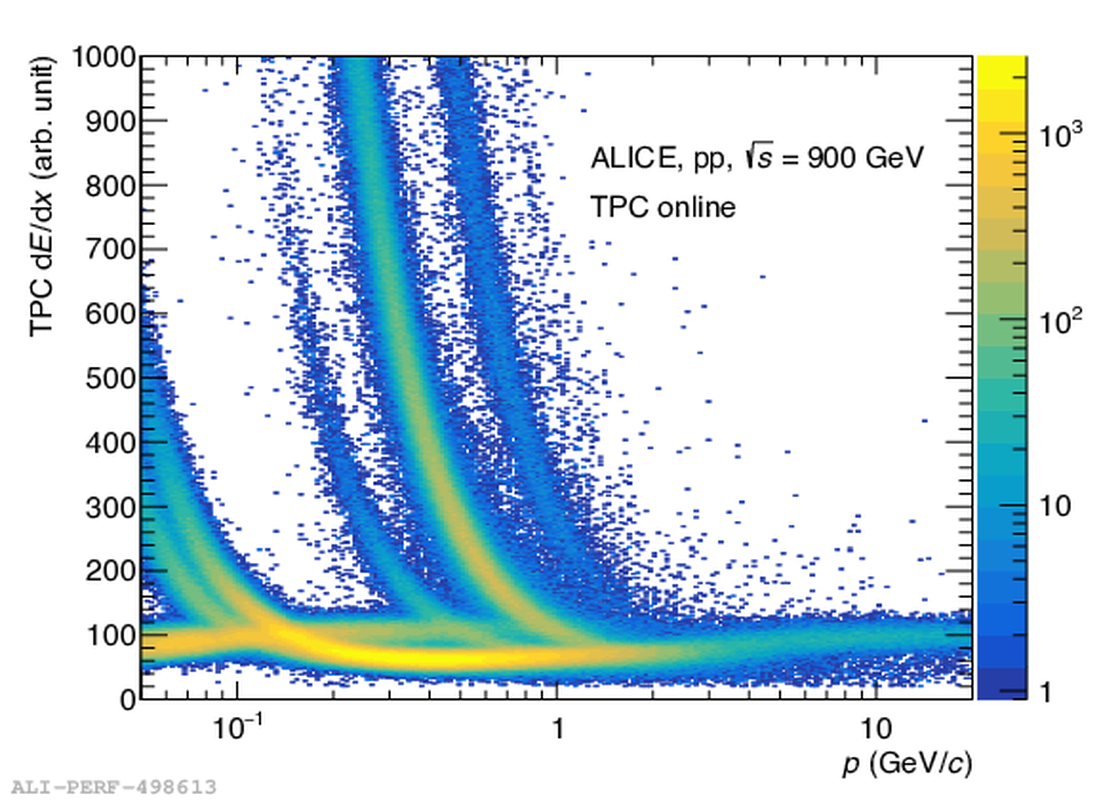
Evaluation of Research
Matter drives a research program (LK I) at the frontier of science and operates top class facilities (LK II) for enabling the research program and serving a large interdisciplinary and international user community.
Research Programs
(LK I)
for in-depth strategic review.
Criteria: scientific excellence, uniqueness and relevance on international level; attraction of best brains etc.
→ Rating on topic level A, B, C
funding recommendation
(strong competition between topics but not between centers!)
ALICE

Slide 13
Evaluation of the Facilities and Operation
(LKII: 321 Mio €/y; GSI: 32.2 Mio €/y)
Matter drives a research program (LK I) at the frontier of science and operates top class facilities (LK II) for enabling the research program and serving a large interdisciplinary and international user community.
Large scale user facilities
(LK II)
For review:
internationally competitive ?
enabling the science program ?
reliability of operation ?
overbooking factor ?
attract best users ?

Slide 14
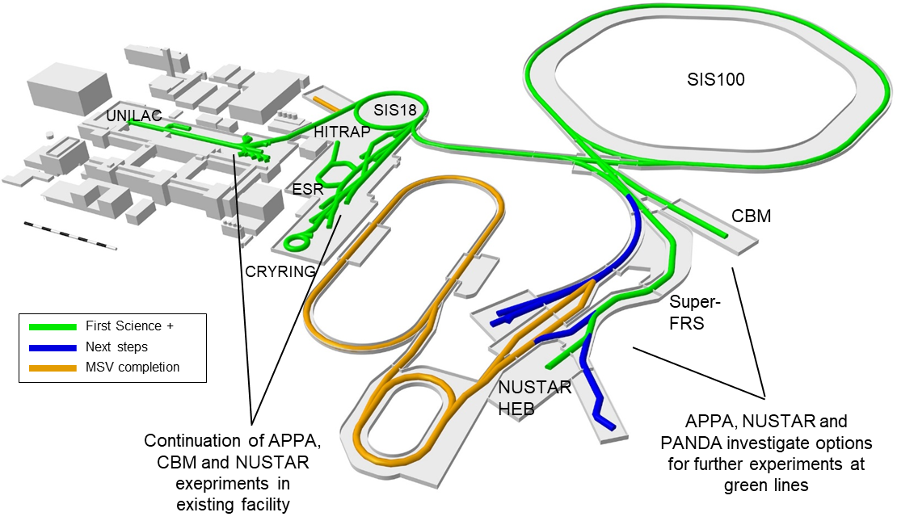
General Remark: GSI Milestones of POF IV subject of evaluation for POF V
To track progress research and facility operation: definition of milestones. For POF, IV milestones were defined in 2019.
Substantial number of milestones achieved but quite some deliverables not yet provided (mostly due to the COVID and energy crisis; no beam time in 2023).
Almost none milestones related to FAIR (there are many) can be achieved before the centre evaluation in 2025.
Beam time in 2026/2027/2028 is a must and not an option.
14

Slide 15
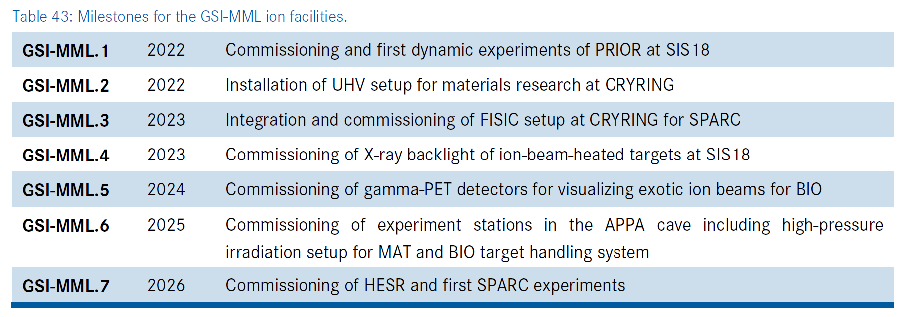
Milestones: Defined for the research topics as well as for the facility operation
Example taken from POF IV application
Delayed
Canceled
Canceled
15

Slide 16
Let`s get more specific on POF V

Slide 17
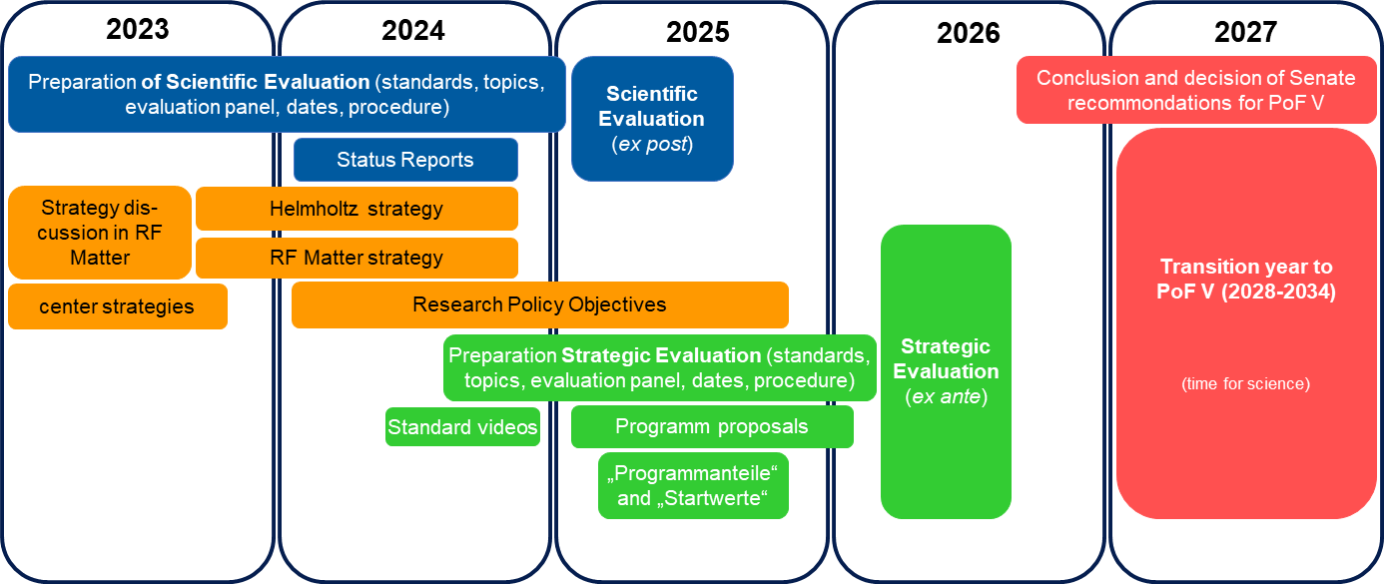
Roadmap Towards POF V
Common actions and tasks
17

Slide 18
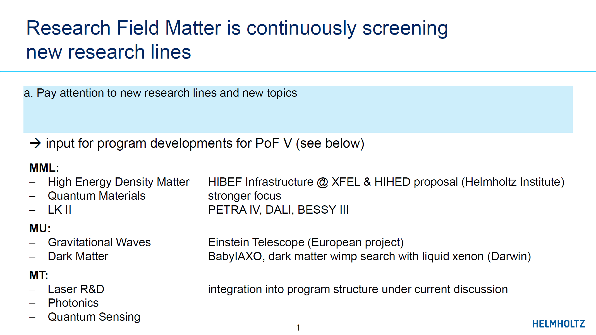
Very important: Are there any new topics?

Slide 19

AdDitional Topics in MML: Photonic and Quantum Technologies (enabling Techn.)
Table-top THz, optical, EUV and attosecond sources
Atomic and nuclear clocks
Quantum sensors
Quantum logic spectroscopy
Quantum state preparation
Quantum sources (non-classical states of light: optical to x-rays)
Quantum imaging (nonlinear mic., X-ray flourescence imag)

Slide 20
MT???: Frontiers in Optical Science and Technology
Photon Sources
High Energy & High Power Lasers
Ultrafast Sources
EUV- Sources
Optical Components and Materials
Organic Nonlinear Optics
Photovoltaics
Electro-Optics
Integrated Optics
X-ray Optics
Optical Systems and Applications
Biomedical Optics
Ultrawideband Signal Processing
Photonic Qunatum Technolgies
Imaging and Microscopy

Slide 21
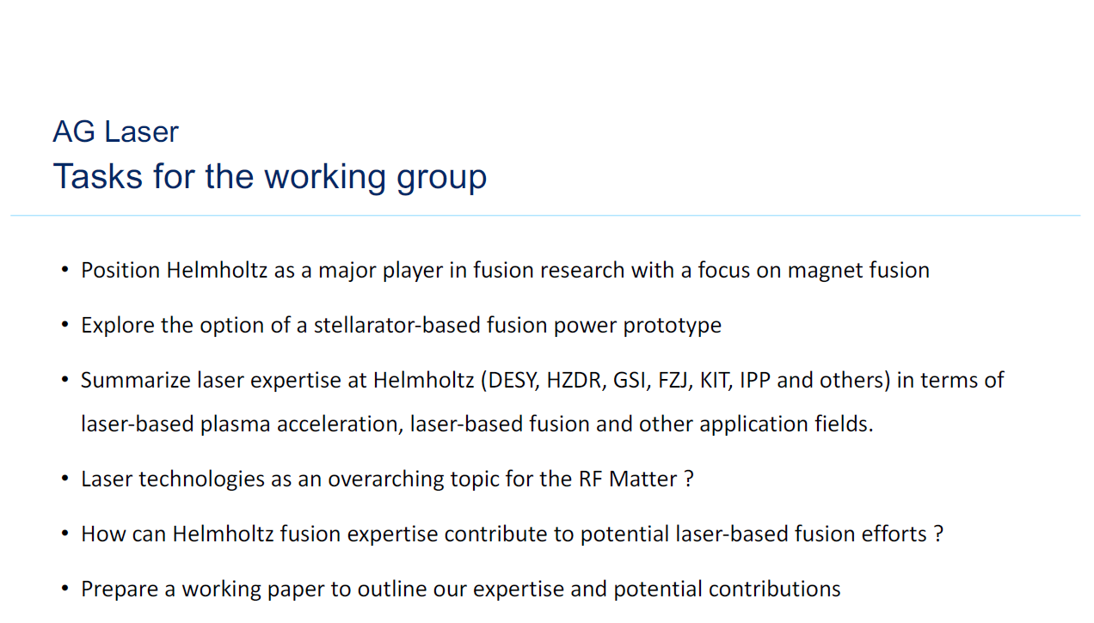
IS FUSION a NEW TOPIC?

Slide 22
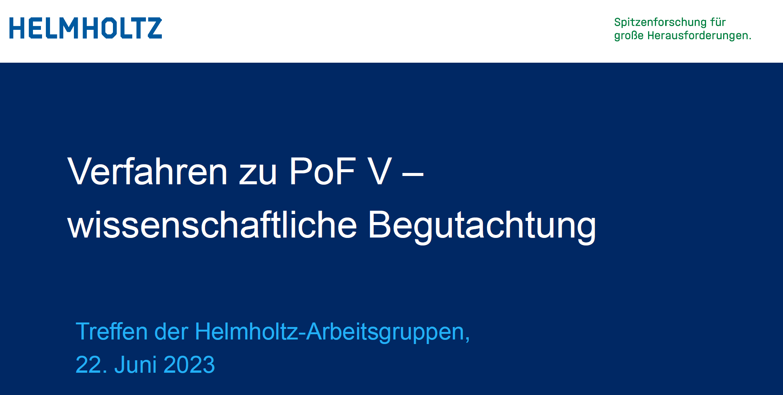
Bericht vom Treffen der PoF-Arbeitsgruppen

Slide 23
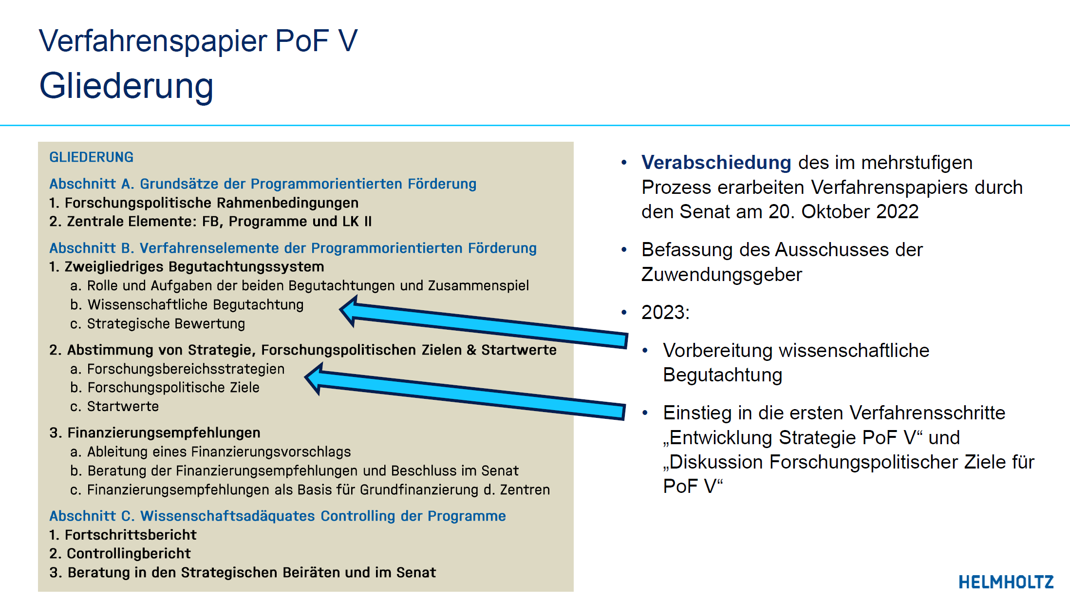
Bericht vom Treffen der PoF-Arbeitsgruppen

Slide 24

Report from the PoF working groups

Slide 25
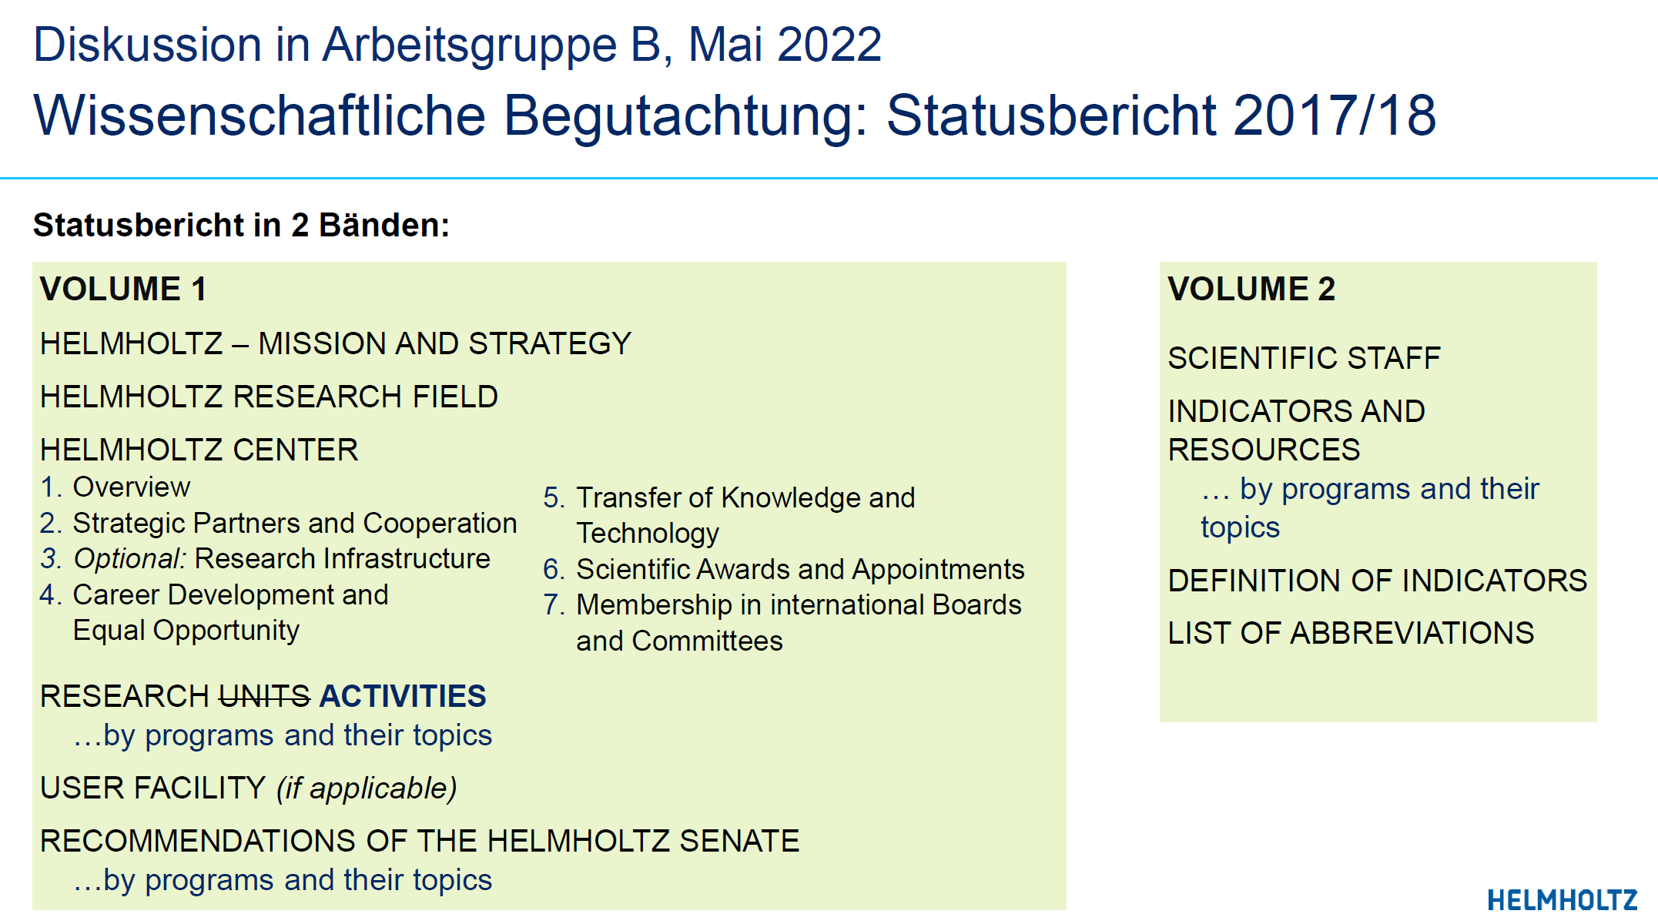

Slide 26
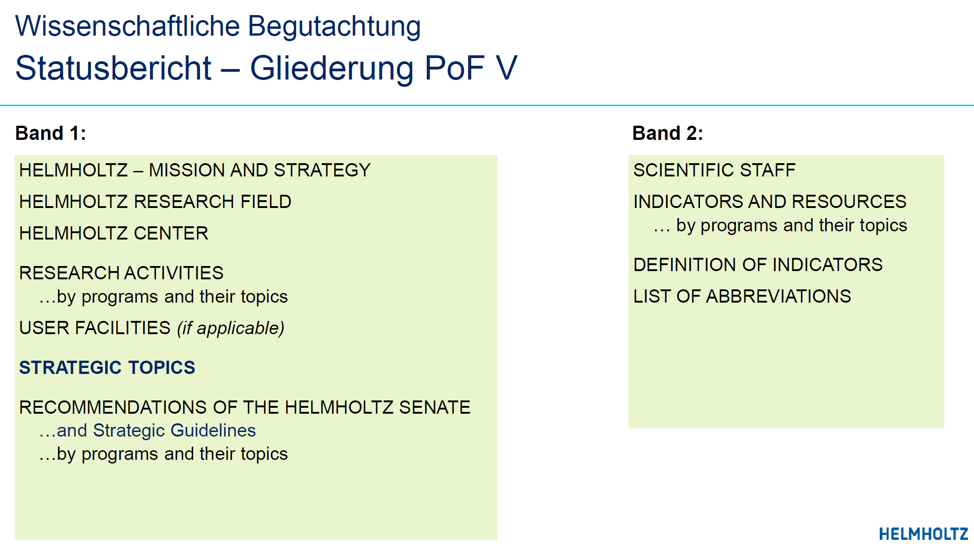

Slide 27
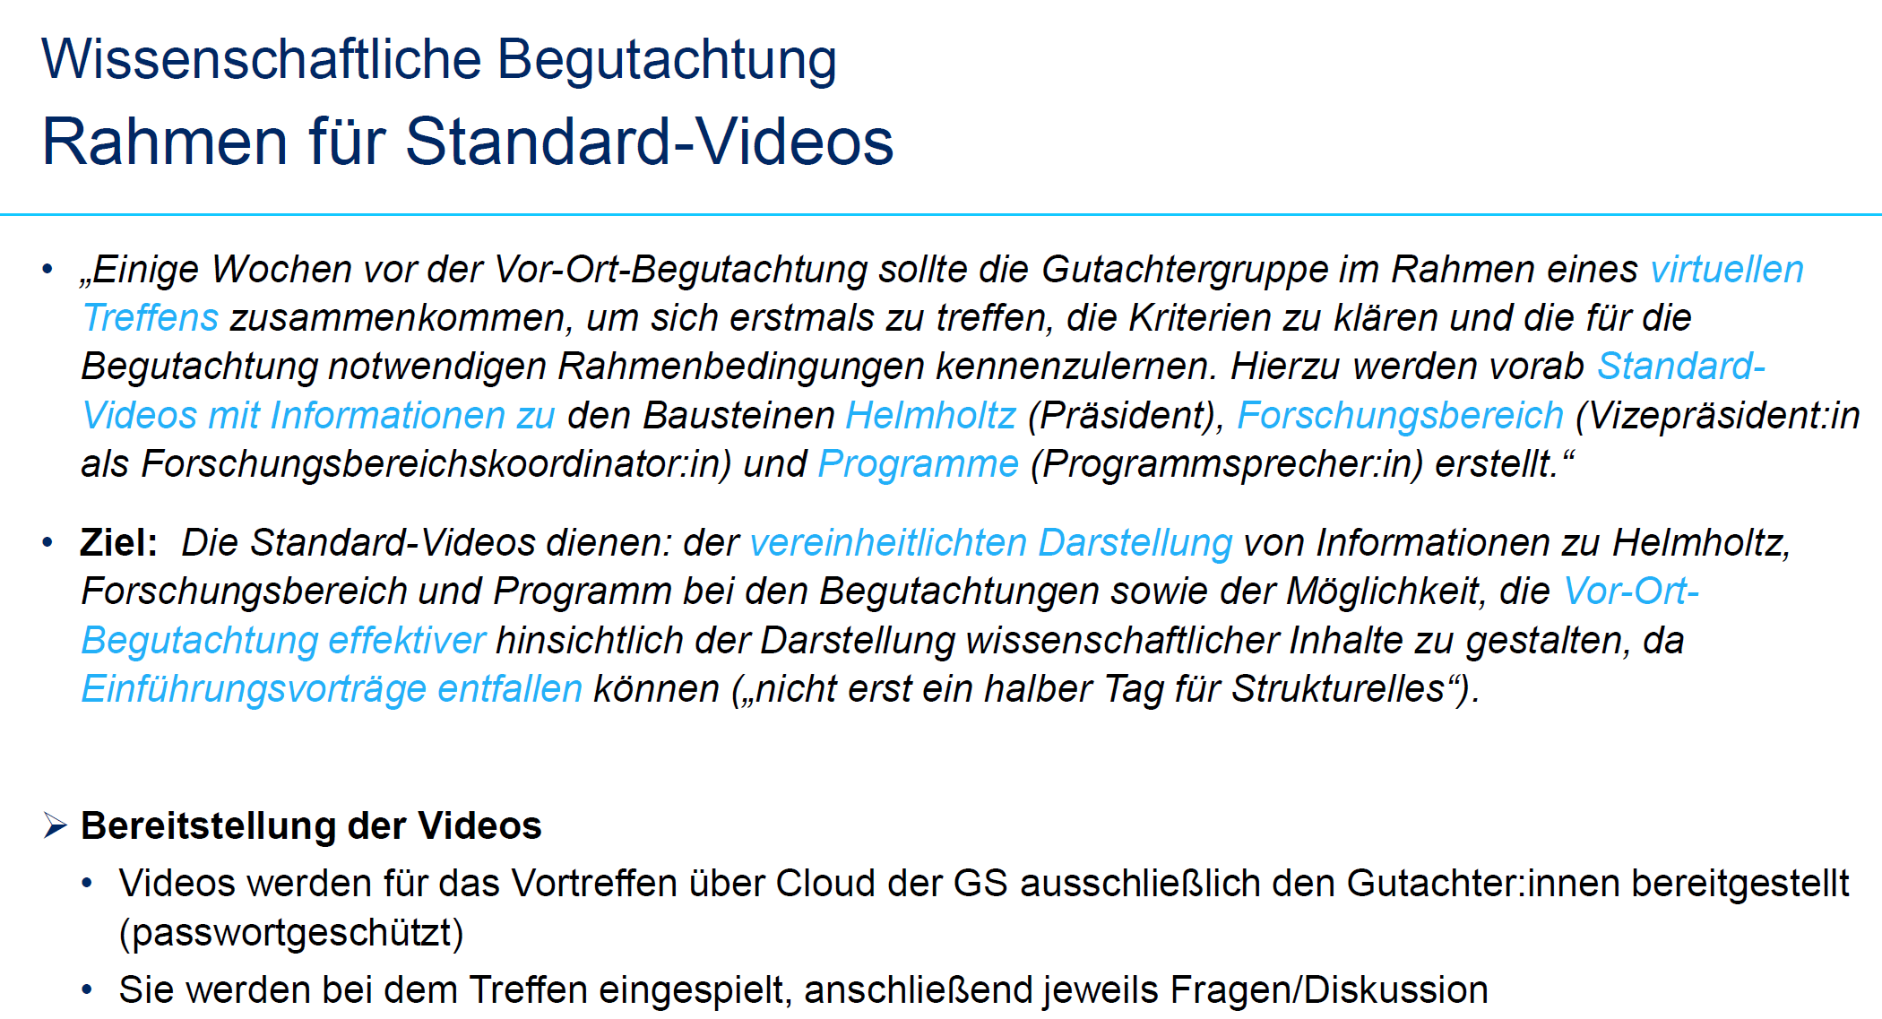

Slide 28
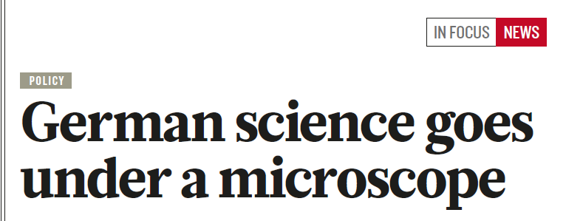
Conclusion and Summary
POF evaluation: Very important for our funding (research and operation) as well as for the scientific standing and reputation of GSI.
Preparation for the POF V evaluation process has already begun and significant efforts are required for 2024 till 2026.
  Center evaluation (step 1)
    excellence in research: scientific achievements
    performance parameters for user operation (facility operation and availability of beam time)
  Strategic evaluation (step 2)
    based on the results of step 1 and the new research perspectives for 2028 to 2034 (FAIR 2028)
Warning: The proper preparation of the evaluation process is time and personnel intensive.
In early 2025 the center evaluation will take place (site visit of about three days) and may collide with the beam time for experiments in spring 2025. This needs to be very carefully coordinated.
NATURE
article 2018 about the POF IV evaluation
28

Slide 29
ToDo
Most important: We need to have a clear vision of the role of GSI for FAIR and for the HGF research field Matter. A vision for 2028 and beyond.
29

Slide 30
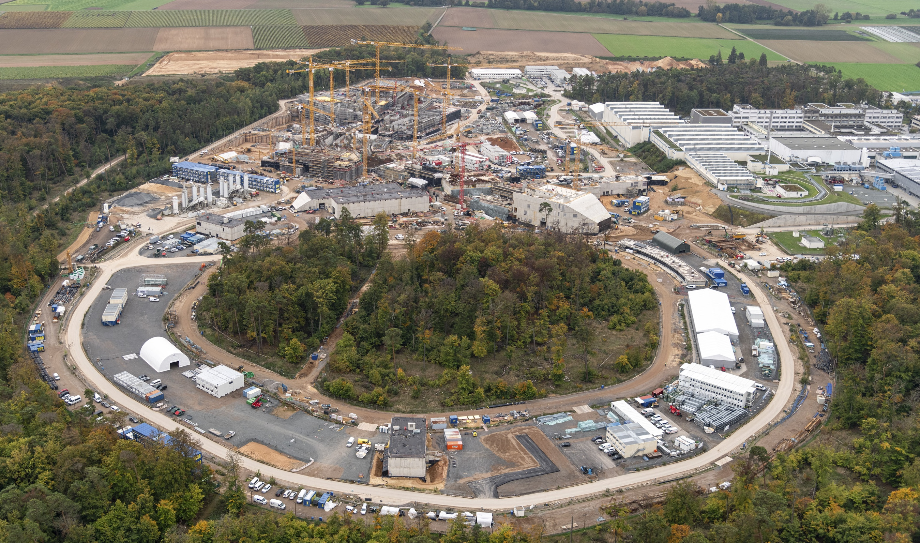
Thank you for
your attention !

Slide 31
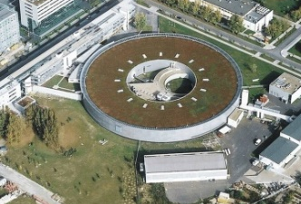
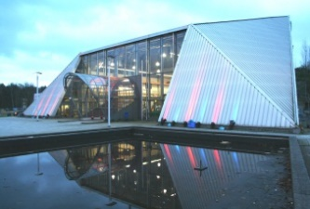
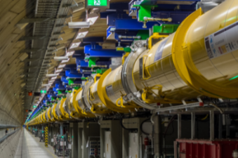
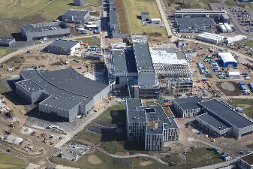
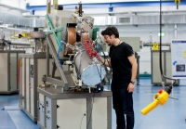
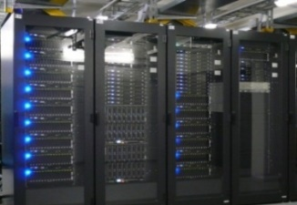
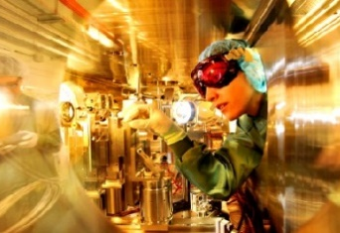
Large Scale User Facilities for Photons, Neutrons, Ions, and High-Fields: cover all relevant parameter spaces
Photon
Facilities
222 Mio €
BESSY II
FLASH
PETRA III
European XFEL
Neutron
Facilities
24.8 Mio €
Resources for safe operation of user facilities (LK II)
321 Mio € / year
FRM II / MLZ
ESS start 2028
Ion
Facilities
42.5 Mio €
Data centers 14 Mio €
IBC
GSI
FAIR start 2028
High-field
Facilities
18.7 Mio €
GridKa
IDAF
ELBE
HLD

Slide 32
Success Metrics and Performance Indicators are established to track our progress
Success Metrics | Performance Indicators
International Benchmarking Research · Large Scale Facilities | Competing labs in Europe, US and Asia
Attraction of Best Brains | High level recruitments on international level Junior groups, Postdocs, PhD Students
Publications | High Impact Papers
Major Grants and Awards | European and international
Matter and Sustainability | Sustainable operation (LK II)
Knowledge Transfer into Society | Public visitors, media releases, school labs
Innovation and Technology Transfer | Start-ups Patent applications
Agenda Setting | Chairs in international advisory boards Leadership in large scale international projects
Scientific Review
(GSI site visit)
2025
Strategic Review
2026
32
Notes:
Cover: https://onlinelibrary.wiley.com/doi/10.1002/anie.201907847
DESY: 6 ERC; 20 leading scientists, 10 females; 6 start ups; patent applications: 19
HZB: 1 ERC; 7 leading scientists, 1 female; 20 patents
GSI: 2 ERC; 1 start-up, 5 Patents
HZDR: 2 ERC; 3 leading scientists, 0 female; 10 start-ups
FZJ: 3 ERC; 3 leading scientists, 1 female; 0 start-ups
KIT: 1 ERC;
HZG:
IPP: --

Slide 33
Resources Research (LK I): robust funding for an ambitious program
272 Mio € / year
MU
94 Mio €
GSI:
15 Mio €
Total Budget
272 Mio € / year
GSI
39 Mio € / year
MT
81 Mio €
GSI:
8,1 Mio €
MML
97 Mio €
GSI
14,6 Mio €
* DESY numbers do not include a (recently decided) annual reduction of 2 Mio €.
** Including HI Jena and HI Mainz

Slide 34

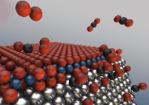
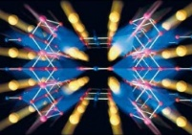
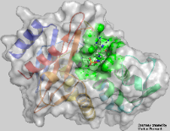
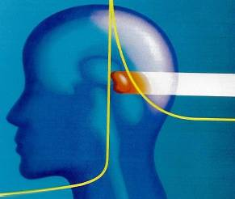
Cross-CUTTING Activities (between research FieldS)
Information/Big Data
Matter, Information
Materials Research
Matter, Aeronautics, Space & Transport, Energy, Health, Information
Quantum Technologies
Matter, Aeronautics, Space & Transport, Information
Structural Biology and Biological Processes
Matter, Health, Information
Radiation Research
Matter, Aeronautics, Space & Transport, Energy, Health
Climate will for sure be added for POF V

Slide 35



Big point of discussion: cross cutting activities need to be financially supported

Slide 36

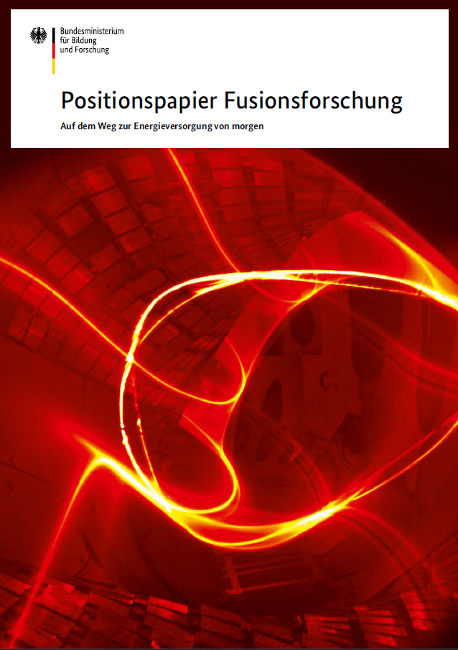
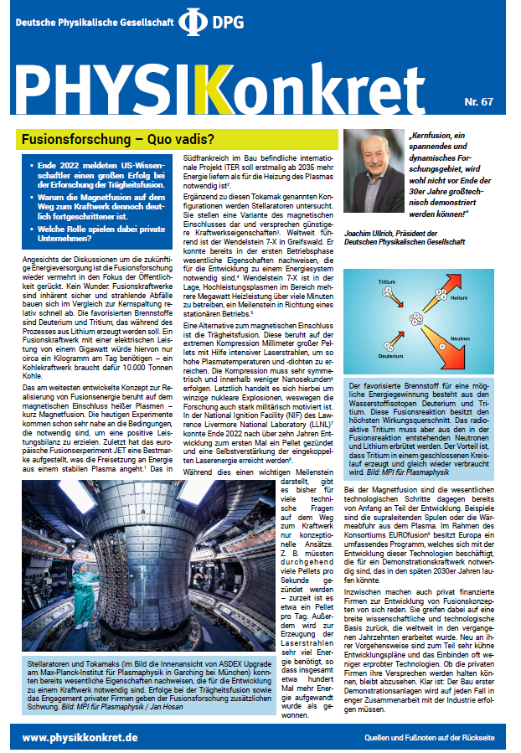
Fusion Research ???

Slide 37
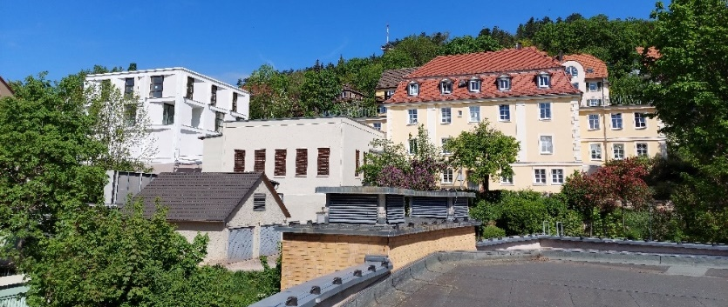
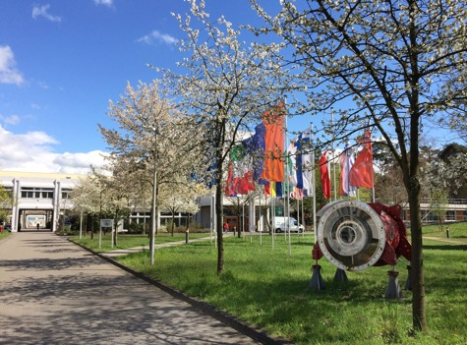
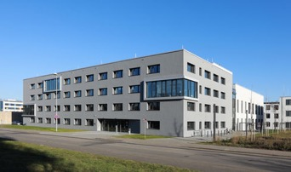
GSI Helmholtzzentrum für Schwerionenforschung GmbH
Member of the Helmholtz Association of German Research Centers (HGF)
founded in 1969
Shareholders: Federal Government (90%), Hesse (8%), Rhineland-Palatinate (1%), Thuringia (1%)
Employees: about 1,500
Helmholtz Institute Jena
(HI-Jena)
Founded in June 2009
Affiliated to Friedrich Schiller University Jena
Budget: 6.9 Mio €
Employees: about 65
Helmholtz Institute Mainz
(HIM)
Founded in June 2009
Affiliated to Johannes Gutenberg University Mainz
Budget: 6.9 Mio €
Employees: about 50

