Slide 1
Welcome to the 2nd research retreat 203
Yvonne Leifels

Slide 2
Some technical details
Talks should not exceed the allocated time
discussion time is included, hence, please try to leave 5 minutes for discussion
zoom is meant to open the meeting to everybody, i.e. registered persons
    in general, the meeting is just streamed, discussion contributions should be put into the chat
    there will be one talk by pre-recorded video (Jim‘s), question will be answered by zoom or phone
    and one talk by zoom (Klaus Peter‘s)

Slide 3
Time schedule
Breaks will take place according to schedule
We will have lunch in the cantine of the Fraunhofer Institute
Option to have dinner together
  on self-pay basis
  drinks will be covered

Slide 4
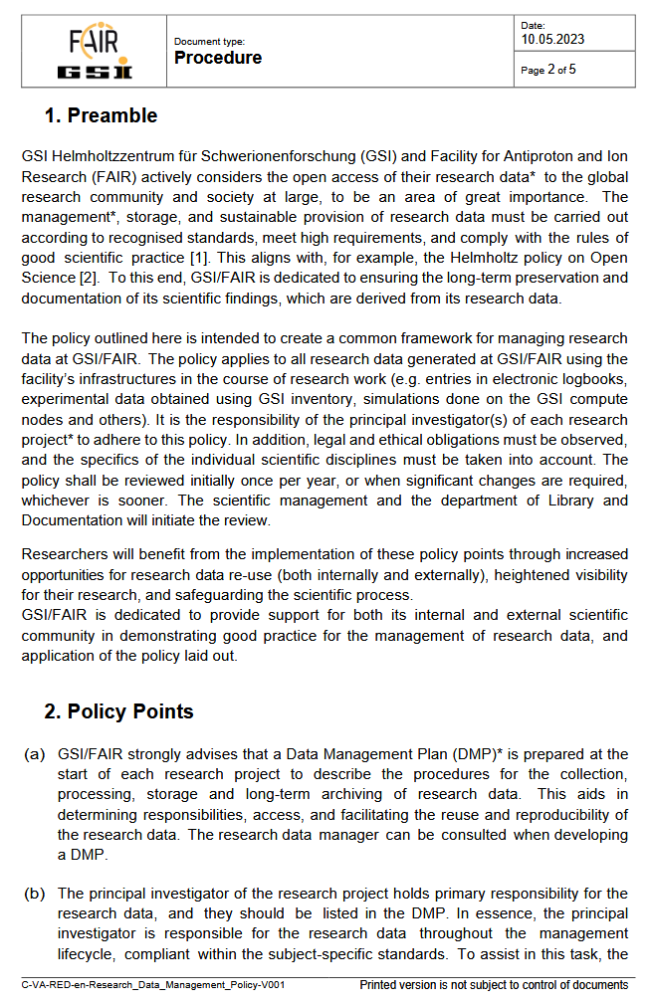

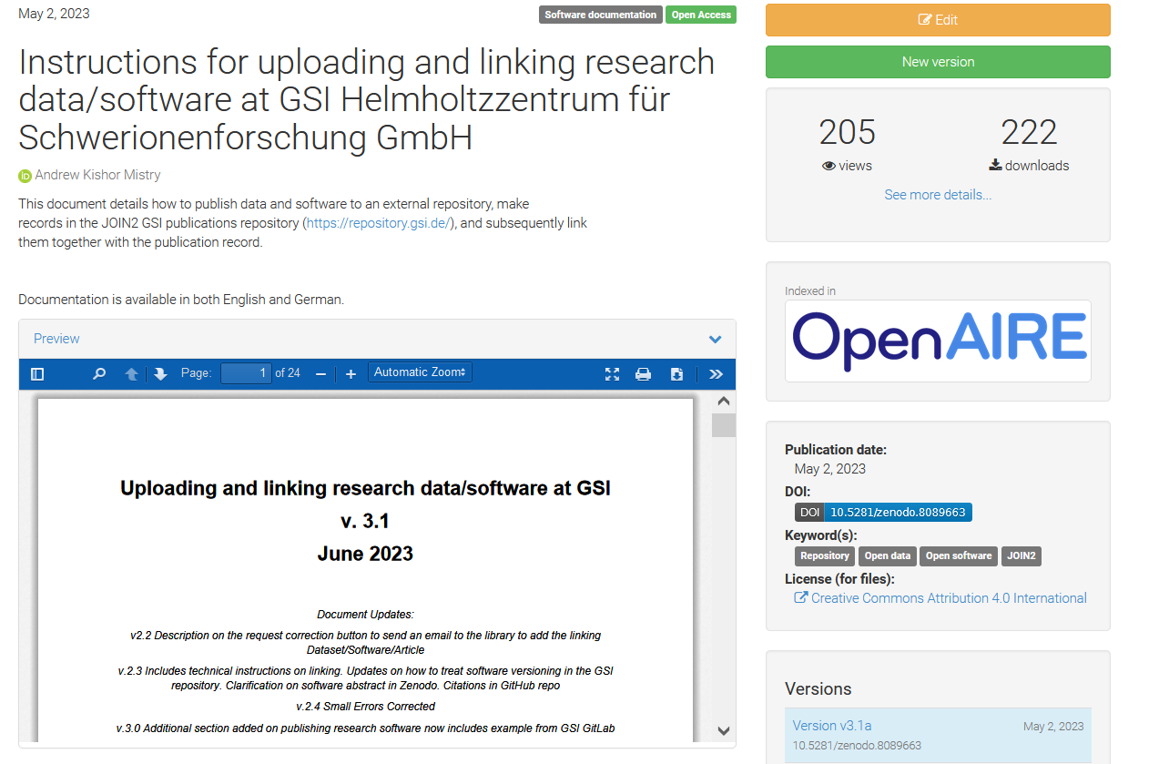
RDM: Status and Update
Research Data Management Policy Published -> http://dx.doi.org/10.15120/GSI-2023-00646
Research Data Management planning -> RDMO Software Under Testing (Thanks to volunteers)
Data/Software Publication -> Interim solution, Instructions available https://doi.org/10.5281/zenodo.7628019
Helmholtz POF IV -> published data items to be counted (quality indicators). Please publish data/software

Slide 5






RDM: Status and Update
Development through:
Open Science Working Group -> discuss, suggest ideas, develop strategy
Working OS collaborations -> national/international projects and initiatives (e.g. GSI/FAIR observers in EOSC, contributing to PUNCH4NFDI, ESCAPE, EuroLabs etc.)
Goals:
Achieve facility wide RDM techniques -> publish Finable, Accessible, Interoperable, and Reusable (FAIR-Principles) Data

Slide 6


RDM/OS: Info sources
Email address: open-science@gsi.de
GSI/FAIR Open Science Webpage: https://www.gsi.de/work/forschung/open-science
GSI/FAIR 1st Open Science Workshop 2023- 19/20th October (two afternoons): https://indico.gsi.de/event/17498/
Please register!

Slide 7
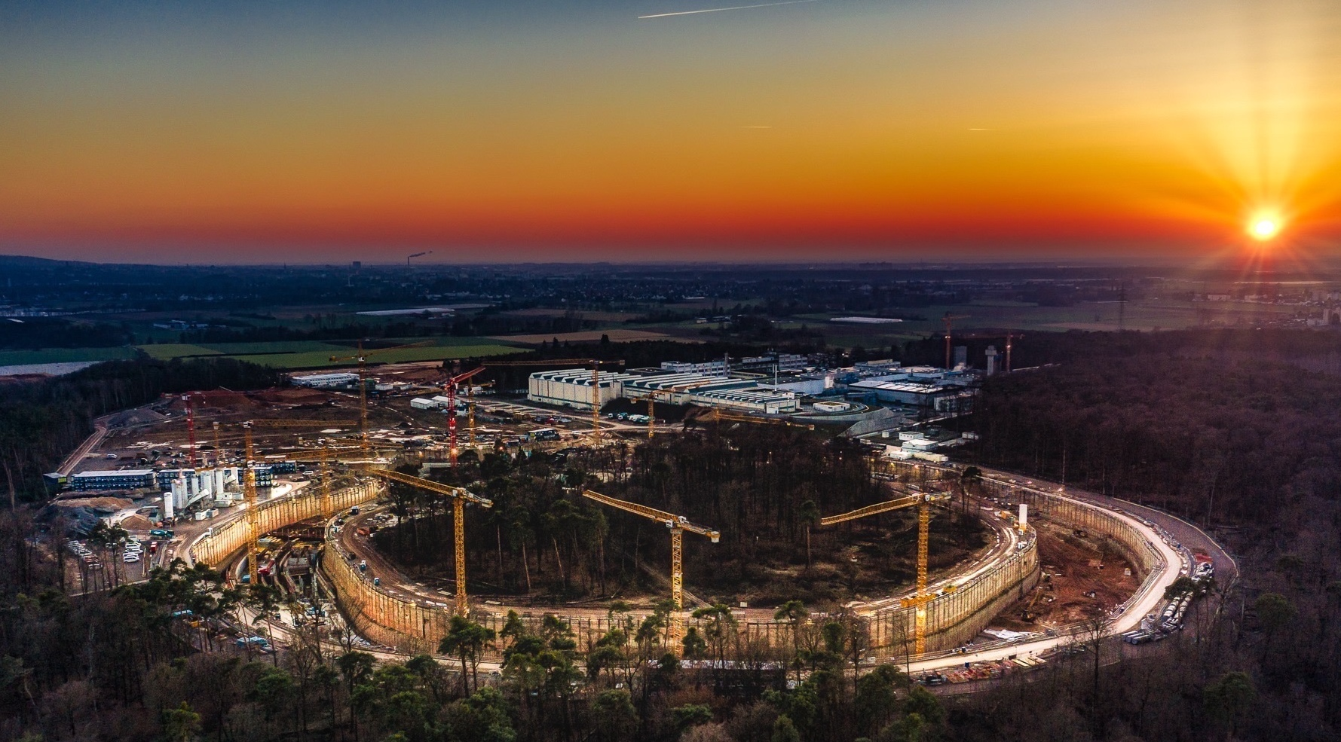
Herzlichen Dank !
Thank you for your attention!
Photo: C. Betz

Slide 8
Operation strategy
  Agree on physics days per year to start discussions with ACC
  Beam time until 2027
    eg. possible beam time extension in 2025 (decision end 2023 needed)
    PAC needed? If so, scheduling for 2025
    Technical or organisational upgrades or limitations by time
  Early Science
    Detailed planning
      ES in direct competition with physics at the operational station + FAIR commissioning (SIS100, HEPT, further S-FRS) + experiment commissioning (eg. R3B)
  First Science and First Science +
    Start discussion on beams
    Detailed discussions on degree of parallel operation (per machine and cross machines)

Slide 9
Injector strategy to ensure FAIR operation
  Define RED needs and wishes (details with timeline)
  UNILAC
    Operation strategy
    Technical or organisational upgrades or limitations by time
  PSU
    Overall timeline including:
      Installation and commissioning strategy
      rf-upgrade schedule
  HELIAC
    Integration into ACC strategy (eg. new UNILAC control system)
    Integration into FAM strategy (eg. fire safety measures / safety concept)
  p-LINAC
    Timeline

Slide 10
FAIR/GSI strategic operation scenario towards FS+
Draft!
Update 2023 (proposal RED)
Acc. Operation total / days
134
44
140
140
100
restricted shutdown
90
90
200
240
240
Main physics beam time/ days
107
0
100
100
80
30
30
100
180
180
m
Parasitic physics beam time/ days
107
30
30
40
Project phases
FAIR Installation of Accelerator Components
FAIR Hardware Commissioning
PCP reached
FCC needed
FAIR Beam Commissioning
Facility availability
SIS18 → SFRS → NUSTAR
SIS100 → SFRS → NUSTAR
SIS100 –> CBM
Last RED retreat
UNILAC → EH, SIS18 → TH, EX, FRS, ESR → HITRAP, Cryring
2022
2023
2024
2025
2026
2027
2028
2029
2030
FAIR Phase 0
Early Science
Early Science & First Science+
10

Slide 11
FAIR/GSI strategic operation scenario towards FS+
Update 2023 (proposal RED)
beam time
Acc. Operation total / days
134
44
140
140
100
restricted shutdown
90
90
200
240
240
beam time
Physics beam time/ days
107
0
100
100
80
120*
140*
180
180
*includes shared blocks with parallel FAIR com.
Project phases (ES, FS, FS+)
FAIR Installation of Accelerator Components
FAIR Hardware Commissioning
FCC needed
FAIR Beam Commissioning
PCP reached
Facility availability
early science (ES) →
SIS18 → SFRS → NUSTAR
first science (FS) →
SIS100 → SFRS → NUSTAR
first science + (FS+) →
SIS100 –> CBM
Last RED retreat
UNILAC → EH, SIS18 → TH, EX, FRS, ESR → HITRAP, Cryring
2022
2023
2024
2025
2026
2027
2028
2029
2030
FAIR Phase 0
Early Science
Early Science & First Science+
11

Slide 12
FAIR/GSI strategic operation scenario towards FS+
DRAFT (fire protection renovation EH)
beam time
Acc. Operation total / days
134
44
140
140+30
8 months
fire protection renovation
EH
90
90
100
90
200
240
240
beam time
Physics beam time/ days
107
0
100
100+30
0
50
70
min 30*
min 120*
180
180
engineering-runs
run to fail
*number of days to be announced for PAC call
(share is reduced due to FAIR commissioning)
Project phases (ES, FS, FS+)
FAIR Installation of Accelerator Components
FAIR Hardware Commissioning
FCC OP ready
UNILAC CS ready
DR
FAIR Beam Commissioning
PCP reached
Facility availability
now
included
early science (ES) →
SIS18 → SFRS → NUSTAR
still
missing
first science (FS) →
SIS100 → SFRS → NUSTAR
first science + (FS+) →
SIS100 –> CBM
UNILAC → EH, SIS18 → TH, EX, FRS, ESR → HITRAP, Cryring
2022
2023
2024
2025
2026
2027
2028
2029
2030
FAIR Phase 0
Early Science
Early Science & First Science+
12

Slide 13
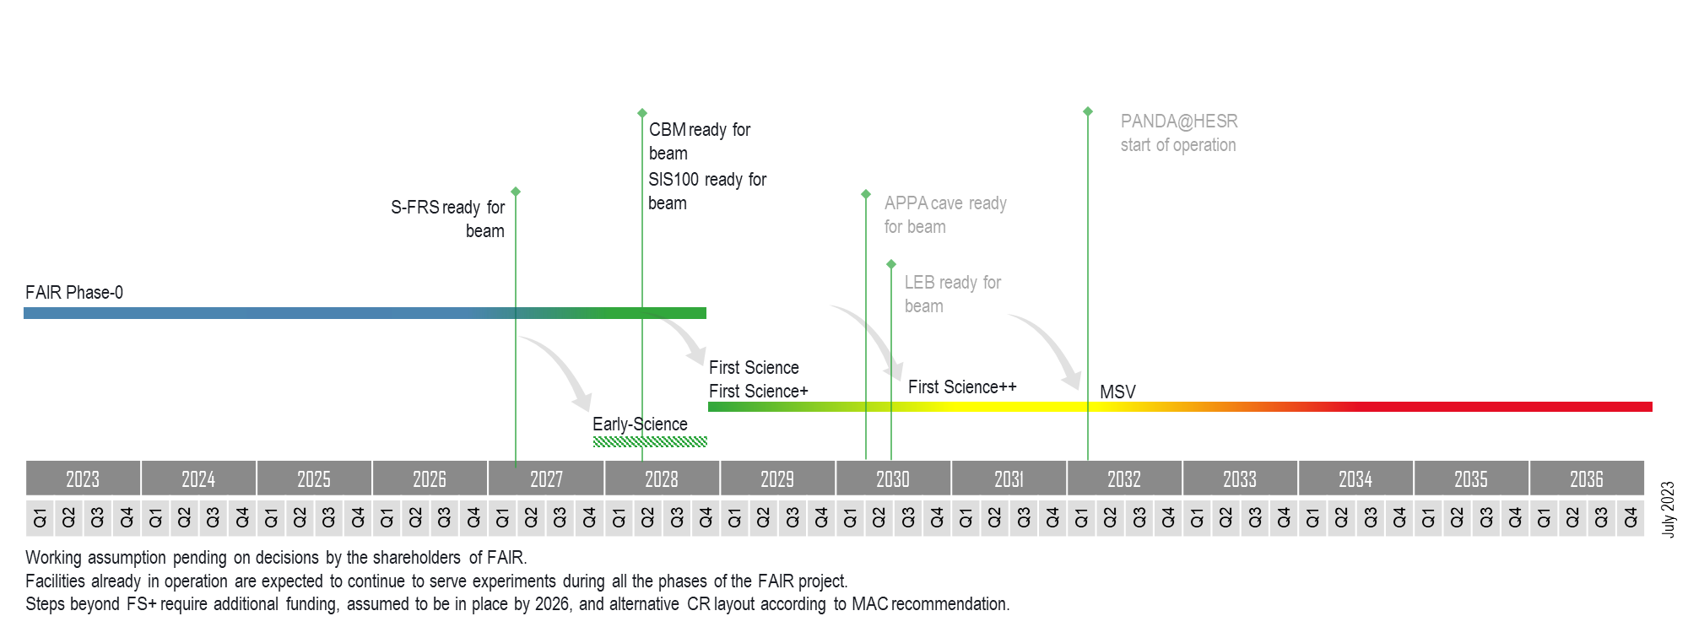
Timeline for FAIR
Towards MSV

Slide 14
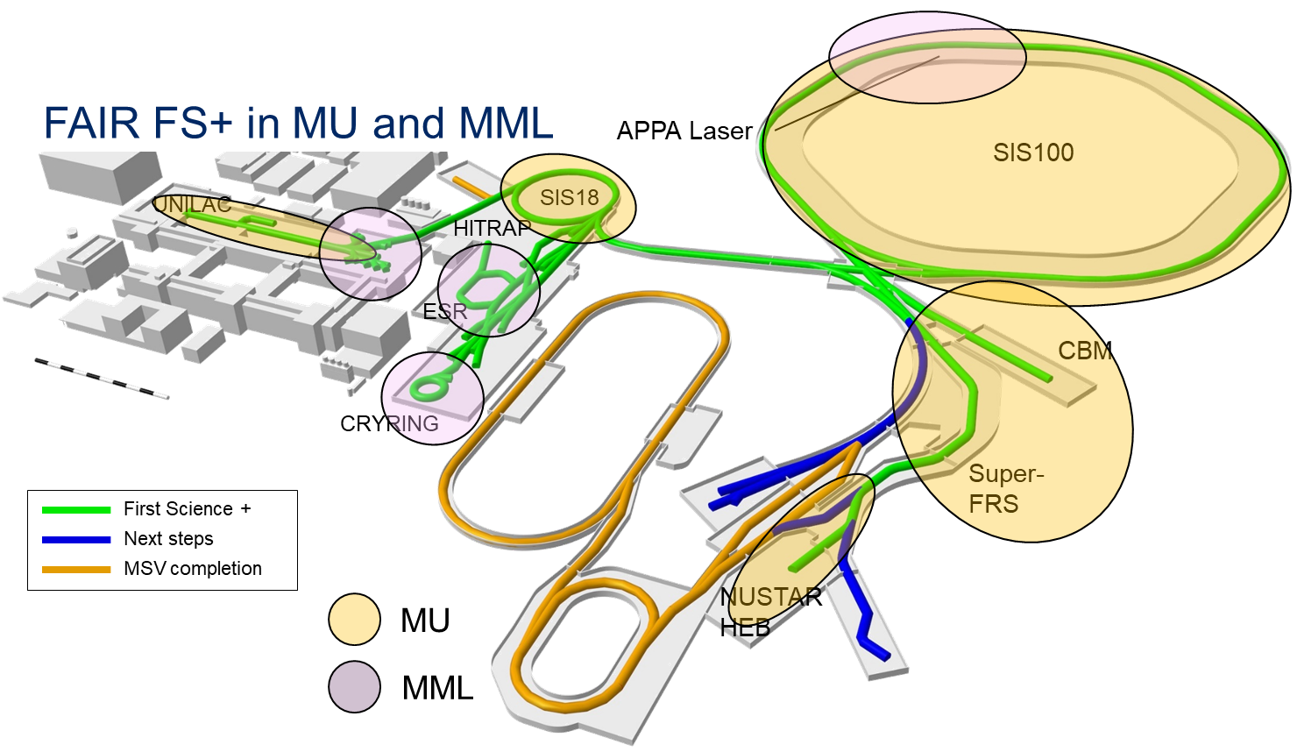
GSI / FAIR in POF
PANDA
including cw-linac

Slide 15
(S)FRS Operating Team
(S)FRS Scientific Department
Head: Physics group leader
Tasks & Responsibilties:
Experiment & Direct experiment support
  Design, production/installation of experiment specific equipment
  experiment simulations, concepts for new ion optical modes
  interface for demands of NUSTAR collaboration
  coordination of external support by experiment groups at the spectrometer facilities
  specialiced analysis support
  detector developments
Own scientific programm
Personnel:
variable, depending on experimental program with a high fraction of non-permanent staff, including contributed staff
Technical Department
Head: Department head at GSI
Tasks & Responsibilities:
maintenance of FRS/Super-FRS standard components
maintenance, Operation and Development of radiation areas (hot-cell, robots, target area)
support for experiments
adaptation of specialized components/R&D results into standard operation (potentially own contribution to experiments)
operation of FRS/Super-FRS standard components
make „CDRs“ for ion optics available
technical/engineering prone Improvements
IT frontend (Controls, Storage, Network, Time distribution systems, Standard software)
Co-ordination and enabling support (Training, Qualification) for ACC operators
Co-ordination of laboratory infrastructure support (Cryo, Magnets, Vacuum, Controls, Transport&Installation, Engineering, … , but also Detlab / EE for detector maintenance)
Technology developments (materials, new separator concepts
Personnel:
engineers, technicians and 80/20 physicists
Operating team formed from the two departments
Head: Task force leader
Tasks & Responsibilities:
Operation
Lessons learned list
Beam data base
List of available modes
co-ordination of external beam-teams and training
co-ordination and enabling support (Training, Qualification) of ACC operators
(standard operations/daily base: centering beam, simple tuning tasks)

Slide 16
Resources with NUSTAR as an example
NUSTAR staff at GSI in 2022: 41
  no phd students, work students and guest scientists
NUSTAR staff in
  2028
  LEB
  Additional ring
Bottom up
  have to be defined for all pillars
Top down
  rescale MSV numbers and get resource request verified by department heads and collaborations

Slide 17
Prioritization of
experiments/experimental set-ups
Idea (scientific case, sketch of the set-up, participating departments / institutes)
  needs to presented to the management
work out the concept
  describe the scientific case and the potential outcome
  expertise / equipment existing
  description of anticipated set-up
  ressources needed (beam time, space, infrastructure, personnel…)
presentation to ECE to obtain a recommendation
  material should be provided prior to the meeting
presentation to JSC
  requests material well before the meeting
submission to the scrutinity group
approval by the FAIR council

Slide 18
Date of next retreat?

Slide 19
Herzlichen Dank !
Good bye and thanks for all the fish!
Photo: C. Betz

Slide 20
Resolutions of the JSC
The JSC highly commends the initiative by the German shareholder to provide very substantial additional funding in times of challenging circumstances. This is very much appreciated as an essential step towards realizing world-class science at FAIR. The JSC very much appreciates the willingness and ongoing efforts of the other shareholders to seek ways to also commit additional funding in a timely manner

Slide 21
Resolutions of the JSC
The JSC had previously made the following recommendation in view of the “First Science and staging report” in 2022: “If a potential decision were to be taken between the scenarios of having SIS-100 beams into S-FRS and HEB cave with or without CBM in parallel (“First Science plus” vs. “First Science”), having CBM in addition (“First Science plus”, FS+) should be strongly preferred. The CBM detector development is already very advanced. The difference in cost is therefore significantly below the current uncertainty of overall costs (as stated in the report), whereas the enormous scientific gain of CBM would outweigh the limited monetary saving relative to the investments already made.” The JSC stands by this assessment.

Slide 22
Resolutions of the JSC
Realizing “First Science plus” (i.e., including CBM) would not only serve a significantly wider community but constitute a major increase in scientific scope and diversity and an enormous scientific gain. The JSC therefore welcomes that the recent decision leaves room for realizing “First Science plus” (or even more) if sufficient funding commitments are made by the partners.

Slide 23
Resolutions of the JSC
The JSC understands that the Collaborations are currently working on detailed plans for the optimal use of the facilities approved within Early Science and First Science (plus). The JSC strongly encourages the Collaborations to continue their plans to maximize the scientific gain and output. This is an ongoing process in which the planning will become successively more concrete and detailed in the near future. The JSC intends to closely monitor the corresponding progress of planning and of the realization of the facilities and experiments until the start of Early Science and First Science.

Slide 24
JSC Resolutions
The current uncertainty concerning the availability of funding for “First Science plus” results in a difficult situation for CBM and for parts of the PANDA and the APPA (in particular BIOMAT), all of which intend to perform experiments in the CBM cave. In the short term, funding applications by the involved university groups necessary for completing the already very advanced construction of the experiments are impeded. In the APPA pillar, substantial external funding from ESA and other agencies would be lost and an opportunity for European leadership in space radiation physics would be missed.

Slide 25
JSC Resolutions
In the mid- and long term, a delay of several years would be particularly detrimental for the CBM pillar. Due to the high specialization of their cutting- edge research, researchers from the CBM community would not be able to benefit from other FAIR experiments, thus putting on hold almost all of their activities at FAIR for an extended period. This would inevitably lead to a loss of CBM research groups who would take up activities elsewhere, resulting in a serious drain of expertise and a serious deterioration of perspectives for young scientists in this field. Even the complete loss of this scientific pillar of FAIR is likely in the case of a longer delay. In view of this, a timeline for the realization of CBM is urgently needed, together with funding decisions for time-critical components within the next year.

Slide 26
JSC Recommendations
The corresponding funding commitments are needed immediately, if necessary combined with a completion schedule optimized for scientific output, for a swift start of the physics program at FAIR.

Slide 27
JSC Recommendations
The JSC looks forward to the non-German shareholders committing the necessary additional funding to secure “First Science” and to make “First Science plus” a reality. These funding decisions need to be taken soon in order to preserve “First Science plus” as a viable option from which outstanding scientific results are expected.
The JSC reiterates the following recommendation, presented to the FAIR Council in October 2022 in view of the "First Science and staging review": “The JSC emphasizes the need to define, in the near future, a timeline for the additional steps towards the IO and the MSV, and thus towards exploiting the full potential of FAIR in a time frame that will enable FAIR to remain at the forefront of world-wide research. A timeline is crucial for giving a perspective in particular to young scientists. They are the future of research in all areas of FAIR.”

Slide 28
JSC Resolutions
The JSC strongly recommends to implement measures for risk mitigation concerning the production of SIS100 quadrupoles. The procurement from alternative suppliers and in particular prototyping should be addressed immediately, as also recommended by the MAC.
The present challenging financial situation of GSI makes mid- and long-term planning difficult, seriously affecting planning of all scientific activities of GSI, and consequently for FAIR. The JSC would like to encourage the funding bodies to address this situation, and in particular conclude on the modus operandi of GSI finances in relation to FAIR.

Slide 29
JSC Resolutions
The JSC recognizes the ideas being developed by the Collaborations to use detector components to augment experiments in First Science and at other existing facilities. At FAIR in particular, the JSC encourages the Management and all Collaborations to, within the approved FS (or FS+) facilities and thus available beams, seek to optimize the science output by using experimental equipment originally foreseen for use elsewhere in the MSV. However, the JSC would encourage ideas for further new experimental setups at FAIR only if they would enable new and unique science opportunities.

Slide 30
JSC Resolutions
The JSC thanks the ECE, MAC, and BFC for their informative presentations.
The JSC commends excellent new results in GSI research and in Phase-0 experiments.
The JSC is very impressed by the outstanding world-leading research performed at the Helmholtz Institute Mainz, as presented especially by young scientists. The strong activities in hadron physics and superheavy elements are fully in line with the scientific priorities of GSI and FAIR
The JSC is extremely impressed by the progress made with the HELIAC accelerator. It could play an important role in view of its potential use as injector for FAIR.

Slide 31
JSC Next Meeting
October 5 – 6, 2023, Darmstadt

Slide 32
Herzlichen Dank !
Thank you for your attention!
Photo: C. Betz

